Slide 1
Intro
“Big Idea” Question
Review Concepts
Check-In Questions
Teacher Engagement
Vocabulary
Student-Friendly Definition
Examples & Non-Examples
Frayer Model
Simulation/Activity
Notes:
OK everyone, get ready for our next lesson. Just as a reminder, these are the different components that our lesson may include, and you’ll see these icons in the top left corner of each slide so that you can follow along more easily!

Slide 2
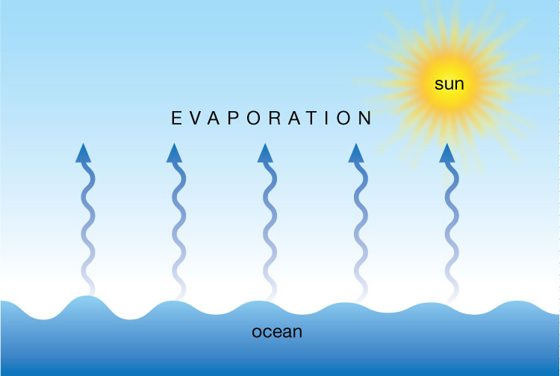
Evaporation
Intro
Intro
Notes:
Today we are going to learn about evaporation.

Slide 3
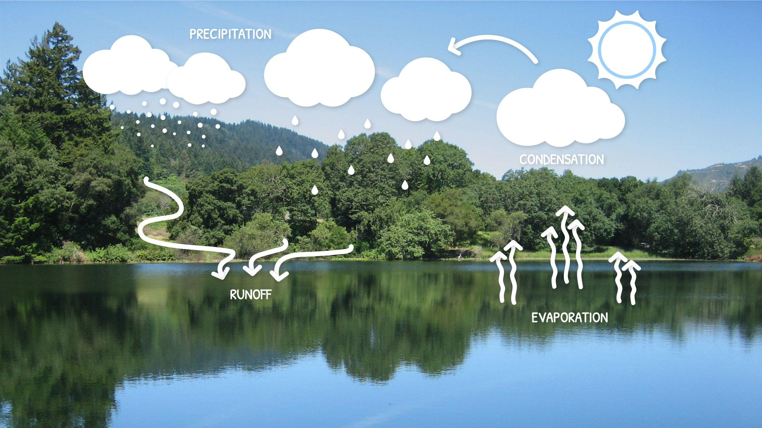
Big Question: How does water move throughout Earth’s atmosphere?
Notes:
Our “big question” is: How does water move throughout Earth’s atmosphere?
[Pause and illicit predictions from students.]
I love all these thoughtful scientific hypotheses! Be sure to keep this question and your predictions in mind as we move through these next few lessons, and we’ll continue to revisit it.

Slide 4
Notes:
Before we move on to our new vocabulary term, let’s review some other words & concepts that you already learned and make sure you are firm in your understanding.

Slide 5
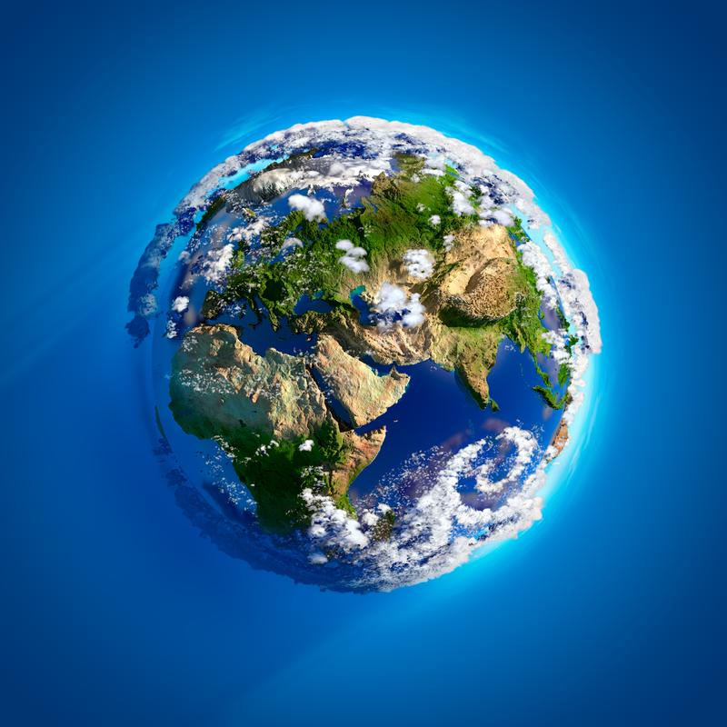
Atmosphere: the layers of gas surrounding the Earth’s surface
Notes:
Atmosphere is the layers of gas surrounding the Earth’s surface. Sometimes, the atmosphere is called a “blanket” of gases.

Slide 6
Cycles: events that happen in the same order over and over again
Notes:
Much of life on Earth depends on cycles. Cycles are events that happen in the same order over and over again. The end of one cycle marks the beginning of another.

Slide 7
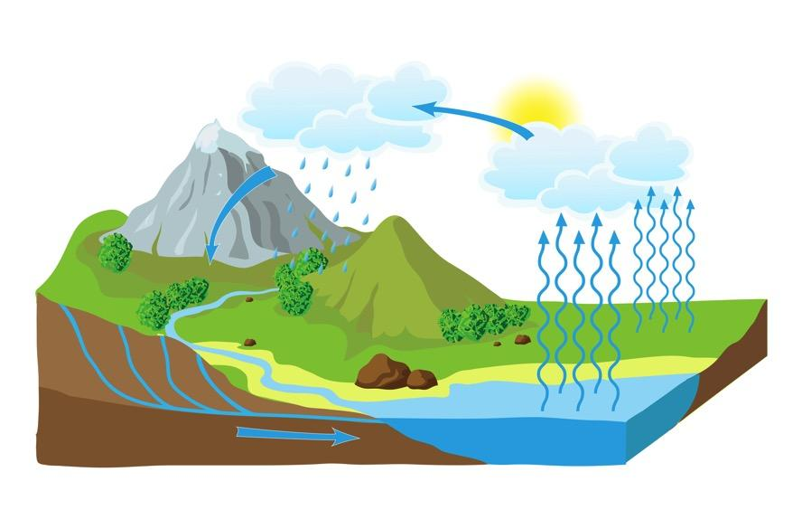
Water Cycle: the process through which water moves from Earth through the atmosphere and returns to Earth
Notes:
The water cycle is the process through which water moves from Earth through the atmosphere and returns to Earth

Slide 8
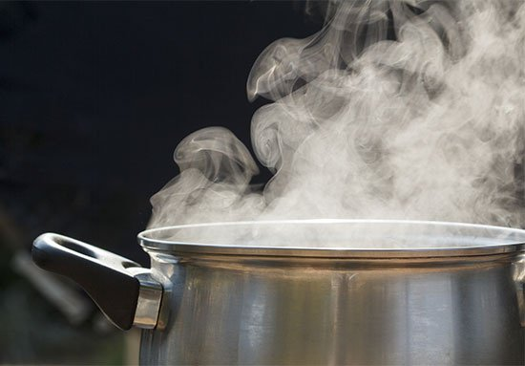
Water Vapor: an invisible gas that is made up of heated water particles
Notes:
Water Vapor is an invisible gas that is made up of heated water particles.

Slide 9
Clouds: groups of cooled water vapor that have turned into water droplets in the sky
Notes:
Clouds are groups of cooled water vapor that have turned into water droplets in the sky.

Slide 10
Notes:
Now let’s pause for a moment to check your understanding.

Slide 11
True or False: The Water Cycle is the process through which water moves from Earth through the atmosphere and returns to Earth
True
False
Notes:
True or false: The Water Cycle is the process through which water moves from Earth through the atmosphere and returns to Earth.
[A. True]

Slide 12
True or False: The Water Cycle is the process through which water moves from Earth through the atmosphere and returns to Earth
True
False
Notes:
True or false: The Water Cycle is the process through which water moves from Earth through the atmosphere and returns to Earth.
[A. True]

Slide 13
Water vapor is created when water particles have ________ ____.
Cooled down
Warmed up
Notes:
Water vapor is created when water particles have _______ _____.
[B. Warmed up]

Slide 14
Water vapor is created when water particles have ________ ____.
Cooled down
Warmed up
Notes:
Water vapor is created when water particles have _______ _____.
[B. Warmed up]

Slide 15
Evaporation
Notes:
Now that we’ve reviewed, let’s define our new term, evaporation.

Slide 16
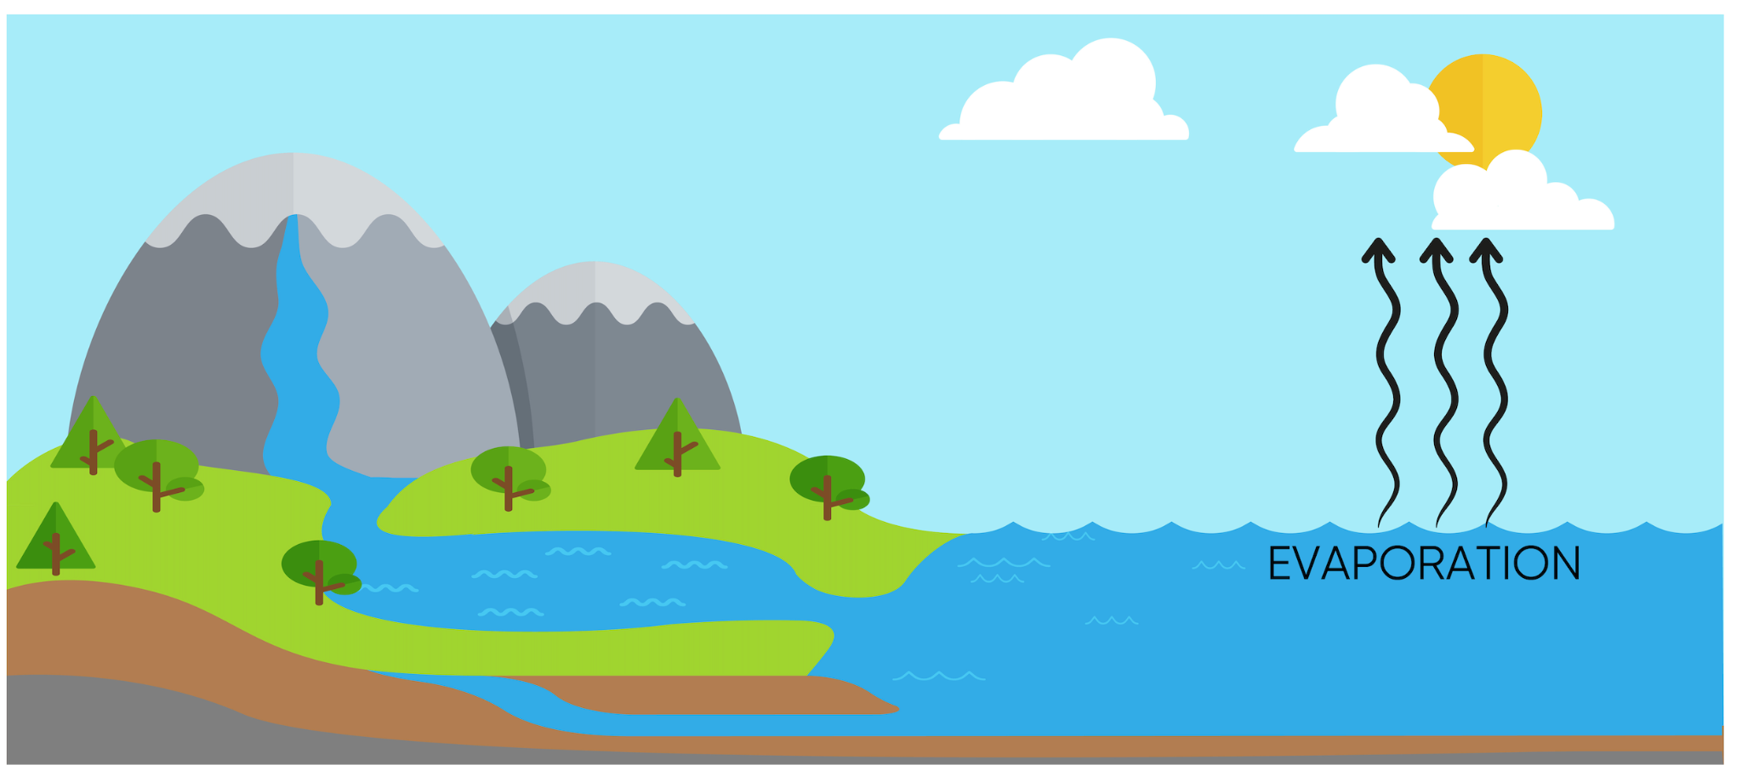
Intro
Evaporation: when water droplets heat up and turn into invisible water vapor in the air
Notes:
Evaporation is when water droplets heat up and turn into invisible water vapor in the air.

Slide 17
Notes:
Now let’s pause for a moment to check your understanding.

Slide 18
What is evaporation?
Intro
Notes:
Evaporation is when water droplets heat up and turn into invisible water vapor in the air.

Slide 19
Notes:
That is the basic definition, but there is a bit more you need to know.

Slide 20
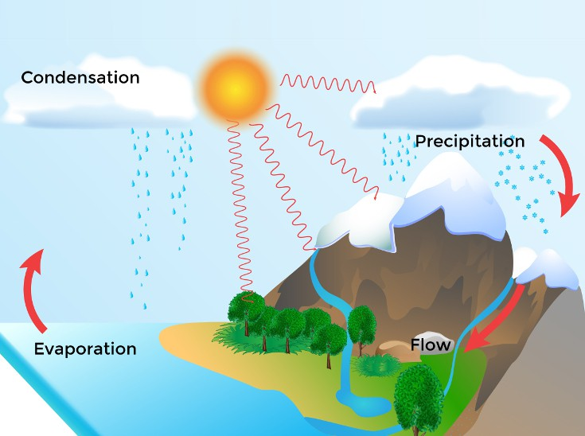
Evaporation is when the Sun heats up water in rivers, lakes, or puddles, and turns it into an invisible gas called water vapor in the water cycle.
Notes:
Evaporation is when the Sun heats up water in rivers, lakes, or puddles, and turns it into an invisible gas called water vapor in the water cycle.

Slide 21
The water vapor goes up into the sky, cools down into water droplets, and forms clouds. This is condensation. Later on in the water cycle, the water is released from the clouds and returns to Earth.
Notes:
The water vapor goes up into the sky, cools down into water droplets, and forms clouds. This is condensation. Later on in the water cycle, the water is released from the clouds and returns to Earth.

Slide 22
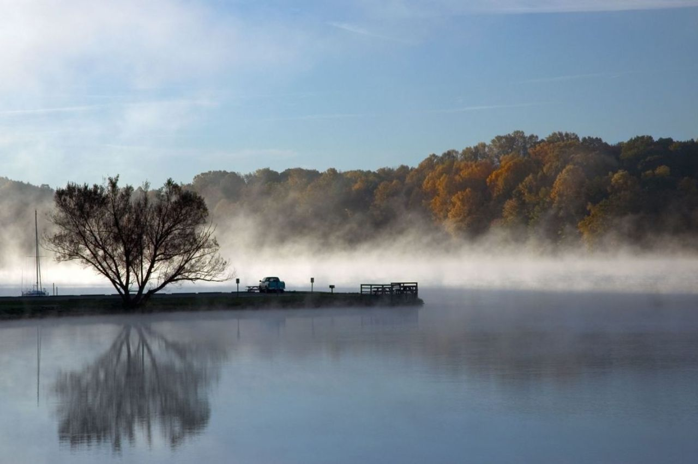
So, evaporation is a super important step that helps keep the water cycle going, making sure Earth always has the water it needs for plants, animals, and people.
Notes:
So, evaporation is a super important step that helps keep the water cycle going, making sure Earth always has the water it needs for plants, animals, and people.

Slide 23
Notes:
Let’s check-in for understanding.

Slide 24
Evaporation is when the Sun _____ ____ water in rivers, lakes, or puddles, turning water droplets into water vapor in the water cycle.
heats up
cools down
Notes:
Evaporation is when the Sun _____ ______ water in rivers, lakes, or puddles, turning water droplets into water vapor in the water cycle.
[A. heats up]

Slide 25
Evaporation is when the Sun _____ ____ water in rivers, lakes, or puddles, turning water droplets into water vapor in the water cycle.
heats up
cools down
Notes:
Evaporation is when the Sun _____ ______ water in rivers, lakes, or puddles, turning water droplets into water vapor in the water cycle.
[A. heats up]

Slide 26
Notes:
Now, let’s talk about some examples of the evaporation.

Slide 27
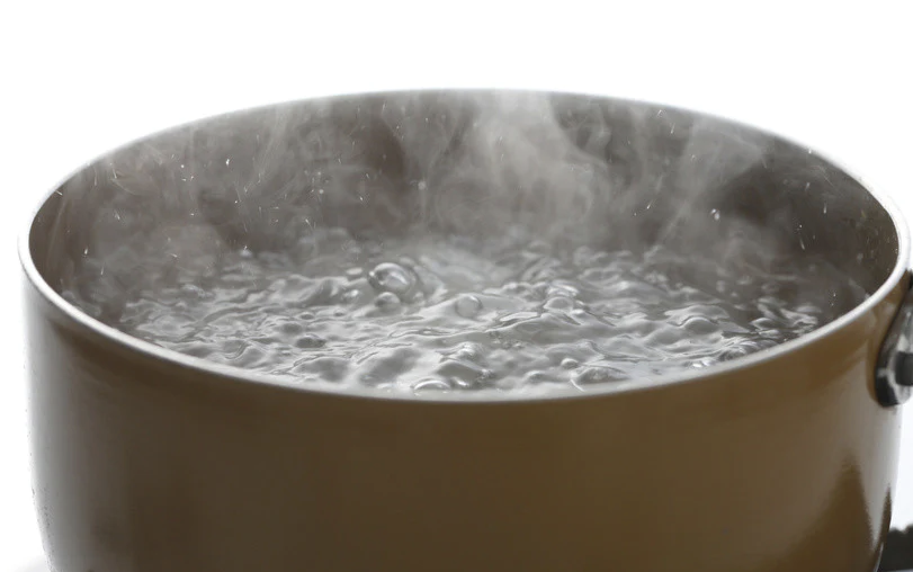
Boiling water is an example of evaporation. The water heats up and creates water vapor as it goes into the air.
Notes:
Boiling water is an example of evaporation. The water heats up and creates water vapor as it goes into the air.

Slide 28
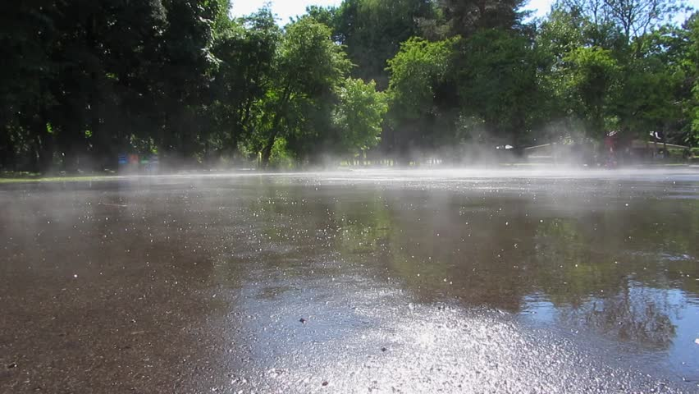
Another example of evaporation is water heating up on the surface of a lake and turning into water vapor in the air.
Notes:
Another example of evaporation is water heating up on the surface of a lake and turning into water vapor in the air.

Slide 29
Notes:
Next, let’s talk about some non-examples of evaporation.

Slide 30
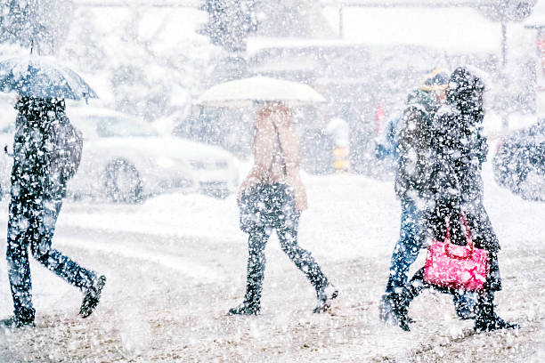
Snow is not an example of evaporation. This is when water droplets fall to Earth when the atmosphere is colder, and is an example of precipitation.
Notes:
Snow is not an example of evaporation. This is when water droplets fall to Earth when the atmosphere is colder, and is an example of precipitation.

Slide 31
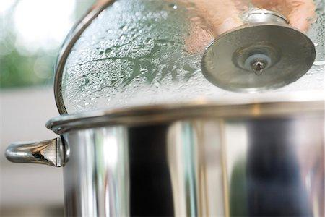
Water droplets on a pot lid are not an example of evaporation. This is when water vapor cools down into water droplets while cooking. This is an example of condensation.
Notes:
Water droplets on a pot lid are not an example of evaporation. This is when water vapor cools down into water droplets while cooking. This is an example of condensation.

Slide 32
Notes:
Now let’s pause for a moment to check your understanding.

Slide 33
Why is boiling water an example of evaporation but the water on a pot lid is not?
Notes:
Why is boiling water an example of evaporation but water on the pot lid is not?
[Boiling water is when water is heated up into water vapor causing evaporation, the water on a pot lid is when water vapor has cooled down into water droplets which is an example of condensation.]

Slide 34
Remember!!!
Notes:
So remember!

Slide 35
Evaporation: when water droplets heat up and turn into invisible water vapor in the air
Notes:
Evaporation is when water droplets heat up and turn into invisible water vapor in the air.

Slide 36
Notes:
We can also break down the term evaporation into different word parts to help us remember the meaning. Let’s take a look!

Slide 37
Evaporation
Evapor -ation
(root word)
(suffix)
Notes:
The word “evaporation” can be broken down into two parts. The root word, “evapor”, and the suffix, “-ation.”

Slide 38
Evaporation
Evapor -ation
turn liquid into vapor
Notes:
The root word, evapor, means ”turn liquid into vapor.”

Slide 39
Evaporation
Evapor -ation
result of an action
Notes:
The suffix, -ation, means “result of an action.”

Slide 40
Evapor -ation
Evaporation
The act of turning liquid into vapor
Notes:
So, when you add the suffix “-ation” to the root word “evapor” it means “the act of turning liquid into vapor”

Slide 41
Notes:
Let’s check-in for understanding.

Slide 42
How can we use the word parts of evaporation to help us remember the definition of the term?
Evaporation
Evapor ation
Notes:
How can we use the word parts of evaporation to help us remember the definition of the term?
[Evapor = turn liquid into vapor
ation = the result of an action
Evaporation is the act of turning liquid into vapor.]

Slide 43
Remember!!!
Notes:
So remember!

Slide 44
Evaporation: when water droplets heat up and turn into invisible water vapor in the air
Notes:
Evaporation is when water droplets heat up and turn into invisible water vapor in the air.

Slide 45
Notes:
We will now complete this concept map, called a Frayer model, to summarize and further clarify what you have learned about the term evaporation.

Slide 46
Definition
Picture
Evaporation
Example
How does evaporation impact my life?
Notes:
To complete the Frayer model, we will choose from four choices the correct picture, definition, example, and response to the question, “How does evaporation impact my life?” Select the best response for each question using the information you just learned. As we select responses, we will see how this model looks filled in for the term evaporation.

Slide 47
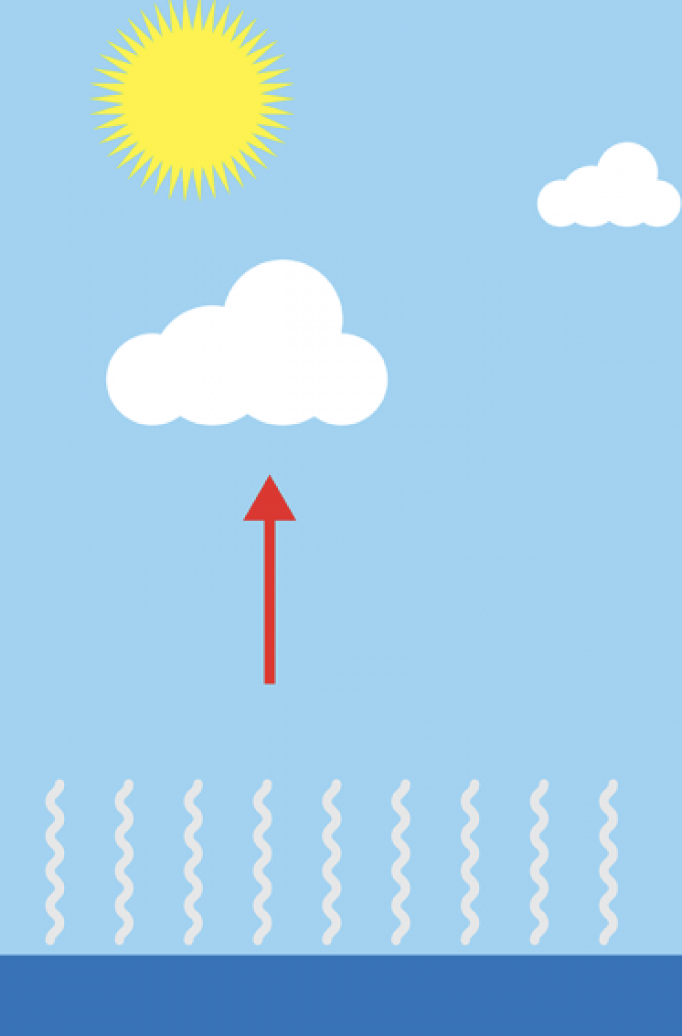
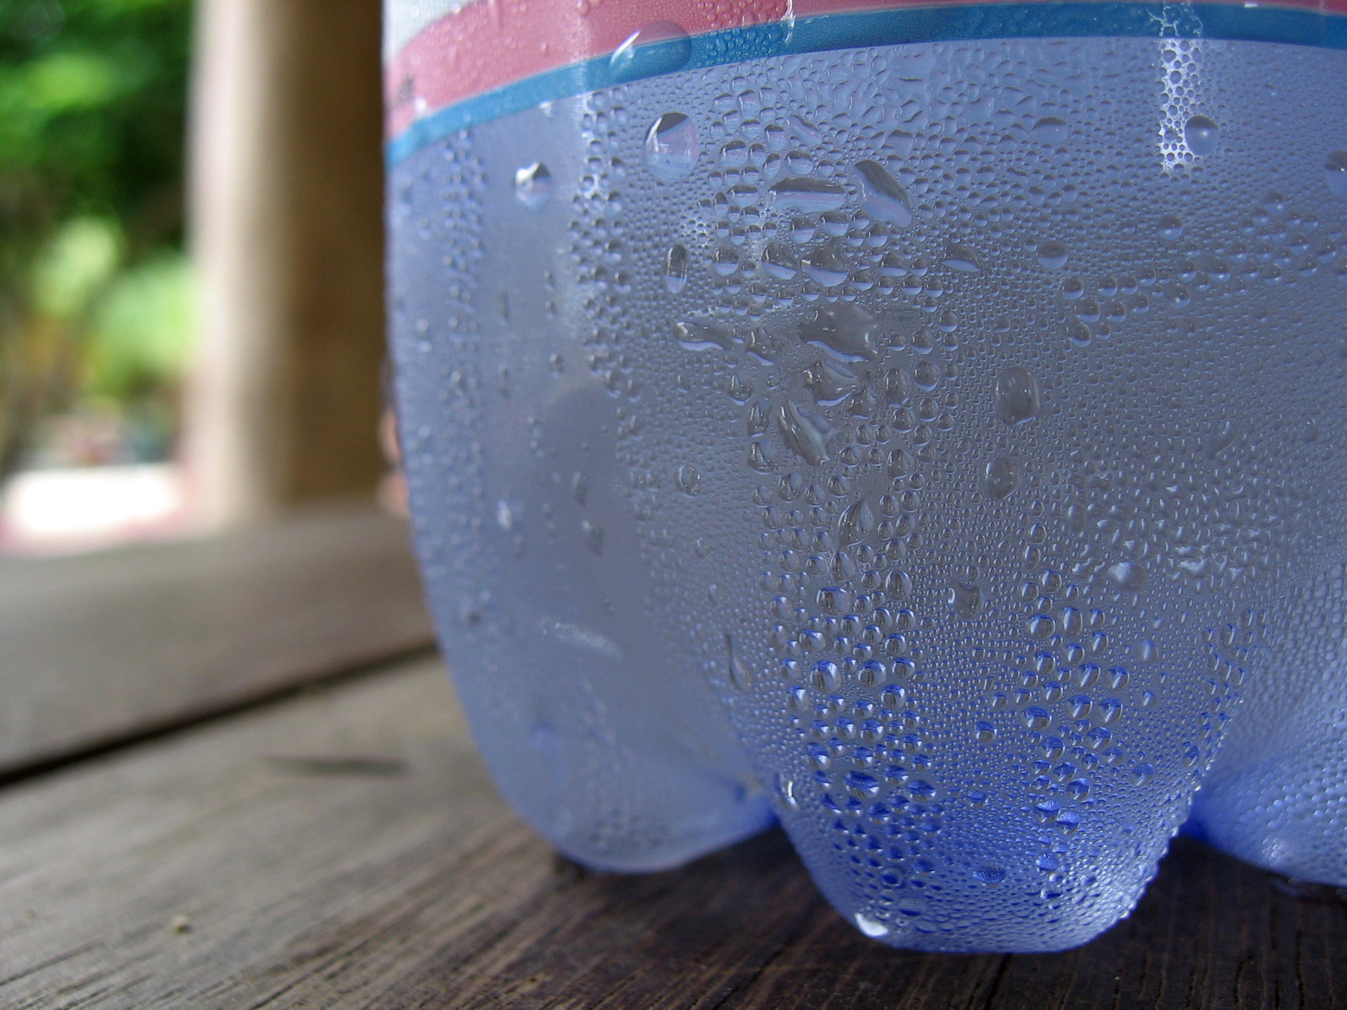
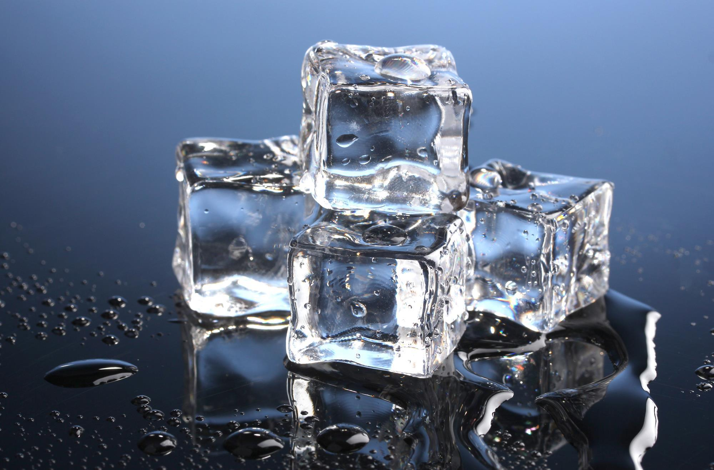
Directions: Choose the correct picture of evaporation from the choices below.
A
B
C
D
Notes:
Choose the one correct picture of evaporation from these four choices.

Slide 48
Directions: Choose the correct picture of evaporation from the choices below.
A
B
C
D
Notes:
This is the correct picture of evaporation.

Slide 49
Definition
Picture
Evaporation
Example
How does evaporation impact my life?
Notes:
Here is the Frayer model filled in with a picture of evaporation.

Slide 50
Directions: Choose the correct definition of evaporation from the choices below.
A
The steady flow of water in a specific direction
B
How water moves through the Earth’s atmosphere
C
When water droplets heat up and turn into invisible water vapor in the air
D
The formation of valleys and mountains as a result of the movement of water
Notes:
Choose the one correct definition of evaporation from these four choices.

Slide 51
Directions: Choose the correct definition of evaporation from the choices below.
A
The steady flow of water in a specific direction
B
How water moves through the Earth’s atmosphere
C
When water droplets heat up and turn into invisible water vapor in the air
D
The formation of valleys and mountains as a result of the movement of water
Notes:
“When water droplets heat up and turn into invisible water vapor in the air” is correct! This is the definition of evaporation.

Slide 52
Definition
Picture
When water droplets heat up and turn into invisible water vapor in the air
Evaporation
Example
How does evaporation impact my life?
Notes:
Here is the Frayer Model with a picture and the definition filled in for evaporation: When water droplets heat up and turn into invisible water vapor in the air.

Slide 53
Directions: Choose the correct example of
evaporation from the choices below.
A
Oceans and seas
B
Invisible gas from boiling water
C
Frozen water turned into ice
D
Rivers, lakes, and valleys
Notes:
Choose the one correct example of evaporation from these four choices.

Slide 54
Directions: Choose the correct example of
evaporation from the choices below.
A
Oceans and seas
B
Invisible gas from boiling water
C
Frozen water turned into ice
D
Rivers, lakes, and valleys
Notes:
“Invisible gas from boiling water” is correct! This is an example of evaporation.

Slide 55
Definition
Picture
When water droplets heat up and turn into invisible water vapor in the air
Evaporation
Invisible gas from boiling water
Example
How does evaporation impact my life?
Notes:
Here is the Frayer Model with a picture, definition, and an example of evaporation: Invisible gas from boiling water.

Slide 56
Directions: Choose the correct response for “how does evaporation impact my life?” from the choices below.
A
Evaporation explains how water moves from the Earth into the air, which is an important part of the water cycle and therefore helps provide us with fresh water.
B
Evaporation shows the different phases of water and how we can use each in our lives.
C
Evaporation explains how gases interact with each other in Earth’s atmosphere.
D
Evaporation creates an environment in which water can freeze into ice which helps cool the planet.
Notes:
Choose the one correct response for “how does evaporation impact my life?” from these four choices.

Slide 57
Directions: Choose the correct response for “how does evaporation impact my life?” from the choices below.
A
Evaporation explains how water moves from the Earth into the air, which is an important part of the water cycle and therefore helps provide us with fresh water.
B
Evaporation shows the different phases of water and how we can use each in our lives.
C
Evaporation explains how gases interact with each other in Earth’s atmosphere.
D
Evaporation creates an environment in which water can freeze into ice which helps cool the planet.
Notes:
You chose “Evaporation explains how water moves from the Earth into the air, which is an important part of the water cycle and therefore helps provide us with fresh water.” That is correct! This is an example of how evaporation impacts your life.

Slide 58
Definition
Picture
When water droplets heat up and turn into invisible water vapor in the air
Evaporation
Evaporation explains how water moves from the Earth into the air, which is an important part of the water cycle and therefore helps provide us with fresh water.
Invisible gas from boiling water
Example
How does evaporation impact my life?
Notes:
Here is the Frayer Model with a picture, definition, example, and a correct response to “how does evaporation impact my life?”: Evaporation explains how water moves from the Earth into the air, which is an important part of the water cycle and therefore helps provide us with fresh water.

Slide 59
Remember!!!
Notes:
So remember!

Slide 60
Evaporation: when water droplets heat up and turn into invisible water vapor in the air
Notes:
Evaporation is when water droplets heat up and turn into invisible water vapor in the air.

Slide 61
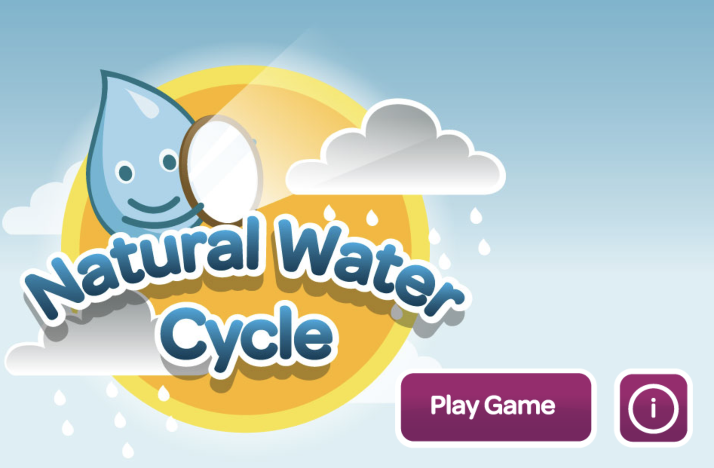
Simulation Activity
Natural Water Cycle Game
In this online game, students go through the different parts of the Water Cycle including evaporation, condensation, and precipitation using the water droplet character, Whoosh to show how water moves through the different parts of the cycle.
Notes:
In this online game, students go through the different parts of the Water Cycle including evaporation, condensation, and precipitation using the water droplet character, Whoosh to show how water moves through the different parts of the cycle.

Slide 62
Big Question: How does water move throughout Earth’s atmosphere?
Notes:
Now that we’ve learned our new term “water cycle”, let’s reflect on our big question. Our “big question” is: How does water move throughout Earth’s atmosphere?
Was there anything that we predicted earlier that was correct or incorrect? Do you have any new hypotheses to share?
I love all these thoughtful scientific hypotheses! Be sure to keep this question and your predictions in mind as we move through these next few lessons, and we’ll continue to revisit it.

Slide 63
Notes:
Thanks for watching, and please continue watching CAPs available from this website.

Slide 64
This Video Was Created With Resources From:
Questions or Comments
Michael Kennedy, Ph.D. MKennedy@Virginia.edu
Rachel L Kunemund, Ph.D. rk8vm@virginia.edu

