Slide 1
Intro
“Big Idea” Question
Review Concepts
Check-In Questions
Teacher Demo
Vocabulary
Student-Friendly Definition
Examples & Non-Examples
Morphological Word Parts
Simulation/Activity
Notes:
OK everyone, get ready for our next lesson. Just as a reminder, these are the different components that our lesson may include, and you’ll see these icons in the top left corner of each slide so that you can follow along more easily!

Slide 2
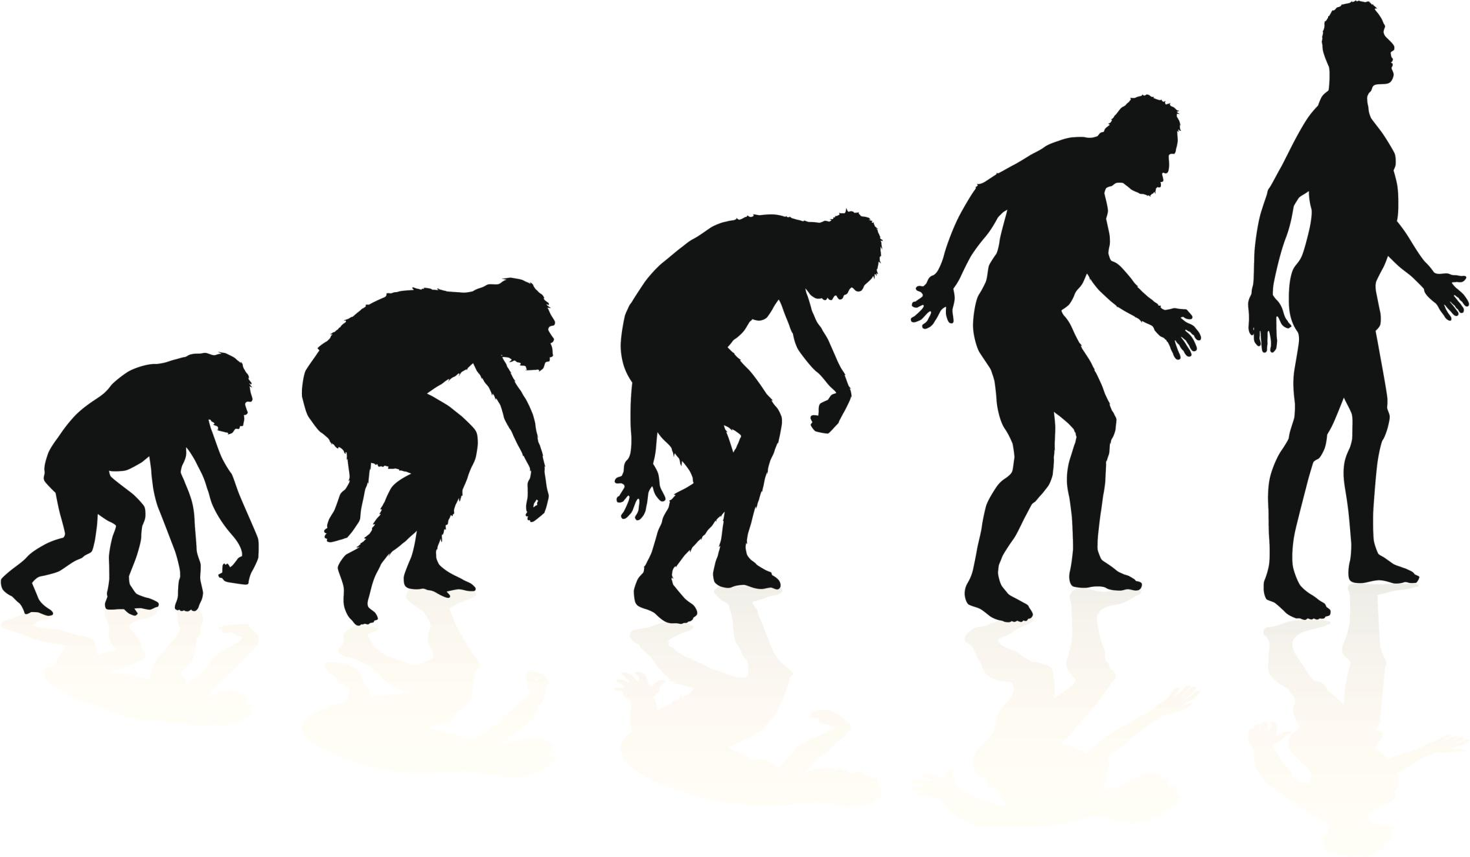
Evolution
Notes:
In this lesson we talk about evolution.

Slide 3
Big Question: How is evolution related to population changes over time?
Notes:
Our “big question” is: How is evolution related to population changes over time?
[Pause and illicit predictions from students.]
I love all these thoughtful scientific hypotheses! Be sure to keep this question and your predictions in mind as we move through these next few lessons, and we’ll continue to revisit it.
Feedback: Asking students to make predictions about how evolution is related to population changes is a great way to activate and elicit student ideas and prior knowledge. This type of activity is evidence of the teacher planning for students’ engagement with science ideas.

Slide 4
Demonstration
Evolution 'Telephone'
A fun way to help students understand DNA mutations in evolution is the childhood game of Telephone—with an evolution-related twist. This game has several parallels to aspects of evolution. Students will enjoy modeling how microevolution can change a species over time.
The message sent through the "telephone" changes as it passes between the students because small mistakes by students accumulate, much like small mutations happen in DNA. In evolution, after enough time passes, mistakes add up to adaptations and can create new species that don't resemble the originals. Instructions for this activity and others are linked above!
Notes:
Feedback: Demonstrations such as this are a terrific way to engage students and offer them a physical representation of the science phenomenon to help them make connections between concepts.

Slide 5
Notes:
Next, let’s review some other words that you already learned, and make sure you are firm in your understanding.

Slide 6
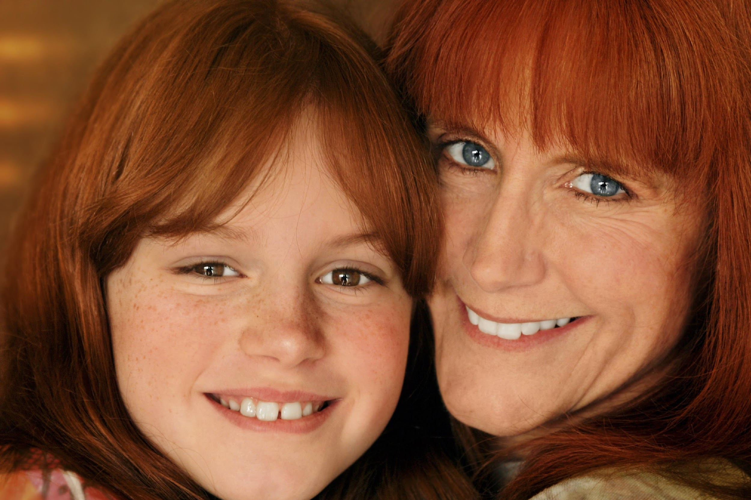
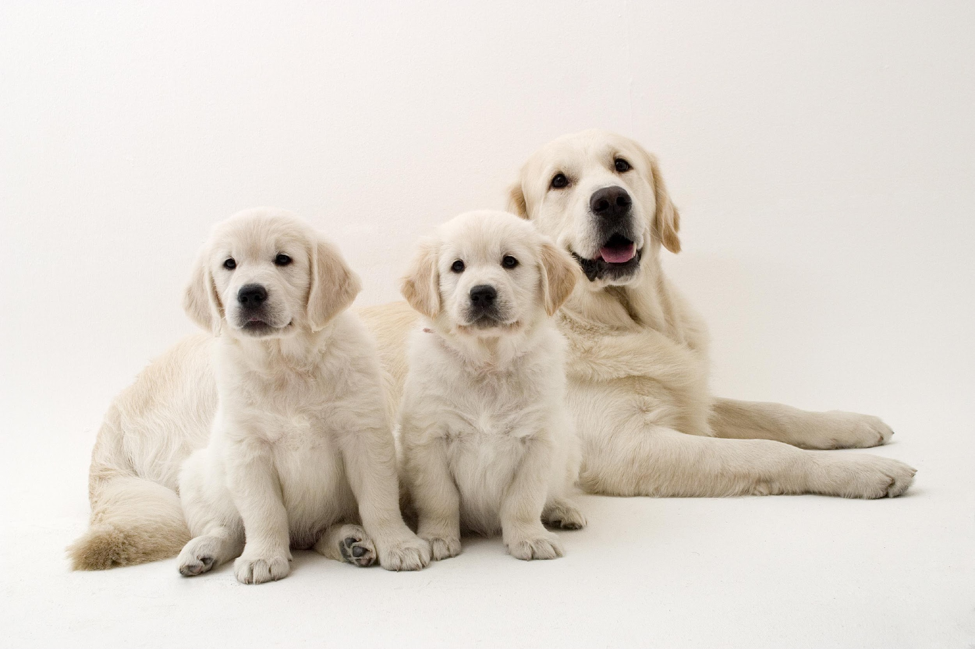
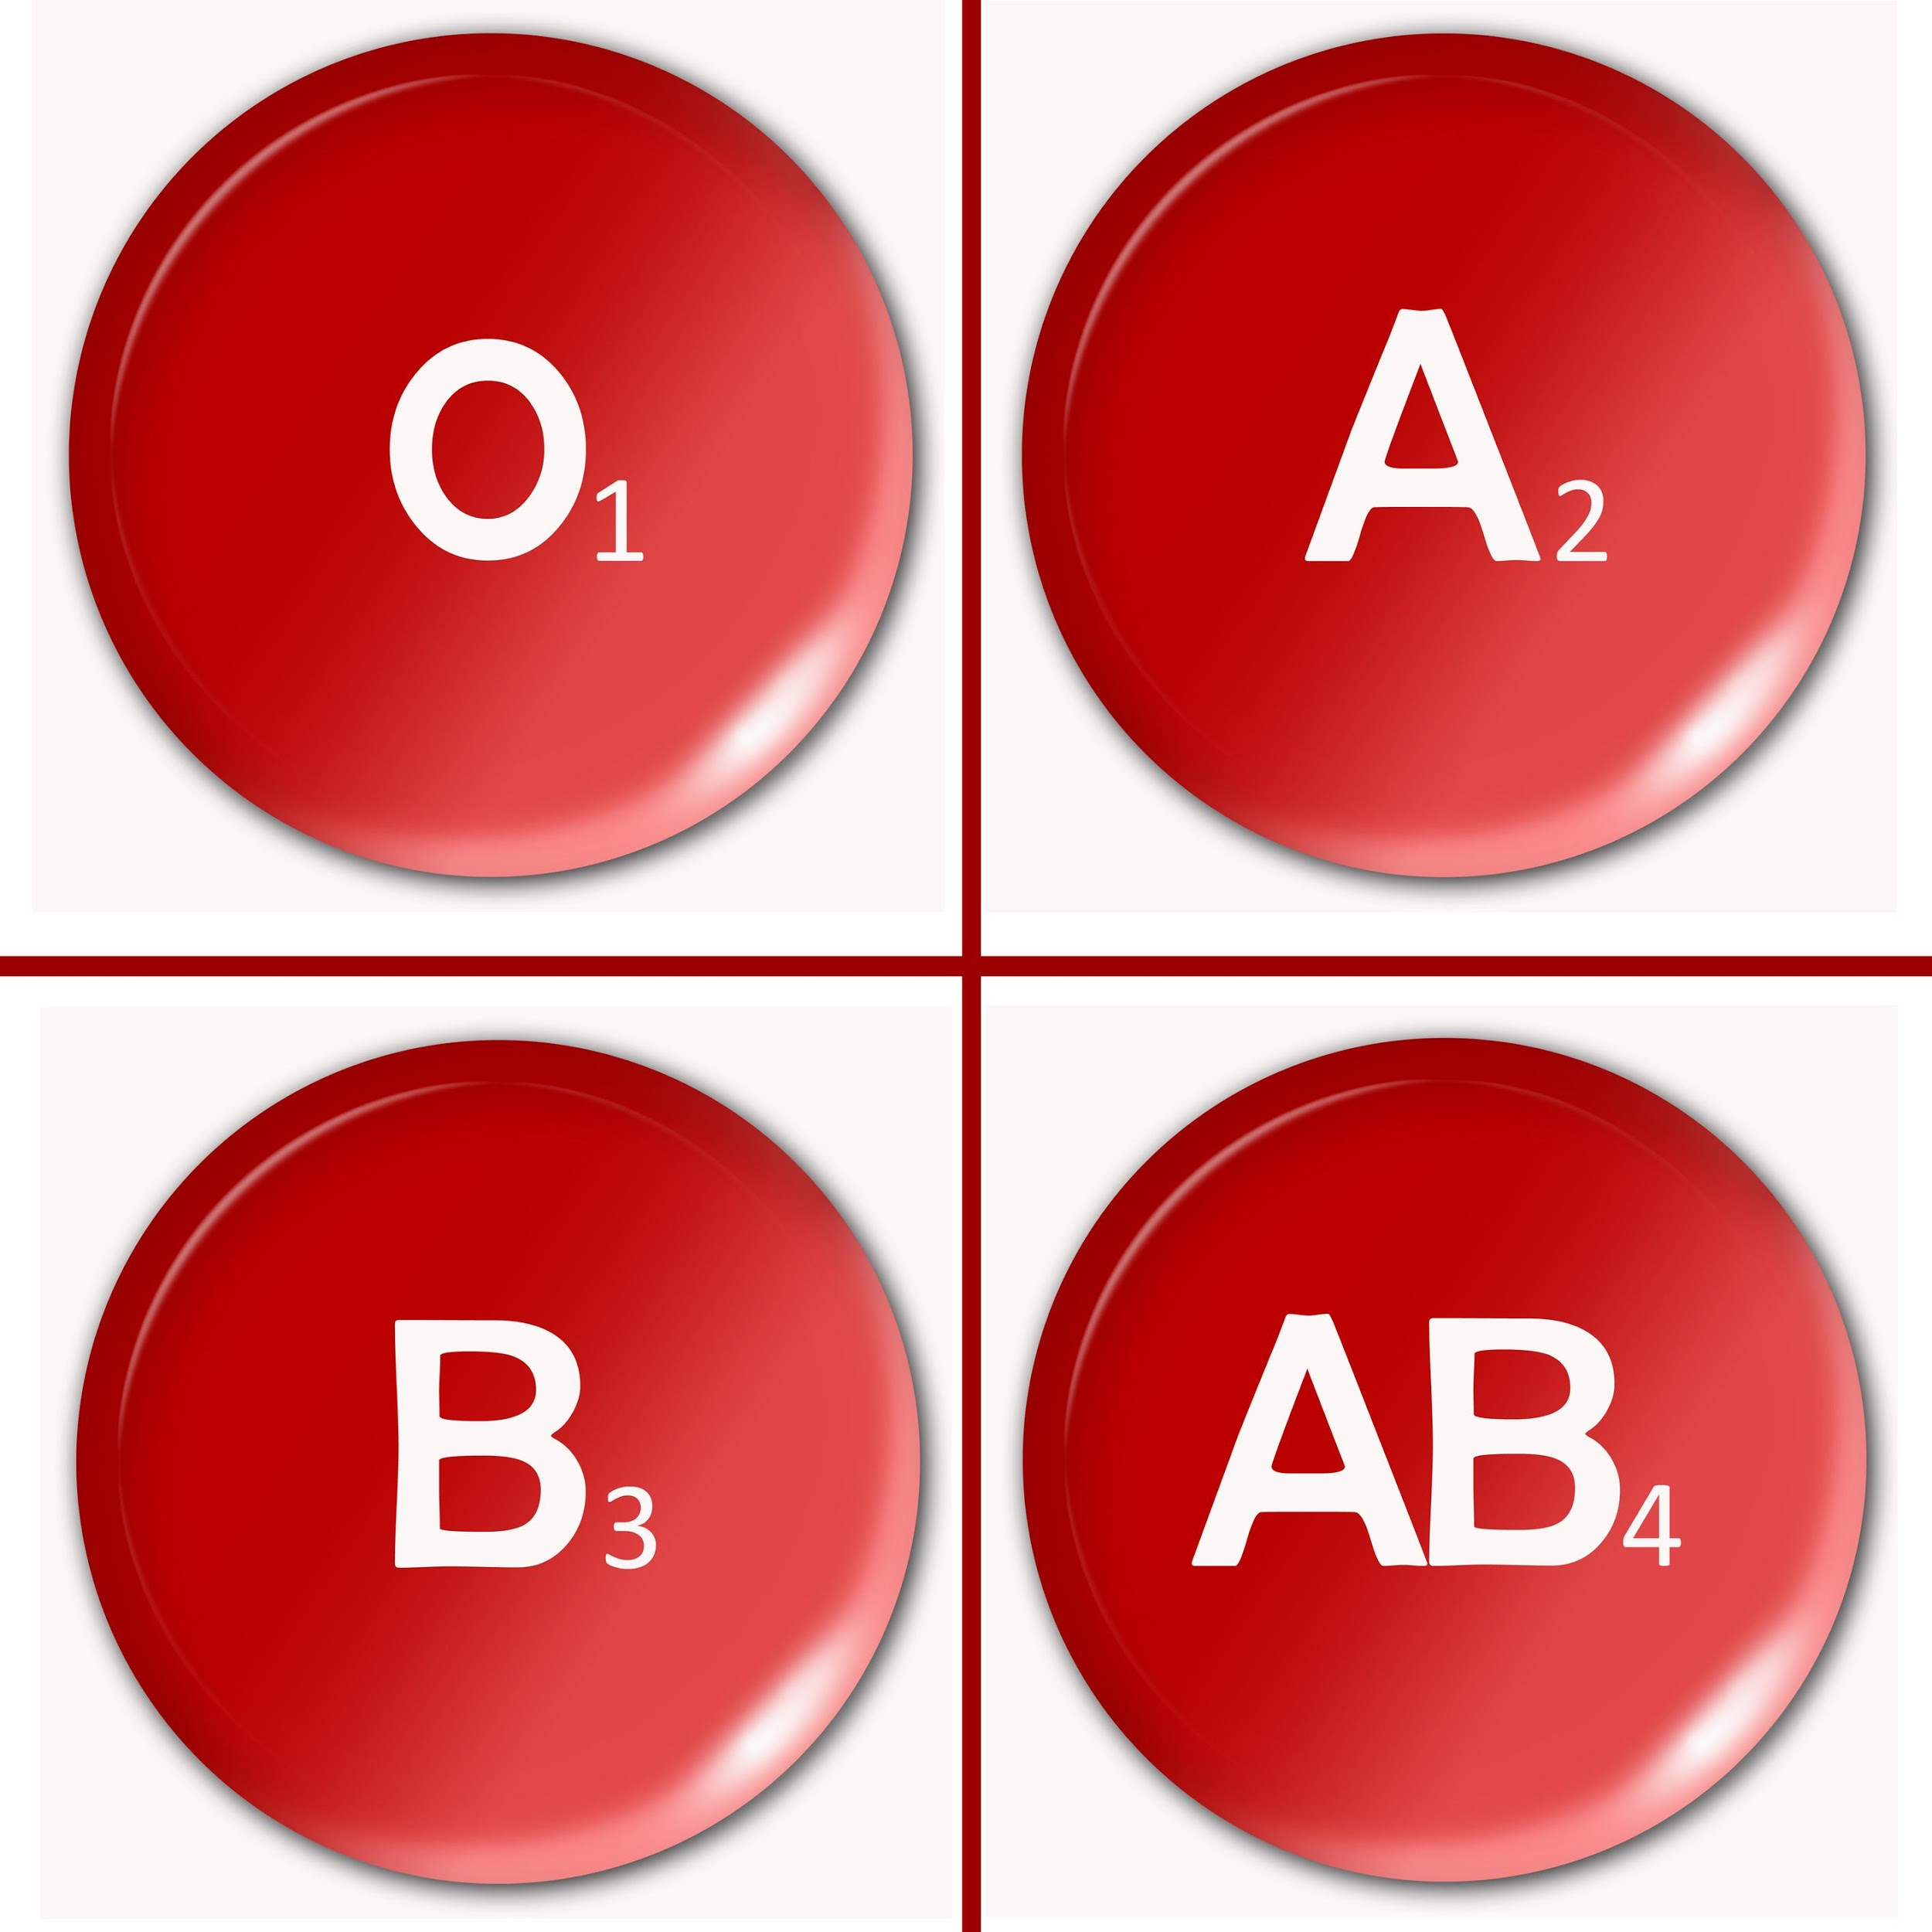
Hereditary
Notes:
Parents’ hereditary material give traits—such as eye color, hair color, blood type, or height—to their offspring, or their children.
Humans have hereditary traits. So do animals, plants, and other organisms.

Slide 7
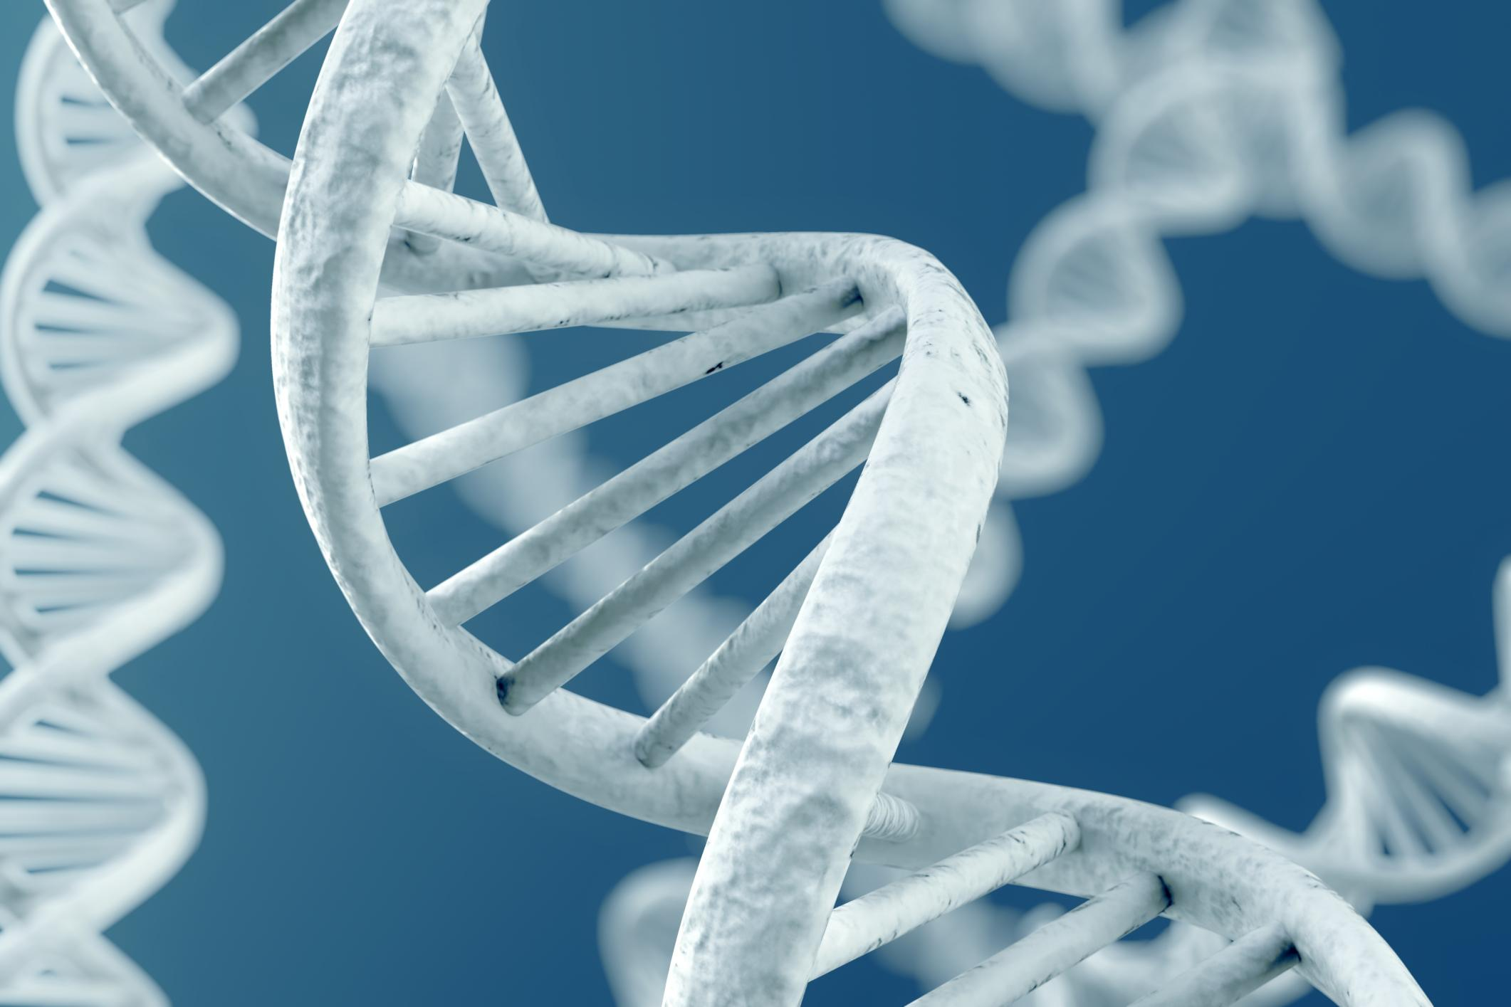
DNA: the hereditary material in
almost all organisms
Notes:
DNA is the hereditary material in all organisms.

Slide 8
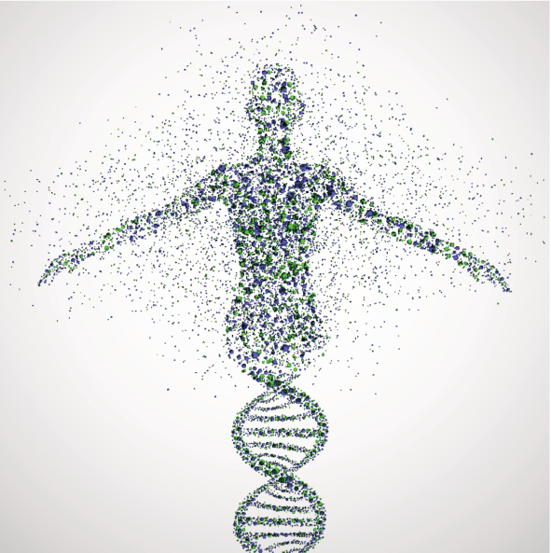
Genes: parts of DNA that carry
information that determines your
traits
Notes:
Genes are the parts of DNA that carry the information that determines your traits—such as hair color, height, baldness, and blood type.

Slide 9
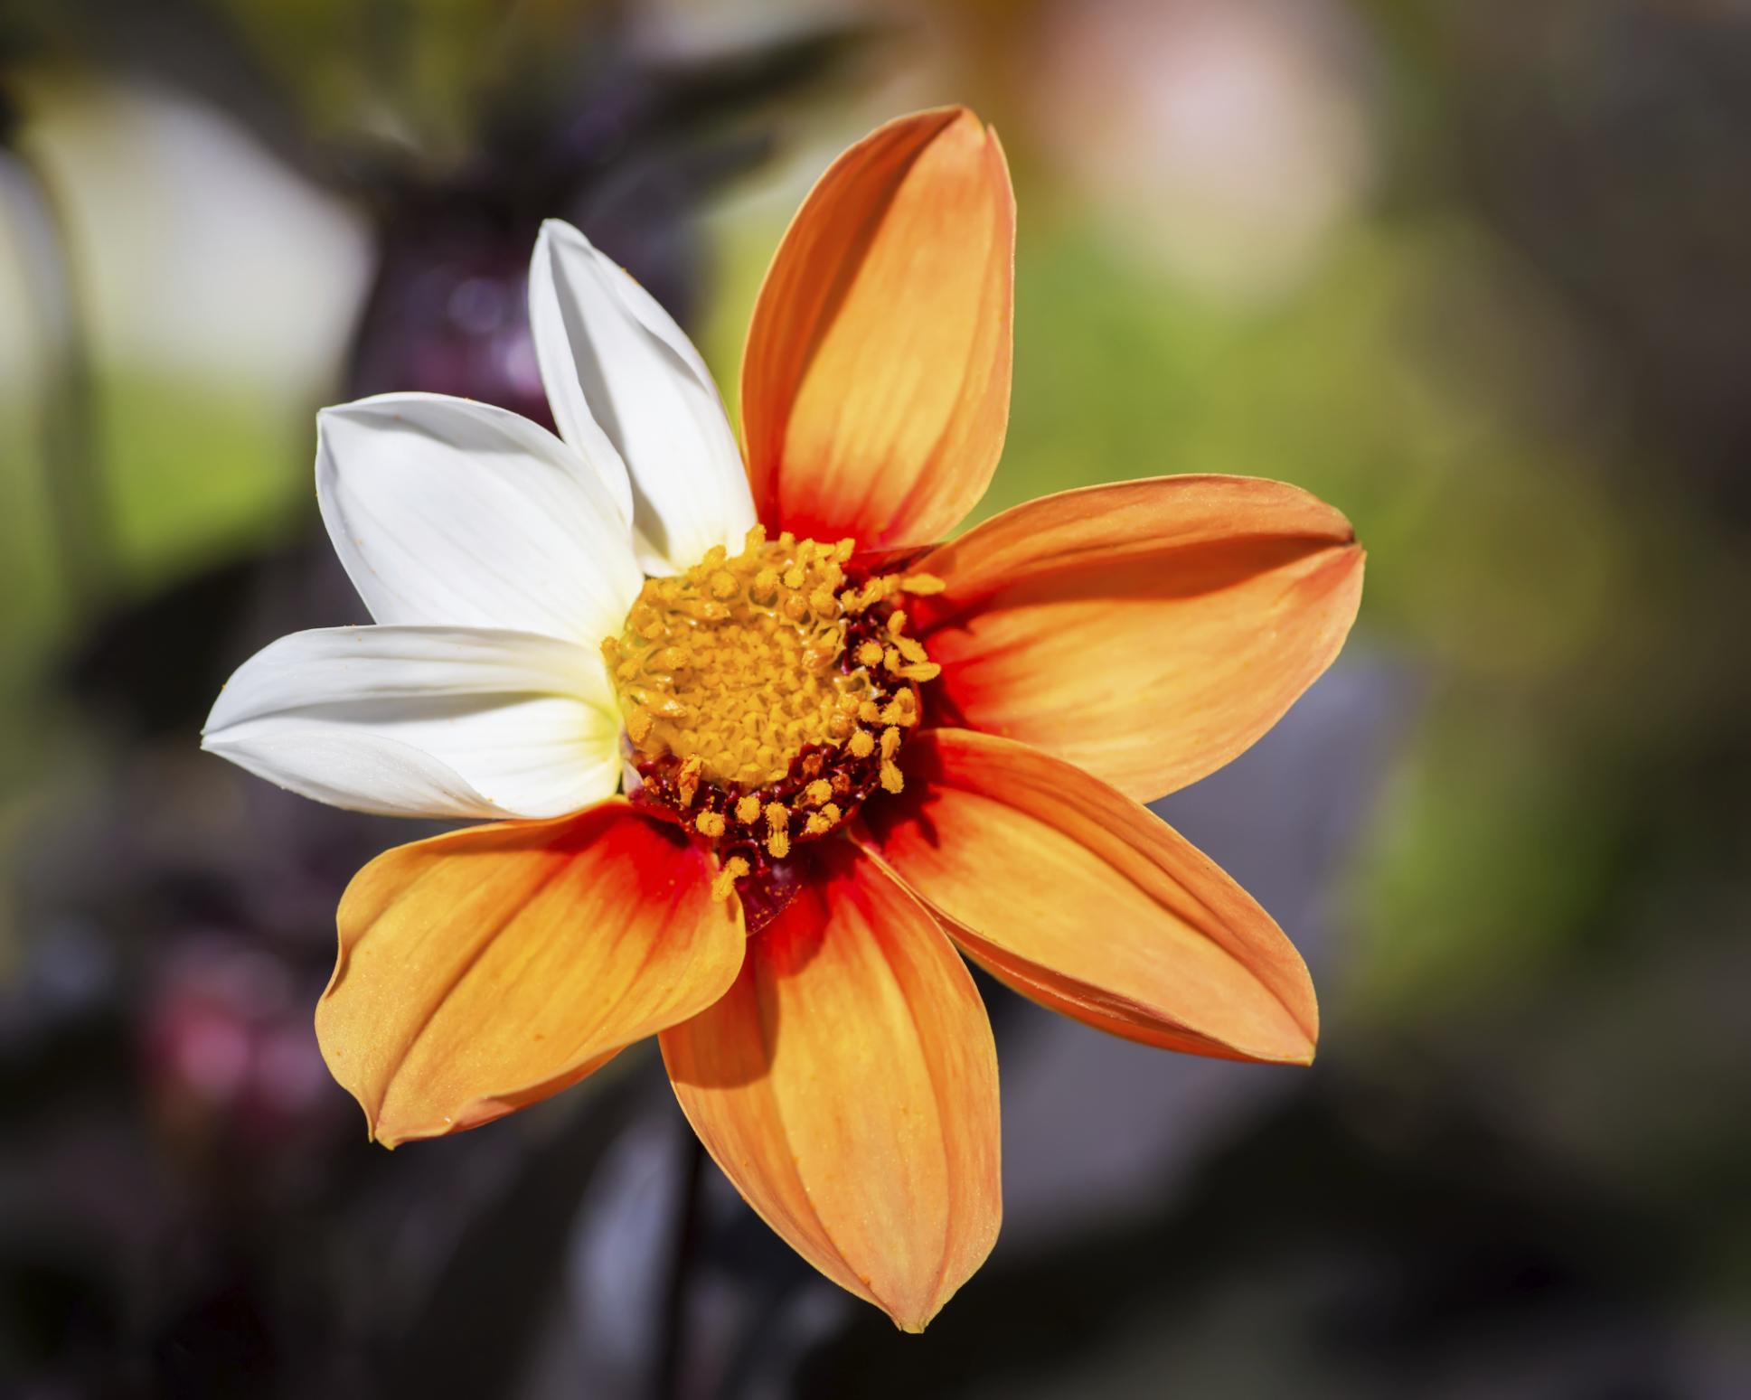
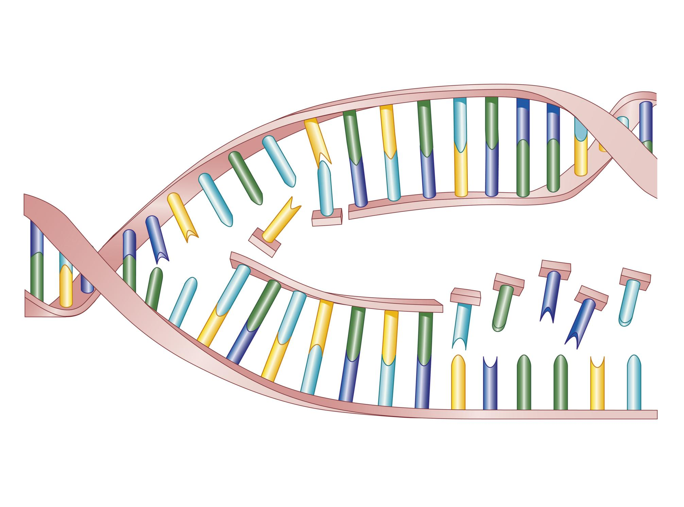
Mutation: a permanent change in the DNA sequence that makes up a gene
Notes:
A mutation is a permanent change in the DNA sequence that makes up a gene.

Slide 10
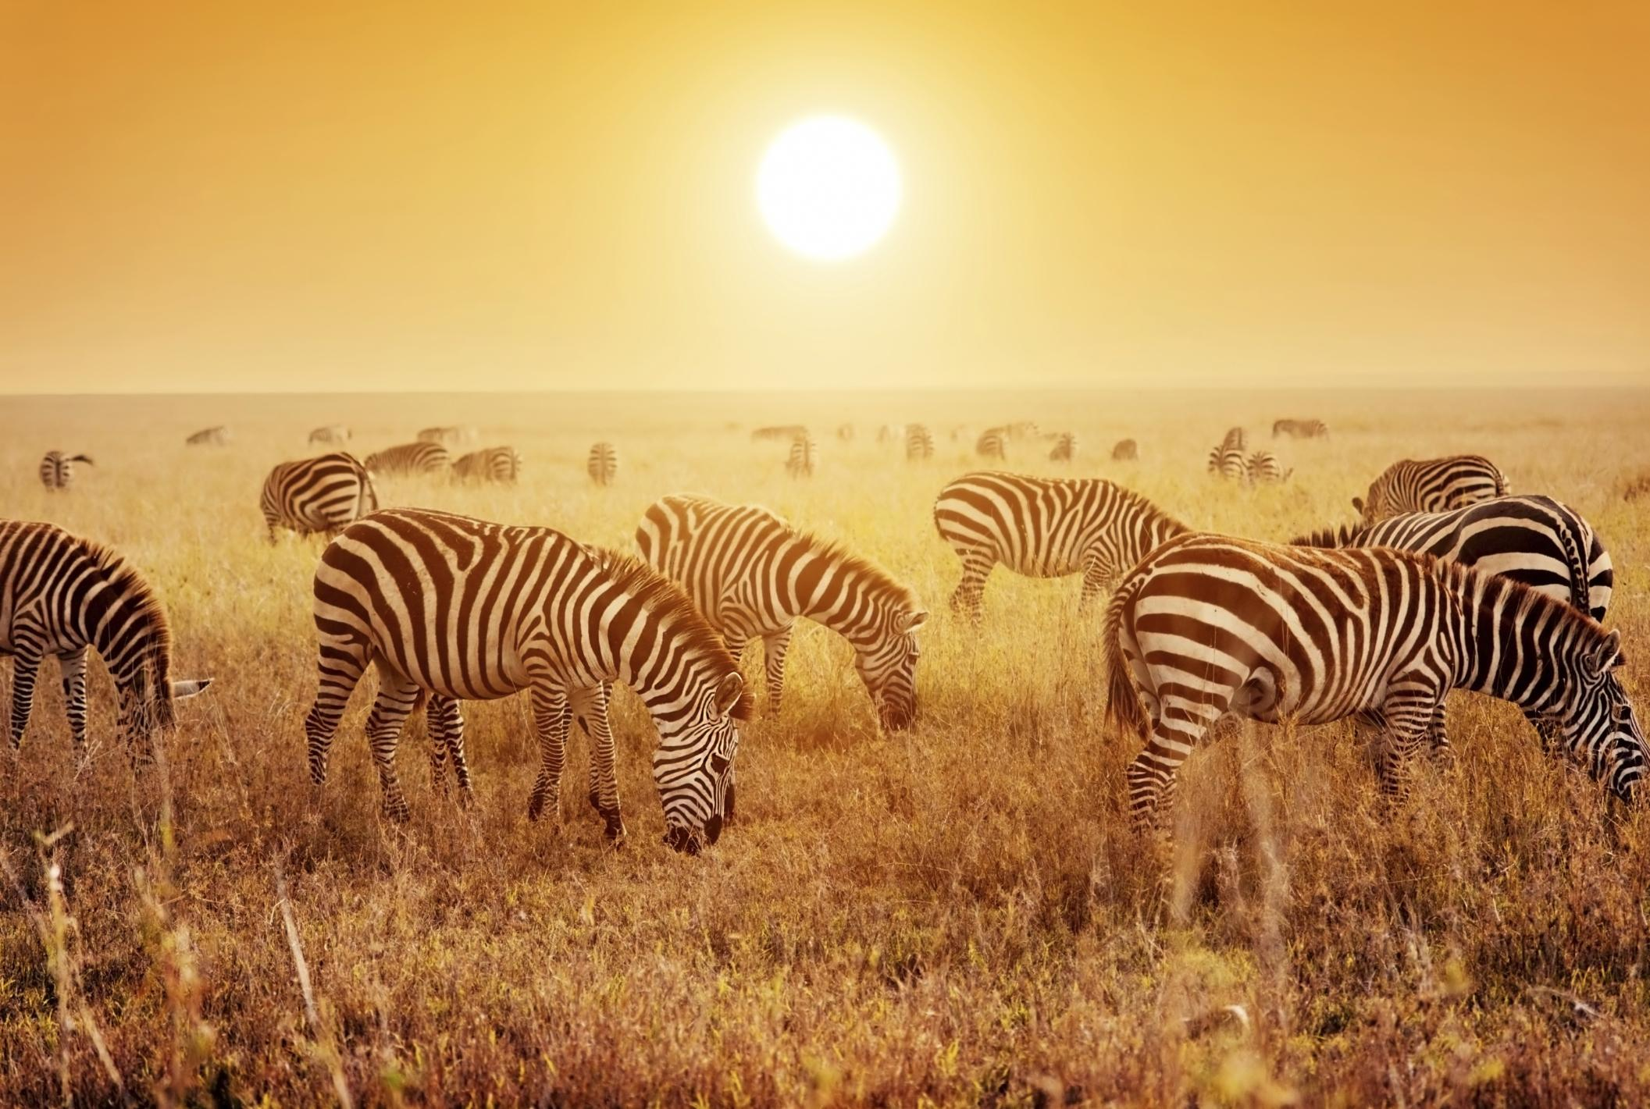
Species: one unique type of organism
Notes:
Species is one unique type of organism.

Slide 11
Notes:
Now let’s pause for a moment to review the information we have covered already.

Slide 12
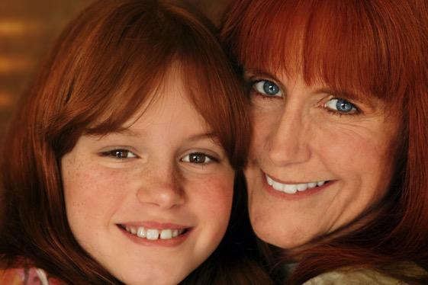
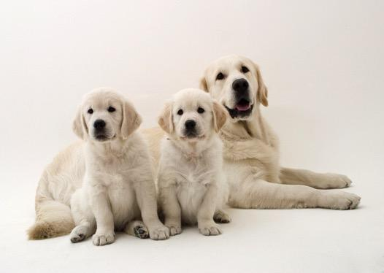
What does inheritable mean?
A trait that is received by choice
A trait that is received by hard work
A trait that is received by genes
A trait that is received by the environment
Notes:
What does inheritable mean?

Slide 13
What does inheritable mean?
A trait that is received by choice
A trait that is received by hard work
A trait that is received by genes
A trait that is received by the environment
Notes:
What does inheritable mean?
[C. A trait that is received by genes.
Remember that parents’ hereditary material gives traits—such as eye color, hair color, blood type, or height—to their offspring, or children.
Humans have hereditary traits. So do animals, plants, and other organisms]

Slide 14
What part of DNA carries the
information that determines our traits?
Notes:
What part of DNA carries the information that determines our traits?
[Genes]

Slide 15
A species is one unique type of ___________
Notes:
A species is one unique type of___________.

Slide 16
A species is one unique type of organism.
Notes:
Also, remember that species is one unique type of organism.

Slide 17
Evolution
Notes:
Let’s define the term.

Slide 18
Evolution: process that changes species genetically over time
Notes:
Evolution is the process that changes species genetically over time.
Feedback: This is a great opportunity to ask students for examples of evolutionary changes. Incorporating student responses into discussion can help students engage and build understanding as well as seek out misconceptions. For example, students may not have a strong understanding of “over time” (i.e., changes over many generations) rather than something an individual develops within a lifetime.

Slide 19
Notes:
Now let’s pause for a moment to review the information we have covered already.

Slide 20
What is evolution?
Notes:
What is evolution?
[Evolution is the process that changes species genetically over time.]

Slide 21
Notes:
That is the basic definition, but there is a bit more you need to know.

Slide 22
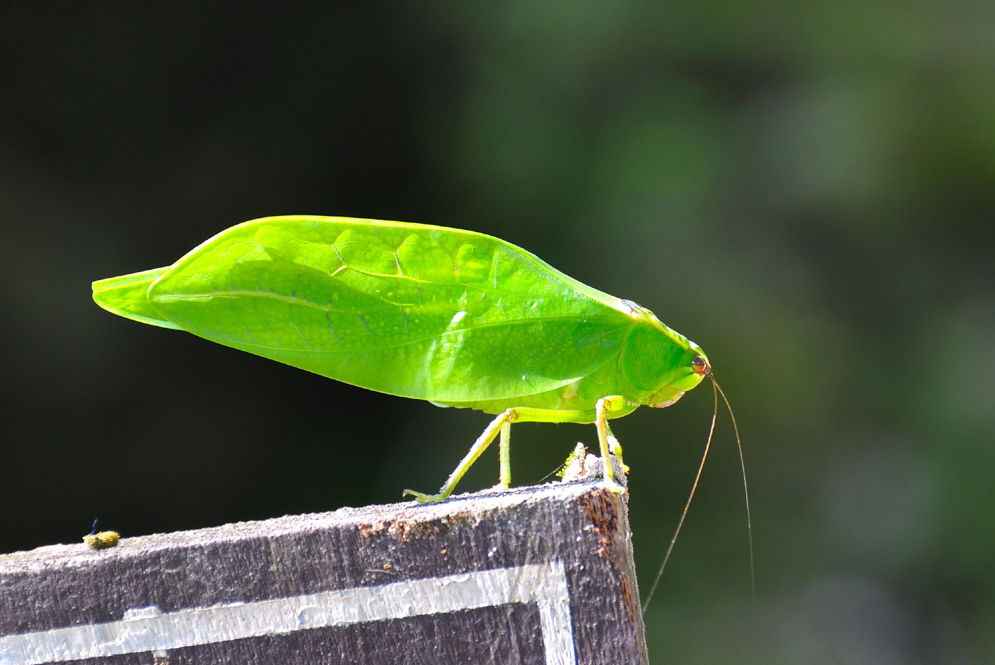
Evolution comes from mutations in an organism’s DNA. These mutations can be helpful.
Notes:
Evolution comes from mutations in an organism’s DNA.
These mutations can be helpful. They can help an organism survive or live longer so they can pass on their genes to their offspring. This insect’s green color and shape shows the result of many years of evolution. Since the color and shape helped the insect hide from their predators and survive, they were more likely to live long enough to reproduce and pass these traits to offspring. Over time, these insect populations came to look more and more like leaves.

Slide 23
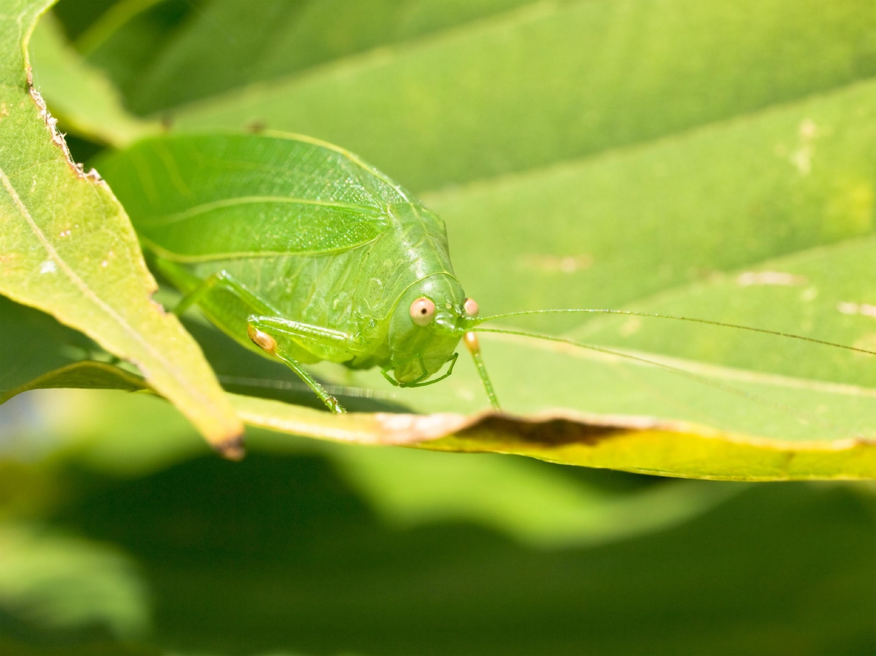
When enough of the population has this new trait, we say that a change has taken place in the species. This change is called evolution.
Notes:
When enough of the population has this new trait we say that a change has taken place in the species.
This change is called evolution.
Through evolution, this insect changed to have the same color and shape as a leaf to hide from predators.

Slide 24
TIME
Notes:
Evolution takes many generations to see a change in a species’ genetic makeup.
The amount of time can also depend on how quickly the species reproduces.

Slide 25
Notes:
Now let’s pause for a moment to review the information we have covered already about evolution.

Slide 26
What is evolution?
Notes:
What is evolution?
[Evolution is the process that changes species genetically over time.]

Slide 27
How does a genetic mutation become evolution among a species?
Notes:
How does a genetic mutation become evolution among a species?
[Sometimes organisms have genetic mutations. These mutations can be helpful. They can help an organism survive or live longer so they can pass on their genes to their offspring. When enough of the population has this new trait (from the mutation) we say that a change has taken place in the species.
In this example, the insect changed through the process of evolution to have the same color and shape as a leaf to hide from predators.]

Slide 28
Notes:
Now, let’s talk about some examples of evolution.

Slide 29
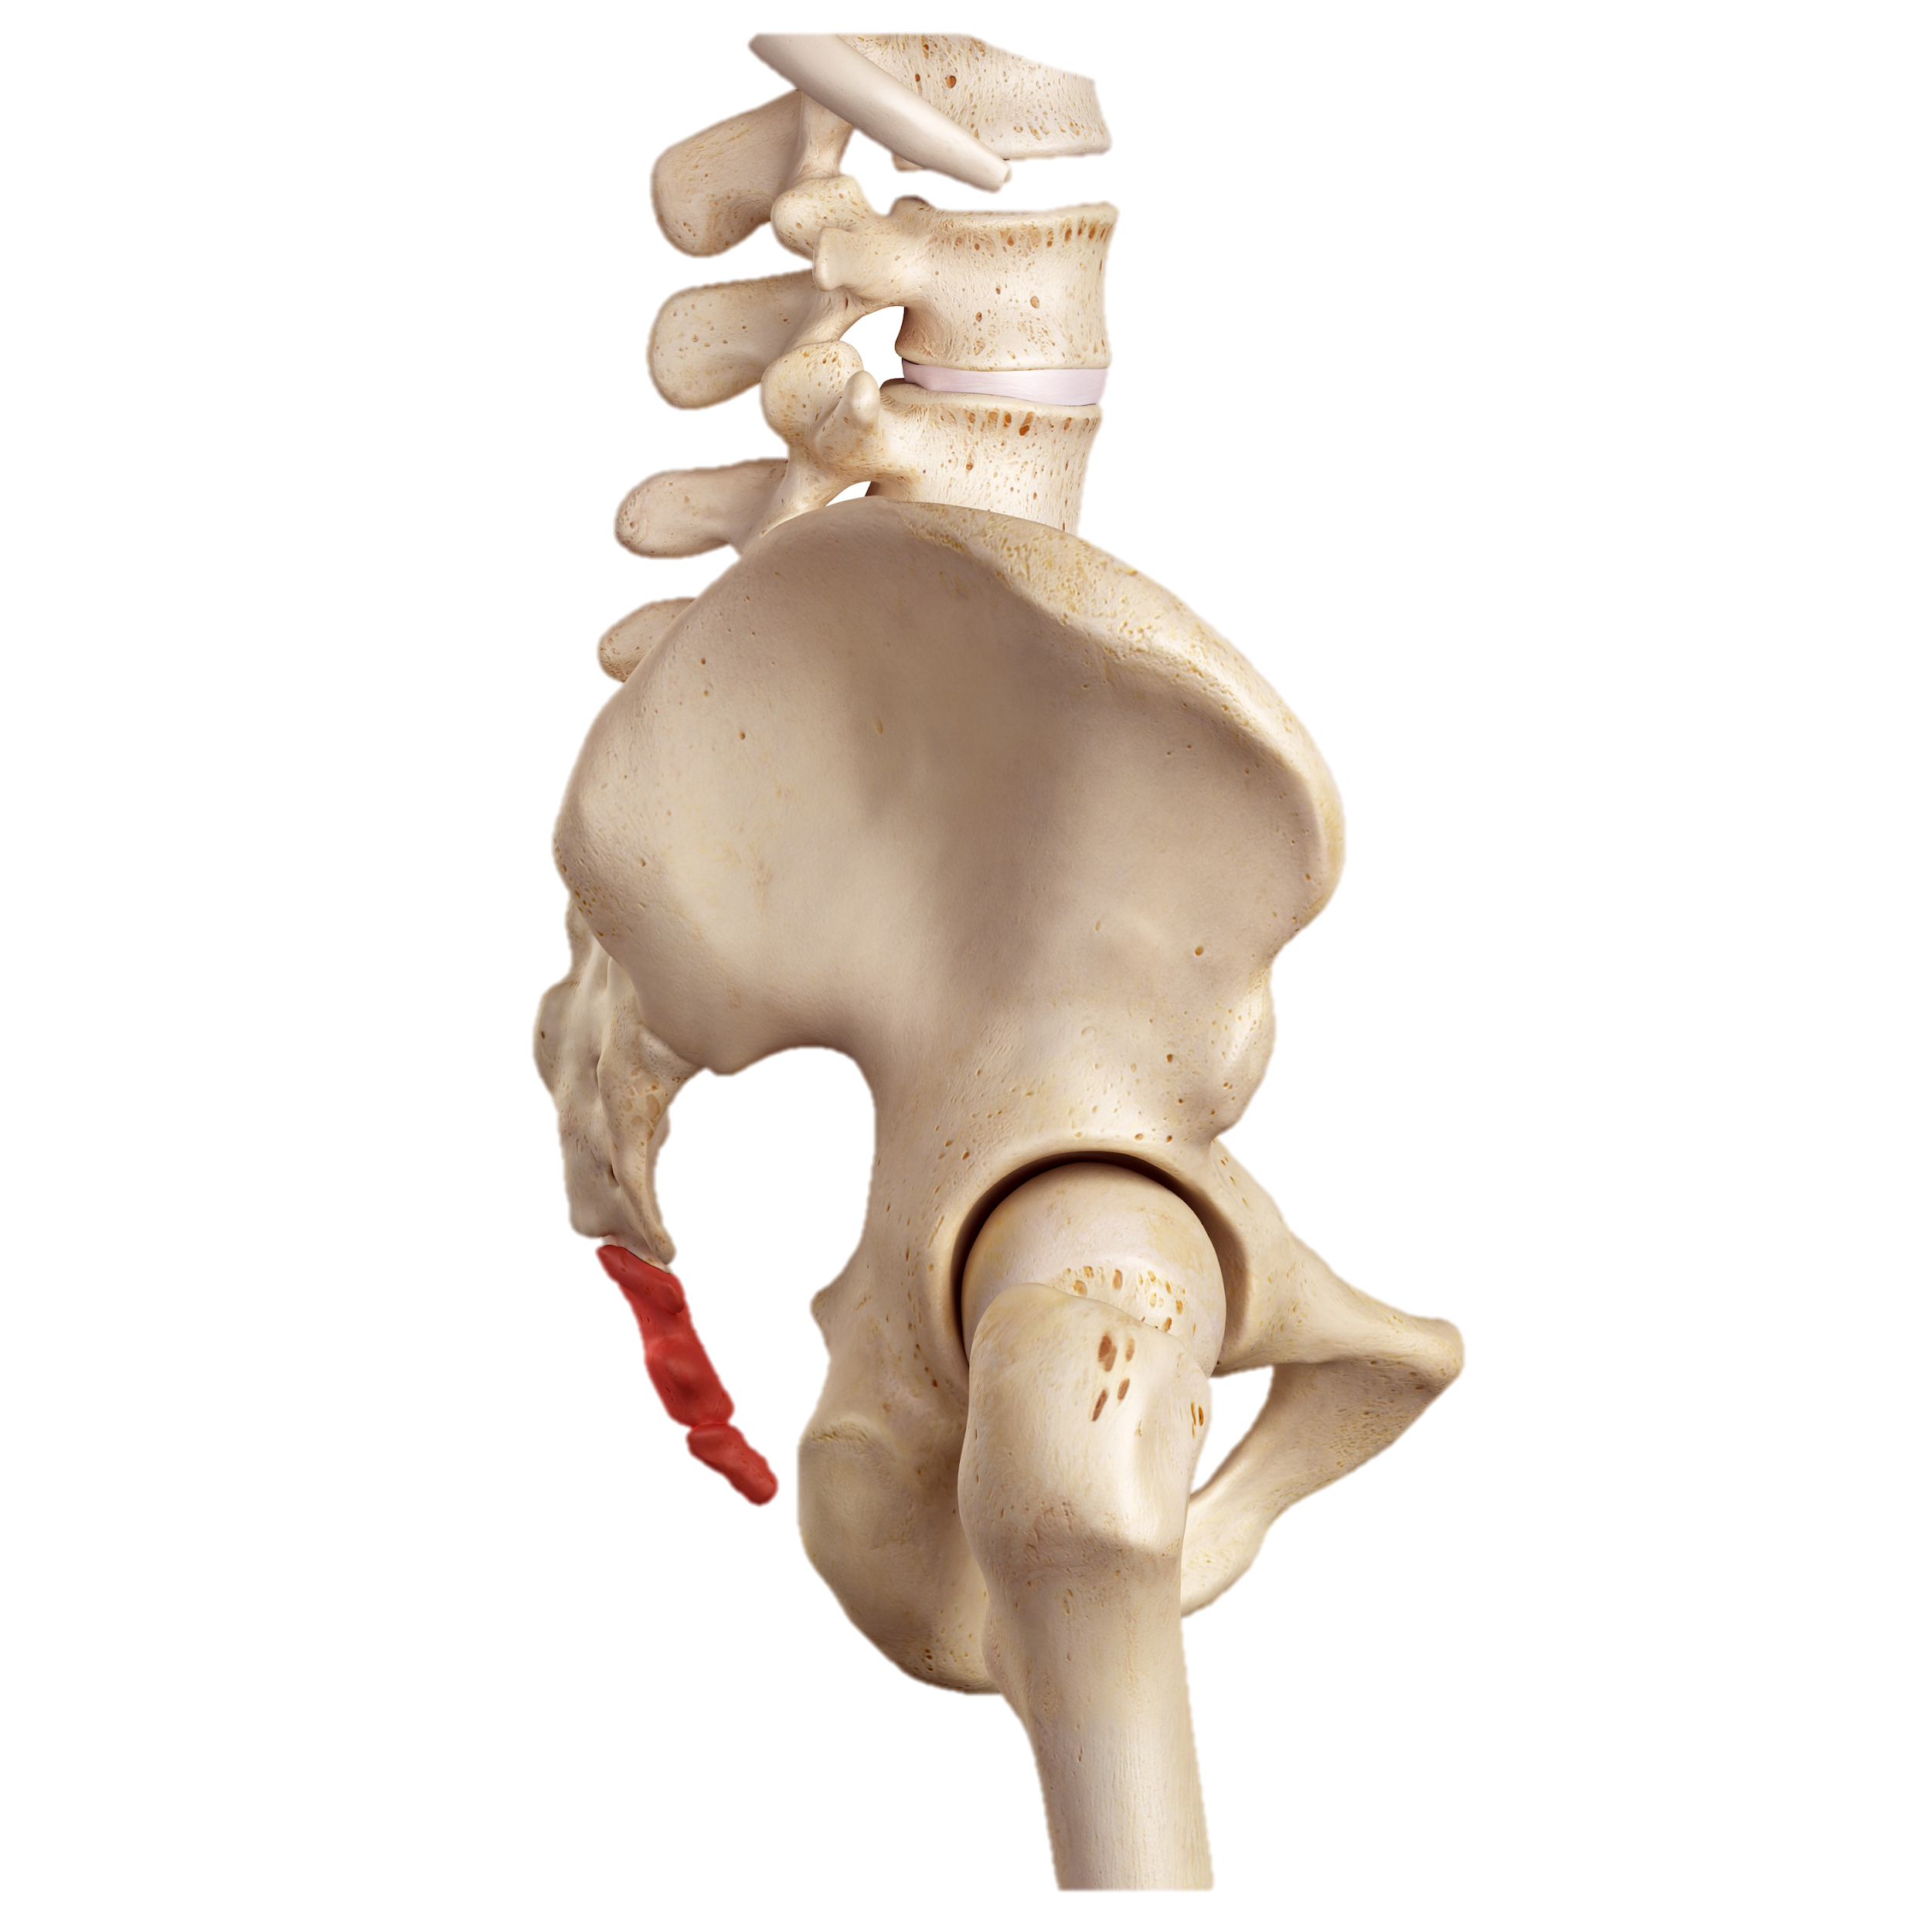
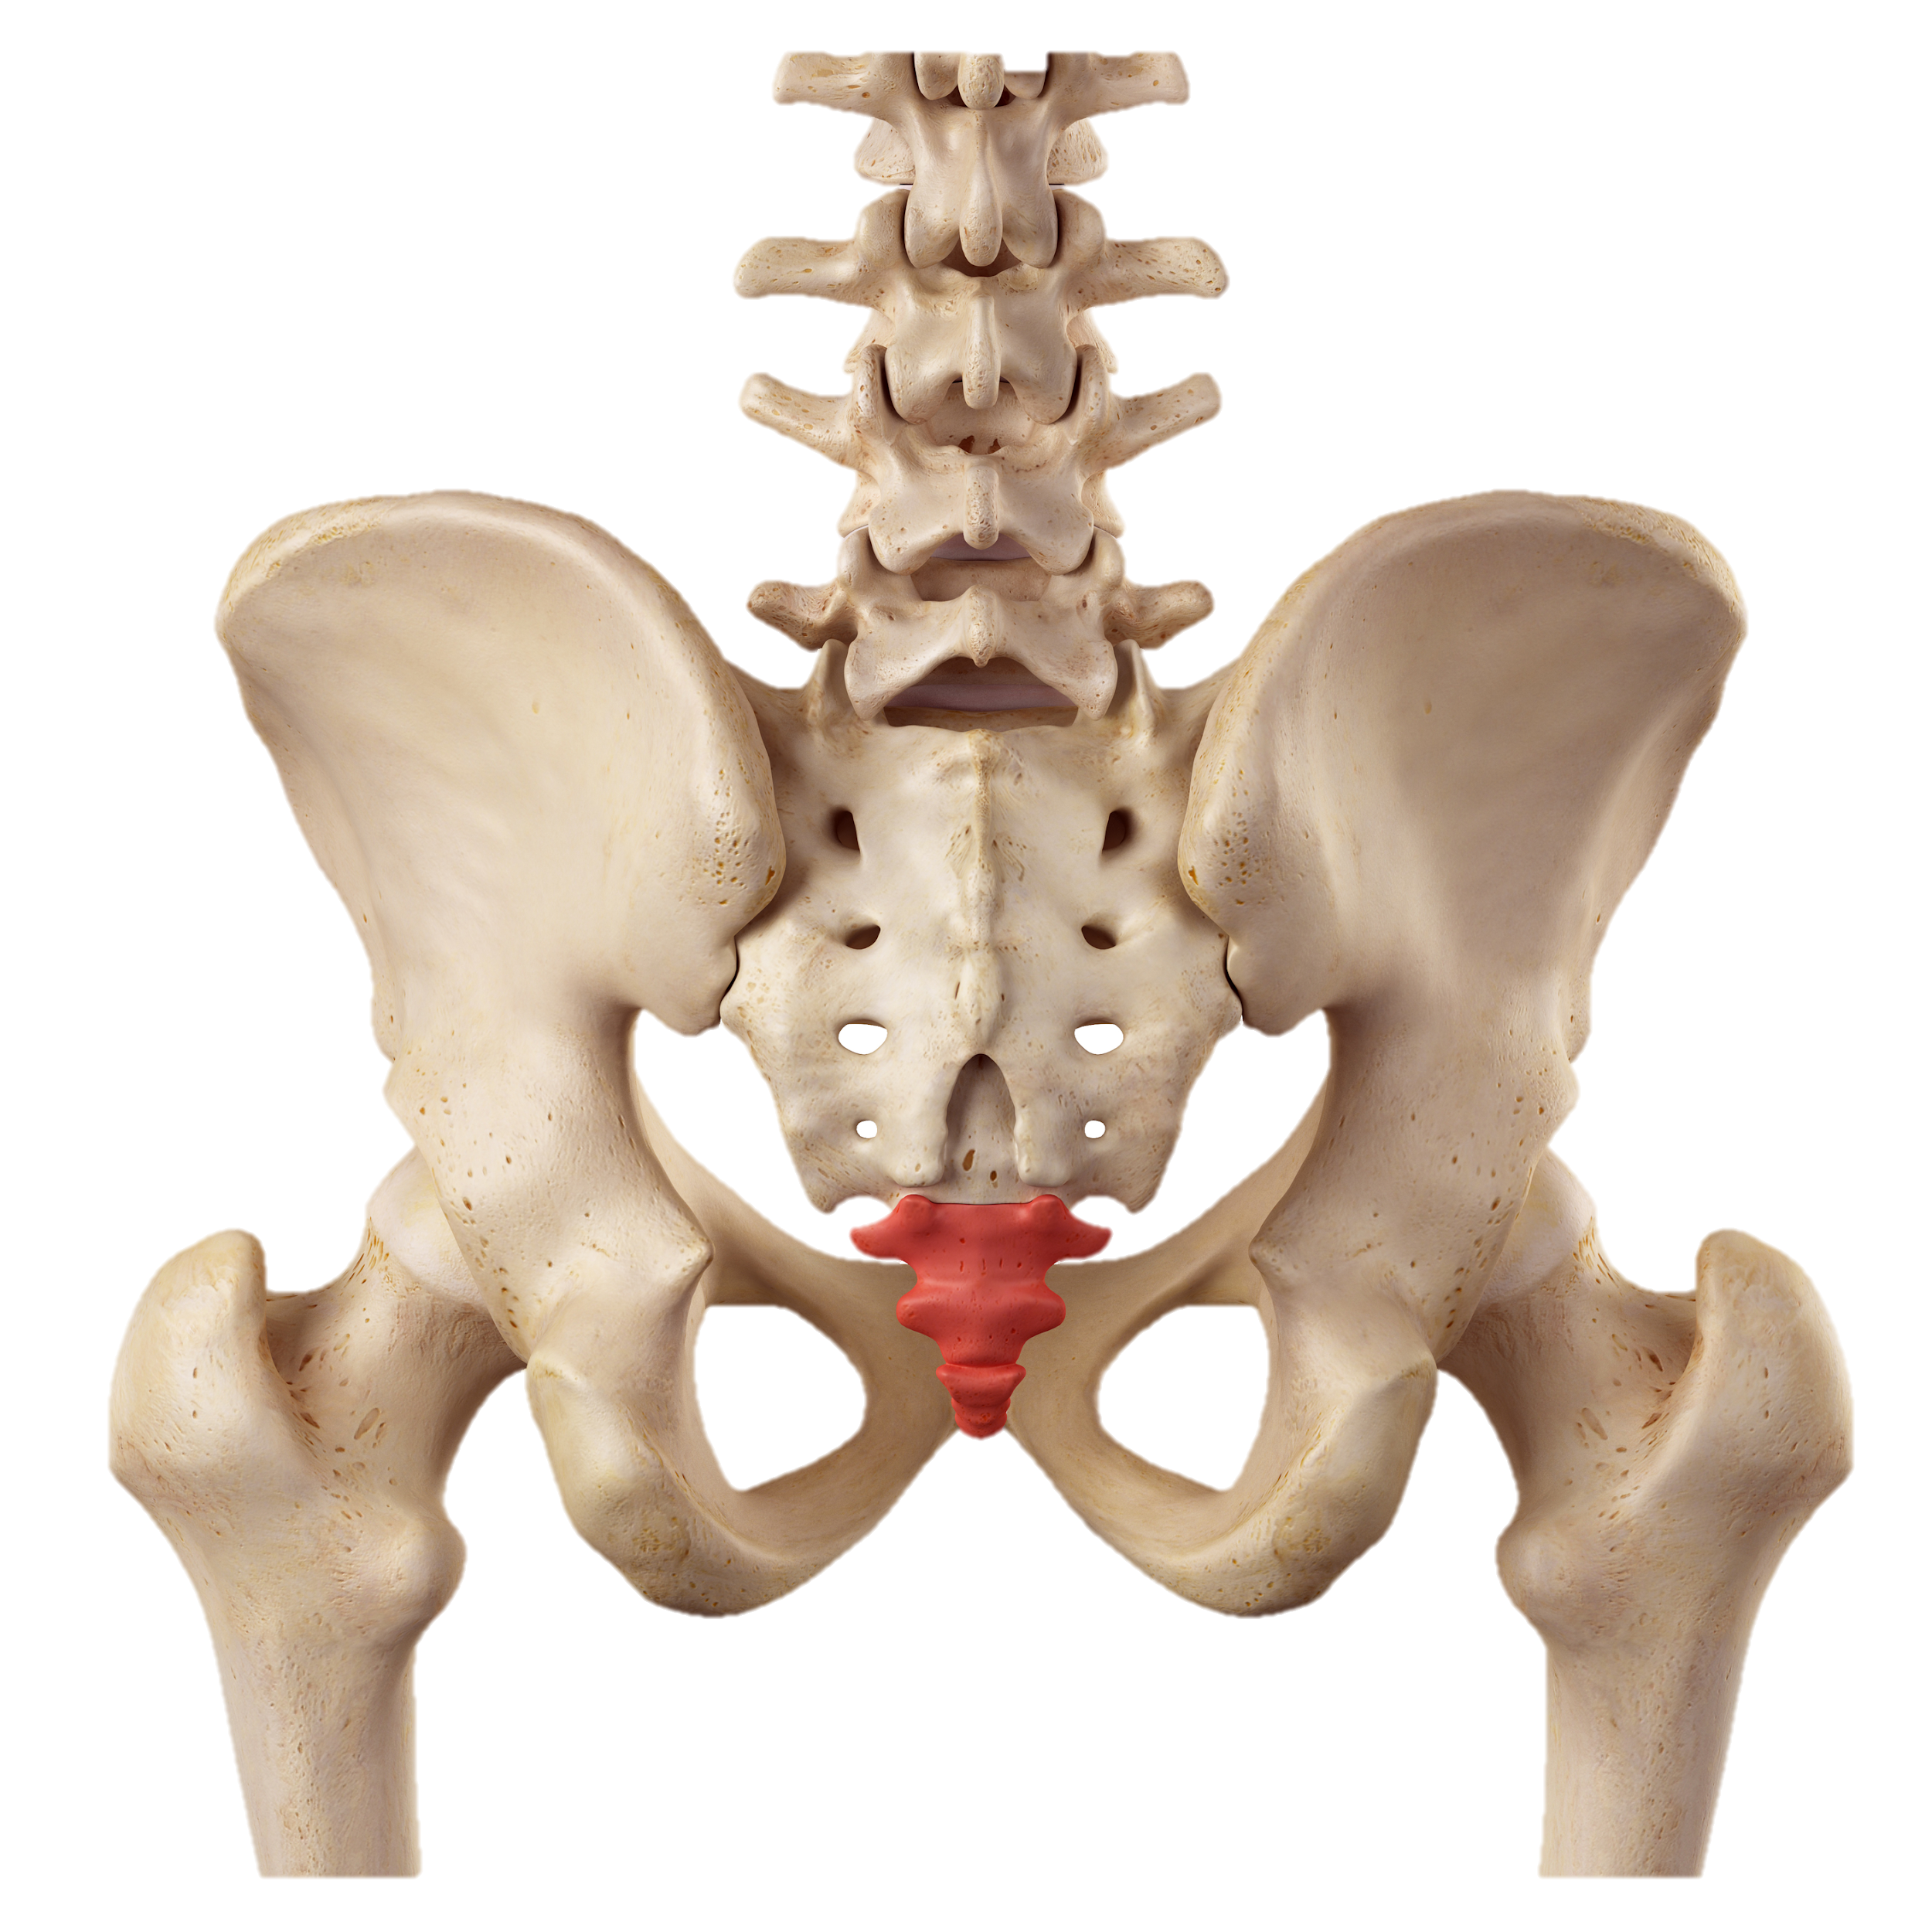
Notes:
An example of evolution can be seen in the human body.
Many, many, many generations ago, a species from which humans evolved most likely had tails.

Slide 30
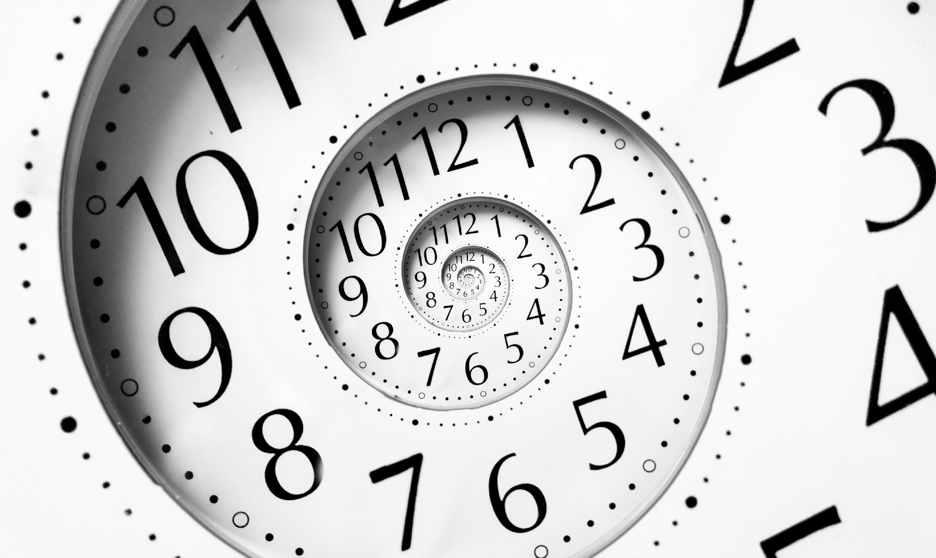
Notes:
Over time a long period of time, humans evolved to not have tails.
What is left over is called the tailbone, but we do not have tails any more.

Slide 31
Slow!
Notes:
Humans reproduce slowly so it takes a long time for evolution to happen in the human body.

Slide 32
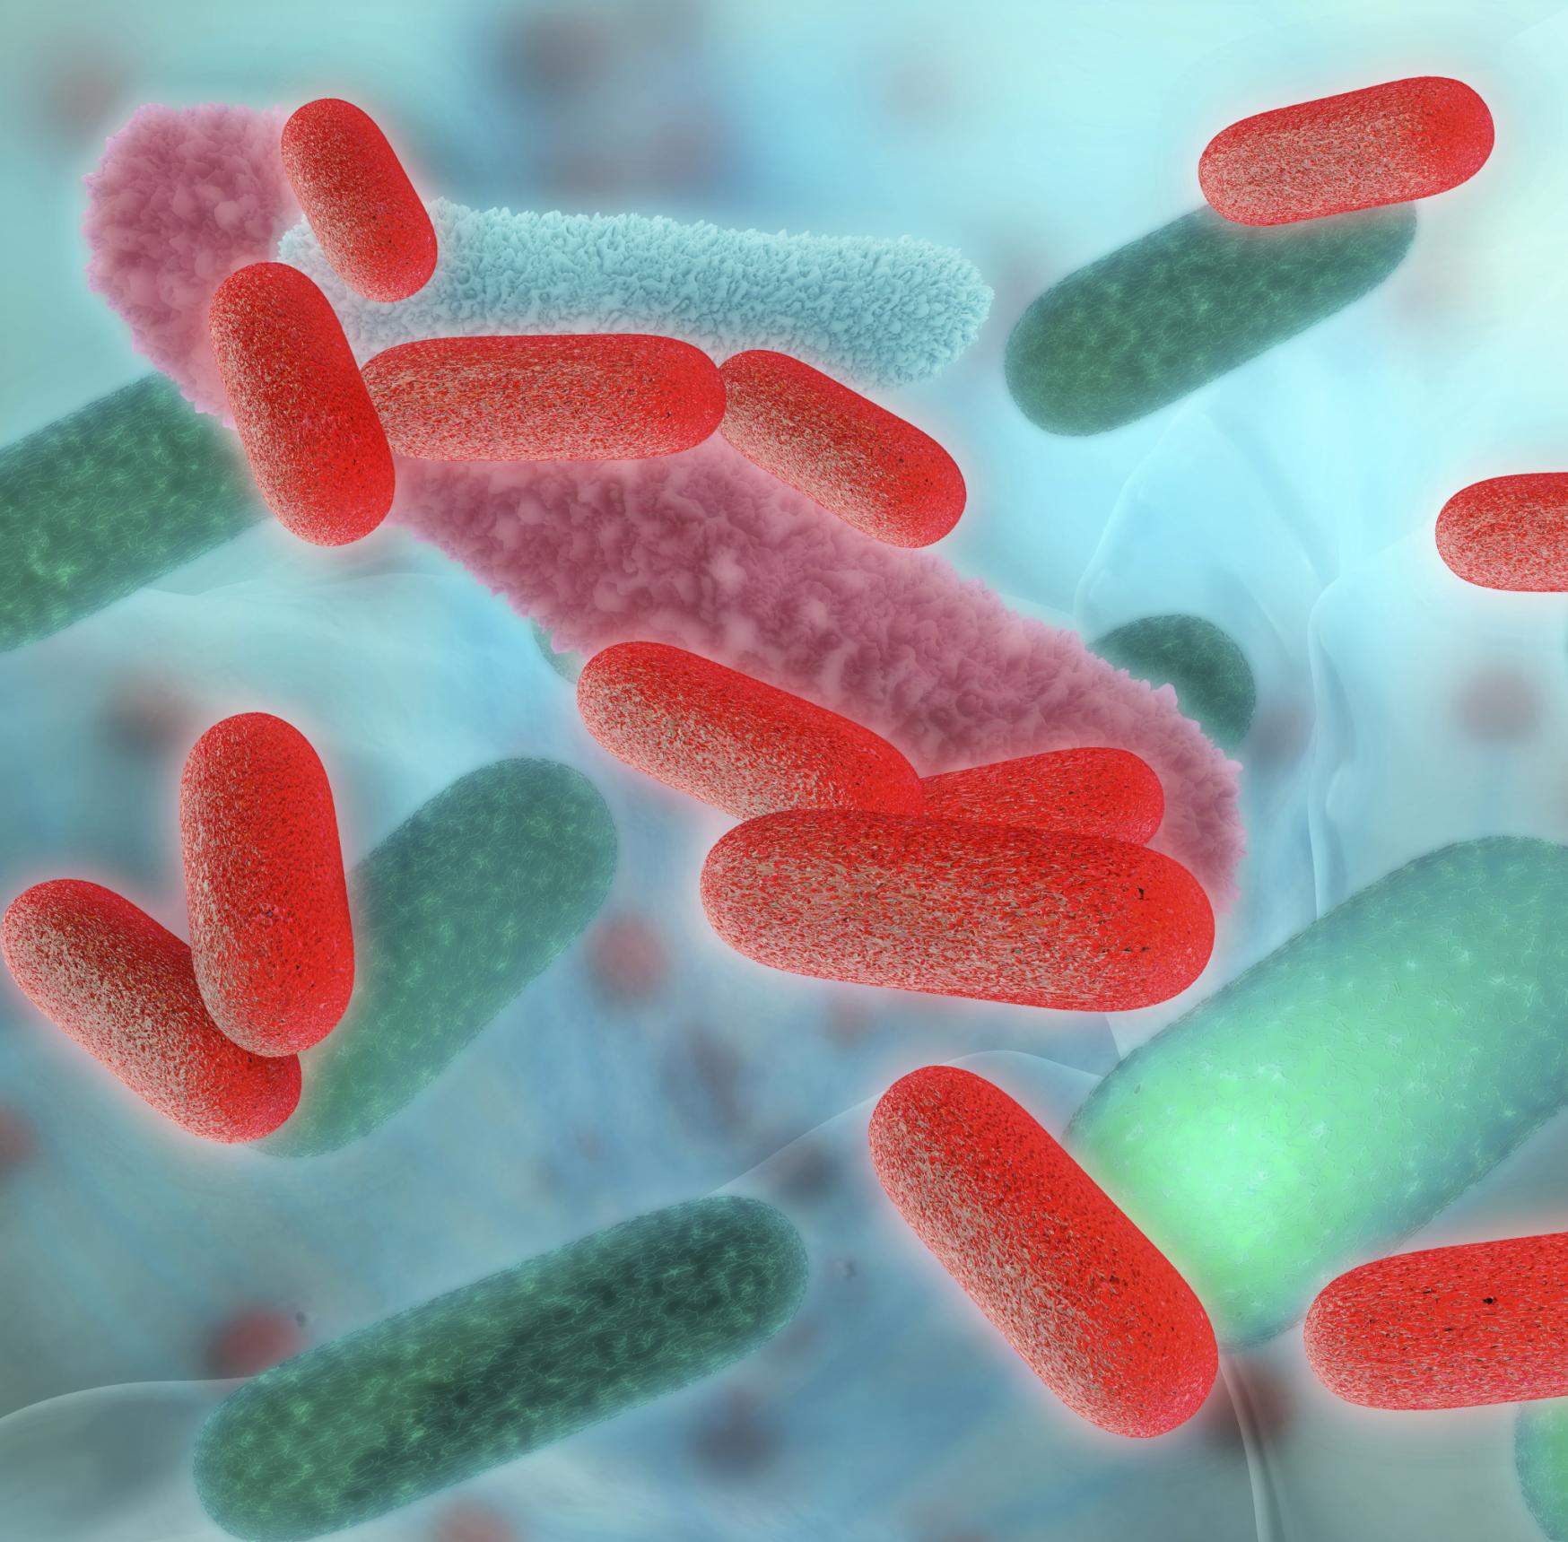
Notes:
Another example of evolution is the increase in the number of bacteria that can survive even when you take medicine, or antibiotics.

Slide 33
Notes:
Certain bacteria had a mutation, or a change in their DNA, that stopped them from being killed by the antibiotics.

Slide 34
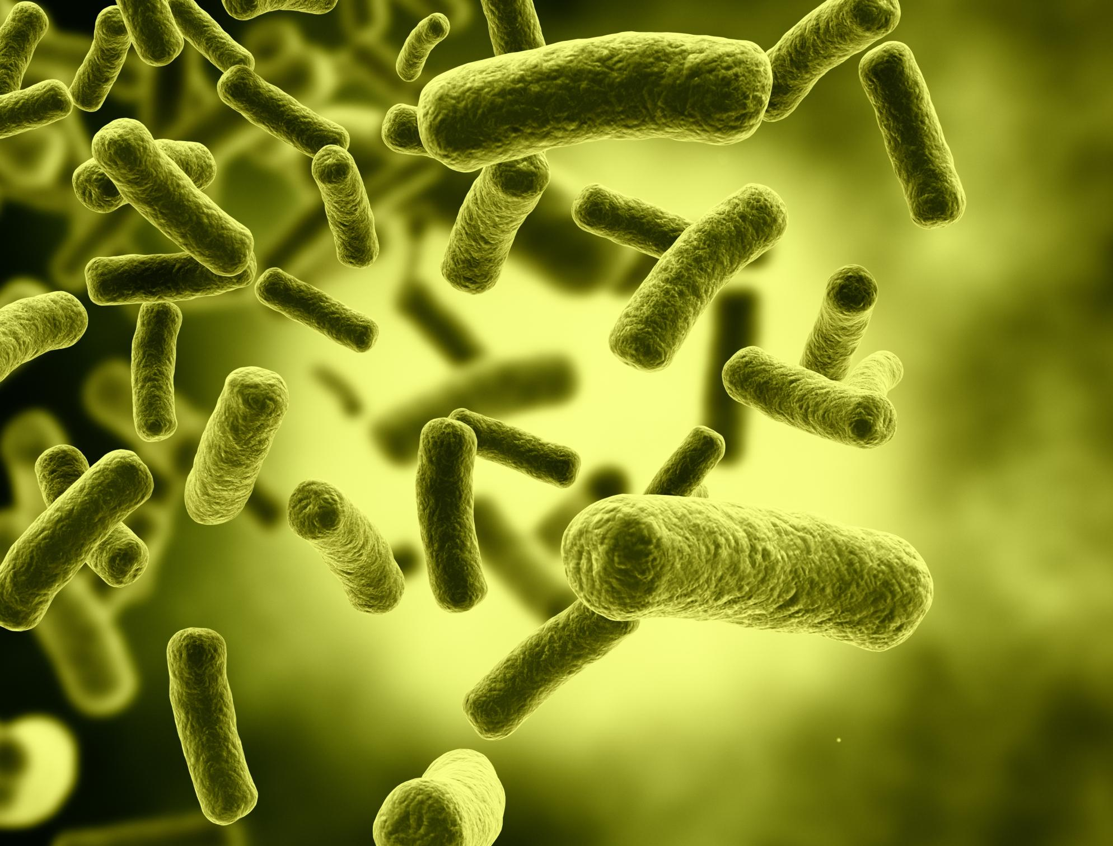
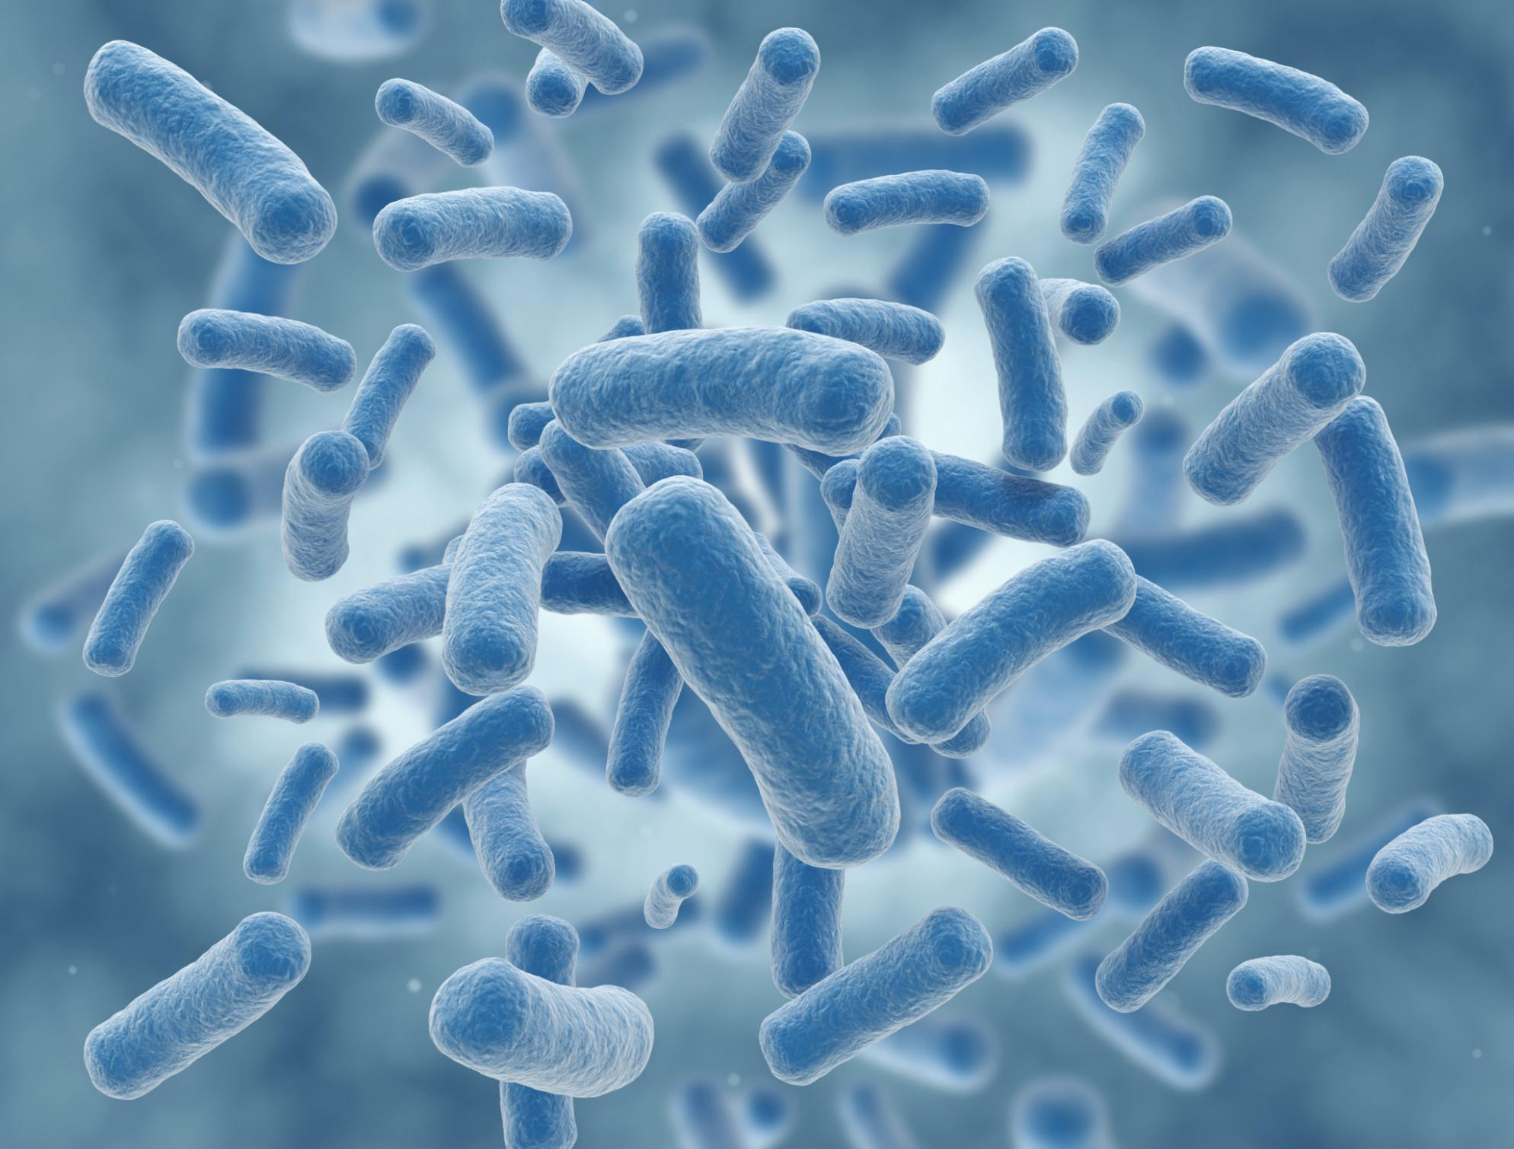
Notes:
Over time this antibiotic resistant gene has spread to more individuals in the bacteria population.

Slide 35
Fast!
Notes:
Bacteria reproduce very quickly so you can have many generations of bacteria in a short period of time.
Because of this, we can see a change in the whole species’ genetic makeup quickly.
Feedback: This visual is a great way to help students understand how different organisms are able to evolve within different time periods.

Slide 36
Notes:
Now let’s pause for a moment to review the information we just covered.

Slide 37
Based on these images of the human body-it is very likely that we evolved from a species that had _________.
Notes:
Based on these images of the human body - it is very likely that we evolved from a species that had ________.

Slide 38
Based on these images of the human body-it is very likely that we evolved from a species that had tails.
Notes:
Based on these images of the human body - it is very likely that we evolved from a species that had tails.

Slide 39
What is another example of evolution?
Notes:
What is another example of evolution?

Slide 40
Notes:
Now, let’s talk about some non-examples of evolution.

Slide 41
If it does NOT pass on to offspring
It is NOT evolution
Notes:
A non-example of evolution is exercise. If you exercise a lot, your muscles will get big. However, this will not pass on to your offspring. They will have to work just as hard to get the same big muscles.
Feedback: When offering non-examples, it is important to explain why it is not an example.

Slide 42
Notes:
Now let’s pause for a moment to review the information we just covered

Slide 43
Why is this not considered an example of evolution?
Notes:
Why is this not considered an example of evolution?
[If it does NOT pass on to offspring
It is NOT evolution]

Slide 44
Notes:
We can also break down the term producer into different word parts to help us remember the meaning. Let’s take a look!

Slide 45
Evolve
Change
Notes:
The word evolve means to change. Evolution changes a species over time.

Slide 46
Evolution
Change
Notes:
Evolution changes a species over time.

Slide 47
Notes:
Let’s review what we have learned one more time

Slide 48
What is evolution?
a.) A change in a species
b.) A skill you gain with hard work
c.) Something that happens when you get older
Notes:
What is evolution?
a.) A change in a species
b.) A skill you gain with hard work
c.) Something that happens when you get older

Slide 49
What is evolution?
a.) A change in a species
b.) A skill you gain with hard work
c.) Something that happens when you get older
Notes:
What is evolution?
a.) A change in a species
b.) A skill you gain with hard work
c.) Something that happens when you get older

Slide 50
Which of these is not an example of evolution? And why not?
Notes:
Which of these is not an example of evolution? And why not?
[Muscle gained through working out
If it does NOT pass on to offspring
It is NOT evolution]

Slide 51
How does a genetic mutation become evolution among a species?
Notes:
How does a genetic mutation become evolution among a species?
[Sometimes organisms have genetic mutations. These mutations can be helpful. They can help an organism survive or live longer so they can pass on their genes to their offspring. When enough of the population has this new trait (from the mutation) we say that a change has taken place in the species.
In this example- Through evolution, this insect changed to have the same color and shape as a leaf to hide from predators.]

Slide 52
Remember!!!
Notes:
So remember!

Slide 53
Evolution
Notes:
Remember that evolution is the process that changes species genetically over time.

Slide 54
Evolution comes from mutations in an organisms’ DNA. These mutations can be helpful.
Notes:
Evolution comes from mutations in an organism’s DNA.
These mutations can be helpful. They can help an organism survive or live longer so they can pass on their genes to their offspring. This insect’s green color and shape is an example of evolution. Since the color and shape helped the insect hide from their predators and survive, they were more likely to live long enough to reproduce and pass these traits on to offspring.

Slide 55
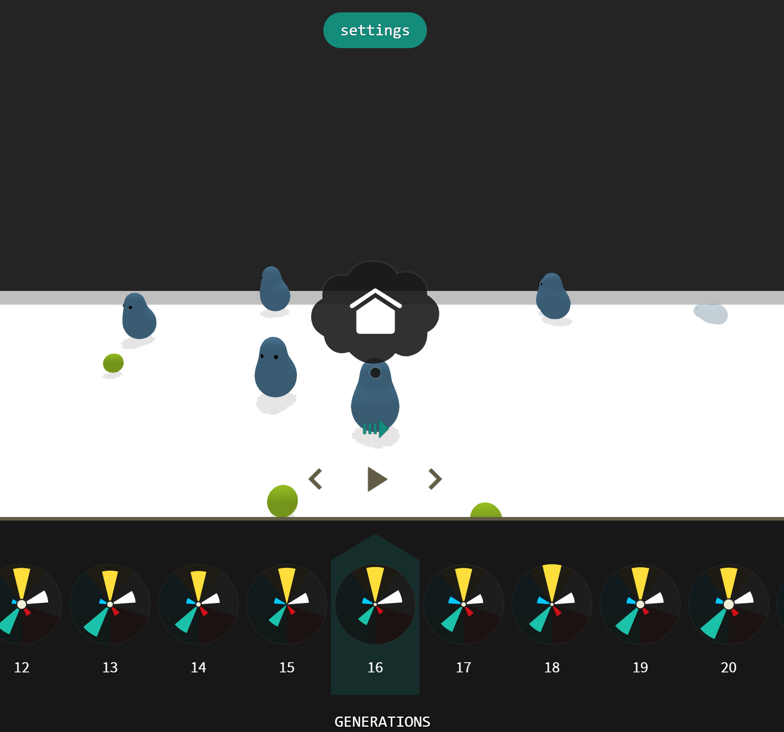
Simulation Activity
The Evolution Simulator
Linked above is a resource for engaging students with an evolution simulator. Students will watch blob creatures seek out food and be able to observe changes in their three important traits over time. The homepage for this resource includes an explanation of the simulation along with instructions for how to use the program.
Notes:
Feedback: Simulations are a great way to help make science thinking visible for students. In this simulation, offer students opportunities to make predictions about changes in traits over time for the blob creatures. This simulation is a great opportunity for students to work independently or in pairs since a large component of inquiry-based activities is encouraging student thinking and independence. Facilitate this activity with open-ended questions, followed by providing explicit explanations, and then asking probing questions to engage students in a discussion while also providing clear explanations.

Slide 56
Big Question: How is evolution related to population changes over time?
Notes:
Explicit cue to revisit the big question at the end of the lesson: Okay everyone. Now that we’ve learned the term, let’s reflect once more on our big question. Was there anything that we predicted earlier that was correct or incorrect? Do you have any new hypotheses to share?

Slide 57
Notes:
Thanks for watching, and please continue watching CAPs available from this website.

Slide 58
This Video Was Created With Resources From:
Questions or Comments
Michael Kennedy, Ph.D. MKennedy@Virginia.edu
Rachel L Kunemund, Ph.D. rk8vm@virginia.edu

