Slide 1
Intro
“Big Idea” Question
Review Concepts
Check-In Questions
Teacher Demo
Vocabulary
Student-Friendly Definition
Examples & Non-Examples
Morphological Word Parts
Simulation/Activity
Notes:
OK everyone, get ready for our next lesson. Just as a reminder, these are the different components that our lesson may include, and you’ll see these icons in the top left corner of each slide so that you can follow along more easily!

Slide 2
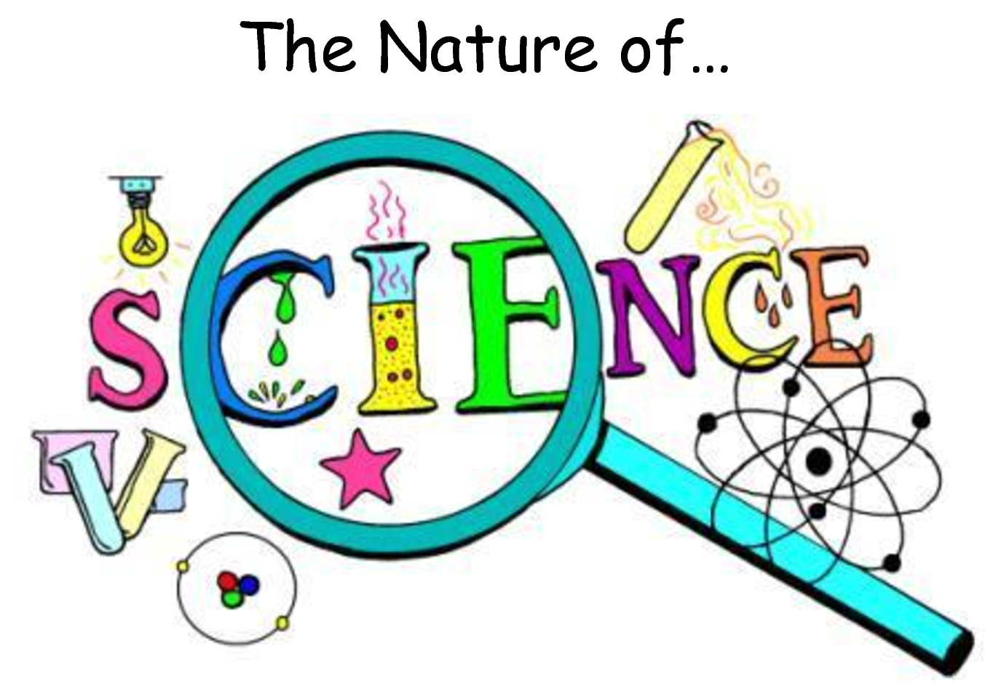
Intro
6 Concepts to Know
Notes:
Today we will be learning about nuclear energy through the process of nuclear fusion.

Slide 3
Big Question: How does the nature of science relate to the development of hypotheses, theories, and laws?
Notes:
Our “big question” is: How does the nature of science relate to the development of hypotheses, theories, and laws?
[Pause and illicit predictions from students.]
I love all these thoughtful scientific hypotheses! Be sure to keep this question and your predictions in mind as we move through these next few lessons, and we’ll continue to revisit it.

Slide 4
Demonstration
How Science Works
The link above takes you to a one-page guide that you could use to create a demonstration video about the nature of science concepts, and how scientists use these concepts to guide their thinking.
You may choose to engage students in making their own observations, questions, and hypotheses (as described in the document) and ask them to share their thoughts on a discussion board or in class, or you may choose to just demonstrate this thinking process yourself.
Notes:
Before we jump in, let’s look at a short demonstration related to the nature of science.
Feedback: It's really important to make sure that you're providing students with frequent opportunities to respond as you're introducing an activity. This will help guide you in scaffolding your support during the activity.

Slide 5
Notes:
Before we move on to our new vocabulary terms, let’s review some other words & concepts that you already learned and make sure you are firm in your understanding.

Slide 6
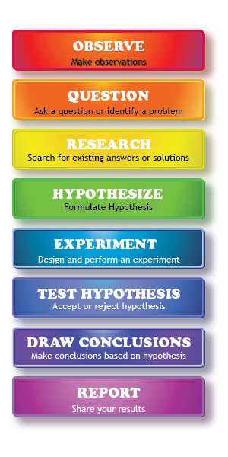
Scientific Method: steps that investigators follow to answer questions about the natural world
Notes:
One term that you’ve likely heard year after year in science class is the scientific method. The scientific method is a series of steps that investigators follow to answer questions about the natural world. Let’s do a quick review of these steps.
Feedback: It can be helpful to break the definition down and explicitly explain each part to help students understand the whole definition.

Slide 7
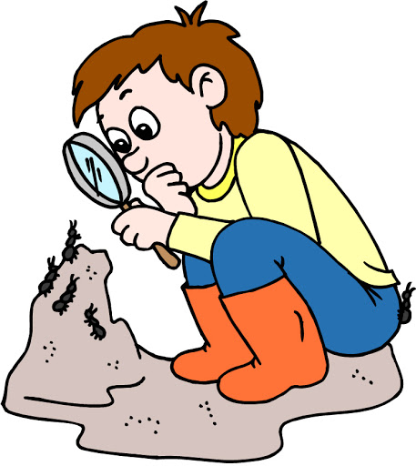
Observation
Notes:
The first step of the scientific method always begins with making an observation, or noticing something interesting that you’d like to explore further.

Slide 8
Question
Notes:
As you observe interesting things, you may find yourself asking some questions about what you saw, or you may even notice a problem that needs to be fixed.

Slide 9
Research
Notes:
This leads you to doing some research into different answers and solutions that may already exist about that topic and helps you to further develop your own ideas.

Slide 10
Hypothesis
Notes:
Researching those existing ideas helps you develop your own hypothesis. A hypothesis is a suggested explanation or idea that can be tested through an experiment. It’s super important to note that a hypothesis must be able to be tested!

Slide 11
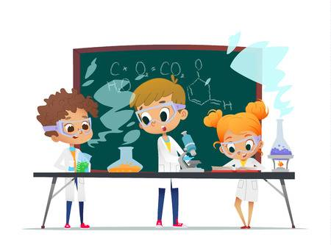
Experiment
Notes:
Once you’ve come up with your testable hypothesis, you need to develop and conduct an experiment to determine if your hypothesis is correct.

Slide 12
Draw Conclusions & Share Results
Notes:
Finally, after you conduct your experiment, you should be able to draw conclusions about whether your hypothesis was correct and then share your results with others!

Slide 13
Notes:
Now let’s pause for a moment to check your understanding.

Slide 14
What are the steps that investigators follow to answer questions about the natural world called?
Experiment
Scientific Method
Questions
Notes:
What are the steps that investigators follow to answer questions about the natural world called?
Feedback: There are a lot of opportunities to respond throughout this portion of your lesson, which is so important for ensuring that your students have a grasp on the prior knowledge.

Slide 15
What are the steps that investigators follow to answer questions about the natural world called?
Experiment
Scientific Method
Questions
Notes:
What are the steps that investigators follow to answer questions about the natural world called?
[Scientific Method]

Slide 16
Why do we begin with making observations when following the scientific method?
Notes:
Why do we begin with making observations when following the scientific method?
[Because when we observe something that we don’t know about, it makes us curious and leads us into the rest of the steps (e.g., asking a question, conducting an experiment, etc.)]

Slide 17
A hypothesis must be...
Notes:
A hypothesis must be…
[testable/able to be tested through an experiment]

Slide 18
Nature of Science
Notes:
Now that we’ve reviewed, let’s define the nature of science.
Feedback: Providing clear cues as to what was coming next in the lesson helps prepared students by letting them know what to expect.

Slide 19
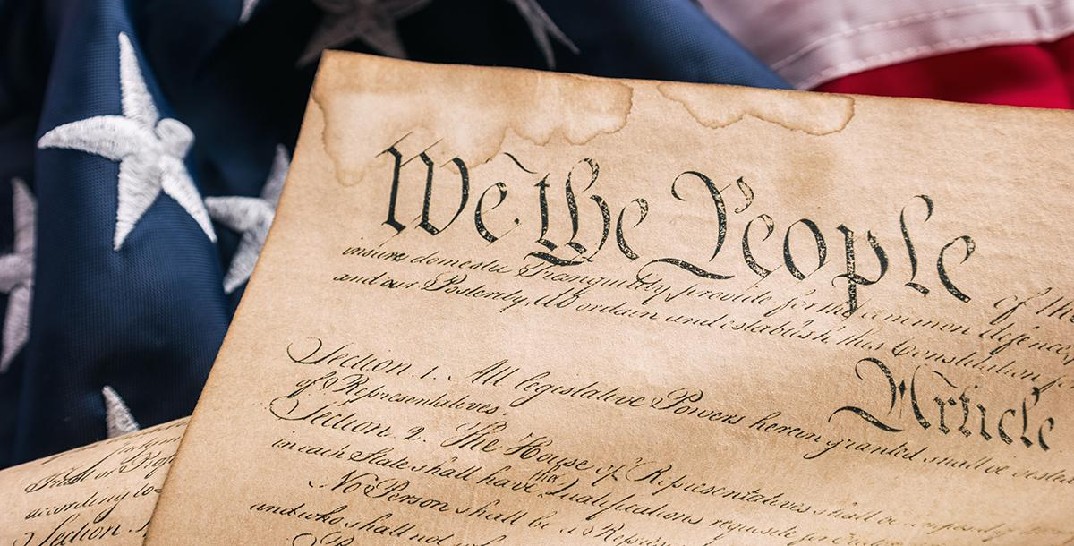
Nature of Science: a “code” that guides scientists’ thinking about the natural world
Notes:
The nature of science is like a “code” that guide scientists’ thinking about the natural world.
We can think of it like the Constitution of the United States. Just as the constitution is like a “code” that US citizens live by, the nature of science is a sort of “code” that scientists live by.

Slide 20
Notes:
Now let’s pause for a moment to review the information we have covered already.

Slide 21
What is the nature of science?
Notes:
What is the nature of science?
[The nature of science is a “code” that guides scientists’ thinking about the natural world.]
Feedback: When introducing new vocabularies, it is crucial to require the students to give out their own interpretation. I would strongly encourage you to ask students to explain the concept in their own words.

Slide 22
Notes:
That is the basic definition, but there is a bit more you need to know.

Slide 23
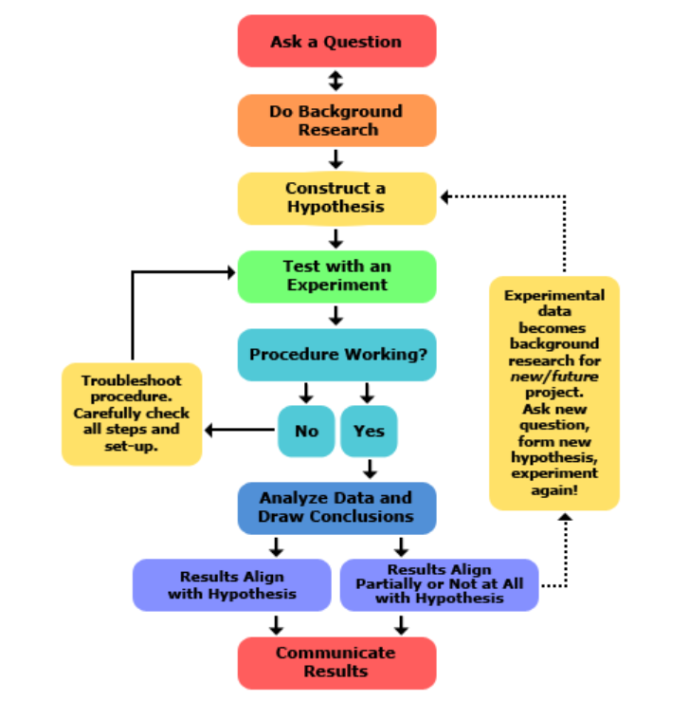
Science is a process that can change from one experiment to the next.
We may not complete every step of the scientific method.
Notes:
The scientific method gives us steps to follow as we begin learning how to conduct investigations. However, if you look up “the scientific method,” you’ll see that there are different steps listed sometimes. That’s because science is a process that can vary or change from case to case, or one experiment to the next. For example, as we begin an investigation, we may realize that something isn’t working, we need to go a different direction with an idea, or we may need to think of a new idea altogether. In these instances, we may not complete every step of the scientific method.

Slide 24
6 Concepts to Know
Notes:
That’s where “The Nature of Science” comes in! The nature of science involves testing and refining our current understanding of the world around us – just like the steps of the scientific method help us do. However, it includes 6 broader concepts, or guidelines, for us to understand and follow as we participate in scientific inquiry. Let’s take a closer look at these 6 concepts.

Slide 25
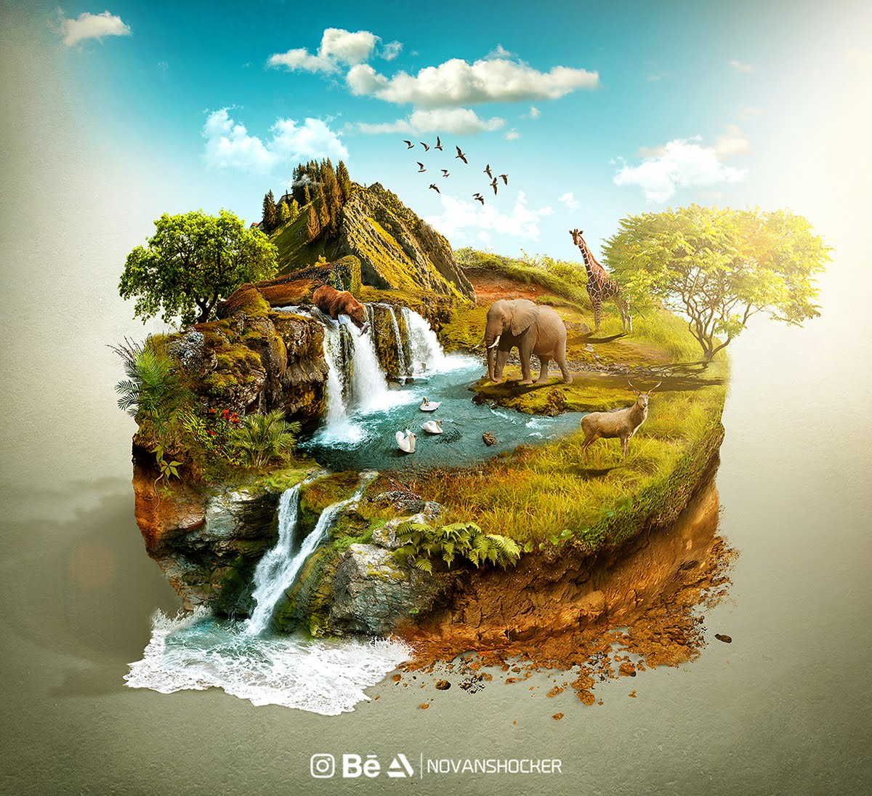
We can understand the natural world through science.
Notes:
First, we can gain an understanding of things in the world around us through science. Science can help us find many different answers, but not answers to everything – only things that can be observed, measured, and tested in the natural world.

Slide 26
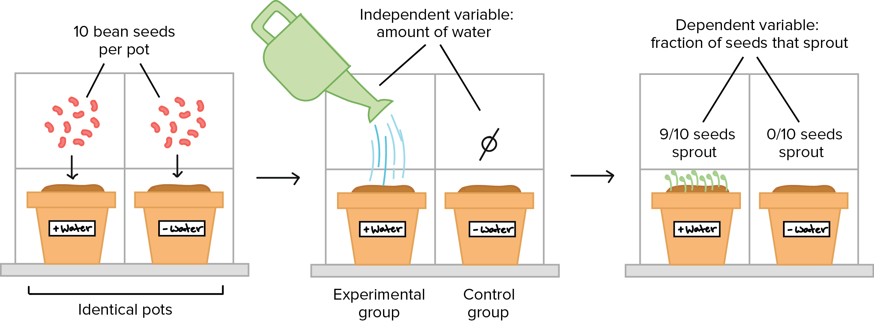
Science is based on evidence - both observational and experimental.
Notes:
Everything in science begins with an observation that makes us curious about something. Then we gather more evidence through experiments and more observations to determine answers to the questions or problems that we were curious about.

Slide 27
Science is a blend of logic and innovation.
Notes:
Engaging in science involves the use of current understandings and science knowledge, as well as creative, innovative ideas and tools that help us expand on what we already know and understand.
Feedback: When providing more student-friendly definitions, it is helpful to provide students with cues so that they can be prepared and know what to expect and be ready to copy down the information.

Slide 28
Scientific ideas can change as new data is collected.
Notes:
Science and technology are closely related to each other. We use science to understand the natural world through observation and experimentation, and new technologies are developed to aid in gathering data. As we collect new data, we gain fresh insights and raise new questions, and this can prompt a need for additional investigations. Through this process, scientific ideas and knowledge can change over time.

Slide 29
Science is a complex, social endeavor.
Notes:
Science involves communication, teamwork, collaboration, careful examination, creativity, and the ability to think outside the box, or innovation.

Slide 30
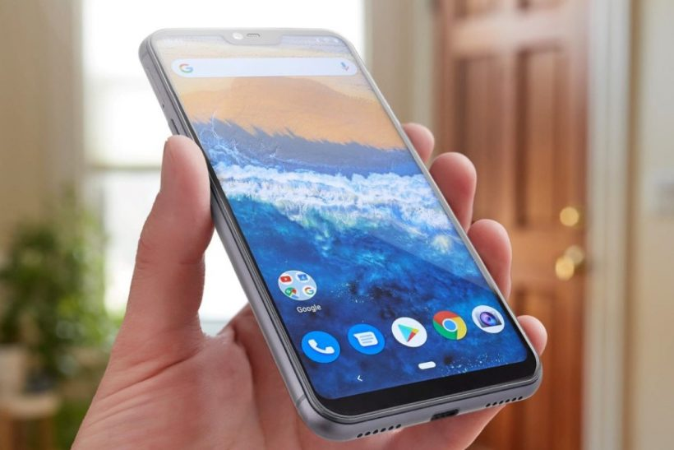
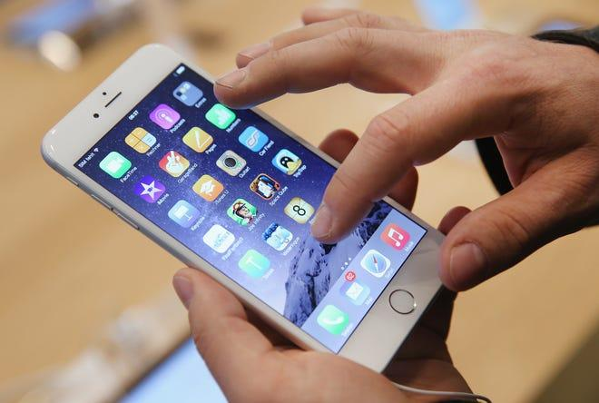
Scientists must try to remain objective to avoid bias.
Notes:
Everyone has their own beliefs, feelings, or opinions about things we encounter in the world. But when scientists are investigating a question or problem, it’s important that they set these personal opinions aside so that they do not impact the results. For example, let’s say we were conducting an experiment to determine if Android or Apple cell phones get better service in our school building. You might be a huge fan of Apple phones and really think that this brand is the best, but you must remain objective and set your personal beliefs aside so that your opinion does not influence the results of the experiment.

Slide 31
Notes:
Now let’s pause for a moment to check your understanding.
Feedback: It's really important to make sure that you're providing students with frequent opportunities to respond as you're closing the lesson – it will help you know if they understood and made sense of the activity and where you can provide further instruction.

Slide 32
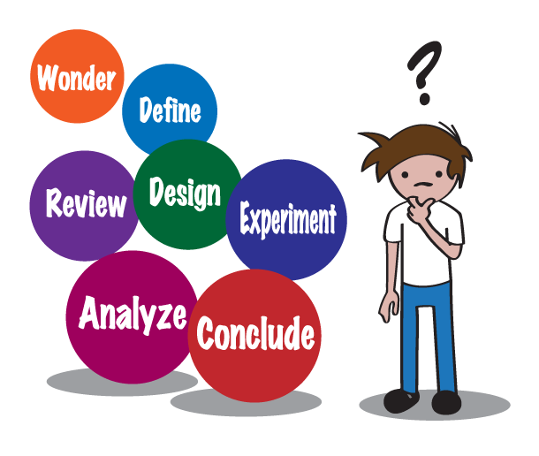
What is the difference between the
scientific method and the nature of science?
Notes:
What is the difference between the scientific method and the nature of science?
[The nature of science includes broader guidelines for scientists, while the scientific method is a set of specific steps to follow.]

Slide 33
Which of the following is NOT one of the 6 concepts to know about the nature of science?
We can understand the natural world through science.
Science is a complex, social endeavor.
Scientific ideas can change as we collect more data.
Once you find an answer you don’t need science anymore.
6 Concepts to Know
Notes:
Which of the following is NOT one of the 6 concepts to know about the nature of science?
[The nature of science includes broader guidelines for scientists, while the scientific method is a set of specific steps to follow.]

Slide 34
Which of the following is NOT one of the 6 concepts to know about the nature of science?
We can understand the natural world through science.
Science is a complex, social endeavor.
Scientific ideas can change as we collect more data.
Once you find an answer you don’t need science anymore.
6 Concepts to Know
Notes:
Which of the following is NOT one of the 6 concepts to know about the nature of science?
[Once you find an answer you don’t need science anymore.]

Slide 35
Remember!!!
Notes:
So remember!

Slide 36
Nature of Science: a “code” that guides scientists’ thinking about the natural world
Notes:
The nature of science is like a “code” that guide scientists’ thinking about the natural world.
We can think of it like the Constitution of the United States. Just as the constitution is like a “code” that US citizens live by, the nature of science is a sort of “code” that scientists live by.
Feedback: Intentionally repeating key information when engaging in this part of the lesson highlights what is important for the students.

Slide 37
Science is a process that can change from one experiment to the next.
We may not complete every step of the scientific method.
Notes:
The scientific method gives us steps to follow as we begin learning how to conduct investigations. However, if you look up “the scientific method,” you’ll see that there are different steps listed sometimes. That’s because science is a process that can vary or change from case to case, or one experiment to the next. For example, as we begin an investigation, we may realize that something isn’t working, we need to go a different direction with an idea, or we may need to think of a new idea altogether. In these instances, we may not complete every step of the scientific method.

Slide 38
6 Concepts to Know
Notes:
That’s where “The Nature of Science” comes in! The nature of science involves testing and refining our current understanding of the world around us – just like the steps of the scientific method help us do. However, it includes 6 broader concepts, or guidelines, for us to understand and follow as we participate in scientific inquiry. Let’s take a closer look at these 6 concepts.

Slide 39
We can understand the natural world through science.
Notes:
First, we can gain an understanding of things in the world around us through science. Science can help us find many different answers, but not answers to everything – only things that can be observed, measured, and tested in the natural world.

Slide 40
Science is based on evidence - both observational and experimental.
Notes:
Everything in science begins with an observation that makes us curious about something. Then we gather more evidence through experiments and more observations to determine answers to the questions or problems that we were curious about.

Slide 41
Science is a blend of logic and innovation.
Notes:
Engaging in science involves the use of current understandings and science knowledge, as well as creative, innovative ideas and tools that help us expand on what we already know and understand.

Slide 42
Scientific ideas can change as new data is collected.
Notes:
Science and technology are closely related to each other. We use science to understand the natural world through observation and experimentation, and new technologies are developed to aid in gathering data. As we collect new data, we gain fresh insights and raise new questions, and this can prompt a need for additional investigations. Through this process, scientific ideas and knowledge can change over time.

Slide 43
Science is a complex, social endeavor.
Notes:
Science involves communication, teamwork, collaboration, careful examination, creativity, and the ability to think outside the box, or innovation.

Slide 44
Scientists must try to remain objective to avoid bias.
Notes:
Everyone has their own beliefs, feelings, or opinions about things we encounter in the world. But when scientists are investigating a question or problem, it’s important that they set these personal opinions aside so that they do not impact the results. For example, let’s say we were conducting an experiment to determine if Android or Apple cell phones get better service in our school building. You might be a huge fan of Apple phones and really think that this brand is the best, but you must remain objective and set your personal beliefs aside so that your opinion does not influence the results of the experiment.

Slide 45
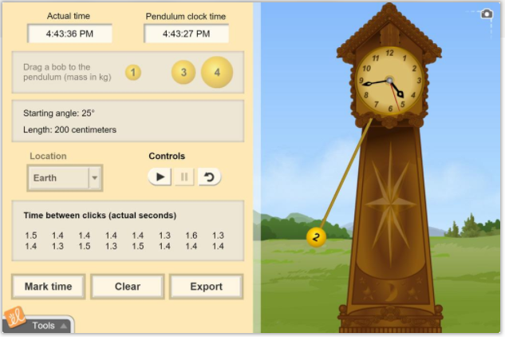
Simulation Activity
Environmental Effects on New Life Form Gizmo
Click the link above to access to a Gizmo activity about the effects of the environment on a new life form. This activity reinforces students’ knowledge about the scientific method and experimental design.
In this simulation activity, students use the scientific method to control the environmental conditions for a fictional alien organism in order to learn how the organism responds to changes in conditions. Sunlight, water, and temperature can be varied to determine their effects on the shape of the aliens.
Notes:
Feedback: Remember, it is important to provide students with opportunities to ask questions themselves and work to define the problem. You can scaffold supports to help them along the way.

Slide 46
Big Question: How does the nature of science relate to the development of hypotheses, theories, and laws?
Notes:
Explicit cue to revisit the big question at the end of the lesson: Okay everyone. Now that we’ve learned the term, let’s reflect once more on our big question. Was there anything that we predicted earlier that was correct or incorrect? Do you have any new hypotheses to share?
Feedback: Providing your students with some reflection time at the end of the lesson is crucial in helping them to put the pieces together and make sense of the activity.

Slide 47
Notes:
Thanks for watching, and please continue watching CAPs available from this website.

Slide 48
This Video Created With Resources From:
Questions or Comments
Michael Kennedy, Ph.D. MKennedy@Virginia.edu
Rachel L Kunemund, Ph.D. rk8vm@virginia.edu

Slide 49
Intro
“Big Idea” Question
Review Concepts
Check-In Questions
Teacher Demo
Vocabulary
Student-Friendly Definition
Examples & Non-Examples
Morphological Word Parts
Simulation/Activity
Notes:
OK everyone, get ready for our next lesson. Just as a reminder, these are the different components that our lesson may include, and you’ll see these icons in the top left corner of each slide so that you can follow along more easily!
Feedback: Explicit cues used at the beginning of each step makes it easy for students to follow along and be prepared to engage in the next part of the lesson.

Slide 50
Intro
Hypothesis, Theory, and Law –
What’s the difference???
Notes:
In this lesson, we’ll define the terms hypothesis, theory, and law, and we’ll discuss the differences between these three things.

Slide 51
Big Question: How does the nature of science relate to the development of hypotheses, theories, and laws?
Notes:
Our “big question” is: How does the nature of science relate to the development of hypotheses, theories, and laws?
[Pause and illicit predictions from students.]
I love all these thoughtful scientific hypotheses! Be sure to keep this question and your predictions in mind as we move through these next few lessons, and we’ll continue to revisit it.
Feedback: Making connections between the new content and past terms/content is important for helping students understand the bigger picture.

Slide 52
Notes:
Before we move on to our new vocabulary terms, let’s review some other words & concepts that you already learned and make sure you are firm in your understanding.

Slide 53
Nature of Science: a “code” that guides scientists’ thinking about the natural world
Notes:
The nature of science is like a “code” that guide scientists’ thinking about the natural world.
We can think of it like the Constitution of the United States. Just as the constitution is like a “code” that US citizens live by, the nature of science is a sort of “code” that scientists live by.

Slide 54
Science is a process that can change from one experiment to the next.
We may not complete every step of the scientific method.
Notes:
The scientific method gives us steps to follow as we begin learning how to conduct investigations. However, if you look up “the scientific method,” you’ll see that there are different steps listed sometimes. That’s because science is a process that can vary or change from case to case, or one experiment to the next. For example, as we begin an investigation, we may realize that something isn’t working, we need to go a different direction with an idea, or we may need to think of a new idea altogether. In these instances, we may not complete every step of the scientific method.

Slide 55
6 Concepts to Know
Notes:
That’s where “The Nature of Science” comes in! The nature of science involves testing and refining our current understanding of the world around us – just like the steps of the scientific method help us do. However, it includes 6 broader concepts, or guidelines, for us to understand and follow as we participate in scientific inquiry. Let’s take a closer look at these 6 concepts.

Slide 56
We can understand the natural world through science.
Notes:
First, we can gain an understanding of things in the world around us through science. Science can help us find many different answers, but not answers to everything – only things that can be observed, measured, and tested in the natural world.

Slide 57
Science is based on evidence - both observational and experimental.
Notes:
Everything in science begins with an observation that makes us curious about something. Then we gather more evidence through experiments and more observations to determine answers to the questions or problems that we were curious about.

Slide 58
Science is a blend of logic and innovation.
Notes:
Engaging in science involves the use of current understandings and science knowledge, as well as creative, innovative ideas and tools that help us expand on what we already know and understand.
Feedback: Using relevant topics and content to activate prior knowledge sets the students up to make important connections to new content.

Slide 59
Scientific ideas can change as new data is collected.
Notes:
Science and technology are closely related to each other. We use science to understand the natural world through observation and experimentation, and new technologies are developed to aid in gathering data. As we collect new data, we gain fresh insights and raise new questions, and this can prompt a need for additional investigations. Through this process, scientific ideas and knowledge can change over time.

Slide 60
Science is a complex, social endeavor.
Notes:
Science involves communication, teamwork, collaboration, careful examination, creativity, and the ability to think outside the box, or innovation.

Slide 61
Scientists must try to remain objective to avoid bias.
Notes:
Everyone has their own beliefs, feelings, or opinions about things we encounter in the world. But when scientists are investigating a question or problem, it’s important that they set these personal opinions aside so that they do not impact the results. For example, let’s say we were conducting an experiment to determine if Android or Apple cell phones get better service in our school building. You might be a huge fan of Apple phones and really think that this brand is the best, but you must remain objective and set your personal beliefs aside so that your opinion does not influence the results of the experiment.

Slide 62
Notes:
Now let’s pause for a moment to check your understanding.

Slide 63
What is the nature of science?
Notes:
What is the nature of science?
[The nature of science is a “code” that guides scientists’ thinking about the natural world.]

Slide 64
What is the difference between the
scientific method and the nature of science?
Notes:
What is the difference between the scientific method and the nature of science?
[The nature of science includes broader guidelines for scientists, while the scientific method is a set of specific steps to follow.]

Slide 65
Which of the following is NOT one of the 6 concepts to know about the nature of science?
We can understand the natural world through science.
Science is a complex, social endeavor.
Scientific ideas can change as we collect more data.
Once you find an answer you don’t need science anymore.
6 Concepts to Know
Notes:
Which of the following is NOT one of the 6 concepts to know about the nature of science?
[The nature of science includes broader guidelines for scientists, while the scientific method is a set of specific steps to follow.]

Slide 66
Which of the following is NOT one of the 6 concepts to know about the nature of science?
We can understand the natural world through science.
Science is a complex, social endeavor.
Scientific ideas can change as we collect more data.
Once you find an answer you don’t need science anymore.
6 Concepts to Know
Notes:
Which of the following is NOT one of the 6 concepts to know about the nature of science?
[Once you find an answer you don’t need science anymore.]

Slide 67
Hypothesis
Notes:
Now, that we’ve reviewed, let’s define our new term, hypothesis.

Slide 68
Hypothesis: an “educated guess” that must be tested
Notes:
A hypothesis is an educated guess that must be tested. Like we discussed with the nature of science and the scientific method, when you have a question or problem that you want to investigate, you use existing knowledge to develop a hypothesis. Then, you test it in an experiment.
Feedback: Using clear language can take make formal more complicated definitions a little easier for students to understand.

Slide 69
Notes:
Now let’s pause for a moment to check your understanding.

Slide 70
What is a hypothesis?
Notes:
What is a hypothesis?
[A hypothesis is an “educated guess” that must be tested.]

Slide 71
Notes:
Now, let’s look at some examples of hypotheses.

Slide 72
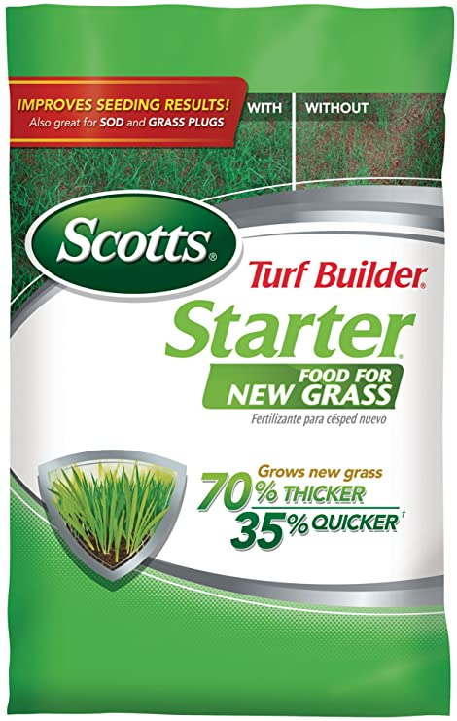
If I use Scott’s fertilizer, then my grass will grow faster.
Notes:
The statement “If I use Scott’s fertilizer, then my grass will grow faster” is an example of a hypothesis because it is an educated guess that I can test. The company claims on the bag that this fertilizer will help me grow grass 35% faster than if I didn’t use this fertilizer. I can conduct an experiment to test whether or not this hypothesis is true.
Feedback: Remember to try and use phrasing and language that is clear and easy for students to understand when going over examples of term meaning.

Slide 73
If I brush my teeth twice a day, then I will not get a cavity.
Notes:
The statement “If I brush my teeth twice a day, then I will not get a cavity,” is another example of a hypothesis because it is an educated guess that we can test. We came up with this hypothesis because we’ve heard people recommend brushing twice a day to avoid problems at the dentist, like cavities. Now we can test this hypothesis by conducting an experiment to determine if brushing twice a day actually does prevent us from getting a cavity.

Slide 74
Notes:
Now let’s pause for a moment to check your understanding.

Slide 75
What is one other example of a scientific hypothesis?
Notes:
What is one other example of a scientific hypothesis?
*It may be helpful to give students a question/scenario to form a hypothesis about.

Slide 76
Theory
Notes:
Next, let’s define the term theory.

Slide 77
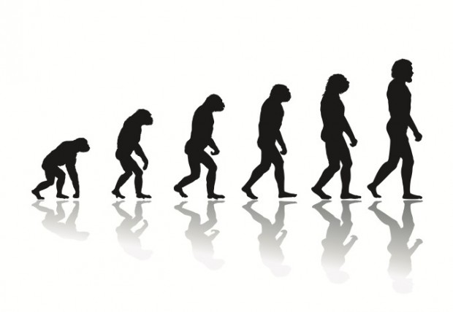
Theory: a widely accepted explanation that has stood up to repeated testing
Notes:
A theory is a widely accepted explanation that has stood up to repeated testing.

Slide 78
Notes:
Now let’s pause for a moment to check your understanding.

Slide 79
What is a theory?
Notes:
What is a theory?
[A theory is a widely accepted explanation that has stood up to repeated testing.]
Feedback: Remember, students might look like they are understanding the definition but it is important that you check for understanding yourself by asking questions or providing them with other opportunities to respond.

Slide 80
Notes:
Now, let’s look at some examples of theories.

Slide 81
Evolution
Notes:
The theory of evolution, or how humans came to exist, is one example of a scientific theory. It hasn’t been proven, but there is a lot of evidence to support this idea. This makes it a theory, or a widely accepted explanation, for how humans developed over time.

Slide 82
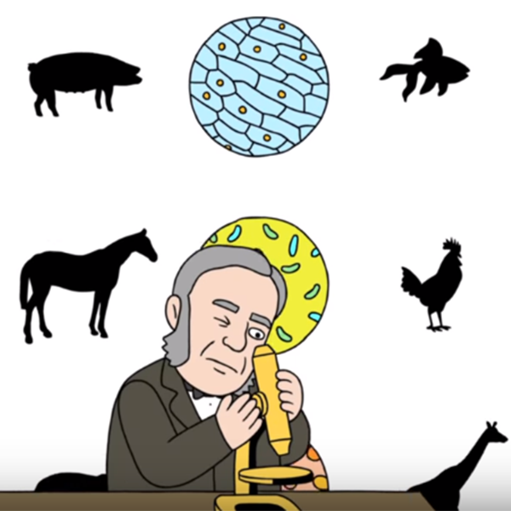
Cell Theory
Notes:
Cell theory is another example of a scientific theory that you learned about in 7th grade. It is a basic set of principles that apply to cells which have been widely accepted by scientists for centuries and has developed over time as more evidence has become available.

Slide 83
Notes:
Now let’s pause for a moment to check your understanding.

Slide 84
What is one other example of scientific theories?
Notes:
What is one other example of scientific theories?

Slide 85
Law
Notes:
Next, let’s define the term law.

Slide 86
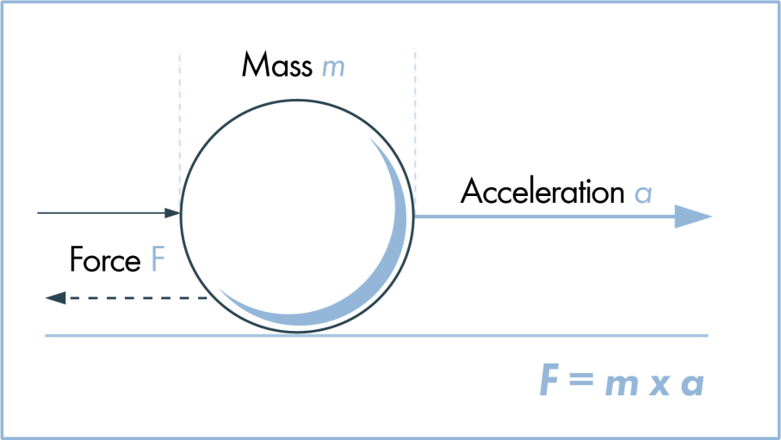
Law: an explanation that always occurs under certain conditions
Notes:
A law is an explanation that always occurs under certain conditions. These usually involve math, as scientists come up with formulas that help explain natural phenomena.

Slide 87
Notes:
Now let’s pause for a moment to check your understanding.

Slide 88
What is a law?
Notes:
What is a law?
[A law is an explanation that always occurs under certain conditions. These usually involve math, as scientists come up with formulas that help explain natural phenomena.]

Slide 89
Notes:
Now, let’s look at some examples of laws.
Feedback: Examples are particularly helpful if they are things that the students are already familiar with or have experienced.

Slide 90
Newton’s Law of Force
Notes:
Newton’s second law of motion, the law of force, is one example of a scientific law. Newton came up with this mathematical formula to explain that force is the product of an object’s mass and its rate of acceleration, or how quickly it is moving. This is considered a scientific law because, given the appropriate conditions, it will always explain the amount of force that an object has.

Slide 91
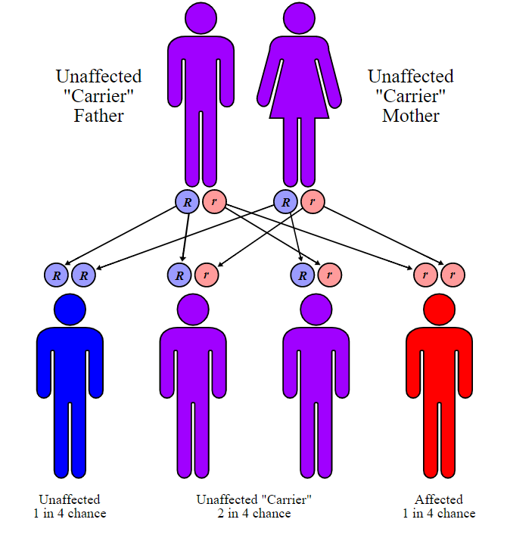
Mendel’s Laws of Inheritance
Notes:
Another example of a scientific law is Mendel’s Laws of Inheritance, which you also learned about in 7th grade. The laws of inheritance are considered laws because they can, given the appropriate conditions, always explain how we get the different physical traits that we have, like hair and eye color.

Slide 92
Notes:
Now let’s pause for a moment to check your understanding.

Slide 93
What is one other example of scientific laws?
Notes:
What is one other example of scientific laws?

Slide 94
Notes:
These three terms can be easily confused, so listen closely as we go over some important information that will help you keep them straight.
Feedback: Explaining the similarities and differences between terms is one way to highlight the importance of specific language in science.

Slide 95
An educated guess that must be tested.
Notes:
First, theories and laws both begin with a hypothesis – or an educated guess that must be tested. When you have a hypothesis, you conduct an experiment to test it, and that experiment may result in a new theory or law.

Slide 96
Theories AND laws are both accepted among scientists.
Notes:
Second, some people may say that something isn’t true because it’s “just a theory.” But scientists actually consider theories AND laws to be acceptable ways to explain natural phenomena.

Slide 97
Testable Explanations
Facts
Hypotheses
Laws
(explain what happens)
Theories
(explain why something happens)
Notes:
However, although both are acceptable ways to explain things, there are some key differences. Laws are proven facts – they work every time and explain what happens, usually using some type of math formula. On the other hand, theories are really just hypotheses that have been tested repeatedly – they’re the best possible explanation that we have currently found to describe why something happens.

Slide 98
Notes:
Now let’s pause for a moment to check your understanding.

Slide 99
What is a hypothesis?
Notes:
What is a hypothesis?
[A hypothesis is an “educated guess” that must be tested.]

Slide 100
What is a theory?
Notes:
What is a theory?
[A theory is a widely accepted explanation that has stood up to repeated testing.]

Slide 101
What is a law?
Notes:
What is a law?
[A law is an explanation that always occurs under certain conditions. These usually involve math, as scientists come up with formulas that help explain natural phenomena.]

Slide 102
What’s the main difference between a theory and a law?
Testable Explanations
Facts
Hypotheses
Laws
(explain what happens)
Theories
(explain why something happens)
Notes:
What’s the main difference between a theory and law?
[A theory is a widely accepted explanation for natural phenomena, while a law is an explanation that always occurs.]

Slide 103
Videos to Re-Explain
(In lieu of a Demonstration)
Fact vs. Theory vs. Hypothesis vs. Law... EXPLAINED!
What's the difference between scientific law and theory?
Teacher Directions: As a demonstration may be difficult to apply in this case, you may choose to share the two video links above with your students so they can hear these concepts explained in additional ways.
Notes:
Feedback: Presenting the same information in a different way (ex: a video) is one way to reinforce the important information.

Slide 104
Remember!!!
Notes:
So remember!
Feedback: A good general strategy for information retention is: 1) tell them what you're going to teach them, 2) teach them, and 3) tell them what you just taught them. Make sure to include the third and final step. While it is easy to think a quick review of what you just went over is unnecessary, it can be incredibly useful in helping the students remember the information over the long term.

Slide 105
Hypothesis: an “educated guess” that must be tested
Notes:
A hypothesis is an educated guess that must be tested. Like we discussed with the nature of science and the scientific method, when you have a question or problem that you want to investigate, you use existing knowledge to develop a hypothesis. Then, you test it in an experiment.

Slide 106
Theory: a widely accepted explanation that has stood up to repeated testing
Notes:
A theory is a widely accepted explanation that has stood up to repeated testing.

Slide 107
Law: an explanation that always occurs under certain conditions
Notes:
A law is an explanation that always occurs under certain conditions. These usually involve math, as scientists come up with formulas that help explain natural phenomena.

Slide 108
Simulation Activity
Pendulum Clock Gizmo
Click the link above to access to the Pendulum Clock Gizmo activity. This activity reinforces students’ knowledge of scientific hypotheses and experimental design principles.
In this simulation activity, find the effect of length, mass, and angle on the period of a pendulum. The pendulum is attached to a clock that can be adjusted to tell time accurately. The clock can be located on Earth or Jupiter to determine the effect of gravity.
Notes:
Feedback: Remember, it is important to include some computational or mathematics concepts in the science activity so that students can apply these concepts as part of the problem solving process.

Slide 109
Big Question: How does the nature of science relate to the development of hypotheses, theories, and laws?
Notes:
Explicit cue to revisit the big question at the end of the lesson: Okay everyone. Now that we’ve learned the term, let’s reflect once more on our big question. Was there anything that we predicted earlier that was correct or incorrect? Do you have any new hypotheses to share?

Slide 110
Notes:
Thanks for watching, and please continue watching CAPs available from this website.

Slide 111
This Video Created With Resources From:
Questions or Comments
Michael Kennedy, Ph.D. MKennedy@Virginia.edu
Rachel L Kunemund, Ph.D. rk8vm@virginia.edu

