Slide 1
Intro
“Big Idea” Question
Review Concepts
Check-In Questions
Teacher Demo
Vocabulary
Student-Friendly Definition
Examples & Non-Examples
Morphological Word Parts
Simulation/Activity
Notes:
OK everyone, get ready for our next lesson. Just as a reminder, these are the different components that our lesson may include, and you’ll see these icons in the top left corner of each slide so that you can follow along more easily!

Slide 2
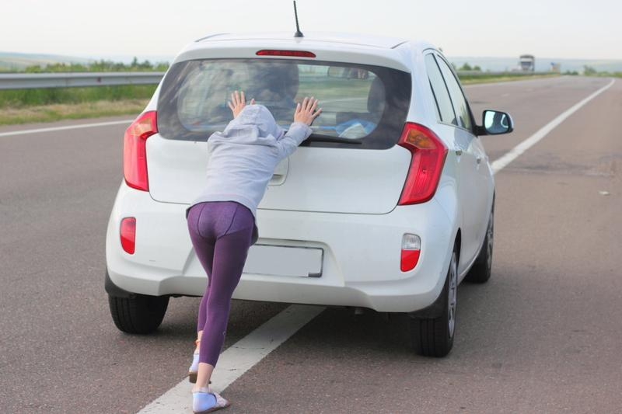
Force
Intro
Notes:
Today we will learn about force.
Feedback: Providing clear cues as to what was coming next in the lesson helps prepared students by letting them know what to expect.

Slide 3
Big Question: How have you experienced force and gravity since you woke up this morning? What is the relationship between force and gravity?
Notes:
Our “big question” is: How have you experienced force and gravity since you woke up this morning? What is the relationship between force and gravity?
[Pause and illicit predictions from students.]
I love all these thoughtful scientific hypotheses! Be sure to keep this question and your predictions in mind as we move through these next few lessons, and we’ll continue to revisit it.

Slide 4
Notes:
Before we move on to our new vocabulary term, let’s review some other words & concepts that you already learned and make sure you are firm in your understanding.
Feedback: Using relevant topics and content to activate prior knowledge sets the students up to make important connections to new content.

Slide 5
Matter: anything that takes up space and has mass
Notes:
Matter is anything that takes up space and has mass. Matter can be in the form of a liquid, solid, or gas.

Slide 6
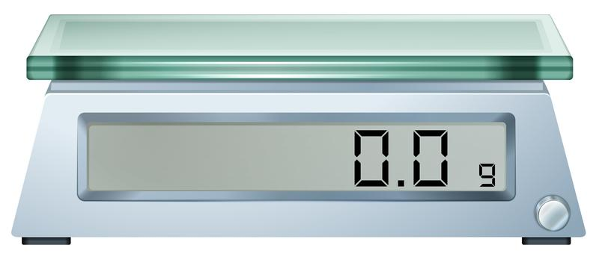
Grams: a unit used to measure mass
Notes:
Grams are a unit used to measure mass.

Slide 7
Notes:
Now let’s pause for a moment to check your understanding.
Feedback: If you notice some students struggling to keep up when you activating prior knowledge, it is important to remember to make adjustments and scaffold your content to meet students current level of understanding.

Slide 8
What unit is mass measured in?
Notes:
What unit is mass measured in?
[Grams]

Slide 9
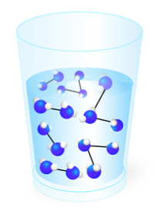
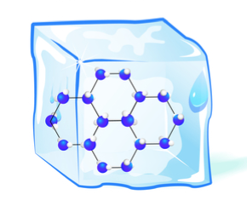
What are the three states of matter?
Notes:
What are the three states of matter?
[Liquid, gas, and solid]

Slide 10
Force
Notes:
Now that we’ve reviewed, let’s define our new term, force.

Slide 11
Force: a push or pull on an object
Notes:
Force is a push or pull of an object. Forces can cause objects to move, stop moving, change speed or change direction.
Feedback: When providing more student-friendly definitions, it is helpful to provide students with cues so that they can be prepared and know what to expect and be ready to copy down the information.

Slide 12
Notes:
Let’s check-in for understanding.

Slide 13
What is force?
Notes:
What is force?
[Force is a push or pull of an object. Forces can cause objects to move, stop moving, change speed or change direction.]

Slide 14
Notes:
That is the basic definition, but there is a bit more you need to know.

Slide 15
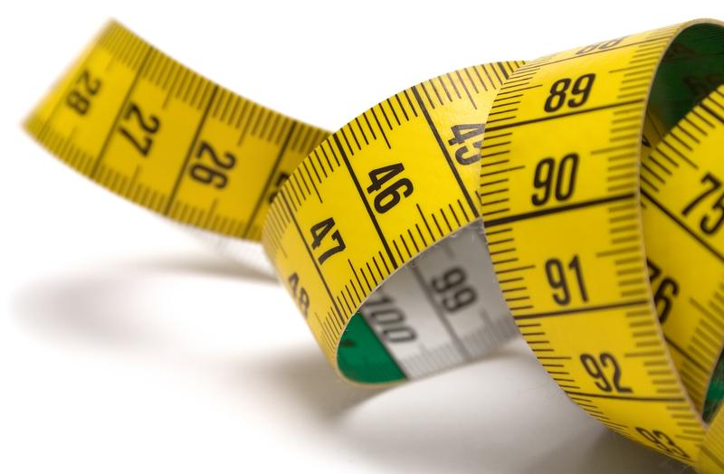
Newton (N)
Notes:
A Newton (N) is what force is measured in.

Slide 16
Newton (N)
N = kg*m/s²
Notes:
A Newton (N) is equivalent to a kg*m/s². This is related to the formula for force.
Feedback: Understanding units is an essential skill in physics. Without units, numbers have no meaning. Take your time in this section to ensure that students really understand.

Slide 17
Notes:
Let’s check-in for understanding.

Slide 18
How do we measure force?
Notes:
How do we measure force?
[In Newtons]

Slide 19
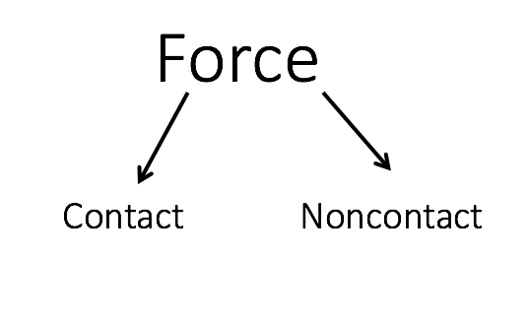
Notes:
There are two types of force that can be applied to an object.

Slide 20
Notes:
The first is a contact force. A contact force is a push or pull applied by touch.

Slide 21
Notes:
Now, let’s talk about some examples of contact force.

Slide 22
Notes:
In this example, the girl is applying force to the car by touching the car to push it forward.
Feedback: It's great practice to introduce an example of the term WITH images to go along with it, this is a great way to help students make connections.

Slide 23
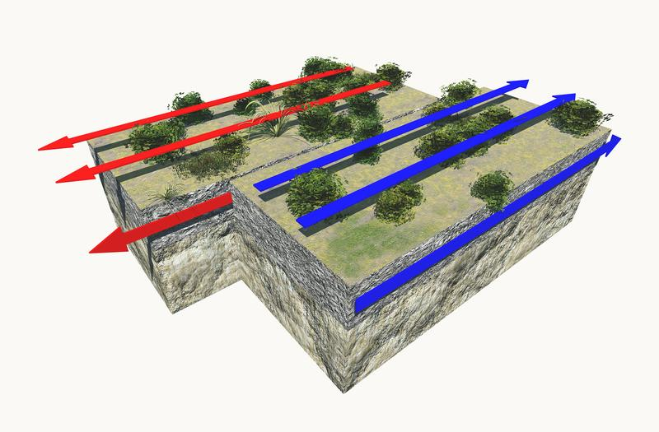
Notes:
In this example, the earth’s plates are moving against each other. Contact force is being applied as the plates pull against each other. This is what causes earthquakes.

Slide 24
Notes:
Let’s check-in for understanding.

Slide 25
What is a contact force?
Notes:
What is a contact force?
[A contact force is a push or pull applied by touch.]

Slide 26
What is an example of a contact force?
Notes:
What is an example of a contact force?
[Pushing on a car, pulling on a door, etc.]
Feedback: Having students produce their own examples is a great way to check for understanding.

Slide 27
Notes:
The second is a noncontact force. A noncontact force is a push or pull on an object without touching it.

Slide 28
Notes:
Now, let’s talk an example of noncontact force.

Slide 29
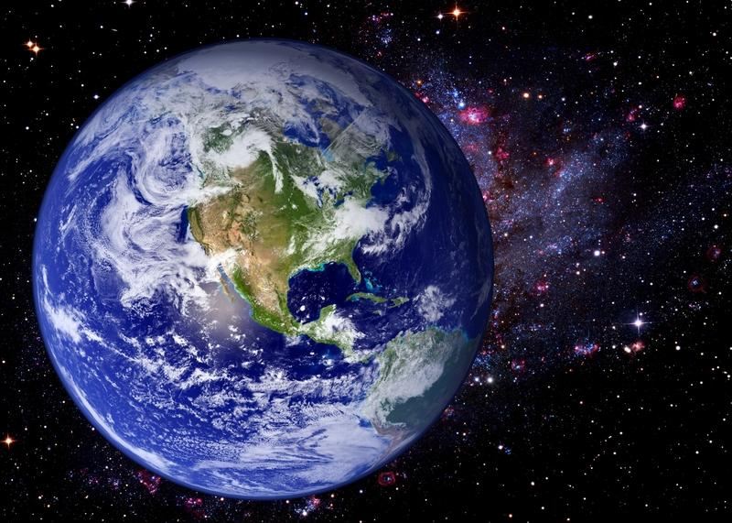
Notes:
Gravity is an example of a noncontact force. We will learn more about gravity later in the unit.
Feedback: It is important to say that you will go over this more later in the unit. That way, students can save their questions and know that they do not need to completely understand this example yet.

Slide 30
Notes:
Let’s check-in for understanding.

Slide 31
What is a noncontact force?
Notes:
What is a noncontact force?
[A noncontact force is a push or pull on an object without touching it.]

Slide 32
What is an example of a noncontact force?
Notes:
What is an example of a noncontact force?
[Gravity, magnetism, etc.]

Slide 33
Net Force: the combination of all the forces acting on an object
Notes:
Net force is the combination of all the forces acting on an object. The arrows represent different forces on the car.

Slide 34
Notes:
Now, let’s talk a couple of examples of net force.

Slide 35
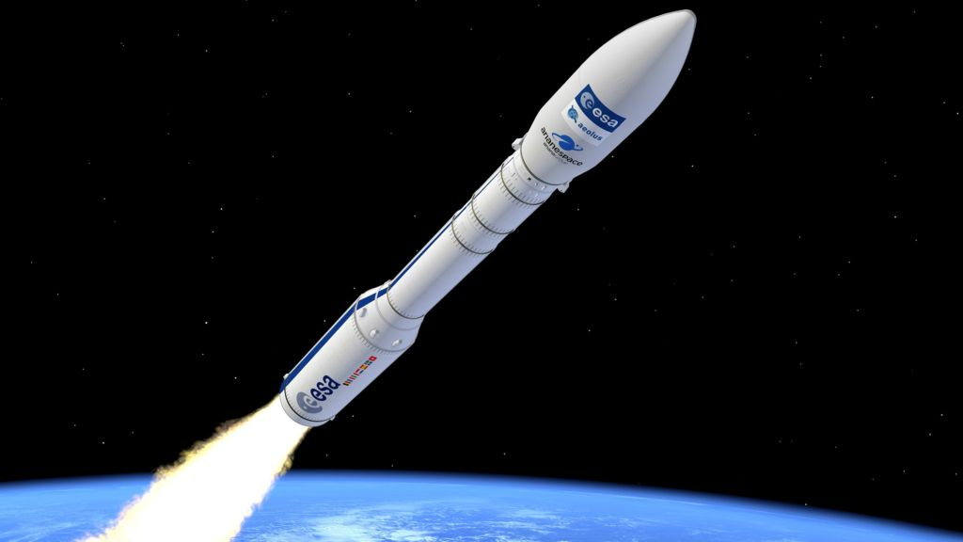
Notes:
There are multiple forces acting on this rocket. One force is gravity, which is working to pull the rocket back to earth. Another force is pushing the rocket into space. The combination of both these forces is the net force. In this example, the net force is going in the direction the rocket is moving, since it is larger than the gravitational force.
Feedback: Remember to try and use phrasing and language that is clear and easy for students to understand when going over examples of term meaning.

Slide 36
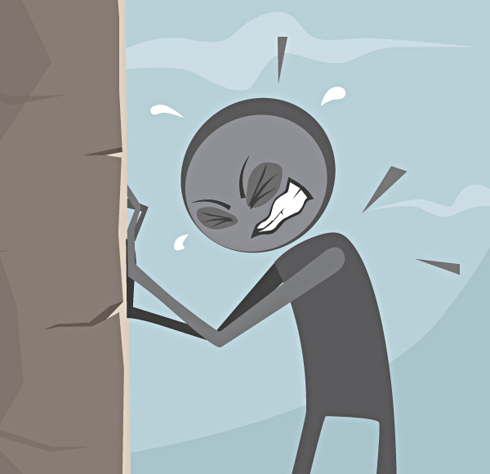
Notes:
The person is an exerting a force on the wall while pushing it. The wall is exerting an equal force on the person. The combination of both these forces is the net force. In this example, the net force is zero because neither the wall not the person are moving.

Slide 37
Notes:
Let’s check-in for understanding.

Slide 38
What are the 2 different types of forces?
Notes:
What are the 2 different types of forces?
[Contact and noncontact]

Slide 39
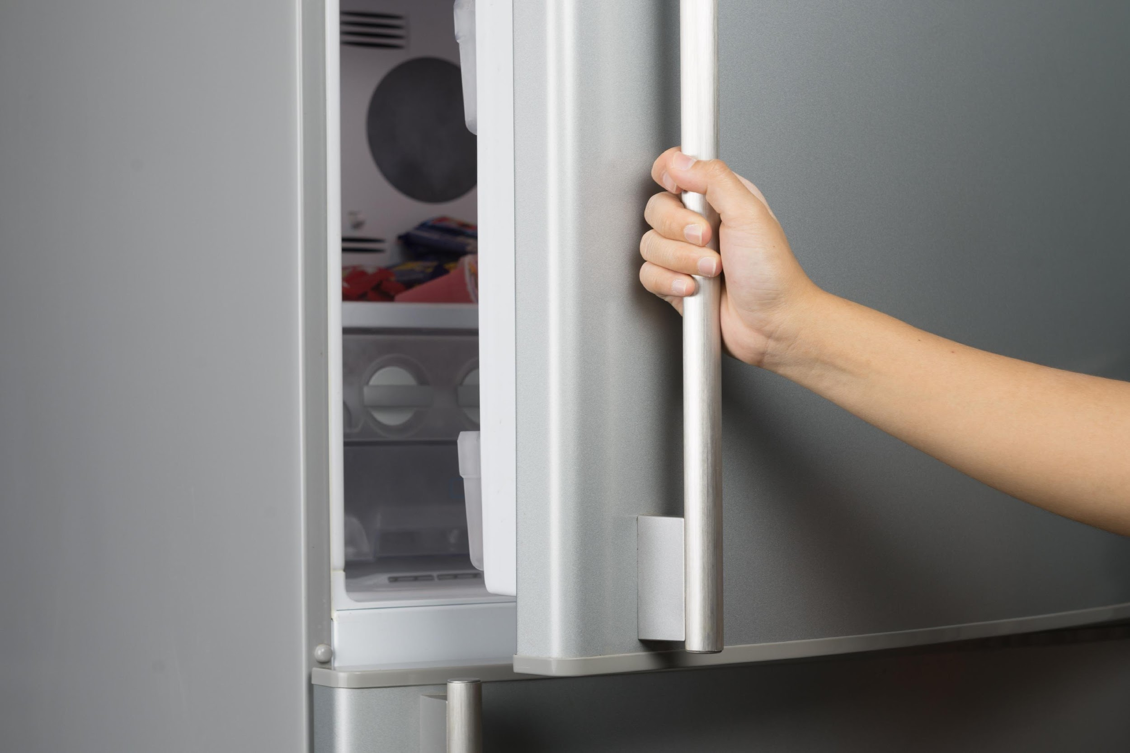
If I am opening my fridge, what type of force am I applying?
Contact
Noncontact
Notes:
If I am opening my fridge, what type of force am I applying?
[Contact]
Feedback: Frequent checks for understanding allow you to tailor your lesson to the class. If they seem to have a strong understanding, maybe increase your pace or do less modeling. If they are struggling, review and do more guided practice.

Slide 40
If I am opening my fridge, what type of force am I applying?
Contact
Noncontact
Notes:
If I am opening my fridge, what type of force am I applying?
[Contact]

Slide 41
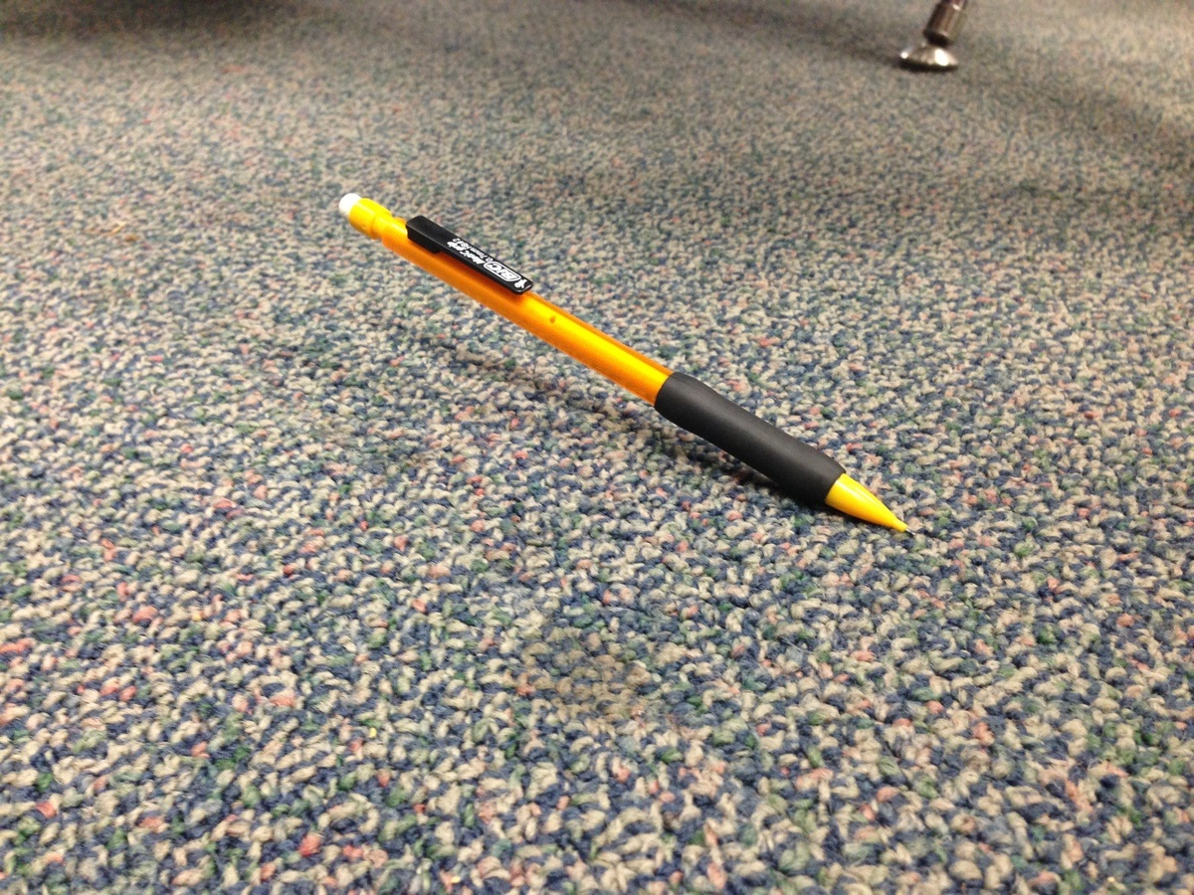
If my pencil falls to the ground, what type of force is being applied?
Contact
Noncontact
Notes:
If my pencil falls to the ground, what type of force is being applied?
[Noncontact (gravity)]

Slide 42
If my pencil falls to the ground, what type of force is being applied?
Contact
Noncontact
Notes:
If my pencil falls to the ground, what type of force is being applied?
[Noncontact (gravity)]

Slide 43
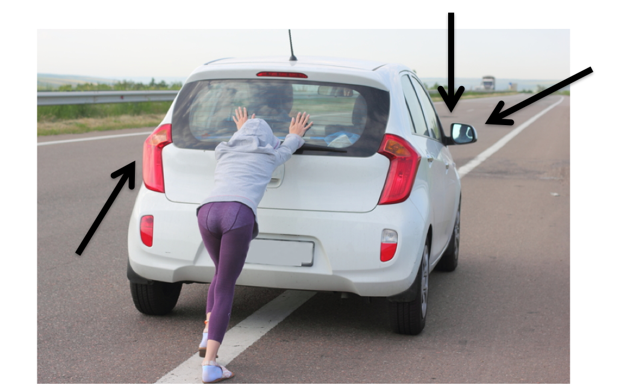
What is net force?
Notes:
What is net force?
[Net force is the combination of all the forces acting on an object.]

Slide 44
Notes:
Let’s dive even deeper to learn how to calculate force.
Feedback: Remember, it is important to have an organized and smooth transition to limit wasted time and reduce any disruptions. By having materials ready in advance and working on a routine with students you can easily get this done!

Slide 45
Force = Mass x Acceleration
F = ma
Notes:
Force = mass x acceleration

Slide 46
Notes:
Now, let’s talk a couple of examples of how to calculate force.

Slide 47
Notes:
A car with a mass of 1,000 kg is accelerating due north at 5 m/s^2. What is the force produced by this acceleration?

Slide 48
Force = Mass x Acceleration
Notes:
Since force equals mass times acceleration, we know that in this example, force equals 1,000 kg x 5 m/s^2.
Feedback: Explicitly modeling these skills for students provides them with visual of the strategy.

Slide 49
Force = Mass x Acceleration
F = 5,000 N
Notes:
When we multiply the mass by the acceleration, we get that the force produced by the acceleration of the car is 5,000 N.

Slide 50
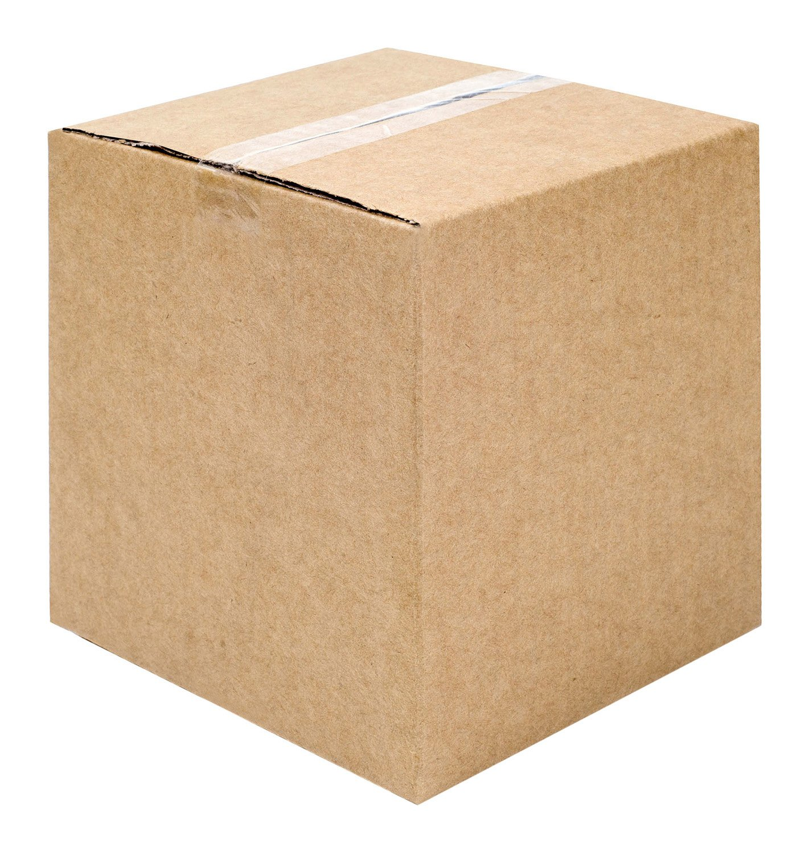
Notes:
Let’s work through another example together. An object with a mass of 4 kg is accelerating at 3 m/s^2. What is the force on this object?
Feedback: Remember to have the students succeed and complete some portions of the task on their own, this will help build confidence along the way.

Slide 51
Force = Mass x Acceleration
Notes:
Since force equals mass times acceleration, we know that in this example, force equals 4 kg x 3 m/s^2.

Slide 52
Force = Mass x Acceleration
F = 12 N
Notes:
When we multiply the mass by the acceleration, we get that the force produced by the object is 12 N.

Slide 53
Notes:
Let’s check-in for understanding.

Slide 54
What is the equation used to calculate force?
Notes:
What is the equation used to calculate force?
[F = mass times acceleration]

Slide 55
Demonstration
Notes:
Demonstration – Let’s see what force looks like!
For this demonstration, all I need are things around my house.
Since a force is any type of push or pull on an object, many things that we do around the house use forces.
For example, when I pull open the door of the refrigerator, I am exerting a force to open it.
When I push in the chair of my kitchen table, I am exerting a force to move it.
What are other ways that you exert forces in your house?
These are all contact forces. We’ll do a demonstration of a non-contact force when we talk about gravity.
Feedback: Remember to continiously check for understanding throughout the demonstration to make sure that students are following along and understand the content.

Slide 56
Notes:
Let’s check-in for understanding.

Slide 57
Which is the equation for force?
F = m/a
F = a/m
F = ma
Notes:
Which is the equation for force?

Slide 58
Which is the equation for force?
F = m/a
F = a/m
F = ma
Notes:
Which is the equation for force?
[F = m x a]

Slide 59
Notes:
An object with a mass of 2 kg is moving at an acceleration of 4 m/s^2. What is the force on this object?

Slide 60
Answer

Slide 61
What is force?
Notes:
What is force?
[Force is a push or pull on an object. Forces can cause objects to move, stop moving, change speed or change direction.]
Feedback: It is important to take time throughout the close of the lesson to check for understanding one last time, this will help you know who may need more instruction or where further explanation is needed.

Slide 62
What is the difference between contact force and noncontact force?
Notes:
What is the difference between contact force and noncontact force?
[A contact force is a push or pull applied by touch. In contrast, a noncontact force is a push or pull on an object without touching it.]

Slide 63
Remember!!!
Notes:
So remember!

Slide 64
Force: a push or pull on an object
Notes:
Force is a push or pull of an object. Forces can cause objects to move, stop moving, change speed or change direction.
Feedback: Intentionally repeating key information when engaging in this part of the lesson highlights what is important for the students.

Slide 65
Notes:
A contact force is a push or pull applied by touch.

Slide 66
Notes:
A noncontact force is a push or pull on an object without touching it.

Slide 67
Net Force: the combination of all the forces acting on an object
Notes:
Net force is the combination of all the forces acting on an object. The arrows represent different forces on the car.

Slide 68
Force = Mass x Acceleration
F = ma
Notes:
Force = mass x acceleration

Slide 69
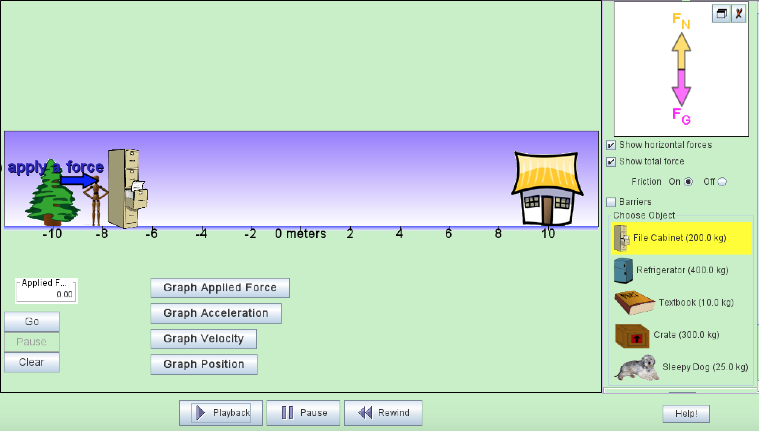
Simulation Activity
Force
(Phet)
Click the link above for a simulation to deepen your understanding of force.
Notes:
Feedback: Remember, it is important to provide students with opportunities to ask questions themselves and work to define the problem. You can scaffold supports to help them along the way.

Slide 70
Big Question: How have you experienced force and gravity since you woke up this morning? What is the relationship between force and gravity?
Notes:
Explicit cue to revisit the big question at the end of the lesson: Okay everyone. Now that we’ve learned the term, force, let’s reflect once more on our big question. Was there anything that we predicted earlier that was correct or incorrect? Do you have any new hypotheses to share?

Slide 71
Notes:
Thanks for watching, and please continue watching CAPs available from this website.

Slide 72
This Video Was Created With Resources From:
Questions or Comments
Michael Kennedy, Ph.D. MKennedy@Virginia.edu
Rachel L Kunemund, Ph.D. rk8vm@virginia.edu

Slide 73
Intro
“Big Idea” Question
Review Concepts
Check-In Questions
Teacher Demo
Vocabulary
Student-Friendly Definition
Examples & Non-Examples
Morphological Word Parts
Simulation/Activity
Notes:
OK everyone, get ready for our next lesson. Just as a reminder, these are the different components that our lesson may include, and you’ll see these icons in the top left corner of each slide so that you can follow along more easily!

Slide 74
Gravity
Intro
Notes:
Today we’re going to learn about gravity.

Slide 75
Big Question: How have you experienced force and gravity since you woke up this morning? What is the relationship between force and gravity?
Notes:
Before we start, let’s think about our “big question”: How have you experienced force and gravity since you woke up this morning? What is the relationship between force and gravity? We recently learned about force, so what predictions do you have to share about the relationship between force and gravity?
[Pause and illicit predictions from students.]
I love all these thoughtful scientific hypotheses! Be sure to keep this question and your predictions in mind as we move through these next few lessons, and we’ll continue to revisit it.
Feedback: Providing students with the opportunity to make predictions about what will happen allows them to think critically about the content.

Slide 76
Notes:
Before we move on to our new vocabulary term, let’s review some other words & concepts that you already learned and make sure you are firm in your understanding.

Slide 77
Force: push or pull on an object
Notes:
Force is a push or pull on an object. Forces can cause objects to move, stop moving, change speed or change direction.

Slide 78
Notes:
A contact force is a push or pull applied by touch.

Slide 79
Notes:
A noncontact force is a push or pull on an object without touching it.

Slide 80
Notes:
Now let’s pause for a moment to check your understanding.

Slide 81
What is a force?
Notes:
What is a force?
[Force is a push or pull on an object. Forces can cause objects to move, stop moving, change speed or change direction.]
Feedback: Even during a review, it is important that students are held accountable by being given the opportunity to participate. This may take some encouragement on your part but I know you can get them to do it!

Slide 82
What is the difference between contact force and noncontact force?
Notes:
What is the difference between contact force and noncontact force?
[A contact force is a push or pull applied by touch. In contrast, a noncontact force is a push or pull on an object without touching it.]

Slide 83
Gravity
Notes:
Now that we’ve reviewed, let’s define our new term, gravity.

Slide 84
Gravity: a noncontact force that attracts any object with mass toward another object with mass
Notes:
Gravity is a noncontact force that attracts any object with mass towards another object with mass.
Feedback: Longer more formal definitions are tricky so it is even more important to use clear language when providing the new definition.

Slide 85
Notes:
Let’s check-in for understanding.

Slide 86
What is gravity?
Notes:
What is gravity?
[Gravity is a noncontact force that attracts any object with mass towards another object with mass.]

Slide 87
Notes:
Now, let’s talk about some examples of gravity.

Slide 88
Throwing a ball in the air
Notes:
Throwing a basketball up in the air and it falling back down is an example of gravity. Basketballs have mass. So, when the basketball comes back down it is because gravity is a noncontact force pulling it back down to earth which also has mass.

Slide 89
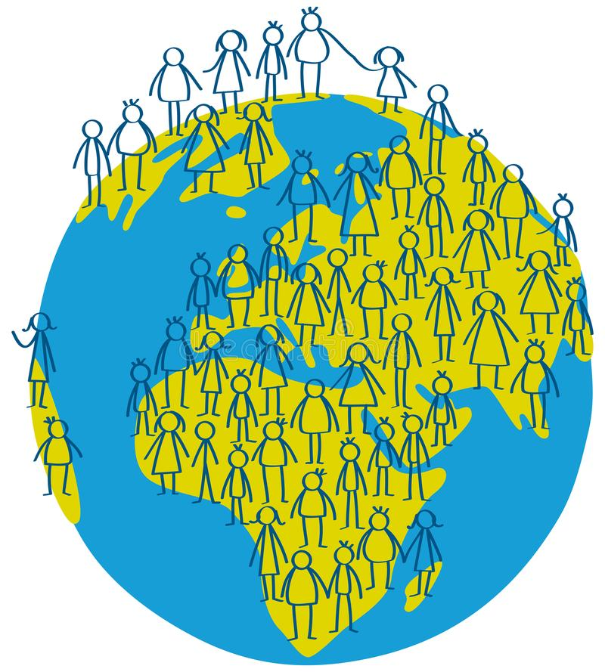
How we stay on the ground
Notes:
Being able to stay on the ground is another example of gravity. Since we have mass, gravity keeps pulling us to the ground, which also has mass. This is why we aren’t just floating around.

Slide 90
Notes:
Let’s check-in for understanding.

Slide 91
What is an example of an object experiencing gravity?
Notes:
What is an example of gravity?
[Throwing a ball into the air, staying on the ground, etc.]

Slide 92
Demonstration
Notes:
Demonstration – Let’s see what gravity looks like!
For this demonstration, all I need is a basketball and a tennis ball.
I am going to hold the basketball and tennis ball at the same height and drop them at the same time.
They both fell at the same rate because the force of gravity is equal on both of them. Gravity is equal on all objects independent of mass.
Feedback: Keep in mind that an organized structure and a clear demonstration will help your students understand the content and make predictions.

Slide 93
Notes:
Let’s check-in for understanding.

Slide 94
In this demonstration, what did you notice about gravity?
Notes:
In this demonstration, what did you notice about gravity?
[It acted on both balls in the same way]
Feedback: Remember, we want students to gather information and then be able to not only evaluate but also effectively communicate what they have learned from this activity.

Slide 95
Gravity is an attractive force between objects that have ________.
Volume
Mass
Distance
Notes:
Gravity is an attractive force between objects that have ___________.
[Mass]

Slide 96
Gravity is an attractive force between objects that have ________.
Volume
Mass
Distance
Notes:
Gravity is an attractive force between objects that have ___________.
[Mass]

Slide 97
Gravity is an example of a _______ force.
Contact
Noncontact
Notes:
Gravity is an example of a _________ force.
[Noncontact]

Slide 98
Gravity is an example of a _______ force.
Contact
Noncontact
Notes:
Gravity is an example of a _________ force.
[Noncontact]

Slide 99
Remember!!!
Notes:
So remember!

Slide 100
Gravity: a noncontact force that attracts any object with mass toward another object with mass
Notes:
Gravity is a noncontact force that attracts any object with mass towards another object with mass.

Slide 101
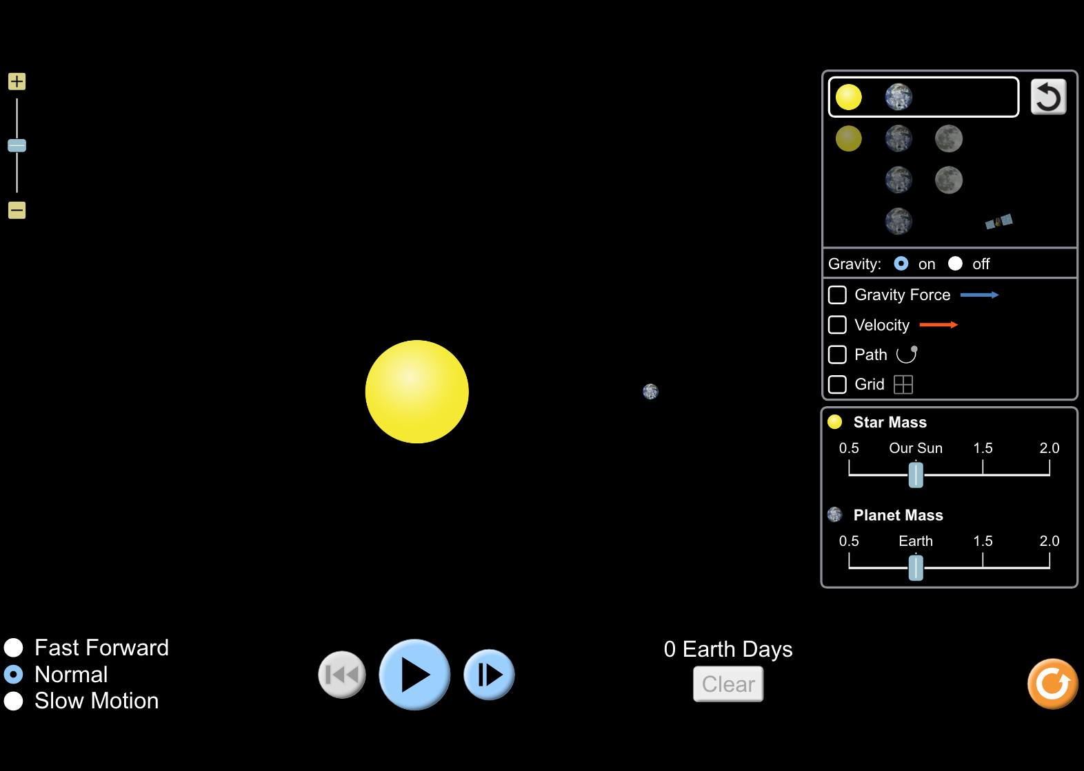
Simulation Activity
Gravity
(Phet)
Click the link above for a simulation to deepen your understanding of gravity.
Notes:
Feedback: Remember, it is important to include some computational or mathematics concepts in the science activity so that students can apply these concepts as part of the problem solving process.

Slide 102
Big Question: How have you experienced force and gravity since you woke up this morning? What is the relationship between force and gravity?
Notes:
Explicit cue to revisit the big question at the end of the lesson: Okay everyone. Now that we’ve learned the term, gravity, let’s reflect once more on our big question. Was there anything that we predicted earlier that was correct or incorrect? Do you have any new hypotheses to share?
Feedback: Providing your students with some reflection time at the end of the lesson is crucial in helping them to put the pieces together and make sense of the activity.

Slide 103
Notes:
Thanks for watching, and please continue watching CAPs available from this website.

Slide 104
This Video Was Created With Resources From:
Questions or Comments
Michael Kennedy, Ph.D. MKennedy@Virginia.edu
Rachel L Kunemund, Ph.D. rk8vm@virginia.edu

Slide 105
Intro
“Big Idea” Question
Review Concepts
Check-In Questions
Teacher Demo
Vocabulary
Student-Friendly Definition
Examples & Non-Examples
Morphological Word Parts
Simulation/Activity
Notes:
OK everyone, get ready for our next lesson. Just as a reminder, these are the different components that our lesson may include, and you’ll see these icons in the top left corner of each slide so that you can follow along more easily!
Feedback: Explicit cues used at the beginning of each step makes it easy for students to follow along and be prepared to engage in the next part of the lesson.

Slide 106
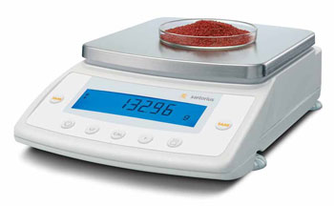
Intro
Mass
Notes:
Today we’ll be learning about mass.

Slide 107
Big Question: What is the difference between mass and weight?
Notes:
Our “big question” is: What is the difference between mass and weight?
[Pause and illicit predictions from students.]
I love all these thoughtful scientific hypotheses! Be sure to keep this question and your predictions in mind as we move through these next few lessons, and we’ll continue to revisit it.

Slide 108
Notes:
Let’s review some terms & concepts that you already learned and make sure you are firm in your understanding.

Slide 109
Gravity: a noncontact force that attracts any object with mass toward another object with mass
Notes:
Gravity is a noncontact force that attracts any object with mass towards another object with mass.

Slide 110
Matter: anything that takes up space and has mass
Notes:
Matter is anything that takes up space and has mass. Matter can be in the form of a liquid, solid, or gas.

Slide 111
Grams: a unit used to measure mass
Notes:
Grams are a unit used to measure mass.

Slide 112
Notes:
Now let’s pause for a moment to check your understanding.
Feedback: It's really important to make sure that you're providing students with frequent opportunities to respond as you're activating prior knowledge – it will save so you so much time if you confirm understanding before asking them to try something independently.

Slide 113
Gravity is an attractive force between objects that have ________.
Volume
Mass
Distance
Notes:
Gravity is an attractive force between objects that have ________.
[Mass]

Slide 114
Gravity is an attractive force between objects that have ________.
Volume
Mass
Distance
Notes:
Gravity is an attractive force between objects that have ________.
[Mass]

Slide 115
Grams are a unit used to measure _______.
Weight
Mass
Notes:
Grams are used to measure ________.
[Mass]

Slide 116
Grams are a unit used to measure _______.
Weight
Mass
Notes:
Grams are used to measure ________.
[Mass]

Slide 117
What is matter?
Notes:
What is matter?
[Matter is anything that takes up space and has mass. Matter can be in the form of a liquid, solid, or gas.]

Slide 118
Mass
Notes:
Now that we’ve reviewed, let’s define our new term, mass.
Feedback: It is important to provide a quick review of background information before introducing your student-friendly definition. Doing so can help students make connections to previously learned material.

Slide 119
Mass: amount of matter in a given substance
Notes:
Mass is the amount of matter in a given substance.

Slide 120
Notes:
Let’s check-in for understanding.

Slide 121
What is mass?
Notes:
What is mass?
[Mass is the amount of matter in a given substance.]
Feedback: Providing feedback is tricky but crucial. Remember to give students with feedback on their response because it helps students know what answers you are actually looking for.

Slide 122
Notes:
Now, let’s talk about some examples of mass.

Slide 123
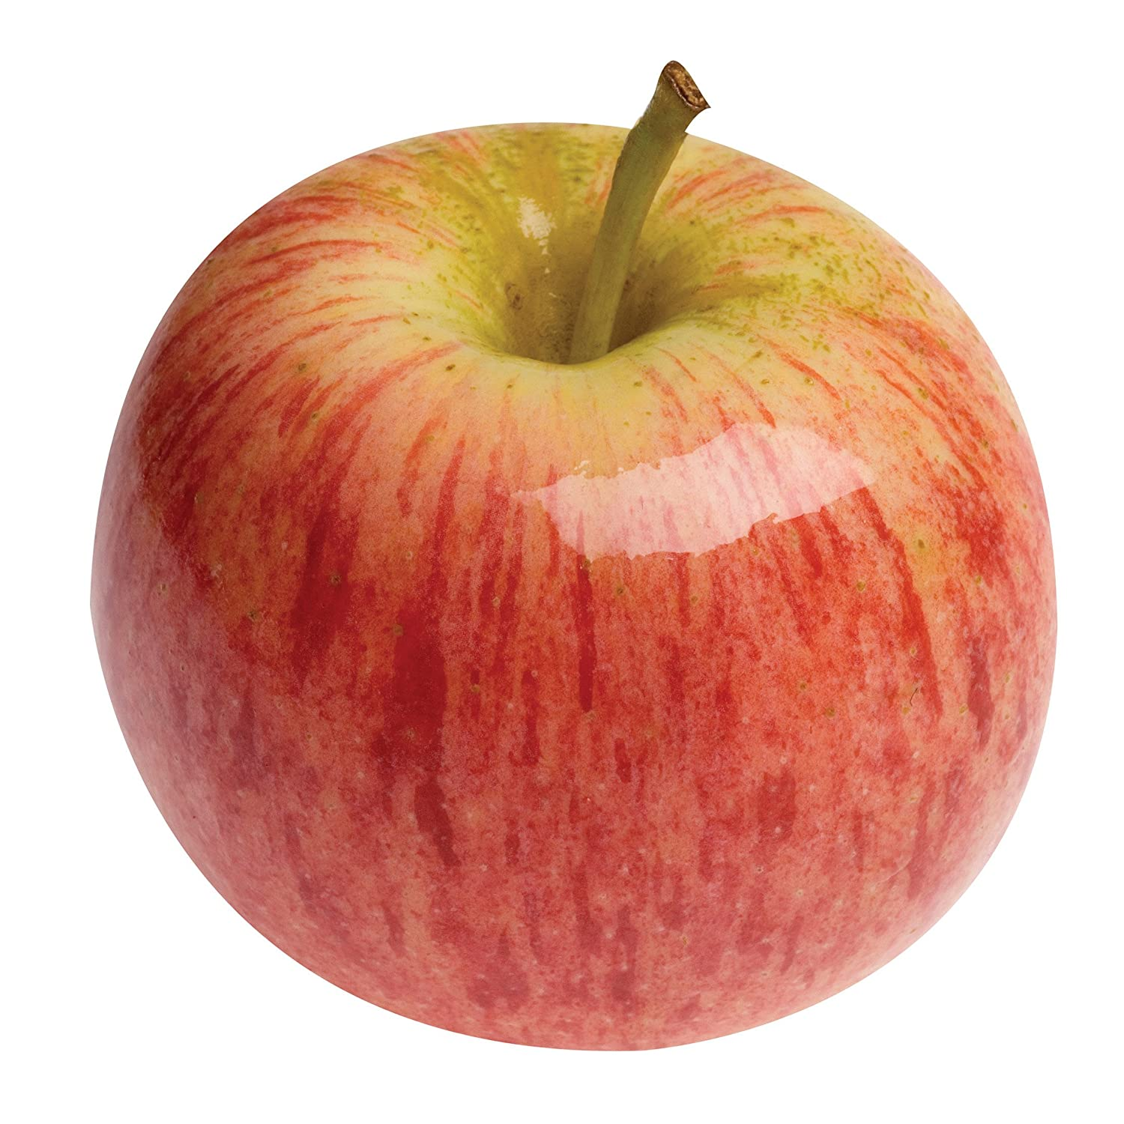
Notes:
This apple is a solid with mass. Its mass is the amount of space it takes up (matter).

Slide 124
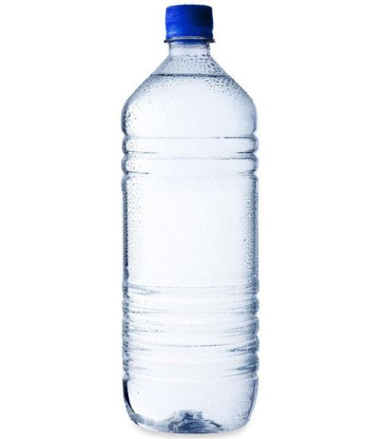
Notes:
This water is a liquid with mass. Its mass is the amount of space it takes up (matter).

Slide 125
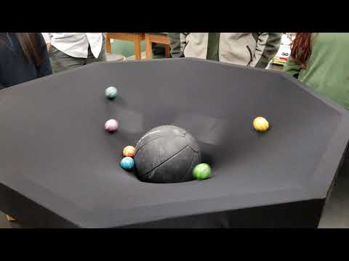
Demonstration
Notes:
Testing the effects of mass
Feedback: Make sure you pause during your demonstration and ask some questions to ensure your students are understanding the activity, this will help them benefit from the demonstration.

Slide 126
Notes:
Let’s check-in for understanding.

Slide 127
What is mass?
Notes:
What is mass?
[Mass is the amount of matter in a given substance.]

Slide 128
How is mass related to gravity?
Notes:
How is mass related to gravity?
[Mass and gravity are related because gravity is an attractive, noncontact force between two objects with MASS.]
Feedback: Making connections between the new content and past terms/content is important for helping students understand the bigger picture.

Slide 129
Remember!!!
Notes:
So remember!

Slide 130
Mass: amount of matter in a given substance
Notes:
Mass is the amount of matter in a given substance.

Slide 131
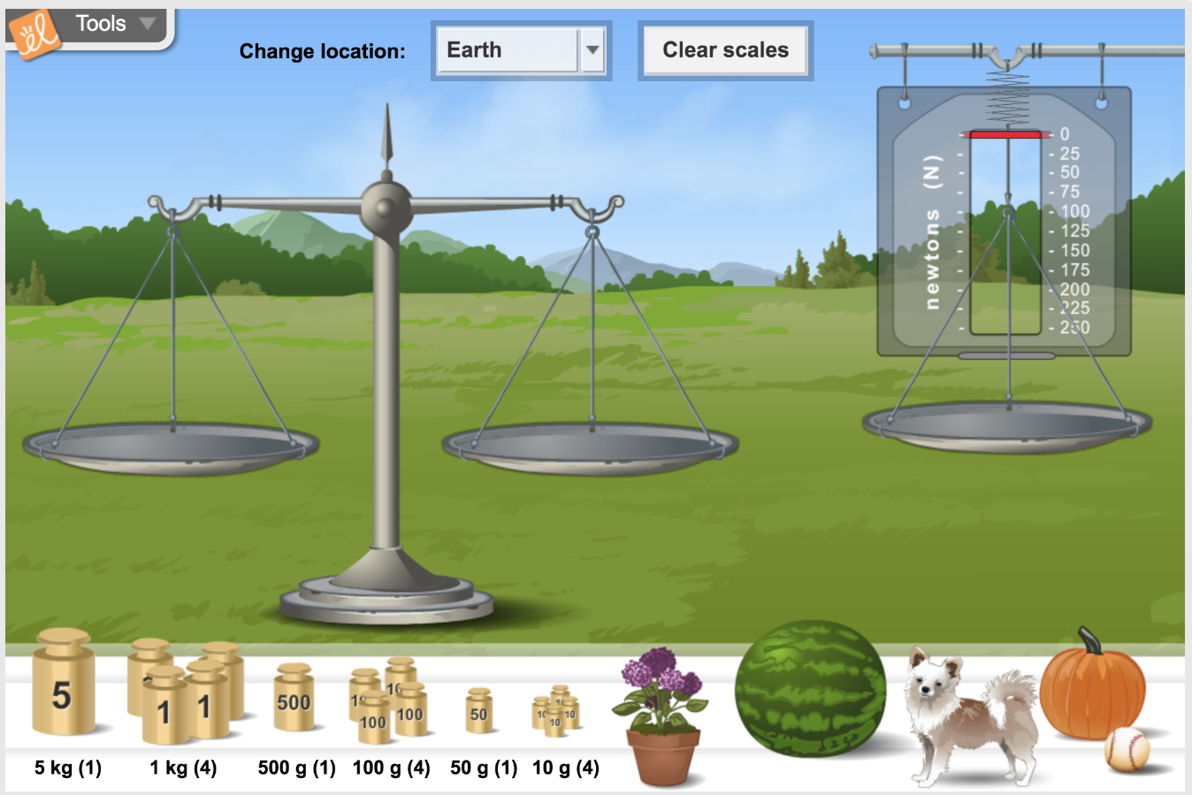
Simulation Activity
Mass
(Gizmos)
Click the link above for a simulation to explore mass.
In this activity, you’ll compare the mass and weight of objects on Earth, Mars, Jupiter, and the Moon .
Notes:
*This is the same simulation for weight – could potentially wait to have the students do it once
Feedback: Providing a rationale during this activity helps students make connections and promotes understanding of the content.

Slide 132
Big Question: What is the difference between mass and weight?
Notes:
Explicit cue to revisit the big question at the end of the lesson: Okay everyone. Now that we’ve learned the term, mass, let’s reflect once more on our big question. Was there anything that we predicted earlier that was correct or incorrect? Do you have any new hypotheses to share?

Slide 133
Notes:
Thanks for watching, and please continue watching CAPs available from this website.

Slide 134
This Video Was Created With Resources From:
Questions or Comments
Michael Kennedy, Ph.D. MKennedy@Virginia.edu
Rachel L Kunemund, Ph.D. rk8vm@virginia.edu

Slide 135
Intro
“Big Idea” Question
Review Concepts
Check-In Questions
Teacher Demo
Vocabulary
Student-Friendly Definition
Examples & Non-Examples
Morphological Word Parts
Simulation/Activity
Notes:
OK everyone, get ready for our next lesson. Just as a reminder, these are the different components that our lesson may include, and you’ll see these icons in the top left corner of each slide so that you can follow along more easily!

Slide 136
Intro
Weight
Notes:
Today we’ll be learning about weight.

Slide 137
Big Question: What is the difference between mass and weight?
Notes:
Before we start, let’s think about our “big question” again: What is the difference between mass and weight?
What predictions do you have about the weight, now that we’ve learned about mass?
[Pause and illicit predictions from students.]
I love all these thoughtful scientific hypotheses! Be sure to keep this question and your predictions in mind as we move through these next few lessons, and we’ll continue to revisit it.
Feedback: Providing a specific goal for use is crucial to letting students know what's expected and why this lesson is important.

Slide 138
Notes:
Let’s review some terms & concepts that you already learned and make sure you are firm in your understanding.
Feedback: Referring to prior topics that are relevant and on topic helps students make connections to the new content they will be learning and tie it to prior knowledge.

Slide 139
Force: a push or pull on an object
Notes:
Force is a push or pull of an object. Forces can cause objects to move, stop moving, change speed or change direction.

Slide 140
Gravity: a noncontact force that attracts any object with mass toward another object with mass
Notes:
Gravity is a noncontact force that attracts any object with mass towards another object with mass.

Slide 141
Mass: amount of matter in a given substance
Notes:
Mass is the amount of matter in a given substance.

Slide 142
Notes:
Now let’s pause for a moment to check your understanding.
Feedback: Remember to make adjustments to your lesson and content if you see some students not demonstrating understanding, this can help them make connections and prevent frustration.

Slide 143
What is a force?
Notes:
What is a force?
[Force is a push or pull on an object. Forces can cause objects to move, stop moving, change speed or change direction.]

Slide 144
Gravity is an attractive force between objects that have ________.
Volume
Mass
Distance
Notes:
Gravity is an attractive force between objects that have ________.
[Mass]

Slide 145
Gravity is an attractive force between objects that have ________.
Volume
Mass
Distance
Notes:
Gravity is an attractive force between objects that have ________.
[Mass]

Slide 146
What is mass?
Notes:
What is mass?
[Mass is the amount of matter in a given substance.]

Slide 147
Weight
Notes:
Now that we’ve reviewed, let’s define our new term, weight.

Slide 148
Weight: the gravitational force exerted on an object
Notes:
Weight is the gravitational force, or amount of gravity, exerted on an object.

Slide 149
Notes:
Let’s check-in for understanding.

Slide 150
What is weight?
Notes:
What is weight?
[Weight is the gravitational force, or amount of gravity, exerted on an object.]
Feedback: When introducing new vocabularies, it is crucial to require the students to give out their own interpretation. I would strongly encourage you to ask students to explain the concept in their own words.

Slide 151
Notes:
That is the basic definition, but there is a bit more you need to know.
Feedback: Cues are very important when teaching vocabulary, it helps the students prepare for what's next by giving them a hint as to what is coming.

Slide 152
Weight is relative
Notes:
Weight is relative to what and where you are measuring.

Slide 153
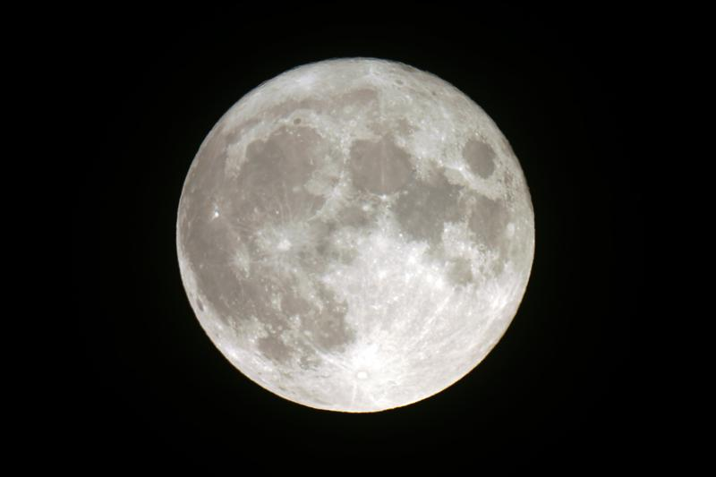
You weigh 10% less orbiting the earth
Notes:
You weigh 10% less orbiting the earth than you do when you are standing on the earth.

Slide 154
100 lbs 90 lbs
Notes:
So, if you weighed 100 pounds while standing on earth, you would weigh 90 pounds while orbiting the earth.

Slide 155
Mass does not change
Notes:
In contrast, mass is NOT affected by gravity like weight is. Your mass stays the same wherever you are.

Slide 156
mass ≠ weight
Notes:
Therefore, mass is not the same thing as weight.

Slide 157
Notes:
Let’s check-in for understanding.
Feedback: There are a lot of opportunities to respond throughout this portion of your lesson, which is so important for ensuring that your students are grasping this new content.

Slide 158
Why does your weight change?
Notes:
Why does your weight change?
[Your weight changes due to gravity. That is why you would weigh less on the moon.]

Slide 159
Notes:
Now, let’s look at an example of weight.

Slide 160
Scales measure weight.
Notes:
When you are measuring your weight, you are measuring the force exerted on you by the earth.
Feedback: In addition to explaining that something is an example, it is important to explain WHY it’s an example.

Slide 161
Notes:
Let’s check-in for understanding.

Slide 162
What is the difference between weight and mass?
Notes:
What is the difference between weight and mass?
[Weight is the gravitational force, or amount of gravity, exerted on an object. Mass is the amount of matter in a given substance.
Weight is affected by gravity and mass is not. Your weight changes depending on where you are, your mass stays the same.]

Slide 163
True/False: Weight changes based on the gravitational force.
Notes:
True/False: Weight changes based on gravitational force.
Feedback: It's really important to make sure that you're providing students with frequent opportunities to respond as you're closing the lesson – it will help you know if they understood and made sense of the activity and where you can provide further instruction.

Slide 164
True/False: Weight changes based on the gravitational force.
Notes:
True/False: Weight changes based on gravitational force.
[True]

Slide 165
Remember!!!
Notes:
So remember!

Slide 166
Weight: the gravitational force exerted on an object
Notes:
Weight is the gravitational force, or amount of gravity, exerted on an object.

Slide 167
You weigh 10% less orbiting the earth
Notes:
You weigh 10% less orbiting the earth than you do when you are standing on the earth.

Slide 168
Mass does not change
Notes:
In contrast, mass is NOT affected by gravity like weight is. Your mass stays the same wherever you are.

Slide 169
Simulation Activity
Weight
(Gizmos)
Click the link above for a simulation to explore weight.
In this activity, you’ll compare the mass and weight of objects on Earth, Mars, Jupiter, and the Moon .
Notes:
*This is the same simulation for mass – could potentially wait to have the students do it once.
Feedback: Giving students a chance to analyze and interpret data is a great way to help them to continue to independently problem solve.

Slide 170
Big Question: What is the difference between mass and weight?
Notes:
Explicit cue to revisit the big question at the end of the lesson: Okay everyone. Now that we’ve learned the term, weight, let’s reflect once more on our big question. Was there anything that we predicted earlier that was correct or incorrect? Do you have any new hypotheses to share?

Slide 171
Notes:
Thanks for watching, and please continue watching CAPs available from this website.
Feedback: Remember, it is important that students have an opportunity to ask questions at the end of the lesson so that they can clarify their own understanding, some students may need a clear cue that it is their turn to ask questions.

Slide 172
This Video Was Created With Resources From:
Questions or Comments
Michael Kennedy, Ph.D. MKennedy@Virginia.edu
Rachel L Kunemund, Ph.D. rk8vm@virginia.edu

