Slide 1
Intro
“Big Idea” Question
Review Concepts
Check-In Questions
Teacher Demo
Vocabulary
Student-Friendly Definition
Examples & Non-Examples
Morphological Word Parts
Simulation/Activity
Notes:
OK everyone, get ready for our next lesson. Just as a reminder, these are the different components that our lesson may include, and you’ll see these icons in the top left corner of each slide so that you can follow along more easily!

Slide 2
Fresh Water
Intro
Notes:
Today we are going to be learning about freshwater.

Slide 3
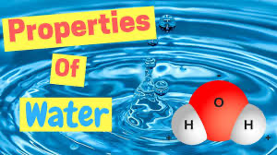
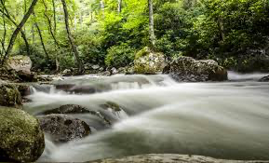
Big Question: How is water important in your everyday life, how do you use it? What are some factors that impact the availability of water for humans?
Notes:
Our “big question” is: How is water important in your everyday life, how do you use it? What are some factors that impact the availability of water for humans?
[Pause and illicit predictions from students.]
I like all of these predictions! Keep thinking about how to answer our big questions as we learn more about water.

Slide 4
Demonstration
Fresh and Salt Water
TEACHER DIRECTIONS:
Before viewing, ask students to recall information about water (e.g. what are the properties of water.). After viewing, ask students to share observations about the types of water on Earth.
You may also choose to do this experiment live for students (on video meeting platform or face-to-face). You can also get a pitcher of water, a test-tube, and salt to help explain salt/fresh water on Earth to students to help activate background knowledge.
Notes:
Let’s watch a quick video that will help get us thinking about the second part of our big question. We already know about the properties of water, now let’s take a look at the role water plays in the natural environment.
Feedback: Provide a lot of opportunities to respond throughout the demonstration helps ensure that your students are grasping this new content.

Slide 5
Notes:
Before we move on to our new vocabulary term, let’s review some other words & concepts that you already learned and make sure you are firm in your understanding.
Feedback: Monitoring understanding during review is an important step before moving on to new material.

Slide 6
Water: liquid made up of 2 hydrogen atoms and 1 oxygen atom
O
H
H
Notes:
Water is a liquid made up of 2 hydrogen atoms and 1 oxygen atom. Water is essential for life.

Slide 7
Polar: has one side that has a negative charge and another that has a positive charge
-
O
+
+
H
H
Notes:
Polar means that one side of the molecule or other object has a negative charge and one side of the molecule has a positive charge.

Slide 8
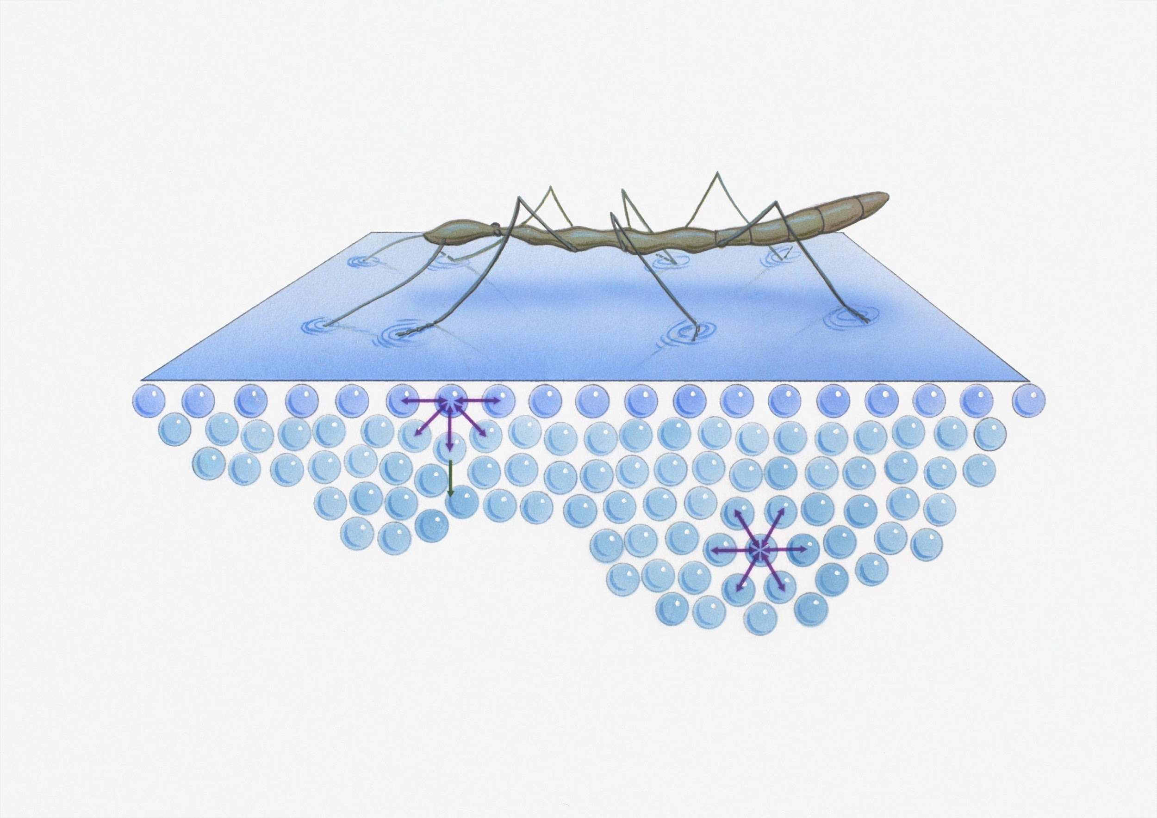
Surface Tension: property of a liquid that lets it resist an external force
Notes:
Surface tension is created when molecules in a liquid, such as water, link together by polar attraction.

Slide 9
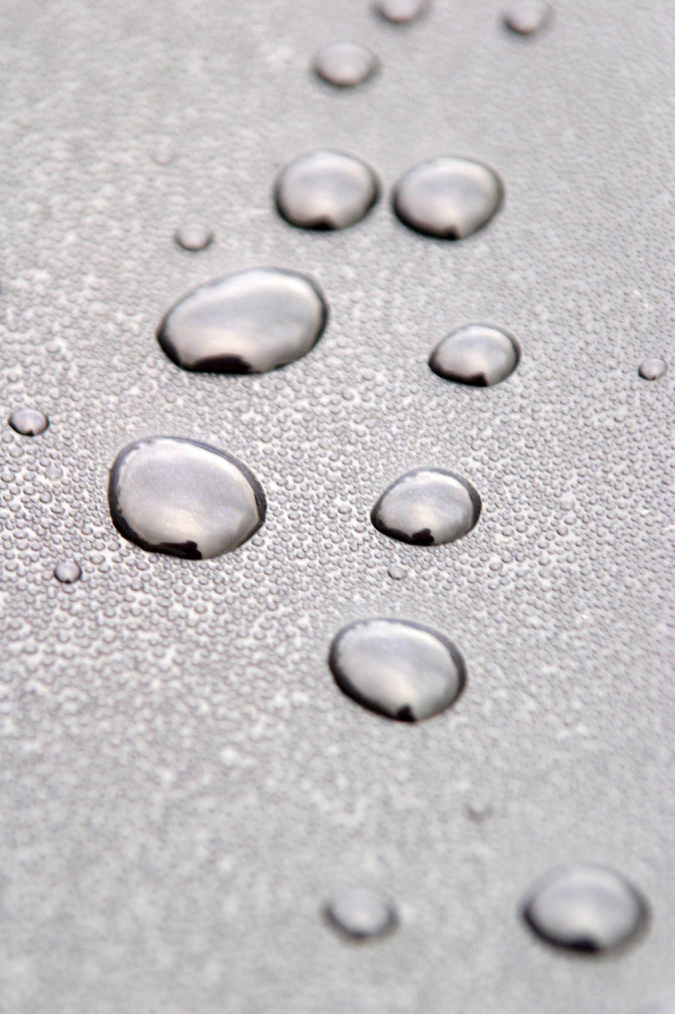
Adhesion: the ability of water molecules to stick to other types of molecules
Notes:
Adhesion is the ability of water molecules to stick to other types of molecules.

Slide 10
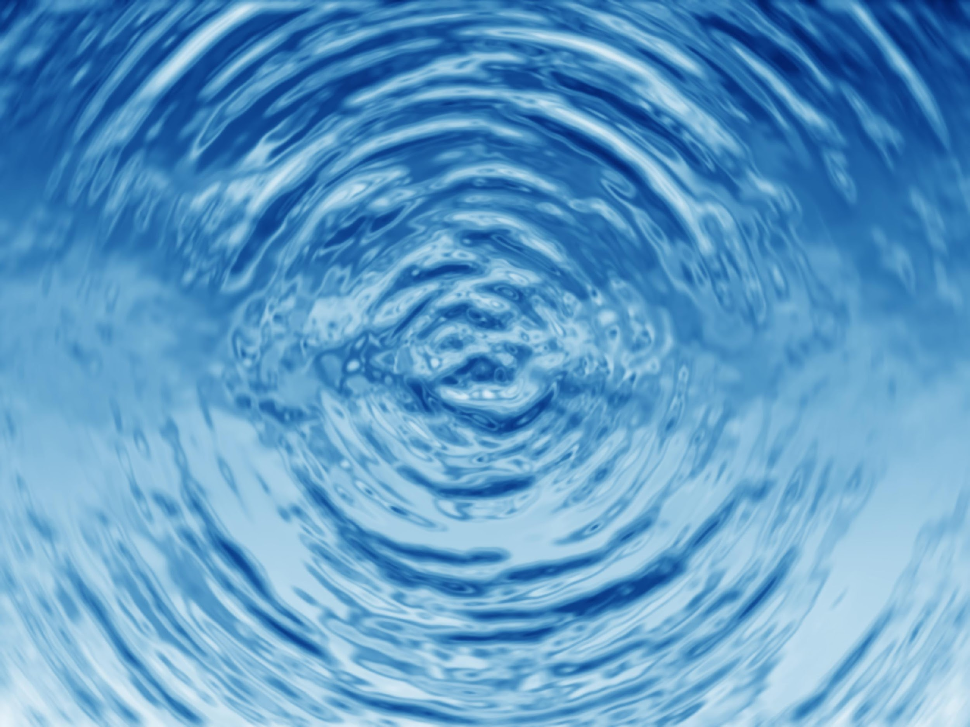
Cohesion: the ability of water molecules to stick to other water molecules
Notes:
Cohesion is the ability of water molecules stick to other water molecules.

Slide 11
Salt Water: water that has a very large amount of salt in it
Notes:
Salt water is water that has a very large amount of salt in it. On earth, salt water is mostly found in oceans.

Slide 12
Notes:
Now let’s pause for a moment to check your understanding.
Feedback: It is important to provide plenty of opportunities to respond and engage with the content.

Slide 13
Why is water polar?
-
O
+
+
H
H
Notes:
Why is water polar?
[When oxygen and hydrogen bond, the side with oxygen is negative and the side with hydrogen is positive, so one side is negative and the other is positive.]

Slide 14
What is surface tension?
Notes:
What is surface tension?
[Surface tension is created when molecules in a liquid, such as water, link together by polar attraction.]

Slide 15
How is surface tension created?
O
-
+
+
H
H
Notes:
How is surface tension created?
[Surface tension is created by molecules linked together by polar attraction.]

Slide 16
What is the difference between surface tension and adhesion?
Notes:
What is the difference between surface tension and adhesion?
[Adhesion is when water molecules stick to other molecules. Surface tension is the property of water that lets it resist an external force.]

Slide 17
What is the relationship between adhesion and cohesion?
Adhesion
Cohesion
Notes:
What is the relationship between adhesion and cohesion?
[Adhesion and cohesion are important to water, but have to do with sticking together. The difference is that water sticks together with other molecules in adhesion, and in cohesion, water sticks to itself.]

Slide 18
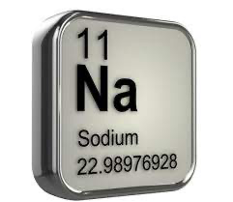
What are the most abundant salt elements in the ocean?
Notes:
What are the most abundant salt elements in the ocean?
[Sodium and Chloride are the most abundant salt elements in the ocean making up 85% of all salt elements in the ocean.]

Slide 19
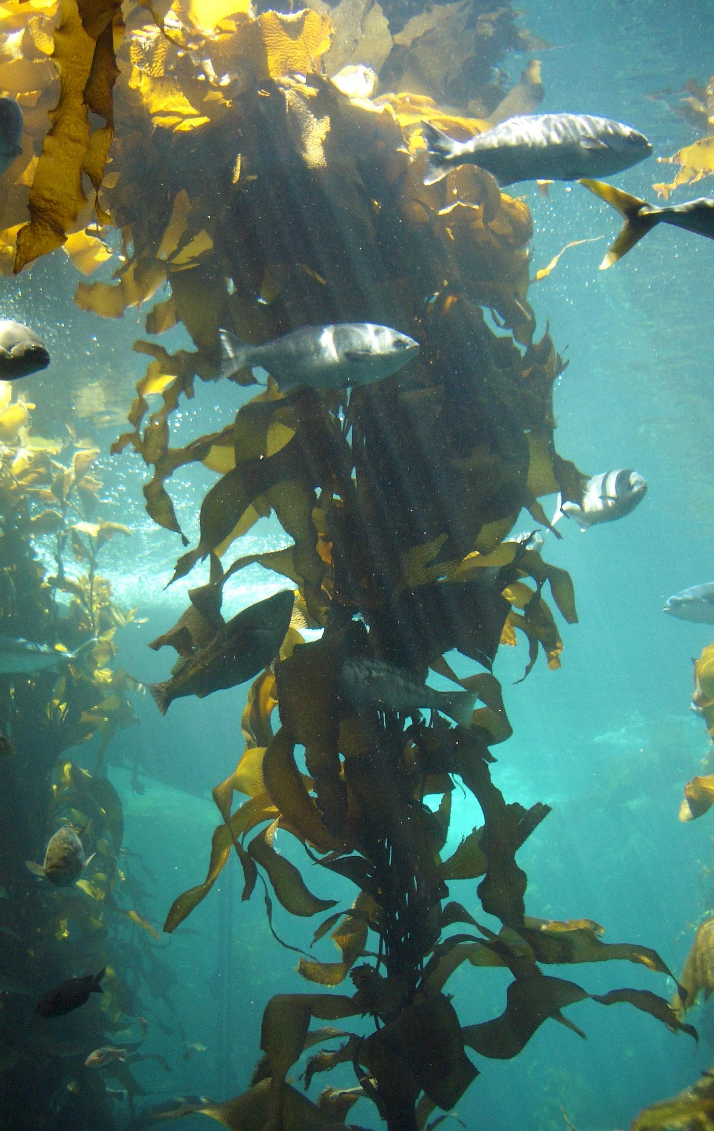
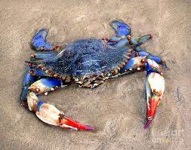
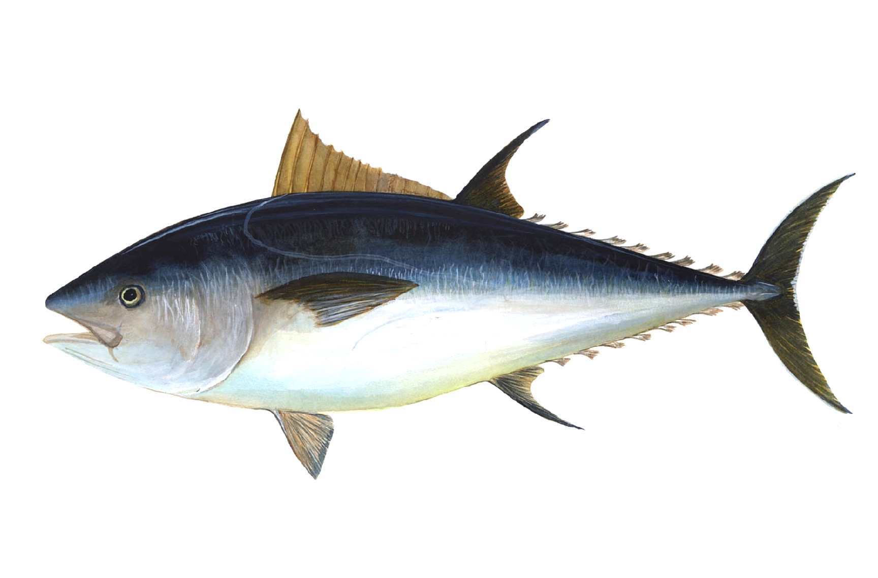
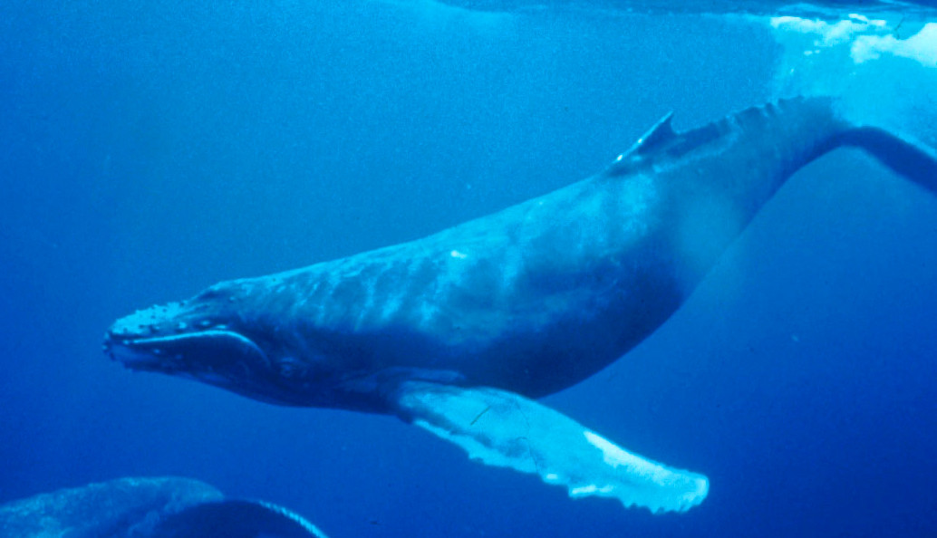
Why is salt water important to the natural environment?
Sea Kelp
Blue Crab
Whale
Tuna
Notes:
Why is salt water important to the natural environment?
[Salt water is important because it is an important environment for certain species. Species that live in salt water can’t live in freshwater.]

Slide 20
Fresh Water
Notes:
Now that we’ve reviewed, let’s define our new term, fresh water.

Slide 21
Fresh Water: water that does not have salt in it
Notes:
Fresh water is water that does not have salt in it. Sometimes we use the term fresh water to mean “not from the ocean.”
Feedback: Longer more formal definitions are tricky, use clear language when providing the new definition.

Slide 22
Notes:
Now let’s pause for a moment to check your understanding.

Slide 23
What is fresh water?
Notes:
What is fresh water?
[Fresh water is water that does not have salt in it.]

Slide 24
Notes:
That is the basic definition, but there is a bit more you need to know.

Slide 25
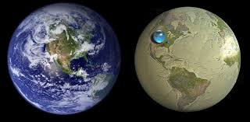
Fresh water less than 1%
Notes:
Unlike salt water, fresh water only makes up 2.5% of all water on Earth, and less than 1% of that is readily available for humans.

Slide 26
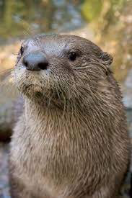
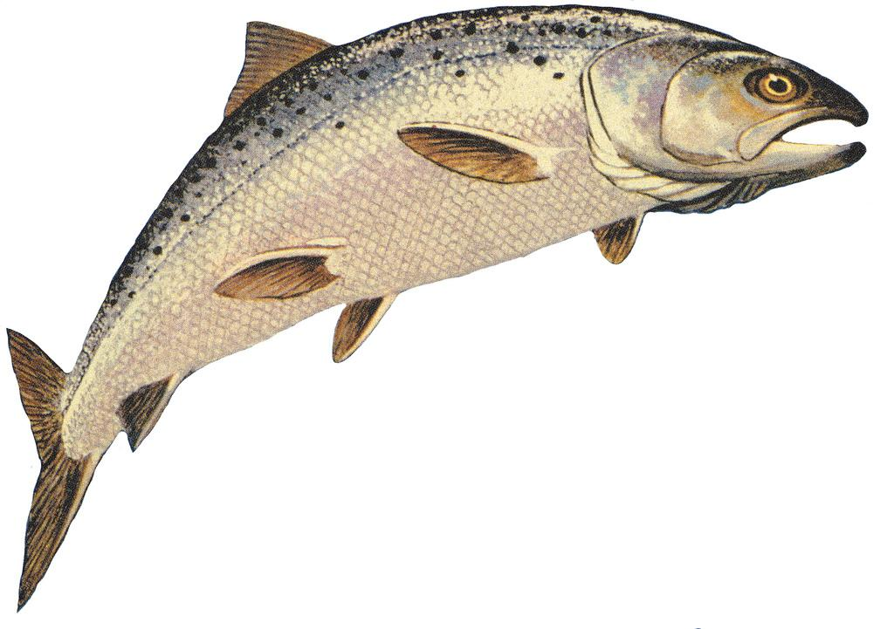
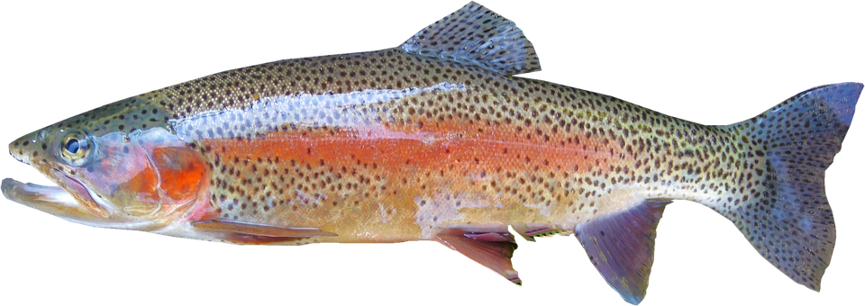
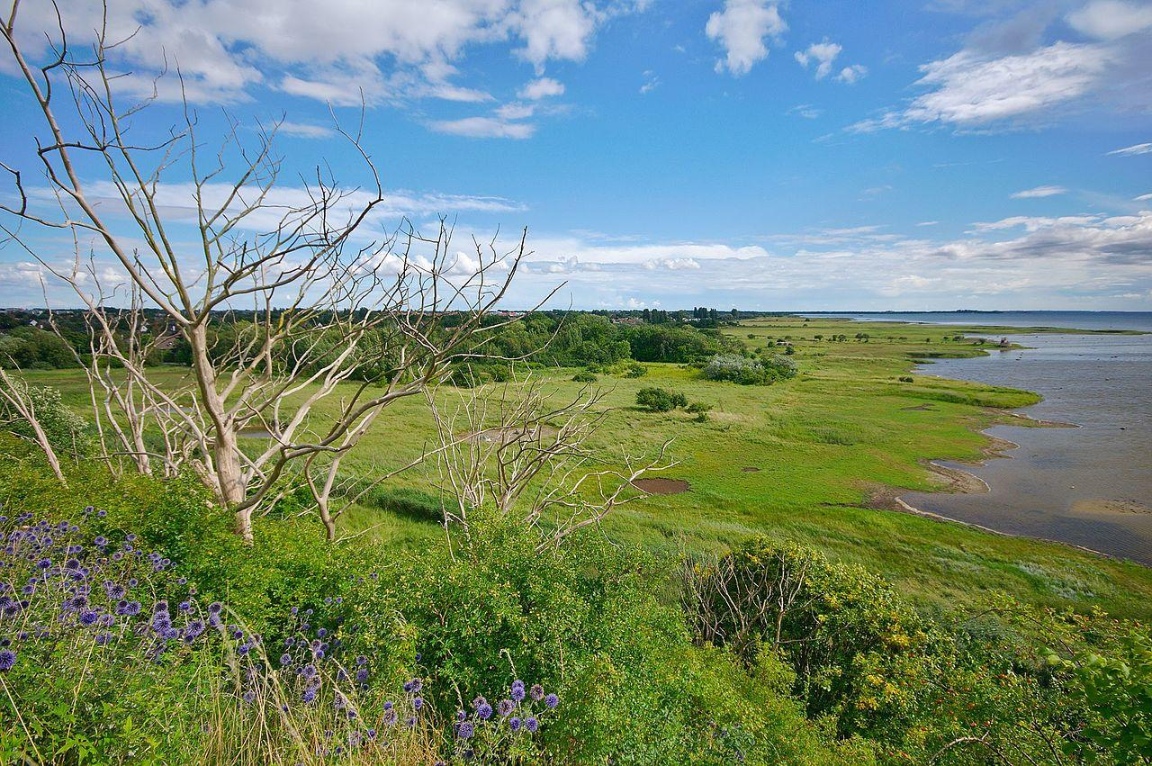
Fresh Water Species
River Otter
Salmon
Trout
Marsh
Notes:
Different species of fish and other organisms live in different kinds of water. Remember, freshwater species can’t live in salt water. There are also species of birds and other animals that depend on fresh water.

Slide 27
Notes:
We also need fresh water. Without fresh water, we can’t survive!

Slide 28
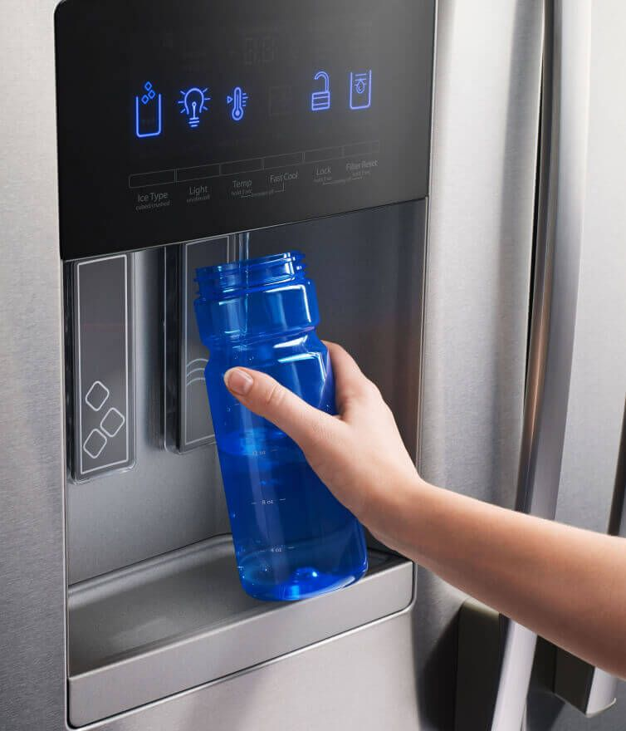
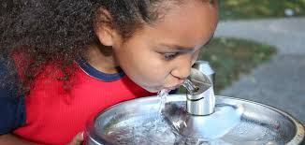
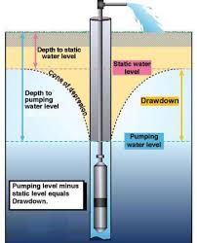
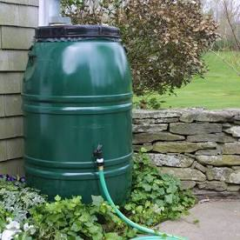
Accessing fresh and safe water
Notes:
Access to fresh water is essential for public health.
Drinking water comes into your house via pipes, boreholes, rainwater collection, and protected wells.

Slide 29
Notes:
Now let’s pause for a moment to check your understanding.
Feedback: You did a great job today by giving students opportunities to demonstrate their understanding. This assures that your students are able to understand the complicated formal definitions.

Slide 30
What is fresh water?
Notes:
What is fresh water?
[Water that does not have salt in it.]

Slide 31
How do we access fresh water for public use?
Notes:
How do we access freshwater for public use?
[Access to fresh water is essential for public health.
Drinking water comes into your house via pipes, boreholes, rainwater collection, and protected wells.]

Slide 32
How much fresh water is readily available to us?
Notes:
How much fresh water is readily available to us?
[Unlike salt water, fresh water only makes up 2.5% of all water on Earth, and less than 1% of that is readily available for humans.]

Slide 33
Notes:
Now, let’s talk about some examples of fresh water.
Feedback: Using clear and concise language is a great way to ensure students are able to follow along and understand the content.

Slide 34
Notes:
The Great Lakes (in blue) are an example of fresh water.

Slide 35
Notes:
Rivers are examples of fresh water.

Slide 36
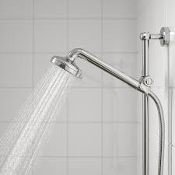
Notes:
Here is an example how we use freshwater in our homes.

Slide 37
Notes:
Now let’s pause for a moment to check your understanding.

Slide 38
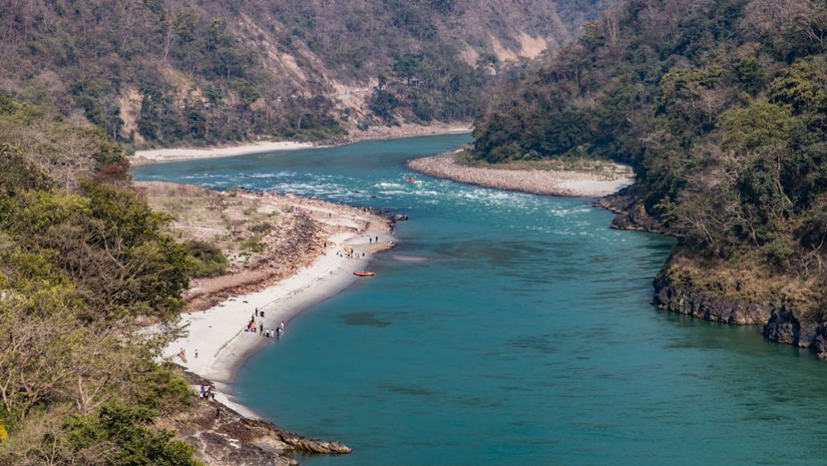
What are some examples of how you access freshwater daily?
Notes:
What are some examples of how you access freshwater daily?

Slide 39
Notes:
Next, let’s talk about some non-examples of fresh water.
Feedback: One important component of using non-examples is by clearly distinguishing similarities and explaining why it is a non-example.

Slide 40
Notes:
Oceans are not an example of fresh water. Oceans are salt water.

Slide 41
Notes:
Now let’s pause for a moment to check your understanding.
Feedback: It is good to review all the information once more at the end of the lesson. Ensure all students are participating in this part of the lesson.

Slide 42
Why are oceans not considered fresh water?
Notes:
Why are oceans not considered fresh water?
[Oceans are not an example of fresh water. Oceans are salt water.]

Slide 43
What is fresh water?
Notes:
What is fresh water?
[Fresh water is water that does not have salt in it. Sometimes we use the term fresh water to mean “not from the ocean.”]

Slide 44
Name an example of a fresh water species.
Notes:
Name an example of a fresh water species
[Salmon, river otter, trout, etc…]

Slide 45
What role does fresh water play in the environment?
River Otter
Salmon
Trout
Notes:
What role does fresh water play in the environment?
[Certain species need fresh water to survive. Although people don’t live in fresh water, we need it to survive!]

Slide 46
How do we access fresh water for public use?
Notes:
How do we access freshwater for public use?
[Access to fresh water is essential for public health.
Drinking water comes into your house via pipes, boreholes, rainwater collection, and protected wells.]

Slide 47
Remember!!!
Notes:
So remember!
Feedback: It is helpful to review key information once more before closing the lesson.

Slide 48
Fresh Water: water that does not have salt in it
Notes:
Fresh water is water that does not have salt in it. Sometimes we use the term fresh water to mean “not from the ocean.”

Slide 49
Simulation Activity
Availability of Fresh Water
In this simulation, students explore how water moves above and below Earth’s surface by using interactive computational models. Students will examine the supply and demand issues around local water sources and meet a hydrogeologist who introduces some of the issues around the sustainability of freshwater resources around the world.
Notes:
Feedback: Encourage students to use and analyze data. This is a great way to help them learn how to independently solve.

Slide 50
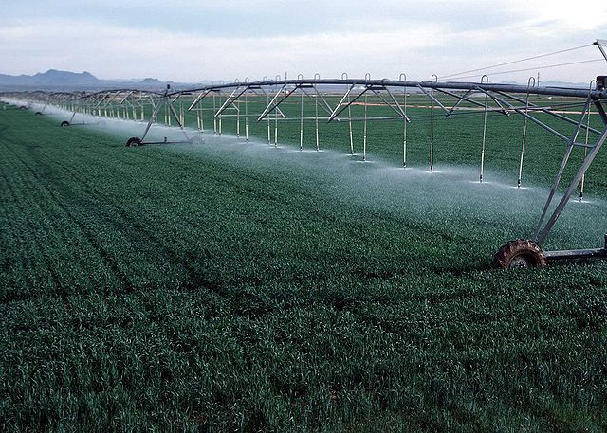
Simulation Activity
Using Fresh Water
In this simulation, students explore maps to discover the distribution of fresh water resources on Earth, and examine graphs to discover how fresh water supplies are used by humans.

Slide 51
Big Question: How is water important in your everyday life, how do you use it? What are some factors that impact the availability of water for humans?
Notes:
Explicit cue to revisit the big question at the end of the lesson: Okay everyone. Now that we’ve learned the term, let’s reflect once more on our big question. Was there anything that we predicted earlier that was correct or incorrect? Do you have any new hypotheses to share?

Slide 52
Notes:
Thanks for watching, and please continue watching CAPs available from this website.

Slide 53
This Video Was Created With Resources From:
Questions or Comments
Michael Kennedy, Ph.D. MKennedy@Virginia.edu
Rachel L Kunemund, Ph.D. rk8vm@virginia.edu

Slide 54
Intro
“Big Idea” Question
Review Concepts
Check-In Questions
Teacher Demo
Vocabulary
Student-Friendly Definition
Examples & Non-Examples
Morphological Word Parts
Simulation/Activity
Notes:
OK everyone, get ready for our next lesson. Just as a reminder, these are the different components that our lesson may include, and you’ll see these icons in the top left corner of each slide so that you can follow along more easily!

Slide 55
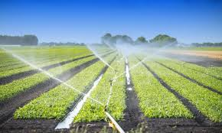
Agricultural Water
Intro
Notes:
Today, we will talk about agricultural water.

Slide 56
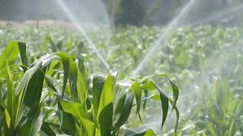
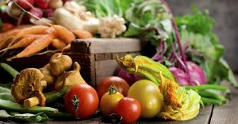
Big Question: How is water important for agricultural use, how may this impact your everyday life?
Notes:
Our “big question” is: How is water important for agricultural use, how may this impact your everyday life? [Pause and illicit predictions from students.]
I like all of these predictions! Keep thinking about how to answer our big questions as we learn more about water.

Slide 57
Notes:
Before we move on to our new vocabulary term, let’s review some other words & concepts that you already learned and make sure you are firm in your understanding.

Slide 58
Water: liquid made up of 2 hydrogen atoms and 1 oxygen atom
O
H
H
Notes:
Water is a liquid made up of 2 hydrogen atoms and 1 oxygen atom. Water is essential for life.

Slide 59
Salt Water: water that has a very large amount of salt in it
Notes:
Salt water is water that has a very large amount of salt in it. On earth, salt water is mostly found in oceans.

Slide 60
Fresh Water: water that does not have salt in it
Notes:
Fresh water is water that does not have salt in it. Sometimes we use the term fresh water to mean “not from the ocean.”

Slide 61
Notes:
Now let’s pause for a moment to check your understanding.

Slide 62
Why is water polar?
-
O
+
+
H
H
Notes:
Why is water polar?
[When oxygen and hydrogen bond, the side with oxygen is negative and the side with hydrogen is positive, so one side is negative and the other is positive.]

Slide 63
Why is salt water important to the natural environment?
Sea Kelp
Blue Crab
Whale
Tuna
Notes:
Why is salt water important to the natural environment?
[Salt water is important because it is an important environment for certain species. Species that live in salt water can’t live in fresh water.]

Slide 64
How do we access fresh water for public use?
Notes:
How do we access freshwater for public use?
[Access to fresh water is essential for public health.
Drinking water comes into your house via pipes, boreholes, rainwater collection, and protected wells.]

Slide 65
Agricultural Water
Notes:
Now that we’ve reviewed, let’s define our new term, agricultural water.

Slide 66
Agricultural Water: water used for food/agricultural purposes such as irrigation, pesticide and fertilizer applications, and to protect crops from cold weather/frost
Notes:
Agricultural water is used for irrigation, pesticide and fertilizer applications, and to protect crops from cold weather/frost.
Feedback: Longer more formal definitions are tricky, use clear language when providing the new definition.

Slide 67
Notes:
Now let’s pause for a moment to check your understanding.

Slide 68
What is agricultural water?
Notes:
What is agricultural water?
[Agricultural water is water used for food/agricultural purposes such as irrigation, pesticide and fertilizer applications and to protect crops from cold weather/frost.]

Slide 69
Notes:
That is the basic definition, but there is a bit more you need to know.

Slide 70
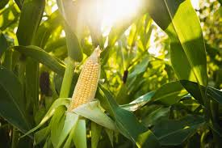
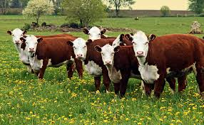
Notes:
Agricultural water is used for growing food/crops and to take care of livestock (farm animals).

Slide 71
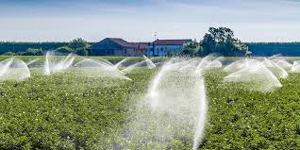
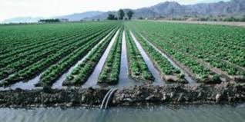
Irrigation: a system that allows you to apply certain amounts of water to plants, used for helping crops grow and thrive
Notes:
Much of the water used for crops comes from irrigation. Irrigation is a system that allows you to apply certain amounts of water to plants, used for helping crops grow and thrive.
Rain water alone may not be enough or occur regularly enough for crops to thrive, think about different climates and environments too. If it is very hot we may need to use water more frequently to protect the crops from drying out or if too cold to keep them from freezing.

Slide 72
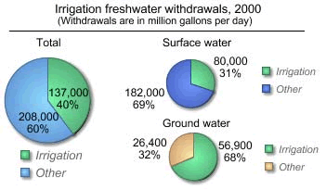
Notes:
Agricultural water comes from several sources - much of it comes from irrigation which comes from ground and surface water.

Slide 73
Notes:
Now let’s pause for a moment to check your understanding.

Slide 74
What is agricultural water? Why is it important?
Notes:
What is agricultural water? Why is it important?
[Agricultural water is used for irrigation, pesticide and fertilizer applications, and to protect crops from cold weather/frost.]

Slide 75
What is irrigation and how is it used for farming and agriculture?
Notes:
What is irrigation and how is it used for farming and agriculture?
[Much of the water used for crops comes from irrigation. Irrigation is a system that allows you to apply certain amounts of water to plants, used for helping crops grow and thrive.]

Slide 76
Notes:
Now, let’s talk about some examples of agricultural water.

Slide 77
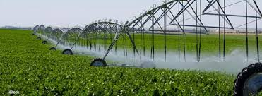
Notes:
Here is an example of an irrigation system, specifically drip irrigation, to deliver controlled amounts of water to crops.

Slide 78
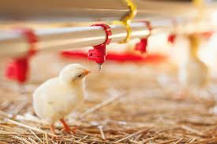
Notes:
This is an example of how livestock, in this case poultry access and drink water for agriculture.

Slide 79
Notes:
Now let’s pause for a moment to check your understanding.

Slide 80
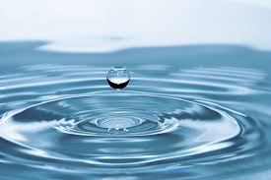
Name another example of how water may used for agriculture/on a farm?
Notes:
Name another example of how water may used for agriculture/on a farm?
(Give students a few minutes to brainstorm some ideas.)

Slide 81
Notes:
Next, let’s talk about some non-examples of agricultural water.

Slide 82
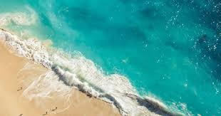
Notes:
Oceans are not an example of agricultural water. Oceans are salt water. The salt could be damaging to crops or animals.

Slide 83
Notes:
Now let’s pause for a moment to check your understanding.

Slide 84
Why wouldn’t we want to use salt water for agricultural crops?
Notes:
Why wouldn’t we want to use salt water for agricultural crops?

Slide 85
What is agricultural water? Why is it important to us?
Notes:
What is agricultural water? Why is it important to us?
[Agricultural water is used for irrigation, pesticide and fertilizer applications, and to protect crops from cold weather/frost.]

Slide 86
What are some sources of agricultural water?
Notes:
What are some sources for agricultural water?
[Irrigation from ground or surface water]

Slide 87
Why do we need to use irrigation in farms, can’t we just depend on rain water?
Notes:
Why do we need to use irrigation in farms, can’t we just depend on rain water?

Slide 88
Notes:
So remember!

Slide 89
Agricultural Water: water used for food/agricultural purposes such as irrigation, pesticide and fertilizer applications, and to protect crops from cold weather/frost
Notes:
Agricultural water is used for irrigation, pesticide and fertilizer applications, and to protect crops from cold weather/frost.

Slide 90
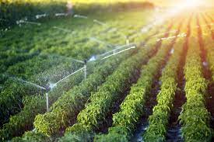
Simulation Activity
Irrigation Ideas
This lesson explores how civil engineering has solved the challenge of moving water using irrigation. Students work in teams to design and build their own “irrigation system” out of everyday items.
Notes:
This lesson explores how civil engineering has solved the challenge of moving water using irrigation. Students work in teams to design and build their own “irrigation system” out of everyday items.
Feedback: Engineering design problems are great for getting students to problem solve and engage in inquiry based activities.

Slide 91
Big Question: How is water important for agricultural use, how may this impact your everyday life?
Notes:
Explicit cue to revisit the big question at the end of the lesson: Okay everyone. Now that we’ve learned the term, let’s reflect once more on our big question. Was there anything that we predicted earlier that was correct or incorrect? Do you have any new hypotheses to share?

Slide 92
Notes:
Thanks for watching, and please continue watching CAPs available from this website.

Slide 93
This Video Was Created With Resources From:
Questions or Comments
Michael Kennedy, Ph.D. MKennedy@Virginia.edu
Rachel L Kunemund, Ph.D. rk8vm@virginia.edu

Slide 94
Intro
“Big Idea” Question
Review Concepts
Check-In Questions
Teacher Demo
Vocabulary
Student-Friendly Definition
Examples & Non-Examples
Morphological Word Parts
Simulation/Activity
Notes:
OK everyone, get ready for our next lesson. Just as a reminder, these are the different components that our lesson may include, and you’ll see these icons in the top left corner of each slide so that you can follow along more easily!

Slide 95
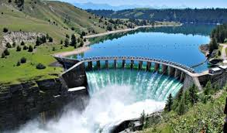
Hydroelectric Power
Intro
Notes:
Today we will talk about hydroelectric power.

Slide 96
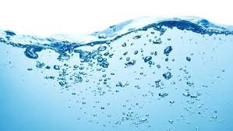
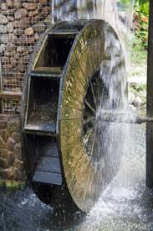
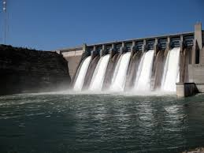
Big Question: How could you use water to power something in your everyday life?
Notes:
Our “big question” is: How could you use water to power something in your everyday life?? [Pause and illicit predictions from students.]
I like all of these predictions! Keep thinking about how to answer our big questions as we learn more about water.

Slide 97
Notes:
Before we move on to our new vocabulary term, let’s review some other words & concepts that you already learned and make sure you are firm in your understanding.

Slide 98
Water: liquid made up of 2 hydrogen atoms and 1 oxygen atom
O
H
H
Notes:
Water is a liquid made up of 2 hydrogen atoms and 1 oxygen atom. Water is essential for life.

Slide 99
Salt Water: water that has a very large amount of salt in it
Notes:
Salt water is water that has a very large amount of salt in it. On earth, salt water is mostly found in oceans.

Slide 100
Fresh Water: water that does not have salt in it
Notes:
Fresh water is water that does not have salt in it. Sometimes we use the term fresh water to mean “not from the ocean.”

Slide 101
Agricultural Water: water used for food/agricultural purposes such as irrigation, pesticide and fertilizer applications, and to protect crops from cold weather/frost
Notes:
Agricultural water is used for irrigation, pesticide and fertilizer applications, and to protect crops from cold weather/frost.

Slide 102
Notes:
Now let’s pause for a moment to check your understanding.

Slide 103
Why is water polar?
-
O
+
+
H
H
Notes:
Why is water polar?
[When oxygen and hydrogen bond, the side with oxygen is negative and the side with hydrogen is positive, so one side is negative and the other is positive.]

Slide 104
Why is salt water important to the natural environment?
Sea Kelp
Blue Crab
Whale
Tuna
Notes:
Why is salt water important to the natural environment?
[Salt water is important because it is an important environment for certain species. Species that live in salt water can’t live in fresh water.]

Slide 105
Why is freshwater important for public use?
Notes:
Why is fresh and safe water important for public use?
[Allow students a few minutes to brainstorm some ideas.
Access to drinking water, cooking, bathroom, washing, etc.]

Slide 106
What is agricultural water? Why is it important to us?
Notes:
What is agricultural water? Why is it important to us?
[Agricultural water is used for irrigation, pesticide and fertilizer applications, and to protect crops from cold weather/frost.]

Slide 107
Hydroelectric Power
Notes:
Now that we’ve reviewed, let’s define our new term, hydroelectric power.

Slide 108
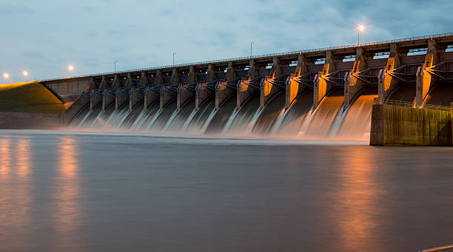
Hydroelectric Power: process of storing and using water in dams and rivers to generate electricity
Notes:
Hydroelectric Power is the process of storing and using water in dams and rivers to generate electricity.

Slide 109
Notes:
Now let’s pause for a moment to check your understanding.

Slide 110
What is hydroelectric power?
Notes:
What is hydroelectric power?
[Hydroelectric power is the process of storing and using water in dams and rivers to generate electricity.]

Slide 111
Notes:
That is the basic definition, but there is a bit more you need to know.

Slide 112
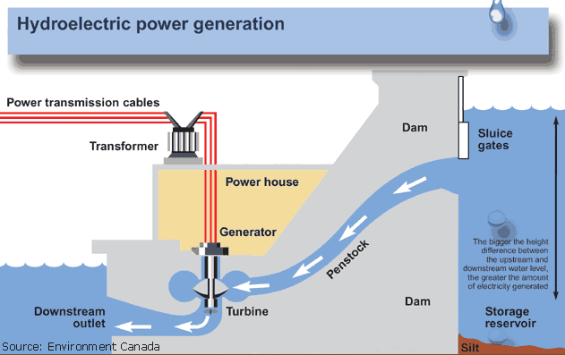
Notes:
The electricity generated by the dam or river is used to power hydropower plants.

Slide 113
Notes:
The incoming water spins the turbine blades, which then rotates a generator. This mechanical energy is converted into electrical energy.

Slide 114
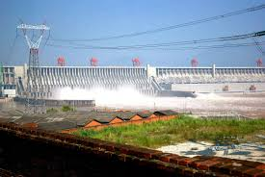
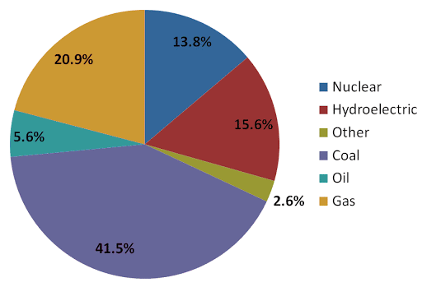
Notes:
Hydropower makes up about 16% of the world’s total electricity production.

Slide 115
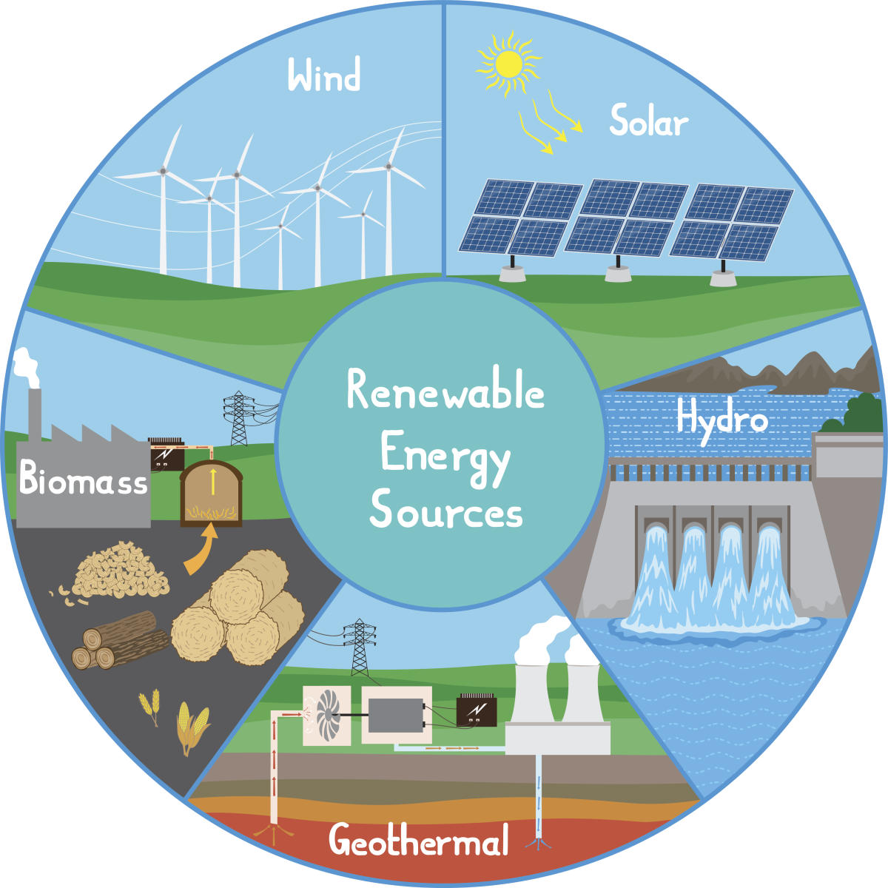
Notes:
Hydropower is a renewable energy.

Slide 116
Notes:
Now let’s pause for a moment to check your understanding.

Slide 117
What is hydroelectric power?
Notes:
What is hydroelectric power?
[Hydroelectric Power is the process of storing and using water in dams and rivers to generate electricity.]

Slide 118
How is electricity generated using hydroelectric power?
How is electricity generated using hydroelectric power?
Notes:
How is electricity generated using hydroelectric power?

Slide 119
Notes:
Now, let’s talk about some examples of hydroelectric power.

Slide 120
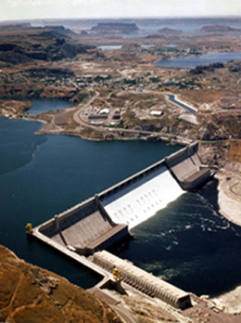
Notes:
The Grand Coulee Dam in Washington State is one of the largest concrete structures in the world.

Slide 121
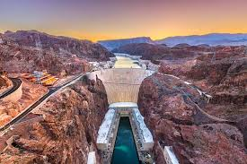
Notes:
The Hoover dam is located between Nevada and Arizona and protects several states from massive floods.

Slide 122
Notes:
Here you can include non-examples of hydroelectric power.

Slide 123
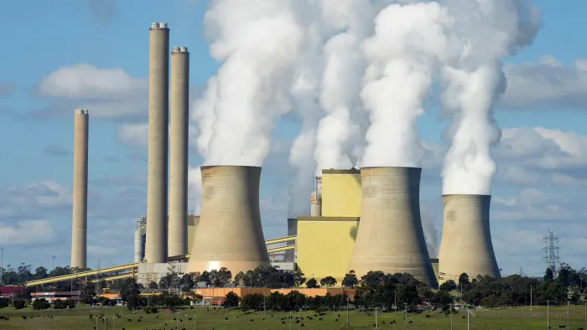
Notes:
This is not an example of hydroelectric power. It is an example of a power plant powered by coal.

Slide 124
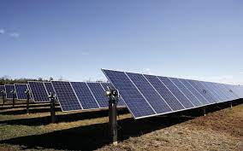
Notes:
This is not an example of hydroelectric power. It is an example of a power plant powered by solar energy.

Slide 125
Notes:
Now let’s pause for a moment to check your understanding.

Slide 126
Which of these is an example of hydropower? How can you tell?
Notes:
Which of these is an example of hydropower? How can you tell?

Slide 127
Which of these is an example of hydropower? How can you tell?
Notes:
Which of these is an example of hydropower? How can you tell?
[This dam is an example of hydropower while the other is a power plant. You can tell because of the water flowing in through the hydropower plant to generate electricity.]

Slide 128
Notes:
To think about the definition of hydroelectric power, it is helpful to look at its word parts.
Feedback: It is important to break down the vocabulary term into word parts and define each part, this is essential in building student understanding of the word parts.

Slide 129
Hydroelectric
Hydro
electric
Notes:
Let’s break the word hydroelectric into two word parts, hydro and electric.

Slide 130
Hydroelectric
Hydro
electric
Water
Notes:
The word hydro typically means water.

Slide 131
Hydroelectric
Hydro
electric
Electric power or electricity
Notes:
The second part of the word, electric, can commonly refer to electric power or electricity.

Slide 132
Hydro
electric
Hydroelectric
Electric power from water
Notes:
So putting together hydro and electric can mean electricity or electric power from water.
Feedback: Reuniting the word parts is a crucial step in helping students understand the whole picture when reviewing morphological word parts.

Slide 133
Notes:
Now let’s pause for a moment to check your understanding.

Slide 134
How can we use the word parts of hydroelectric to help us remember the definition of the term?
Hydroelectric
Hydro
electric
Notes:
How can we use the word parts of hydroelectric to help us remember the definition of the term?
[Let’s break the word hydroelectric into two word parts, hydro and electric.
The word hydro typically means water.
The second part of the word, electric, can commonly refer to electric power or electricity.
So putting together hydro and electric can mean electricity or electric power from water.]

Slide 135
What is hydroelectric power?
Notes:
What is hydroelectric power?
[Hydroelectric Power is the process of storing and using water to in dams and rivers to generate electricity.]

Slide 136
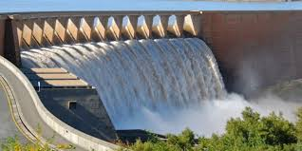
True/False: Hydroelectric power is a renewable energy source.
Notes:
True/False: Hydroelectric power is a renewable energy source.

Slide 137
True/False: Hydroelectric power is a renewable energy source.
Notes:
True/False: Hydroelectric power is a renewable energy source.

Slide 138
How is electricity generated using hydroelectric power?
How is electricity generated using hydroelectric power?
Notes:
How is electricity generated using hydroelectric power?

Slide 139
Notes:
So remember!

Slide 140
Hydroelectric Power: process of storing and using water in dams and rivers to generate electricity
Notes:
Hydroelectric Power is the process of storing and using water in dams and rivers to generate electricity.

Slide 141
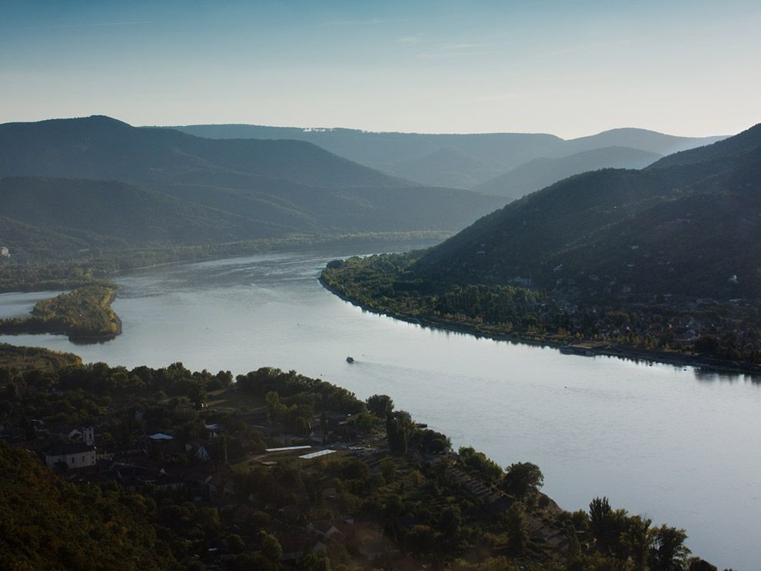
Simulation Activity
Rivers and the Gabčíkovo-Nagymaros Project
Students read about a project to dam the Danube River for hydroelectric power and flood control, and the conflicts that surround the project. Then students take on stakeholder roles and imagine they will present their point of view about how the conflict can be solved to the International Court of Justice. They present to their classmates.
Notes:
Feedback: Having students take a side and form a position is a great way to encourage critical thinking.

Slide 142
Big Question: How could you use water to power something in your everyday life?
Notes:
Explicit cue to revisit the big question at the end of the lesson: Okay everyone. Now that we’ve learned the term, let’s reflect once more on our big question. Was there anything that we predicted earlier that was correct or incorrect? Do you have any new hypotheses to share?

Slide 143
Notes:
Thanks for watching, and please continue watching CAPs available from this website.

Slide 144
This Video Was Created With Resources From:
Questions or Comments
Michael Kennedy, Ph.D. MKennedy@Virginia.edu
Rachel L Kunemund, Ph.D. rk8vm@virginia.edu

