Slide 1
Intro
“Big Idea” Question
Review Concepts
Check-In Questions
Teacher Engagement
Vocabulary
Student-Friendly Definition
Examples & Non-Examples
Morphological Word Parts
Frayer Model
Simulation/Activity
Notes:
OK everyone, get ready for our next lesson. Just as a reminder, these are the different components that our lesson may include, and you’ll see these icons in the top left corner of each slide so that you can follow along more easily!

Slide 2
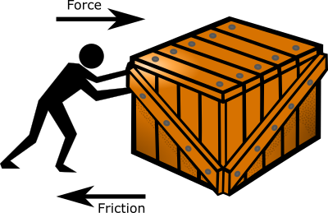
Intro
Friction
Notes:
Today, we’ll be learning about the word: Friction.

Slide 3
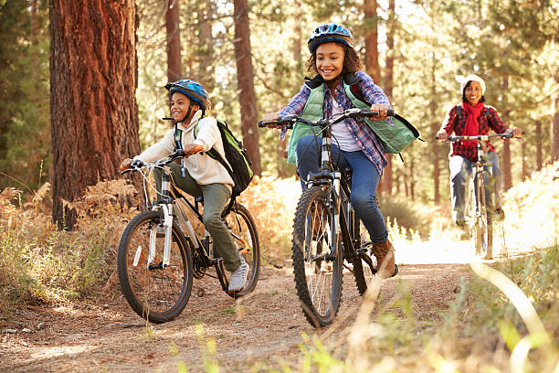
Big Question: How do friction and resistance impact the way objects move through the world?
Notes:
Our “big question” is: How do friction and resistance impact the way objects move through the world?
[Pause and illicit predictions from students.]
I love all these thoughtful scientific hypotheses! Be sure to keep this question and your predictions in mind as we move through these next few lessons, and we’ll continue to revisit it.

Slide 4
Notes:
Before we move on to our new topic, let’s review some other words & concepts that you already learned and make sure you are firm in your understanding.

Slide 5
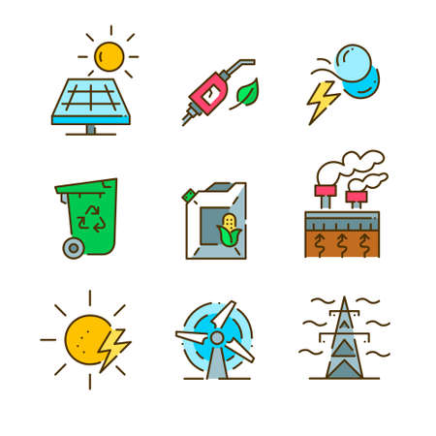
Energy: the ability to cause change
Notes:
Energy is the ability to cause change.

Slide 6
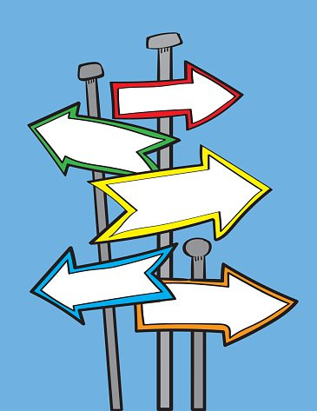
Direction: where something moves or points
Notes:
Direction is where something moves or points.

Slide 7
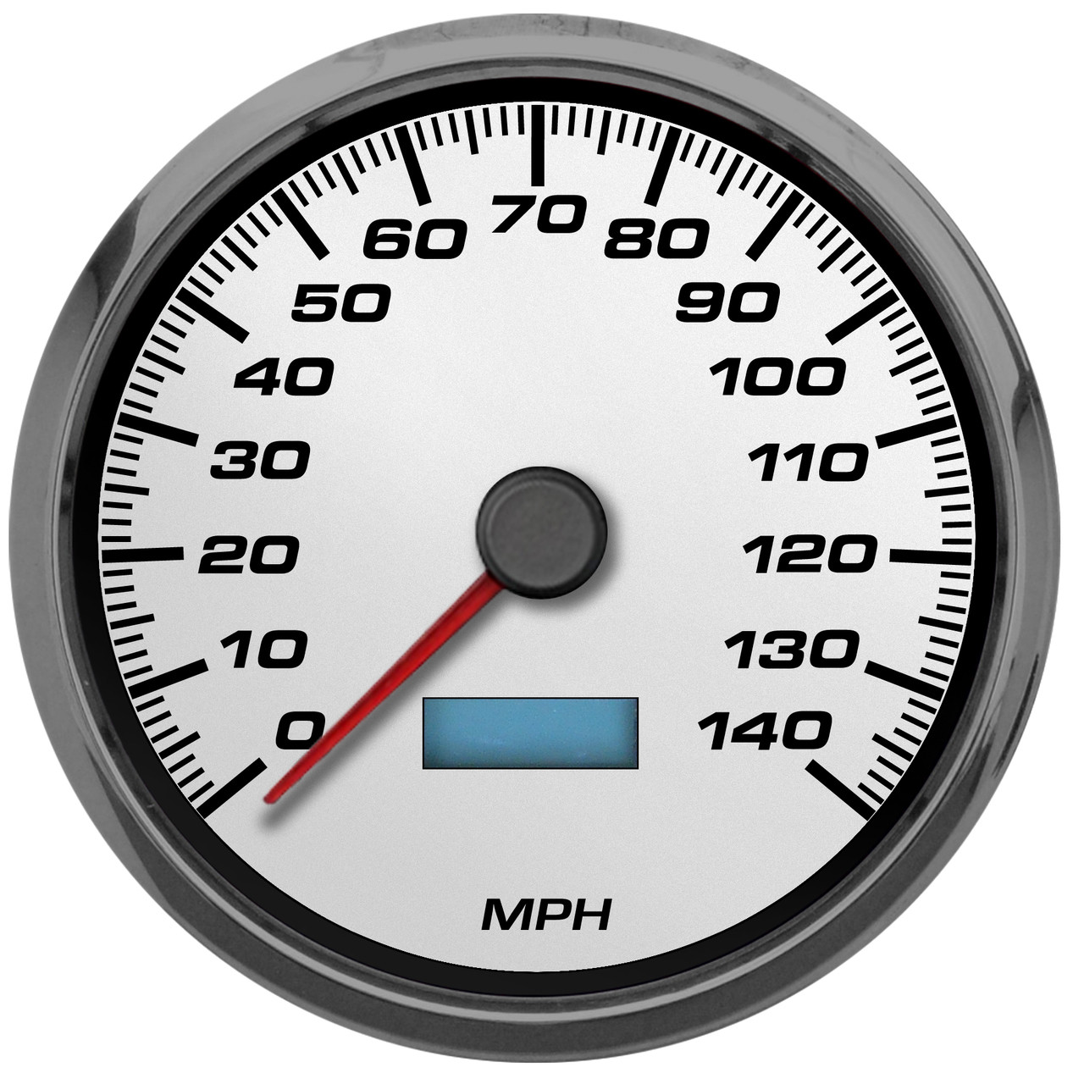
Speed: how fast an object moves
Notes:
Speed is how fast an object moves.

Slide 8
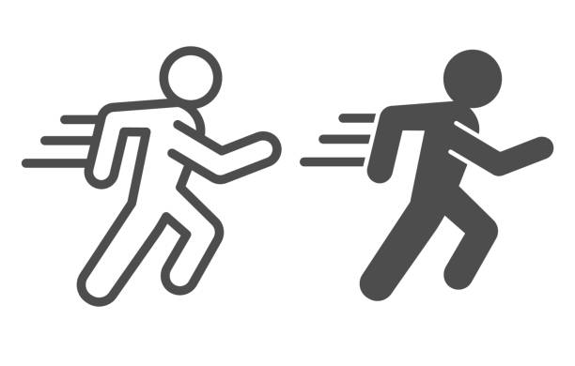
Motion: an object’s direction and speed
Notes:
Motion is an object’s direction and speed.

Slide 9
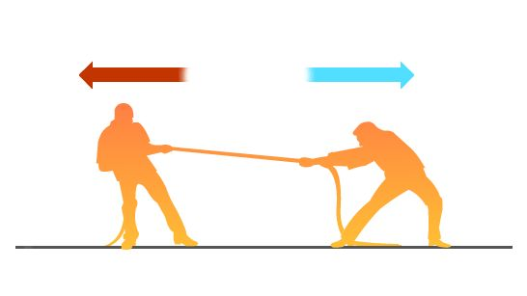
Force: any push or pull that causes an object to move, stop, or change direction.
Notes:
A force is any push or pull that causes an object to move, stop, or change direction.

Slide 10
Notes:
Now let’s pause for a moment to review the information we have covered already.

Slide 11
Energy is the ability to cause ____________.
Work
Change
Distance
Notes:
Energy is the ability to cause ____________.
[B. Change]

Slide 12
Energy is the ability to cause ____________.
Work
Change
Distance
Notes:
Energy is the ability to cause change.

Slide 13
___________ is where something moves or points.
Speed
Force
Direction
Notes:
_____ is where something moves or points.
[C. Direction]

Slide 14
___________ is where something moves or points.
Speed
Force
Direction
Notes:
Direction is where something moves or points.

Slide 15
What is speed?
Notes:
What is speed?
[Speed is how fast something moves.]

Slide 16
Motion is ___________ and __________.
Notes:
Motion is _________ and __________.
[Direction / Speed]

Slide 17
Motion is direction and speed.
Notes:
Motion is direction and speed.

Slide 18
A force is adding or taking away energy that causes objects to melt or freeze.
True
False
Notes:
True or False: A force is adding or taking away energy that causes objects to melt or freeze.
[False]

Slide 19
A force is adding or taking away energy that causes objects to melt or freeze.
True
False
Notes:
False: A force is a push or pull that causes an object to move, stop, or change direction.

Slide 20
Friction
Notes:
Now that we’ve reviewed, let’s define the word friction.

Slide 21
Friction: a force that opposes the motion of an object.
Notes:
Friction is a force that opposes the motion of an object.

Slide 22
Notes:
Let’s check-in for understanding.

Slide 23
What is friction?
Notes:
What is friction?
[A force that opposes the motion of an object]

Slide 24
Notes:
That is the basic definition, but there is a bit more you need to know.

Slide 25
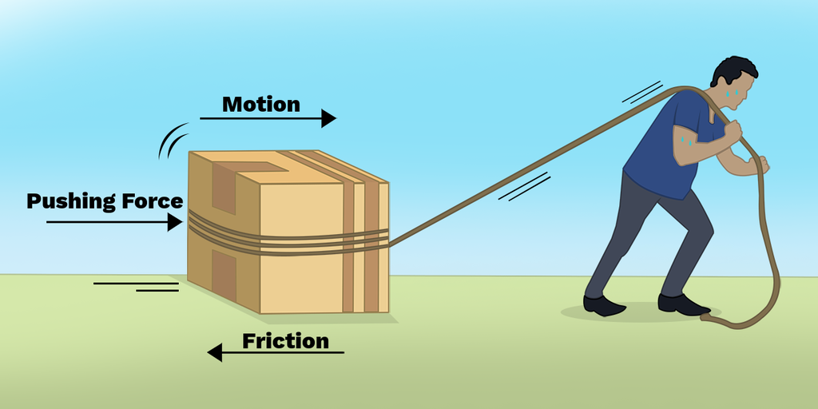
Notes:
Friction is a force that happens when two objects rub against each other. When an object is moving in a certain direction, friction pushes against the object in the opposite direction. This causes the object to slow down and eventually stop.

Slide 26
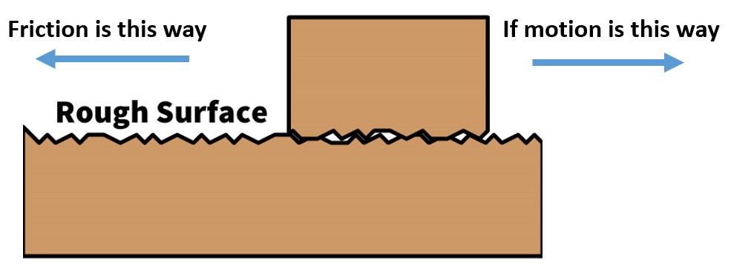
Notes:
Friction is created when two rough surfaces come into contact. Even surfaces that seem very smooth have small bumps that can create friction! The rougher the objects are, the more friction is created between them.

Slide 27
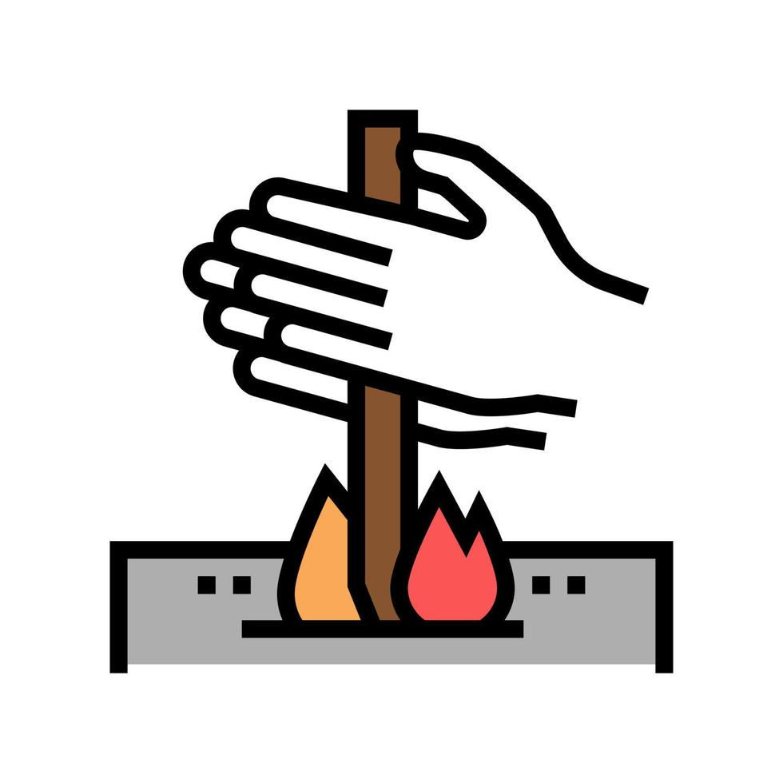
Notes:
As the two surfaces push and pull against each other, they release a little energy in the form of heat. For example, when you rub two sticks together, the friction produces enough heat that it can start a fire.

Slide 28
Notes:
Let’s check-in for understanding.

Slide 29
Friction pushes in the ________ direction of an object’s motion.
Same
Opposite
Notes:
Friction pushes in the _____ direction of an object’s motion.
[B. Opposite]

Slide 30
Friction pushes in the ________ direction of an object’s motion.
Same
Opposite
Notes:
Friction pushes in the opposite direction of an object’s motion.

Slide 31
What causes friction?
Notes:
What causes friction?
[Two rough surfaces coming into contact]

Slide 32
What causes friction?
Notes:
What causes friction? Two rough surfaces coming into contact.

Slide 33
Friction between two objects can produce _______________.
Notes:
Friction between two objects can produce _____________.
[Heat]

Slide 34
Friction between two objects can produce heat.
Notes:
Friction between two objects can produce heat.

Slide 35
Notes:
Now, let’s talk about some examples of friction.

Slide 36
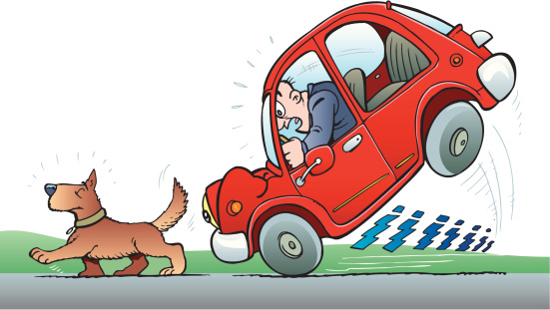
Notes:
A car’s brakes is an example of friction. When the driver steps on the pedal, the brakes create friction with the car wheels. This causes the car to slow down and eventually stop.

Slide 37
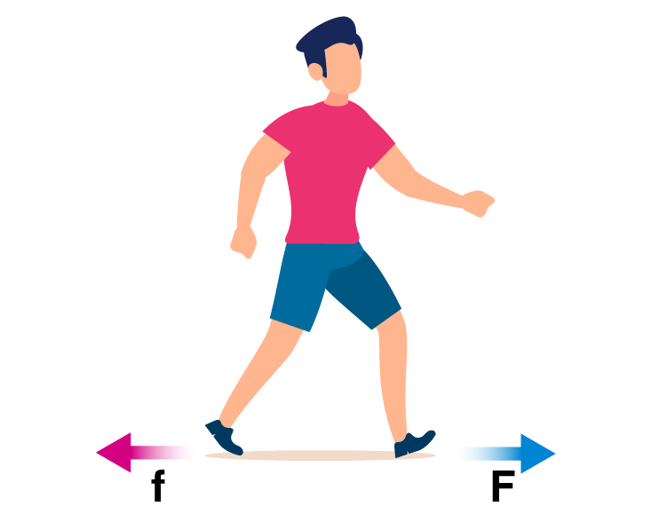
Notes:
Walking is another example of friction. When we walk, our shoes create friction with the road. This helps our feet from slipping when we take our next step.

Slide 38
Notes:
Now, let’s talk about some non-examples of friction.

Slide 39
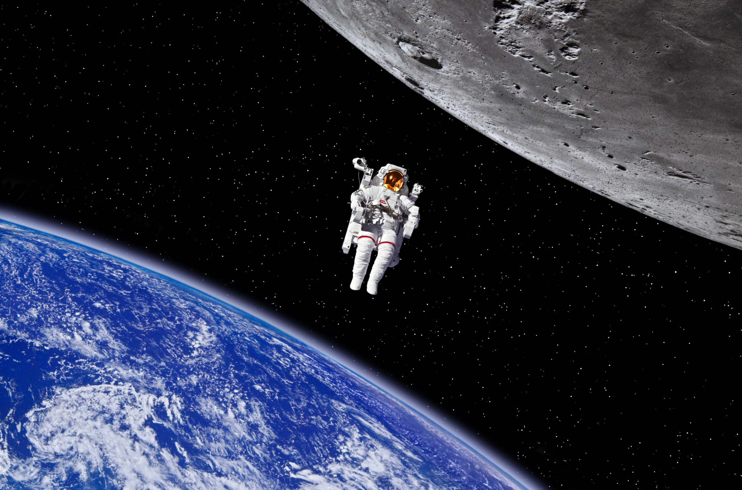
Notes:
This is a non-example of friction. An astronaut in space doesn’t experience friction because there is no air or other materials to rub up against in space. This makes movement in space easier and smoother than on Earth.

Slide 40
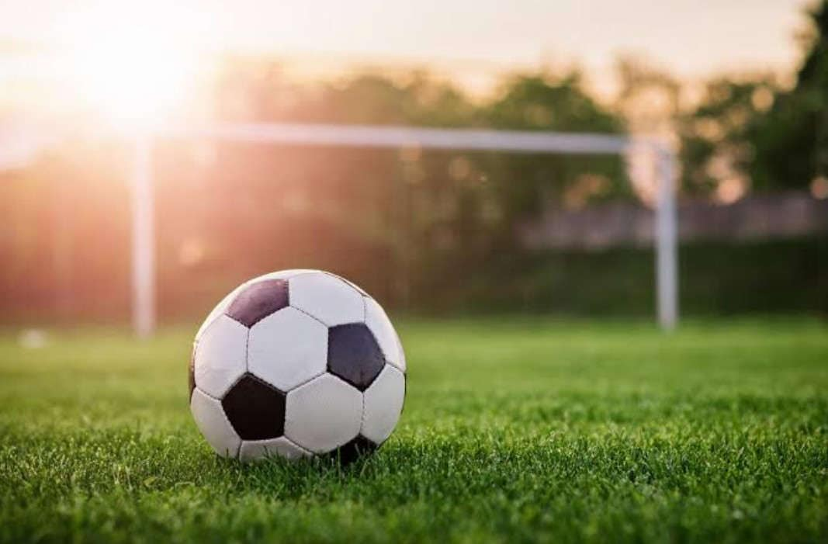
Notes:
Here is another non-example of friction. The ball is not in motion, so it is not rubbing up against the grass or another surface. Without movement, no friction is created.

Slide 41
Notes:
Now let’s pause for a moment to check your understanding.

Slide 42
What is friction?
Notes:
What is friction?
[A force that opposes the motion of an object]

Slide 43
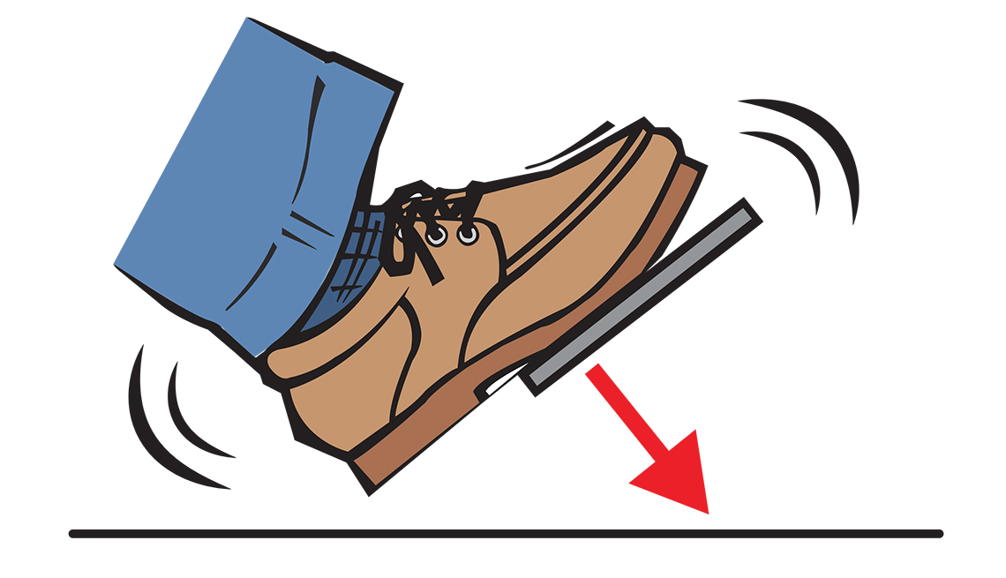
Which one is NOT an example of a friction?
Car Brakes
Making Fire
Still
Ball
Notes:
Which one is NOT an example of a friction?
[a still ball]

Slide 44
Which one is NOT an example of a friction?
Car Brakes
Making Fire
Still
Ball
Notes:
Which one is NOT an example of a friction? A still ball

Slide 45
Notes:
We can also break down the term friction into different word parts to help us remember the meaning. Let’s take a look!

Slide 46
Friction
(root word)
(suffix)
Notes:
We can break up the term variable into two parts: a root word and a suffix.

Slide 47
Friction
Fric = rub
Notes:
First, we have the root word “fric” which means "rub”.

Slide 48
Friction
-tion = an action, process, or result
Notes:
Next, we have the suffix “-tion”. This means something “an action, process or result”

Slide 49
Fric tion
Friction
the action, process, or result of rubbing
Notes:
So when we put it all together, friction means the action, process, or result of rubbing. Friction is created when two objects rub together.

Slide 50
Remember!!!
Notes:
So remember!

Slide 51
Friction: a force that opposes the motion of an object
Notes:
Friction is a force that opposes the motion of an object.

Slide 52
Notes:
We will now complete this concept map, called a Frayer model, to summarize and further clarify what you have learned about the term friction.

Slide 53
Definition
Picture
Friction
Example
How does friction impact my life?
Notes:
To complete the Frayer model, we will choose from four choices the correct picture, definition, example, and response to the question, “How does friction impact my life?” Select the best response for each question using the information you just learned. As we select responses, we will see how this model looks filled in for the term friction.

Slide 54
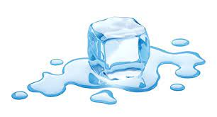
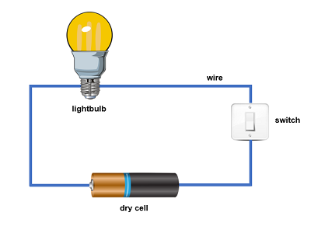
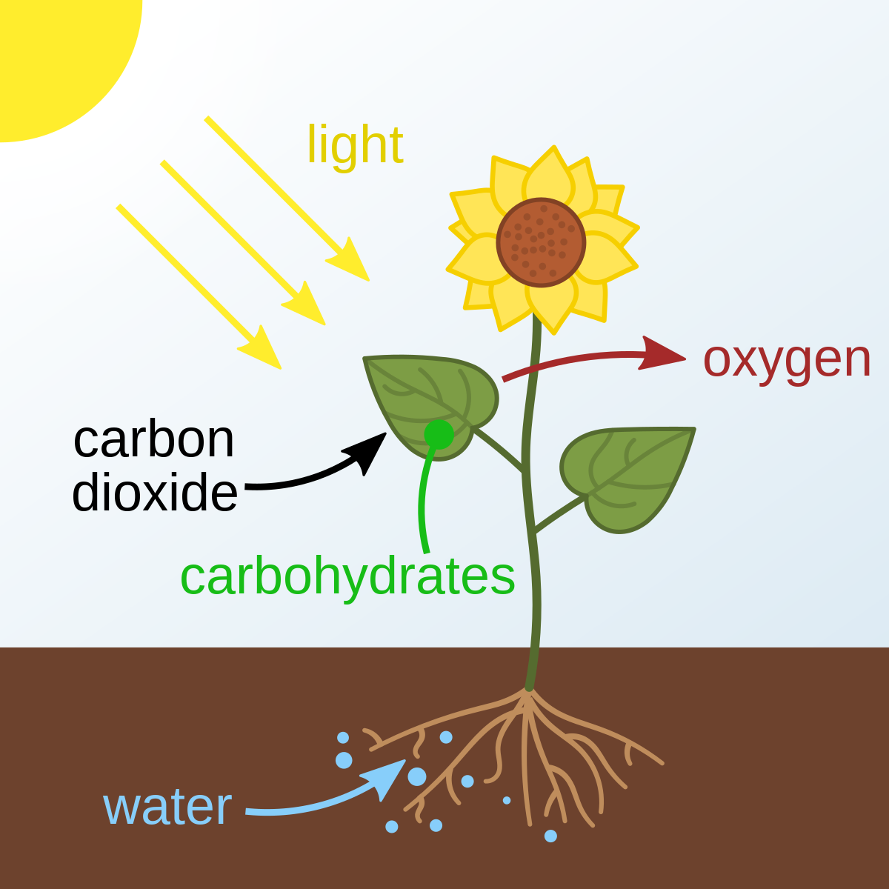
Directions: Choose the correct picture of friction from the choices below.
A
B
C
D
Notes:
Choose the one correct picture of friction from these four choices.

Slide 55
Directions: Choose the correct picture of friction from the choices below.
A
B
C
D
Notes:
This is the picture that shows friction.

Slide 56
Definition
Picture
Friction
Example
How does friction impact my life?
Notes:
Here is the Frayer model filled in with a picture of friction.

Slide 57
Directions: Choose the correct definition of friction from the choices below.
A
the process of breaking down rock over long periods of time
B
anything that has mass and takes up space
C
an electric current can follow only one path
D
a force that opposes the motion of an object
Notes:
Choose the one correct definition of friction from these four choices.

Slide 58
Directions: Choose the correct definition of friction from the choices below.
A
the process of breaking down rock over long periods of time
B
anything that has mass and takes up space
C
an electric current can follow only one path
D
a force that opposes the motion of an object
Notes:
“A force that opposes the motion of an object against another surface” is correct! This is the definition of friction.

Slide 59
Definition
Picture
a force that opposes the motion of an object
Friction
Example
How does friction impact my life?
Notes:
Here is the Frayer Model with a picture and the definition filled in for friction: a force that opposes the motion of an object.

Slide 60
Directions: Choose the correct example of friction from the choices below.
A
A pot of water that boils on the stove
B
A light bulb that lights up when the switch is turned on
C
A child using the brakes on their bicycle
D
A thunderstorm producing rain and lightning
Notes:
Choose the one correct example of friction from these four choices.

Slide 61
Directions: Choose the correct example of friction from the choices below.
A
A pot of water that boils on the stove
B
A light bulb that lights up when the switch is turned on
C
A child using the brakes on their bicycle
D
A thunderstorm producing rain and lightning
Notes:
“A child using the brakes on their bicycle” is correct! This is an example of friction.

Slide 62
Definition
Picture
a force that opposes the motion of an object
Friction
A child using the brakes on their bicycle
Example
How does friction impact my life?
Notes:
Here is the Frayer Model with a picture, definition, and an example of friction: a child using the brakes on their bicycle.

Slide 63
Directions: Choose the correct response for “how does friction impact my life?” from the choices below.
A
Friction helps our ears to vibrate so we can hear sound in our environment.
B
Friction is an important nutrient found in plants that animals need to get energy and stay healthy.
C
Friction helps keep Earth orbiting around the Sun so we experience all four seasons.
Friction helps us move around our world safely by helping us slow down and stop.
D
Notes:
Choose the one correct response for “how does friction impact my life?” from these four choices.

Slide 64
Directions: Choose the correct response for “how does friction impact my life?” from the choices below.
A
Friction helps our ears to vibrate so we can hear sound in our environment.
B
Friction is an important nutrient found in plants that animals need to get energy and stay healthy.
C
Friction helps keep Earth orbiting around the Sun so we experience all four seasons.
Friction helps us move around our world safely by helping us slow down and stop.
D
Notes:
“Friction helps us move around our world safely by helping us slow down and stop. ” That is correct! This is an example of how friction impacts your life.

Slide 65
Definition
Picture
a force that opposes the motion of an object
Friction
Friction helps us move around our world safely by helping us slow down and stop.
A child using the brakes on their bicycle
Example
How does friction impact my life?
Notes:
Here is the Frayer Model with a picture, definition, example, and a correct response to “how does friction impact my life?”:

Slide 66
Remember!!!
Notes:
So remember!

Slide 67
Friction: a force that opposes the motion of an object.
Notes:
Friction is a force that opposes the motion of an object.

Slide 68
Big Question: How do friction and resistance impact the way objects move through the world?
Notes:
Let’s reflect again on our big question. Our “big question” is: How do friction and resistance impact the way objects move through the world?

Slide 69
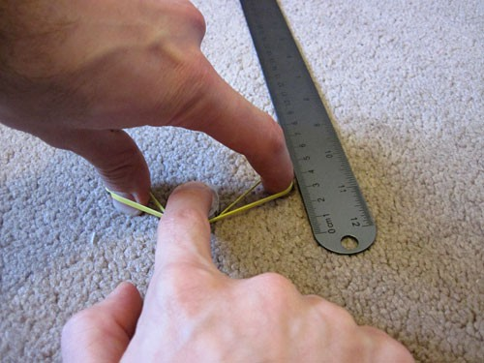
Simulation Activity
Friction Experiment
In this experiment, you will test the friction created when objects slides across different kinds of surfaces.
Make a hypothesis:
What kinds of surfaces (bumpy, smooth, etc.) will create the most friction? Which will create the least? Why?

Slide 70
Intro
“Big Idea” Question
Review Concepts
Check-In Questions
Teacher Engagement
Vocabulary
Student-Friendly Definition
Examples & Non-Examples
Morphological Word Parts
Frayer Model
Simulation/Activity
Notes:
OK everyone, get ready for our next lesson. Just as a reminder, these are the different components that our lesson may include, and you’ll see these icons in the top left corner of each slide so that you can follow along more easily!

Slide 71
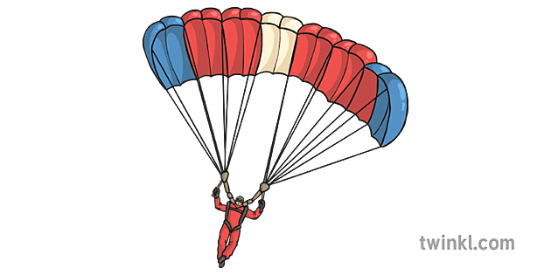
Resistance
Intro
resistance
gravity
Notes:
Today, we’ll be learning about the word: Resistance.

Slide 72
Big Question: How do friction and resistance impact the way objects move through the world?
Notes:
Our “big question” is: How do friction and resistance impact the way objects move through the world?
[Pause and illicit predictions from students.]
I love all these thoughtful scientific hypotheses! Be sure to keep this question and your predictions in mind as we move through these next few lessons, and we’ll continue to revisit it.

Slide 73
Notes:
Before we move on to our new topic, let’s review some other words & concepts that you already learned and make sure you are firm in your understanding.

Slide 74
Motion: an object’s direction and speed
Notes:
Motion is an object’s direction and speed.

Slide 75
Force: any push or pull that causes an object to move, stop, or change direction.
Notes:
A force is any push or pull that causes an object to move, stop, or change direction.

Slide 76
Friction: a force that opposes the motion of an object.
Notes:
Friction is a force that opposes the motion of an object.

Slide 77
Notes:
Now let’s pause for a moment to review the information we have covered already.

Slide 78
___________ is an object’s direction and speed.
Notes:
__________ is an object’s direction and speed.
[Motion]

Slide 79
Motion is an object’s direction and speed.
Notes:
Motion is an object’s direction and speed.

Slide 80
Force is any ______ or _______ that causes an object to move, stop, or change direction.
Notes:
Force is any ______ or _____ that causes an object to move, stop, or change direction.

Slide 81
Force is any push or pull that causes an object to move, stop, or change direction.
Notes:
Force is any push or pull that causes an object to move, stop, or change direction.

Slide 82
What is a force that opposes the motion of an object?
Work
Energy
Friction
Notes:
What is a force that opposes the motion of an object?
[C. Friction]

Slide 83
What is a force that opposes the motion of an object?
Work
Energy
Friction
Notes:
What is a force that opposes the motion of an object?
[C. Friction]

Slide 84
Resistance
Notes:
Now that we’ve reviewed, let’s define the phrase resistance.

Slide 85
Resistance: the force that tries to stop or slow down the movement of an object.
resistance
gravity
Notes:
Resistance is the force that tried to stop or slow down the movement of an object.

Slide 86
Notes:
Let’s check-in for understanding.

Slide 87
What is resistance?
resistance
gravity
Notes:
What is resistance?
[the force that tried to stop or slow down the movement of an object]

Slide 88
Notes:
That is the basic definition, but there is a bit more you need to know.

Slide 89
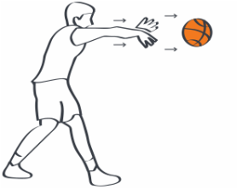
Notes:
Resistance happens when any object is in motion. If an object is thrown, like this basketball, resistance pushes against the object in the opposite direction. This causes the ball to eventually slow down and stop. Without resistance, the ball would continue on forever!

Slide 90
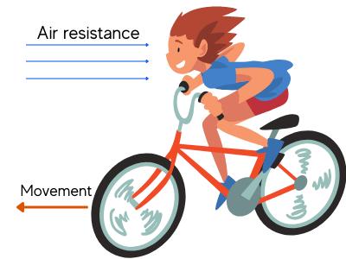
Notes:
Resistance is a special kind of friction. Remember, friction is a force that opposes the motion of the object when two surfaces are rubbing together. In resistance, the object is in contact with either air or water that causes it to slow down or stop.

Slide 91
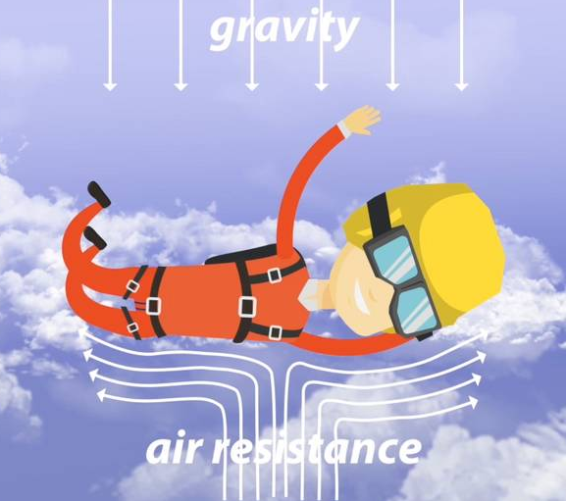
Notes:
Air resistance happens whenever an object is in motion through the air. As the force of gravity pulls the sky diver to the ground, air resistance pushes up against the sky diver to slow them down.

Slide 92
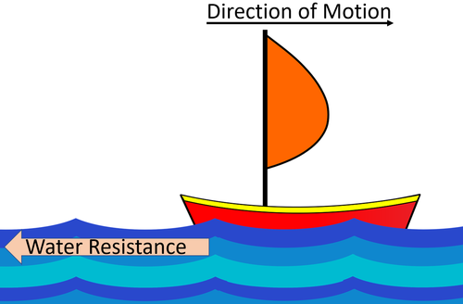
Notes:
Water resistance is another kind of resistance. As the sail boat moves through the water, the water pushes back against the boat. The wind in the sail helps keep the boat in motion. Without the wind, water resistance will eventually stop the boat.

Slide 93
Notes:
Let’s check-in for understanding.

Slide 94
Resistance pushes in the opposite direction of an object’s motion.
True
False
Notes:
True or False: Resistance pushes in the opposite direction of an object’s motion.
[True]

Slide 95
Resistance pushes in the opposite direction of an object’s motion.
True
False
Notes:
Resistance pushes in the opposite direction of an object’s motion. True

Slide 96
Resistance is a special kind of ______________.
Friction
Energy
Work
Notes:
Resistance is a special kind of ___________.
[friction]

Slide 97
Resistance is a special kind of ______________.
Friction
Energy
Work
Notes:
Resistance is a special kind of ___________. A. Friction

Slide 98
How does air resistance help a sky diver slow down?
Notes:
How does air resistance help a sky diver slow down?
[It pushes up against gravity and that causes them to slow down]

Slide 99
Notes:
Now, let’s talk about some examples of resistance.

Slide 100
Resistance
Notes:
Here is an example of resistance. As an airplane flies through the air, air resistance pushes against the airplane. The airplane uses its engines to keep the airplane in motion.

Slide 101
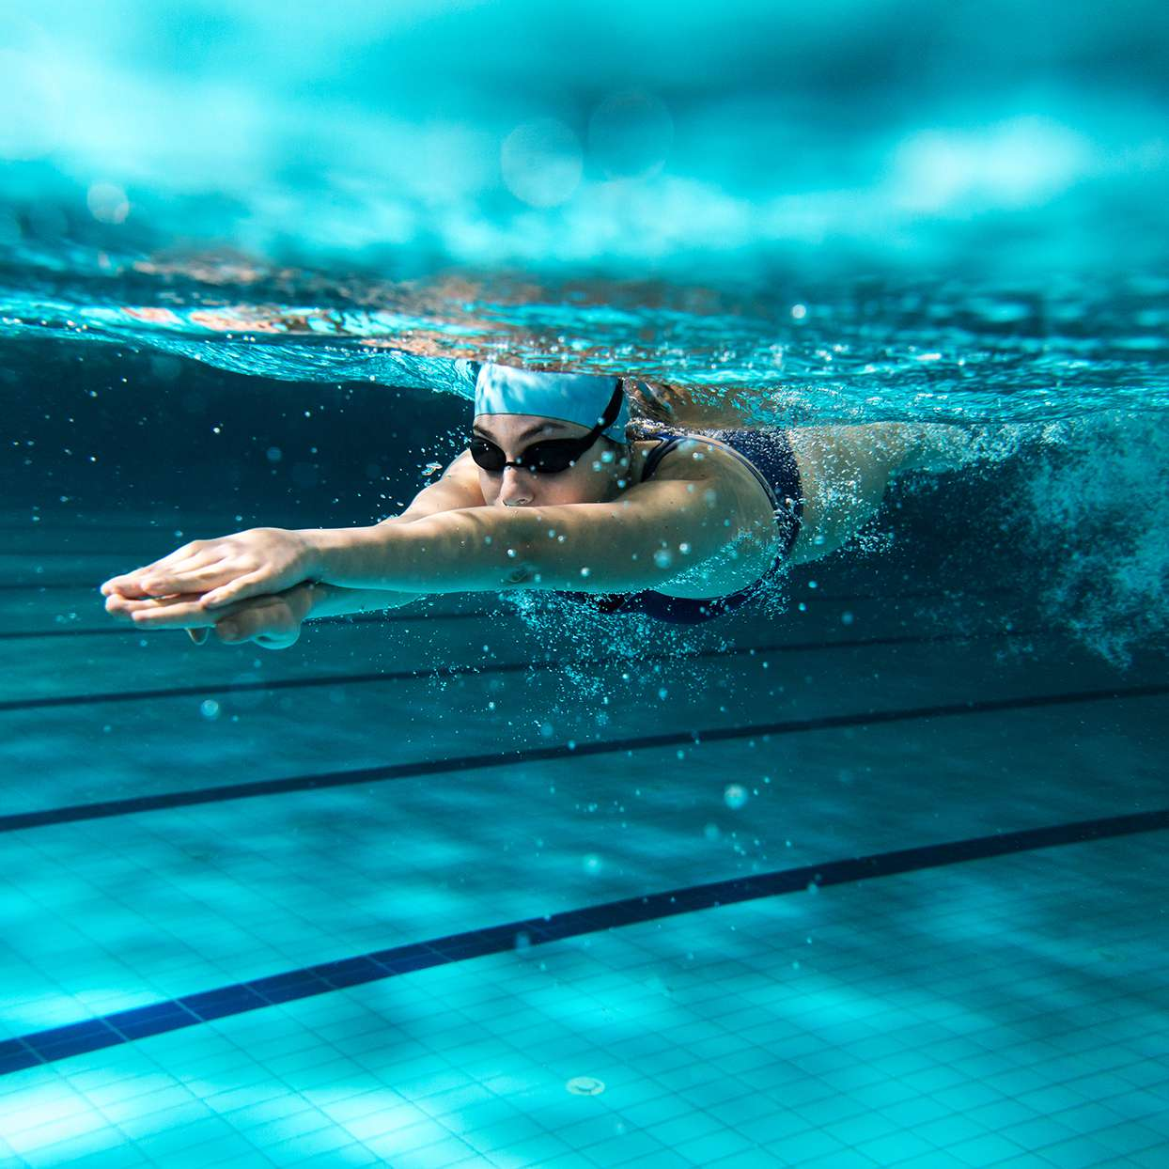
Notes:
Here is another example of resistance. When we move through water, the particles in water are pushing against us. Our leg and arm muscles have to work hard to keep our motion going, otherwise the resistance would eventually make us stop.

Slide 102
Notes:
Now, let’s talk about some non-examples of resistance.

Slide 103
Notes:
Here is a non-example of resistance. The mug sitting on the table is at rest. Because the mug is not in motion, there is no resistance.

Slide 104
Notes:
Watching TV is another non-example of resistance. The images on the screen are not in motion through air or space, so they do not experience resistance.

Slide 105
Notes:
Now let’s pause for a moment to check your understanding.

Slide 106
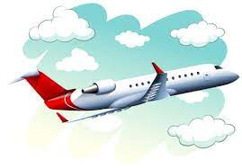
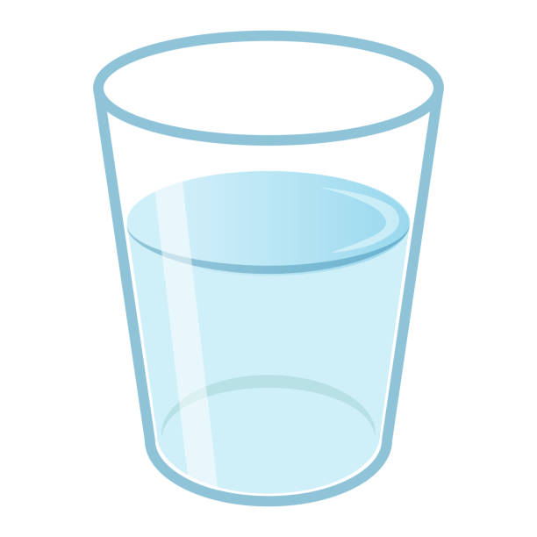
Find an example of resistance
Airplane flying
Glass of water
Book on a table
Notes:
Find an example of resistance.
[airplane flying]

Slide 107
Find an example of resistance
Airplane flying
Glass of water
Book on a table
Notes:
Find an example of resistance. Airplane flying.

Slide 108
Notes:
We can also break down the term resistance into different word parts to help us remember the meaning. Let’s take a look!

Slide 109
Resistance
(root)
(suffix)
Notes:
We can break up the term resistance into two parts: root and suffix.

Slide 110
Resistance
Resist = to act against or oppose
Notes:
First, we have the root word “resist” which means "to act against or oppose”.

Slide 111
Resistance
-ance= the state or quality of
Notes:
Next, we have the suffix “-ance”. This means something “the state or quality of”

Slide 112
Resist ance
Resistance
the state of opposing or acting against
Notes:
So when we put it all together, resistance means the state of opposing or acting against. Resistance opposes, or acts against, an object in motion to slow it down.

Slide 113
Remember!!!
Notes:
So remember!

Slide 114
Resistance: the force that tries to stop or slow down the movement of an object.
resistance
gravity
Notes:
Resistance is the force that tried to stop or slow down the movement of an object.

Slide 115
Notes:
We will now complete this concept map, called a Frayer model, to summarize and further clarify what you have learned about the term resistance.

Slide 116
Definition
Picture
Resistance
Example
How does resistance impact my life?
Notes:
To complete the Frayer model, we will choose from four choices the correct picture, definition, example, and response to the question, “How does resistance impact my life?” Select the best response for each question using the information you just learned. As we select responses, we will see how this model looks filled in for the term resistance.

Slide 117
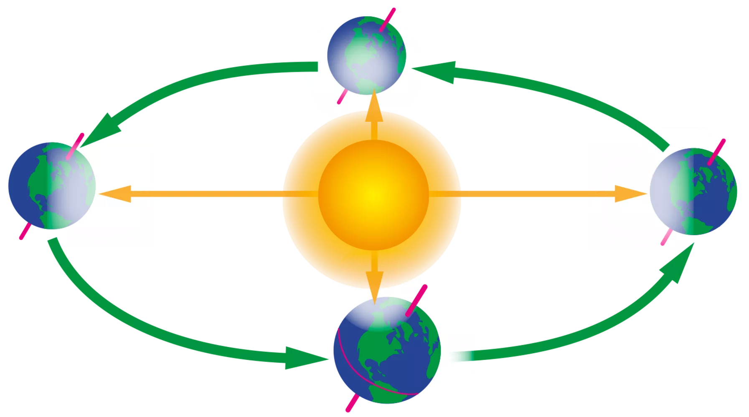
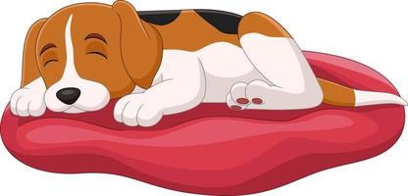
Directions: Choose the correct picture of resistance from the choices below.
A
B
C
D
Notes:
Choose the one correct picture of resistance from these four choices.

Slide 118
Directions: Choose the correct picture of resistance from the choices below.
A
B
C
D
Notes:
This is the picture that shows resistance.

Slide 119
Definition
Picture
Resistance
Example
How does resistance impact my life?
Notes:
Here is the Frayer model filled in with a picture of resistance.

Slide 120
Directions: Choose the correct definition of resistance from the choices below.
A
smallest whole unit of matter
B
energy that is carried by vibration of one or more objects or particles
C
energy in an electric current
D
the force that tries to stop or slow down the movement of an object.
Notes:
Choose the one correct definition of resistance from these four choices.

Slide 121
Directions: Choose the correct definition of resistance from the choices below.
A
smallest whole unit of matter
B
energy that is carried by vibration of one or more objects or particles
C
energy in an electric current
D
the force that tries to stop or slow down the movement of an object.
Notes:
“The force that tries to stop or slow down the movement of an object” is correct! This is the definition of resistance.

Slide 122
Definition
Picture
the force that tries to stop or slow down the movement of an object.
Resistance
Example
How does resistance impact my life?
Notes:
Here is the Frayer Model with a picture and the definition filled in for resistance: the force that tries to stop or slow down the movement of an object.

Slide 123
Directions: Choose the correct example of resistance from the choices below.
A
A sailboat moving through the water
B
A lamp resting on a table
C
A flower growing in a garden
D
Soundwaves vibrating our eardrums
Notes:
Choose the one correct example of resistance from these four choices.

Slide 124
Directions: Choose the correct example of resistance from the choices below.
A
A sailboat moving through the water
B
A lamp resting on a table
C
A flower growing in a garden
D
Soundwaves vibrating our eardrums
Notes:
“A sailboat moving through the water” is correct! This is an example of resistance.

Slide 125
Definition
Picture
the force that tries to stop or slow down the movement of an object.
Resistance
A sailboat moving through the water
Example
How does resistance impact my life?
Notes:
Here is the Frayer Model with a picture, definition, and an example of resistance: a sailboat moving through the water.

Slide 126
Directions: Choose the correct response for “how does resistance impact my life?” from the choices below.
A
Resistance is the smallest building block to life, including our own bodies.
B
Resistance creates a protective layer around the Earth so we don’t get too much light or heat from the Sun.
C
Resistance affects how people and things move through our world. It helps us slow down and stay safe.
Resistance give plants the light energy they need to make food. This energy then helps power our own bodies.
D
Notes:
Choose the one correct response for “how does resistance impact my life?” from these four choices.

Slide 127
Directions: Choose the correct response for “how does resistance impact my life?” from the choices below.
A
Resistance is the smallest building block to life, including our own bodies.
B
Resistance creates a protective layer around the Earth so we don’t get too much light or heat from the Sun.
C
Resistance affects how people and things move through our world. It helps us slow down and stay safe.
Resistance give plants the light energy they need to make food. This energy then helps power our own bodies.
D
Notes:
“ Resistance affects how people and things move through our world. It helps us slow down and stay safe.” That is correct! This is an example of how resistance impacts your life.

Slide 128
Definition
Picture
the force that tries to stop or slow down the movement of an object.
Resistance
Resistance affects how people and things move through our world. It helps us slow down and stay safe.
A sailboat moving through the water
Example
How does resistance impact my life?
Notes:
Here is the Frayer Model with a picture, definition, example, and a correct response to “how does resistance impact my life?”: Resistance affects how people and things move through our world. It helps us slow down and stay safe.

Slide 129
Remember!!!
Notes:
So remember!

Slide 130
Resistance: the force that tries to stop or slow down the movement of an object.
resistance
gravity
Notes:
Resistance is the force that tried to stop or slow down the movement of an object.

Slide 131
Big Question: How do friction and resistance impact the way objects move through the world?
Notes:
Let’s reflect again on our big question. Our “big question” is: How do friction and resistance impact the way objects move through the world?

Slide 132
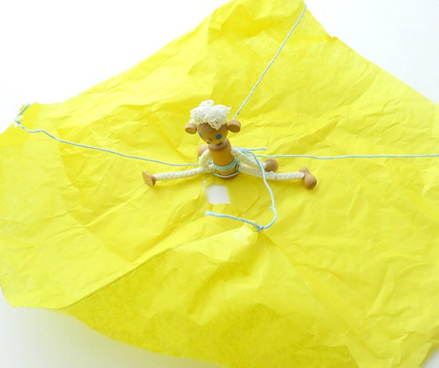
Demonstration Activity
Make a Parachute
In this demonstration, you will build your own parachute.
How does the parachute use air resistance to help the figure land safely?

Slide 133
Notes:
Thanks for watching, and please continue watching CAPs available from this website.

Slide 134
This Was Created With Resources From:
Questions or Comments
Michael Kennedy, Ph.D. MKennedy@Virginia.edu
Rachel L Kunemund, Ph.D. rk8vm@virginia.edu

