Slide 1
Intro
“Big Idea” Question
Review Concepts
Check-In Questions
Teacher Demo
Vocabulary
Student-Friendly Definition
Examples & Non-Examples
Morphological Word Parts
Simulation/Activity
Notes:
OK everyone, get ready for our next lesson. Just as a reminder, these are the different components that our lesson may include, and you’ll see these icons in the top left corner of each slide so that you can follow along more easily!

Slide 2
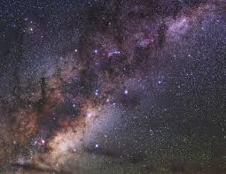
Galaxy
Intro
Notes:
Today we will learn about the galaxy.

Slide 3
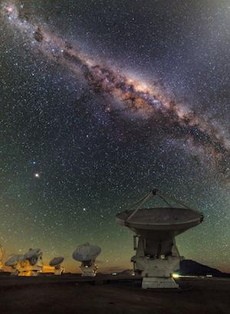
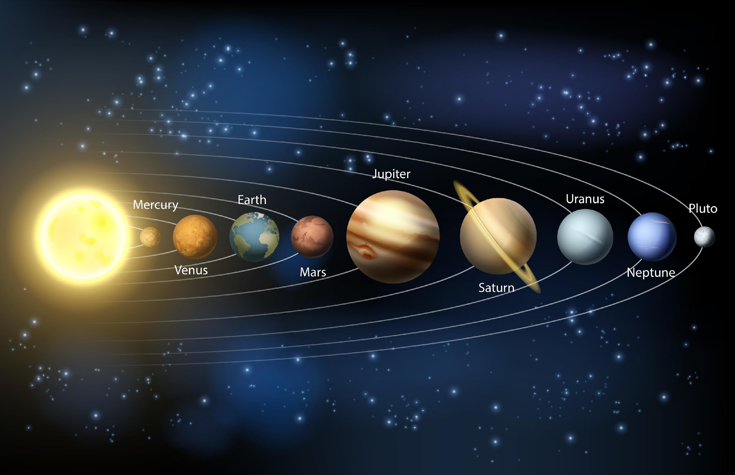
Big Question: How are galaxies, like the Milky Way, related to our Solar System, including the sun and earth?
Notes:
Our “big question” is: How are galaxies, like the Milky Way, related to our Solar System, including the sun and earth?
[Pause and illicit predictions from students.]
I love all these thoughtful scientific hypotheses! Be sure to keep this question and your predictions in mind as we move through these next few lessons, and we’ll continue to revisit it.
Feedback: Asking students to make predictions about how galaxies are related to our Solar System is a great way to activate and elicit student ideas and prior knowledge. This type of activity is evidence of the teacher planning for students’ engagement with science ideas.

Slide 4
Notes:
Before we move on to our new vocabulary term, let’s review some other words & concepts that you already learned and make sure you are firm in your understanding.

Slide 5
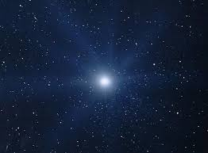
Star: an object in space made up of gases such as hydrogen and helium that produce light and heat
Notes:
A star is an object in space made up of gases such as hydrogen and helium that produce light and heat. The sun is a star.
Feedback: Definitions don’t always make a lot of sense for students, so the use of clear language can be very beneficial for students’ understanding.

Slide 6
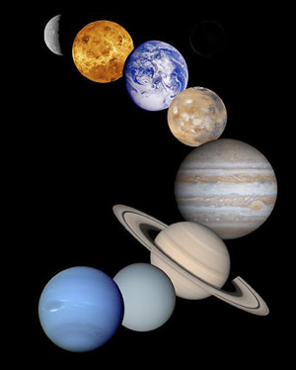
Planet: a body or object in space that revolves around a star and has a spherical shape
Notes:
A planet is a body or object in space that revolves around a star and has a spherical shape.

Slide 7
The Solar System: the sun with all the planets and other bodies that revolve around it
Notes:
The solar system is the sun with all the planets and other bodies that revolve around it.

Slide 8
Notes:
Now let’s pause for a moment to check your understanding.

Slide 9
What is a star?
Notes:
What is a star?
[A star is an object in space made up of gases such as hydrogen and helium that produce light and heat. The sun is a star.]

Slide 10
A plant is a body or object in space that revolves around a _____ and has a _____ shape.
Notes:
A planet is a body or object in space that revolves around a _____ and has a _____ shape.

Slide 11
A plant is a body or object in space that revolves around a star and has a spherical shape.
Notes:
A planet is a body or object in space that revolves around a star and has a spherical shape.

Slide 12
What is a solar system?
Notes:
What is a solar system?
[A solar system is the sun with all the planets and other bodies that revolve around it.]

Slide 13
Galaxy
Notes:
Now that we’ve reviewed, let’s define our new term, galaxy.
Feedback: Using cues, such as on this slide, helps prepare students for what is coming up next in the lesson. This is important especially for students who may struggle with new vocabulary instruction.

Slide 14
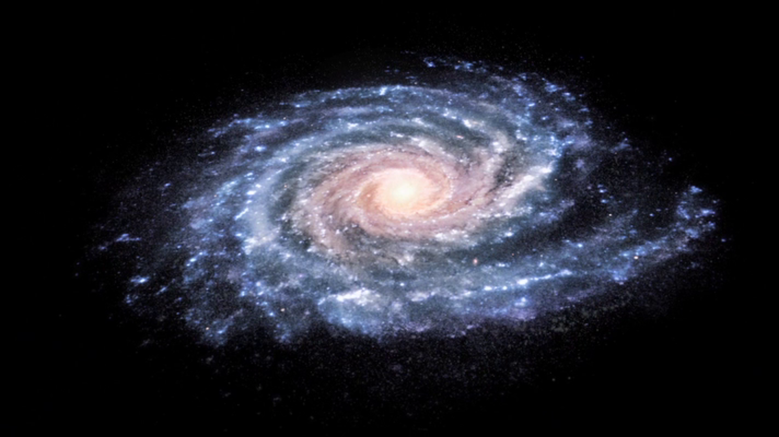
Galaxy: a cluster of stars, dust and gases that are held together with gravity
Notes:
A galaxy is a cluster of stars, dust and gases that are held together with gravity .

Slide 15
Notes:
Now let’s pause for a moment to check your understanding.

Slide 16
What is a galaxy?
Notes:
What is a galaxy?
[A galaxy is a cluster of stars, dust and gases that are held together with gravity.]

Slide 17
Notes:
That is the basic definition, but there is a bit more you need to know.

Slide 18
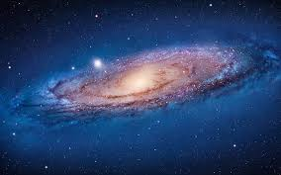
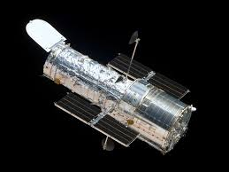
Notes:
There are billions of galaxies in our universe, we can only see a few with telescopes.

Slide 19
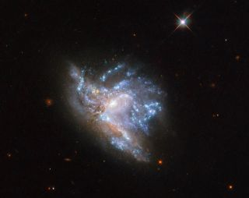
Notes:
Sometimes galaxies can collide which can change the shapes and size of the galaxy. Because the stars are so far apart they do not actually run into each other.

Slide 20
Notes:
Earth resides in a galaxy called the milky way-we will learn more about the milky way later on.

Slide 21
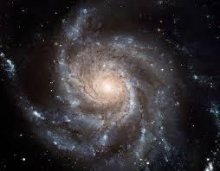
Center or Bulge
Spiral arms
Notes:
Galaxies can have spiral arms or a bulge in the center depending on the shape of the galaxy. The bulge is a cluster of stars in the center of the galaxy.

Slide 22
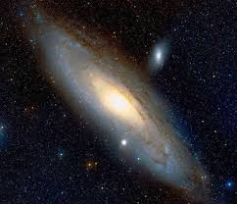
Elliptical Galaxy
Notes:
There are three types of Galaxies: Spiral, Elliptical, and irregular. This is an elliptical galaxy-meaning that it is shaped like an oval or circle and has a bulge or cluster of stars in the center.

Slide 23
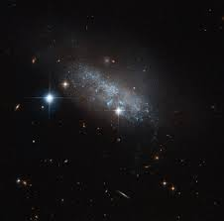
Irregular Galaxy
Notes:
This is an irregular galaxy-it does not have a defined shape and appears somewhat messy compared to the other types of galaxies-they do not have a bulge or spiral arms.

Slide 24
Spiral Galaxy
Notes:
Just like its name suggests-a spiral galaxy is shaped like a spiral with arms spiraling out of it and bulge in the center.

Slide 25
Notes:
Now let’s pause for a moment to check your understanding.

Slide 26
What is a galaxy?
Notes:
What is a galaxy?
[A galaxy is a cluster of stars, dust and gases that are held together with gravity.]

Slide 27
What are the three types of galaxies?
Notes:
What are the three types of galaxies?
[Spiral, Irregular, Elliptical]
Feedback: Including some visual aids in this portion of the lesson is helpful for students to be able to understand the new content.

Slide 28
Notes:
Now, let’s talk about some examples of galaxies.

Slide 29
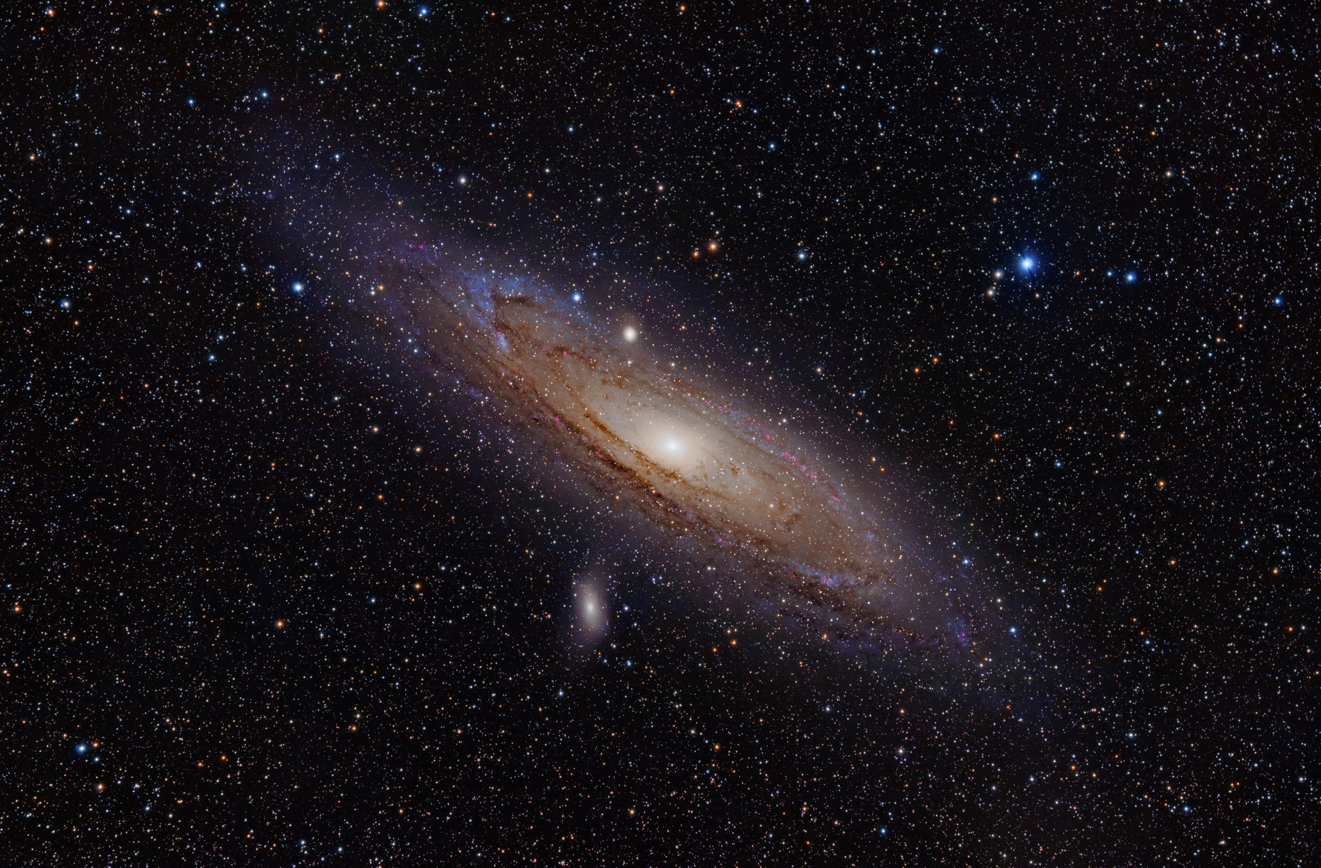
Notes:
This is an example of a spiral galaxy known as the Andromeda galaxy.

Slide 30
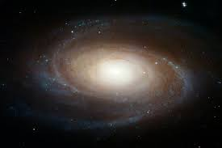
Notes:
Another example of a well-known spiral galaxy is Messier 81.

Slide 31
Notes:
Next, let’s talk about some non-examples of galaxies.
Feedback: Offering clear and explicit explanation for non-examples is a great way for students to make sense of the new content. Explanations for non-examples are provided in the slides below.

Slide 32
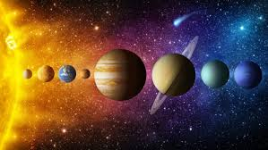
Notes:
This is the solar system-while part of a galaxy-this is not a galaxy itself.

Slide 33
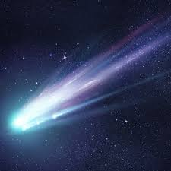
Notes:
This is not a galaxy - it is a comet - another type of object in space.

Slide 34
Notes:
Now let’s pause for a moment to check your understanding.

Slide 35
Which one of these is an example of a galaxy?
Notes:
Which one is an example of a galaxy?

Slide 36
Which one of these is an example of a galaxy?
Notes:
Which one is an example of a galaxy?
[That is right! This is an example of a spiral galaxy.]

Slide 37
What kind of a galaxy is this?
Notes:
What kind of a galaxy is this?
[Another example of a well-known spiral galaxy is Messier 81.]

Slide 38
What is a galaxy?
Notes:
What is a galaxy?
[A galaxy is a cluster of stars, dust and gases that are held together with gravity.]

Slide 39
Label these three types of galaxies.
Notes:
Label these three types of galaxies.

Slide 40
Label these three types of galaxies.
Elliptical
Spiral
Irregular
Notes:
[Label these three types of galaxies.]
Elliptical
Irregular
Spiral

Slide 41
Remember!!!
Notes:
So remember!

Slide 42
Galaxy: a cluster of stars, dust and gases that are held together by gravity
Notes:
A galaxy is a cluster of stars, dust and gases that are held together with gravity.

Slide 43
Simulation Activity
Galaxy Collision
Click on the simulation above to see what happens when galaxies collide.
Notes:
Feedback: Providing a simulation activity is a great way to make science thinking visible. In this simulation, students have the opportunity to make predictions and apply an idea to a new situation by changing the variables in the simulation (i.e., mass, position, velocity).

Slide 44
Big Question: How are galaxies, like the Milky Way, related to the Solar System, including the sun and earth?
Notes:
Our “big question” is: How are galaxies, like the Milky Way, related to the Solar System, including the sun and earth?
[Pause and illicit predictions from students.]
I love all these thoughtful scientific hypotheses! Be sure to keep this question and your predictions in mind as we move through these next few lessons, and we’ll continue to revisit it.

Slide 45
Notes:
Thanks for watching, and please continue watching CAPs available from this website.

Slide 46
This Video Was Created With Resources From:
Questions or Comments
Michael Kennedy, Ph.D. MKennedy@Virginia.edu
Rachel L Kunemund, Ph.D. rk8vm@virginia.edu

Slide 47
Intro
“Big Idea” Question
Review Concepts
Check-In Questions
Teacher Demo
Vocabulary
Student-Friendly Definition
Examples & Non-Examples
Morphological Word Parts
Simulation/Activity
Notes:
OK everyone, get ready for our next lesson. Just as a reminder, these are the different components that our lesson may include, and you’ll see these icons in the top left corner of each slide so that you can follow along more easily!

Slide 48
Milky Way
Intro
Notes:
Today we will learn about the Milky Way.

Slide 49
Big Question: How are galaxies, like the Milky Way, related to our Solar System, including the sun and earth?
Notes:
Our “big question” is: How are galaxies, like the Milky Way, related to our Solar System, including the sun and earth?
[Pause and illicit predictions from students.]
I love all these thoughtful scientific hypotheses! Be sure to keep this question and your predictions in mind as we move through these next few lessons, and we’ll continue to revisit it.

Slide 50
Notes:
Before we move on to our new vocabulary term, let’s review some other words & concepts that you already learned and make sure you are firm in your understanding.

Slide 51
Star: an object in space made up of gases such as hydrogen and helium that produce light and heat
Notes:
A star is an object in space made up of gases such as hydrogen and helium that produce light and heat. The sun is a star.

Slide 52
Planet: a body or object in space that revolves around a star and has a spherical shape
Notes:
A planet is a body or object in space that revolves around a star and has a spherical shape.

Slide 53
The Solar System: the sun with all the planets and other bodies that revolve around it
Notes:
The solar system is the sun with all the planets and other bodies that revolve around it.

Slide 54
Galaxy: a cluster of stars, dust and gases that are held together with gravity
Notes:
A galaxy is a cluster of stars, dust and gases that are held together with gravity .

Slide 55
Notes:
Now let’s pause for a moment to check your understanding.

Slide 56
What is a star?
Notes:
What is a star?
[A star is an object in space made up of gases such as hydrogen and helium that produce light and heat. The sun is a star.]

Slide 57
A planet is a body or object in space that revolves around a _____ and has a _____ shape.
Notes:
A planet is a body or object in space that revolves around a _____ and has a _____ shape.

Slide 58
A planet is a body or object in space that revolves around a star and has a spherical shape.
Notes:
A planet is a body or object in space that revolves around a star and has a spherical shape.

Slide 59
What is a solar system?
Notes:
What is a solar system?
[A solar system is the sun with all the planets and other bodies that revolve around it.]

Slide 60
What is a galaxy?
Notes:
What is a galaxy?
[A galaxy is a cluster of stars, dust and gases that are held together with gravity.]

Slide 61
Milky Way
Notes:
Now that we’ve reviewed, let’s define our new term, Milky Way.

Slide 62
Milky Way: a galaxy that contains the sun and all of the nearby planets and stars-including our own solar system
Notes:
The Milky Way is a galaxy that contains the sun and all of the nearby planets and stars-including our own solar system.

Slide 63
Notes:
Now let’s pause for a moment to check your understanding.

Slide 64
What is the Milky Way?
Notes:
What is the Milky Way?
[The Milky Way is a galaxy that contains the sun and all of the nearby planets and stars-including our own solar system.]

Slide 65
Notes:
That is the basic definition, but there is a bit more you need to know.

Slide 66
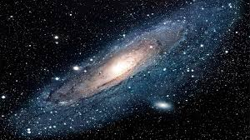
Notes:
The Milky Way is a spiral galaxy.

Slide 67
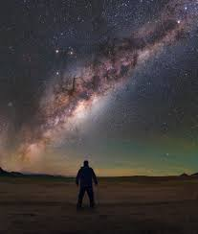
Notes:
Scientists at NASA estimate that the Milky Way contains about 100 BILLION stars.
Feedback: This is a great opportunity to give an example of how much more a billion is than a million (i.e., if one day was a million how many days would be a billion etc). This may be a bigger scale of thinking than most students are used to and will help them to understand the vastness of the concepts they are learning.

Slide 68
Notes:
Now let’s pause for a moment to check your understanding.

Slide 69
The Milky Way a ______that contains the sun and all of the nearby planets and stars-including our own solar system.
Notes:
The Milky Way is a _______ that contains the sun and all of the nearby planets and stars-including our own solar system.

Slide 70
The Milky Way a galaxy that contains the sun and all of the nearby planets and stars-including our own solar system.
Notes:
The Milky Way is a galaxy that contains the sun and all of the nearby planets and stars-including our own solar system.

Slide 71
What kind of galaxy is the Milky Way?
Notes:
What kind of galaxy is the Milky Way?
[The Milky Way is a spiral galaxy.]

Slide 72
Notes:
Now, let’s talk about some examples of the Milky Way.

Slide 73
Notes:
An example of what the milky way looks like from earth.

Slide 74
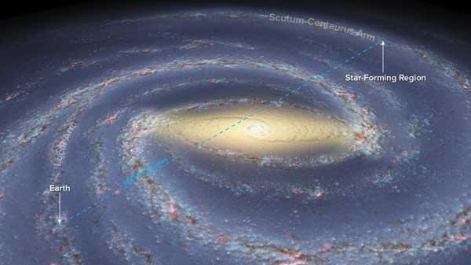
Notes:
An example of what the milky way may look like from above-this diagram shows the spiral arms and bulge of the Milky Way.

Slide 75
Notes:
Next, let’s talk about some non-examples of the Milky Way.

Slide 76
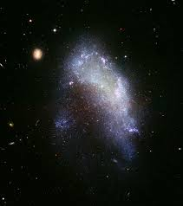
Notes:
This is an irregular galaxy-not a spiral galaxy like the Milky Way.

Slide 77
Notes:
Now let’s pause for a moment to check your understanding.

Slide 78
What is this a picture of?
Notes:
What is this a picture of?
[An example of what the milky way looks like from earth.]

Slide 79
Which one is the Milky Way, how can you tell?
Notes:
Which one is the Milky Way, how can you tell?

Slide 80
Which one is the Milky Way, how can you tell?
Notes:
Which one is the Milky Way, how can you tell?
[You can tell this one is the milky way compared to the other picture because of the shape. Remember the milky way is a spiral galaxy.]
Feedback: Open-ended questions are a great way to gauge student understanding by requiring deeper thought than a rote opportunity to respond. This offers you the opportunity to provide feedback and incorporate student responses into discussion as well!

Slide 81
What is the Milky Way?
Notes:
What is the Milky Way?
[The Milky way is a galaxy that contains the sun and all of the nearby planets and stars-including our own solar system.]

Slide 82
What kind of galaxy is the Milky Way?
Notes:
What kind of galaxy is the Milky Way?
[The Milky Way is a spiral galaxy.]

Slide 83
Which one is NOT the Milky Way, how can you tell?
Notes:
Which one is not the Milky Way, how can you tell?

Slide 84
Which one is NOT the Milky Way, how can you tell?
Notes:
Which one is NOT the Milky Way, how can you tell?
[You can tell this one is not the Milky Way because it does not have the spiral shape of the Milky Way-it is an Irregularly Shaped galaxy.]

Slide 85
How many stars do scientists believe are in the Milky Way?
Notes:
How many stars do scientists believe are in the Milky Way?
[Scientists at NASA estimate that the Milky Way contains about 100 BILLION stars.]

Slide 86
Remember!!!
Notes:
So remember!

Slide 87
Milky Way: a galaxy that contains the sun and all of the nearby planets and stars-including our own solar system
Notes:
The Milky Way is a galaxy that contains the sun and all of the nearby planets and stars-including our own solar system.

Slide 88
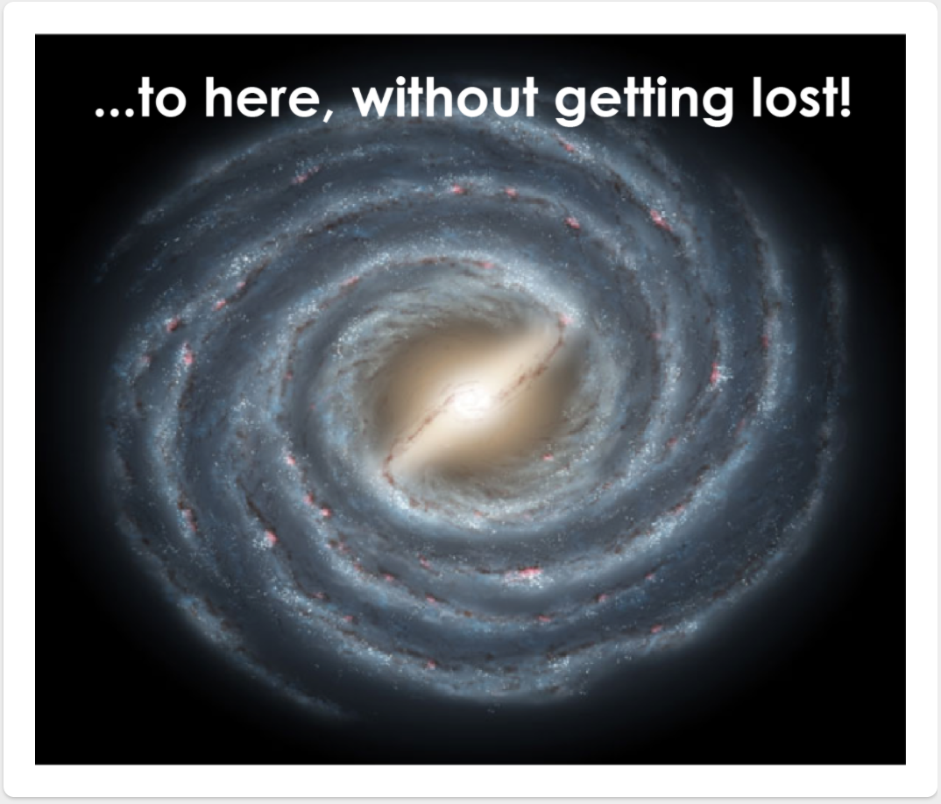
Simulation Activity
Your Cosmic Address
Click the link above to determine your cosmic address in the Milky Way.

Slide 89
Big Question: How are galaxies, like the Milky Way, related to the Solar System, including the sun and earth?
Notes:
Our “big question” is: How are galaxies, like the Milky Way, related to the Solar System, including the sun and earth?
[Pause and illicit predictions from students.]
I love all these thoughtful scientific hypotheses! Be sure to keep this question and your predictions in mind as we move through these next few lessons, and we’ll continue to revisit it.
Feedback: Offering students an opportunity to evaluate their earlier hypotheses and make changes based on their new understandings is an important part of the iterative process in science. This is a great opportunity to help students build an epistemic understanding by explicitly stating how continuing to change and build on hypotheses as your knowledge grows is an important part of the discipline of science!

Slide 90
Notes:
Thanks for watching, and please continue watching CAPs available from this website.

Slide 91
This Video Was Created With Resources From:
Questions or Comments
Michael Kennedy, Ph.D. MKennedy@Virginia.edu
Rachel L Kunemund, Ph.D. rk8vm@virginia.edu

