Slide 1
Intro
“Big Idea” Question
Review Concepts
Check-In Questions
Teacher Demo
Vocabulary
Student-Friendly Definition
Examples & Non-Examples
Morphological Word Parts
Frayer Model
Simulation/Activity
Notes:
OK everyone, get ready for our next lesson. Just as a reminder, these are the different components that our lesson may include, and you’ll see these icons in the top left corner of each slide so that you can follow along more easily!

Slide 2
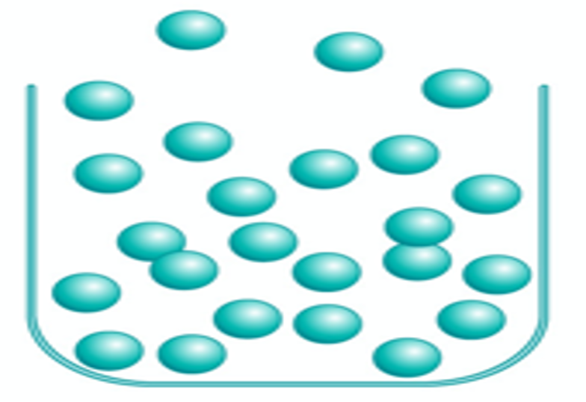
Gas
Intro
Notes:
Today we will learn about gases.

Slide 3
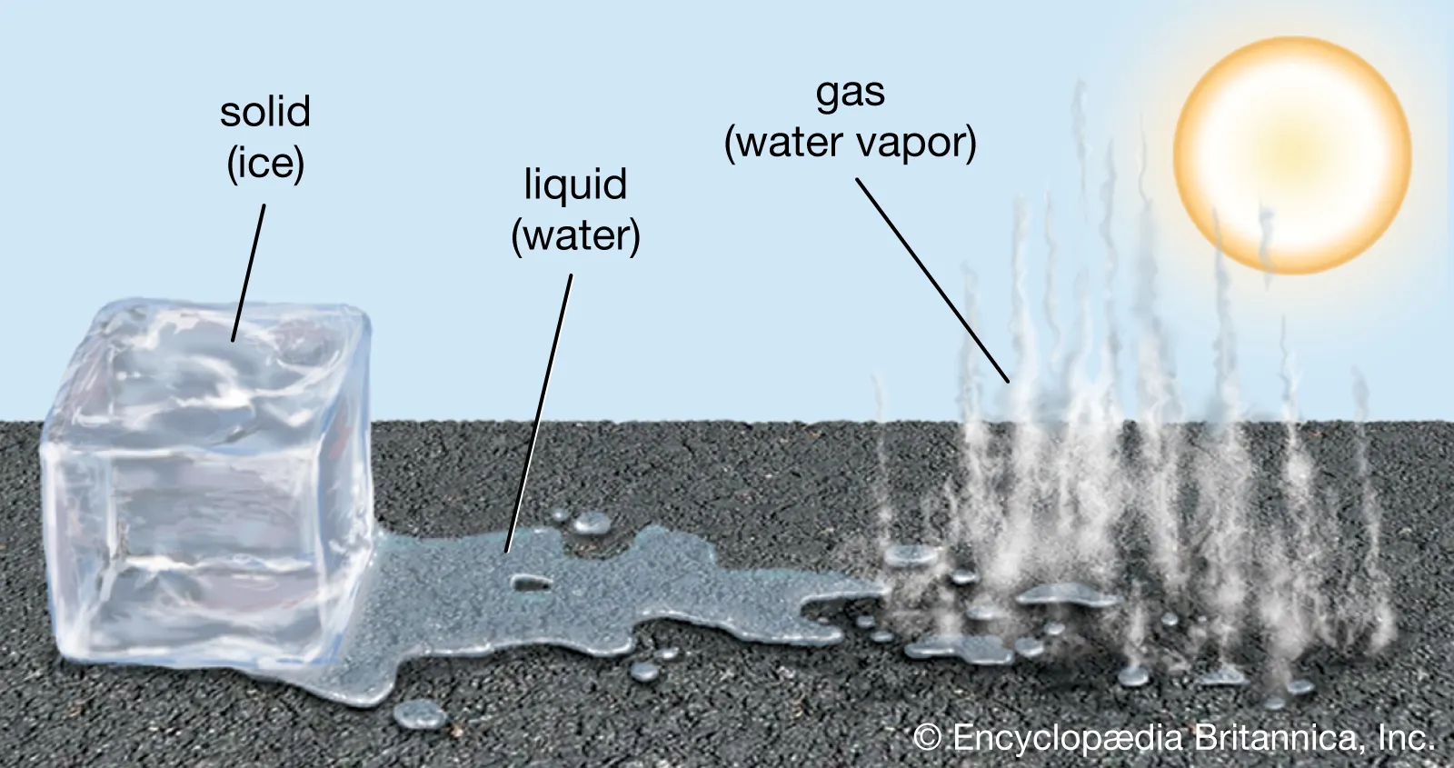
Big Question: How does temperature affect the matter around us?
Notes:
Our “big question” is: How does temperature affect the matter around us?
[Pause and illicit predictions from students.]
I love all these thoughtful scientific hypotheses! Be sure to keep this question and your predictions in mind as we move through these next few lessons, and we’ll continue to revisit it.
Feedback: Asking students to make predictions about how temperature is related to states of matter is a great way to activate and elicit student ideas and prior knowledge. This type of activity is evidence of the teacher planning for students’ engagement with science ideas.

Slide 4
Notes:
Before we move on to our new vocabulary term, let’s review some other words & concepts that you already learned and make sure you are firm in your understanding.

Slide 5
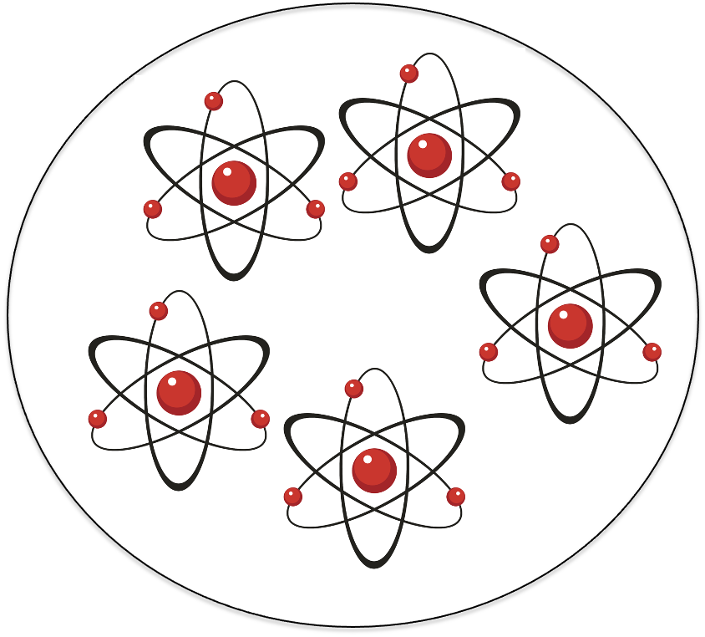
Matter: has mass and takes up space
Notes:
Matter is anything that has mass and takes up space.

Slide 6
Mass: amount of matter in an object.
Notes:
Mass is the amount of matter in an object.

Slide 7
Atom: smallest whole unit of matter.
Notes:
An atom is the smallest whole unit of matter. All matter is made up of atoms.

Slide 8
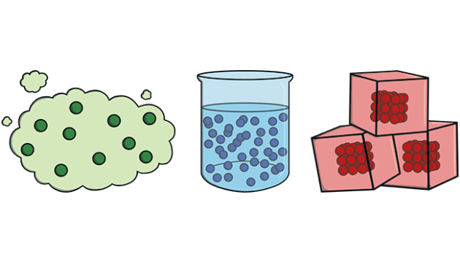
States of Matter
Gas
Liquid
Solid
Notes:
Matter can be found in three different states: solid, liquid, and gas.

Slide 9
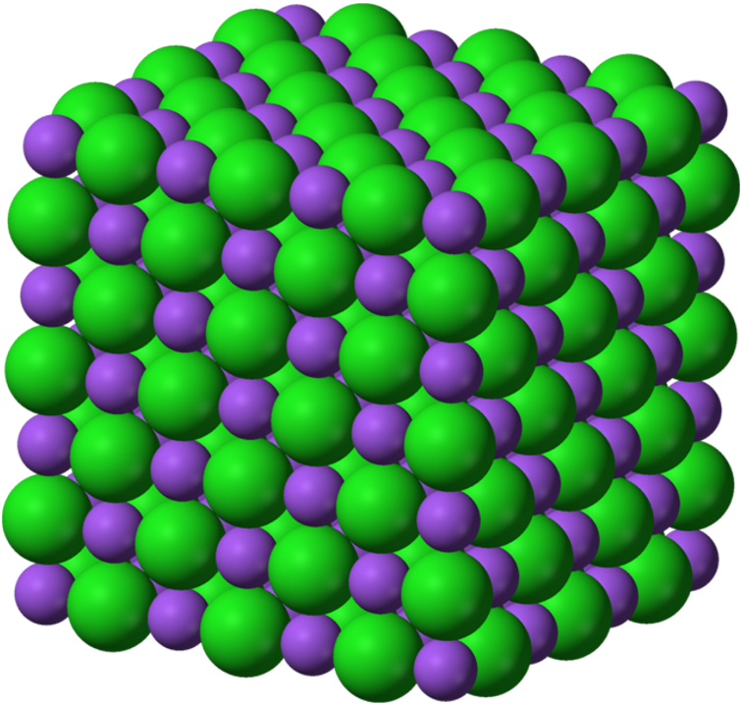
Solid: has particles that are tightly packed together in a fixed pattern
Notes:
A solid has particles that are tightly packed together in a fixed pattern. The tables and chairs we are sitting in are kinds of solids.

Slide 10
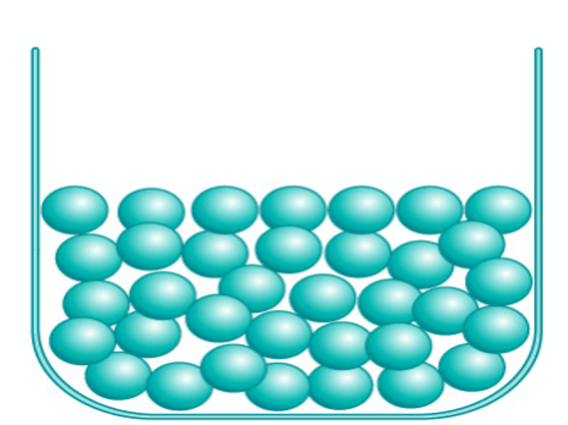
Liquid: has particles that are close together but can move around
Notes:
A liquid has particles that are close together but can move around. The water we drink is a kind of liquid.

Slide 11
Notes:
Now let’s pause for a moment to check your understanding.

Slide 12
___________ has mass and takes up space.
Notes:
______ has mass and takes up space.
[Matter]

Slide 13
Matter has mass and takes up space.
Notes:
Matter has mass and takes up space.

Slide 14
What is the amount of matter in an object?
Size
Mass
Temperature
Notes:
What is the amount of matter in an object?
[B. Mass]

Slide 15
What is the amount of matter in an object?
Size
Mass
Temperature
Notes:
What is the amount of matter in an object? B. Mass

Slide 16
What is an atom?
Notes:
What is an atom?
[The smallest whole unit of matter]

Slide 17
Label the three states of matter.
Notes:
Label the three states of matter.
[gas, liquid, solid]

Slide 18
Label the three states of matter.
Gas
Liquid
Solid
Notes:
Label the three states of matter: gas, liquid, solid.

Slide 19
A _______ has particles that are tightly packed together in a fixed pattern.
Notes:
A ________ has particles that are tightly packed together in a fixed pattern.
[Solid]

Slide 20
A solid has particles that are tightly packed together in a fixed pattern.
Notes:
A solid has particles that are tightly packed together in a fixed pattern.

Slide 21
What state of matter has particles that are close together but can move around?
Solid
Liquid
Gas
Notes:
What state of matter has particles that are close together but can move around?
[B. Liquid]

Slide 22
What state of matter has particles that are close together but can move around?
Solid
Liquid
Gas
Notes:
What state of matter has particles that are close together but can move around? B. Liquid

Slide 23
Gas
Notes:
Now that we’ve reviewed, let’s define our new term, gas.
Feedback: Using cues, such as on this slide, helps prepare students for what is coming up next in the lesson. This is important especially for students who may struggle with new vocabulary instruction.

Slide 24
Gas: has particles that are spread far apart and are constantly moving
Notes:
A gas has particles that are spread far apart and are constantly moving.

Slide 25
Notes:
Now let’s pause for a moment to check your understanding.

Slide 26
What is a gas?
Notes:
What is a gas?
[A gas has particles that are spread far apart and are constantly moving.]

Slide 27
Gas: has particles that are spread far apart and are constantly moving
Notes:
What is a gas?
[A gas has particles that are spread far apart and are constantly moving.]

Slide 28
Notes:
That is the basic definition, but there is a bit more you need to know.

Slide 29
Notes:
Gases are usually colorless and invisible, like the air around us. Although we might be able to feel the air move, we can’t actually see it.

Slide 30
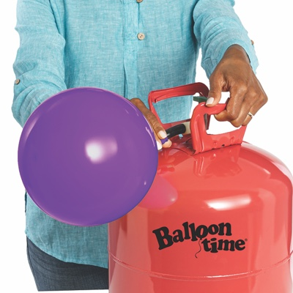
Notes:
Gases, like liquids, do not have a fixed shape. Instead, they evenly fill up any container that they are in.

Slide 31
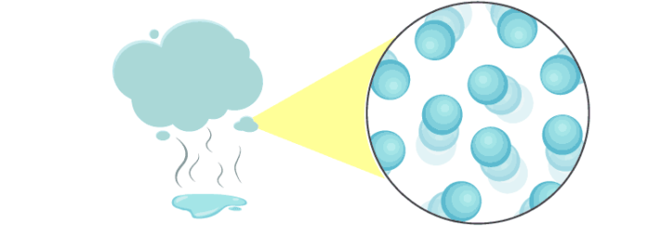
Notes:
The particles in a gas have lots of energy and space between them to move around freely. This space allows the gas to get bigger or smaller in order to fit the container it is in.

Slide 32
temperature
Notes:
When the temperature of a liquid increases, the particles get more energy and start to move around more quickly. This quick moveement causes them to move further apart and the matter turns into a gas. This process is called evaporation.

Slide 33
temperature
Notes:
Similarly, when a gas begins to cool down, the particles lose energy and slow down. Eventually the gas will turn into a liquid. This is called condensation.

Slide 34
Notes:
Now let’s pause for a moment to check your understanding.

Slide 35
Gases are often colorless and _________.
hot
rough
invisible
Notes:
Gases are often colorless and __________.
[invisible]

Slide 36
Gases are often colorless and _________.
hot
rough
invisible
Notes:
Gases are often colorless and invisible.

Slide 37
Gases take the shape of their _____________.
Notes:
Gases take the shape of their _________.
[container]

Slide 38
Gases take the shape of their container.
Notes:
Gases take the shape of their container.

Slide 39
What are the particles in a gas like?
Notes:
What are the particles in a gas like?
[They are far apart, have energy, and move freely around.]

Slide 40
A liquid changes to a gas when the temperature _________.
Notes:
A liquid changes to a gas when the temperature __________.
[rises]

Slide 41
A liquid changes to a gas when the temperature rises.
Notes:
A liquid changes to a gas when the temperature rises.

Slide 42
A gas changes into a ________ when the temperature decreases.
liquid
solid
light
Notes:
A gas changes into a ____ when the temperature decreases.
[liquid]

Slide 43
A gas changes into a ________ when the temperature decreases.
liquid
solid
light
Notes:
A gas changes into a liquid when the temperature decreases.

Slide 44
Notes:
Now, let’s talk about some examples of gases.

Slide 45
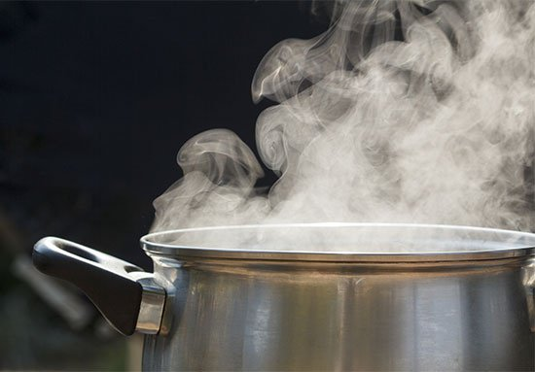
Notes:
Here is an example of a gas. When liquid water is heated, it changes into its gas form we call steam.

Slide 46
Notes:
Helium is another example of a gas. It is used to fill balloons, car air bags, and can even be used for scientific research.

Slide 47
Notes:
Next, let’s talk about some non-examples of gases.
Feedback: Offering clear and explicit explanation for non-examples is a great way for students to make sense of the new content. Explanations for non-examples are provided in the slides below.

Slide 48
Notes:
Orange juice is not an example of a gas. Juice is a kind of liquid that we drink.

Slide 49
Notes:
Light is also not an example of a gas. It is a kind of energy, so it does not have its own mass and it is not made up of matter.

Slide 50
Notes:
Now let’s pause for a moment to check your understanding.

Slide 51
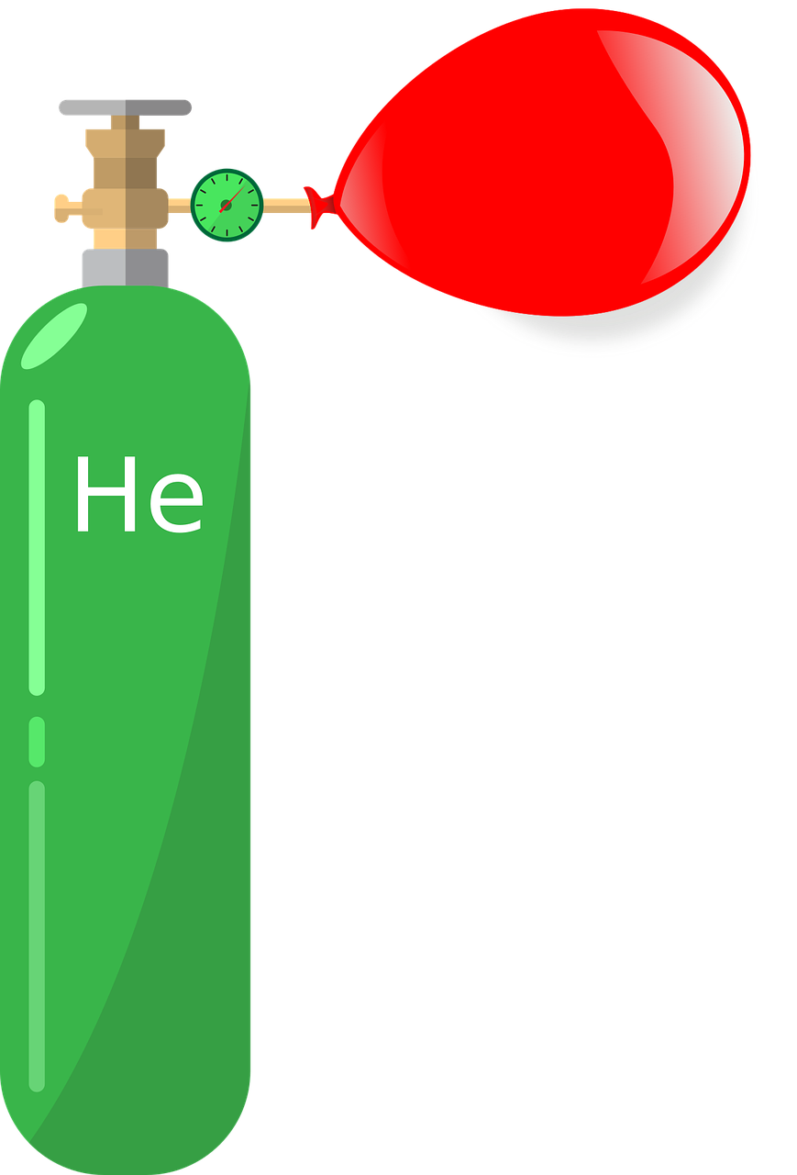
Which one is NOT an example of a gas?
Air
Helium
Light
Notes:
Which one is NOT an example of a gas?
[Light]

Slide 52
Which one is NOT an example of a gas?
Air
Helium
Light
Notes:
Which one is NOT an example of a gas? Light

Slide 53
Remember!!!
Notes:
So remember!

Slide 54
Gas: has particles that are spread far apart and are constantly moving
Notes:
A gas has particles that are spread far apart and are constantly moving.

Slide 55
Notes:
We will now complete this concept map, called a Frayer model, to summarize and further clarify what you have learned about the term gas.

Slide 56
Definition
Picture
Gas
Example
How do gases impact my life?
Notes:
To complete the Frayer model, we will choose from four choices the correct picture, definition, example, and response to the question, “How do gases impact my life?” Select the best response for each question using the information you just learned. As we select responses, we will see how this model looks filled in for the term gas.

Slide 57
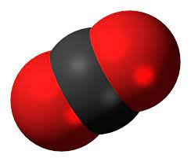
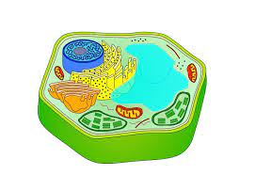
Directions: Choose the correct picture of a
gas from the choices below.
A
B
C
D
Notes:
Choose the one correct picture of gas from these four choices.

Slide 58
Directions: Choose the correct picture of a
gas from the choices below.
A
B
C
D
Notes:
This is the picture that shows a gas.

Slide 59
Definition
Picture
Gas
Example
How do gases impact my life?
Notes:
Here is the Frayer model filled in with a picture of gas.

Slide 60
Directions: Choose the correct definition of
gas from the choices below.
A
the distance between two successive crests or troughs of a wave
B
has particles that are spread far apart and are constantly moving
C
the process of breaking down rock over long periods of time
D
a push or pull of an object
Notes:
Choose the one correct definition of gas from these four choices.

Slide 61
Directions: Choose the correct definition of
gas from the choices below.
A
the distance between two successive crests or troughs of a wave
B
has particles that are spread far apart and are constantly moving
C
the process of breaking down rock over long periods of time
D
a push or pull of an object
Notes:
“A gas has particles that are spread far apart and are constantly moving” is correct! This is the definition of gas.

Slide 62
Definition
Picture
has particles that are spread far apart and are constantly moving
Gas
Example
How do gases impact my life?
Notes:
Here is the Frayer Model with a picture and the definition filled in for gas: has particles that are spread far apart and are constantly moving

Slide 63
Directions: Choose the correct example of
a gas from the choices below.
A
An apple on a tree
B
A knock on the door
C
Ice on a frozen pond
D
Steam from a tea kettle
Notes:
Choose the one correct example of a gas from these four choices.

Slide 64
Directions: Choose the correct example of
a gas from the choices below.
A
An apple on a tree
B
A knock on the door
C
Ice on a frozen pond
D
Steam from a tea kettle
Notes:
“Steam from a tea kettle” is correct! This is an example of a gas.

Slide 65
Definition
Picture
has particles that are spread far apart and are constantly moving
Gas
Steam from a tea kettle
Example
How do gases impact my life?
Notes:
Here is the Frayer Model with a picture, definition, and an example of gas: steam from a tea kettle.

Slide 66
Directions: Choose the correct response for “how do gases impact my life?” from the choices below.
A
It keeps our feet on the ground and keeps the Earth in orbit around the Sun.
B
They help us digest our food into energy for our bodies to use to complete our daily activities
C
They are used to build homes and other buildings in our communities.
D
It is the air we breathe and makes up the atmosphere that surrounds Earth that keeps us safe.
Notes:
Choose the one correct response for “how do gases impact my life?” from these four choices.

Slide 67
Directions: Choose the correct response for “how do gases impact my life?” from the choices below.
A
It keeps our feet on the ground and keeps the Earth in orbit around the Sun.
B
They help us digest our food into energy for our bodies to use to complete our daily activities
C
They are used to build homes and other buildings in our communities.
D
It is the air we breathe and makes up the atmosphere that surrounds Earth that keeps us safe.
Notes:
“It is the air we breathe and makes up the atmosphere that surrounds Earth that keeps us safe.” That is correct! This is an example of how gases impact your life.

Slide 68
Definition
Picture
has particles that are spread far apart and are constantly moving
Gas
It is the air we
breathe and makes up the atmosphere that surrounds Earth that keeps us safe.
Steam from a tea kettle
Example
How do gases impact my life?
Notes:
Here is the Frayer Model with a picture, definition, example, and a correct response to “how do gases impact my life?”: It is the air we breathe and makes up the atmosphere that surrounds Earth that keeps us safe.

Slide 69
Phases of Water Experiment
Tell students that they are going to be learning more about the properties of each state of matter. You may choose to do this experiment live for students (on video meeting platform or face-to-face) or show a video of each change. Set up the materials – bowl of ice, (show it melting but a have separate bowl of water for time purposes), then a pot to boil the water to show it changing to a gas.
Before observing a phase change: Observe the different properties of each state. Does it keep its shape? Change to fit its container? What do you think the particles look like?
During the phase change: Note whether temperature is added or subtracted. Observe what happens as heat is applied.
After observing a phase change: Ask which properties stayed the same? Changes? How are the particles behaving differently?

Slide 70
Big Question: How does temperature affect the matter around us?
Notes:
Our “big question” is: How does temperature affect the matter around us?
[Pause and illicit predictions from students.]
I love all these thoughtful scientific hypotheses! Be sure to keep this question and your predictions in mind as we move through these next few lessons, and we’ll continue to revisit it.

Slide 71
Notes:
Thanks for watching, and please continue watching CAPs available from this website.

Slide 72
This Video Was Created With Resources From:
Questions or Comments
Michael Kennedy, Ph.D. MKennedy@Virginia.edu
Rachel L Kunemund, Ph.D. rk8vm@virginia.edu

