Slide 1
Intro
“Big Idea” Question
Review Concepts
Check-In Questions
Teacher Engagement
Vocabulary
Student-Friendly Definition
Examples & Non-Examples
Morphological Word Parts
Frayer Model
Simulation/Activity
Notes:
OK everyone, get ready for our next lesson. Just as a reminder, these are the different components that our lesson may include, and you’ll see these icons in the top left corner of each slide so that you can follow along more easily!

Slide 2
Intro
Geology
Notes:
Today, we’ll be learning about the word: Geology.

Slide 3
Big Question: What are key characteristics of the ocean environment?
Notes:
Our “big question” is: What are the key characteristics of the ocean environment?
[Pause and illicit predictions from students.]
I love all these thoughtful scientific hypotheses! Be sure to keep this question and your predictions in mind as we move through these next few lessons, and we’ll continue to revisit it.

Slide 4
Notes:
Before we move on to our new topic, let’s review some other words & concepts that you already learned and make sure you are firm in your understanding.

Slide 5
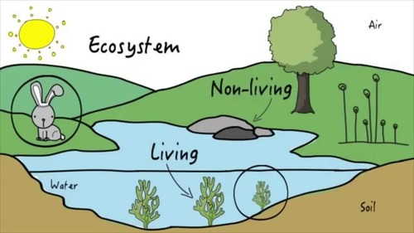
Ecosystem: an area where living and nonliving things interact
Notes:
Ecosystem is an area where living and nonliving things interact.

Slide 6
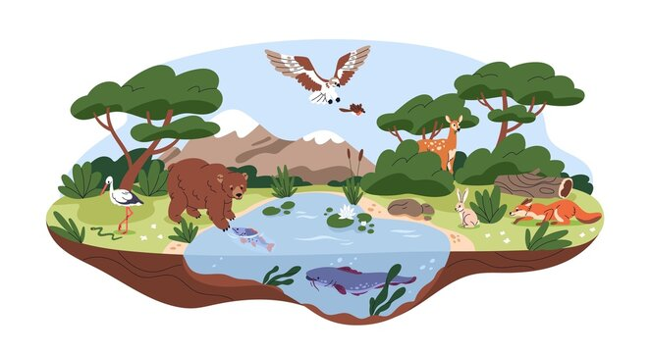
Habitat: the place where an animal or plant naturally lives
Notes:
Habitat is the place where an animal or plant naturally lives.

Slide 7
Organism: any living thing
Notes:
An organism is any living thing.

Slide 8
Notes:
Now let’s pause for a moment to review the information we have covered already.

Slide 9
An ecosystem is an area where living and nonliving things ________.
investigate
interact
Notes:
An ecosystem is an area where living and nonliving things ______
[B. interact]

Slide 10
An ecosystem is an area where living and nonliving things ________.
investigate
interact
Notes:
An ecosystem is an area where living and nonliving things ______
[B. interact]

Slide 11
A habitat is the place where an animal or plant naturally _____.
lives
listens
Notes:
A habitat is the place where an animal or plant naturally ______
[A. lives]

Slide 12
A habitat is the place where an animal or plant naturally _____.
lives
listens
Notes:
A habitat is the place where an animal or plant naturally ______
[A. lives]

Slide 13
True or false: An organism is any non-living thing.
True
False
Notes:
True or false: An organism is any non-living thing.
[B. False]

Slide 14
True or false: An organism is any non-living thing.
True
False
Notes:
True or false: An organism is any non-living thing. Remember - an organism is any living thing.
[B. False]

Slide 15
Geology
Notes:
Now that we’ve reviewed, let’s define the term geology.

Slide 16
Geology: the study of the Earth
Notes:
Geology is the study of the Earth.

Slide 17
Notes:
Let’s check-in for understanding.

Slide 18
What is geology?
Notes:
What is geology?
[The study of the Earth.]

Slide 19
Notes:
That is the basic definition, but there is a bit more you need to know.

Slide 20
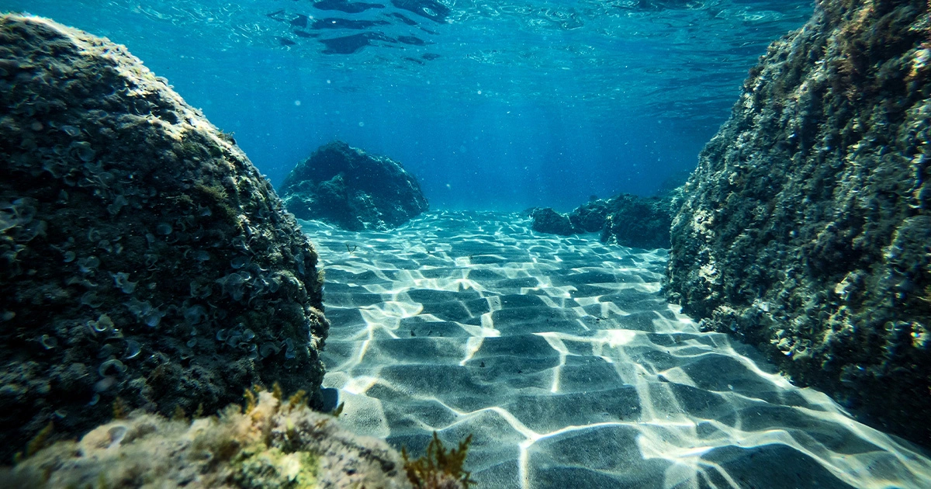
We can study the geology of the ocean floor. The ocean floor (or oceanic crust) is primarily made up of basalt - a type of volcanic rock.
Notes:
We can study the geology of the ocean floor. The ocean floor (or oceanic crust) is primarily made up of basalt - a type of volcanic rock.

Slide 21
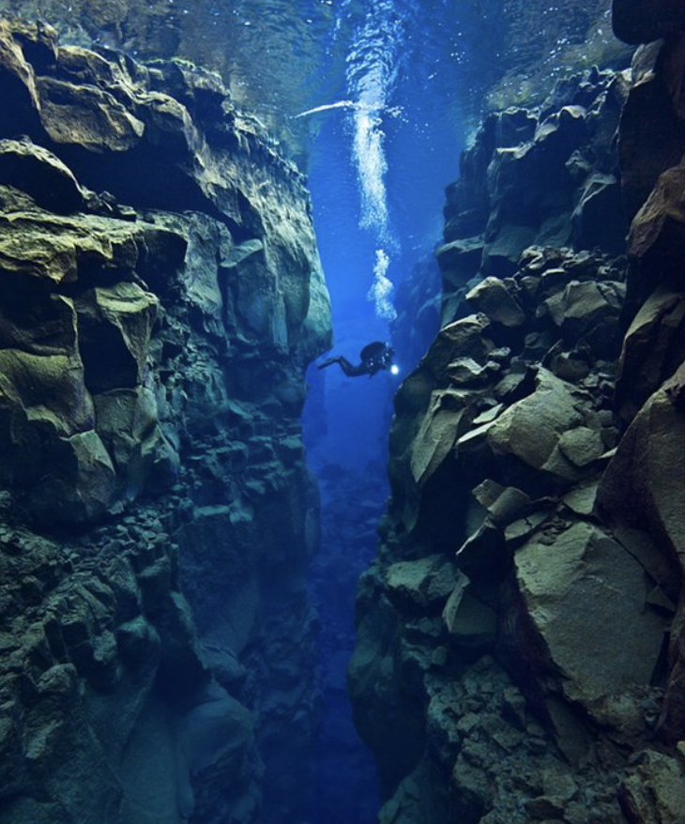
The ocean floor can also have underwater mountain ranges. These are called mid-ocean ridges.
Notes:
The ocean floor can also have underwater mountain ranges. These are called mid-ocean ridges.

Slide 22
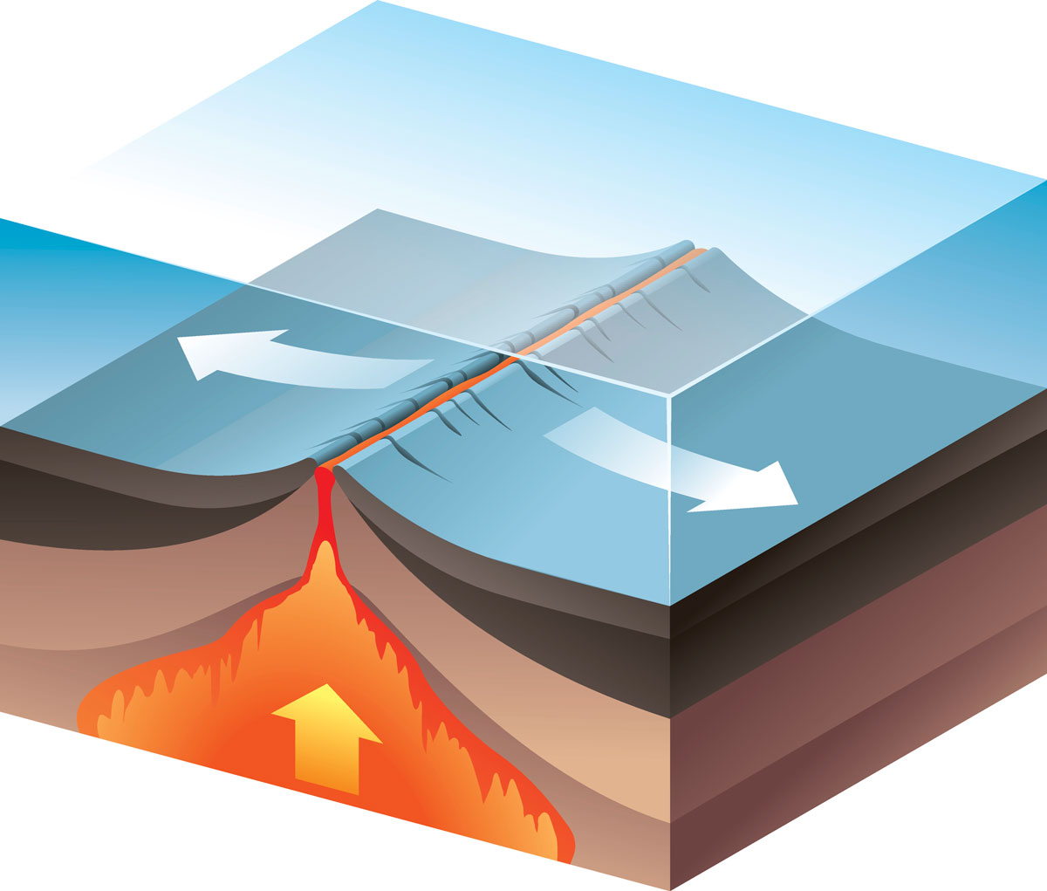
Mid-ocean ridges are sites of seafloor spreading. Seafloor spreading is the process by which new oceanic crust is formed as tectonic plates move apart.
Notes:
Mid-ocean ridges are sites of seafloor spreading. Seafloor spreading is the process by which new oceanic crust is formed as tectonic plates move apart.

Slide 23
Notes:
Let’s check-in for understanding.

Slide 24
The ocean floor is primarily made up of this type of volcanic rock…
basalt
sandstone
Notes:
The ocean floor is primarily made up of this type of volcanic rock…
[A. basalt]

Slide 25
The ocean floor is primarily made up of this type of volcanic rock…
basalt
sandstone
Notes:
The ocean floor is primarily made up of this type of volcanic rock…
[A. basalt]

Slide 26
True or false: The ocean floor can also have underwater mountain ranges. These are called mid-ocean ridges.
True
False
Notes:
True or false: The ocean floor can also have underwater mountain ranges. These are called mid-ocean ridges.

Slide 27
True or false: The ocean floor can also have underwater mountain ranges. These are called mid-ocean ridges.
True
False
Notes:
True or false: The ocean floor can also have underwater mountain ranges. These are called mid-ocean ridges.

Slide 28
_________ _________ is the process by which new oceanic crust is formed as tectonic plates move apart.
Seafloor spreading
Seafloor shrinking
Notes:
_____ _____ is the process by which new oceanic crust is formed as tectonic plates move apart.
[A. Seafloor spreading]

Slide 29
_________ _________ is the process by which new oceanic crust is formed as tectonic plates move apart.
Seafloor spreading
Seafloor shrinking
Notes:
_____ _____ is the process by which new oceanic crust is formed as tectonic plates move apart.
[A. Seafloor spreading]

Slide 30
Notes:
Now, let’s talk about some examples of geology.

Slide 31
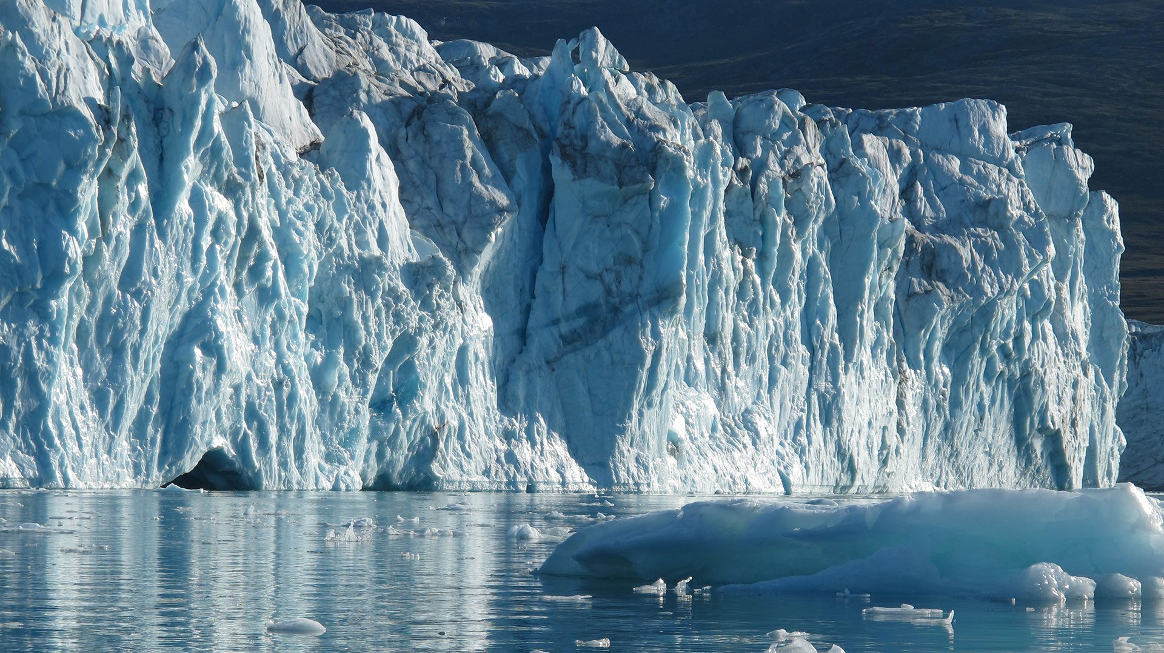
This is an example of geology. Because glaciers are on the Earth, they can be studied.
Notes:
This is an example of geology. Because glaciers are on the Earth, they can be studied.

Slide 32
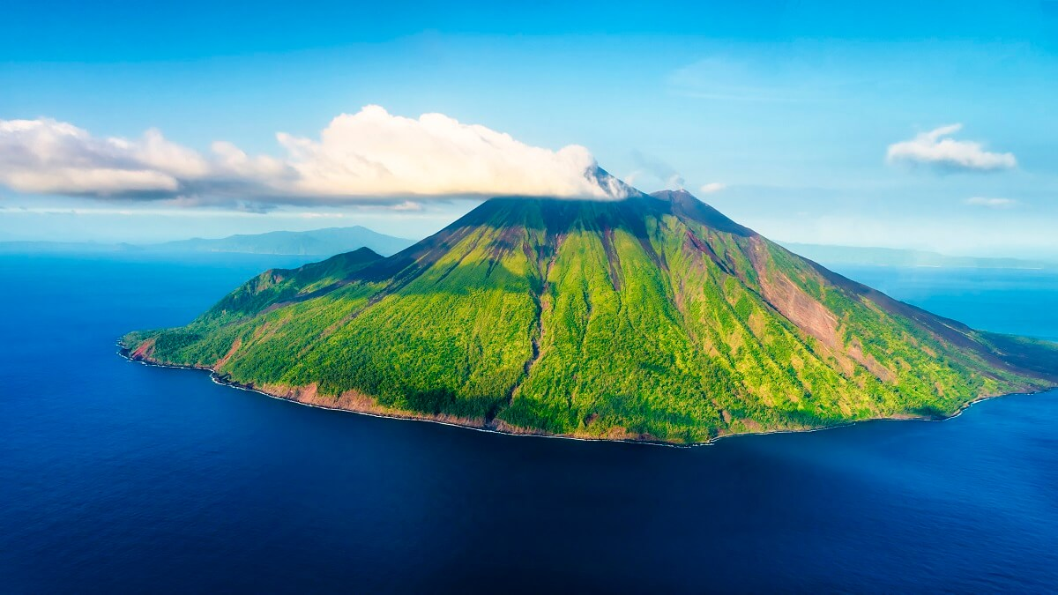
This is also an example of geology. Because volcanoes are on the Earth, they can be studied.
Notes:
This is also an example of geology. Because volcanoes are on the Earth, they can be studied.

Slide 33
Notes:
Now, let’s talk about some non-examples of geology.

Slide 34
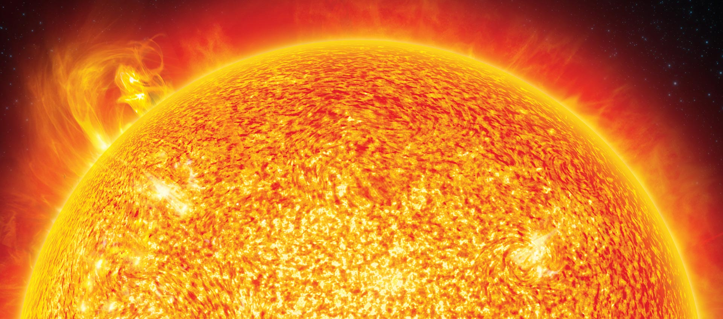
This is a non-example of geology. The sun is not on the Earth.
Notes:
This is a non-example of geology. The sun is not on the Earth.

Slide 35
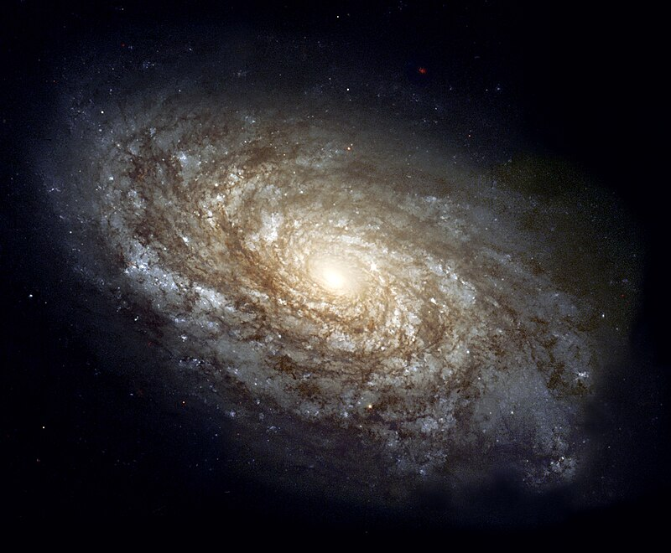
This is another non-example of geology. Galaxies are not on the Earth.
Notes:
This is another non-example of geology. Galaxies are not on the Earth.

Slide 36
Notes:
Now let’s pause for a moment to check your understanding.

Slide 37
Which is an example of geology?
Notes:
Which is an example of geology?

Slide 38
Which is an example of geology?
Notes:
Which is an example of geology?

Slide 39
Notes:
We can also break down the term geology into different word parts to help us remember the meaning. Let’s take a look!

Slide 40
Geology
(root)
(suffix)
Notes:
We can break up the term geology into two parts: a root and a suffix

Slide 41
Geology
Geology
Earth
Notes:
The root, geo, means Earth.

Slide 42
Geology
Geology
the study of
Notes:
The suffix, -logy, means the study of

Slide 43
Geo logy
Geology
the study of the Earth
Notes:
Geology is the study of the Earth.

Slide 44
Notes:
Let’s check-in for understanding.

Slide 45
How can we use the word parts of geology to help us remember the definition of the term?
Geology
Geo logy
Notes:
How can we use the word parts of geology to help us remember the definition of the term?
[Geo = Earth
-logy = the study of
Geology is the study of the Earth.]

Slide 46
Remember!!!
Notes:
So remember!

Slide 47
Geology: the study of the Earth
Notes:
Geology is the study of the Earth.

Slide 48
Notes:
We will now complete this concept map, called a Frayer model, to summarize and further clarify what you have learned about the term geology.

Slide 49
Definition
Picture
Geology
Example
How does geology impact my life?
Notes:
To complete the Frayer model, we will choose from four choices the correct picture, definition, example, and response to the question, “How does geology impact my life?” Select the best response for each question using the information you just learned. As we select responses, we will see how this model looks filled in for the term geology.

Slide 50
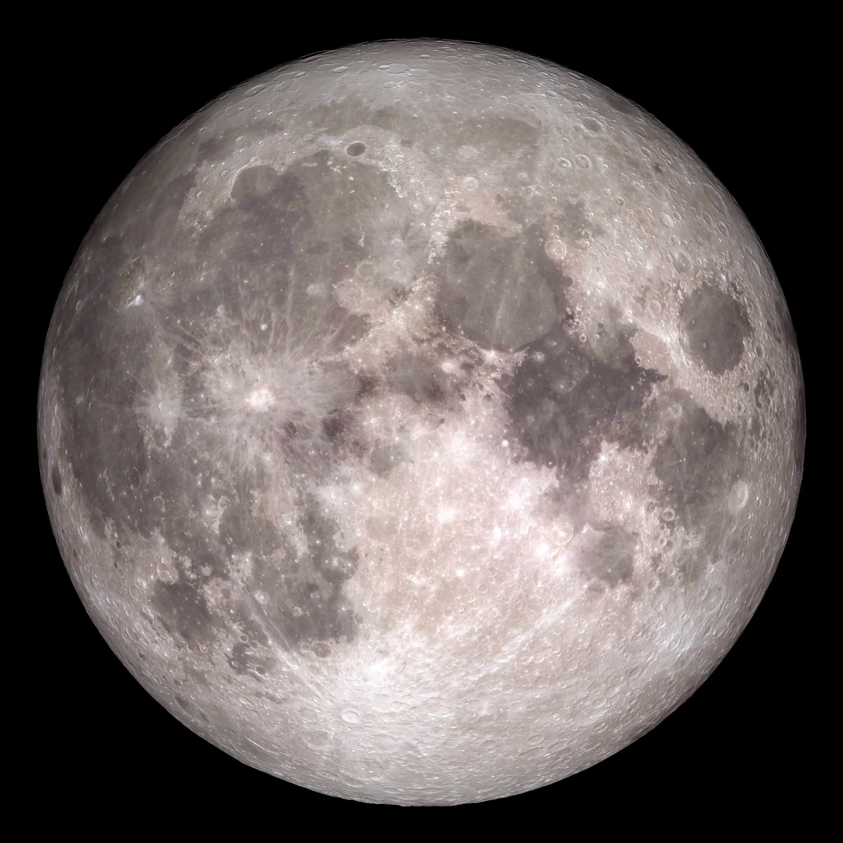
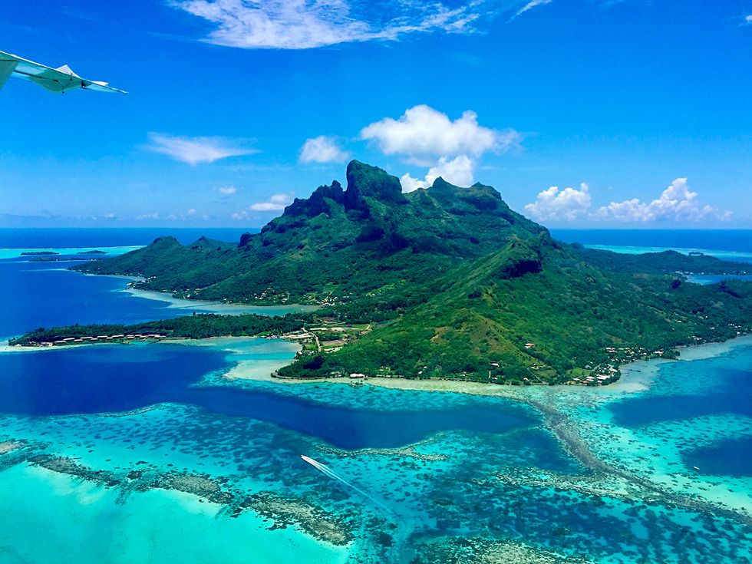
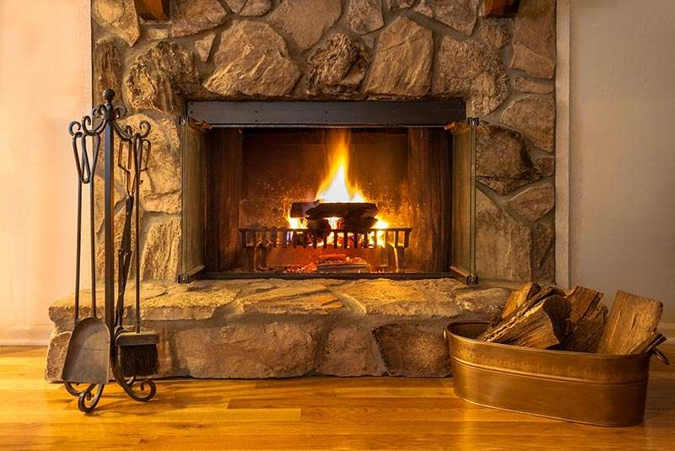
Directions: Choose the correct picture of geology from the choices below.
A
B
C
D
Notes:
Choose the one correct picture of geology from these four choices.

Slide 51
Directions: Choose the correct picture of geology from the choices below.
A
B
C
D
Notes:
Choose the one correct picture of geology from these four choices.

Slide 52
Definition
Picture
Geology
Example
How does geology impact my life?
Notes:
Here is the Frayer model filled in with a picture of geology.

Slide 53
Directions: Choose the correct definition of geology from the choices below.
A
The study of the stars
B
The study of the planets
C
The study of money
D
The study of the Earth
Notes:
Choose the one correct definition of geology from these four choices.

Slide 54
Directions: Choose the correct definition of geology from the choices below.
A
The study of the stars
B
The study of the planets
C
The study of money
D
The study of the Earth
Notes:
“The study of the Earth” is correct! This is the definition of geology.

Slide 55
Definition
Picture
The study of the Earth
Geology
Example
How does geology impact my life?
Notes:
Here is the Frayer Model with a picture and the definition filled in for geology: The study of the Earth.

Slide 56
Directions: Choose the correct example of geology from the choices below.
A
The surface of the moon
B
The surface of the ocean floor
C
The surface of an asteroid
D
The surface of a kitchen table
Notes:
Choose the one correct example of geology from these four choices.

Slide 57
Directions: Choose the correct example of geology from the choices below.
A
The surface of the moon
B
The surface of the ocean floor
C
The surface of an asteroid
D
The surface of a kitchen table
Notes:
“The surface of the ocean floor” is correct! This is an example of geology.

Slide 58
Definition
Picture
The study of the Earth
Geology
The surface of the ocean floor
Example
How does geology impact my life?
Notes:
Here is the Frayer Model with a picture, definition, and an example of geology: The study of the ocean floor.

Slide 59
Directions: Choose the correct response for “how does geology impact my life?” from the choices below.
A
We can study the mountains, rivers, and oceans around us.
B
We can study the sun, moon, and stars that we see everyday.
C
We can study how the electricity we use everyday is made.
D
We can study how our bodies need rest.
Notes:
Choose the one correct response for “how does geology impact my life?” from these four choices.

Slide 60
Directions: Choose the correct response for “how does geology impact my life?” from the choices below.
A
We can study the mountains, rivers, and oceans around us.
B
We can study the sun, moon, and stars that we see everyday.
C
We can study how the electricity we use everyday is made.
D
We can study how our bodies need rest.
Notes:
You chose “We can study the mountains, rivers, and oceans around us.” That is correct! This is an example of how geology impacts your life.

Slide 61
Definition
Picture
The study of the Earth
Geology
We can study the mountains, rivers, and oceans around us.
The surface of the ocean floor
Example
How does geology impact my life?
Notes:
Here is the Frayer Model with a picture, definition, example, and a correct response to “how does geology impact my life?”: We can study the mountains, rivers, and oceans around us.

Slide 62
Remember!!!
Notes:
So remember!

Slide 63
Geology: the study of the Earth
Notes:
Geology is the study of the Earth.

Slide 64
Big Question: What are key characteristics of the ocean environment?
Notes:
Our “big question” is: What are the key characteristics of the ocean environment?
Does anyone have any additional examples to share that haven’t been discussed yet?

Slide 65
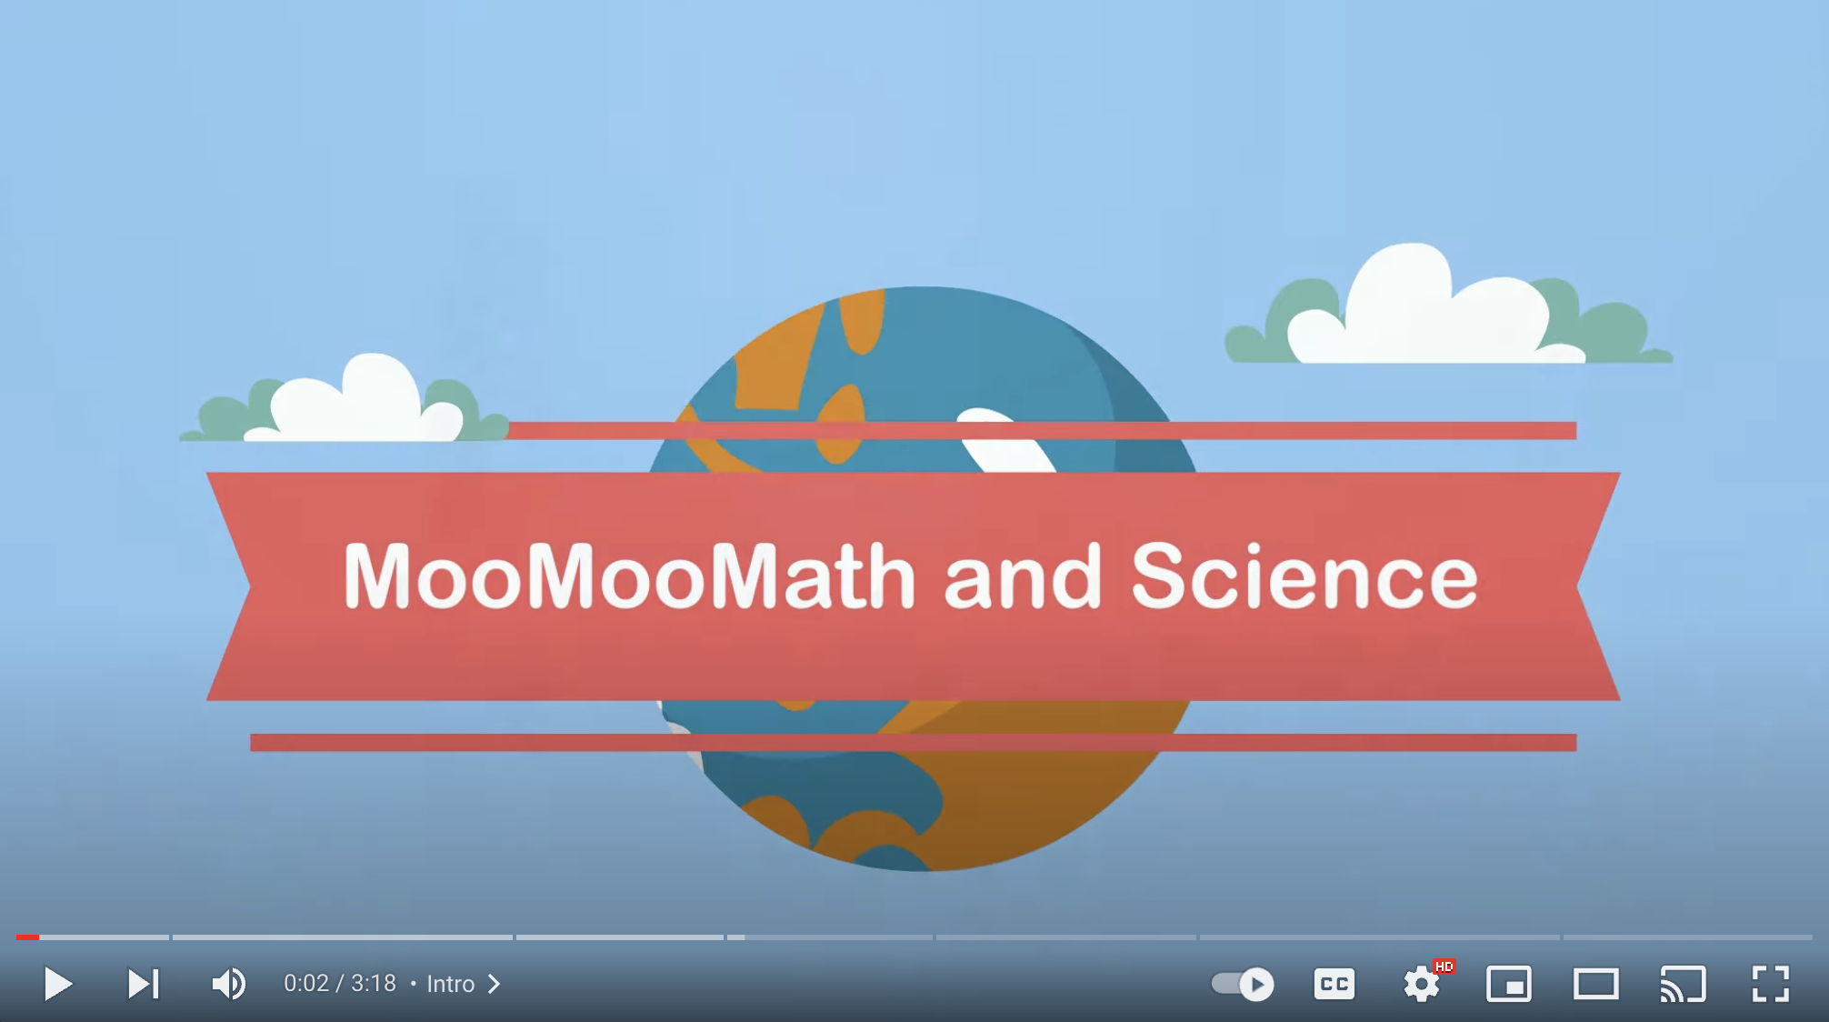
Extension Video
Ocean Floor Geology
(YouTube)
Click the link above for an extension video to deepen your understanding of ocean floor geology.
Watch the video and identify 1 or 2 different features of the ocean floor that were not yet discussed.

Slide 66
Notes:
Thanks, and please continue watching and using CAPs available from this website.

Slide 67
This Was Created With Resources From:
Questions or Comments
Michael Kennedy, Ph.D. MKennedy@Virginia.edu
Rachel L Kunemund, Ph.D. rk8vm@virginia.edu

