Slide 1
Intro
“Big Idea” Question
Review Concepts
Check-In Questions
Teacher Demo
Vocabulary
Student-Friendly Definition
Examples & Non-Examples
Morphological Word Parts
Simulation/Activity
Notes:
OK everyone, get ready for our next lesson. Just as a reminder, these are the different components that our lesson may include, and you’ll see these icons in the top left corner of each slide so that you can follow along more easily!

Slide 2
Intro
Gravity
Notes:
Today we will learn about gravity.

Slide 3
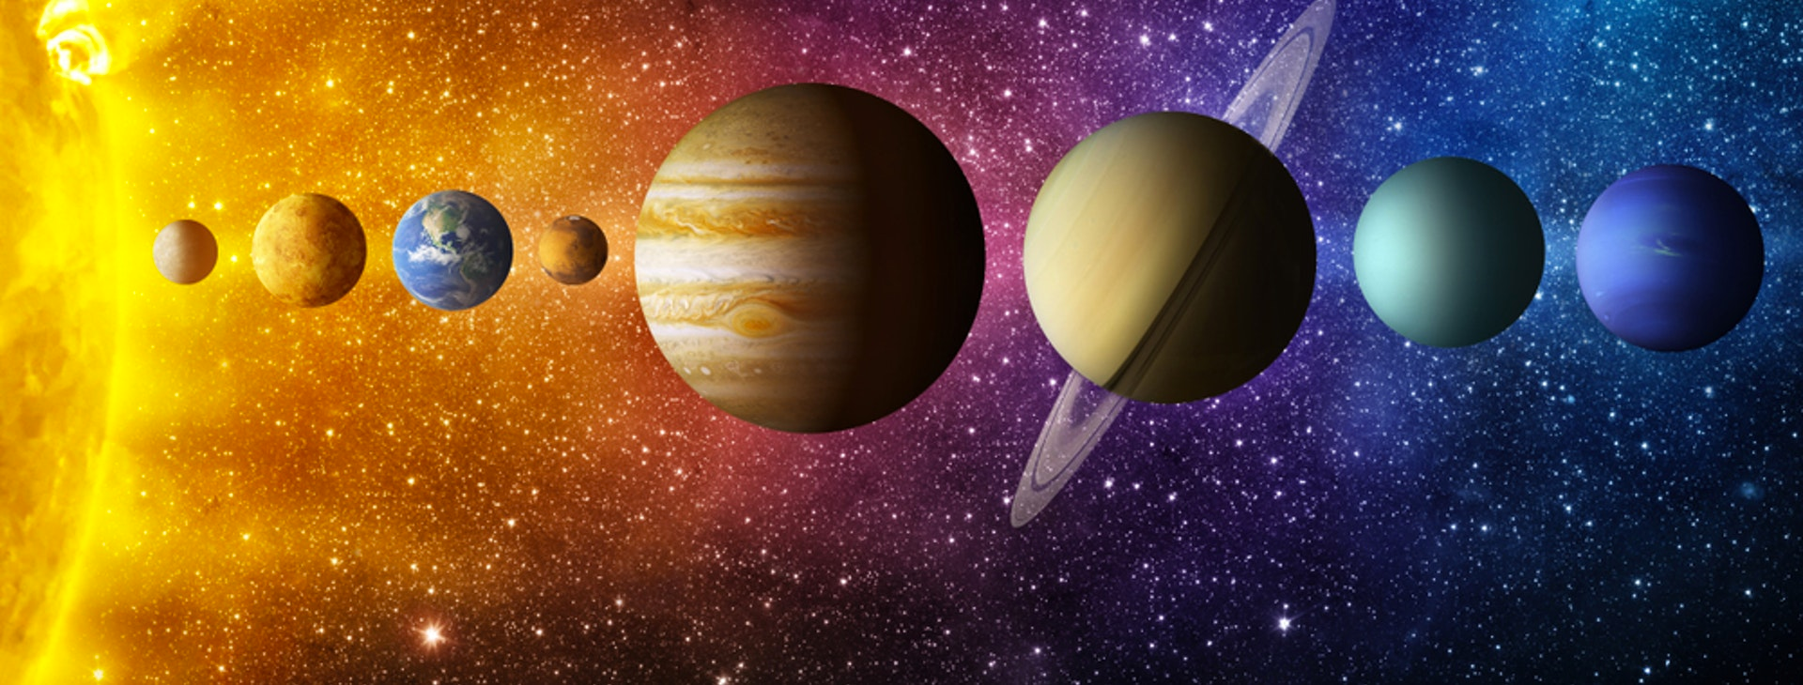
Big Question: What are the differences between the inner and outer planets?
Notes:
Our “big question” is: What are the differences between the inner and outer planets?
[Pause and illicit predictions from students.]
I love all these thoughtful scientific hypotheses! Be sure to keep this question and your predictions in mind as we move through these next few lessons, and we’ll continue to revisit it.

Slide 4
Demonstration
Notes:
Demonstration – Let’s see what gravity looks like!
For this demonstration, all I need is a basketball and a tennis ball.
I am going to hold the basketball and tennis ball at the same height and drop them at the same time.
They both fell at the same rate because the force of gravity is equal on both of them. Gravity is equal on all objects independent of mass.
Feedback: Make your demonstration clear and follow a logical order of steps that helps the students make sense of the activity and stay engaged.

Slide 5
Notes:
Let’s check-in for understanding.
Feedback: Prompt students with questioning throughout demonstration you helped ensure that your students are grasping this new content.

Slide 6
What did you notice about gravity in our demonstration?
Notes:
What did you notice about gravity in our demonstration?

Slide 7
Notes:
Before we move on to our new vocabulary term, let’s review some other words & concepts that you already learned and make sure you are firm in your understanding.
Feedback: Reviewing key background knowledge helps lay the context and sets the students up to make sense of the new content you are introducing, it also reinforces previously learned material.

Slide 8
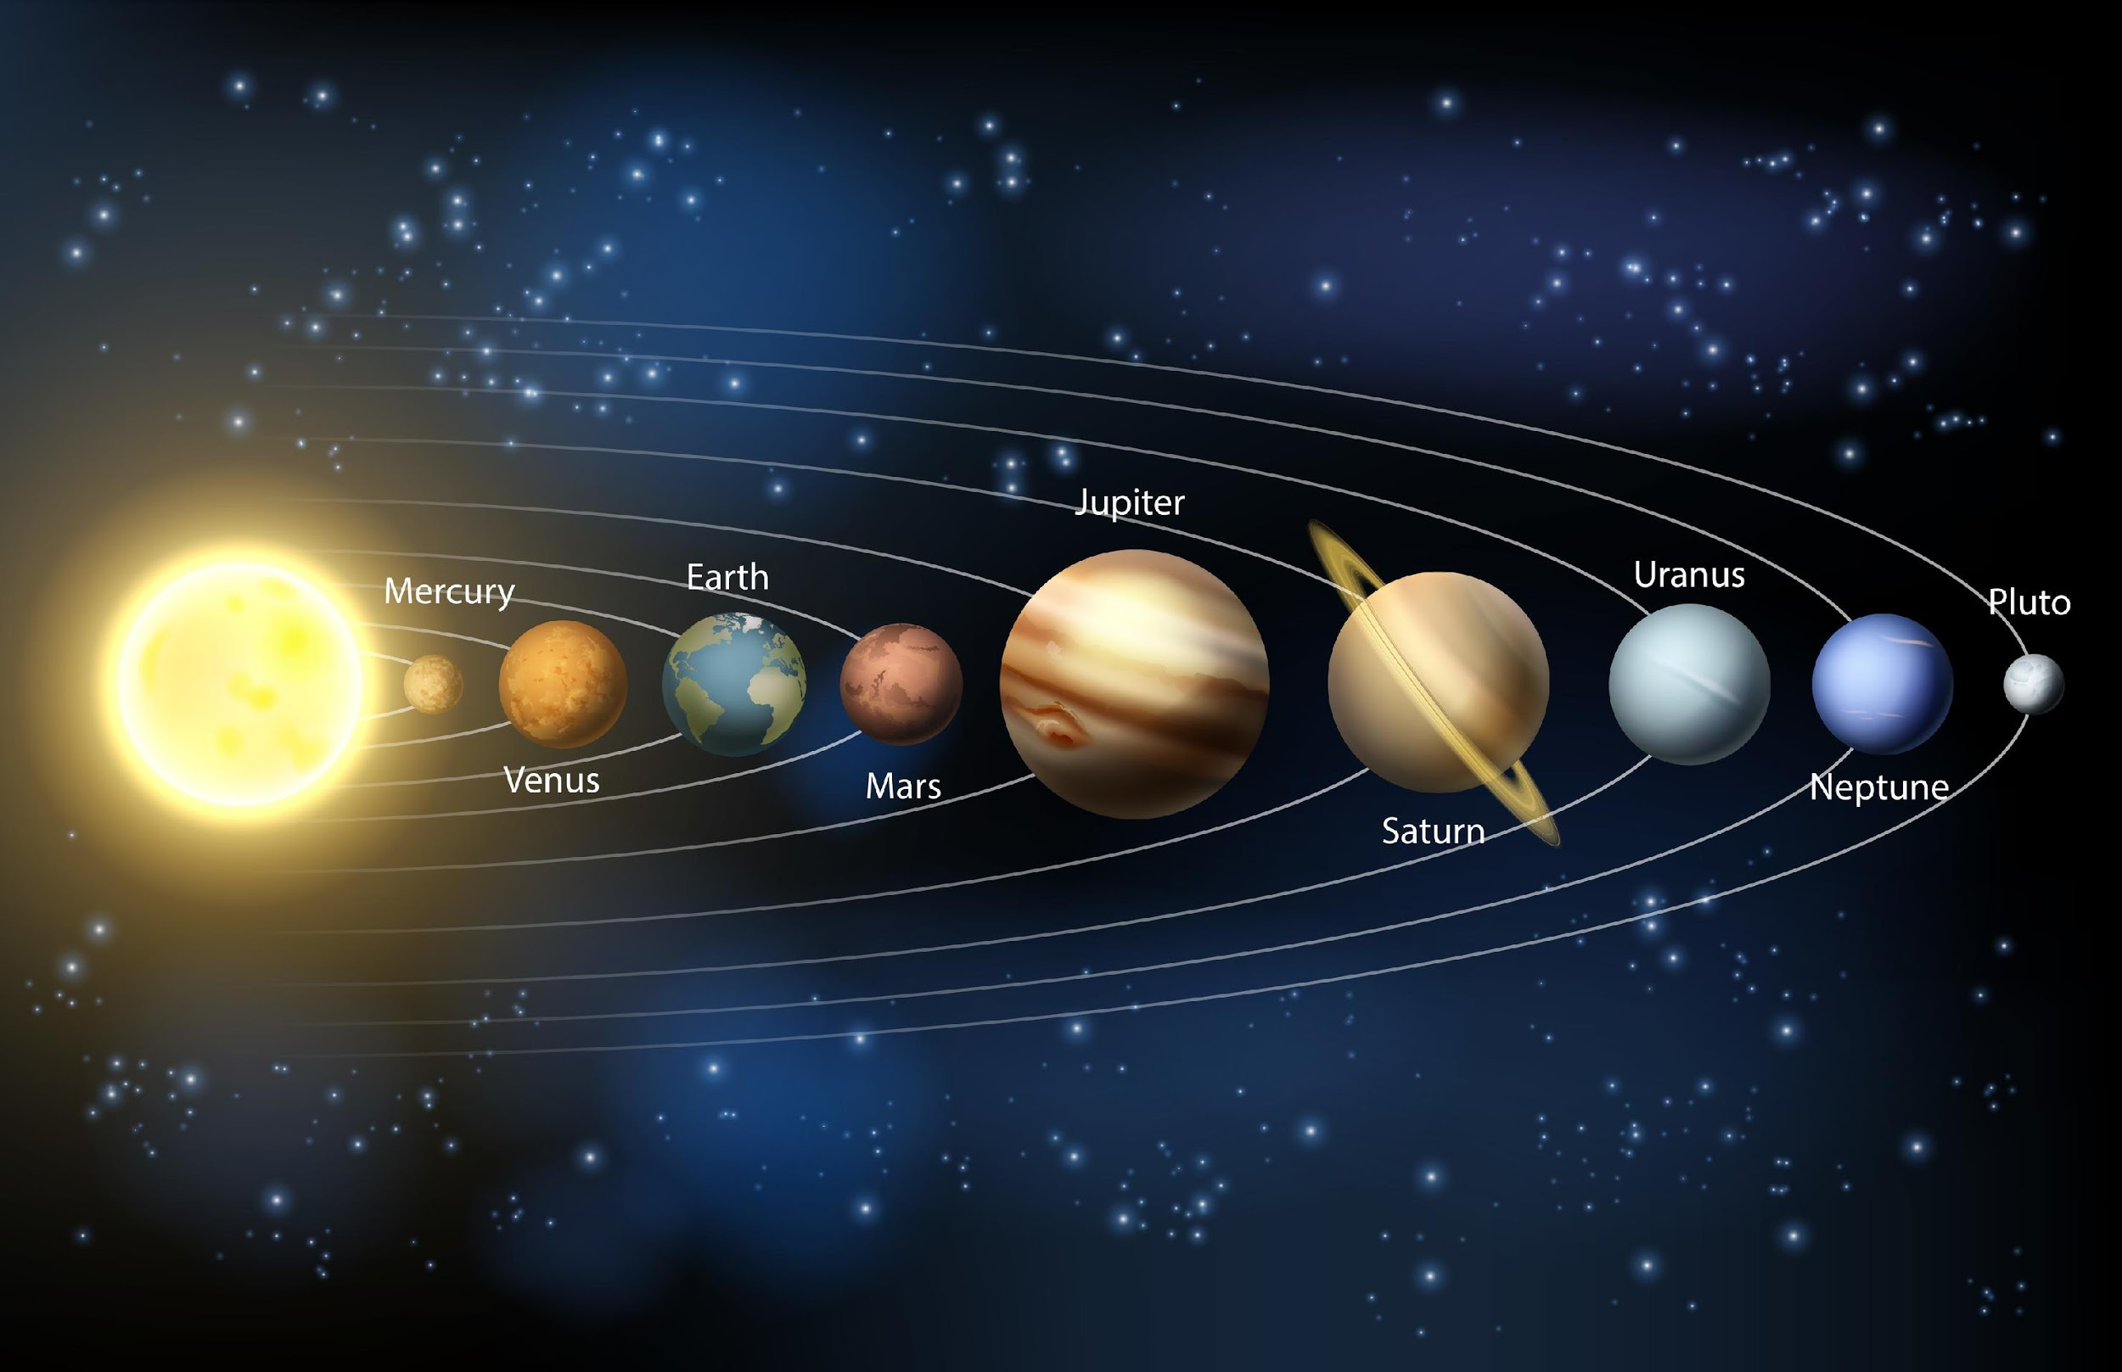
The Solar System: the sun with all the planets and other bodies that revolve around it
Notes:
The solar system is the sun with all the planets and other bodies that revolve around it.

Slide 9
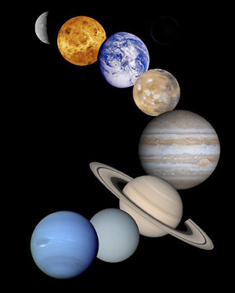
Planet: a body or object in space that revolves around a star and has a spherical shape
Notes:
A planet is a body or object in space that revolves around a star and has a spherical shape.

Slide 10
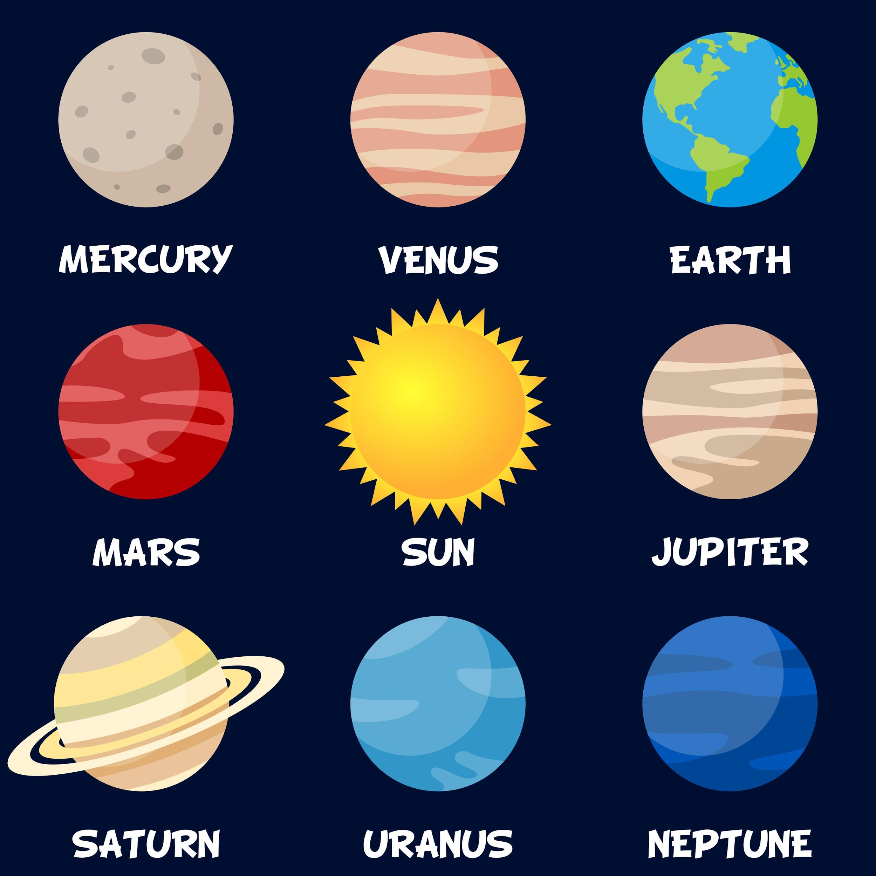
Notes:
Our solar system has 8 planets.

Slide 11
Notes:
Now let’s pause for a moment to check your understanding.
Feedback: Monitoring understanding during review is an important step before moving on to new material.

Slide 12
What is a solar system?
Notes:
What is a solar system?
[A solar system is the sun with all the planets and other bodies that revolve around it.]

Slide 13
What is a planet?
Notes:
What is a planet?
[A planet is a body or object in space that revolves around a star and has a spherical shape.

Slide 14
Gravity
Notes:
Now that we’ve reviewed, let’s define our new term, gravity.

Slide 15
Gravity: a force that attracts objects toward the center of another object
Notes:
Gravity is a force that attracts objects toward the center of another object.
Feedback: Longer more formal definitions are tricky, use clear language you used when providing the new definition.

Slide 16
Notes:
Let’s check-in for understanding.

Slide 17
What is gravity?
Notes:
What is gravity?
[Gravity is a force that attracts objects toward the center of another object.]

Slide 18
Notes:
That is the basic definition, but there is a bit more you need to know.

Slide 19
Gravitational field strength is influenced by mass and distance
Notes:
The strength of an object’s gravitational field depends on its mass and the distance between it and another object with mass.

Slide 20
The sun has the most mass.
Notes:
The sun is the most massive object in our solar system, so it has the strongest gravitational field (or pull).

Slide 21
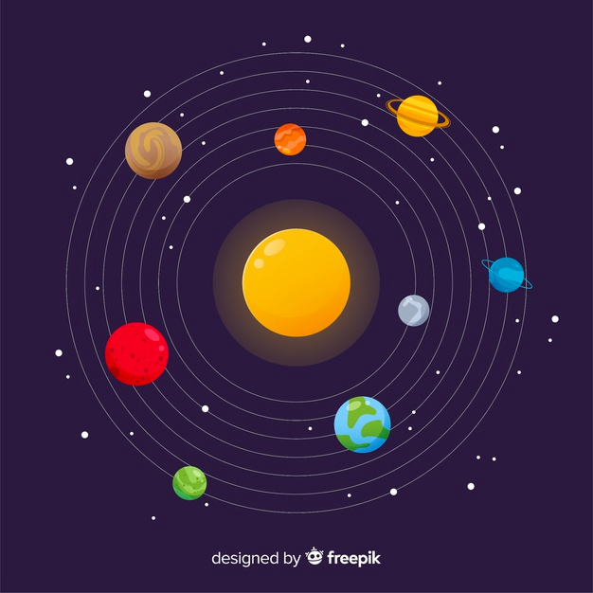
Notes:
Gravity is what keeps the planets in orbit around the sun.

Slide 22
Notes:
Let’s check-in for understanding.

Slide 23
What factors impact gravitational strength?
Notes:
What factors impact gravitational strength?
[Mass and distance]

Slide 24
How does gravity impact the orbit of the planets?
Notes:
How does gravity impact the orbit of the planets?
[Gravity is what keeps the planets in orbit around the sun.]

Slide 25
Notes:
Now, let’s talk about some examples of gravity.
Feedback: When introducing examples use clear and easy to understand language.

Slide 26
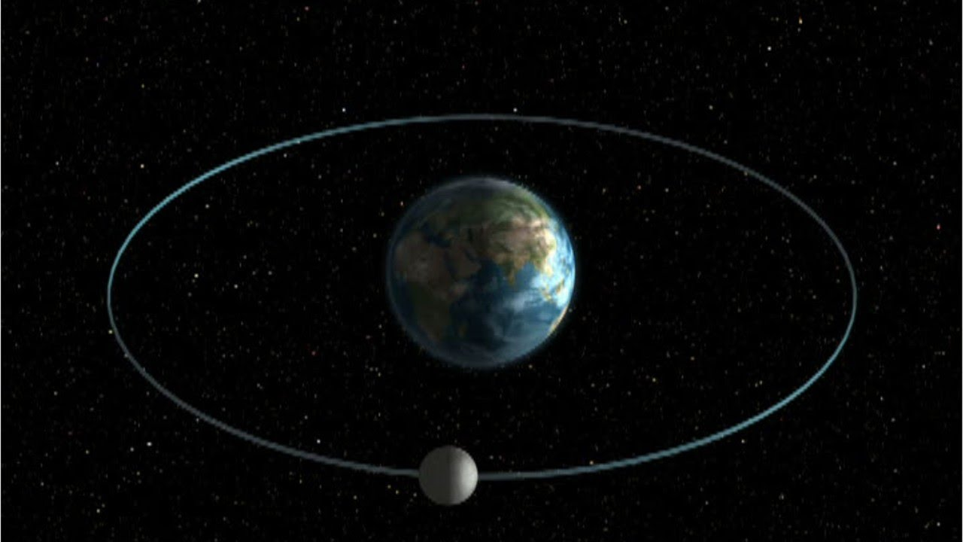
The moon orbiting the Earth
Notes:
An example of gravity is the moon orbiting the Earth. It stays in orbit due to the Earth’s gravitational force, the same way the planets orbit the sun.

Slide 27
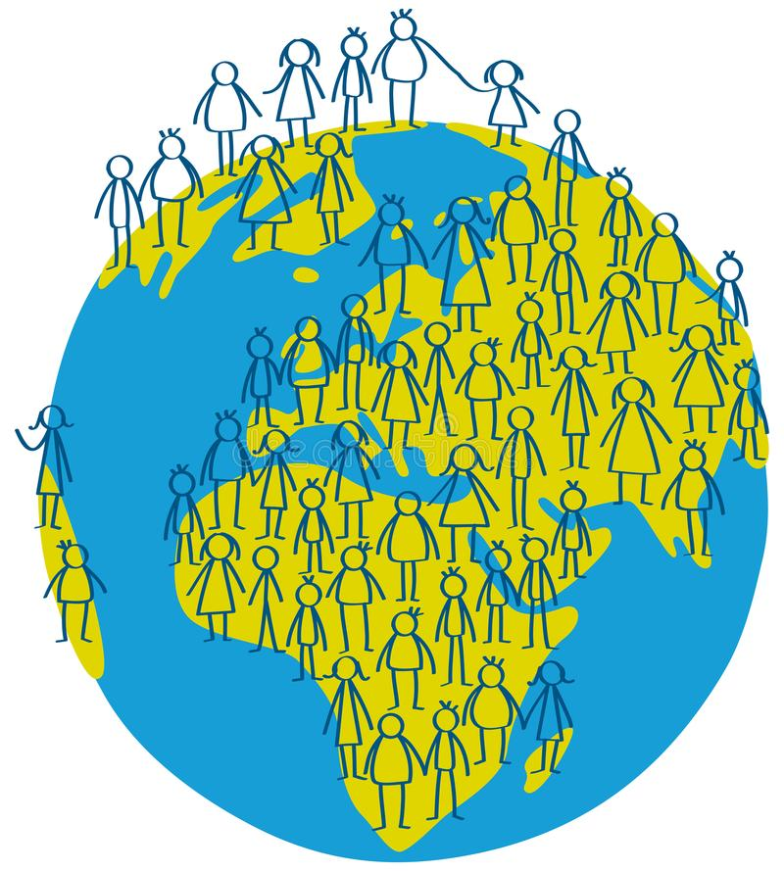
How we stay on the ground
Notes:
Being able to stay on the ground is another example of gravity. Since we have mass, gravity keeps pulling us to the ground, which also has mass. This is why we aren’t just floating around.

Slide 28
Notes:
Next, let’s talk about some non-examples of gravity.
Feedback: One important component of using non-examples is by clearly distinguishing similarities and explaining why it is a non-example.

Slide 29
Notes:
Throwing a ball is not an example of gravity. Force is applied to counteract gravity.

Slide 30
Notes:
Let’s check-in for understanding.

Slide 31
What is an example of gravity?
Notes:
What is an example of gravity?
Feedback: Having students come up with their own examples can showcase their understanding and uncover misconceptions.

Slide 32
Why is throwing a ball not an example of gravity?
Notes:
Why is throwing a ball not an example of gravity?
[Throwing a ball is not an example of gravity. Force is applied to counteract gravity.]

Slide 33
What is gravity?
Notes:
What is gravity?
[Gravity is a force that attracts objects toward the center of another object.]

Slide 34
Which two factors influence the strength of an object’s gravitational field?
Mass and density
Mass and distance
Distance and temperature
Temperature and density
Notes:
Which two factors influence the strength of an object’s gravitational field?

Slide 35
Which two factors influence the strength of an object’s gravitational field?
Mass and density
Mass and distance
Distance and temperature
Temperature and density
Notes:
Which two factors influence the strength of an object’s gravitational field?
[Mass and distance]

Slide 36
What is an example of gravity?
Notes:
What is an example of gravity?
Feedback: Confirming students' understanding with lots of opportunities to respond when closing a lesson is super important.

Slide 37
Remember!!!
Notes:
So remember!
Feedback: It is important to review the key term when closing the lesson.

Slide 38
Gravity: a force that attracts objects toward the center of another object
Notes:
Gravity is a force that attracts objects toward the center of another object.

Slide 39
Gravitational field strength is influenced by mass and distance
Notes:
The strength of an object’s gravitational field depends on its mass and the distance between it and another object with mass.

Slide 40
Big Question: What are the differences between the inner and outer planets?
Notes:
Explicit cue to revisit the big question at the end of the lesson: Okay everyone. Now that we’ve learned the term, let’s reflect once more on our big question. Was there anything that we predicted earlier that was correct or incorrect? Do you have any new hypotheses to share?

Slide 41
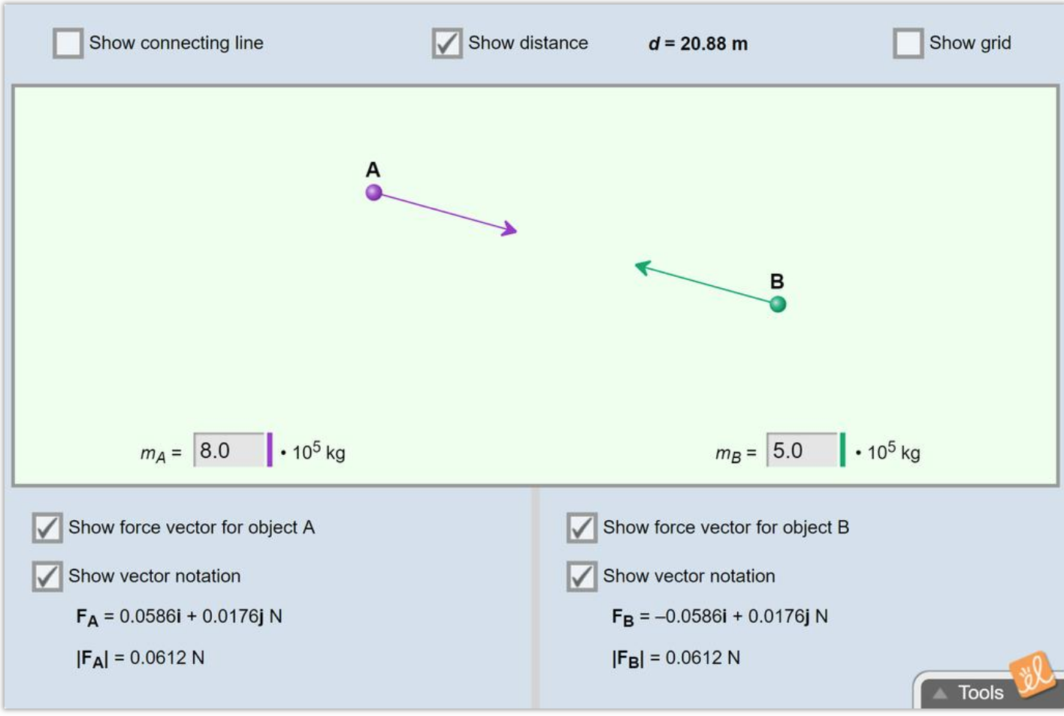
Simulation Activity
Gravitational Force
(Gizmos)
Click the link above to explore gravity and the gravitational force between two objects.
Notes:
Click the link above to explore gravity and the gravitational force between two objects.
Feedback: Explore learning gizmos are a great resource for inquiry based learning activities.

Slide 42
Notes:
Thanks for watching, and please continue watching CAPs available from this website.

Slide 43
This Video Was Created With Resources From:
Questions or Comments
Michael Kennedy, Ph.D. MKennedy@Virginia.edu
Rachel L Kunemund, Ph.D. rk8vm@virginia.edu

Slide 44
Intro
“Big Idea” Question
Review Concepts
Check-In Questions
Teacher Demo
Vocabulary
Student-Friendly Definition
Examples & Non-Examples
Morphological Word Parts
Simulation/Activity
Notes:
OK everyone, get ready for our next lesson. Just as a reminder, these are the different components that our lesson may include, and you’ll see these icons in the top left corner of each slide so that you can follow along more easily!

Slide 45
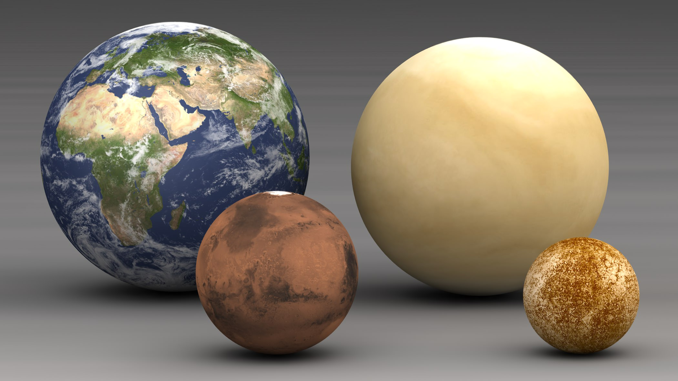
Intro
Inner Planets
Notes:
Today we’re going to learn about inner planets.

Slide 46
Big Question: What are the differences between the inner and outer planets?
Notes:
Before we start, let’s think about our “big question”: What are the differences between the inner and outer planets?
[Pause and illicit predictions from students.]
I love all these thoughtful scientific hypotheses! Be sure to keep this question and your predictions in mind as we move through these next few lessons, and we’ll continue to revisit it.

Slide 47
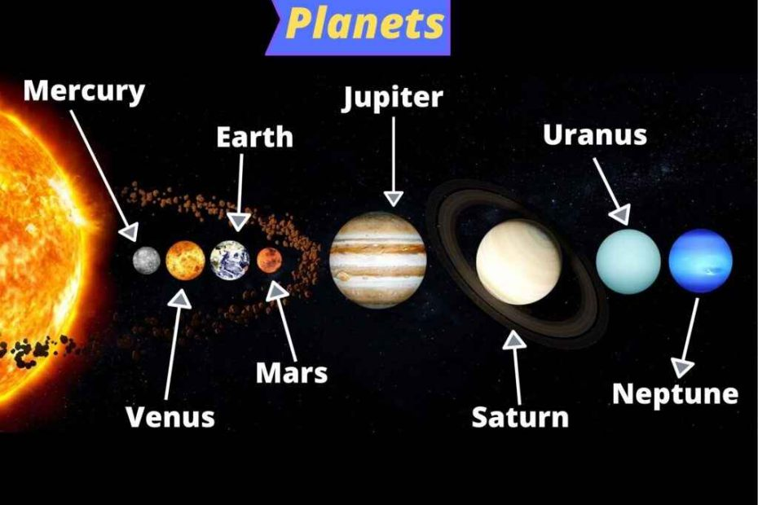
Demonstration
Notes:
The image above shows the order of planets from the sun. Think of the term inner planets and predict what you think the four inner planets in our solar system. What criteria did you use to determine the four inner planets?
Feedback: Providing students with the opportunity to make predictions about what will happen allows them to think critically about the content.

Slide 48
Notes:
Now let’s pause for a moment to check your understanding.

Slide 49
What do you predict are the four inner planets? Explain your reasoning.
Notes:
What do you predict are the four inner planets? explain your reasoning. (*Provide wait time and give specific feedback based on student responses)

Slide 50
Notes:
Before we move on to our new vocabulary term, let’s review some other words & concepts that you already learned and make sure you are firm in your understanding.

Slide 51
The Solar System: the sun with all the planets and other bodies that revolve around it
Notes:
The solar system is the sun with all the planets and other bodies that revolve around it.

Slide 52
Planet: a body or object in space that revolves around a star and has a spherical shape
Notes:
A planet is a body or object in space that revolves around a star and has a spherical shape.

Slide 53
Gravity: a force that attracts objects toward the center of another object
Notes:
Gravity is a force that attracts objects toward the center of another object.

Slide 54
Notes:
Now let’s pause for a moment to check your understanding.

Slide 55
What is a solar system?
Notes:
What is a solar system? (*Provide wait time and give specific feedback based on student responses)
[A solar system is the sun with all the planets and other bodies that revolve around it.]

Slide 56
What is the relationship between gravity, the planets, and the sun?
Notes:
What is the relationship between gravity, the planets, and the sun? (*Provide wait time and give specific feedback based on student responses)
[The gravitational force of the sun is what keeps the planets in orbits around the sun.]

Slide 57
Inner Planets
Notes:
Now that we’ve reviewed, let’s define our new term, inner planets.

Slide 58
Inner Planets: first four (closest) planets in our solar system
Notes:
The inner planets are the first four planets in our solar system, closest to the sun. Mercury, Venus, Earth, and Mars are the inner planets.

Slide 59
Notes:
Let’s check-in for understanding.

Slide 60
What is an inner planet?
Notes:
What is an inner planet? (*Provide wait time and give specific feedback based on student responses)
(The inner planets are the first four planets in our solar system, closest to the sun.)

Slide 61
Notes:
That is the basic definition, but there is a bit more you need to know.

Slide 62
Notes:
These planets are grouped together because they are closer to the sun, and because they are relatively small in size and have rocky surfaces.

Slide 63
Notes:
Let’s check-in for understanding.

Slide 64
Why are the inner planets grouped together?
Notes:
Why are the inner planets grouped together? (*Provide wait time and give specific feedback based on student responses)
[These planets are grouped together because they are closer to the sun, and because they are relatively small in size and have rocky surfaces.]

Slide 65
Notes:
Now, let’s talk about some examples of the inner planets.

Slide 66
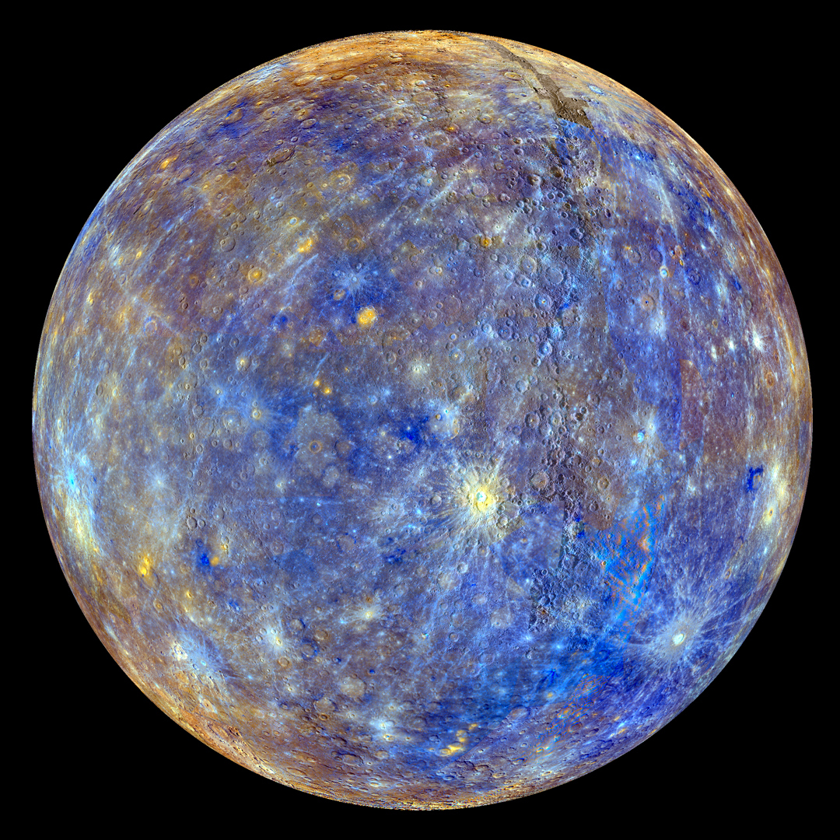
Notes:
Mercury is one of the inner planets. It has a solid surface with many craters.

Slide 67
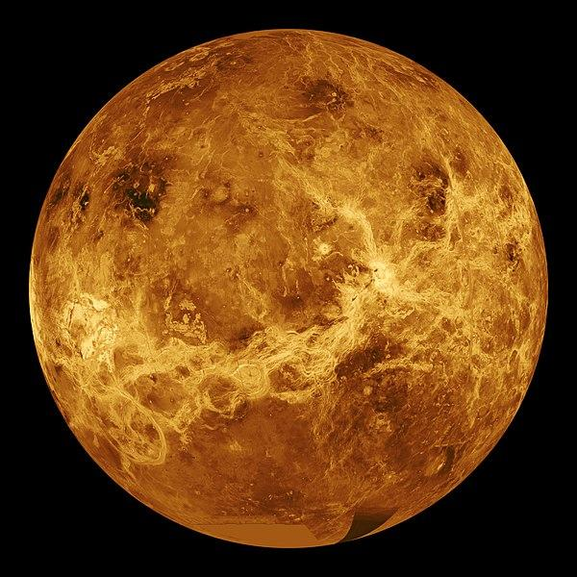
Notes:
Venus is one of the inner planets. Its crust is mostly basalt (rocky) and it is the hottest planet in the solar system.

Slide 68
Notes:
Earth is one of the inner planets. Its surface has mountains, valleys, canyons, plains, and more. Most of the surface is water.

Slide 69
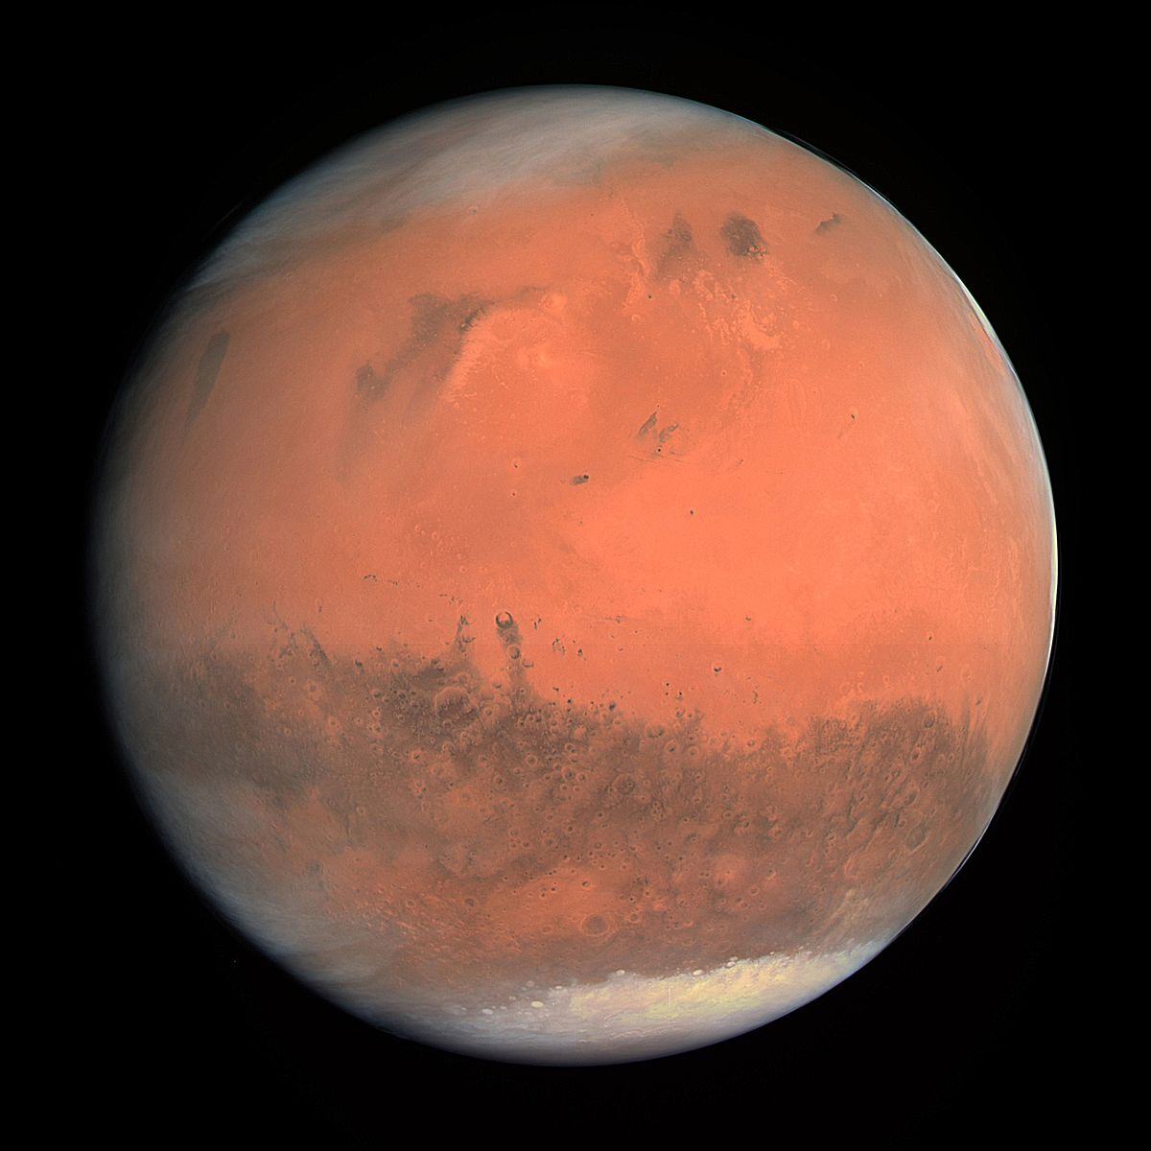
Notes:
Mars is one of the inner planets. Its surface is rocky – it has canyons, volcanoes, and craters. Red dust covers most of the surface.

Slide 70
Notes:
Next, let’s talk about some non-examples of inner planets.

Slide 71
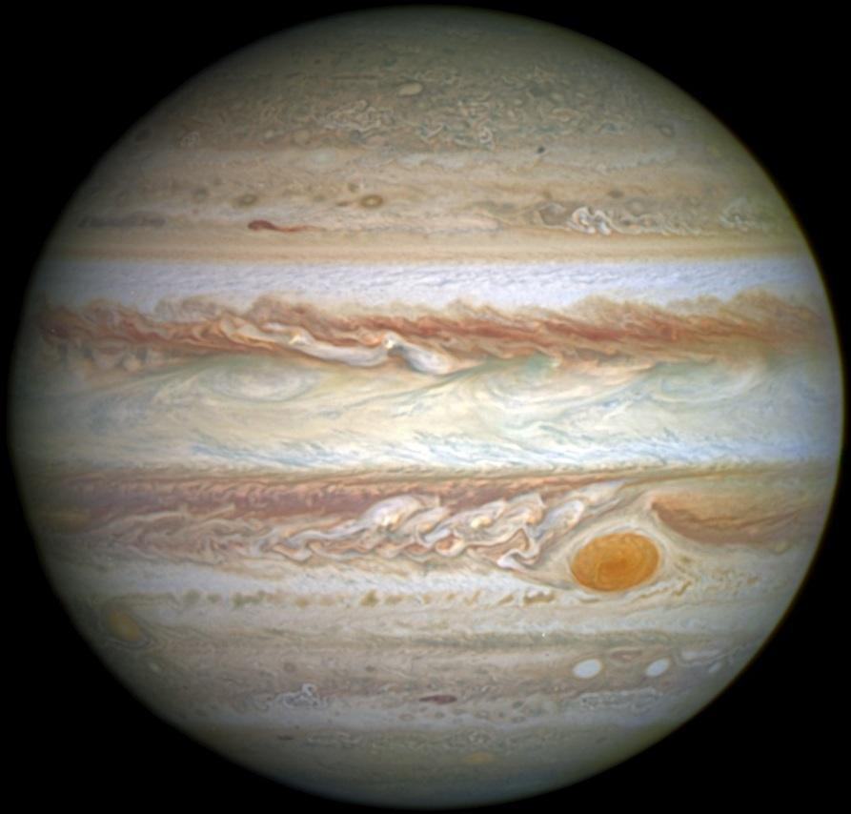
Notes:
Jupiter is not one of the inner planets. It is not one of the first four planets.

Slide 72
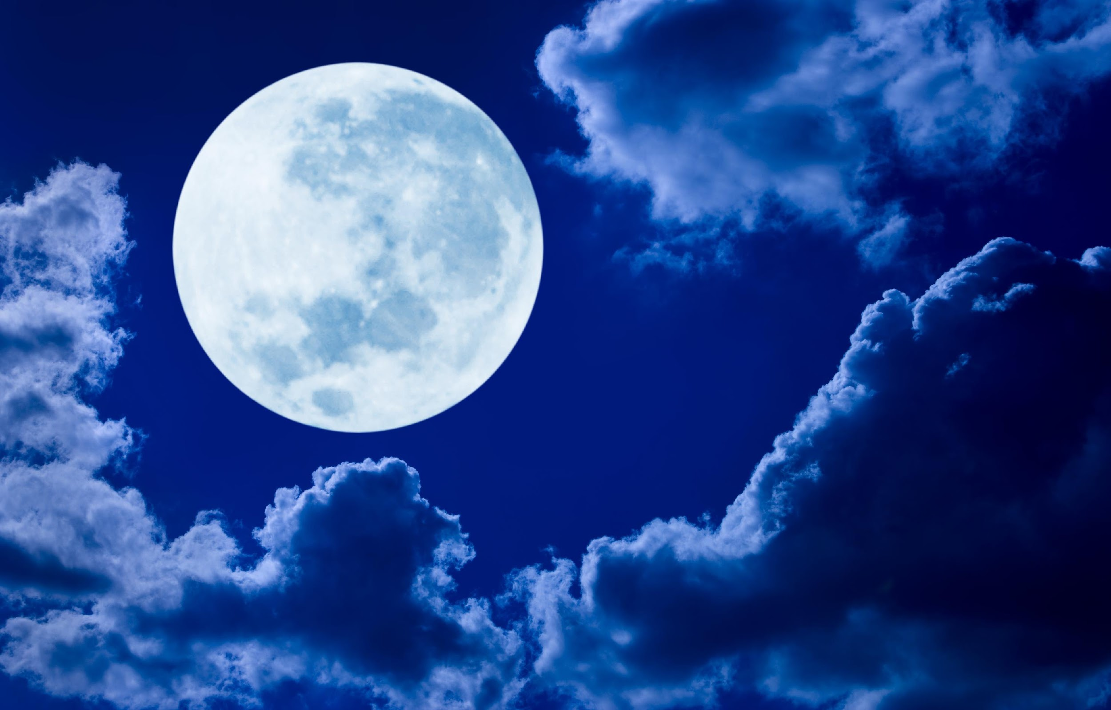
Notes:
Moons are not inner planets because they are not planets at all.

Slide 73
Notes:
Let’s check-in for understanding.

Slide 74
List some examples of inner planets and their characteristics.
Notes:
List some examples of inner planets and their characteristics. (*Provide wait time and give specific feedback based on student responses)

Slide 75
What is a non-example of an inner planet?
NON
Notes:
What is a non-example of an inner planet? (*Provide wait time and give specific feedback based on student responses)

Slide 76
Notes:
Let’s check-in for understanding.

Slide 77
What is an inner planet and what are its characteristics?
Notes:
What is an inner planet and what are its characteristics? (*Provide wait time and give specific feedback based on student responses)
[The inner planets are the first four planets in our solar system, closest to the sun. They are also relatively small and have rocky surfaces.]

Slide 78
List some examples of inner planets and their characteristics.
Notes:
List some examples of inner planets and their characteristics. (*Provide wait time and give specific feedback based on student responses)

Slide 79
Remember!!!
Notes:
So remember!

Slide 80
Inner Planets: first four (closest) planets in our solar system
Notes:
The inner planets are the first four planets in our solar system, closest to the sun. Mercury, Venus, Earth, and Mars are the inner planets.

Slide 81
Notes:
These planets are grouped together because they are closer to the sun, and because they are relatively small in size and have rocky surfaces.

Slide 82
Big Question: What are the differences between the inner and outer planets?
Notes:
Explicit cue to revisit the big question at the end of the lesson: Okay everyone. Now that we’ve learned the term, let’s reflect once more on our big question. Was there anything that we predicted earlier that was correct or incorrect? Do you have any new hypotheses to share?

Slide 83
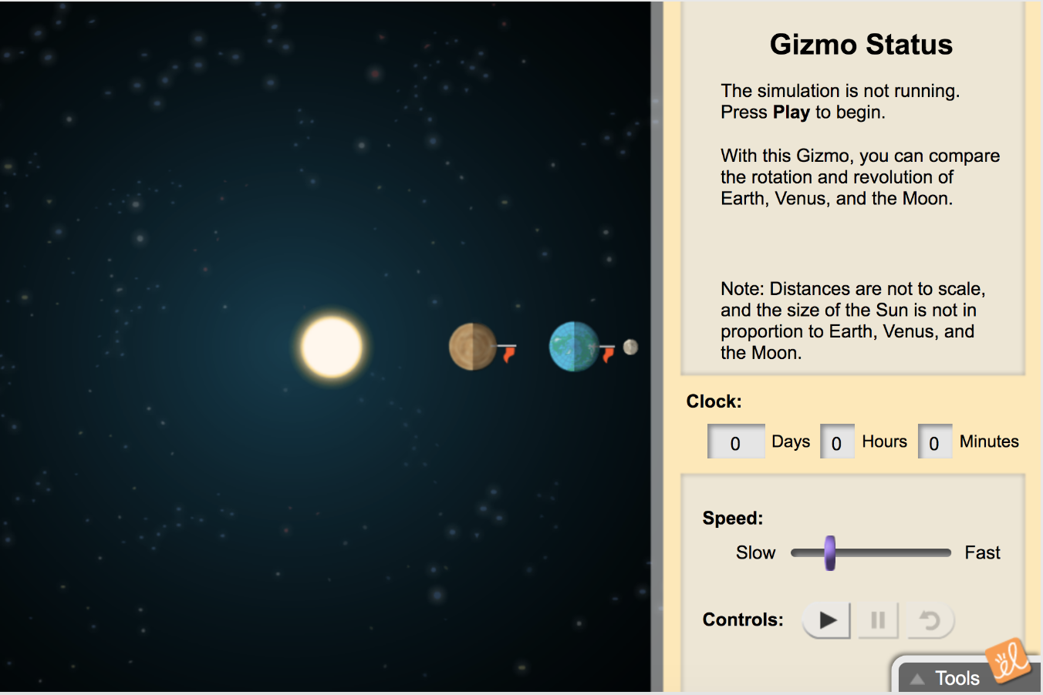
Simulation Activity
Comparing Venus and Earth
(Gizmos)
Click the link above to explore the differences between Venus and Earth, two of the inner planets.
Notes:
Click the link above to explore the differences between Venus and Earth, two of the inner planets.
Feedback: Comparison is one of the strongest tools to help students understand the similarities and differences between two terms.

Slide 84
Notes:
Thanks for watching, and please continue watching CAPs available from this website.

Slide 85
This Video Created With Resources From:
Questions or Comments
Michael Kennedy, Ph.D. MKennedy@Virginia.edu
Rachel L Kunemund, Ph.D. rk8vm@virginia.edu

Slide 86
Intro
“Big Idea” Question
Review Concepts
Check-In Questions
Teacher Demo
Vocabulary
Student-Friendly Definition
Examples & Non-Examples
Morphological Word Parts
Simulation/Activity
Notes:
OK everyone, get ready for our next lesson. Just as a reminder, these are the different components that our lesson may include, and you’ll see these icons in the top left corner of each slide so that you can follow along more easily!

Slide 87
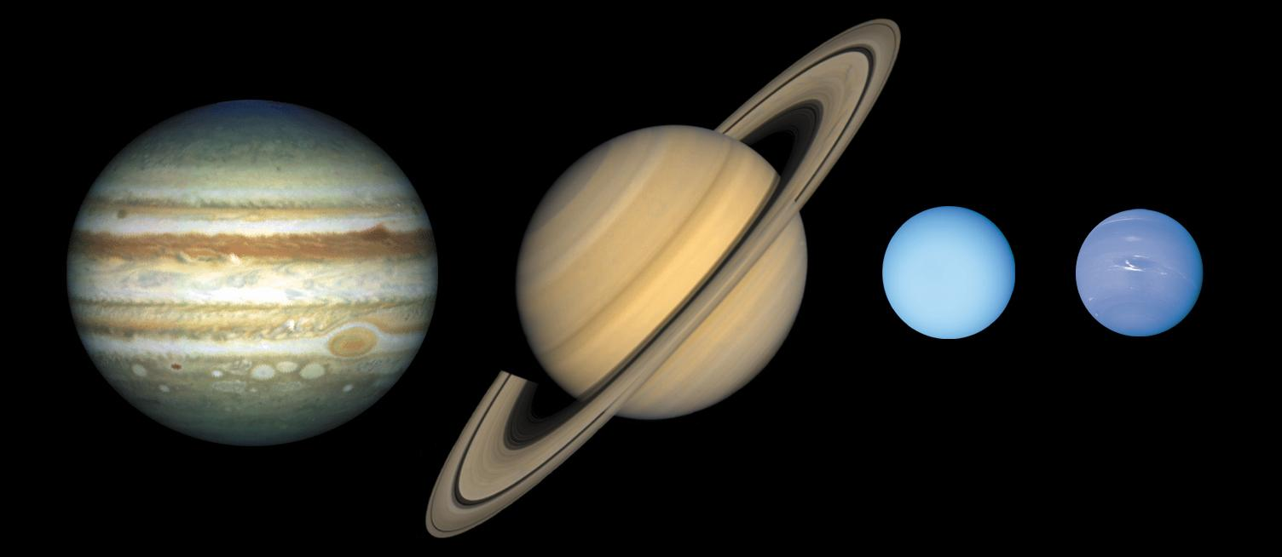
Intro
Outer Planets
Notes:
Today we’ll be learning about the outer planets.

Slide 88
Big Question: What are the differences between the inner and outer planets?
Notes:
Before we start, let’s think about our “big question” again: What are the differences between the inner and outer planets?
[Pause and illicit predictions from students.]
I love all these thoughtful scientific hypotheses! Be sure to keep this question and your predictions in mind as we move through these next few lessons, and we’ll continue to revisit it.

Slide 89
Demonstration
Notes:
The image above shows the order of planets from the sun. Think of the term outer planets and predict what you think the four outer planets in our solar system. What criteria did you use to determine the four outer planets?

Slide 90
Notes:
Now let’s pause for a moment to check your understanding.

Slide 91
What do you predict are the four outer planets? Explain your reasoning.
Notes:
What do you predict are the four outer planets? explain your reasoning. (*Provide wait time and give specific feedback based on student responses)

Slide 92
Notes:
Let’s review some terms & concepts that you already learned and make sure you are firm in your understanding.

Slide 93
The Solar System: the sun with all the planets and other bodies that revolve around it
Notes:
The solar system is the sun with all the planets and other bodies that revolve around it.

Slide 94
Planet: a body or object in space that revolves around a star and has a spherical shape
Notes:
A planet is a body or object in space that revolves around a star and has a spherical shape.

Slide 95
Gravity: a force that attracts objects toward the center of another object
Notes:
Gravity is a force that attracts objects toward the center of another object.

Slide 96
Inner Planets: first four (closest) planets in our solar system
Notes:
The inner planets are the first four planets in our solar system, closest to the sun. Mercury, Venus, Earth, and Mars are the inner planets.

Slide 97
Notes:
Now let’s pause for a moment to check your understanding.

Slide 98
What is a solar system?
Notes:
What is a solar system? (*Provide wait time and give specific feedback based on student responses)
[A solar system is the sun with all the planets and other bodies that revolve around it.]

Slide 99
What is the relationship between gravity, the planets, and the sun?
Notes:
What is the relationship between gravity, the planets, and the sun? (*Provide wait time and give specific feedback based on student responses)
[The gravitational force of the sun is what keeps the planets in orbits around the sun.]

Slide 100
What are the inner planets?
Notes:
What are the inner planets? (*Provide wait time and give specific feedback based on student responses)
[The inner planets are the first four planets in our solar system, closest to the sun. Mercury, Venus, Earth, and Mars are the inner planets.]

Slide 101
Outer Planets
Notes:
Now that we’ve reviewed, let’s define our new term, outer planets.

Slide 102
Outer Planets: last four (farthest) planets in our solar system
Notes:
The outer planets are the las four planets in our solar system, farthest away from the sun. Jupiter, Saturn, Uranus, and Neptune are the outer planets.

Slide 103
Notes:
Let’s check-in for understanding.

Slide 104
What are outer planets?
Notes:
What are outer planets? (*Provide wait time and give specific feedback based on student responses)
[The outer planets are the last four planets in our solar system, farthest away from the sun. Jupiter, Saturn, Uranus, and Neptune are the outer planets.]

Slide 105
Notes:
That is the basic definition, but there is a bit more you need to know.

Slide 106
Notes:
These planets are grouped together because they are farther away from the sun, and because they are relatively large in size and are made up of mostly gases.

Slide 107
Notes:
Let’s check-in for understanding.

Slide 108
Why are the outer planets grouped together?
Notes:
Why are the outer planets grouped together? (*Provide wait time and give specific feedback based on student responses)
[These planets are grouped together because they are farther away from the sun, and because they are relatively large in size and are made up of mostly gases.]

Slide 109
Notes:
Now, let’s talk about some examples of outer planets.

Slide 110
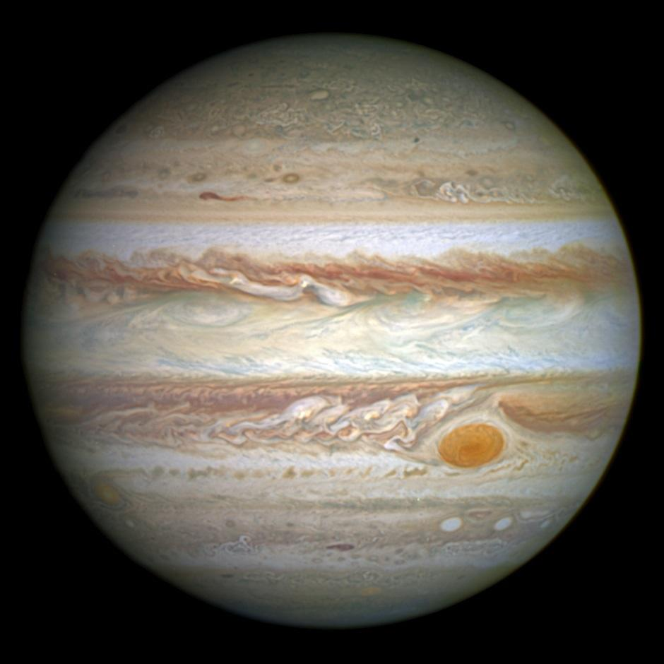
Notes:
Jupiter is an outer planet. It is large and has a low density. The atmosphere in Jupiter is very opaque.

Slide 111
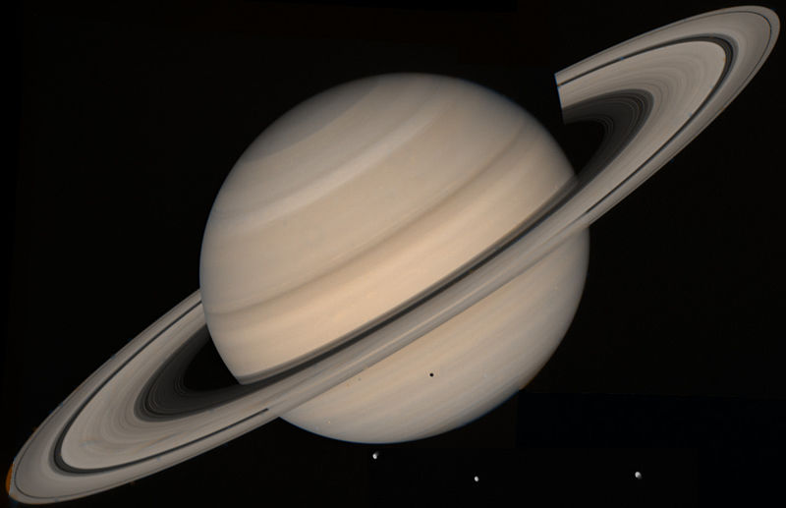
Notes:
Saturn is an outer planet. The rings are not solid. You cannot stand on Saturn because it is mostly made of gas. Because of this, Saturn could float in water – even though it is so huge.

Slide 112
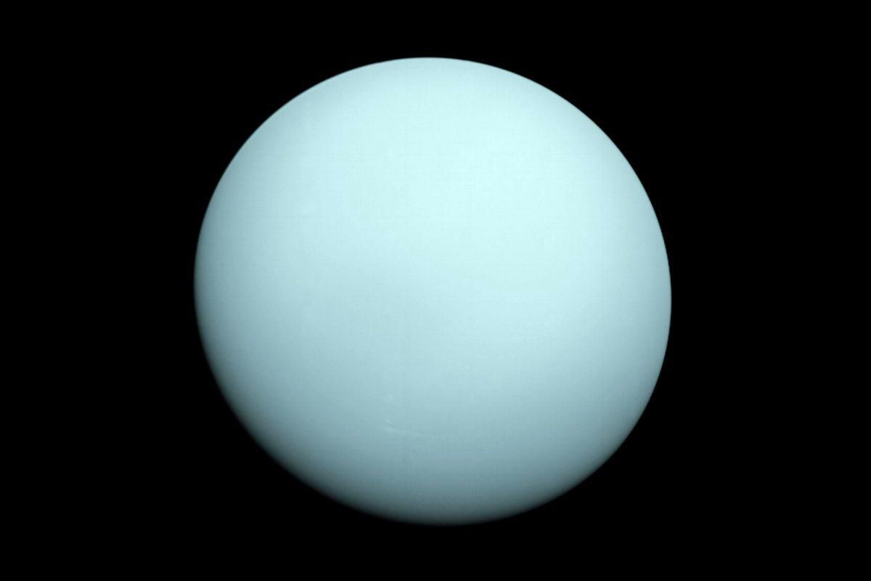
Notes:
Uranus is an outer planet. Its color is because of the methane in its hydrogen-helium atmosphere. Uranus is made up of mostly ice due to a mixture of water, ammonia, and methane.

Slide 113
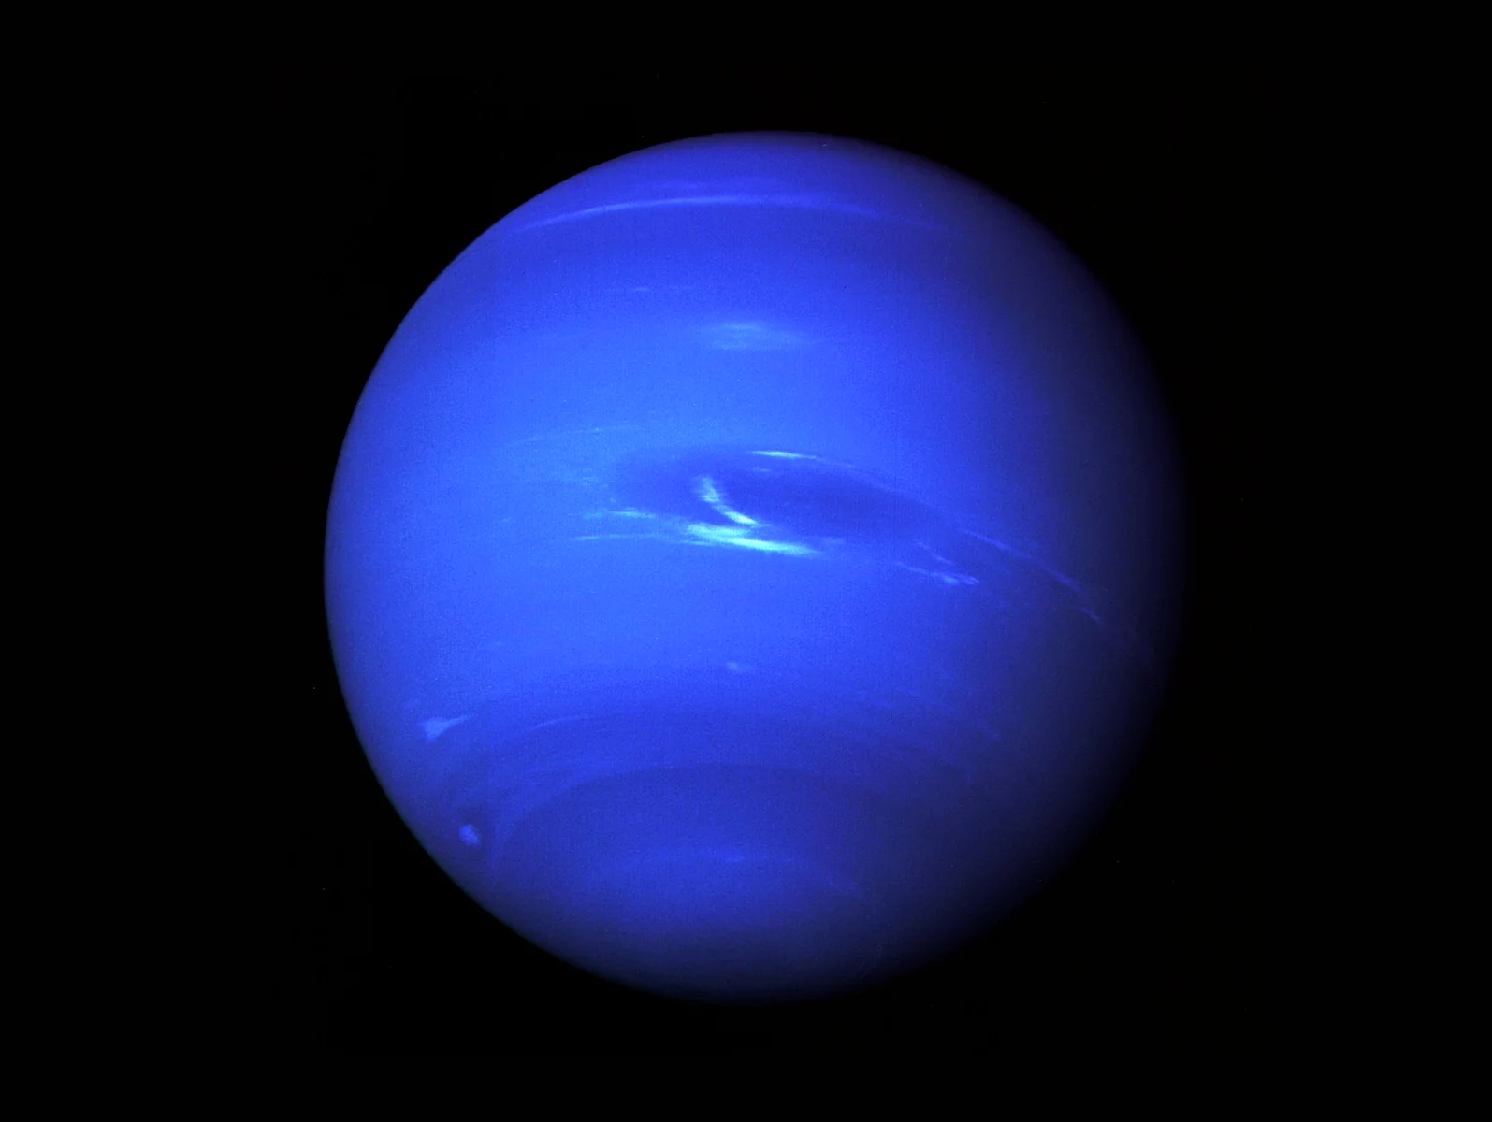
Notes:
Neptune is an outer planet. It has very similar characteristics to Uranus.

Slide 114
Notes:
Let’s talk about some non-examples of outer planets.

Slide 115
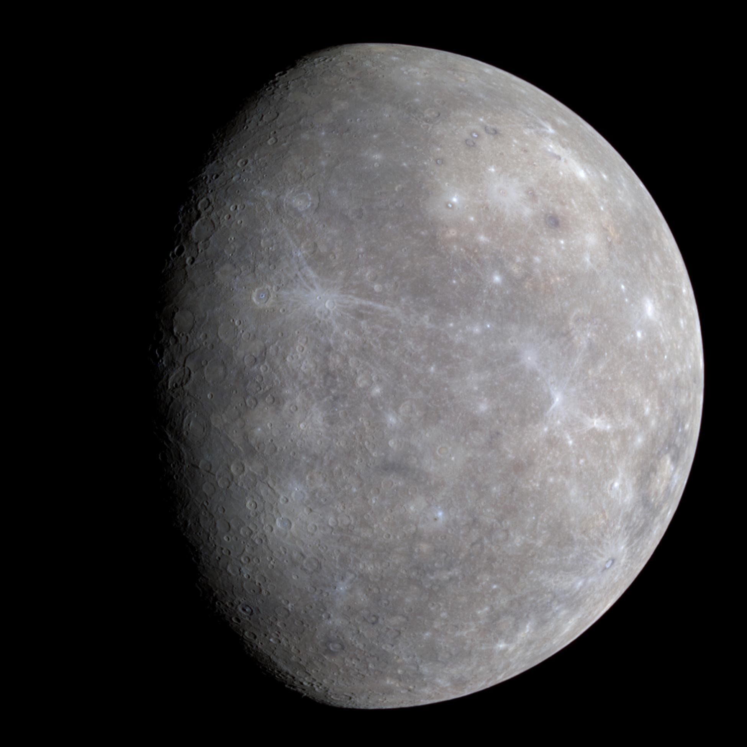
Notes:
Mercury is not an outer planet. It is an inner planet. It is the closest planet to the sun.

Slide 116
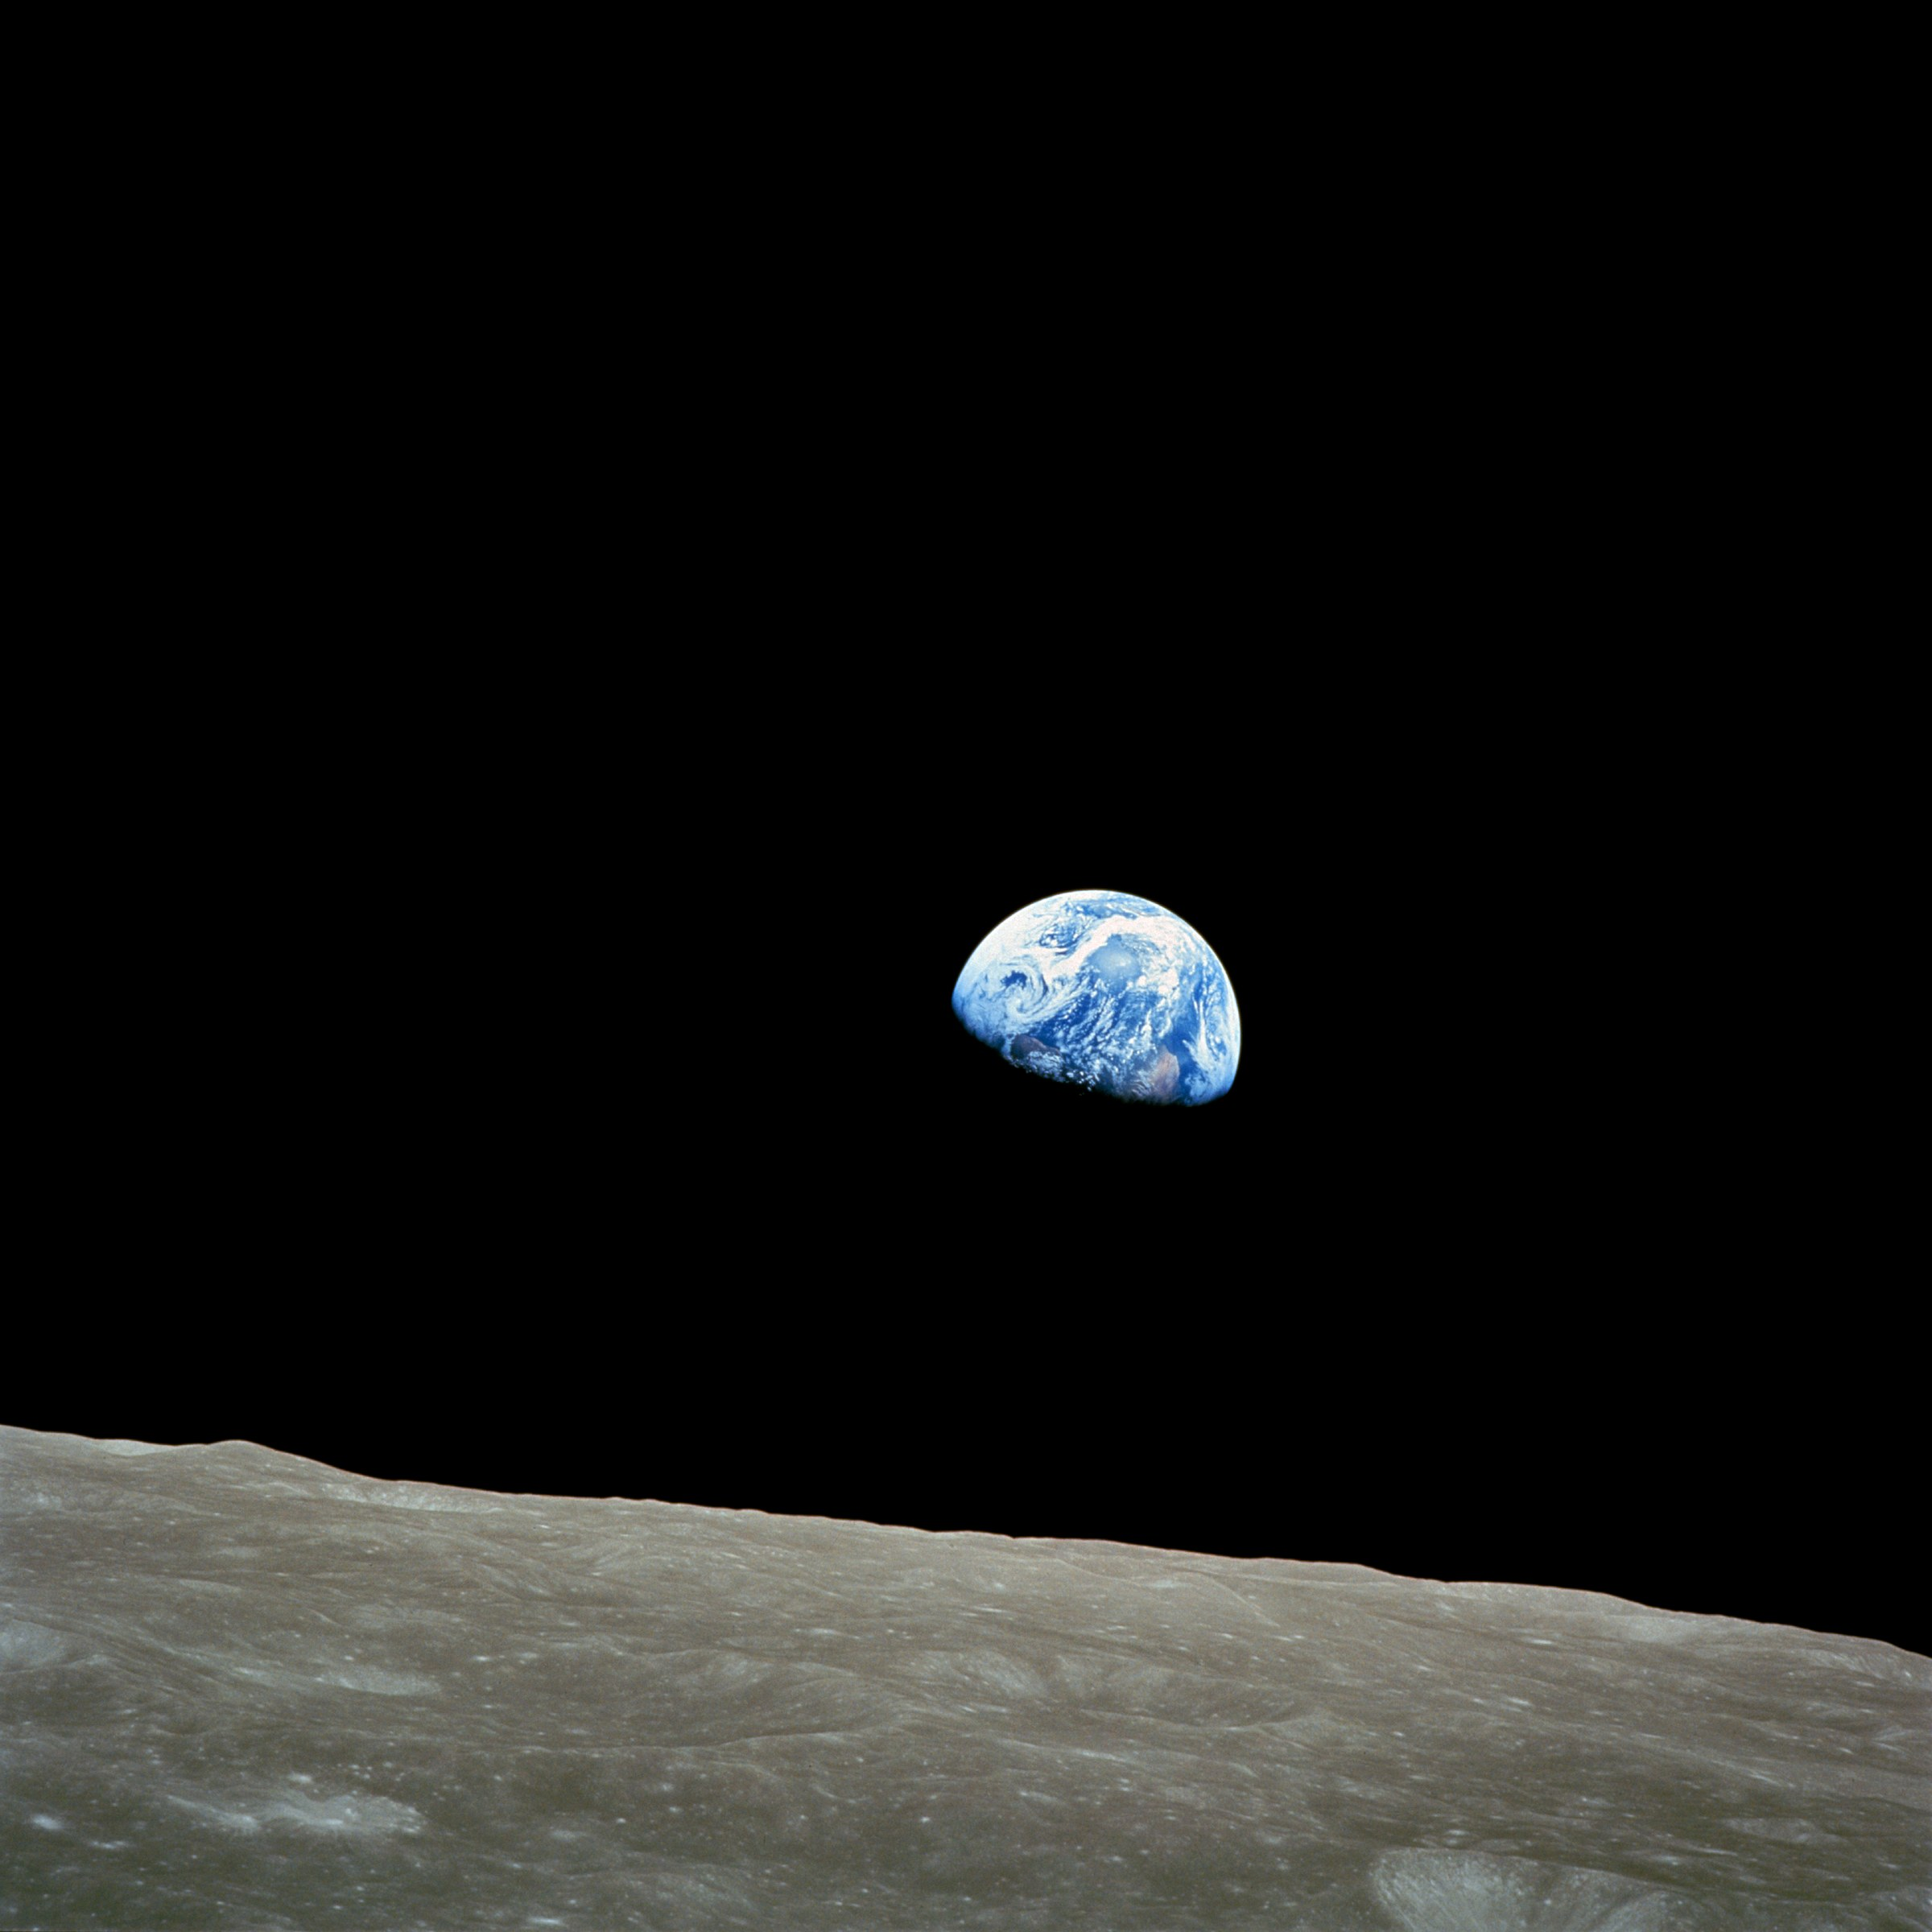
Notes:
Earth is not an outer planet. It is an inner planet.

Slide 117
Notes:
Let’s check-in for understanding.

Slide 118
List some examples of inner planets and their characteristics.
Notes:
List some examples of inner planets and their characteristics. (*Provide wait time and give specific feedback based on student responses)

Slide 119
What is a non-example of an outer planet?
NON
Notes:
What is a non-example of an outer planet? (*Provide wait time and give specific feedback based on student responses)

Slide 120
Notes:
Let’s check-in for understanding.

Slide 121
What are outer planets?
Notes:
What are outer planets? (*Provide wait time and give specific feedback based on student responses)
[The outer planets are the last four planets in our solar system, farthest away from the sun. Jupiter, Saturn, Uranus, and Neptune are the outer planets.]

Slide 122
What are the major differences between the inner planets and the outer planets?
Notes:
What are the major differences between the inner planets and the outer planets? (*Provide wait time and give specific feedback based on student responses)
[Inner planets - These planets are grouped together because they are closer to the sun, and because they are relatively small in size and have rocky surfaces.
Outer Planets - These planets are grouped together because they are farther away from the sun, and because they are relatively large in size and are made up of mostly gases.]

Slide 123
List some examples of outer planets and their characteristics.
Notes:
List some examples of outer planets and their characteristics. (*Provide wait time and give specific feedback based on student responses)

Slide 124
Remember!!!
Notes:
So remember!

Slide 125
Outer Planets: last four (farthest) planets in our solar system
Notes:
The outer planets are the las four planets in our solar system, farthest away from the sun. Jupiter, Saturn, Uranus, and Neptune are the outer planets.

Slide 126
Notes:
These planets are grouped together because they are farther away from the sun, and because they are relatively large in size and are made up of mostly gases.

Slide 127
Big Question: What are the differences between the inner and outer planets?
Notes:
Explicit cue to revisit the big question at the end of the lesson: Okay everyone. Now that we’ve learned the term, let’s reflect once more on our big question. Was there anything that we predicted earlier that was correct or incorrect? Do you have any new hypotheses to share?

Slide 128
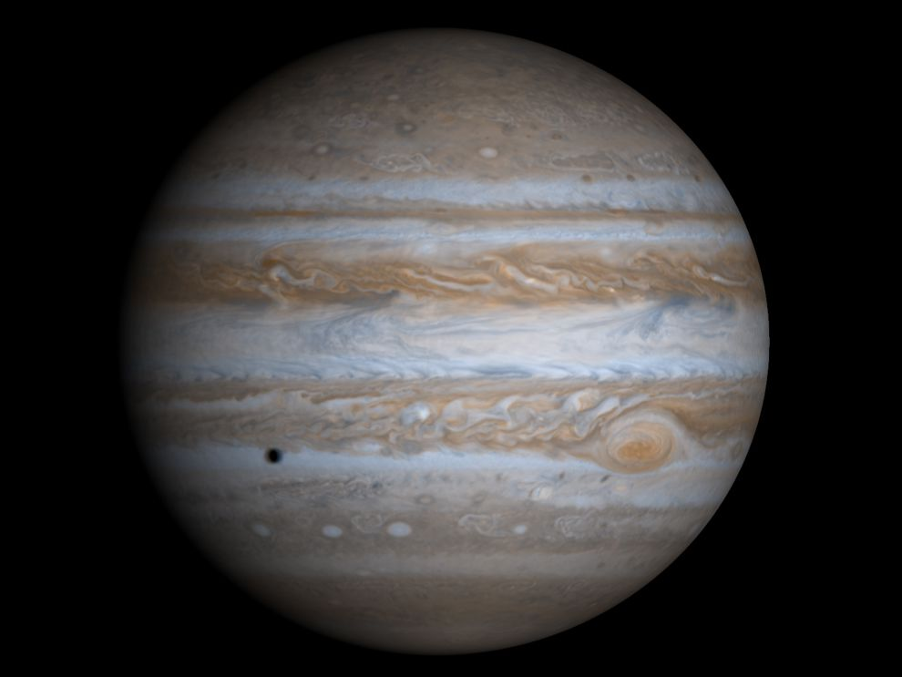
Simulation Activity
Jupiter’s Great Red Spot
Click the link to learn about one of the outer planets, Jupiter. You will observe, measure, and draw conclusions about the size of Jupiter's Great Red Spot.
Notes:
Click the link to learn about one of the outer planets, Jupiter. You will observe, measure, and draw conclusions about the size of Jupiter's Great Red Spot.

Slide 129
Notes:
Thanks for watching, and please continue watching CAPs available from this website.

Slide 130
This Video Created With Resources From:
Questions or Comments
Michael Kennedy, Ph.D. MKennedy@Virginia.edu
Rachel L Kunemund, Ph.D. rk8vm@virginia.edu

