Slide 1
Intro
“Big Idea” Question
Review Concepts
Check-In Questions
Teacher Engagement
Vocabulary
Student-Friendly Definition
Examples & Non-Examples
Morphological Word Parts
Frayer Model
Simulation/Activity
Notes:
OK everyone, get ready for our next lesson. Just as a reminder, these are the different components that our lesson may include, and you’ll see these icons in the top left corner of each slide so that you can follow along more easily!

Slide 2
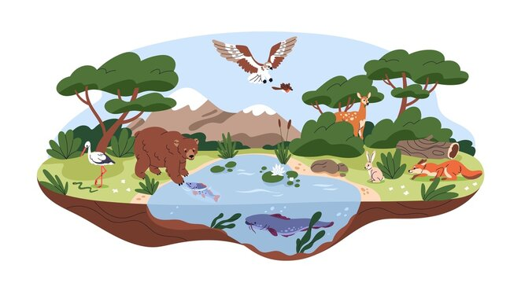
Intro
Habitat
Notes:
Today, we’ll be learning about the word: Habitat.

Slide 3
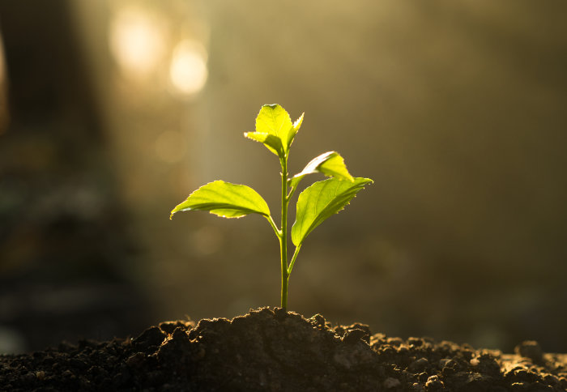
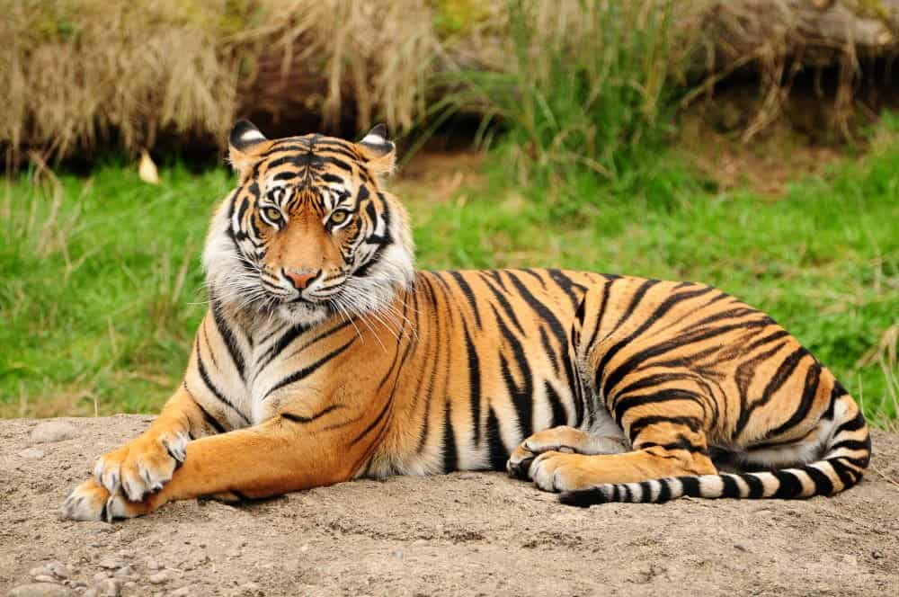
Big Question: How do plants and animals interact with their environments?
Notes:
Our “big question” is: How do plants and animals interact with their environments?
[Pause and illicit predictions from students.]
I love all these thoughtful scientific hypotheses! Be sure to keep this question and your predictions in mind as we move through these next few lessons, and we’ll continue to revisit it.

Slide 4
Notes:
Before we move on to our new topic, let’s review some other words & concepts that you already learned and make sure you are firm in your understanding.

Slide 5
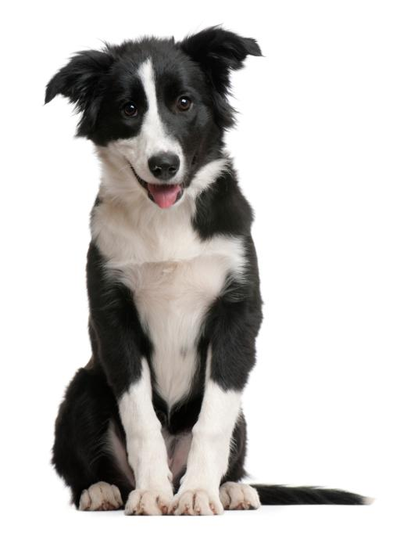
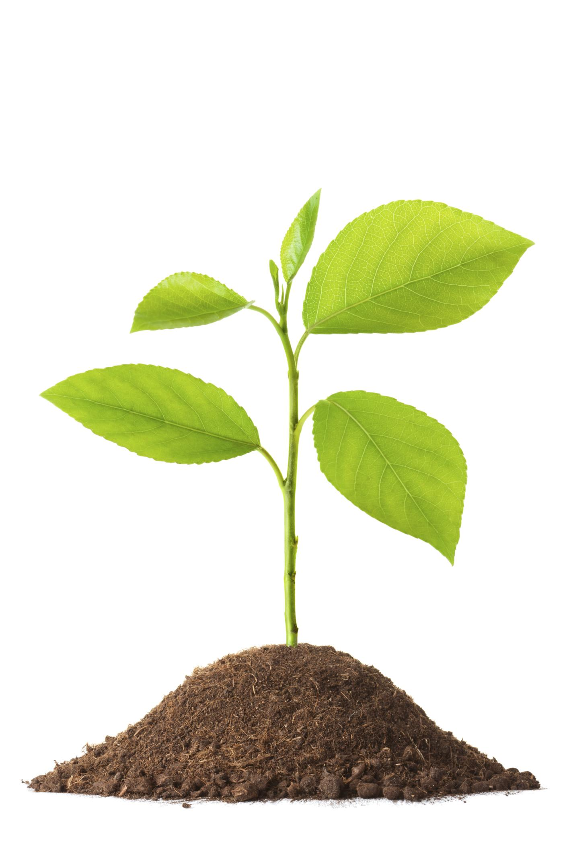
Organism: any living thing
Notes:
An organism is any living thing.

Slide 6
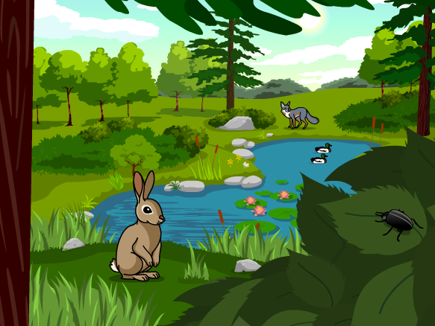
Ecosystem: an area where living and nonliving things interact.
Notes:
An ecosystem is an area where living and nonliving things interact.

Slide 7
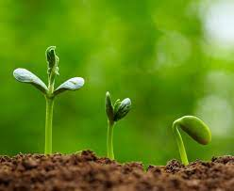
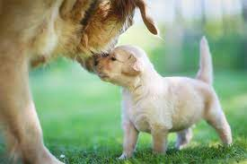
Living Thing: organisms that move, grow, change, and respond to its environment
Notes:
Living things are organisms that grow, change, and respond to its environment.

Slide 8
Non-living Thing: do not grow, reproduce, and need food
Notes:
Non-living things do not grow, reproduce, and need food.

Slide 9
Notes:
Now let’s pause for a moment to review the information we have covered already.

Slide 10
True or false: An organism is any non-living thing.
True
False
Notes:
True or false: An organism is any non-living thing.
[B. False]

Slide 11
True or false: An organism is any non-living thing.
True
False
Notes:
True or false: An organism is any non-living thing. False - an organism is any living thing.
[B. False]

Slide 12
What is another word for an area where living and nonliving things interact?
System
Ecosystem
Economy
Notes:
What is another word for an area where living and nonliving things interact?
[B. Ecosystem]

Slide 13
What is another word for an area where living and nonliving things interact?
System
Ecosystem
Economy
Notes:
What is another word for an area where living and nonliving things interact? B. Ecosystem

Slide 14
_________ __________ are organisms that move, grow, change, and respond to the environment
Abiotic Factors
Non-living things
Living things
Notes:
______ _______ are organisms that move, grow, change, and respond to the environment.
[C. Living things]

Slide 15
_________ __________ are organisms that move, grow, change, and respond to the environment
Abiotic Factors
Non-living things
Living things
Notes:
Living things are organisms that move, grow, change, and respond to the environment.

Slide 16
_________ __________ are things that do not grow, reproduce, and need food
Non-living things
Living things
Abiotic Factors
Notes:
______ _______ are things that no not grow, reproduce, and need food.
[A. Non-living things]

Slide 17
_________ __________ are things that do not grow, reproduce, and need food
Non-living things
Living things
Abiotic Factors
Notes:
Non-living things are things that no not grow, reproduce, and need food.

Slide 18
Habitat
Notes:
Now that we’ve reviewed, let’s define the word habitat.

Slide 19
Habitat: the place where an animal or plant naturally lives
Notes:
Habitat is the place where an animal and/or plant naturally lives.

Slide 20
Notes:
Let’s check-in for understanding.

Slide 21
What is habitat?
Notes:
What is habitat?
[The place where an animal and/or plant naturally lives.]

Slide 22
Notes:
That is the basic definition, but there is a bit more you need to know.

Slide 23
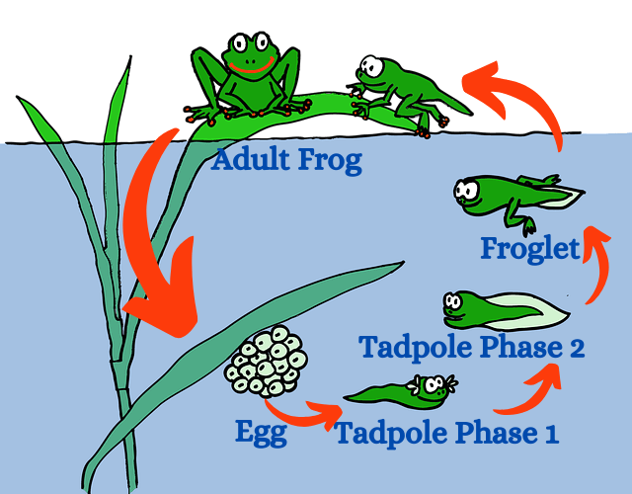
Changes in an organism’s habitat may occur at various stages in its life cycle.
Notes:
Changes in an organism’s habitat may occur at various stages in its life cycle. For example, when frogs begin the life cycle (as eggs), their habitat is in water. When the frog fully matures, their habitat changes to be able to live out of the water.

Slide 24
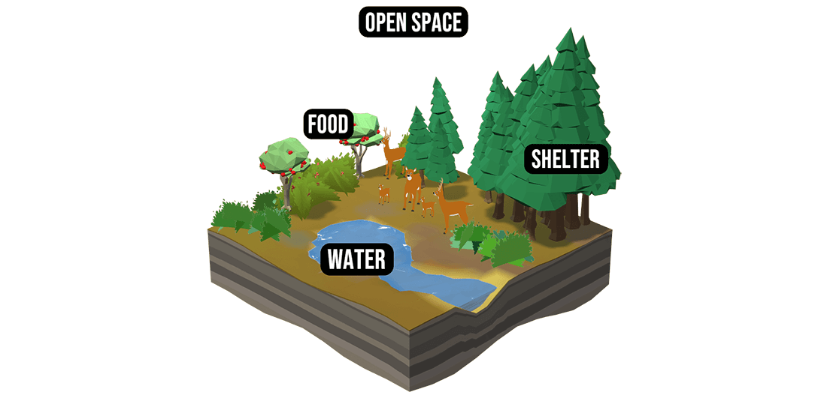
An organism’s habitat provides food, water, shelter, and space.
Notes:
An organism’s habitat provides food, water, shelter, and space.

Slide 25
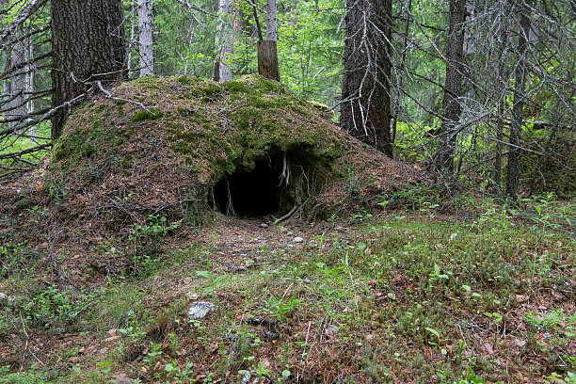
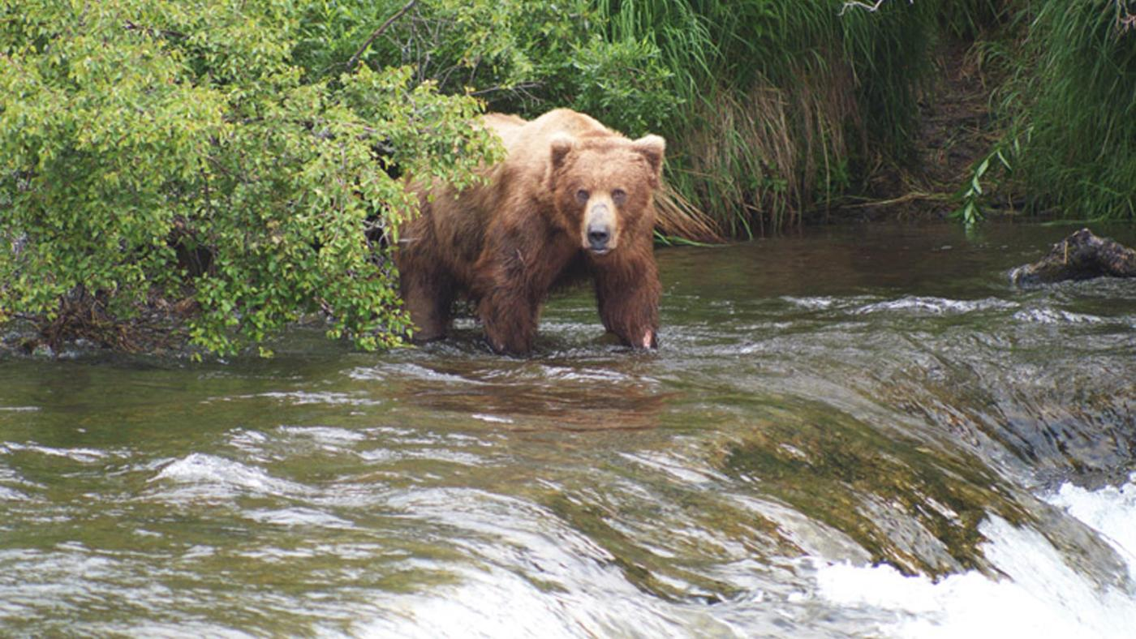
The size of the habitat depends on the organism’s needs.
Bear den habitat
Bear feeding habitat
Notes:
The size of the habitat depends on the organism’s needs. For example, a bear den habitat is small. Bears do not need much space when they sleep. But when a bear needs to eat, their habitat is much larger as they are searching for food.

Slide 26
Notes:
Let’s check-in for understanding.

Slide 27
Changes in an organism’s habitat may occur at various stages in its _____ _____.
Life circle
Life cycle
Life arrow
Notes:
Changes in an organism’s habitat may occur at various stages in its ______ _______.
[B. Life cycle]

Slide 28
Changes in an organism’s habitat may occur at various stages in its _____ _____.
Life circle
Life cycle
Life arrow
Notes:
Changes in an organism’s habitat may occur at various stages in its life cycle.
[B. Life cycle]

Slide 29
True or false: An organism’s habitat provides food, water, shelter, and space.
True
False
Notes:
True or false: An organism’s habitat provides food, water, shelter, and space.
[A. True]

Slide 30
True or false: An organism’s habitat provides food, water, shelter, and space.
True
False
Notes:
True or false: An organism’s habitat provides food, water, shelter, and space.
[A. True]

Slide 31
The _____ of the habitat depends on the organism’s needs.
Size
Shape
Style
Bear den habitat
Bear feeding habitat
Notes:
The ______ of the habitat depends on the organism’s needs.
[A. Size]

Slide 32
The _____ of the habitat depends on the organism’s needs.
Size
Shape
Style
Bear den habitat
Bear feeding habitat
Notes:
The size of the habitat depends on the organism’s needs.
[A. Size]

Slide 33
Notes:
Now, let’s talk about some examples of habitat.

Slide 34
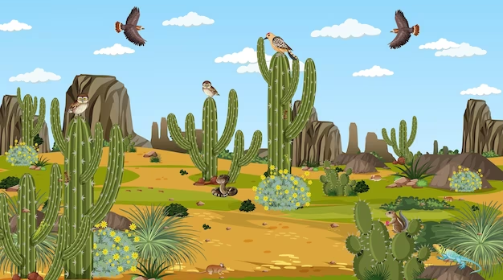
Notes:
Here is an example of a desert habitat. In the picture, you can see that animals and plants are living naturally.

Slide 35
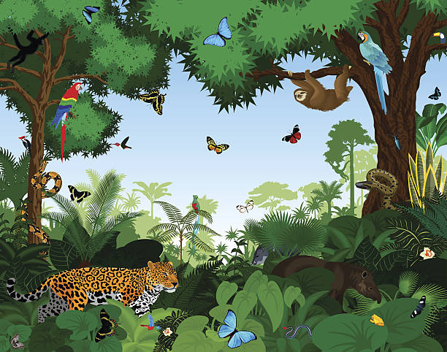
Notes:
Here is another example of a habitat. This picture shows a rainforest habitat. Again, you can see that plants and animals are living naturally.

Slide 36
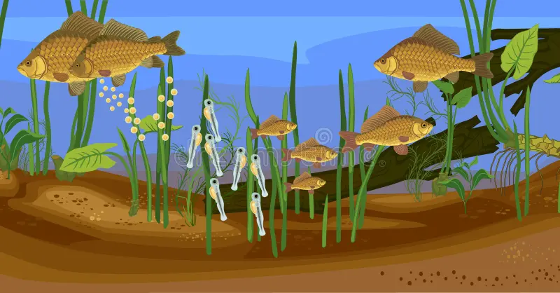
Notes:
Here is another example of a habitat. This picture shows a freshwater habitat. Again, you can see that plants and animals are living naturally.

Slide 37
Notes:
Now, let’s talk about some non-examples of habitat.

Slide 38
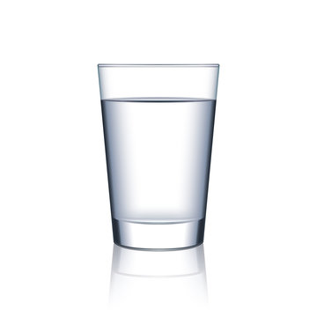
Notes:
This is a non-example of a habitat. The glass of water does not have the things necessary for plants and animals to live naturally.

Slide 39
Notes:
This is also a non-example of habitat. Just like the glass of water, the books do not have the things necessary for plants and animals to live naturally.

Slide 40
Notes:
Now let’s pause for a moment to check your understanding.

Slide 41
Which one is NOT an example of habitat?
Desert
Freshwater
Books
Notes:
Which one is NOT an example of habitat?
[Books]

Slide 42
Which one is NOT an example of habitat?
Desert
Freshwater
Books
Notes:
Which one is NOT an example of habitat? Books. Books do not have the things necessary for plants and animals to live naturally
[Books]

Slide 43
Remember!!!
Notes:
So remember!

Slide 44
Habitat: the place where an animal and/or plant naturally lives
Notes:
Habitat is the place where an animal and/or plant naturally lives.

Slide 45
Notes:
We will now complete this concept map, called a Frayer model, to summarize and further clarify what you have learned about the term habitat.

Slide 46
Definition
Picture
Habitat
Example
How does habitat impact my life?
Notes:
To complete the Frayer model, we will choose from four choices the correct picture, definition, example, and response to the question, “How does habitat impact my life?” Select the best response for each question using the information you just learned. As we select responses, we will see how this model looks filled in for the term habitat.

Slide 47
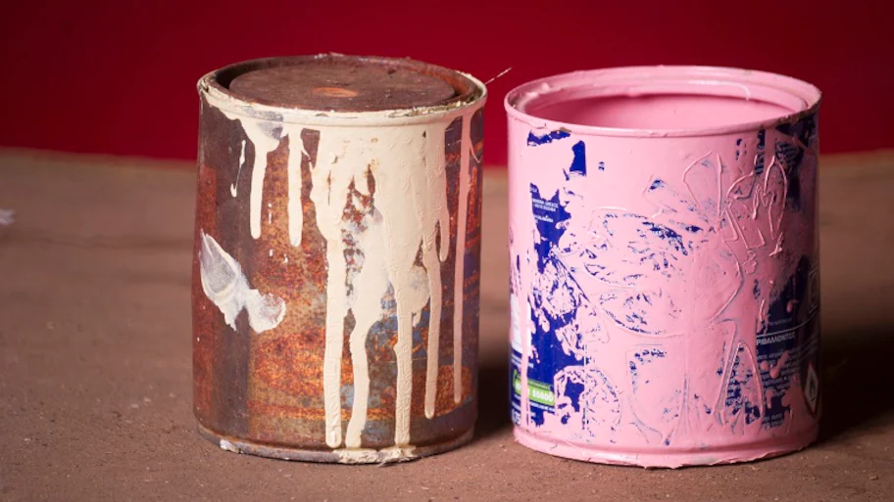
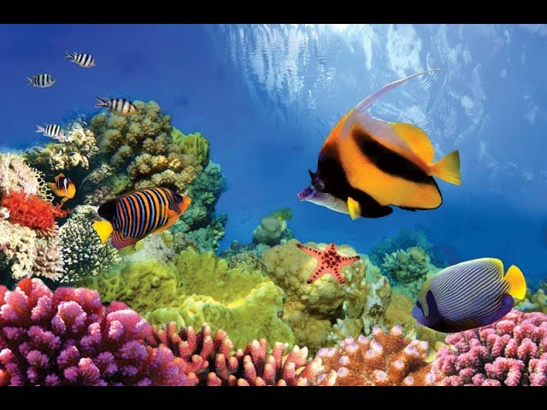
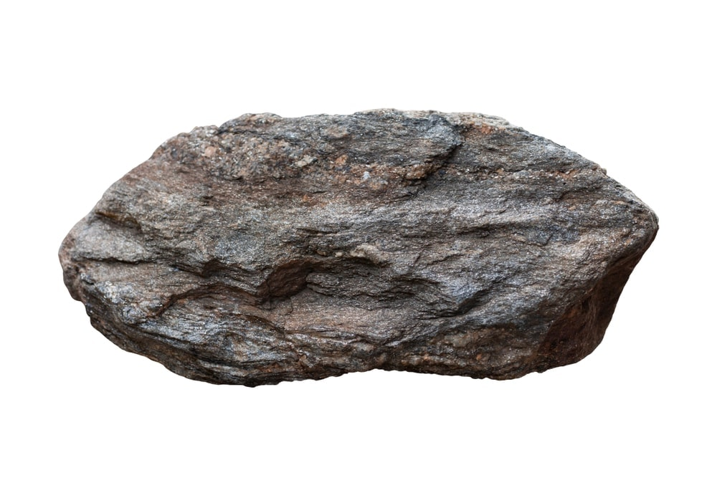
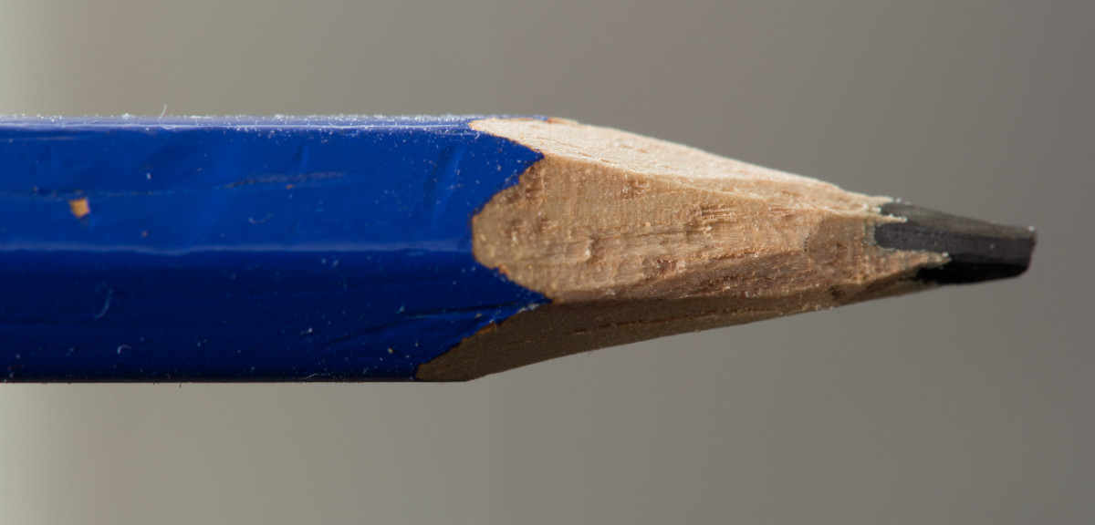
Directions: Choose the correct picture of habitat from the choices below.
A
B
C
D
Notes:
Choose the one correct picture of habitat from these four choices.

Slide 48
Directions: Choose the correct picture of habitat from the choices below.
A
B
C
D
Notes:
This is the picture that shows habitat.

Slide 49
Definition
Picture
Habitat
Example
How does habitat impact my life?
Notes:
Here is the Frayer model filled in with a picture of habitat.

Slide 50
Directions: Choose the correct definition of habitat from the choices below.
A
The place to watch a baseball game
B
The place to buy a computer
C
The place where an animal and/or plant lives naturally
D
The place to go snowboarding
Notes:
Choose the one correct definition of habitat from these four choices.

Slide 51
Directions: Choose the correct definition of habitat from the choices below.
A
The place to watch a baseball game
B
The place to buy a computer
C
The place where an animal and/or plant lives naturally
D
The place to go snowboarding
Notes:
“The place where an animal and/or plant lives naturally” is correct! This is the definition of habitat.

Slide 52
Definition
Picture
The place where an animal and/or plant lives naturally
Habitat
Example
How does habitat impact my life?
Notes:
Here is the Frayer Model with a picture and the definition filled in for habitat: The place where an animal and/or plant lives naturally.

Slide 53
Directions: Choose the correct example of habitat from the choices below.
A
A stream full of fish
B
A whiteboard with pictures on it
C
A pair of headphones with music playing
D
A piece of cheese in a sandwich
Notes:
Choose the one correct example of habitat from these four choices.

Slide 54
Directions: Choose the correct example of habitat from the choices below.
A
A stream full of fish
B
A whiteboard with pictures on it
C
A pair of headphones with music playing
D
A piece of cheese in a sandwich
Notes:
“A stream full of fish” is correct! This is an example of habitat.

Slide 55
Definition
Picture
The place where an animal and/or plant lives naturally
Habitat
A stream full of fish
Example
How does habitat impact my life?
Notes:
Here is the Frayer Model with a picture, definition, and an example of habitat: A stream full of fish.

Slide 56
Directions: Choose the correct response for “how does habitat impact my life?” from the choices below.
A
Habitat helps me get to school everyday
B
Habitat gives me a way to describe animals
C
Habitat gives me a way to describe plants
D
I wake up everyday in my habitat - a house
Notes:
Choose the one correct response for “how does habitat impact my life?” from these four choices.

Slide 57
Directions: Choose the correct response for “how does habitat impact my life?” from the choices below.
A
Habitat helps me get to school everyday
B
Habitat gives me a way to describe animals
C
Habitat gives me a way to describe plants
D
I wake up everyday in my habitat - a house
Notes:
“I wake up everyday in my habitat - a house.” That is correct! This is an example of how habitat impacts your life.

Slide 58
Definition
Picture
The place where an animal and/or plant lives naturally
Habitat
A stream full of fish
I wake up everyday in my habitat - a house
Example
How does habitat impact my life?
Notes:
Here is the Frayer Model with a picture, definition, example, and a correct response to “how does habitat impact my life?”: I wake up everyday in my habitat - a house.

Slide 59
Remember!!!
Notes:
So remember!

Slide 60
Habitat: the place where an animal and/or plant naturally lives
Notes:
Habitat is the place where an animal and/or plant naturally lives.

Slide 61
Big Question: How do plants and animals interact with their environments?
Notes:
Let’s reflect once more on our big question. Our “big question” is: How do plants and animals interact with their environments?
Does anyone have any additional examples to share that haven’t been discussed yet?

Slide 62
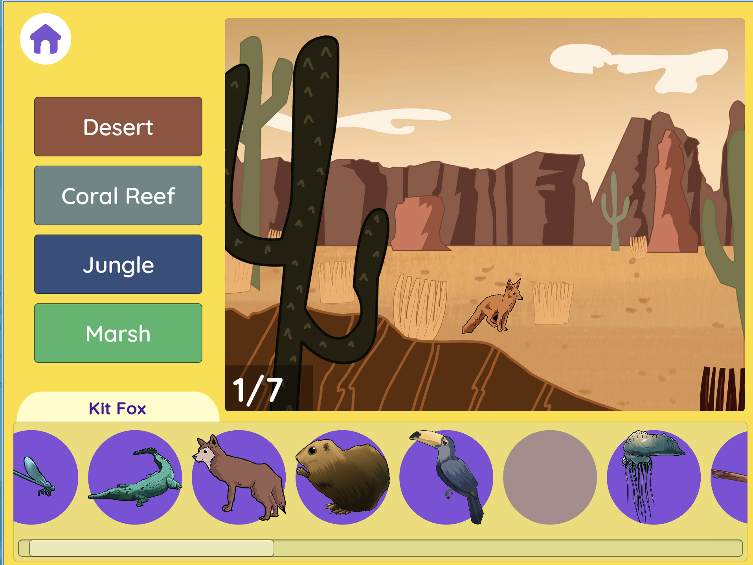
Habitat Simulation
Habitat Simulation (Smithsonian)
Click the link to engage with a simulation where your task is to put animals in their appropriate habitats.
Notes:
Click the link to engage in a habitat simulation with your students. Try to have students place animals in the correct habitats (desert, coral reef, jungle, marsh). Please note the scroll bar at the bottom of the activity that scrolls through more animals.

Slide 63
Notes:
Thanks for watching, and please continue watching CAPs available from this website.

Slide 64
This Was Created With Resources From:
Questions or Comments
Michael Kennedy, Ph.D. MKennedy@Virginia.edu
Rachel L Kunemund, Ph.D. rk8vm@virginia.edu

