Slide 1
Intro
“Big Idea” Question
Review Concepts
Check-In Questions
Teacher Demo
Vocabulary
Student-Friendly Definition
Examples & Non-Examples
Morphological Word Parts
Simulation/Activity
Notes:
OK everyone, get ready for our next lesson. Just as a reminder, these are the different components that our lesson may include, and you’ll see these icons in the top left corner of each slide so that you can follow along more easily!

Slide 2
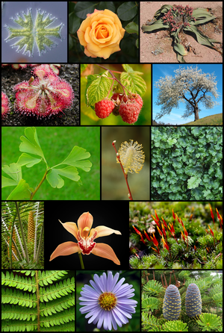
Intro
Plant Divisions
Notes:
Today we will learn about major plant divisions.

Slide 3
Big Question: How do scientists divide plants into distinct and logical categories for study?
Notes:
Our “big question” is: How do scientists divide plants into distinct and logical categories for study?
[Pause and illicit predictions from students.]
I love all these thoughtful scientific hypotheses! Be sure to keep this question and your predictions in mind as we move through these next few lessons, and we’ll continue to revisit it.
Feedback: Asking students to make predictions about the differences between these factors is a great way to activate and elicit student ideas and prior knowledge. This type of activity is evidence of the teacher planning for students’ engagement with science ideas.

Slide 4
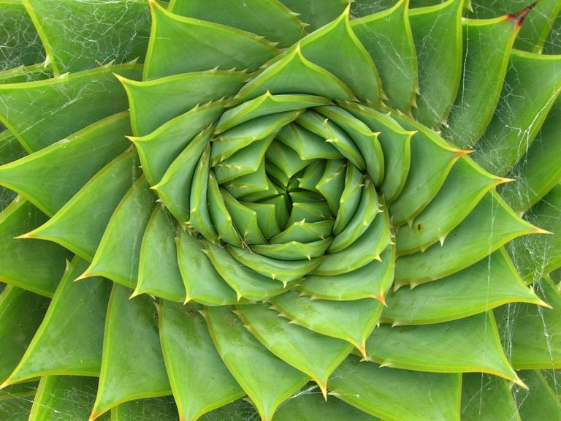
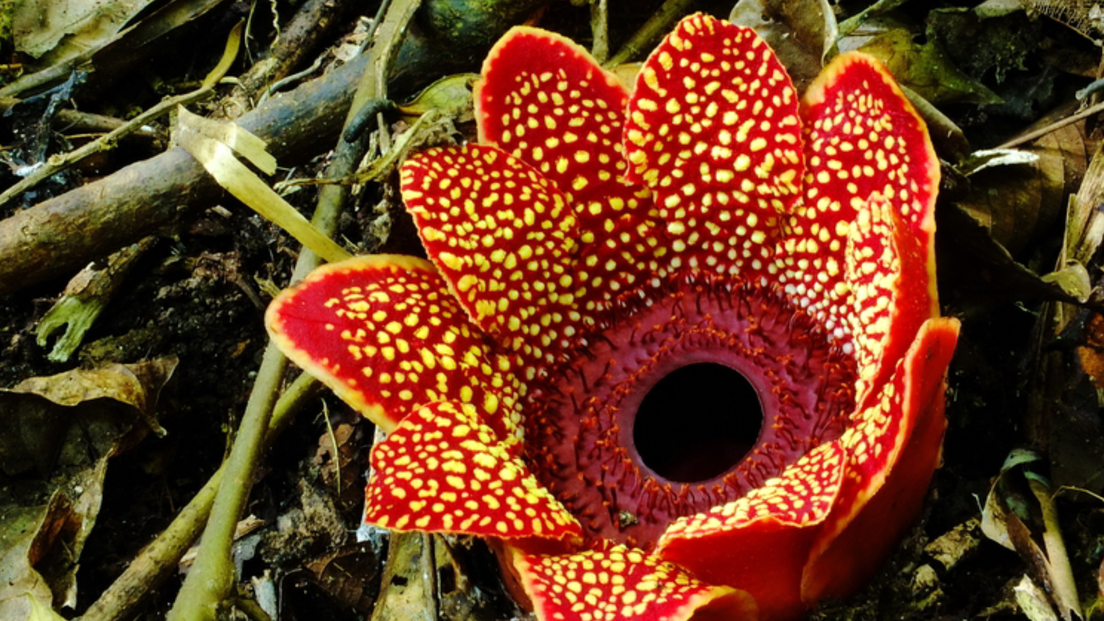
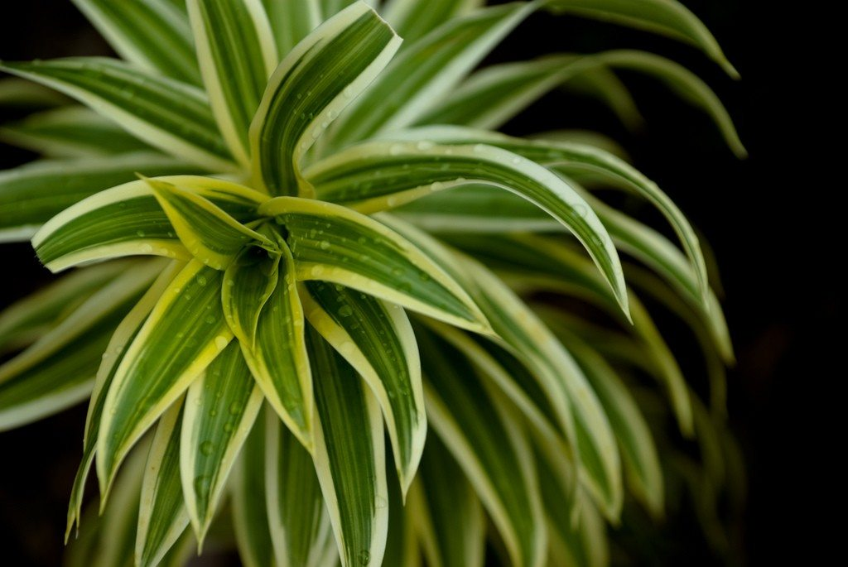
Demonstration
“What is a plant?” Think-Pair-Share
Have students engage in a think-pair-share discussion about what characteristics qualify an organism as an plant. Have students come up with specific examples and write their ideas on the board while you prompt students to consider what features are unique to animals.
Notes:
Feedback: Restating and expanding upon student responses is a great way to include their ideas in the discussion and expand on them to make connections.

Slide 5
Notes:
Before we move on to our new vocabulary term, let’s review some other words & concepts that you already learned and make sure you are firm in your understanding.

Slide 6
Scientific Classification: system to organize different types of living things according to their different characteristics
Notes:
We use a classification system to organize different types of living things according to their different characteristics.
Feedback: Incorporating visuals is a great way to help students make connections with new content.

Slide 7
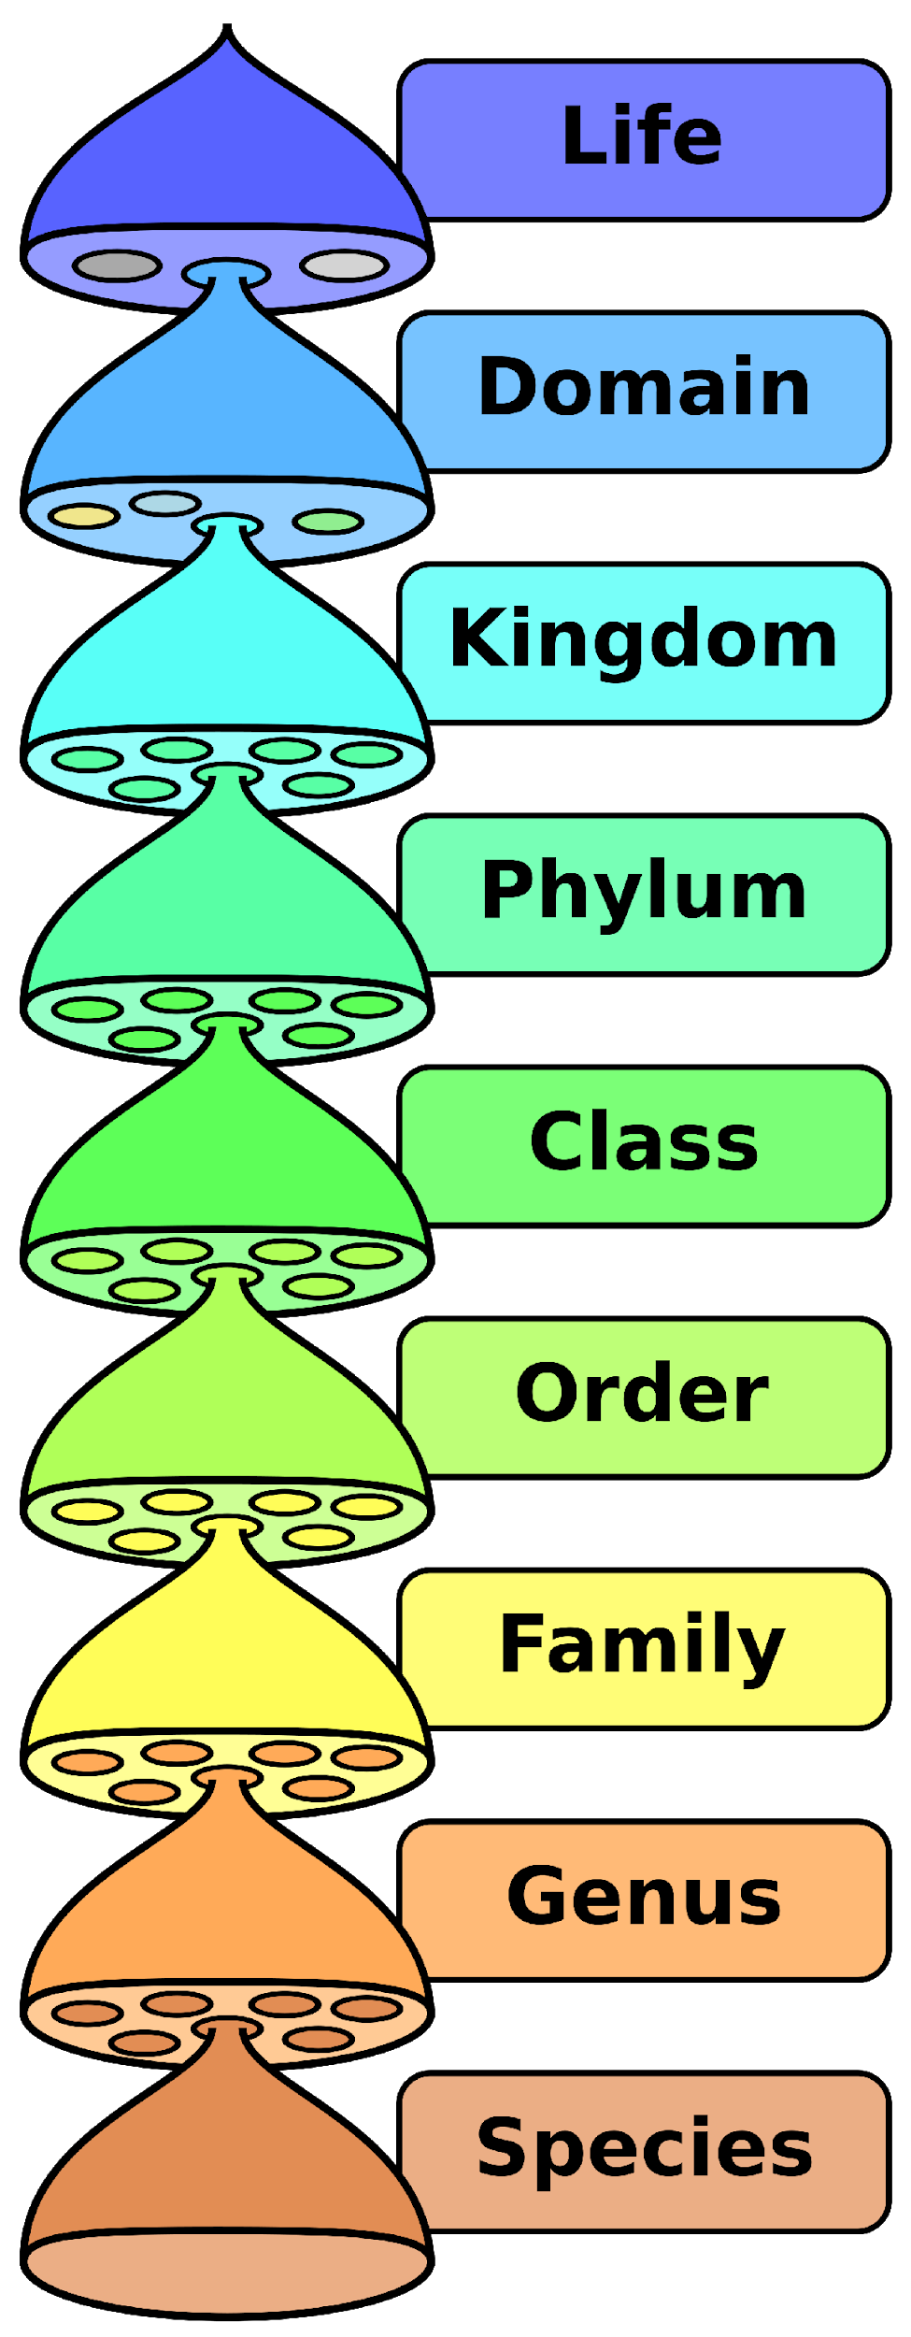
Notes:
The classification of living things includes 8 levels.

Slide 8
Becomes More Specific and Detailed
Notes:
The classification of living things is hierarchical and ordered. This means that as you move through the levels of organization, the classification becomes more and more specific and detailed. There are eight levels of classification.

Slide 9
Domain: highest level of scientific classification
Notes:
Domain is the highest level of classification.

Slide 10
Kingdom: the second highest level of scientific classification
Notes:
Kingdom is the second highest level of scientific classification.

Slide 11
Phylum: the third level of classification
Notes:
Next is the phylum level of the classification system.

Slide 12
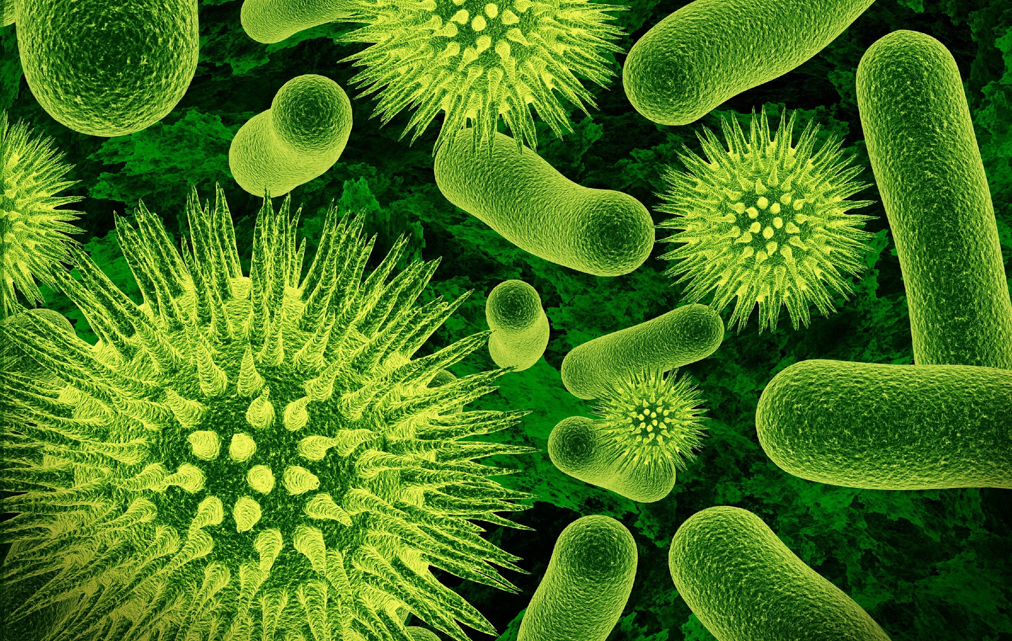
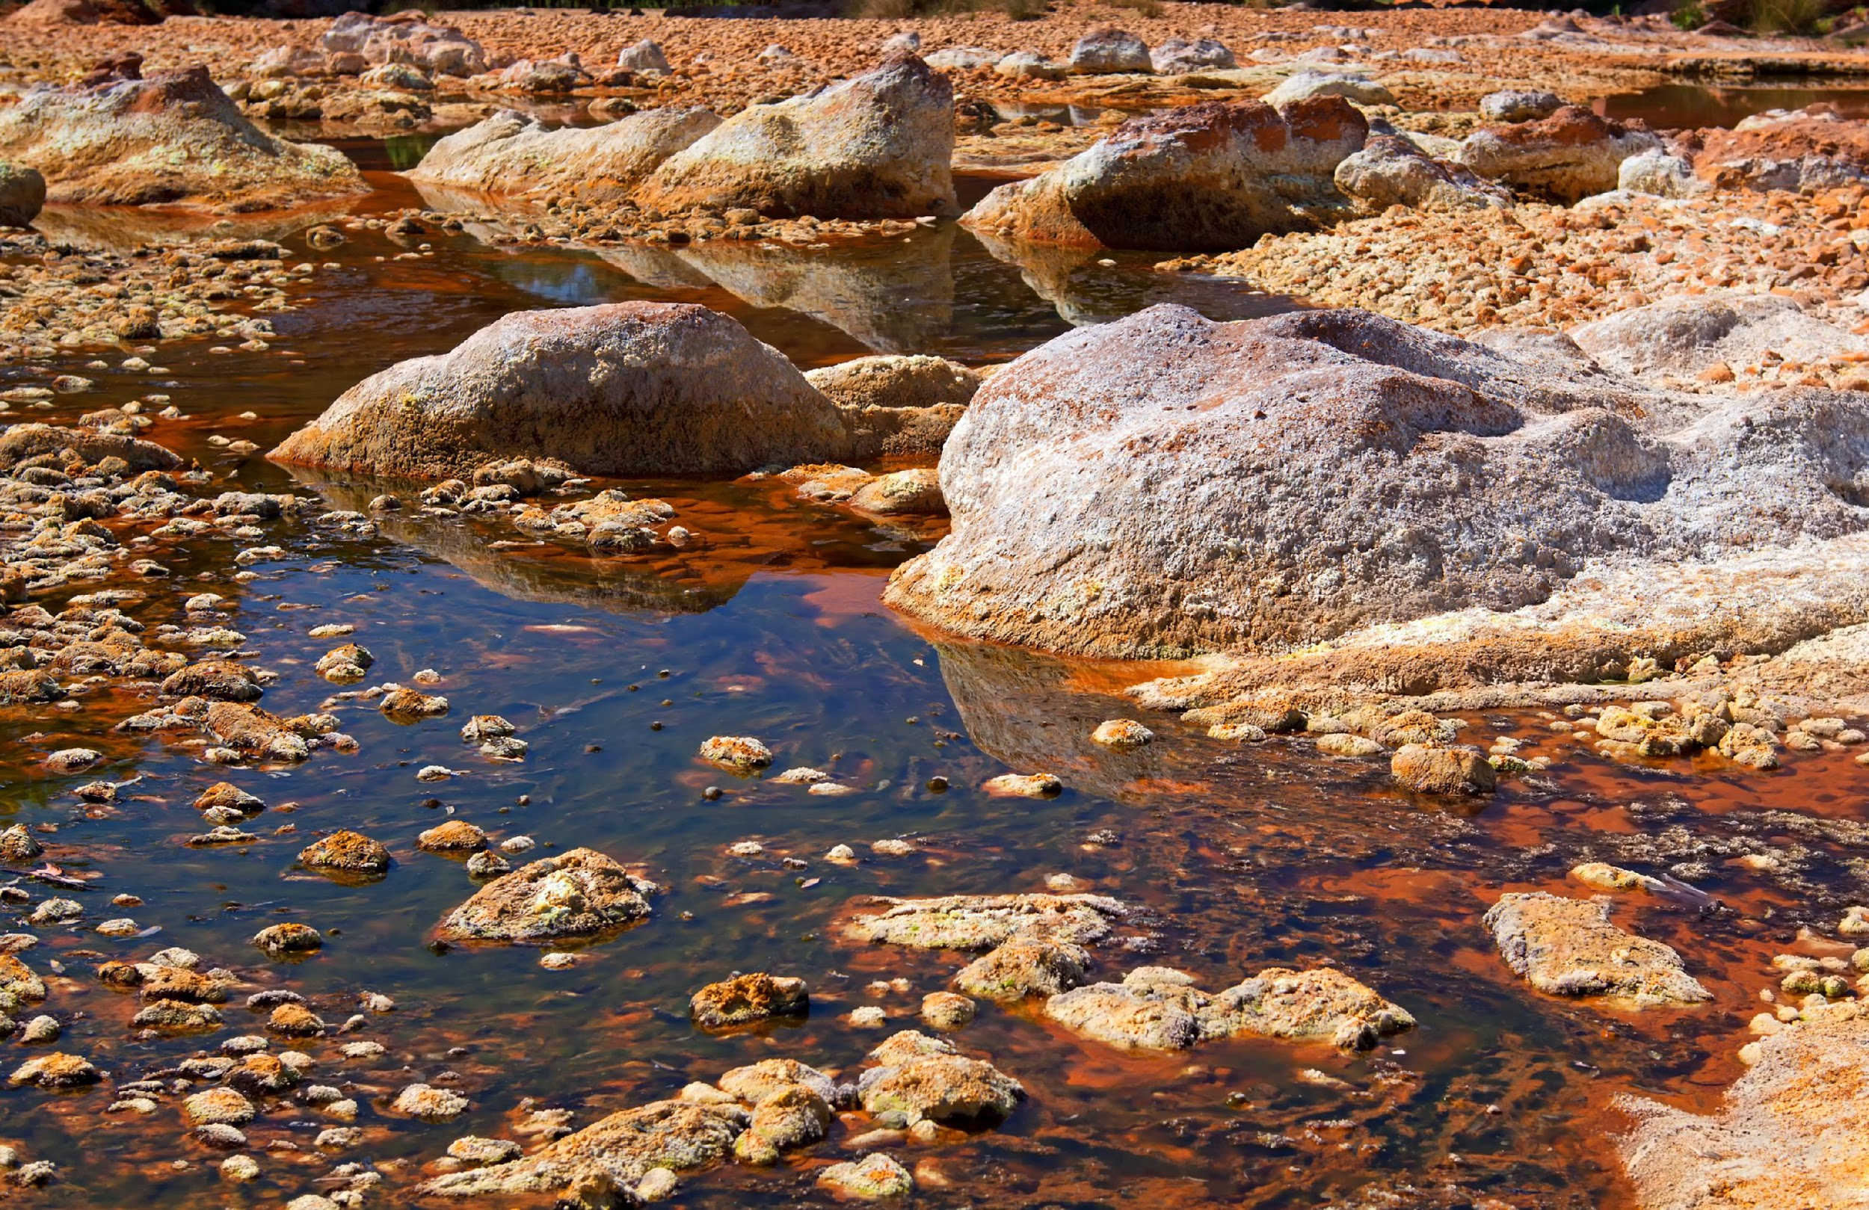
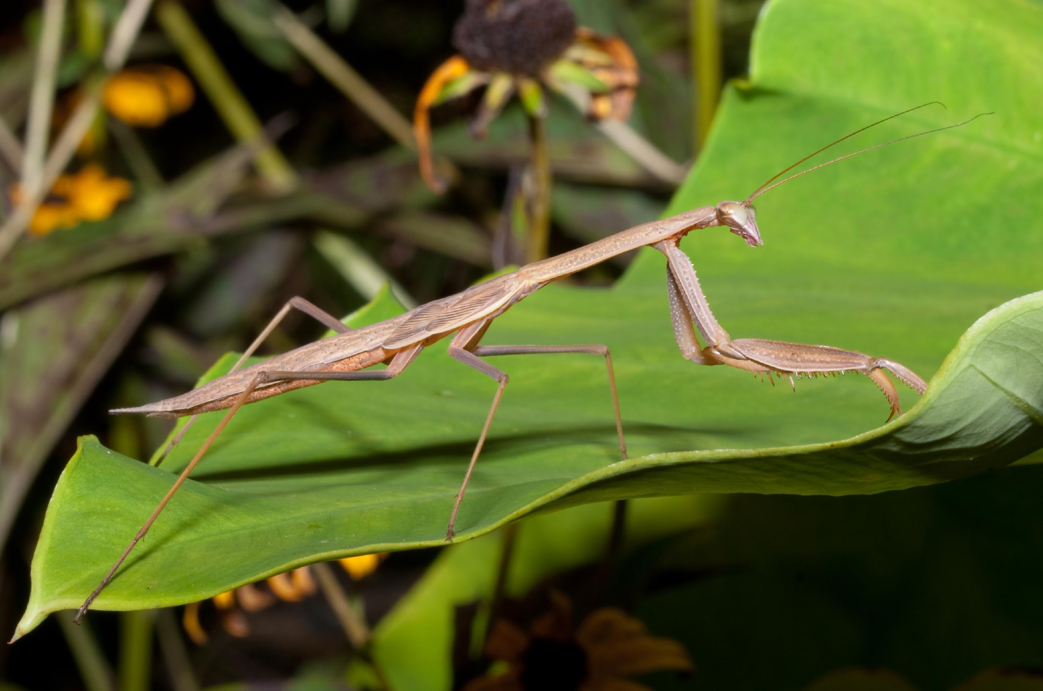
Domains
Bacteria
Archaea
Eukarya
Notes:
The three domains are bacteria, archaea, and eukarya. Today we will be focusing on organisms belonging to the eukarya domain, which includes all eukaryotes.

Slide 13
Protista
Plantae
Fungi
Animalia
Notes:
The 4 eukaryotic kingdoms are protista, fungi, animalia, and plantae. Today we will be focusing on plantae - the plant kingdom.

Slide 14
Notes:
Now let’s pause for a moment to check your understanding.

Slide 15
Which level of classification is most specific and detailed?
Notes:
Which level of classification is most specific and detailed?
[The species level is most specific and exclusive. The characteristics that define organisms at the species level are very specific to one type of organism.

Slide 16
What are the three domains?
Domains
Notes:
What are the three domains?
[Bacteria, archaea, and eukarya]

Slide 17
How many kingdoms are there?
2
3
4
6
Notes:
How many kingdoms are there?

Slide 18
How many kingdoms are there?
2
3
4
6
Protista
Plantae
Fungi
Animalia
Notes:
How many kingdoms are there?
[There are four kingdoms - protista, plantae, fungi, and animalia.]

Slide 19
Which of these is in the correct order?
Kingdom, Domain, Phylum, Family, Class, Order
Domain, Kingdom, Order, Class, Phylum, Family
Family, Domain, Kingdom, Order, Phylum, Class
Domain, Kingdom, Phylum, Class, Order, Family
Notes:
Which of these is in the correct order?

Slide 20
Which of these is in the correct order?
Kingdom, Domain, Phylum, Family, Class, Order
Domain, Kingdom, Order, Class, Phylum, Family
Family, Domain, Kingdom, Order, Phylum, Class
Domain, Kingdom, Phylum, Class, Order, Family
Notes:
Which of these is in the correct order?
[Domain, Kingdom Phylum, Class, Order, Family]

Slide 21
Plant Divisions
Notes:
Let’s take a look at the major plant divisions.
Feedback: Slides such as this are important for their use of cues with students. By telling students what is coming either with images or words, it helps them know what to expect.

Slide 22
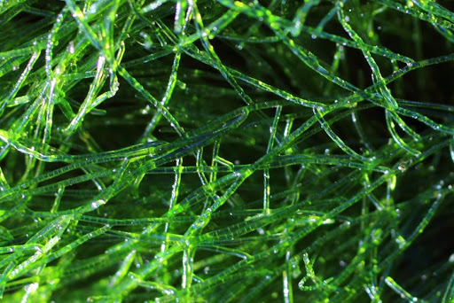
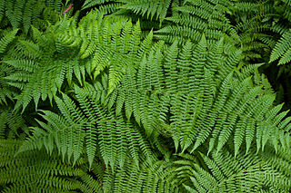
Scientists divide the Plantae kingdom into two major groups - the green algae and embryophytes.
Green Algae
Plantae
Embryophytes
Notes:
Scientists divide the Plantae kingdom into two major groups - the green algae and the embryophytes. Embryophytes are also commonly called land plants.

Slide 23
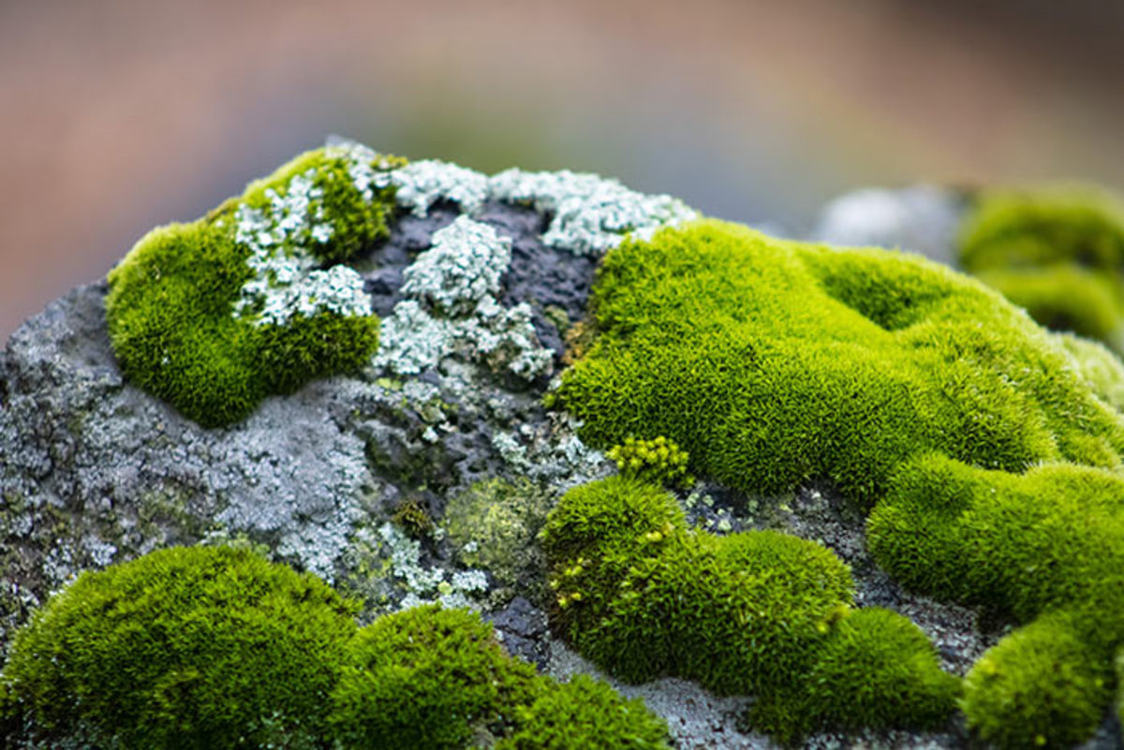
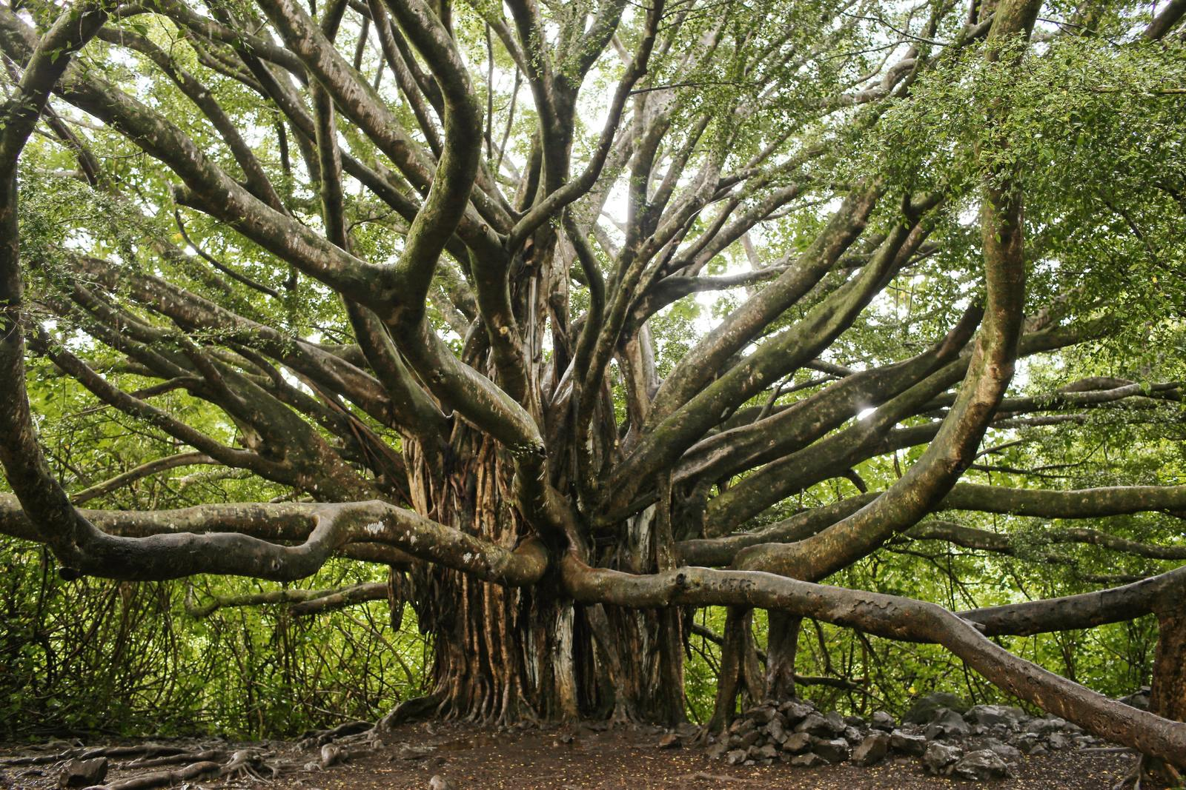
The embryophytes can generally be grouped into vascular and nonvascular plants.
Embryophytes
Bryophyta
“moss plants”
Tracheophyta
“tube plants”
Notes:
The embryophytes can generally be grouped into vascular and nonvascular plants. These used to be the only two major categories for land plants - similar to phyla for animals.

Slide 24
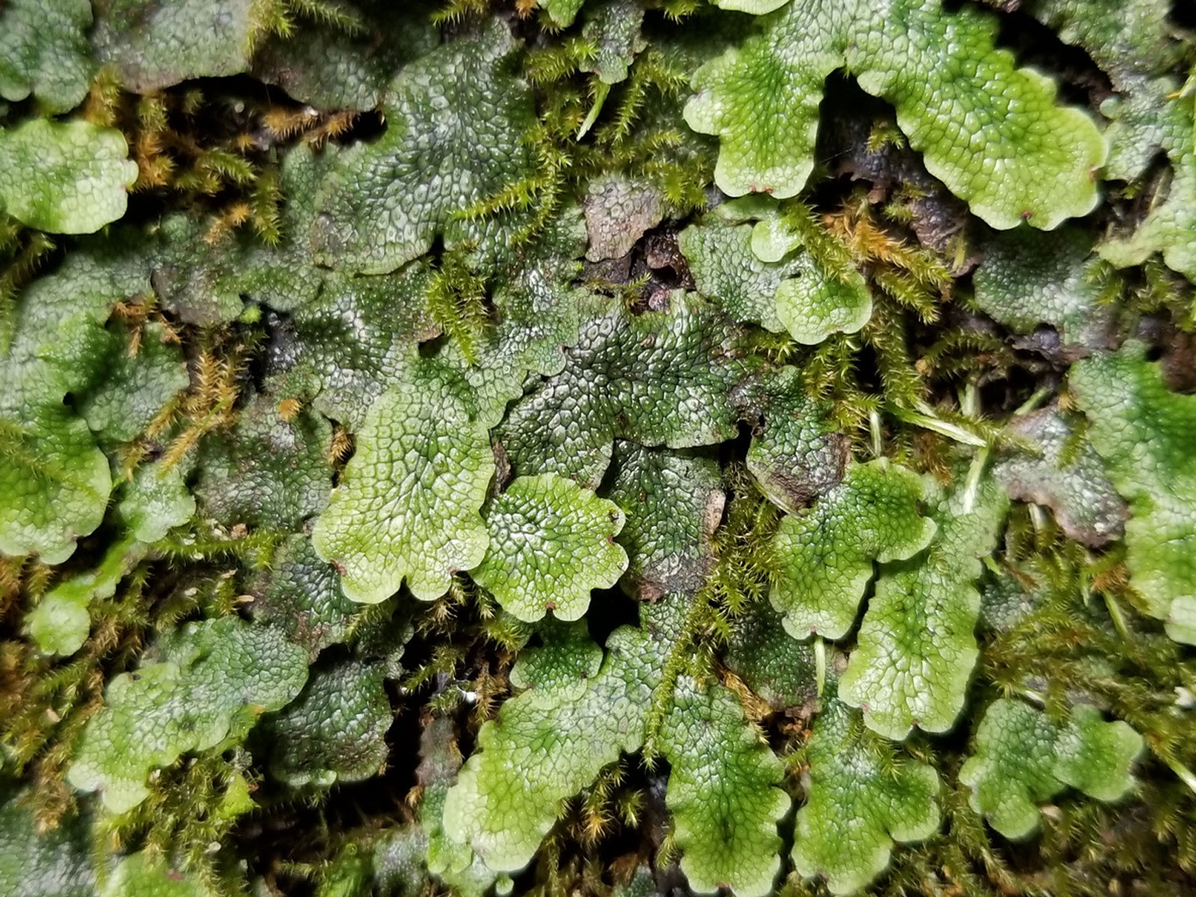
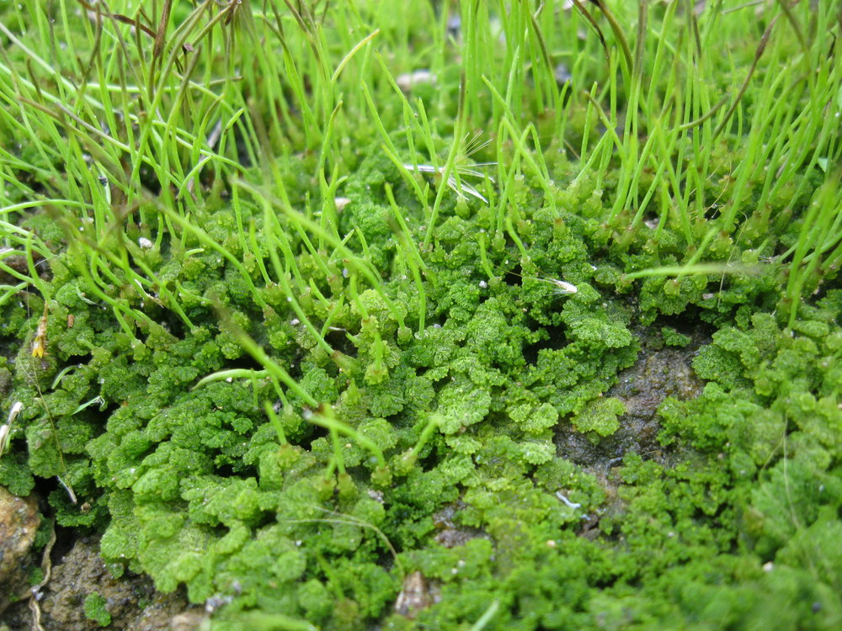
Scientists now divide the bryophytes into three different categories representing major evolutionary branches.
Bryophyta
“moss plants”
Liverworts
Hornworts
Mosses
Notes:
Scientists now divide the bryophytes into three different categories representing major evolutionary branches - liverworts, hornworts, and mosses.

Slide 25
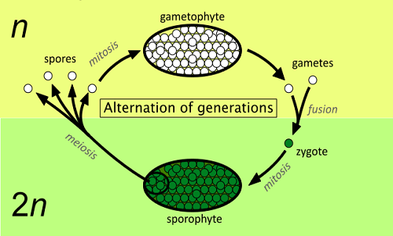
Gametophytes vs Sporophytes
Notes:
Before we look at specifics about the plant divisions, it’s important to understand that there are two dominant reproductive strategies among plants. Gametophytes reproduce sexually, having haploid gametes that fuse to form a diploid zygote. Sporophytes have diploid cells that must undergo meiosis in order to produce haploid spores.

Slide 26
Notes:
Let’s check-in for understanding.

Slide 27
What are the two major groups of the Plantae kingdom?
Plantae
Notes:
What are the two major groups of the Plantae kingdom?
[Green algae and the embryophytes]

Slide 28
What is the difference between gametophytes and sporophytes?
Notes:
What is the difference between gametophytes and sporophytes?
[Gametophytes reproduce sexually, having haploid gametes that fuse to form a diploid zygote.
Sporophytes have diploid cells that must undergo meiosis in order to produce haploid spores.]

Slide 29
Green Algae
Notes:
Let’s start by looking at the green algae.
Feedback: Slides such as this are important for their use of cues with students. By telling students what is coming either with images or words, it helps them know what to expect.

Slide 30
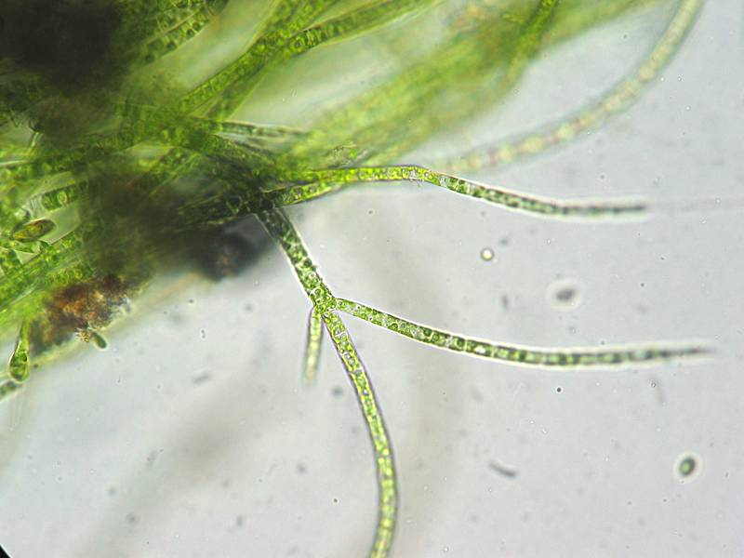
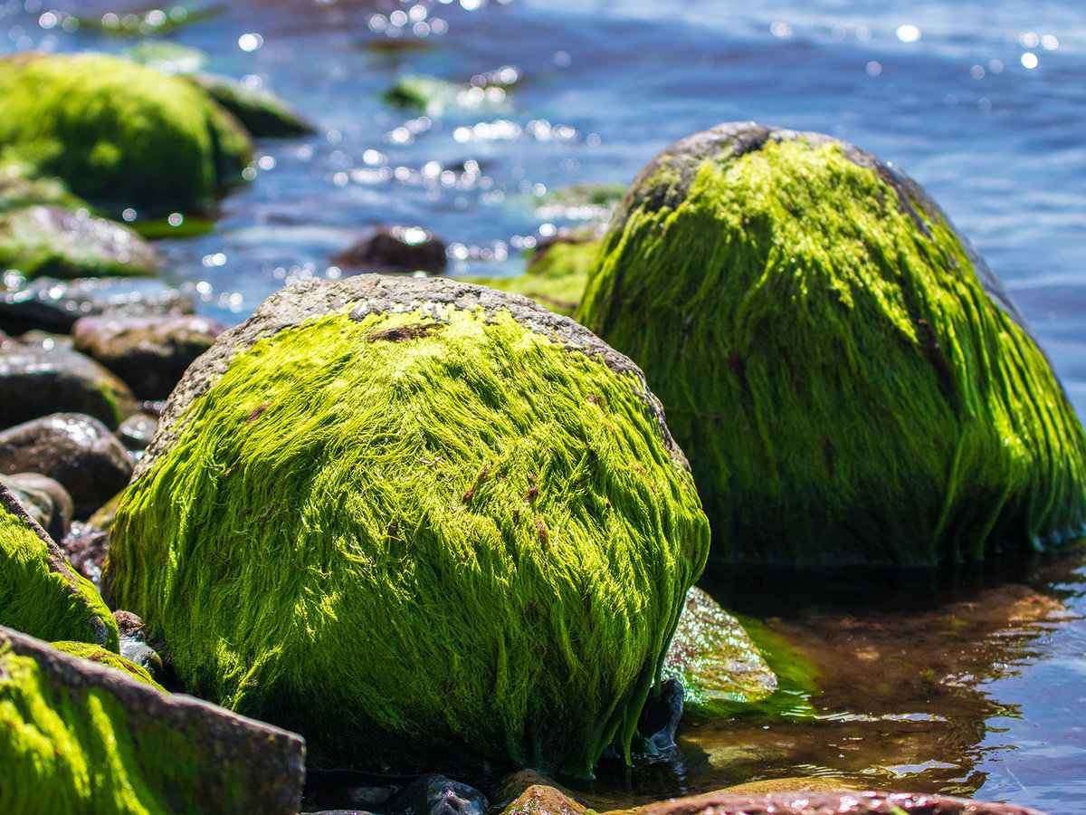
Green Algae: eukaryotic photosynthesizers ranging from unicellular to more complex multicellular forms
Notes:
Green algae are eukaryotic photosynthesizers ranging from unicellular to more complex multicellular forms.

Slide 31
Notes:
Let’s check-in for understanding.

Slide 32
What are green algae?
Notes:
What are green algae?
[Green algae are eukaryotic photosynthesizers ranging from unicellular forms to more complex multicellular forms.]

Slide 33
Notes:
That’s the basic description, but there is a bit more you need to know.

Slide 34
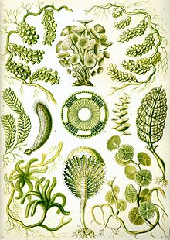
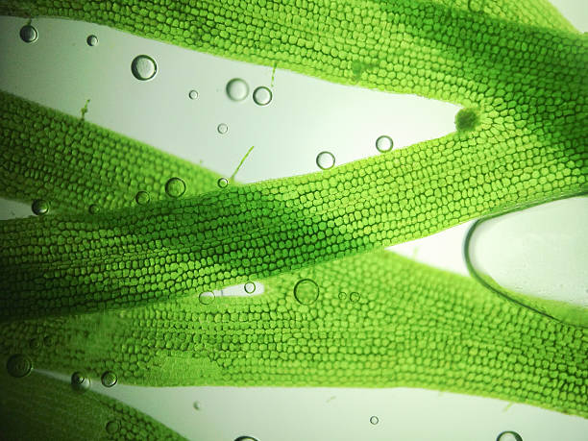
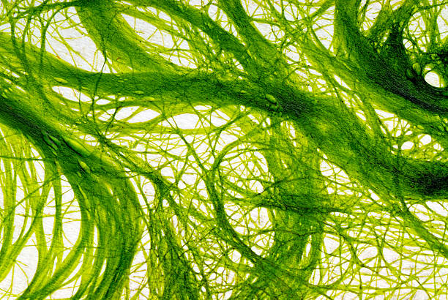
While green algae have diverse forms, all green algae contain chloroplasts - the structures which allow them to photosynthesize.
Notes:
While green algae have diverse forms, all green algae contain chloroplasts - the structures which allow them to photosynthesize.

Slide 35
Notes:
Let’s check-in for understanding.

Slide 36
What is one thing that all green algae contain?
Notes:
What is one thing that all green algae contain?
[They all contain chloroplasts. This allows them to photosynthesize.]

Slide 37
Liverworts
Notes:
Now let’s move on to look at the embryophytes. We’ll start with the liverworts.
Feedback: Slides such as this are important for their use of cues with students. By telling students what is coming either with images or words, it helps them know what to expect.

Slide 38
Liverworts: small plants which have a gametophyte-dominant life cycle and are characterized by their flattened stem shape
Notes:
Liverworts are small plants which have a gametophyte-dominant life cycle and are characterized by their flattened stem shape.

Slide 39
Notes:
Let’s check-in for understanding.

Slide 40
What are liverworts?
Notes:
What are liverworts?
[Liverworts are small plants which have a gametophyte-dominant life cycle and are characterized by their flattened stem shape.]

Slide 41
Notes:
That’s the basic description, but there is a bit more you need to know.

Slide 42
Their ribbon-like or branching body is called a thallus.
Notes:
Liverworts often have a flattened shape with small scale-like leaves that grow in ranks or segments. Their ribbon-like or branching body is called a thallus.

Slide 43
Notes:
Let’s check-in for understanding.

Slide 44
How are liverworts shaped?
Notes:
How are liverworts shaped?
[Liverworts often have a flattened shape with small scale-like leaves that grow in ranks or segments. Their ribbon-like or branching body is called a thallus.]

Slide 45
Hornworts
Notes:
Next, let’s look at hornworts.
Feedback: Slides such as this are important for their use of cues with students. By telling students what is coming either with images or words, it helps them know what to expect.

Slide 46
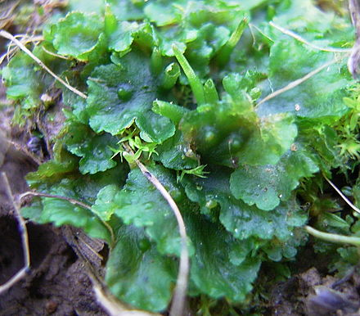
Hornworts: flattened gametophyte plants which grow horn-like sporophyte structures
Notes:
Hornworts are flattened gametophyte plants which grown horn-like sporophyte structures.

Slide 47
Notes:
Let’s check-in for understanding.

Slide 48
What are hornworts?
Notes:
What are hornworts?
[Hornworts are flattened gametophyte plants which grow horn-like sporophyte structures.]

Slide 49
Notes:
That’s the basic description, but there is a bit more you need to know.

Slide 50
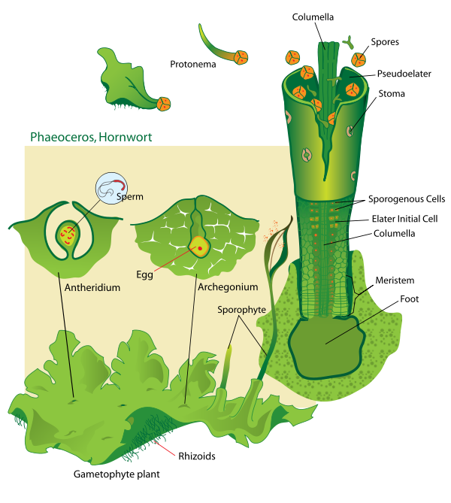
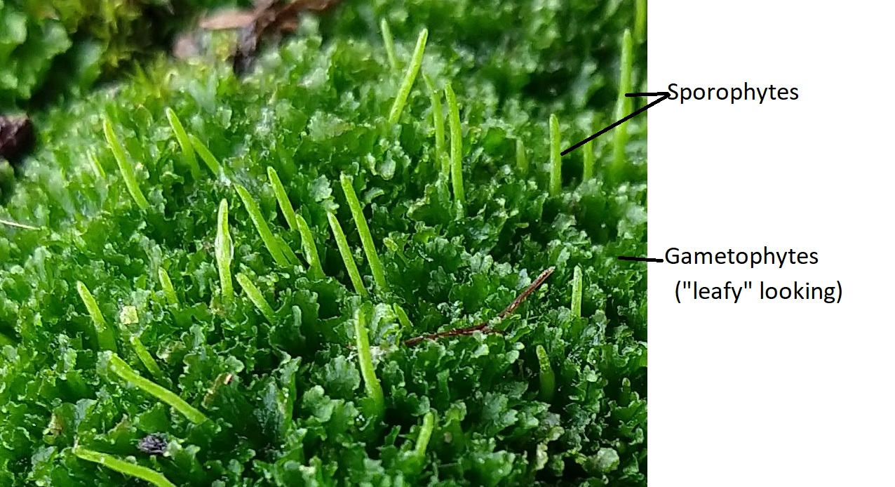
Grow spore-producing structures that resemble horns
Notes:
Hornworts, like liverworts, have a thallus structure, but hornworts additionally grow spore-producing structures that resemble horns.

Slide 51
Notes:
Let’s check-in for understanding.

Slide 52
How are hornworts different from liverworts?
Notes:
How are hornworts different from liverworts?
[Hornworts, like liverworts, have a thallus structure, but hornworts additionally grow spore-producing structures that resemble horns.]

Slide 53
Mosses
Notes:
Our last grouping for bryophytes is mosses.
Feedback: Slides such as this are important for their use of cues with students. By telling students what is coming either with images or words, it helps them know what to expect.

Slide 54
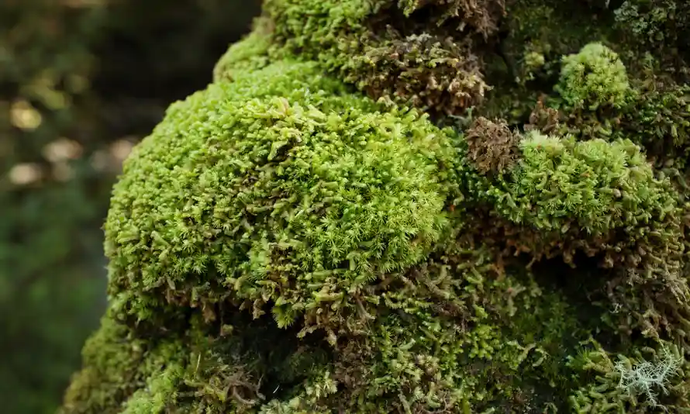
Mosses: nonvascular plants with narrow leaves through which they absorb nutrients and water
Notes:
Mosses are nonvascular plants with narrow leaves through which they absorb nutrients and water.

Slide 55
Notes:
Let’s check-in for understanding.

Slide 56
What are mosses?
Notes:
What are mosses?
[Mosses are nonvascular plants with narrow leaves through which they absorb nutrients and water.]

Slide 57
Notes:
That’s the basic description, but there is a bit more you need to know.

Slide 58
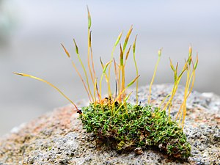
No extensive root structures
Notes:
Unlike many other plants, mosses do not have extensive root structures.

Slide 59
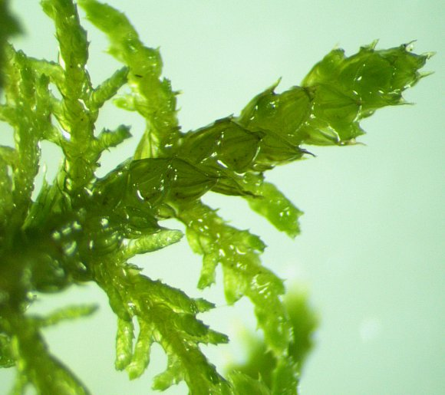
Absorb water and nutrients through small leaves
Notes:
Rather than absorbing water and nutrients through their roots, mosses, absorb these through their small leaves. Sometimes their leaves are only the width of one cell.

Slide 60
Notes:
Let’s check-in for understanding.

Slide 61
What do liverworts, hornworts, and mosses all have in common?
Liverworts
Hornworts
Mosses
Notes:
What do liverworts, hornworts, and mosses all have in common?
[All of these plants are nonvascular and have a gametophyte-dominant life cycle.]

Slide 62
What is the ribbon-like or branching body of the liverwort plant called?
Sporophyte
Gametophyte
Platyhelminthes
Thallus
Notes:
What is the ribbon-like or branching body of the liverwort plant called?
[The main portion of the liverwort plant body is called the thallus.]

Slide 63
Where do mosses absorb most of the water and nutrients they need?
Notes:
Where do mosses absorb most of the water and nutrients they need?
[Mosses absorb most water and nutrients through their leaves.]

Slide 64
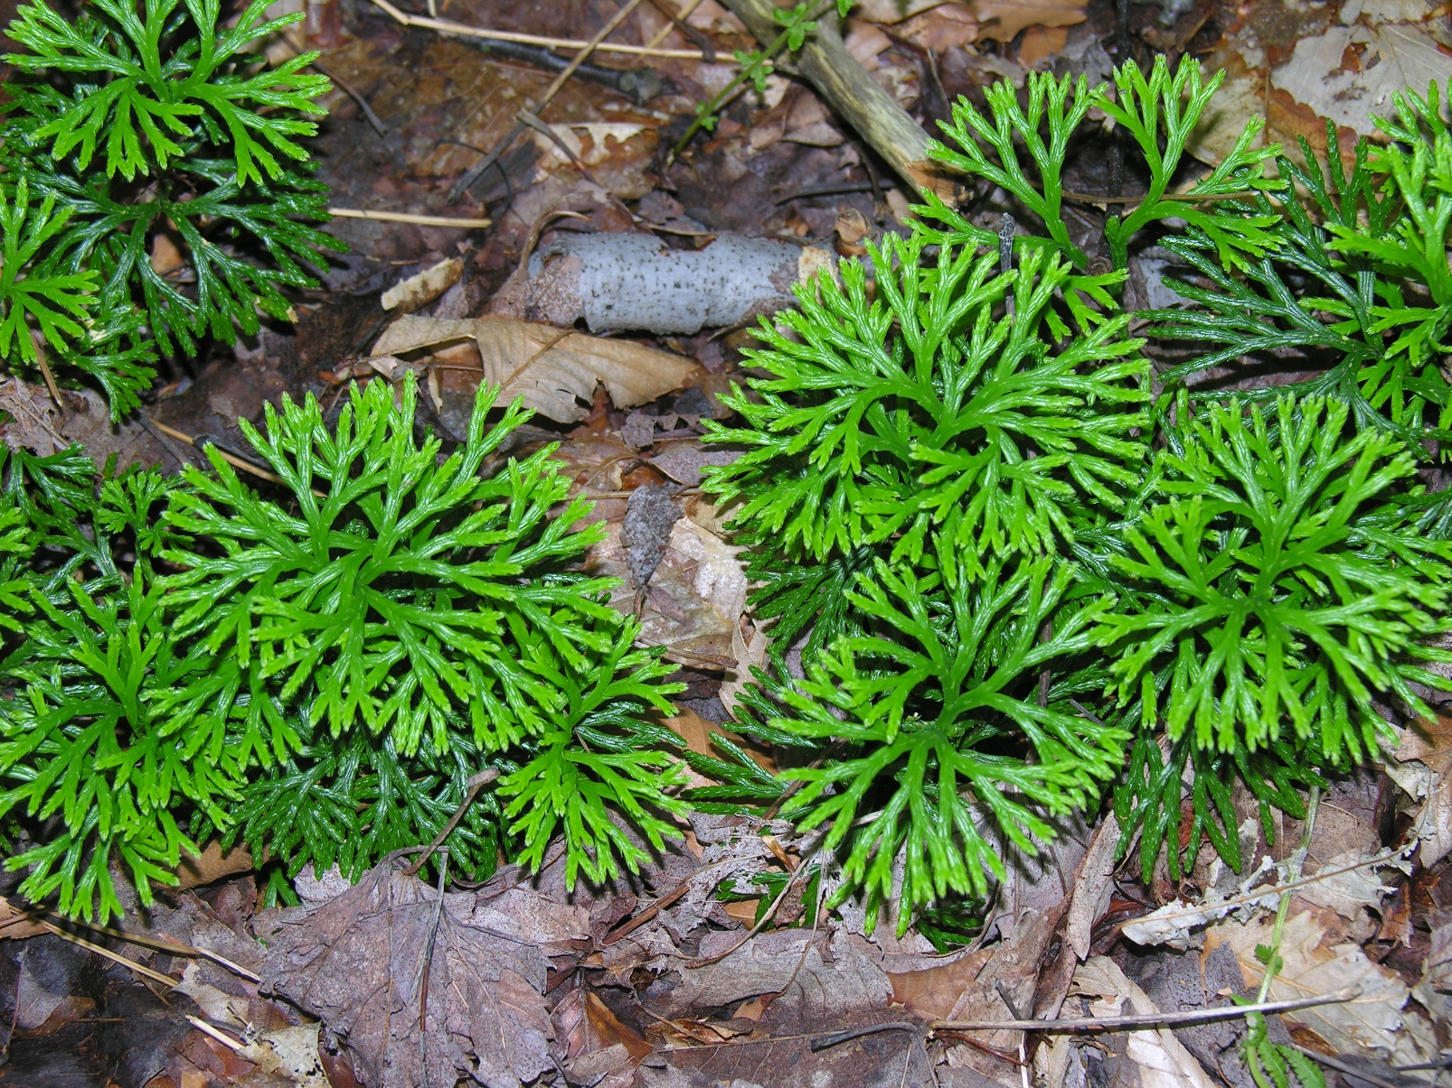
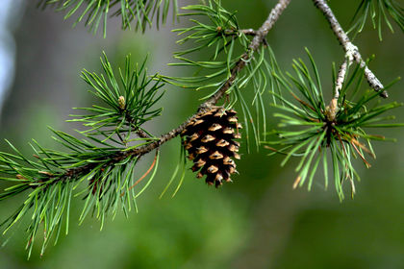
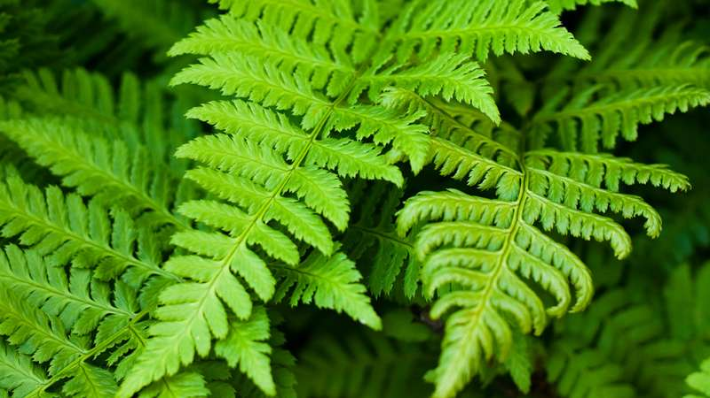
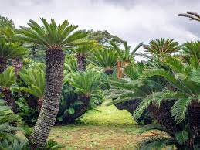
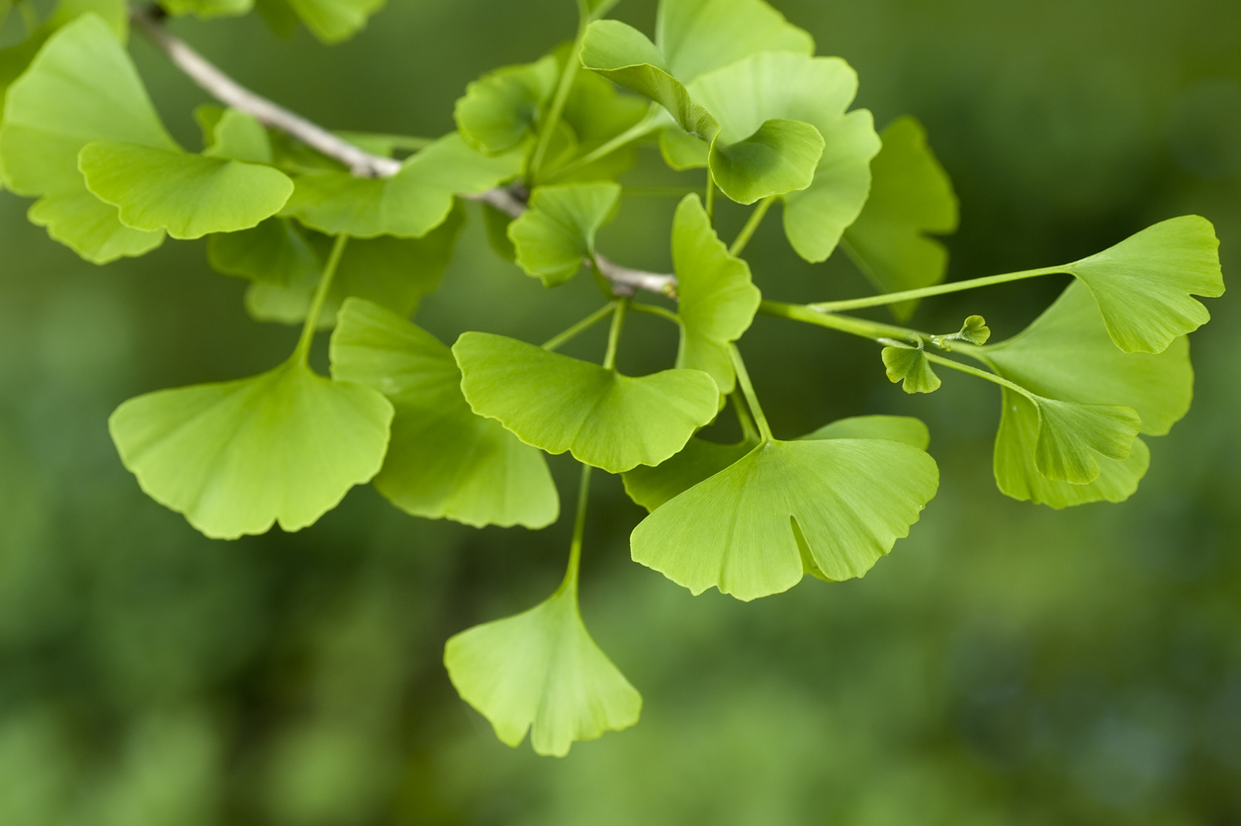
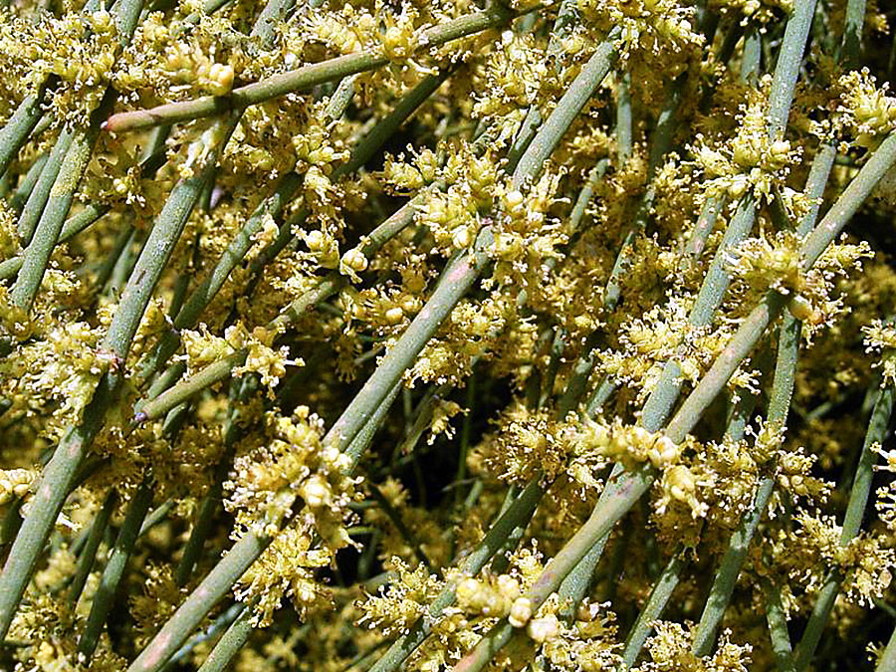
Tracheophyta
“tube plants”
Ferns and Horsetails
Flowering Plants
Clubmosses
Conifers
Cycads
Ginkgos
Gnetae
Notes:
Scientists divide the tracheophytes into at least seven different classifications.

Slide 65
Clubmosses
Notes:
First we’ll look at clubmosses.
Feedback: Slides such as this are important for their use of cues with students. By telling students what is coming either with images or words, it helps them know what to expect.

Slide 66
Clubmosses: vascular plants having branching stems and bearing simple leaves
Notes:
Clubmosses are vascular plants having branching stems and bearing simple leaves.

Slide 67
Notes:
Let’s check-in for understanding.

Slide 68
What are clubmosses?
Notes:
What are clubmosses?
[Clubmosses are vascular plants having branching stems and bearing simple leaves.]

Slide 69
Notes:
That’s the basic description, but there is a bit more you need to know.

Slide 70
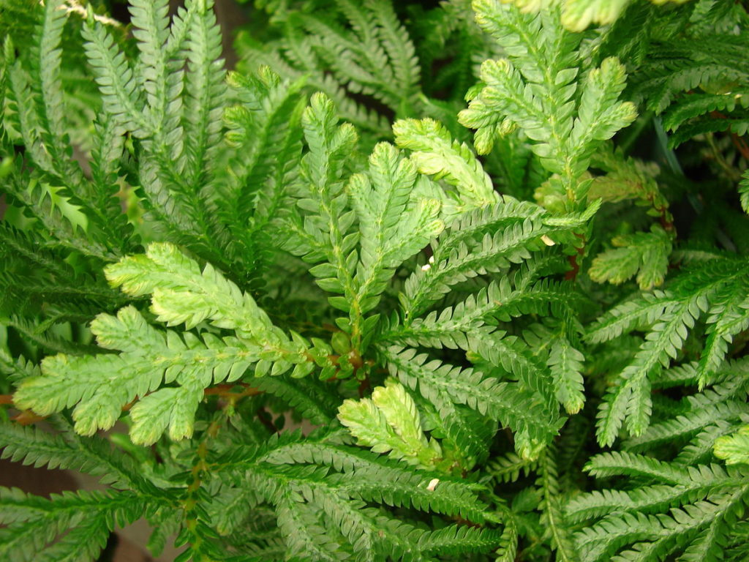
Microphylls
Notes:
The leaves of clubmoss plants are called microphylls.

Slide 71
Notes:
Let’s check-in for understanding.

Slide 72
What are the leaves of clubmoss plants called?
Notes:
What are the leaves of clubmoss plants called?
[Microphylls]

Slide 73
Ferns and Horsetails
Notes:
Next let’s take a look at ferns and horsetails.
Feedback: Slides such as this are important for their use of cues with students. By telling students what is coming either with images or words, it helps them know what to expect.

Slide 74
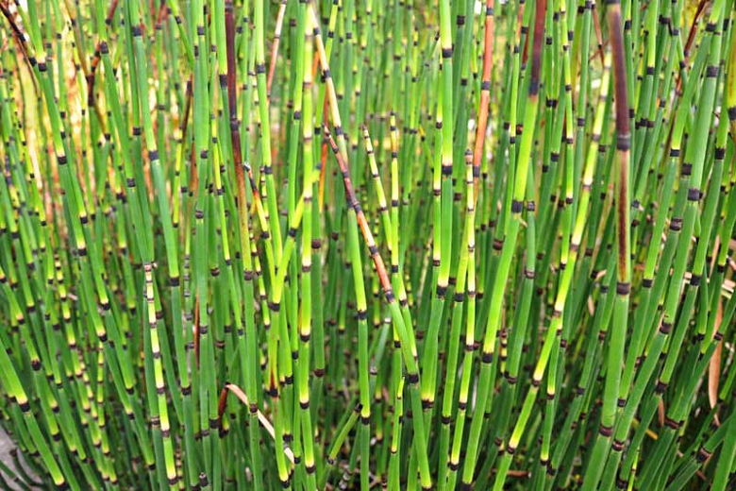
Ferns and Horsetails: some of the first vascular plants to develop circulatory systems that allow them to grow longer
Notes:
Ferns and horsetails were some of the first vascular plants to develop circulatory systems that allow them to grow longer.

Slide 75
Notes:
Let’s check-in for understanding.

Slide 76
What are ferns and horsetails?
Notes:
What are ferns and horsetails?
[Ferns and horsetails were some of the first vascular plants to develop circulatory systems that allow them to grow longer.]

Slide 77
Notes:
That’s the basic description, but there is a bit more you need to know.

Slide 78
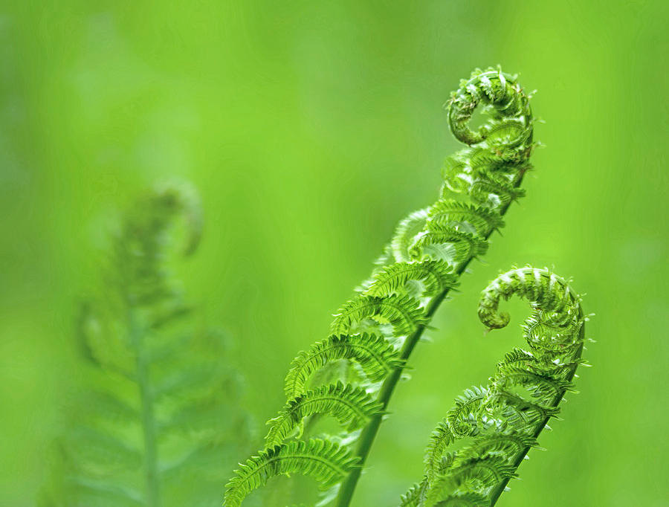
Fronds
Notes:
Ferns have specialized leaves called fronds. Fronds unroll as they mature and spread out into a fan shape.

Slide 79
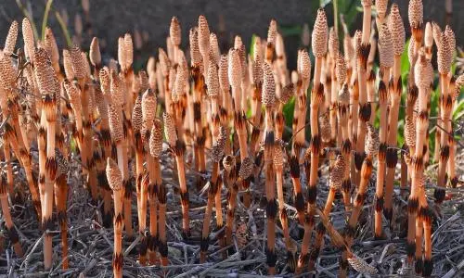
Horsetails have adapted to extreme environments
Notes:
Horsetails have adapted to extreme environments with hard silica in their epidermal cells.

Slide 80
Notes:
Let’s check-in for understanding.

Slide 81
What are fronds?
Notes:
What are fronds?
[Specialized leaves on ferns. They unroll as they mature and spread out into a fan shape.]

Slide 82
How have horsetails adapted to extreme environments?
Notes:
How have horsetails adapted to extreme environments?
[They’ve adapted with hard silica in their epidermal cells.]

Slide 83
Conifers
Notes:
Next let’s take a look at conifers.
Feedback: Slides such as this are important for their use of cues with students. By telling students what is coming either with images or words, it helps them know what to expect.

Slide 84
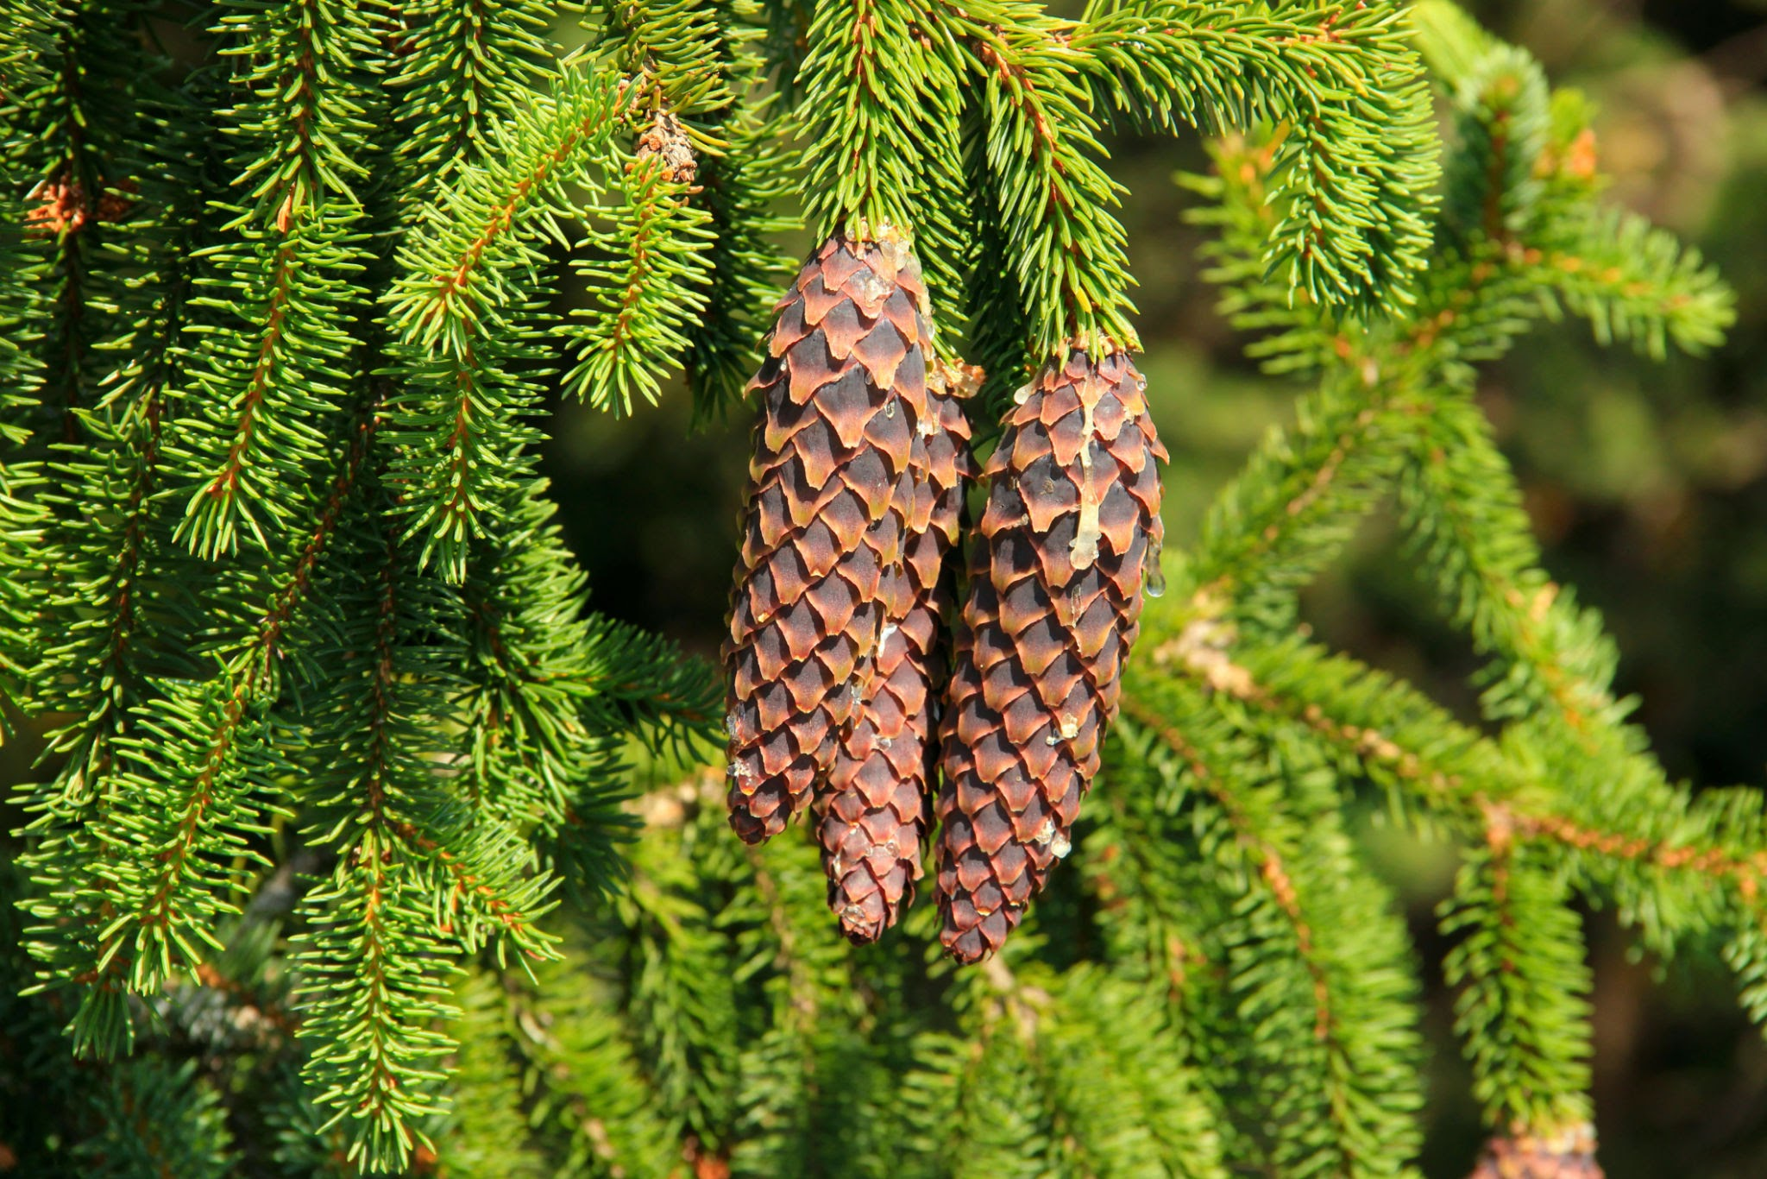
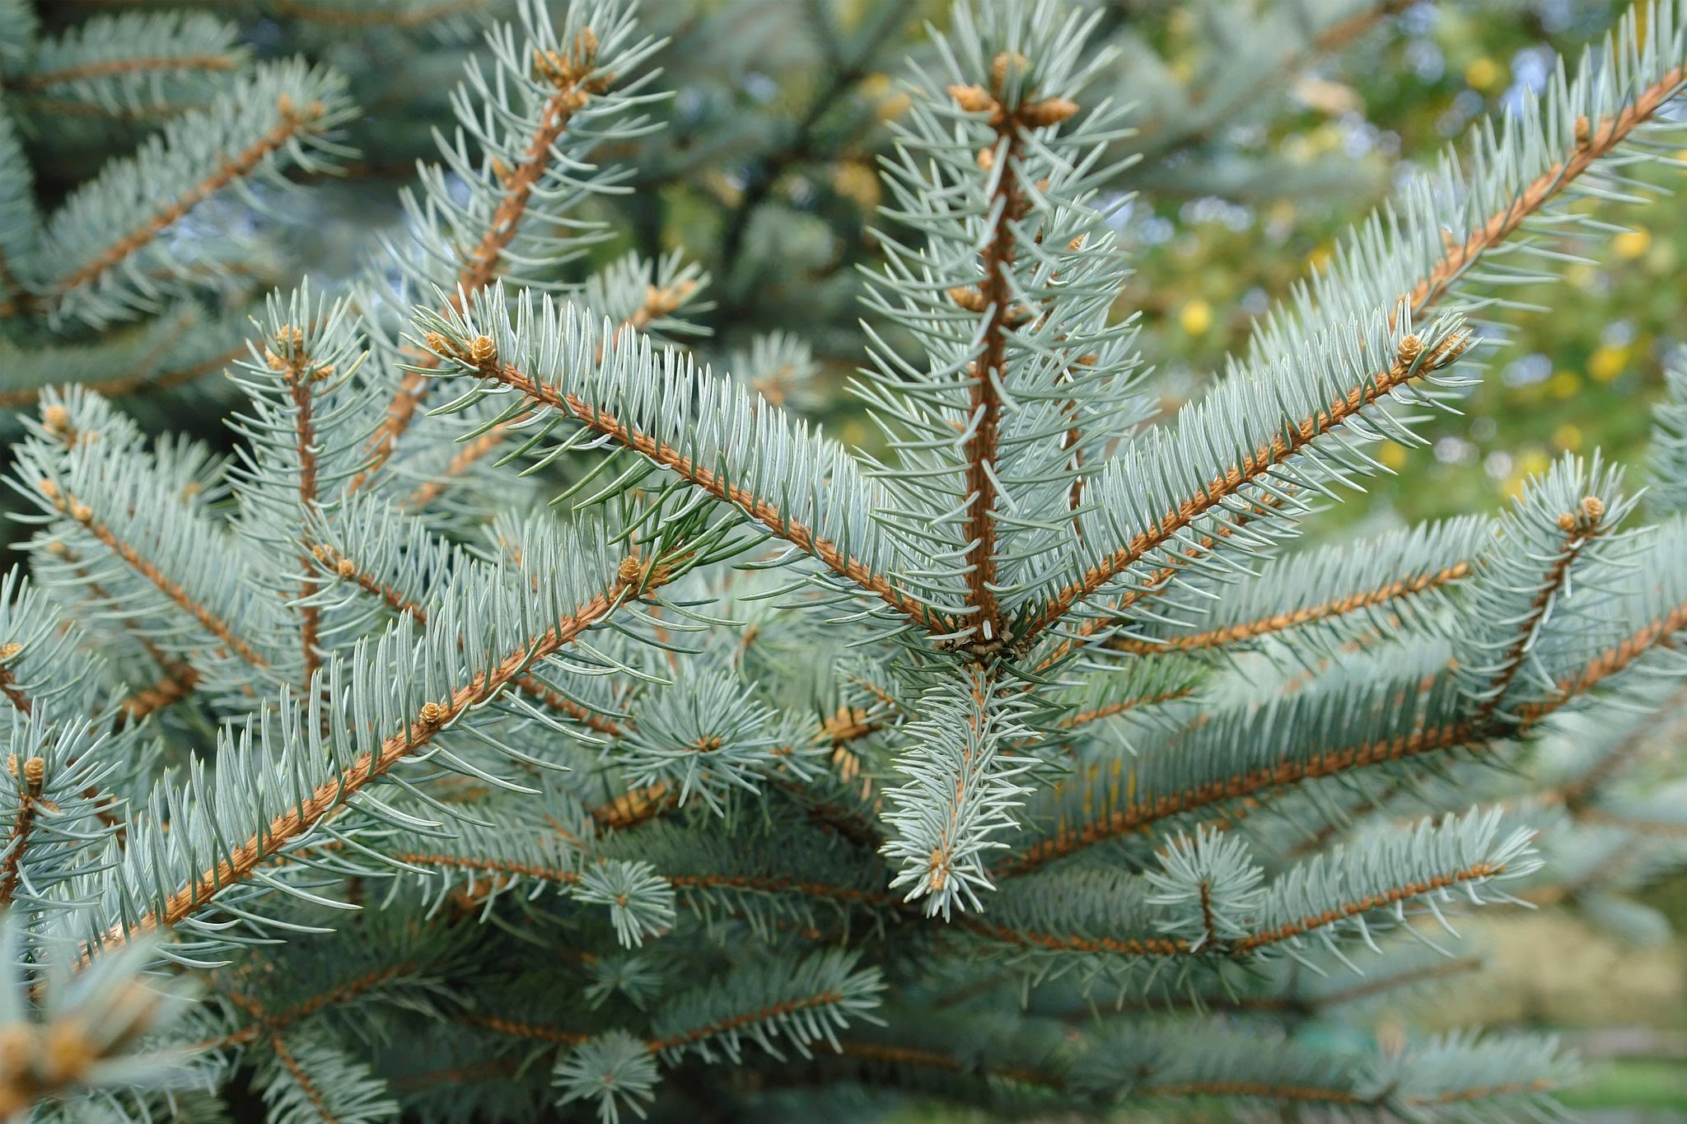
Conifers: trees that bear cones and needle or scale-like leaves that are typically evergreen
Notes:
Conifers are trees that bear cones and needle or scale-like leaves that are typically evergreen.

Slide 85
Notes:
Let’s check-in for understanding.

Slide 86
What are conifers?
Notes:
What are conifers?
[Conifers are trees that bear cones and needle or scale-likes leaves that are typically evergreen.]

Slide 87
Notes:
That’s the basic description, but there is a bit more you need to know.

Slide 88
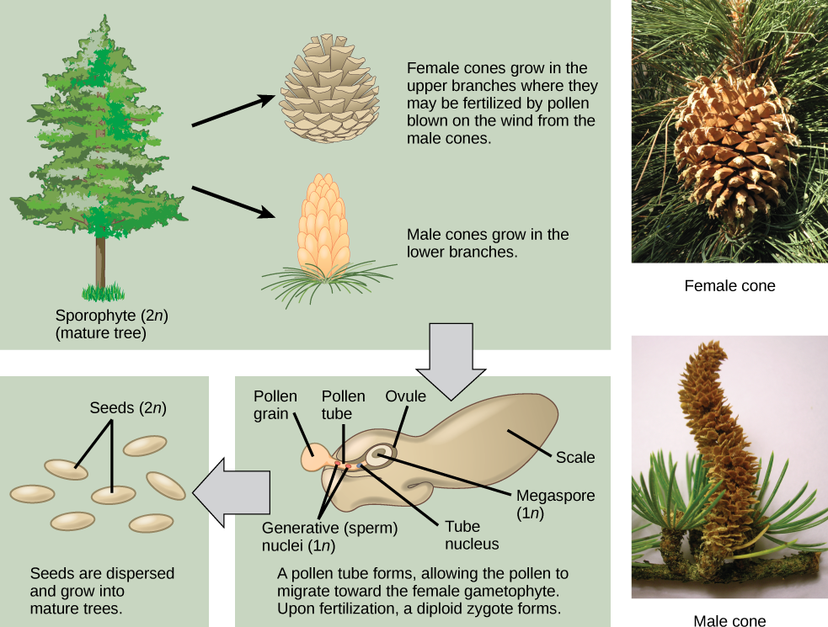
Conifers have a sporophyte-dominant life cycles
Notes:
Conifers have a sporophyte-dominant life cycles. Their male and female cones produce haploid gametes that combine to produce diploid seeds, which then grow into a mature tree.

Slide 89
Notes:
Let’s check-in for understanding.

Slide 90
What type of life cycle do conifers have?
Notes:
What type of life cycle do conifers have?
[Conifers have a sporophyte-dominant life cycle. Their male and female cones produce haploid gametes that combine to produce diploid seeds, which then grow into a mature tree.]

Slide 91
Flowering Plants
Notes:
Now let’s take a look at flowering plants.
Feedback: Slides such as this are important for their use of cues with students. By telling students what is coming either with images or words, it helps them know what to expect.

Slide 92
Flowering Plants: also called angiosperms, these plants produce flowers and seeds
Notes:
Flowering plants, also called angiosperms, these plants produce flowers and seeds.

Slide 93
Notes:
Let’s check-in for understanding.

Slide 94
What are flowering plants?
Notes:
What are flowering plants?
[Flowering plants, also called angiosperms, these plants produce flowers and seeds.]

Slide 95
Notes:
That’s the basic description, but there is a bit more you need to know.

Slide 96
Produce haploid gametes
Notes:
Like the conifers, flowers have male and female parts that produce haploid gametes.

Slide 97
The stamen is the male gametophyte
Notes:
The stamen is the male gametophyte, which includes the anther and filament and produces pollen.

Slide 98
The pistil is the female gametophyte
Notes:
The pistil is the female gametophyte. It includes the stigma, style, and ovary and it produces ovules.

Slide 99
Notes:
Let’s check-in for understanding.

Slide 100
What is the difference between the pistil and the stamen in a flowering plant?
Notes:
What is the difference between a pistil and a stamen in a flowering plant?
[The pistil is the female gametophyte. It includes the stigma, style, and ovary and it produces ovules.
The stamen is the male gametophyte, which includes the anther and filament and produces pollen.]

Slide 101
Cycads
Notes:
Now let’s take a look at cycads.
Feedback: Slides such as this are important for their use of cues with students. By telling students what is coming either with images or words, it helps them know what to expect.

Slide 102
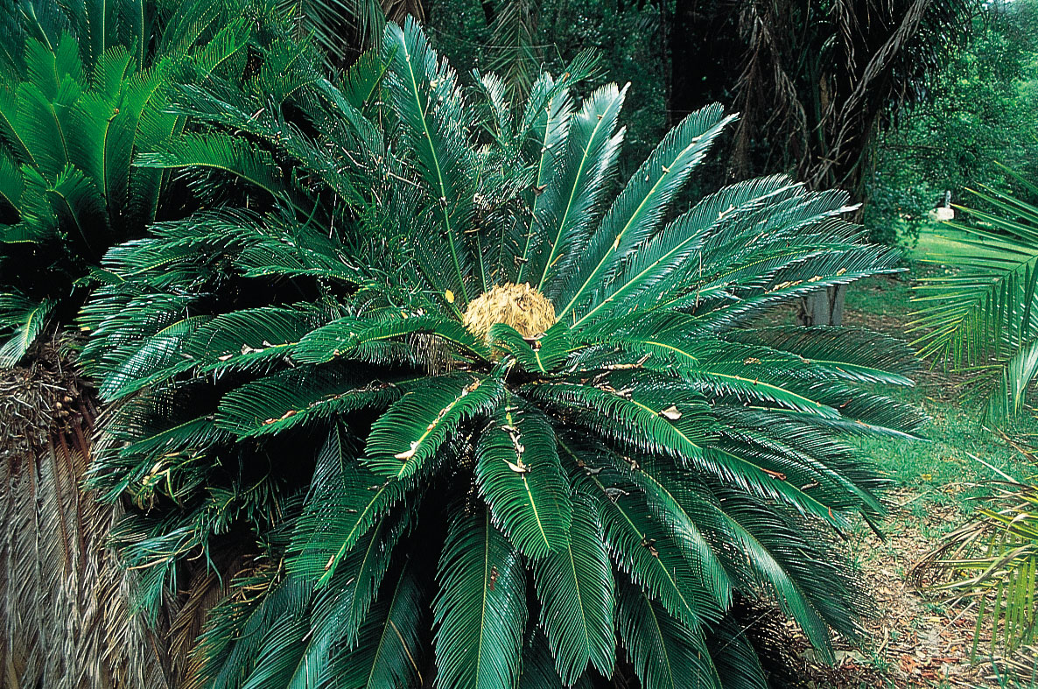
Cycads: palm-like plants growing in tropical and subtropical regions and bearing large male or female cones
Notes:
Cycads are palm-like plants growing in a tropical and subtropical regions and bearing large male or female cones.

Slide 103
Notes:
Let’s check-in for understanding.

Slide 104
What are cycads?
Notes:
What are cycads?
[Cycads are palm-like plants growing in tropical and subtropical regions and bearing large male or female cones.]

Slide 105
Notes:
That’s the basic description, but there is a bit more you need to know.

Slide 106
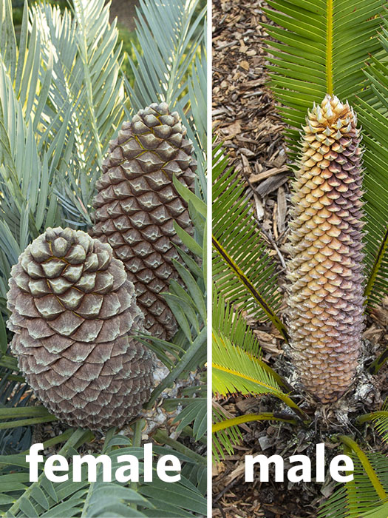
Either male or female cones
Notes:
Unlike conifers, cycads either have male or female cones - one individual does not have both.

Slide 107
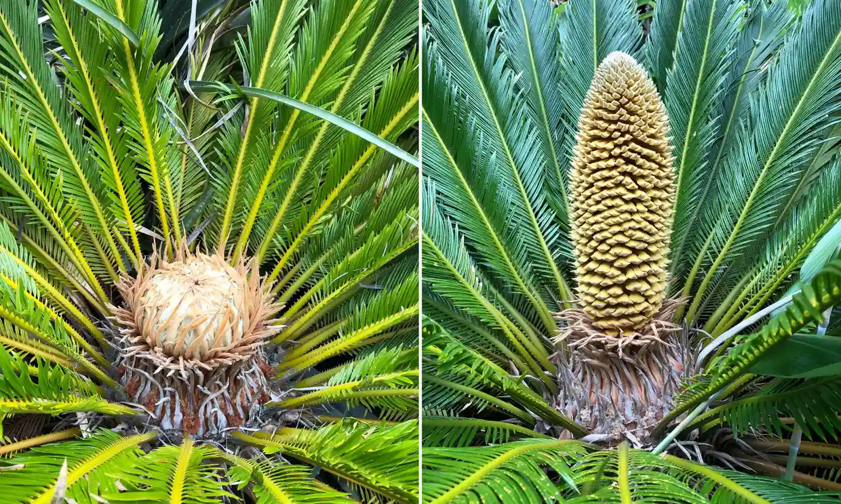
Have been around for about 60 million years
Notes:
Cycads have been around for about 60 million years, making them the oldest seed plants.

Slide 108
Notes:
Let’s check-in for understanding.

Slide 109
True/False: Cycads are either male or female.
Notes:
True/False: Cycads are either male or female.

Slide 110
True/False: Cycads are either male or female.
Notes:
True/False: Cycads are either male or female.
[True - they are can only be one.]

Slide 111
Ginkgos
Notes:
Next we’ll look at the ginkgos.
Feedback: Slides such as this are important for their use of cues with students. By telling students what is coming either with images or words, it helps them know what to expect.

Slide 112
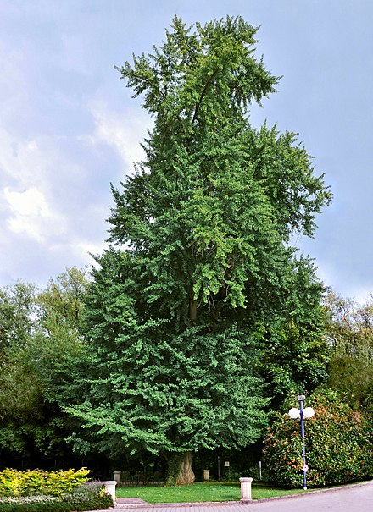
Ginkgos: trees with fan-like leaves and separate sexes, some being male and others female
Notes:
Ginkgos are trees with fan-like leaves and separate sexes, some being male and others female.

Slide 113
Notes:
Let’s check-in for understanding.

Slide 114
What are ginkgos?
Notes:
What are ginkgos?
[Ginkgos are trees with fan-like leaves and separate sexes, some being male and others female.]

Slide 115
Notes:
That’s the basic description, but there is a bit more you need to know.

Slide 116
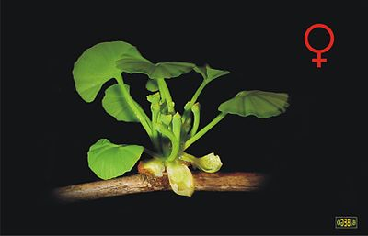
Notes:
Male ginkgos hav

Slide 117
Remember!!!
Notes:
So remember!

Slide 118
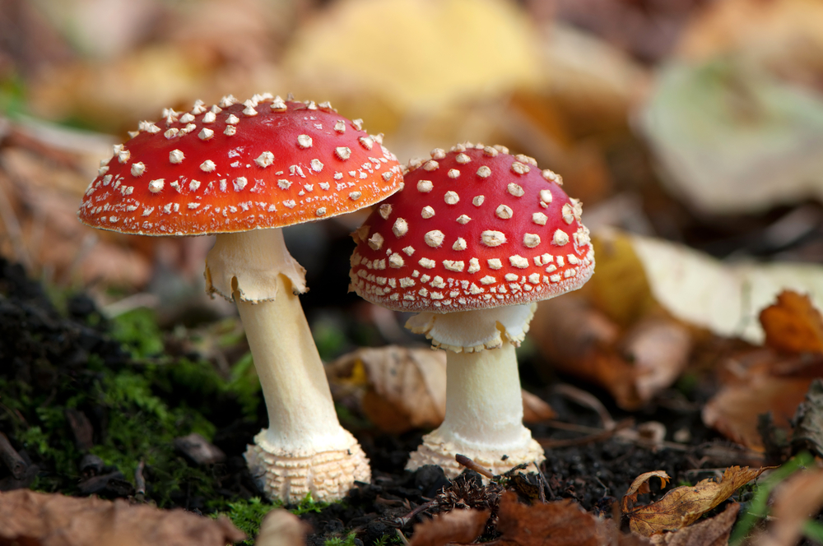
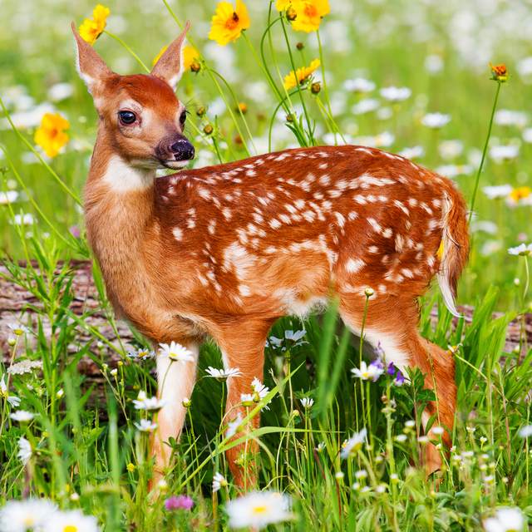
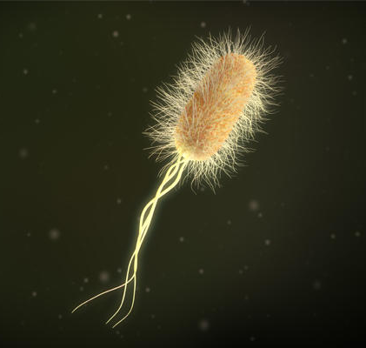
Biotic Factors: living things, plants or animals, that influence or affect an ecosystem
Notes:
Biotic factors are the living things that influence or affect an ecosystem. And, we will learn more about ecosystems later in the unit.

Slide 119
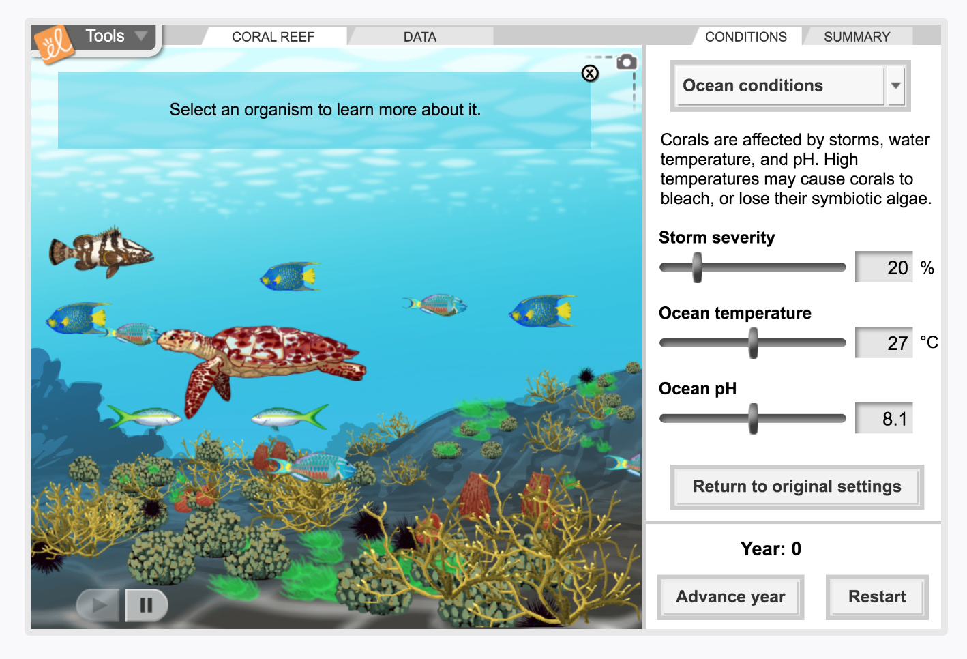
Simulation Activity
Biotic Factors
(Gizmos)
Click the link above to explore the different biotic factors in the coral reef.
In this simulation activity, you’ll learn about the characteristics of the biotic factors and how they are involved in the environment.
Notes:
Feedback: Providing a simulation activity is a great way to make science thinking visible. In this simulation, students have the opportunity to make predictions and apply an idea to a new situation by changing the variables in the simulation (i.e., storm severity, ocean temperature, ocean pH).

Slide 120
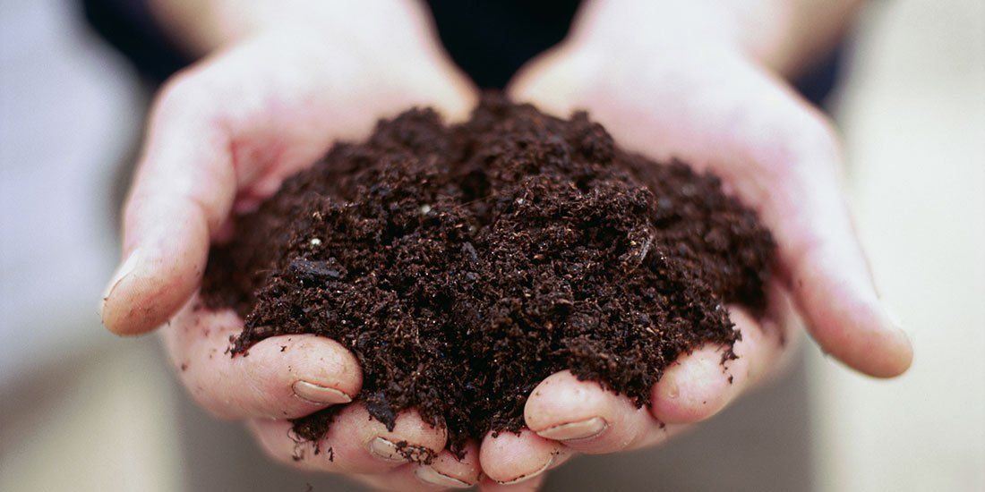
Big Question: What is the difference between biotic and abiotic factors?
Notes:
Explicit cue to revisit the big question at the end of the lesson: Okay everyone. Now that we’ve learned the term, biotic factors, let’s reflect once more on our big question. Was there anything that we predicted earlier that was correct or incorrect? Do you have any new hypotheses to share?

Slide 121
Notes:
Thanks for watching, and please continue watching CAPs available from this website.

Slide 122
This Video Was Created With Resources From:
Questions or Comments
Michael Kennedy, Ph.D. MKennedy@Virginia.edu
Rachel L Kunemund, Ph.D. rk8vm@virginia.edu

