Slide 1
Intro
“Big Idea” Question
Review Concepts
Teacher Demo
Check-In Questions
Vocabulary
Student-Friendly Definition
Examples & Non-Examples
Morphological Word Parts
Simulation/Activity
Notes:
OK everyone, get ready for our next lesson. Just as a reminder, these are the different components that our lesson may include, and you’ll see these icons in the top left corner of each slide so that you can follow along more easily!

Slide 2
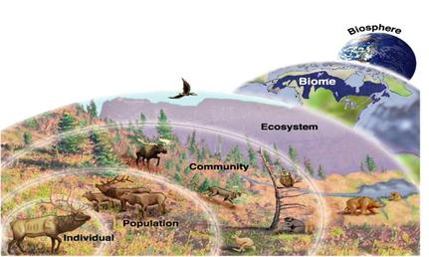
Levels of Organization
Intro
Notes:
Today we are going to start learning about levels of organization in ecology.

Slide 3
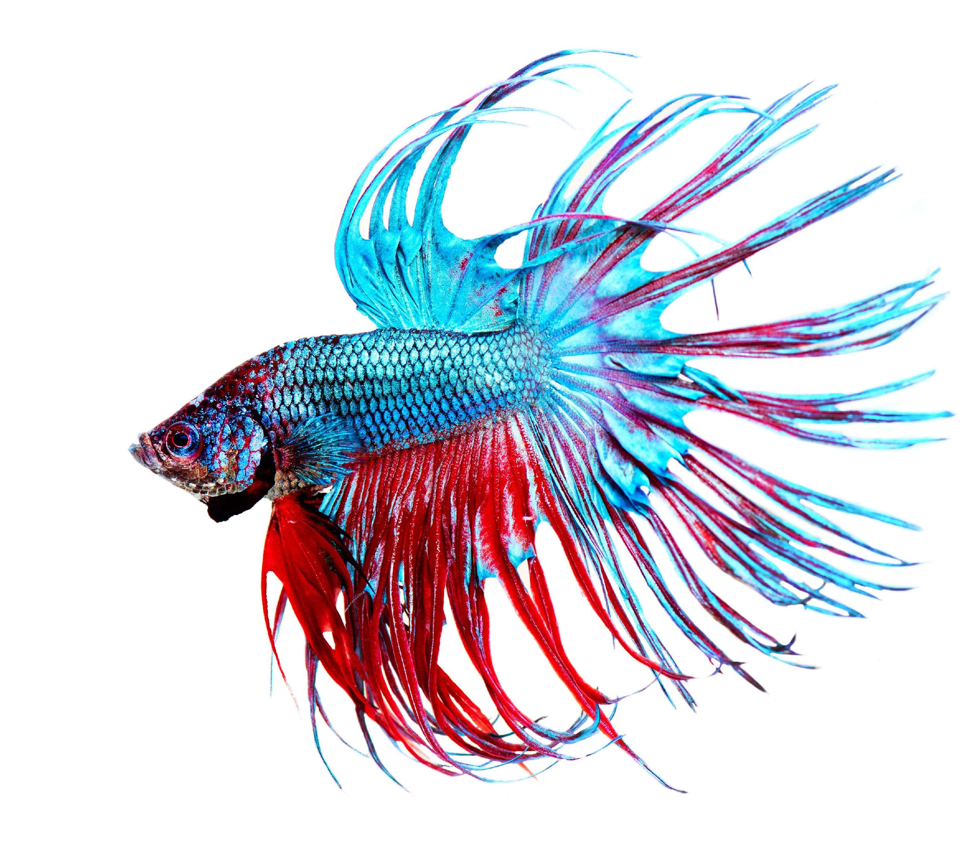
Individual
Intro
Notes:
The first level we’ll learn about is individual.

Slide 4
Big Question: Why do you think levels of organization are important within ecosystems?
Notes:
Our “big question” is: Why do you think levels of organization are important within ecosystems?
[Pause and illicit predictions from students.]
I love all these thoughtful scientific hypotheses! Be sure to keep this question and your predictions in mind as we move through these next few lessons, and we’ll continue to revisit it.

Slide 5
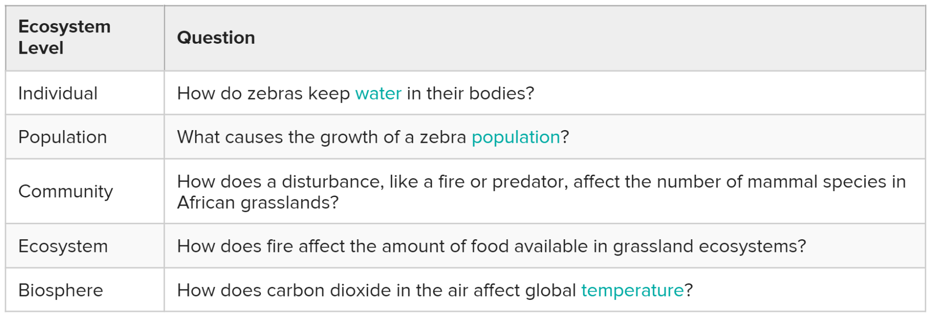
Demonstration
Levels of Scientific Questioning
Scientists study nature at a variety of levels. Today, we are going to look at these different levels of organization and consider why they might be important. Let’s consider the scientific questions below and make some predictions about what the definition of each level is or what other examples might fit into the same category...
Notes:
Feedback: Use the provided questions to engage students in the process of making predictions about ecological levels of organization. For this presentation, you might focus solely on individual. Consider drawing connections between the ecological levels and related words that students have used or heard before. Ex) When you think of a population, what comes to mind? What components would you include in describing a “community” as you understand it?
The resource for these questions can be found by clicking the included link.

Slide 6
Notes:
Before we define the term individual, let’s review some other words that you already learned, and make sure you are firm in your understanding.

Slide 7
Notes:
There are many different organisms living within ecosystems, and they range in structure from unicellular organisms (like amoeba) to multicellular organisms (like bees).

Slide 8
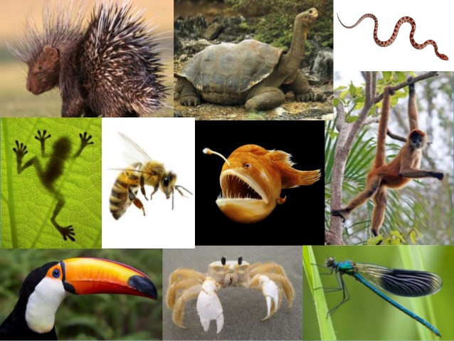
Form fits function!
Notes:
An important concept to remember in science is that form fits function. This is true for cells as well as whole organisms! Recall that cells within multicellular organisms are specialized and have specific jobs to help organisms carry out life’s processes. Further, the differences in the ways that organisms look are purposeful – as we’ll learn about in this unit.

Slide 9
Notes:
Now let’s pause for a moment to check your understanding.

Slide 10
Explain how the phrase “form fits function” applies to the cells that make up multicellular organisms.
Notes:
Explain how the phrase “form fits function” applies to the cells that make up multicellular organisms.
[Cells in multicellular organisms take on special forms and carry out specific functions to support life’s processes.]

Slide 11
Individual
Notes:
Next, let’s define our new term, individual.

Slide 12
Individual: a single organism
Notes:
An individual is a single organism. This fish is an example of an individual organism.

Slide 13
Notes:
Now let’s pause for a moment to check your understanding.

Slide 14
What is an individual?
Notes:
What is an individual?
[An individual is a single organism.]

Slide 15
Notes:
Now, let’s look at some examples of individuals.

Slide 16
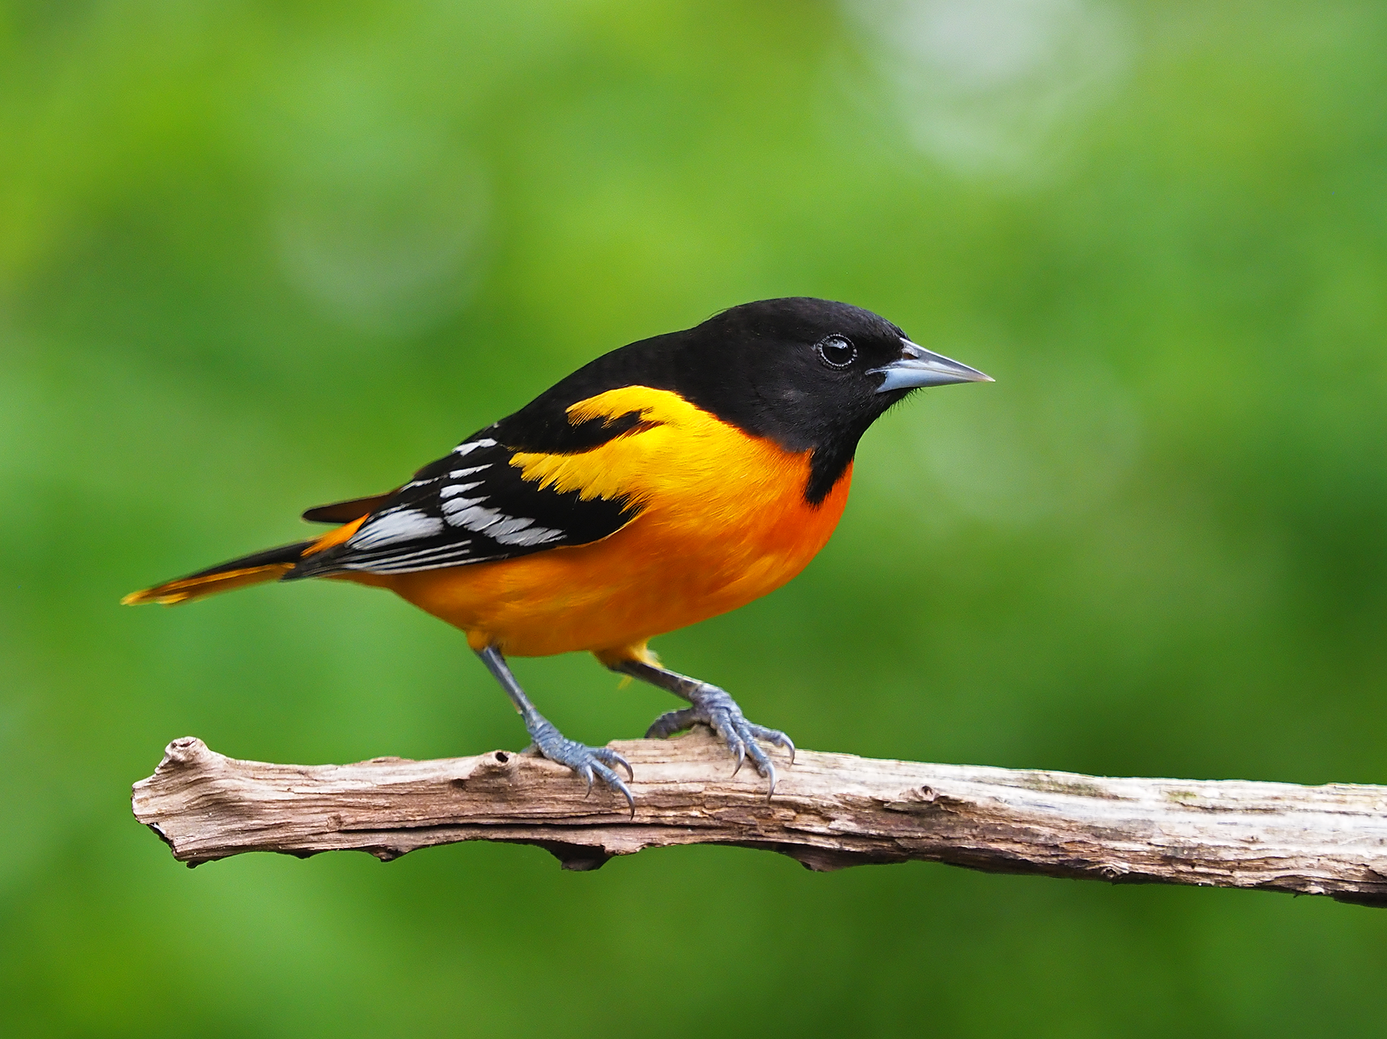
Notes:
This bird is an example of an individual because it is a single organism.

Slide 17
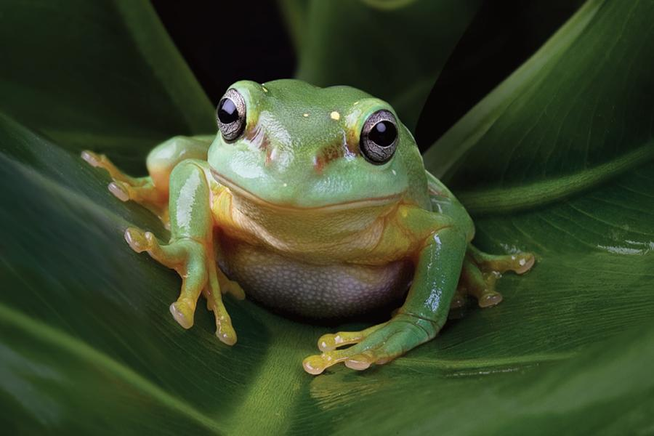
Notes:
This frog is an example of an individual because it is a single organism.

Slide 18
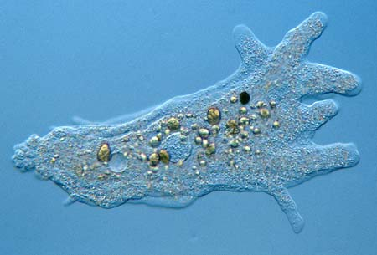
Notes:
This amoeba is also an example of an individual. As a unicellular organism, it certainly is not as complex as the other examples, yet it still performs all functions needed to support life - it is a single organism.

Slide 19
Notes:
Let’s check-in for understanding.

Slide 20
Define the term individual.
Notes:
Define the term individual.
[An individual is a single organism.]

Slide 21
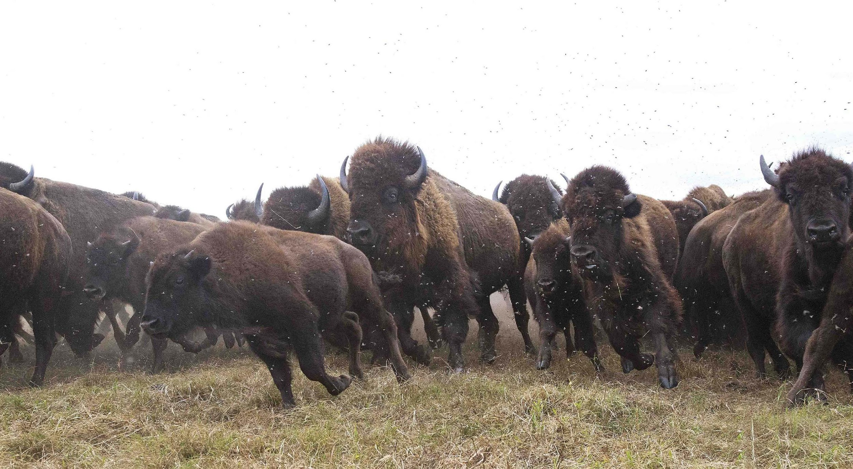
True/False: These bison are an example of an individual.
Notes:
True/False: These bison are an example of an individual.

Slide 22
True/False: These bison are an example of an individual.
Notes:
True/False: These bison are an example of an individual.
[False. This is a group of bison, not an individual bison. If we were to focus on any one bison in particular, that single bison would be an individual.]

Slide 23
Name two other examples of individuals.
Notes:
Name 2 other examples of individuals.
[Answers will vary.]

Slide 24
Notes:
Next, let’s talk about some non-examples of individuals.

Slide 25
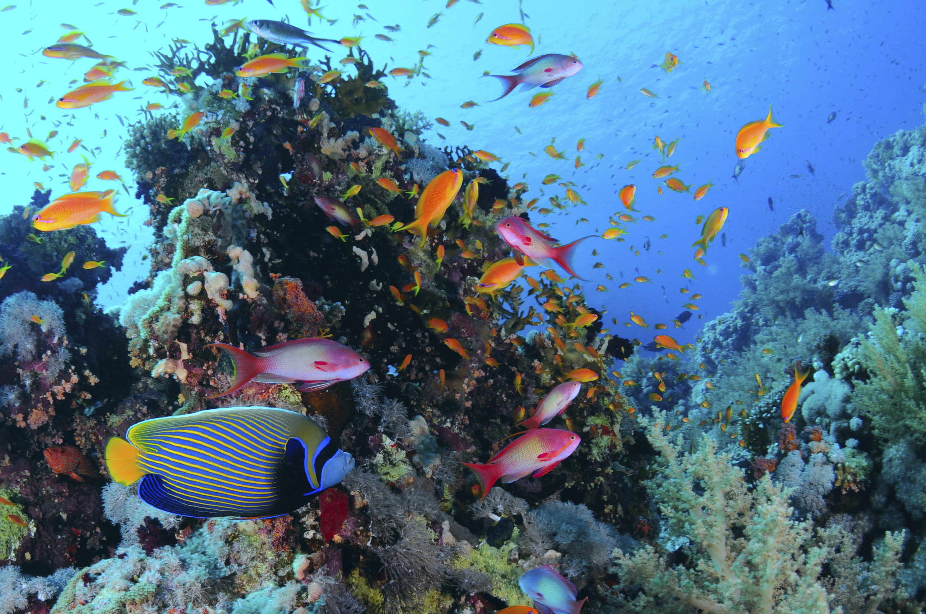
Notes:
This is not an example of individuals because there are many different types of organisms in this picture, including different species of fish and coral.

Slide 26
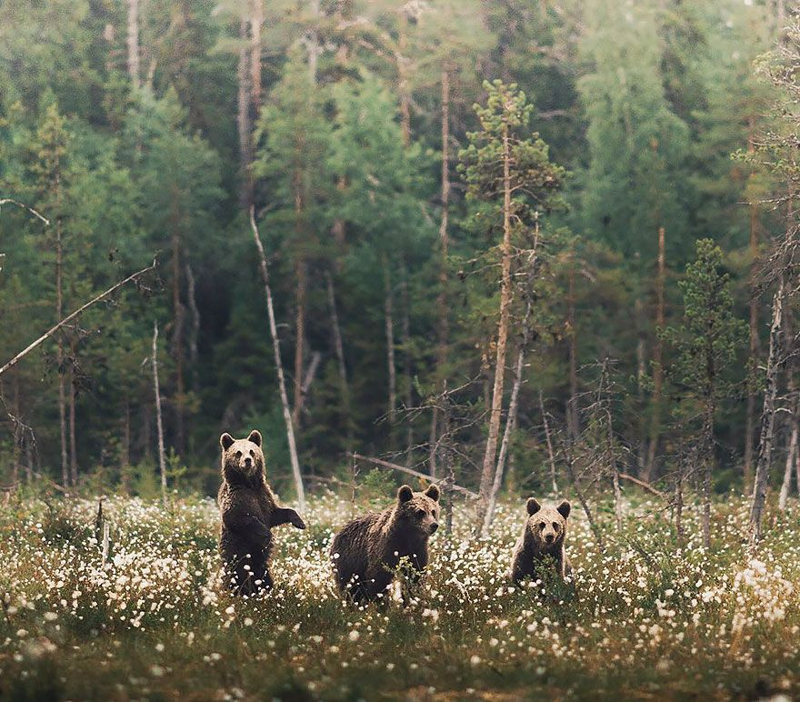
Notes:
This is also not an example of individuals because there are several different types of organisms in this picture, like bears, flowers, and trees. When we focus on individuals specifically, we would not include other elements of the individual’s environment.

Slide 27
Notes:
Let’s check-in for understanding.

Slide 28
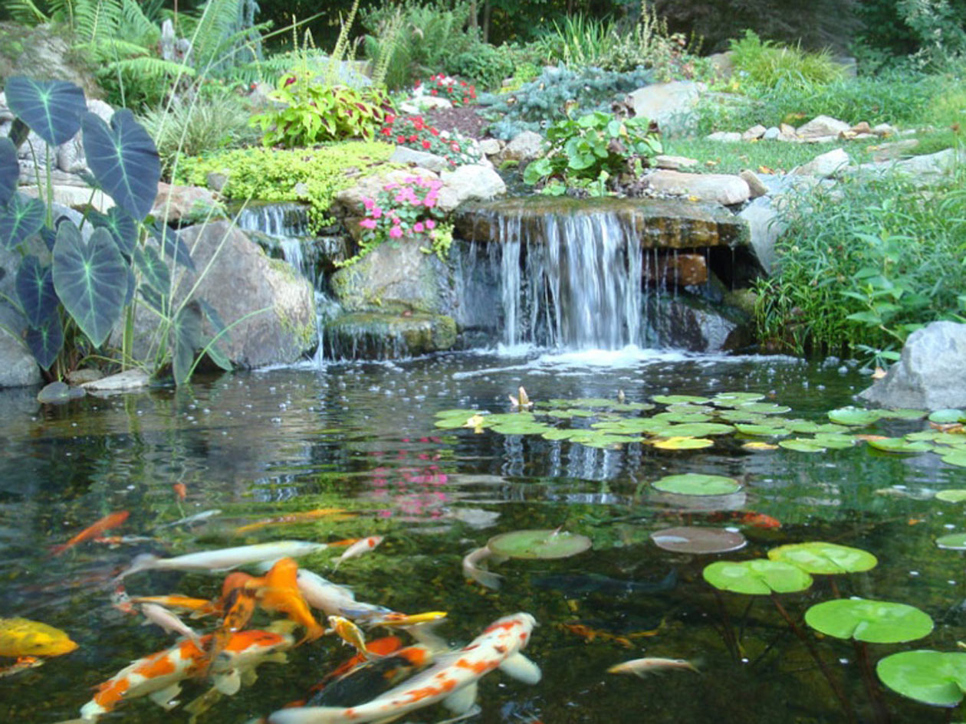
Why is this photo not an example of individuals?
Notes:
Why is this photo not an example of individuals?
[Because there are many different types of organisms in this picture.]

Slide 29
Remember!!!
Notes:
So remember!

Slide 30
Individual: a single organism
Notes:
An individual is a single organism. The term individual does not include other organisms or other factors within the organism’s environment.

Slide 31
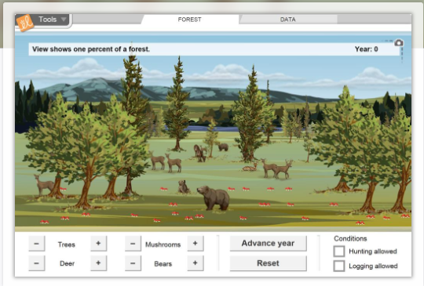
Simulation Activity
Forest Ecosystems Gizmo
Click the link above to access the Forest Ecosystems Gizmo.
In this simulation activity, you’ll observe and manipulate the populations of four creatures (trees, deer, bears, and mushrooms) in a forest, and investigate the feeding relationships in the forest. Determine which creatures are producers, consumers, and decomposers. Pictographs and line graphs show changes in populations over time.
Notes:
Feedback: Providing a simulation activity is a great way to make science thinking visible. In this simulation, students have the opportunity to make predictions and apply an idea to a new situation by changing the variables in the simulation (i.e., populations of creatures).

Slide 32
Big Question: Why do you think levels of organization are important within ecosystems?
Notes:
Explicit cue to revisit the big question at the end of the lesson: Okay everyone. Now that we’ve learned the term, individuals, let’s reflect once more on our big question. Was there anything that we predicted earlier that was correct or incorrect? Do you have any new hypotheses to share?

Slide 33
Notes:
Thanks for watching!

Slide 34
This Video Was Created With Resources From:
Questions or Comments
Michael Kennedy, Ph.D. MKennedy@Virginia.edu
Rachel L Kunemund, Ph.D. rk8vm@virginia.edu

Slide 35
Intro
“Big Idea” Question
Review Concepts
Teacher Demo
Check-In Questions
Vocabulary
Student-Friendly Definition
Examples & Non-Examples
Morphological Word Parts
Simulation/Activity
Notes:
OK everyone, get ready for our next lesson. Just as a reminder, these are the different components that our lesson may include, and you’ll see these icons in the top left corner of each slide so that you can follow along more easily!

Slide 36
Levels of Organization
Intro
Notes:
Today we will continue learning about levels of organization in ecology.

Slide 37
Population
Intro
Notes:
The next level we’ll learn about is population.

Slide 38
Big Question: Why do you think levels of organization are important within ecosystems?
Notes:
Our “big question” is: Why do you think levels of organization are important within ecosystems?
[Pause and illicit predictions from students.]
I love all these thoughtful scientific hypotheses! Be sure to keep this question and your predictions in mind as we move through these next few lessons, and we’ll continue to revisit it.

Slide 39
Demonstration
Levels of Scientific Questioning
Scientists study nature at a variety of levels. Today, we are going to look at these different levels of organization and consider why they might be important. Let’s consider the scientific questions below and make some predictions about what the definition of each level is or what other examples might fit into the same category...
Notes:
Feedback: Use the provided questions to engage students in the process of making predictions about ecological levels of organization. For this presentation, you might focus solely on population. Consider drawing connections between the ecological levels and related words that students have used or heard before. Ex) When you think of a population, what comes to mind? What components would you include in describing a “community” as you understand it?

Slide 40
Notes:
Before we define the term population, let’s review some other words that you already learned, and make sure you are firm in your understanding.

Slide 41
Notes:
There are many different organisms living within ecosystems, and they range in structure from unicellular organisms (like amoeba) to multicellular organisms (like bees).

Slide 42
Form fits function!
Notes:
An important concept to remember in science is that form fits function. The is true for cells as well as whole organisms! Recall that cells within multicellular organisms are specialized and have specific jobs to help organisms carry out life’s processes. Further, the differences in the ways that organisms look are purposeful – as we’ll learn about in this unit.

Slide 43
Individual: a single organism
Notes:
An individual is a single organism. This fish is an example of an individual organism.

Slide 44
Notes:
Now let’s pause for a moment to check your understanding.

Slide 45
Explain how the phrase “form fits function” applies to the cells that make up multicellular organisms.
Notes:
Explain how the phrase “form fits function” applies to the cells that make up multicellular organisms.
[Multicellular organisms take on special forms, that carry out specific functions to support life’s processes.]

Slide 46
Define the term individual.
Notes:
Define the term individual.
[An individual is a single organism.]

Slide 47
Why is this photo not an example of individuals?
Notes:
Why is this photo not an example of individuals?
[Because there are many different types of organisms in this picture.]

Slide 48
Population
Notes:
Now, let’s define population.

Slide 49
Population: a group of the same types of organisms within a certain area
Notes:
Population is a group of the types of organisms living within a certain area. So, one of these fish would be an individual, but a group of them would makes up a population. When scientists talk about populations they refer to a group of similar organisms within a given area - they have to specify the area that they are referring to. Similarly, when we consider human populations, we often talk about them within specific cities, counties, countries, etc.

Slide 50
Notes:
Now let’s pause for a moment to check your understanding.

Slide 51
What is a population?
Notes:
What is a population?
[A population is a group of the same types of organisms within a certain area.]

Slide 52
Notes:
Now, let’s look at some examples of populations.

Slide 53
Notes:
These bison are an example of a population because they are a group of the same types of organisms.

Slide 54
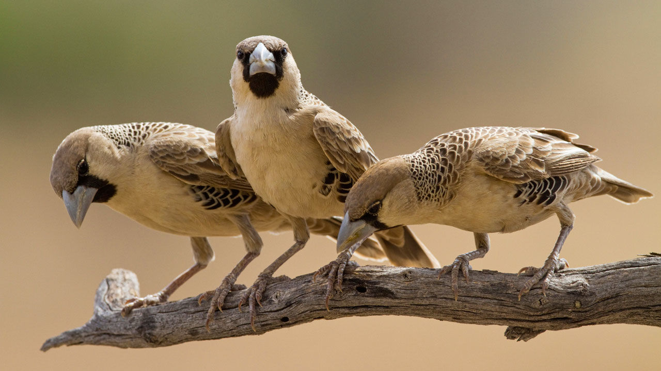
Notes:
These birds are an example of a population because they are a group of the same types of organisms.

Slide 55
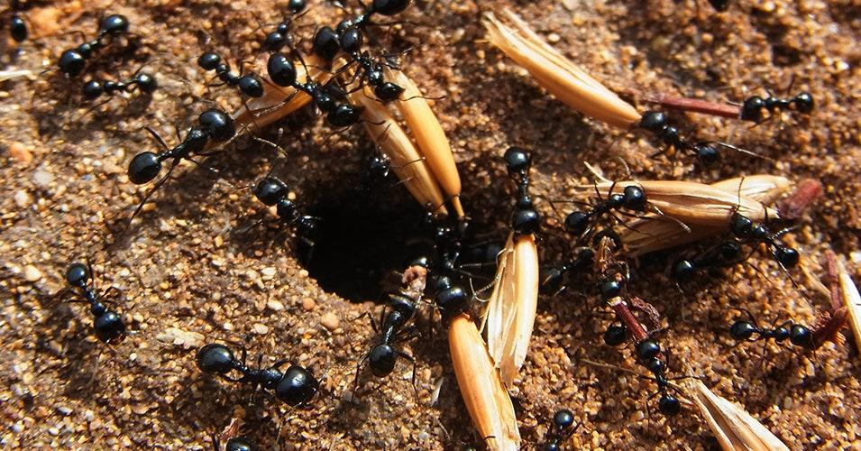
Notes:
These ants are an example of a population because they are a group of the same types of organisms.

Slide 56
Notes:
Let’s check-in for understanding.

Slide 57
What is a population?
Notes:
What is a population?
[A population is a group of the same types of organisms living within a certain area.]

Slide 58
True/False: These bison are an example of a population.
Notes:
True/False: These bison are an example of a population.

Slide 59
True/False: These bison are an example of a population.
Notes:
True/False: These bison are an example of a population.
[True – they are all bison.]

Slide 60
Name two other examples of populations.
Notes:
Name 2 other examples of populations.
[Answers will vary.]

Slide 61
Notes:
Next, let’s talk about some non-examples of populations.

Slide 62
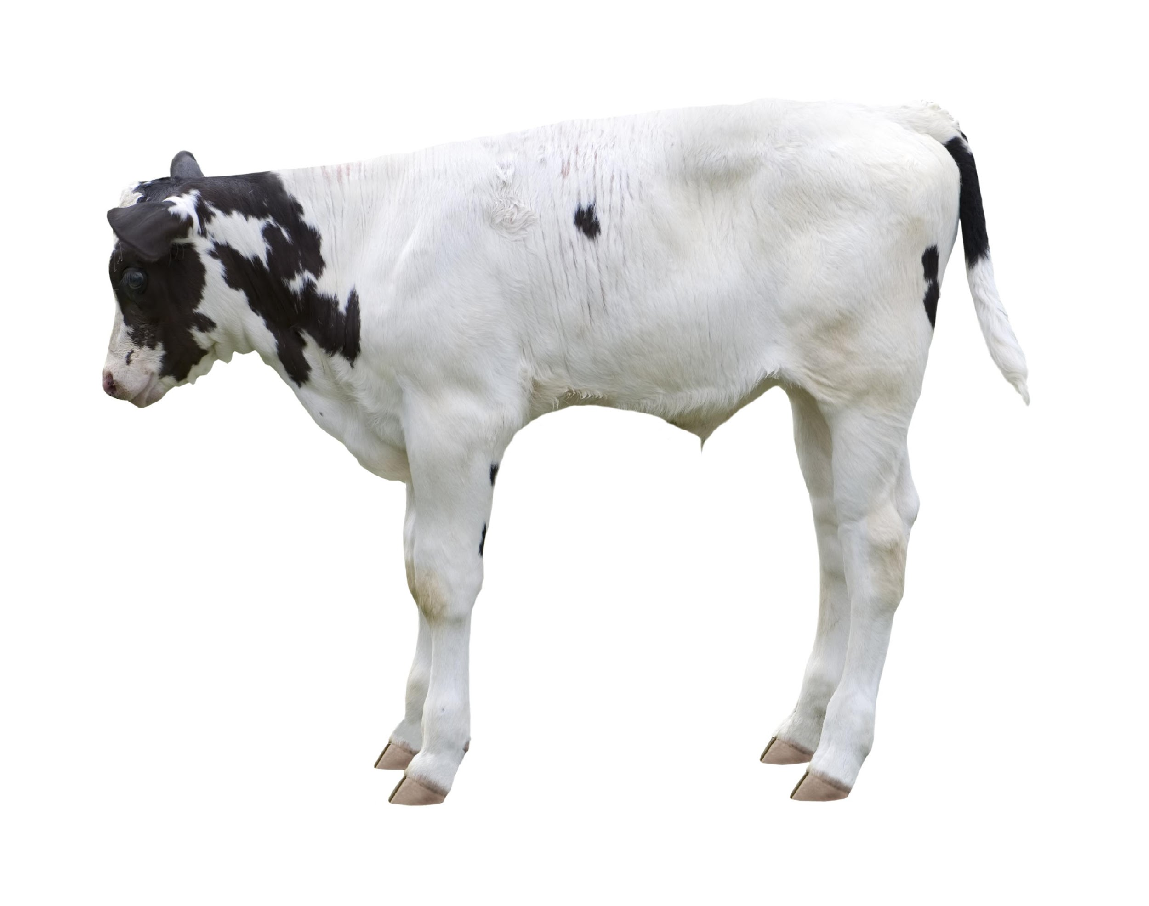
Notes:
This cow is not an example of a population – this is an individual organism.

Slide 63
Notes:
Let’s check-in for understanding.

Slide 64
Describe the difference between an individual and a population.
Notes:
Describe the difference between an individual and a population.
[An individual is a single organism, and a population is a group of the same type of organism living in a certain area.]

Slide 65
Remember!!!
Notes:
So remember!

Slide 66
Population: a group of the same types of organisms
Notes:
Population is a group of the types of organisms living within a certain area.

Slide 67
Big Question: Why do you think levels of organization are important within ecosystems?
Notes:
Explicit cue to revisit the big question at the end of the lesson: Okay everyone. Now that we’ve learned the term, population, let’s reflect once more on our big question. Was there anything that we predicted earlier that was correct or incorrect? Do you have any new hypotheses to share?

Slide 68
Notes:
Thanks for watching!

Slide 69
This Video Was Created With Resources From:
Questions or Comments
Michael Kennedy, Ph.D. MKennedy@Virginia.edu
Rachel L Kunemund, Ph.D. rk8vm@virginia.edu

Slide 70
Intro
“Big Idea” Question
Review Concepts
Teacher Demo
Check-In Questions
Vocabulary
Student-Friendly Definition
Examples & Non-Examples
Morphological Word Parts
Simulation/Activity
Notes:
OK everyone, get ready for our next lesson. Just as a reminder, these are the different components that our lesson may include, and you’ll see these icons in the top left corner of each slide so that you can follow along more easily!

Slide 71
Levels of Organization
Intro
Notes:
Today we will continue learning about levels of organization in ecology.

Slide 72
Community
Intro
Notes:
The next level we’ll learn about is community.

Slide 73
Big Question: Why do you think levels of organization are important within ecosystems?
Notes:
Our “big question” is: Why do you think levels of organization are important within ecosystems?
[Pause and illicit predictions from students.]
I love all these thoughtful scientific hypotheses! Be sure to keep this question and your predictions in mind as we move through these next few lessons, and we’ll continue to revisit it.

Slide 74
Notes:
Before we define the term population, let’s review some other words that you already learned, and make sure you are firm in your understanding.

Slide 75
Notes:
There are many different organisms living within ecosystems, and they range in structure from unicellular organisms (like amoeba) to multicellular organisms (like bees).

Slide 76
Form fits function!
Notes:
An important concept to remember in science is that form fits function. The is true for cells as well as whole organisms! Recall that cells within multicellular organisms are specialized and have specific jobs to help organisms carry out life’s processes. Further, the differences in the ways that organisms look are purposeful – as we’ll learn about in this unit.

Slide 77
Individual: a single organism
Notes:
An individual is a single organism. This fish is an example of an individual organism.

Slide 78
Population: a group of the same types of organisms living in a certain area
Notes:
Population is a group of the types of organisms living in a certain area. So, one of these fish would be an individual, but a group of them would makes up a population.

Slide 79
Notes:
Now let’s pause for a moment to check your understanding.

Slide 80
Explain how the phrase “form fits function” applies to the cells that make up multicellular organisms.
Notes:
Explain how the phrase “form fits function” applies to the cells that make up multicellular organisms.
[Multicellular organisms have cells that take on special forms, which carry out specific functions to support life’s processes.]

Slide 81
Why is this photo not an example of individuals?
Notes:
Why is this photo not an example of individuals?
[Because there are many different types of organisms in this picture.]

Slide 82
Describe the difference between an individual and a population.
Notes:
Describe the difference between an individual and a population.
[An individual is a single organism, and a population is a group of the same type of organism living in a certain area.]

Slide 83
Community
Notes:
Now that we’ve reviewed, let’s define community.

Slide 84
Community: a group of different populations living in the same place
Notes:
A community is a group of different populations living in the same place. All the animals in this photo are part of a community.

Slide 85
Notes:
Now let’s pause for a moment to check your understanding.

Slide 86
What is a community?
Notes:
What is a community?
[A community is a group of different populations living in the same place.]

Slide 87
Notes:
That is the basic definition, but there is a bit more you need to know.

Slide 88
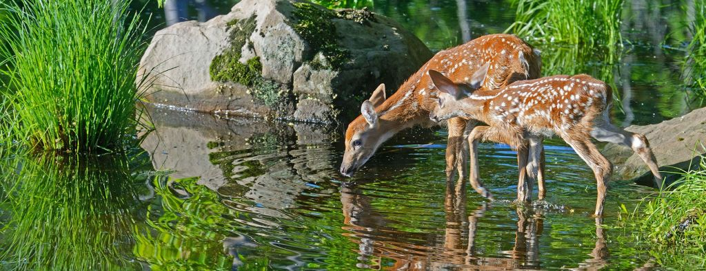
Only living things are part of a community.
Notes:
Only living things are part of a community.

Slide 89
Notes:
So, these deer and grasses are part of this community because they are living things...

Slide 90
Notes:
...but the rock and the water are not part of the community, because they are non-living things.

Slide 91
Notes:
Now, let’s talk about some examples of communities.

Slide 92
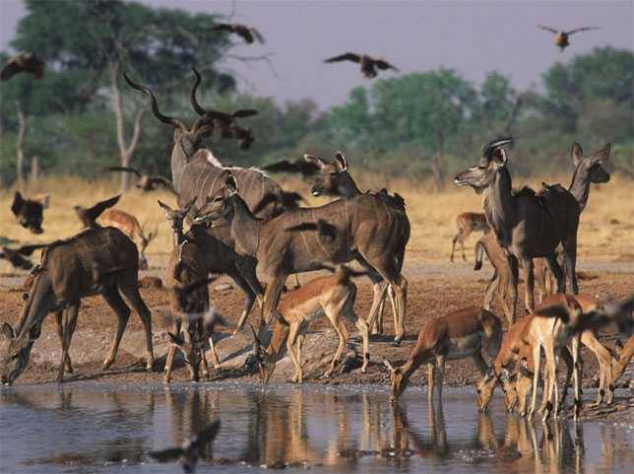
Notes:
The animals at this watering hole are an example of a community because they are many different organisms living together.

Slide 93
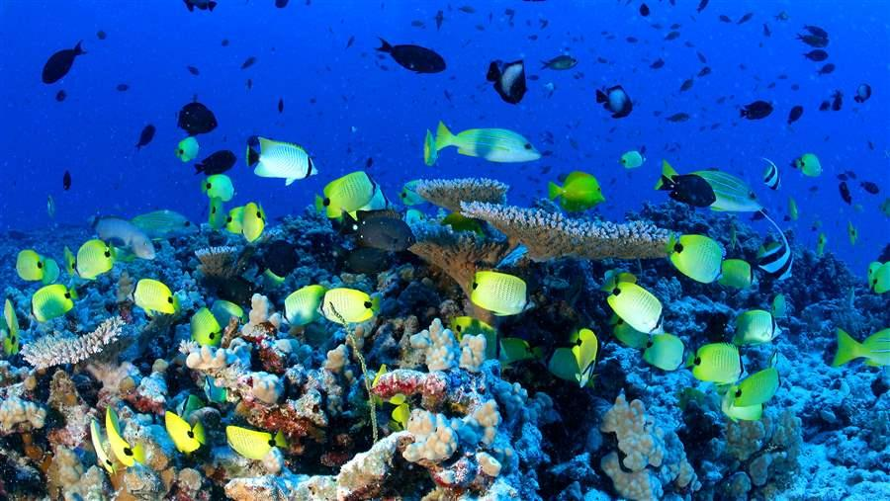
Notes:
All the fish and coral are an example of a community because there are many different living things living together.

Slide 94
Notes:
Now let’s pause for a moment to check your understanding.

Slide 95
What is a community?
Notes:
What is a community?
[A community is a group of different populations living in the same place.]

Slide 96
Name two other examples of communities.
Notes:
Name 2 other examples of communities.
[Answers will vary.]

Slide 97
Notes:
Let’s talk about some non-examples of communities.

Slide 98
Notes:
These birds are not an example of a community because they are a group of organisms that are the same species.

Slide 99
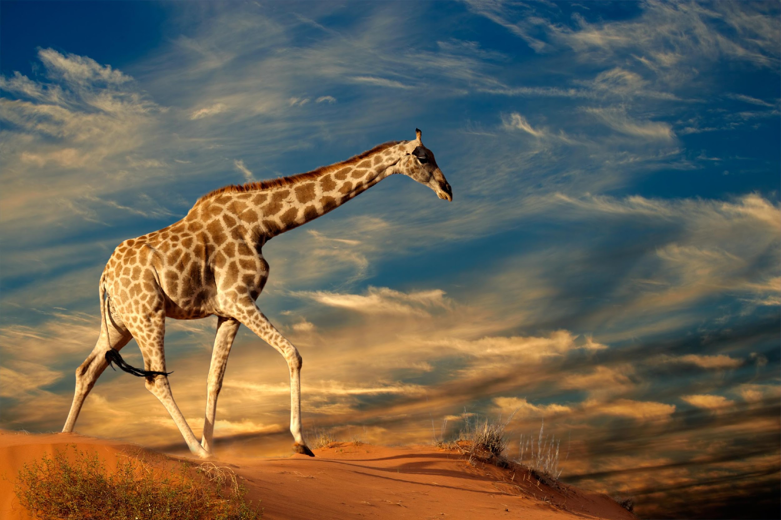
Notes:
This is an individual giraffe, not a community.

Slide 100
Notes:
Now let’s pause for a moment to check your understanding.

Slide 101
True/False: This group of birds is an example of a community.
Notes:
True/False: This group of birds is an example of a community.

Slide 102
True/False: This group of birds is an example of a community.
Notes:
True/False: This group of birds is an example of a community.
[False – they are a population because they are the same type of bird.]

Slide 103
Explain the difference between an individual, a population, and a community.
Notes:
Explain the difference between an individual, a population, and a community.
[An individual is a single organism; a population is a group of the same type organism; and a community is a group of different populations living in the same place.]

Slide 104
Remember!!!
Notes:
So remember!

Slide 105
Community: a group of different populations living in the same place
Notes:
A community is a group of different populations living in the same place. All the animals in this photo are part of a community.

Slide 106
Only living things are part of a community.
Notes:
Only living things are part of a community.

Slide 107
Big Question: Why do you think levels of organization are important within ecosystems?
Notes:
Explicit cue to revisit the big question at the end of the lesson: Okay everyone. Now that we’ve learned the term, community, let’s reflect once more on our big question. Was there anything that we predicted earlier that was correct or incorrect? Do you have any new hypotheses to share?

Slide 108
Notes:
Thanks for watching!

Slide 109
This Video Was Created With Resources From:
Questions or Comments
Michael Kennedy, Ph.D. MKennedy@Virginia.edu
Rachel L Kunemund, Ph.D. rk8vm@virginia.edu

Slide 110
Intro
“Big Idea” Question
Review Concepts
Teacher Demo
Check-In Questions
Vocabulary
Student-Friendly Definition
Examples & Non-Examples
Morphological Word Parts
Simulation/Activity
Notes:
OK everyone, get ready for our next lesson. Just as a reminder, these are the different components that our lesson may include, and you’ll see these icons in the top left corner of each slide so that you can follow along more easily!

Slide 111
Levels of Organization
Intro
Notes:
Today we continue learning about levels of organization in ecology.

Slide 112
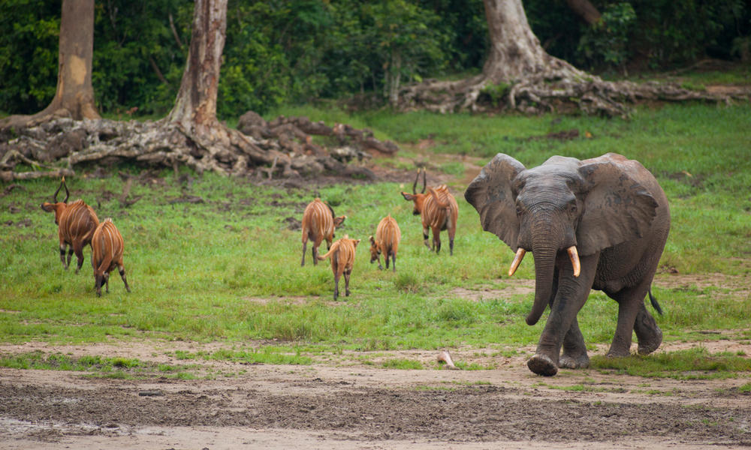
Ecosystem
Intro
Notes:
The next level we’ll learn about is ecosystem.

Slide 113
Big Question: Why do you think levels of organization are important within ecosystems?
Notes:
Our “big question” is: Why do you think levels of organization are important within ecosystems?
[Pause and illicit predictions from students.]
I love all these thoughtful scientific hypotheses! Be sure to keep this question and your predictions in mind as we move through these next few lessons, and we’ll continue to revisit it.

Slide 114
Notes:
Before we define the term ecosystem, let’s review some other words that you already learned, and make sure you are firm in your understanding.

Slide 115
Notes:
There are many different organisms living within ecosystems, and they range in structure from unicellular organisms (like amoeba) to multicellular organisms (like bees).

Slide 116
Form fits function!
Notes:
An important concept to remember in science is that form fits function. The is true for cells as well as whole organisms! Recall that cells within multicellular organisms are specialized and have specific jobs to help organisms carry out life’s processes. Further, the differences in the ways that organisms look are purposeful – as we’ll learn about in this unit.

Slide 117
Individual: a single organism
Notes:
An individual is a single organism. This fish is an example of an individual organism.

Slide 118
Population: a group of the same types of organisms
Notes:
Population is a group of the types of organisms. So, one of these fish would be an individual, but a group of them would makes up a population.

Slide 119
Community: a group of different populations living in the same place
Notes:
A community is a group of different populations living in the same place. All the animals in this photo are part of a community.

Slide 120
Only living things are part of a community.
Notes:
Only living things are part of a community.

Slide 121
Notes:
Now let’s pause for a moment to check your understanding.

Slide 122
Explain how the phrase “form fits function” applies to the cells that make up multicellular organisms.
Notes:
Explain how the phrase “form fits function” applies to the cells that make up multicellular organisms.
[Multicellular organisms have cells that take on special forms, which carry out specific functions to support life’s processes.]

Slide 123
Why is this photo not an example of individuals?
Notes:
Why is this photo not an example of individuals?
[Because there are many different types of organisms in this picture.]

Slide 124
Explain the difference between an individual, a population, and a community.
Notes:
Explain the difference between an individual, a population, and a community.
[An individual is a single organism; a population is a group of the same type organism; and a community is a group of different populations living in the same place.]

Slide 125
Ecosystem
Notes:
Now, let’s define the term ecosystem.

Slide 126
Ecosystem: a community of organisms that interact with each other and the environment
Notes:
An ecosystem is a community of organisms that interact with each other and the environment.

Slide 127
Notes:
Now let’s pause for a moment to check your understanding.

Slide 128
What is an ecosystem?
Notes:
What is an ecosystem?
[An ecosystem is a community of organisms that interact with each other and the environment.]

Slide 129
Notes:
That is the basic definition, but there is a bit more you need to know.

Slide 130
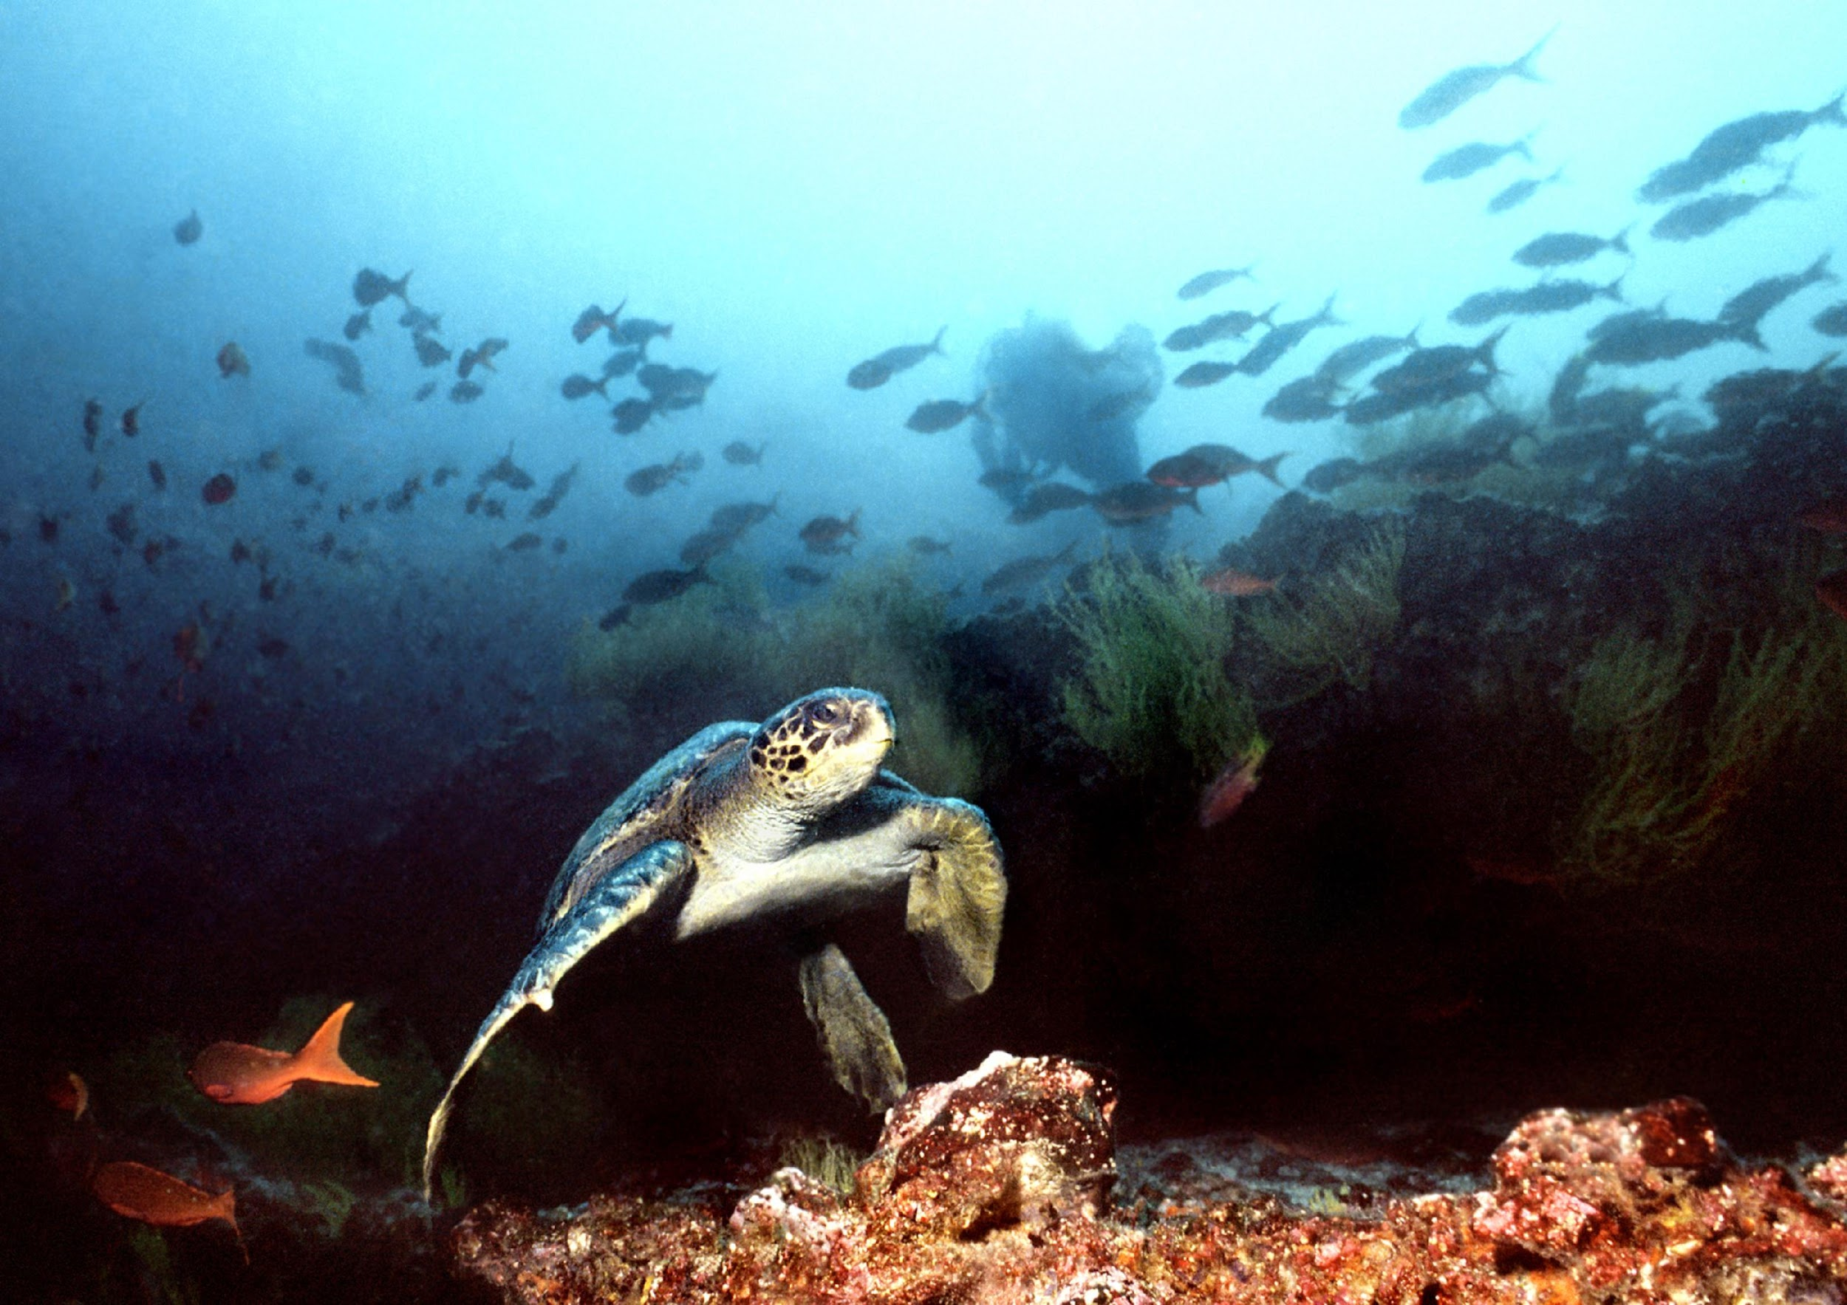
Ecosystem
Living and non-living things
interacting together
Notes:
An ecosystem is made up of living things (like this turtle and these fish)....

Slide 131
Ecosystem
Living and non-living things
interacting together
Notes:
...and non-living things (like the water and this sand) interacting together.

Slide 132
Notes:
Let’s check-in for understanding.

Slide 133
What is an ecosystem?
Notes:
What is an ecosystem?
[An ecosystem is a community of organisms interacting with each other and their environment.]

Slide 134
Describe the difference between a community and an ecosystem.
Notes:
Describe the difference between a community and an ecosystem.
[A community is different species living in the same place; however, an ecosystem also includes the non-living things in a habitat that organisms interact with.]

Slide 135
Notes:
Now, let’s talk about some examples of ecosystems.

Slide 136
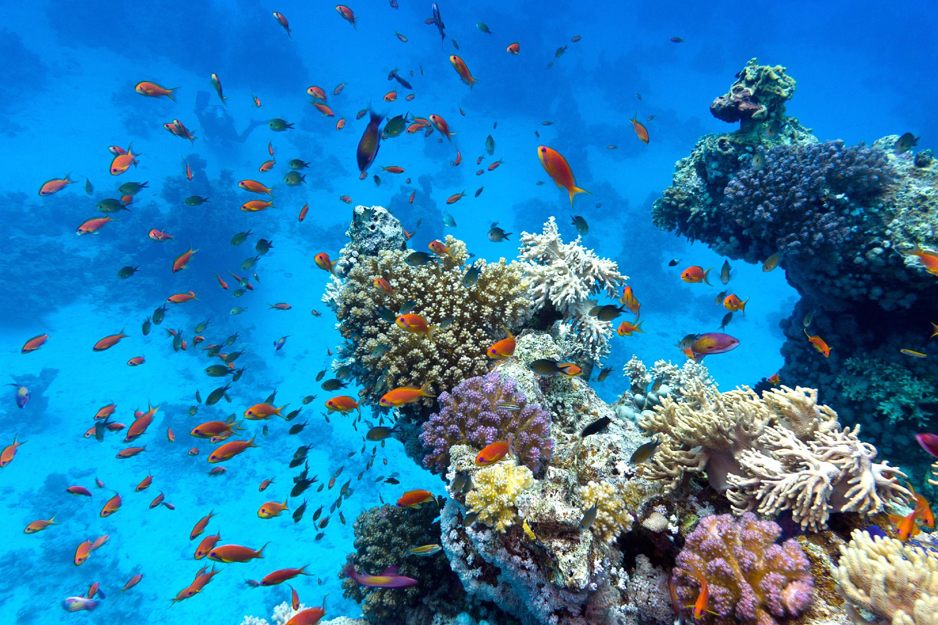
Notes:
This is an example of an ecosystem. The living fish and coral interact with the water and rocks in this ecosystem.

Slide 137
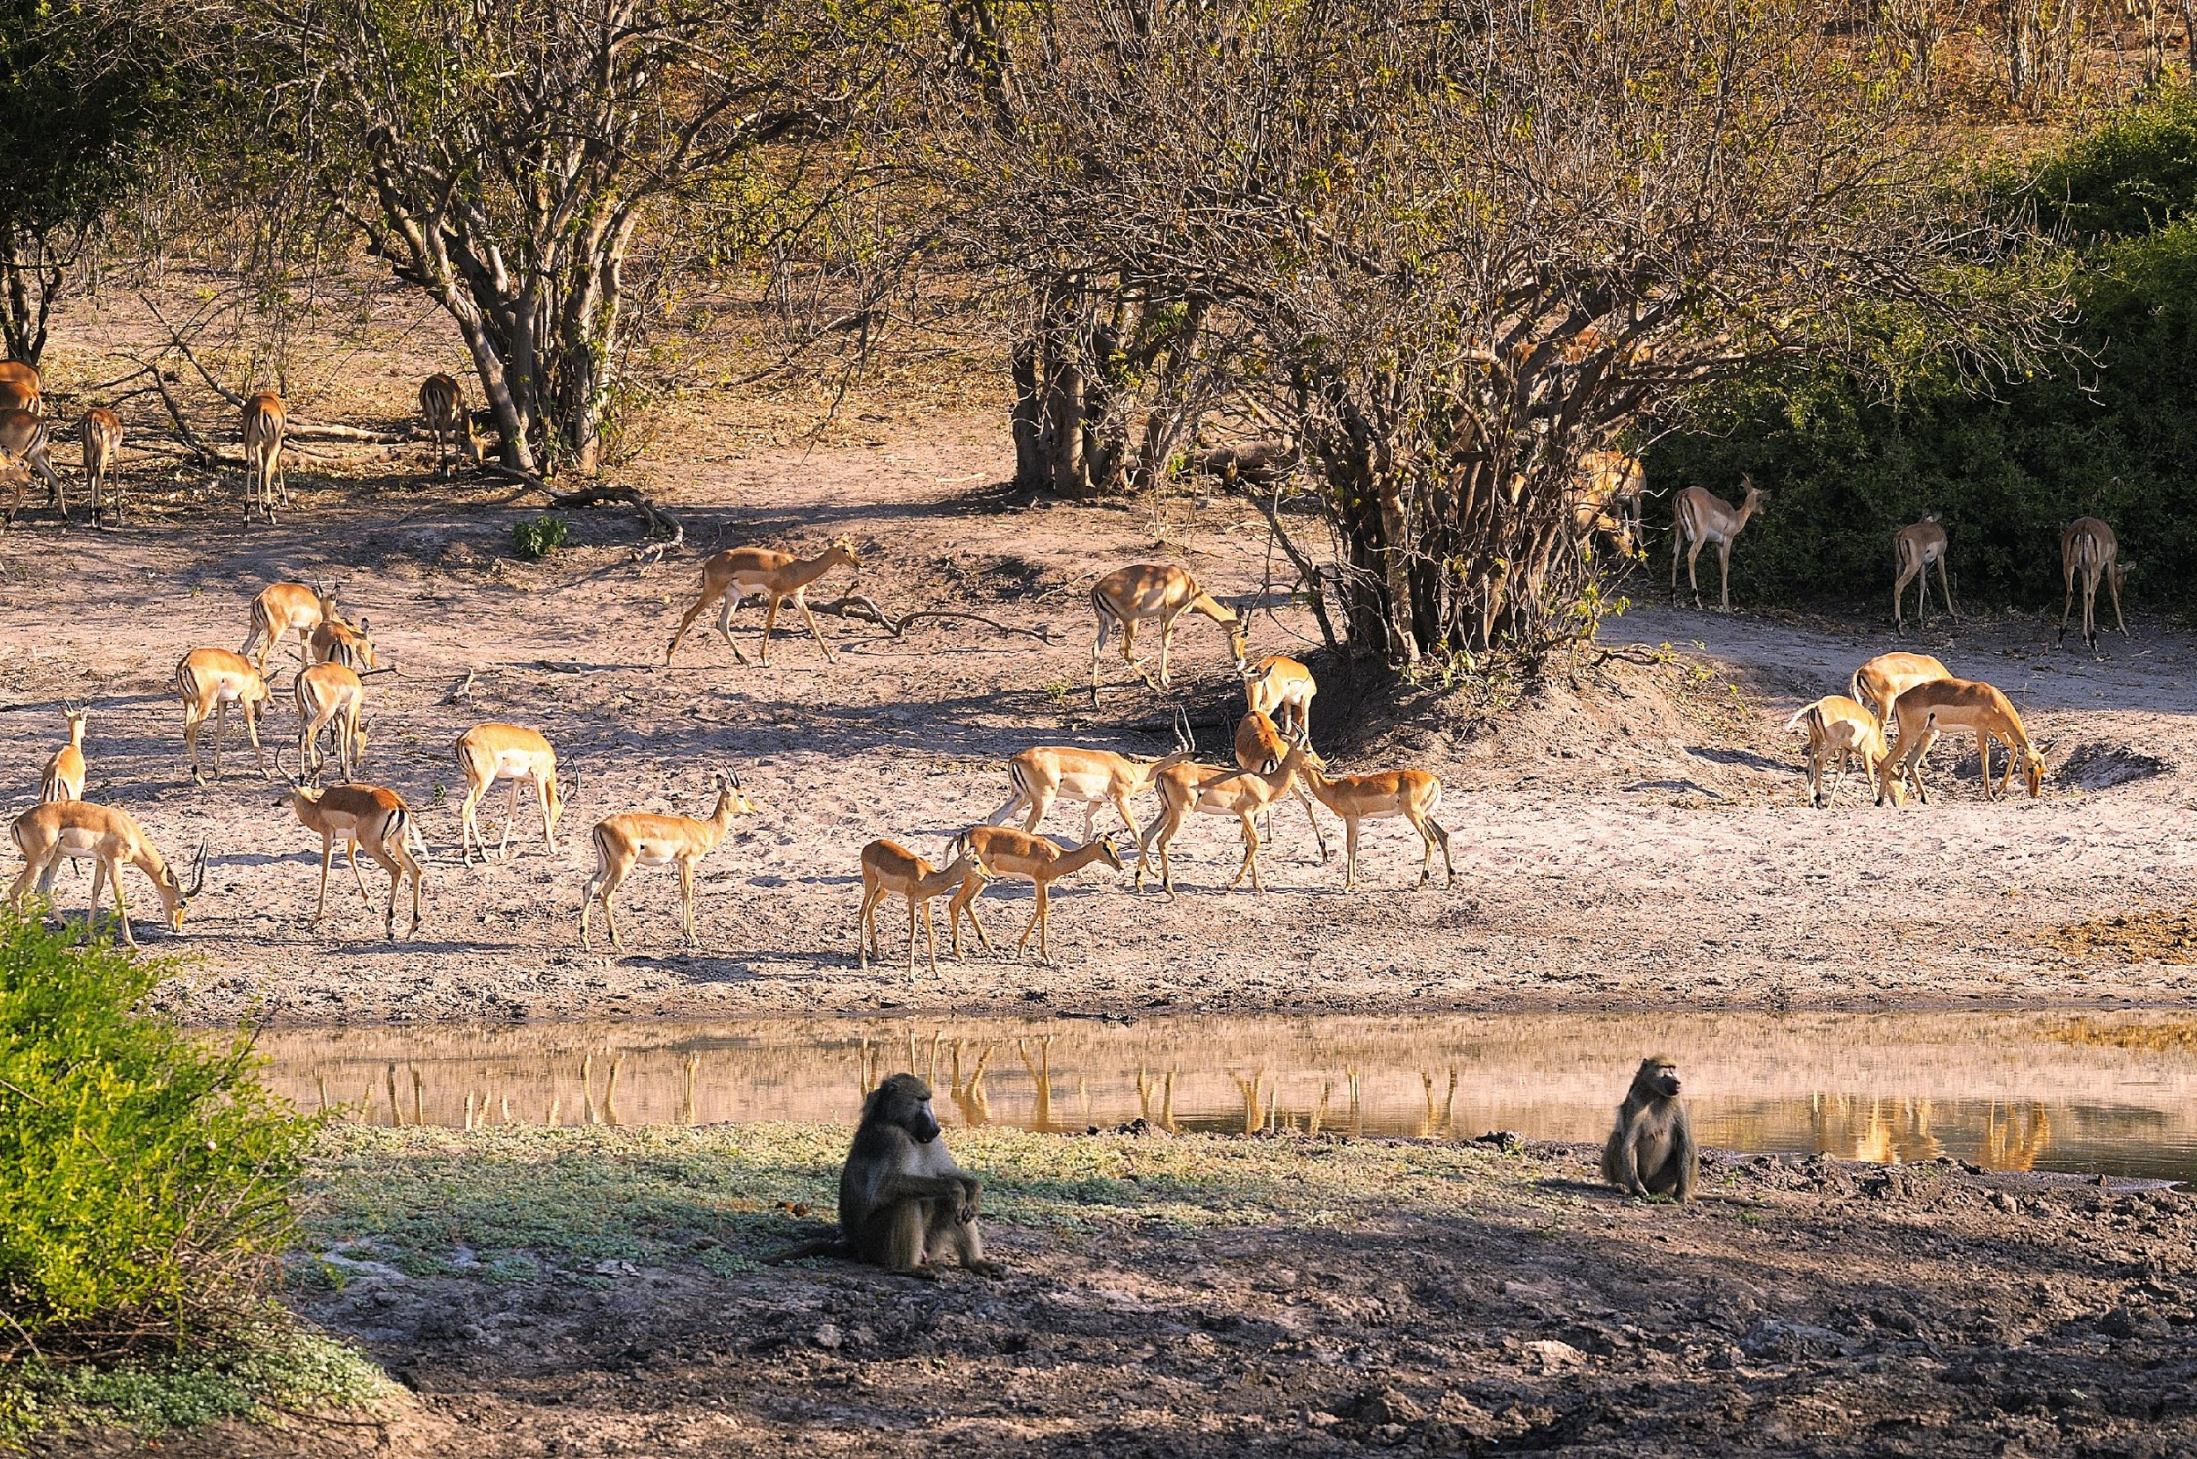
Notes:
This is an example of an ecosystem. The living animals and trees interact with the soil and water supply in this ecosystem.

Slide 138
Notes:
Let’s check-in for understanding.

Slide 139
Name two other examples of ecosystems.
Notes:
Name 2 other examples of ecosystems.
[Answers will vary.]

Slide 140
Notes:
Let’s talk about some non-examples of ecosystems.

Slide 141
Notes:
This fish is not an example of an ecosystem – this is an individual organism.

Slide 142
Notes:
Let’s check-in for understanding.

Slide 143
Describe the difference between a community and an ecosystem.
Notes:
Describe the difference between a community and an ecosystem.
[A community is different species living in the same place; however, an ecosystem also includes the non-living things in a habitat that organisms interact with.]

Slide 144
Remember!!!
Notes:
So remember!

Slide 145
Ecosystem: a community of organisms that interact with each other and the environment
Notes:
An ecosystem is a community of organisms that interact with each other and the environment.

Slide 146
Ecosystem
Living and non-living things
interacting together
Notes:
An ecosystem is made up of living AND non-living things interacting together.

Slide 147
Big Question: Why do you think levels of organization are important within ecosystems?
Notes:
Explicit cue to revisit the big question at the end of the lesson: Okay everyone. Now that we’ve learned the term, ecosystem, let’s reflect once more on our big question. Was there anything that we predicted earlier that was correct or incorrect? Do you have any new hypotheses to share?

Slide 148
Notes:
Thanks for watching!

Slide 149
This Video Was Created With Resources From:
Questions or Comments
Michael Kennedy, Ph.D. MKennedy@Virginia.edu
Rachel L Kunemund, Ph.D. rk8vm@virginia.edu

