Slide 1
Intro
“Big Idea” Question
Review Concepts
Check-In Questions
Teacher Demo
Vocabulary
Student-Friendly Definition
Examples & Non-Examples
Morphological Word Parts
Simulation/Activity
Notes:
OK everyone, get ready for our next lesson. Just as a reminder, these are the different components that our lesson may include, and you’ll see these icons in the top left corner of each slide so that you can follow along more easily!

Slide 2
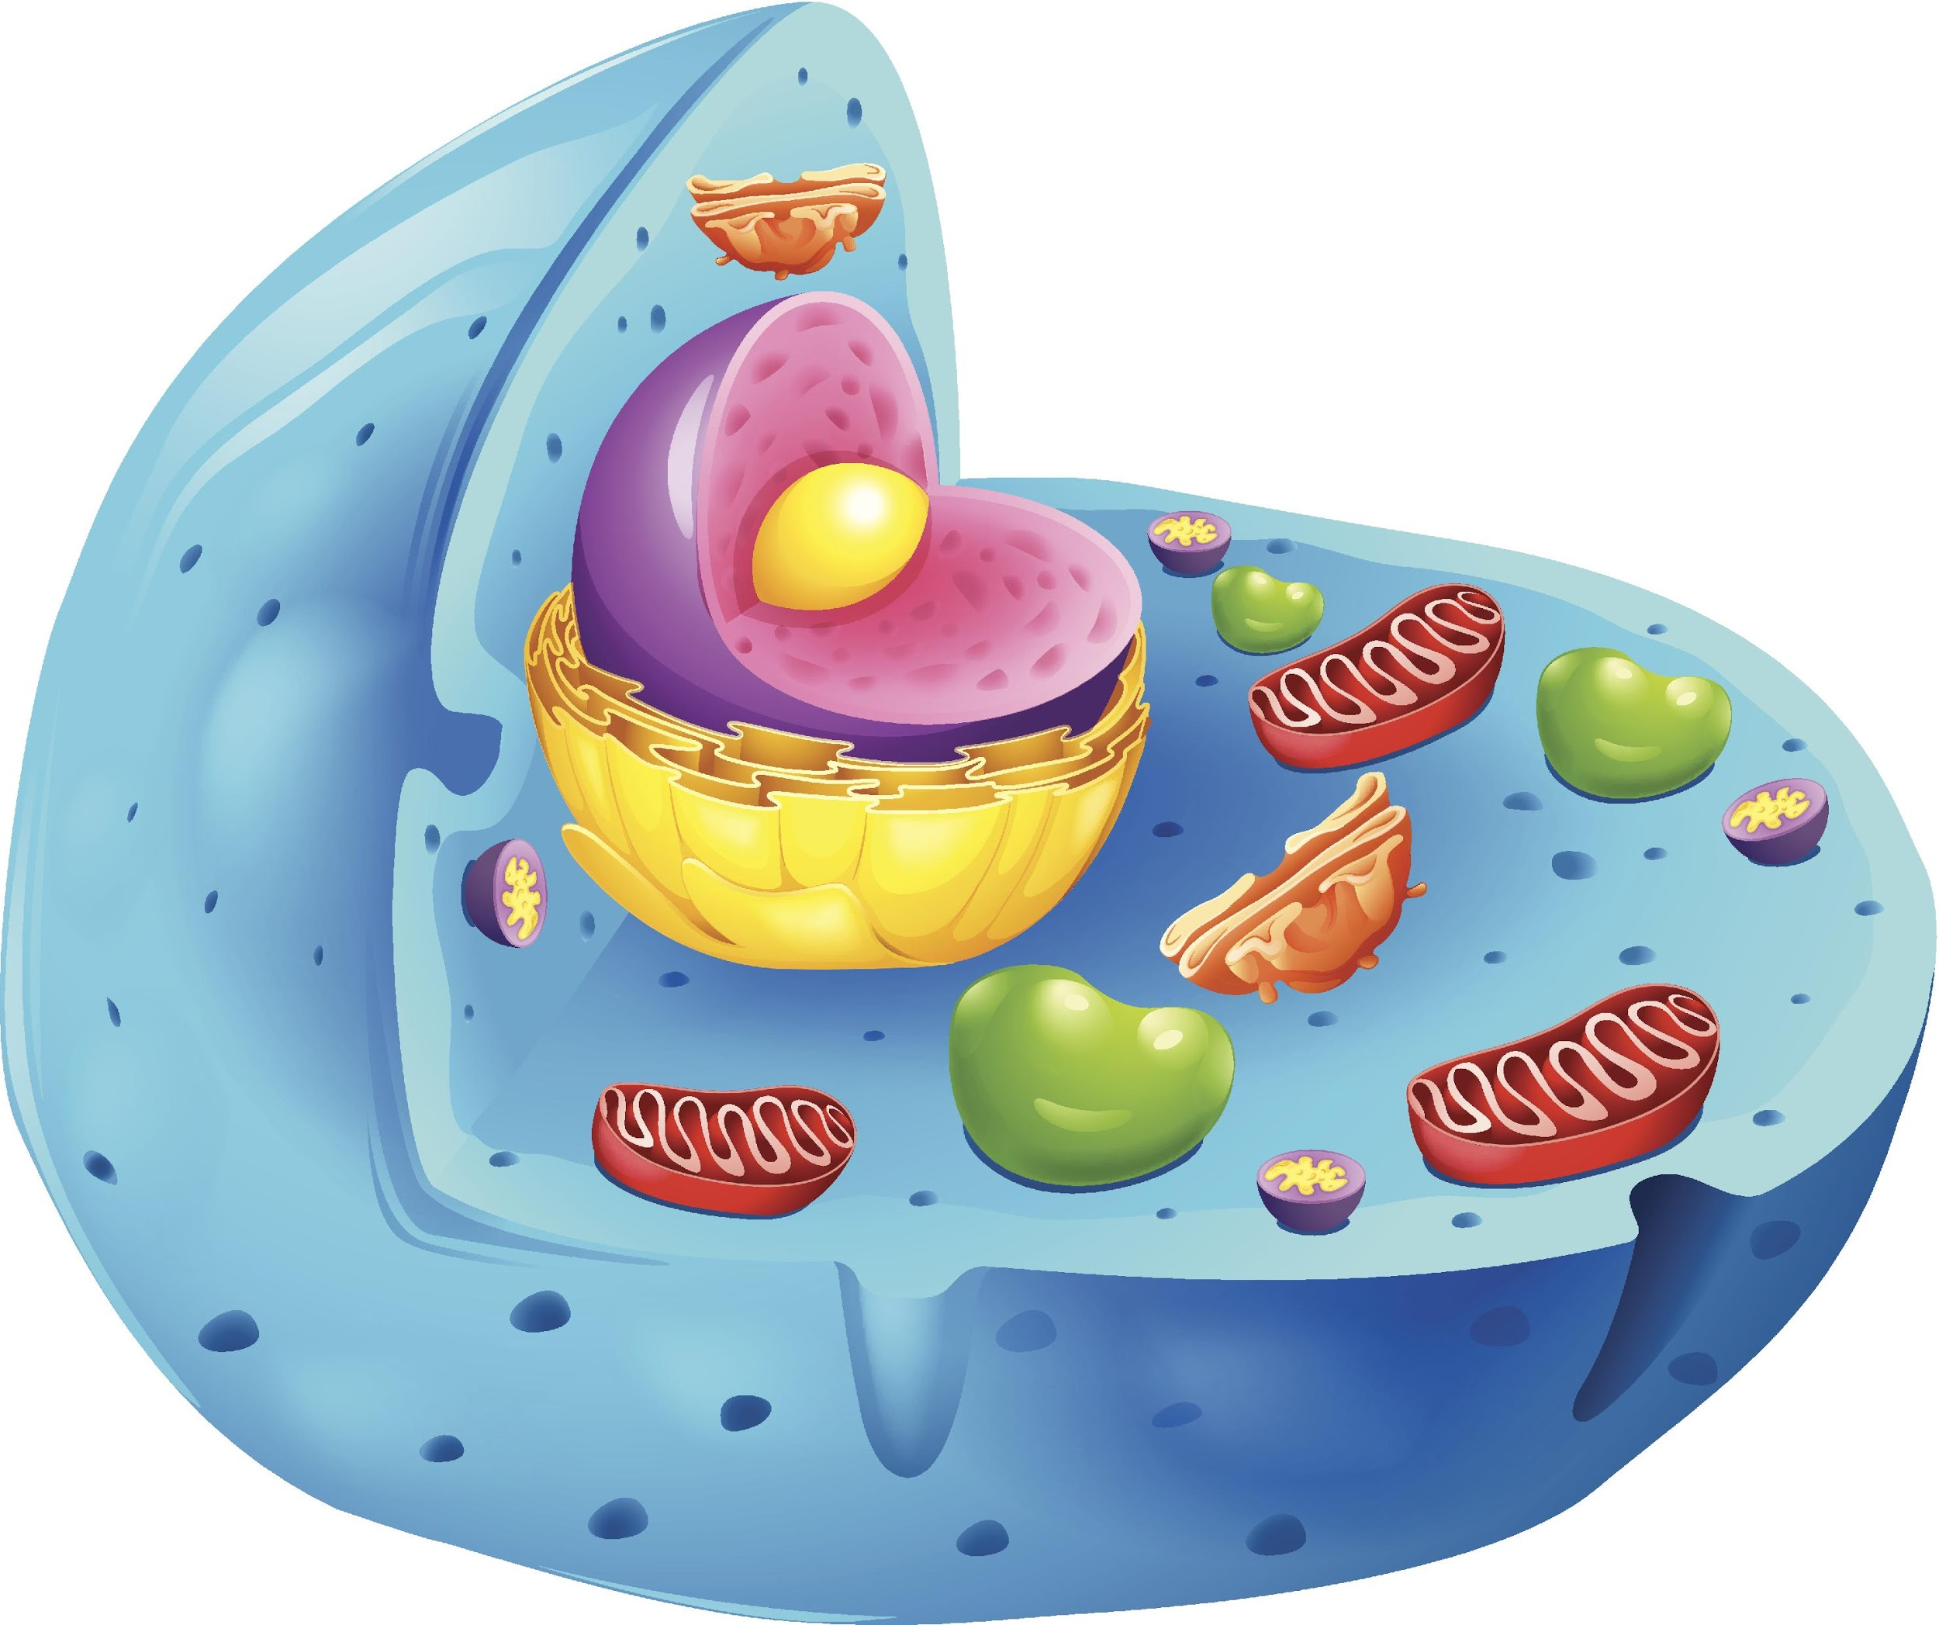
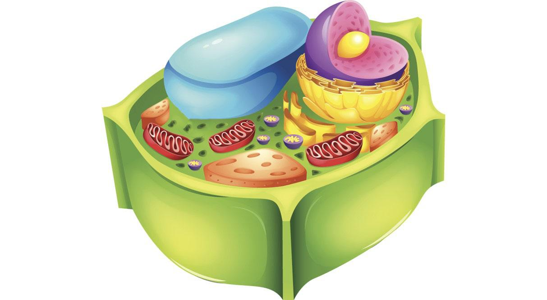
Cells
Intro
Notes:
Today we are going to begin learning about cells in more detail. We will begin with defining the term cell.

Slide 3
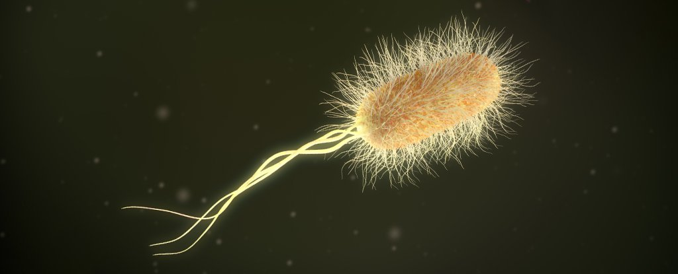
Intro
Multicellular & Unicellular
Organisms
Notes:
Then we’ll define and compare multicellular and unicellular organisms…
Feedback: Giving students cues helps them to prepare for what is coming next.

Slide 4
Big Question: How can we differentiate between the various types of cells?
Notes:
Our “big question” is: How can we differentiate between the various types of cells?
[Pause and illicit predictions from students.]
I love all these thoughtful scientific hypotheses! Be sure to keep this question and your predictions in mind as we move through these next few lessons, and we’ll continue to revisit it.

Slide 5
Notes:
Before we start going through new terms and information, let’s review some other words that you already learned and make sure you are firm in your understanding.

Slide 6
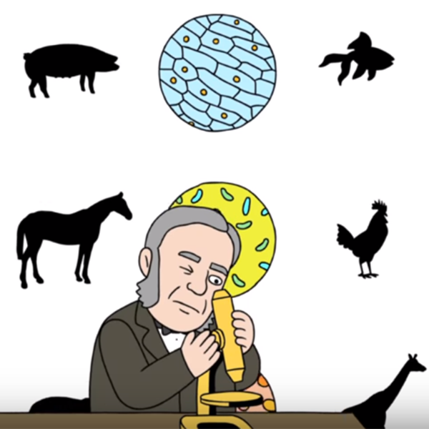
Cell Theory: the scientific theory stating that all living things are made of cells.
Notes:
Cell theory is the scientific theory that all living things are made of cells. This theory was developed by a few different scientists as advancements were made in microscope technology.

Slide 7
Cell Theory
is made up of 3 basic rules
Notes:
The cell theory is made up of 3 basic principles, or rules. All living things are made of cells, so these rules apply to every living thing.

Slide 8
Rule #1: The cell is the basic unit of life.
Notes:
Rule #1: The cell is the basic unit of life.

Slide 9
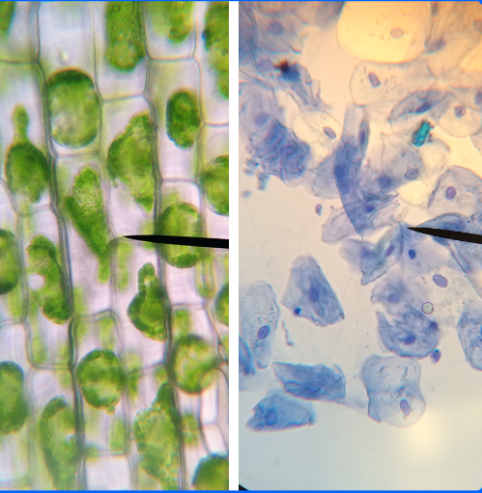
Rule #2: All living things are made of one or more cells.
Notes:
Rule #2: All living things are made up of one or more cells.

Slide 10
Rule #3: All new cells are made from cells that already exist.
Notes:
Rule #3: All new cells are made from cells that already exist.

Slide 11
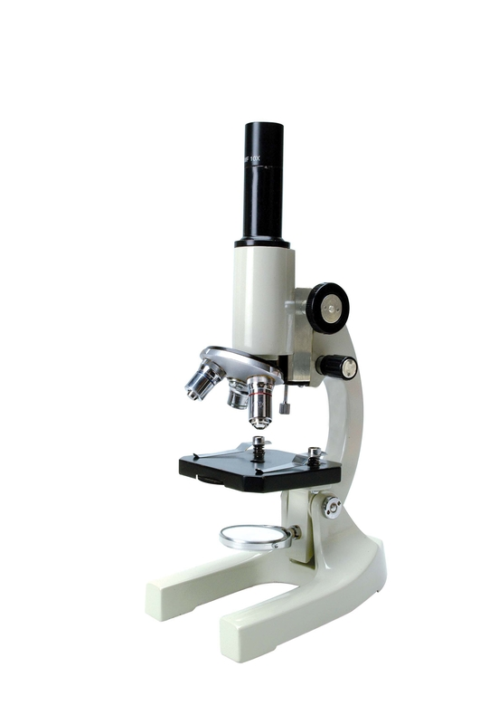
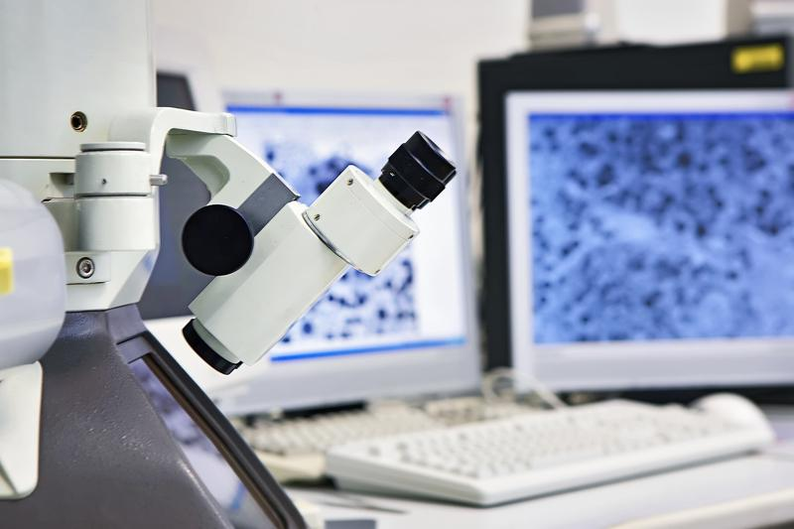
The invention of electron and light microscopes helped scientists gain new knowledge about cells.
Notes:
Also, the invention of electron and light microscopes helped scientists gain new knowledge about cells.

Slide 12
We can look at cells with both microscopes – but each one helps us see and understand different things.
Notes:
We can look at cells with both microscopes, but each one helps us see and understand different things.

Slide 13
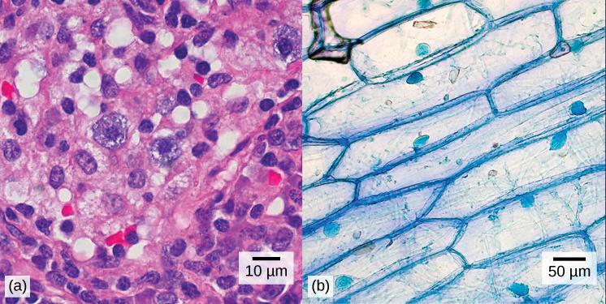
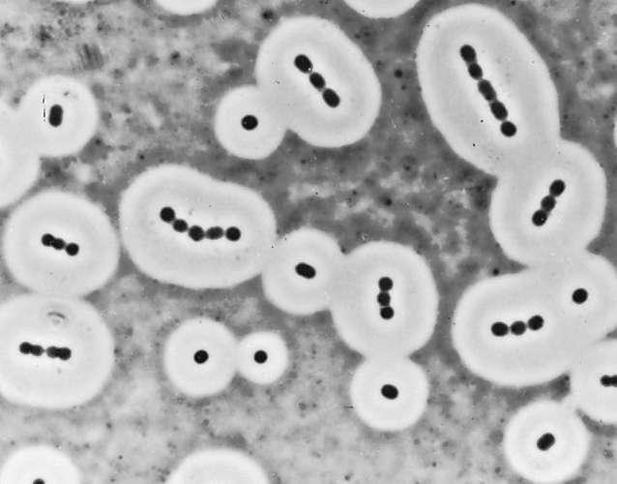
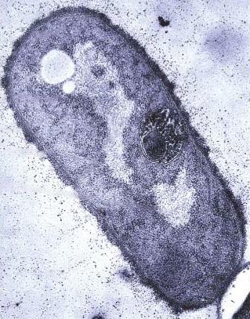
Light microscopes 🡪 cell shape and how they’re structured together
Electron microscopes 🡪 individual cells and differences in their parts
Light Microscope
Electron Microscope
Notes:
With a light microscope, we can see the general shape of cells and how they’re structured together (or not). With an electron microscope, we can an up-close view of the different parts that are unique to each type of cell and help them function properly.

Slide 14
Notes:
Okay, now let’s check your understanding.

Slide 15
What is the definition of cell theory?
Notes:
What is the definition of cell theory?
[The scientific theory stating that all living things are made of cells.]

Slide 16
Which is NOT one of the rules of cell theory?
All living things are made of one or more cells.
Non-living things have cells too.
The cell is the basic unit of life.
All new cells are made from cells that already exist.
Notes:
Which is NOT one of the rules of cell theory?

Slide 17
Which is NOT one of the rules of cell theory?
All living things are made of one or more cells.
Non-living things have cells too.
The cell is the basic unit of life.
All new cells are made from cells that already exist.
Notes:
Which is NOT one of the rules of cell theory?
[Non-living things have cells too. Remember – the cell theory states that all LIVING things are made of cells, so cell theory cannot be applied to non-living things.]

Slide 18
Which type of microscope provides extremely detailed images of objects?
Notes:
Which type of microscope provides extremely detailed images of objects?
[An electron microscope.]

Slide 19
True/False: You cannot see animal and plant cells with a light microscope.
Notes:
True or False: You cannot see animal and plant cells with a light microscope.

Slide 20
True/False: You cannot see animal and plant cells with a light microscope.
Notes:
True or False: You cannot see animal and plant cells with a light microscope.
[False – You CAN see animal and plant cells with a light microscope. It just won’t show you as much detail as an electron microscope.]

Slide 21
Cell
Notes:
The first term is cell. Let’s define it.

Slide 22
Cell: the basic unit of life
Notes:
A cell is the basic unit of life.

Slide 23
Notes:
Okay, now let’s check your understanding.

Slide 24
What is a cell?
Notes:
What is a cell?
[A cell is the basic unit of life.]

Slide 25
Notes:
That is the basic definition, but there is a bit more you need to know.

Slide 26
The cell theory states that all living things are made of one or more cells.
Notes:
As cell theory states, all living things are made of one or more cells. This dog, this bacteria, and this plant are all living things, so that means that they are made of one or more cells.

Slide 27
Notes:
But there are some important differences between bacteria cells and plant or animal cells that we need to understand.

Slide 28
Multicellular Organisms
Notes:
First, most animals and plants are considered multicellular organisms, though there are some exceptions...

Slide 29
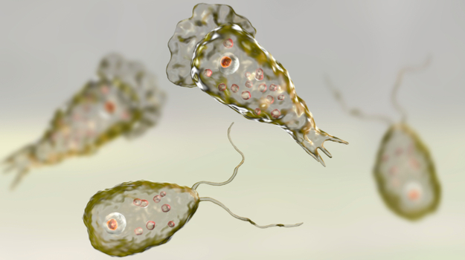
Unicellular Organisms
Notes:
...while bacteria and amoeba, for example, are considered unicellular organisms.

Slide 30
Multicellular Organisms
Notes:
Let’s take a minute to define those terms, starting with multicellular organisms.

Slide 31
Multicellular Organisms: living things made of more than one cell
Notes:
Multicellular organisms are living things made of more than one cell. Most multicellular organisms have many cells.

Slide 32
Notes:
Okay, now let’s check your understanding.

Slide 33
What is a multicellular organism?
Notes:
What is a multicellular organism?
[Multicellular organisms are living things made of more than one cell. Most multicellular organisms have many cells.]

Slide 34
Notes:
That is the basic definition but there is a bit more you need to know.

Slide 35
Multicellular organisms have “specialized” cells that carry out different jobs needed to function.
Essential Life Processes
Notes:
Multicellular organisms not only have many cells, but their cells are considered “specialized” because they carry out different jobs necessary for an organism to function properly. These different jobs, or functions, are considered “essential life processes.” This picture shows some of the different types of human cells that help our bodies function to complete these essential life processes. Notice that the shape of the cells are different - this has to do with the different functions they are carrying out.
Feedback: Visuals help students to build understanding of new content.

Slide 36
Notes:
We can think of this like teachers in a middle or high school – each teacher “specializes” in a different subject and, together, they help the school function properly. Their different teaching roles are essential life processes for the school.

Slide 37
Notes:
Okay, now let’s check your understanding.

Slide 38
True/False: In a multicellular organism, cells are “specialized” because they carry out different jobs necessary for the organism to function properly.
Notes:
True/False: In a multicellular organism, cells are “specialized” because they carry out different jobs necessary for the organism to function properly.

Slide 39
True/False: In a multicellular organism, cells are “specialized” because they carry out different jobs necessary for the organism to function properly.
Notes:
True/False: In a multicellular organism, cells are “specialized” because they carry out different jobs necessary for the organism to function properly.
[True]

Slide 40
Notes:
Let’s look at some examples of multicellular organisms.

Slide 41
Notes:
This bird is multicellular. Its body has many cells and many different types of cells. The cells in the bird’s brain are performing a very different function than the cells in the bird’s stomach.

Slide 42
Notes:
This tree is multicellular. The tree has specialized cells in its roots, trunk, and leaves.

Slide 43
Notes:
Okay, now let’s check your understanding.

Slide 44
What is an example of a multicellular organism (that we didn’t already talk about)?
Notes:
What is an example of a multicellular organism (that we didn’t already talk about?

Slide 45
Notes:
Let’s look at some non-examples of multicellular organisms.

Slide 46
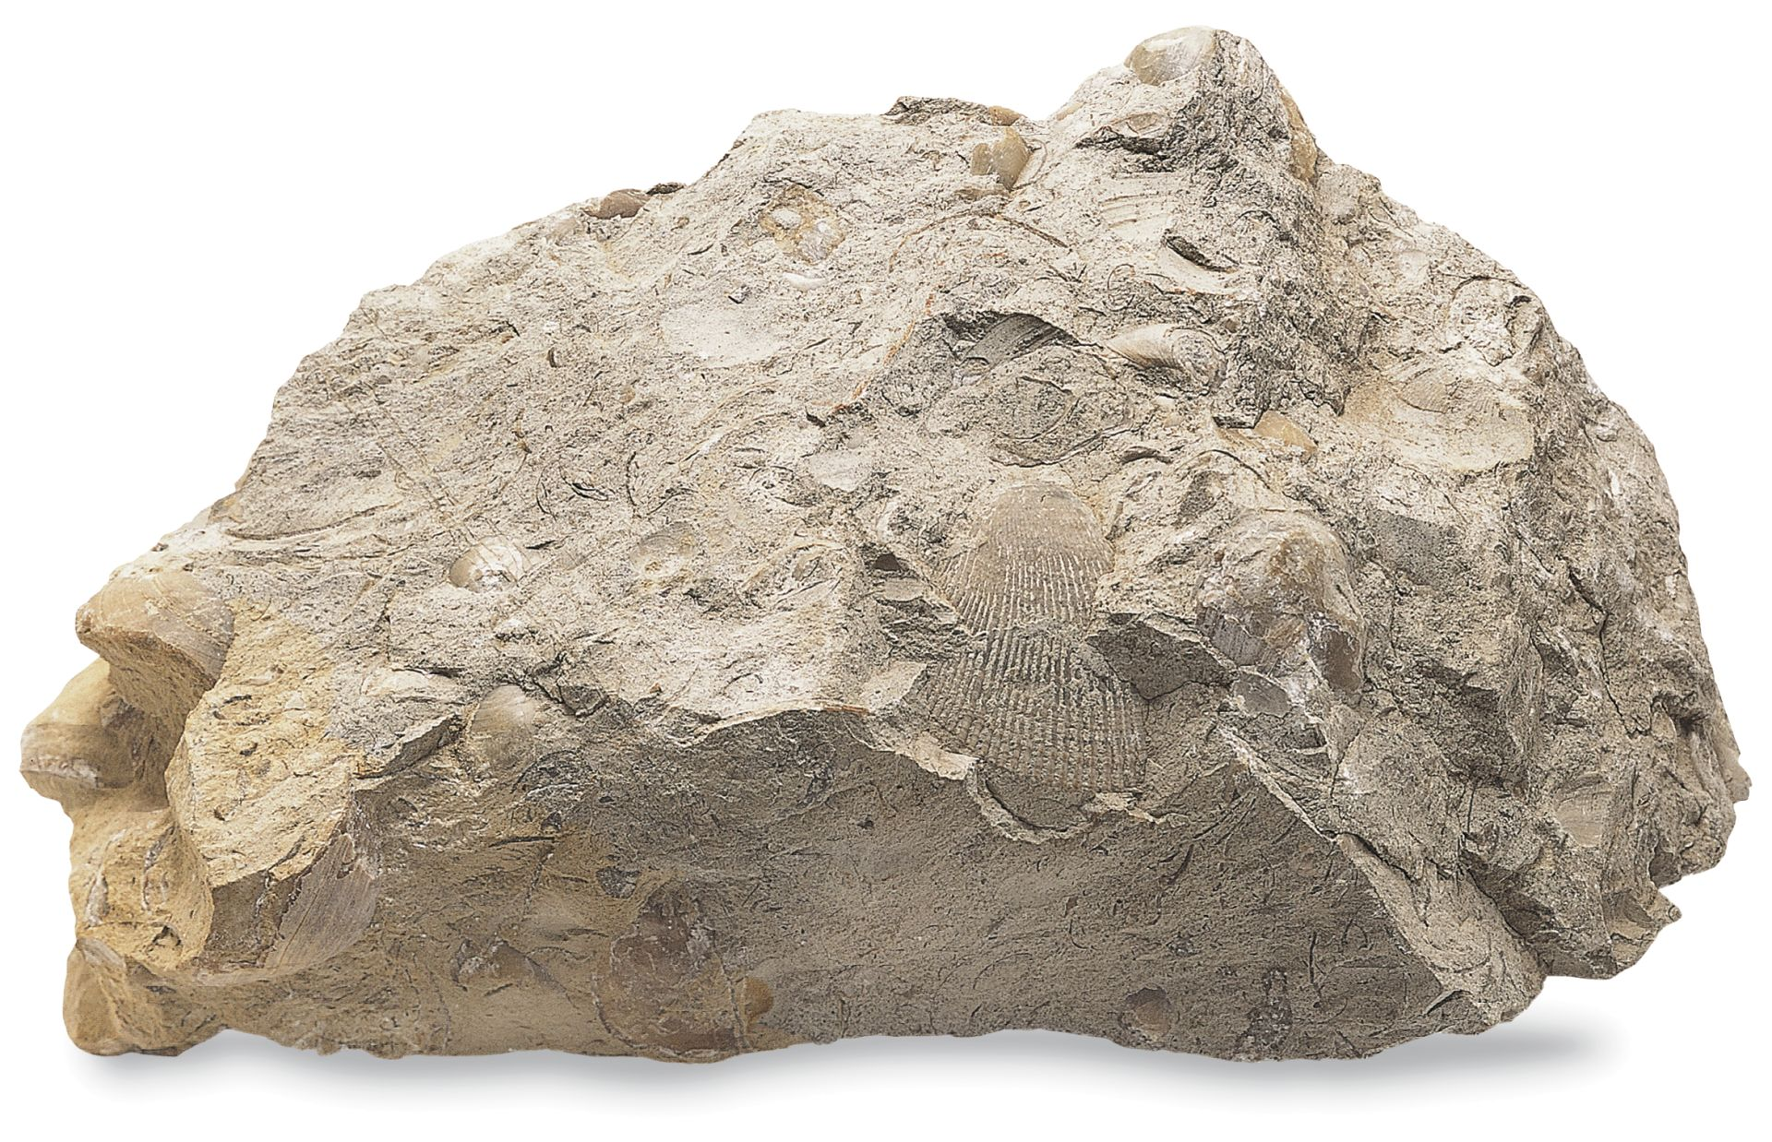
Notes:
This rock is not a multicellular organism because it is not made up of cells.

Slide 47
Notes:
Water is not a multicellular organism. Much like the rock, it is not made up of cells. It’s important to remember that many organisms do depend on water, which is why we often find organisms living in or around water.

Slide 48
Notes:
Okay, now let’s check your understanding.

Slide 49
What is a non-example of a multicellular organism (that we didn’t already talk about)?
NON
Notes:
What is a non-example of a multicellular organism that we didn’t already talk about?
Feedback: Remember to use images to provide the students with a visual of the non-example as it can help them better grasp the content.

Slide 50
Notes:
We can break down the term multicellular organism into different parts to help us remember what it means.

Slide 51
Multicellular Organism
(prefix)
(root word)
Notes:
Multicellular can be broken down into two parts, the prefix and root word.

Slide 52
Multicellular Organism
More than one, or many
Notes:
The prefix “multi” means more than one, or many.
Feedback: An important part of successfully using morphological word parts is defining each part for the students. Be sure and try to incorporate these smaller definitions in the future.

Slide 53
Multicellular Organism
Made of cells
Notes:
Cellular means made of cells.

Slide 54
Multicellular Organism
Life form, or living thing
Notes:
And the word organism means life form or living thing.

Slide 55
Multi- cellular Organism
Multicellular Organism
Living thing made of many cells
Notes:
So, when we put it altogether multicellular organism means, “living thing made of many cells.”
Feedback: Reuniting the word parts is a crucial step in helping students understand the whole picture when reviewing morphological word parts.

Slide 56
Notes:
Okay, now let’s check your understanding.

Slide 57
How can we use the word parts of multicellular organism to help us remember the definition of the term?
Multicellular Organism
(prefix)
(root word)
Notes:
How can we use the word parts of multicellular organism to help us remember the definition of the term?
[The prefix “multi” means more than one, or many.
Cellular means made of cells.
And the word organism means life form or living thing.
So, when we put it altogether multicellular organism means, “living thing made of many cells.”]

Slide 58
Unicellular Organisms
Notes:
Now, let’s define unicellular organisms.

Slide 59
Unicellular Organisms: living things made of one cell
Notes:
Unicellular organisms are living things that are made of only one cell.

Slide 60
Notes:
Okay, now let’s check your understanding.

Slide 61
What is a unicellular organism?
Notes:
What is a unicellular organism?
[A unicellular organism is a living thing made up of only one cell.]

Slide 62
Notes:
That is the basic definition but there is a bit more you need to know.

Slide 63
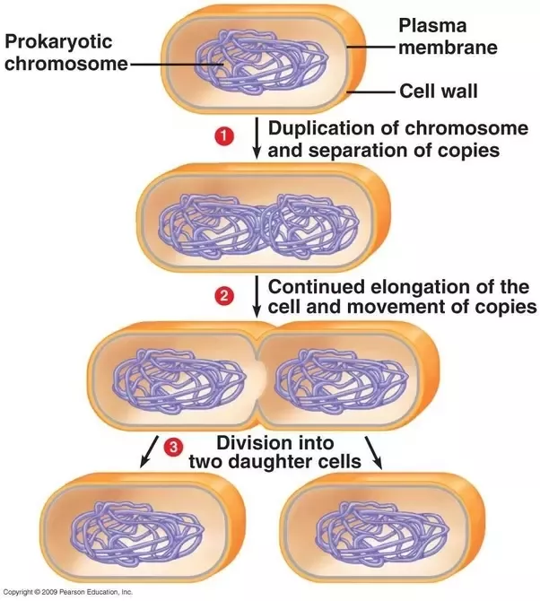
Unicellular organisms are only made of one cell, so this cell does all the jobs needed to function.
Notes:
Unicellular organisms are only made of one cell, so this cell does all the jobs needed to function properly. This means that all those essential life processes – like reproducing, eating, and digesting – occur within that one cell. For example, the bacteria parent cell pictured above, reproduces on its own by dividing into two daughter cells. Humans, on the other hand, need two parent cells (one male and one female) in order to reproduce.

Slide 64
Notes:
We can think of this like teachers in an elementary school. Instead of specializing in one subject, they teach all subjects. Each elementary school teacher does all the essential life processes that help the school function properly.

Slide 65
Notes:
Okay, now let’s check your understanding.

Slide 66
True/False: In a unicellular organism, the cell does all the jobs needed to function properly.
Notes:
True/False: In a unicellular organism, the cell does all the jobs needed to function properly.

Slide 67
True/False: In a unicellular organism, the cell does all the jobs needed to function properly.
Notes:
True/False: In a unicellular organism, the cell does all the jobs needed to function properly.
[True]

Slide 68
Notes:
Let’s look at some examples of unicellular organisms.

Slide 69
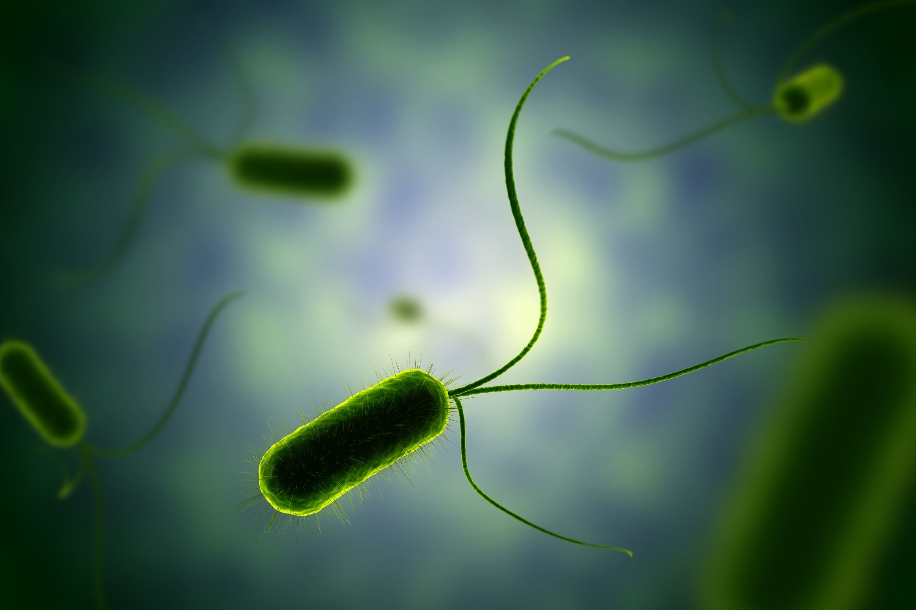
Notes:
Bacteria is unicellular. These organisms are a cell that performs all functions needed for life and reproduction.

Slide 70
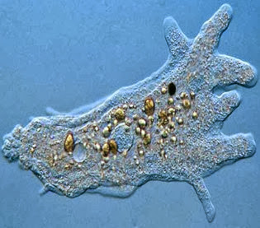
Notes:
This amoeba is unicellular. The microscopic picture shows us a single blob, which is the cell.

Slide 71
Notes:
Okay, now let’s check your understanding.

Slide 72
What are some examples of unicellular organisms (that we didn’t talk about)?
Notes:
What are some examples of unicellular organisms (that we didn’t talk about)?

Slide 73
Notes:
Let’s look at some non-examples of unicellular organisms.

Slide 74
Notes:
This kitten has many cells, so we would call it multicellular.

Slide 75
Notes:
The sunflower has many cells. Don’t forget that most plants and animals are multicellular, containing many cells that perform different functions and allow the organism to survive.

Slide 76
Notes:
Okay, now let’s check your understanding.

Slide 77
Why is this sunflower NOT an example of a unicellular organism?
Notes:
Why is this sunflower NOT an example of a unicellular organism?
[The sunflower has many cells. Don’t forget that most plants and animals are multicellular, containing many cells that perform different functions and allow the organism to survive.]

Slide 78
Notes:
We can break down the term unicellular organism into parts to remember what it means.

Slide 79
Unicellular Organism
(prefix)
(root word)
Notes:
Unicellular can be broken down into two parts, the prefix and root word.

Slide 80
Unicellular Organism
One
Notes:
The prefix “uni” means one. This is actually the only thing that makes it different from the term multicellular organism!

Slide 81
Unicellular Organism
Made of cells
Notes:
Cellular means made of cells.

Slide 82
Unicellular Organism
Life form, or living thing
Notes:
And the word organism means life form or living thing.

Slide 83
Uni- cellular Organism
Unicellular Organism
Living thing made of one cell
Notes:
So, when we put it altogether unicellular organism means, “living thing made of one cell.”

Slide 84
Notes:
Now, let’s review the new terms we’ve learned so far.

Slide 85
How can we use the word parts of unicellular organism to help us remember the definition of the term?
Unicellular Organism
(prefix)
(root word)
Notes:
How can we use the word parts of unicellular organisms to help us remember the definition of the term?
[The prefix “uni” means one. This is actually the only thing that makes it different from the term multicellular organism!
Cellular means made of cells.
And the word organism means life form or living thing.
So, when we put it altogether unicellular organism means, “living thing made of one cell.”]

Slide 86
What is the basic unit of life called?
Cell
Organism
Organelle
Tissue
Notes:
What is the basic unit of life called?

Slide 87
What is the basic unit of life called?
Cell
Organism
Organelle
Tissue
Notes:
What is the basic unit of life called?
[Cell]

Slide 88
What is the difference between a multicellular organism and a unicellular organism?
Notes:
What is the difference between a multicellular organism and a unicellular organism?
[A multicellular organism has multiple cells, each with a specific function, and a unicellular organism only has one cell, which does all necessary functions.]

Slide 89
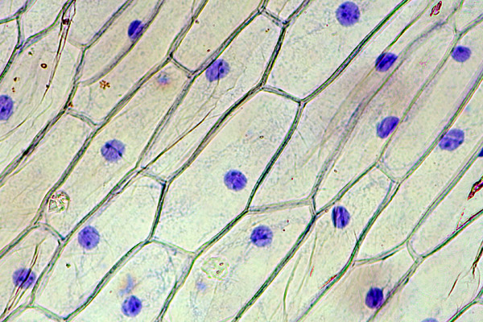
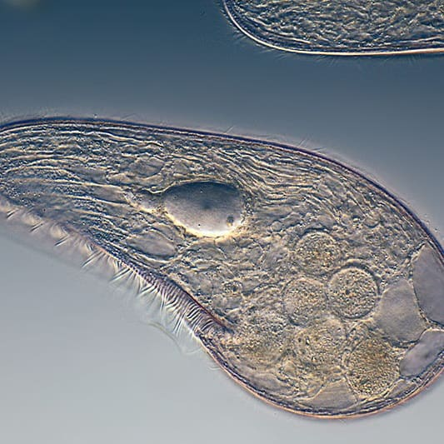
Demonstration
Multi and Unicellular Organisms Under the Microscope
Guide students in observing real onion skin cells under the microscope. This simple activity can be used as the foundation for class conversation about cell specialization. The skin cells, which form a tissue, have a unified structure and function. These cells can be compared to organisms living in pond water, which include bacteria, algae and amoebas. These unicellular organisms perform all required functions of life with just one cell!
Notes:
Guide students in observing real onion skin cells under the microscope. This simple activity can be used as the foundation for class conversation about cell specialization. The skin cells, which form a tissue, have a unified structure and function. These cells can be compared to organisms living in pond water, which include bacteria, algae and amoebas. These unicellular organisms perform all required functions of life with just one cell!
Feedback: Observation of onion cells may provide an opportunity for introducing the concept of levels of organization for life - cells, tissues, organs, etc.

Slide 90
Remember!!!
Notes:
So remember!

Slide 91
Cell: the basic unit of life
Notes:
A cell is the basic unit of life.

Slide 92
The cell theory states that all living things are made of one or more cells.
Notes:
As cell theory states, all living things are made of one or more cells. This dog, this bacteria, and this plant are all living things, so that means that they are made of one or more cells.

Slide 93
Multicellular Organisms: living things made of more than one cell
Notes:
Multicellular organisms are living things made of more than one cell.

Slide 94
Multicellular organisms have “specialized” cells that carry out different jobs needed to function.
Essential Life Processes
Notes:
Multicellular organisms not only have many cells, but their cells are considered “specialized” because they carry out different jobs necessary for an organism to function properly. These different jobs, or functions, are considered “essential life processes.” This picture shows some of the different types of human cells that help our bodies function to complete these essential life processes.

Slide 95
Unicellular Organisms: living things made of one cell
Notes:
Unicellular organisms are living things that are made of one cell.

Slide 96
Unicellular organisms are only made of one cell, so this cell does all the jobs needed to function.
Notes:
Unicellular organisms are only made of one cell, so this cell does all the jobs needed to function properly. This means that all those essential life processes – like reproducing, eating, and digesting – occur within that one cell. For example, the bacteria parent cell pictured above, reproduces on its own by dividing into two daughter cells. Humans, on the other hand, need two parent cells (one male and one female) in order to reproduce.

Slide 97
Optional Video
Unicellular vs Multicellular
Notes:
Feedback: This video may be used to further clarify the difference between unicellular and multicellular organisms if needed.

Slide 98
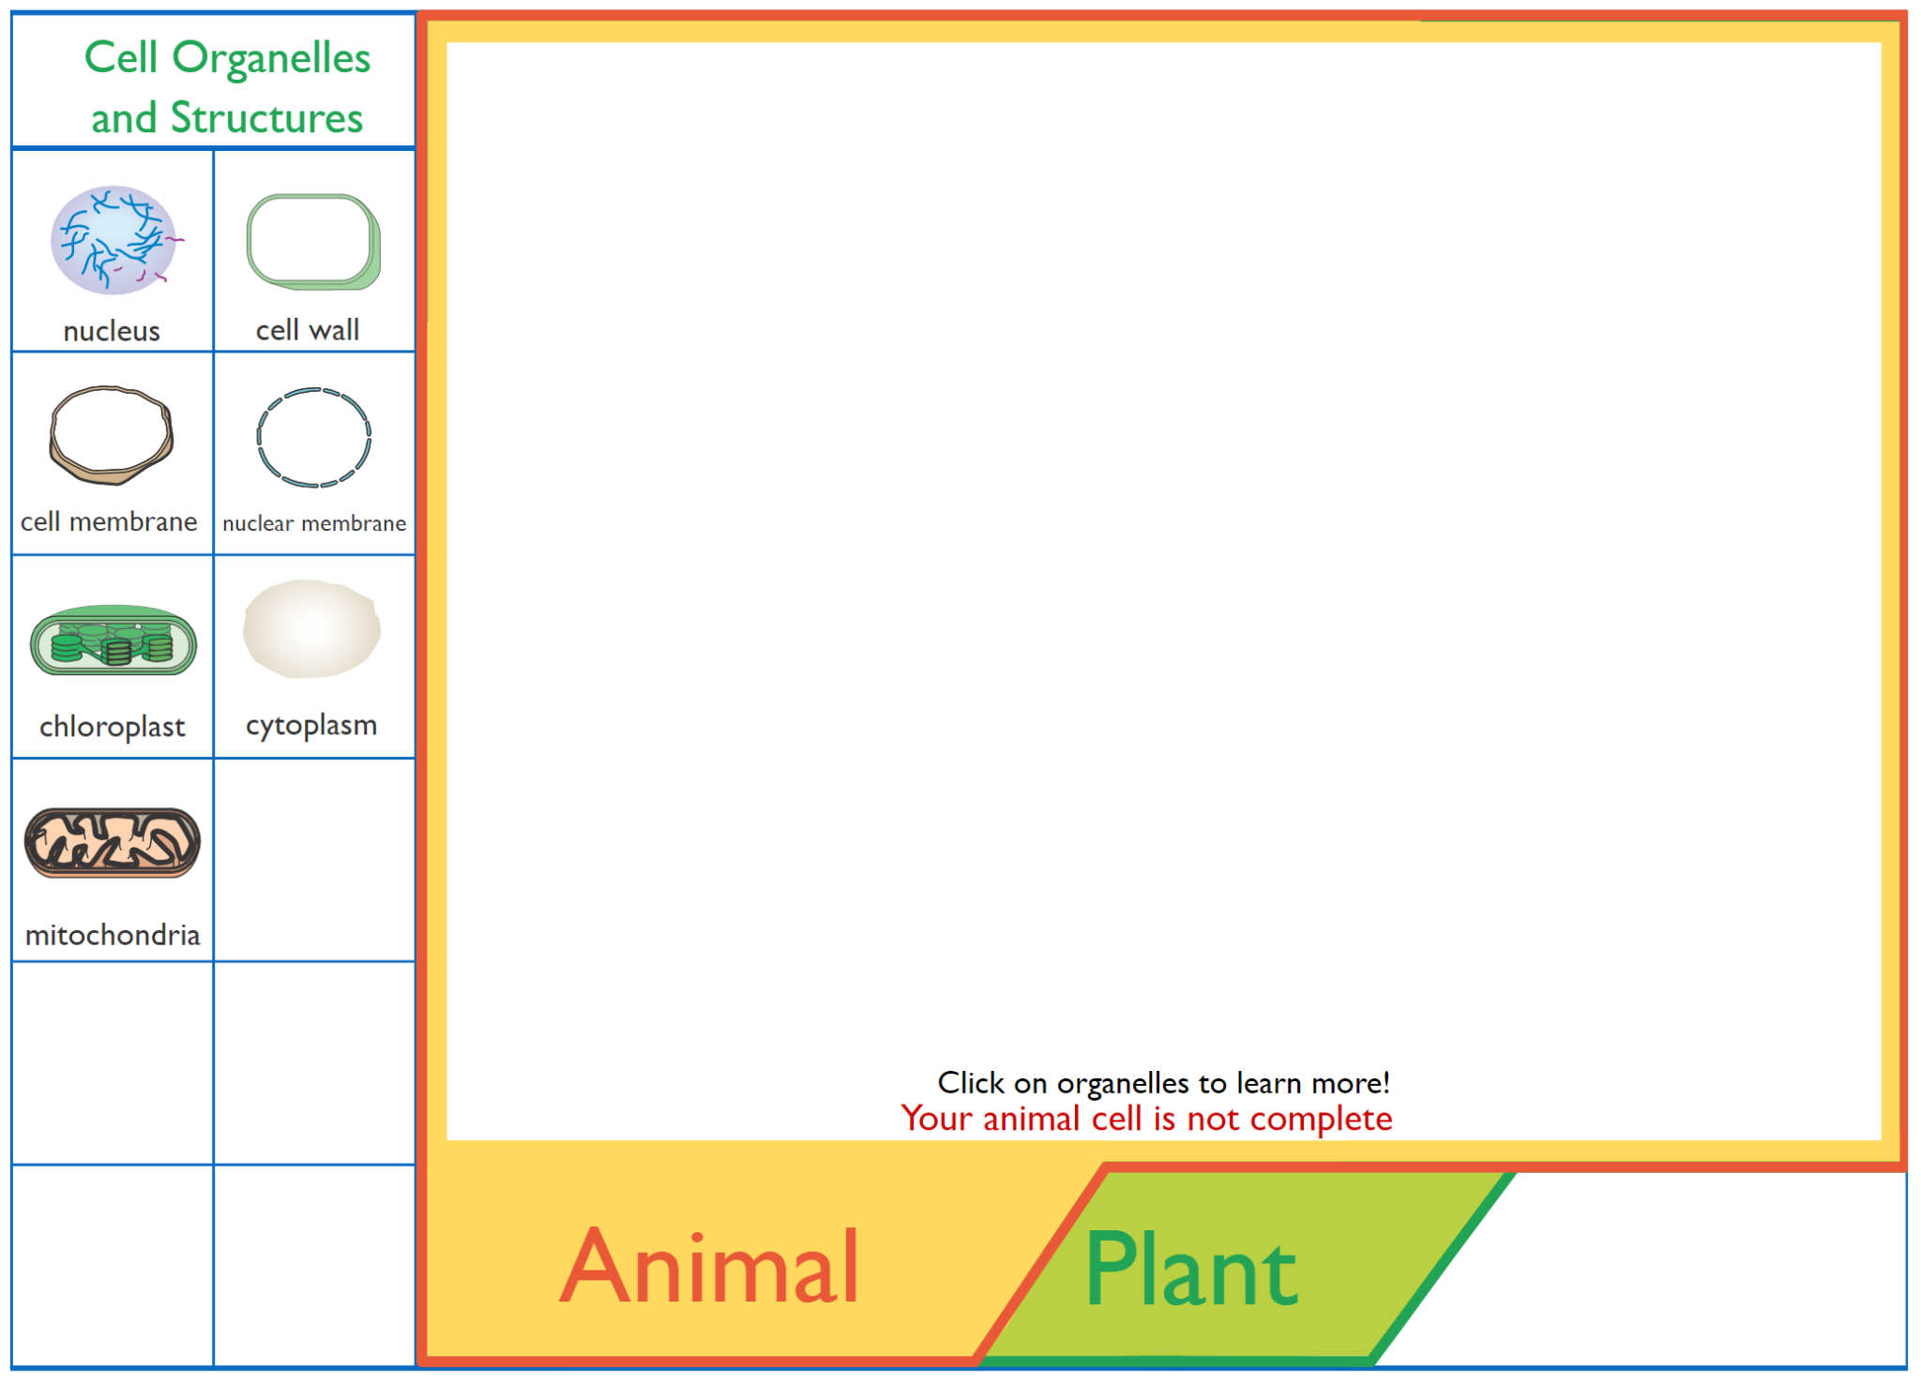
Simulation
Interactive Animations: Cell Structure
Click the link above to access an interactive activity that reviews eukaryotic (plant and animal) cells.
This activity will allow you to observe the basic differences between plant and animal cells. We will go into more detail about specific organelles later on.
Notes:
Feedback: These simulations / reinforcement activities are a great way to differentiate for students based on their needs and / or interests. These activities can be offered in different places throughout the slides or unit as students finish early, need additional activities for understanding, or need to be engaged in the content in a different way.

Slide 99
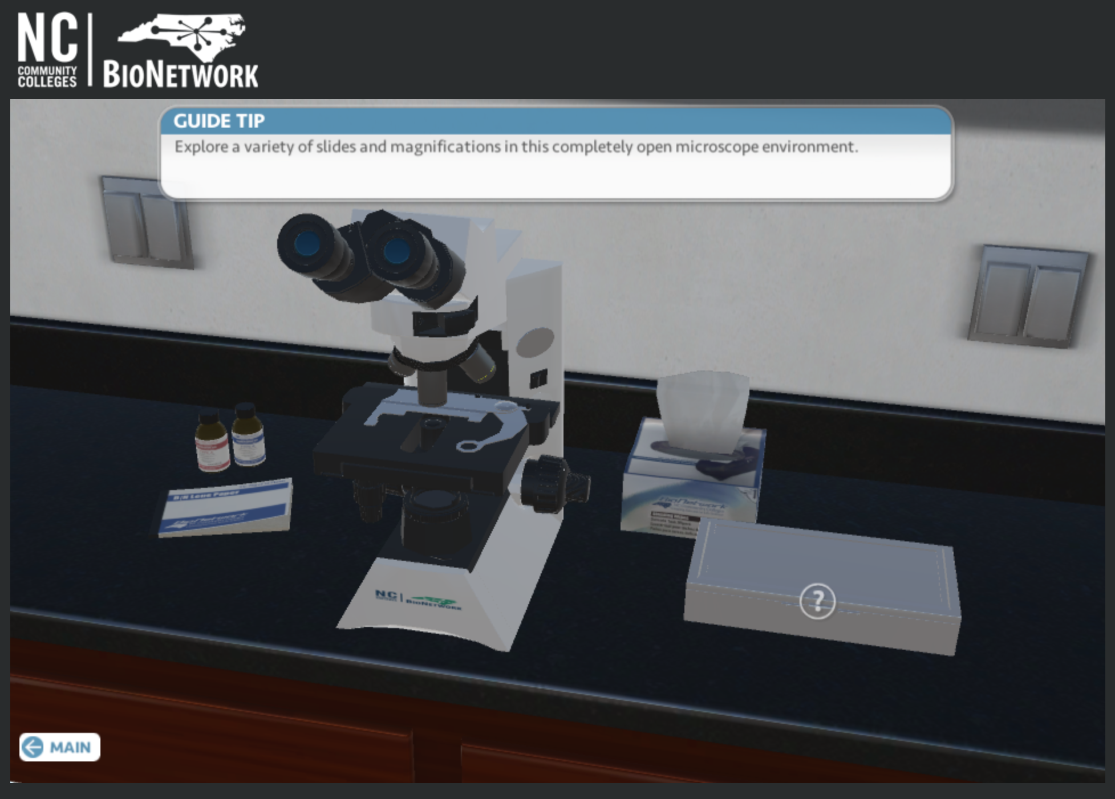
Reinforcement Activity
Virtual Microscope Lab
In this virtual lab activity, students will view different types of cells under a virtual microscope.
The Google doc linked above provides questions that reinforce concepts including similarities and differences between plant and animal cells while also helping students learn about how to operate a compound light microscope.

Slide 100
Big Question: How can we differentiate between the various types of cells?
Notes:
Explicit cue to revisit the big question at the end of the lesson: Okay everyone. Now that we’ve learned more about unicellular and multicellular organisms, let’s reflect once more on our big question. Was there anything that we predicted earlier that was correct or incorrect? Do you have any new thoughts to share?

Slide 101
Notes:
Thanks for watching, and please continue watching CAPs available from this website.

Slide 102
This Video Was Created With Resources From:
Questions or Comments
Michael Kennedy, Ph.D. MKennedy@Virginia.edu
Rachel L Kunemund, Ph.D. rk8vm@virginia.edu

Slide 103
Intro
“Big Idea” Question
Review Concepts
Check-In Questions
Teacher Demo
Vocabulary
Student-Friendly Definition
Examples & Non-Examples
Morphological Word Parts
Simulation/Activity
Notes:
OK everyone, get ready for our next lesson. Just as a reminder, these are the different components that our lesson may include, and you’ll see these icons in the top left corner of each slide so that you can follow along more easily!

Slide 104
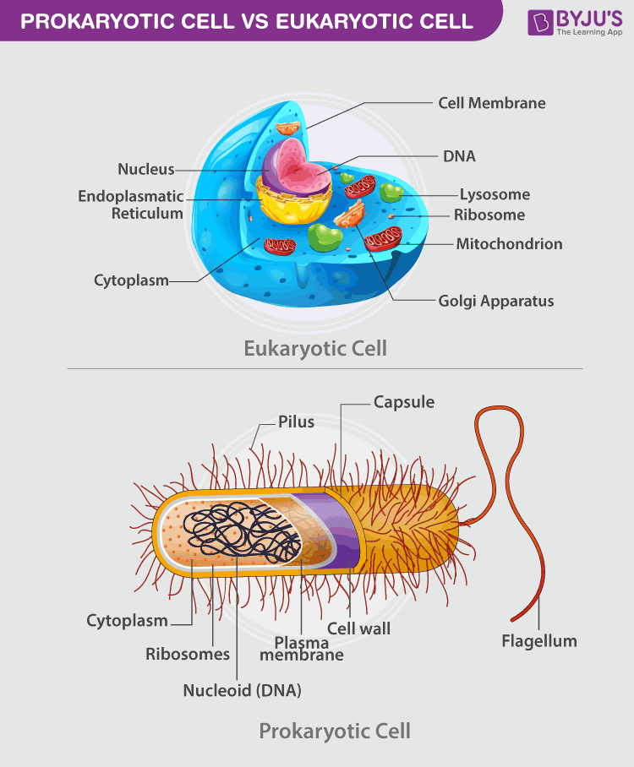
Intro
Eukaryotic & Prokaryotic
Cells
Notes:
Today we’re going to define and compare eukaryotic and prokaryotic cells.

Slide 105
Big Question: How can we differentiate between the various types of cells?
Notes:
Our “big question” is: How can we differentiate between the various types of cells?
[Pause and illicit predictions from students.]
I love all these thoughtful scientific hypotheses! Be sure to keep this question and your predictions in mind as we move through these next few lessons, and we’ll continue to revisit it.

Slide 106
Notes:
Before we start going through new terms and information, let’s review some other words that you already learned and make sure you are firm in your understanding.

Slide 107
Cell: the basic unit of life
Notes:
A cell is the basic unit of life. There are smaller structures that make up cells, but none of these things are alive by themselves.

Slide 108
Multicellular Organisms: living things made of more than one cell
Notes:
Multicellular organisms are living things made of more than one cell (often many).

Slide 109
Multicellular organisms have “specialized” cells that carry out different jobs needed to function.
Essential Life Processes
Notes:
Multicellular organisms not only have many cells, but their cells are considered “specialized” because they carry out different jobs necessary for an organism to function properly. These different jobs, or functions, are considered “essential life processes.” This picture shows some of the different types human cells that help our bodies function to complete these essential life processes.

Slide 110
Unicellular Organisms: living things made of one cell
Notes:
Unicellular organisms are living things that are made of one cell.

Slide 111
Unicellular organisms are only made of one cell, so this cell does all the jobs needed to function.
Notes:
Unicellular organisms are only made of one cell, so this cell does all the jobs needed to function properly. This means that all those essential life processes – like reproducing, eating, and digesting – occur within that one cell. For example, the bacteria parent cell pictured above, reproduces on its own by dividing into two daughter cells. Humans, on the other hand, need two parent cells (one male and one female) in order to reproduce.

Slide 112
Notes:
Now, let’s review.

Slide 113
What is the basic unit of life called?
Cell
Organism
Organelle
Tissue
Notes:
What is the basic unit of life called?

Slide 114
What is the basic unit of life called?
Cell
Organism
Organelle
Tissue
Notes:
What is the basic unit of life called?
[Cell]

Slide 115
Is this dog a unicellular or multicellular organism? Why?
Notes:
Is this dog a unicellular or multicellular organism?
[Multicellular organism, because dogs are made of many specialized cells.]

Slide 116
Is this bacteria a unicellular or multicellular organism?
Why?
Notes:
Is this bacteria a unicellular or multicellular organism?
[Unicellular organism, because bacteria is a single-celled organism that can carry out all the jobs that a cell needs to do.]

Slide 117
What is the difference between a multicellular organism and a unicellular organism?
Notes:
What is the difference between a multicellular organism and a unicellular organism?
[Unicellular organisms perform all the cell’s essential life processes; whereas, multicellular organisms have specialized cells, each of which performs different life processes.]

Slide 118
Eukaryotic Cell
Notes:
Let’s define the term, eukaryotic cell.

Slide 119
Eukaryotic Cell: has a nucleus and other structures enclosed in a membrane.
Notes:
A eukaryotic cell has a nucleus and other structures enclosed in a membrane. The nucleus holds the genetic material, or DNA, for the cell. We’ll go into more detail about the nucleus as we learn about all of the different organelles in a cell.

Slide 120
Notes:
Let’s pause for another moment to review.

Slide 121
What is a eukaryotic cell?
Notes:
What is a eukaryotic cell?
[A eukaryotic cell has a nucleus and other structures enclosed in a membrane. The nucleus holds the genetic material, or DNA, for the cell. We’ll go into more detail about the nucleus as we learn about all of the different organelles in a cell.]

Slide 122
Notes:
That is the basic definition but there is a bit more you need to know.

Slide 123
Our Focus: Eukaryotic Cells
Animal Cells
Plant Cells
Notes:
In 7th grade, we’re really going to focus in on two types of eukaryotic cells – animal and plant cells. This is where we’ll be headed in our next lesson! Because you are made up of animal cells, it might make it easier to remember that eukaryotic cells have a membrane-bound nucleus. You = eukaryotic

Slide 124
Multicellular and unicellular organisms can be made of eukaryotic cells.
Notes:
Multicellular and unicellular organisms can be made of eukaryotic cells. For example, the dog pictured above is a multicellular organism made of eukaryotic cells, while the amoeba is a unicellular organism made of a single eukaryotic cell.

Slide 125
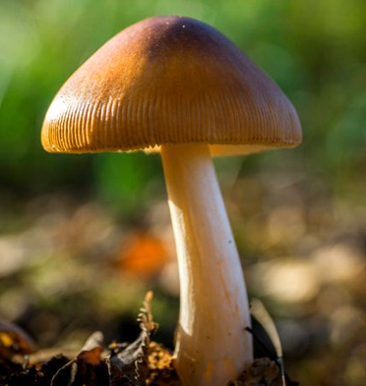
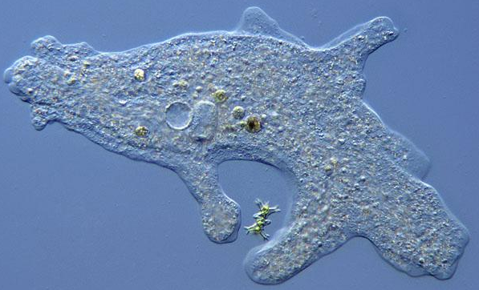
Animals, plants, fungi, and protists are all made of eukaryotic cells.
Notes:
Animals, plants, fungi, and protists are all made of eukaryotic cells. Like this dog, baby tree, mushroom, and amoeba.

Slide 126
Notes:
Let’s pause for another moment to review.

Slide 127
True/False: Only multicellular organisms can be made of eukaryotic cells.
Notes:
True/False: Only multicellular organisms can be made of eukaryotic cells.

Slide 128
True/False: Only multicellular organisms can be made of eukaryotic cells.
Notes:
True/False: Only multicellular organisms can be made of eukaryotic cells.
[False - both multicellular and unicellular organisms can be made of eukaryotic cells.]

Slide 129
Notes:
Let’s look at some examples of eukaryotic cells.

Slide 130
Notes:
This bird is an example of a multicellular animal. All animals have eukaryotic cells.

Slide 131
Notes:
This tree is an example of a multicellular plant. All plants have eukaryotic cells.

Slide 132
Notes:
Let’s pause for another moment to review.

Slide 133
How is this bird an example of eukaryotic cells?
Notes:
How is this bird an example of eukaryotic cells?
[This bird is an example of a multicellular animal. All animals have eukaryotic cells.]

Slide 134
Notes:
Let’s look at some non-examples of eukaryotic cells.

Slide 135
Notes:
As we’ve mentioned previously, the rock is not living and is not made up of cells.

Slide 136
Notes:
Bacteria do not fall into the categories of animals, plants, fungi or protists.

Slide 137
Notes:
Let’s pause for another moment to review.

Slide 138
Why is bacteria NOT an example of eukaryotic cells?
Notes:
Why is bacteria NOT an example of eukaryotic cells?
[Bacteria do not fall into the categories of animals, plants, fungi or protists.]

Slide 139
Prokaryotic Cell
Notes:
And now, let’s define prokaryotic cell.

Slide 140
Prokaryotic Cell: does not have a nucleus, and its parts are not enclosed in membrane.
Notes:
A prokaryotic cell does not have a nucleus, and its parts are not enclosed in membrane. Instead of a nucleus, the genetic material, or DNA, of a prokaryotic cell is stored in the nucleoid, which looks kind of like a disorganized ball of spaghetti.

Slide 141
Notes:
Let’s pause for another moment to review.

Slide 142
What is a prokaryotic cell?
Notes:
What is a prokaryotic cell?
[A prokaryotic cell does not have a nucleus, and its parts are not enclosed in membrane. Instead of a nucleus, the genetic material, or DNA, of a prokaryotic cell is stored in the nucleoid, which looks kind of like a disorganized ball of spaghetti.]

Slide 143
Notes:
That is the basic definition but there is a bit more you need to know.

Slide 144
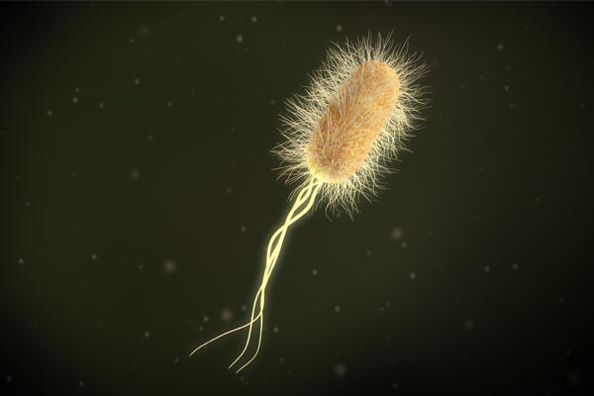
Prokaryotic cells are only found in unicellular organisms.
Notes:
Prokaryotic cells are only found in unicellular organisms – specifically, bacteria. There are no multicellular organisms that have prokaryotic cells.

Slide 145
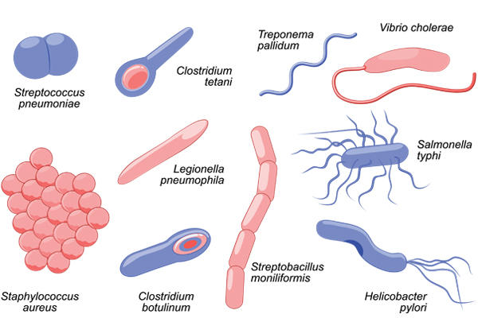
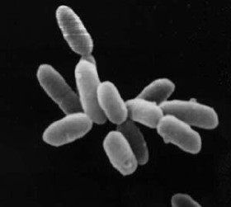
All bacteria and archaea = Prokaryotic Cells
Notes:
All bacteria and archaea are prokaryotic cells. These organisms lack a nucleus and membrane bound cell structures. Bacteria and archaea cells look so similar that scientists used to classify archaea as bacteria. Technological advances and careful investigation led to the discovery that there are some small but important differences. Many Archaea are adapted to survive in extreme environments.

Slide 146
Notes:
Let’s look at some examples of prokaryotic cells.

Slide 147
Notes:
All bacteria lack a nucleus and other membrane bound structures.

Slide 148
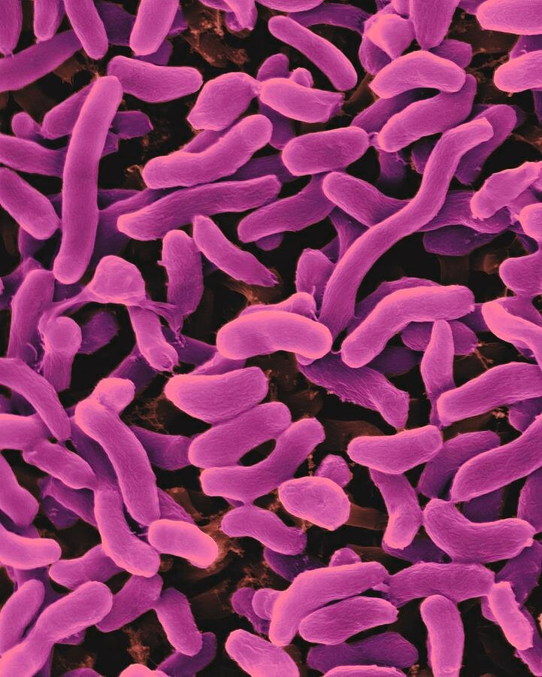
Notes:
All archaea are prokaryotes and lack a nucleus. These specific archaea are able to survive in extremely salty environments.

Slide 149
Notes:
Let’s pause for another moment to review.

Slide 150
What organisms only have prokaryotic cells?
Notes:
What organisms only have prokaryotic cells?
[Bacteria and archaea]

Slide 151
Notes:
Let’s look at some non-examples of prokaryotic cells.

Slide 152
Notes:
The kitten is multicellular and all of its cells are eukaryotic - containing a nucleus.

Slide 153
Notes:
The sunflower, much like the kitten, is multicellular and contains eukaryotic cells.

Slide 154
Notes:
Let’s pause for another moment to review.

Slide 155
True/False: Some unicellular organisms are considered eukaryotic.
Notes:
True/False: Some unicellular organisms are considered eukaryotic.

Slide 156
True/False: Some unicellular organisms are considered eukaryotic.
Notes:
True/False: Some unicellular organisms are considered eukaryotic.
[True – some unicellular organisms, like amoeba, are considered eukaryotic because they have a nucleus.]

Slide 157
Which of the following is NOT one of the differences between eukaryotic and prokaryotic cells?
Eukaryotic cells have a nucleus, prokaryotic cells do not.
Eukaryotic cells have their parts enclosed in membrane, prokaryotic cells do not.
Eukaryotic cells have genetic material (DNA), prokaryotic cells do not.
Notes:
Which of the following is NOT one of the differences between eukaryotic and prokaryotic cells?

Slide 158
Which of the following is NOT one of the differences between eukaryotic and prokaryotic cells?
Eukaryotic cells have a nucleus, prokaryotic cells do not.
Eukaryotic cells have their parts enclosed in membrane, prokaryotic cells do not.
Eukaryotic cells have genetic material (DNA), prokaryotic cells do not.
Notes:
Which of the following is NOT one of the differences between eukaryotic and prokaryotic cells?
[Eukaryotic cells have genetic material (DNA), prokaryotic cells do not - This is NOT true, both cells have genetic material.]

Slide 159
Demonstration
Multi and Unicellular Organisms Under the Microscope
Guide students in observing real onion skin cells under the microscope. This simple activity can be used as the foundation for class conversation about cell specialization. The skin cells, which form a tissue, have a unified structure and function. These cells can be compared to organisms living in pond water, which include bacteria, algae and amoebas. These unicellular organisms perform all required functions of life with just one cell!
Notes:
Guide students in observing real onion skin cells under the microscope. This simple activity can be used as the foundation for class conversation about cell specialization. The skin cells, which form a tissue, have a unified structure and function. These cells can be compared to organisms living in pond water, which include bacteria, algae and amoebas. These unicellular organisms perform all required functions of life with just one cell!
*Observation of onion cells may provide an opportunity for introducing the concept of levels of organization for life - cells, tissues, organs, etc.

Slide 160
Remember!!!
Notes:
So remember!!!

Slide 161
Eukaryotic Cell: has a nucleus and other structure enclosed in a membrane
Notes:
A eukaryotic cell has a nucleus and other structures enclosed in a membrane.

Slide 162
Multicellular and unicellular organisms can be made of eukaryotic cells.
Notes:
Multicellular AND unicellular organisms can be made of eukaryotic cells. For example, the dog pictured above is a multicellular organism made of eukaryotic cells, while the amoeba is a unicellular organism made of a single eukaryotic cell.

Slide 163
Animals, plants, fungi, and protists are all made of eukaryotic cells.
Notes:
Animals, plants, fungi, and protists are all made of eukaryotic cells. Like this dog, baby tree, mushroom, and amoeba.

Slide 164
Prokaryotic Cell: does not have a nucleus, and its parts are not enclosed in membrane.
Notes:
A prokaryotic cell does NOT have a nucleus, and its parts are NOT enclosed in membrane.

Slide 165
Prokaryotic cells are only found in unicellular organisms.
Notes:
Prokaryotic cells are only found in unicellular organisms. There are NO multicellular organisms with prokaryotic cells.

Slide 166
All bacteria and archaea = Prokaryotic Cells
Notes:
All bacteria and archaea are prokaryotic cells. These organisms lack a nucleus and membrane bound cell structures.

Slide 167
Simulation
Interactive Animations: Cell Structure
Click the link above to access an interactive activity that reviews eukaryotic (plant and animal) cells.
This activity will allow you to observe the basic differences between plant and animal cells. We will go into more detail about specific organelles later on.

Slide 168
Reinforcement Activity
Virtual Microscope Lab
In this virtual lab activity, students will view different types of cells under a virtual microscope.
The Google doc linked above provides questions that reinforce concepts including similarities and differences between plant and animal cells while also helping students learn about how to operate a compound light microscope.

Slide 169
Big Question: How can we differentiate between the various types of cells?
Notes:
Explicit cue to revisit the big question at the end of the lesson: Okay everyone. Now that we’ve learned more about unicellular and multicellular organisms, as well as prokaryotic and eukaryotic cells, let’s reflect once more on our big question. Was there anything that we predicted earlier that was correct or incorrect? Do you have any new thoughts to share?

Slide 170
Notes:
Thanks for watching, and please continue watching CAPs available from this website.

Slide 171
This Video Was Created With Resources From:
Questions or Comments
Michael Kennedy, Ph.D. MKennedy@Virginia.edu
Rachel L Kunemund, Ph.D. rk8vm@virginia.edu

