Slide 1
Intro
“Big Idea” Question
Review Concepts
Check-In Questions
Teacher Demo
Vocabulary
Student-Friendly Definition
Examples & Non-Examples
Morphological Word Parts
Simulation/Activity
Notes:
OK everyone, get ready for our next lesson. Just as a reminder, these are the different components that our lesson may include, and you’ll see these icons in the top left corner of each slide so that you can follow along more easily!

Slide 2
Kinetic Energy
Intro
Notes:
Today we will learn about kinetic energy.

Slide 3
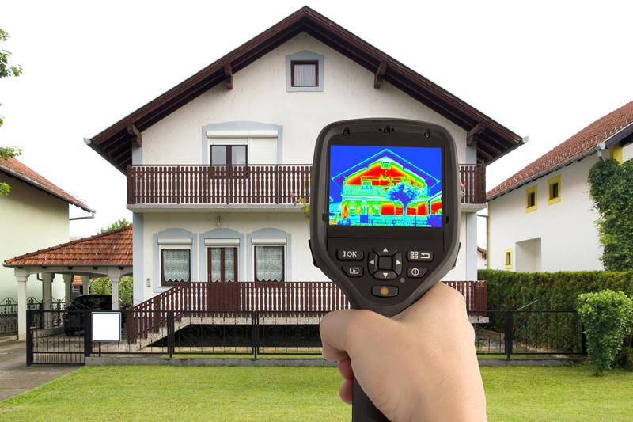
Big Question: What forms can energy take? How is each an example of energy?
Notes:
Our “big question” is: What forms can energy take? How is each an example of energy?
[Pause and illicit predictions from students.]
I love all these thoughtful scientific hypotheses! Be sure to keep this question and your predictions in mind as we move through these next few lessons, and we’ll continue to revisit it.

Slide 4
Notes:
Before we move on to our new vocabulary term, let’s review some other words & concepts that you already learned and make sure you are firm in your understanding.

Slide 5
Energy: the ability to cause change
Notes:
Energy is the ability to cause change.

Slide 6
Potential energy: stored energy
Notes:
Potential energy is stored energy.

Slide 7
Notes:
Now let’s pause for a moment to check your understanding.

Slide 8
What is energy?
Notes:
What is energy?
[Energy is the ability to cause change.]

Slide 9
What is potential energy?
Notes:
What is potential energy?
[Potential energy is stored energy.]

Slide 10
Kinetic Energy
Notes:
Now that we’ve reviewed, let’s define our new term, kinetic energy.

Slide 11
Kinetic Energy: energy from motion
Notes:
Kinetic energy is energy from motion.

Slide 12
Notes:
Let’s check-in for understanding.

Slide 13
What is kinetic energy?
Notes:
What is kinetic energy?
[Kinetic energy is energy from motion.]

Slide 14
Notes:
That is the basic definition, but there is a bit more you need to know.

Slide 15
Notes:
Here, kinetic energy is shown in the bowling ball.

Slide 16
mass
Notes:
Kinetic energy is measured by mass,

Slide 17
velocity
Notes:
and velocity (speed and direction).

Slide 18
Notes:
Let’s check-in for understanding.

Slide 19
How do we measure kinetic energy?
Notes:
How do we measure kinetic energy?
[Kinetic energy is measured by mass and velocity.]

Slide 20
Notes:
Let’s look at some examples of kinetic energy.

Slide 21
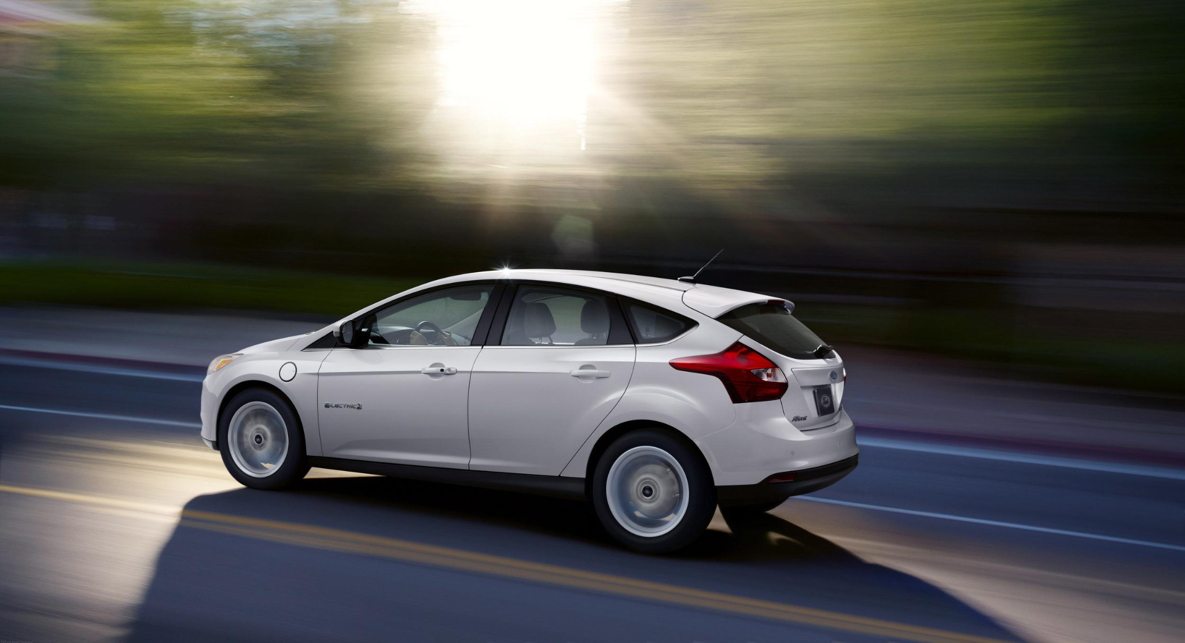
Notes:
A driving car has kinetic energy because it has mass and is moving (has velocity).

Slide 22
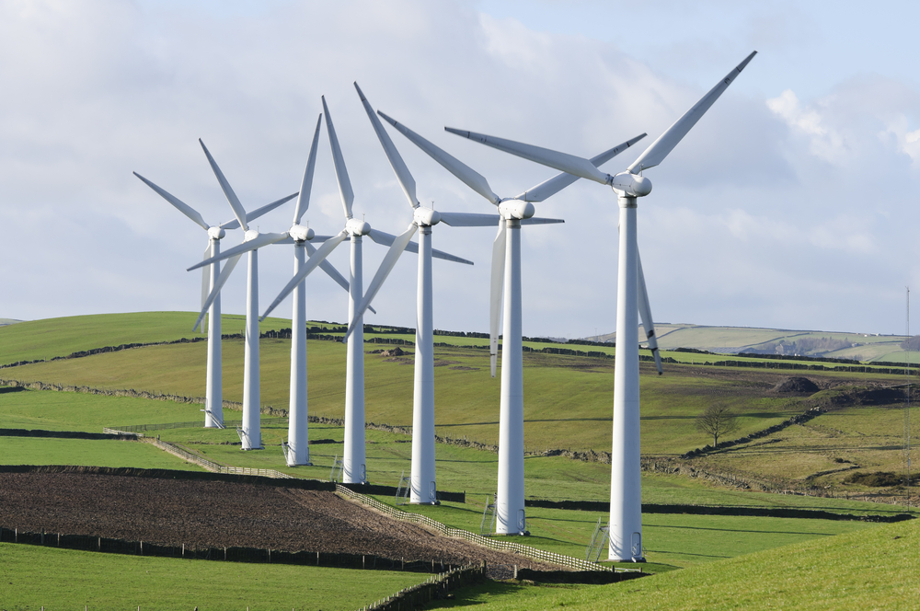
Notes:
Windmills spinning also have kinetic energy. The blades have mass and are moving (have velocity).

Slide 23
Notes:
Let’s look at a non-example of kinetic energy.

Slide 24
Notes:
A desk sitting on the floor does not have kinetic energy because it is not moving (has no velocity).

Slide 25
Notes:
Let’s check-in for understanding.

Slide 26
Which of these people have kinetic energy?
Notes:
Which of these people have kinetic energy?

Slide 27
Which of these people have kinetic energy?
Notes:
Which of these people have kinetic energy?
[Answer, the ones that are moving]

Slide 28
What is kinetic energy?
Notes:
What is kinetic energy?
[Kinetic energy is energy from motion.]

Slide 29
Remember!!!
Notes:
So remember!

Slide 30
Kinetic Energy: energy from motion
Notes:
Kinetic energy is energy from motion.

Slide 31
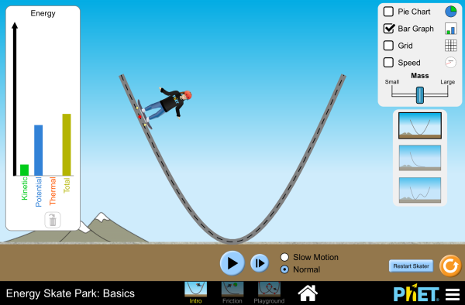
Simulation Activity
Energy Skate Park
Notes:
At what points does the skater have kinetic energy? At what points does the skated not have kinetic energy?

Slide 32
Big Question: What forms can energy take? How is each an example of energy?
Notes:
Explicit cue to revisit the big question at the end of the lesson: Okay everyone. Now that we’ve learned the term, kinetic energy, let’s reflect once more on our big question. Was there anything that we predicted earlier that was correct or incorrect? Do you have any new hypotheses to share?

Slide 33
Notes:
Thanks for watching, and please continue watching CAPs available from this website.

Slide 34
This Video Created With Resources From:
Questions or Comments
Michael Kennedy, Ph.D. MKennedy@Virginia.edu
Rachel L Kunemund, Ph.D. rk8vm@virginia.edu

Slide 35
Intro
“Big Idea” Question
Review Concepts
Check-In Questions
Teacher Demo
Vocabulary
Student-Friendly Definition
Examples & Non-Examples
Morphological Word Parts
Simulation/Activity
Notes:
OK everyone, get ready for our next lesson. Just as a reminder, these are the different components that our lesson may include, and you’ll see these icons in the top left corner of each slide so that you can follow along more easily!

Slide 36
Intro
Electrical Energy
Notes:
Today we’re going to learn about electrical energy.

Slide 37
Big Question: What forms can energy take? How is each an example of energy?
Notes:
Our “big question” is: What forms can energy take? How is each an example of energy?
[Pause and illicit predictions from students.]
I love all these thoughtful scientific hypotheses! Be sure to keep this question and your predictions in mind as we move through these next few lessons, and we’ll continue to revisit it.

Slide 38
Notes:
Before we move on to our new vocabulary term, let’s review some other words & concepts that you already learned and make sure you are firm in your understanding.

Slide 39
Energy: the ability to cause change
Notes:
Energy is the ability to cause change.

Slide 40
Potential energy: stored energy
Notes:
Potential energy is stored energy.

Slide 41
Kinetic Energy: energy from motion
Notes:
Kinetic energy is energy from motion.

Slide 42
Notes:
Now let’s pause for a moment to check your understanding.

Slide 43
What is energy?
Notes:
What is energy?
[Energy is the ability to cause change.]

Slide 44
What is the difference between kinetic and potential energy?
Notes:
What is the difference between kinetic and potential energy?
[Potential energy is energy that is stored while kinetic energy is released energy (energy of motion).]

Slide 45
Electrical Energy
Notes:
Now that we’ve reviewed, let’s define our new term, electrical energy.

Slide 46
Electrical Energy: energy in an electric current
Notes:
Electrical energy is energy in an electric current.

Slide 47
Notes:
Let’s check-in for understanding.

Slide 48
What is electrical energy?
Notes:
What is electrical energy?
[Electrical energy is energy in an electric current.]

Slide 49
Notes:
That is the basic definition, but there is a bit more you need to know.

Slide 50
electron
Notes:
There is energy in the circuit because electrons are moving.

Slide 51
Notes:
In an electrified wire, electrons are moving from the negative side to positive side because of attraction.

Slide 52
Notes:
Let’s check-in for understanding.

Slide 53
How do electrons move in an electrified wire?
Notes:
How do electrons move in an electrified wire?
[In an electrified wire, electrons are moving from the negative side to the positive side because of attraction.]

Slide 54
Notes:
Let’s look at an example of electrical energy.

Slide 55
Notes:
Electrical energy is necessary to power a lamp. Electricity travels through circuits to reach the lightbulb.

Slide 56
Notes:
Let’s check-in for understanding.

Slide 57
Name as many examples of electrical energy as you can.
Notes:
Name as many examples of electrical energy as you can.
[Cell phone, television, street lamps, car, etc.]

Slide 58
What is electrical energy?
Notes:
What is electrical energy?
[Electrical energy is energy in an electric current.]

Slide 59
Remember!!!
Notes:
So remember!

Slide 60
Electrical Energy: energy in an electric current
Notes:
Electrical energy is energy in an electric current.

Slide 61
Big Question: What forms can energy take? How is each an example of energy?
Notes:
Explicit cue to revisit the big question at the end of the lesson: Okay everyone. Now that we’ve learned the term, electrical energy, let’s reflect once more on our big question. Was there anything that we predicted earlier that was correct or incorrect? Do you have any new hypotheses to share?

Slide 62
Notes:
Thanks for watching, and please continue watching CAPs available from this website.

Slide 63
This Video Created With Resources From:
Questions or Comments
Michael Kennedy, Ph.D. MKennedy@Virginia.edu
Rachel L Kunemund, Ph.D. rk8vm@virginia.edu

Slide 64
Intro
“Big Idea” Question
Review Concepts
Check-In Questions
Teacher Demo
Vocabulary
Student-Friendly Definition
Examples & Non-Examples
Morphological Word Parts
Simulation/Activity
Notes:
OK everyone, get ready for our next lesson. Just as a reminder, these are the different components that our lesson may include, and you’ll see these icons in the top left corner of each slide so that you can follow along more easily!

Slide 65
Mechanical Energy
Intro
Notes:
Today we’re going to learn about mechanical energy.

Slide 66
Big Question: What forms can energy take? How is each an example of energy?
Notes:
Our “big question” is: What forms can energy take? How is each an example of energy?
[Pause and illicit predictions from students.]
I love all these thoughtful scientific hypotheses! Be sure to keep this question and your predictions in mind as we move through these next few lessons, and we’ll continue to revisit it.

Slide 67
Notes:
Before we move on to our new vocabulary term, let’s review some other words & concepts that you already learned and make sure you are firm in your understanding.

Slide 68
Energy: the ability to cause change
Notes:
Energy is the ability to cause change.

Slide 69
Potential energy: stored energy
Notes:
Potential energy is stored energy.

Slide 70
Kinetic Energy: energy from motion
Notes:
Kinetic energy is energy from motion.

Slide 71
Electrical Energy: energy in an electric current
Notes:
Electrical energy is energy in an electric current.

Slide 72
Notes:
Now let’s pause for a moment to check your understanding.

Slide 73
What is energy?
Notes:
What is energy?
[Energy is the ability to cause change.]

Slide 74
What is the difference between kinetic and potential energy?
Notes:
What is the difference between kinetic and potential energy?
[Potential energy is energy that is stored while kinetic energy is released energy (energy of motion).]

Slide 75
What is electrical energy?
Notes:
What is electrical energy?
[Electrical energy is energy in an electric current.]

Slide 76
Mechanical Energy
Notes:
Now that we’ve reviewed, let’s define our new term, mechanical energy.

Slide 77
Mechanical Energy: the total potential and kinetic energy in a system
Notes:
Mechanical energy is the total potential and kinetic energy in a system.

Slide 78
Notes:
Let’s check-in for understanding.

Slide 79
What is mechanical energy?
Notes:
What is mechanical energy?
[Mechanical energy is the total potential and kinetic energy in a system.]

Slide 80
Notes:
That is the basic definition, but there is a bit more you need to know.

Slide 81
Notes:
Mechanical energy is used to do work.

Slide 82
Notes:
Mechanical energy is based on motion and position.

Slide 83
Potential Energy
Kinetic Energy
Mechanical Energy
Notes:
Mechanical energy is potential energy + kinetic energy.

Slide 84
Notes:
Let’s check-in for understanding.

Slide 85
What is mechanical energy based on?
Notes:
What is mechanical energy based on?
[Mechanical energy is based on motion and position.]

Slide 86
What is mechanical energy?
Notes:
What is mechanical energy?
[Mechanical energy is the total potential and kinetic energy in a system.]

Slide 87
Remember!!!
Notes:
So remember!

Slide 88
Mechanical Energy: the total potential and kinetic energy in a system
Notes:
Mechanical energy is the total potential and kinetic energy in a system.

Slide 89
Simulation Activity
Energy Skate Park
Notes:
What can you tell about mechanical energy? Look at the potential and kinetic energy as the skater moves.

Slide 90
Big Question: What forms can energy take? How is each an example of energy?
Notes:
Explicit cue to revisit the big question at the end of the lesson: Okay everyone. Now that we’ve learned the term, mechanical energy, let’s reflect once more on our big question. Was there anything that we predicted earlier that was correct or incorrect? Do you have any new hypotheses to share?

Slide 91
Notes:
Thanks for watching, and please continue watching CAPs available from this website.

Slide 92
This Video Created With Resources From:
Questions or Comments
Michael Kennedy, Ph.D. MKennedy@Virginia.edu
Rachel L Kunemund, Ph.D. rk8vm@virginia.edu

Slide 93
Intro
“Big Idea” Question
Review Concepts
Check-In Questions
Teacher Demo
Vocabulary
Student-Friendly Definition
Examples & Non-Examples
Morphological Word Parts
Simulation/Activity
Notes:
OK everyone, get ready for our next lesson. Just as a reminder, these are the different components that our lesson may include, and you’ll see these icons in the top left corner of each slide so that you can follow along more easily!

Slide 94
Big Question: What forms can energy take? How is each an example of energy?
Notes:
Our “big question” is: What forms can energy take? How is each an example of energy?
[Pause and illicit predictions from students.]
I love all these thoughtful scientific hypotheses! Be sure to keep this question and your predictions in mind as we move through these next few lessons, and we’ll continue to revisit it.

Slide 95
Thermal Energy
Intro
Notes:
Today we’re going to learn about thermal energy.

Slide 96
Notes:
Before we move on to our new vocabulary term, let’s review some other words & concepts that you already learned and make sure you are firm in your understanding.

Slide 97
Energy: the ability to cause change
Notes:
Energy is the ability to cause change.

Slide 98
Potential energy: stored energy
Notes:
Potential energy is stored energy.

Slide 99
Kinetic Energy: energy from motion
Notes:
Kinetic energy is energy from motion.

Slide 100
Electrical Energy: energy in an electric current
Notes:
Electrical energy is energy in an electric current.

Slide 101
Mechanical Energy: the total potential and kinetic energy in a system
Notes:
Mechanical energy is the total potential and kinetic energy in a system.

Slide 102
Notes:
Now let’s pause for a moment to check your understanding.

Slide 103
What is energy?
Notes:
What is energy?
[Energy is the ability to cause change.]

Slide 104
What is the difference between kinetic and potential energy?
Notes:
What is the difference between kinetic and potential energy?
[Potential energy is energy that is stored while kinetic energy is released energy (energy of motion).]

Slide 105
What is electrical energy?
Notes:
What is electrical energy?
[Electrical energy is energy in an electric current.]

Slide 106
What is mechanical energy?
Notes:
What is mechanical energy?
[Mechanical energy is the total potential and kinetic energy in a system.]

Slide 107
Thermal Energy
Notes:
Now that we’ve reviewed, let’s define our new term, thermal energy.

Slide 108
Thermal Energy: the energy generated and measured by heat
Notes:
Thermal energy is the energy generated and measured by heat

Slide 109
Notes:
Let’s check-in for understanding.

Slide 110
What is thermal energy?
Notes:
What is thermal energy?
[Thermal energy is the energy generated and measured by heat]

Slide 111
Notes:
That is the basic definition, but there is a bit more you need to know.

Slide 112
Notes:
Here we are looking at heat. Blue is read on the gun when an item is colder.

Slide 113
Notes:
Red is seen on the gun when an item is hotter and moving faster.

Slide 114
Notes:
Let’s check-in for understanding.

Slide 115
What is thermal energy?
Notes:
What is thermal energy?
[Thermal energy is the energy generated and measured by heat]

Slide 116
Remember!!!
Notes:
So remember!

Slide 117
Thermal Energy: the energy generated and measured by heat
Notes:
Thermal energy is the combined potential and kinetic energy of a particle.
We will talk more about heat next class!

Slide 118
Big Question: What forms can energy take? How is each an example of energy?
Notes:
Explicit cue to revisit the big question at the end of the lesson: Okay everyone. Now that we’ve learned the term, thermal energy, let’s reflect once more on our big question. Was there anything that we predicted earlier that was correct or incorrect? Do you have any new hypotheses to share?

Slide 119
Notes:
Thanks for watching, and please continue watching CAPs available from this website.

Slide 120
This Video Created With Resources From:
Questions or Comments
Michael Kennedy, Ph.D. MKennedy@Virginia.edu
Rachel L Kunemund, Ph.D. rk8vm@virginia.edu

