Slide 1
Intro
“Big Idea” Question
Review Concepts
Check-In Questions
Teacher Engagement
Vocabulary
Student-Friendly Definition
Examples & Non-Examples
Morphological Word Parts
Frayer Model
Simulation/Activity
Notes:
OK everyone, get ready for our next lesson. Just as a reminder, these are the different components that our lesson may include, and you’ll see these icons in the top left corner of each slide so that you can follow along more easily!

Slide 2
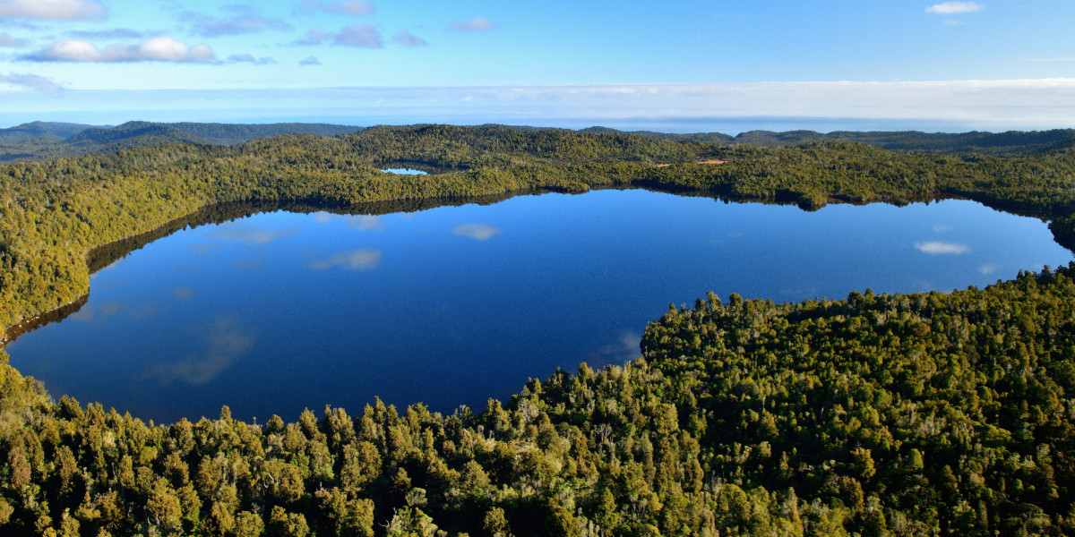
Intro
Lake
Notes:
Today, we’ll be learning about the word: Lake.

Slide 3
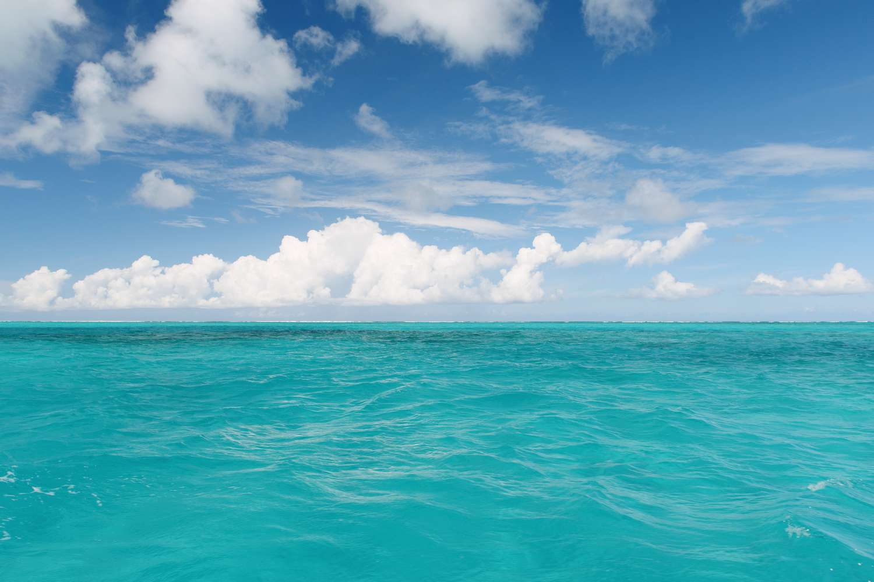
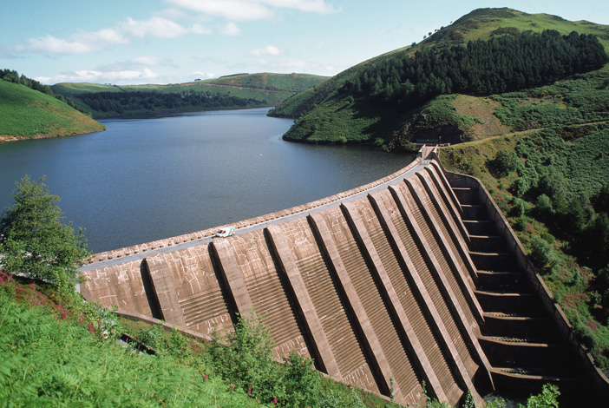
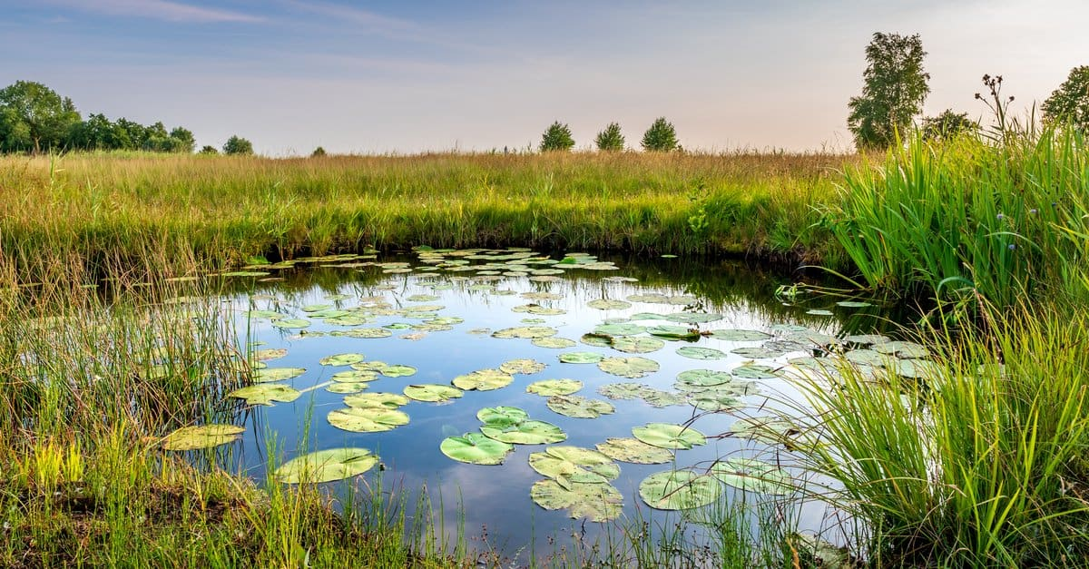
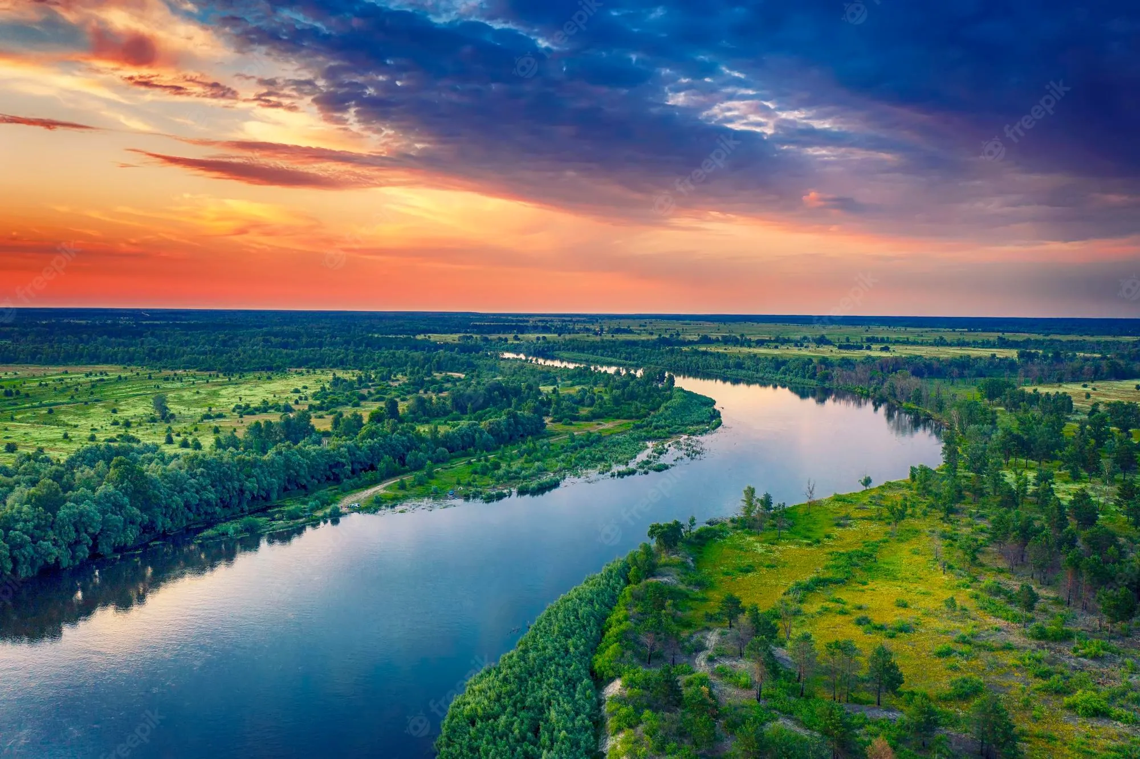
Big Question: What are the differences between lakes, oceans, ponds, reservoirs, and rivers?
Notes:
Our “big question” is: What are the differences between lakes, oceans, ponds, reservoirs, and rivers?
[Pause and illicit predictions from students.]
I love all these thoughtful scientific hypotheses! Be sure to keep this question and your predictions in mind as we move through these next few lessons, and we’ll continue to revisit it.

Slide 4
Notes:
Before we move on to our new topic, let’s review some other words & concepts that you already learned and make sure you are firm in your understanding.

Slide 5
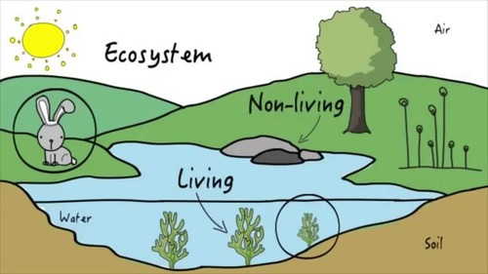
Ecosystem: an area where living and nonliving things interact
Notes:
An ecosystem is an area where living and nonliving things interact.

Slide 6
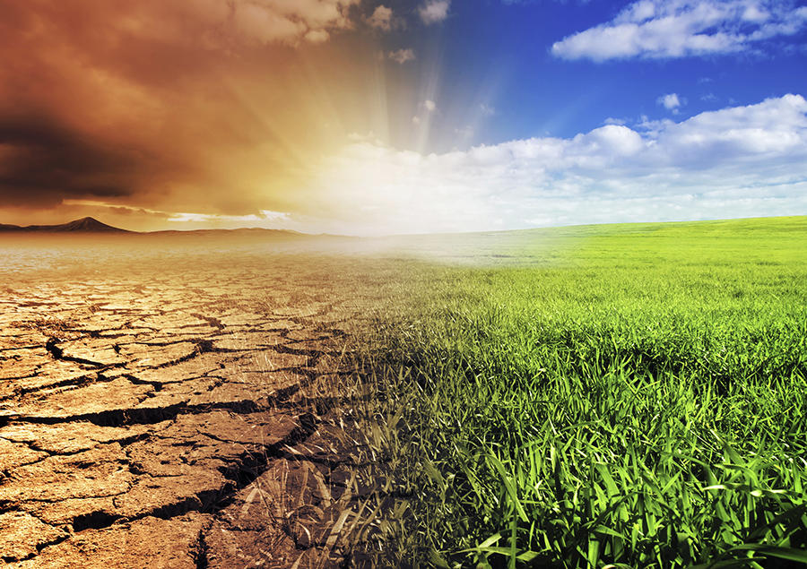
Environment: the surroundings of a person, animal, plant or thing
Notes:
Environments are the surroundings of a person, animal, plant, or thing.

Slide 7
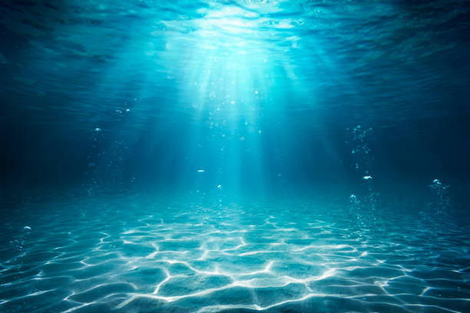
Aquatic: living, growing, or often found in the water
Notes:
Aquatic means something living, growing, or often found in water.

Slide 8
Notes:
Now let’s pause for a moment to review the information we have covered already.

Slide 9
An ecosystem is where ______ and _______ things interact.
Notes:
An ecosystem is where ______ and _______ things interact.
[living, non-living]

Slide 10
An ecosystem is where living and non-living things interact.
Notes:
An ecosystem is where ______ and _______ things interact.
[living, non-living]

Slide 11
True or false: Environments are the surroundings of a person, animal, plant, or thing
True
False
Notes:
True or false; Environments are the surroundings of a person, animal, plant, or thing
[True]

Slide 12
True or false: Environments are the surroundings of a person, animal, plant, or thing
True
False
Notes:
True or false; Environments are the surroundings of a person, animal, plant, or thing
[True]

Slide 13
Aquatic means living, growing, or often found in/on…
land
water
Notes:
Aquatic means living, growing, or often found in/on…
[water]

Slide 14
Aquatic means living, growing, or often found in/on…
land
water
Notes:
Aquatic means living, growing, or often found in/on…
[water]

Slide 15
Lake
Notes:
Now that we’ve reviewed, let’s define the phrase lake.

Slide 16
Lake: A natural, large body of water surrounded by land
Notes:
A lake is a natural, large body of water surrounded by land

Slide 17
Notes:
Let’s check-in for understanding.

Slide 18
What is a lake?
Notes:
What is a lake?
[A lake is a natural, large body of water surrounded by land.]

Slide 19
Notes:
That is the basic definition, but there is a bit more you need to know.

Slide 20
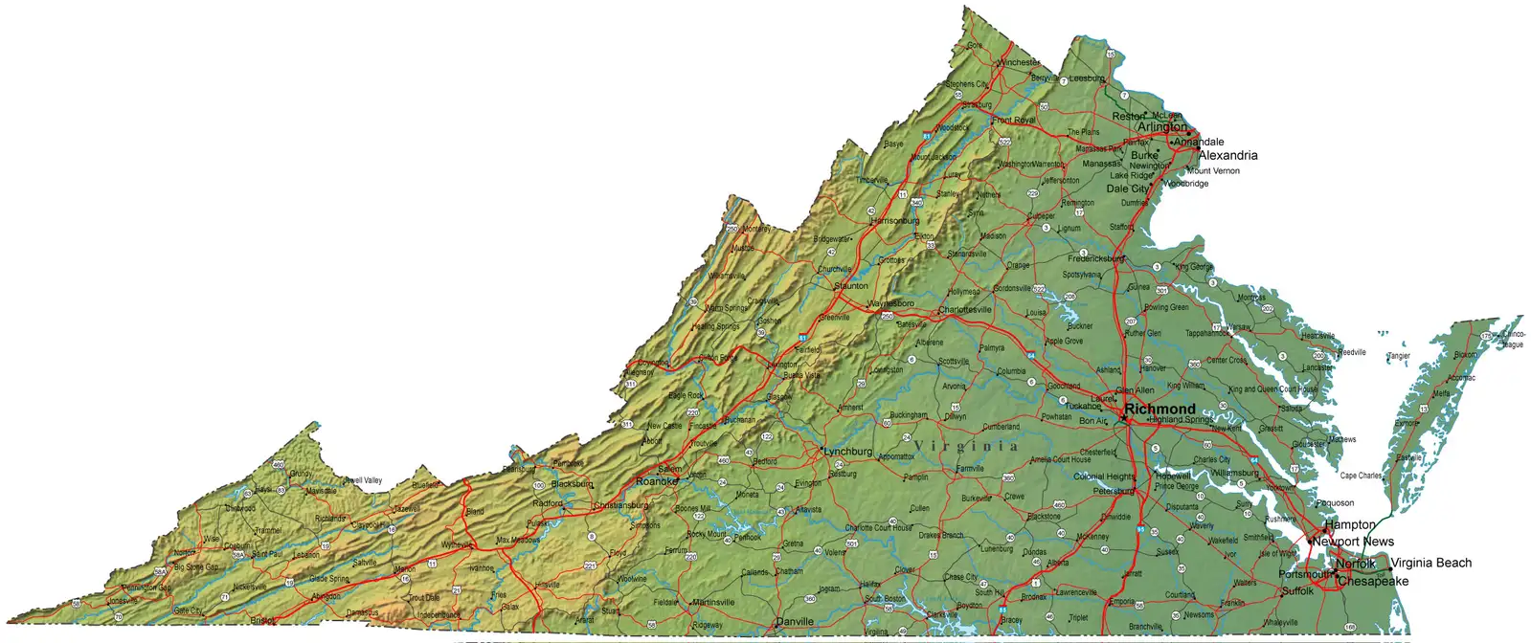
Drummond Lake and Mountain Lake are two popular natural lakes in Virginia. Drummond Lake is near Virginia Beach and Mountain Lake is near Virginia Tech University.
Drummond Lake
Mountain Lake
Notes:
Drummond Lake and Mountain Lake are two popular natural lakes in Virginia. Drummond Lake is near Virginia Beach and Mountain Lake is near Virginia Tech University.

Slide 21
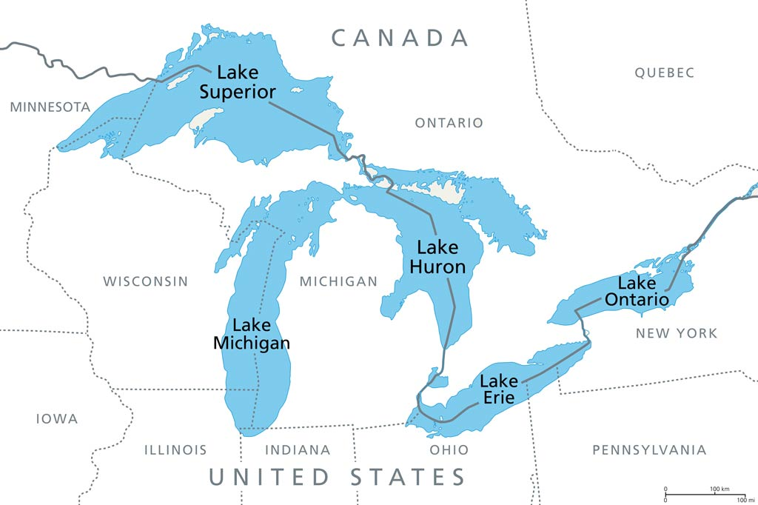
The Great Lakes are a group of interconnected freshwater lakes between the United States and Canada. The Great Lakes consist of Lake Superior, Lake Michigan, Lake Huron, Lake Erie, and Lake Ontario.
Notes:
The Great Lakes are a group of interconnected freshwater lakes between the United States and Canada. The Great Lakes consist of Lake Superior, Lake Michigan, Lake Huron, Lake Erie, and Lake Ontario.

Slide 22
The important fact to remember about lakes is that they are naturally made.
Notes:
The important fact to remember about lakes is that they are naturally made.

Slide 23
Notes:
Let’s check-in for understanding.

Slide 24
________ Lake and _______ Lake are two popular natural lakes in Virginia. One is near Virginia Beach and the other is near Virginia Tech University.
Drummond Lake
Mountain Lake
Notes:
________ Lake and _______ Lake are two popular natural lakes in Virginia. Drummond Lake is near Virginia Beach and Mountain Lake is near Virginia Tech University.
[Drummond, Mountain]

Slide 25
Drummond Lake and Mountain Lake are two popular natural lakes in Virginia. One is near Virginia Beach and the other is near Virginia Tech University.
Drummond Lake
Mountain Lake
Notes:
________ Lake and _______ Lake are two popular natural lakes in Virginia. Drummond Lake is near Virginia Beach and Mountain Lake is near Virginia Tech University.
[Drummond, Mountain]

Slide 26
The ______ Lakes are a group of interconnected freshwater lakes between the United States and Canada. They consist of Lake Superior, Lake Michigan, Lake Huron, Lake Erie, and Lake Ontario.
Small
Large
Great
Notes:
The ______ Lakes are a group of interconnected freshwater lakes between the United States and Canada. The Great Lakes consist of Lake Superior, Lake Michigan, Lake Huron, Lake Erie, and Lake Ontario.
[Great]

Slide 27
The ______ Lakes are a group of interconnected freshwater lakes between the United States and Canada. They consist of Lake Superior, Lake Michigan, Lake Huron, Lake Erie, and Lake Ontario.
Small
Large
Great
Notes:
The ______ Lakes are a group of interconnected freshwater lakes between the United States and Canada. The Great Lakes consist of Lake Superior, Lake Michigan, Lake Huron, Lake Erie, and Lake Ontario.
[Great]

Slide 28
True or False: The important fact to remember about lakes is that they are man-made.
True
False
Notes:
True or False: The important fact to remember about lakes is that they are man-made.
[False - Remember lakes are naturally made]

Slide 29
True or False: The important fact to remember about lakes is that they are man-made.
True
False
Notes:
True or False: The important fact to remember about lakes is that they are man-made.
[False - Remember lakes are naturally made]

Slide 30
Notes:
Now, let’s talk about some examples of lakes.

Slide 31
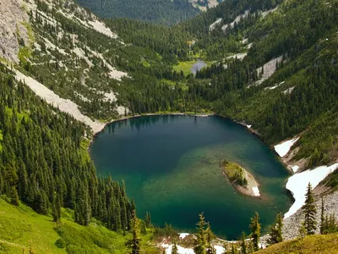
This is an example of a lake. It is a natural body of water surrounded by land.
Notes:
This is an example of a lake. It is a natural body of water surrounded by land.

Slide 32
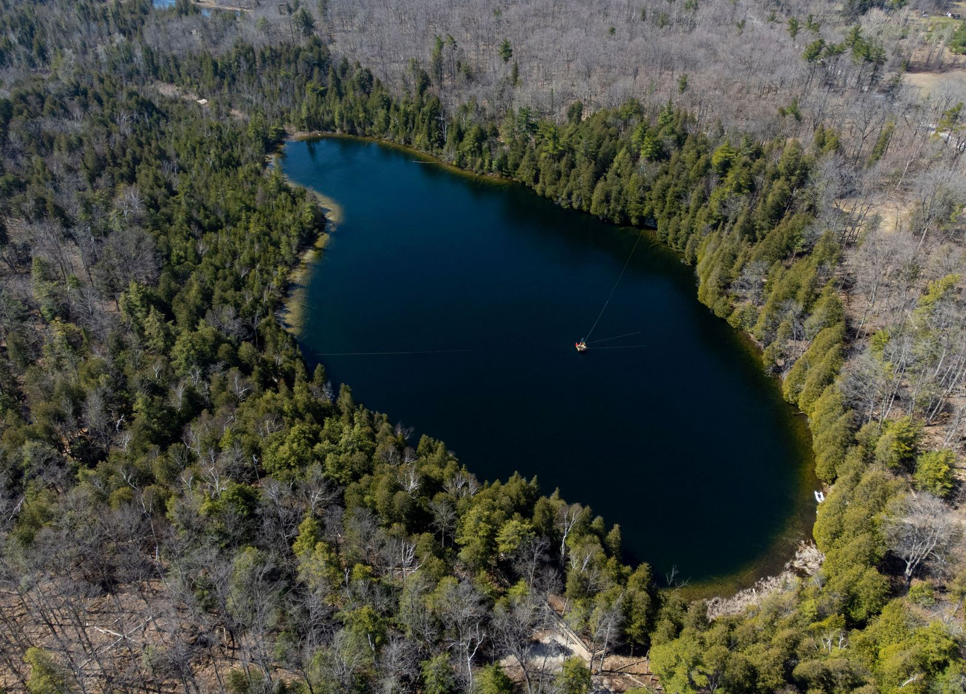
This is a different example of a lake. Again, this picture shows a natural body of water surrounded by land.
Photo: Georgia Coast Atlas
Notes:
This is a different example of a lake. Again, this picture shows a natural body of water surrounded by land.

Slide 33
Notes:
Now, let’s talk about some non-examples of lakes.

Slide 34
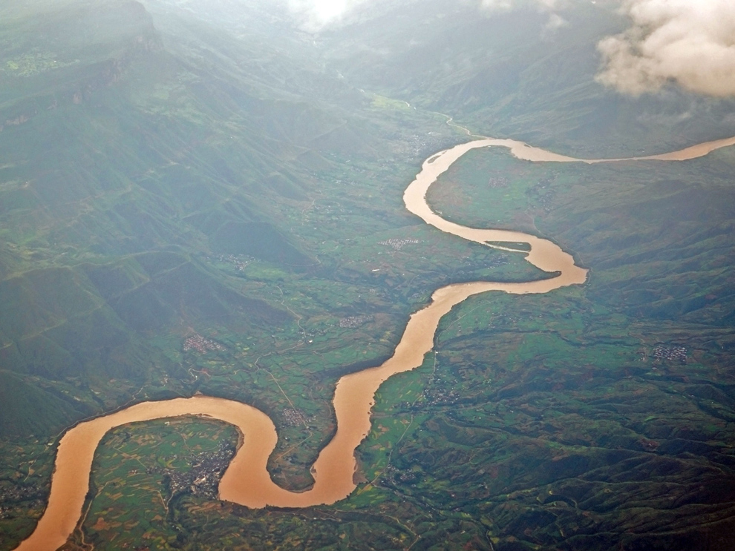
This is not a lake. This body of water is natural, but it is not completely surrounded by land.
Notes:
This is not a lake. This body of water is natural, but it is not completely surrounded by land.

Slide 35
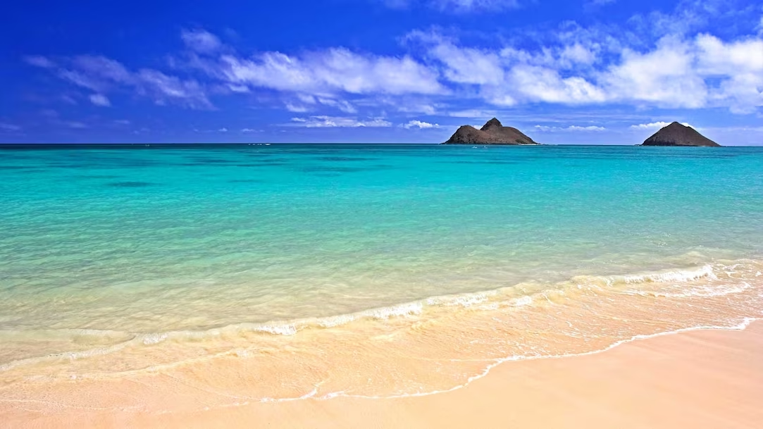
This is also not a lake. This body of water is natural, but it is not completely surrounded by land.
Notes:
This is also not a lake. This body of water is natural, but it is not completely surrounded by land.

Slide 36
Notes:
Now let’s pause for a moment to check your understanding.

Slide 37
Which of these is a lake?
Notes:
Which of these is a lake?
[The left picture.]

Slide 38
Which of these is a lake?
Notes:
Which of these is a lake?
[The left picture.]

Slide 39
Remember!!!
Notes:
So remember!

Slide 40
Lake: A natural, large body of water surrounded by land
Notes:
A lake is a natural, large body of water surrounded by land.

Slide 41
Notes:
We will now complete this concept map, called a Frayer model, to summarize and further clarify what you have learned about the term lake.

Slide 42
Definition
Picture
Lake
Example
How do lakes impact my life?
Notes:
To complete the Frayer model, we will choose from four choices the correct picture, definition, example, and response to the question, “How do lakes impact my life?” Select the best response for each question using the information you just learned. As we select responses, we will see how this model looks filled in for the term lakes.

Slide 43
Directions: Choose the correct picture of a lake from the choices below.
A
B
C
D
Notes:
Choose the one correct picture of a lake from these four choices.

Slide 44
Directions: Choose the correct picture of a lake from the choices below.
A
B
C
D
Notes:
This is the picture that shows a lake.

Slide 45
Definition
Picture
Lake
Example
How do lakes impact my life?
Notes:
Here is the Frayer model filled in with a picture of a lake

Slide 46
Directions: Choose the correct definition of a lake from the choices below.
A
A man-made, large body of water surrounded by land
B
A natural, large body of water surrounded by land
C
A giant body of saltwater
D
A long, winding stream of water that constantly moves
Notes:
Choose the correct definition of a lake from the choices below.

Slide 47
Directions: Choose the correct definition of a lake from the choices below.
A
A man-made, large body of water surrounded by land
B
A natural, large body of water surrounded by land
C
A giant body of saltwater
D
A long, winding stream of water that constantly moves
Notes:
Choose the correct definition of a lake from the choices below.
[B. A natural, large body of water surrounded by land.]

Slide 48
Definition
Picture
A natural, large body of water surrounded by land
Lake
Lake
Example
How do lakes impact my life?
How do lakes impact my life?
Notes:
Here is the Frayer Model with a picture and the definition filled in for a lake: A natural, large body of water surrounded by land.

Slide 49
Directions: Choose the correct example of a lake from the choices below.
A
A stream flowing between two mountains
B
A large body of water that is formed using a dam
C
A giant body of saltwater
D
A large body of water in a forest
Notes:
Choose the correct example of a lake from the choices below.

Slide 50
Directions: Choose the correct example of a lake from the choices below.
A
A stream flowing between two mountains
B
A large body of water that is formed using a dam
C
A giant body of saltwater
D
A large body of water in a forest
Notes:
“A large body of water in a forest” is correct! This is an example of a lake.

Slide 51
Definition
Picture
A natural, large body of water surrounded by land
Lake
A large body of water in a forest
Example
How do lakes impact my life?
Notes:
Here is the Frayer Model with a picture, definition, and an example of a lake: A large body of water in a forest.

Slide 52
Directions: Choose the correct response for “How do lakes impact my life?” from the choices below.
A
Lakes can offer a source for drinking water
B
Lakes can offer electricity to homes
C
Lakes can provide an ecosystem for humans
D
Lakes help me get to school
Notes:
Choose the one correct response for “how do lakes impact my life?” from these four choices.

Slide 53
Directions: Choose the correct response for “How do lakes impact my life?” from the choices below.
A
Lakes can offer a source for drinking water
B
Lakes can offer electricity to homes
C
Lakes can provide an ecosystem for humans
D
Lakes help me get to school
Notes:
“Lakes can offer a source for drinking water” That is correct! This is an example of how lakes impact your life.

Slide 54
Definition
Picture
A natural, large body of water surrounded by land
Lake
A large body of water in a forest
Lakes can offer a source for drinking water
Example
How do lakes impact my life?
Notes:
Here is the Frayer Model with a picture, definition, example, and a correct response to “how do lakes impact my life?”: Lakes can offer a source for drinking water.

Slide 55
Remember!!!
Notes:
So remember!

Slide 56
Lake: A natural, large body of water surrounded by land
Notes:
A lake is a natural, large body of water surrounded by land.

Slide 57
Big Question: What are the differences between lakes, oceans, ponds, reservoirs, and rivers?
Notes:
Our “big question” is: What are the differences between lakes, oceans, ponds, reservoirs, and rivers?
Does anyone have any additional examples to share that haven’t been discussed yet?
I love all these thoughtful scientific hypotheses! Be sure to keep this question and your predictions in mind as we move through these next few lessons, and we’ll continue to revisit it.

Slide 58
Extension Activity
The Great Lakes
Click the link above for an extension video giving a little more detail about the Great Lakes.
Jot down 2 or 3 new facts that you learn about the Great Lakes.
Discuss them as a class.
Notes:
Click the link above for an extension video giving a little more detail about the Great Lakes. Jot down 2 or 3 new facts that you learn about the Great Lakes. Discuss them as a class.

Slide 59
Notes:
Thanks for watching, and please continue watching CAPs available from this website.

Slide 60
This Was Created With Resources From:
Questions or Comments
Michael Kennedy, Ph.D. MKennedy@Virginia.edu
Rachel L Kunemund, Ph.D. rk8vm@virginia.edu

