Slide 1
Intro
“Big Idea” Question
Review Concepts
Check-In Questions
Teacher Engagement
Vocabulary
Student-Friendly Definition
Examples & Non-Examples
Morphological Word Parts
Frayer Model
Simulation/Activity
Notes:
OK everyone, get ready for our next lesson. Just as a reminder, these are the different components that our lesson may include, and you’ll see these icons in the top left corner of each slide so that you can follow along more easily!

Slide 2
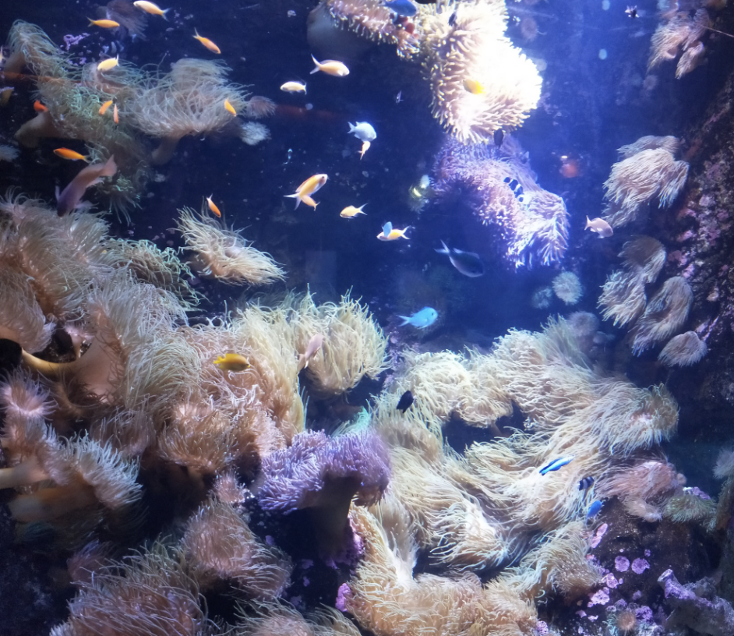
Intro
Marine Organism
Notes:
Today, we’ll be learning about the word: Marine Organism.

Slide 3
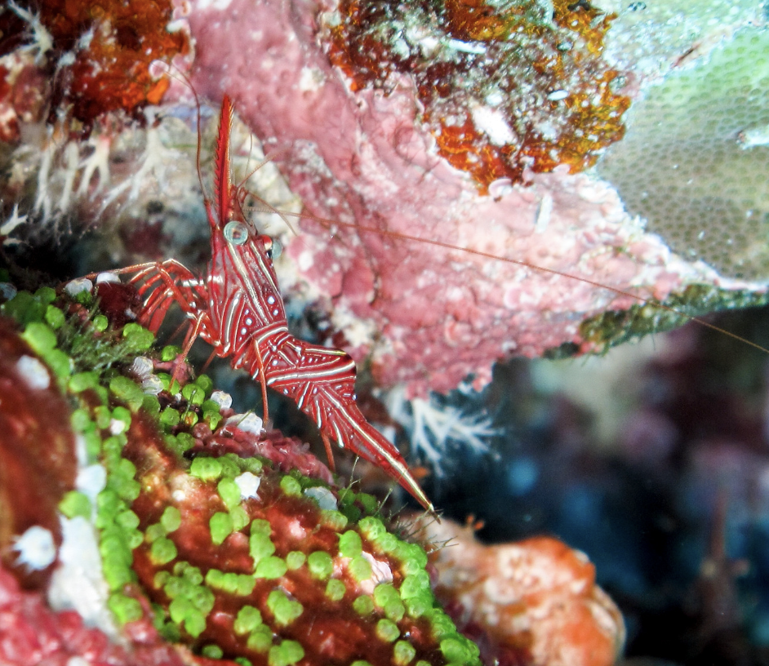
Big Question: How do the variety of marine organisms in the ocean add to the balance of life on Earth?
Notes:
Our “big question” is: How do the variety of marine organisms in the ocean add to the balance of life on Earth?
[Pause and illicit predictions from students.]
I love all these thoughtful scientific hypotheses! Be sure to keep this question and your predictions in mind as we move through these next few lessons, and we’ll continue to revisit it.

Slide 4
Notes:
Before we move on to our new topic, let’s review some other words & concepts that you already learned and make sure you are firm in your understanding.

Slide 5
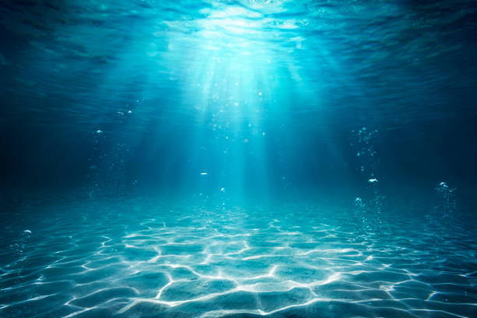
Aquatic: living, growing, or often found in the water
Notes:
Aquatic means something living, growing, or often found in water.

Slide 6
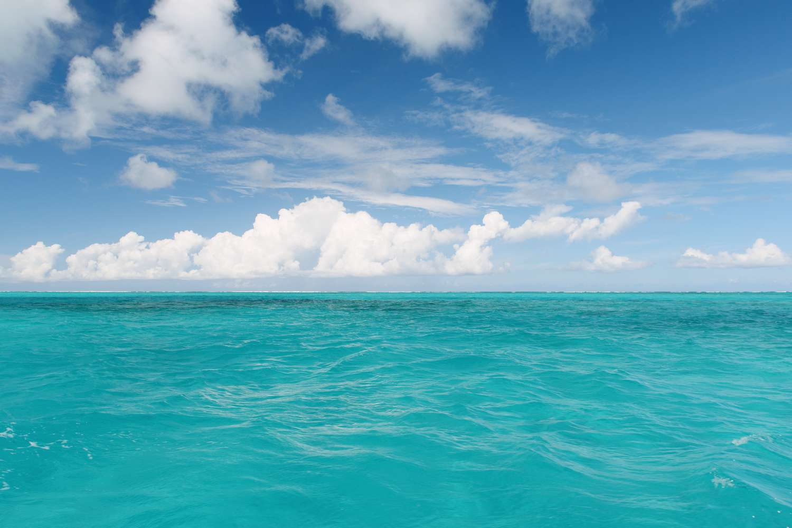
Ocean: A giant body of saltwater.
Notes:
An ocean is a giant body of saltwater.

Slide 7
Organism: any living thing
Notes:
An organism is any living thing.

Slide 8
Notes:
Now let’s pause for a moment to review the information we have covered already.

Slide 9
Aquatic means living, growing, or often found in/on…
land
water
Notes:
Aquatic means living, growing, or often found in/on…
[water]

Slide 10
Aquatic means living, growing, or often found in/on…
land
water
Notes:
Aquatic means living, growing, or often found in/on…
[water]

Slide 11
True or False: An ocean is a giant body of fresh water.
Notes:
True or False: An ocean is a giant body of fresh water.
[False]

Slide 12
True or False: An ocean is a giant body of fresh water.
Notes:
False: An ocean is a giant body of saltwater.

Slide 13
Organism: any thing
Notes:
An organism is any thing.
[living]

Slide 14
Organism: any thing
Notes:
Organism: any living thing.

Slide 15
Marine Organism
Notes:
Now that we’ve reviewed, let’s define the term marine organism.

Slide 16
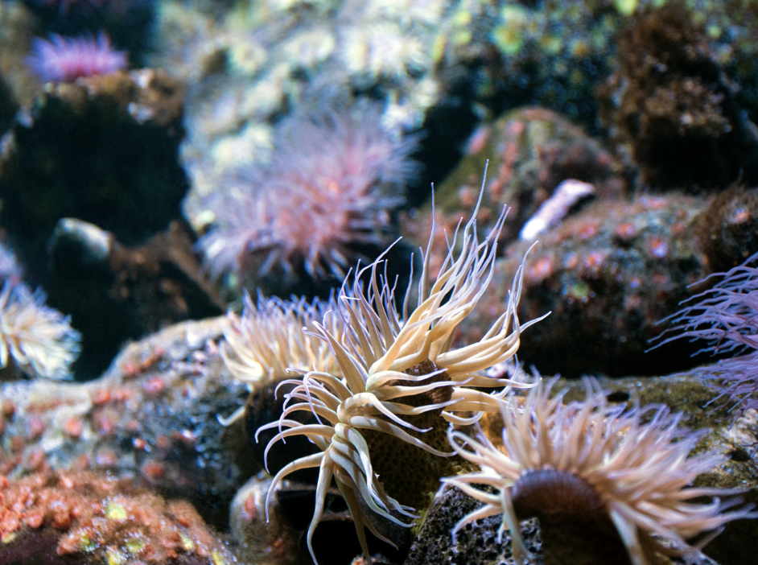
Marine Organism: any living thing that lives in the ocean
Notes:
Marine Organism: any living thing that lives in the ocean

Slide 17
Notes:
Let’s check-in for understanding.

Slide 18
What is a marine organism?
Notes:
What is are marine organism?
[any living thing that lives in the ocean]

Slide 19
Notes:
That is the basic definition, but there is a bit more you need to know.

Slide 20
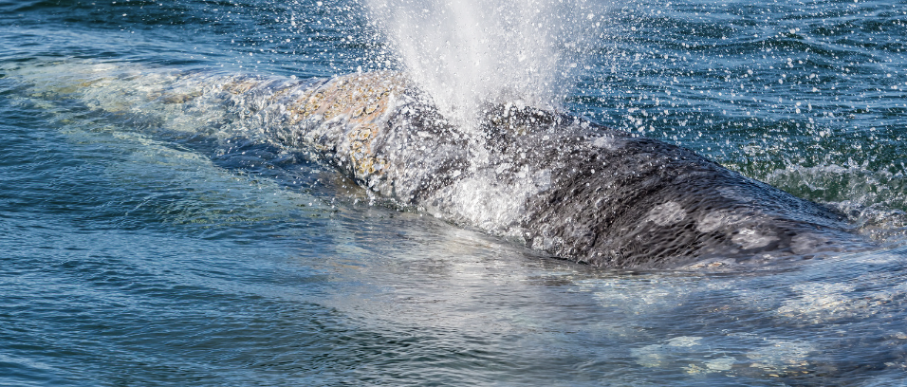
Adaptations to Water: Marine organisms have special adaptations that help them survive in the unique conditions of the ocean. For example, fish have gills to extract oxygen from water, while marine mammals like dolphins and whales have lungs for breathing air at the surface.
Notes:
Adaptations to Water: Marine organisms have special adaptations that help them survive in the unique conditions of the ocean. For example, fish have gills to extract oxygen from water, while marine mammals like dolphins and whales have lungs for breathing air at the surface.

Slide 21
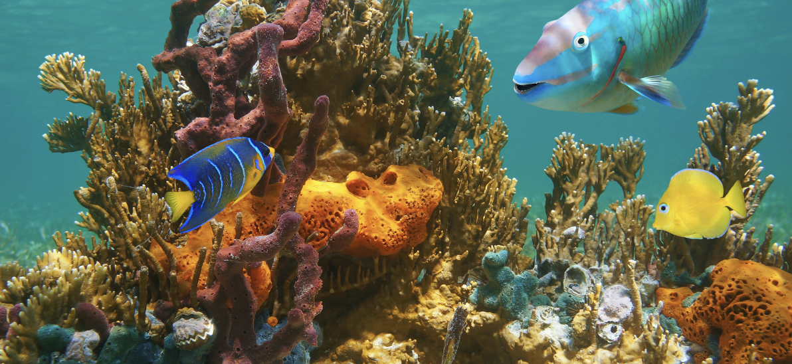
Diversity of Life: The ocean is teeming with diversity, and marine organisms come in all shapes and sizes. From tiny microscopic plankton to massive whales, the variety of life in the ocean is astonishing. This diversity is crucial for maintaining a balanced and healthy marine ecosystem.
Notes:
Diversity of Life: The ocean is teeming with diversity, and marine organisms come in all shapes and sizes. From tiny microscopic plankton to massive whales, the variety of life in the ocean is astonishing. This diversity is crucial for maintaining a balanced and healthy marine ecosystem.

Slide 22
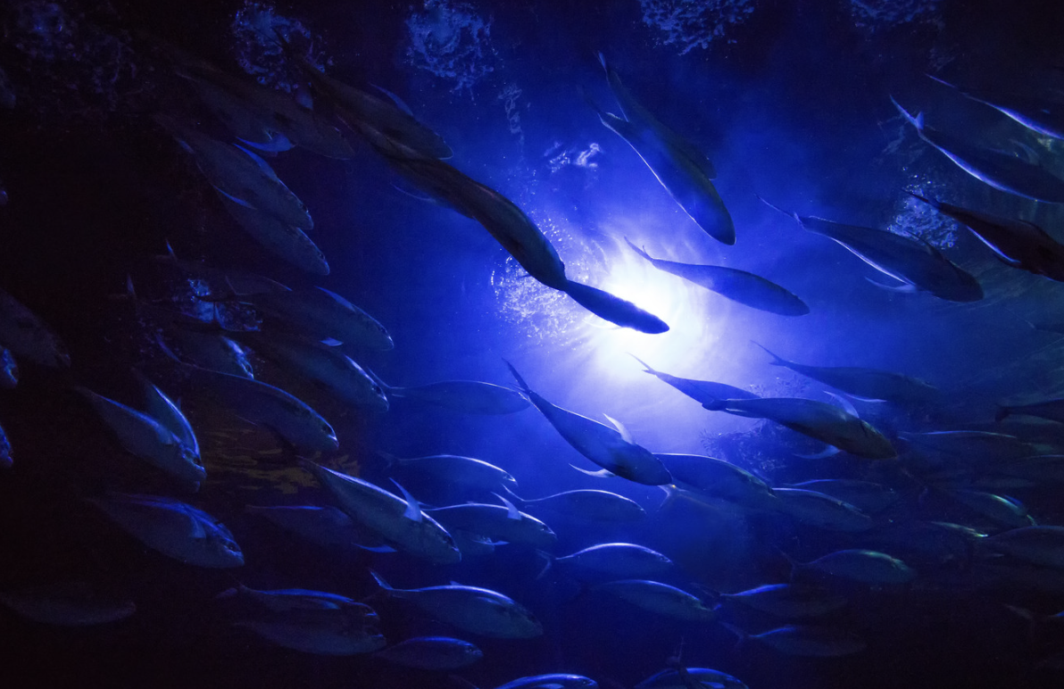
Habitats in the Ocean: Marine organisms inhabit various zones within the ocean, including the surface, the deep sea, and everything in between. Some organisms, like seaweed and coral, thrive in shallow, sunlit waters, while others, like certain types of fish, are adapted to the dark depths.
Notes:
Habitats in the Ocean: Marine organisms inhabit various zones within the ocean, including the surface, the deep sea, and everything in between. Some organisms, like seaweed and coral, thrive in shallow, sunlit waters, while others, like certain types of fish, are adapted to the dark depths.

Slide 23
Notes:
Let’s check-in for understanding.

Slide 24
True or False: Marine organisms have special adaptations that help them survive in the unique conditions of the ocean.
Notes:
True or False: Marine organisms have special adaptations that help them survive in the unique conditions of the ocean.
[True]

Slide 25
True or False: Marine organisms have special adaptations that help them survive in the unique conditions of the ocean.
Notes:
True: Marine organisms have special adaptations that help them survive in the unique conditions of the ocean.

Slide 26
Notes:
Now, let’s talk about some examples of ocean.

Slide 27
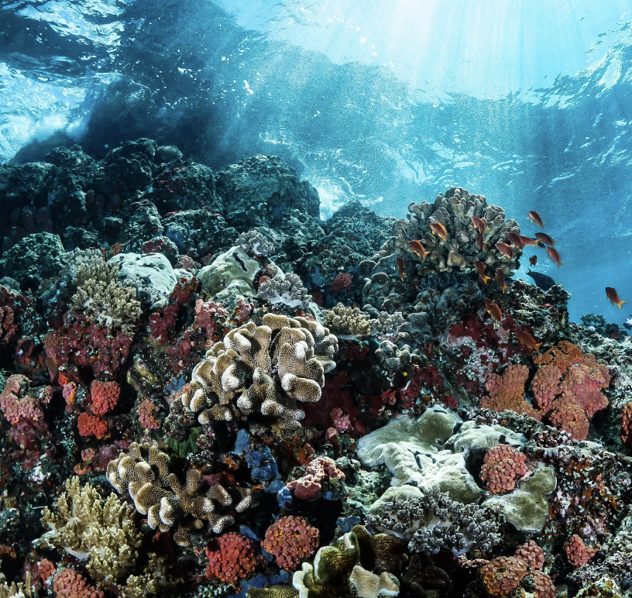
Coral is an example of a marine organism. It is a living thing that lives in the ocean.
Notes:
Coral is an example of a marine organism. It is a living thing that lives in the ocean.

Slide 28
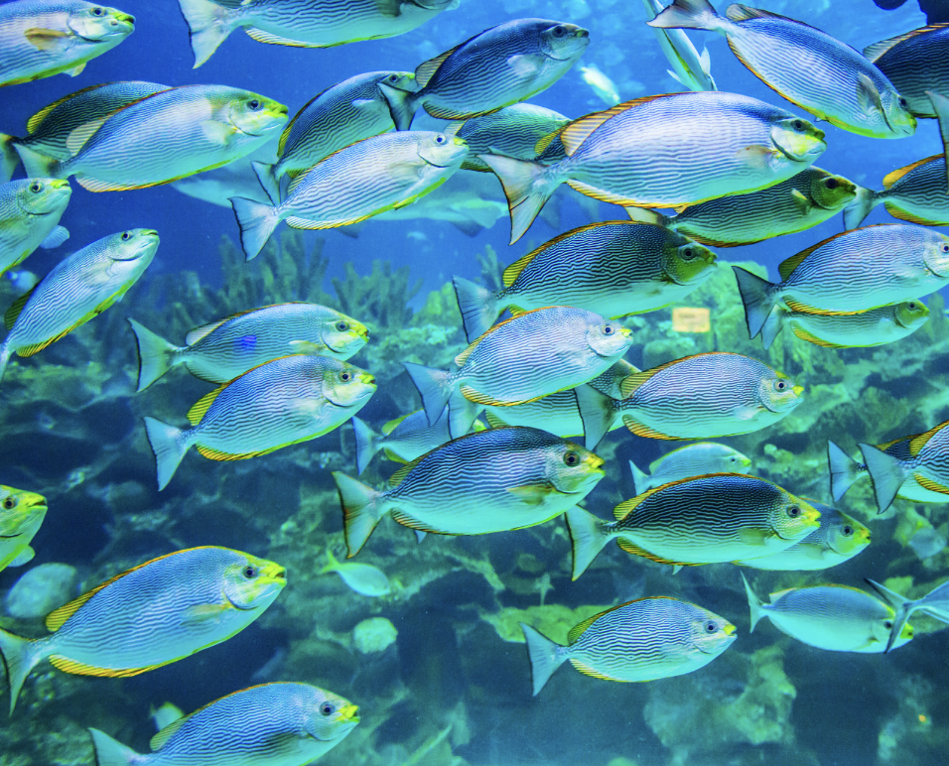
Fish are an example of a marine organism. They are living things that live in the ocean.
Notes:
Fish are an example of a marine organism. They are living things that live in the ocean.

Slide 29
Notes:
Now, let’s talk about some non-examples of ocean.

Slide 30
Saltwater is NOT an example of a marine organism. Even though saltwater makes up the ocean it is not a living thing.
Notes:
Saltwater is NOT an example of a marine organism. Even though saltwater makes up the ocean it is not a living thing.

Slide 31
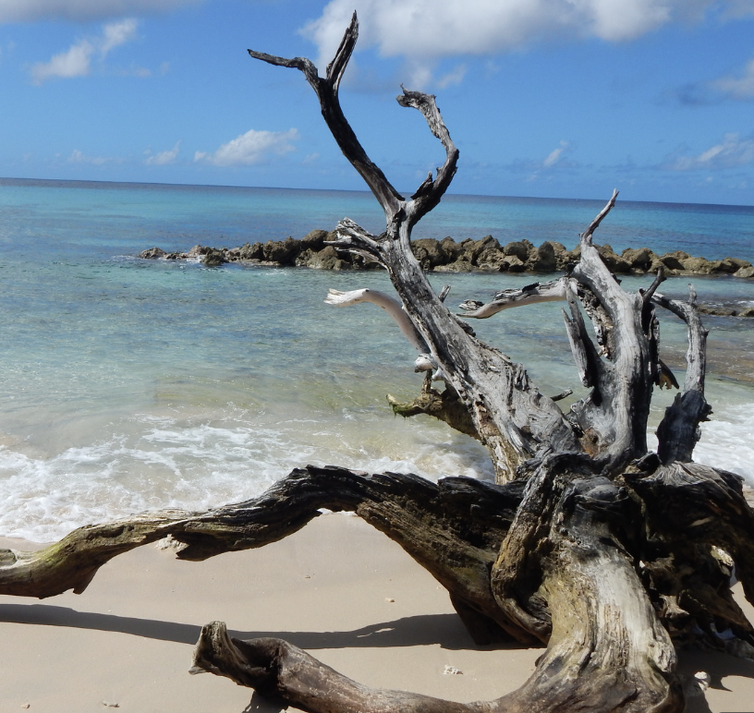
Driftwood is also NOT an example of a marine organism. Driftwood may be found in the ocean, but it is not a living thing.
Notes:
Driftwood is also NOT an example of a marine organism. Driftwood may be found in the ocean, but it is not a living thing.

Slide 32
Notes:
Now let’s pause for a moment to check your understanding.

Slide 33
Why are saltwater and driftwood NOT examples of marine organisms?
Notes:
Why are saltwater and driftwood NOT examples of marine organisms?
[They are not living things]

Slide 34
Remember!!!
Notes:
So remember!

Slide 35
Marine Organisms: any living thing that lives in the ocean
Notes:
Marine Organisms: any living thing that lives in the ocean

Slide 36
Notes:
We will now complete this concept map, called a Frayer model, to summarize and further clarify what you have learned about the term ocean.

Slide 37
Definition
Picture
Marine Organisms
Example
How do marine organisms impact my life?
Notes:
To complete the Frayer model, we will choose from four choices the correct picture, definition, example, and response to the question, “How do marine organisms impact my life?” Select the best response for each question using the information you just learned. As we select responses, we will see how this model looks filled in for the term marine organisms.

Slide 38
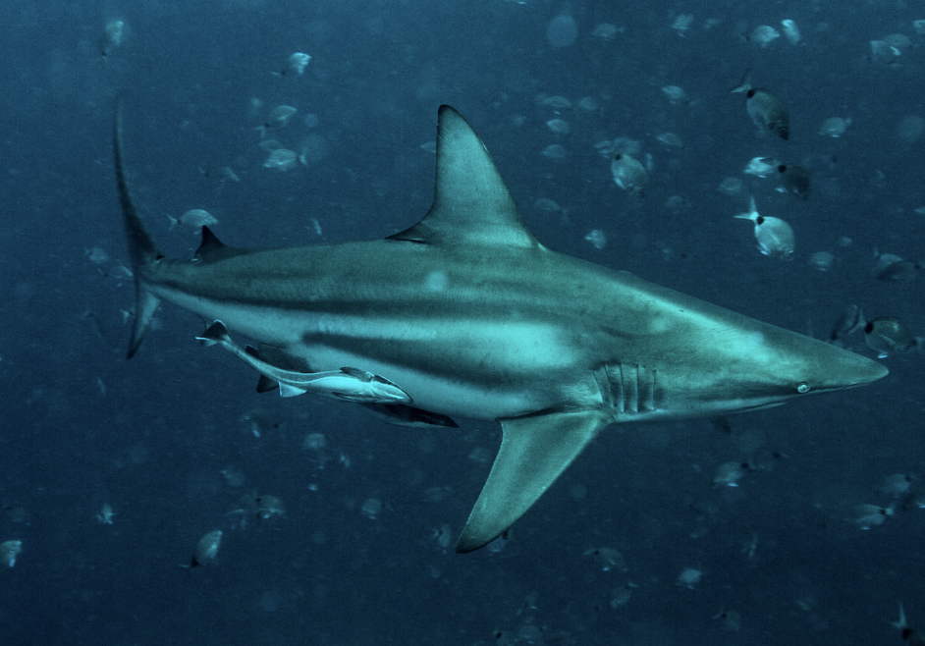
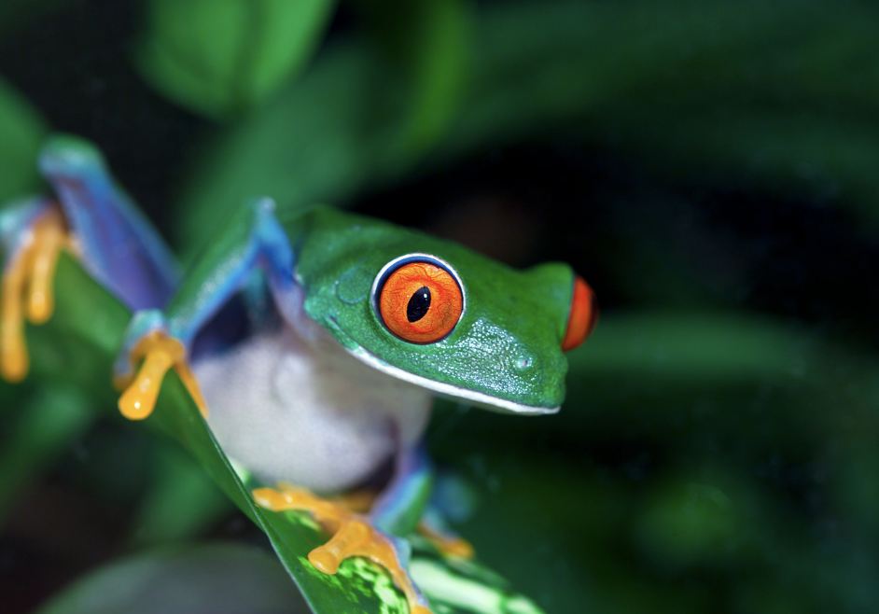
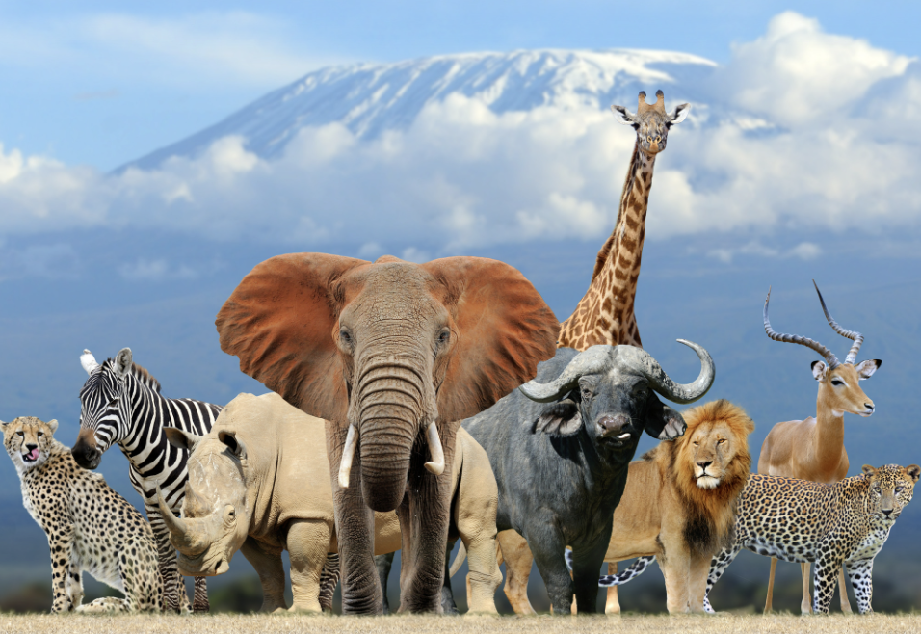
Directions: Choose the correct picture of marine organisms from the choices below.
A
B
C
D
Notes:
Choose the one correct picture of marine organisms from these four choices.

Slide 39
Directions: Choose the correct picture of marine organisms from the choices below.
A
B
C
D
Notes:
Choose the one correct picture of marine organisms from these four choices.

Slide 40
Definition
Picture
Marine Organisms
Example
How do marine organisms impact my life?
Notes:
To complete the Frayer model, we will choose from four choices the correct picture, definition, example, and response to the question, “How do marine organisms impact my life?” Select the best response for each question using the information you just learned. As we select responses, we will see how this model looks filled in for the term marine organisms.

Slide 41
Directions: Choose the correct definition of a marine organism from the choices below.
A
Any living thing that lives in the ocean
B
A natural, large body of water surrounded by land
C
A giant body of saltwater
D
Any living thing
Notes:
Choose the correct definition of a marine organism from the choices below.

Slide 42
Directions: Choose the correct definition of a marine organism from the choices below.
A
Any living thing that lives in the ocean
B
A natural, large body of water surrounded by land
C
A giant body of saltwater
D
Any living thing
Notes:
“Any living thing that lives in the ocean” is correct! This is the definition of a marine organism.

Slide 43
Definition
Picture
Any living thing that lives in the ocean
Marine Organisms
Example
How do marine organisms impact my life?
Notes:
Here is the Frayer Model with a picture and the definition filled in for a marine organism: Any living thing that lives in the ocean.

Slide 44
Directions: Choose the correct example of a marine organism from the choices below.
A
A giraffe
B
A whale
C
A tiger
D
A lizard
Notes:
Choose the correct example of a marine organism from the choices below.

Slide 45
Directions: Choose the correct example of a marine organism from the choices below.
A
A giraffe
B
A whale
C
A tiger
D
A lizard
Notes:
“A whale” is correct! This is an example of a marine organism.

Slide 46
Definition
Picture
Any living thing that lives in the ocean
Marine Organisms
A whale
Example
How do marine organisms impact my life?
Notes:
Here is the Frayer Model with a picture, definition, and an example of a marine organism: A whale.

Slide 47
Directions: Choose the correct response for “How do marine organisms impact my life?” from the choices below.
A
Marine organisms help us to learn how to drive.
B
Marine organisms help make the oxygen we breathe, and they provide a source of food.
C
Marine organisms make the Wi-Fi we use to access the internet
D
Marine organisms help us to learn how to fly airplanes
Notes:
Choose the one correct response for “how do marine organisms impact my life?” from these four choices.

Slide 48
Directions: Choose the correct response for “How do marine organisms impact my life?” from the choices below.
A
Marine organisms help us to learn how to drive.
B
Marine organisms help make the oxygen we breathe, and they provide a source of food.
C
Marine organisms make the Wi-Fi we use to access the internet
D
Marine organisms help us to learn how to fly airplanes
Notes:
“Marine organisms help make the oxygen we breathe, and they provide a source of food.” That is correct! This is an example of how marine organisms impact your life.

Slide 49
Definition
Picture
Any living thing that lives in the ocean
Marine Organisms
Marine organisms help make the oxygen we breathe, and they provide a source of food.
A whale
Example
How do marine organisms impact my life?
Notes:
Here is the Frayer Model with a picture, definition, example, and a correct response to “how do marine organisms impact my life?”: Marine organisms help make the oxygen we breathe, and they provide a source of food.

Slide 50
Remember!!!
Notes:
So remember!

Slide 51
Marine Organisms: any living thing that lives in the ocean
Notes:
Marine Organisms: any living thing that lives in the ocean

Slide 52
Big Question: How do the variety of marine organisms in the ocean add to the balance of life on Earth?
Notes:
Our “big question” is: How do the variety of marine organisms in the ocean add to the balance of life on Earth?
Does anyone have any additional examples to share that haven’t been discussed yet?
I love all these thoughtful scientific hypotheses! Be sure to keep this question and your predictions in mind as we move through these next few lessons, and we’ll continue to revisit it.

Slide 53
Notes:
Thanks for watching, and please continue watching CAPs available from this website.

Slide 54
This Was Created With Resources From:
Questions or Comments
Michael Kennedy, Ph.D. MKennedy@Virginia.edu
Rachel L Kunemund, Ph.D. rk8vm@virginia.edu

