Slide 1
Intro
“Big Idea” Question
Review Concepts
Check-In Questions
Teacher Engagement
Vocabulary
Student-Friendly Definition
Examples & Non-Examples
Morphological Word Parts
Frayer Model
Simulation/Activity
Notes:
OK everyone, get ready for our next lesson. Just as a reminder, these are the different components that our lesson may include, and you’ll see these icons in the top left corner of each slide so that you can follow along more easily!

Slide 2
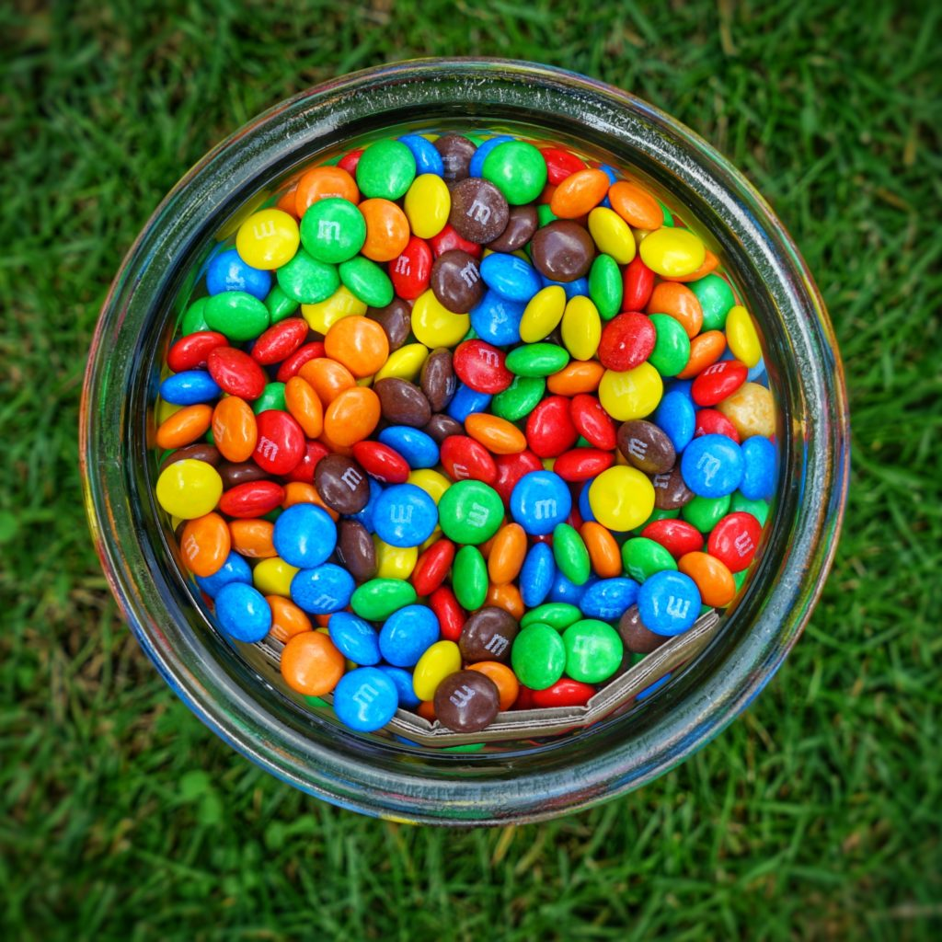
Mixture
Intro
Notes:
Today, we’ll be learning about the word: mixture.

Slide 3
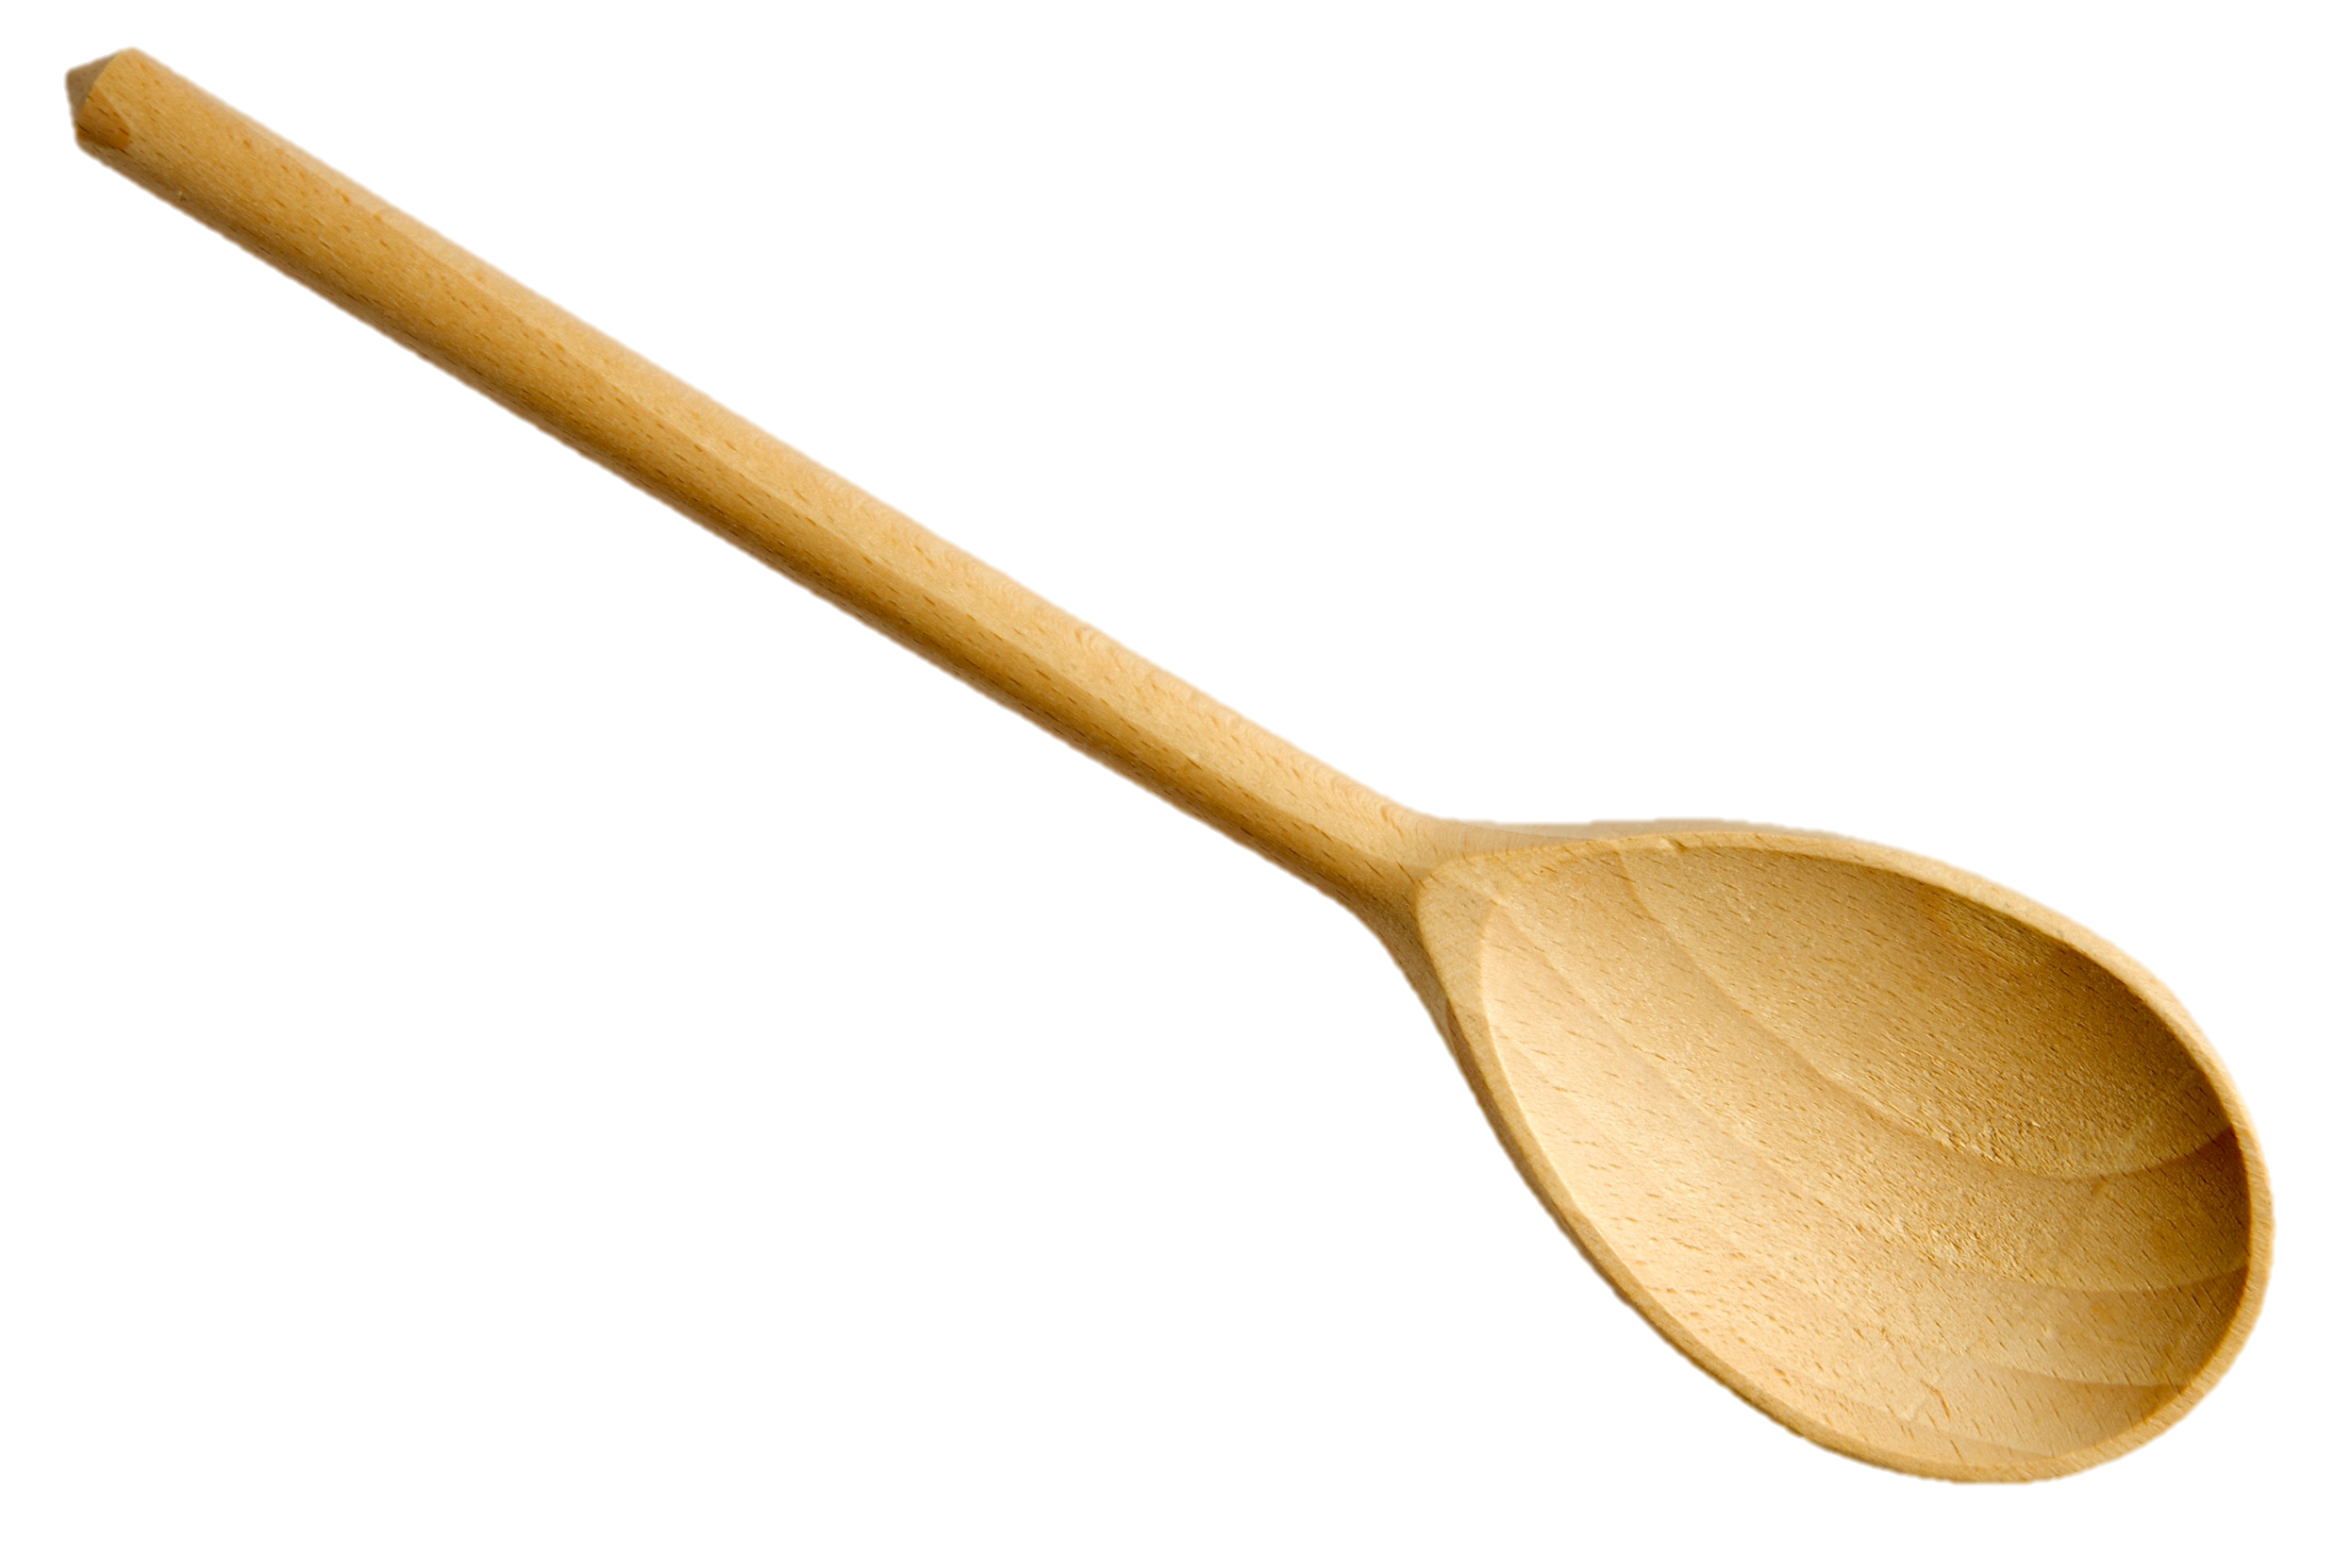
Big Question: How can two or more substances be combined?
Notes:
Our “big question” is: How can two or more substances be combined?
[Pause and illicit predictions from students.]
I love all these thoughtful scientific hypotheses! Be sure to keep this question and your predictions in mind as we move through these next few lessons, and we’ll continue to revisit it.

Slide 4
Notes:
Before we move on to our new topic, let’s review some other words & concepts that you already learned and make sure you are firm in your understanding.

Slide 5
Matter: has mass and takes up space
Notes:
Matter is anything that has mass and takes up space.

Slide 6
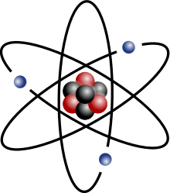
Atom: smallest whole unit of matter
Notes:
An atom is the smallest whole unit of matter. All matter is made up of atoms.

Slide 7
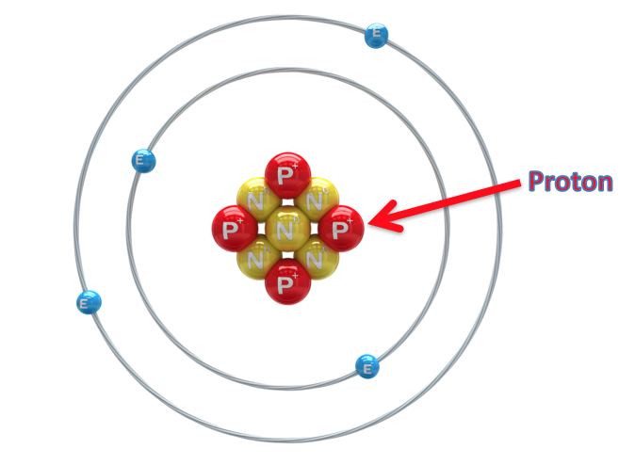
Proton: positively charged subatomic particle found in the nucleus of an atom
Notes:
A proton is a positively charged subatomic particle found in the nucleus of an atom.

Slide 8
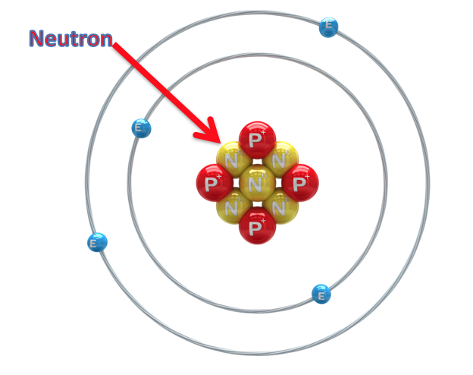
Neutron: subatomic particle with a neutral charge, found in the nucleus of an atom
Notes:
A neutron is a subatomic particle with a neutral charge, found in the nucleus of an atom.

Slide 9
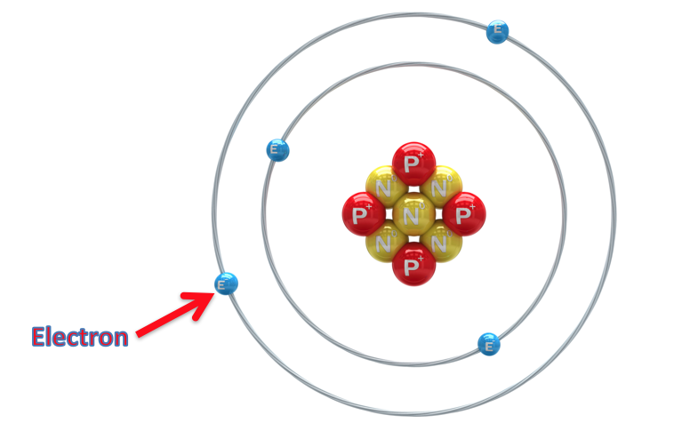
Electron: negatively charged particle that orbits the nucleus of an atom
Notes:
An electron is a negatively charged particle that orbits the nucleus.

Slide 10
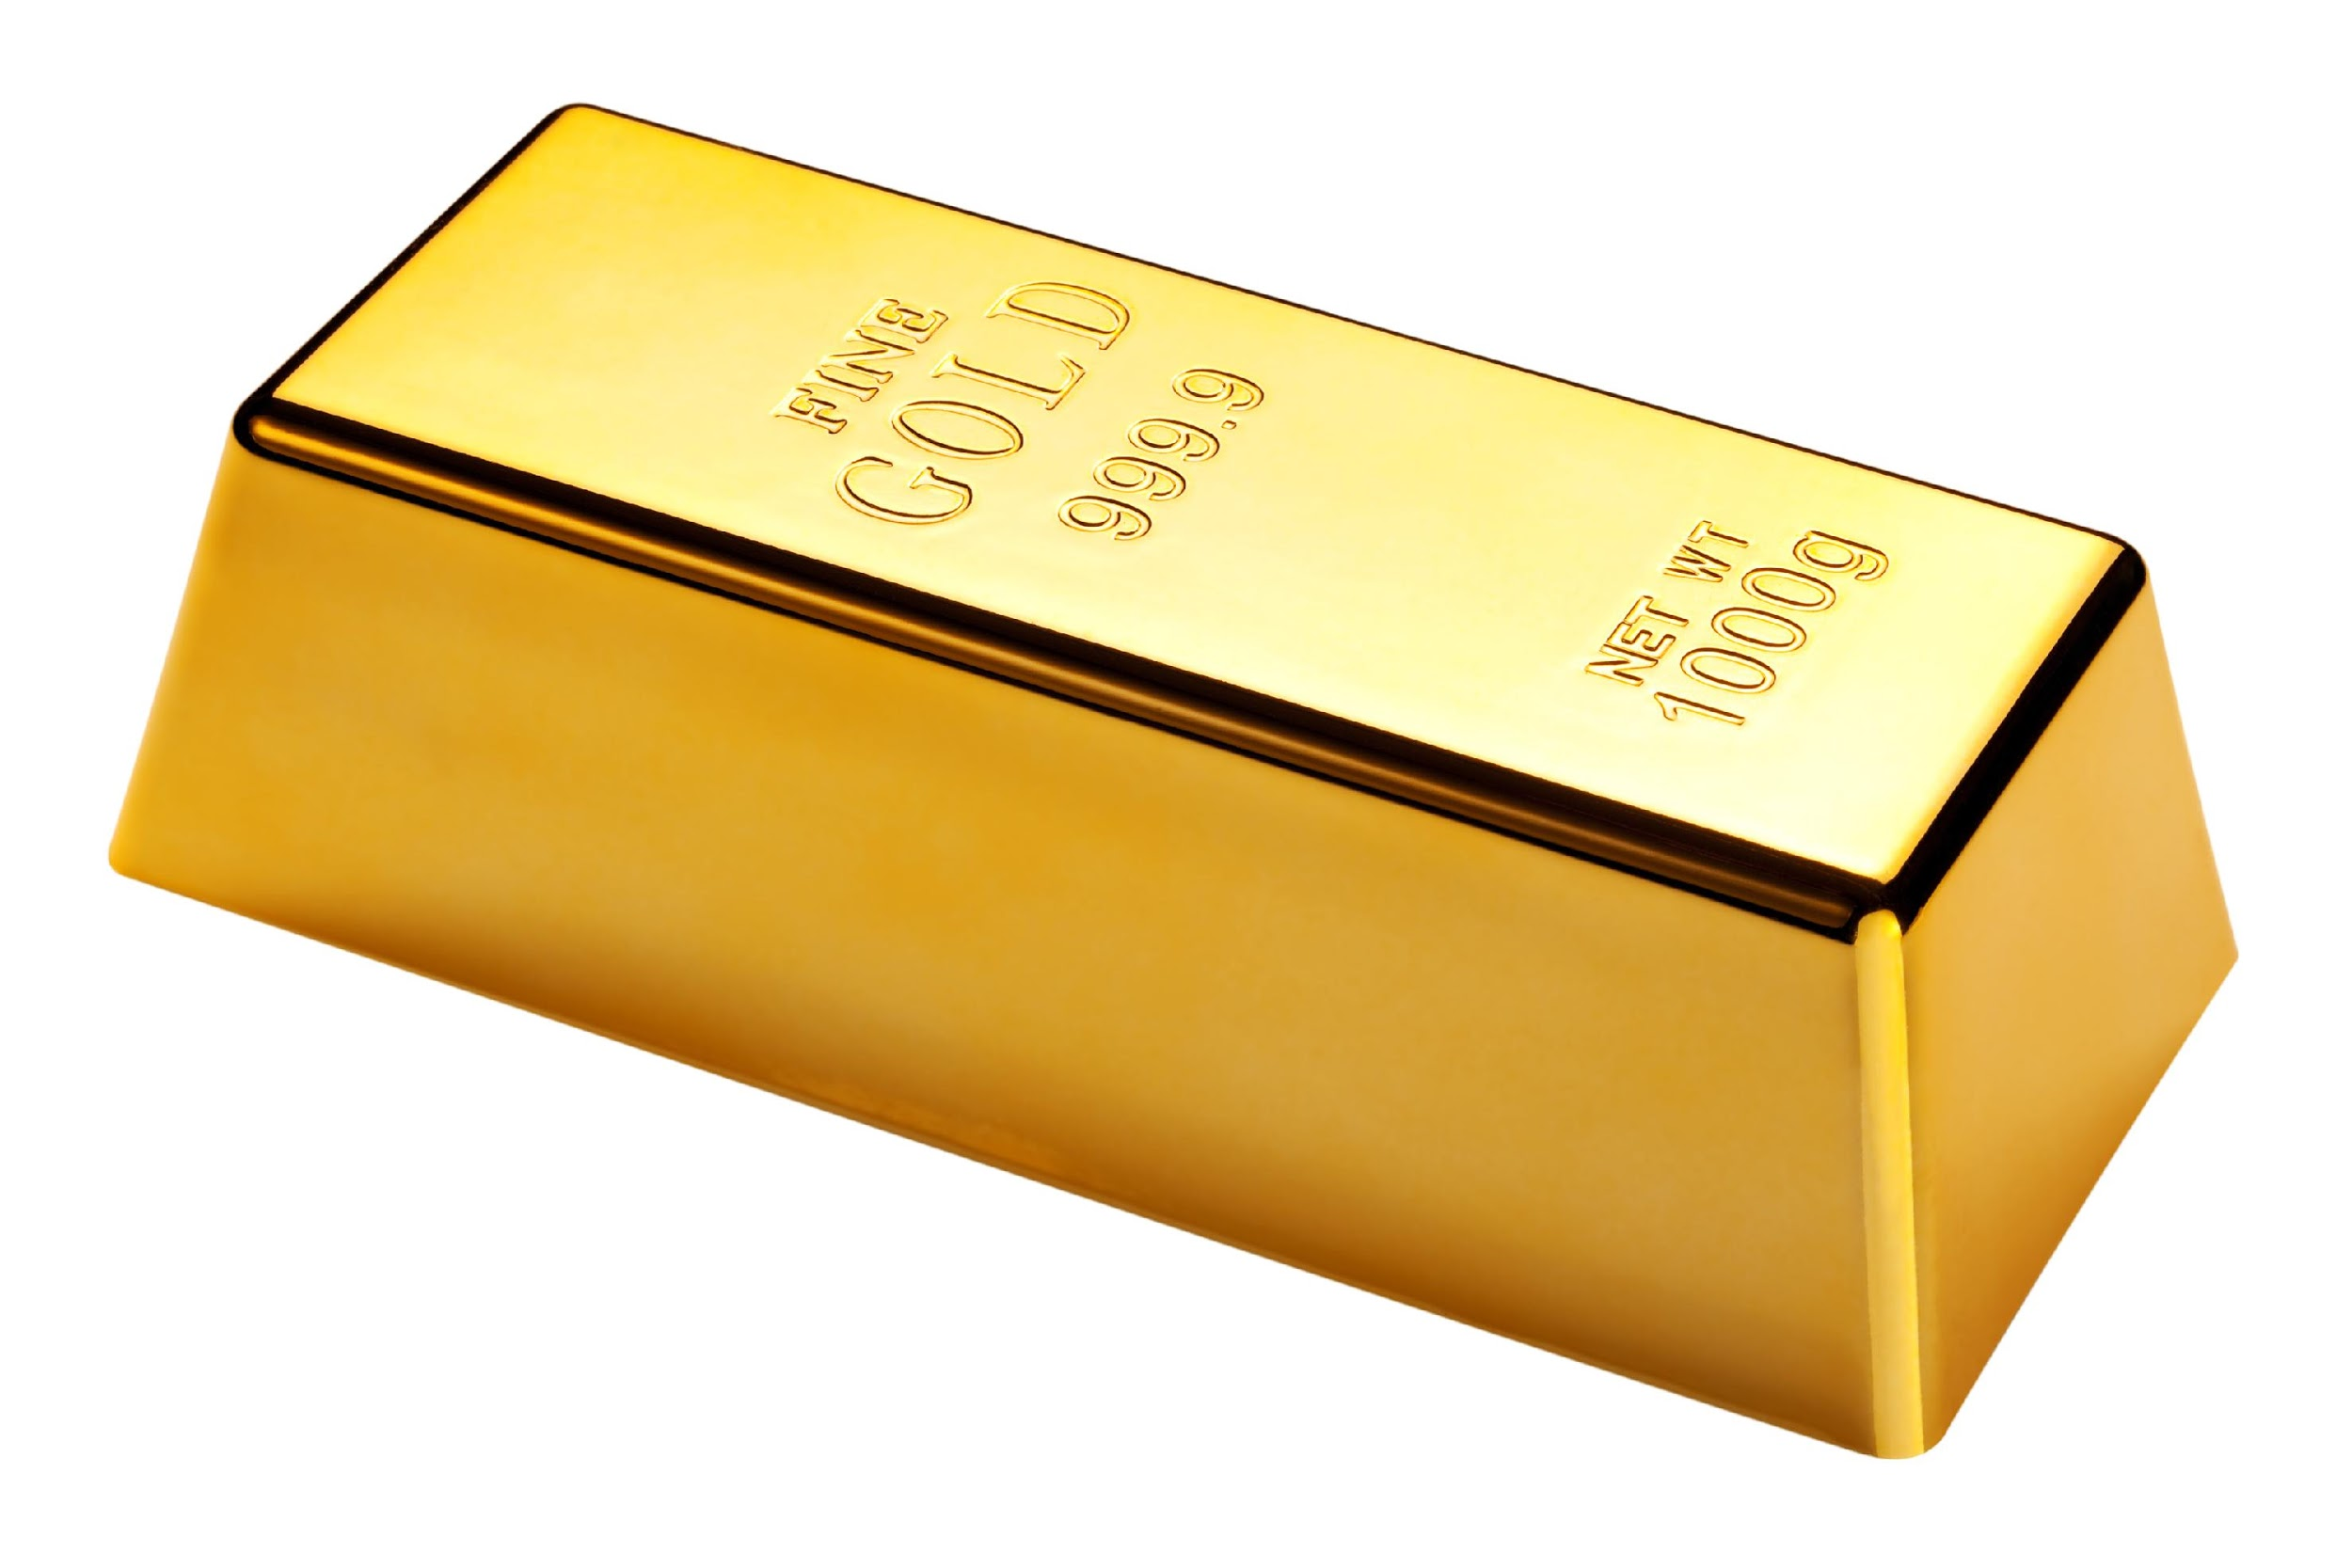
Element: a pure substance containing only one type of atom
Notes:
An element is a pure substance containing only one type of atom.

Slide 11
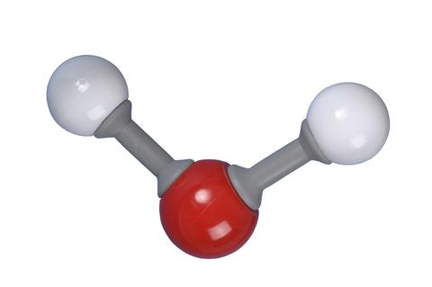
Molecule: particle containing two or more atoms of the same OR different elements
Notes:
A molecule is a particle containing 2 or more atoms of the same OR different elements. Molecules are the smallest pieces of compounds.

Slide 12
Compound: substance made up of two or more different elements
Notes:
A compound is a substance that is made up of two or more different elements.

Slide 13
Notes:
Now let’s pause for a moment to review the information we have covered already.

Slide 14
Matter is…
Anything that has mass and takes up space
Something important
Notes:
Matter is…
Anything that has mass and takes up space
Something important

Slide 15
Matter is…
Anything that has mass and takes up space
Something important
Notes:
Matter is… [anything that has mass and takes up space].

Slide 16
True or False: Atoms are the smallest unit of matter, making up everything.
True
False
Notes:
True or False: Atoms are the smallest unit of matter, making up everything.
True
False

Slide 17
True or False: Atoms are the smallest unit of matter, making up everything.
True
False
Notes:
Atoms are the smallest unit of matter, making up everything: [True]

Slide 18
An _________ is a pure substance containing only one type of ______.
Notes:
An ______ is a pure substance containing only one type of ____.
[element, atom]

Slide 19
An element is a pure substance containing only one type of atom.
Notes:
[An element is a pure substance containing only one type of atom.]

Slide 20
What is a molecule?
Notes:
What is a molecule?
[A molecule is a particle containing 2 or more atoms of the same OR different elements. Molecules are the smallest pieces of compounds.]

Slide 21
Molecule: particle containing two or more atoms of the same OR different elements
Notes:
A molecule is a particle containing two or more atoms of the same OR different elements
[A molecule is a particle containing 2 or more atoms of the same OR different elements. Molecules are the smallest pieces of compounds.]

Slide 22
What is a compound?
Notes:
What is a compound?
[A compound is a substance that is made up of two or more DIFFERENT elements.]

Slide 23
Compound: substance made up of two or more different elements
Notes:
A compound is a substance made of two or more different elements
[A compound is a substance that is made up of two or more DIFFERENT elements.]

Slide 24
What is the relationship between compounds and molecules?
Notes:
What is the relationship between compounds and molecules?

Slide 25
Mixture
Notes:
Now that we’ve reviewed, let’s define the phrase mixture.

Slide 26
Mixture: two or more substances are
combined physically, not chemically
Notes:
A mixture is when two or more substances are combined physically, not chemically.

Slide 27
Notes:
Let’s check-in for understanding.

Slide 28
A mixture is when ____ or more substances are combined __________, not chemically.
Notes:
A mixture is when _____ or more substances are combined _________, not chemically.
[two, physically]

Slide 29
A mixture is when two or more substances are combined physically, not chemically.
Notes:
A mixture is when two or more substances are combined physically, not chemically.

Slide 30
Notes:
That is the basic definition, but there is a bit more you need to know.

Slide 31
A mixture is a blend of different things combined together that keep their own properties.
Notes:
A mixture is like a blend of different things that are combined together but not chemically joined. Imagine you have a bag of assorted candies – each candy is different, but they're all mixed up in the bag. Similarly, in a mixture, the substances keep their own properties and don't change each other.

Slide 32
In a mixture, substances are physically combined.
Notes:
In a mixture, substances are physically combined. Yet, you can still see the individual substances in the mixture. This means that if you needed to separate the substances after they were mixed together, you would be able to do that. In this picture, we see the light green and dark green circles combined into a mixture. In the mixture, we can see the individual circles and would be able to separate them if we needed to.

Slide 33
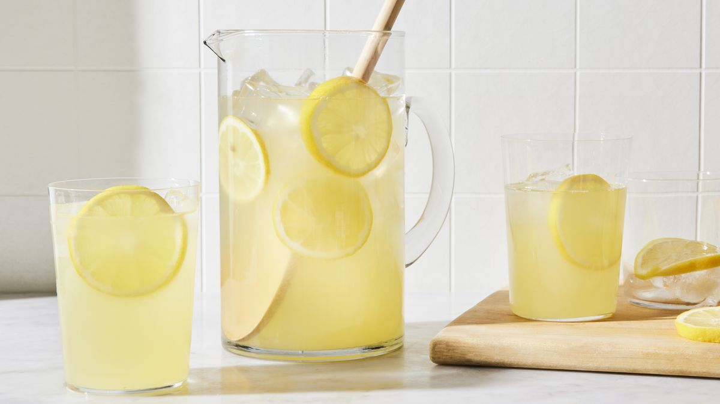
In a homogeneous mixture, you can’t see or separate the different parts. We also call these mixtures solutions.
Notes:
There are two main types of mixtures, the first is a Homogeneous Mixture. This is when everything is evenly mixed, like lemonade where you can't see or separate the sugar and lemon juice. We also call these mixtures solutions.

Slide 34
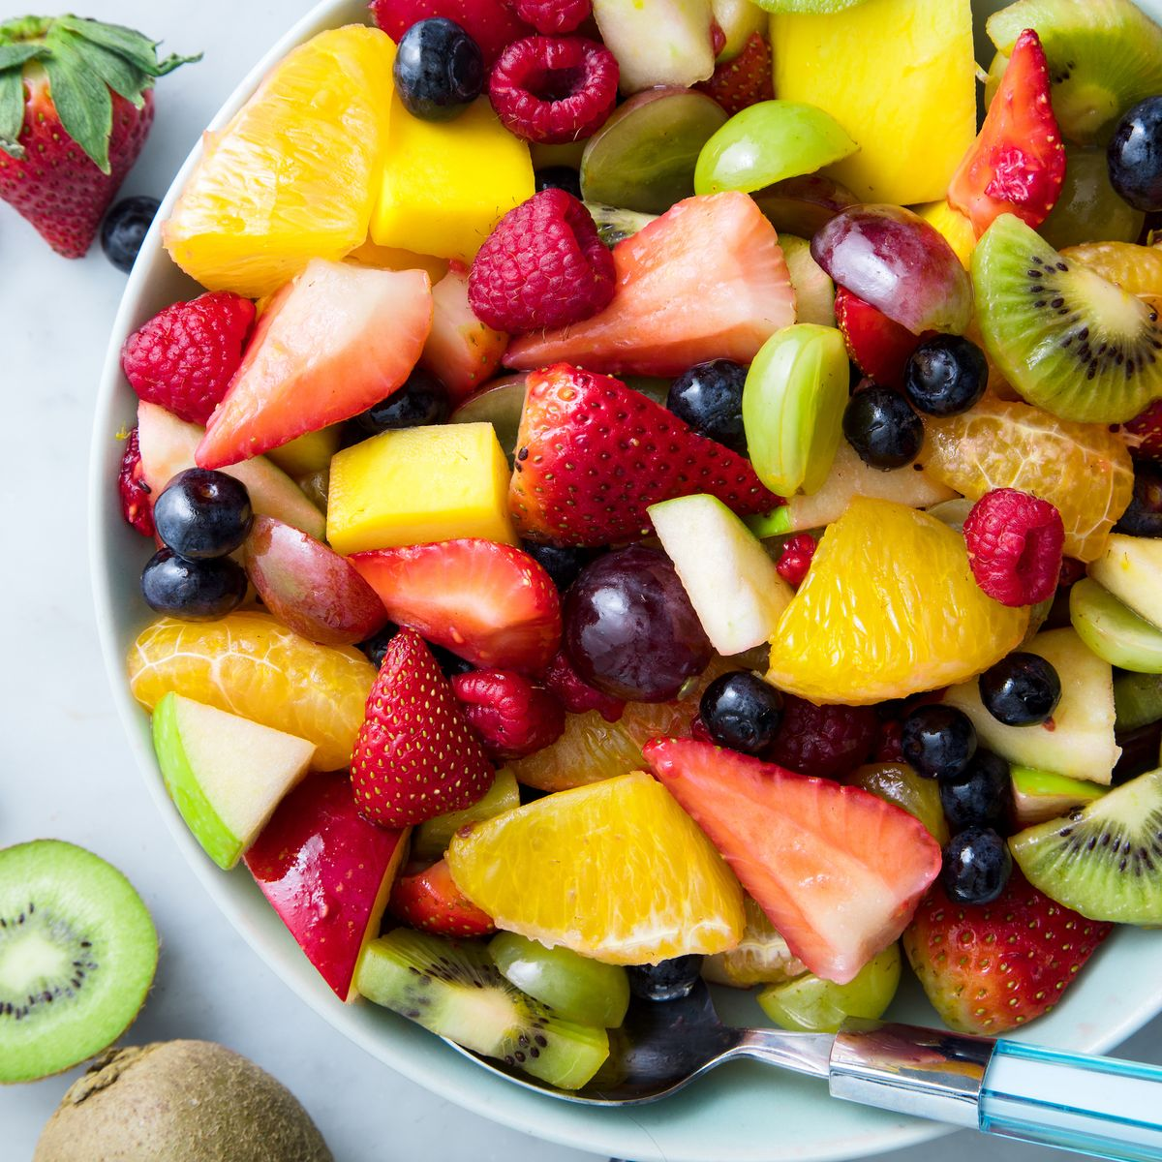
In a heterogeneous mixture, you can see and easily separate the different parts.
Notes:
The second type of mixture is a Heterogeneous Mixture. In this type, you can see and easily separate the different parts, like a fruit salad with various fruits.

Slide 35
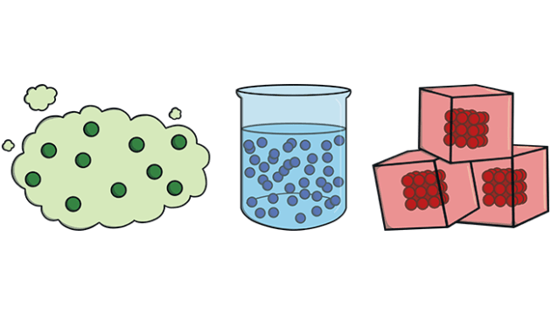
Mixtures can be made of solids, liquids, or gases.
Notes:
Mixtures can be made up of solids, liquids, or gases. Mixtures are common in our daily lives – think of the air we breathe (a mixture of gases) or the soil in your garden (a mixture of minerals and organic matter). Unlike compounds, where the elements are chemically bonded, mixtures are all about things hanging out together without changing their individual characteristics.

Slide 36
Notes:
Let’s check-in for understanding.

Slide 37
A mixture is a blend of things _______ together that _____ their own properties.
Notes:
A mixture is a blend of different things _______ together that _____ their own properties.
[combined, keep]

Slide 38
A mixture is a blend of things combined together that keep their own properties.
Notes:
A mixture is a blend of different things combined together that keep their own properties.

Slide 39
In a mixture, substances are _______ combined…
Physically
Chemically
Notes:
In a mixture, substances are ______ combined…
Physically
Chemically

Slide 40
In a mixture, substances are _______ combined…
Physically
Chemically
Notes:
In a mixture, substances are physically combined.

Slide 41
Notes:
Now, let’s talk about some examples of mixtures.

Slide 42
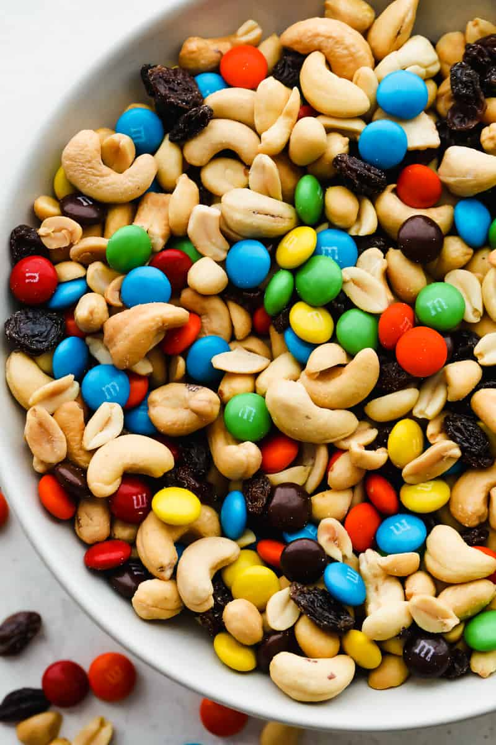
Notes:
An example of a mixture is trail mix. In trail mix, nuts, candies, dried fruits, and other ingredients are mixed together. You could separate the ingredients if needed.

Slide 43
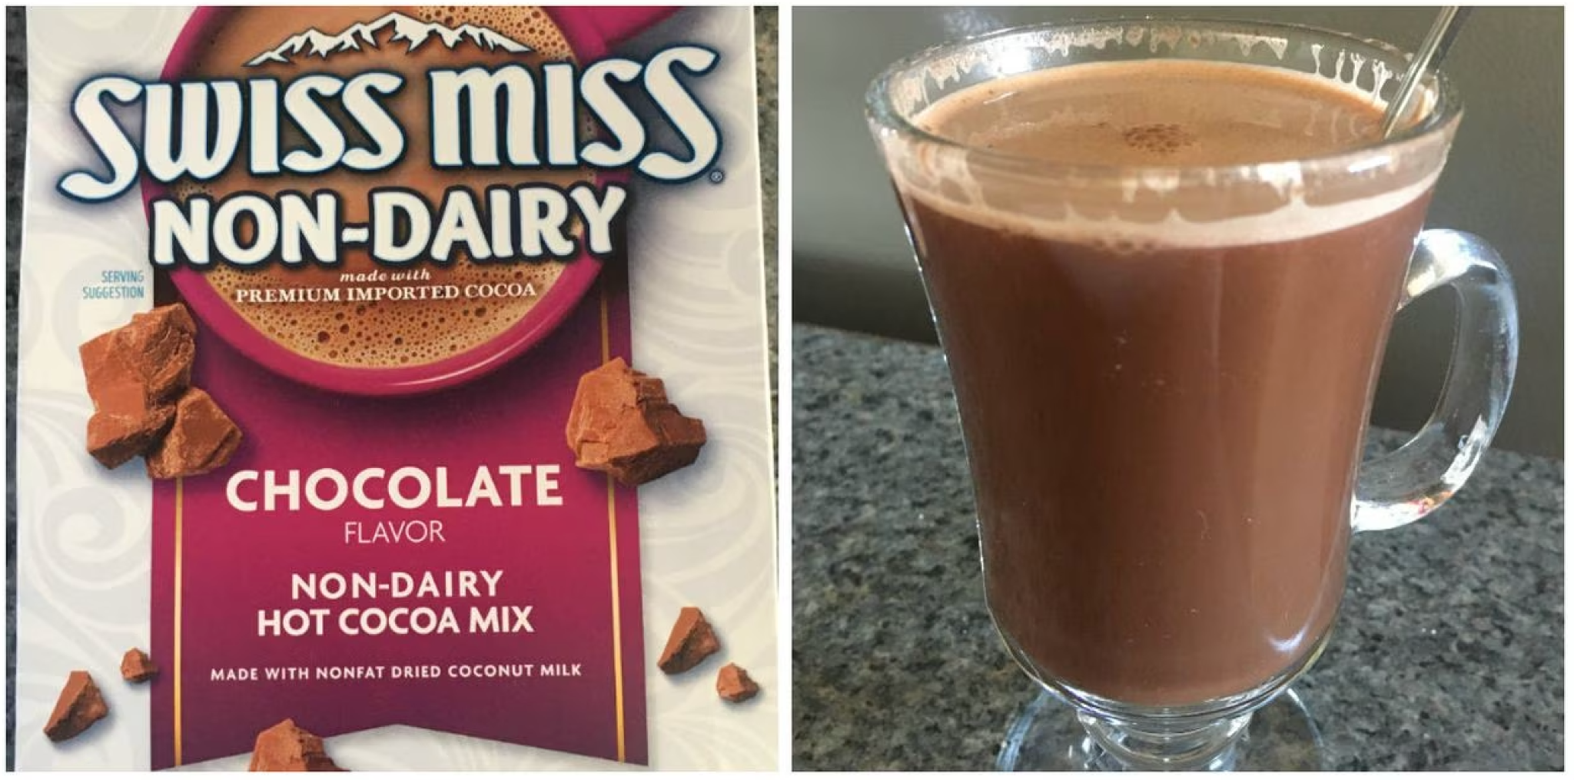
Notes:
Another example of a mixture is hot chocolate. You mix the hot cocoa mix with milk or water together to make hot chocolate! You cannot separate the hot cocoa mix and liquid once mixed.

Slide 44
Notes:
Let’s check-in for understanding.

Slide 45
In a homogeneous mixture, you ____ see or separate the different parts. We also call these mixtures _________.
Notes:
In a homogeneous mixture, you ____ see or separate the different parts. We also call these mixtures _________.
[can’t, solutions]

Slide 46
In a homogeneous mixture, you can’t see or separate the different parts. We also call these mixtures solutions.
Notes:
[In a homogeneous mixture, you can]t see or separate the different parts. We also call these mixtures solutions.]

Slide 47
In a heterogeneous mixture, you ___ see and easily separate the different parts.
Notes:
In a heterogeneous mixture, you ___ see and easily separate the different parts.
[Can]

Slide 48
In a heterogeneous mixture, you can see and easily separate the different parts.
Notes:
In a heterogeneous mixture, you can see and easily separate the different parts.

Slide 49
Notes:
Now, let’s talk about some non-examples of mixtures.

Slide 50
Notes:
An atom is not an example of a mixture. It is the smallest unit of matter and therefore only one thing.

Slide 51
Notes:
An element, such as gold, is not an example of a mixture because it only contains one type of atom.

Slide 52
Notes:
Now let’s pause for a moment to check your understanding.

Slide 53
Why is an element not an example of a mixture?
Notes:
Why is an element not an example of a mixture?
[Elements are only made up of one type of atom. Mixtures consist of at least two substances that are physically combined.]

Slide 54
Notes:
We can also break down the term mixture into different word parts to help us remember the meaning. Let’s take a look!

Slide 55
Mixture
(root)
Notes:
We can only break the word “mixture” down into one part, the root: mix.

Slide 56
Mixture
Mix = the act of combining different things
Notes:
The root of the word mixture is "mix." The root carries the core meaning of the word, which is the act of combining different things.

Slide 57
Mix ture
Mixture
The act of combining different things
Notes:
So when we put it all together, mixture means the act of combining different things.

Slide 58
Notes:
Let’s check-in for understanding.

Slide 59
How can we use the word parts of mixture to help us remember the definition of the term?
Mixture
(root)
Notes:
How can we use the word parts of the word mixture to help us remember the definition of the term?
[The root mix means the act of combining different things.
So when we put it all together, a mixture means to combine things.]

Slide 60
Remember!!!
Notes:
So remember!

Slide 61
Mixture: two or more substances are
combined physically, not chemically
Notes:
A mixture is when two or more substances are combined physically, not chemically.

Slide 62
Notes:
We will now complete this concept map, called a Frayer model, to summarize and further clarify what you have learned about the term mixture.

Slide 63
Definition
Picture
Mixtures
Example
How do mixtures impact my life?
Notes:
To complete the Frayer model, we will choose from four choices the correct picture, definition, example, and response to the question, “How do mixtures impact my life?” Select the best response for each question using the information you just learned. As we select responses, we will see how this model looks filled in for the term mixtures.

Slide 64
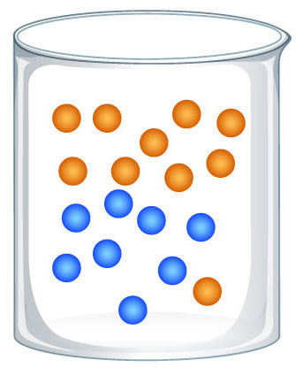
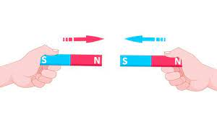
Directions: Choose the correct picture of a Mixture from the choices below.
A
B
C
D
Notes:
Choose the one correct picture of constants from these four choices.

Slide 65
Directions: Choose the correct picture of a Mixture from the choices below.
A
B
C
D
Notes:
This is the picture that shows a mixture.

Slide 66
Definition
Picture
Mixtures
Example
How do mixtures impact my life?
Notes:
Here is the Frayer model filled in with a picture of mixtures.

Slide 67
Directions: Choose the correct definition of Mixture from the choices below.
A
The smallest whole unit of matter
B
The push or pull of an object
C
Two or more substances are combined physically, not chemically
D
A place where animals and plants live together
Notes:
Choose the one correct definition of mixture from these four choices.

Slide 68
Directions: Choose the correct definition of Mixture from the choices below.
A
The smallest whole unit of matter
B
The push or pull of an object
C
Two or more substances are combined physically, not chemically
D
A place where animals and plants live together
Notes:
“Two or more substances are combined physically, not chemically.” is correct! This is the definition of mixture.

Slide 69
Definition
Picture
Two or more substances are combined physically, not chemically
Mixtures
Example
How do mixtures impact my life?
Notes:
Here is the Frayer Model with a picture and the definition filled in for mixtures: Two or more substances are combined physically, not chemically.

Slide 70
Directions: Choose the correct example of a Mixture from the choices below.
A
A bowl of pasta salad
B
A puppy
C
A piece of silver
D
A sailboat
Notes:
Choose the one correct example of mixture from these four choices.

Slide 71
Directions: Choose the correct example of a Mixture from the choices below.
A
A bowl of pasta salad
B
A puppy
C
A piece of silver
D
A sailboat
Notes:
“A bowl of pasta salad” is correct! This is an example of a mixture.

Slide 72
Definition
Picture
Two or more substances are combined physically, not chemically
Mixtures
A bowl of pasta salad
Example
How do mixtures impact my life?
Notes:
Here is the Frayer Model with a picture, definition, and an example of mixtures: A bowl of pasta salad.

Slide 73
Directions: Choose the correct response for “how do mixtures impact my life?” from the choices below.
A
Mixtures combine substances that have many uses in our daily lives.
B
Mixtures grow plants that we can eat to be healthy.
C
Mixtures teach us about weather so we can understand the world around us.
D
Mixtures provide electricity to power our devices in our day to day lives.
Notes:
Choose the one correct response for “how do mixtures impact my life?” from these four choices.

Slide 74
Directions: Choose the correct response for “how do mixtures impact my life?” from the choices below.
A
Mixtures combine substances that have many uses in our daily lives.
B
Mixtures grow plants that we can eat to be healthy.
C
Mixtures teach us about weather so we can understand the world around us.
D
Mixtures provide electricity to power our devices in our day to day lives.
Notes:
“Mixtures combine substances that have many uses in our daily lives.” That is correct! This is an example of how mixtures impact your life.

Slide 75
Definition
Picture
Two or more substances are combined physically, not chemically
Mixtures
Mixtures combine substances that have many uses in our daily lives.
A bowl of pasta salad
Example
How do mixtures impact my life?
Notes:
Here is the Frayer Model with a picture, definition, example, and a correct response to “how do mixtures impact my life?”: Mixtures combine substances that have many uses in our daily lives.

Slide 76
Remember!!!
Notes:
So remember!

Slide 77
Mixture: two or more substances are
combined physically, not chemically
Notes:
A mixture is when two or more substances are combined physically, not chemically.

Slide 78
Big Question: How can two or more substances be combined?
Notes:
Let’s reflect once more on our big question. Our “big question” is: How can two or more substances be combined?
Does anyone have any additional examples to share that haven’t been discussed yet?
[Pause and illicit predictions from students.]

Slide 79
Demonstration
Separating Mixtures
TEACHER DIRECTIONS:
Materials: coffee filter, funnel, cups, magnet, sifter/strainer, tweezers, iron filings, sand, rocks, water, paper clips, colored beads, bowls
Set up four mixtures in four different bowls for students: iron filings and sand, rocks and sand, water and sand, and paper clips and colored beads.
Give students four different tools for separating mixtures: coffee filter, magnet, sifter/strainer, and tweezers.
Task students with separating the mixtures into their component parts using one of the four tools.
Students can work individually or in groups.
Notes:
Let’s do a demonstration.

Slide 80
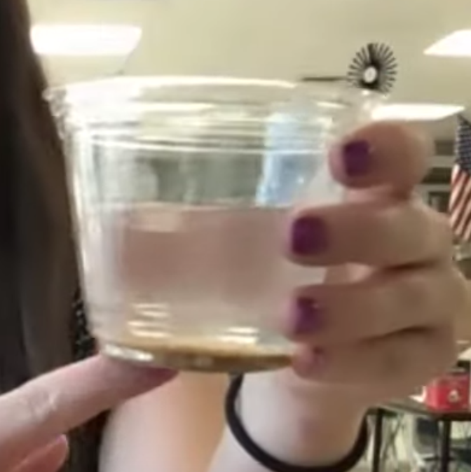
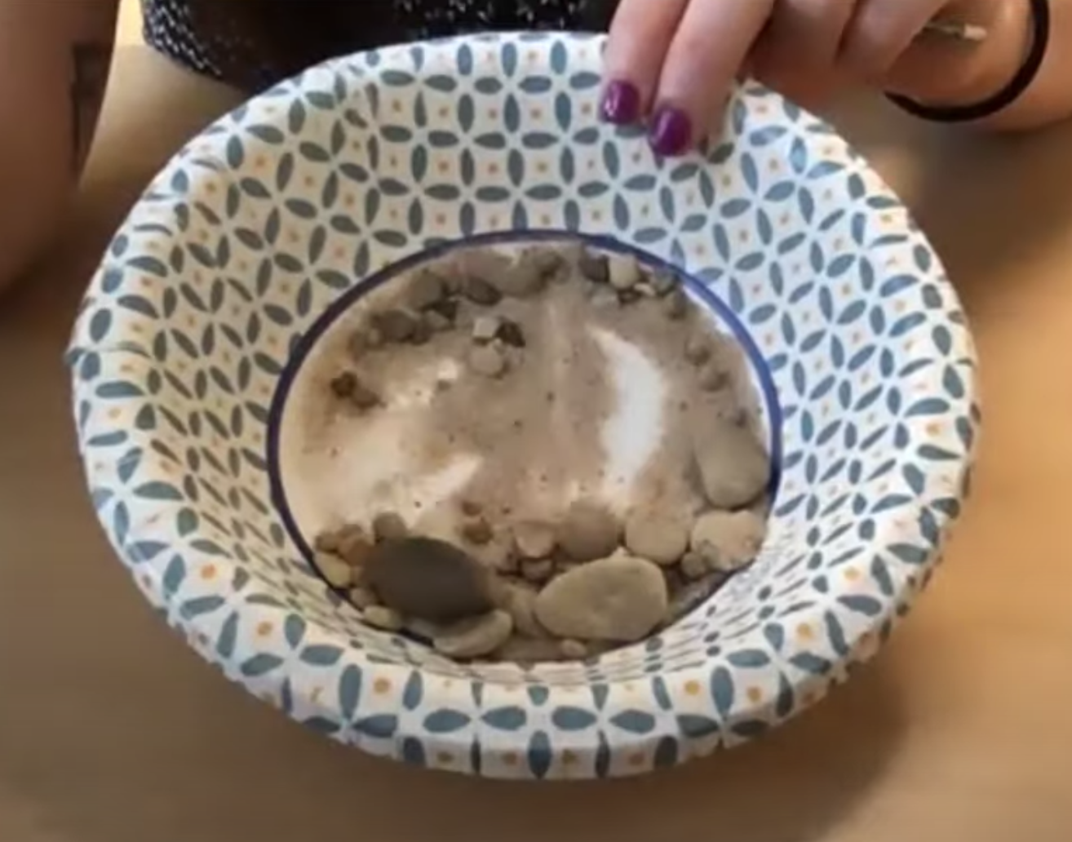
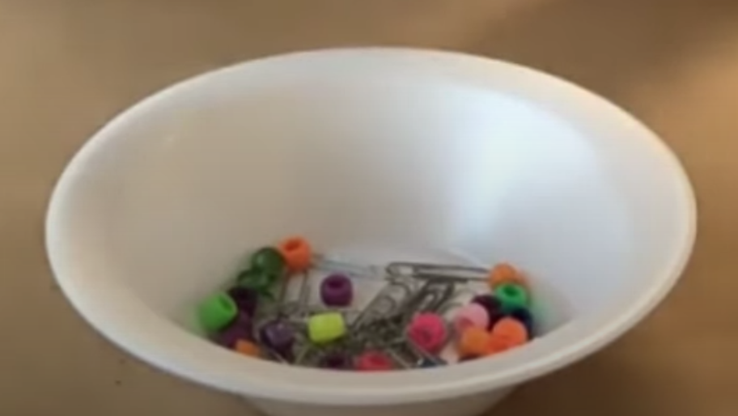
Reflection Activity
Ask yourselves…
What is the best way to separate iron and sand?
what is the best way to separate rock and sand?
What is the best way to separate water and sand?
What is the best way to separate paper clips and beads?
Notes:
Have students look at the pictures and answer these questions.
What is the best way to separate iron and sand? [Magnet]
What is the best way to separate rock and sand? [Sifter/strainer]
What is the best way to separate water and sand? [Coffee filter]
What is the best way to separate paper clips and beads? [Magnet and tweezers]
This activity shows us how different mixtures can be separated.

Slide 81
Notes:
Thanks for watching, and please continue watching CAPs available from this website.

Slide 82
This Was Created With Resources From:
Questions or Comments
Michael Kennedy, Ph.D. MKennedy@Virginia.edu
Rachel L Kunemund, Ph.D. rk8vm@virginia.edu

