Slide 1
Intro
“Big Idea” Question
Review Concepts
Check-In Questions
Teacher Demo
Vocabulary
Student-Friendly Definition
Examples & Non-Examples
Morphological Word Parts
Simulation/Activity
Notes:
OK everyone, get ready for our next lesson. Just as a reminder, these are the different components that our lesson may include, and you’ll see these icons in the top left corner of each slide so that you can follow along more easily!

Slide 2
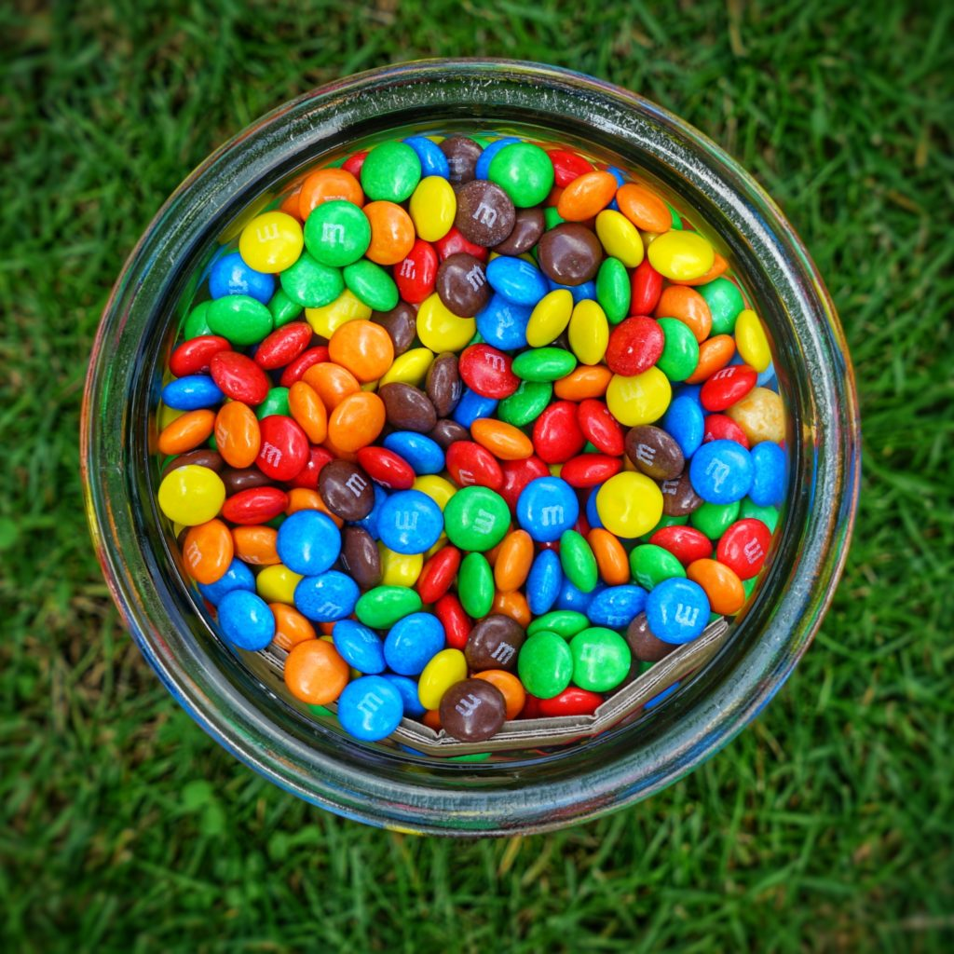
Intro
Mixture
Notes:
Today, we will learn about the term, mixture.

Slide 3
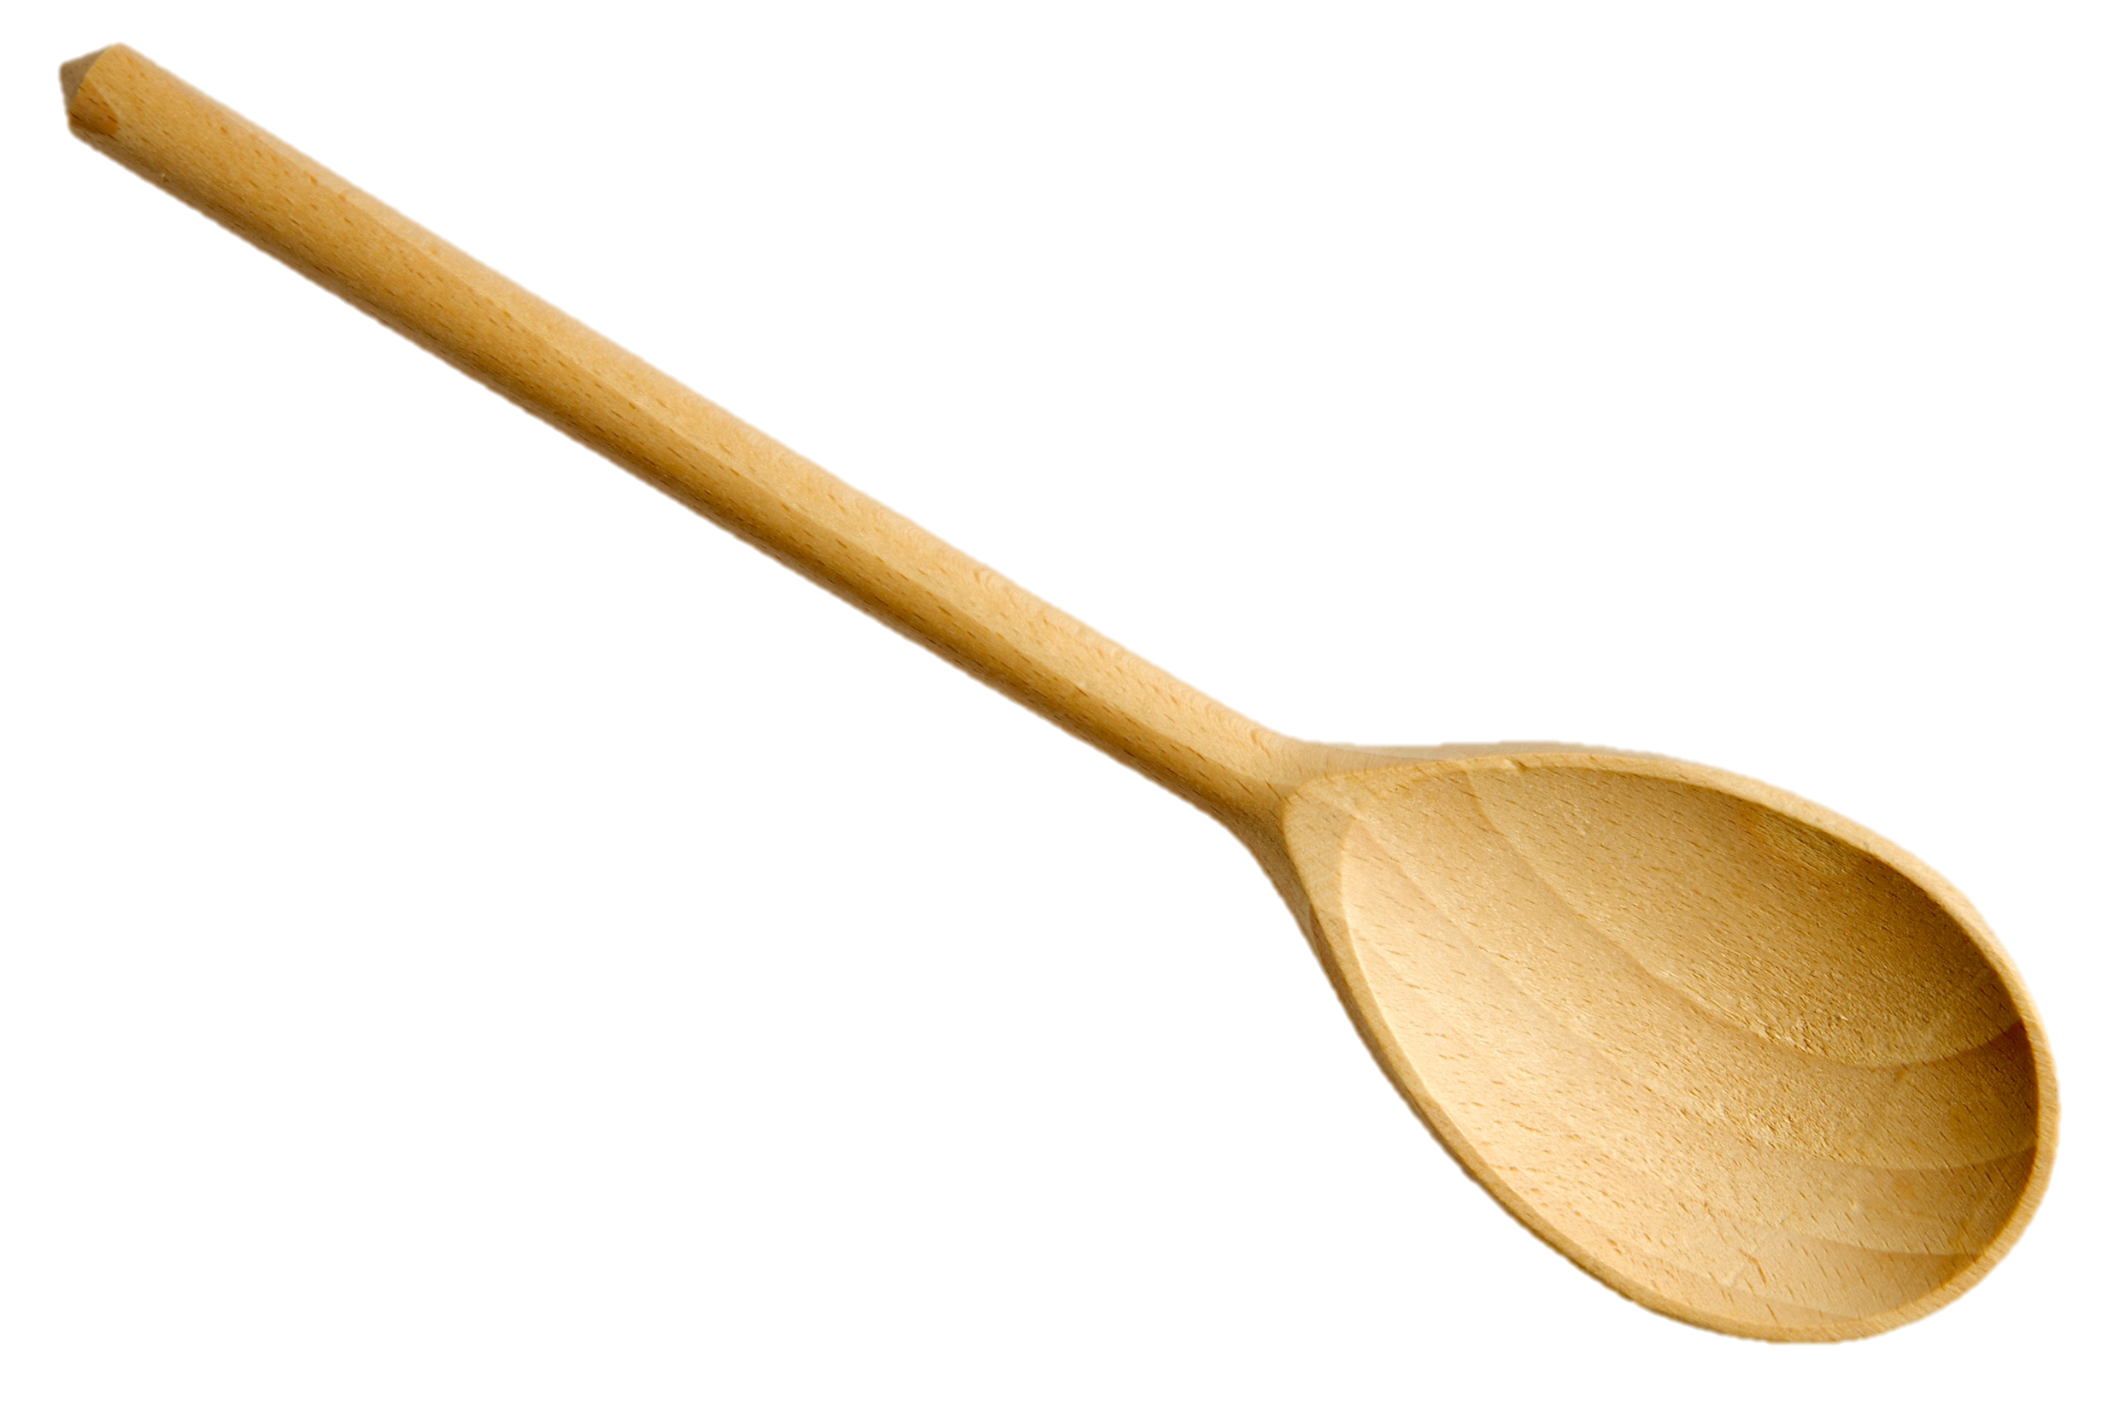
Big Question: How can two or more substances be combined?
Notes:
Our “big question” is: How can two or more substances be combined?
[Pause and illicit predictions from students.]
I love all these thoughtful scientific hypotheses! Be sure to keep this question and your predictions in mind as we move through these next few lessons, and we’ll continue to revisit it.

Slide 4
Demonstration
Separating Mixtures
TEACHER DIRECTIONS:
Materials: coffee filter, funnel, cups, magnet, sifter/strainer, tweezers, iron filings, sand, rocks, water, paper clips, colored beads, bowls
Set up four mixtures in four different bowls for students: iron filings and sand, rocks and sand, water and sand, and paper clips and colored beads.
Give students four different tools for separating mixtures: coffee filter, magnet, sifter/strainer, and tweezers.
Task students with separating the mixtures into their component parts using one of the four tools.
Students can work individually or in groups.
Notes:
Let’s start with a quick demonstration.
Feedback: Provide the demonstration with a logical sequence of events, this helps students follow along and make connections.

Slide 5
Notes:
Now, let’s pause for a moment to check your understanding.
Feedback: Provide a lot of opportunities to respond throughout the demonstration to help ensured that your students are grasping this new content.

Slide 6
What is the best way to separate iron and sand?
Notes:
What is the best way to separate iron and sand?
[Magnet]

Slide 7
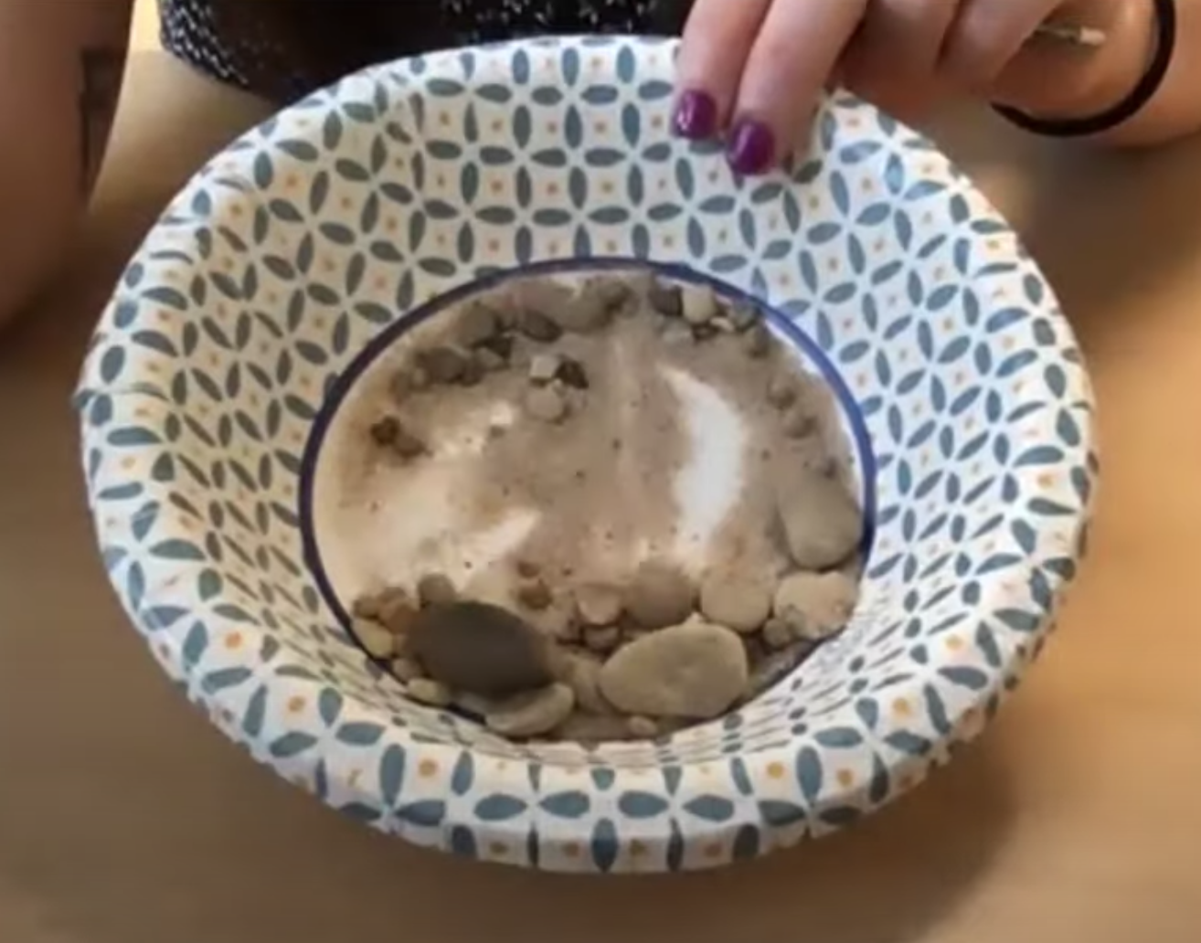
What is the best way to separate rock and sand?
Notes:
What is the best way to separate rock and sand?
[Sifter/strainer]

Slide 8
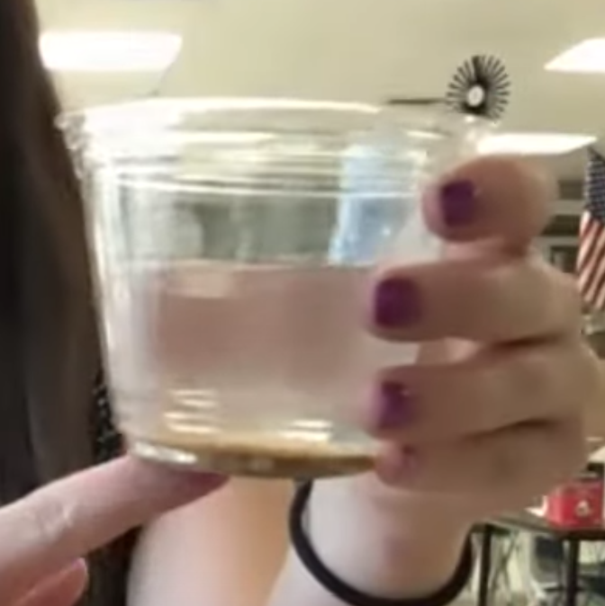
What is the best way to separate water and sand?
Notes:
What is the best way to separate water and sand?
[Coffee filter]

Slide 9
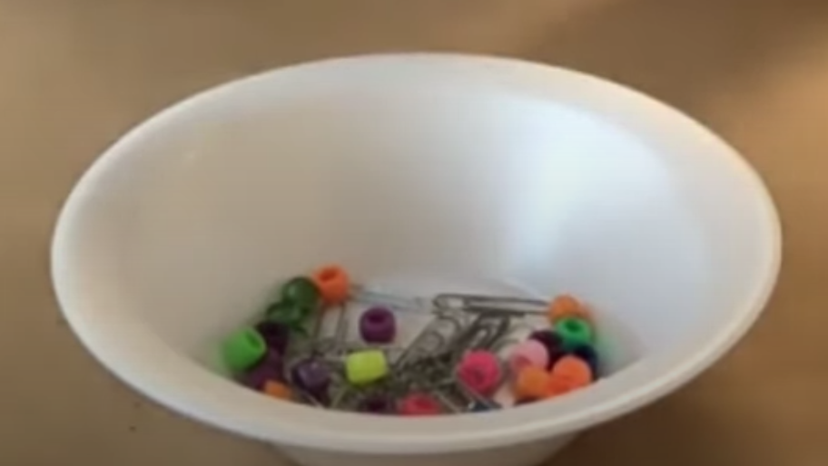
What is the best way to separate paper clips and beads?
Notes:
What is the best way to separate paper clips and beads?
[Magnet and tweezers]

Slide 10
Notes:
Before we move on to our new vocabulary term, let’s review some other words & concepts that you already learned and make sure you are firm in your understanding.
Feedback: Reviewing key background knowledge helps lay the context and sets the students up to make sense of the new content you are introducing, it also reinforces previously learned material.

Slide 11
Matter: has mass and takes up space
Notes:
Matter is anything that has mass and takes up space.

Slide 12
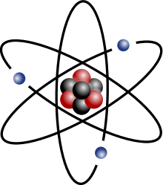
Atom: smallest whole unit of matter
Notes:
An atom is the smallest whole unit of matter. All matter is made up of atoms.

Slide 13
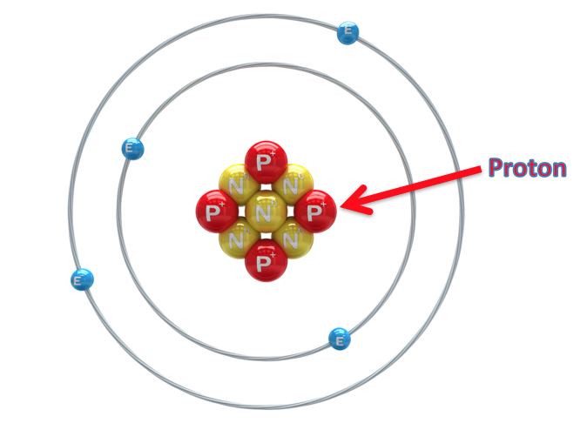
Proton: positively charged subatomic particle found in the nucleus of an atom
Notes:
A proton is a positively charged subatomic particle found in the nucleus of an atom.

Slide 14
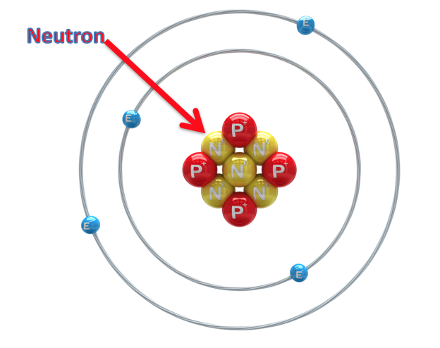
Neutron: subatomic particle with a neutral charge, found in the nucleus of an atom
Notes:
A neutron is a subatomic particle with a neutral charge, found in the nucleus of an atom.

Slide 15
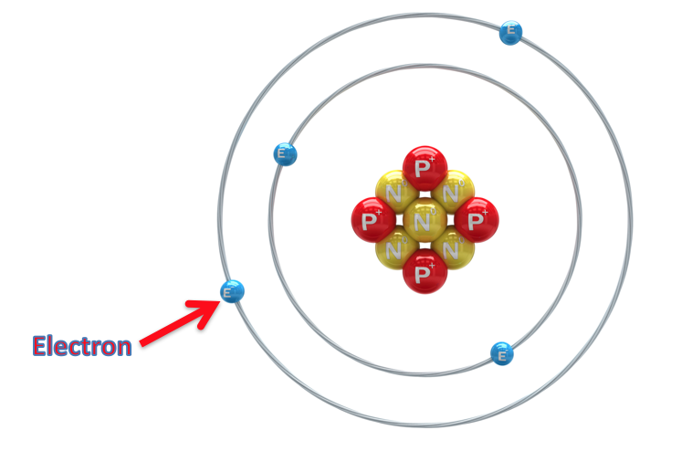
Electron: negatively charged particle that orbits the nucleus of an atom
Notes:
An electron is a negatively charged particle that orbits the nucleus.

Slide 16
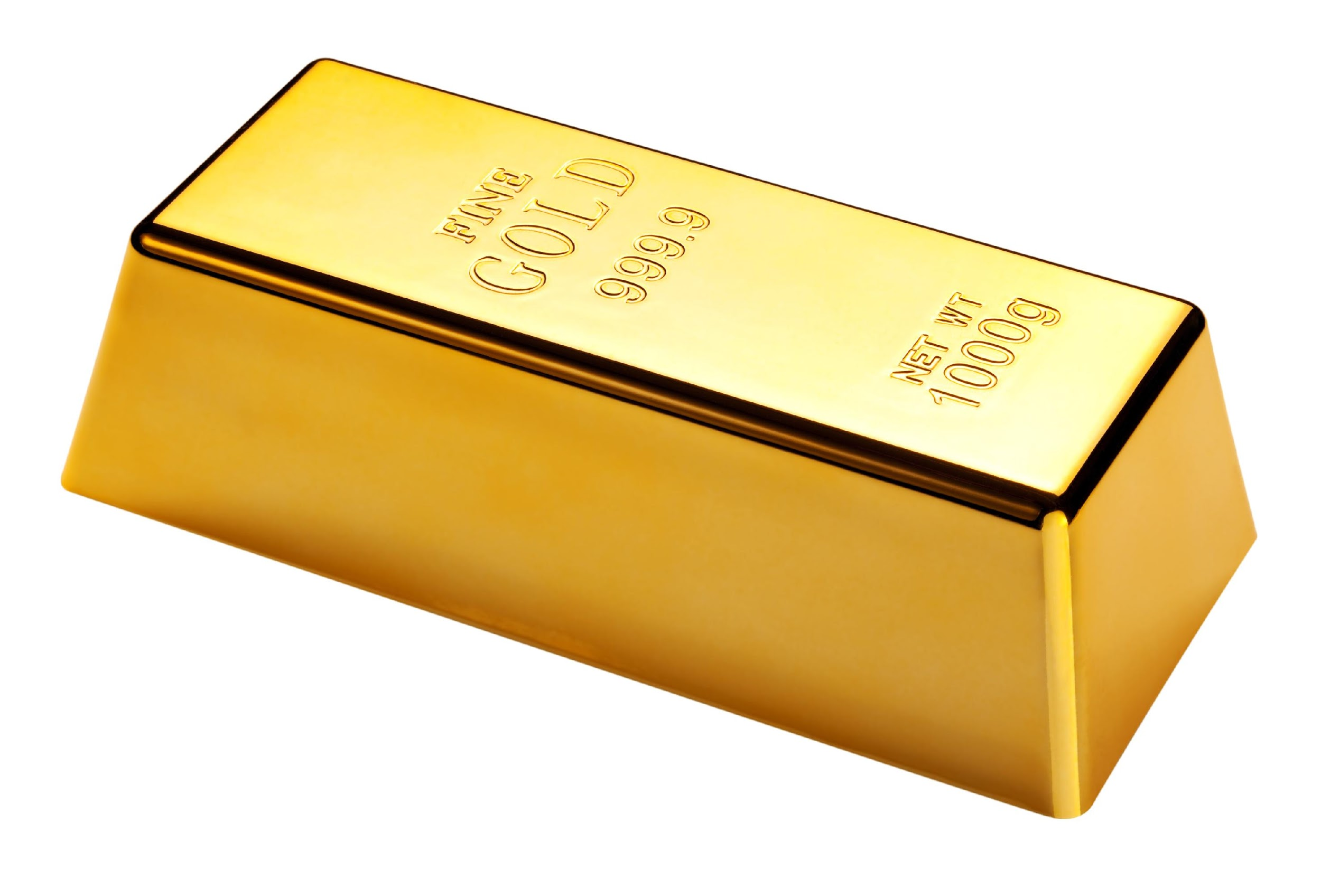
Element: a pure substance containing only one type of atom
Notes:
An element is a pure substance containing only one type of atom.

Slide 17
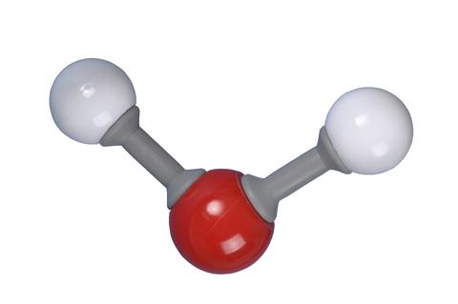
Molecule: particle containing two or more atoms of the same OR different elements
Notes:
A molecule is a particle containing 2 or more atoms of the same OR different elements. Molecules are the smallest pieces of compounds.

Slide 18
Compound: substance made up of two or more different elements
Notes:
A compound is a substance that is made up of two or more different elements.

Slide 19
Notes:
Now let’s pause for a moment to check your understanding.
Feedback: Monitoring understanding during review is an important step before moving on to new material.

Slide 20
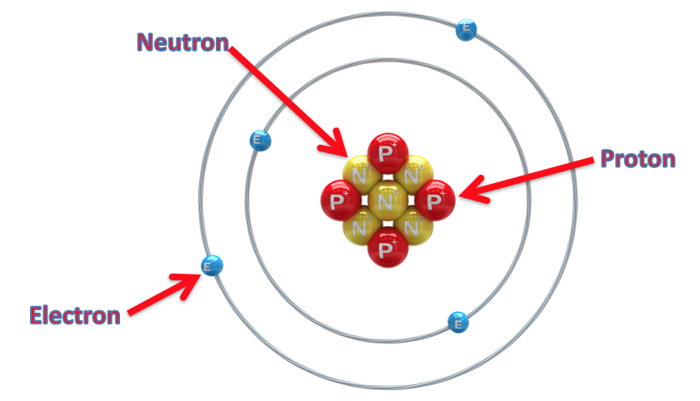
What are the 3 subatomic particles? Explain their similarities and differences.
Notes:
What are the 3 subatomic particles? Explain their similarities and differences.
[The 3 subatomic particles are protons, neutrons, and electrons. Neutrons and protons are both found in the atomic nucleus, however protons are positively charged and neutrons have a neutral charge. Electrons are negatively charged and orbit the nucleus.]

Slide 21
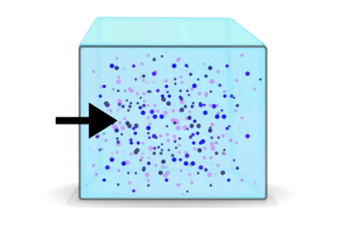
How are mass and matter related?
Notes:
How are mass and matter related?
[Matter is anything that has mass and takes up space and mass is the amount of matter in an object.]

Slide 22
What is an element?
Notes:
What is an element?
[An element is a pure substance containing only one type of atom.]

Slide 23
What is a molecule?
Notes:
What is a molecule?
[A molecule is a particle containing 2 or more atoms of the same OR different elements. Molecules are the smallest pieces of compounds.]

Slide 24
What is a compound?
Notes:
What is a compound?
[A compound is a substance that is made up of two or more DIFFERENT elements.]

Slide 25
What is the relationship between compounds and molecules?
Notes:
What is the relationship between compounds and molecules?

Slide 26
Mixture
Notes:
Now that we’ve reviewed, let’s define our new term, mixture.

Slide 27
Mixture: two or more substances are
combined physically, not chemically
Notes:
A mixture is when two or more substances are combined physically, not chemically.
Feedback: Longer more formal definitions are tricky, use clear language when providing the new definition.

Slide 28
Notes:
Let’s check-in for understanding.

Slide 29
How is a mixture formed?
Notes:
How is a mixture formed?
[A mixture is when two or more substances are combined physically, not chemically.]

Slide 30
Notes:
That is the basic definition, but there is a bit more you need to know.

Slide 31
Mixture
Heterogenous
Mixture
Solution
Notes:
There are two types of mixtures: a heterogeneous mixture and a solution.
Feedback: It is helpful to show how the new terms will be related to the old term to better help students chunk the new content.

Slide 32
Mixture
Heterogenous
Mixture
Solution
Notes:
First, let’s talk about a heterogeneous mixture.

Slide 33
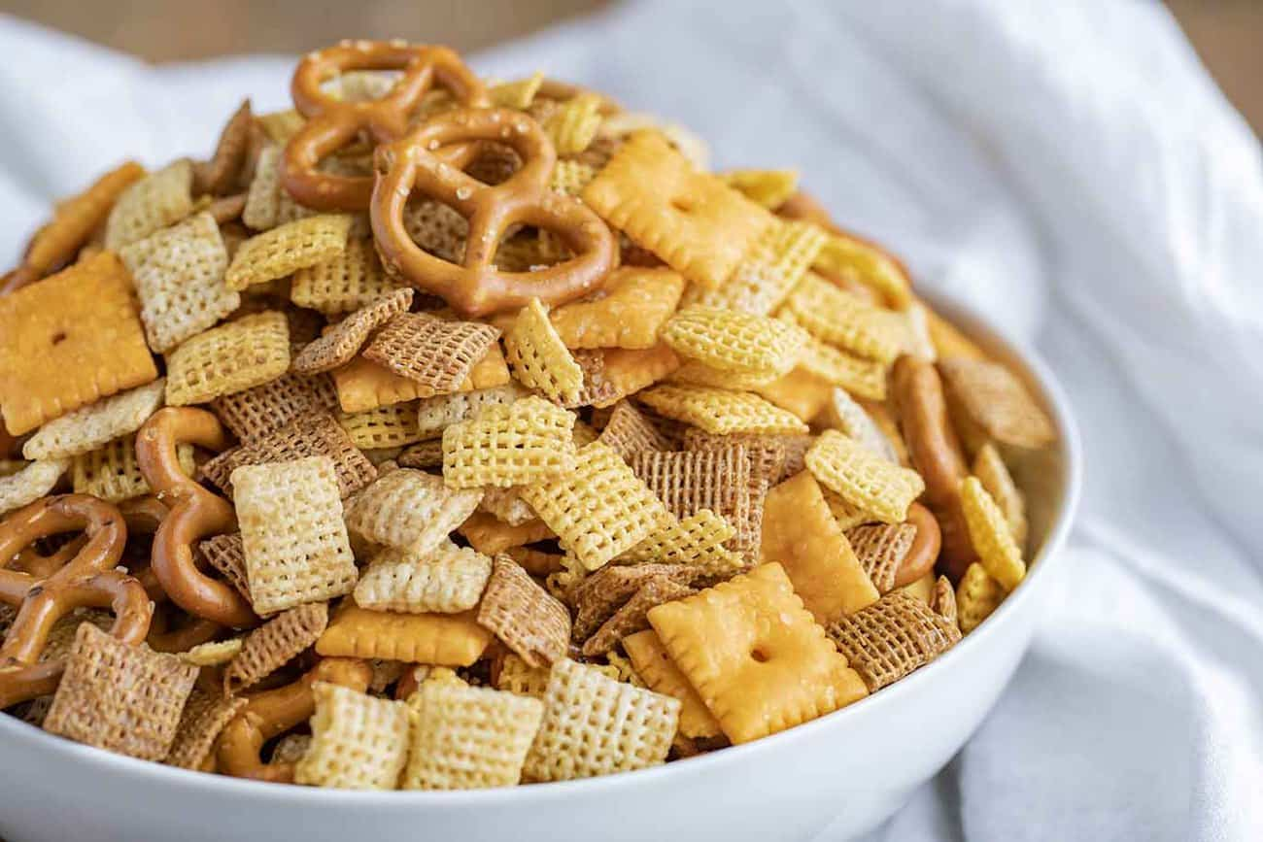
Heterogenous Mixture: a mixture in which the components can be seen separately
Notes:
A heterogenous mixture is a mixture in which the components can be seen separately.

Slide 34
The separate parts in a heterogenous mixture are easy to tell apart.
Notes:
The separate parts in a heterogeneous mixture are easy to tell apart. In this bowl of chex mix, we can easily see the different parts: cheez-its, pretzels, and cereal.

Slide 35
Notes:
Let’s check-in for understanding.

Slide 36
What is a heterogeneous mixture?
Notes:
What is a heterogeneous mixture?
[A heterogeneous mixture is a mixture in which the components can be seen separately.]

Slide 37
Mixture
Heterogenous
Mixture
Solution
Notes:
Now, let’s talk about a solution.

Slide 38
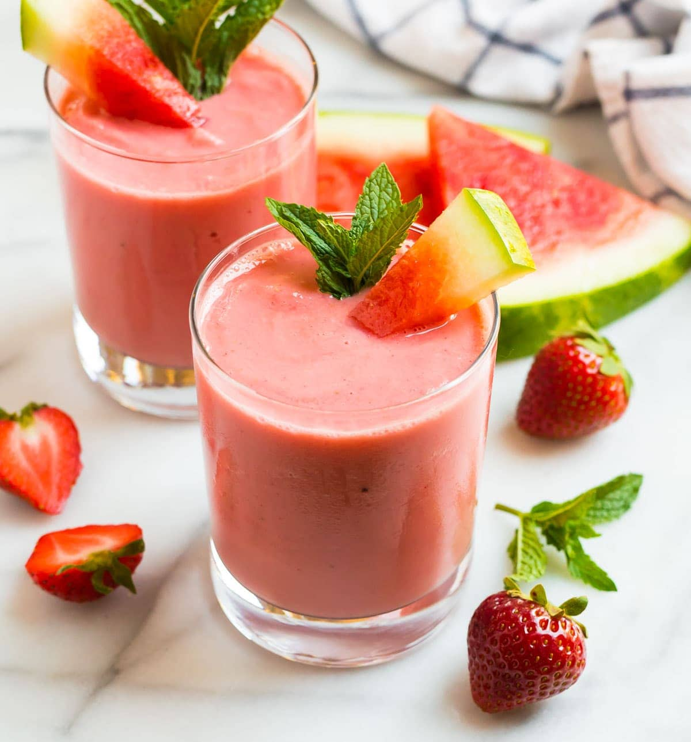
Solution: a mixture in which the components cannot be seen separately
Notes:
A solution is a mixture in which the components cannot be seen separately.

Slide 39
The separate parts in a solution are not easy to tell apart.
Notes:
The separate parts in a solution are not easy to tell apart. In this fruit smoothie, there is frozen fruit, water, honey, sugar, etc. We cannot see the individual ingredients in this smoothie because they are all blended together in a solution.

Slide 40
Notes:
Let’s check-in for understanding.

Slide 41
How is a mixture formed?
Notes:
How is a mixture formed?
[A mixture is when two or more substances are combined physically, not chemically.]

Slide 42
Mixture
?
?
What are the two types of mixtures?
Notes:
What are the two types of mixtures?

Slide 43
Mixture
Heterogenous
Mixture
Solution
What are the two types of mixtures?
Notes:
What are the two types of mixtures?
[Heterogenous mixture and solution]

Slide 44
How is a heterogeneous mixture different from a solution?
Notes:
How is a heterogeneous mixture different from a solution?

Slide 45
Notes:
Now, let’s talk about some examples of mixture.
Feedback: Using clear and concise language is a great way to ensure students are able to follow along and understand the content.

Slide 46
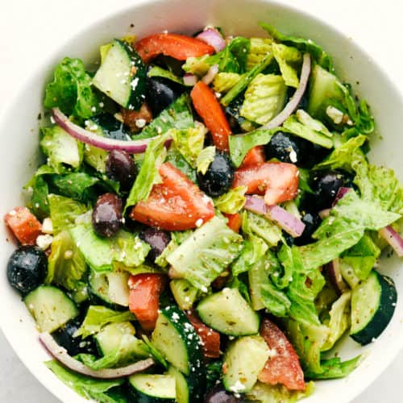
Notes:
A salad is a mixture because two or more substances are combined physically. This is an example of a heterogeneous mixture.

Slide 47
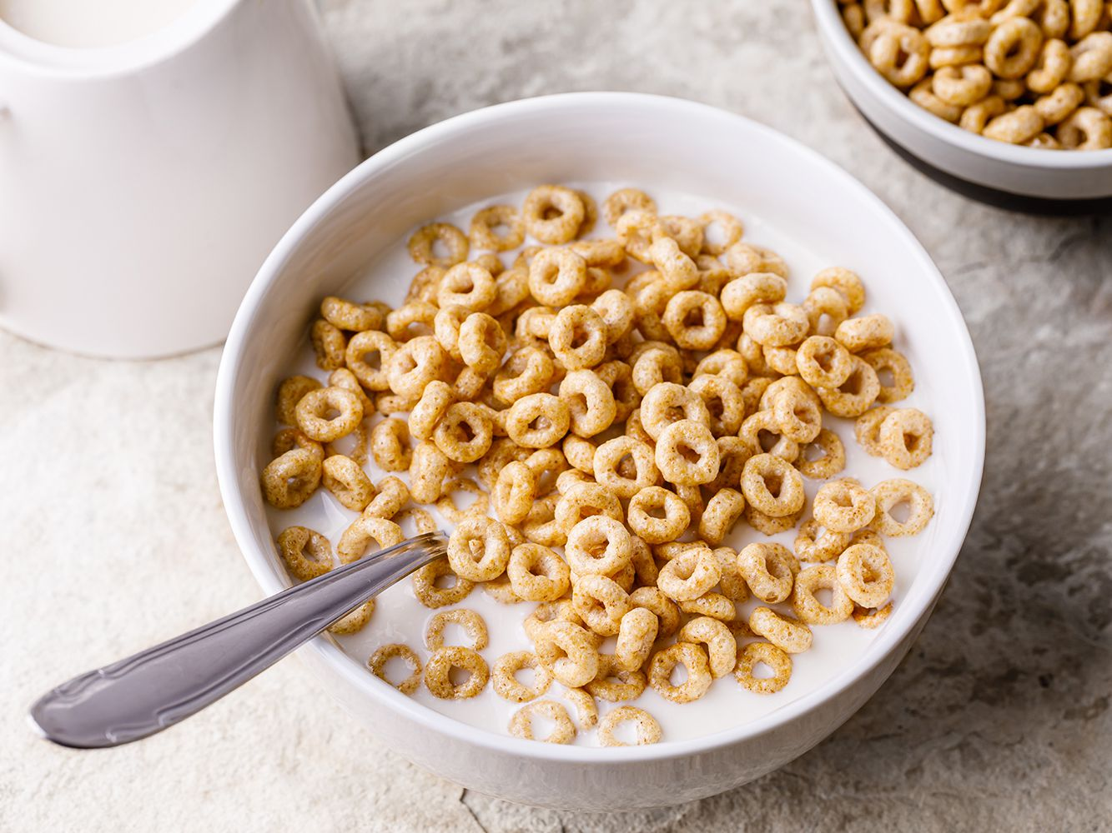
Notes:
Cereal is also a mixture. This is an example of a heterogeneous mixture.

Slide 48
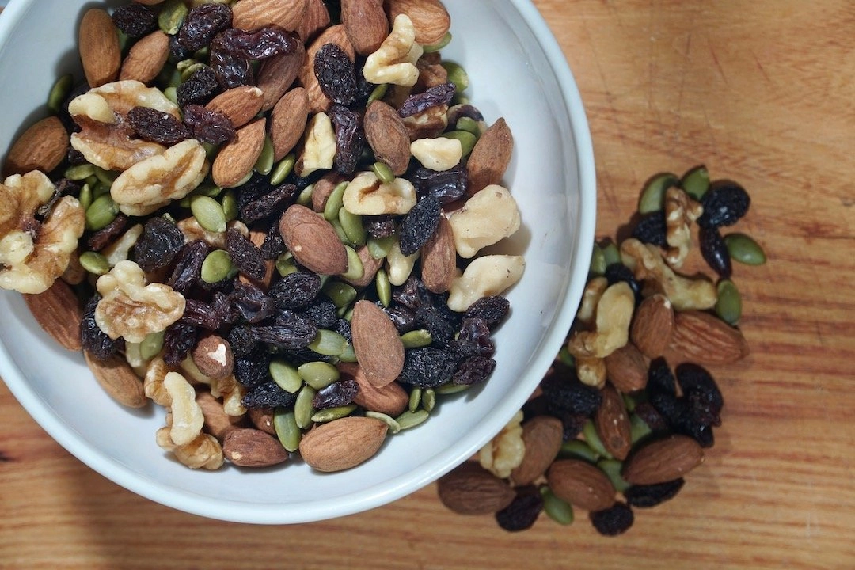
Notes:
Trail mix is also a mixture. This is an example of a heterogeneous mixture.

Slide 49
Notes:
Coffee is a mixture. This is an example of a solution.

Slide 50
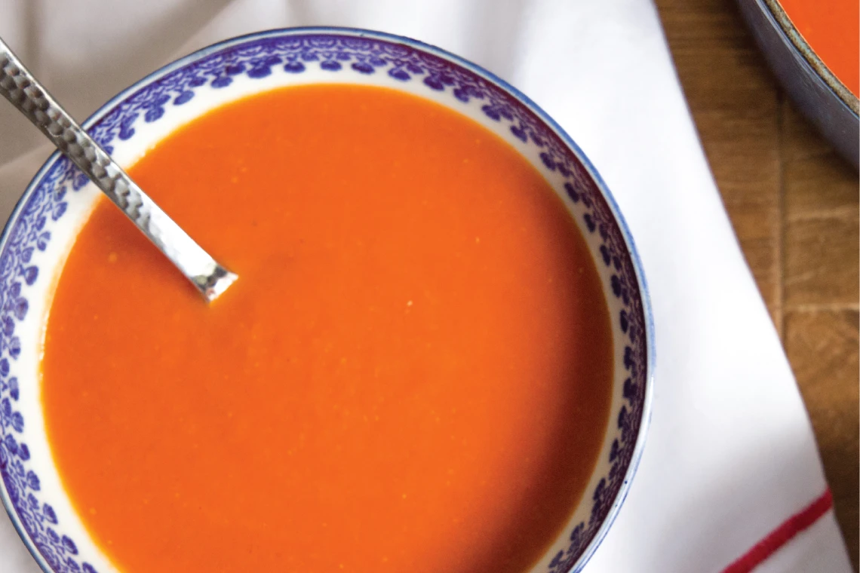
Notes:
Tomato soup is a mixture. This is an example of a solution.

Slide 51
Notes:
Next, let’s talk about some non-examples of mixture.
Feedback: Using an explicit and clear explanation for the non-example is a great way to help students make sense of the new content.

Slide 52
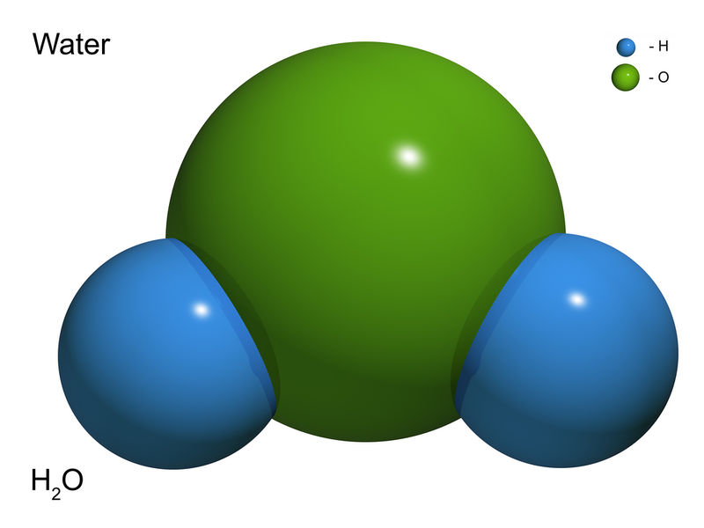
Notes:
Water is a compound, not a mixture, because it is made of two or more elements.

Slide 53
Notes:
Tylenol or acetaminophen is a compound because it is made of two or more substances combined chemically. Since the substances are combined chemically, not physically, tylenol is not a mixture.

Slide 54
Notes:
Let’s check-in for understanding.
Feedback: Providing a lot of opportunities to respond throughout this portion of your lesson is so important for ensuring that your students are grasping this new skill.

Slide 55
Give an example of a heterogenous mixture.
Notes:
Give an example of a heterogeneous mixture.

Slide 56
Give an example of a solution.
Notes:
Give an example of a solution.

Slide 57
Why is water not a mixture?
Notes:
Why is water not a mixture?

Slide 58
How is a mixture formed?
Notes:
How is a mixture formed?
[A mixture is when two or more substances are combined physically, not chemically.]

Slide 59
Mixture
?
?
What are the two types of mixtures?
Notes:
What are the two types of mixtures?

Slide 60
Mixture
Heterogenous
Mixture
Solution
What are the two types of mixtures?
Notes:
What are the two types of mixtures?
[Heterogenous mixture and solution]

Slide 61
How is a heterogeneous mixture different from a solution?
Notes:
How is a heterogeneous mixture different from a solution?

Slide 62
Remember!!!
Notes:
So remember!
Feedback: Review the key terms once more at the end of the lesson to lock in students understanding.

Slide 63
Mixture: two or more substances are
combined physically, not chemically
Notes:
A mixture is when two or more substances are combined physically, not chemically.

Slide 64
Heterogenous Mixture: a mixture in which the components can be seen separately
Notes:
A heterogenous mixture is a mixture in which the components can be seen separately.

Slide 65
Solution: a mixture in which the components cannot be seen separately
Notes:
A solution is a mixture in which the components cannot be seen separately.

Slide 66
Big Question: How can two or more substances be combined?
Notes:
Explicit cue to revisit the big question at the end of the lesson: Okay everyone. Now that we’ve learned the term, let’s reflect once more on our big question. Was there anything that we predicted earlier that was correct or incorrect? Do you have any new hypotheses to share?
Feedback: Offering students an opportunity to evaluate their earlier hypotheses and make changes based on their new understandings is an important part of the iterative process in science. This is a great opportunity to help students build an epistemic understanding by explicitly stating how continuing to change and build on hypotheses as your knowledge grows is an important part of the discipline of science!

Slide 67
Notes:
Thanks for watching, and please continue watching CAPs available from this website.

Slide 68
This Video Was Created With Resources From:
Questions or Comments
Michael Kennedy, Ph.D. MKennedy@Virginia.edu
Rachel L Kunemund, Ph.D. rk8vm@virginia.edu

