Slide 1
Intro
“Big Idea” Question
Review Concepts
Check-In Questions
Teacher Demo
Vocabulary
Student-Friendly Definition
Examples & Non-Examples
Morphological Word Parts
Simulation/Activity
Notes:
OK everyone, get ready for our next lesson. Just as a reminder, these are the different components that our lesson may include, and you’ll see these icons in the top left corner of each slide so that you can follow along more easily!

Slide 2
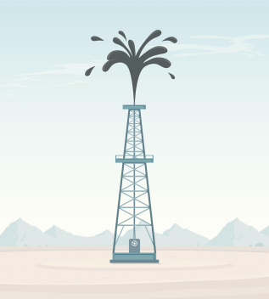
Intro
Non-renewable Resources
Notes:
Today, we will learn about non-renewable resources.

Slide 3
Intro
Renewable Resources
Notes:
and renewable resources.

Slide 4
Big Question: How do the resources we use affect humans and the environment?
Notes:
Our “big question” is: How do the resources we use affect humans and the environment?
[Pause and illicit predictions from students.]
I love all these thoughtful scientific hypotheses! Be sure to keep this question and your predictions in mind as we move through these next few lessons, and we’ll continue to revisit it.

Slide 5
Demonstration
Renew-a-Bean
Materials: White beans, kidney beans, worksheet
Students will understand the difference between renewable and nonrenewable resources. Students will work in groups pulling beans out of a bag. They will work through an activity to explore using renewable and nonrenewable activity.
Notes:
Let’s do a quick demonstration that will help get our brains ready to think about non-renewable and renewable energy, and how it relates to our big question.
Feedback: Creating an organized demonstration that is clear and well structured is key to promoting student understanding.

Slide 6
Notes:
Now, let’s pause for a moment to check your understanding.
Feedback: By providing a lot of opportunities to respond throughout demonstration you help ensure that your students are grasping this new content.

Slide 7
How many years did it take for the non-renewable energy sources to run out when you used 10 energy beans per year?
Notes:
How many years did it take for the non-renewable energy sources to run out when you used 10 energy beans per year?

Slide 8
How many years did it take for the non-renewable energy sources to run out when you increased the rate at which we consumed resources each year?
Notes:
How many years did it take for the non-renewable energy sources to run out when you increased the rate at which we consumed resources each year?

Slide 9
What are some examples of renewable and non-renewable energy sources?
Notes:
What are some examples of renewable and non-renewable energy sources?

Slide 10
What does this activity demonstrate about our consumption of resources - what will happen if we keep using non-renewable resources?
Notes:
What does this activity demonstrate about our consumption of resources - what will happen if we keep using non-renewable resources?

Slide 11
Describe what happens to the proportion of renewable vs. non-renewable energy sources that remain available, as energy is used over time.
Notes:
Describe what happens to the proportion of renewable vs. non-renewable energy sources that remain available, as energy is used over time.

Slide 12
Notes:
Before we move on to our new vocabulary term, let’s review some other words & concepts that you already learned and make sure you are firm in your understanding.
Feedback: Reviewing key background knowledge helps lay the context and sets the students up to make sense of the new content you are introducing, it also reinforces previously learned material.

Slide 13
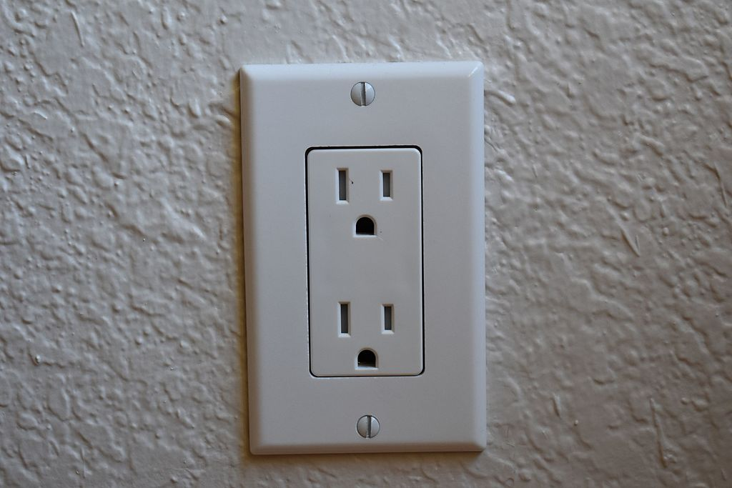
Resource: an energy source that is turned into power
Notes:
A resource is the energy source that is turned into power. In buildings, electrical power comes from the outlets, and the electricity in the outlets comes from a power station.

Slide 14
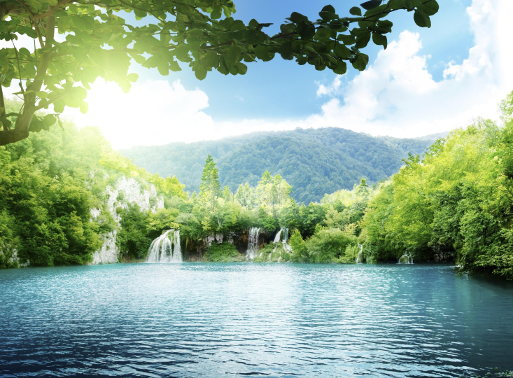
Natural resource: anything found in nature and used by humans
Notes:
A natural resources is anything found in nature and used by humans.

Slide 15
Notes:
Now let’s pause for a moment to check your understanding.
Feedback: Monitoring understanding during review is an important step before moving on to new material.

Slide 16
A resource is the energy source turned into _______.
Notes:
A resource is the energy source turned into _______.

Slide 17
A resource is the energy source turned into power.
Notes:
A resource is the energy source turned into power.

Slide 18
What is an example of an energy source you use?
Notes:
What is an example of an energy source you use?

Slide 19
Non-renewable Resources
Notes:
Now that we’ve reviewed, let’s define our new term, non-renewable resources.

Slide 20
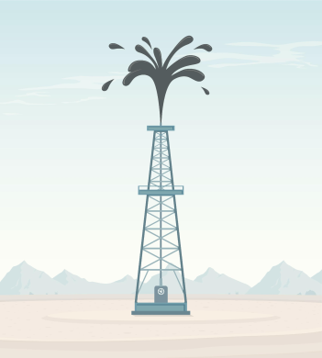
Non-renewable resource: remade slowly or not at all
Notes:
A non-renewable resource is remade slowly or not at all.
Feedback: Using clear language can take make formal more complicated definitions a little easier for students to understand.

Slide 21
Notes:
Now, let’s pause for a moment to check your understanding.

Slide 22
What is a non-renewable resource?
Notes:
What is a non-renewable resource?
[A non-renewable resource is remade slowly or not at all.]

Slide 23
Notes:
That’s the basic definition, but there’s more you need to know.

Slide 24
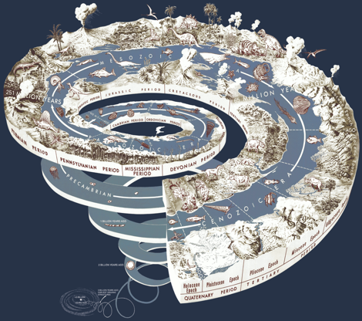
Non-renewable = Millions of Years
Notes:
When we say that nonrenewable resources are replaced very slowly, we mean that they can take millions of years to form.

Slide 25
Notes:
Now, let’s talk about some examples of non-renewable resources.
Feedback: It is important to not only introduce an example of the term but also include images to go along with it, this is a great way to help students make connections.

Slide 26
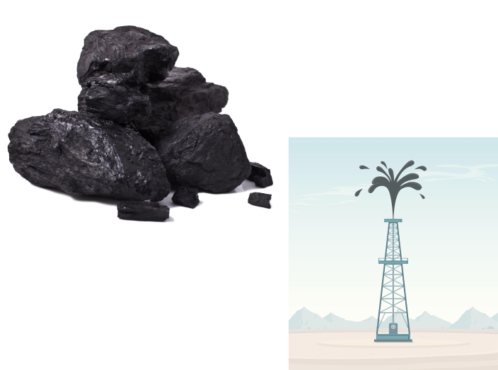
Notes:
Two examples of nonrenewable resources are oil and coal. Once they are taken from the Earth and used, they take millions of years to be replaced.

Slide 27
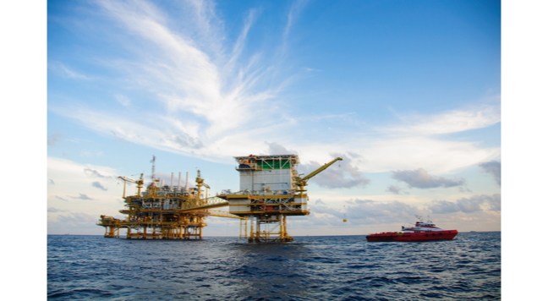
Notes:
Coal and oil are made from plants and animals that dies millions of years ago.

Slide 28
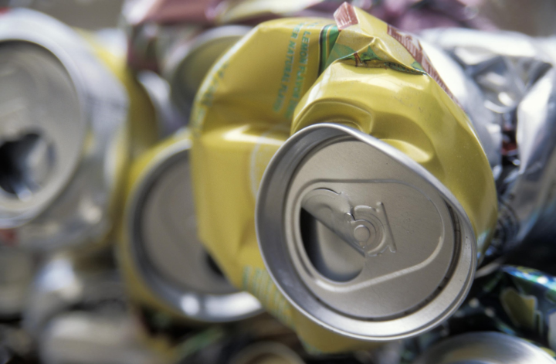
Notes:
An example that may be confusing is that aluminum is a nonrenewable resource. Even though we recycle aluminum cans, the amount of aluminum in the Earth does not increase or replace itself. In other words, since there is a limited amount of aluminum, it is non-renewable.

Slide 29
Notes:
Next, let’s talk about some non-examples of non-renewable resources.
Feedback: Use clear language as you introduce the non-example to make it easier for students to make sense of the difference.

Slide 30
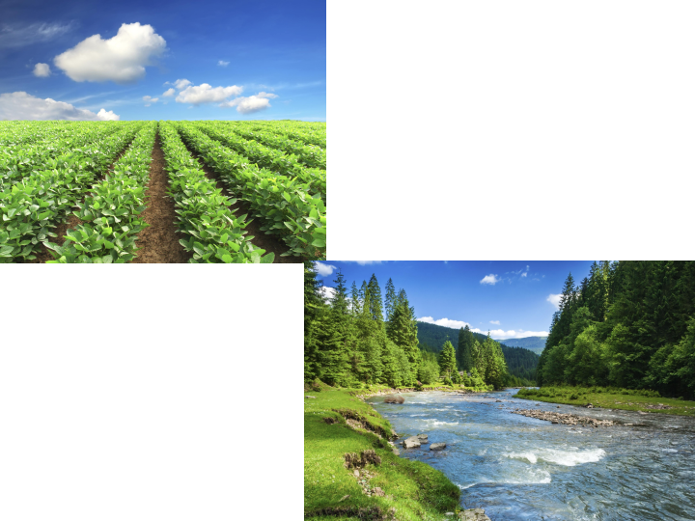
Notes:
Things like plants, fresh water, and sunlight are not examples of nonrenewable resources. Unlike nonrenewable resources, they are replaced fairly quickly.

Slide 31
Notes:
Let’s check-in for understanding.
Feedback: It is important to provide multiple opportunities for students to demonstrate understanding, this helps you catch some confusion early and get students back on track.

Slide 32
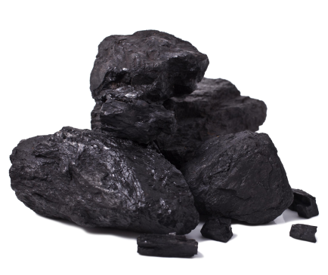
Is coal a non-renewable resource?
Notes:
Is coal a non-renewable resource?
[Yes.]

Slide 33
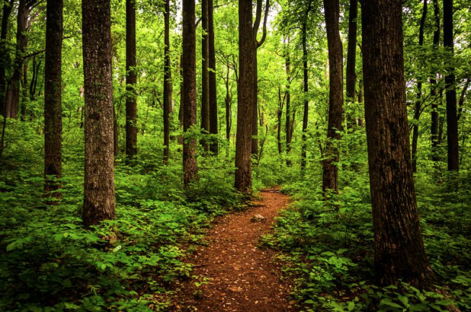
Are trees a non-renewable resource?
Notes:
Are trees a non-renewable resource?
[No.]

Slide 34
Is aluminum a non-renewable resource?
Notes:
Is aluminum a non-renewable resource?
[Yes.]

Slide 35
Notes:
To think about the definition of non-renewable, it is helpful to look at its word parts.
Feedback: Using morphological word parts is extremely beneficial for students. Take the time to break the word down and define each individual word part for students.

Slide 36
Notes:
One way to help you figure out what nonrenewable means is two of its word parts: Non- and Re-.

Slide 37
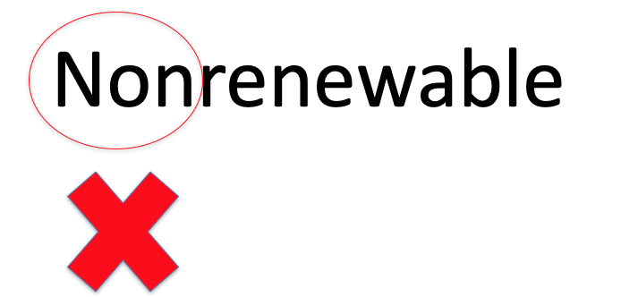
Notes:
Non- means not.

Slide 38
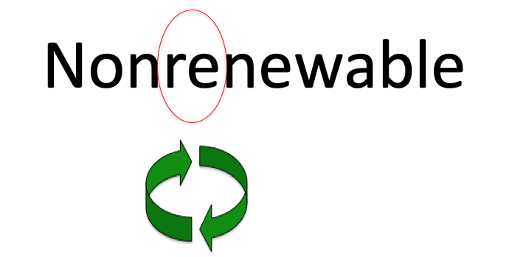
Notes:
Re- means again.

Slide 39
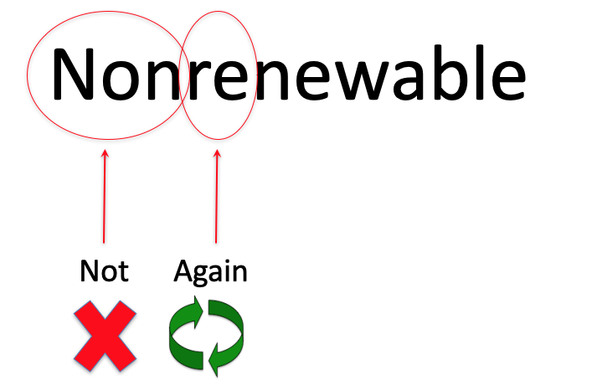
Notes:
So, something that is nonrenewable is not made again or is replaced very slowly.
Feedback: Once you had broken down the word parts it was great to see you put it all back together again and review one more time for the students.

Slide 40
Notes:
Let’s check-in for understanding.

Slide 41
How can we use the word parts of non-renewable to help us remember the definition of the term?
Notes:
How can we use the word parts of non-renewable to help us remember the definition of the term?
[One way to help you figure out what nonrenewable means is two of its word parts: Non- and Re-.
Non- means not.
Re- means again.
So, something that is nonrenewable is not made again or is replaced very slowly.]
Feedback: As you broke down the vocab term into parts take a second and confirm student understanding before moving on.

Slide 42
Renewable Resources
Notes:
Now, let’s define our new term, renewable resources.

Slide 43
Renewable resource: remade quickly over and over again
Notes:
A renewable resource is a resource that is remade quickly over and over again.

Slide 44
Notes:
Now, let’s pause for a moment to check your understanding.

Slide 45
What is a renewable resource?
Notes:
What is a renewable resource?
[A renewable resource is a resource that is remade quickly over and over again.]

Slide 46
Notes:
Now, let’s talk about some examples of renewable resources.

Slide 47
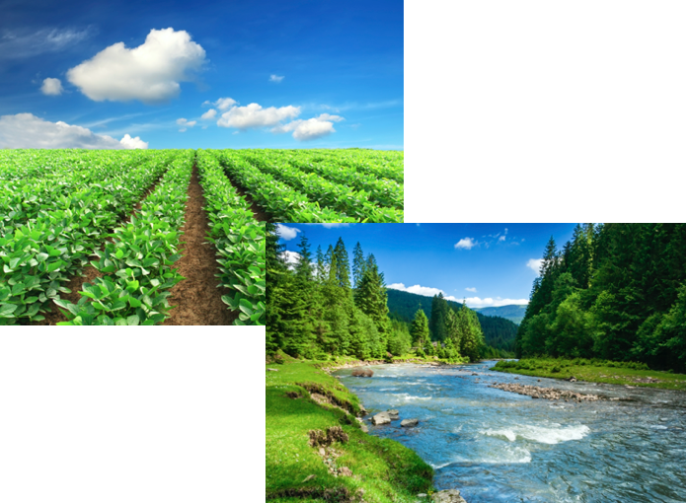
Notes:
Two examples of renewable resources are plants and water. Once they are used, they can be quickly replaced by nature. This may mean a season or several years. For example, plants are renewed by season.

Slide 48
Notes:
Sunlight is renewable because it is made over and over again.

Slide 49
Notes:
Next, let’s talk about some non-examples of renewable resources.

Slide 50
Notes:
Oil is not renewable. Once oil is used as fuel, it cannot be used again.

Slide 51
Notes:
Once gasoline is used as an energy source, it cannot be reused. Gasoline is non-renewable.

Slide 52
Notes:
Let’s check-in for understanding.

Slide 53
Provide two examples of a renewable resource.
Notes:
Provide two examples of a renewable resource.

Slide 54
Is gasoline a renewable resource? Explain your answer.
Notes:
Is gasoline a renewable resource? Explain your answer.
[No, gasoline is a non-renewable resource. Once gasoline is used as an energy source, it cannot be reused.]

Slide 55
Notes:
To think about the definition of renewable, it is helpful to look at its word parts.

Slide 56
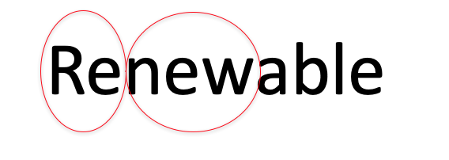
Notes:
One way to help you figure out what renewable means is its word parts, Re- and new.

Slide 57
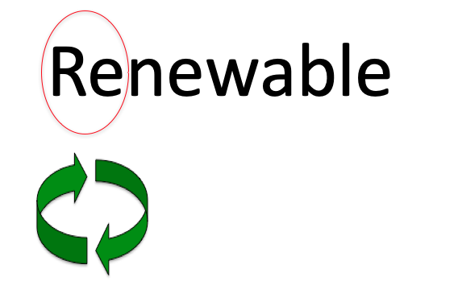
Notes:
Re- means again. Any time you see a word that begins with the prefix Re-, you know something is happening again.

Slide 58
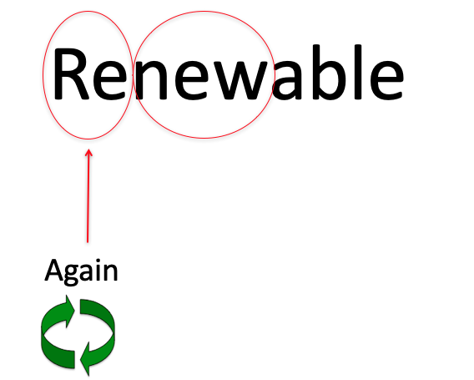
Notes:
So, something that is renewable is made new over again.

Slide 59
Notes:
Let’s check-in for understanding.

Slide 60
How can we use the word parts of renewable to help us remember the definition of the term?
Notes:
How can we use the word parts of renewable to help us remember the definition of the term?
[One way to help you figure out what renewable means is its word parts, Re- and new.
Re- means again. Any time you see a word that begins with the prefix Re-, you know something is happening again.
So, something that is renewable is made new over again.]

Slide 61
What is a non-renewable resource?
Notes:
What is a non-renewable resource?
[A non-renewable resource is remade slowly or not at all.]

Slide 62
Is coal a non-renewable resource?
Notes:
Is coal a non-renewable resource?
[Yes.]

Slide 63
Are trees a non-renewable resource?
Notes:
Are trees a non-renewable resource?
[No.]

Slide 64
Is aluminum a non-renewable resource?
Notes:
Is aluminum a non-renewable resource?
[Yes.]

Slide 65
What is a renewable resource?
Notes:
What is a renewable resource?
[A renewable resource is a resource that is remade quickly over and over again.]

Slide 66
Provide two examples of a renewable resource.
Notes:
Provide two examples of a renewable resource.

Slide 67
Is gasoline a renewable resource? Explain your answer.
Notes:
Is gasoline a renewable resource? Explain your answer.
[No, gasoline is a non-renewable resource. Once gasoline is used as an energy source, it cannot be reused.]

Slide 68
What is the difference between renewable and non-renewable resources?
Notes:
What is the difference between renewable and non-renewable resources?

Slide 69
Remember!!!
Notes:
So remember!
Feedback: Review key information one last time before closing the lesson.

Slide 70
Non-renewable resource: remade slowly or not at all
Notes:
A non-renewable resource is remade slowly or not at all.

Slide 71
Renewable resource: remade quickly over and over again
Notes:
A renewable resource is a resource that is remade quickly over and over again.

Slide 72
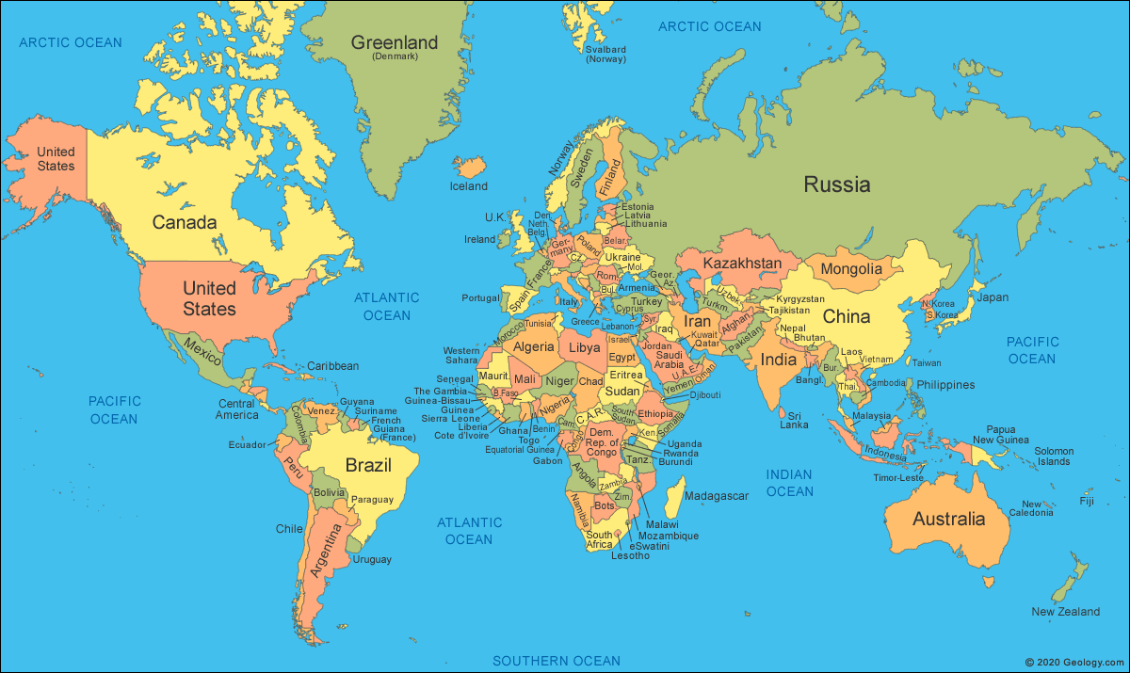
Simulation Activity
Extension Activity: World Energy Usage
TEACHER DIRECTIONS
Do the extension activity. Students will be “ambassadors” for different continents and countries will freely trade resources or energy for their continents. Ties in with social studies and geography. Discuss how different populations use differing amounts of energy and resources, and how that can affect the planet.

Slide 73
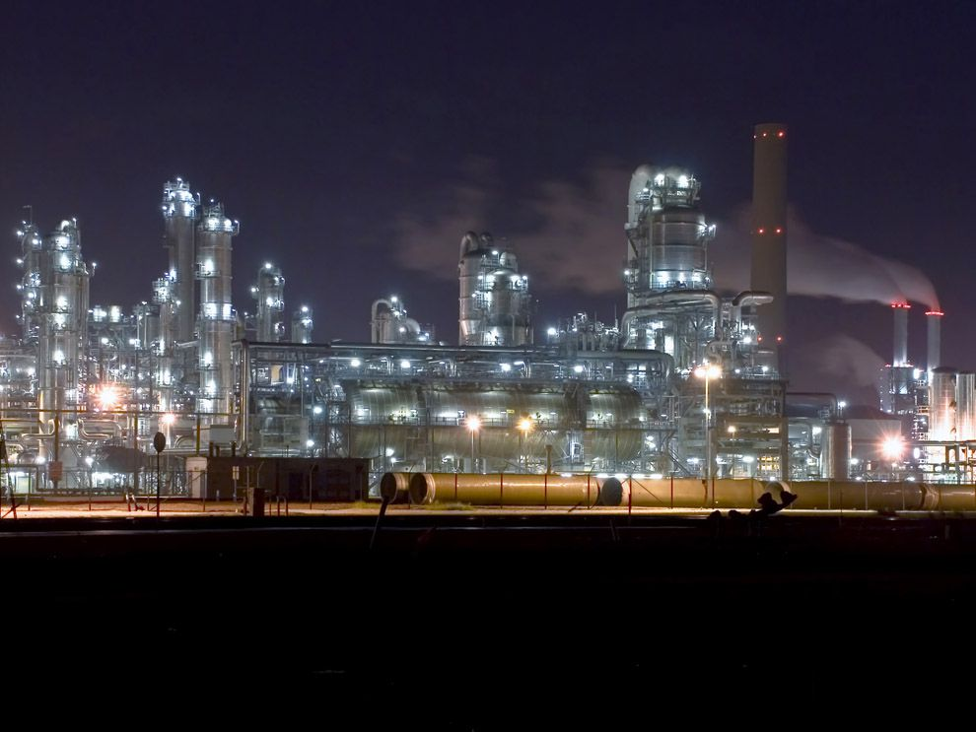
Simulation Activity
Non-Renewable Energy Resources
In this simulation, students take on the roles of consumers, utility companies, and fuel companies to simulate the effect of a finite supply of non-renewable energy resources on our supply of electricity.
Notes:
In this simulation, students take on the roles of consumers, utility companies, and fuel companies to simulate the effect of a finite supply of non-renewable energy resources on our supply of electricity.

Slide 74
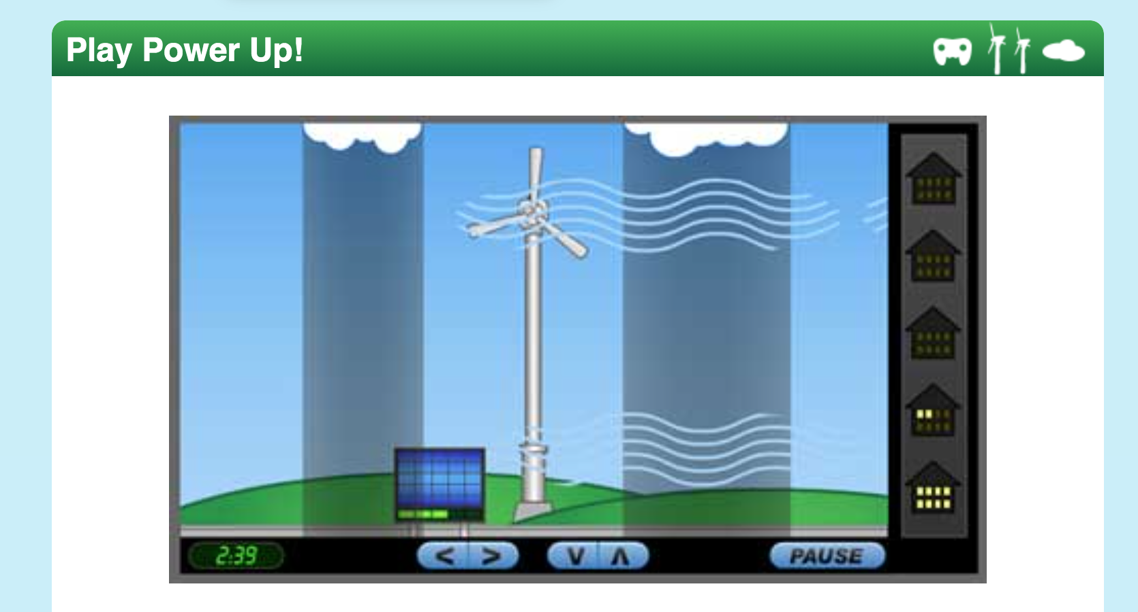
Simulation Activity
Play Power Up!
Capture clean energy from the wind and the Sun to produce enough electricity to run the town. Move your wind turbine up and down to keep it in the strongest, fastest winds. Keep your solar panels in the bright sunlight and out of the rain. See if you can light up the whole town. Win the clean energy Platinum Award!
Notes:
Capture clean energy from the wind and the Sun to produce enough electricity to run the town. Move your wind turbine up and down to keep it in the strongest, fastest winds. Keep your solar panels in the bright sunlight and out of the rain. See if you can light up the whole town. Win the clean energy Platinum Award!

Slide 75
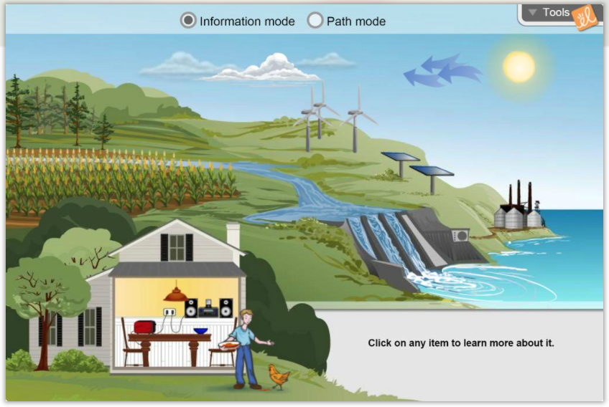
Simulation Activity
Energy Conversions
In this Gizmo, students can discover how living things get energy to move and grow. Students will trace the path of energy and see how energy is converted from one form to another. The energy sources in this Gizmo are renewable.
Notes:
In this Gizmo, students can discover how living things get energy to move and grow. Students will trace the path of energy and see how energy is converted from one form to another. The energy sources in this Gizmo are renewable.

Slide 76
Big Question: How do the resources we use affect humans and the environment?
Notes:
Explicit cue to revisit the big question at the end of the lesson: Okay everyone. Now that we’ve learned the term, let’s reflect once more on our big question. Was there anything that we predicted earlier that was correct or incorrect? Do you have any new hypotheses to share?

Slide 77
Notes:
Thanks for watching, and please continue watching CAPs available from this website.

Slide 78
This Video Was Created With Resources From:
Questions or Comments
Michael Kennedy, Ph.D. MKennedy@Virginia.edu
Rachel L Kunemund, Ph.D. rk8vm@virginia.edu

