Slide 1
Intro
“Big Idea” Question
Review Concepts
Check-In Questions
Teacher Demo
Vocabulary
Student-Friendly Definition
Examples & Non-Examples
Morphological Word Parts
Simulation/Activity
Notes:
OK everyone, get ready for our next lesson. Just as a reminder, these are the different components that our lesson may include, and you’ll see these icons in the top left corner of each slide so that you can follow along more easily!

Slide 2
Intro
Nuclear Energy
Notes:
Today we will learn about nuclear energy.

Slide 3
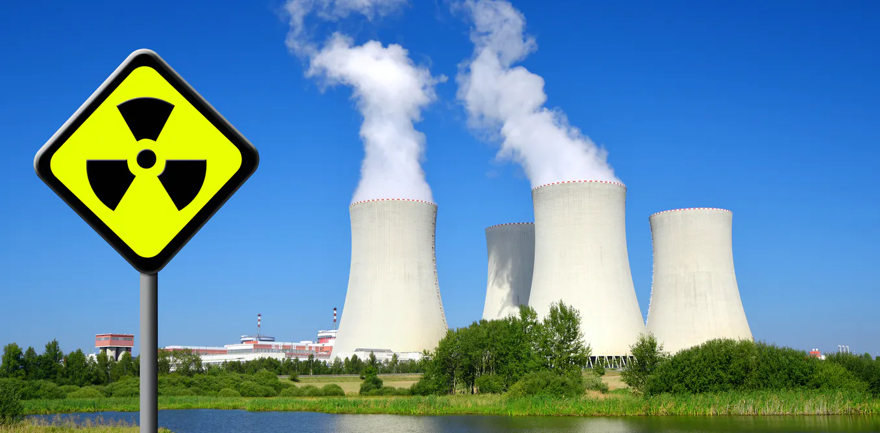
Big Question: How can nuclear energy be converted into other forms of energy?
Notes:
Our “big question” is: How can nuclear energy be converted into other forms of energy?
[Pause and illicit predictions from students.]
I love all these thoughtful scientific hypotheses! Be sure to keep this question and your predictions in mind as we move through these next few lessons, and we’ll continue to revisit it.

Slide 4
Notes:
Before we move on to our new vocabulary term, let’s review some other words & concepts that you already learned and make sure you are firm in your understanding.
Feedback: Reviewing key background knowledge helps lay the context and sets the students up to make sense of the new content you are introducing, it also reinforces previously learned material.

Slide 5
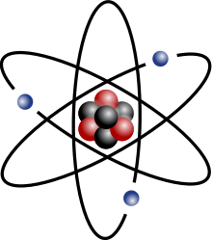
Atom: smallest whole unit of matter
Notes:
An atom is the smallest whole unit of matter.

Slide 6
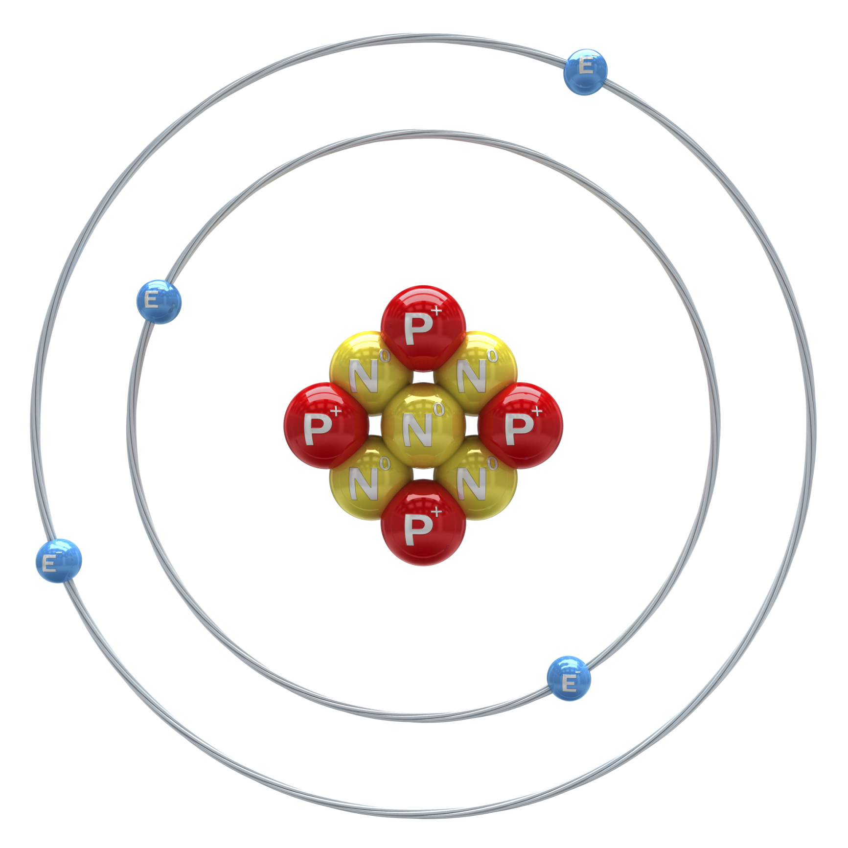
Atomic Nucleus: the center of the atom
Nucleus
Notes:
The atomic nucleus is the center of the atom.

Slide 7
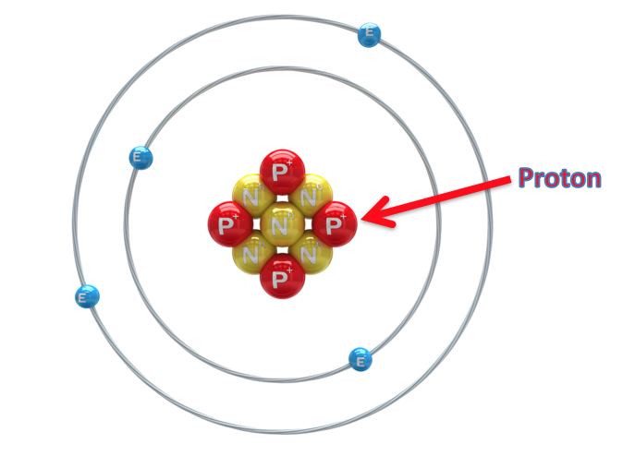
Proton: positively charged subatomic particle found in the nucleus of an atom
Notes:
A proton is a positively charged subatomic particle found in the nucleus of an atom.

Slide 8
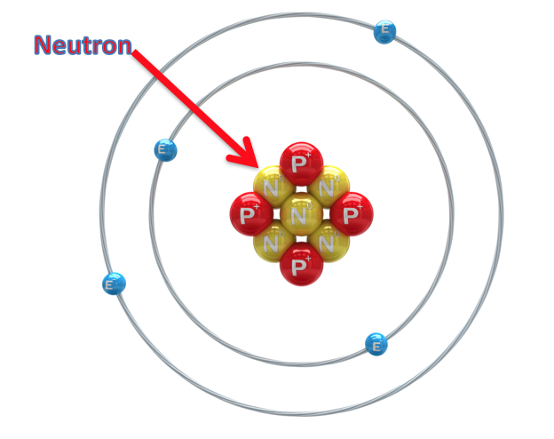
Neutron: subatomic particle with a neutral charge, found in the nucleus of an atom
Notes:
A neutron is a subatomic particle with a neutral charge, found in the nucleus of an atom.

Slide 9
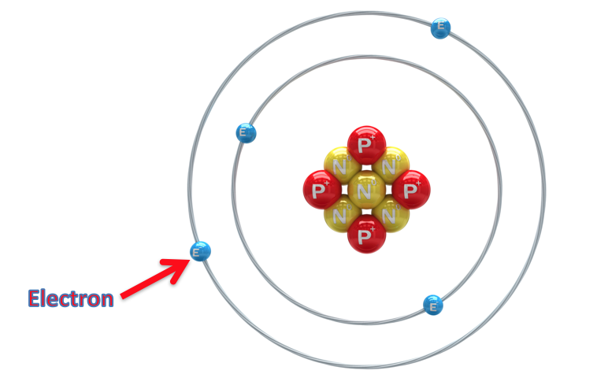
Electron: negatively charged particle that orbits the nucleus of an atom
Notes:
An electron is a negatively charged particle that orbits the nucleus.

Slide 10
Energy: the ability to cause change
Notes:
Energy is the ability to cause change.

Slide 11
Notes:
Now, let’s pause for a moment to check your understanding.
Feedback: Monitoring understanding during review is an important step before moving on to new material.

Slide 12
What is an atom?
Notes:
What is an atom?
[An atom is the smallest whole unit of matter.]

Slide 13
What is an atomic nucleus?
Nucleus
Notes:
What is an atomic nucleus?
[The atomic nucleus is the center of an atom.]

Slide 14
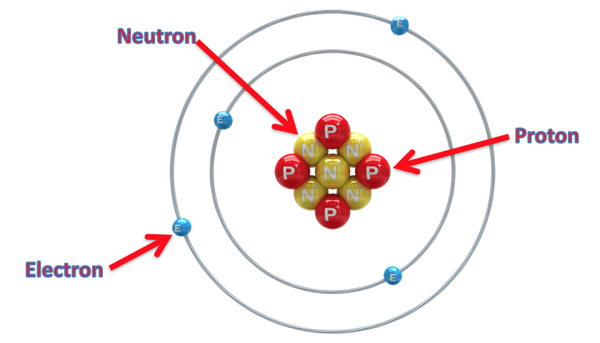
What are the 3 subatomic particles? Explain their similarities and differences.
Notes:
What are the 3 subatomic particles? Explain their similarities and differences.
[The 3 subatomic particles are protons, neutrons, and electrons. Neutrons and protons are both found in the nucleus, however, protons are positively charged and neutrons have a neutral charge. Electrons are negatively charged and orbit the nucleus.]

Slide 15
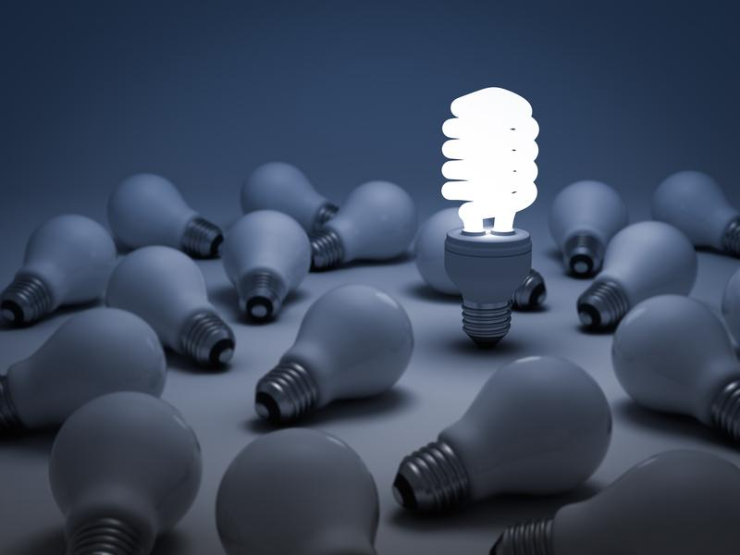
What is energy?
Notes:
What is energy?
[Energy is the ability to cause change.]

Slide 16
Nuclear Energy
Notes:
Now that we’ve reviewed, let’s define our new term, nuclear energy.

Slide 17
Nuclear Energy: energy released by nuclear reactions
Notes:
Nuclear energy is energy released by nuclear reactions (fusion, fission, or decay).
Feedback: Using clear language can take make formal more complicated definitions a little easier for students to understand.

Slide 18
Notes:
Now, let’s pause for a moment to check your understanding.
Feedback: It is important to provide opportunities for students to demonstrate understanding, this help you catch some confusion early and get students back on track.

Slide 19
What is nuclear energy?
Notes:
What is nuclear energy?
[Nuclear energy is energy released by nuclear reactions (fusion, fission, or decay).]

Slide 20
Notes:
That’s the basic definition, but there’s more you need to know.

Slide 21
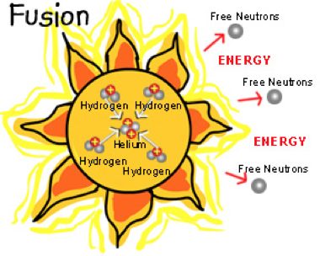
Can be Natural
Notes:
Nuclear energy can be natural or man-made. An example of natural nuclear energy is the heat and light produced by the sun. The sun is an example of nuclear fusion where two atoms are fused or joined together to become one atom.

Slide 22
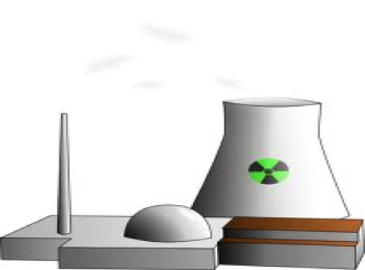
Can be Man-Made
Notes:
An example of man-made nuclear energy is the energy produced by a nuclear power plant reactor. Nuclear reactors use nuclear fission. One uranium atom is split to form two new atoms and release a huge amount of energy.

Slide 23
Notes:
Nuclear energy is a non-renewable resource.

Slide 24
Notes:
Now, let’s pause for a moment to check your understanding.

Slide 25
True/False: Nuclear energy can be natural or man-made.
Notes:
True/False: Nuclear energy can be natural or man-made.

Slide 26
True/False: Nuclear energy can be natural or man-made.
Notes:
True/False: Nuclear energy can be natural or man-made.
[True]

Slide 27
Is nuclear energy a renewable or non-renewable resource?
Notes:
Is nuclear energy a renewable or non-renewable resource?
[Nuclear energy is a non-renewable resource.]

Slide 28
Notes:
Now, let’s talk about some examples of nuclear energy.
Feedback: It is important to not only introduce an example of the term but also include images to go along with it, this is a great way to help students make connections.

Slide 29
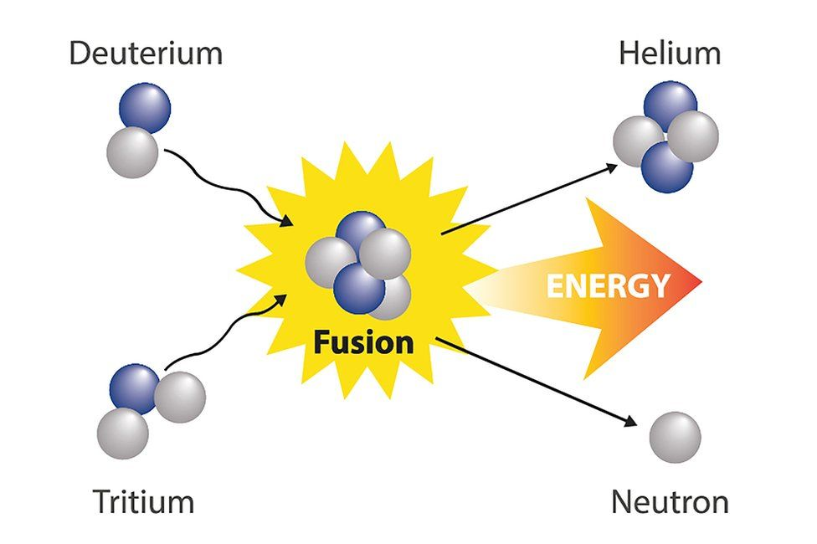
Notes:
A fusion reaction is a type nuclear reaction in which two or more nuclei form one new nucleus.

Slide 30
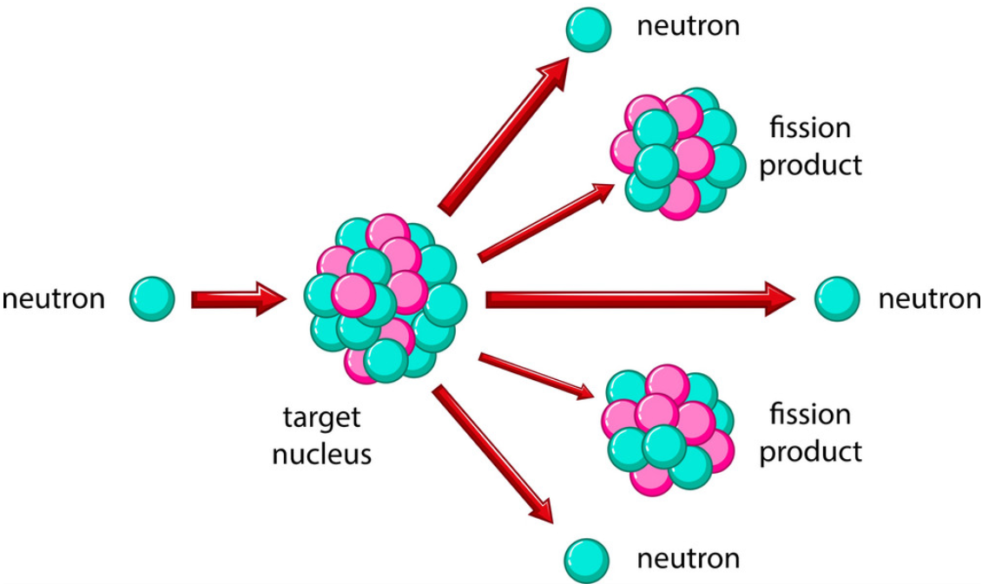
Notes:
A fission reaction is a type nuclear reaction in which one nucleus is split into two or more nuclei.

Slide 31
Notes:
Next, let’s talk about some non-examples of nuclear energy.
Feedback: Take a moment to explicitly distinguish between the similarities of the non-examples and the vocabulary term. This helps students resolve any misconceptions they may have.

Slide 32
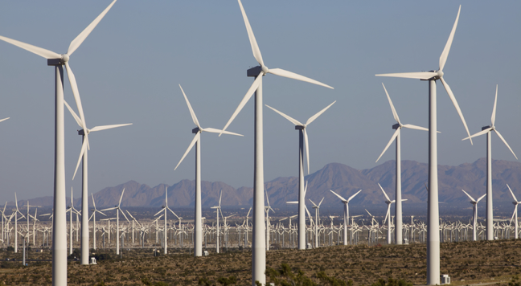
Renewable
Notes:
Renewable energy can be replaced in a short amount of time. Wind is renewable energy. You can replace it in a short amount of time. Renewable energy is not an example of nuclear energy.

Slide 33
Notes:
Let’s check-in for understanding.

Slide 34
What are two examples of nuclear reactions that produce energy?
Notes:
What are two examples of nuclear reactions that produce energy?
[Fusion and fission]

Slide 35
Is wind energy an example of nuclear energy?
Notes:
Is wind energy an example of nuclear energy?
[No, wind energy is a renewable energy source.]

Slide 36
Notes:
To think about the definition of nuclear energy, it is helpful to look at its word parts.
Feedback: Your use of morphological word parts was extremely beneficial for students, you took the time to break the word down and define each individual word part for students.

Slide 37
Nuclear Energy
Nucleus = “of or belonging to the nucleus of an atom”
Notes:
Nuclear comes from the word nucleus which means “of or belonging to the nucleus of an atom.”

Slide 38
Nuclear Energy
Energy from the nucleus of an atom
Notes:
So, when we put it all together, we get that nuclear energy is energy from the nucleus of an atom.
Feedback: Reuniting the word parts is a crucial step in helping students understand the whole picture when reviewing morphological word parts.

Slide 39
Notes:
Let’s check-in for understanding.

Slide 40
What is nuclear energy?
Notes:
What is nuclear energy?
[Nuclear energy is energy released by nuclear reactions (fusion, fission, or decay).]

Slide 41
True/False: Nuclear energy can be natural or man-made.
Notes:
True/False: Nuclear energy can be natural or man-made.

Slide 42
True/False: Nuclear energy can be natural or man-made.
Notes:
True/False: Nuclear energy can be natural or man-made.
[True]

Slide 43
Is nuclear energy a renewable or non-renewable resource?
Notes:
Is nuclear energy a renewable or non-renewable resource?
[Nuclear energy is a non-renewable resource.]

Slide 44
What are two examples of nuclear reactions that produce energy?
Notes:
What are two examples of nuclear reactions that produce energy?
[Fusion and fission]

Slide 45
Is wind energy an example of nuclear energy?
Notes:
Is wind energy an example of nuclear energy?
[No, wind energy is a renewable energy source.]

Slide 46
Remember!!!
Notes:
So remember!
Feedback: Review the key term one last time before closing the lesson to lock in students’ understanding.

Slide 47
Nuclear Energy: energy released by nuclear reactions
Notes:
Nuclear energy is energy released by nuclear reactions (fusion, fission, or decay).

Slide 48
Big Question: How can nuclear energy be converted into other forms of energy?
Notes:
Explicit cue to revisit the big question at the end of the lesson: Okay everyone. Now that we’ve learned the term, let’s reflect once more on our big question. Was there anything that we predicted earlier that was correct or incorrect? Do you have any new hypotheses to share?

Slide 49
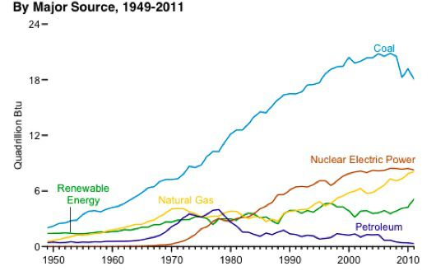
Simulation Activity
Evaluating Other Energy Sources
Students analyze various energy sources, comparing the costs and benefits of natural gas, coal, biomass, nuclear, wind, hydropower, and solar power for generating electricity. Students use real-world data to evaluate the relative costs and benefits of using different fuel sources to generate electricity.
Notes:
Students analyze various energy sources, comparing the costs and benefits of natural gas, coal, biomass, nuclear, wind, hydropower, and solar power for generating electricity. Students use real-world data to evaluate the relative costs and benefits of using different fuel sources to generate electricity.
Feedback: Have students analyze and interpret data, this is a great way to help them to continue to independently problem solve.

Slide 50
Notes:
Thanks for watching, and please continue watching CAPs available from this website.

Slide 51
This Video Was Created With Resources From:
Questions or Comments
Michael Kennedy, Ph.D. MKennedy@Virginia.edu
Rachel L Kunemund, Ph.D. rk8vm@virginia.edu

