Slide 1
Intro
“Big Idea” Question
Review Concepts
Check-In Questions
Teacher Engagement
Vocabulary
Student-Friendly Definition
Examples & Non-Examples
Morphological Word Parts
Frayer Model
Simulation/Activity
Notes:
OK everyone, get ready for our next lesson. Just as a reminder, these are the different components that our lesson may include, and you’ll see these icons in the top left corner of each slide so that you can follow along more easily!

Slide 2
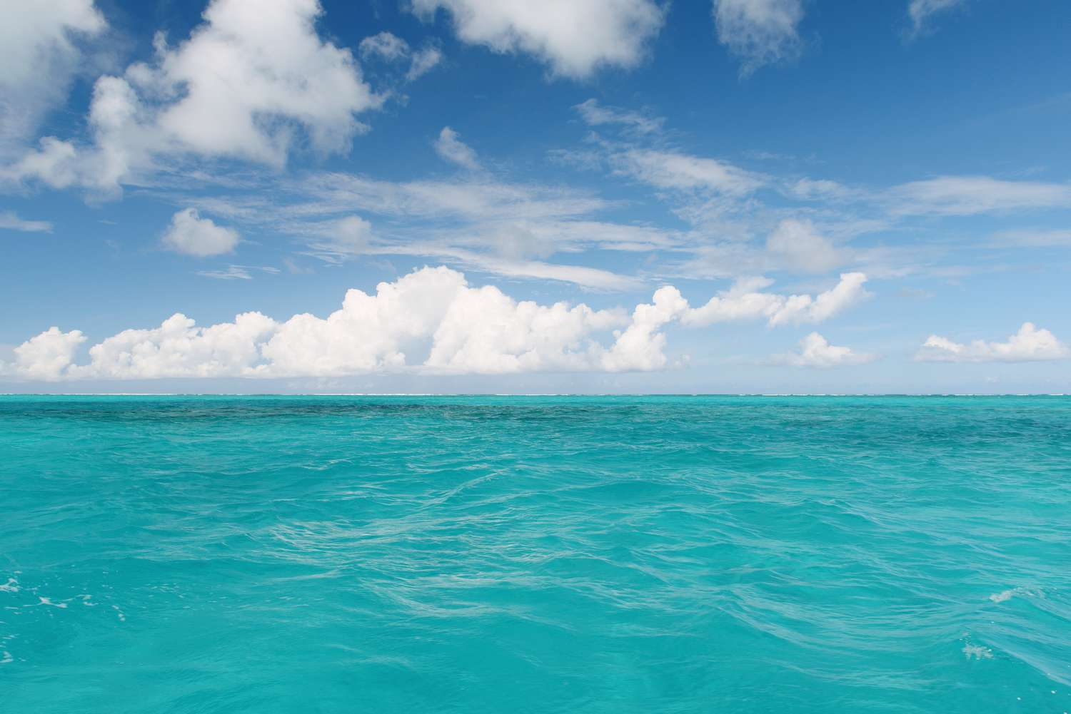
Intro
Ocean
Notes:
Today, we’ll be learning about the word: Ocean.

Slide 3
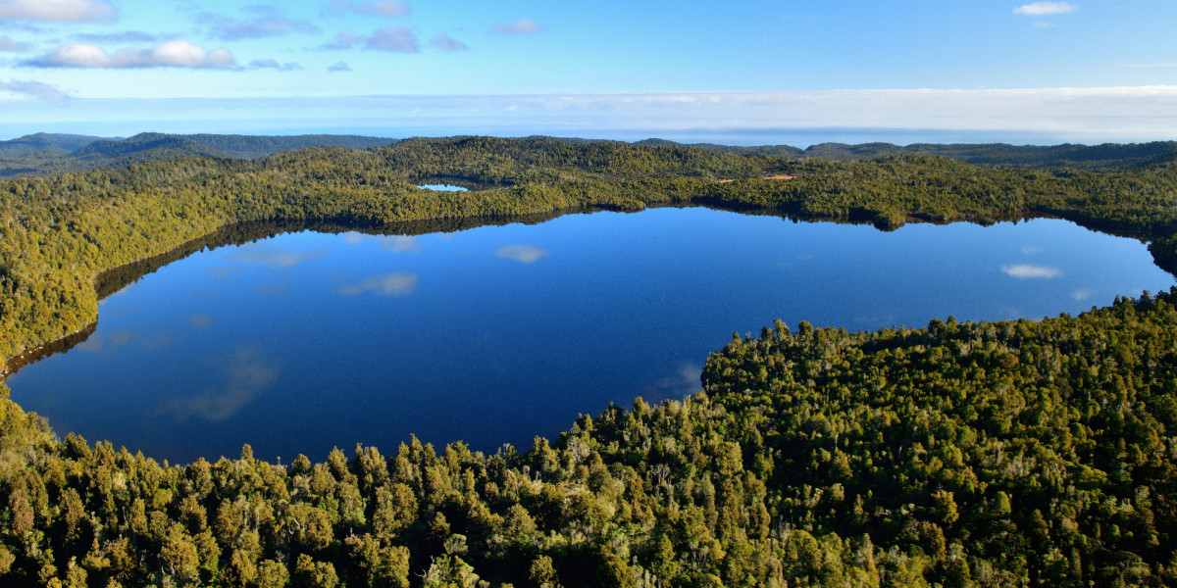
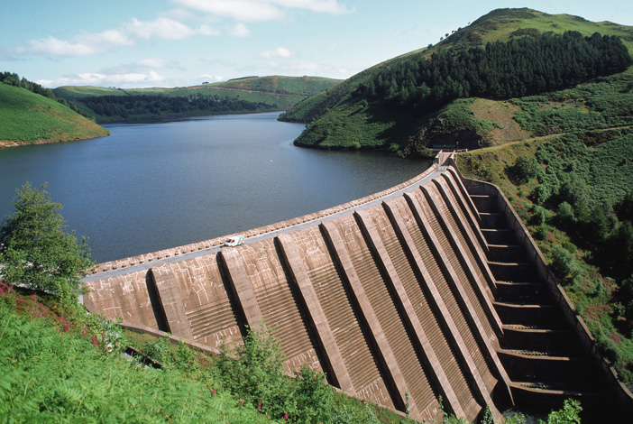
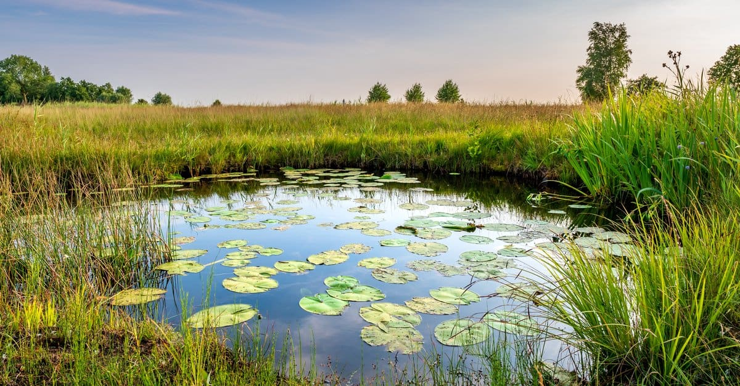
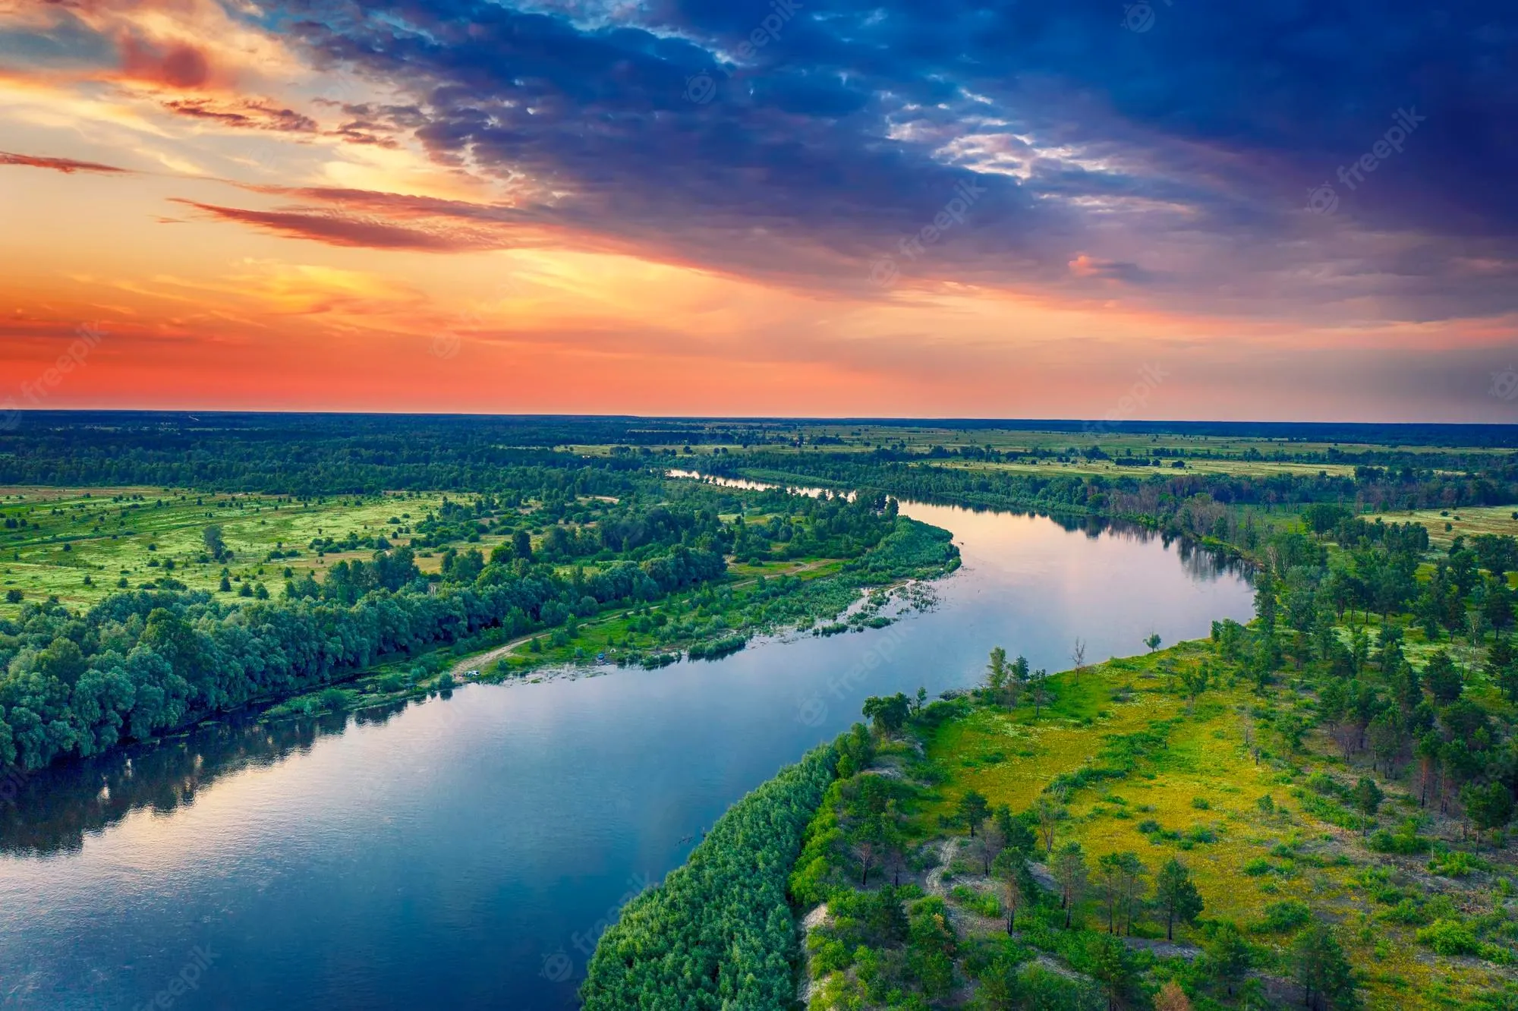
Big Question: What are the differences between lakes, oceans, ponds, reservoirs, and rivers?
Notes:
Our “big question” is: What are the differences between lakes, oceans, ponds, reservoirs, and rivers?
[Pause and illicit predictions from students.]
I love all these thoughtful scientific hypotheses! Be sure to keep this question and your predictions in mind as we move through these next few lessons, and we’ll continue to revisit it.

Slide 4
Notes:
Before we move on to our new topic, let’s review some other words & concepts that you already learned and make sure you are firm in your understanding.

Slide 5
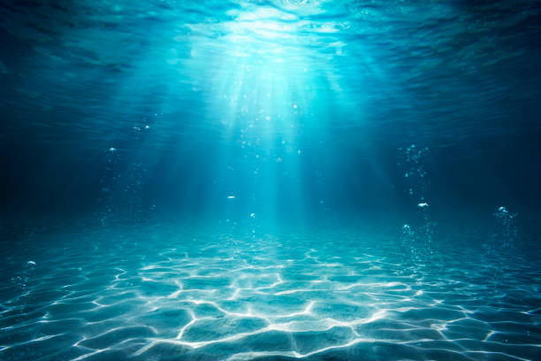
Aquatic: living, growing, or often found in the water
Notes:
Aquatic means something living, growing, or often found in water.

Slide 6
Lake: A natural, large body of water surrounded by land
Notes:
A lake is a natural, large body of water surrounded by land.

Slide 7
Reservoir: A man-made, large body of water surrounded by land.
Notes:
A reservoir is a man-made, large body of water surrounded by land.

Slide 8
Notes:
Now let’s pause for a moment to review the information we have covered already.

Slide 9
Aquatic means living, growing, or often found in/on…
land
water
Notes:
Aquatic means living, growing, or often found in/on…
[water]

Slide 10
Aquatic means living, growing, or often found in/on…
land
water
Notes:
Aquatic means living, growing, or often found in/on…
[water]

Slide 11
A lake is a _____, large body of water surrounded by land.
man-made
natural
Notes:
A lake is a ______, large body of water surrounded by land
[natural]

Slide 12
A lake is a _____, large body of water surrounded by land.
man-made
natural
Notes:
A lake is a ______, large body of water surrounded by land
[natural]

Slide 13
True or false: A reservoir is a man-made, large body of water surrounded by land.
True
False
Notes:
True or false: A reservoir is a man-made, large body of water surrounded by land.
[True]

Slide 14
True or false: A reservoir is a man-made, large body of water surrounded by land.
True
False
Notes:
True or false: A reservoir is a man-made, large body of water surrounded by land.
[True]

Slide 15
Ocean
Notes:
Now that we’ve reviewed, let’s define the phrase ocean.

Slide 16
Ocean: A giant body of saltwater.
Notes:
An ocean is a giant body of saltwater.

Slide 17
Notes:
Let’s check-in for understanding.

Slide 18
What is an ocean?
Notes:
What is an ocean?
[An ocean is a giant body of saltwater.]

Slide 19
Notes:
That is the basic definition, but there is a bit more you need to know.

Slide 20
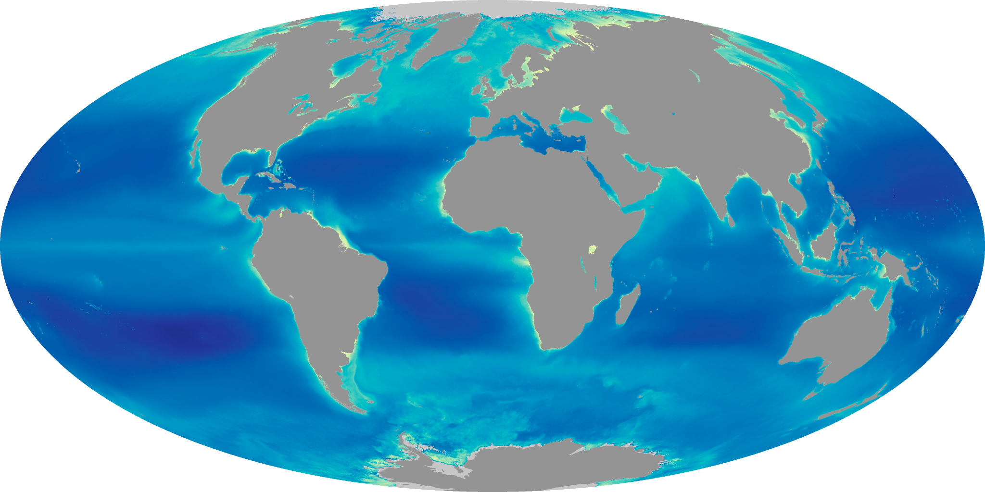
Oceans are the largest habitat on Earth. They cover over 70% of the Earth’s surface.
Notes:
Oceans are the largest habitat on Earth. They cover over 70% of the Earth’s surface.

Slide 21
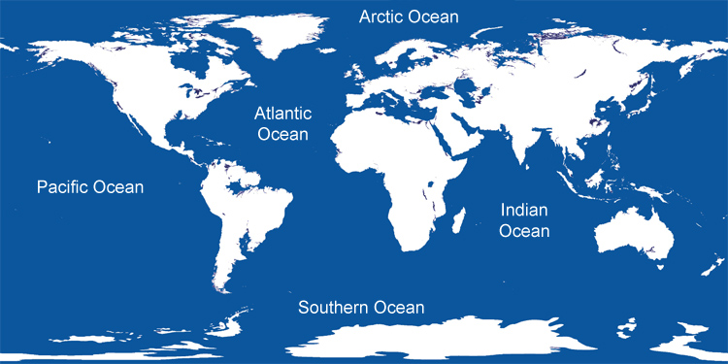
Earth has five major oceans: Pacific Ocean, Atlantic Ocean, Indian Ocean, Southern Ocean, and the Arctic Ocean
Notes:
Earth has five major oceans: Pacific Ocean, Atlantic Ocean, Indian Ocean, Southern Ocean, and the Arctic Ocean

Slide 22
Oceans are critical habitats for Earth. Tiny plants that live in the ocean (called phytoplankton), produce about 50-85% of the Earth’s oxygen through photosynthesis.
oxygen
Notes:
Oceans are critical habitats for Earth. Tiny plants that live in the ocean (called phytoplankton), produce about 50-85% of the Earth’s oxygen through photosynthesis.

Slide 23
Notes:
Let’s check-in for understanding.

Slide 24
Oceans are the largest habitat on Earth. They cover over ____ of the Earth’s surface.
30%
70%
100%
Notes:
Oceans are the largest habitat on Earth. They cover over ____ of the Earth’s surface.
[70%]

Slide 25
Oceans are the largest habitat on Earth. They cover over 70% of the Earth’s surface.
30%
70%
100%
Notes:
Oceans are the largest habitat on Earth. They cover over ____ of the Earth’s surface.
[70%]

Slide 26
Earth has five major oceans. Can you name them?
Notes:
Earth has five major oceans. Can you name them?
[Arctic Ocean, Atlantic Ocean, Pacific Ocean, Indian Ocean, Southern Ocean]

Slide 27
Earth has five major oceans. Can you name them?
Notes:
Earth has five major oceans. Can you name them?
[Arctic Ocean, Atlantic Ocean, Pacific Ocean, Indian Ocean, Southern Ocean]

Slide 28
Oceans are critical habitats for Earth. Tiny plants that live in the ocean (called phytoplankton), produce about 50-85% of the Earth’s ________ through photosynthesis.
light
oxygen
Notes:
Oceans are critical habitats for Earth. Tiny plants that live in the ocean (called phytoplankton), produce about 50-85% of the Earth’s ________ through photosynthesis.
[B. oxygen]

Slide 29
Oceans are critical habitats for Earth. Tiny plants that live in the ocean (called phytoplankton), produce about 50-85% of the Earth’s oxygen through photosynthesis.
light
oxygen
oxygen
Notes:
Oceans are critical habitats for Earth. Tiny plants that live in the ocean (called phytoplankton), produce about 50-85% of the Earth’s ________ through photosynthesis.
[B. oxygen]

Slide 30
Notes:
Now, let’s talk about some examples of ocean.

Slide 31
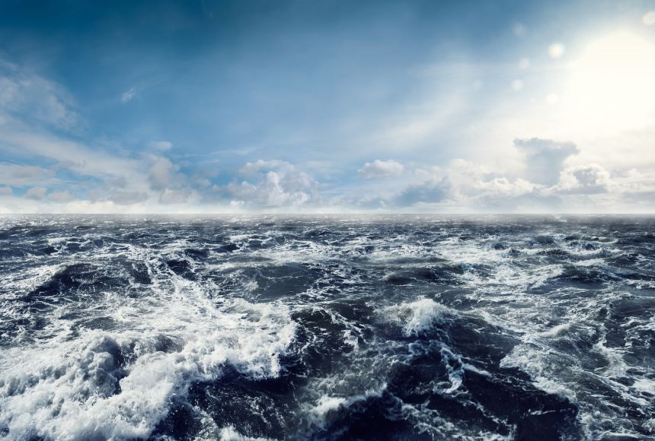
This is an example of an ocean. It is a giant body of saltwater.
Notes:
This is an example of an ocean. It is a giant body of saltwater.

Slide 32
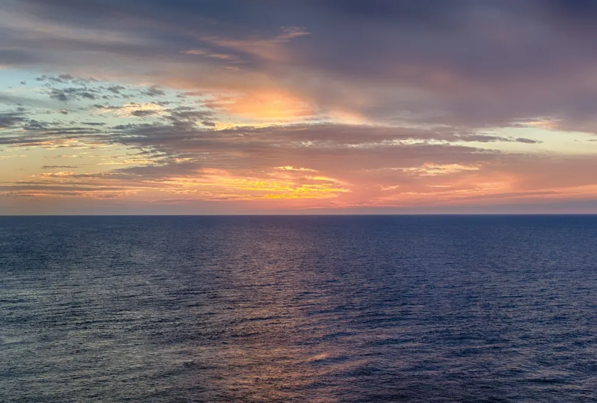
This is also an example of an ocean. Again, it is a giant body of saltwater.
Photo: Georgia Coast Atlas
Notes:
This is also an example of an ocean. Again, it is a giant body of saltwater.

Slide 33
Notes:
Now, let’s talk about some non-examples of ocean.

Slide 34
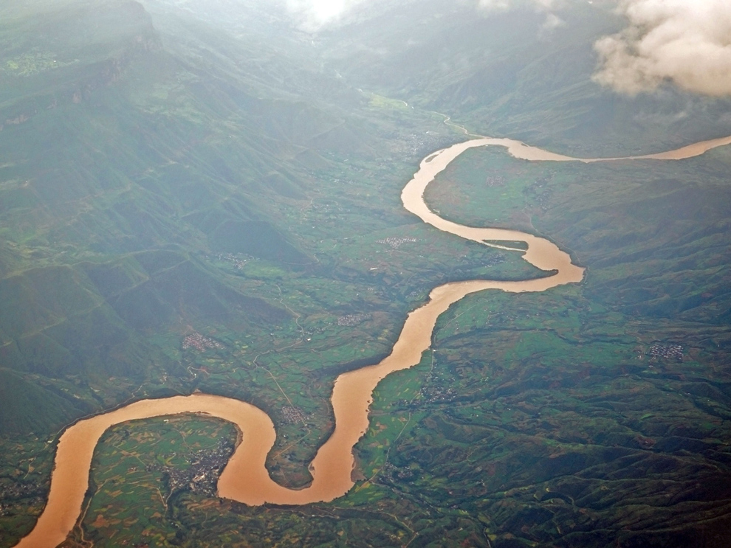
This is not an ocean. It is not a giant body of saltwater.
Notes:
This is not an ocean. It is not a giant body of saltwater.

Slide 35
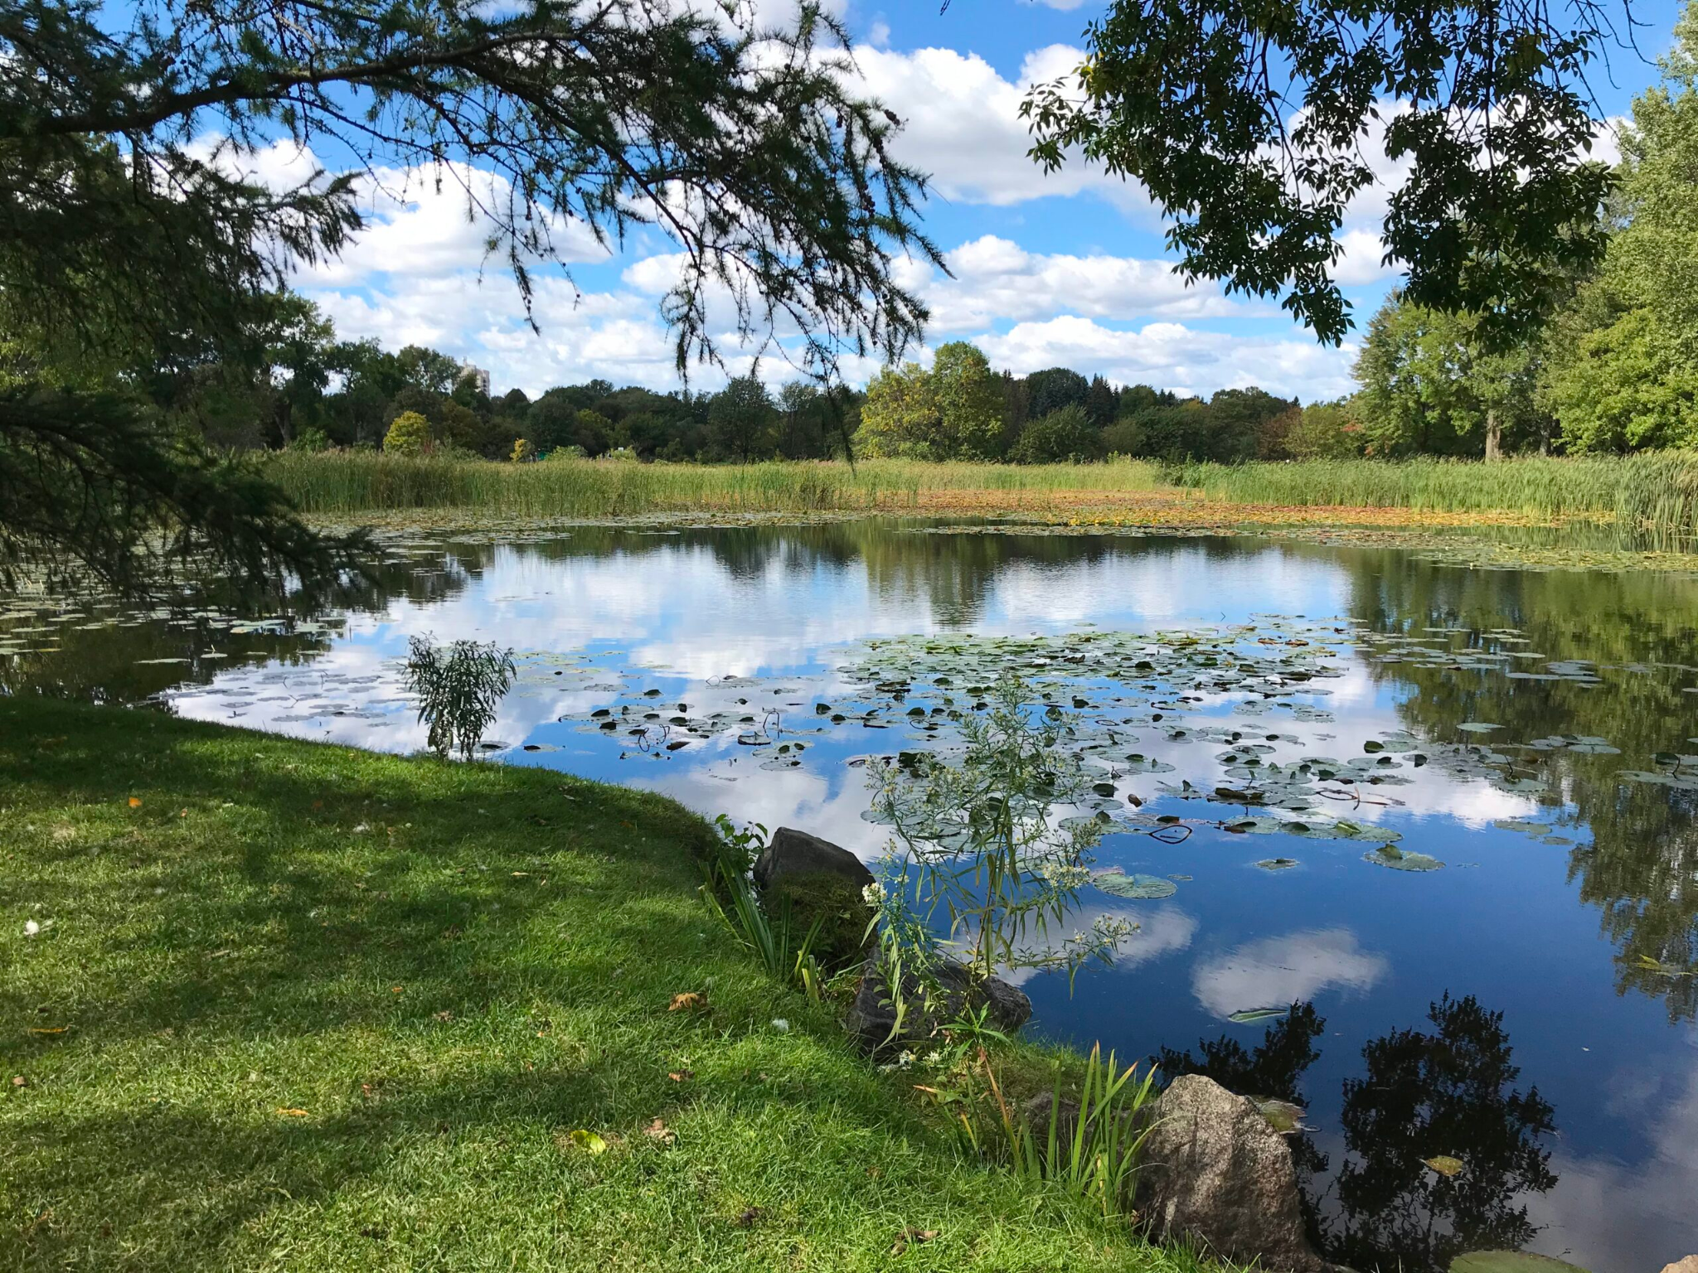
This is also not an ocean. It is not a giant body of saltwater.
Notes:
This is also not an ocean. It is not a giant body of saltwater.

Slide 36
Notes:
Now let’s pause for a moment to check your understanding.

Slide 37
Which of these is an ocean?
Notes:
Which of these is an ocean?
[The right picture.]

Slide 38
Which of these is an ocean?
Notes:
Which of these is an ocean?
[The right picture.]

Slide 39
Remember!!!
Notes:
So remember!

Slide 40
Ocean: A giant body of saltwater.
Notes:
An ocean is a giant body of saltwater.

Slide 41
Notes:
We will now complete this concept map, called a Frayer model, to summarize and further clarify what you have learned about the term ocean.

Slide 42
Definition
Picture
Ocean
Example
How do oceans impact my life?
Notes:
To complete the Frayer model, we will choose from four choices the correct picture, definition, example, and response to the question, “How do oceans impact my life?” Select the best response for each question using the information you just learned. As we select responses, we will see how this model looks filled in for the term ocean.

Slide 43
Directions: Choose the correct picture of an ocean from the choices below.
A
B
C
D
Notes:
Choose the one correct picture of an ocean from these four choices.

Slide 44
Directions: Choose the correct picture of an ocean from the choices below.
A
B
C
D
Notes:
Choose the one correct picture of an ocean from these four choices.

Slide 45
Definition
Picture
Ocean
Example
How do oceans impact my life?
Notes:
Here is the Frayer model filled in with a picture of an ocean.

Slide 46
Directions: Choose the correct definition of an ocean from the choices below.
A
A man-made, large body of water surrounded by land
B
A natural, large body of water surrounded by land
C
A giant body of saltwater
D
A long, winding stream of water that constantly moves
Notes:
Choose the correct definition of an ocean from the choices below.

Slide 47
Directions: Choose the correct definition of an ocean from the choices below.
A
A man-made, large body of water surrounded by land
B
A natural, large body of water surrounded by land
C
A giant body of saltwater
D
A long, winding stream of water that constantly moves
Notes:
Choose the correct definition of an ocean from the choices below.
[C. A giant body of saltwater.]

Slide 48
Definition
Picture
A giant body of saltwater
Ocean
Example
How do oceans impact my life?
Notes:
Here is the Frayer Model with a picture and the definition filled in for an ocean: A giant body of saltwater.

Slide 49
Directions: Choose the correct example of an ocean from the choices below.
A
A giant stream flowing between two mountains
B
A giant body of water that is formed using a dam
C
A giant body of freshwater
D
A giant home for sharks, dolphins, and whales
Notes:
Choose the correct example of an ocean from the choices below.

Slide 50
Directions: Choose the correct example of an ocean from the choices below.
A
A giant stream flowing between two mountains
B
A giant body of water that is formed using a dam
C
A giant body of freshwater
D
A giant home for sharks, dolphins, and whales
Notes:
“A giant home for sharks, dolphins, and whales” is correct! This is an example of an ocean.

Slide 51
Definition
Picture
A giant body of saltwater
Ocean
A giant home for sharks, dolphins, and whales
Example
How do oceans impact my life?
Notes:
Here is the Frayer Model with a picture, definition, and an example of an ocean: A giant home for sharks, dolphins, and whales.

Slide 52
Directions: Choose the correct response for “How do oceans impact my life?” from the choices below.
A
Oceans help to create oxygen that we breathe.
B
Oceans provide shelter for humans.
C
Oceans keep us warm in the winter.
D
Oceans give us drinking water.
Notes:
Choose the one correct response for “how do oceans impact my life?” from these four choices.

Slide 53
Directions: Choose the correct response for “How do oceans impact my life?” from the choices below.
A
Oceans help to create oxygen that we breathe.
B
Oceans provide shelter for humans.
C
Oceans keep us warm in the winter.
D
Oceans give us drinking water.
Notes:
“Oceans help to create oxygen that we breathe.” That is correct! This is an example of how oceans impact your life.

Slide 54
Definition
Picture
A giant body of saltwater
Ocean
A giant home for sharks, dolphins, and whales
Oceans help to create oxygen that we breathe.
Example
How do oceans impact my life?
Notes:
Here is the Frayer Model with a picture, definition, example, and a correct response to “how do oceans impact my life?”: Oceans help to create oxygen that we breathe.

Slide 55
Remember!!!
Notes:
So remember!

Slide 56
Ocean: A giant body of saltwater.
Notes:
An ocean is a giant body of saltwater.

Slide 57
Big Question: What are the differences between lakes, oceans, ponds, reservoirs, and rivers?
Notes:
Our “big question” is: What are the differences between lakes, oceans, ponds, reservoirs, and rivers?
Does anyone have any additional examples to share that haven’t been discussed yet?
I love all these thoughtful scientific hypotheses! Be sure to keep this question and your predictions in mind as we move through these next few lessons, and we’ll continue to revisit it.

Slide 58
Extension Activity
Ocean Currents
Click the link above for an extension video about ocean currents.
Jot down 2 or 3 new facts that you learn about oceans or ocean currents.
Discuss them as a class.
Notes:
Click the link above for an extension video about ocean currents. Jot down 2 or 3 new facts that you learn about oceans or ocean currents. Discuss them as a class.

Slide 59
Notes:
Thanks for watching, and please continue watching CAPs available from this website.

Slide 60
This Was Created With Resources From:
Questions or Comments
Michael Kennedy, Ph.D. MKennedy@Virginia.edu
Rachel L Kunemund, Ph.D. rk8vm@virginia.edu

