Slide 1
Intro
“Big Idea” Question
Review Concepts
Check-In Questions
Teacher Engagement
Vocabulary
Student-Friendly Definition
Examples & Non-Examples
Morphological Word Parts
Frayer Model
Simulation/Activity
Notes:
OK everyone, get ready for our next lesson. Just as a reminder, these are the different components that our lesson may include, and you’ll see these icons in the top left corner of each slide so that you can follow along more easily!

Slide 2
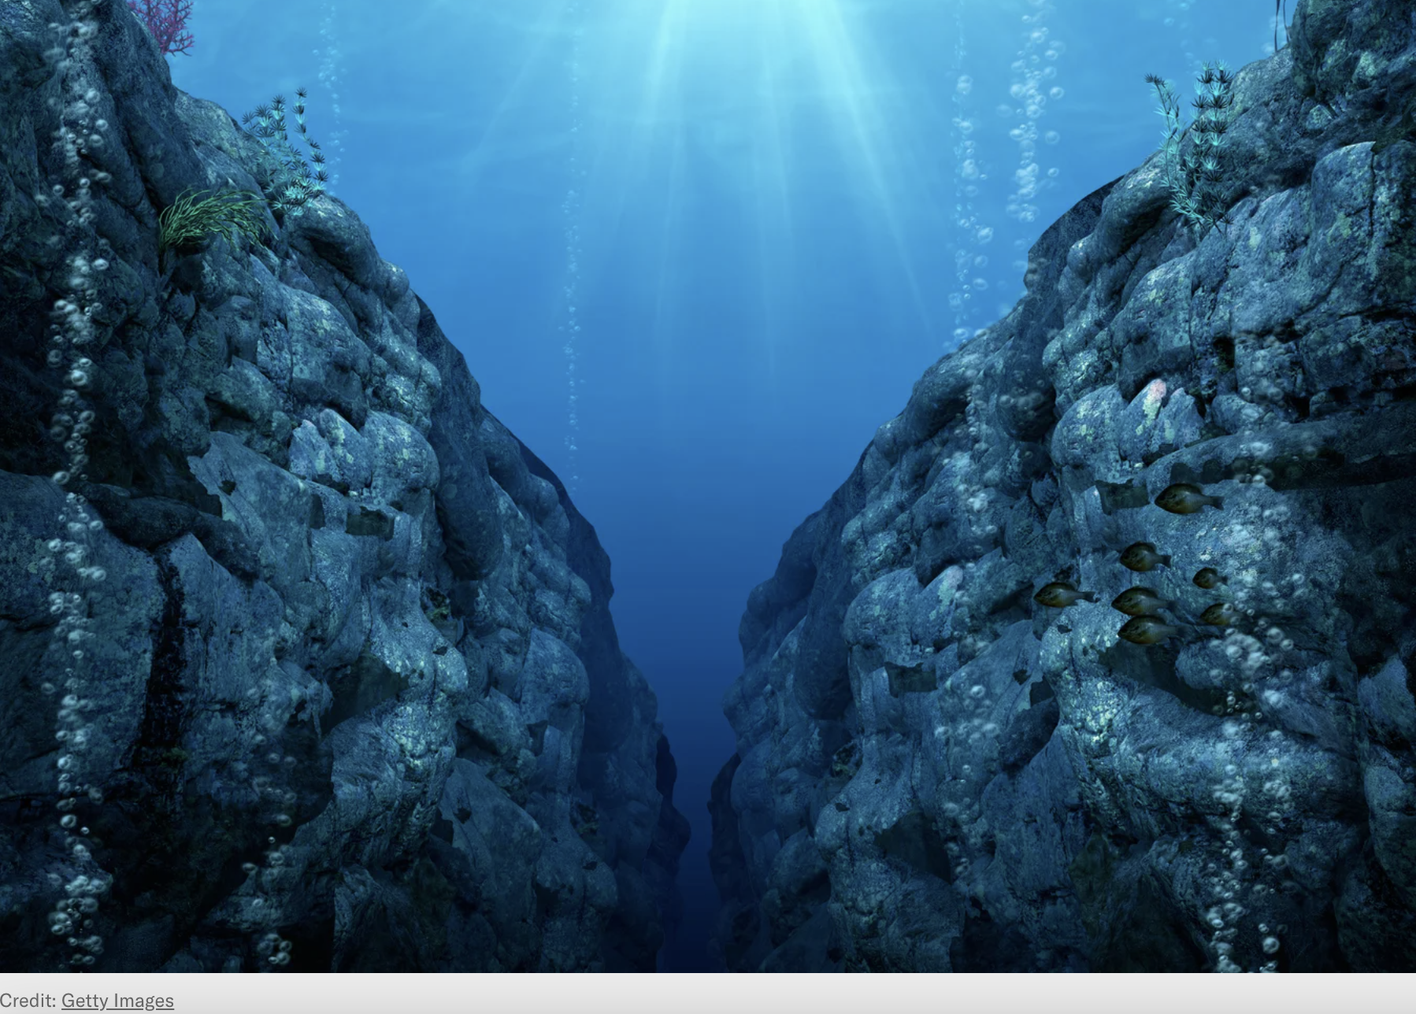
Intro
Ocean Trench
Notes:
Today, we’ll be learning about the word: Ocean Trench

Slide 3
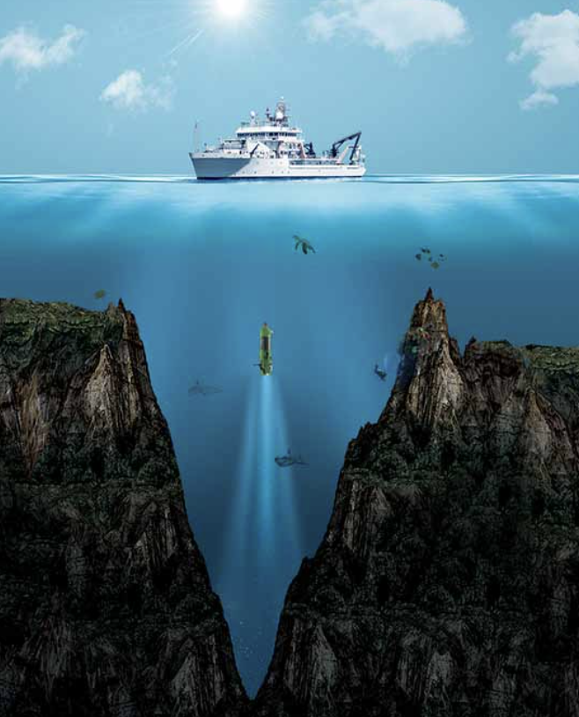
Big Question: How do ocean trenches influence the balance of life in the underwater world and impact the health of our entire planet?
Notes:
Our “big question” is: How do ocean trenches influence the balance of life in the underwater world and impact the health of our entire planet?
[Pause and illicit predictions from students.]
I love all these thoughtful scientific hypotheses! Be sure to keep this question and your predictions in mind as we move through these next few lessons, and we’ll continue to revisit it.
Image Source: Shutterstock/DOERS

Slide 4
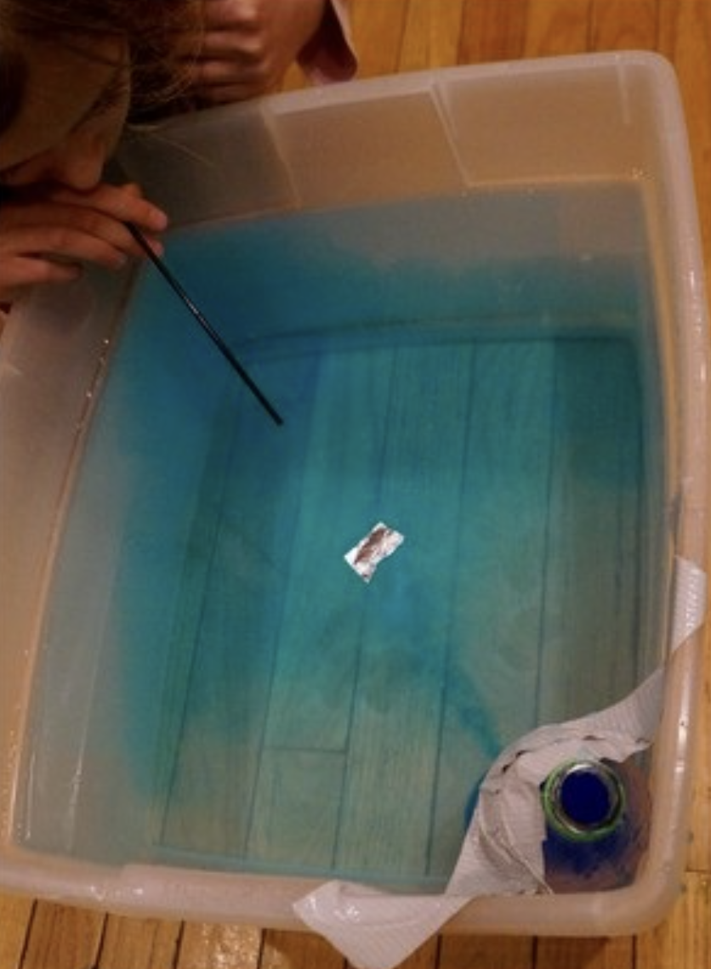
Demonstration
TEACHER DIRECTIONS:
Before viewing: Ask students what they already know about ocean trenches. Tell students today they will be learning about ocean trenches.
During: Discuss what students notice about the depth of the trench compared to the rest of the ocean floor and how the shape of the trench differs from the other parts of the ocean floor.
After: Tell students that today they will be learning more about ocean trenches.
Notes:
Feasible and Effective Classroom Demonstration for an Ocean Trench:
Materials:
Large, transparent container (like a fish tank or plastic storage bin)
Blue food coloring
Sand or gravel
Modeling clay or playdough
Ruler
Water
Procedure:
Fill the transparent container with water to about halfway.
Add a few drops of blue food coloring to the water to represent the ocean.
Create a "landmass" using modeling clay or playdough on one side of the container to simulate a coastline.
Gently sprinkle sand or gravel along the "coastline" to represent the continental shelf.
Gradually slope the sand or gravel downwards to simulate the continental slope.
In a specific area, create a deep trench by removing some of the sand or gravel and lowering the surface level of the ocean floor.
Use a ruler to measure the depth of the trench, emphasizing its significant depth compared to the rest of the ocean floor.
Discuss the characteristics of ocean trenches, such as their depth and location in the ocean.
Explain how trenches are formed, such as through subduction zones where tectonic plates collide.
Facilitate a class discussion about the importance of ocean trenches in oceanography and their role in the overall ocean system.
This demonstration visually represents the structure of the ocean floor, with a specific focus on the ocean trench. It allows students to observe and understand the unique features of trenches and their significance in the ocean system.

Slide 5
Notes:
Before we move on to our new topic, let’s review some other words & concepts that you already learned and make sure you are firm in your understanding.

Slide 6
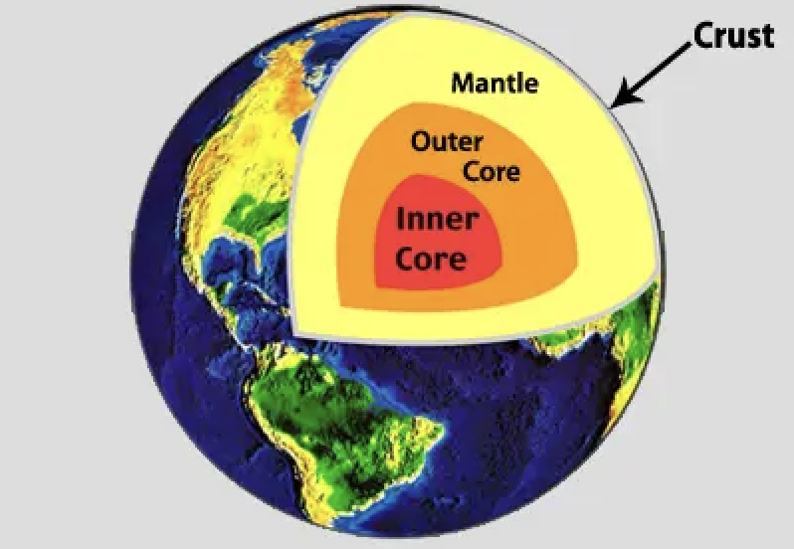
Crust: The outermost shell of the Earth
Notes:
Crust is the outermost shell of the Earth

Slide 7
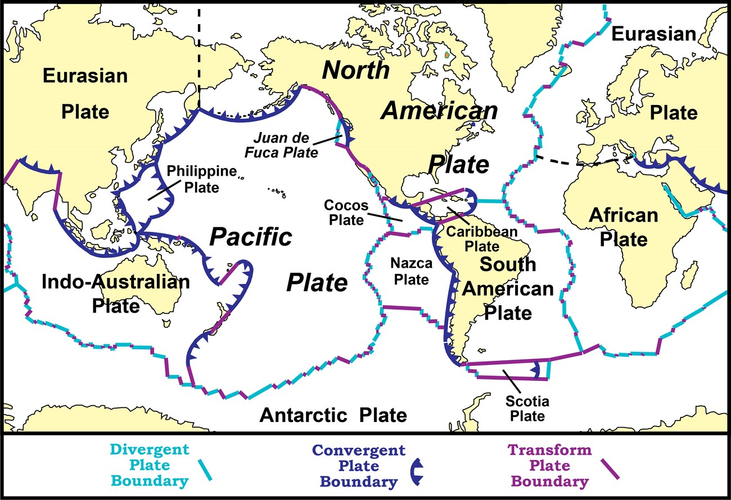
Tectonic Plates: Huge pieces of the Earth's surface that fit together like a puzzle and move very slowly over time
Notes:
Tectonic plates are huge pieces of the Earth’s surface that fit together like a puzzle an d move very slowly over time.

Slide 8
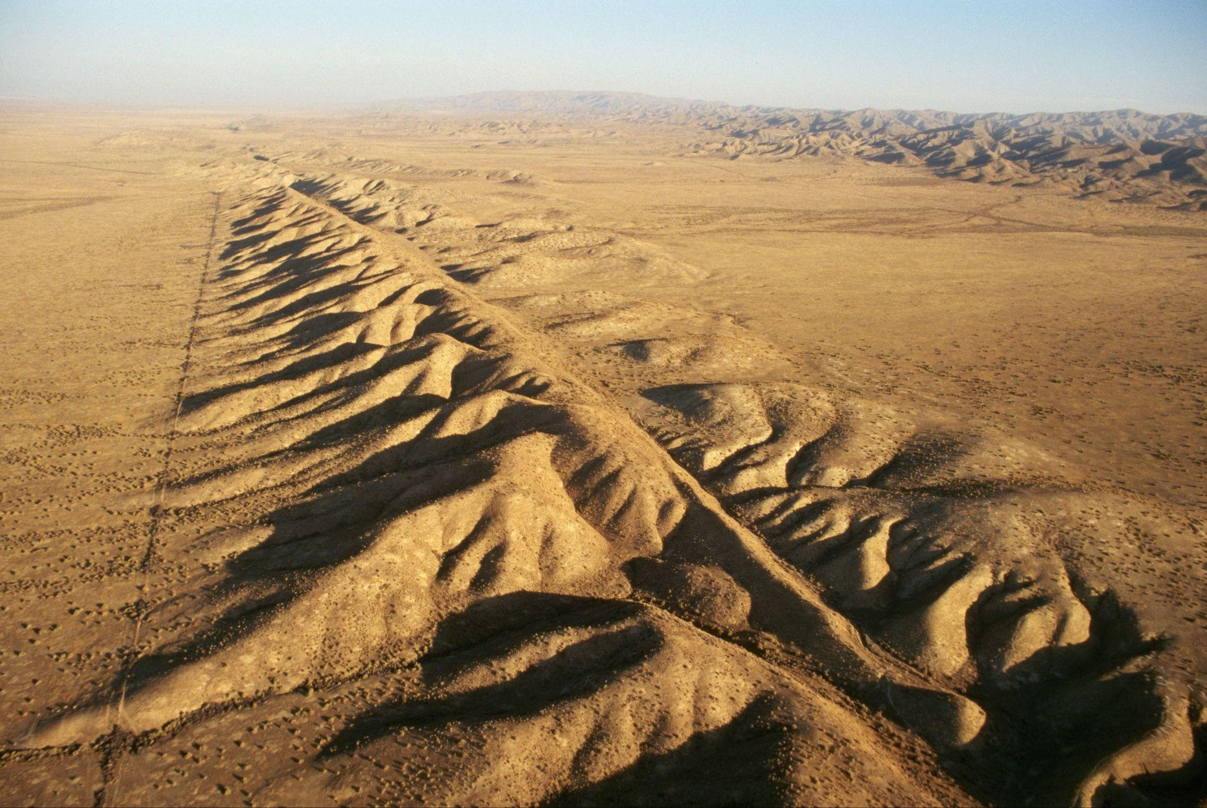
Fault: Long crack in the surface of the Earth
Notes:
A fault is a long crack in the surface of the Earth.

Slide 9
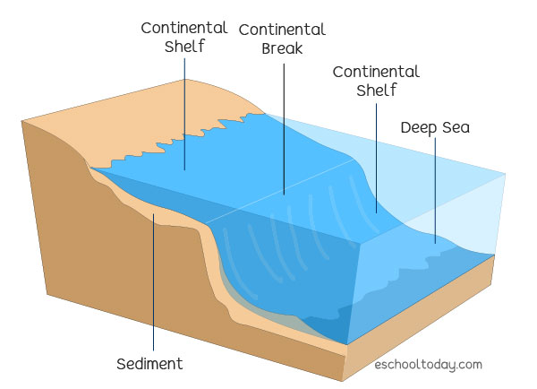
Continental Shelf: The edge of a continent that is underwater
Notes:
A continental shelf is the edge of a continent that is underwater

Slide 10
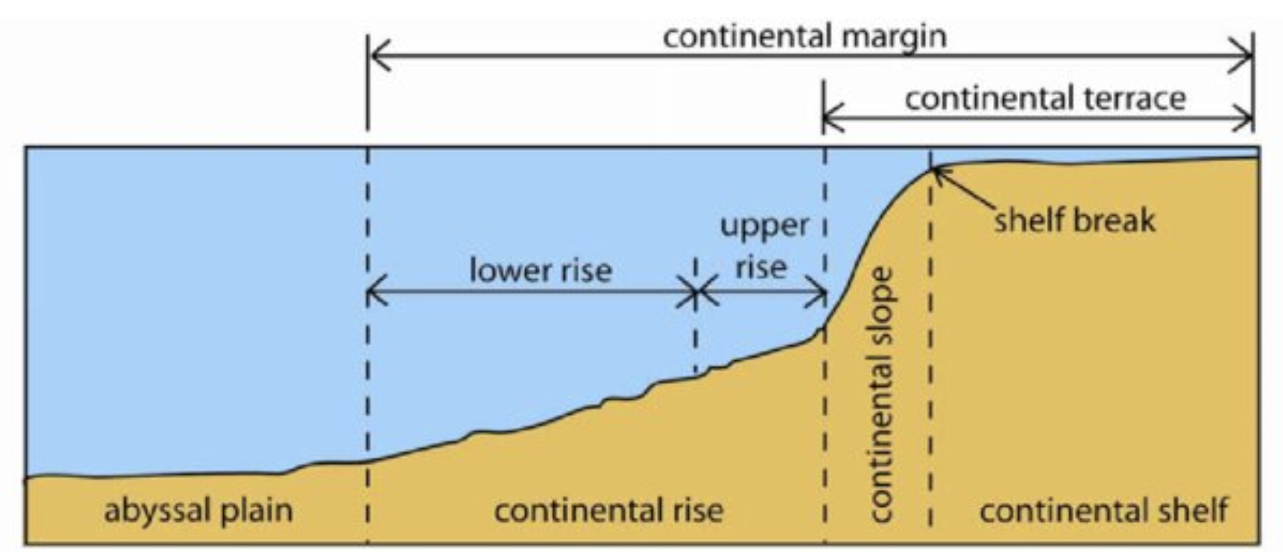
Woo (2005)
Continental Rise: a gentle slope at the ocean's bottom where sand and mud collect
Notes:
A continental rise is a gentle slope at the ocean's bottom where sand and mud collect, linking the steeper continental slope to the flat ocean floor
Image source: Woo, L. M. (2005). Summer circulation and water masses along the West Australian coast (Doctoral dissertation, University of Western Australia).
Chicago

Slide 11
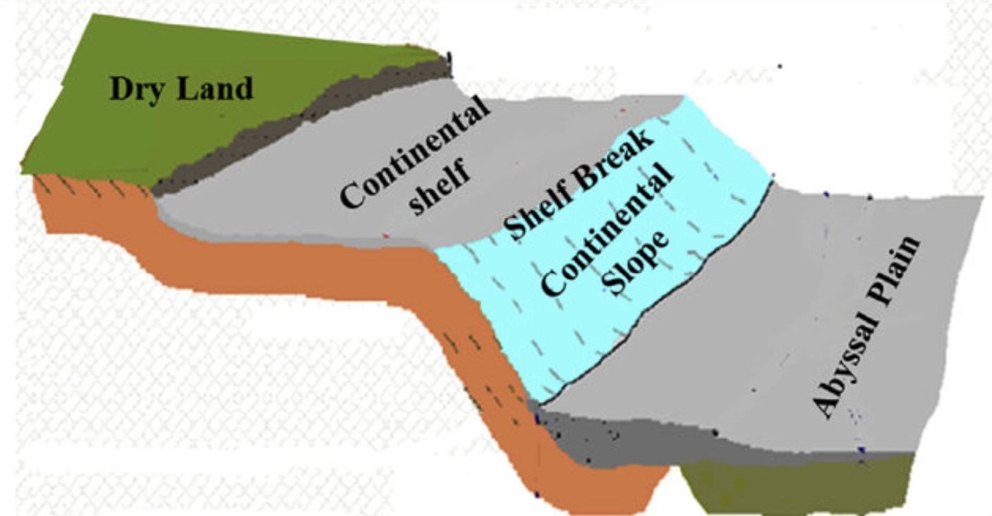
Solangi et al. (2018)
Continental Slope: a steep underwater hill that goes down from the edge of the continent into the deeper parts of the ocean
Notes:
A continental slope is a steep underwater hill that goes down from the edge of the continent into the deeper parts of the ocean
Image source: Solangi, S. H., Nazeer, A., Abbasi, S., & Zulkifil, M. M. (2019). Morphological features of continental shelf margin: Examples from the Pakistan Offshore. Geodesy and Geodynamics, 10(1), 77-91.

Slide 12
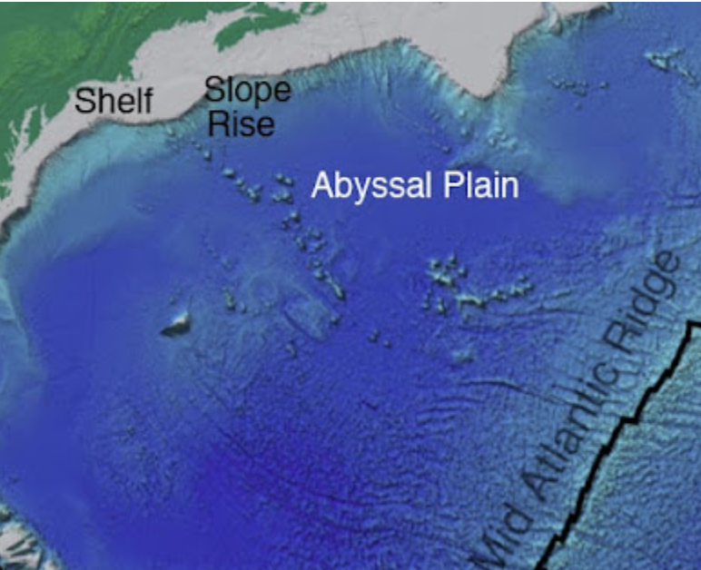
Abyssal Plain: A large flat surface on the ocean floor
Notes:
An abyssal plain is a large flat surface on the ocean floor
Image source: https://geologylearn.blogspot.com/2015/09/abyssal-plain.html

Slide 13
Notes:
Now let’s pause for a moment to review the information we have covered already.

Slide 14
The outermost shell of the Earth is called the…
Crust
Core
Notes:
The outermost shell of the Earth is called the…
[Crust]

Slide 15
The outermost shell of the Earth is called the…
Crust
Core
Notes:
The outermost shell of the Earth is called the…
[Crust]

Slide 16
True or False: Tectonic plates are huge pieces of the Earth's surface that fit together like a puzzle and move very slowly over time.
Notes:
True or False: Huge pieces of the Earth's surface that fit together like a puzzle and move very slowly over time.
[True]

Slide 17
True or False: Tectonic plates are huge pieces of the Earth's surface that fit together like a puzzle and move very slowly over time.
Notes:
True or False: Huge pieces of the Earth's surface that fit together like a puzzle and move very slowly over time.
[True]

Slide 18
A _____ is a long _____ in the surface of the Earth.
fault, crack
crack, fault
Notes:
A _____ is a long _____ in the surface of the Earth.
[fault, crack]

Slide 19
A _____ is a long _____ in the surface of the Earth.
fault, crack
crack, fault
Notes:
A _____ is a long _____ in the surface of the Earth.
[fault, crack]

Slide 20
Continental Shelf: The of a continent that is underwater
Notes:
A continental shelf is the of a continent that is underwater
[edge]

Slide 21
Continental Shelf: The edge of a continent that is underwater
Notes:
A continental shelf is the edge of a continent that is underwater

Slide 22
Woo (2005)
Continental Rise: a gentle slope at the ocean's bottom where and collect
Notes:
A continental rise is a gentle slope at the ocean's bottom where and collect, linking the steeper continental slope to the flat ocean floor
[sand, mud]
Image source: Woo, L. M. (2005). Summer circulation and water masses along the West Australian coast (Doctoral dissertation, University of Western Australia).
Chicago

Slide 23
Woo (2005)
Continental Rise: a gentle slope at the ocean's bottom where sand and mud collect
Notes:
A continental rise is a gentle slope at the ocean's bottom where sand and mud collect, linking the steeper continental slope to the flat ocean floor
Image source: Woo, L. M. (2005). Summer circulation and water masses along the West Australian coast (Doctoral dissertation, University of Western Australia).
Chicago

Slide 24
Solangi et al. (2018)
True or False: A continental slope is an above water hill that people roll down to get into the ocean.
Notes:
True or False: A continental slope is an above water hill that people roll down to get into the ocean.
[False]
Image source: Solangi, S. H., Nazeer, A., Abbasi, S., & Zulkifil, M. M. (2019). Morphological features of continental shelf margin: Examples from the Pakistan Offshore. Geodesy and Geodynamics, 10(1), 77-91.

Slide 25
Solangi et al. (2018)
True or False: A continental slope is an above water hill that people roll down to get into the ocean.
Notes:
False: A continental slope is a steep underwater hill that goes down from the edge of the continent into the deeper parts of the ocean
Image source: Solangi, S. H., Nazeer, A., Abbasi, S., & Zulkifil, M. M. (2019). Morphological features of continental shelf margin: Examples from the Pakistan Offshore. Geodesy and Geodynamics, 10(1), 77-91.

Slide 26
Abyssal Plain: A flat surface on the ocean .
Notes:
An abyssal plain is a flat surface on the ocean .
[large, floor]
Image source: https://geologylearn.blogspot.com/2015/09/abyssal-plain.html

Slide 27
Abyssal Plain: A flat surface on the ocean .
Notes:
An abyssal plain is a large flat surface on the ocean floor
Image source: https://geologylearn.blogspot.com/2015/09/abyssal-plain.html

Slide 28
Ocean Trench
Notes:
Now that we’ve reviewed, let’s define the phrase ocean trench.

Slide 29
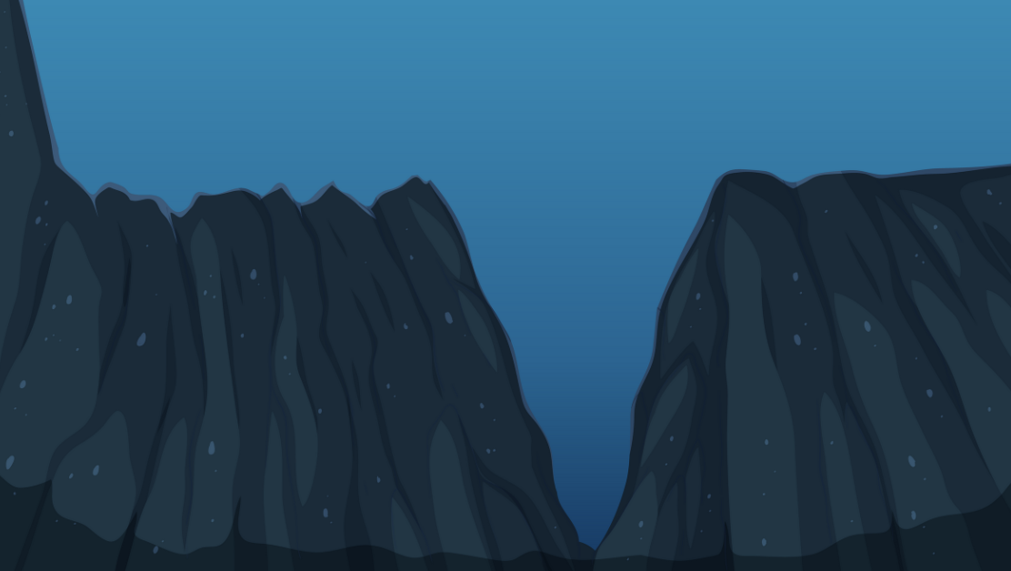
Ocean Trench: a very deep crack or trench on the ocean floor
Notes:
An ocean trench is a very deep crack or trench on the ocean floor

Slide 30
Notes:
Let’s check-in for understanding.

Slide 31
What is an ocean trench?
Notes:
What is an ocean trench?
[a very deep crack or trench on the ocean floor]

Slide 32
Notes:
That is the basic definition, but there is a bit more you need to know.

Slide 33
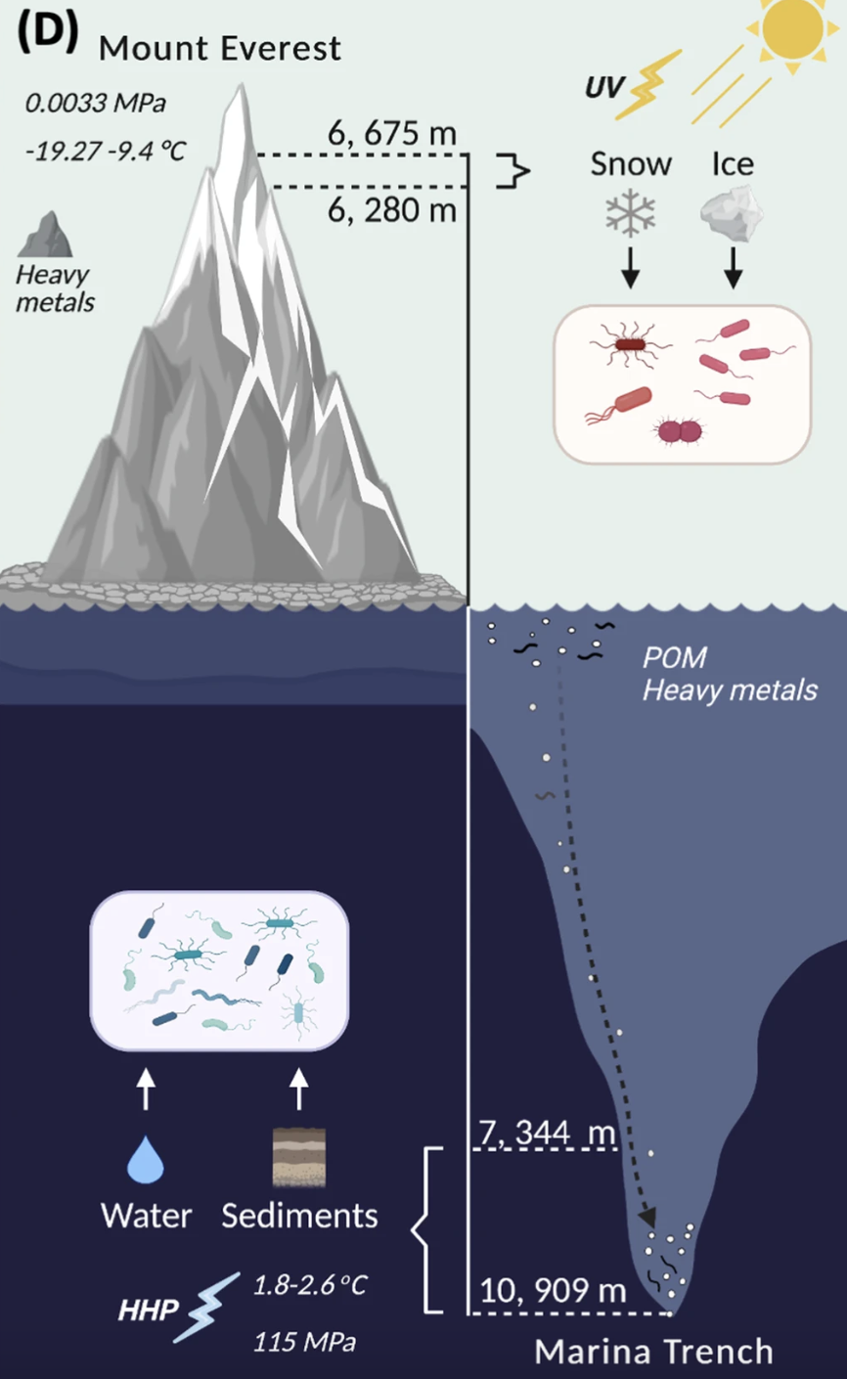
Ocean trenches are like hidden valleys at the bottom of the ocean. They are the deepest parts of the ocean floor, and some of them can be much deeper than the highest mountains on land.
Image: Liu, et al. (2022)
Notes:
Ocean trenches are like hidden valleys at the bottom of the ocean. They are the deepest parts of the ocean floor, and some of them can be much deeper than the highest mountains on land.
Image Source: Liu, Y., Zhang, Z., Ji, M., Hu, A., Wang, J., Jing, H., ... & Zhao, W. (2022). Comparison of prokaryotes between Mount Everest and the Mariana Trench. Microbiome, 10(1), 215.

Slide 34
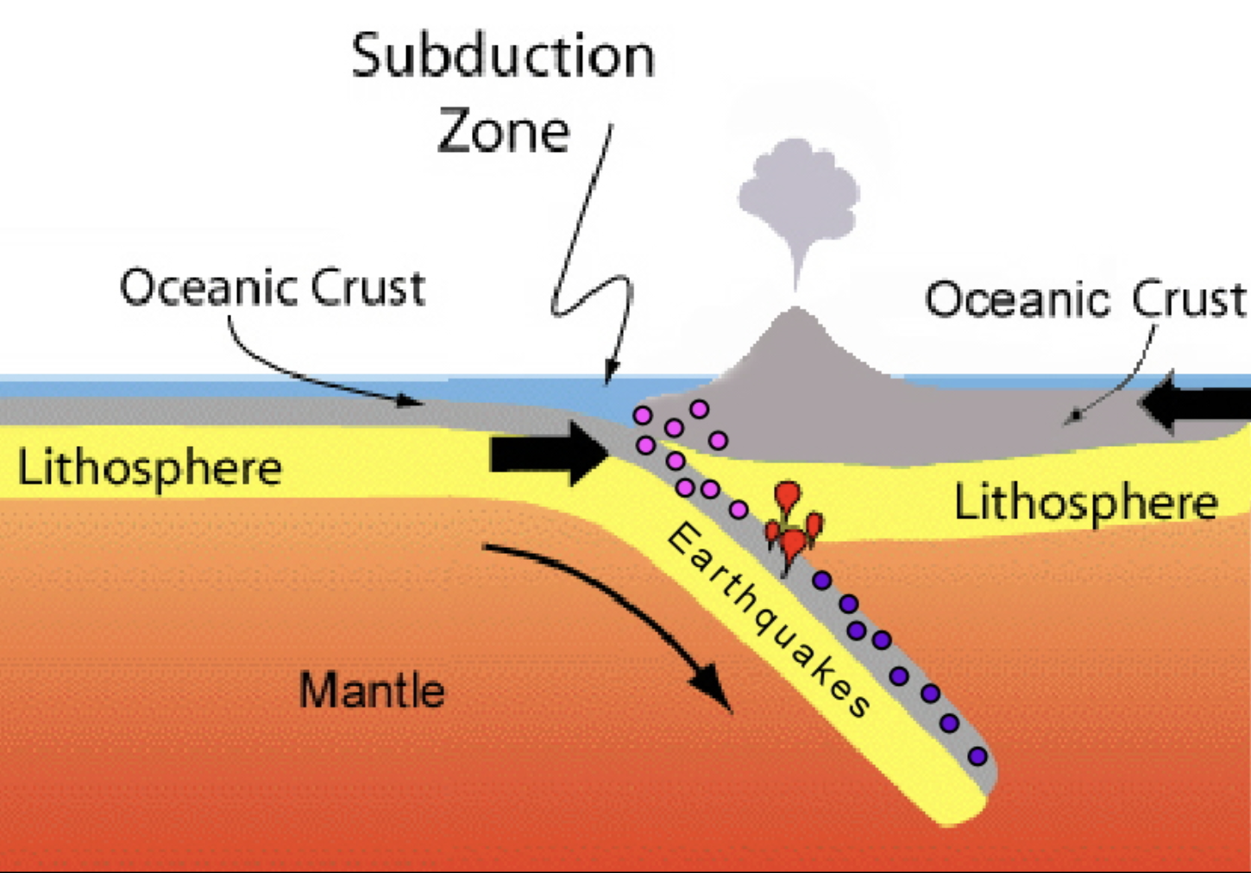
Ocean trenches are often formed where one tectonic plate is sliding beneath another in a process called subduction. This movement creates a deep trench in the ocean floor.
Notes:
Ocean trenches are often formed where one tectonic plate is sliding beneath another in a process called subduction. This movement creates a deep trench in the ocean floor.
Image Source: http://www.geo.cornell.edu/hawaii/220/PRI/PRI_PT_subduction.html

Slide 35
The depth of ocean trenches can be amazing. The deepest trench, called Challenger Deep in the Mariana Trench, reaches down more than 36,000 feet.
Notes:
The depth of ocean trenches can be amazing. The deepest trench, called Challenger Deep in the Mariana Trench, reaches down more than 36,000 feet.

Slide 36
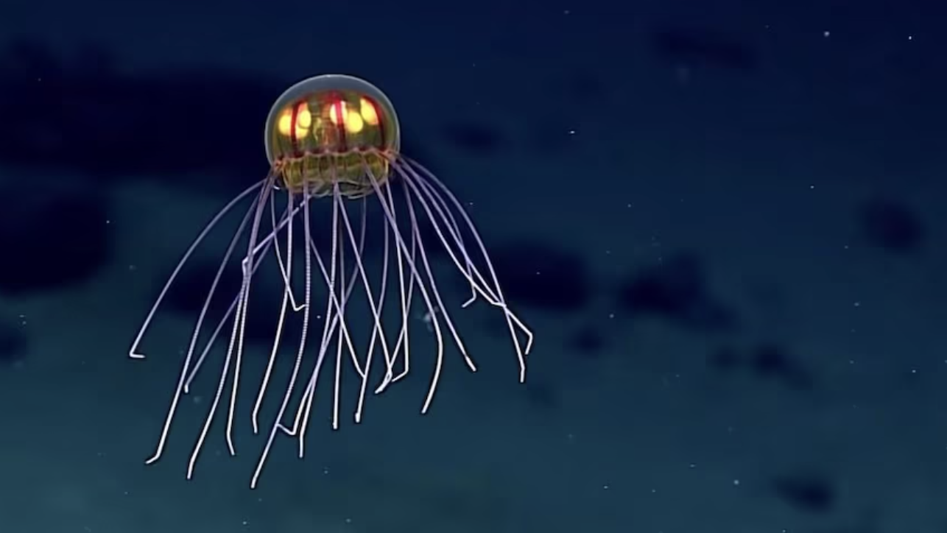
Because of their extreme depth, ocean trenches experience a lot of pressure from the weight of the water above them. This makes them a difficult place to explore.
Notes:
Because of their extreme depth, ocean trenches experience a lot of pressure from the weight of the water above them. This makes them a difficult place to explore.
Image Source: NOAA Office of Ocean Exploration and Research

Slide 37
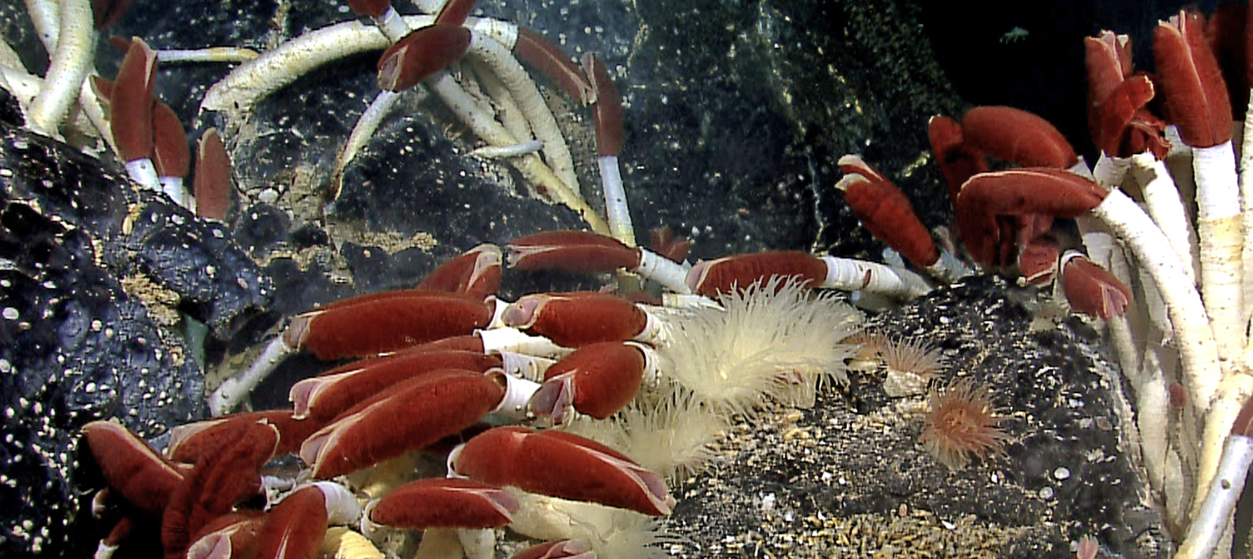
Despite the harsh conditions, some unique and interesting creatures have adapted to life in the trenches. Creatures like giant tube worms and deep-sea fish have evolved to survive in this extreme environment.
Notes:
Despite the harsh conditions, some unique and interesting creatures have adapted to life in the trenches. Creatures like giant tube worms and deep-sea fish have evolved to survive in this extreme environment.
Image Source: NOAA Okeanos Explorer Program, Galapagos Rift Expedition 2011 - https://www.flickr.com/photos/noaaphotolib/9660806745/in/set-72157635360690997

Slide 38
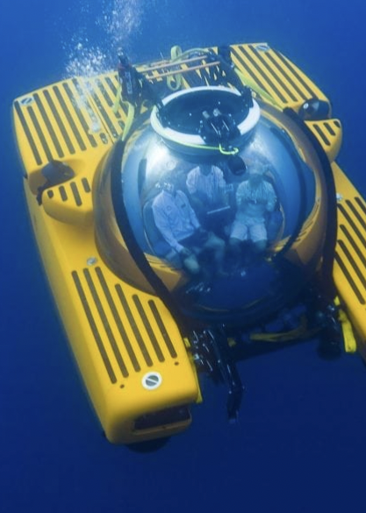
Scientists use special submarines and remotely operated vehicles to explore ocean trenches. They study the geology, biology, and chemistry of these deep-sea environments to learn more about Earth's processes.
Notes:
Scientists use special submarines and remotely operated vehicles to explore ocean trenches. They study the geology, biology, and chemistry of these deep-sea environments to learn more about Earth's processes.

Slide 39
Notes:
Let’s check-in for understanding.

Slide 40
True or False: The highest mountains on land are much higher than the deepest ocean trench.
Image: Liu, et al. (2022)
Notes:
True or False: The highest mountains on land are much deeper than the deepest ocean trench.
[False]
Image Source: Liu, Y., Zhang, Z., Ji, M., Hu, A., Wang, J., Jing, H., ... & Zhao, W. (2022). Comparison of prokaryotes between Mount Everest and the Mariana Trench. Microbiome, 10(1), 215.

Slide 41
True or False: The highest mountains on land are much higher than the deepest ocean trench.
Image: Liu, et al. (2022)
Notes:
False: The deepest ocean trenches are much deeper than the highest mountains on.
Image Source: Liu, Y., Zhang, Z., Ji, M., Hu, A., Wang, J., Jing, H., ... & Zhao, W. (2022). Comparison of prokaryotes between Mount Everest and the Mariana Trench. Microbiome, 10(1), 215.

Slide 42
What process creates an ocean trench?
Induction
Subduction
Conduction
Notes:
What process creates an ocean trench?
Induction
Subduction
Conduction
Image Source: http://www.geo.cornell.edu/hawaii/220/PRI/PRI_PT_subduction.html

Slide 43
What process creates an ocean trench?
Induction
Subduction
Conduction
Notes:
What process creates an ocean trench?
Induction
Subduction
Conduction
Image Source: http://www.geo.cornell.edu/hawaii/220/PRI/PRI_PT_subduction.html

Slide 44
The deepest trench is called Deep and is locate in the Mariana Trench
Notes:
The deepest trench is called Deep and is locate in the Mariana Trench
[Challenger]

Slide 45
The deepest trench is called Challenger Deep and is locate in the Mariana Trench
Notes:
The deepest trench is called Challenger Deep and is locate in the Mariana Trench

Slide 46
True of False: Deep ocean trenches are easy to explore
Notes:
True of False: Deep ocean trenches are easy to explore
[False]
Image Source: NOAA Office of Ocean Exploration and Research

Slide 47
True of False: Deep ocean trenches are easy to explore
Notes:
False: Deep ocean trenches are very difficult to explore
Image Source: NOAA Office of Ocean Exploration and Research

Slide 48
Notes:
Now, let’s talk about some examples of a continental shelf.

Slide 49
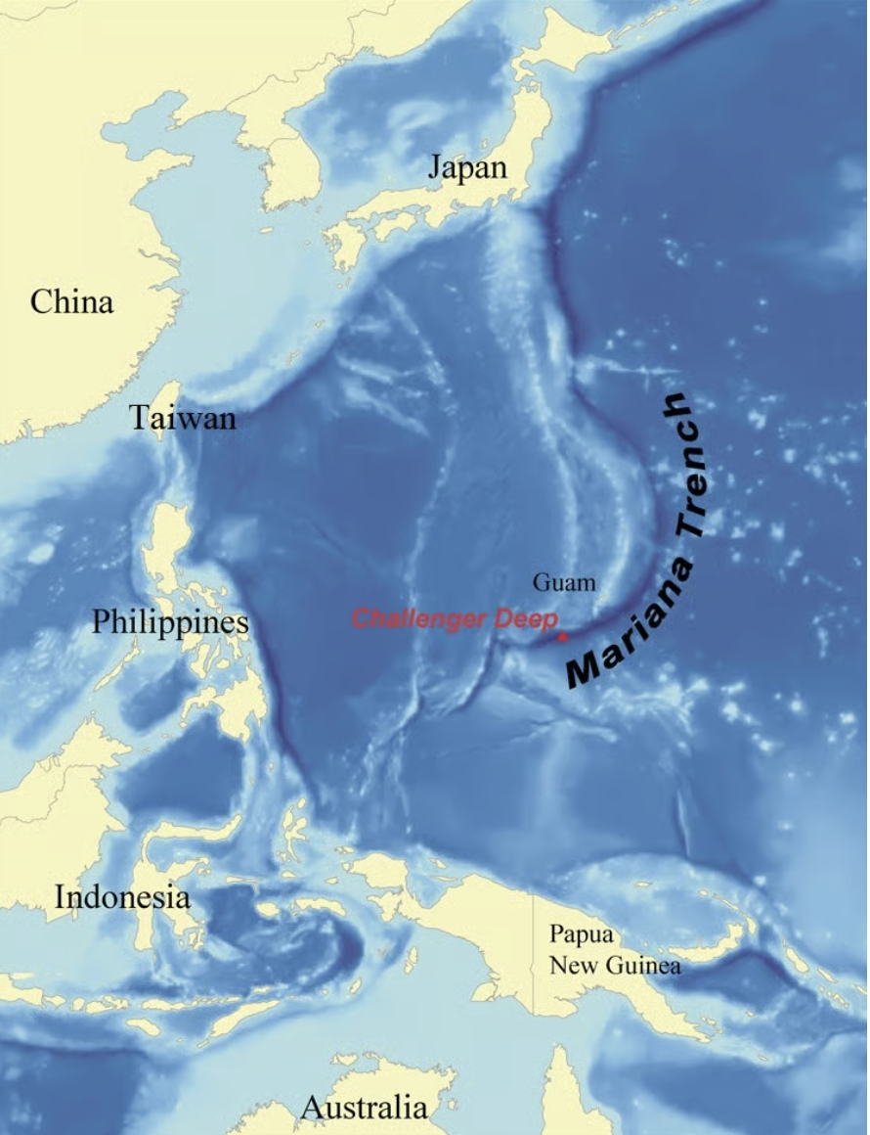
The Mariana Trench is an example of an ocean trench. It is located in the western Pacific Ocean.
Notes:
The Mariana Trench is an example of an ocean trench. It is located in the western Pacific Ocean.
Image Source: https://www.curiouspeoples.com/p/mariana-trench

Slide 50
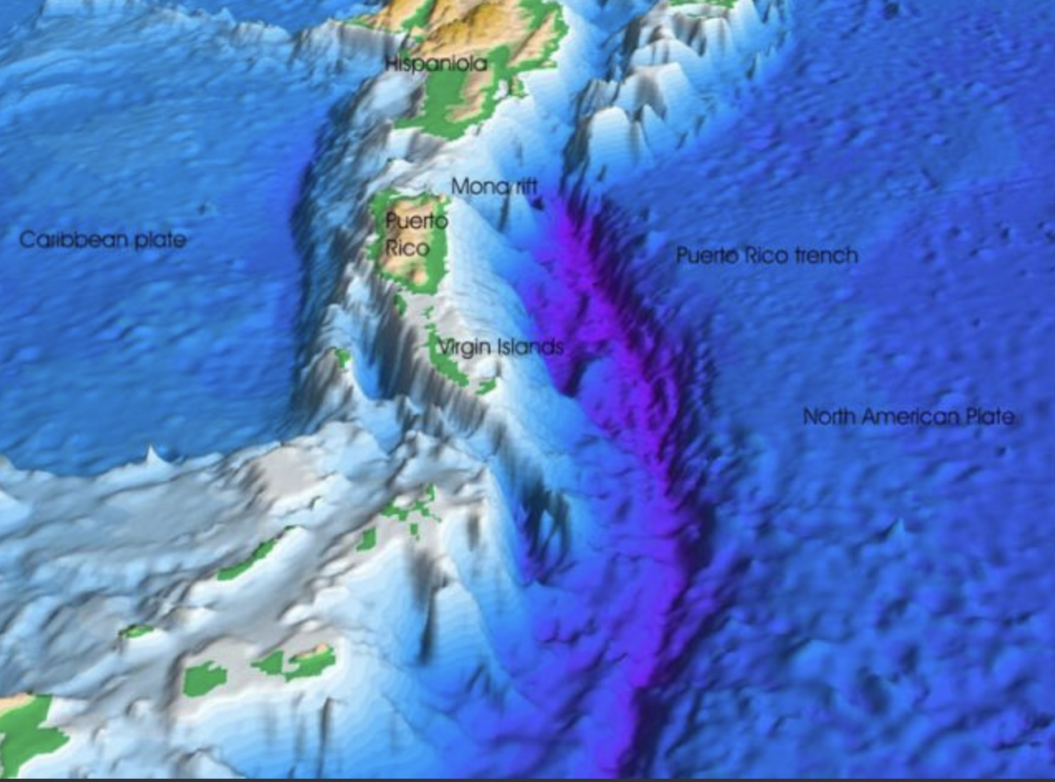
Another example of an ocean trench is the Puerto Rico Trench. This ocean trench is in the Atlantic Ocean near Puerto Rico and the Virgin Islands. While the Mariana Trench is the deepest ocean trench in the world, the Puerto Rico Trench is the deepest one in the Atlantic Ocean, reaching depths of over 28,000 feet.
Notes:
Another example of an ocean trench is the Puerto Rico Trench. This ocean trench is in the Atlantic Ocean near Puerto Rico and the Virgin Islands. While the Mariana Trench is the deepest ocean trench in the world, the Puerto Rico Trench is the deepest one in the Atlantic Ocean, reaching depths of over 28,000 feet.
Source: https://storymaps.arcgis.com/stories/d84231afdad14b97a2eacc191eac5b2a

Slide 51
Notes:
Now, let’s talk about some non-examples of continental shelf.

Slide 52
An abyssal plain is NOT an example of an ocean trench. Abyssal plains are large flat surfaces on the ocean floor, while ocean trenches are deep cracks in the floor.
Notes:
An abyssal plain is NOT an example of an ocean trench. Abyssal plains are large flat surfaces on the ocean floor, while ocean trenches are deep cracks in the floor.

Slide 53
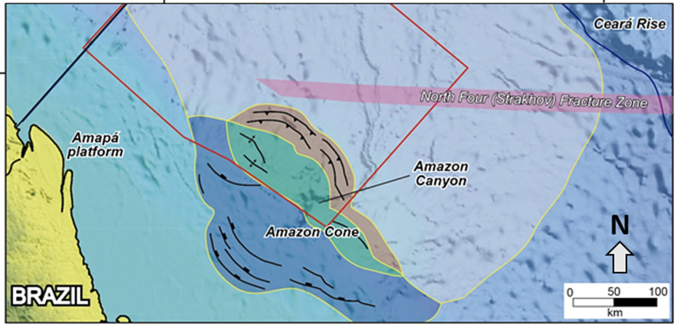
The Amazon Cone is NOT an example of an ocean trench. It is an example of a continental rise because it is is a gentle slope at the ocean's bottom where sand and mud collect
Notes:
The Amazon Cone is NOT an example of an ocean trench. It is an example of a continental rise because it is is a gentle slope at the ocean's bottom where sand and mud collect

Slide 54
Notes:
Now let’s pause for a moment to check your understanding.

Slide 55
Why are abyssal plains and the Amazon Cone not examples of an ocean trench?
Notes:
Why are abyssal plains and the Amazon Cone not examples of an ocean trench?
[Abyssal plains are large flat surfaces on the ocean floor, the Amazon cone is a continental rise which is a gentle slope at the ocean’s floor where sand and mud collect, while an ocean trench is a deep crack in the ocean floor.]

Slide 56
Remember!!!
Notes:
So remember!

Slide 57
Ocean Trench: a very deep crack or trench on the ocean floor
Notes:
An ocean trench is a very deep crack or trench on the ocean floor

Slide 58
Notes:
We will now complete this concept map, called a Frayer model, to summarize and further clarify what you have learned about the term continental shelf.

Slide 59
Definition
Picture
Ocean Trench
Example
How do ocean trenches impact my life?
Notes:
To complete the Frayer model, we will choose from four choices the correct picture, definition, example, and response to the question, “How do ocean trenches impact my life?” Select the best response for each question using the information you just learned. As we select responses, we will see how this model looks filled in for the term ocean trench.

Slide 60
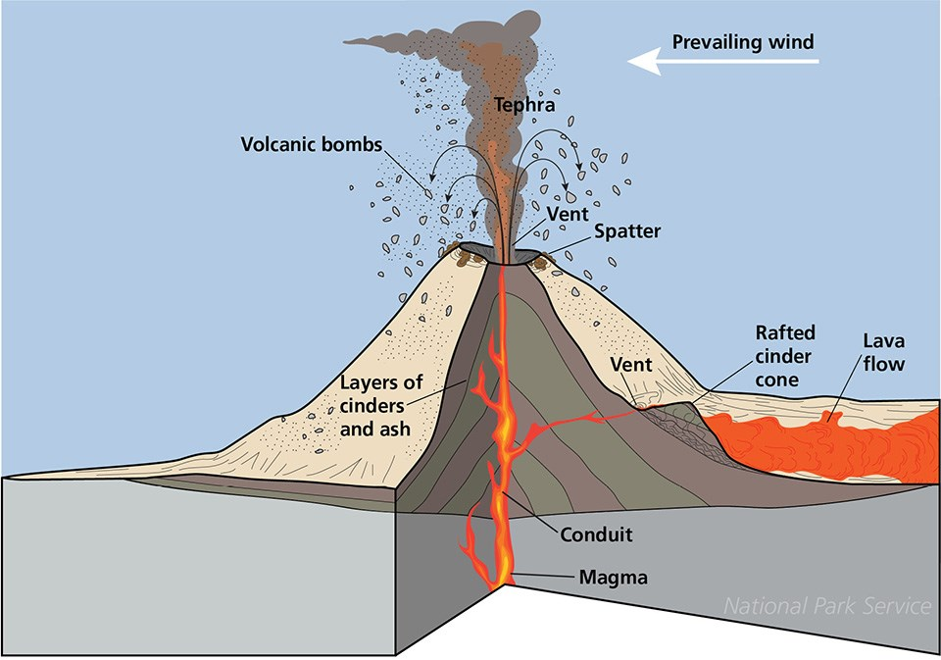
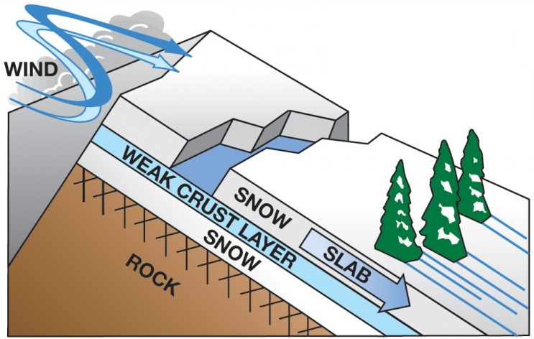
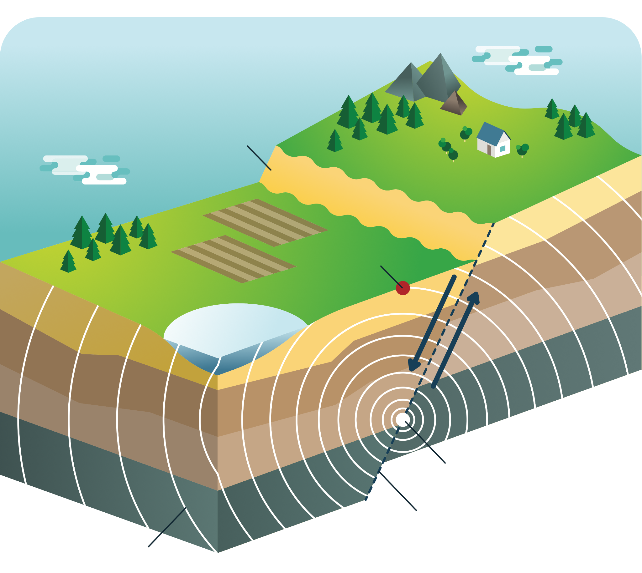
Directions: Choose the correct picture of an ocean trench from the choices below.
A
B
C
D
Notes:
Choose the one correct picture of an ocean trench from these four choices.

Slide 61
Directions: Choose the correct picture of an ocean trench from the choices below.
A
B
C
D
Notes:
This is the picture that shows an ocean trench.

Slide 62
Definition
Picture
Ocean Trench
Example
How do ocean trench impact my life?
Notes:
Here is the Frayer model filled in with a picture of an ocean trench.

Slide 63
Directions: Choose the correct definition of an ocean trench from the choices below.
A
A very deep crack or trench in the ocean floor
B
The edge of a continent that is underwater
C
Underwater ecosystem made up of coral polyps
D
Deep, steep-sided valleys carved into the seafloor by erosion.
Notes:
Choose the correct definition of an ocean trench from the choices below.

Slide 64
Directions: Choose the correct definition of an ocean trench from the choices below.
A
A very deep crack or trench in the ocean floor
B
The edge of a continent that is underwater
C
Underwater ecosystem made up of coral polyps
D
Deep, steep-sided valleys carved into the seafloor by erosion.
Notes:
“A very deep crack or trench in the ocean floor” is correct! This is the definition of an ocean trench.

Slide 65
Definition
Picture
A very deep crack or trench in the ocean floor
Ocean Trench
Example
How do ocean trench impact my life?
Notes:
Here is the Frayer Model with a picture and the definition filled in for an ocean trench: A very deep crack or trench in the ocean floor

Slide 66
Directions: Choose the correct example of an ocean trench from the choices below.
A
Snow sliding down a plane
B
North Sea Continental Shelf
C
The Amazon Cone
D
Puerto Rico Trench
Notes:
Choose the correct example of an ocean trench from the choices below.

Slide 67
Directions: Choose the correct example of an ocean trench from the choices below.
A
Snow sliding down a plane
B
North Sea Continental Shelf
C
The Amazon Cone
D
Puerto Rico Trench
Notes:
“Puerto Rico Trench” is correct! This is an example of an ocean trench.

Slide 68
Definition
Picture
A very deep crack or trench in the ocean floor
Ocean Trench
Puerto Rico Trench
Example
How do ocean trench impact my life?
Notes:
Here is the Frayer Model with a picture, definition, and an example of an ocean trench: Puerto Rico Trench

Slide 69
Directions: Choose the correct response for “How do ocean trenches impact my life?” from the choices below.
A
Ocean trenches help protect the coast from big waves, making beaches safer for activities like swimming and playing.
B
Ocean trenches explain how movement of animals on our planet impacts food and crops we have available to us.
C
Ocean trenches account for the amount of land we have on our planet versus ocean and tells us where to build habitats.
Ocean trenches can help scientists discover new medicines from unique deep-sea life, adding to progress in medical research and our understanding of Earth's ecosystems.
D
Notes:
Choose the one correct response for “how do ocean trenches impact my life?” from these four choices.

Slide 70
Directions: Choose the correct response for “How do ocean trenches impact my life?” from the choices below.
A
Ocean trenches help protect the coast from big waves, making beaches safer for activities like swimming and playing.
B
Ocean trenches explain how movement of animals on our planet impacts food and crops we have available to us.
C
Ocean trenches account for the amount of land we have on our planet versus ocean and tells us where to build habitats.
Ocean trenches can help scientists discover new medicines from unique deep-sea life, adding to progress in medical research and our understanding of Earth's ecosystems.
D
Notes:
“Ocean trenches can help scientists discover new medicines from unique deep-sea life, adding to progress in medical research and our understanding of Earth's ecosystems..” That is correct! This is an example of how ocean trenches impact your life.

Slide 71
Definition
Picture
A very deep crack or trench in the ocean floor
Ocean Trench
Ocean trenches can help scientists discover new medicines from unique deep-sea life, adding to progress in medical research and our understanding of Earth's ecosystems.
Puerto Rico Trench
Example
How do ocean trench impact my life?
Notes:
Here is the Frayer Model with a picture, definition, example, and a correct response to “how do ocean trenches impact my life?”: Ocean trenches can help scientists discover new medicines from unique deep-sea life, adding to progress in medical research and our understanding of Earth's ecosystems.

Slide 72
Remember!!!
Notes:
So remember!

Slide 73
Ocean Trench: a very deep crack or trench on the ocean floor
Notes:
An ocean trench is a very deep crack or trench on the ocean floor

Slide 74
Big Question: How do ocean trenches influence the balance of life in the underwater world and impact the health of our entire planet?
Notes:
Let’s reflect once more on our big question. Our “big question” is: How do ocean trenches influence the balance of life in the underwater world and impact the health of our entire planet?
Does anyone have any additional examples to share that haven’t been discussed yet?
I love all these thoughtful scientific hypotheses! Be sure to keep this question and your predictions in mind as we move through these next few lessons, and we’ll continue to revisit it.

Slide 75
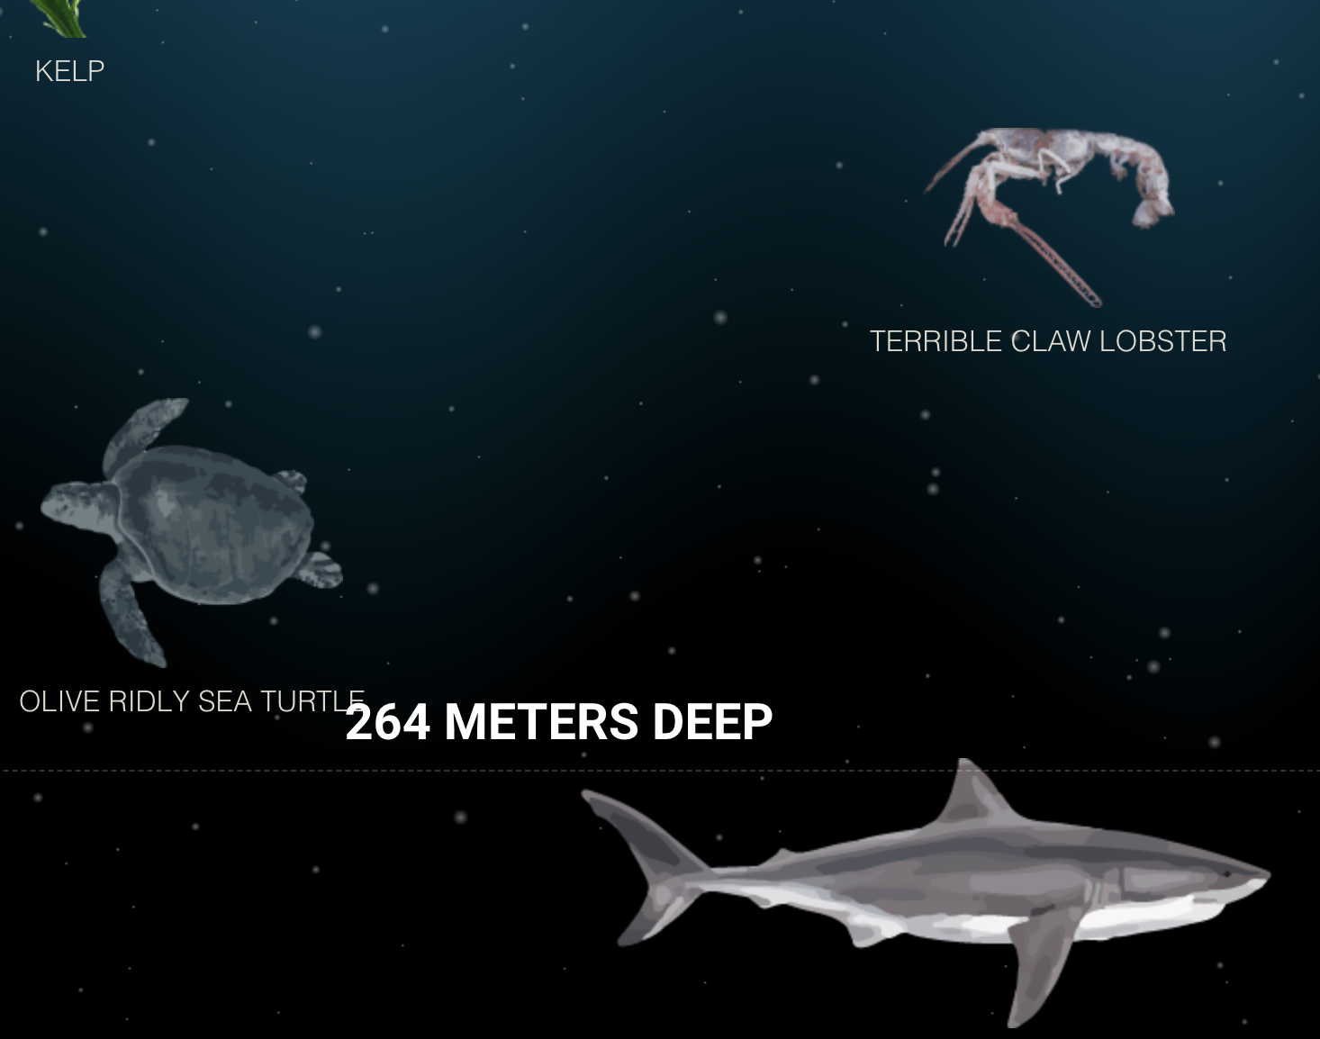
Activity
Deep Sea Activity
Click the link above for an activity to deepen your knowledge of the deep sea.
Notes:
Click the link above for an activity to deepen your knowledge of the deep sea. As you scroll down you encounter the different marine life at different depths in the ocean.

Slide 76
Notes:
Thanks for watching, and please continue watching CAPs available from this website.

Slide 77
This Was Created With Resources From:
Questions or Comments
Michael Kennedy, Ph.D. MKennedy@Virginia.edu
Rachel L Kunemund, Ph.D. rk8vm@virginia.edu

