Slide 1
Intro
“Big Idea” Question
Review Concepts
Check-In Questions
Teacher Engagement
Vocabulary
Student-Friendly Definition
Examples & Non-Examples
Frayer Model
Simulation/Activity
Notes:
OK everyone, get ready for our next lesson. Just as a reminder, these are the different components that our lesson may include, and you’ll see these icons in the top left corner of each slide so that you can follow along more easily!

Slide 2
Intro
Organism
Notes:
Today, we’ll be learning about the word: Photosynthesis.

Slide 3
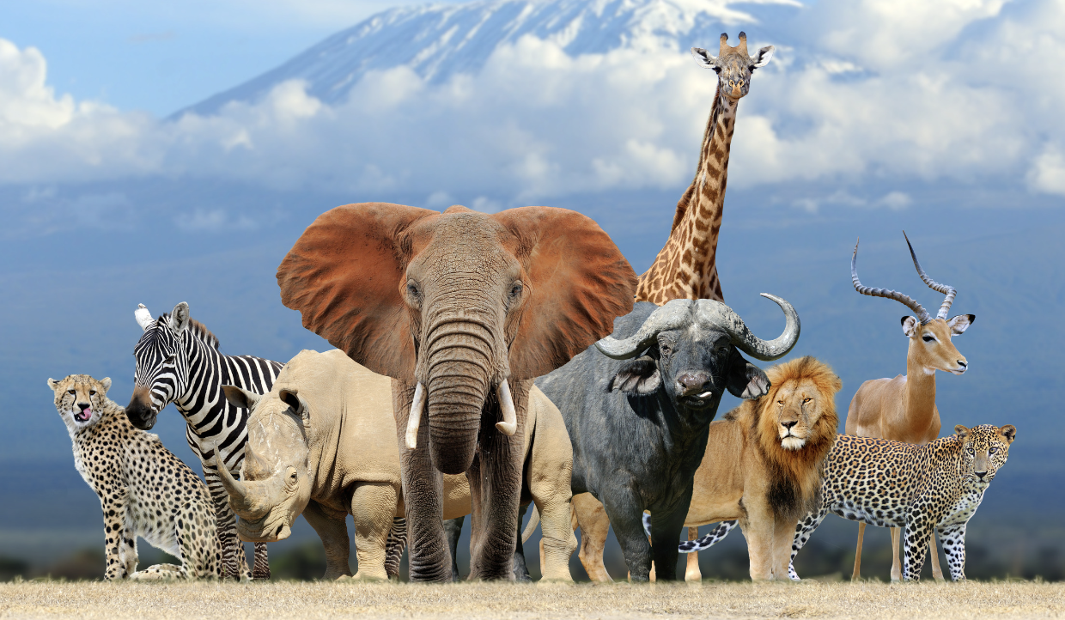
Big Question: How are living things important to the environment?
Notes:
Our “big question” is: How are living things important to the environment?
[Pause and illicit predictions from students.]
I love all these thoughtful scientific hypotheses! Be sure to keep this question and your predictions in mind as we move through these next few lessons, and we’ll continue to revisit it.

Slide 4
Notes:
Before we move on to our new topic, let’s review some other words & concepts that you already learned and make sure you are firm in your understanding.

Slide 5
Non-living thing: something that does not grow or reproduce and does not need food
Notes:
Non-living things do not grow or reproduce and do not need food.

Slide 6
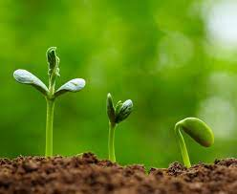
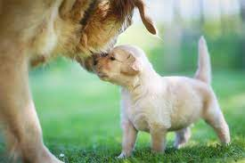
Living Thing: something that grows, reproduces, needs food, and responds to its environment
Notes:
Living things are organisms that grow, change, and respond to its environment.

Slide 7
Notes:
Now let’s pause for a moment to review the information we have covered already.

Slide 8
Something that does not grow or reproduce and does not need food is a thing.
Notes:
Something that does not grow or reproduce and does not need food is a . Thing
[non-living]

Slide 9
Something that does not grow or reproduce and does not need food is a non-living thing.
Notes:
Something that does not grow or reproduce and does not need food is a . Thing
[non-living]

Slide 10
All of the following describe a living thing EXCEPT: A. something that grows B. something that does not need food C. something that reproduces
Notes:
All of the following describe a living thing EXCEPT: A. something that grows B. something that does not need food C. something that reproduces

Slide 11
All of the following describe a living thing EXCEPT: A. something that grows B. something that does not need food C. something that reproduces
Notes:
All of the following describe a living thing EXCEPT: A. something that grows B. something that does not need food C. something that reproduces

Slide 12
Organism
Notes:
Now that we’ve reviewed, let’s define the phrase photosynthesis.

Slide 13
Organism: any living thing
Notes:
An organism is any living thing.

Slide 14
Notes:
Let’s check-in for understanding.

Slide 15
What is an organism?
Notes:
What is an organism?
[any living thing]

Slide 16
Notes:
That is the basic definition, but there is a bit more you need to know.

Slide 17
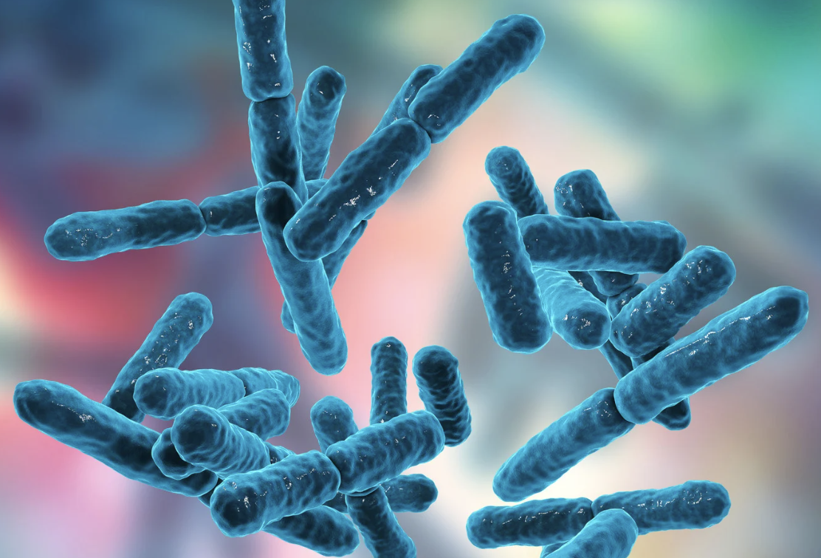
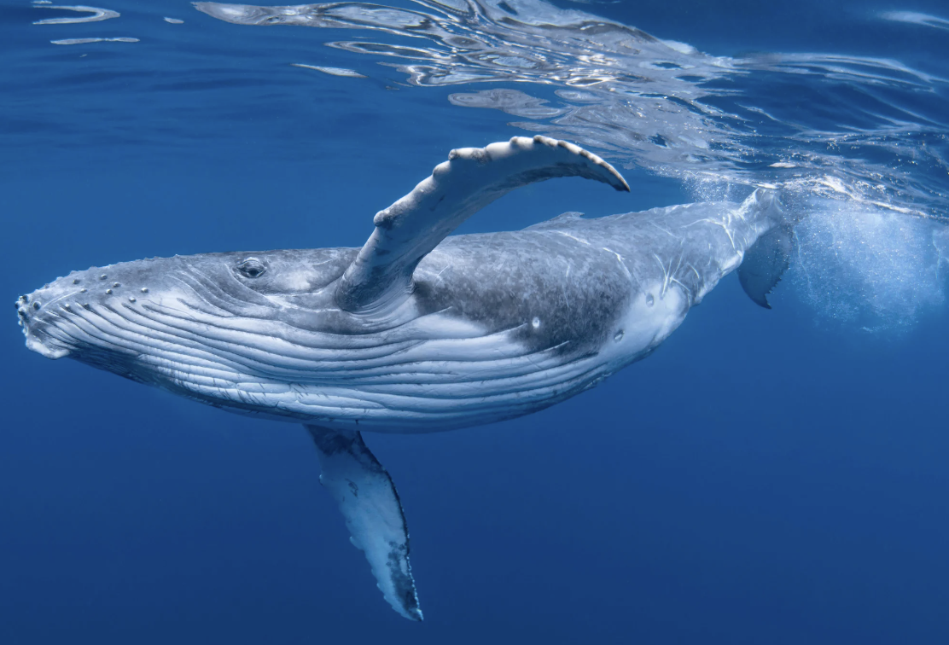
An organism can be so tiny that it can only be seen under a microscope, or as large as a blue whale.
Notes:
An organism is a living thing. It can be as tiny as a microorganism that can only be seen under a microscope, or as large as a blue whale, the largest animal on Earth. Organisms can be plants, animals,
fungi, or microorganisms like bacteria and viruses.

Slide 18
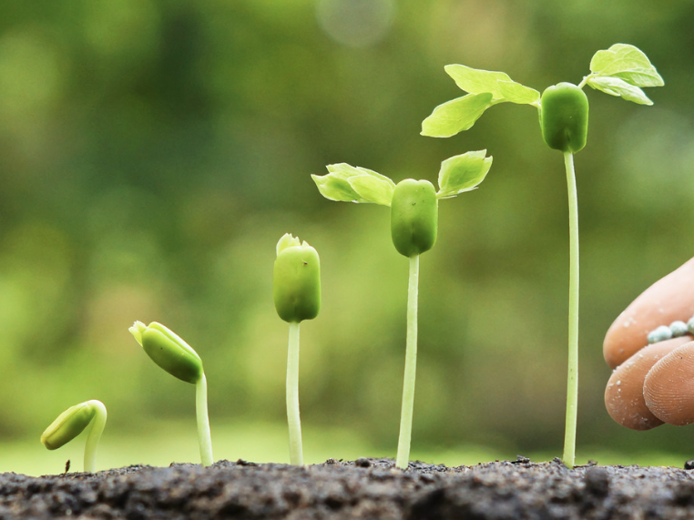
Organisms grow. For example, plants grow taller.
Notes:
Organisms grow. When you were a baby, you were much smaller than you are now. Plants grow taller, animals grow larger, and even tiny organisms grow in size and number of cells.

Slide 19
Organisms can make more of their own kind.
Notes:
Organisms can make more of their own kind, they reproduce. Plants produce seeds, animals give birth to babies, and microorganisms divide into two or more cells. Reproduction ensures that life continues
from one generation to the next.

Slide 20
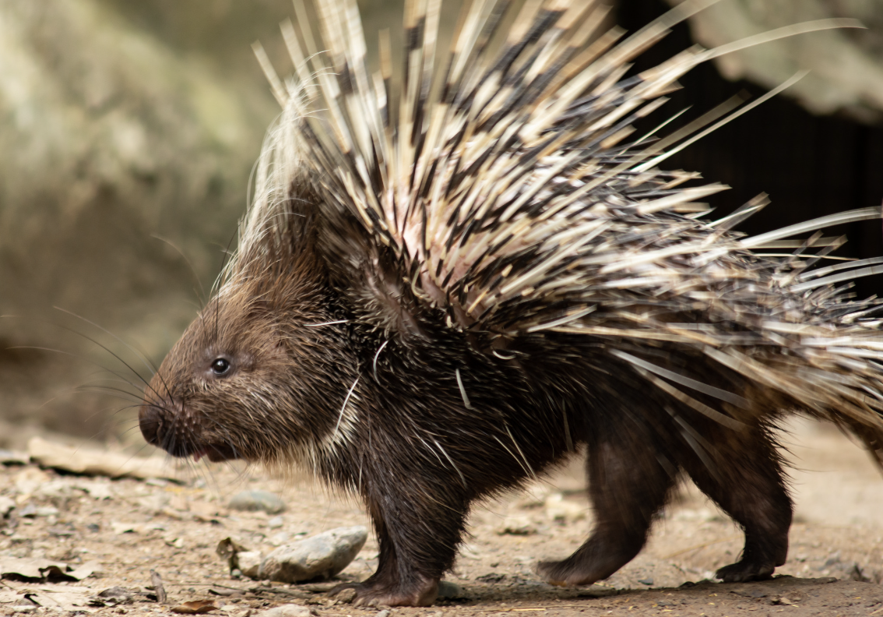
Organisms can respond to changes in
their environment.
Notes:
Organisms can respond to changes in their environment. For example, plants turn their leaves toward the sunlight, animals move away from danger, and your body shivers when you’re cold.

Slide 21
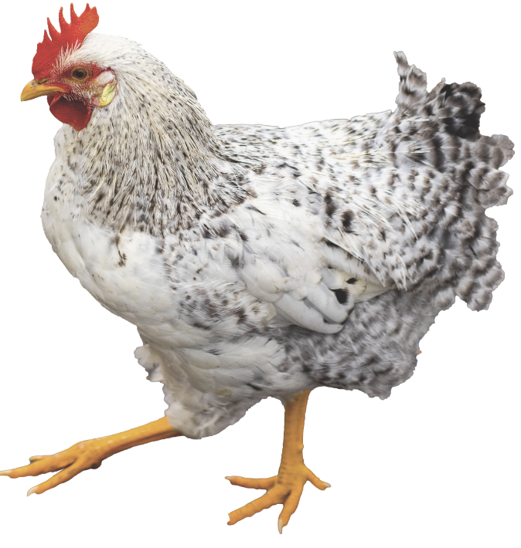
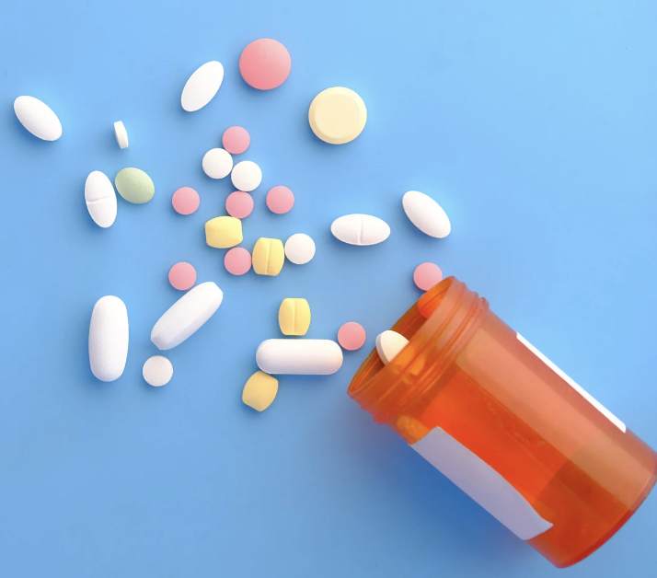
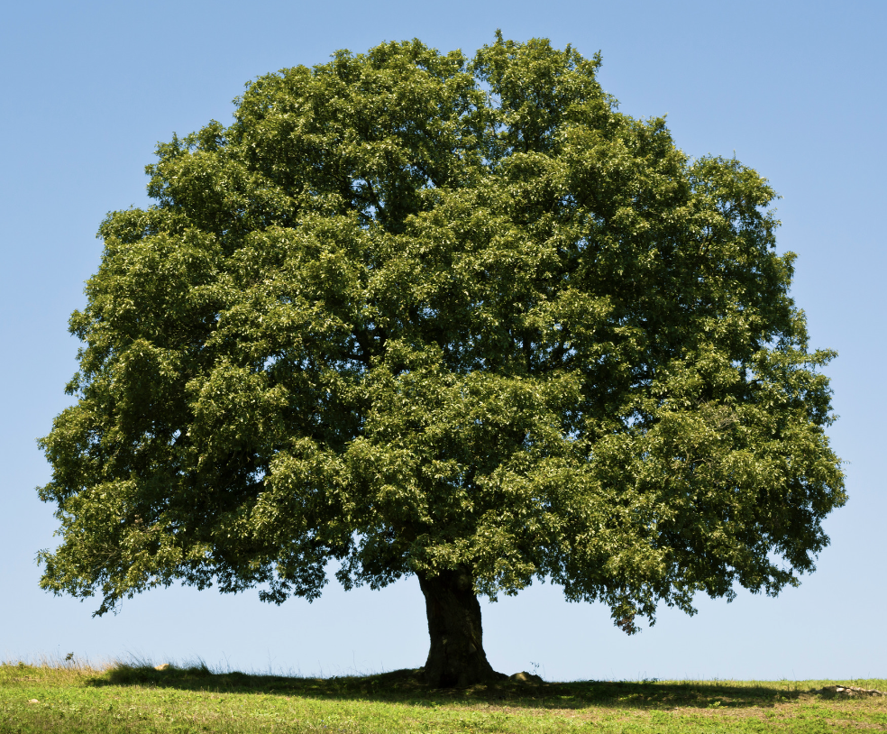
Organisms make up the food we eat, give us the air we breathe, and are used to make many medicines we take.
Notes:
Organisms have several affects on our lives, from the food we eat to the air we breathe and the medicines we take. We eat other organisms such as plants and animals, plants provide us with the air we
breathe, and many medicines are made from different types of plants.

Slide 22
Notes:
Let’s check-in for understanding.

Slide 23
True/False: Parents having a child is an example of organisms making more of their own kind (reproducing).
Notes:
True/False: Parents having a child is an example of organisms making more of their own kind (reproducing).
True

Slide 24
True/False: Parents having a child is an example of organisms making more of their own kind (reproducing).
Notes:
True: Parents having a child is an example of organisms making more of their own kind (reproducing).

Slide 25
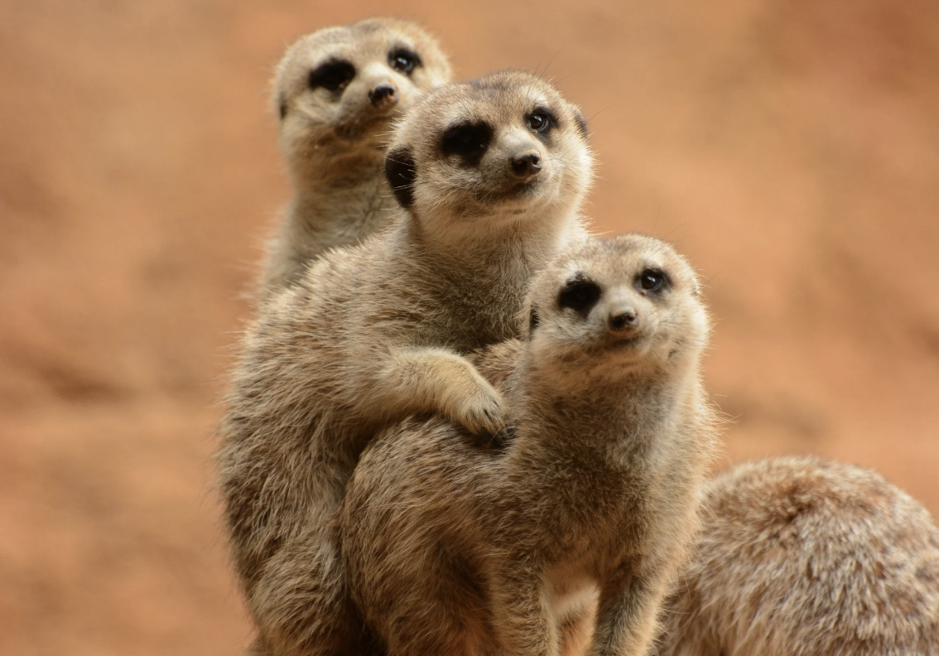
True/False: Organisms are typically around the same size.
Notes:
True/False: Organisms are typically around the same size.
False

Slide 26
True/False: Organisms are typically around the same size.
Notes:
False: Organisms are all sorts of sizes. From microscopic to the size of a blue whale.

Slide 27
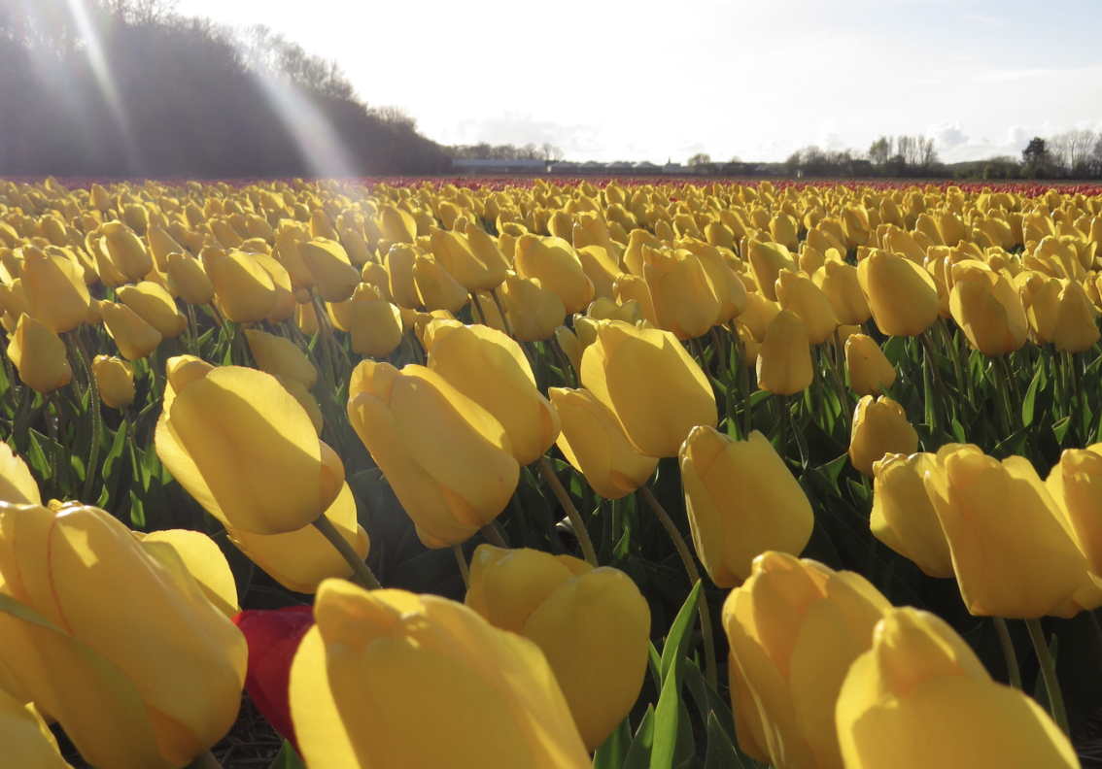
Organisms can respond to in
their environment
Notes:
Organisms can respond to in their environment.
[changes]

Slide 28
Organisms can respond to changes in
their environment
Notes:
Organisms can respond to changes in their environment.

Slide 29
Notes:
Now, let’s talk about some examples of photosynthesis.

Slide 30
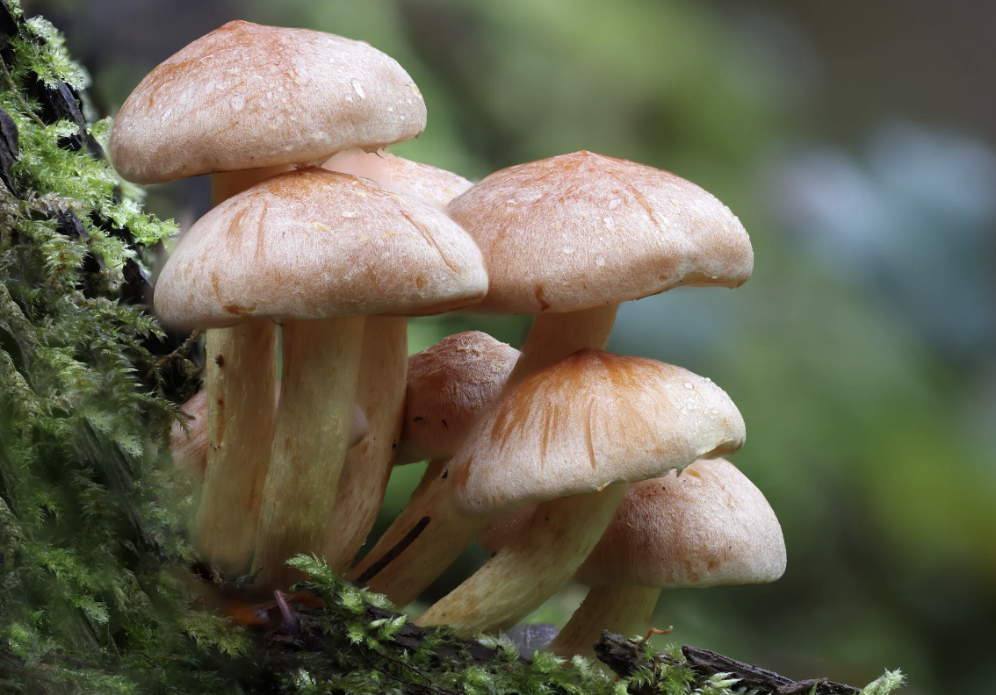
A mushroom is an example of an organism.
Notes:
A mushrooms is an example of an organism. They absorb things they need to live and grow from their surroundings.

Slide 31
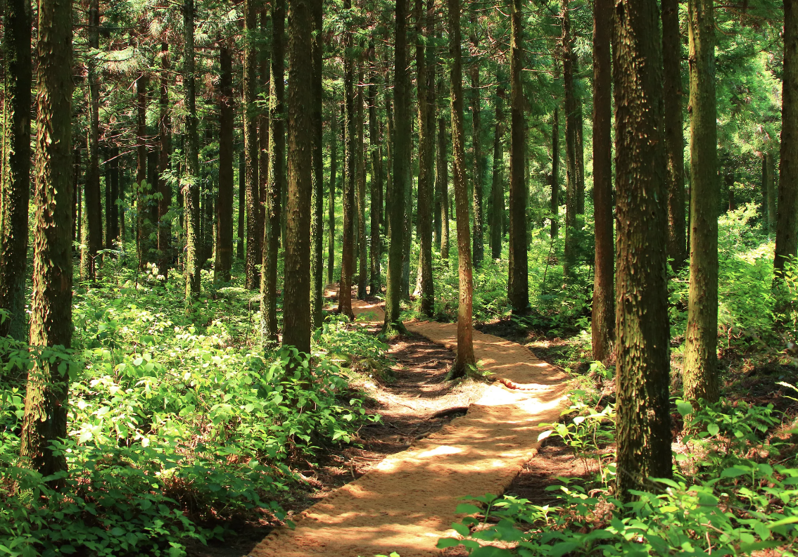
Trees in a forest are examples of organisms.
Notes:
Trees in a forest are examples of organisms. Each tree is an individual living thing.

Slide 32
Notes:
Now, let’s talk about some non-examples of an organism.

Slide 33
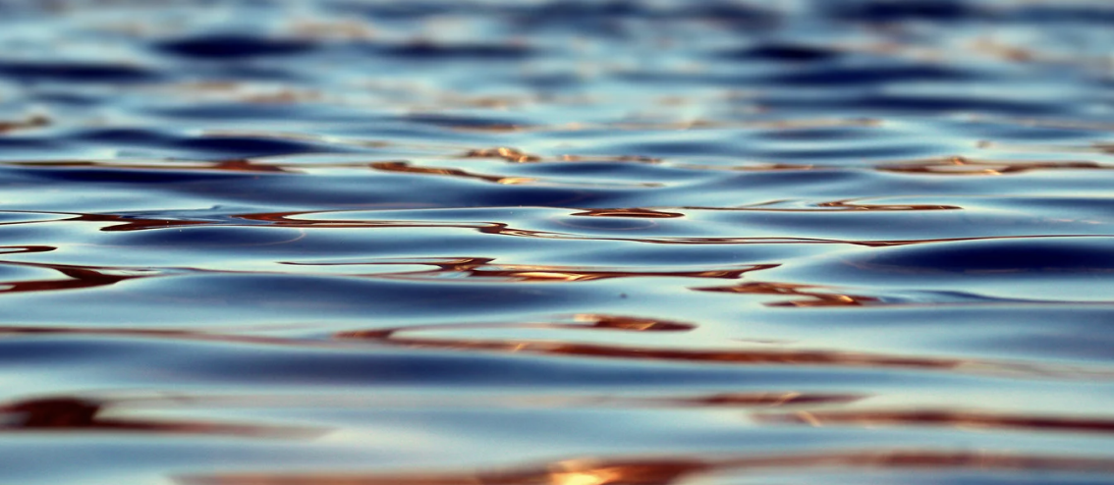
Water is NOT an example of an organism.
Notes:
Water is not an example of an organism. Water is not a living thing. For example, it cannot reproduce, or grow.

Slide 34
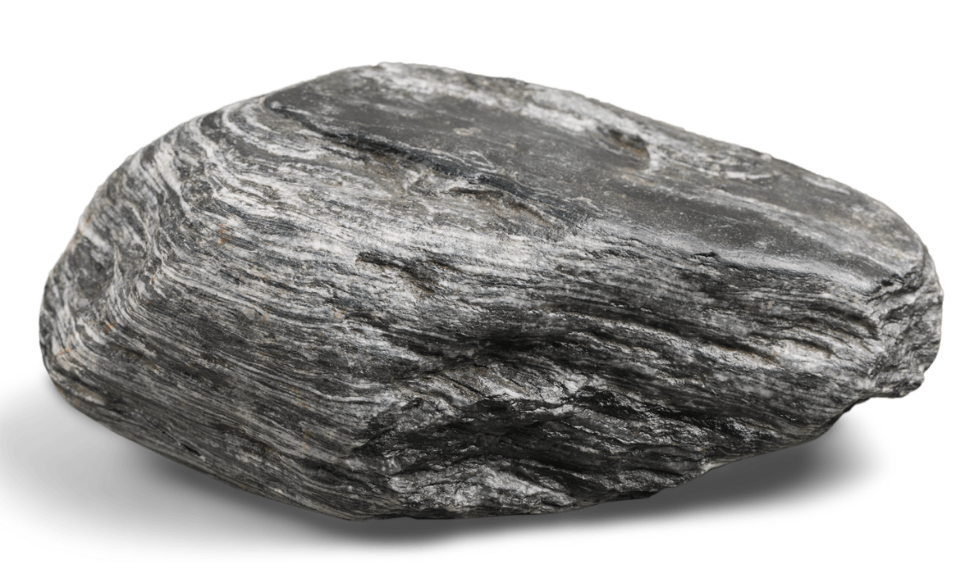
A rock is NOT an example of an organism.
Notes:
A rock is not an example of an organism. For example, rocks cannot respond to changes in their environment.

Slide 35
Notes:
Now let’s pause for a moment to check your understanding.

Slide 36
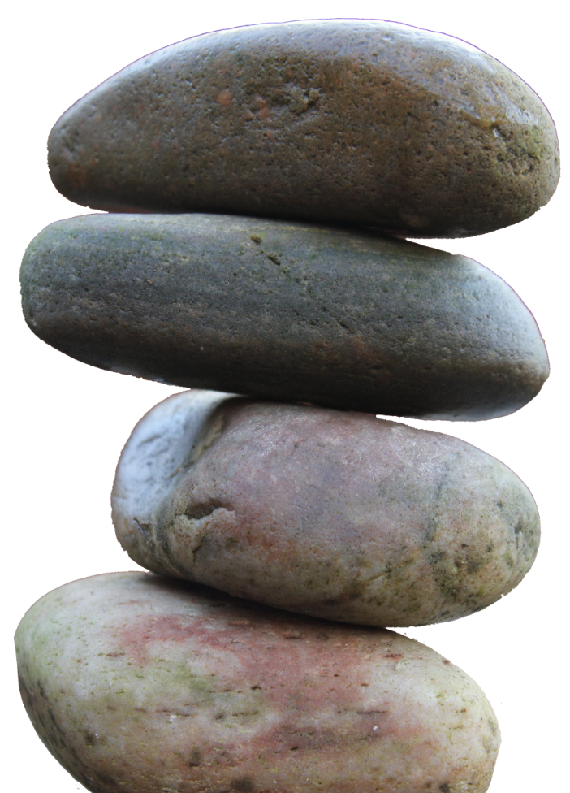
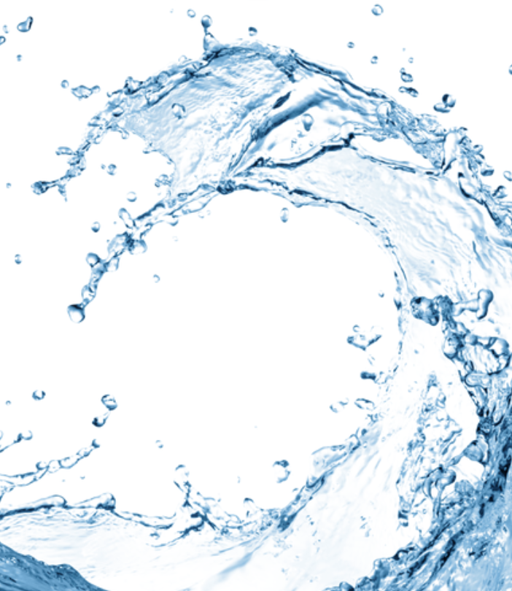
Why are water and rocks not examples of an organism?
Notes:
Why are the water and rock cycles not examples of photosynthesis?
[The water cycle shows how water moves through the environment. The rock cycle shows how different types of rocks are made. Neither show how plants make their own food, which is what photosynthesis is.]

Slide 37
Remember!!!
Notes:
So remember!

Slide 38
Organism: any living thing
Notes:
Organism: any living thing

Slide 39
Notes:
We will now complete this concept map, called a Frayer model, to summarize and further clarify what you have learned about the term photosynthesis.

Slide 40
Definition
Picture
Organism
Example
How do organisms impact my life?
Notes:
To complete the Frayer model, we will choose from four choices the correct picture, definition, example, and response to the question, “How do organisms impact my life?” Select the best response for each question using the information you just learned. As we select responses, we will see how this model looks filled in for the term organism.

Slide 41
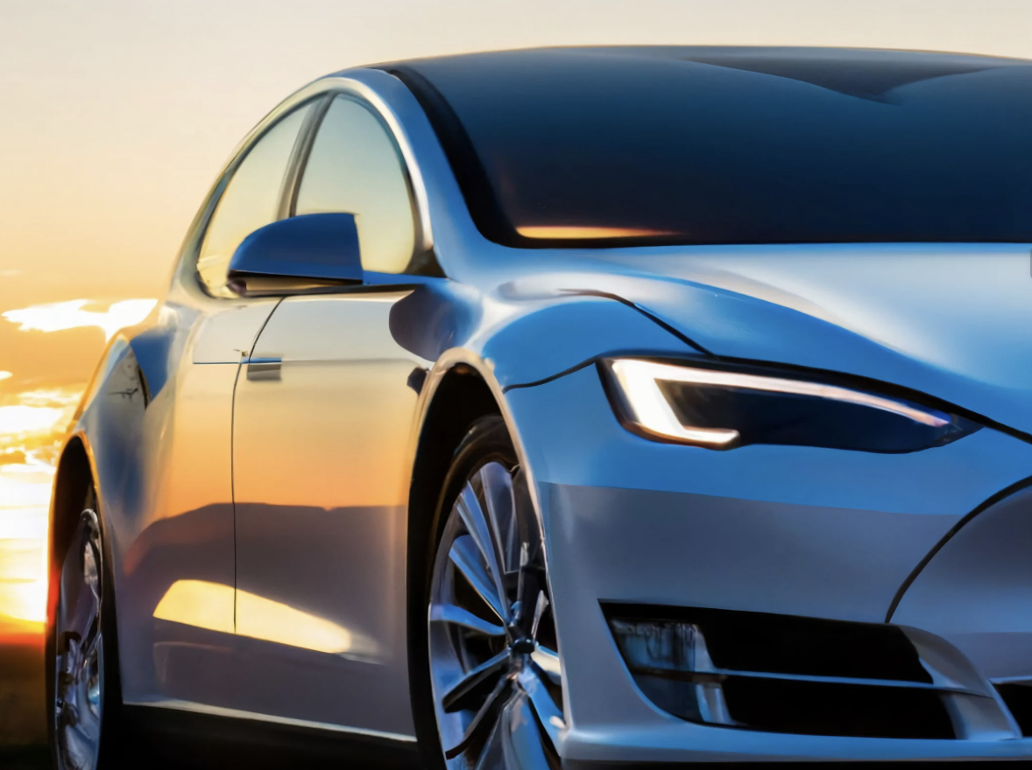
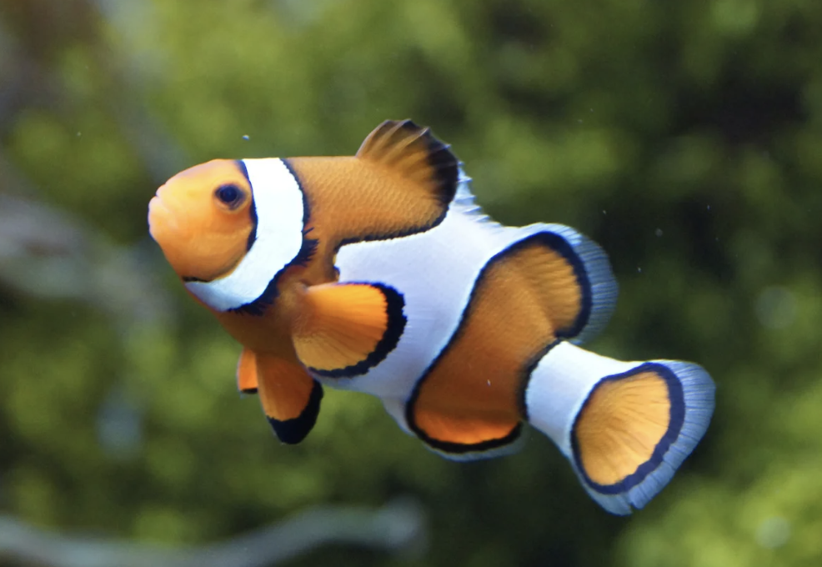
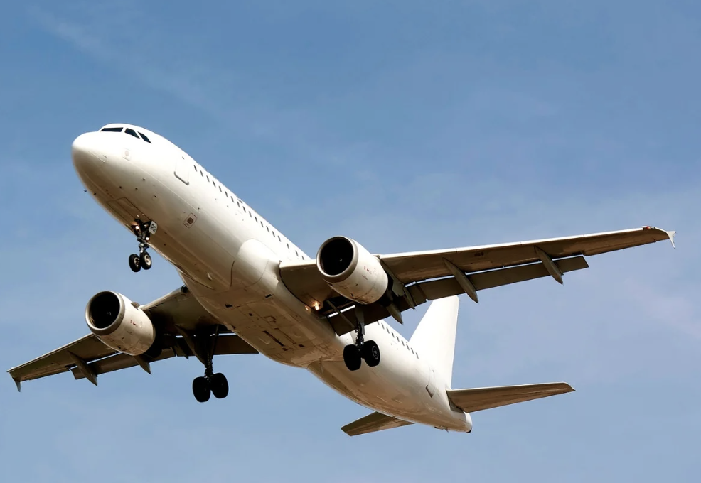
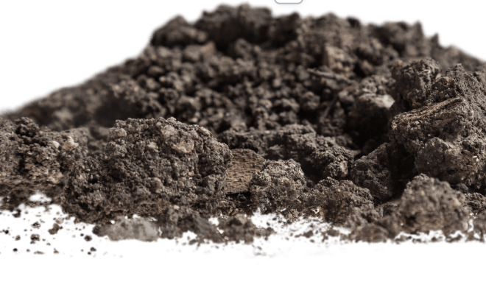
Directions: Choose the correct picture of an organism from the choices below.
A
B
C
D
Notes:
Choose the one correct picture of an organism from these four choices.

Slide 42
Directions: Choose the correct picture of an organism from the choices below.
A
B
C
D
Notes:
This is the picture that shows an organism.

Slide 43
Definition
Picture
Organism
Example
How do organisms impact my life?
Notes:
Here is the Frayer model filled in with a picture of an organism.

Slide 44
Directions: Choose the correct definition of an organism from the choices below.
A
Any living thing
B
Something made out of metal or plastic
C
A thing that never changes
D
Anything created in a factor
Notes:
Choose the one correct definition of an organism from these four choices.

Slide 45
Directions: Choose the correct definition of an organism from the choices below.
A
Any living thing
B
Something made out of metal or plastic
C
A thing that never changes
D
Anything created in a factor
Notes:
“Any living thing” is correct! This is the definition of an organism.

Slide 46
Definition
Picture
Any living thing
Organism
Example
How do organisms impact my life?
Notes:
Here is the Frayer Model with a picture and the definition filled in for organism: any living thing.

Slide 47
Directions: Choose the correct example of an organism from the choices below.
A
A computer
B
A house
C
A baby
D
A bicycle
Notes:
Choose the one correct example of an organism from these four choices.

Slide 48
Directions: Choose the correct example of an organism from the choices below.
A
A computer
B
A house
C
A baby
D
A bicycle
Notes:
“A baby” is correct! This is an example of an organism.

Slide 49
Definition
Picture
Any living thing
Organism
A baby
Example
How do organisms impact my life?
Notes:
Here is the Frayer Model with a picture, definition, and an example of organism: A baby.

Slide 50
Directions: Choose the correct response for “how do organisms impact my life?” from the choices below.
A
Organisms are the powerhouse of the cell.
B
Plants and animals are organisms, and we eat them as food to help us grow and survive.
C
Organisms make sure we always take flattering photographs.
D
Organisms are the different processes our bodies use to breathe.
Notes:
Choose the one correct response for “how do organisms impact my life?” from these four choices.

Slide 51
Directions: Choose the correct response for “how do organisms impact my life?” from the choices below.
A
Organisms are the powerhouse of the cell.
B
Plants and animals are organisms, and we eat them as food to help us grow and survive.
C
Organisms make sure we always take flattering photographs.
D
Organisms are the different processes our bodies use to breathe.
Notes:
“Plants and animals are organisms, and we eat them as food to help us grow and survive.” That is correct! This is an example of how organisms impact your life.

Slide 52
Definition
Picture
Any living thing
Organism
Plants and animals are organisms, and we eat them as food to help us grow and survive.
A baby
Example
How do organisms impact my life?
Notes:
Here is the Frayer Model with a picture, definition, example, and a correct response to “how do organisms impact my life?”: Plants and animals are organisms, and we eat them as food to help us grow and survive.”

Slide 53
Remember!!!
Notes:
So remember!

Slide 54
Organism: any living thing
Notes:
An organism is any living thing.

Slide 55
Big Question: How are living things important to the environment?
Notes:
Let’s reflect once more on our big question. Our “big question” is: How are living things important to the environment?
Does anyone have any additional examples to share that haven’t been discussed yet?

Slide 56
Notes:
Thanks for watching, and please continue watching CAPs available from this website.

Slide 57
This Was Created With Resources From:
Questions or Comments
Michael Kennedy, Ph.D. MKennedy@Virginia.edu
Rachel L Kunemund, Ph.D. rk8vm@virginia.edu

