Slide 1
Intro
“Big Idea” Question
Review Concepts
Check-In Questions
Teacher Demo
Vocabulary
Student-Friendly Definition
Examples & Non-Examples
Morphological Word Parts
Simulation/Activity
Notes:
OK everyone, get ready for our next lesson. Just as a reminder, these are the different components that our lesson may include, and you’ll see these icons in the top left corner of each slide so that you can follow along more easily!

Slide 2
Periodic Table
Intro
Notes:
Today we will learn about the Periodic Table.

Slide 3
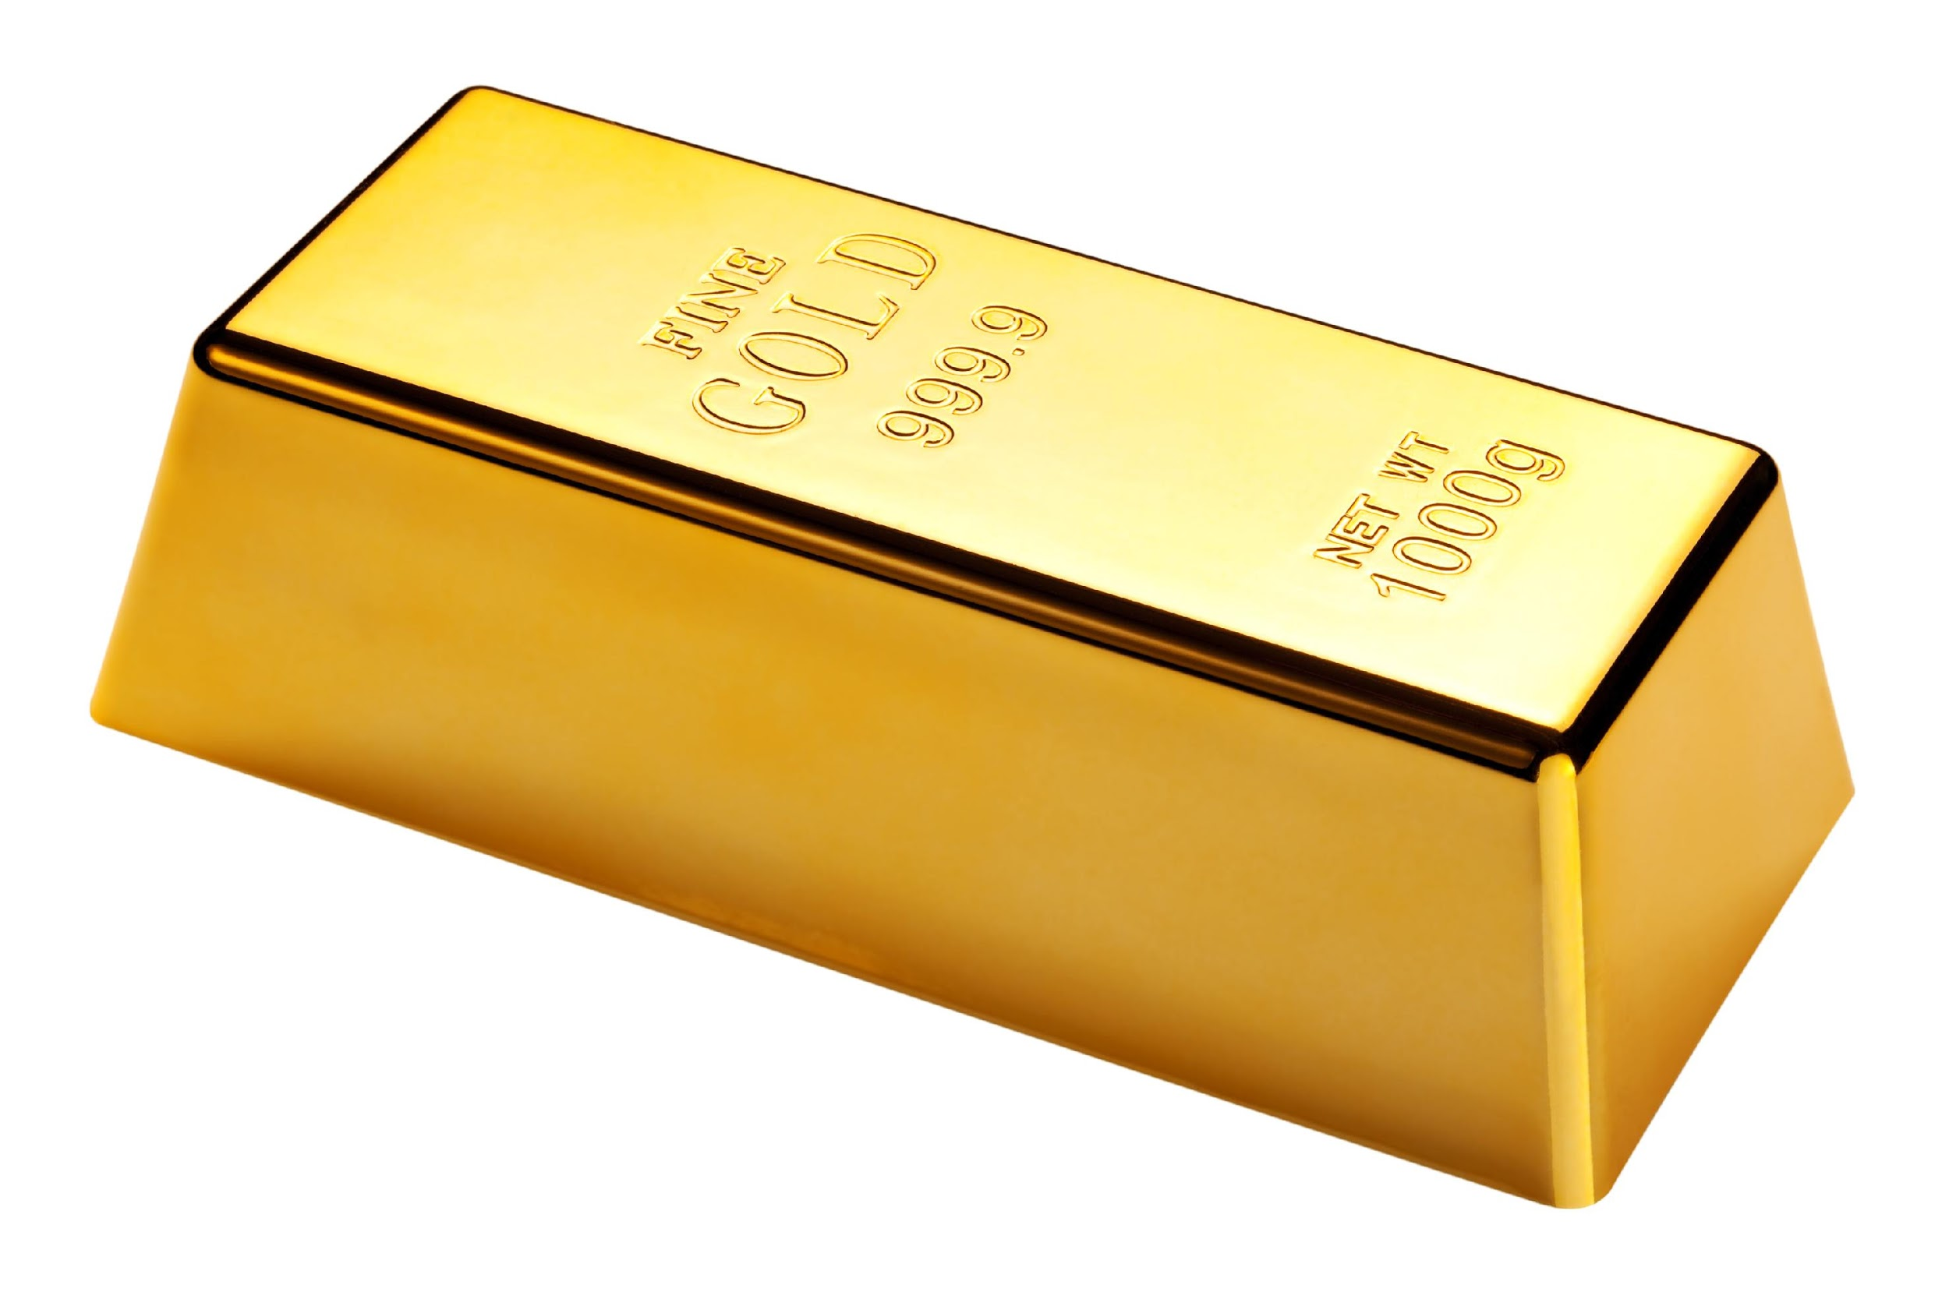
Big Question: How does the Periodic Table help us understand elements?
Notes:
Our “big question” is: How does the Periodic Table help us understand elements?
[Pause and illicit predictions from students.]
I love all these thoughtful scientific hypotheses! Be sure to keep this question and your predictions in mind as we move through this lesson, and we’ll revisit it.

Slide 4
Demonstration
The Periodic Table Song
TEACHER DIRECTIONS:
Play the periodic table song for students at the beginning of the lesson as a way to engage students about the content.
Notes:
Let’s watch a video about all the elements on the periodic table.
Feedback: This video introduces the elements quite quickly which could be overwhelming for some students. To avoid overwhelming students, set expectations before the video. For example, explicitly tell students that the video moves quickly and is just meant to be an introduction. Before the video, it might help to ask if students know examples of any of the elements and then suggest that they see if their examples are shown in the video. Or ask students to jot down 2 or 3 examples of elements as they see them to share together afterwards as a class. A simple task like this could help students to stay engaged without causing the stress of needing to capture every example in a quick-moving video.

Slide 5
Notes:
Before we move on to our new vocabulary term, let’s review some other words & concepts that you already learned and make sure you are firm in your understanding.

Slide 6
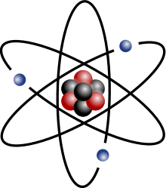
Atom: smallest whole unit of matter
Notes:
An atom is the smallest whole unit of matter. All matter is made up of atoms.

Slide 7
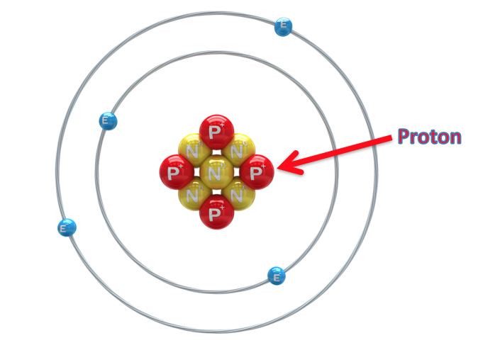
Proton: positively charged subatomic particle found in the nucleus of an atom.
Notes:
A proton is a positively charged subatomic particle found in the nucleus of an atom.
Feedback: Incorporating visuals is an important way to help students build conceptual understanding when learning new definitions.

Slide 8
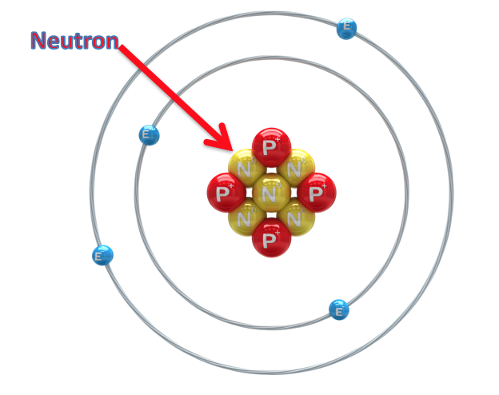
Neutron: subatomic particle with a neutral charge, found in the nucleus of an atom.
Notes:
A neutron is a subatomic particle with a neutral charge, found in the nucleus of an atom.

Slide 9
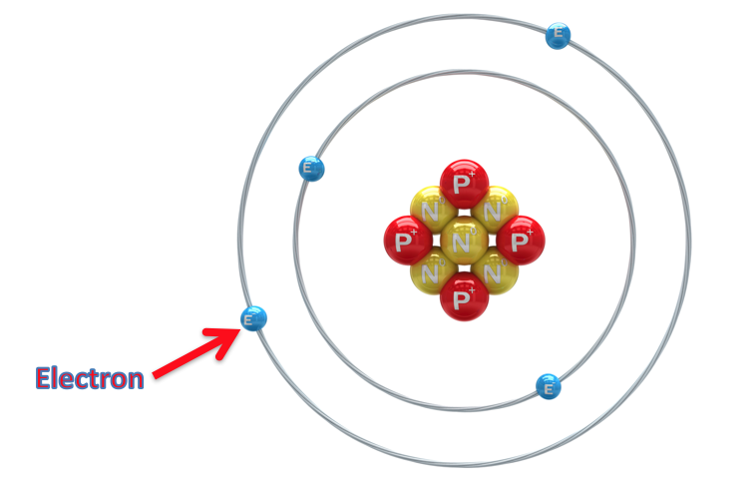
Electron: negatively charged particle that orbits the nucleus of an atom.
Notes:
An electron is a negatively charged particle that orbits the nucleus.
Feedback: These visuals help support the definition of the vocabulary term; referring to these visual references gives the students another means of accessing the content.

Slide 10
Element: a pure substance containing only one type of atom
Notes:
An element is a pure substance containing only one type of atom.

Slide 11
Notes:
Now let’s pause for a moment to check your understanding.

Slide 12
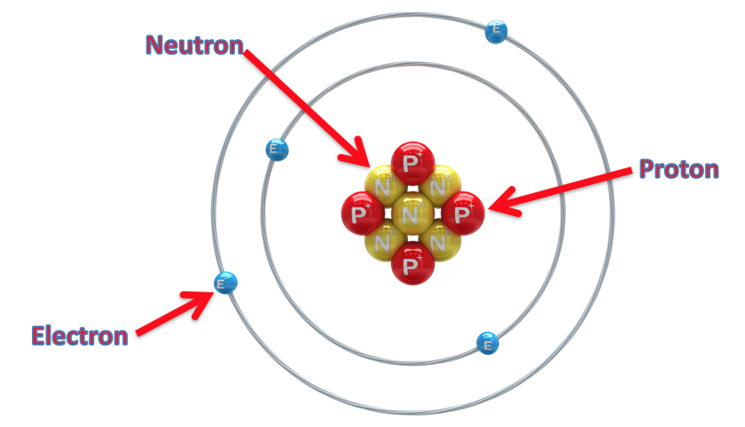
What are the 3 subatomic particles? Explain their similarities and differences.
Notes:
What are the 3 subatomic particles? Explain their similarities and differences.
[The 3 subatomic particles are protons, neutrons, and electrons. Neutrons and protons are both found in the nucleus, however, protons are positively charged and neutrons have a neutral charge. Electrons are negatively charged and orbit the nucleus.]

Slide 13
What is an element?
Notes:
What is an element?
[An element is a pure substance containing only one type of atom.]

Slide 14
Periodic Table
Notes:
Now that we’ve reviewed, let’s define our new term, the Periodic Table.

Slide 15
Periodic Table: chart of all the known elements organized according to chemical and physical properties
Notes:
The Periodic Table is a chart of all the known elements, organized according to chemical and physical properties.

Slide 16
Notes:
Let’s check-in for understanding.

Slide 17
What is the Periodic Table?
Notes:
What is the Periodic Table?
[The Periodic Table is a chart of all the known elements, organized according to chemical and physical properties.]

Slide 18
Notes:
That is the basic definition, but there is a bit more you need to know.

Slide 19
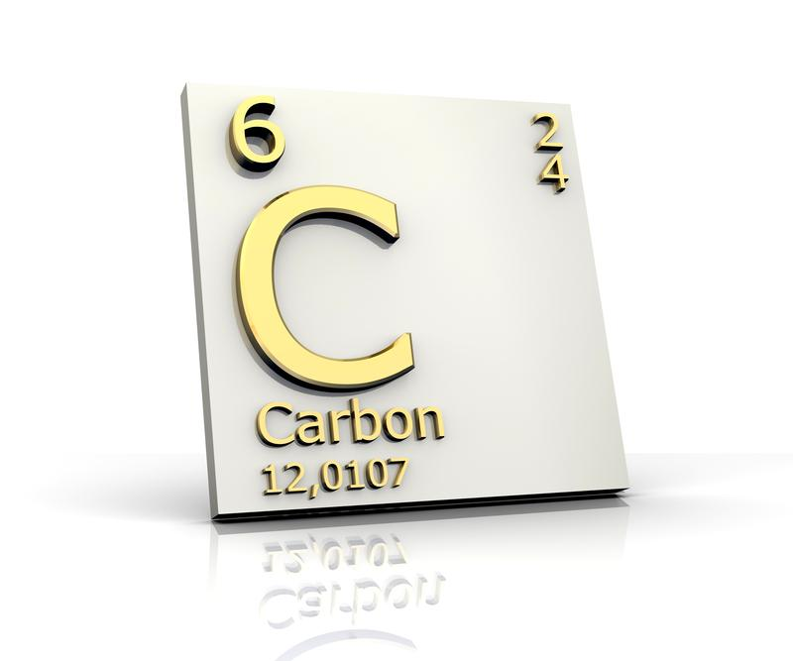
Atomic Symbol
Notes:
The atomic symbol is the abbreviation of an element’s name. It is either one or two letters, and the first one is always capitalized. The atomic symbol for carbon is C.

Slide 20
Trends
Notes:
The Periodic Table allows us to see trends within the elements that would not be understandable if they were not organized.
Feedback: This is a great opportunity to make a connection to a real-life situation.

Slide 21
Dmitri Mendeleev
Notes:
The Periodic Table was first organized by a scientist named Dmitri Mendeleev.

Slide 22
Dmitri Mendeleev
Notes:
Mendeleev decided to organize his periodic table by atomic mass.

Slide 23
Atomic Mass Number
Notes:
Atomic mass is the total number of protons and neutrons in an atom.

Slide 24
Notes:
When you look up an element on the periodic table, you can find its atomic mass number listed below the name of the element.
Feedback: Here you can engage students by asking why it may be important to know the atomic mass number and then incorporate their responses into a discussion in which you give examples.

Slide 25
Notes:
Let’s check-in for understanding.

Slide 26
What is the difference between atomic symbol and atomic mass number?
Notes:
What is the difference between atomic symbol and atomic mass number?
[The atomic symbol is the abbreviation of an element’s name. It is either one or two letters, and the first one is always capitalized. The atomic symbol for carbon is C.
Atomic mass is the total number of protons and neutrons in an atom.]

Slide 27
Why is the Periodic Table important?
Notes:
Why is the Periodic Table important?
[The Periodic Table allows us to see trends within the elements that would not be understandable if they were not organized.]

Slide 28
How did Dmitri Mendeleev organize the first Periodic Table?
Notes:
How did Dmitri Mendeleev organize the first Periodic Table?
[By atomic mass]

Slide 29
Notes:
Now, let’s talk about some examples of atomic mass.

Slide 30
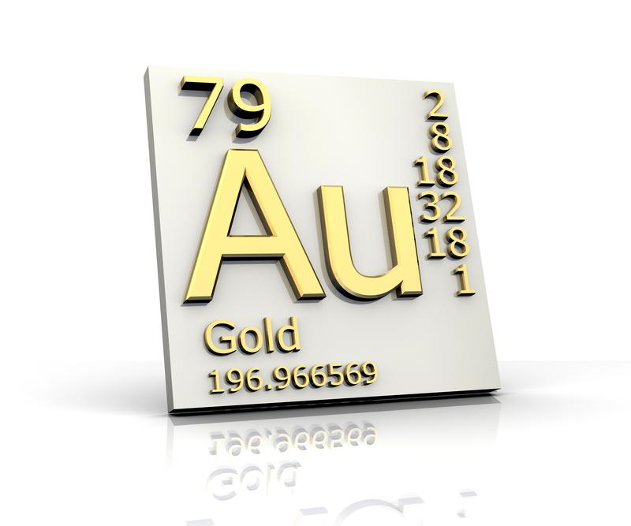
Notes:
The atomic mass of gold is 196 units.

Slide 31
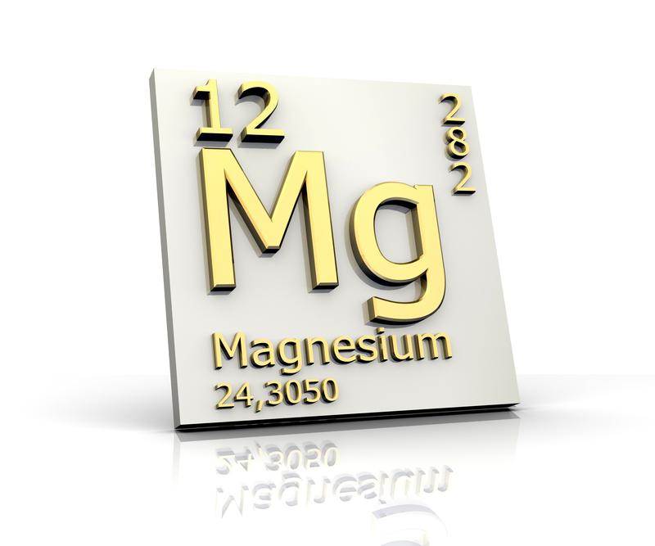
Notes:
The atomic mass of magnesium is 24 units.

Slide 32
Notes:
Let’s check-in for understanding.

Slide 33
Where do we find the atomic mass of an element?
Notes:
Where do we find the atomic mass of an element?
[At the bottom, under its name]

Slide 34
Periodic Table and Atomic Number
Notes:
Today, the Periodic Table is no longer organized by atomic mass, Like Mendeleev’s was. Now we organize the periodic table by atomic number.
Feedback: This could be an interesting opportunity to engage in why the periodic table was reorganized - what was the catalyst for changing its organization and how does this benefit us now?

Slide 35
Atomic Number
Notes:
The atomic number is the total number of protons in an element. It can be found in the top left corner of an element.

Slide 36
Protons give an element its identity
Notes:
Protons give an element its identity. Carbon, for example, is the element that has 6 protons.

Slide 37
Notes:
Let’s check-in for understanding.

Slide 38
How is the Periodic Table organized today?
Notes:
How is the Periodic Table organized today?
[By atomic number]

Slide 39
What does the atomic number tell us about the element?
Notes:
What does the atomic number tell us about the element?
[It tells us how many protons an element has.]

Slide 40
Notes:
Now, let’s talk about some examples of atomic number.

Slide 41
Notes:
The atomic mass of gold is 79. One atom of gold has 79 protons in its nucleus.

Slide 42
Notes:
The atomic number of magnesium is 12. One atom of magnesium has 12 protons in its nucleus.

Slide 43
Notes:
Let’s check-in for understanding.

Slide 44
Where can we find the atomic number of an element?
Notes:
Where can we find the atomic number of an element?
[At the top left corner]

Slide 45
Notes:
So, how do we figure out the number of neutrons?

Slide 46
Atomic Mass
Atomic Number
Number of neutrons
– =
Notes:
To find the number of neutrons in an atom, all we need to do is subtract the atomic number from the atomic mass number.
Feedback: Using a mathematical model to help students understand how to find the number of neutrons is a great connection between mathematics and science. In this case, and particularly at this grade band, explicitly telling and showing the students the model is important for conceptual understanding.

Slide 47
Notes:
Let’s look at gold.

Slide 48
Notes:
The atomic mass number of gold is 196 and the atomic number is 79.

Slide 49
Atomic Mass
Atomic Number
Number of neutrons
– =
196
79
Notes:
Therefore, we would need to subtract 79 from 196.

Slide 50
Atomic Mass
Atomic Number
Number of neutrons
– =
196
79
117
Notes:
A gold atom has 117 neutrons.

Slide 51
Notes:
Let’s check-in for understanding.

Slide 52
How do we figure out the number of neutrons in an element?
Notes:
How do we figure out the number of neutron in an element?
[Subtract the atomic number from the atomic mass number]

Slide 53
Notes:
How many neutrons are in Magnesium?

Slide 54
Atomic Mass
Atomic Number
Number of neutrons
– =
Notes:
How many neutrons are in Magnesium?

Slide 55
Atomic Mass
Atomic Number
Number of neutrons
– =
24
12
12
Notes:
How many neutrons are in Magnesium?

Slide 56
What is the difference between the atomic number and atomic mass?
Notes:
What is the difference between the atomic number and the atomic mass?
[Atomic number is the number of protons in an atom, while atomic mass is the number of protons AND neutrons in an atom.]

Slide 57
The modern periodic table is organized by __________.
Atomic symbol
Atomic number
Atomic mass
Element name
Notes:
The modern periodic table is organized by ___________.

Slide 58
The modern periodic table is organized by __________.
Atomic symbol
Atomic number
Atomic mass
Element name
Notes:
The modern periodic table is organized by ___________.
[Atomic number]

Slide 59
How did Mendeleev originally organize the periodic table?
Notes:
How did Mendeleev originally organize the periodic table?
[Mendeleev organized his periodic table by atomic mass.]

Slide 60
Remember!!!
Notes:
So remember!

Slide 61
Periodic Table: chart of all the known elements organized according to chemical and physical properties
Notes:
The Periodic Table is a chart of all the known elements, organized according to chemical and physical properties.

Slide 62
Atomic Symbol
Notes:
The atomic symbol is the abbreviation of an element’s name. It is either one or two letters, and the first one is always capitalized. The atomic symbol for carbon is C.

Slide 63
Atomic Mass
Notes:
Atomic mass is the total amount of neutrons and protons in an element.

Slide 64
Atomic Number
Notes:
The atomic number is the total number of protons in an element.

Slide 65
Atomic Mass
Atomic Number
Number of neutrons
– =
Notes:
To find the number of neutrons in an atom, all we need to do is subtract the atomic number from the atomic mass.

Slide 66
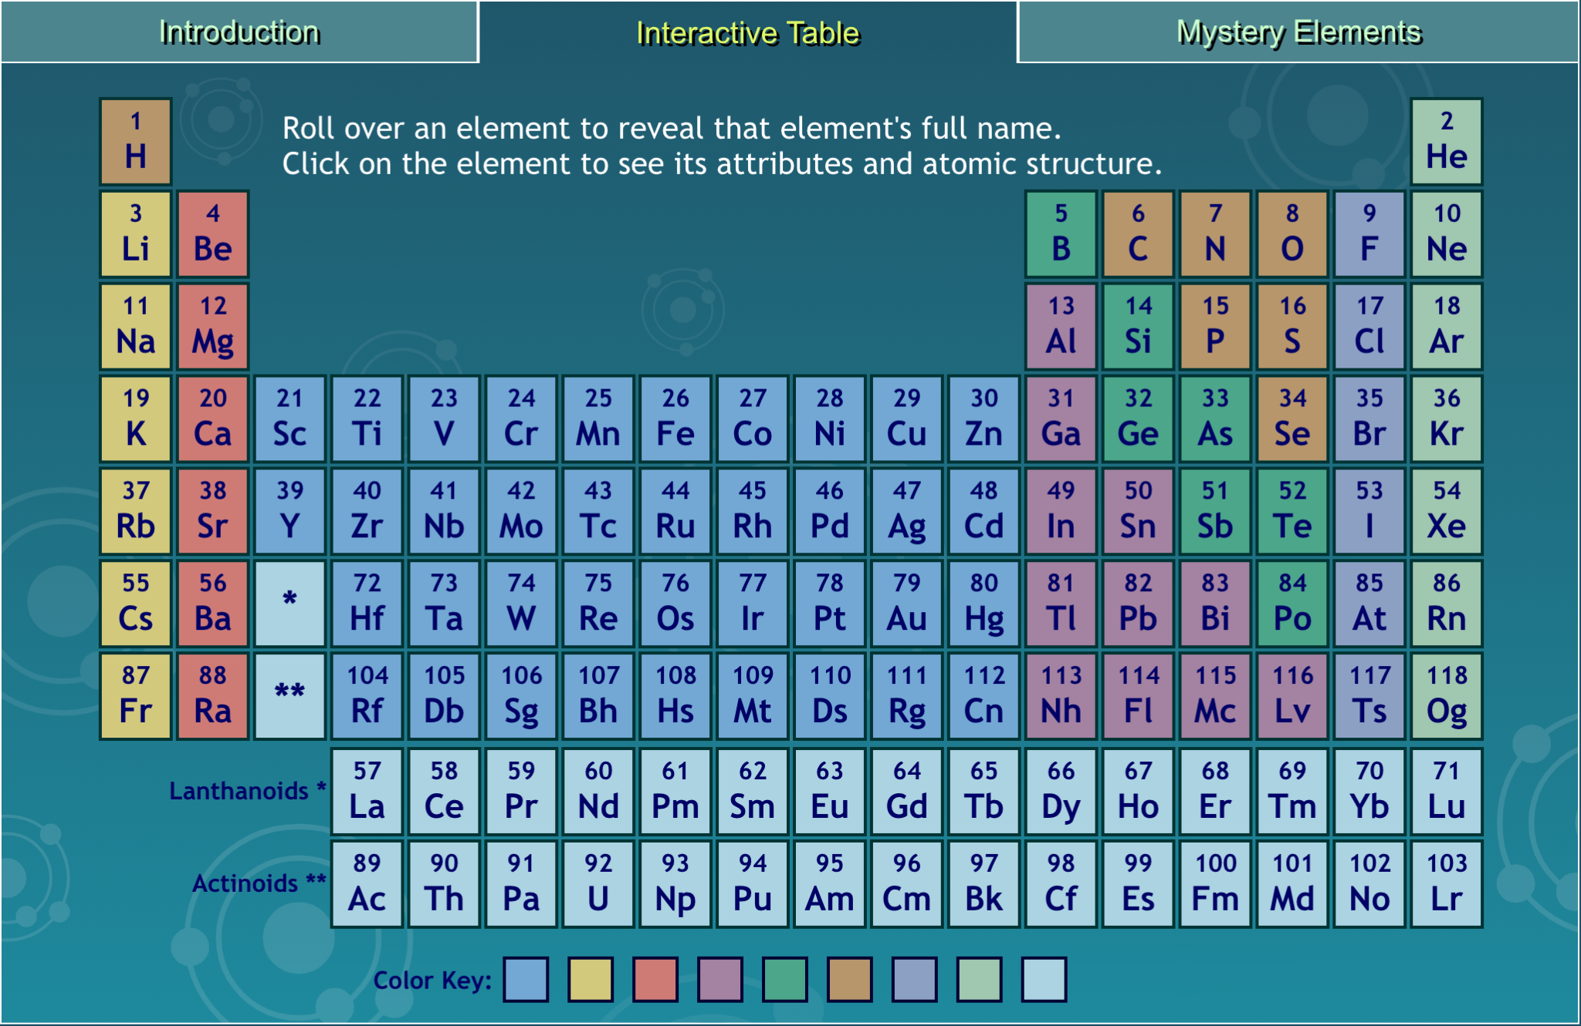
Simulation
Interactive Table
On the interactive periodic table, students can hover over elements to learn their names and click on elements to see its atomic and mass numbers as well as other attributes.
Notes:
On the interactive periodic table, students can hover over elements to learn their names and click on elements to see its atomic and mass numbers as well as other attributes.
Feedback: This simulation is a great way to engage students in interacting with the periodic table in a low-stakes way. This simulation may be helpful earlier in the presentation as an introduction to the periodic table or here as a review of what students have learned. Be sure to offer students opportunities to ask questions to gauge their understanding.

Slide 67
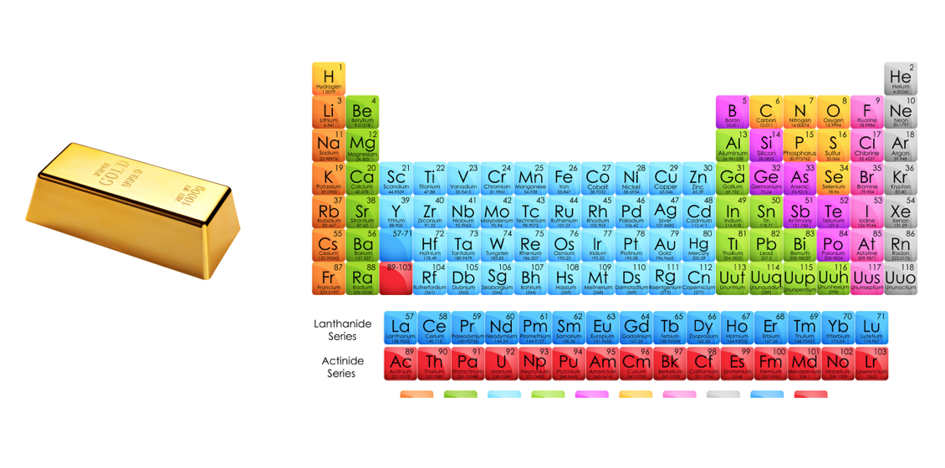
Big Question: How does the Periodic Table help us understand elements?
Notes:
Explicit cue to revisit the big question at the end of the lesson: Okay everyone. Now that we’ve learned the term, let’s reflect once more on our big question. Was there anything that we predicted earlier that was correct or incorrect? Do you have any new hypotheses to share?

Slide 68
Notes:
Thanks for watching, and please continue watching CAPs available from this website.

Slide 69
This Video Was Created With Resources From:
Questions or Comments
Michael Kennedy, Ph.D. MKennedy@Virginia.edu
Rachel L Kunemund, Ph.D. rk8vm@virginia.edu

