Slide 1
Intro
“Big Idea” Question
Review Concepts
Check-In Questions
Teacher Demo
Vocabulary
Student-Friendly Definition
Examples & Non-Examples
Morphological Word Parts
Simulation/Activity
Notes:
OK everyone, get ready for our next lesson. Just as a reminder, these are the different components that our lesson may include, and you’ll see these icons in the top left corner of each slide so that you can follow along more easily!

Slide 2
Intro
Physical Property
Notes:
Today we will learn about physical properties.

Slide 3
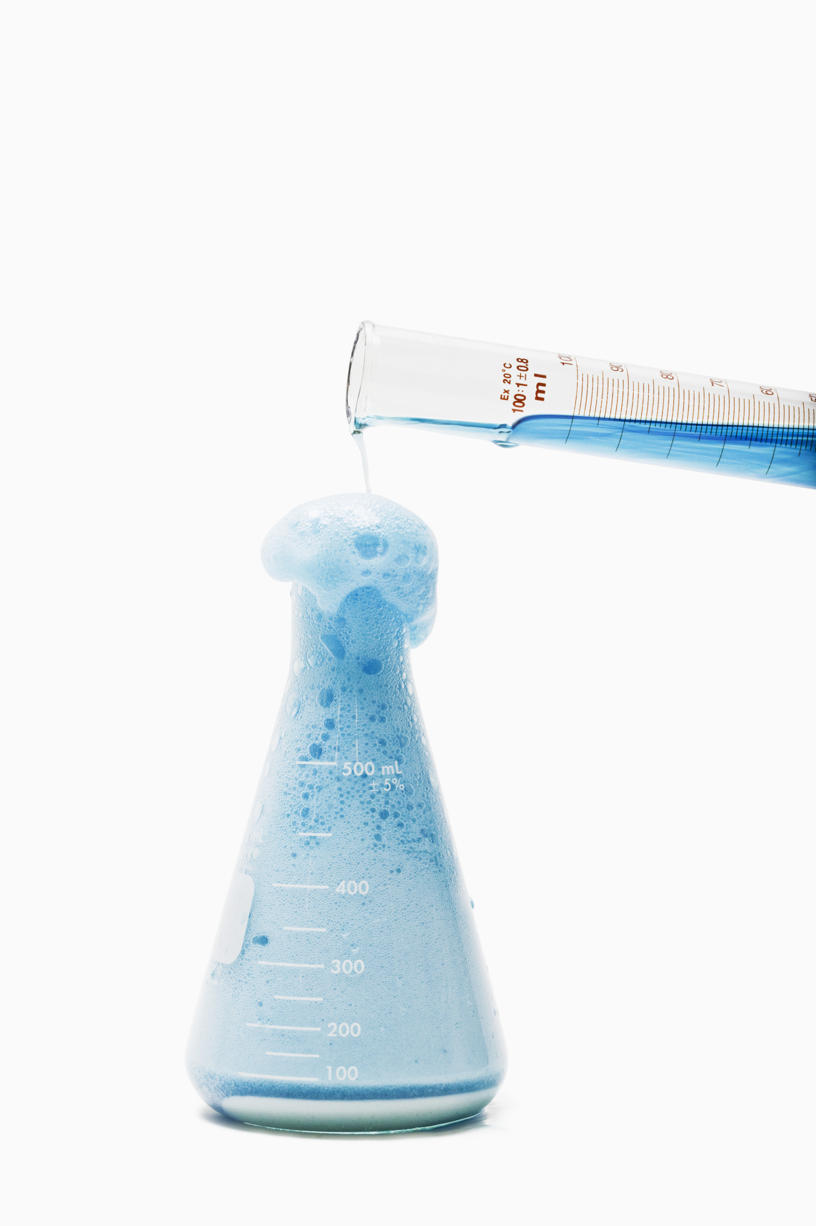
Big Question: What are the similarities and differences between physical and chemical properties and changes, and what do they tell us about a substance?
Physical Property vs Physical Change
H₂O
Chemical Property vs Chemical Change
Notes:
Our “big question” is: What are the difference between physical properties and physical changes? What is the difference between chemical properties and chemical changes? How are physical and chemical different? What do they tell us about a substance?
[Pause and illicit predictions from students.]
I love all these thoughtful scientific hypotheses! Be sure to keep this question and your predictions in mind as we move through these next few lessons, and we’ll continue to revisit it.
Feedback: Providing a rationale during the anticipatory set makes it clear to students what is expected of them and what they should focus on learning.

Slide 4
Demonstration
TEACHER DIRECTIONS
To demonstrate physical properties, you can use objects found in your classroom (This can also be done virtually). Ask students what they already know about physical properties. Show students different objects and have them tell you what they notice about each objects (color, size, shape, state of matter, etc). Tells students that everything they observed were physical properties. Tell students that in this lesson they will learn more about physical properties.
Notes:
Let’s do a quick demonstration that will help get our brains ready to think about physical properties, and how they relate to our big question.
Feedback: Keep in mind that an organized structure and a clear demonstration will help your students understand the content and make predictions.

Slide 5
Notes:
Before we move on to our new vocabulary term, let’s review some other words & concepts that you already learned and make sure you are firm in your understanding.

Slide 6
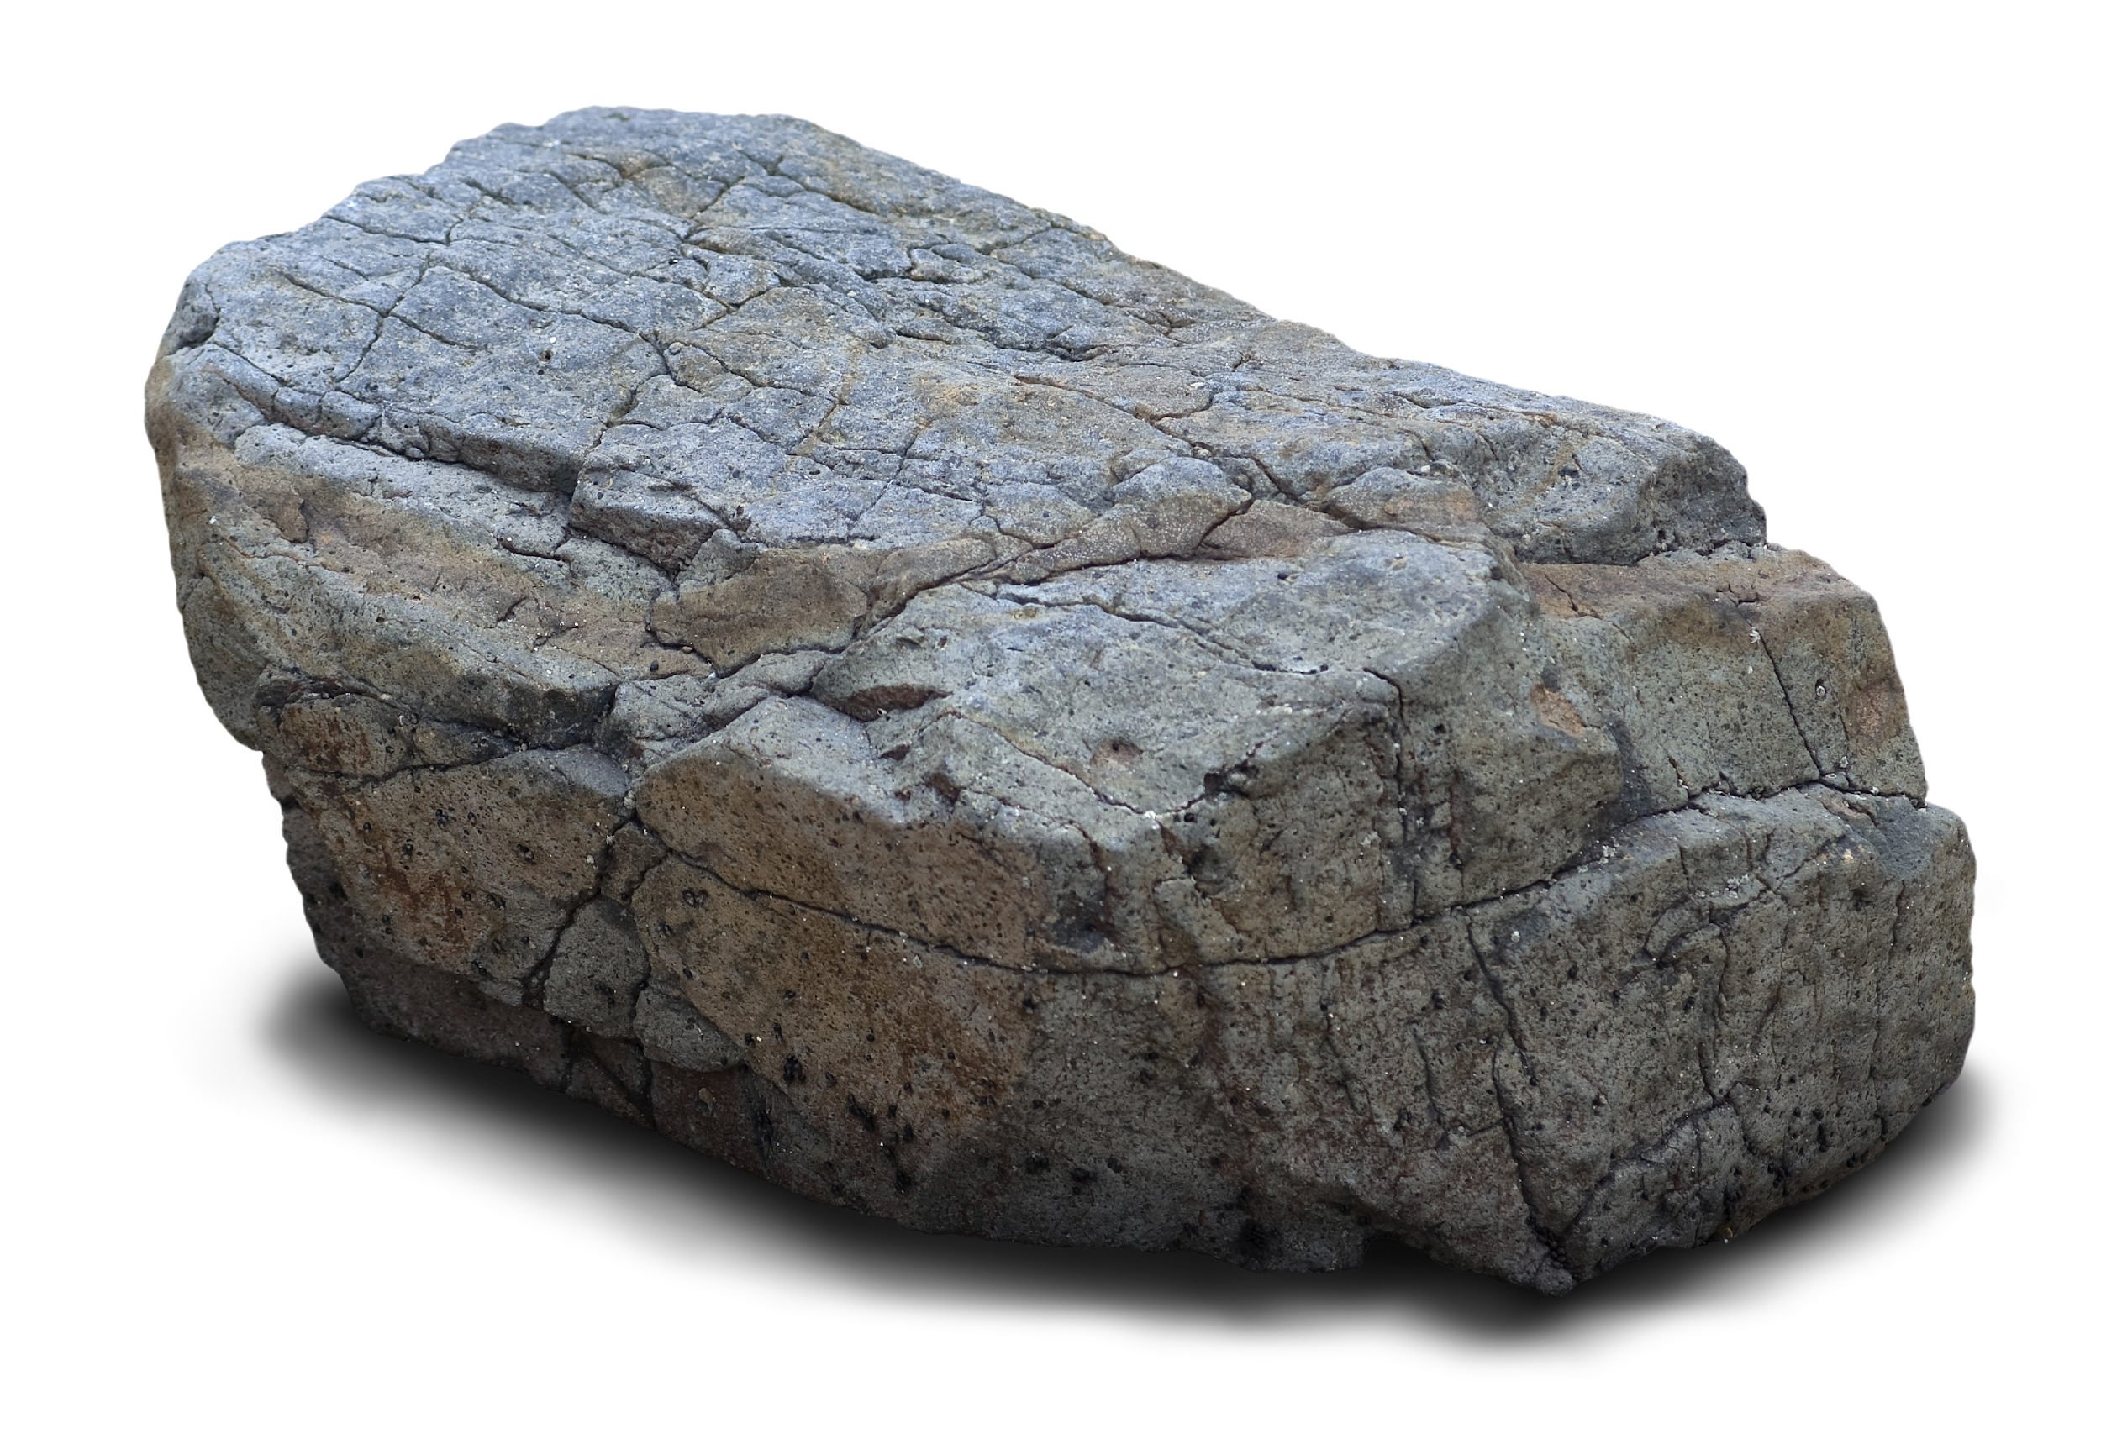
Matter: has mass and takes up space
Notes:
Matter is anything that has mass and takes up space.

Slide 7
Atoms: smallest whole unit of matter
Notes:
All matter is made of atoms. Atoms are the smallest whole unit of matter.

Slide 8
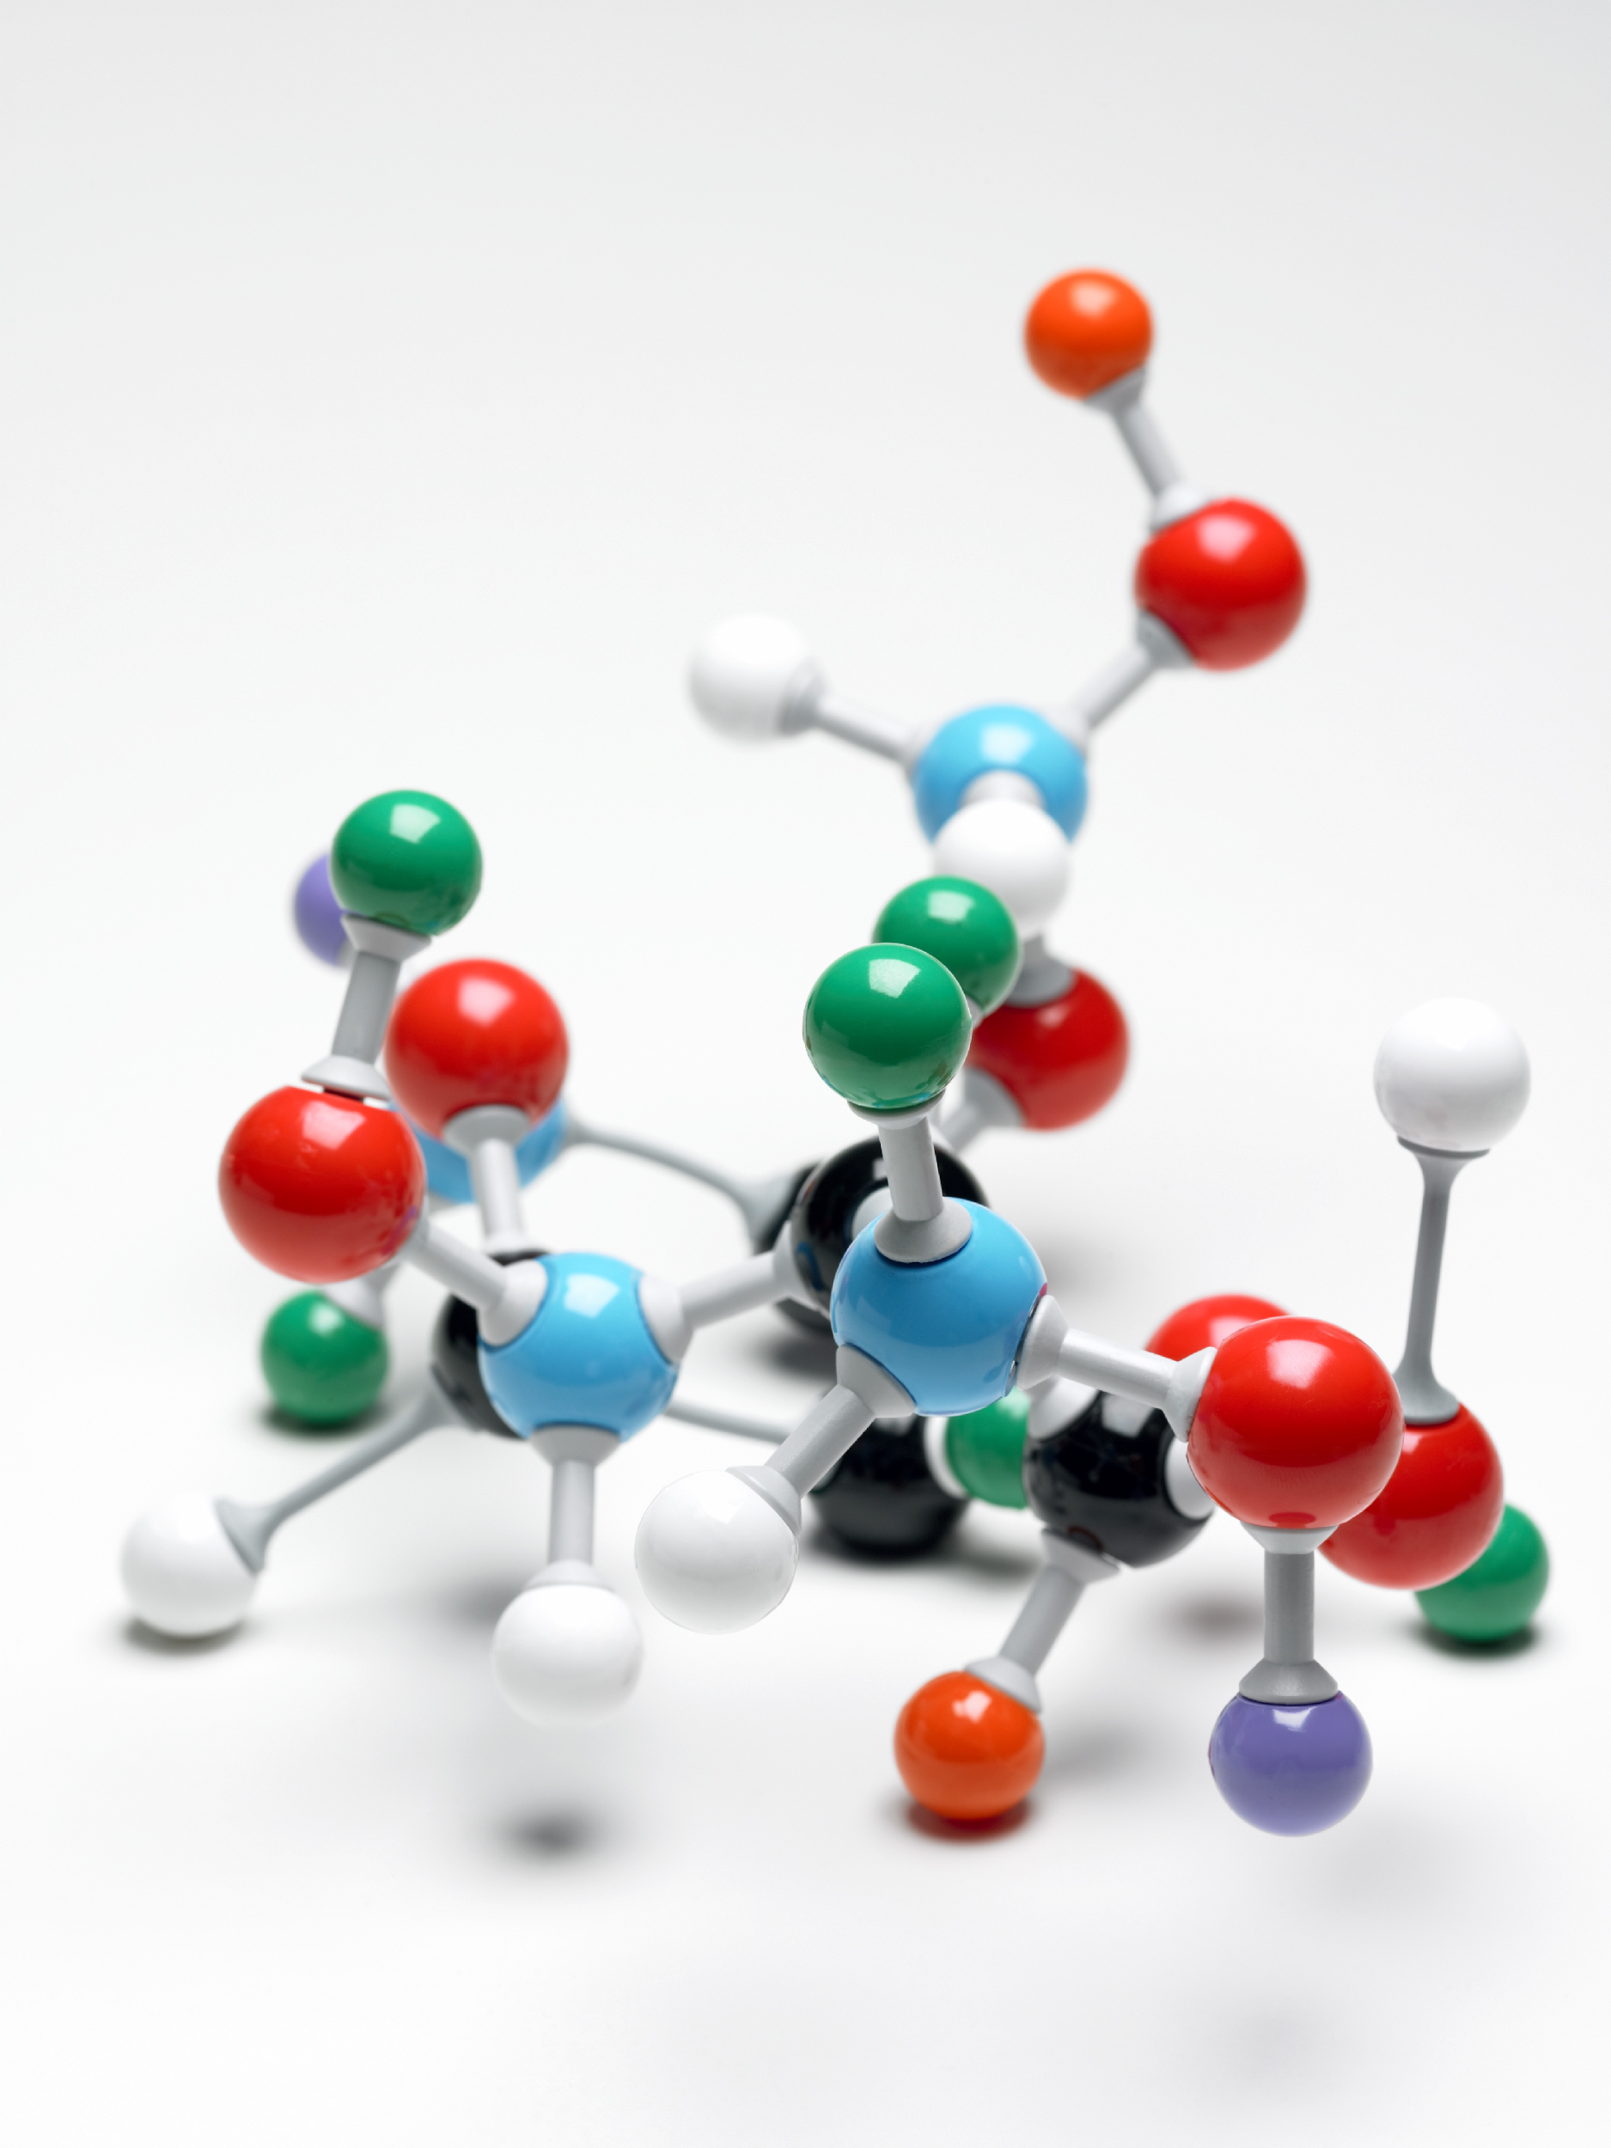
Notes:
All substances have unique properties because of the atoms they are made of.

Slide 9
Property: observed characteristic
chemical
physical
Notes:
Properties are observed characteristics. Properties can either be defined by their physical or chemical characteristics. They are used to describe what you see.

Slide 10
Notes:
Now let’s pause for a moment to check your understanding.
Feedback: It is important when reviewing previously learned material that you pause and check for understanding, if students are grasping previous material you may need to tailor your instruction.

Slide 11
What is the relationship between matter and atoms?
Notes:
What is the relationship between matter and atoms?
[Matter has mass and takes up space and atoms are the smallest whole unit of matter.]

Slide 12
What is a property?
Notes:
What is a property?
[Properties are observed characteristics. The are used to describe what you see.]

Slide 13
Physical Property
Notes:
Now that we’ve reviewed, let’s define our new term, physical property…

Slide 14
Physical Property: a characteristic of matter that can be observed without the substance changing into a new substance
Anchor image
Notes:
A physical property is a characteristic of matter that can be observed without the substance changing into a new substance
Feedback: It's great to consistently use images in your lesson, this helps students make connections to the words in the definition.

Slide 15
Notes:
Now let’s pause for a moment to check your understanding.

Slide 16
What is a physical property?
Notes:
What is a physical property?
[A physical property is a characteristic of matter that can be observed without the substance changing into a new substance.]

Slide 17
Notes:
Now, let’s talk about some examples of physical properties.

Slide 18
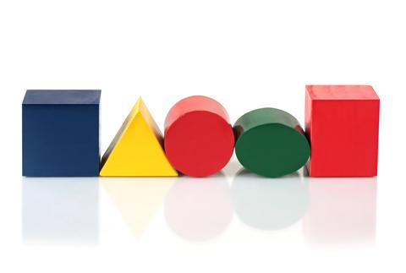
Color
Size
Shape
Notes:
Often times physical properties describe the physical makeup of a substance. For example color, size, and shape are all physical properties.

Slide 19
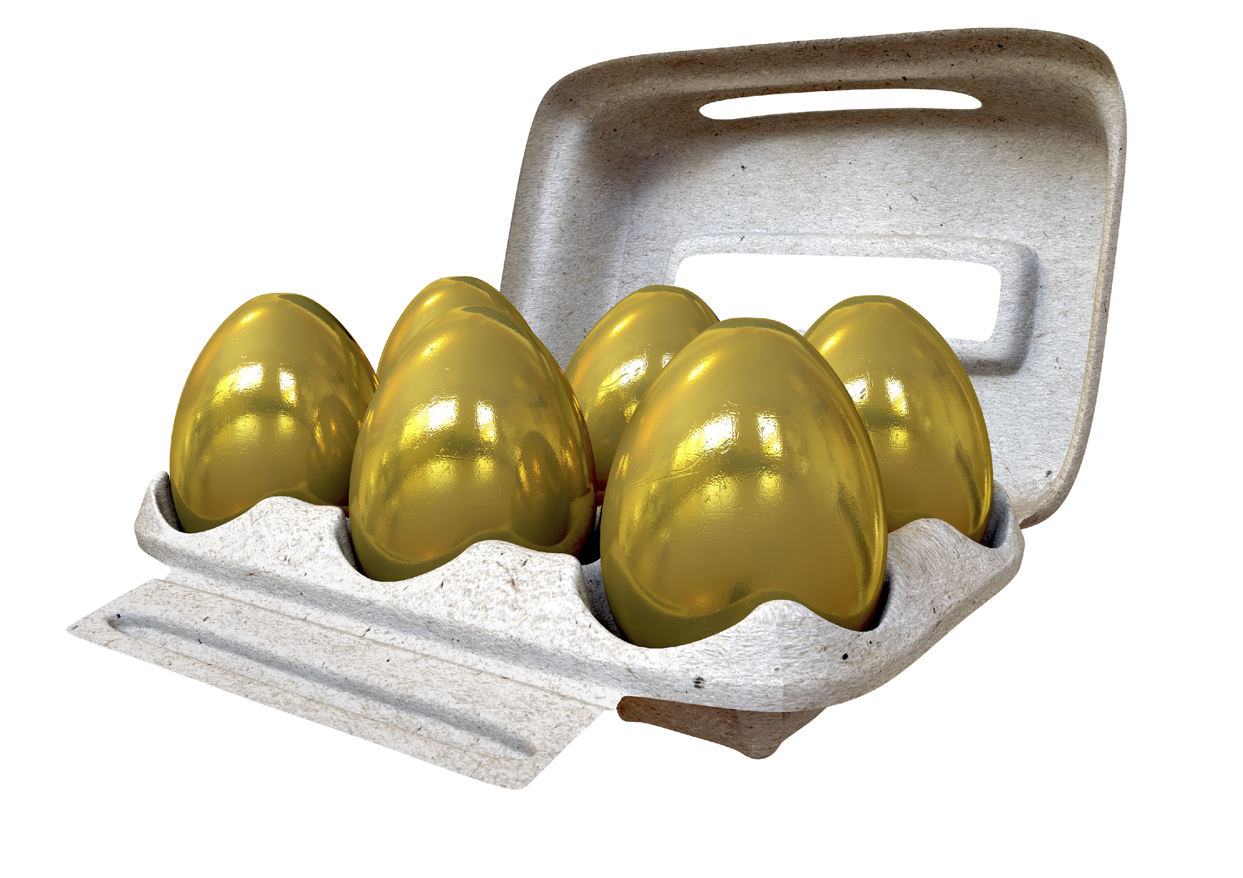
Luster
State of matter
Notes:
State of matter and luster are also physical properties. If a substance changes its state of matter, it is a physical change because it is still the same substance. Luster, or how shiny, a substance is, is also a physical property.
Feedback: Remember to try and use phrasing and language that is clear and easy for students to understand when going over examples of term meaning.

Slide 20
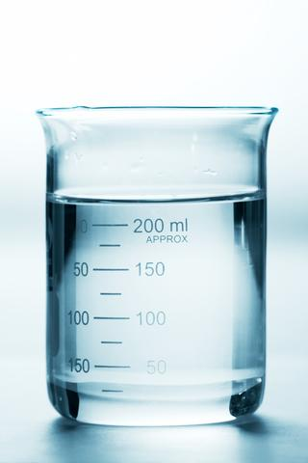
Units of Measure
Notes:
Other examples include units of measure like length, mass, volume, weight and density.

Slide 21
Notes:
Odor or smell is a physical property. You can describe how a substance smells without changing the substance.

Slide 22
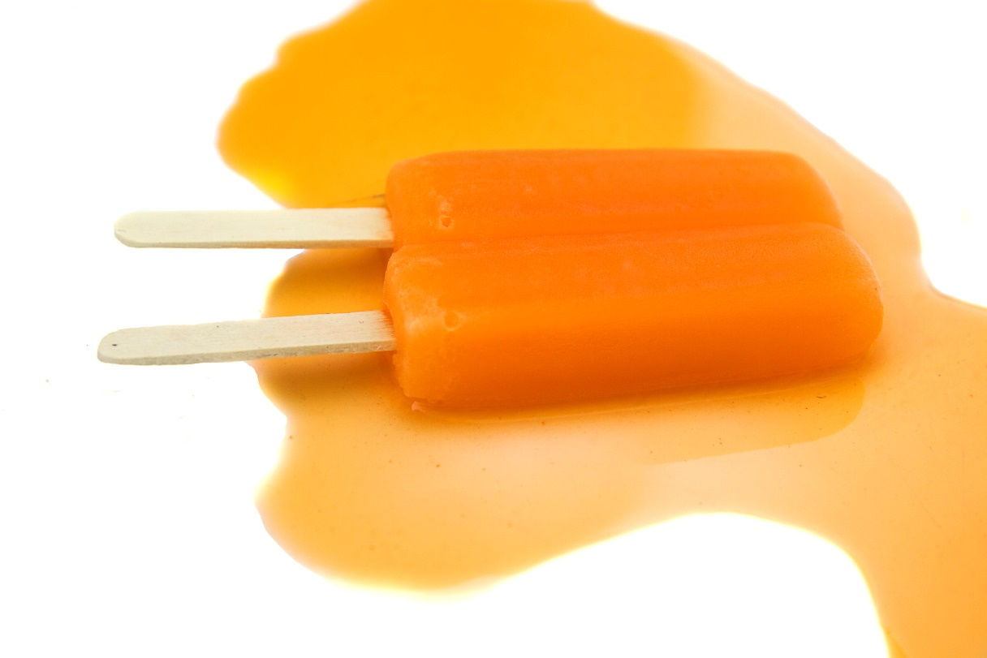
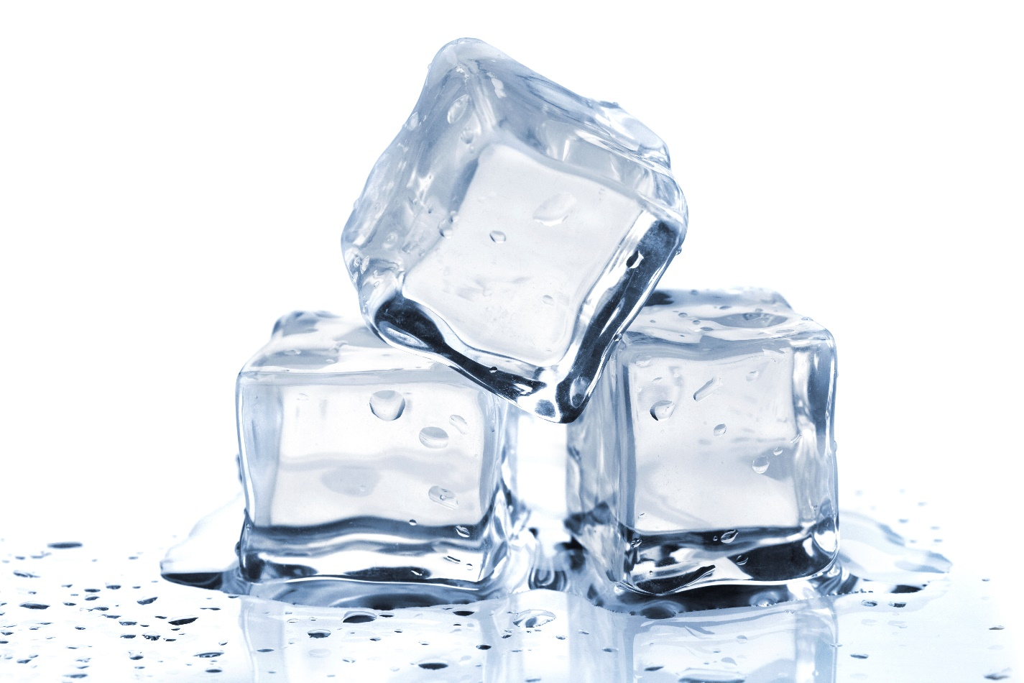
Melting point
Notes:
Melting point, the temperature at which a substance will melt, is a physical property because you can measure it the point in which a substance melts. Remember, units of measurement are physical properties.

Slide 23
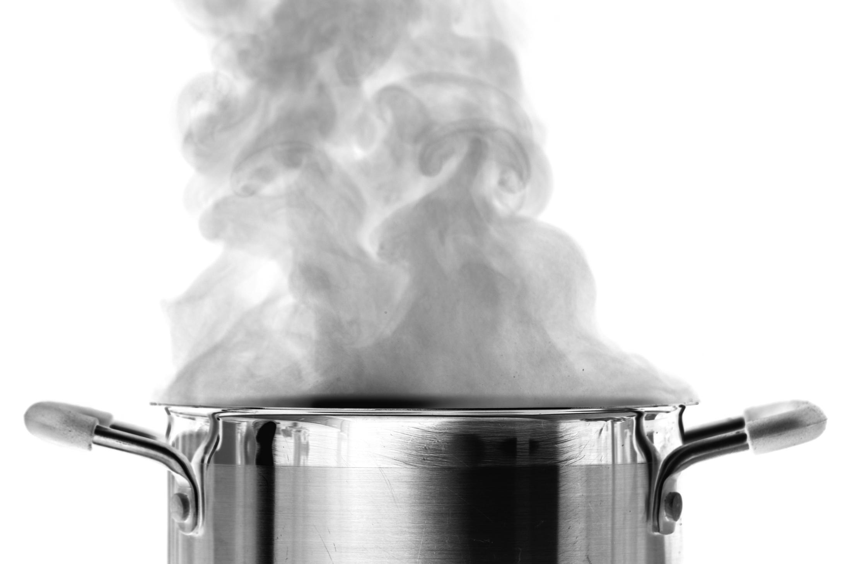
Notes:
Boiling point, like melting point is a physical property. You can measure a substance’s boiling point without changing the substance.

Slide 24
Notes:
Let’s check-in for understanding.

Slide 25
What are some examples of physical properties?
Notes:
What are some examples of physical properties?

Slide 26
Notes:
Next, let’s talk about some non-examples of physical properties.

Slide 27
Notes:
Reactivity is not a physical property because when you mix the two reactants together a new product is formed. This has a different chemical formula, giving it a new identity. Remember than in a physical property the identity is not changed.
Feedback: It's great to include images as part of your non-example, this helps students recognize the differences and similarities between the term and the non-example.

Slide 28
Notes:
Flammability is not a physical property. To measure flammability, you would have to set the substance on fire to see if it burns. If a substance burns, then its identity changes, so flammability is not a physical property.

Slide 29
Notes:
Let’s check-in for understanding.

Slide 30
What are physical properties?
Anchor image
Notes:
What are physical properties?
[A physical property is a characteristic of matter that can be observed without the substance changing into a new substance.]
Feedback: Intentionally repeating key information when engaging in this part of the lesson highlights what is important for the students.

Slide 31
What are some examples of physical properties?
Notes:
What are some examples of physical properties?

Slide 32
Is odor a physical property?
Notes:
Is odor a physical property?
[Yes! Odor or smell is a physical property. You can describe how a substance smells without changing the substance.]

Slide 33
Is flammability a physical property?
Notes:
Is flammability a physical property?
[No! Flammability is not a physical property. To measure flammability, you would have to set the substance on fire to see if it burns. If a substance burns, then its identity changes, so flammability is not a physical property.]

Slide 34
Remember!!!
Notes:
So remember!
Feedback: A good general strategy for information retention is: 1) tell them what you're going to teach them, 2) teach them, and 3) tell them what you just taught them. Make sure to include the third and final step. While it is easy to think a quick review of what you just went over is unnecessary, it can be incredibly useful in helping the students remember the information over the long term.

Slide 35
Physical Property: a characteristic of matter that can be observed without the substance changing into a new substance
Anchor image
Notes:
A physical property is a characteristic of matter that can be observed without the substance changing into a new substance.

Slide 36
Big Question: What are the similarities and differences between physical and chemical properties and changes, and what do they tell us about a substance?
Physical Property vs Physical Change
H₂O
Chemical Property vs Chemical Change
Notes:
Explicit cue to revisit the big question at the end of the lesson: Okay everyone. Now that we’ve learned the term, let’s reflect once more on our big question. Was there anything that we predicted earlier that was correct or incorrect? Do you have any new hypotheses to share?

Slide 37
Notes:
Thanks for watching, and please continue watching CAPs available from this website.

Slide 38
This Video Created With Resources From:
Questions or Comments
Michael Kennedy, Ph.D. MKennedy@Virginia.edu
Rachel L Kunemund, Ph.D. rk8vm@virginia.edu

Slide 39
Intro
“Big Idea” Question
Review Concepts
Check-In Questions
Teacher Demo
Vocabulary
Student-Friendly Definition
Examples & Non-Examples
Morphological Word Parts
Simulation/Activity
Notes:
OK everyone, get ready for our next lesson. Just as a reminder, these are the different components that our lesson may include, and you’ll see these icons in the top left corner of each slide so that you can follow along more easily!

Slide 40
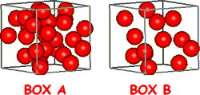
Intro
Density
Notes:
Today we will learn about density.

Slide 41
Big Question: What are the similarities and differences between physical and chemical properties and changes, and what do they tell us about a substance?
Physical Property vs Physical Change
H₂O
Chemical Property vs Chemical Change
Notes:
Our “big question” is: What are the similarities and differences between physical and chemical properties and changes, and what do they tell us about a substance?
What have we learned so far? What are our current predictions?

Slide 42
Demonstration
Density Demonstration
TEACHER DIRECTIONS
Before: Ask students what they know about density. Ask students to hypothesize about how density is related to physical properties.
During: (This experiment can also be done in school or virtually). Ask students questions during the experiment (i.e. why they think some larger objects stay on top, why different liquids matter, etc.).
After: Tell students that density is a physical property and they well learn more about density in this lesson.
Notes:
Let’s do a quick demonstration that will help get our brains ready to think about density, and how it relates to our big question.
Feedback: Keep in mind that you can use questions and opportunities to participate to keep students engaged. Engagement is key to promoting student understanding.

Slide 43
Notes:
Before we move on to our new vocabulary term, let’s review some other words & concepts that you already learned and make sure you are firm in your understanding.

Slide 44
Matter: has mass and takes up space
Notes:
Matter is anything that has mass and takes up space.

Slide 45
Atoms: smallest whole unit of matter
Notes:
All matter is made of atoms. Atoms are the smallest whole unit of matter.

Slide 46
Notes:
All substances have unique properties because of the atoms they are made of.

Slide 47
Property: observed characteristic
chemical
physical
Notes:
Properties are observed characteristics. Properties can either be defined by their physical or chemical characteristics. They are used to describe what you see.
Feedback: It's awesome to include many opportunities for students to demonstrate understanding, this can help you catch some confusion early and get students back on track.

Slide 48
Physical Property: a characteristic of matter that can be observed without the substance changing into a new substance
Anchor image
Notes:
A physical property is a characteristic of matter that can be observed without the substance changing into a new substance.

Slide 49
Notes:
Now let’s pause for a moment to check your understanding.

Slide 50
What is the relationship between matter and atoms?
Notes:
What is the relationship between matter and atoms?
[Matter has mass and takes up space and atoms are the smallest whole unit of matter.]

Slide 51
What is a property?
Notes:
What is a property?
[Properties are observed characteristics. The are used to describe what you see.]

Slide 52
What are some examples of physical properties?
Anchor image
Notes:
What are some examples of physical properties?
[A physical property is a characteristic of matter that can be observed without the substance changing into a new substance. For example, color, shape, luster, state of matter, size, etc.]
Feedback: Reviewing the previous lesson before an upcoming related lesson is a way to assess student retention while also making sure students are prepared for the new content.

Slide 53
Density
Notes:
We know that units of measurement are physical properties. One particular unit we need to know that is a physical property is density.

Slide 54
Density: mass per unit of volume
Notes:
Density is the mass per unit of volume of a substance. This will always remain constant---or the same---for a compound or element.
Feedback: When providing more student-friendly definitions, it is helpful to provide students with cues so that they can be prepared and know what to expect and be ready to copy down the information.

Slide 55
Notes:
Now let’s pause for a moment to check your understanding.

Slide 56
What is density?
Notes:
What is density?
[Density is the mass per unit of volume of a substance. This will always remain constant---or the same---for a compound or element.]
Feedback: When introducing new vocabularies, it is crucial to require the students to give out their own interpretation. I would strongly encourage you to ask students to explain the concept in their own words.

Slide 57
Notes:
That’s the basic definition, but there is more you need to know.

Slide 58
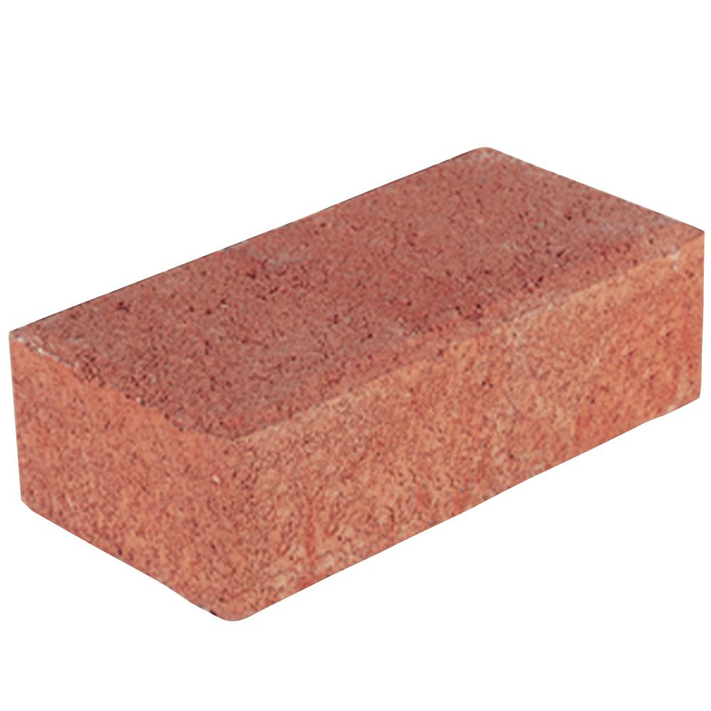
Heavy + Compact = Highly Dense
Notes:
If something is heavy and compact, or doesn’t take up a lot of space, then it has high density.

Slide 59
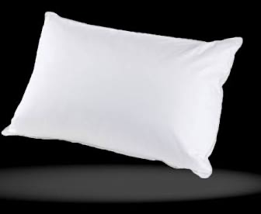
Takes up Space + Light = Low Density
Notes:
If an object takes up space but is light, then it has low density. Think about a pillow. A pillow is bigger than a brick (takes up more space), but it is much lighter than a brick so it has lower density.

Slide 60
Density = physical property
Notes:
Density is a physical property because it does not change the substance. We can find out the density of the brick and the pillow, but they do not change. The brick will still be a brick and the pillow will still be a pillow.

Slide 61
Notes:
Now let’s pause for a moment to check your understanding.

Slide 62
What are the characteristics of objects with high density compared to objects with low density?
Notes:
What are the characteristics of objects with high density compared to objects with low density?
[If something is heavy and compact, or doesn’t take up a lot of space, then it has high density.
If an object takes up space but is light, then it has low density. Think about a pillow. A pillow is bigger than a brick (takes up more space), but it is much lighter than a brick so it has lower density.]

Slide 63
Notes:
Now, let’s talk about some examples of density.

Slide 64
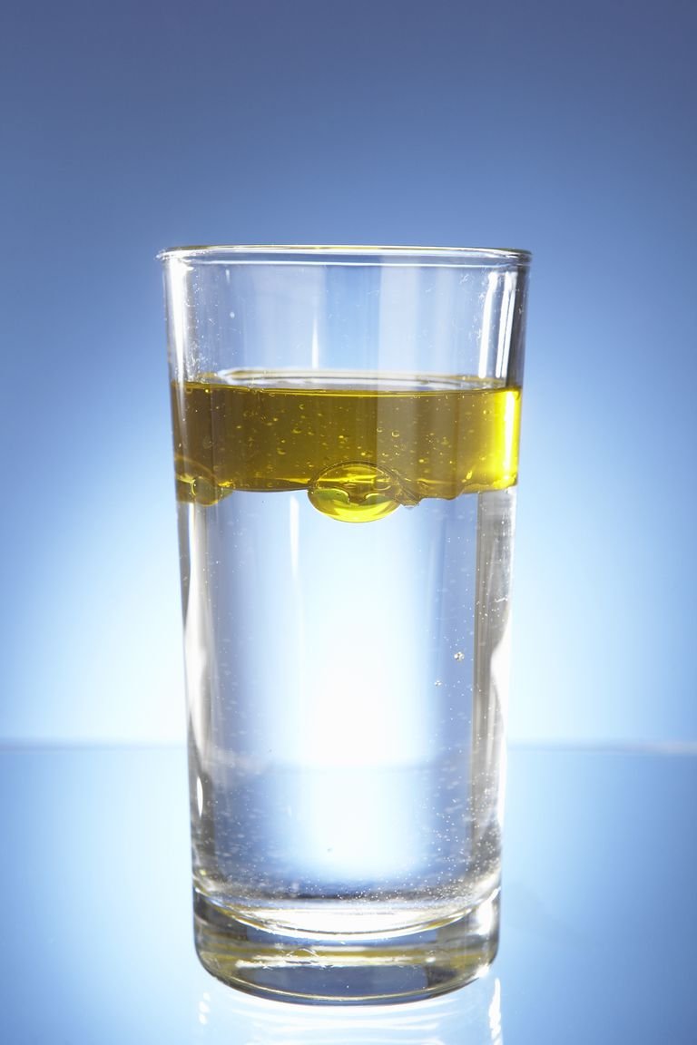
Notes:
Oil’s density is lighter than water, which is why oil and water don’t mix.

Slide 65
Notes:
A balloon filled with helium is another example of density. The balloon floats in the air because the helium has a lower density than the surrounding air.

Slide 66
Notes:
We can tell that the brick is more dense than the pillow. Remember, the brick is heavy and compact so it is highly dense, but the pillow takes up space and is light, so it has a low density.

Slide 67
Notes:
Let’s check-in for understanding.

Slide 68
Give an example of an object that has high density.
Notes:
Give an example of an object that has high density.
[Brick, bowling ball, etc.]
Also, ask students why they picked a particular object, i.e. why do you think the brick is highly dense?
Feedback: Keep in mind, it is important to continuously ask students questions and check for understanding. This will let you know if further instruction on certain content is needed.

Slide 69
What is density?
Notes:
What is density?
[Density is the mass per unit of volume of a substance. This will always remain constant---or the same---for a compound or element.]

Slide 70
How can you tell if something has high or low density?
Notes:
How can you tell if something has high or low density?
[If something has high density, it is heavy and compact, if it has low density it takes up space but is light. Alternatively, measure its mass and volume to calculate density.]

Slide 71
Why is density a physical property?
Notes:
Why is density a physical property?
[Density is a physical property because it does not change the substance. We can find out the density of the brick and the pillow, but they do not change. The brick will still be a brick and the pillow will still be a pillow.]
Feedback: Questions that ask “why” are especially important because they test a higher-order thinking skill.

Slide 72
Remember!!!
Notes:
So remember!

Slide 73
Density: mass per unit of volume
Notes:
Density is the mass per unit of volume of a substance. This will always remain constant---or the same---for a compound or element.

Slide 74
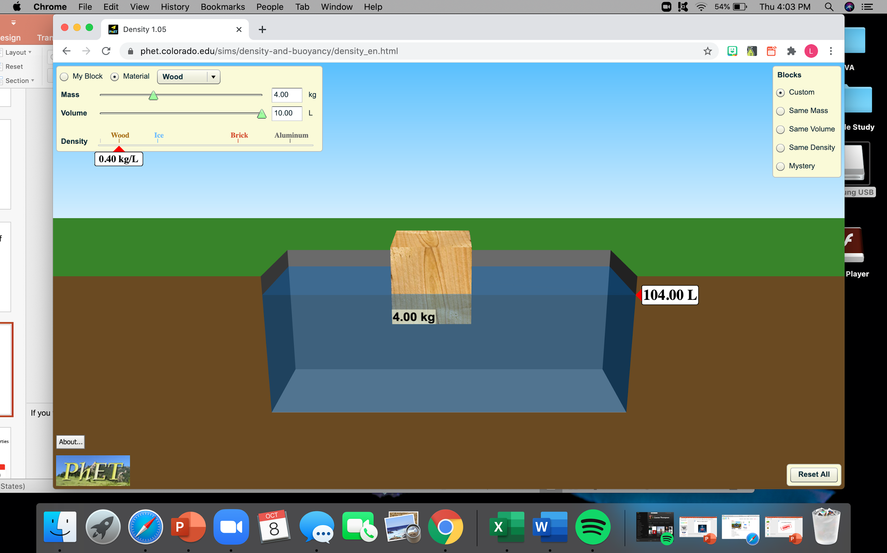
Simulation Activity
Density Simulation
(PHET)
Click the link above to look at the density of different objects.
In this simulation activity, you can change the object, mass, and volume. See how different objects compare. Why do some objects float and some sink? Does the mass and volume effect density?
Notes:
Feedback: Giving students a chance to analyze and interpret data is a great way to help them to continue to independently problem solve.

Slide 75
Big Question: What are the similarities and differences between physical and chemical properties and changes, and what do they tell us about a substance?
Physical Property vs Physical Change
H₂O
Chemical Property vs Chemical Change
Notes:
Explicit cue to revisit the big question at the end of the lesson: Okay everyone. Now that we’ve learned the term, let’s reflect once more on our big question. Was there anything that we predicted earlier that was correct or incorrect? Do you have any new hypotheses to share?

Slide 76
Notes:
Thanks for watching, and please continue watching CAPs available from this website.

Slide 77
This Video Created With Resources From:
Questions or Comments
Michael Kennedy, Ph.D. MKennedy@Virginia.edu
Rachel L Kunemund, Ph.D. rk8vm@virginia.edu

Slide 78
Intro
“Big Idea” Question
Review Concepts
Check-In Questions
Teacher Demo
Vocabulary
Student-Friendly Definition
Examples & Non-Examples
Morphological Word Parts
Simulation/Activity
Notes:
OK everyone, get ready for our next lesson. Just as a reminder, these are the different components that our lesson may include, and you’ll see these icons in the top left corner of each slide so that you can follow along more easily!

Slide 79
Intro
Physical Change
H₂O
Notes:
Today we will learn about physical change.
Feedback: Using clear and simple language when introducing content helps students understand what is expected.

Slide 80
Big Question: What are the similarities and differences between physical and chemical properties and changes, and what do they tell us about a substance?
Physical Property vs Physical Change
H₂O
Chemical Property vs Chemical Change
Notes:
Our “big question” is: What are the similarities and differences between physical and chemical properties and changes, and what do they tell us about a substance?
What have we learned so far? What are our current predictions?

Slide 81
Demonstration
TEACHER DIRECTIONS
Before: Ask students what they remember about physical properties. Then have students give their hypothesis on what they think a physical change is and how it is different/similar to physical properties.
During: All you need for this experiment is paper and markers. First, change the shape of the paper by balling it up. Then change the color by coloring on the paper, and finally change the shape of the paper by tearing it up. Ask students what they notice is happening during the experiment. How is the paper changing (This demonstration can also be done virtually.
After: Tell students that the paper did change, but it still kept its form of being paper. This type of change is called a physical change. Tell students in this lesson they will learn more about physical change.
Notes:
Let’s do a quick demonstration that will help get our brains ready to think about physical change, and how it relates to our big question.
Feedback: It can take some getting used to but talking through your thoughts/process during the demonstration can be a great way to demonstrate to your students how to process the information and think it through.

Slide 82
Notes:
Before we move on to our new vocabulary term, let’s review some other words & concepts that you already learned and make sure you are firm in your understanding.

Slide 83
Matter: has mass and takes up space
Notes:
Matter is anything that has mass and takes up space.

Slide 84
Atoms: smallest whole unit of matter
Notes:
All matter is made of atoms. Atoms are the smallest whole unit of matter.

Slide 85
Notes:
All substances have unique properties because of the atoms they are made of.

Slide 86
Property: observed characteristic
chemical
physical
Notes:
Properties are observed characteristics. Properties can either be defined by their physical or chemical characteristics. They are used to describe what you see.

Slide 87
Physical Property: a characteristic of matter that can be observed without the substance changing into a new substance
Anchor image
Notes:
A physical property is a characteristic of matter that can be observed without the substance changing into a new substance.
Feedback: If you notice some students struggling to keep up when you activating prior knowledge, it is important to remember to make adjustments and scaffold your content to meet students current level of understanding.

Slide 88
Density: mass per unit of volume
Notes:
Density is the mass per unit of volume of a substance. This will always remain constant---or the same---for a compound or element. Remember, density is a physical property because it does not change the substance.

Slide 89
Notes:
Now let’s pause for a moment to check your understanding.

Slide 90
What is the relationship between matter and atoms?
Notes:
What is the relationship between matter and atoms?
[Matter has mass and takes up space and atoms are the smallest whole unit of matter.]

Slide 91
What is a property?
Notes:
What is a property?
[Properties are observed characteristics. The are used to describe what you see.]

Slide 92
What are some examples of physical properties?
Anchor image
Notes:
What are some examples of physical properties?
[A physical property is a characteristic of matter that can be observed without the substance changing into a new substance. For example, color, shape, luster, state of matter, size, etc.]

Slide 93
What is density?
Notes:
What is density?
[Density is the mass per unit of volume of a substance. This will always remain constant---or the same---for a compound or element.]

Slide 94
Why is density a physical property?
Notes:
Why is density a physical property?
[Remember, density is a physical property because it does not change the substance.]

Slide 95
Physical Change
Notes:
Now that we’ve reviewed, let’s define our new term, physical change.

Slide 96
Physical Change: a substance is changed but does not form a new substance
H₂O
Notes:
A physical change is one that does not change the identity of a substance.

Slide 97
Notes:
Now let’s pause for a moment to check your understanding.
Feedback: Remember, students might look like they are understanding the definition but it is important that you check for understanding yourself by asking questions or providing them with other opportunities to respond.

Slide 98
What is a physical change?
H₂O
Notes:
What is a physical change?
[A physical change is one in which a substance is changed but does not form a new substance.]

Slide 99
Notes:
That’s the basic definition, but there is more you need to know.

Slide 100
Change
Size
Shape
Form
Notes:
When a physical change happens, a physical property of the substance changes. For example, a change can happen to the size, shape, or form of a substance.
Feedback: It can be helpful to break the definition down and explicitly explain each part to help students understand the whole definition.

Slide 101
Ice Melting
Notes:
Here ice is melting to water. The size of the ice cube is changing. It is getting smaller. The shape of the ice cube is changing. It is losing its square shape. And the state of matter is changing from solid to liquid.

Slide 102
Ice Melting 🡪 Water
Ice = H₂O 🡪 Water = H₂O
Notes:
But both the ice and water are made of H20 so it keep the same identity.

Slide 103
Notes:
Now let’s pause for a moment to check your understanding.

Slide 104
What are three ways a physical change can happen?
Notes:
What are three ways a physical change can happen?
[A change can happen to the size, shape, or form of a substance.]

Slide 105
How is ice melting an example of a physical change?
Notes:
How is ice melting an example of physical change?
[The size of the ice cube is changing. It is getting smaller. The shape of the ice cube is changing. It is losing its square shape. And the state of matter is changing from solid to liquid.]

Slide 106
Notes:
Now, let’s talk about some examples of physical change.

Slide 107
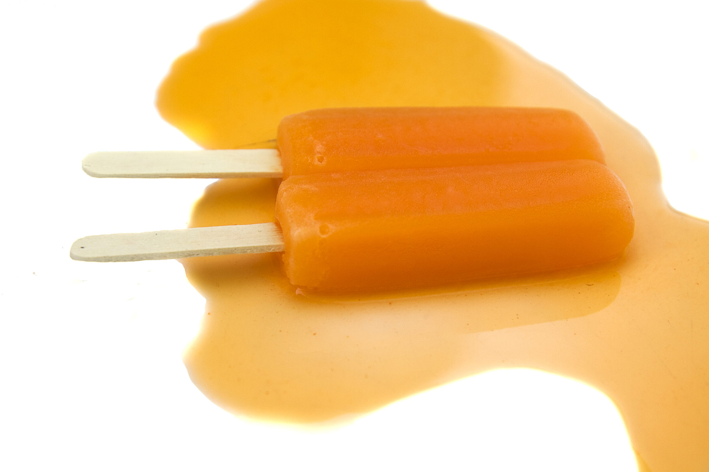
Notes:
An example of a physical change is when a popsicle melts on a hot day. Although the popsicle may look different its identity has not changed. This is like ice melting. The state of matter is changing. The amount of mass and energy contained in the popsicle remains the same.

Slide 108
Notes:
Physical changes are like changes you make to your physical self. Although you may look different, you are still made of the same stuff. This is changing the size and shape of your hair.

Slide 109
Notes:
Next, let’s talk about some non-examples of physical change.

Slide 110
Physical Change
Notes:
Rust on a nail is not a physical change because the chemical makeup on the surface has also changed. Rust is the formation of a new substance!
Feedback: Using clear language as you introduce a non-example helps students to make sense of the difference.

Slide 111
Notes:
Let’s check-in for understanding.
Feedback: It is important to take time throughout the close of the lesson to check for understanding one last time, this will help you know who may need more instruction or where further explanation is needed.

Slide 112
What is a physical change?
H₂O
Notes:
What is a physical change?
[A physical change is one that does not change the identity of a substance.]

Slide 113
What are some ways a substance can go through a physical change?
?
?
?
Notes:
What are some ways a substance can go through a physical change?
[When a physical change happens, a physical property of the substance changes. For example, a change can happen to the size, shape, or form of a substance]

Slide 114
Why is ice melting an example of a physical change?
Ice = H₂O 🡪 Water = H₂O
Notes:
Why is ice melting an example of a physical change?
[But both the ice and water are made of H20 so it keep the same identity but it changes because it changes state of matter: solid to liquid]

Slide 115
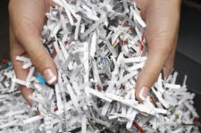
What is the relationship between physical property and physical change?
Notes:
What is the relationship between physical property and physical change?
[Remember physical properties and physical changes are different. If a physical property (size, shape, state of matter, etc.) of a substance changes, and the substance itself stays the same then it is a physical change]

Slide 116
Remember!!!
Notes:
So remember!

Slide 117
Physical Change: a substance is changed but does not form a new substance
H₂O
Notes:
A physical change is one that does not change the identity of a substance.

Slide 118
Big Question: What are the similarities and differences between physical and chemical properties and changes, and what do they tell us about a substance?
Physical Property vs Physical Change
H₂O
Chemical Property vs Chemical Change
Notes:
Explicit cue to revisit the big question at the end of the lesson: Okay everyone. Now that we’ve learned the term, let’s reflect once more on our big question. Was there anything that we predicted earlier that was correct or incorrect? Do you have any new hypotheses to share?
Feedback: Providing your students with some reflection time at the end of the lesson is crucial in helping them to put the pieces together and make sense of the activity.

Slide 119
Notes:
Thanks for watching, and please continue watching CAPs available from this website.

Slide 120
This Video Created With Resources From:
Questions or Comments
Michael Kennedy, Ph.D. MKennedy@Virginia.edu
Rachel L Kunemund, Ph.D. rk8vm@virginia.edu

