Slide 1
Intro
“Big Idea” Question
Review Concepts
Check-In Questions
Teacher Demo
Vocabulary
Student-Friendly Definition
Examples & Non-Examples
Morphological Word Parts
Simulation/Activity
Notes:
OK everyone, get ready for our next lesson. Just as a reminder, these are the different components that our lesson may include, and you’ll see these icons in the top left corner of each slide so that you can follow along more easily!
Feedback: Explicit cues used at the beginning of each step makes it easy for students to follow along and be prepared to engage in the next part of the lesson.

Slide 2
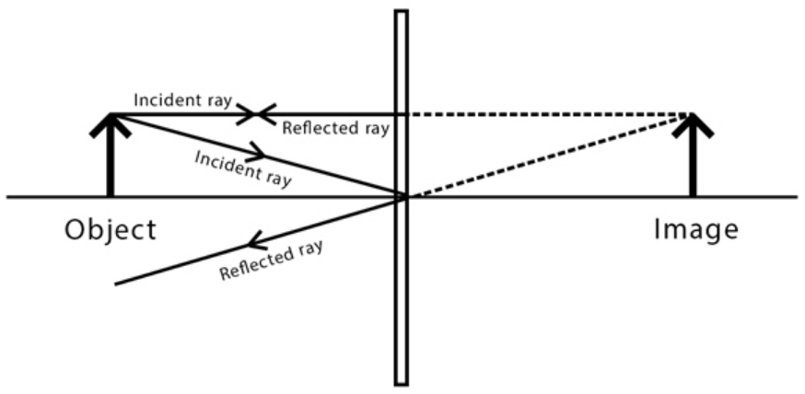
Intro
Plane Mirrors
Notes:
Today we will learn about plane mirrors.

Slide 3
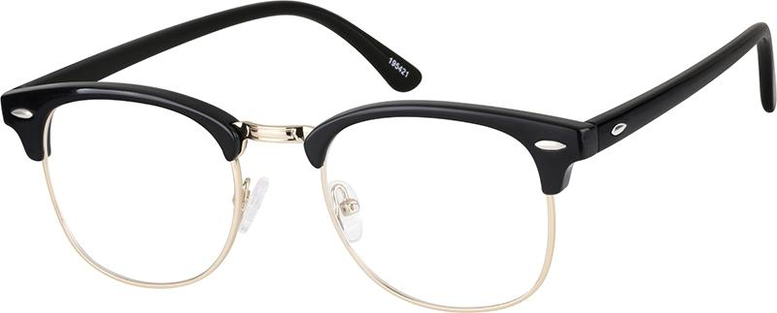
Big Question: How do you benefit from mirrors and lenses every day? What images are formed by mirrors and lenses?
Notes:
Our “big question” is: How do you benefit from mirrors and lenses every day? What images are formed by mirrors and lenses?
[Pause and illicit predictions from students.]
I love all these thoughtful scientific hypotheses! Be sure to keep this question and your predictions in mind as we move through these next few lessons, and we’ll continue to revisit it.
Feedback: Providing a specific goal for use is crucial to letting students know what's expected and why this lesson is important.

Slide 4
Notes:
Before we move on to our new vocabulary term, let’s review some other words & concepts that you already learned and make sure you are firm in your understanding.

Slide 5
Visible Light: wavelengths that are visible to the human eye
Notes:
Visible light waves are wavelengths that are visible to the human eye. They are the only waves on the electromagnetic spectrum that are visible. They have wavelengths that are shorter than infrared radiation and longer than ultraviolet radiation. Visible light also has higher frequencies and energy than infrared radiation.

Slide 6
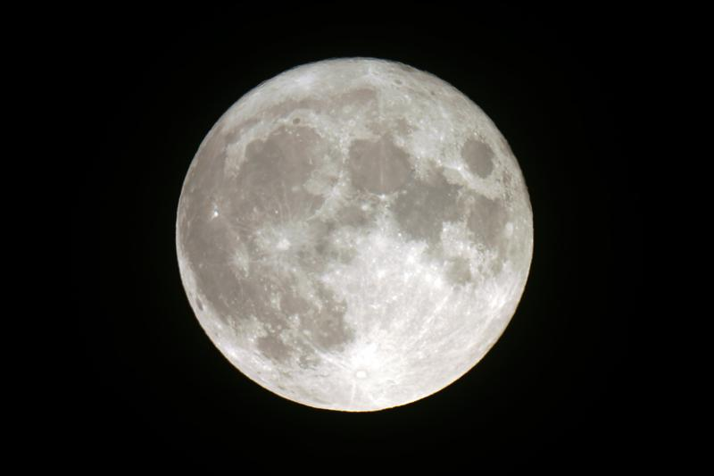
Reflection: occurs when a wave bounces off of a surface
Notes:
Reflection occurs when a wave bounces off of a surface.
Feedback: Referring to prior topics that are relevant and on topic helps students make connections to the new content they will be learning and tie it to prior knowledge.

Slide 7
Law of Reflection: when a wave is reflected on a surface, the angle of reflection equals the angle of incidence
Notes:
The law of reflection states that when a wave is reflected on a surface, the angle of reflection equals the angle of incidence.

Slide 8
Regular Reflection: the reflection of light from a smooth, shiny surface
Notes:
Regular reflection is the reflection of light from a smooth, shiny surface.

Slide 9
Diffuse Reflection: the reflection of light from a rough surface
Notes:
Diffuse reflection is the reflection of light from a rough surface.

Slide 10
Notes:
Now let’s pause for a moment to check your understanding.
Feedback: Remember to make adjustments to your lesson and content if you see some students not demonstrating understanding, this can help them make connections and prevent frustration.

Slide 11
What is visible light?
Notes:
What is visible light?
[Visible light waves are wavelengths that are visible to the human eye. They are the only waves on the electromagnetic spectrum that are visible. They have wavelengths that are shorter than infrared radiation and longer than ultraviolet radiation. Visible light also has higher frequencies and energy than infrared radiation.]

Slide 12
How are the angle of reflection and the angle of incidence related?
Notes:
How are the angle of reflection and the angle of incidence related?
[The angle of incidence is equal to the angle of reflection.]

Slide 13
What is the difference between regular reflection and diffuse reflection?
Notes:
What is the difference between regular reflection and diffuse reflection?
[Regular reflection is the reflection of light from a smooth, shiny surface.
Diffuse reflection is the reflection of light from a rough surface.]

Slide 14
Plane Mirrors
Notes:
Now that we’ve reviewed, let’s define our new term, plane mirrors.

Slide 15
Plane Mirrors: have flat reflective surfaces and produce an upright image that is the same size and distance away as the object
Notes:
Plane mirrors have flat reflective surfaces and produce an upright image that is the same size and distance away as the object.
Feedback: It can be helpful to break the definition down and explicitly explain each part to help students understand the whole definition.

Slide 16
Notes:
Let’s check-in for understanding.

Slide 17
What are plane mirrors?
Notes:
What are plane mirrors?
[Plane mirrors have flat, reflective surfaces and produce an upright image that is the same size and distance away of the object it is reflecting.]
Feedback: Providing feedback is tricky but crucial. Remember to give students with feedback on their response because it helps students know what answers you are actually looking for.

Slide 18
Notes:
Now, let’s talk about some examples of plane mirrors.

Slide 19
Notes:
Full length mirrors that we typically have in hallways are examples of plane mirrors. They are flat and produce an upright image that is the same size and distance as the object. This is why when we look at ourselves in one of these mirrors, we look “normal”. Our image is not distorted.
Feedback: It's great practice to introduce an example of the term WITH images to go along with it, this is a great way to help students make connections.

Slide 20
Notes:
Bathroom mirrors are also examples of plane mirrors. They have flat surfaces and like the full length mirrors from the previous example, they produce a “normal” reflection of ourselves when we look at them.

Slide 21
Notes:
Let’s check-in for understanding.

Slide 22
What are some examples of plane mirrors?
Notes:
What are some examples of plane mirrors?
[Bathroom mirrors, full length mirrors, etc.]

Slide 23
Demonstration
Notes:
Demonstration – Let’s see what kind of image a plane mirror produces!
For this demonstration, all I am going to need is any of the mirrors in my house.
Since all of the mirrors in my house have a flat surface, they produce an upright image that is similar in size and distance to the object it is reflecting. This is why when I look at myself, the mirror is reflecting what I actually look like.
Feedback: Keep in mind that you can use questions and opportunities to participate to keep students engaged. Engagement is key to promoting student understanding.

Slide 24
Notes:
Let’s check-in for understanding.

Slide 25
In this demonstration, what did you notice about plane mirrors?
Notes:
In this demonstration, what did you notice about plane mirrors?
[They create a “normal” image - upright, same height/distance away as the original image]
Feedback: Remember, we want students to gather information and then be able to not only evaluate but also effectively communicate what they have learned from this activity.

Slide 26
What are plane mirrors?
Notes:
What are plane mirrors?
[Plane mirrors have flat, reflective surfaces and produce an upright image that is the same size and distance of the object it is reflecting.]

Slide 27
How do plane mirrors represent regular reflection?
Notes:
How do plane mirrors represent regular reflection?
[Regular reflection is the reflection of light from a smooth, shiny surface. Plane mirrors provide that smooth, shiny surface.]

Slide 28
Remember!!!
Notes:
So remember!
Feedback: A good general strategy for information retention is: 1) tell them what you're going to teach them, 2) teach them, and 3) tell them what you just taught them. Make sure to include the third and final step. While it is easy to think a quick review of what you just went over is unnecessary, it can be incredibly useful in helping the students remember the information over the long term.

Slide 29
Plane Mirrors: have flat reflective surfaces and produce an upright image that is the same size and distance away as the object
Notes:
Plane mirrors have flat reflective surfaces and produce an upright image that is the same size and distance away as the object.

Slide 30
Big Question: How do you benefit from mirrors and lenses every day? What images are formed by mirrors and lenses?
Notes:
Explicit cue to revisit the big question at the end of the lesson: Okay everyone. Now that we’ve learned the term, let’s reflect once more on our big question. Was there anything that we predicted earlier that was correct or incorrect? Do you have any new hypotheses to share?
Feedback: Providing your students with some reflection time at the end of the lesson is crucial in helping them to put the pieces together and make sense of the activity.

Slide 31
Notes:
Thanks for watching, and please continue watching CAPs available from this website.

Slide 32
This Video Was Created With Resources From:
Questions or Comments
Michael Kennedy, Ph.D. MKennedy@Virginia.edu
Rachel L Kunemund, Ph.D. rk8vm@virginia.edu

Slide 33
Intro
“Big Idea” Question
Review Concepts
Check-In Questions
Teacher Demo
Vocabulary
Student-Friendly Definition
Examples & Non-Examples
Morphological Word Parts
Simulation/Activity
Notes:
OK everyone, get ready for our next lesson. Just as a reminder, these are the different components that our lesson may include, and you’ll see these icons in the top left corner of each slide so that you can follow along more easily!

Slide 34
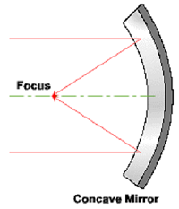
Intro
Concave Mirrors
Notes:
Today we’re going to learn about concave mirrors.

Slide 35
Big Question: How do you benefit from mirrors and lenses every day? What images are formed by mirrors and lenses?
Notes:
Before we start, let’s think about our “big question”: How do you benefit from mirrors and lenses every day? What images are formed by mirrors and lenses? [Pause and illicit predictions from students.]
I love all these thoughtful scientific hypotheses! Be sure to keep this question and your predictions in mind as we move through these next few lessons, and we’ll continue to revisit it.
Feedback: Providing students with the opportunity to make predictions about what will happen allows them to think critically about the content.

Slide 36
Notes:
Before we move on to our new vocabulary term, let’s review some other words & concepts that you already learned and make sure you are firm in your understanding.

Slide 37
Visible Light: wavelengths that are visible to the human eye
Notes:
Visible light waves are wavelengths that are visible to the human eye. They are the only waves on the electromagnetic spectrum that are visible. They have wavelengths that are shorter than infrared radiation and longer than ultraviolet radiation. Visible light also has higher frequencies and energy than infrared radiation.

Slide 38
Reflection: occurs when a wave bounces off of a surface
Notes:
Reflection occurs when a wave bounces off of a surface.

Slide 39
Law of Reflection: when a wave is reflected on a surface, the angle of reflection equals the angle of incidence
Notes:
The law of reflection states that when a wave is reflected on a surface, the angle of reflection equals the angle of incidence.

Slide 40
Plane Mirrors: have flat reflective surfaces and produce an upright image that is the same size and distance away as the object
Notes:
Plane mirrors have flat reflective surfaces and produce an upright image that is the same size and distance away as the object.

Slide 41
Notes:
Now let’s pause for a moment to check your understanding.
Feedback: Providing clear cues as to what was coming next in the lesson helps prepared students by letting them know what to expect.

Slide 42
What is reflection?
Notes:
What is reflection?
[Reflection occurs when a wave bounces off of a surface.]

Slide 43
What are plane mirrors?
Notes:
What are plane mirrors?
[Plane mirrors have flat reflective surfaces and produce an upright image that is the same size and distance of the object it is reflecting.]

Slide 44
Concave Mirrors
Notes:
Now that we’ve reviewed, let’s define our new term, concave mirrors.

Slide 45
Concave Mirrors: mirrors that curve inwards. They converge light and produce an upright, magnified image if close and an inverted, smaller image if far away
Notes:
Concave mirrors are mirrors that curve inwards. They converge light and produce an upright, magnified image if close and an inverted, smaller image if far away.
Feedback: Using clear language can take make formal more complicated definitions a little easier for students to understand.

Slide 46
Notes:
Let’s check-in for understanding.

Slide 47
What is a concave mirror?
Notes:
What is a concave mirror?
[Concave mirrors are mirrors that curve inwards. They converge light and produce an upright, magnified image if close and an inverted, smaller image if far away.

Slide 48
Notes:
That is the basic definition, but there is a bit more you need to know.

Slide 49
Concave Mirrors: mirrors that curve inwards. They converge light and produce an upright, magnified image if close and an inverted, smaller image if far away
Notes:
Let’s define what converge means so that we can fully understand this definition.
Feedback: During long periods of instruction, it is still important to check for understanding. Informal questioning can keep students engaged and give you a sense of their progress.

Slide 50
Converge: the physical joining together of light rays
Notes:
In concave mirrors, the convergence of light means that the light rays are physically joining together.

Slide 51
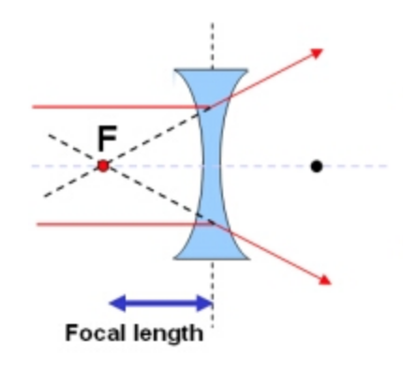
Focal Point
Notes:
The focal point of a concave mirror is the point at which the light waves meet after reflection.

Slide 52
Focal Length
Notes:
Focal length is the distance from the mirror to the focal point.

Slide 53
Notes:
So, why is the focal point of a mirror so important?

Slide 54
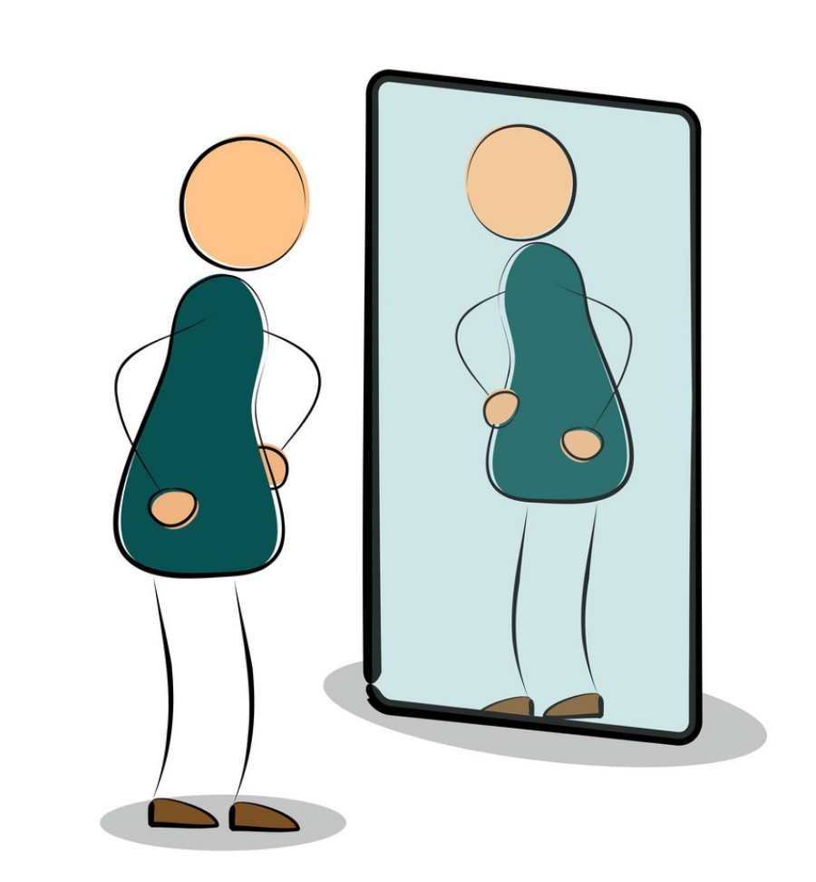
Clear Image
Notes:
A perfect mirror would send all of the light waves through that one focal point, which would result in the clearest image.

Slide 55
Notes:
Let’s check-in for understanding.
Feedback: Remember, students might look like they are understanding the definition but it is important that you check for understanding yourself by asking questions or providing them with other opportunities to respond.

Slide 56
What does converge mean?
Notes:
What does converge mean?
[In concave mirrors, the convergence of light means that the light rays are physically joining together.]

Slide 57
Why is the focal point of a mirror important?
Notes:
Why is the focal point of a mirror important?
[A perfect mirror would send all of the light waves through that one focal point, which would result in the clearest image.]

Slide 58
Notes:
Now, let’s talk about some examples of concave mirrors.
Feedback: Remember to try and use phrasing and language that is clear and easy for students to understand when going over examples of term meaning.

Slide 59
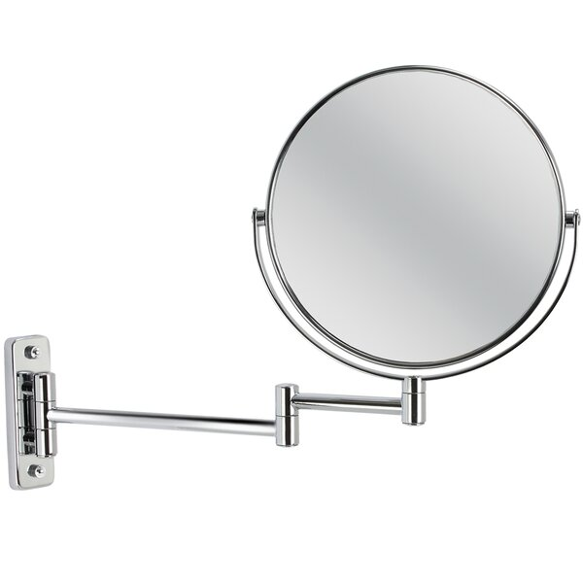
Notes:
Makeup/shaving mirrors are usually concave mirrors. They are curved inwards so that the image becomes enlarged when up close. They are made this way to increase the precision of the person putting on makeup or shaving.

Slide 60
Notes:
Car headlights also use concave mirrors. The light source is placed at the focal point so that the mirrors converge the light farther away.

Slide 61
Notes:
Let’s check-in for understanding.

Slide 62
What are some examples of concave mirrors?
Notes:
What are some examples of concave mirrors?
[Makeup/shaving mirrors, car headlights, etc.]

Slide 63
Notes:
We can break down the term concave into different word parts to help us remember the meaning. Let’s take a look!
Feedback: Using morphological word parts can be extremely beneficial for students. It is important to take time when breaking the word down and define each individual word part for students.

Slide 64
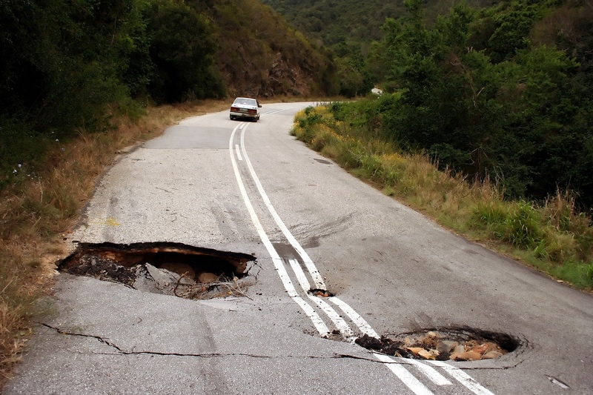
Concave
Notes:
We can think of cave like when something goes inward (“caves in”), similar to these potholes on the road, since concave mirrors bend inwards.

Slide 65
Notes:
Let’s check-in for understanding.

Slide 66
How can we use the word parts of concave to remember the definition of concave mirrors?
Notes:
How can we use the word parts of concave to remember the definition of concave mirrors?
[We can think of cave like when something goes inward (“caves in”), similar to these potholes on the road, since concave mirrors bend inwards.]

Slide 67
Demonstration
Notes:
Demonstration – Let’s see what kind of image a concave mirror produces!
For this demonstration, all I am going to need is a spoon.
The inside of a spoon is curved inwards, making it a concave mirror. So, when I look at myself, it looks like I am upside down.
Feedback: Remember to plan out the demonstration so that you are able to follow a logical order. This will help students make sense of the activity and not become lost.

Slide 68
Notes:
Let’s check-in for understanding.

Slide 69
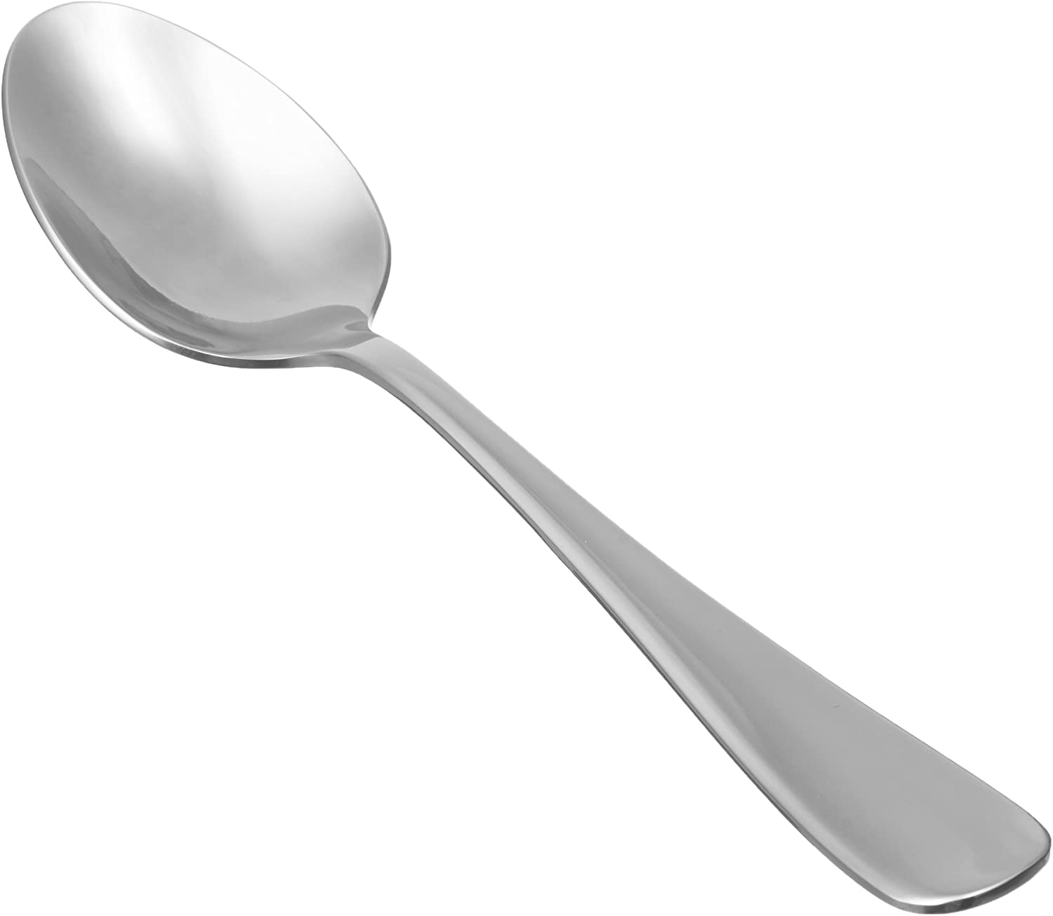
From our demonstration, how is a spoon an example of a concave mirror?
Notes:
From our demonstration, how is a spoon an example of a concave mirror?
[It is curved inwards and produces an inverted, distorted image]

Slide 70
What is a concave mirror?
Notes:
What is a concave mirror?
[Concave mirrors are mirrors that curve inwards. They converge light and produce an upright, magnified image if close and an inverted, smaller image if far away.]
Feedback: It's really important to make sure that you're providing students with frequent opportunities to respond as you're closing the lesson – it will help you know if they understood and made sense of the lesson and where you can provide further instruction.

Slide 71
How can we use the word concave to help us remember its meaning?
Notes:
How can we use the word concave to help us remember its meaning?
[We can think of cave like when something goes inward (“caves in”), since concave mirrors bend inwards.]

Slide 72
Why is a focal point important?
Notes:
Why is a focal point important?
[A perfect mirror would send all the light waves through that one point, which would result in the clearest image.]

Slide 73
Remember!!!
Notes:
So remember!

Slide 74
Concave Mirrors: mirrors that curve inwards. They converge light and produce an upright, magnified image if close and an inverted, smaller image if far away
Notes:
Concave mirrors are mirrors that curve inwards. They converge light and produce an upright, magnified image if close and an inverted, smaller image if far away.
Feedback: Remember, it is important that students have an opportunity to ask questions at the end of the lesson so that they can clarify their own understanding, some students may need a clear cue that it is their turn to ask questions.

Slide 75
Converge: the physical joining together of light rays
Notes:
In concave mirrors, the convergence of light means that the light rays are physically joining together.

Slide 76
Focal Point
Notes:
The focal point of a concave mirror is the point at which the light waves meet after reflection.

Slide 77
Focal Length
Notes:
Focal length is the distance from the mirror to the focal point.

Slide 78
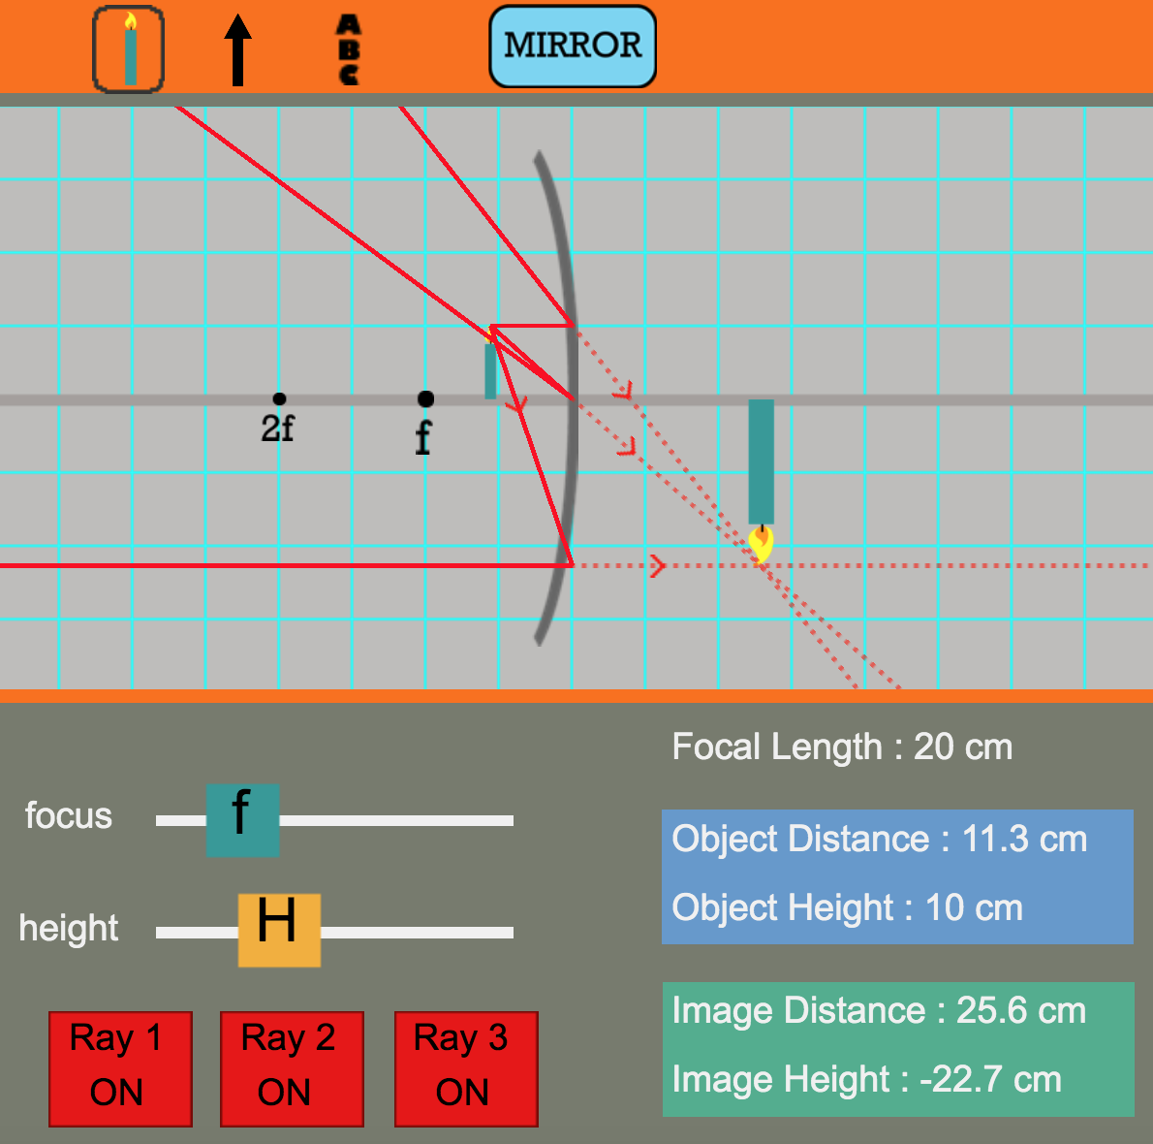
Simulation Activity
Concave Mirrors
Click the link above for a simulation to deepen your understanding of concave mirrors.
Notes:
Feedback: Providing a rationale during this activity helps students make connections and promotes understanding of the content.

Slide 79
Big Question: What images are formed by mirrors and lenses?
Notes:
Explicit cue to revisit the big question at the end of the lesson: Okay everyone. Now that we’ve learned the term, let’s reflect once more on our big question. Was there anything that we predicted earlier that was correct or incorrect? Do you have any new hypotheses to share?

Slide 80
Notes:
Thanks for watching, and please continue watching CAPs available from this website.

Slide 81
This Video Created With Resources From:
Questions or Comments
Michael Kennedy, Ph.D. MKennedy@Virginia.edu
Rachel L Kunemund, Ph.D. rk8vm@virginia.edu

Slide 82
Intro
“Big Idea” Question
Review Concepts
Check-In Questions
Teacher Demo
Vocabulary
Student-Friendly Definition
Examples & Non-Examples
Morphological Word Parts
Simulation/Activity
Notes:
OK everyone, get ready for our next lesson. Just as a reminder, these are the different components that our lesson may include, and you’ll see these icons in the top left corner of each slide so that you can follow along more easily!

Slide 83
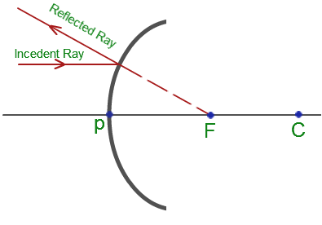
Intro
Convex Mirrors
Notes:
Today we’ll be learning about convex mirrors.

Slide 84
Big Question: How do you benefit from mirrors and lenses every day? What images are formed by mirrors and lenses?
Notes:
Before we start, let’s think about our “big question” again: How do you benefit from mirrors and lenses every day? What images are formed by mirrors and lenses?
[Pause and illicit predictions from students.]
I love all these thoughtful scientific hypotheses! Be sure to keep this question and your predictions in mind as we move through these next few lessons, and we’ll continue to revisit it.
Feedback: Providing a rationale during the anticipatory set makes it clear to students what is expected of them and what they should focus on learning.

Slide 85
Notes:
Let’s review some terms & concepts that you already learned and make sure you are firm in your understanding.

Slide 86
Visible Light: wavelengths that are visible to the human eye
Notes:
Visible light waves are wavelengths that are visible to the human eye. They are the only waves on the electromagnetic spectrum that are visible. They have wavelengths that are shorter than infrared radiation and longer than ultraviolet radiation. Visible light also has higher frequencies and energy than infrared radiation.

Slide 87
Reflection: occurs when a wave bounces off of a surface
Notes:
Reflection occurs when a wave bounces off of a surface.

Slide 88
Law of Reflection: when a wave is reflected on a surface, the angle of reflection equals the angle of incidence
Notes:
The law of reflection states that when a wave is reflected on a surface, the angle of reflection equals the angle of incidence.
Feedback: This is a long period of review. It might be helpful to intersperse questions that check for understanding. Use your judgement to keep your class engaged!

Slide 89
Plane Mirrors: have flat reflective surfaces and produce an upright image that is the same size and distance away as the object
Notes:
Plane mirrors have flat reflective surfaces and produce an upright image that is the same size and distance away as the object.

Slide 90
Concave Mirrors: mirrors that curve inwards. They converge light and produce an upright, magnified image if close and an inverted, smaller image if far away
Notes:
Concave mirrors are mirrors that curve inwards. They converge light and produce an upright, magnified image if close and an inverted, smaller image if far away.

Slide 91
Focal Point
Notes:
The focal point of a concave mirror is the point at which the light waves meet after reflection.

Slide 92
Focal Length
Notes:
Focal length is the distance from the mirror to the focal point.

Slide 93
Notes:
Now let’s pause for a moment to check your understanding.
Feedback: It's really important to make sure that you're providing students with frequent opportunities to respond as you're activating prior knowledge – it will save so you so much time if you confirm understanding before asking them to try something independently.

Slide 94
What is reflection and what does the law of reflection tell us about it?
Notes:
What is reflection and what does the law of reflection tell us about it?
[Reflection occurs when a wave bounces off of a surface.
The angle of incidence equals the angle of reflection.]

Slide 95
What is the difference between plane mirrors and concave mirrors?
Notes:
What is the difference between plane and concave mirrors?
[Plane mirrors have flat reflective surfaces and produce an upright image is that is the same size and distance away of the object it is reflecting.
Concave mirrors are mirrors that curve inwards. They converge light and produce an upright, and magnified image if close and inverted, smaller image if far away.]

Slide 96
How are focal point and focal length related?
Notes:
How are focal point and focal length related?
[The focal point of a concave mirror is the point at which the light waves meet after reflection.
Focal length is the distance from the mirror to the focal point.]

Slide 97
Convex Mirrors
Notes:
Now that we’ve reviewed, let’s define our new term, convex mirrors.

Slide 98
Convex Mirrors: are mirrors that curve outwards. They diverge and produce a smaller, upright image.
Notes:
Convex mirrors are mirrors that curve outwards. They diverge light and produce a smaller, upright image.
Feedback: It's great to consistently use images in your lesson, this helps students make connections to the words in the definition.

Slide 99
Notes:
Let’s check-in for understanding.

Slide 100
What is a convex mirror?
Notes:
What is a convex mirror?
[Convex mirrors are mirrors that curve outwards. They diverge light and produce a smaller, upright image.]
Feedback: When introducing new vocabularies, it is crucial to require the students to give out their own interpretation. I would strongly encourage you to ask students to explain the concept in their own words.

Slide 101
Notes:
That is the basic definition, but there is a bit more you need to know.

Slide 102
Convex Mirrors: are mirrors that curve outwards. They diverge and produce a smaller, upright image.
Notes:
Let’s define what diverge means so that we can fully understand this definition.

Slide 103
Diverge: the light waves are spread out when they are reflected off the mirror
Notes:
For convex mirrors, to diverge means that the light waves are spread out when they are reflected off the mirror.

Slide 104
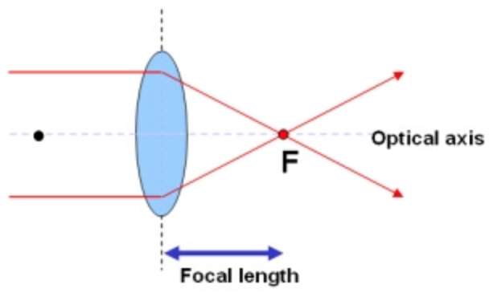
Focal Point
Notes:
The focal point of a convex mirror is the point from which diverging light waves appear to proceed after being reflected.
Feedback: While going through this content, it might be helpful to compare concave and convex mirrors for students. That could help them keep the two terms separate in their minds/notes.

Slide 105
Focal Length
Notes:
Like concave mirrors, the focal length of convex mirrors is the distance from the mirror to the focal point.

Slide 106
Notes:
So, why is the focal point of a mirror important?

Slide 107
Clear Image
Notes:
A perfect mirror would send all the light waves through that one focal point, which would result in the clearest image.

Slide 108
Notes:
Let’s check-in for understanding.
Feedback: It's awesome to include many opportunities for students to demonstrate understanding, this can help you catch some confusion and get students back on track.

Slide 109
What does it mean for light to diverge?
Notes:
What does it mean for light to diverge?
[For convex mirrors, to diverge means that the light waves are spread out when they are reflected off the mirror.]

Slide 110
What is the focal point of a convex mirror?
Notes:
What is the focal point of a convex mirror?
[The focal point of a convex mirror is the point from which diverging light waves appear to proceed after being reflected.]

Slide 111
Notes:
Now, let’s talk about some examples of convex mirrors.

Slide 112
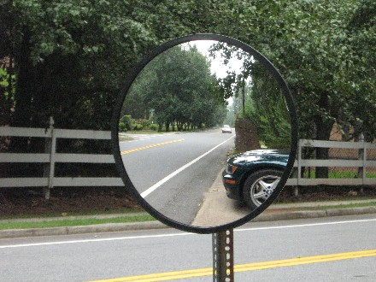
Notes:
Traffic mirrors are examples of convex mirrors. They are inverted outwards so that drivers can see more of the road.
Feedback: Remember to use explicit language when providing explanations of examples, it will help to simplify things for students.

Slide 113
Notes:
A magnifying glass is an example of a convex mirror. Two convex mirrors are placed back to back to make a magnifying glass.

Slide 114
Notes:
Let’s check-in for understanding.

Slide 115
What are some examples of convex mirrors?
Notes:
What are some examples of convex mirrors?
[Magnifying glass, traffic mirrors, etc.]

Slide 116
Demonstration
Notes:
Demonstration - Let’s see what kind of image a convex mirror produces!
For this demonstration, all I am going to need is a spoon.
The outside of a spoon is curved outwards, making it a convex mirror. This is why, when I look at myself on the outside of a spoon, my reflection is upright.
Feedback: It's really important to make sure that you're providing students with frequent opportunities to respond as you're introducing an activity. This will help guide you in scaffolding your support during the activity.

Slide 117
Notes:
Let’s check-in for understanding.

Slide 118
From this demonstration, how is a spoon an example of a convex mirror?
Notes:
From this demonstration, how is a spoon an example of a convex mirror?
[The back of a spoon is curved outwards - it produces a larger, distorted image]

Slide 119
How are convex mirrors different from concave mirrors?
Notes:
How are convex mirrors different from concave mirrors?
[Convex mirrors are mirrors that curve outwards. They diverge light and produce a smaller, upright image. In contrast, concave mirrors are mirrors that curve inwards. They converge light and produce an upright magnified image if close and an inverted, smaller image if far away.]
Feedback: It is important to take time throughout the close of the lesson to check for understanding one last time, this will help you know who may need more instruction or where further explanation is needed.

Slide 120
What is an example of a convex mirror?
Notes:
What is an example of a convex mirror?
[Traffic mirrors, magnifying glass, etc.]

Slide 121
What is the difference between diverge and converge?
Notes:
What is the difference between diverge and converge?
[When light diverges, the light waves spread out when they are reflected off the mirror. In contrast, when light converges, the light waves are physically joining together.]

Slide 122
Why is the focal point of a mirror important?
Notes:
Why is the focal point of a mirror important?
[A perfect mirror would send all the light waves through that one focal point, which would result in the clearest image.]

Slide 123
Remember!!!
Notes:
So remember!

Slide 124
Convex Mirrors: are mirrors that curve outwards. They diverge and produce a smaller, upright image.
Notes:
Convex mirrors are mirrors that curve outwards. They diverge light and produce a smaller, upright image.

Slide 125
Diverge: the light waves are spread out when they are reflected off the mirror
Notes:
For convex mirrors, to diverge means that the light waves are spread out when they are reflected off the mirror.

Slide 126
Focal Point
Notes:
The focal point of a convex mirror is the point from which diverging light waves appear to proceed after being reflected.

Slide 127
Focal Length
Notes:
Like concave mirrors, the focal length of convex mirrors is the distance from the mirror to the focal point.

Slide 128
Big Question: What images are formed by mirrors and lenses?
Notes:
Explicit cue to revisit the big question at the end of the lesson: Okay everyone. Was there anything that we predicted earlier that was correct or incorrect? Do you have any new hypotheses to share?
Feedback: It is useful to offer a small preview of the next lesson at the very end of the class. This not only offers the students a slight mental preparation for the next lesson but also helps the students see connections between the material.

Slide 129
Notes:
Thanks for watching, and please continue watching CAPs available from this website.

Slide 130
This Video Created With Resources From:
Questions or Comments
Michael Kennedy, Ph.D. MKennedy@Virginia.edu
Rachel L Kunemund, Ph.D. rk8vm@virginia.edu

Slide 131
Intro
“Big Idea” Question
Review Concepts
Check-In Questions
Teacher Demo
Vocabulary
Student-Friendly Definition
Examples & Non-Examples
Morphological Word Parts
Simulation/Activity
Notes:
OK everyone, get ready for our next lesson. Just as a reminder, these are the different components that our lesson may include, and you’ll see these icons in the top left corner of each slide so that you can follow along more easily!

Slide 132
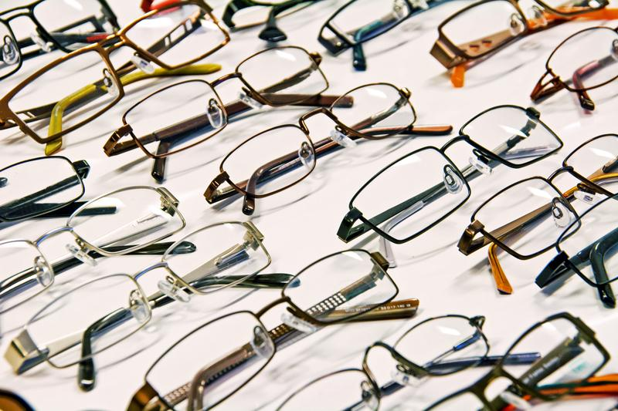
Intro
Lenses
Notes:
Today we’ll be learning about lenses.
Feedback: Using clear and simple language when introducing content helps students understand what is expected.

Slide 133
Big Question: How do you benefit from mirrors and lenses every day? What images are formed by mirrors and lenses?
Notes:
Before we start, let’s think about our “big question” again: How do you benefit from mirrors and lenses every day? What images are formed by mirrors and lenses?
[Pause and illicit predictions from students.]
I love all these thoughtful scientific hypotheses! Be sure to keep this question and your predictions in mind as we move through these next few lessons, and we’ll continue to revisit it.

Slide 134
Notes:
Let’s review some terms & concepts that you already learned and make sure you are firm in your understanding.

Slide 135
Visible Light: wavelengths that are visible to the human eye
Notes:
Visible light waves are wavelengths that are visible to the human eye. They are the only waves on the electromagnetic spectrum that are visible. They have wavelengths that are shorter than infrared radiation and longer than ultraviolet radiation. Visible light also has higher frequencies and energy than infrared radiation.

Slide 136
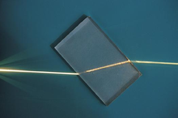
Refraction: the change of direction as a light wave passes from one medium to another
Notes:
Refraction is the change of direction as a light wave passes from one medium to another.

Slide 137
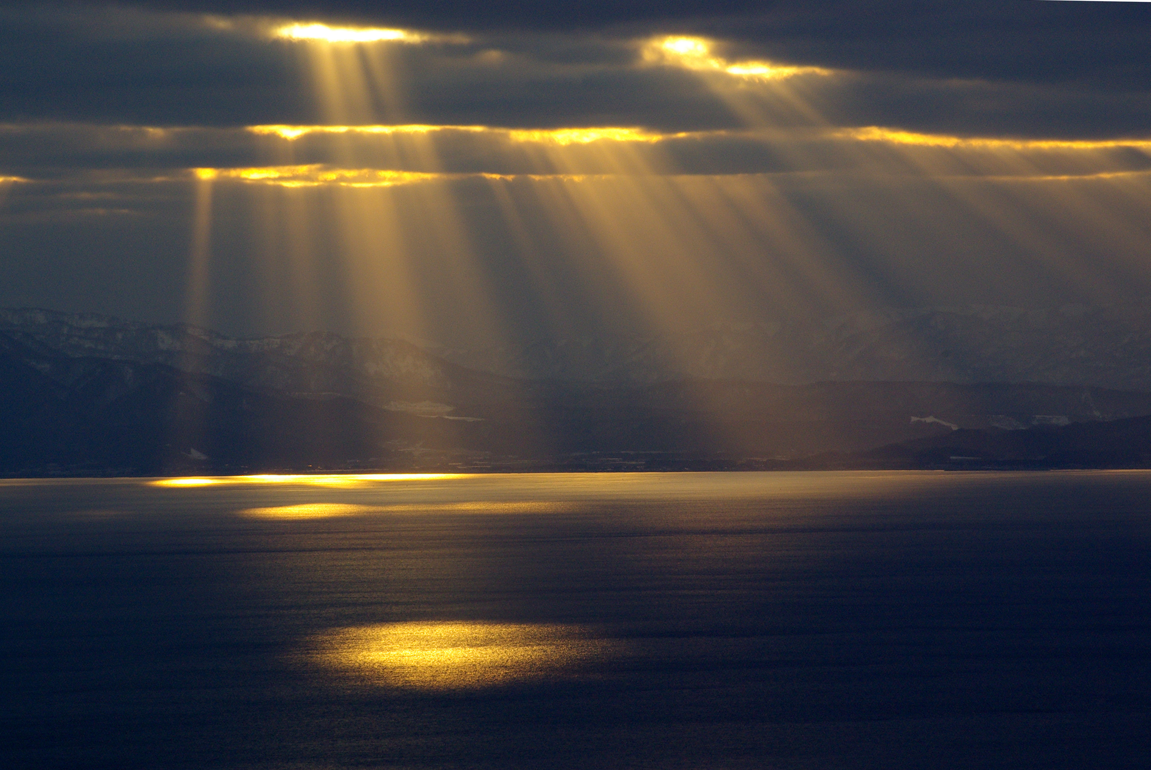
Diffraction: when light waves strike an obstacle and new waves are produced
Notes:
Diffraction is when light waves strike an obstacle and new waves are produced.
Feedback: Making connections between the new content and past terms/content is important for helping students understand the bigger picture.

Slide 138
Interference: when two or more waves overlap and combine as a result of diffraction
Notes:
Interference takes place when two or more waves overlap and combine as a result of diffraction.

Slide 139
Concave Mirrors: mirrors that curve inwards. They converge light and produce an upright magnified image if close, and an inverted, smaller image if far away
Notes:
Concave mirrors are mirrors that curve inwards. They converge light and produce an upright magnified image if close, and an inverted, smaller image if far away.

Slide 140
Convex Mirrors: mirrors that curve outwards. They diverge light and produce a smaller, upright image
Notes:
Convex mirrors are mirrors that curve outwards. They diverge light and produce a smaller, upright image.

Slide 141
Notes:
Now let’s pause for a moment to check your understanding.
Feedback: If you notice some students struggling to keep up when you activating prior knowledge, it is important to remember to make adjustments and scaffold your content to meet students current level of understanding.

Slide 142
What is the difference between refraction and diffraction?
Notes:
What is the difference between diffraction and refraction?
[In refraction, light passes through the object to cause the bent impression. In diffraction, the object acts as an object to cause the bent impression.]

Slide 143
How is interference related to diffraction?
Notes:
How is interference related to diffraction?
[Interference takes place when two or more waves overlap and combine as a result of diffraction.]

Slide 144
What is the difference between a concave mirror and a convex mirror?
Notes:
What is the difference between a concave mirror and a convex mirror?
[Concave mirrors are mirrors that curve inwards. They converge light and produce an upright magnified image if close and an inverted, smaller image if far away.
Convex mirrors are mirrors that curve outwards. They diverge light and produce a smaller, upright image.]

Slide 145
Lenses
Notes:
Now that we’ve reviewed, let’s define our new term, lenses.

Slide 146
Lenses: transparent material that are shaped to cause light waves to bend in a specific way as they pass through it
Notes:
Lenses are transparent material that are shaped to cause light waves to bend in a specific way as they pass through it. The light waves either converge to a specific point or diverge from a specific point.
Feedback: When providing more student-friendly definitions, it is helpful to provide students with cues so that they can be prepared and know what to expect and be ready to copy down the information.

Slide 147
Notes:
Let’s check-in for understanding.

Slide 148
What are lenses?
Notes:
What are lenses?
[Lenses are transparent material that are shaped to cause light waves to bend a specific wave as they pass through it]
Feedback: Provide clear and straightforward directions when asking students to explain the definitions. This helps to avoid confusion!

Slide 149
Notes:
That is the basic definition, but there is a bit more you need to know.

Slide 150
Converge or Diverge?
Notes:
So, when do lenses converge light? And when do they diverge light?

Slide 151
Convex Lenses
Notes:
Convex lenses converge light.

Slide 152
Convex Lenses: have at least one surface that is curved outward and converges light
Notes:
Convex lenses have at least one surface that is curved outward and converges light. This means that the lens focuses the light to one point.

Slide 153
Notes:
Now, let’s talk about some examples of convex lenses.

Slide 154
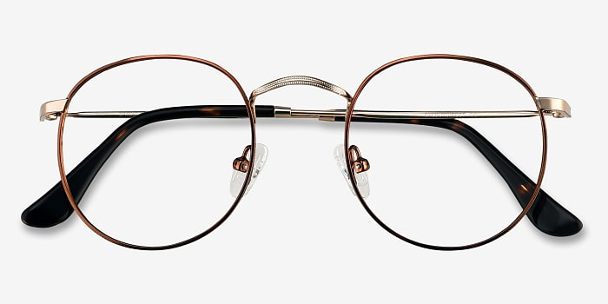
Notes:
Glasses that correct farsightedness are an example of convex lenses. The lens is thicker in the middle than the edges to converge the light people see.
Feedback: Examples that students have access to in their everyday life are particularly effective.

Slide 155
Notes:
Let’s check-in for understanding.

Slide 156
What are convex lenses?
Notes:
What are convex lenses?
[Convex lenses have at least one surface that is curved outward and converges light. This means that the lens focuses the light to one point.]

Slide 157
How are glasses an example of convex lenses?
Notes:
How are glasses an example of convex lenses?
[They are thicker in the middle of the lens and thinner on the edges]

Slide 158
Concave Lenses
Notes:
Concave lenses diverge light.

Slide 159
Concave Lenses: have at least one surface that is curved inward and diverges light
Notes:
Concave lenses have at least one surface that curves inward and diverges light. This means that the lens spread out the light waves that have been refracted through it.

Slide 160
Notes:
Now, let’s talk about some examples of concave lenses.
Feedback: It's good to pick a variety of examples to work through with your students. This prepares them for some types that might trip them up when they try it on their own.

Slide 161
Notes:
Glasses that correct nearsightedness are an example of concave lenses. The lens is thinner at the center than the edge to diverge the light people see.

Slide 162
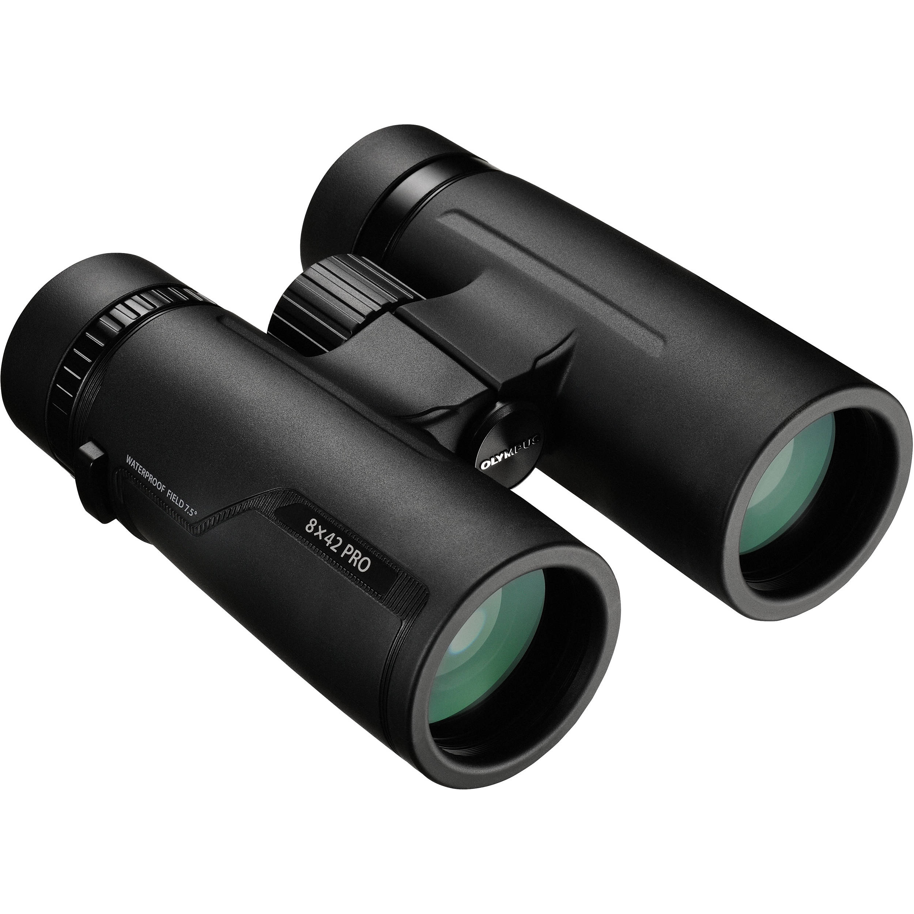
Notes:
Binoculars also use concave lenses. They diverge light.

Slide 163
Notes:
Let’s check-in for understanding.

Slide 164
What are concave lenses?
Notes:
What are concave lenses?
[Concave lenses have at least one surface that curves inward and diverges light. This means that the lens spread out the light waves that have been refracted through it.]

Slide 165
How are glasses also an example of concave lenses?
Notes:
How are glasses also an example of concave lenses?
[They are thinner in the middle of the lens and thicker at the edges]

Slide 166
What are lenses?
Notes:
What are lenses?
[Lenses are transparent material that are shaped to cause light waves to bend a specific wave as they pass through it. The light waves either converge to be a specific point or diverge from a specific point.]
Feedback: Providing a ton of opportunities to respond throughout this portion of your lesson is so important for ensuring that your students are grasping this new skill/topic.

Slide 167
How are lenses related to refraction?
Notes:
How are lenses related to refraction?
[Lenses refract light. They either converge it or diverge it.]

Slide 168
What is the difference between convex and concave lenses?
Notes:
What is the difference between convex and concave lenses?
[Convex lenses have at least one surface that is curved outward and converges light. This means that the lens focuses the light to one point.
Concave lenses are the opposite. They have at least one surface that curves inward and diverges light. This means that the lens spreads out the light waves that have been refracted through it.]

Slide 169
How can glasses be an example of both convex and concave lenses?
Notes:
How can glasses be an example of both convex and concave lenses?
[Glasses that correct farsightedness are an example of convex lenses because the lens is thicker in the middle than the edges to converge light. Glasses can also be concave lenses when they correct nearsightedness because the lens is thinner in the center than the edge to diverge light.]

Slide 170
Remember!!!
Notes:
So remember!
Feedback: Intentionally repeating key information when engaging in this part of the lesson highlights what is important for the students.

Slide 171
Lenses: transparent material that are shaped to cause light waves to bend in a specific way as they pass through it
Notes:
Lenses are transparent material that are shaped to cause light waves to bend in a specific way as they pass through it. The light waves either converge to a specific point or diverge from a specific point.

Slide 172
Convex Lenses: have at least one surface that is curved outward and converges light
Notes:
Convex lenses have at least one surface that is curved outward and converges light. This means that the lens focuses the light to one point.

Slide 173
Concave Lenses: have at least one surface that is curved inward and diverges light
Notes:
Concave lenses have at least one surface that curves inward and diverges light. This means that the lens spread out the light waves that have been refracted through it.

Slide 174
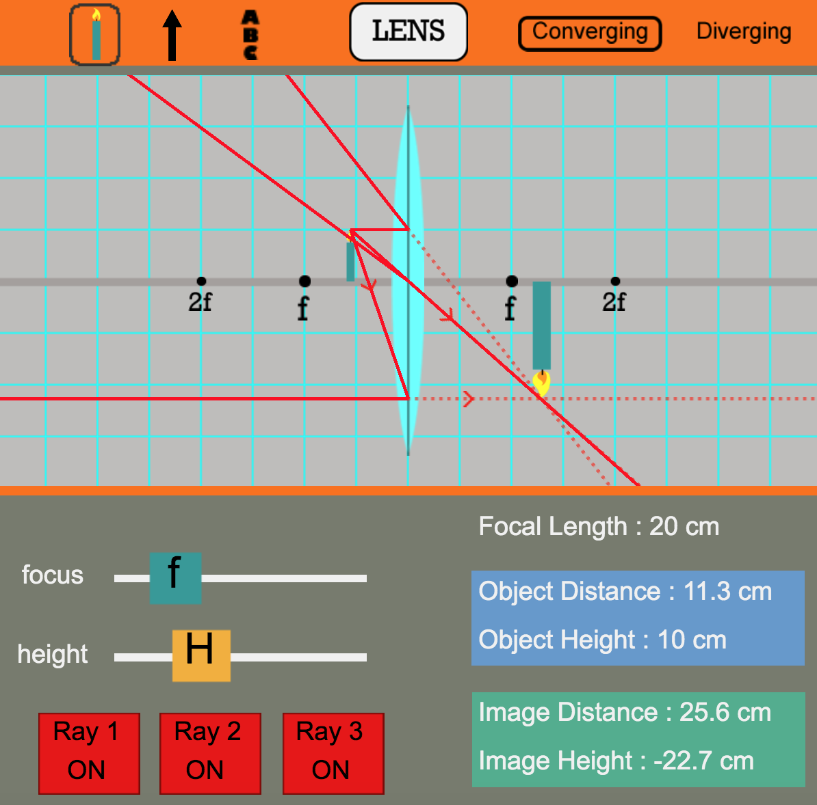
Simulation Activity
Concave and Convex Lenses
Click the link above for a simulation to deepen your understanding of concave and convex lenses.
Notes:
Feedback: Remember to try and scaffold instruction to encourage students to build and use models when working through an inquiry-based problem, this will help deepen their understanding of the content

Slide 175
Big Question: How do you benefit from mirrors and lenses every day? What images are formed by mirrors and lenses?
Notes:
Explicit cue to revisit the big question at the end of the lesson: Okay everyone. Was there anything that we predicted earlier that was correct or incorrect? Do you have any new hypotheses to share?

Slide 176
Notes:
Thanks for watching, and please continue watching CAPs available from this website.

Slide 177
This Video Created With Resources From:
Questions or Comments
Michael Kennedy, Ph.D. MKennedy@Virginia.edu
Rachel L Kunemund, Ph.D. rk8vm@virginia.edu

