Slide 1
Intro
“Big Idea” Question
Review Concepts
Check-In Questions
Teacher Demo
Vocabulary
Student-Friendly Definition
Examples & Non-Examples
Morphological Word Parts
Simulation/Activity
Notes:
OK everyone, get ready for our next lesson. Just as a reminder, these are the different components that our lesson may include, and you’ll see these icons in the top left corner of each slide so that you can follow along more easily!

Slide 2
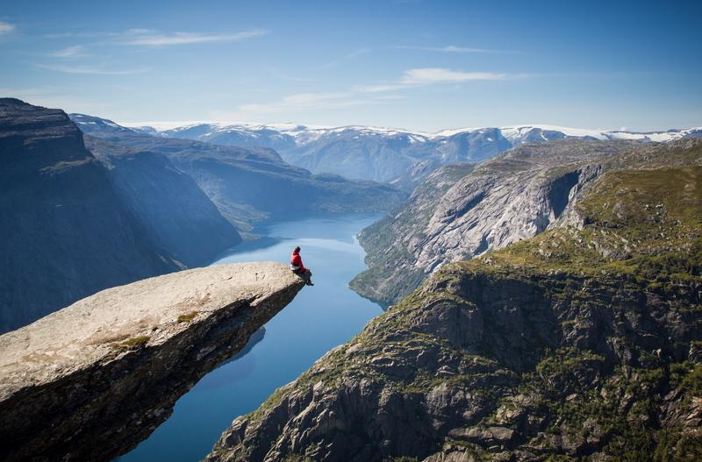
Intro
Potential Energy
Notes:
Today we will learn the definition of potential energy.

Slide 3
Energy
Intro
Potential Energy
Gravitational Potential
Energy
Chemical
Energy
Nuclear
Energy
Notes:
And we will learn about the types of potential energy.

Slide 4
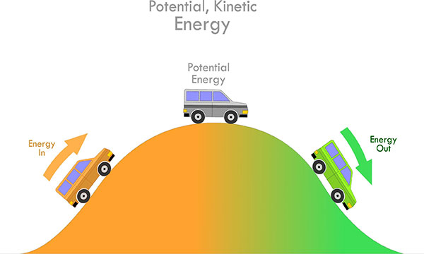
Big Question: What is the relationship between kinetic energy and potential energy?
Kinetic Energy
Kinetic Energy
Notes:
Our “big question” is: What relationships between kinetic and potential energy?
[Pause and illicit predictions from students.]
I love all these thoughtful scientific hypotheses! Be sure to keep this question and your predictions in mind as we move through these next few lessons, and we’ll continue to revisit it.
Feedback: Asking students to make predictions about the relationship between kinetic and potential energy is a great way to activate and elicit student ideas and prior knowledge. This type of activity is evidence of the teacher planning for students’ engagement with science ideas.

Slide 5
Demonstration
TEACHER DIRECTIONS:
Before viewing, ask students to recall what they already know about energy.
After viewing, ask students to share observations, relating those observations back to what they know about energy. Tell students that the marble rolling down the inclined surface represents two different kinds of energy: potential and kinetic. Today we will be focusing on potential energy.
You can set up the materials – all you need is a marble an an inclined plane. Set up an inclined surface and roll the marble down the plan. *You can also change the size of the marble/the incline of the plane the marble rolls on to have students make observations about these changes (i.e. does the bigger marble go faster slower, etc.)
Notes:
Let’s do a quick demonstration that will help get our brains ready to think about potential energy, and how it relates to our big question.
Feedback: This demonstration is a great way to introduce students to an investigation. In your classroom, you may encourage students to plan and conduct this investigation more independently since a large component of inquiry-based activities is encouraging student thinking and independence. As suggested by the slide, beginning with open-ended questions, followed by providing explicit explanations, and then asking probing questions is a great way to engage students in a discussion while also providing clear explanations.

Slide 6
Notes:
Before we move on to our new vocabulary term, let’s review some other words & concepts that you already learned and make sure you are firm in your understanding.

Slide 7
Atom: smallest whole unit of matter
Atom
Atom
Atom
Atom
Atom
Notes:
An atom is the smallest whole unit of matter.

Slide 8
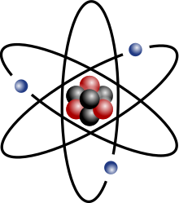
Nucleus: the center of the atom that is made up of protons and neutrons
Notes:
The nucleus is at the center of the atom and is made up of protons (positively charged particles) and neutrons (neutral particles).

Slide 9
Mass: a type of measurement that tells us how much matter is in an object
Notes:
Mass is the measurement of the matter in an object.
When most people think about mass, they also think about weight. Remember that mass and weight are different.
The mass of an object is a measure of the amount of matter in the object, but weight is a measure of the force (or how gravity pulls) on an object. So, for example, weight on Earth and Mars is different because the gravitational pull changes, but mass is always the same.

Slide 10
Energy: the ability to cause change
Notes:
Energy is the ability to cause change.

Slide 11
Gravity: force that exists between all objects with mass
Notes:
Gravity is a force the exists between all objects with mass. This is why apples fall to the earth. They are being pulled in by the Earth’s gravity.

Slide 12
Chemical Change: rearranges the atoms in the original substance to make a new substance
Notes:
A chemical change rearranges the atoms in the original substance to make a new substance.

Slide 13
Chemical Reaction: made up of chemical changes that happen when two or more elements are combined
Notes:
A chemical reaction is made up of chemical changes that happen when two or more elements are combined.

Slide 14
Notes:
Now let’s pause for a moment to check your understanding.

Slide 15
What is found in the nucleus of an atom?
Notes:
What is found in the nucleus of an atom?
[Protons and neutrons]

Slide 16
What does mass tell us about an object (as opposed to weight)?
Notes:
What does mass tell us about an object (as opposed to weight)?
[It tells us how much matter is in an object.]

Slide 17
What is energy?
Notes:
What is energy?
[Energy is 6he ability to cause change.]

Slide 18
What is the relationship between gravity and mass?
Notes:
What is the relationship between gravity and mass?
[Gravity is a force that exists between all objects with mass.]

Slide 19
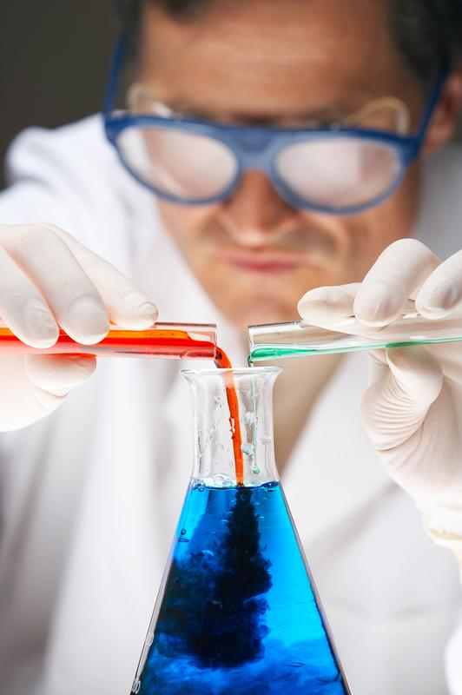
What is the relationship between a chemical change and chemical reaction?
Notes:
What is the relationship between a chemical change and a chemical reaction?
[A chemical reaction is a series of chemical changes that happen when two or more substances are combined.]

Slide 20
Potential Energy
Notes:
Now that we’ve reviewed, let’s define our new term, potential energy.

Slide 21
Potential energy: stored energy
Notes:
Potential energy is stored energy.

Slide 22
Notes:
Now let’s pause for a moment to check your understanding.

Slide 23
What is potential energy?
Notes:
What is potential energy?
[Potential energy is stored energy.]

Slide 24
Notes:
That is the basic definition, but there is a bit more you need to know.

Slide 25
Let’s Think About an Analogy

Slide 26
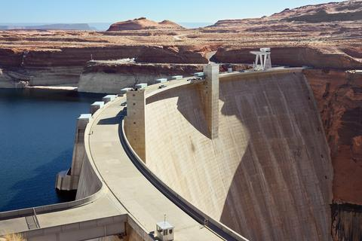
INCREASED PRESSURE
Potential energy is like water behind a dam
Notes:
Potential energy, or stored energy, is like water behind a dam. Imagine all of that water building. As more and more water builds up, the pressure on the dam increases.

Slide 27
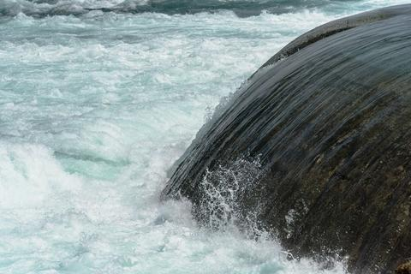
Potential
Energy
Notes:
If the dam were to break, all of that water would be released. Think of the energy those rushing waves would have! The energy would no longer be stored.

Slide 28
Energy
Potential Energy
Chemical
Energy
Nuclear
Energy
Gravitational Potential
Energy
Notes:
There are three types of potential energy, so we are going to look at each type of potential or stored energy. First, we are going to look at gravitational potential energy.

Slide 29
Gravitational Potential Energy
Notes:
Now, let’s look at gravitational potential energy.

Slide 30
Gravitational Potential Energy: energy stored because of an object’s position or height above Earth’s surface
Notes:
Gravitational potential energy is energy stored because of an object’s position or height above earth’s surface.

Slide 31
Notes:
Now let’s pause for a moment to check your understanding.

Slide 32
What is gravitational potential energy?
Notes:
What is gravitational potential energy?
[Gravitational potential energy is energy stored because of an object’s position or height above Earth’s surface.]

Slide 33
Notes:
That is the basic definition, but there is a bit more you need to know.

Slide 34
Gravitational potential energy depends on the object’s:
MASS
Notes:
The amount of gravitational potential energy an object has depends on its mass,

Slide 35
Gravitational potential energy depends on the object’s:
MASS
DISTANCE
Notes:
and its distance from the Earth.

Slide 36
Notes:
Now let’s pause for a moment to check your understanding.

Slide 37
What does gravitational potential energy depend on?
Notes:
What does gravitational potential energy depend on?
[Mass and distance]

Slide 38
Notes:
Now, let’s look at an example of gravitational potential energy.

Slide 39
Notes:
Here there is gravitational potential energy.

Slide 40
Mass
Notes:
There is gravitational potential energy because the apple and Earth have mass.

Slide 41
Distance
Notes:
There is gravitational potential energy because the apple is “y” distance from the Earth.

Slide 42
Distance
Notes:
As the apple begins to fall, it loses potential energy because it is closer to the ground.

Slide 43
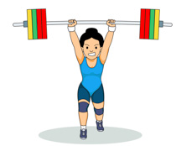
Notes:
Holding weights in the air is another example of gravitational potential energy. The weights and the ground both have mass. There is gravitational potential energy because the weight is “y” distance from the earth. If the weight is dropped, it loses potential energy because it then falls to the ground.

Slide 44
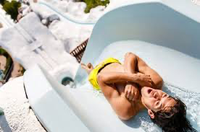
Notes:
If you are at the top of a water slide, you have potential energy. You and the Earth both have mass, and because you are at the top of the water slide, you are a certain distance from Earth. As you go down the waterslide, you lose potential energy because you are getting closer to earth by going down the slide.

Slide 45
Notes:
Next, let’s talk about some a non-example of gravitational potential energy.

Slide 46
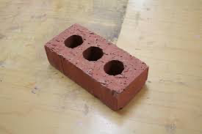
Notes:
The brick on the ground does not have gravitational potential energy. It does not because it is NOT above the Earth’s surface. The only way for something to have gravitational potential energy is if it has both mass and is some distance above Earth’s surface.

Slide 47
Notes:
Let’s check-in for understanding.

Slide 48
What is potential energy?
Notes:
What is potential energy?
[Potential energy is stored energy.]

Slide 49
Once the dam is broken, does the water still have potential energy?
Potential
Energy
Notes:
Once the dam is broken, does the water still have potential energy?
[Potential energy is stored energy, but once the dam is broken, the energy is released and is no longer potential energy.]

Slide 50
What is gravitational potential energy?
Notes:
What is gravitational potential energy?
[Gravitational potential energy is energy stored because of an object’s position or height above earth’s surface.]

Slide 51
What two things does gravitational potential energy depend on?
Notes:
What two things does gravitational potential energy depend on?
[Mass and distance]

Slide 52
Think of your own example of gravitational potential energy.
Notes:
Think of your own example of gravitational potential energy.
[An apple hanging in a tree, holding weights above the ground, a rollercoaster at the top of a hill, etc.]

Slide 53
Energy
Potential Energy
Chemical
Energy
Nuclear
Energy
Gravitational Potential
Energy
Notes:
We have talked about potential energy, and the first type of potential energy: gravitational potential energy. Now we are going to focus on the second type of potential energy: chemical energy
Feedback: Giving students cues helps them to prepare for what is coming next.

Slide 54
Chemical Energy
Notes:
Now that we’ve reviewed, let’s define our new term, chemical energy.

Slide 55
Chemical Energy: energy stored in the bonds of chemical compounds, like atoms and molecules
Notes:
Chemical energy is the energy stored in the bonds of chemical compounds, like atoms and molecules.

Slide 56
Notes:
Let’s check-in for understanding.

Slide 57
What is chemical energy?
Notes:
What is chemical energy?
[Chemical energy is energy stored in the bonds of chemical compounds, like atoms and molecules.]

Slide 58
Notes:
That is the basic definition, but there is a bit more you need to know.

Slide 59
Bonds
Notes:
Bonds between molecules or compounds must be present for chemical energy to exist. Bonds store and release energy.

Slide 60
Formed Bond = Energy Stored
Notes:
If a bond is formed, energy is stored.

Slide 61
Broken Bond = Energy Released
Notes:
If a bond is broken, energy is released.

Slide 62
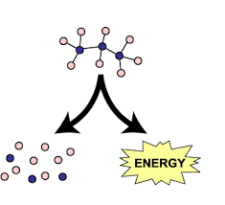
chemical reaction = energy released
Notes:
When a chemical reaction happens, chemical energy is released.

Slide 63
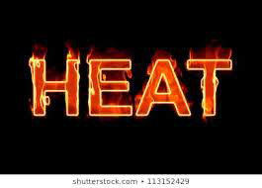
Notes:
Heat is often the product of a chemical reaction.

Slide 64
Notes:
Let’s check-in for understanding.

Slide 65
How do we know when chemical energy is being stored?
Notes:
How do we know when chemical energy is being stored?
[When bonds are formed, chemical energy is stored.]

Slide 66
What happens when chemical energy is released?
Notes:
What happens when chemical energy is released?
[When chemical energy is released, a chemical reaction happens, which also causes heat to be released.]

Slide 67
Notes:
Now, let’s look at an example of chemical energy.

Slide 68
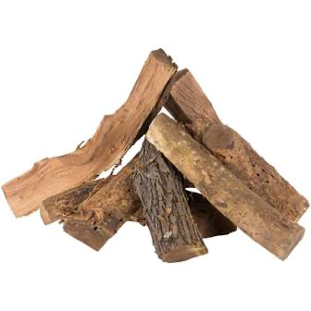
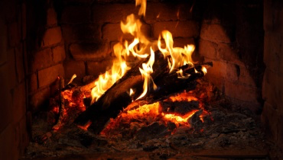
Energy released
Chemical energy stored
Bonds broken
Notes:
Dry wood has stored chemical energy. When the wood is burned, chemical energy is released (bonds are broken) and turned into heat. We know a chemical reaction has taken place because the wood has turned into ash (a new substance).

Slide 69
We need chemical energy!
Notes:
Our food contains chemical energy! The bonds in food contain chemical energy. When we breakdown food, The bonds in the food are broken and a chemical reaction takes place causing the chemical energy to be released. The energy from the food helps to keep us warm (heat from the reaction), helps us move, and allows us to grow.

Slide 70
Notes:
Let’s check-in for understanding.

Slide 71
What is potential energy?
Notes:
What is potential energy?
[Potential energy is stored energy.]

Slide 72
What is chemical energy?
Notes:
What is chemical energy?
[Chemical energy is energy stored in the bonds of chemical compounds, like atoms and molecules.]

Slide 73
What happens when chemical energy is released?
Notes:
What happens when chemical energy is released?
[When chemical energy is released, a chemical reaction happens, which also causes heat to be released.]

Slide 74
Why do we need chemical energy?
Notes:
Why do we need chemical energy?
[Our bodies break down the energy and use the energy to help keep us warm, move, and grow.]

Slide 75
What is gravitational potential energy?
Notes:
What is gravitational potential energy?
[Gravitational potential energy is energy stored because of an object’s position or height above earth’s surface.]

Slide 76
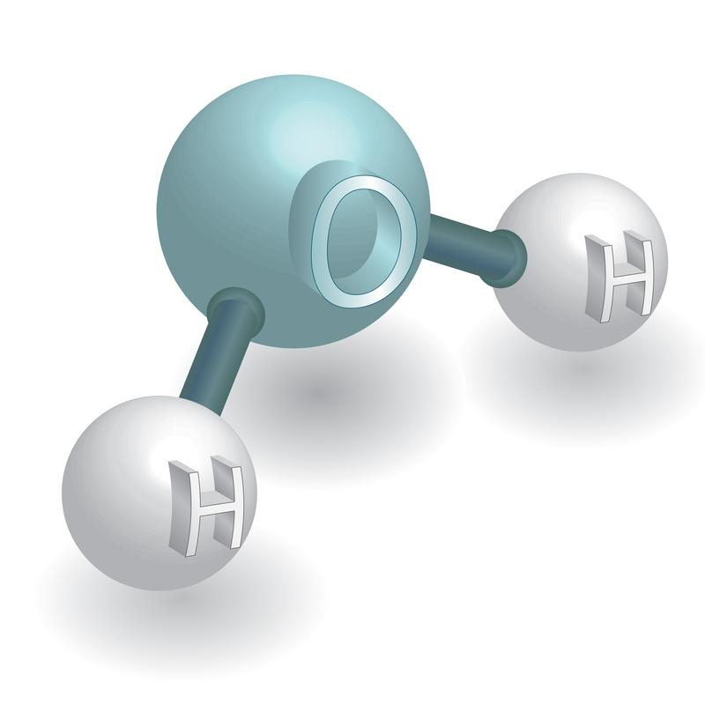
How are gravitational potential energy and chemical energy similar?
Notes:
How are gravitational potential energy and chemical energy similar?
[They both are types of stored (or potential) energy.]

Slide 77
Energy
Potential Energy
Chemical
Energy
Nuclear
Energy
Gravitational Potential
Energy
Notes:
We have talked about two types of potential energy: gravitational potential energy, and chemical energy. Now we are going to talk about the final type of potential energy: nuclear energy.

Slide 78
Nuclear Energy
Notes:
Now that we’ve reviewed, let’s define our new term, nuclear energy.

Slide 79
Nuclear Energy: energy stored in the nucleus of an atom
Notes:
Nuclear energy is energy stored in the nucleus of an atom.

Slide 80
Notes:
Let’s check-in for understanding.

Slide 81
What is nuclear energy?
Notes:
What is nuclear energy?
[Nuclear energy is energy stored in the nucleus of an atom.]

Slide 82
Notes:
That is the basic definition, but there is a bit more you need to know.

Slide 83
Notes:
Nuclear energy holds the nucleus of an atom together. It keeps protons and neutrons next to each other.

Slide 84
Notes:
Let’s check-in for understanding.

Slide 85
What does nuclear energy do?
Notes:
What does nuclear energy do?
[Nuclear energy holds the nucleus of an atom together. It keeps protons and neutrons next to each other.]

Slide 86
Notes:
Now, let’s look at an example of nuclear energy.

Slide 87
Notes:
Nuclear energy can be extremely explosive when used. The sun is powered by nuclear energy, so the sun is one example of how we can see nuclear energy.

Slide 88
Notes:
We can also break down the term producer into different word parts to help us remember the meaning. Let’s take a look!

Slide 89
Nuclear
Nucleus
Notes:
Here we can see how the word ”nuclear” comes from the word “nucleus.” This helps us remember that nuclear energy is stored in the nucleus of atoms

Slide 90
Notes:
Let’s check-in for understanding.

Slide 91
What is potential energy?
Notes:
What is potential energy?
[Potential energy is stored energy.]

Slide 92
What is nuclear energy?
Notes:
What is nuclear energy?
[Nuclear energy is energy stored in the nucleus of an atom.]

Slide 93
How are nuclear energy and chemical energy similar?
Notes:
How are nuclear energy and chemical energy similar?
[They both are types of stored (or potential) energy.]

Slide 94
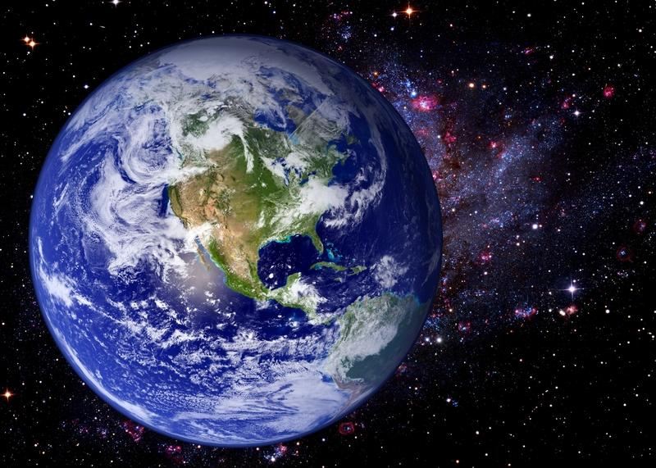
How are gravitational potential energy, nuclear energy, and chemical energy similar?
Notes:
How are gravitational potential energy and chemical energy similar?
[They are all ways energy is stored, meaning they are all types of potential energy.]

Slide 95
Remember!!!
Notes:
So remember!

Slide 96
Potential energy: stored energy
Notes:
Potential energy is stored energy.

Slide 97
Gravitational Potential Energy: energy stored because of an object’s position or height above Earth’s surface
Notes:
Gravitational potential energy is energy stored because of an object’s position or height above earth’s surface.

Slide 98
Chemical Energy: energy stored in the bonds of chemical compounds, like atoms and molecules
Notes:
Gravitational potential energy is the energy an object has because of its position in a gravitational field.

Slide 99
Nuclear Energy: energy stored in the nucleus of an atom
Notes:
Nuclear energy is energy stored in the nucleus of an atom.

Slide 100
Simulation Activity
Potential Energy Gizmo
Click the link above to explore more about potential energy.
In this simulation activity, you’ll use the bar chart to observe how the potential energy of different objects changes as you move them. Think about, for example, what causes the ball to have higher potential energy than the paper clips, even when the paperclips are higher.
Notes:
Feedback: Providing a simulation activity is a great way to make science thinking visible. In this simulation, students have the opportunity to make predictions and apply an idea to a new situation by changing the variables in the simulation (i.e., potential energy levels).

Slide 101
Big Question: What is the relationship between kinetic energy and potential energy?
Kinetic Energy
Kinetic Energy
Notes:
Our “big question” is: What relationships between kinetic and potential energy?
Explicit cue to revisit the big question at the end of the lesson: Okay everyone. Now that we’ve learned the term, potential energy (and the three different types), let’s reflect once more on our big question. Was there anything that we predicted earlier that was correct or incorrect? Do you have any new hypotheses to share?

Slide 102
Notes:
Thanks for watching, and please continue watching CAPs available from this website.

Slide 103
This Video Was Created With Resources From:
Questions or Comments
Michael Kennedy, Ph.D. MKennedy@Virginia.edu
Rachel L Kunemund, Ph.D. rk8vm@virginia.edu

Slide 104
Intro
“Big Idea” Question
Review Concepts
Check-In Questions
Teacher Demo
Vocabulary
Student-Friendly Definition
Examples & Non-Examples
Morphological Word Parts
Simulation/Activity
Notes:
OK everyone, get ready for our next lesson. Just as a reminder, these are the different components that our lesson may include, and you’ll see these icons in the top left corner of each slide so that you can follow along more easily!

Slide 105
Kinetic Energy
Intro
Notes:
Today we will be learning about kinetic energy.

Slide 106
Big Question: What is the relationship between kinetic energy and potential energy?
Kinetic Energy
Kinetic Energy
Notes:
Our “big question” is: What relationships between kinetic and potential energy?
[Pause and illicit predictions from students.]
What are our hypothesis so far? What changed in our thinking?

Slide 107
Demonstration
TEACHER DIRECTIONS:
Before viewing, ask students to recall what they already know and have learned about energy.
After viewing, ask students to share observations, relating those observations back to what they know about energy. Tell students that the marble rolling down the inclined surface represents two different kinds of energy: potential and kinetic. Today we will be focusing on kinetic energy. Ask students to identify where potential energy happens. Have students make observations/hypothesis on where kinetic energy is taking place in this demonstration.
You can set up the materials – all you need is a marble an an inclined plane. Set up an inclined surface and roll the marble down the plan. *You can also change the size of the marble/the incline of the plane the marble rolls on to have students make observations about these changes (i.e. does the bigger marble go faster slower, etc.)
Notes:
Let’s do a quick demonstration that will help get our brains ready to think about kinetic energy, and how it relates to our big question.
Feedback: Asking open-ended questions is a great way to gauge student understanding by requiring deeper thought than a rote opportunity to respond. Be sure to incorporate open-ended questions into the demonstration.

Slide 108
Notes:
Before we move on to our new vocabulary term, let’s review some other words & concepts that you already learned and make sure you are firm in your understanding.

Slide 109
Energy: the ability to cause change
Notes:
Energy is the ability to cause change.

Slide 110
Potential energy: stored energy
Notes:
Potential energy is stored energy.

Slide 111
Energy
Potential Energy
Chemical
Energy
Nuclear
Energy
Gravitational Potential
Energy
Notes:
There are three types of potential energy, so we are going to look at each type of potential or stored energy. First, we are going to look at gravitational potential energy.

Slide 112
Gravitational Potential Energy: energy stored because of an object’s position or height above Earth’s surface
Notes:
Gravitational potential energy is energy stored because of an object’s position or height above Earth’s surface.

Slide 113
Chemical Energy: energy stored in the bonds of chemical compounds, like atoms and molecules
Notes:
Chemical energy is energy stored in the bonds of chemical compounds, like atoms and molecules.

Slide 114
Nuclear Energy: energy stored in the nucleus of an atom
Notes:
Nuclear energy is energy stored in the nucleus of an atom.

Slide 115
Mass: a type of measurement that tells us how much matter is in an object
Notes:
Mass is the measurement of the matter in an object.
When most people think about mass, they also think about weight. Remember that mass and weight are different.
The mass of an object is a measure of the amount of matter in the object, but weight is a measure of the force (or how gravity pulls) on an object. So, for example, weight on Earth and Mars is different because the gravitational pull changes, but mass is always the same.

Slide 116
Notes:
Now let’s pause for a moment to check your understanding.

Slide 117
What is energy?
Notes:
What is energy?
[Energy is the ability to cause change.]

Slide 118
What is potential energy?
Notes:
What is potential energy?
[Potential energy is stored energy.]

Slide 119
Energy
Potential Energy
Notes:
What are the three types of potential energy?
[(1) Gravitational potential energy , (2) nuclear energy, (3) chemical energy]

Slide 120
What is gravitational potential energy?
Notes:
What is gravitational potential energy?
[Gravitational potential energy is energy stored because of an object’s position or height above Earth’s surface.]

Slide 121
How are nuclear energy and chemical energy different?
Notes:
How are nuclear energy and chemical energy different?
[Nuclear energy is energy stored in the nucleus of an atom while chemical energy is energy stored in the bonds of chemical compounds.]

Slide 122
Kinetic Energy
Notes:
Now that we’ve reviewed, let’s define our new term, kinetic energy.

Slide 123
Kinetic Energy: energy of mass in motion
Notes:
Kinetic energy is energy from motion.
Feedback: Using concise, clear language is helpful as students are exposed to new concepts.

Slide 124
Notes:
Now let’s pause for a moment to check your understanding.

Slide 125
What is kinetic energy?
Notes:
What is kinetic energy?
[Kinetic energy is the energy of mass in motion.]

Slide 126
Notes:
That is the basic definition, but there is a bit more you need to know.

Slide 127
Notes:
Here, kinetic energy is shown in the bowling ball.

Slide 128
mass
Notes:
Kinetic energy is measured by mass...

Slide 129
speed
Notes:
...and speed. The kinetic energy is the energy being released when the bowling ball is thrown. It has mass, and is moving (speed) so a bowling ball rolling down to hit the pins is kinetic energy

Slide 130
Notes:
Now let’s pause for a moment to check your understanding.

Slide 131
How is kinetic energy measured?
Notes:
How is kinetic energy measured?
[Using mass and speed]

Slide 132
Notes:
Now, let’s look at an example of kinetic energy.

Slide 133
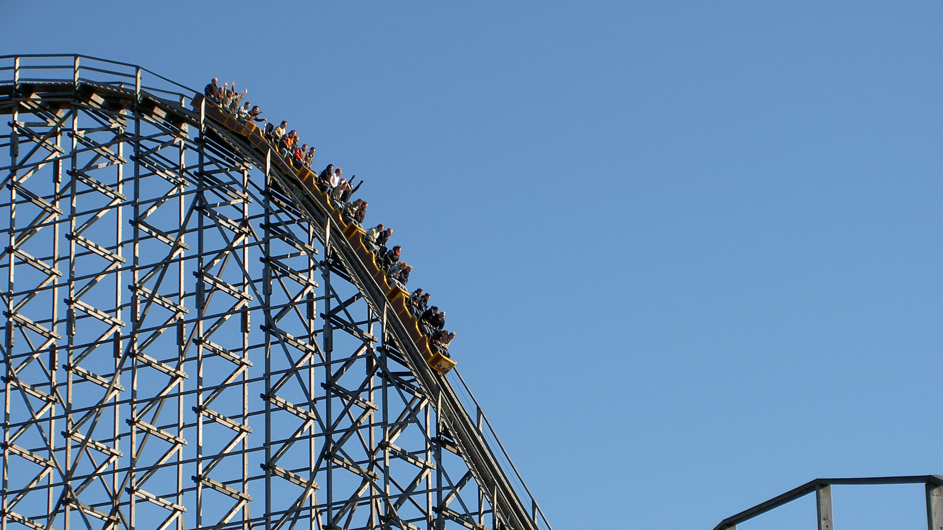
Notes:
When you are on a roller coaster and you reach the top of the hill, you start to go down. When you are going down the hill, that is kinetic energy. The roller coaster cars have mass, and is going down the hill at a certain speed, so kinetic energy is being released.

Slide 134
Notes:
An arrow that is shot from a bow is also an example of kinetic energy. The arrow has mass and is traveling to the target at a certain speed, so we know that kinetic energy has been released.

Slide 135
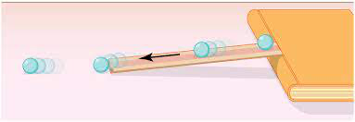
Notes:
Let’s think back to our demonstration. A marble rolling down an inclined plane is also an example of kinetic energy. This is because the marble has mass and is traveling at a certain speed.

Slide 136
Notes:
Next, let’s talk about some non-examples of kinetic energy.

Slide 137
Notes:
Waiting to go down a waterslide is NOT an example of potential energy. You do have mass but you are not moving so you do not have speed, so there is no kinetic energy.
What kind of energy IS this? [gravitational potential energy]

Slide 138
Notes:
The brick on the ground does not have kinetic energy. It does have mass but it does not have speed so it is not an example of kinetic energy.

Slide 139
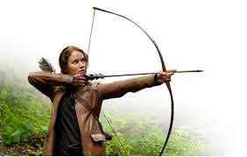
Notes:
Drawing back a bow and arrow is also NOT kinetic energy. They have mass but there is no speed. Drawing back a bow and arrow is an example of potential energy. When the energy is released and the bow is moving in the air, that is kinetic energy.

Slide 140
Notes:
Now let’s pause for a moment to check your understanding.

Slide 141
What is an example of kinetic energy?
Notes:
What is an example of kinetic energy?

Slide 142
What is a non-example of kinetic energy?
NON
Notes:
What is a non-example of kinetic energy?

Slide 143
Notes:
We can also break down the term producer into different word parts to help us remember the meaning. Let’s take a look!

Slide 144
Kinetic Energy
Kinet
-ic
Notes:
The word kinetic can be broken up into two parts: kinet and ic.

Slide 145
Kinetic Energy
Kinet
-ic
to move
Notes:
The first part of kinetic comes from the Greek word “to move.”

Slide 146
Kinetic Energy
Kinet
-ic
Suffix: pertaining to
Notes:
The suffix –ic means “of or pertaining to.”

Slide 147
Kinet
-ic
Kinetic Energy
Pertaining to moving energy
Notes:
So, we can remember that kinetic energy involves movement. Think about how all of our examples involved speed. If something has speed, it is moving.

Slide 148
Notes:
Let’s check-in for understanding.

Slide 149
How can we use the word parts of kinetic to help us remember the definition of the term?
Kinetic Energy
Kinet
-ic
Notes:
How can we use the word parts of kinetic to help us remember the definition of the term?
[The word kinetic can be broken up into two parts: kinet and ic.
The first part of kinetic comes from the Greek word “to move.”
The suffix –ic means “of or pertaining to.”
So, we can remember that kinetic energy involves movement. Think about how all of our examples involved speed. If something has speed, it is moving.]
Feedback: Reuniting the word parts is a crucial step in helping students understand the whole picture when reviewing morphological word parts.

Slide 150
What is kinetic energy?
Notes:
What is kinetic energy?
[Kinetic energy is energy from motion.]

Slide 151
What have to be present for an object to have kinetic energy?
Notes:
What has to be present for an object to have kinetic energy?
[Mass and speed]

Slide 152
What is the difference between kinetic and potential energy?
Notes:
What is the difference between kinetic and potential energy?
[Potential energy is energy that is stored while kinetic energy is released energy (energy of motion).]

Slide 153
Remember!!!
Notes:
So remember!

Slide 154
Kinetic Energy: energy of mass in motion
Notes:
Kinetic energy is energy from motion.

Slide 155
Simulation Activity
Roller Coaster Gizmo
Click the link above to explore more about kinetic energy.
In this simulation, you are changing the hills to make the car reach the egg without breaking it. How do we know this is kinetic energy? What are two important things you need to remember about kinetic energy?
Notes:
Feedback: Remind students that with kinetic energy, you have to pay attention to both speed and mass. You can also relate this back to potential energy. Ask students why they thing potential energy is also going to effect the car.

Slide 156
Big Question: What is the relationship between kinetic energy and potential energy?
Kinetic Energy
Kinetic Energy
Notes:
Explicit cue to revisit the big question at the end of the lesson: Okay everyone now that we’ve learned the terms potential energy and kinetic energy, let’s reflect once more on our big question. Was there anything that we predicted earlier that was correct or incorrect? Do you have any new hypotheses to share? Since we’ve covered both of these terms at this point, are there any relationships between kinetic energy and potential energy that we haven’t thought of yet?

Slide 157
Notes:
Thanks for watching, and please continue watching CAPs available from this website.

Slide 158
This Video Was Created With Resources From:
Questions or Comments
Michael Kennedy, Ph.D. MKennedy@Virginia.edu
Rachel L Kunemund, Ph.D. rk8vm@virginia.edu

