Slide 1
Intro
“Big Idea” Question
Review Concepts
Check-In Questions
Teacher Demo
Vocabulary
Student-Friendly Definition
Examples & Non-Examples
Morphological Word Parts
Simulation/Activity
Notes:
OK everyone, get ready for our next lesson. Just as a reminder, these are the different components that our lesson may include, and you’ll see these icons in the top left corner of each slide so that you can follow along more easily!

Slide 2
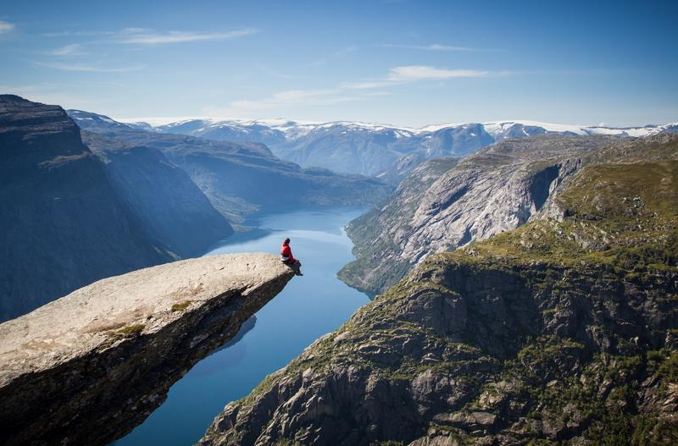
Intro
Potential Energy
Notes:
Today we will learn the definition of potential energy.

Slide 3
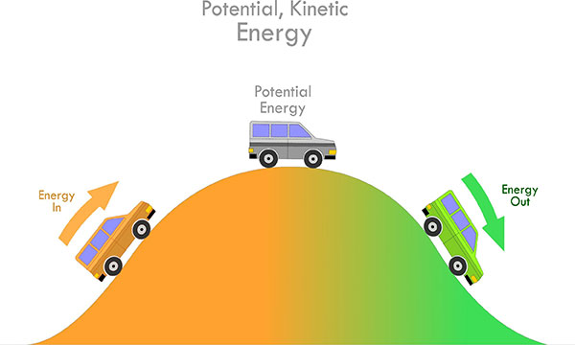
Big Question: What is the relationship between kinetic energy and potential energy?
Kinetic Energy
Kinetic Energy
Notes:
Our “big question” is: What relationships between kinetic and potential energy?
[Pause and illicit predictions from students.]
I love all these thoughtful scientific hypotheses! Be sure to keep this question and your predictions in mind as we move through these next few lessons, and we’ll continue to revisit it.

Slide 4
Demonstration
Potential & Kinetic Energy Marble Roller Coaster
TEACHER DIRECTIONS:
Before viewing, ask students to recall what they already know about energy.
After viewing, ask students to share observations, relating those observations back to what they know about energy. Tell students that the marble rolling down the inclined surface represents two different kinds of energy: potential and kinetic. Today we will be focusing on potential energy.
You can set up the materials – all you need is a marble an an inclined plane. Set up an inclined surface and roll the marble down the plane. *You can also change the size of the marble/the incline of the plane the marble rolls on to have students make observations about these changes (i.e. does the bigger marble go faster slower, etc.).
Notes:
Let’s do a quick demonstration that will help get our brains ready to think about potential energy, and how it relates to our big question.
Feedback: Providing students with the opportunity to make predictions about what will happen allows them to think critically about the content.

Slide 5
Notes:
Now let’s pause for a moment to check your understanding.
Feedback: Provide students with plenty of opportunities to demonstrate their understanding through questions and other opportunities to respond throughout the demonstration. This is so important for ensuring that your students are grasping this new skill.

Slide 6
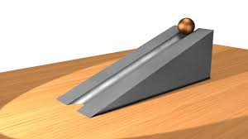
When the marble is at the top of the plane and not moving, what type of energy do you predict it has: potential or kinetic? Explain.
Notes:
When the marble is at the top of the plane and not moving, what type of energy do you predict it has: potential or kinetic? Explain.

Slide 7
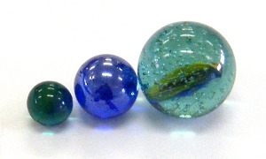
What do you predict will happen if we change the size of the marbles?
Notes:
What do you predict will happen if we change the size of the marbles?
Do you think the marbles will all roll at the same speed, go the same distance, etc.?

Slide 8
Discuss: What did you change about the plane you made for the marble (incline, thickness, etc.)? When the marble was pushed down your ramp, how was it different from my demonstration?
Notes:
Discuss: What did you change about the plane you made for the marble (incline, thickness, etc.)? When the marble was pushed down your ramp, how was it different from my demonstration?

Slide 9
Notes:
Before we move on to our new vocabulary term, let’s review some other words & concepts that you already learned and make sure you are firm in your understanding.
Feedback: Reviewing key background knowledge helps lay the context and sets the students up to make sense of the new content you are introducing, it also reinforces previously learned material.

Slide 10
Atom: smallest whole unit of matter
Atom
Atom
Atom
Atom
Atom
Notes:
Remember that an atom is the smallest whole unit of matter.

Slide 11
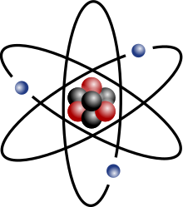
Nucleus: the center of the atom that is made up of protons and neutrons
Notes:
The nucleus is the center of the atom that is made up of protons and neutrons.

Slide 12
Protons: positively charged subatomic particles found in the nucleus of an atom
Proton
Notes:
We will be learning about protons which are positively charged subatomic particles found in the nucleus of an atom.

Slide 13
Neutrons: subatomic particles with no charge (neutral charge) found in the nucleus of atoms
Neutron
Notes:
We are going to talk about neutrons, which are subatomic particles with no charge (neutral charge) found in the nucleus of atoms.

Slide 14
Mass: a type of measurement that tells us how much matter is in an object
Notes:
We have also learned about mass. Remember that mass is the measurement of the matter in an object.
When most people think about mass, they also think about weight. Remember that mass and weight are different.
The mass of an object is a measure of the amount of matter in the object, but weight is a measure of the force (or how gravity pulls) on an object. So, for example, weight on Earth and Mars is different because the gravitational pull changes, but mass is always the same.

Slide 15
Energy: the ability to cause change
Notes:
Energy is the ability to cause change.

Slide 16
Gravity: force that exists between all objects with mass
Notes:
Gravity is a force the exists between all objects with mass. This is why apples fall to the earth. They are being pulled in by the earth's gravity.

Slide 17
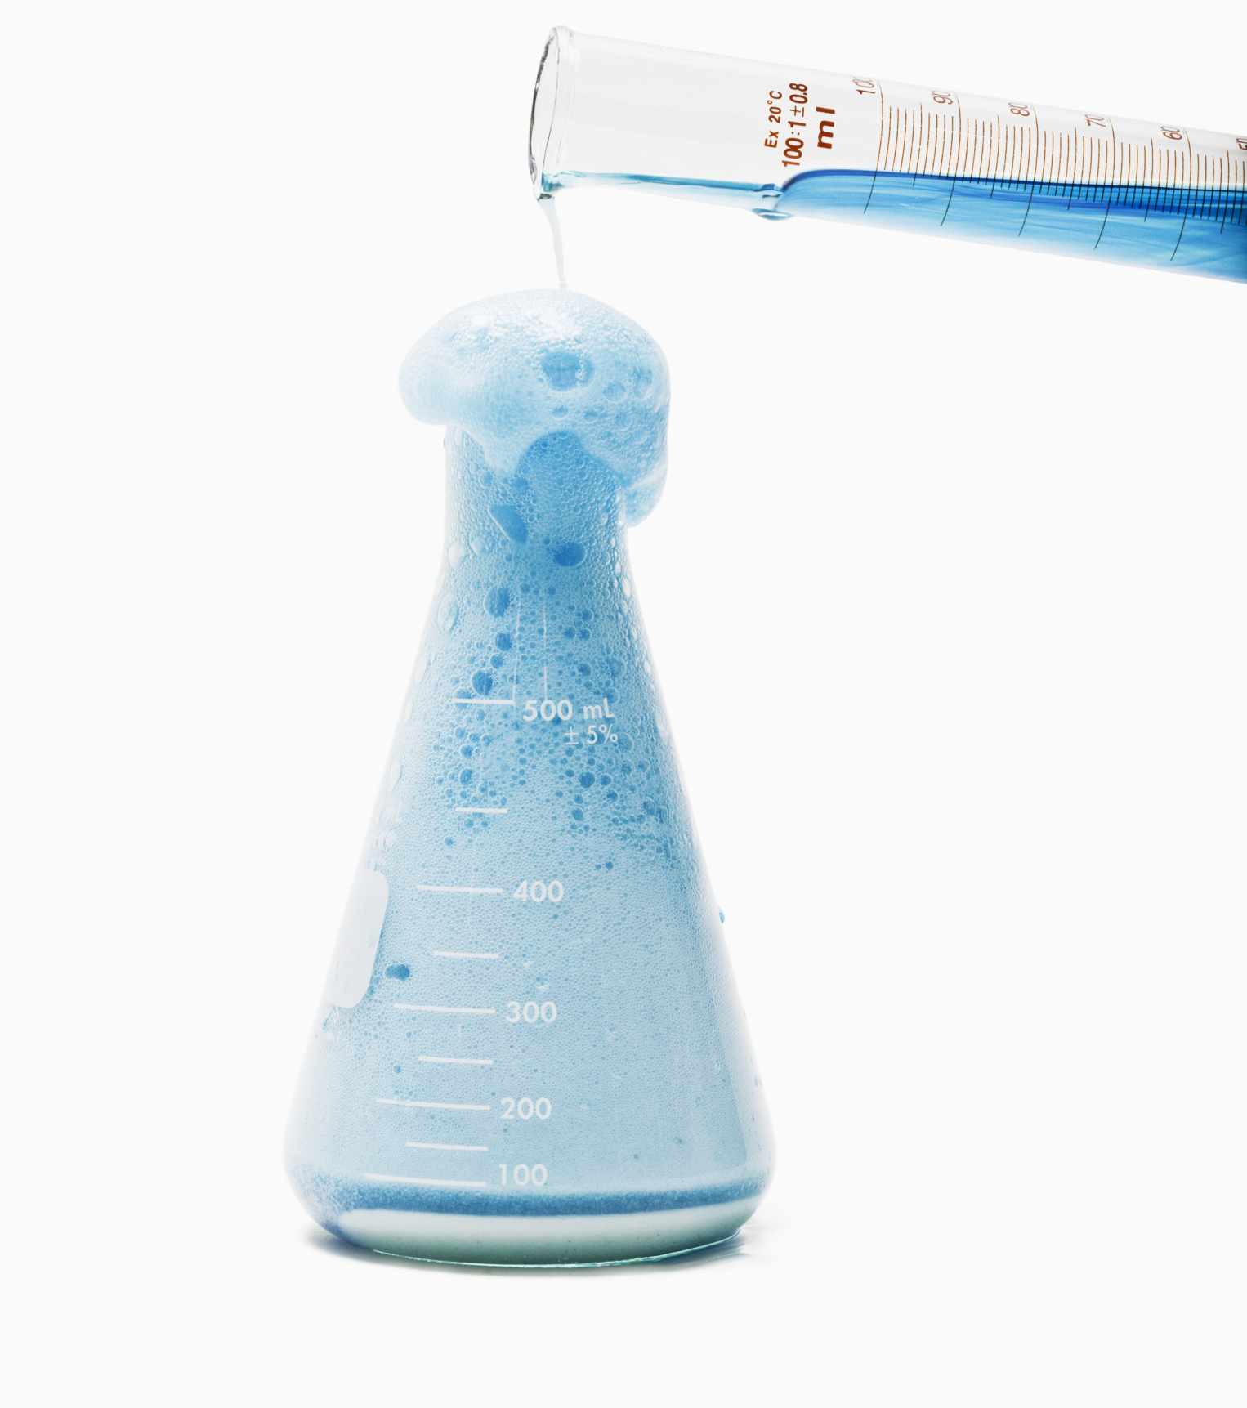
Chemical Change: rearranges the atoms in the original substance to make a new substance
Notes:
A chemical change rearranges the atoms in the original substance to make a new substance.

Slide 18
Chemical Reaction: made up of chemical changes that happen when two or more elements are combined
Notes:
A chemical reaction is made up of chemical changes that happen when two or more elements are combined.

Slide 19
Notes:
Now let’s pause for a moment to check your understanding.
Feedback: Monitoring understanding during review is an important step before moving on to new material.

Slide 20
What is found in the nucleus of an atom?
Notes:
What is found in the nucleus of an atom?
Protons and neutrons

Slide 21
What does mass tell us about an object?
Notes:
What does mass tell us about an object?
It tells us how much matter is in an object.

Slide 22
What is energy?
Notes:
What is energy?
The ability to cause change

Slide 23
What is the relationship between gravity and mass?
Notes:
What is the relationship between gravity and mass?
Gravity is a force that exists between all objects with mass.

Slide 24
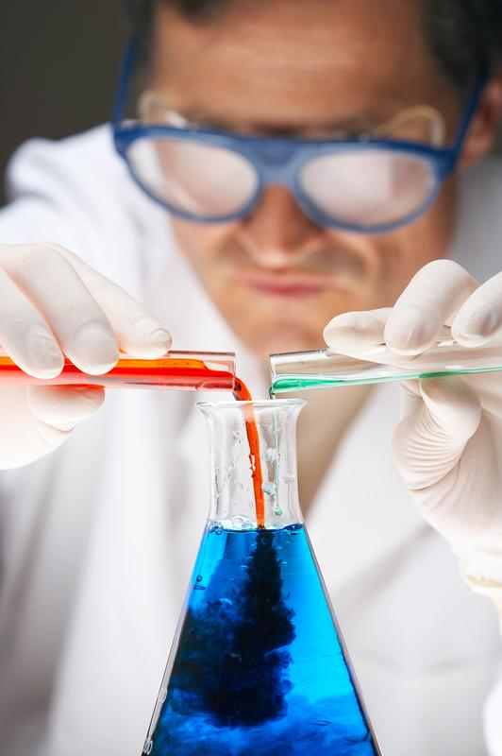
What is the difference between a chemical change and chemical reaction?
Notes:
What is the difference between a chemical change and chemical reaction?

Slide 25
Potential Energy
Notes:
Now that we’ve reviewed, let’s define our new term, potential energy.

Slide 26
Potential Energy: stored energy
Notes:
Potential energy is stored energy.
Feedback: Keeping definitions clear and concise helps to promote better understanding for students.

Slide 27
Notes:
That is the basic definition, but there is a bit more you need to know.

Slide 28
Let’s Think About an Analogy
Notes:
Let’s think about an analogy.
Feedback: Use clear and consistent language when introducing the analogy, this helps students understand what is expected.

Slide 29
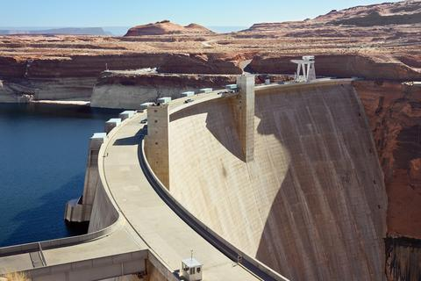
INCREASED PRESSURE
Potential energy is like water behind a dam.
Notes:
Potential energy, or stored energy, is like water behind a dam. Imagine all of that water building. As more and more water builds up, the pressure on the dam increases.
(make sure you write out the analogy and then provide an extended context/explanation)

Slide 30
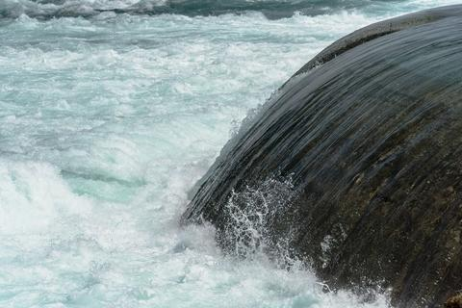
Potential
Energy
Notes:
If the dam were to break, all of that water would be released. Think of the energy those rushing waves would have! The energy would no longer be stored.

Slide 31
Energy
Potential Energy
Chemical
Energy
Nuclear
Energy
Gravitational Potential
Energy
Notes:
There are three types of potential energy: Gravitational Potential Energy, Chemical Energy, and Nuclear Energy. So we are going to look at each type of potential or stored energy later.

Slide 32
Notes:
Now let’s pause for a moment to check your understanding.
Feedback: Analogies can be tricky, provide students with opportunities to respond so that you could monitor understanding.

Slide 33
What is potential energy?
Notes:
What is potential energy?
Potential energy is stored energy.

Slide 34
Energy
What are the 3 types of potential energy?
Potential Energy
Notes:
What are the three types of potential energy?
Gravitational Potential Energy, Chemical Energy, Nuclear Energy

Slide 35
Notes:
Now, let’s look at examples of potential energy. We will talk about examples of the types of potential energy later.
Feedback: Using clear and concise language for your examples is a great way to ensure students are able to follow along and understand the content.

Slide 36
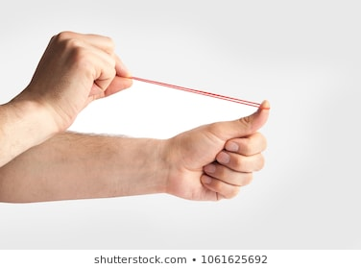
Notes:
Stretching a rubber band is an example of potential energy. We know this is potential energy because if you let go of the rubber band, it will release its energy and shoot across the room.

Slide 37
Notes:
In our demonstration, when the marble was at the top of the plane it had potential energy. We know this is potential energy because if pushed, the marble would release its energy and roll down the plane.

Slide 38
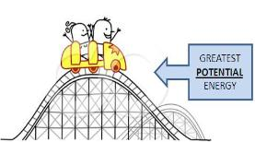
Notes:
If you are at the top of a rollercoaster, you have potential energy. Energy is stored at the top (potential energy) and is then released, which then makes you go down the hill.

Slide 39
Notes:
Now let’s pause for a moment to check your understanding.

Slide 40
Why is stretching a rubber band an example of potential energy?
Notes:
Why is stretching a rubber band an example of potential energy?
Stretching a rubber band is an example of potential energy. We know this is potential energy because if you let go of the rubber band, it will release its energy and shoot across the room.

Slide 41
Is the marble at the top of this plane an example of potential energy? Explain your answer.
Notes:
Is the marble at the top of this plane an example of potential energy? Explain your answer.
Yes. We know this is potential energy because if pushed, the marble would release its energy and roll down the plane.

Slide 42
Give your own example of potential energy.
Notes:
Give your own example of potential energy.
Feedback: Having students think of their own example for the term can strengthen their understanding of the term and uncover any misconceptions.

Slide 43
Notes:
Next, let’s talk about some a non-examples of potential energy.
Feedback: Include images as part of your non-example, this helps students recognize the differences and similarities between the term and the non-example.

Slide 44
Notes:
Running is not an example of potential energy because energy is not stored. When you are running, you are releasing energy.

Slide 45
Notes:
Releasing a basketball to shoot it is not potential energy. When you release the basketball energy is released and not stored.

Slide 46
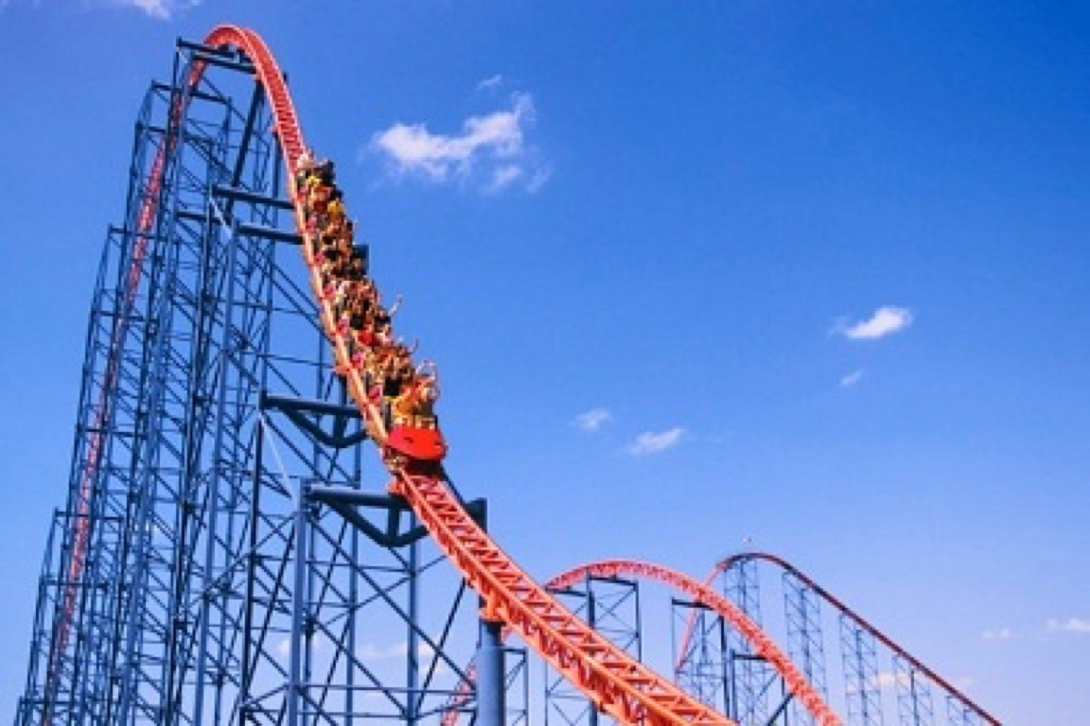
Notes:
Going down the hill of a roller coaster is NOT an example of potential energy. It is not potential energy because energy has been released, which is why you are moving down the hill instead of sitting at the top.

Slide 47
Notes:
Now let’s pause for a moment to check your understanding.

Slide 48
Is running potential energy? Explain.
Notes:
Is running potential energy? Explain.
Running is not an example of potential energy because energy is not stored. When you are running, you are releasing energy.

Slide 49
Why is shooting a basketball NOT an example of potential energy?
Notes:
Why is shooting a basketball NOT an example of potential energy?
Releasing a basketball to shoot it is not potential energy. When you release the basketball energy is released and not stored.

Slide 50
Is going downhill on a rollercoaster an example of potential energy? Explain.
Notes:
Is going downhill on a roller coaster an example of potential energy? Explain.
Going down the hill of a roller coaster is NOT an example of potential energy. It is not potential energy because energy has been released, which is why you are moving down the hill instead of sitting at the top.

Slide 51
Notes:
Let’s break down the word parts for potential energy to help us remember what potential energy is.
Feedback: Using morphological word parts can be extremely beneficial for students. Take the time to break the word down and define each individual word part for students.

Slide 52
Potential
Potenti(alis) -ial
(root word derived from latin)
(suffix)
Notes:
The word potential can be broken down into two parts: potentialis (root word that comes from Latin) and the suffix –ial.

Slide 53
Potential
Potenti(alis) -al
possible
Notes:
The root of potential comes from the latin word potentialis meaning “possible.”

Slide 54
Potential
Potentialis -ial
The suffix -ial means pertaining to
Notes:
The suffix –al means “pertaining to.”

Slide 55
Potenti -ial
Potential
Pertaining to something that is possible
Notes:
When you add the suffix –ial to the root word Potenti(alis) we get our word potential that means “pertaining to something that is possible.”
Feedback: Once you break down the word parts, put it all back together again and review one more time for the students.

Slide 56
Potential energy: stored energy (energy that is possible)
Notes:
So when we think about potential meaning “pertaining to something that is possible” and we are talking about potential energy, we can remember that potential energy is stored energy, or energy that is possible.

Slide 57
Notes:
Now let’s pause for a moment to check your understanding.
Feedback: Create opportunities during this portion of the lesson to monitor understanding. This is a key strategy to ensure everyone is on track with morphological word parts and putting it all together.

Slide 58
What does the root word "potenti(alis)” mean?
Potential
Potenti(alis) -al
?
Notes:
What does the root word “potenti(alis)” mean?
The root of potential comes from the latin word potentialis meaning “possible.”

Slide 59
What does the suffix “-ial” mean?
Potential
Potentialis -ial
?
Notes:
What does the suffix “-ial” mean?
The suffix –al means “pertaining to.”

Slide 60
How do the word parts of “potential” help us remember what potential energy is?
Notes:
How do the word parts of “potential” help us remember what potential energy is?
So when we think about potential meaning “pertaining to something that is possible” and we are talking about potential energy, we can remember that potential energy is stored energy, or energy that is possible.

Slide 61
Notes:
Now lets review everything we have learned about potential energy.

Slide 62
What is potential energy?
Notes:
What is potential energy?
Potential energy is stored energy.

Slide 63
Energy
What are the 3 types of potential energy?
Potential Energy
Notes:
What are the 3 types of potential energy?
Gravitational Potential Energy, Chemical Energy, Nuclear Energy

Slide 64
Is the marble at the top of this plane an example of potential energy? Explain your answer.
Notes:
Is the marble at the top of this plane an example of potential energy? Explain your answer.
Yes. We know this is potential energy because if pushed, the marble would release its energy and roll down the plane.

Slide 65
Give your own example of potential energy.
Notes:
Give your own example of potential energy.

Slide 66
Why is shooting a basketball NOT an example of potential energy?
Notes:
Why is shooting a basketball NOT an example of potential energy?
Releasing a basketball to shoot it is not potential energy. When you release the basketball energy is released and not stored.

Slide 67
Remember!!!
Notes:
So remember!
Feedback: It is important to review the key terms once more to lock in students’ understanding before closing the lesson.

Slide 68
Potential energy: stored energy
Notes:
Potential energy is stored energy.

Slide 69
Big Question: What is the relationship between kinetic energy and potential energy?
Kinetic Energy
Kinetic Energy
Notes:
Our “big question” is: What relationships between kinetic and potential energy?
Explicit cue to revisit the big question at the end of the lesson: Okay everyone. Now that we’ve learned the term, potential energy let’s reflect once more on our big question. Was there anything that we predicted earlier that was correct or incorrect? Do you have any new hypotheses to share?

Slide 70
Simulation Activity
Potential Energy Gizmo
Click the link above to explore more about potential energy.
In this simulation activity, you’ll use the bar chart to observe how the potential energy of different objects changes as you move them. Think about, for example, what causes the ball to have higher potential energy than the paper clips, even when the paperclips are higher.
Notes:
Explain to students that when the person on the skateboard is at the top of the track, that is gravitational potential energy. This is because of mass and distance to earth’s surface. When the person goes down the track, the energy is released. Try releasing the person at different heights and see what happens. How do you thing potential energy can relate to kinetic energy after using this simulation?

Slide 71
Notes:
Thanks for watching, and please continue watching CAPs available from this website.

Slide 72
This Video Created With Resources From:
Questions or Comments
Michael Kennedy, Ph.D. MKennedy@Virginia.edu
Rachel L Kunemund, Ph.D. rk8vm@virginia.edu

Slide 73
Intro
“Big Idea” Question
Review Concepts
Check-In Questions
Teacher Demo
Vocabulary
Student-Friendly Definition
Examples & Non-Examples
Morphological Word Parts
Simulation/Activity
Notes:
OK everyone, get ready for our next lesson. Just as a reminder, these are the different components that our lesson may include, and you’ll see these icons in the top left corner of each slide so that you can follow along more easily!

Slide 74
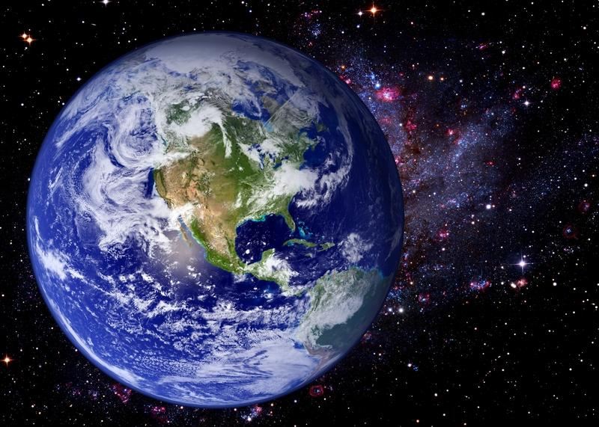
Gravitational Potential Energy
Intro
Notes:
Today we will be learning about gravitational potential energy.

Slide 75
Big Question: What is the relationship between kinetic energy and potential energy?
Kinetic Energy
Kinetic Energy
Notes:
Our “big question” is: What relationships between kinetic and potential energy?
[Pause and illicit predictions from students.]
I love all these thoughtful scientific hypotheses! Be sure to keep this question and your predictions in mind as we move through these next few lessons, and we’ll continue to revisit it.

Slide 76
Demonstration
TEACHER DIRECTIONS:
Before: Ask students what they remember about potential energy. Have them hypothesize what they think gravitational potential energy is.
During: Have different objects with different masses (baseball, coin, toy, etc.). Have students hold the items at the same height and drop them. Ask students what they observed (what hit the ground first, did the heavier item fall quicker, etc.). Then take the same objects and drop them at the same time but at different heights. Ask students for their observations (you can continue to switch which items are dropped from which distance).
After: Tell students gravitational potential energy has to do with how high an object is, and they will learn more about potential gravitational energy in this lesson.
Notes:
Let’s do a quick demonstration that will help get our brains ready to think about gravitational potential energy, and how it relates to our big question.

Slide 77
Notes:
Now let’s pause for a moment to check your understanding.

Slide 78
When all of the objects were dropped from the same height, which one hit the ground first?
Notes:
When all of the objects were dropped from the same height, which on hit the ground first?

Slide 79
When objects were dropped from different heights, what variable(s) affect which item hit the ground first?
Notes:
When objects were dropped from different heights, what variable(s) affet which item hit the ground first?
Mass (how heavy the object was that was dropped)

Slide 80
What do you predict gravitational potential energy is based on this demonstration?
Notes:
What do you predict gravitational potential energy is based on this demonstration?

Slide 81
Notes:
Before we move on to our new vocabulary term, let’s review some other words & concepts that you already learned and make sure you are firm in your understanding.

Slide 82
Atom: smallest whole unit of matter
Atom
Atom
Atom
Atom
Atom
Notes:
Remember that an atom is the smallest whole unit of matter.

Slide 83
Nucleus: the center of the atom that is made up of protons and neutrons
Notes:
The nucleus is the center of the atom that is made up of protons and neutrons.

Slide 84
Protons: positively charged subatomic particles found in the nucleus of an atom
Proton
Notes:
We will be learning about protons which are positively charged subatomic particles found in the nucleus of an atom.

Slide 85
Neutrons: subatomic particles with no charge (neutral charge) found in the nucleus of atoms
Neutron
Notes:
We are going to talk about neutrons, which are subatomic particles with no charge (neutral charge) found in the nucleus of atoms.

Slide 86
Mass: a type of measurement that tells us how much matter is in an object
Notes:
We have also learned about mass. Remember that mass is the measurement of the matter in an object.
When most people think about mass, they also think about weight. Remember that mass and weight are different.
The mass of an object is a measure of the amount of matter in the object, but weight is a measure of the force (or how gravity pulls) on an object. So, for example, weight on Earth and Mars is different because the gravitational pull changes, but mass is always the same.

Slide 87
Energy: the ability to cause change
Notes:
Energy is the ability to cause change.

Slide 88
Gravity: force that exists between all objects with mass
Notes:
Gravity is a force the exists between all objects with mass. This is why apples fall to the earth. They are being pulled in by the earth's gravity.

Slide 89
Chemical Change: rearranges the atoms in the original substance to make a new substance.
Notes:
A chemical change rearranges the atoms in the original substance to make a new substance.

Slide 90
Chemical Reaction: made up of chemical changes that happen when two or more elements are combined
Notes:
A chemical reaction is made up of chemical changes that happen when two or more elements are combined.

Slide 91
Potential energy: stored energy
Notes:
Potential energy is stored energy.

Slide 92
Notes:
Now let’s pause for a moment to check your understanding.

Slide 93
What is found in the nucleus of an atom?
Notes:
What is found in the nucleus of an atom?
Protons and neutrons

Slide 94
What does mass tell us about an object?
Notes:
What does mass tell us about an object?
It tells us how much matter is in an object.

Slide 95
What is energy?
Notes:
What is energy?
The ability to cause change

Slide 96
What is the relationship between gravity and mass?
Notes:
What is the relationship between gravity and mass?
Gravity is a force that exists between all objects with mass.

Slide 97
What is the difference between a chemical change and chemical reaction?
Notes:
What is the difference between a chemical change and chemical reaction?

Slide 98
What is potential energy?
Notes:
What is potential energy?
Potential energy is stored energy.

Slide 99
Gravitational Potential Energy
Notes:
Now, let’s look at gravitational potential energy, which is the first type of potential energy we are going to look at.

Slide 100
Gravitational Potential Energy: energy stored because of an object’s position or height above Earth’s surface
Notes:
Gravitational potential energy is energy stored because of an object’s position or height above earth’s surface.

Slide 101
Notes:
That is the basic definition, but there is a bit more you need to know.

Slide 102
Gravitational potential energy depends on the object’s:
MASS
Notes:
The amount of gravitational potential energy an object has depends on its mass,

Slide 103
Gravitational potential energy depends on the object’s:
MASS
DISTANCE
Notes:
and its distance from the Earth.

Slide 104
Notes:
Now let’s pause for a moment to check your understanding.

Slide 105
What is gravitational potential energy?
Notes:
What is gravitational potential energy?
Gravitational potential energy is energy stored because of an object’s position or height above earth’s surface.

Slide 106
What two things does gravitational potential energy depend on?
Notes:
What two things does gravitational potential energy depend on?
An object’s mass and distance

Slide 107
Notes:
Now, let’s look at an example of gravitational potential energy.

Slide 108
Notes:
Here there is gravitational potential energy.

Slide 109
Mass
Notes:
There is gravitational potential energy because the apple and earth have mass.

Slide 110
Distance
Notes:
There is gravitational potential energy because the apple is “x” distance from the earth.

Slide 111
Notes:
As the apple begins to fall, it loses potential energy because it is closer to the ground.

Slide 112
Notes:
Holding weights in the air is another example of gravitational potential energy. The weights and the ground both have mass. There is gravitational potential energy because the weight is “x” distance from the earth. If the weight is dropped, it loses potential energy because it then falls to the ground.

Slide 113
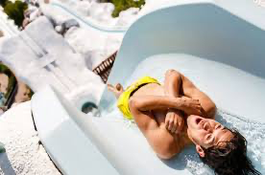
Notes:
If you are at the top of a water slide, you have potential energy. You and the earth both have mass, and because you are at the top of the water slide, you are a certain distance from earth. As you go down the waterslide, you lose potential energy because you are getting closer to earth by going down the slide.

Slide 114
Notes:
Now let’s pause for a moment to check your understanding.

Slide 115
Why is holding weights an example of gravitational potential energy?
Notes:
Why is holding weights an example of gravitational potential energy?
Holding weights in the air is another example of gravitational potential energy. The weights and the ground both have mass. There is gravitational potential energy because the weight is “x” distance from the earth. If the weight is dropped, it loses potential energy because it then falls to the ground.

Slide 116
Is being at the top of a water slide an example of gravitational potential energy? Explain.
Notes:
Is being at the top of a water slide an example of gravitational potential energy? Explain.
If you are at the top of a water slide, you have gravitational potential energy. You and the earth both have mass, and because you are at the top of the water slide, you are a certain distance from earth. As you go down the waterslide, you lose potential energy because you are getting closer to earth by going down the slide.

Slide 117
Give your own example of gravitational potential energy.
Notes:
Give your own example of gravitational potential energy?

Slide 118
Notes:
Next, let’s talk about some a non-example of gravitational potential energy.

Slide 119
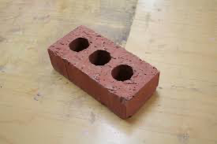
Notes:
The brick on the ground does not have gravitational potential energy. It does not because it is NOT above the Earth’s surface. The only way for something to have gravitational potential energy is if it has both mass and is some distance above Earth’s surface.

Slide 120
Notes:
Now let’s pause for a moment to check your understanding.

Slide 121
What is gravitational potential energy?
Notes:
What is gravitational potential energy?
Gravitational potential energy is energy stored because of an object’s position or height above earth’s surface.

Slide 122
Explain why this brick does not have gravitational potential energy.
Notes:
Explain why this brick does not have gravitational potential energy.
The brick on the ground does not have gravitational potential energy. It does not because it is NOT above the Earth’s surface. The only way for something to have gravitational potential energy is if it has both mass and is some distance above Earth’s surface.

Slide 123
Notes:
Now let’s pause for a moment to check your understanding.

Slide 124
What is potential energy?
Notes:
What is potential energy?
Stored energy

Slide 125
Why would the water flowing from a broken dam not be potential energy?
Potential
Energy
Notes:
Why would the water flowing from a broken dam not be potential energy?
Potential energy is stored energy, but once the dam is broken, the energy is released and is no longer potential energy.

Slide 126
What is gravitational potential energy?
Notes:
What is gravitational potential energy?
Gravitational potential energy is energy stored because of an object’s position or height above earth’s surface.

Slide 127
What two things does gravitational potential energy depend on?
Notes:
What two things does gravitational potential energy depend on?
Mass and distance

Slide 128
Think of your own example of gravitational potential energy.
Notes:
Think of your own example of gravitational potential energy.

Slide 129
Remember!!!
Notes:
So remember!

Slide 130
Gravitational Potential Energy: energy stored because of an object’s position or height above Earth’s surface
Notes:
Gravitational potential energy is energy stored because of an object’s position or height above earth’s surface.

Slide 131
Big Question: What is the relationship between kinetic energy and potential energy?
Kinetic Energy
Kinetic Energy
Notes:
Our “big question” is: What relationships between kinetic and potential energy?
Based on what we learned about gravitational potential energy, how did our hypotheses change/how can we add to them? How does this help us answer our big question?

Slide 132
Simulation Activity
Potential Energy Gizmo
Click the link above to explore more about gravitational potential energy.
In this simulation activity, you’ll use the bar chart to observe how the potential energy of different objects changes as you move them. Think about, for example, what causes the ball to have higher potential energy than the paper clips, even when the paperclips are higher.

Slide 133
Notes:
Thanks for watching, and please continue watching CAPs available from this website.

Slide 134
This Video Created With Resources From:
Questions or Comments
Michael Kennedy, Ph.D. MKennedy@Virginia.edu
Rachel L Kunemund, Ph.D. rk8vm@virginia.edu

Slide 135
Intro
“Big Idea” Question
Review Concepts
Check-In Questions
Teacher Demo
Vocabulary
Student-Friendly Definition
Examples & Non-Examples
Morphological Word Parts
Simulation/Activity
Notes:
OK everyone, get ready for our next lesson. Just as a reminder, these are the different components that our lesson may include, and you’ll see these icons in the top left corner of each slide so that you can follow along more easily!

Slide 136
Chemical Energy
Intro
Notes:
Today we will be learning about chemical energy.

Slide 137
Big Question: What is the relationship between kinetic energy and potential energy?
Kinetic Energy
Kinetic Energy
Notes:
Our “big question” is: What relationships between kinetic and potential energy?
[Pause and illicit predictions from students.]
I love all these thoughtful scientific hypotheses! Be sure to keep this question and your predictions in mind as we move through these next few lessons, and we’ll continue to revisit it.

Slide 138
Demonstration
Chemical Energy in a Bottle
Materials: balloon, 1 liter bottle, plastic spoon, funnel, vinegar, baking soda goggle
Set up the demonstration for class ahead of time. Perform the demonstration for students and lead them in questioning afterwards.
Notes:
Not all terms will have a demonstration, if you want to add a demonstration, you can insert one here.

Slide 139
Notes:
Now let’s pause for a moment to check your understanding.

Slide 140
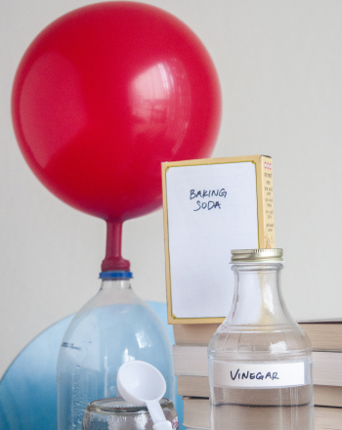
What kind of energy is released?
Notes:
What kind of energy is released?

Slide 141
Notes:
Before we move on to our new vocabulary term, let’s review some other words & concepts that you already learned and make sure you are firm in your understanding.

Slide 142
Atom: smallest whole unit of matter
Atom
Atom
Atom
Atom
Atom
Notes:
Remember that an atom is the smallest whole unit of matter.

Slide 143
Nucleus: the center of the atom that is made up of protons and neutrons
Notes:
The nucleus is the center of the atom that is made up of protons and neutrons.

Slide 144
Protons: positively charged subatomic particles found in the nucleus of an atom
Proton
Notes:
We will be learning about protons which are positively charged subatomic particles found in the nucleus of an atom.

Slide 145
Neutrons: subatomic particles with no charge (neutral charge) found in the nucleus of atoms
Neutron
Notes:
We are going to talk about neutrons, which are subatomic particles with no charge (neutral charge) found in the nucleus of atoms.

Slide 146
Mass: a type of measurement that tells us how much matter is in an object
Notes:
We have also learned about mass. Remember that mass is the measurement of the matter in an object.
When most people think about mass, they also think about weight. Remember that mass and weight are different.
The mass of an object is a measure of the amount of matter in the object, but weight is a measure of the force (or how gravity pulls) on an object. So, for example, weight on Earth and Mars is different because the gravitational pull changes, but mass is always the same.

Slide 147
Energy: the ability to cause change
Notes:
Energy is the ability to cause change.

Slide 148
Gravity: force that exists between all objects with mass
Notes:
Gravity is a force the exists between all objects with mass. This is why apples fall to the earth. They are being pulled in by the earth's gravity.

Slide 149
Chemical Change: rearranges the atoms in the original substance to make a new substance
Notes:
A chemical change rearranges the atoms in the original substance to make a new substance.

Slide 150
Chemical Reaction: made up of chemical changes that happen when two or more elements are combined
Notes:
A chemical reaction is made up of chemical changes that happen when two or more elements are combined.

Slide 151
Potential energy: stored energy
Notes:
Potential energy is stored energy.

Slide 152
Gravitational Potential Energy: energy stored because of an object’s position or height above Earth’s surface
Notes:
Gravitational potential energy is energy stored because of an object’s position or height above earth’s surface.

Slide 153
Notes:
Now let’s pause for a moment to check your understanding.

Slide 154
What is found in the nucleus of an atom?
Notes:
What is found in the nucleus of an atom?
Protons and neutrons

Slide 155
What does mass tell us about an object?
Notes:
What does mass tell us about an object?
It tells us how much matter is in an object.

Slide 156
What is energy?
Notes:
What is energy?
The ability to cause change

Slide 157
What is the relationship between gravity and mass?
Notes:
What is the relationship between gravity and mass?
Gravity is a force that exists between all objects with mass.

Slide 158
What is the difference between a chemical change and chemical reaction?
Notes:
What is the difference between a chemical change and chemical reaction?

Slide 159
What is potential energy?
Notes:
What is potential energy?
Potential energy is stored energy.

Slide 160
How is gravitational energy stored?
Notes:
How is gravitational energy stored?
Gravitational potential energy is energy stored because of an object’s position or height above earth’s surface

Slide 161
Chemical Energy
Notes:
Now that we’ve reviewed, let’s define our new term, chemical energy, which is another type of potential energy.

Slide 162
Chemical Energy: energy stored in the bonds of chemical compounds, like atoms and molecules
Notes:
Chemical energy is energy stored in the bonds of chemical compounds like atoms and molecules.

Slide 163
Notes:
That is the basic definition, but there is a bit more you need to know.

Slide 164
Bonds
Notes:
Bonds between molecules or compounds must be present for chemical energy to exist. Bonds store and release energy.

Slide 165
Formed Bond = Energy Stored
Notes:
If a bond is formed, energy is stored.

Slide 166
Broken Bond = Energy Released
Notes:
If a bond is broken, energy is released.

Slide 167
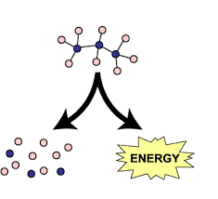
Chemical Reaction = energy released
Notes:
When a Chemical reaction happens, chemical energy is released.

Slide 168
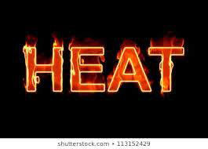
Notes:
Heat is often the product of a chemical reaction

Slide 169
Notes:
Now let’s pause for a moment to check your understanding.

Slide 170
What is chemical energy?
Notes:
What is chemical energy?
Chemical energy is energy stored in the bonds of chemical compounds like atoms and molecules.

Slide 171
What happens if bonds are broken?
Notes:
What happens if bonds are broken?
If a bond is broken, energy is released.

Slide 172
If bonds are broken, a chemical reaction happens and _______ is released.
Notes:
If bond are broken, chemical reaction happens and chemical energy is released.

Slide 173
What is often the product of a chemical reaction?
Notes:
What is often the product of a chemical reaction?
Heat

Slide 174
Notes:
Let’s look at some examples of chemical energy.

Slide 175
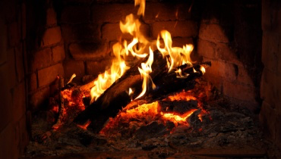
Energy released
Chemical energy stored
Bonds broken
Notes:
Dry wood has stored chemical energy. When the wood is burned, chemical energy is released (bonds are broken) and turned into heat. We know a chemical reaction has taken place because the wood has turned into ash (a new substance).

Slide 176
We need chemical energy!
Notes:
Our food contains chemical energy! The bonds in food contain chemical energy. When we breakdown food, The bonds in the food are broken and a chemical reaction takes place causing the chemical energy to be released. The energy from the food helps to keep us warm (heat from the reaction), helps us move, and allows us to grow.

Slide 177
Notes:
Now let’s pause for a moment to check your understanding.

Slide 178
How do we know dry wood has stored chemical energy?
Chemical energy stored
Notes:
How do we know dry wood has stored chemical energy?
Dry wood has stored chemical energy. When the wood is burned, chemical energy is released (bonds are broken) and turned into heat. We know a chemical reaction has taken place because the wood has turned into ash (a new substance).

Slide 179
How do we know that our food has stored chemical energy?
Notes:
How do we know that our food has stored chemical energy?
Our food contains chemical energy! The bonds in food contain chemical energy. When we breakdown food, The bonds in the food are broken and a chemical reaction takes place causing the chemical energy to be released. The energy from the food helps to keep us warm (heat from the reaction), helps us move, and allows us to grow.

Slide 180
Notes:
Now let’s look at some non-examples of chemical energy.

Slide 181
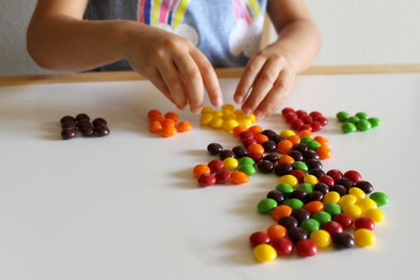
Notes:
Separating a mixture skittles by color does not not release any chemical energy because there were no bonds holding them together.

Slide 182
Notes:
Let’s check-in for understanding.

Slide 183
What is potential energy?
Notes:
What is potential energy?
Stored energy

Slide 184
What is chemical energy?
Notes:
What is chemical energy?
Energy stored in the bonds of chemical compounds, like atoms and molecules.

Slide 185
What is created when chemical energy is released?
Notes:
What is create when chemical energy is released?
When chemical energy is released, a chemical reaction happens, which also causes heat to be released.

Slide 186
Why do we need chemical energy?
Notes:
Why do we need chemical energy?
Our bodies break down the energy and use the energy to help keep us warm, move, and grow.

Slide 187
What is gravitational potential energy?
Notes:
What is gravitational potential energy?
Gravitational potential energy is energy stored because of an object’s position or height above earth’s surface.

Slide 188
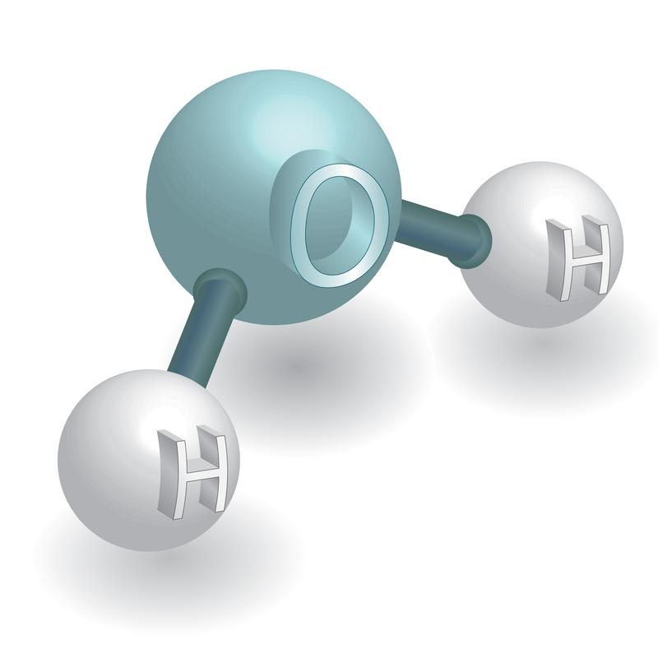
How are gravitational potential energy and chemical energy similar?
Notes:
How are gravitational potential energy and chemical energy similar?
They both are types of stored (or potential) energy.

Slide 189
Remember!!!
Notes:
So remember!

Slide 190
Chemical Energy: energy stored in the bonds of chemical compounds, like atoms and molecules
Notes:
Chemical energy is energy stored in the bonds of chemical compounds, like atoms and molecules.

Slide 191
Big Question: What is the relationship between kinetic energy and potential energy?
Kinetic Energy
Kinetic Energy
Notes:
Our “big question” is: What relationships between kinetic and potential energy?
Based on what we learned about chemical energy how did our hypotheses change? What can we add to them? How does this help us answer our big question?

Slide 192
Notes:
Thanks for watching, and please continue watching CAPs available from this website.

Slide 193
This Video Created With Resources From:
Questions or Comments
Michael Kennedy, Ph.D. MKennedy@Virginia.edu
Rachel L Kunemund, Ph.D. rk8vm@virginia.edu

Slide 194
Intro
“Big Idea” Question
Review Concepts
Check-In Questions
Teacher Demo
Vocabulary
Student-Friendly Definition
Examples & Non-Examples
Morphological Word Parts
Simulation/Activity
Notes:
OK everyone, get ready for our next lesson. Just as a reminder, these are the different components that our lesson may include, and you’ll see these icons in the top left corner of each slide so that you can follow along more easily!

Slide 195
Nuclear Energy
Intro
Notes:
Today we will be learning about nuclear energy.

Slide 196
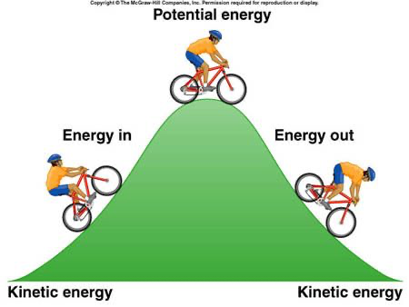
Big Question: What is the relationship between kinetic energy and potential energy?
Notes:
Our “big question” is: What relationships between kinetic and potential energy?
[Pause and illicit predictions from students.]
I love all these thoughtful scientific hypotheses! Be sure to keep this question and your predictions in mind as we move through these next few lessons, and we’ll continue to revisit it.

Slide 197
Notes:
Before we move on to our new vocabulary term, let’s review some other words & concepts that you already learned and make sure you are firm in your understanding.

Slide 198
Atom: smallest whole unit of matter
Atom
Atom
Atom
Atom
Atom
Notes:
Remember that an atom is the smallest whole unit of matter.

Slide 199
Nucleus: the center of the atom that is made up of protons and neutrons
Notes:
The nucleus the center of the atom that is made up of protons and neutrons.

Slide 200
Protons: positively charged subatomic particles found in the nucleus of an atom
Proton
Notes:
We will be learning about protons which are positively charged subatomic particles found in the nucleus of an atom.

Slide 201
Neutrons: subatomic particles with no charge (neutral charge) found in the nucleus of atoms
Neutron
Notes:
We are going to talk about neutrons, which are subatomic particles with no charge (neutral charge) found in the nucleus of atoms.

Slide 202
Mass: a type of measurement that tells us how much matter is in an object
Notes:
We have also learned about mass. Remember that mass is the measurement of the matter in an object.
When most people think about mass, they also think about weight. Remember that mass and weight are different.
The mass of an object is a measure of the amount of matter in the object, but weight is a measure of the force (or how gravity pulls) on an object. So, for example, weight on Earth and Mars is different because the gravitational pull changes, but mass is always the same.

Slide 203
Energy: the ability to cause change
Notes:
Energy is the ability to cause change.

Slide 204
Gravity: force that exists between all objects with mass
Notes:
Gravity is a force the exists between all objects with mass. This is why apples fall to the earth. They are being pulled in by the earth's gravity.

Slide 205
Chemical Change: rearranges the atoms in the original substance to make a new substance
Notes:
A chemical change rearranges the atoms in the original substance to make a new substance.

Slide 206
Chemical Reaction: made up of chemical changes that happen when two or more elements are combined
Notes:
A chemical reaction is made up of chemical changes that happen when two or more elements are combined.

Slide 207
Potential energy: stored energy
Notes:
Potential energy is stored energy.

Slide 208
Gravitational Potential Energy: energy stored because of an object’s position or height above Earth’s surface
Notes:
Gravitational potential energy is energy stored because of an object’s position or height above earth’s surface.

Slide 209
Chemical Energy: energy stored in the bonds of chemical compounds, like atoms and molecules
Notes:
Gravitational potential energy is the energy an object has because of its position in a gravitational field.

Slide 210
Notes:
Now let’s pause for a moment to check your understanding.

Slide 211
What is found in the nucleus of an atom?
Notes:
What is found in the nucleus of an atom?
Protons and neutrons

Slide 212
What does mass tell us about an object?
Notes:
What does mass tell us about an object?
It tells us how much matter is in an object.

Slide 213
What is energy?
Notes:
What is energy?
The ability to cause change

Slide 214
What is the relationship between gravity and mass?
Notes:
What is the relationship between gravity and mass?
Gravity is a force that exists between all objects with mass.

Slide 215
What is the difference between a chemical change and chemical reaction?
Notes:
What is the difference between a chemical change and chemical reaction?

Slide 216
What is potential energy?
Notes:
What is potential energy?
Potential energy is stored energy.

Slide 217
How is gravitational energy stored?
Notes:
How is gravitational energy stored?
Gravitational potential energy is energy stored because of an object’s position or height above earth’s surface

Slide 218
What is chemical energy?
Notes:
What is chemical energy?
Chemical energy is energy stored in the bonds of chemical compounds like atoms and molecules

Slide 219
Nuclear Energy
Notes:
Now that we’ve reviewed, let’s define our new term, nuclear energy.

Slide 220
Nuclear Energy: energy stored in the nucleus of an atom
Notes:
Nuclear energy is energy stored in the nucleus of an atom.

Slide 221
Notes:
That is the basic definition, but there is a bit more you need to know.

Slide 222
Notes:
Nuclear energy holds the nucleus of an atom together. It keeps protons and neutrons next to each other.

Slide 223
Notes:
Now let’s pause for a moment to check your understanding.

Slide 224
What is nuclear energy?
Notes:
What is nuclear energy?
Nuclear energy is energy stored in the nucleus of an atom.

Slide 225
What is the function of nuclear energy in an atom?
Notes:
What is the function of nuclear energy in an atom?
Nuclear energy holds the nucleus of an atom together. It keeps protons and neutrons next to each other.

Slide 226
Notes:
Now, let’s look at an example of nuclear energy.

Slide 227
Notes:
Nuclear energy can be extremely explosive when used. The sun is powered by nuclear energy, so the sun is one example of how we can see nuclear energy.

Slide 228
Notes:
Now let’s pause for a moment to check your understanding.

Slide 229
How can we see nuclear energy?
Notes:
How can we see nuclear energy?
Nuclear energy can be extremely explosive when used. The sun is powered by nuclear energy, so the sun is one example of how we can see nuclear energy.

Slide 230
Notes:
Let’s look at some non-examples of nuclear energy.

Slide 231
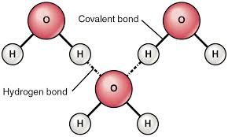
Notes:
The energy stored in molecules is an example of chemical energy not nuclear energy.

Slide 232
Notes:
Let's look at the word parts for nuclear and nucleus to help remember what nuclear energy means.

Slide 233
Nuclear
Nucleus
Notes:
Here we can see how the word ”nuclear” comes from the word “nucleus.” This helps us remember that nuclear energy is stored in the nucleus of atoms.

Slide 234
Notes:
Let’s check-in for understanding.

Slide 235
Nuclear
How does the word nucleus help us remember what nuclear energy is?
Nucleus
Notes:
How does the word nucleus help us remember what nuclear energy is?
Here we can see how the word ”nuclear” comes from the word “nucleus.” This helps us remember that nuclear energy is stored in the nucleus of atoms.

Slide 236
Notes:
Let’s review what we have learned so far.

Slide 237
What is potential energy?
Notes:
What is potential energy?
Stored energy

Slide 238
What is nuclear energy?
Notes:
What is nuclear energy?
Nuclear energy is energy stored in the nucleus of an atom.

Slide 239
How are nuclear energy and chemical energy different?
Notes:
How are nuclear energy and chemical energy different?
Nuclear energy is energy stored in the nucleus of an atom, but chemical energy is energy stored in the bonds of chemical compounds.

Slide 240
How are gravitational potential energy, nuclear energy, and chemical energy related?
Notes:
How are gravitational potential energy, nuclear energy, and chemical energy related?
They are all ways energy is stored, meaning they are all types of potential energy.

Slide 241
Remember!!!
Notes:
So remember!

Slide 242
Nuclear Energy: energy stored in the nucleus of an atom
Notes:
Nuclear energy is energy stored in the nucleus of an atom.

Slide 243
Big Question: What is the relationship between kinetic energy and potential energy?
Kinetic Energy
Kinetic Energy
Notes:
Our “big question” is: What relationships between kinetic and potential energy?
Explicit cue to revisit the big question at the end of the lesson: Okay everyone. Now that we’ve learned the term, potential energy (and the three different types), let’s reflect once more on our big question. Was there anything that we predicted earlier that was correct or incorrect? Do you have any new hypotheses to share?

Slide 244
Notes:
Thanks for watching, and please continue watching CAPs available from this website.

Slide 245
This Video Created With Resources From:
Questions or Comments
Michael Kennedy, Ph.D. MKennedy@Virginia.edu
Rachel L Kunemund, Ph.D. rk8vm@virginia.edu

Slide 246
Intro
“Big Idea” Question
Review Concepts
Check-In Questions
Teacher Demo
Vocabulary
Student-Friendly Definition
Examples & Non-Examples
Morphological Word Parts
Simulation/Activity
Notes:
OK everyone, get ready for our next lesson. Just as a reminder, these are the different components that our lesson may include, and you’ll see these icons in the top left corner of each slide so that you can follow along more easily!

Slide 247
Kinetic Energy
Intro
Notes:
Today we will be learning about kinetic energy.

Slide 248
Big Question: What is the relationship between kinetic energy and potential energy?
Kinetic Energy
Kinetic Energy
Notes:
Our “big question” is: What relationships between kinetic and potential energy?
[Pause and illicit predictions from students.]
What are our hypothesis so far? What changed in our thinking?

Slide 249
Demonstration
Potential & Kinetic Energy Marble Roller Coaster
TEACHER DIRECTIONS:
Before viewing, ask students to recall what they already know about energy.
After viewing, ask students to share observations, relating those observations back to what they know about energy. Tell students that the marble rolling down the inclined surface represents two different kinds of energy: potential and kinetic. Today we will be focusing on kinetic energy.
You can set up the materials – all you need is a marble an an inclined plane. Set up an inclined surface and roll the marble down the plane. *You can also change the size of the marble/the incline of the plane the marble rolls on to have students make observations about these changes (i.e. does the bigger marble go faster slower, etc.).
Notes:
Let’s do a quick demonstration that will help get our brains ready to think about kinetic energy, and how it relates to our big question.

Slide 250
Notes:
Now let’s pause for a moment to check your understanding.

Slide 251
When the marble is at the top of the plane and not moving, what type of energy does it have?
Notes:
When the marble is at the top of the plane and not moving, what type of energy does it have?
Gravitational potential energy because it is at a height above the earth’s surface and has mass.

Slide 252
What type of energy do you think the marble has when it is pushed and starts to roll down the plane?
Notes:
What type of energy do you think the marble has when it is pushed and starts to roll down the plane?
Kinetic energy because the potential energy was released when the marble was pushed.

Slide 253
Do you think changing the size of the marbles will affect the kinetic energy? Explain.
Notes:
Do you think changing the size of the marbles will affect the kinetic energy? Explain.

Slide 254
Notes:
Before we move on to our new vocabulary term, let’s review some other words & concepts that you already learned and make sure you are firm in your understanding.

Slide 255
Energy: the ability to cause change
Notes:
Energy is the ability to cause change.

Slide 256
Potential energy: stored energy
Notes:
Potential energy is stored energy.

Slide 257
Energy
Potential Energy
Chemical
Energy
Nuclear
Energy
Gravitational Potential
Energy
Notes:
There are three types of potential energy, so we are going to look at each type of potential or stored energy. First, we are going to look at gravitational potential energy.

Slide 258
Gravitational Potential Energy: energy stored because of an object’s position or height above Earth’s surface
Notes:
Gravitational potential energy is energy stored because of an object’s position or height above earth’s surface.

Slide 259
Chemical Energy: energy stored in the bonds of chemical compounds, like atoms and molecules
Notes:
Chemical energy is energy stored in the bonds of chemical compounds, like atoms and molecules.

Slide 260
Nuclear Energy: energy stored in the nucleus of an atom
Notes:
Nuclear energy is energy stored in the nucleus of an atom.

Slide 261
Mass: a type of measurement that tells us how much matter is in an object
Notes:
We have also learned about mass. Remember that mass is the measurement of the matter in an object.
When most people think about mass, they also think about weight. Remember that mass and weight are different.
The mass of an object is a measure of the amount of matter in the object, but weight is a measure of the force (or how gravity pulls) on an object. So, for example, weight on Earth and Mars is different because the gravitational pull changes, but mass is always the same.

Slide 262
Notes:
Now let’s pause for a moment to check your understanding.

Slide 263
What is energy?
Notes:
What is energy?
Energy is the ability to cause change.

Slide 264
What is potential energy?
Notes:
What is potential energy?
Potential energy is stored energy.

Slide 265
Energy
Potential Energy
Notes:
What are the three types of potential energy?
Gravitational potential energy
Nuclear Energy
Chemical Energy

Slide 266
What is gravitational potential energy?
Notes:
What is gravitational potential energy?
Gravitational potential energy is energy stored because of an object’s position or height above earth’s surface

Slide 267
How are nuclear energy and chemical energy different?
Notes:
How are nuclear energy and chemical energy different?
Nuclear energy is energy stored in the nucleus of an atom, but chemical energy is energy stored in the bonds of chemical compounds.

Slide 268
Kinetic Energy
Notes:
Now that we’ve reviewed, let’s define our new term, kinetic energy.

Slide 269
Kinetic Energy: energy of mass in motion
Notes:
Kinetic energy is energy from motion.

Slide 270
Notes:
That is the basic definition, but there is a bit more you need to know.

Slide 271
Notes:
Here, kinetic energy is shown in the bowling ball.

Slide 272
mass
Notes:
Kinetic energy is measured by mass,

Slide 273
speed
Notes:
and speed. The kinetic energy is the energy being released when the bowling ball is thrown. It has mass, and is moving (speed) so a bowling ball rolling down to hit the pins is kinetic energy.

Slide 274
Notes:
Now let’s pause for a moment to check your understanding.

Slide 275
What is kinetic energy?
Notes:
What is kinetic energy?
Kinetic energy is energy from motion.

Slide 276
How is kinetic energy measured?
?
Notes:
How is kinetic energy measured?
Kinetic energy is measured by mass and speed.

Slide 277
Notes:
Now, let’s look at some examples of kinetic energy.

Slide 278
Notes:
When you are on a roller coaster and you reach the top of the hill, you start to go down. When you are going down the hill, that is kinetic energy. The roller coaster cars have mass, and is going down the hill at a certain speed, so kinetic energy is being released.

Slide 279
Notes:
An arrow that is shot from a bow is also an example of kinetic energy. The arrow has mass and is traveling to the target at a certain speed, so we know that kinetic energy has been released.

Slide 280
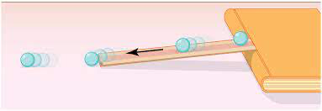
Notes:
Let’s think back to our demonstration. A marble rolling down an inclined plane is also an example of kinetic energy. This is because the marble has mass and is traveling at a certain speed.

Slide 281
Notes:
Now let’s pause for a moment to check your understanding.

Slide 282
Why is going downhill on a roller coaster an example of kinetic energy?
Notes:
Why is going downhill on a roller coaster an example of kinetic energy?
When you are on a roller coaster and you reach the top of the hill, you start to go down. When you are going down the hill, that is kinetic energy. The roller coaster cars have mass, and is going down the hill at a certain speed, so kinetic energy is being released.

Slide 283
Is an arrow that is shot from a bow an example of kinetic energy? Explain.
Notes:
Is an arrow that is shot from a bow an example of kinetic energy? Explain.
An arrow that is shot from a bow is also an example of kinetic energy. The arrow has mass and is traveling to the target at a certain speed, so we know that kinetic energy has been released.

Slide 284
Think of your own example of gravitational kinetic energy.
Notes:
Think of your own example of gravitational kinetic energy.

Slide 285
Notes:
Next, let’s talk about some non-examples of kinetic energy.

Slide 286
Notes:
Waiting to go down a waterslide is NOT an example of potential energy. You do have mass but you are not moving so you do not have speed, so there is no kinetic energy.

Slide 287
Notes:
The brick on the ground does not have kinetic energy. It does have mass but it does not have speed so it is not an example of potential kinetic energy.

Slide 288
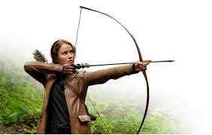
Notes:
Drawing back a bow and arrow is also NOT kinetic energy. They have mass but there is no speed. Drawing back a bow and arrow is an example of potential energy. When the energy is released and the bow is moving in the air, that is kinetic energy.

Slide 289
Notes:
Now let’s pause for a moment to check your understanding.

Slide 290
Is being at the top of a waterslide an example of one of the types of potential energy or kinetic energy? Explain.
Notes:
Is being at the top of a waterslide an example of one of the types of potential energy or kinetic energy? Explain.
Waiting to go down a waterslide is NOT an example of kinetic energy. You do have mass but you are not moving so you do not have speed, so there is no kinetic energy.
What kind of energy is this? *allow students to respond: gravitational potential energy* (Give feedback as needed).

Slide 291
Does this brick have either potential or kinetic energy? Explain.
Notes:
Does this brick have either potential or kinetic energy? Explain.
The brick on the ground does not have kinetic energy (or potential energy). It does have mass but it does not have speed so it is not an example of potential kinetic energy.

Slide 292
Drawing back a bow and arrow is what type of energy?
Notes:
Drawing back a bow and arrow is what type of energy?
Drawing back a bow and arrow is also NOT kinetic energy. They have mass but there is no speed. Drawing back a bow and arrow is an example of potential energy. When the energy is released and the bow is moving in the air, that is kinetic energy.

Slide 293
Notes:
Let’s break down the word parts of kinetic to help us remember what kinetic energy means.

Slide 294
Kinetic Energy
to move
Notes:
The first part of kinetic comes from the Greek word “to move.”

Slide 295
Kinetic Energy
Suffix: pertaining to
Notes:
The suffix –ic means “of or pertaining to.”

Slide 296
Kinetic Energy
Pertaining to moving energy
Notes:
So, we can remember that kinetic energy involves movement. Think about how all of our examples involved speed. If something has speed, it is moving.

Slide 297
Notes:
Now let’s pause for a moment to check your understanding.

Slide 298
What does the root word “Kine” mean?
Kinetic Energy
?
Notes:
What does the root word “Kine” mean?
The first part of kinetic comes from the Greek word “to move.”

Slide 299
What does the suffix “-ic” mean?
Kinetic Energy
?
Notes:
What does the suffix “-ic” mean?
The suffix –ic means “of or pertaining to”

Slide 300
When we put the word parts of kinetic together, how does that help us remember what kinetic energy means?
Kinetic Energy
?
Notes:
When we put the word parts of kinetic together, how does that help us remember what kinetic energy means?
So, we can remember that kinetic energy involves movement. Think about how all of our examples involved speed. If something has speed, it is moving.

Slide 301
Notes:
Let’s review what we have learned.

Slide 302
What is kinetic energy?
Notes:
What is kinetic energy?
Kinetic energy is energy from motion.

Slide 303
What has to be present for an object to have kinetic energy?
Notes:
What has to be present for an object to have kinetic energy?
Mass and speed

Slide 304
What is the difference between kinetic and potential energy?
Notes:
What is the difference between kinetic and potential energy?
Potential energy is energy that is stored but kinetic energy is released energy. Kinetic energy must have mass and speed to be considered kinetic energy.
Feedback: Give students opportunities to demonstrate their understanding throughout the lesson. This assures that your students are able to understand the complicated formal definitions.

Slide 305
Remember!!!
Notes:
So remember!

Slide 306
Kinetic Energy: energy of mass in motion
Notes:
Kinetic energy is energy from motion.

Slide 307
Big Question: What is the relationship between kinetic energy and potential energy?
Kinetic Energy
Kinetic Energy
Notes:
Explicit cue to revisit the big question at the end of the lesson: Okay everyone now that we’ve learned the terms potential energy and kinetic energy, let’s reflect once more on our big question. Was there anything that we predicted earlier that was correct or incorrect? Do you have any new hypotheses to share? Since we’ve covered both of these terms at this point, are there any relationships between kinetic energy and potential energy that we haven’t thought of yet?

Slide 308
Simulation Activity
Roller Coaster Gizmo
Click the link above to explore more about kinetic energy.
In this simulation, you are changing the hills to make the car reach the egg without breaking it. How do we know this is kinetic energy? What are two important things you need to remember about kinetic energy?
Notes:
Remind students that with kinetic energy, you have to pay attention to both speed and mass. You can also relate this back to potential energy. Ask students why they thing potential energy is also going to effect the car.

Slide 309
Notes:
Thanks for watching, and please continue watching CAPs available from this website.

Slide 310
This Video Created With Resources From:
Questions or Comments
Michael Kennedy, Ph.D. MKennedy@Virginia.edu
Rachel L Kunemund, Ph.D. rk8vm@virginia.edu

