Slide 1
Intro
“Big Idea” Question
Review Concepts
Check-In Questions
Teacher Demo
Vocabulary
Student-Friendly Definition
Examples & Non-Examples
Morphological Word Parts
Simulation/Activity
Notes:
OK everyone, get ready for our next lesson. Just as a reminder, these are the different components that our lesson may include, and you’ll see these icons in the top left corner of each slide so that you can follow along more easily!

Slide 2
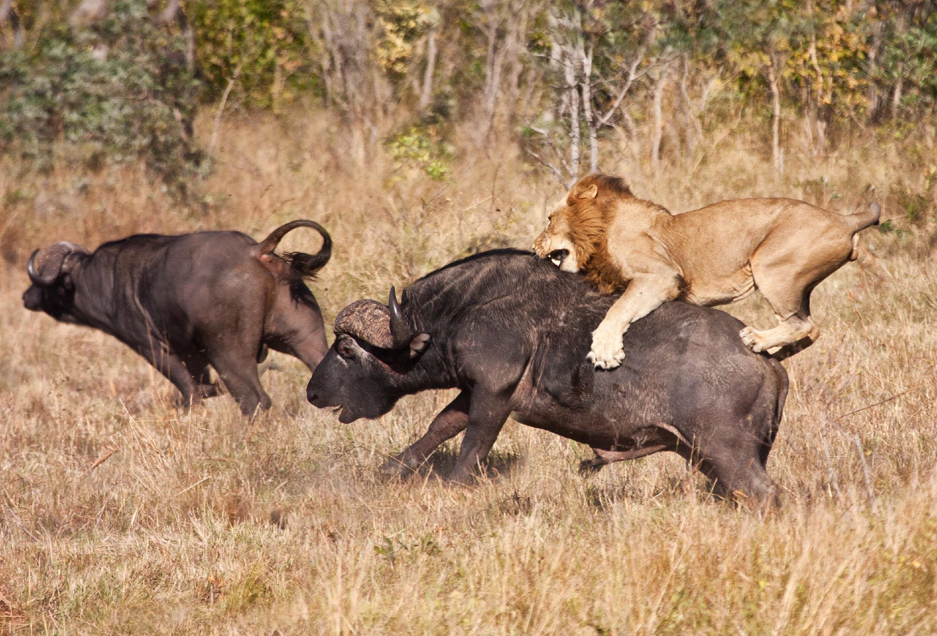
Predators and Prey
Notes:
Today we will learn about predators and prey.

Slide 3
Big Question: What factors characterize a predator-prey interaction and what types of organisms do we see take part in these interactions?
Notes:
Before we start, let’s think about our “big question”: What factors characterize a predator-prey interaction and what types of organisms do we see take part in these interactions?
[Pause and illicit predictions from students.]
I love all these thoughtful scientific hypotheses! Be sure to keep this question and your predictions in mind as we move through the lesson, and we’ll revisit it.

Slide 4
Notes:
Let’s review some other words & concepts that you already learned and make sure you are firm in your understanding.
Feedback: Cues are an important way to prepare students for what is coming next.

Slide 5
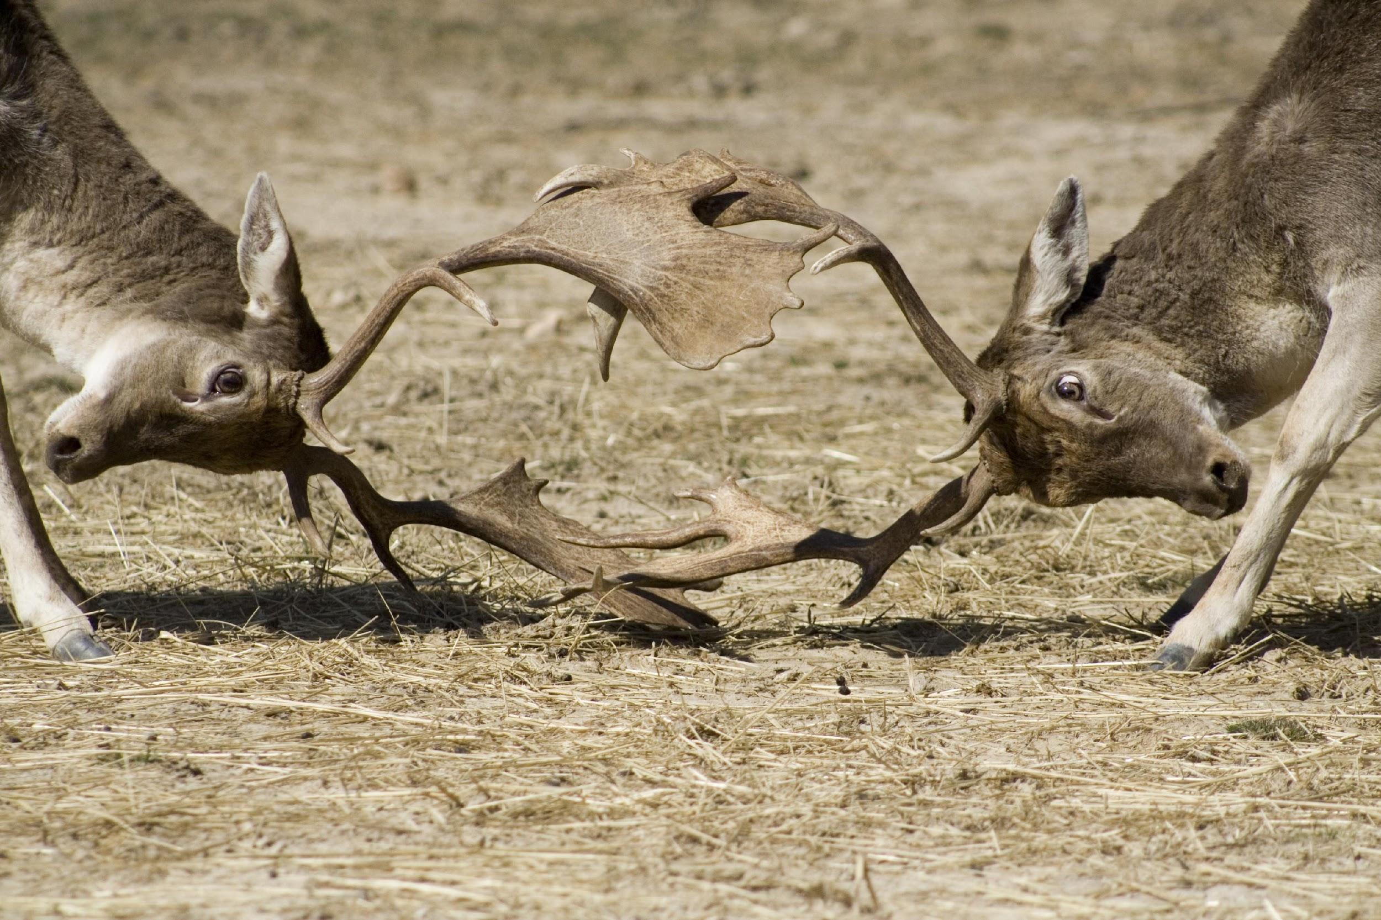
Competition: when individuals within a population try to use the same limited resources
Notes:
Competition is when individuals within a population try to use the same limited resources – they compete with one another.

Slide 6
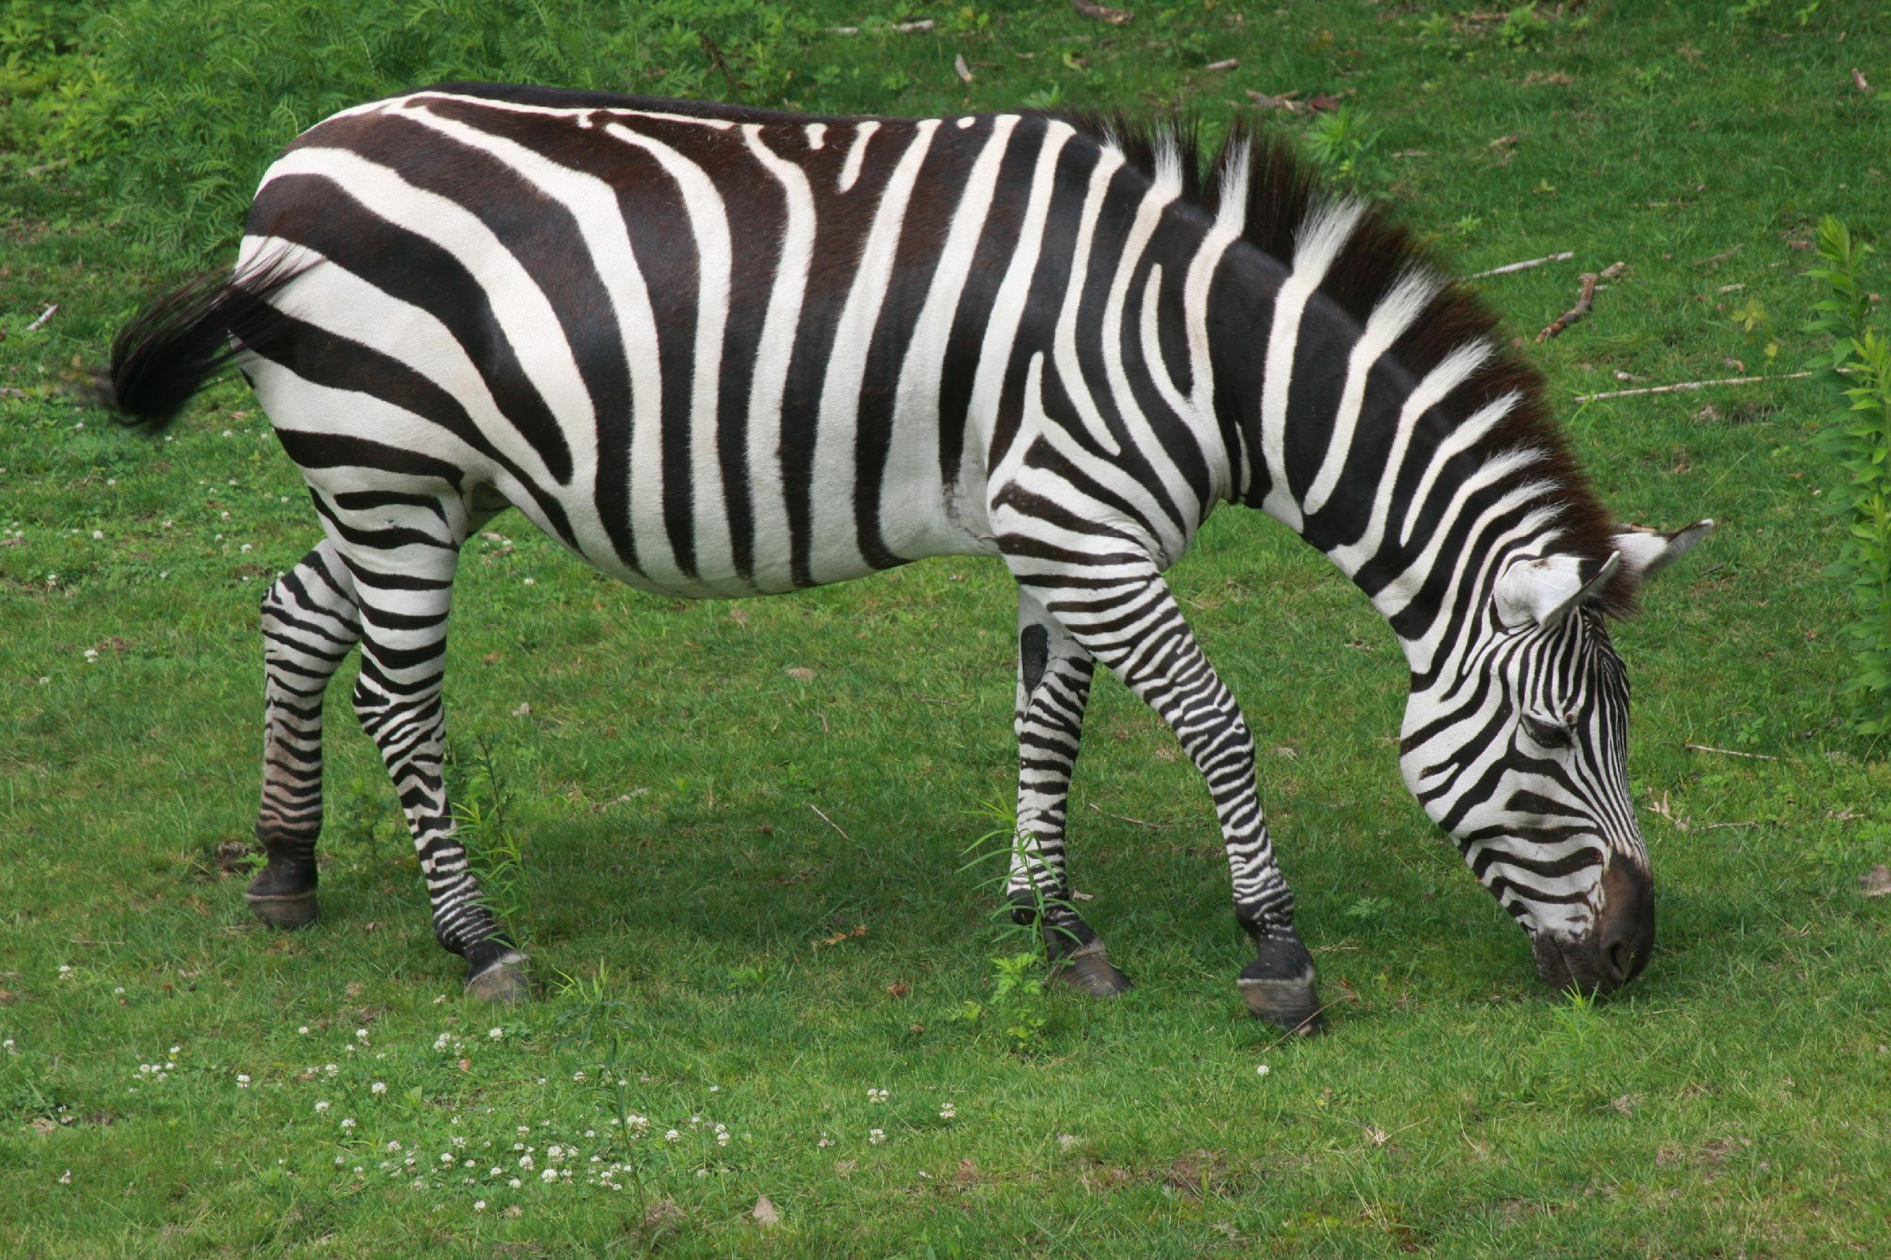
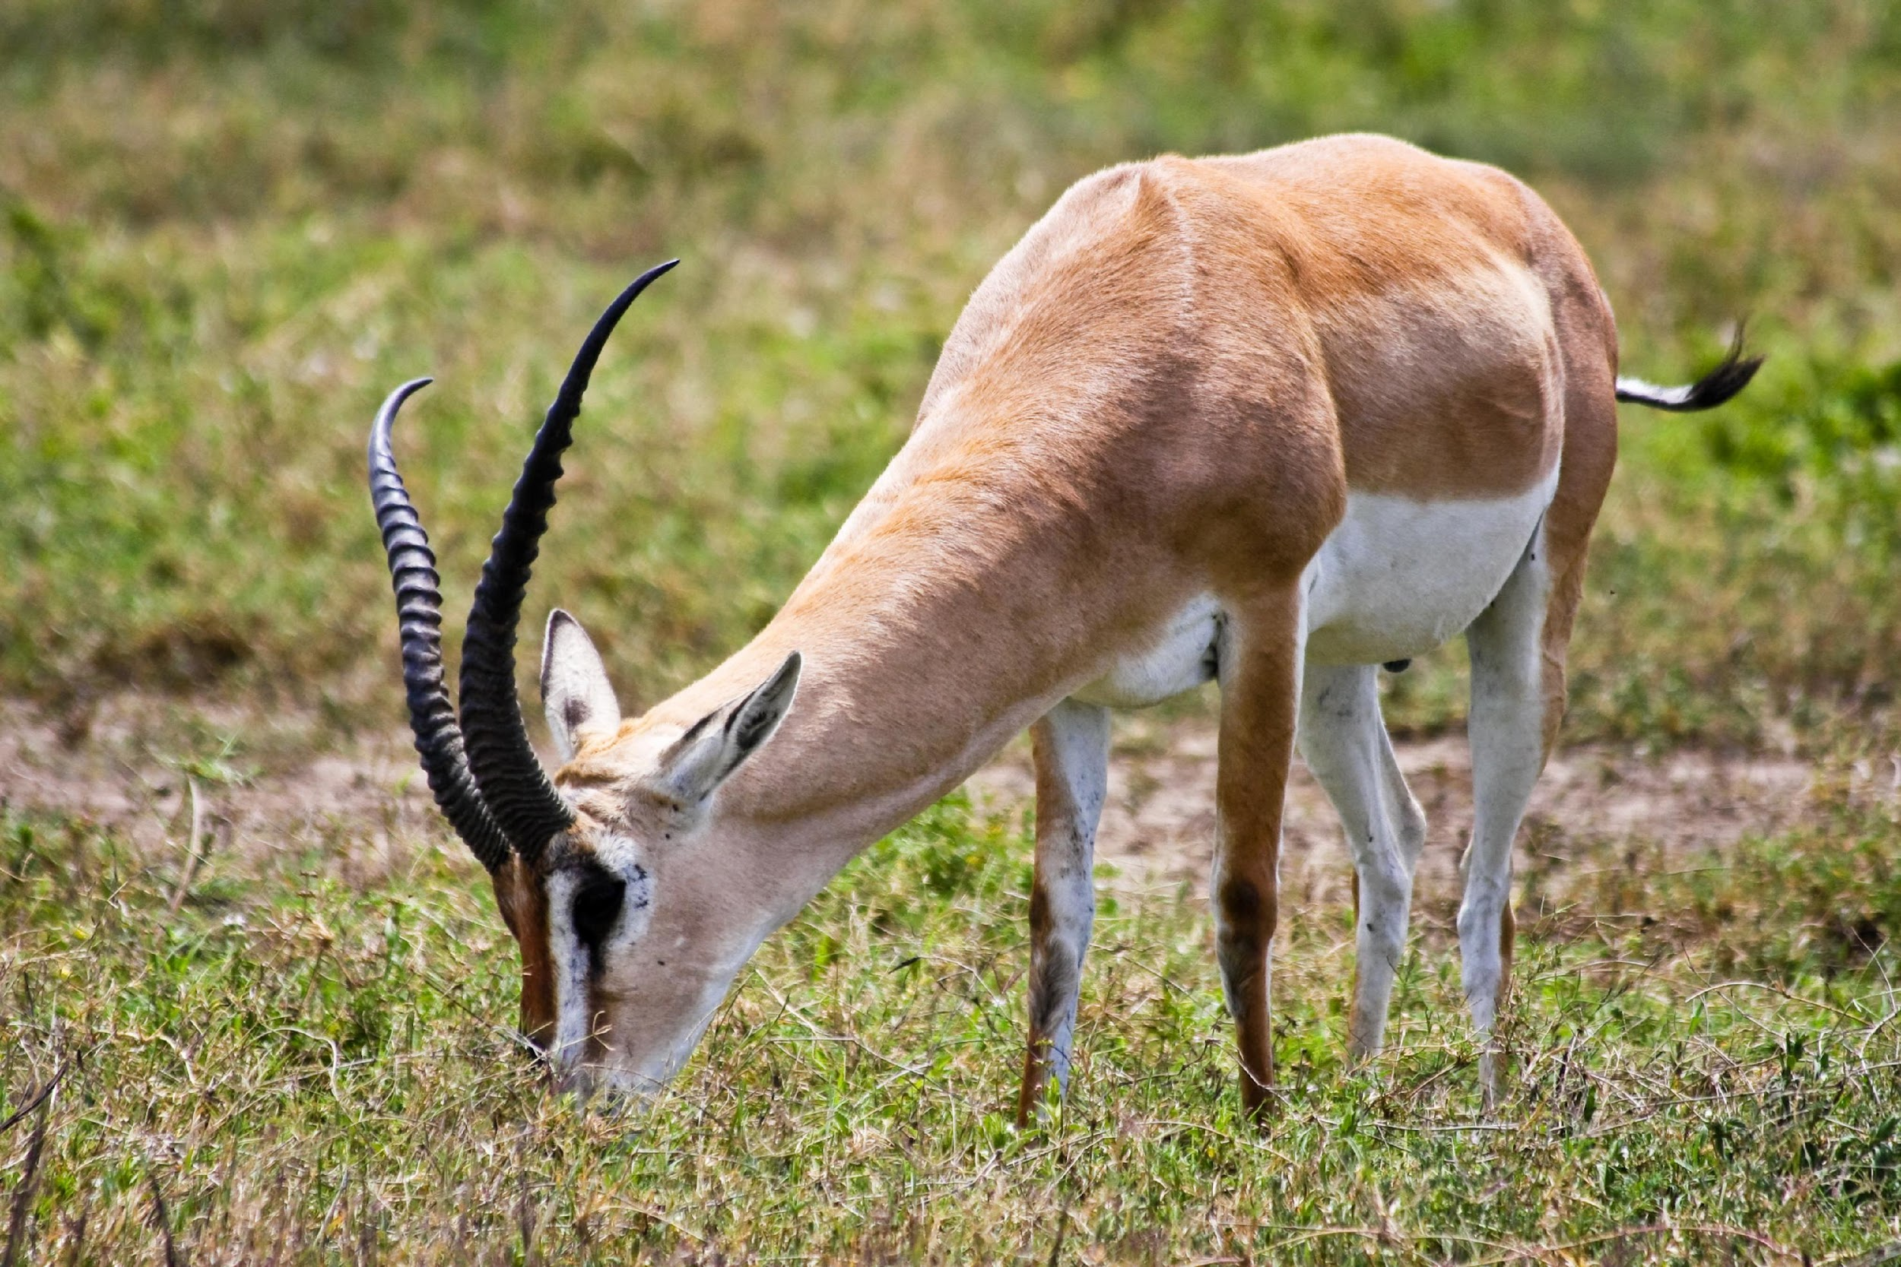
Competition can occur between:
Members of the same species
Members of different species
Notes:
Competition can occur between members of the same or different species.

Slide 7
Notes:
Now let’s pause for a moment to check your understanding.

Slide 8
What is competition?
Notes:
What is competition?
[Competition is when individuals within a population try to use the same limited resources – they compete with one another.]

Slide 9
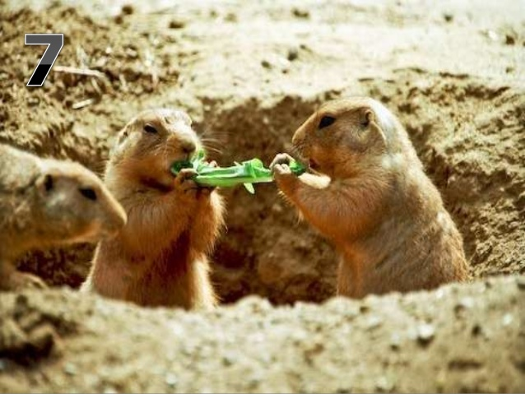
Can you give an example of competition?
Notes:
Can you give an example of competition?

Slide 10
Predator-Prey Relationship
Notes:
Now that we’ve reviewed, let’s look at the predator-prey relationship.

Slide 11
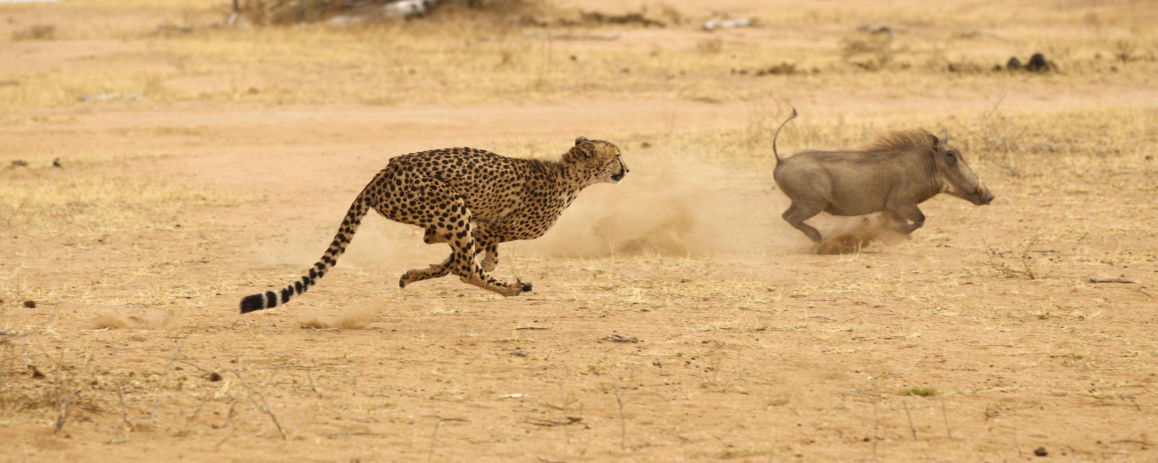
Predator-prey relationship: animals eat other animals for energy and nutrients
Notes:
In a predator prey relationship, animals eat other animals for energy and nutrients.

Slide 12
Notes:
Now let’s pause for a moment to check your understanding.

Slide 13
What is a predator-prey relationship?
Notes:
What is a predator-prey relationship?
[In a predator-prey relationship, animals eat other animals for energy and nutrients.]

Slide 14
Notes:
That is the basic definition, but there is a bit more you need to know.

Slide 15
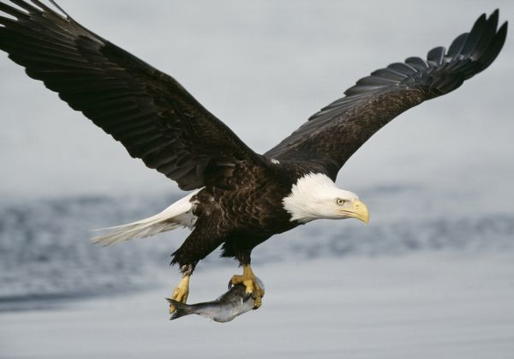
Predator: animal that hunts and eats the other animal
Notes:
The predator is the animal that hunts and eats the other animal.

Slide 16
Notes:
Let’s check-in for understanding.

Slide 17
What is a predator?
Notes:
What is a predator?
[In a predator-prey relationship, the predator is the animal that hunts and eats the other animal.]

Slide 18
Notes:
Now, let’s talk about some examples of predators.

Slide 19
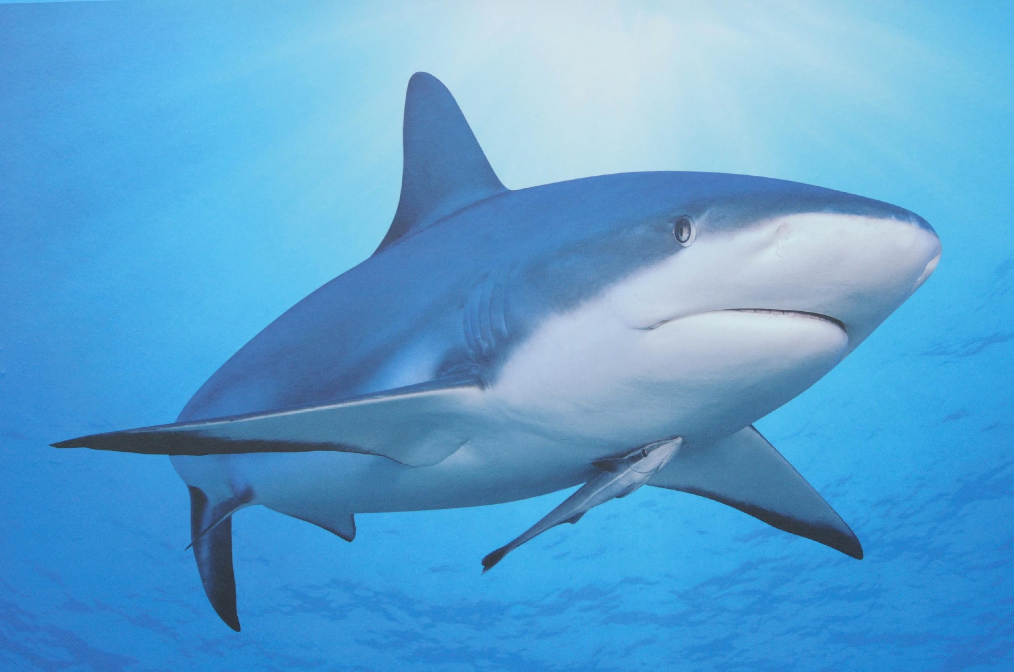
YES
Notes:
Sharks eat a wide variety of other fish.

Slide 20
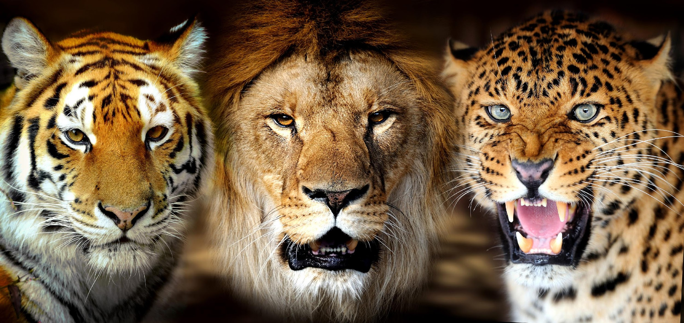
Notes:
Big cats are also examples of predators.

Slide 21
Notes:
Next, let’s talk about some non-examples of predators.

Slide 22
Notes:
Plants are generally not predators. They do not hunt and eat other animals.

Slide 23
Notes:
Let’s check-in for understanding.

Slide 24
Which of the following is a predator?
A giraffe that only eats leaves
A rabbit that eats carrots
A fish that only eats algae
A bald eagle that eats mice and other rodents
Notes:
Which of the following is a predator?

Slide 25
Which of the following is a predator?
A giraffe that only eats leaves
A rabbit that eats carrots
A fish that only eats algae
A bald eagle that eats mice and other rodents
Notes:
Which of the following is a predator?
[A bald eagle that eats mice and other rodents]

Slide 26
Prey: animal that gets hunted and is eaten by the predator
Notes:
The prey is the animal that is hunted and gets eaten by the predator.

Slide 27
Notes:
Let’s check-in for understanding.

Slide 28
What is prey?
Notes:
What is prey?
[The prey is the animal that is hunted and gets eaten by the predator.]

Slide 29
Notes:
Now, let’s look at an example of prey.

Slide 30
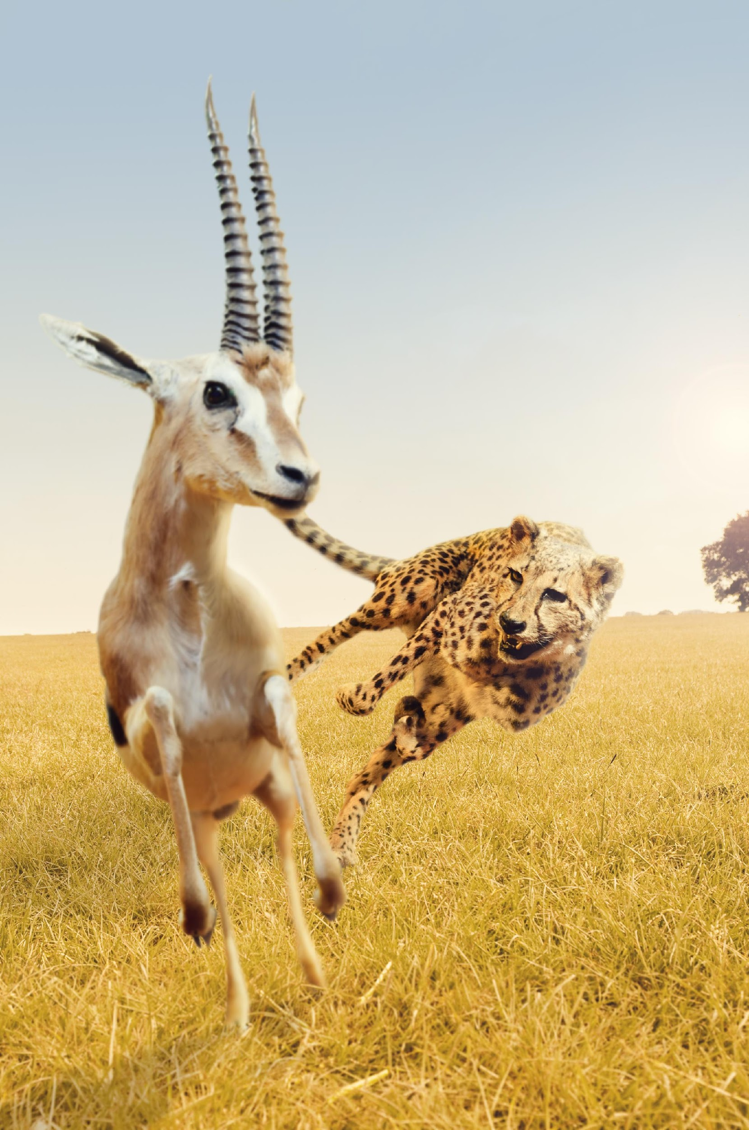
Notes:
A gazelle is an example of prey.

Slide 31
Notes:
Next, let’s look at a non-example of prey.

Slide 32
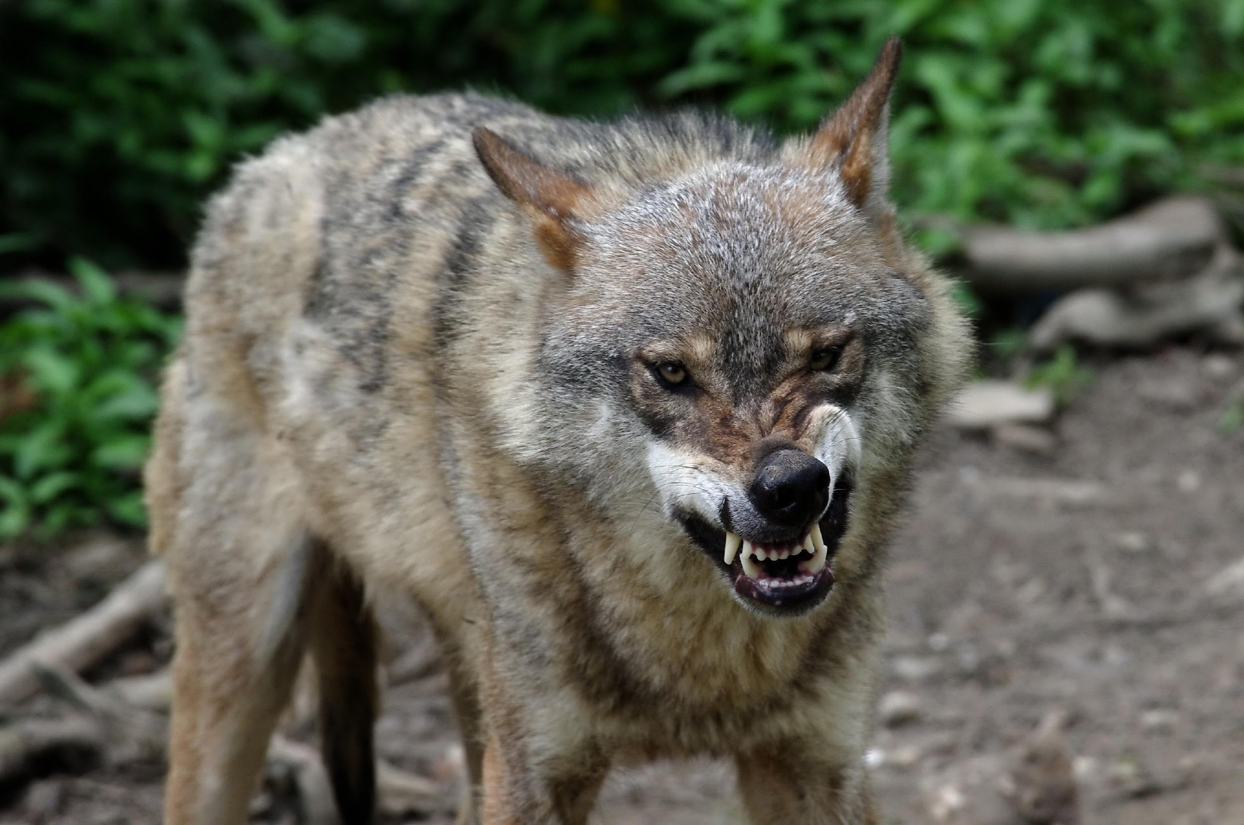
Notes:
Wolves are not prey - they are predators.

Slide 33
Some animals can be both
Frog as a predator
Frog as prey
Notes:
Some animals can be both predator and prey. For example, this frog is a predator in the first picture (as it hunts the big) and prey in the second picture, as it is hunted by the eagle.

Slide 34
Notes:
Let’s check-in for understanding.

Slide 35
Prey are animals that …
Eat other animals
Make their own food
Are eaten by other animals
Can survive in extremely cold conditions
Notes:
Prey are animals that…

Slide 36
Prey are animals that …
Eat other animals
Make their own food
Are eaten by other animals
Can survive in extremely cold conditions
Notes:
Prey are animals that…

Slide 37
Which of the following is not an example of a predator?
A hawk
A deer
A lion
A meat-eating human
A grizzly bear
Notes:
Which of the following is not an example of a predator?

Slide 38
Which of the following is not an example of a predator?
A hawk
A deer
A lion
A meat-eating human
A grizzly bear
Notes:
Which of the following is not an example of a predator?
[A deer]

Slide 39
True/False: Animals cannot be both a predator and prey.
Notes:
True/False: Animals cannot be both a predator and prey.

Slide 40
True/False: Animals cannot be both a predator and prey.
Notes:
True/False: Animals cannot be both a predator and prey.
[False – depends on context. Some animals are predators of animals while also being prey for other animals.]

Slide 41
Identify the animal in the picture that is a predator.
Notes:
Identify the animal in this picture that is a predator.

Slide 42
Identify the animal in the picture that is a predator.
Notes:
Identify the animal in this picture that is a predator.

Slide 43
Remember!!!
Notes:
So remember!

Slide 44
Predator-prey relationship: animals eat other animals for energy and nutrients
Notes:
In a predator prey relationship, animals eat other animals for energy and nutrients.

Slide 45
Predator: animal that hunts and eats the other animal
Notes:
The predator is the animal that hunts and eats the other animal.

Slide 46
Prey: animal that gets hunted and is eaten by the predator
Notes:
The prey is the animal that is hunted and gets eaten by the predator.

Slide 47
Extension Activity
Predator and Prey Venn Diagram
Have students complete a Venn diagram of animals that are predators, prey, or both (example on next slide)
Alternatively, you can do this as a class and have students come up to write their own example on the board
Notes:
Feedback: This resource can be explored ahead of time if you wish to provide students with links to specific videos or with questions to extend their learning.

Slide 48
Predator
Prey
Both

Slide 49
Big Question: What factors characterize a predator-prey interaction and what types of organisms do we see take part in these interactions?
Notes:
Explicit cue to revisit the big question at the end of the lesson: Okay everyone. Now that we’ve learned about predator-prey interactions, let’s reflect once more on our big question. Was there anything that we predicted earlier that was correct or incorrect? Do you have any new hypotheses to share?
Feedback: Offering students an opportunity to evaluate their earlier hypotheses and make changes based on their new understandings is an important part of the iterative process in science. This is a great opportunity to help students build an epistemic understanding by explicitly stating how continuing to change and build on hypotheses as your knowledge grows is an important part of the discipline of science!

Slide 50
Notes:
Thanks for watching, and please continue watching CAPs available from this website.

Slide 51
This Video Was Created With Resources From:
Questions or Comments
Michael Kennedy, Ph.D. MKennedy@Virginia.edu
Rachel L Kunemund, Ph.D. rk8vm@virginia.edu

