Slide 1
Intro
“Big Idea” Question
Review Concepts
Check-In Questions
Teacher Demo
Vocabulary
Student-Friendly Definition
Examples & Non-Examples
Morphological Word Parts
Simulation/Activity
Notes:
OK everyone, get ready for our next lesson. Just as a reminder, these are the different components that our lesson may include, and you’ll see these icons in the top left corner of each slide so that you can follow along more easily!

Slide 2
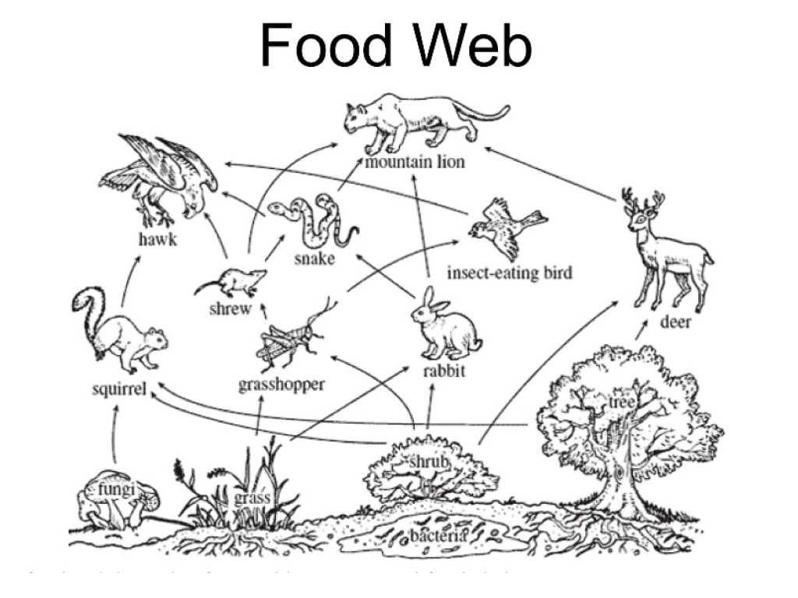
Primary, Secondary, and Tertiary Consumers
Intro
Notes:
Today we will learn about primary, secondary, and tertiary consumers. You may also see these categories labelled as “first-order, second-order, and third-order consumers”.

Slide 3
Big Question: How are consumers important to our world?
Notes:
Our “big question” is: How are consumers important to our world?
[Pause and illicit predictions from students.]
I love all these thoughtful scientific hypotheses! Be sure to keep this question and your predictions in mind as we move through these next few lessons, and we’ll continue to revisit it.
Feedback: Asking students to make predictions about how scientists determine how consumers are important to our world is a great way to activate and elicit student ideas and prior knowledge. This type of activity is evidence of the teacher planning for students’ engagement with science ideas. Further, this type of activity helps to build students’ epistemic knowledge of how and why scientists engage in specific practices. Making connections to science practices is an important way to help students understand their own role and potential within the field of science.

Slide 4
Notes:
Before we move on to our new vocabulary term, let’s review some other words & concepts that you already learned and make sure you are firm in your understanding.

Slide 5
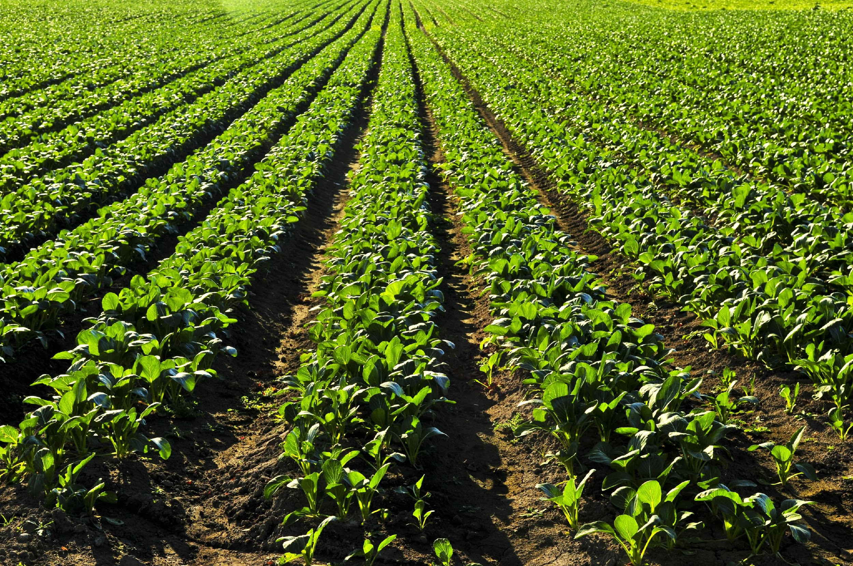
Producers: use energy to make their own food
Notes:
Producers use energy to make their own food.

Slide 6
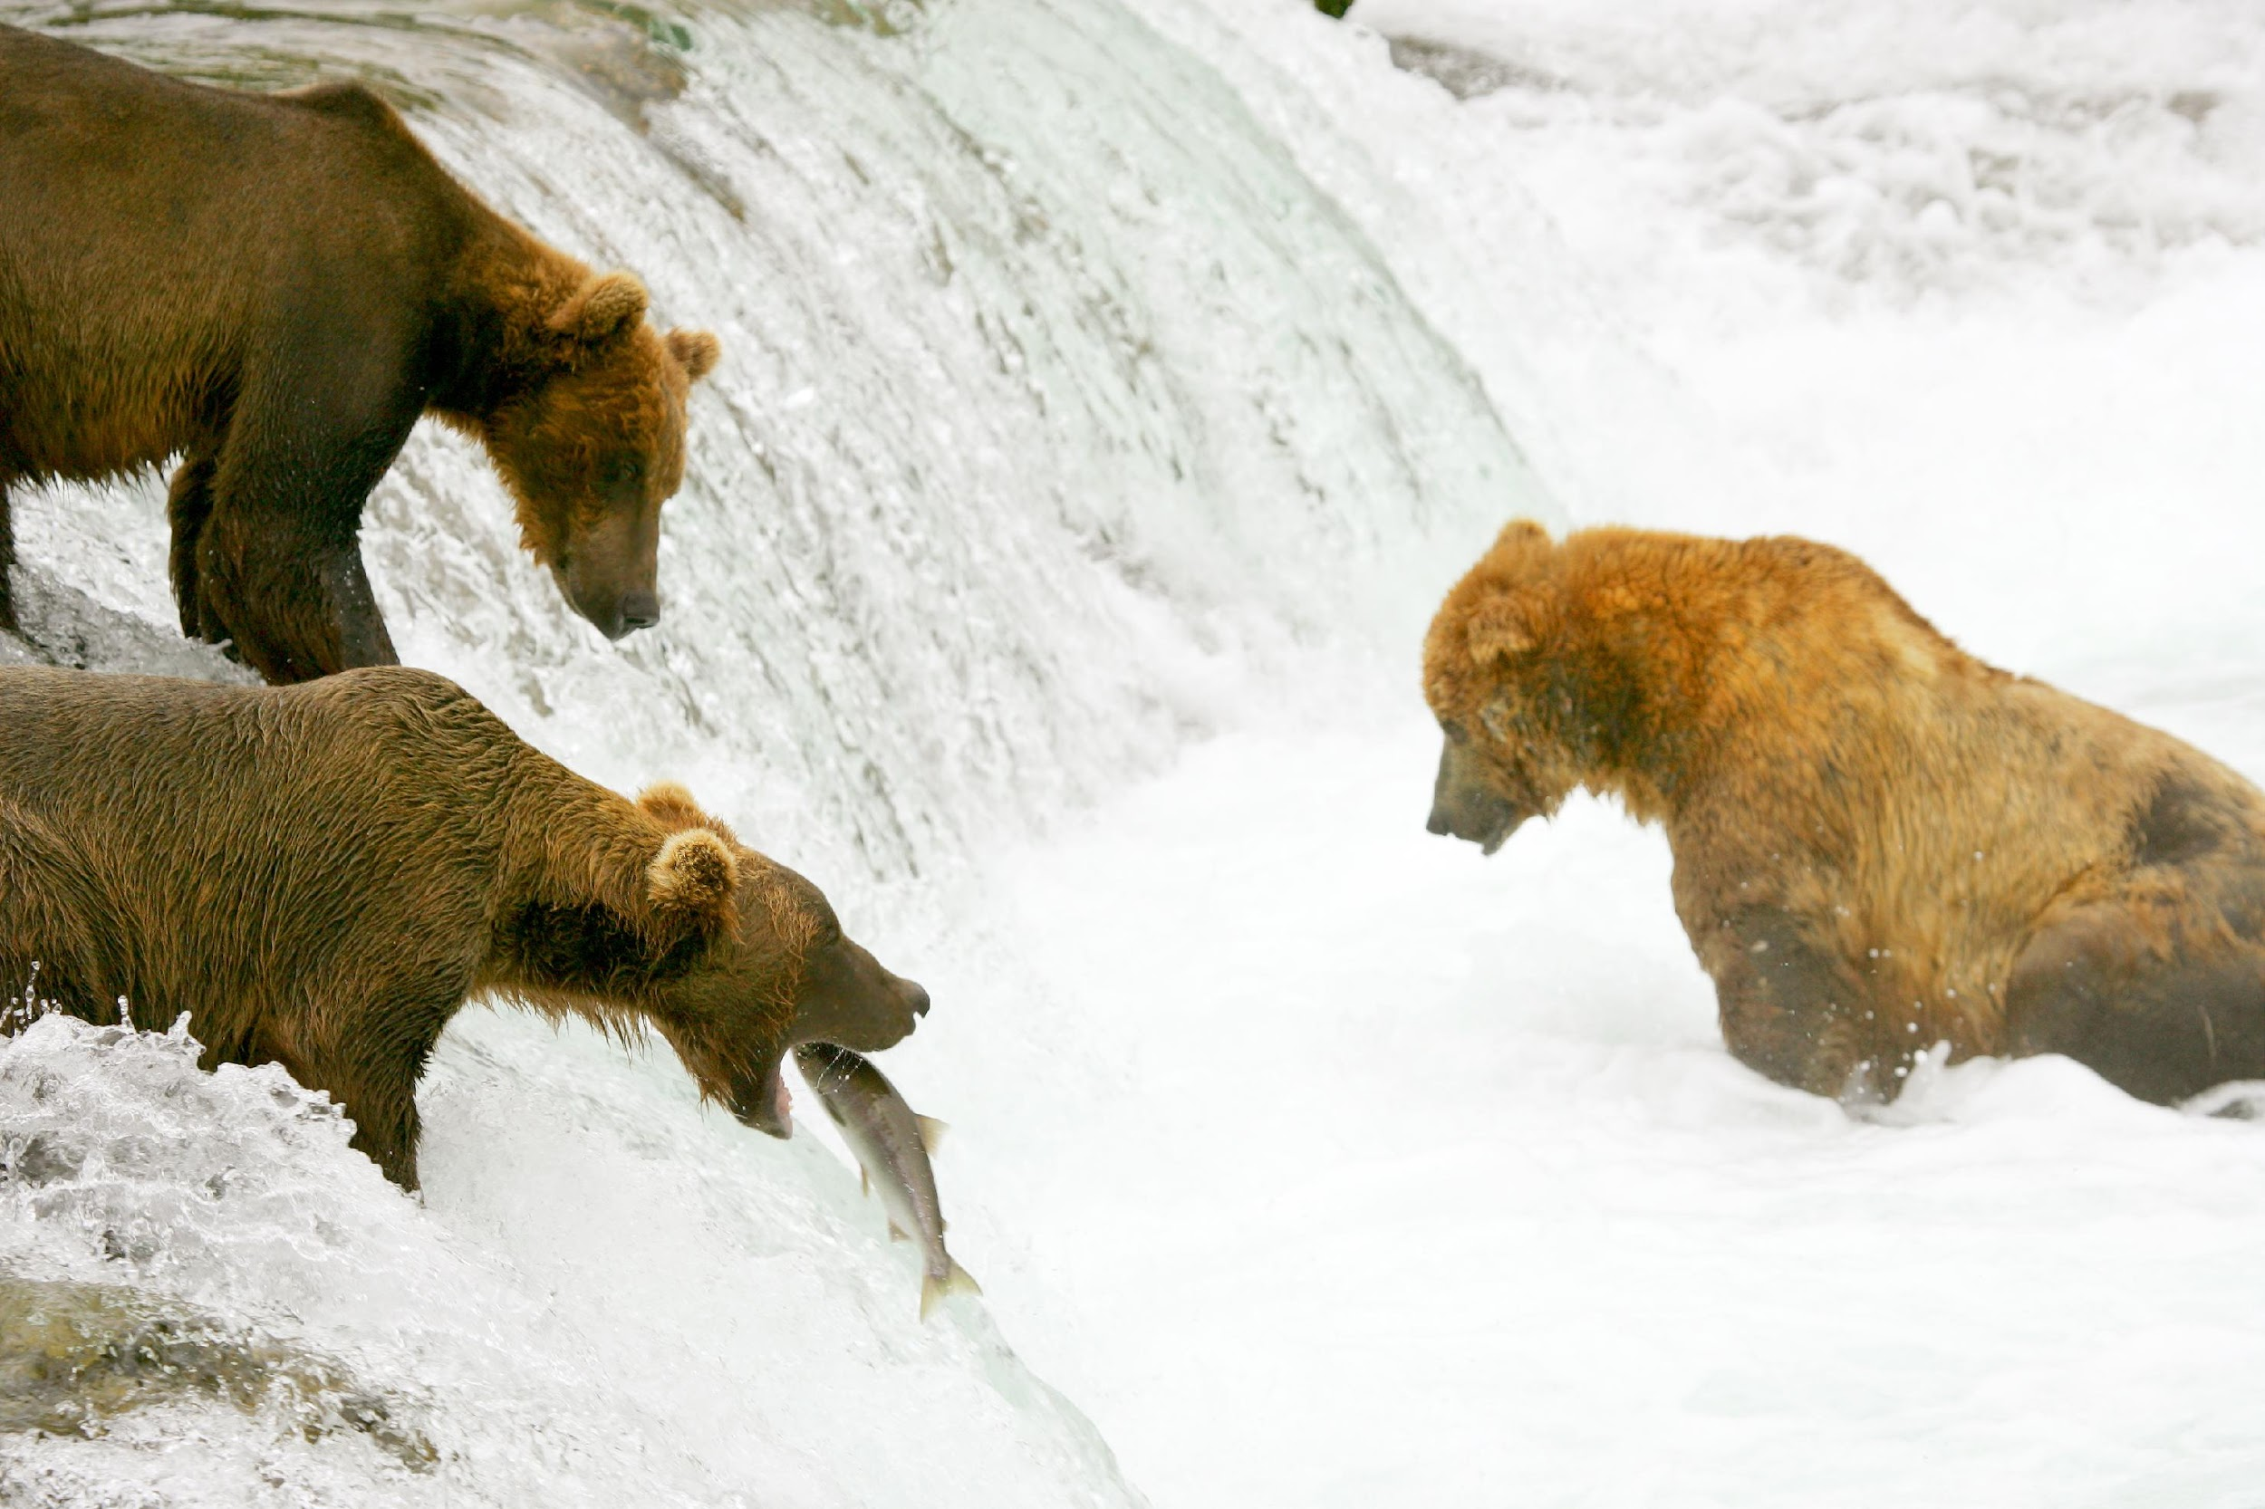
Consumers: eat other organisms
Notes:
Consumers eat other organisms.

Slide 7
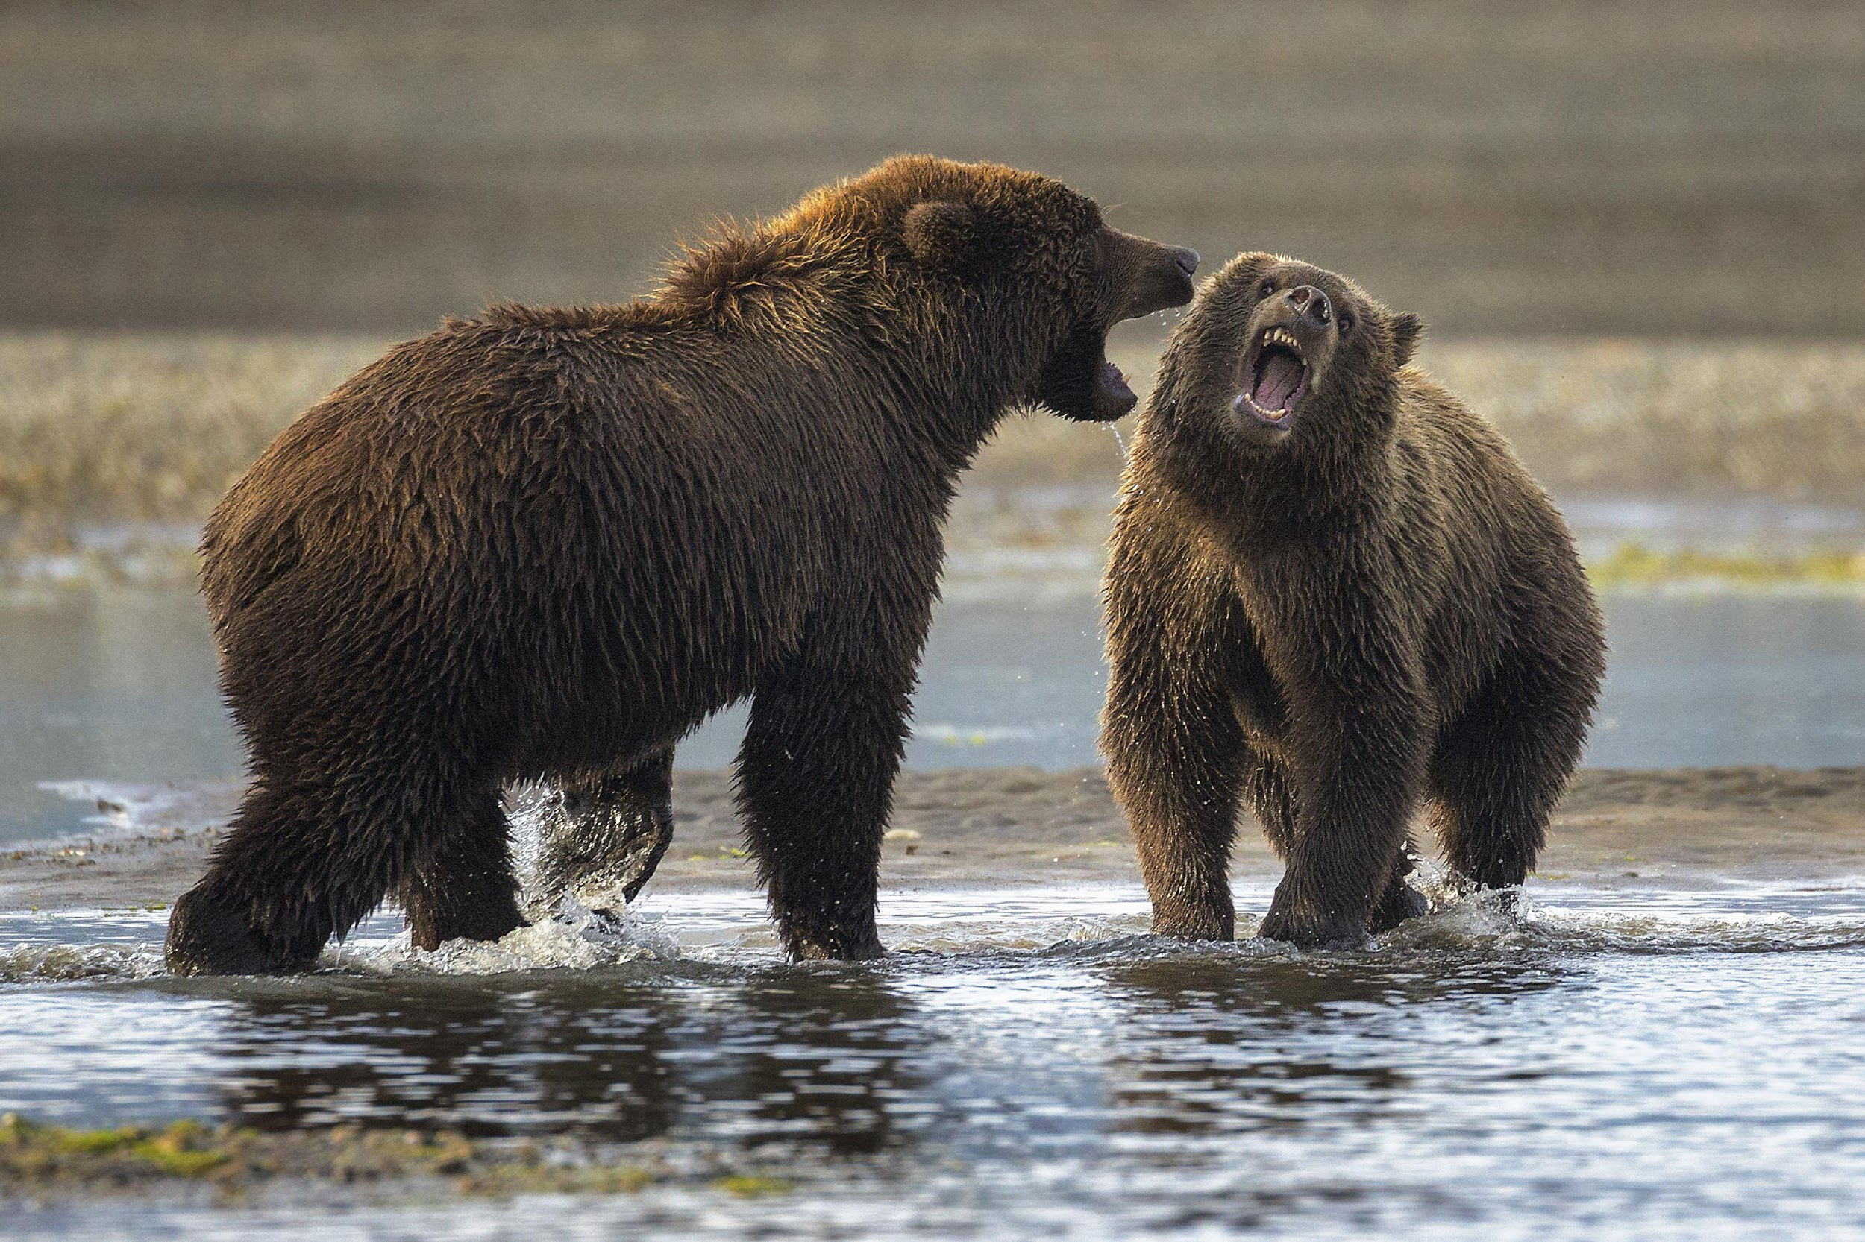
Notes:
Bears are consumers because they eat other organisms (fish).

Slide 8
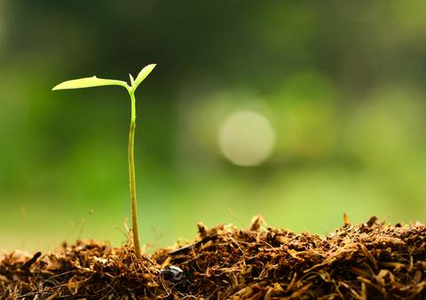
Notes:
Most plants are producers because they use energy to make their own food and do not eat other organisms.

Slide 9
Notes:
Now let’s pause for a moment to check your understanding.

Slide 10
What is a producer?
Notes:
What is a producer?
[Producers use energy to make their own food.]

Slide 11
What is a consumer?
Notes:
What is a consumer?
[Consumers eat other organisms.]

Slide 12
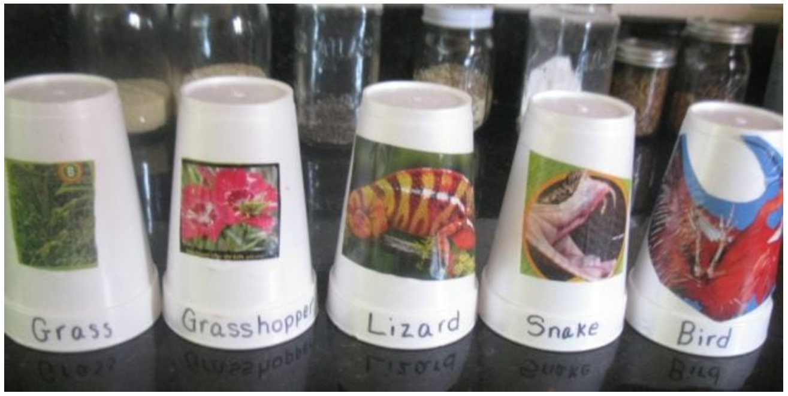
Demonstration
Food Chain Cup Stacking
One creative way to demonstrate food chain energy transfer is to use cups in illustrating a series of consumers in an ecosystem. You can model by stacking consumers on top of lower level consumers and producers or challenge the students in groups to stack their cups correctly as fast as possible. More details and other ideas are linked above!
Notes:
Feedback: This cup stacking activity can be a great activity for getting students to think about the order of consumers within an ecosystem. If you already used the activity for food chains, you might consider simply referring back to it and explicitly using new terms to extend student understanding.

Slide 13
Primary Consumer
Notes:
Now that we’ve reviewed, let’s define our new term, primary consumer.

Slide 14
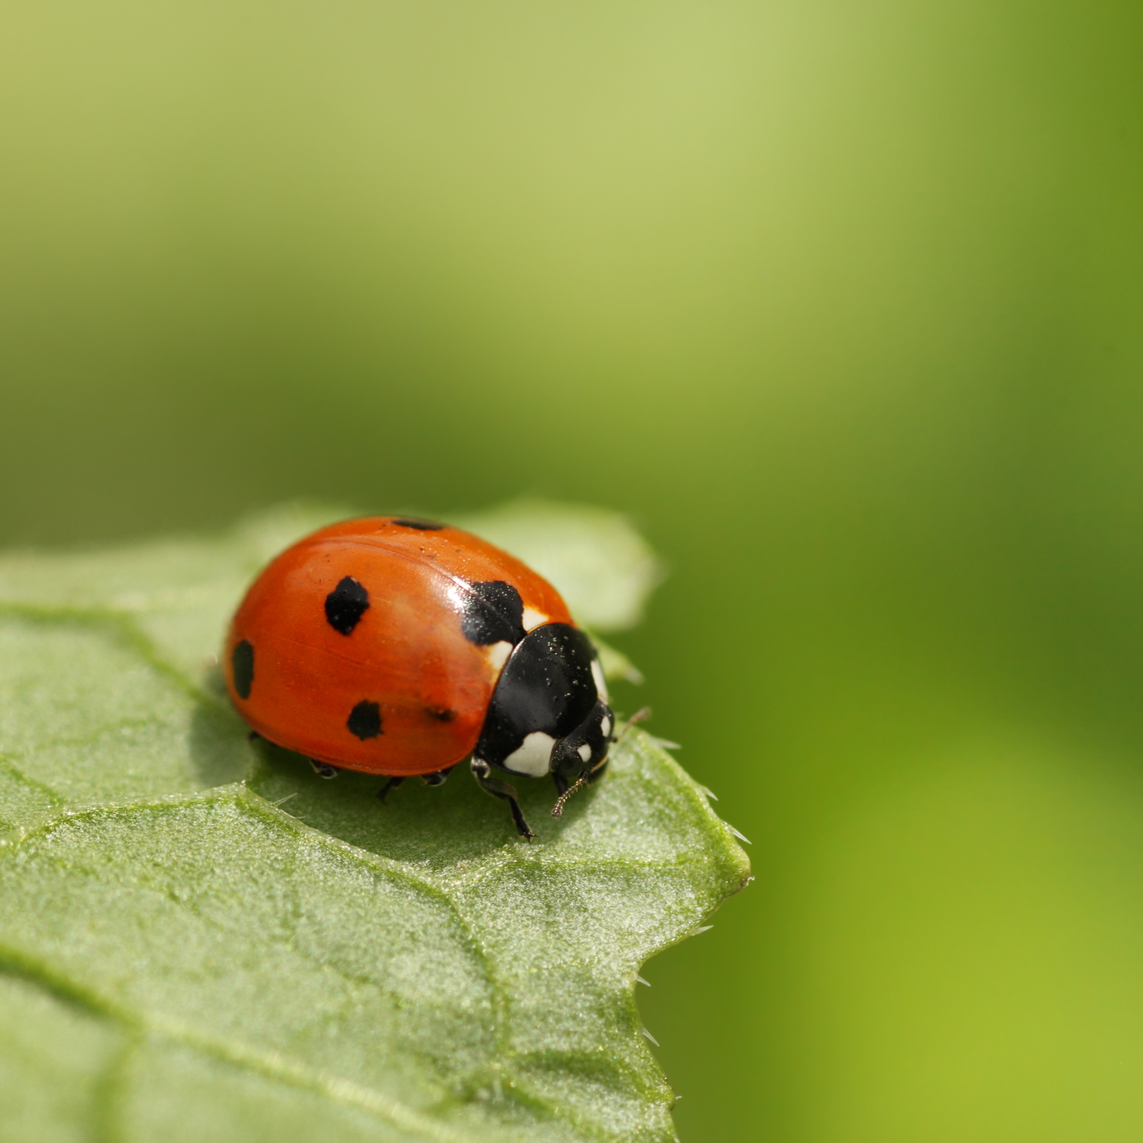
Primary Consumers: “first-order consumers”; animals that eat plants and are eaten by other organisms
Notes:
Primary consumers, also known as first-order consumers, are animals that eat plants and are eaten by other organisms.
Feedback: It is important to use clear and concise language when introducing new terms.

Slide 15
Notes:
Now let’s pause for a moment to check your understanding.

Slide 16
What are primary consumers?
Notes:
What are primary consumers?
[Primary consumers, also known as first-order consumers, are animals that eat plants and are eaten by other organisms.]

Slide 17
Notes:
That’s the basic definition, but there’s a little more you should know.

Slide 18
Consumers can be further categorized
Tertiary Consumers
Secondary Consumers
Primary Consumers
Producers
Notes:
Now let’s think about three specific ways to categorize consumers: first-order (primary), second-order (secondary), and third-order (tertiary) consumers.
Feedback: Visuals can help students make connections to new content.

Slide 19
Tertiary Consumers
Secondary Consumers
Decreasing population size
Decreasing energy availability
Primary Consumers
Producers
Notes:
This pyramid shows that moving up through the levels of consumers, the amount of energy available for consumption decreases, as does the population of consumers.

Slide 20
Primary Consumers
Producers
Notes:
There are more producers than primary consumers.

Slide 21
Notes:
Now let’s pause for a moment to check your understanding.

Slide 22
What does the pyramid tell us about the population size and energy availability for consumers?
Tertiary Consumers
Secondary Consumers
Primary Consumers
Producers
Notes:
What does the pyramid tell us about the population size and energy availability for consumers?
[This pyramid shows that moving up through the levels of consumers, the amount of energy available for consumption decreases, as does the population of consumers.]

Slide 23
Notes:
Now, let’s look at some examples of primary consumers.

Slide 24
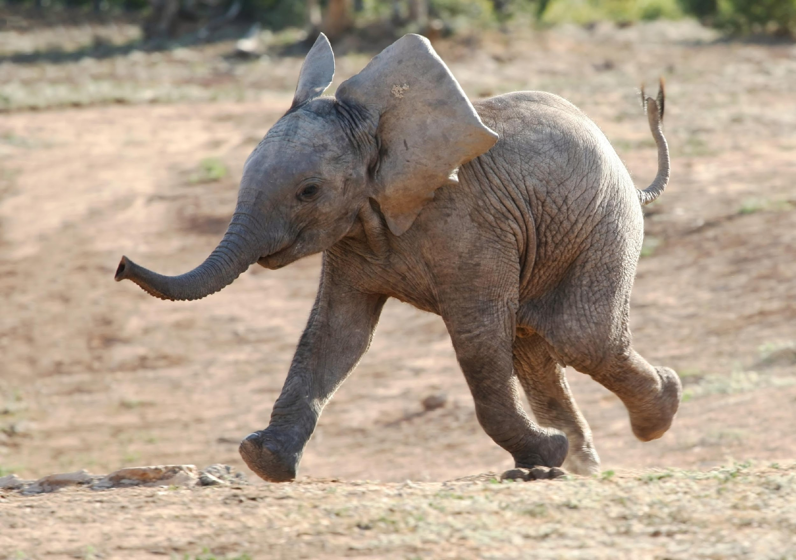
Elephant
Notes:
This elephant is a primary consumer because it only eats plants.

Slide 25
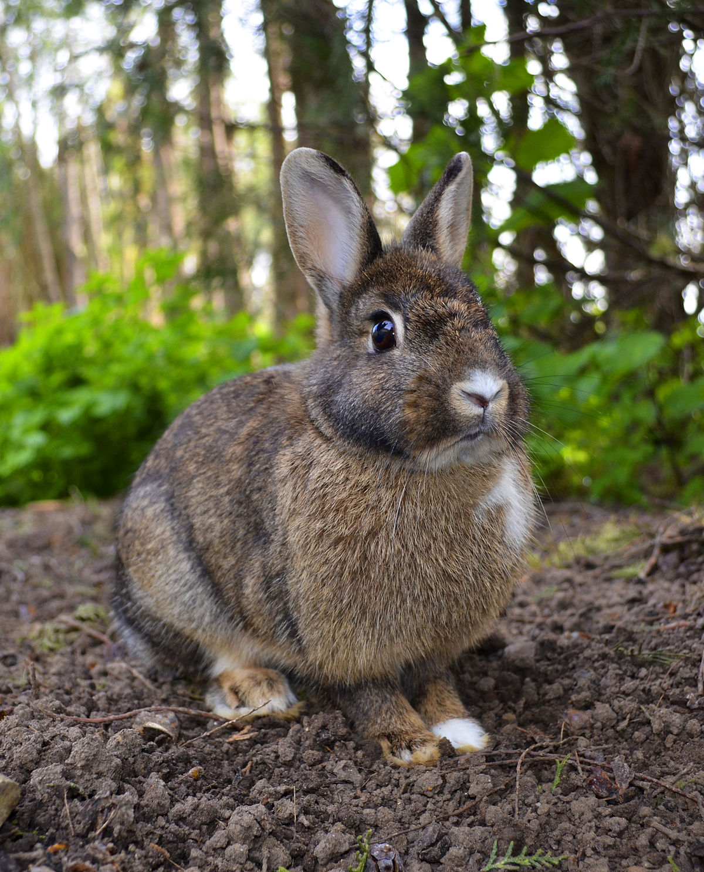
Notes:
This rabbit is an example of a primary consumer

Slide 26
Notes:
Now, let’s look at some non-examples of primary consumers.

Slide 27
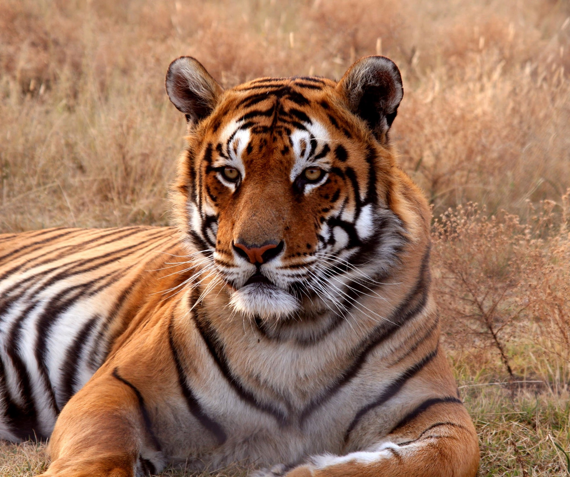
Notes:
This tiger is not a primary consumer because it eats meat (other consumers), not producers.

Slide 28
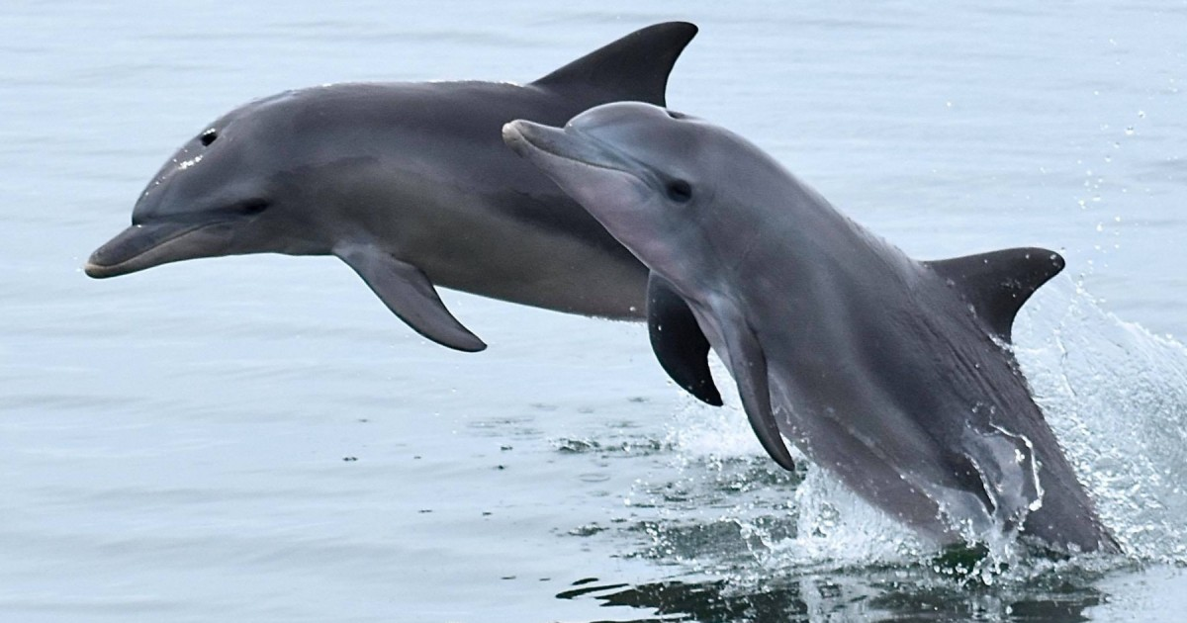
Notes:
Dolphins are not primary consumers because they eat other consumers (fish).

Slide 29
Notes:
Now let’s pause for a moment to check your understanding.

Slide 30
What is another example of a primary consumer?
Notes:
What is another example of a primary consumer?
Feedback: Selecting a variety of examples to work through with your students enables you to make sure to go over some types that might trip them up when they try it on their own.

Slide 31
Notes:
We can break down the term “primary” into different word parts to help us remember the meaning. Let’s take a look!

Slide 32
Primary
Prim -ary
(root word)
(suffix)
Notes:
Primary can be broken down into two parts.
Feedback: An important part of successfully using morphological word parts is defining each part for the students. Be sure and try to incorporate these smaller definitions in the future.

Slide 33
Primary
Prim -ary
First
Notes:
The root word “prim” means first.

Slide 34
Primary
Prim -ary
Describing something
Notes:
The suffix “-ary” turns the word into a descriptor. So the term “primary” describes consumers as the first in order when we refer to “primary consumers”.

Slide 35
Notes:
Now let’s pause for a moment to check your understanding.

Slide 36
How can we use the word parts of primary to help us remember the definition of the term?
Primary
Prim -ary
(root word)
(suffix)
Notes:
How can we use the word parts of primary to help us remember the definition of the term?
[Primary can be broken down into two parts.
The root word “prim” means first.
The suffix “-ary” turns the word into a descriptor. So the term “primary” describes consumers as the first in order when we refer to “primary consumers”.]
Feedback: Reuniting the word parts is a crucial step in helping students understand the whole picture when reviewing morphological word parts.

Slide 37
Consumers do which of the following?
Eat only plants
Eat other organisms
Make their own food
Are at the bottom of the energy pyramid
Notes:
Consumers do which of the following?

Slide 38
Consumers do which of the following?
Eat only plants
Eat other organisms
Make their own food
Are at the bottom of the energy pyramid
Notes:
Consumers do which of the following?
[Eat other organisms]

Slide 39
What are primary consumers?
Notes:
What are primary consumers?
[Primary consumers, also known as first-order consumers, are animals that eat plants and are eaten by other organisms.]

Slide 40
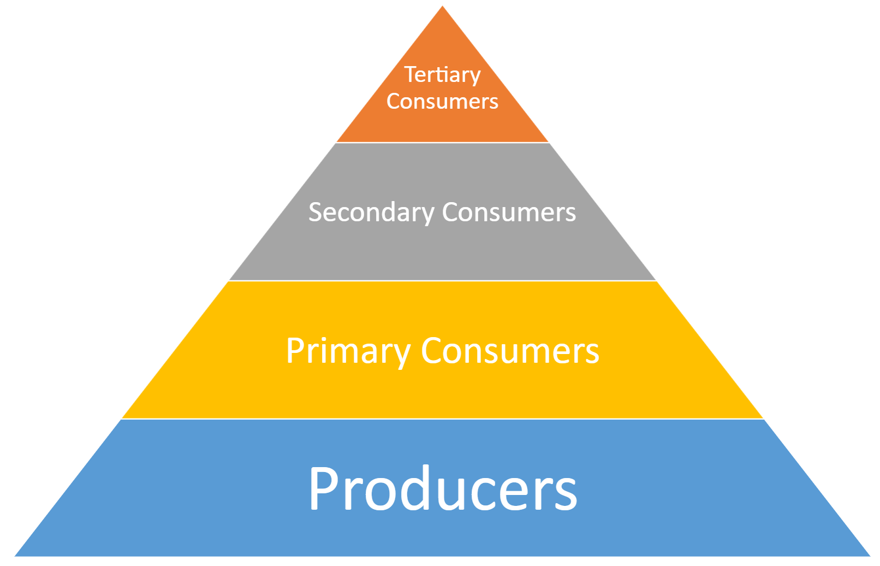
As the population decreases, what else decreases?
Notes:
As the population decreases, what else decreases?
[As the population among consumers decreases, so does the amount of energy available for consumption.]

Slide 41
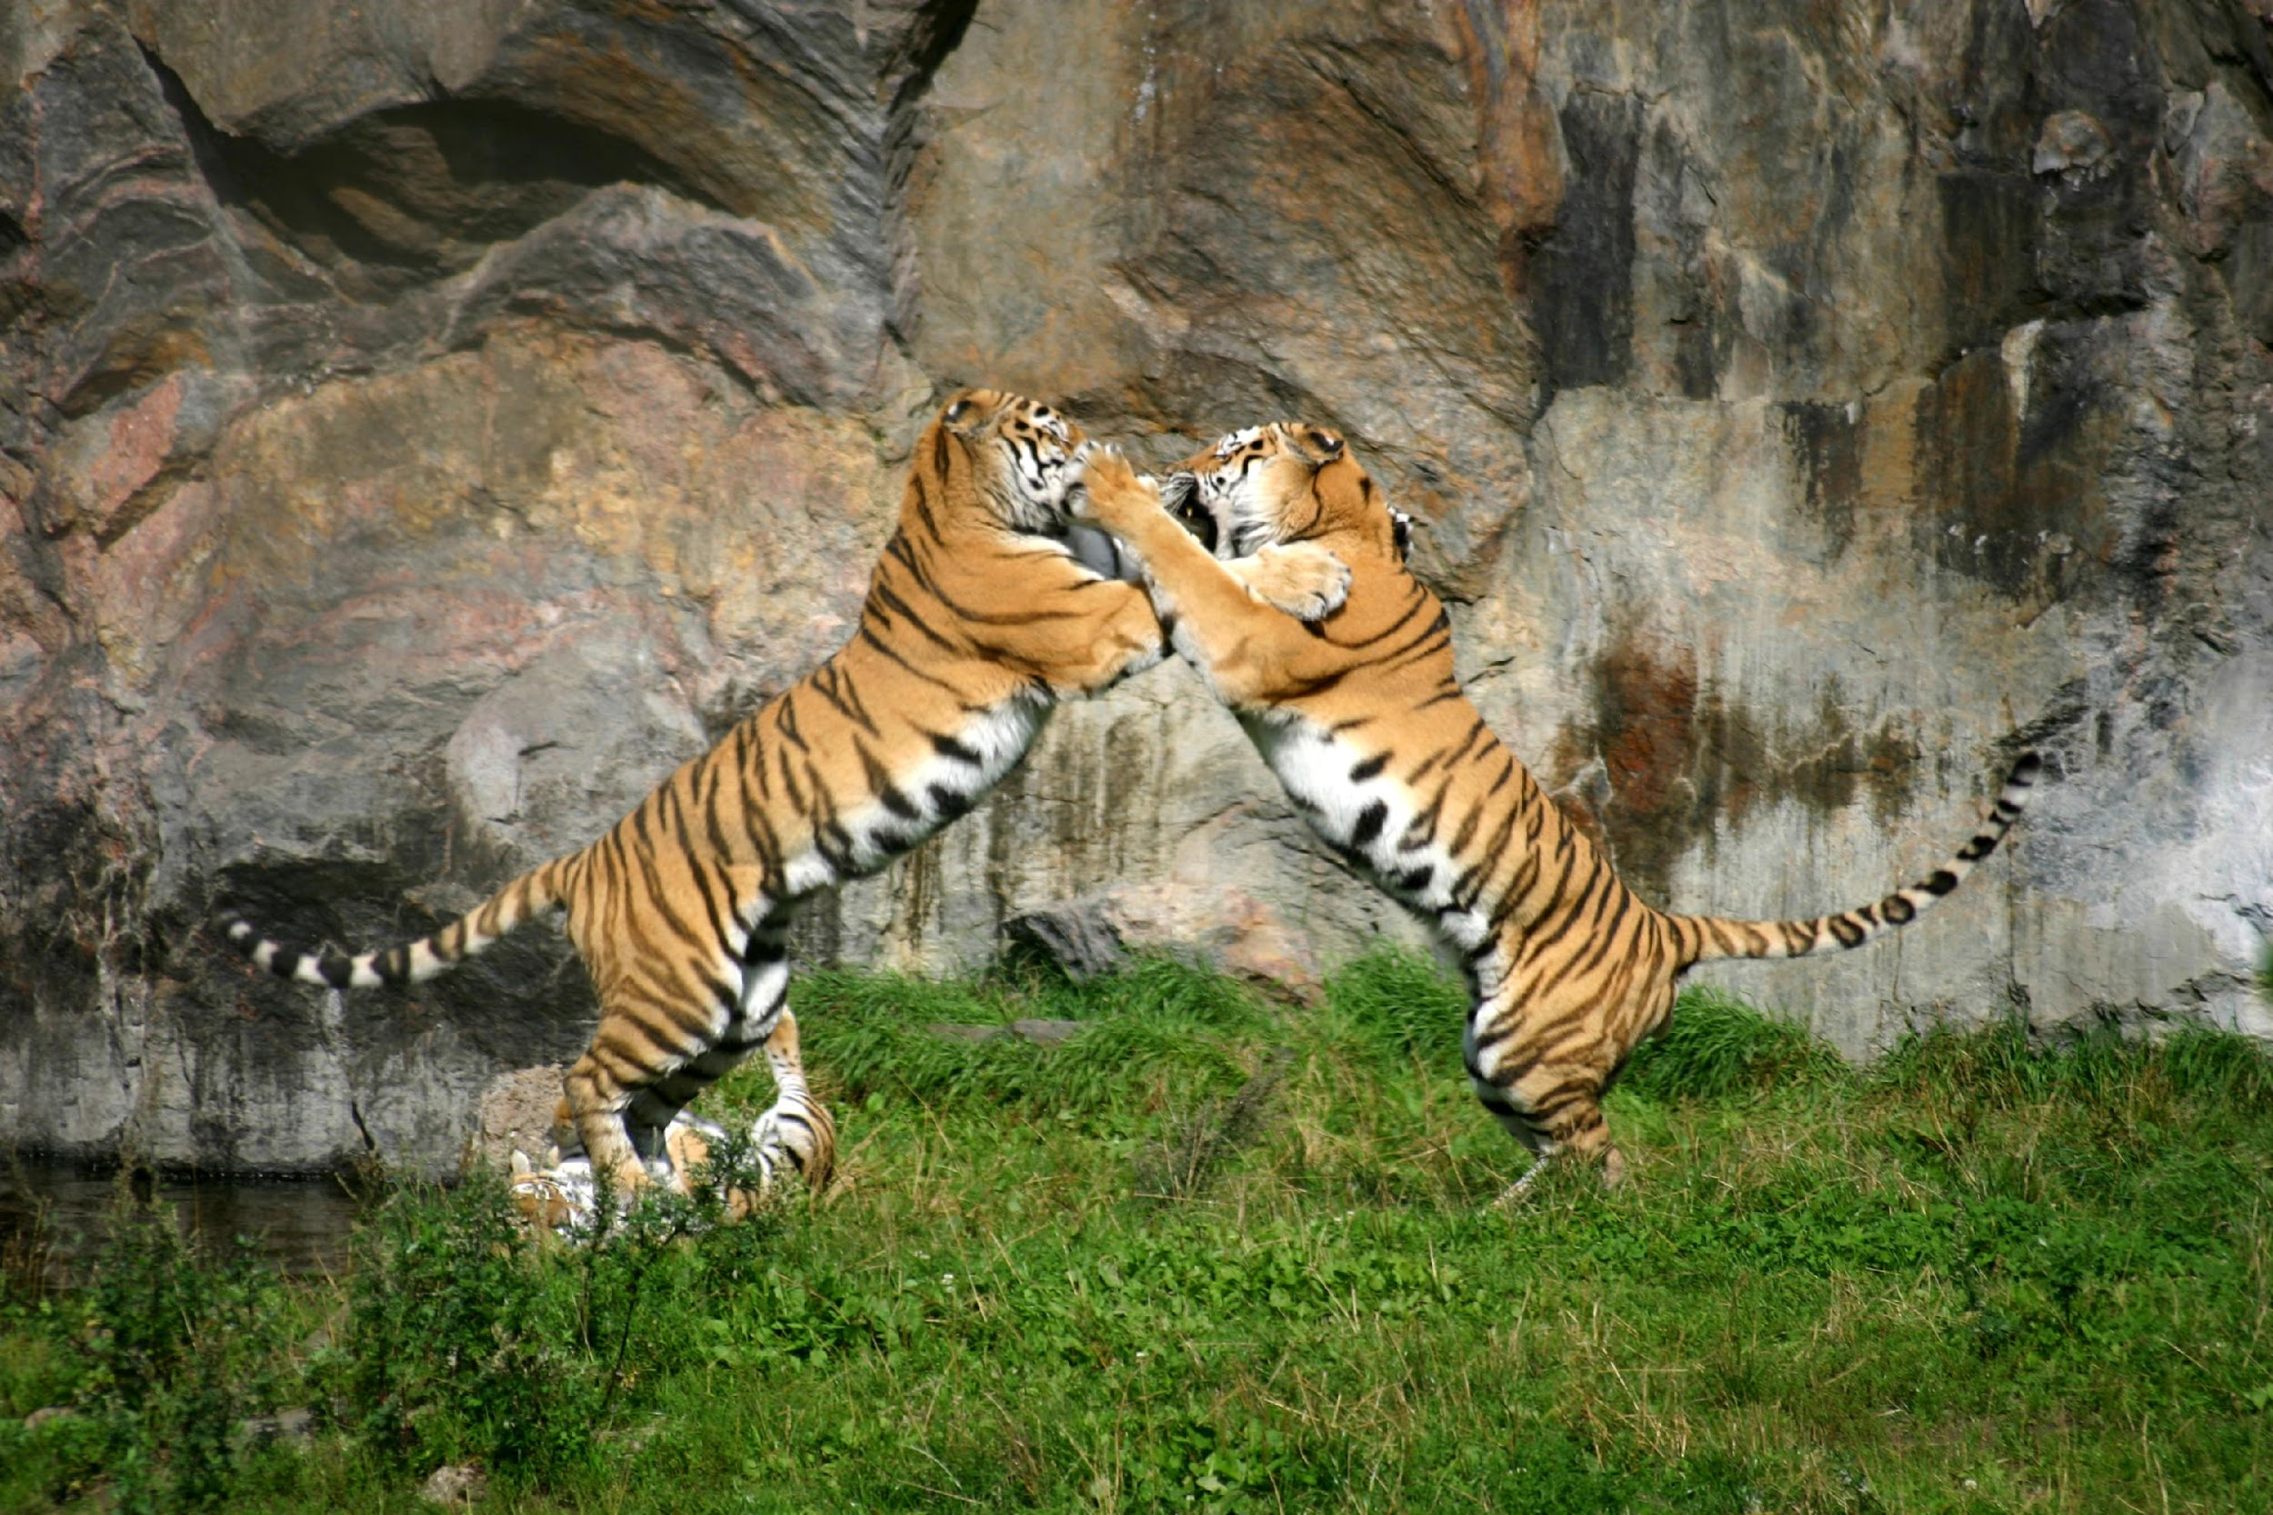
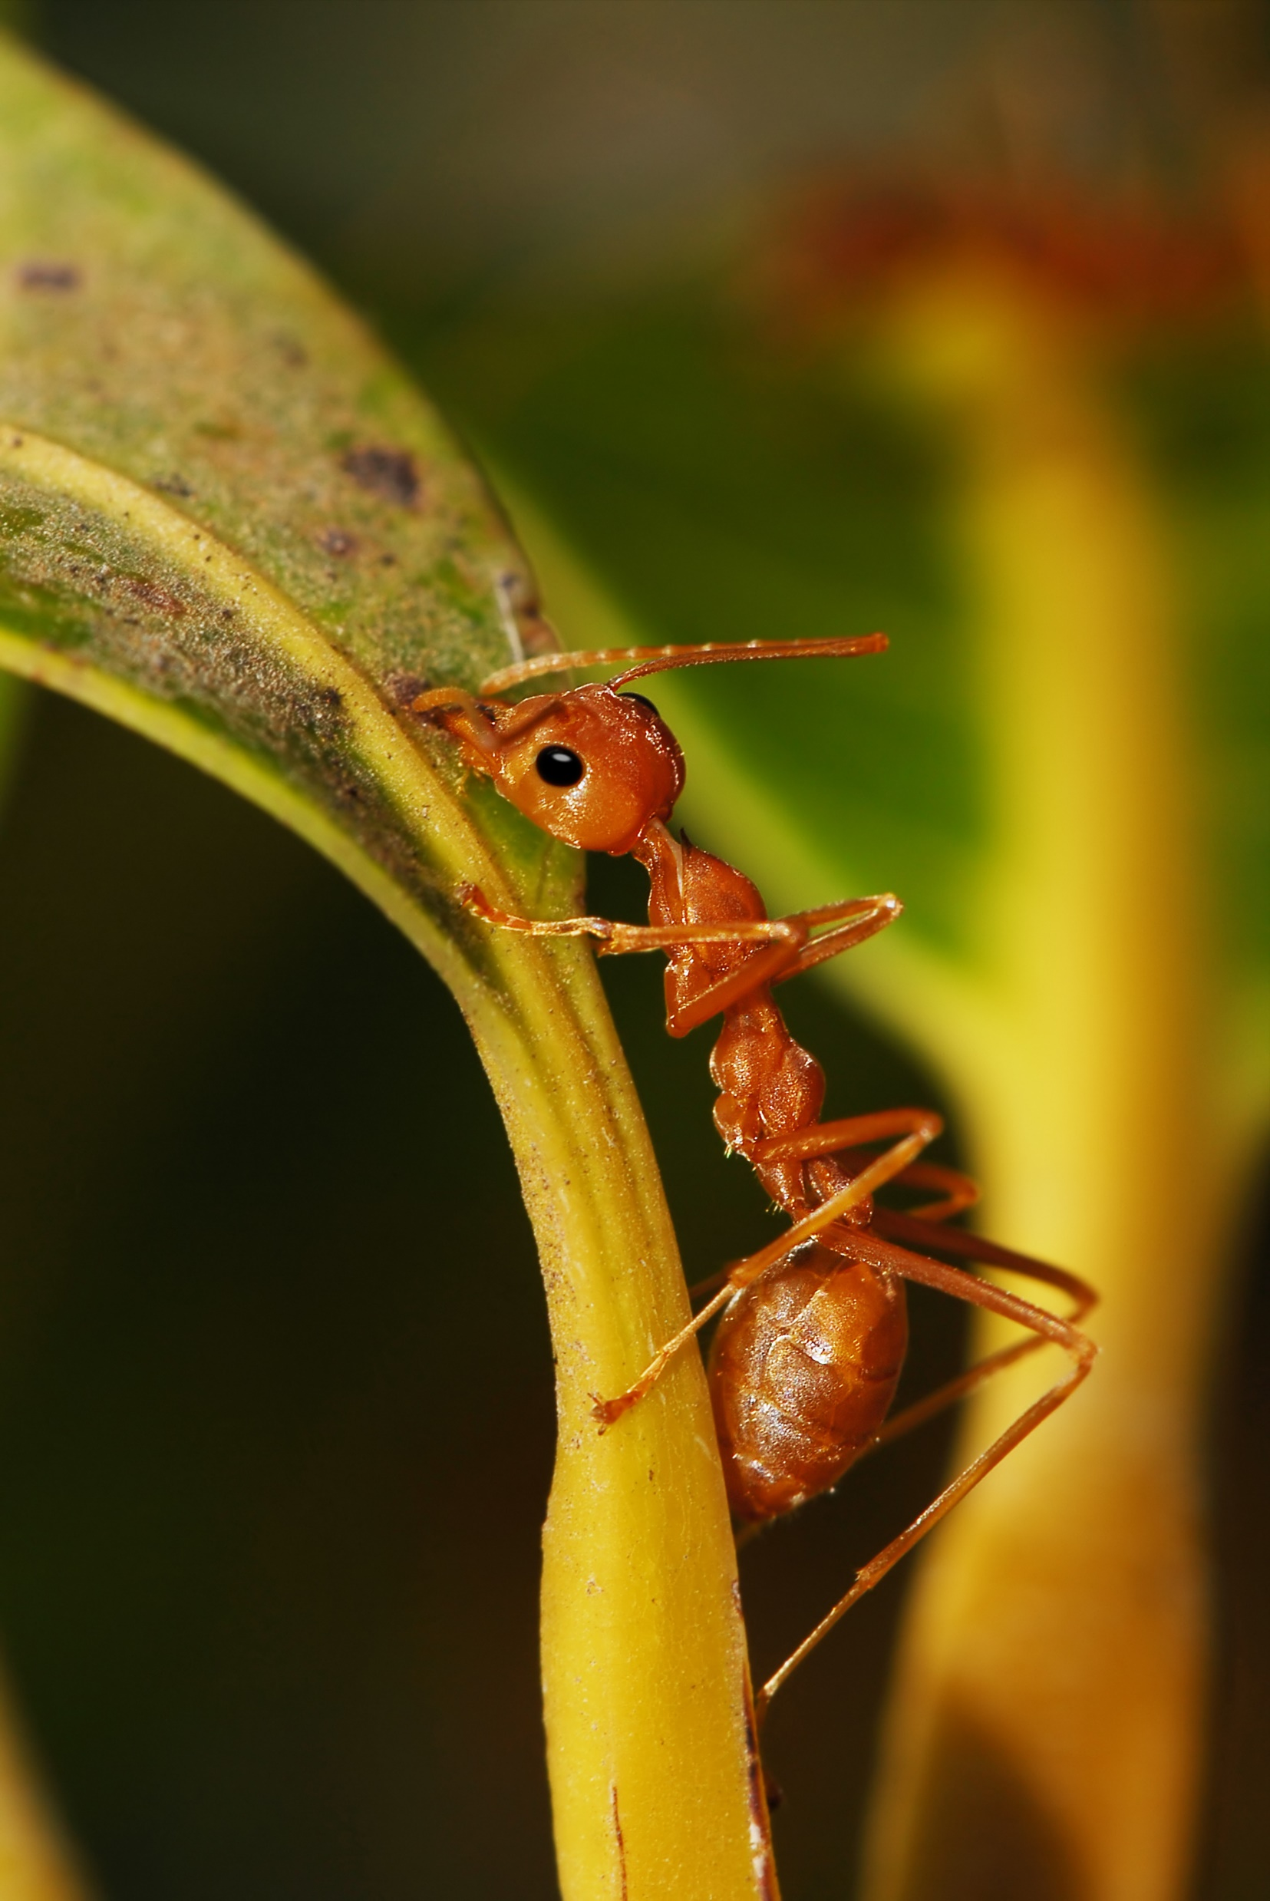
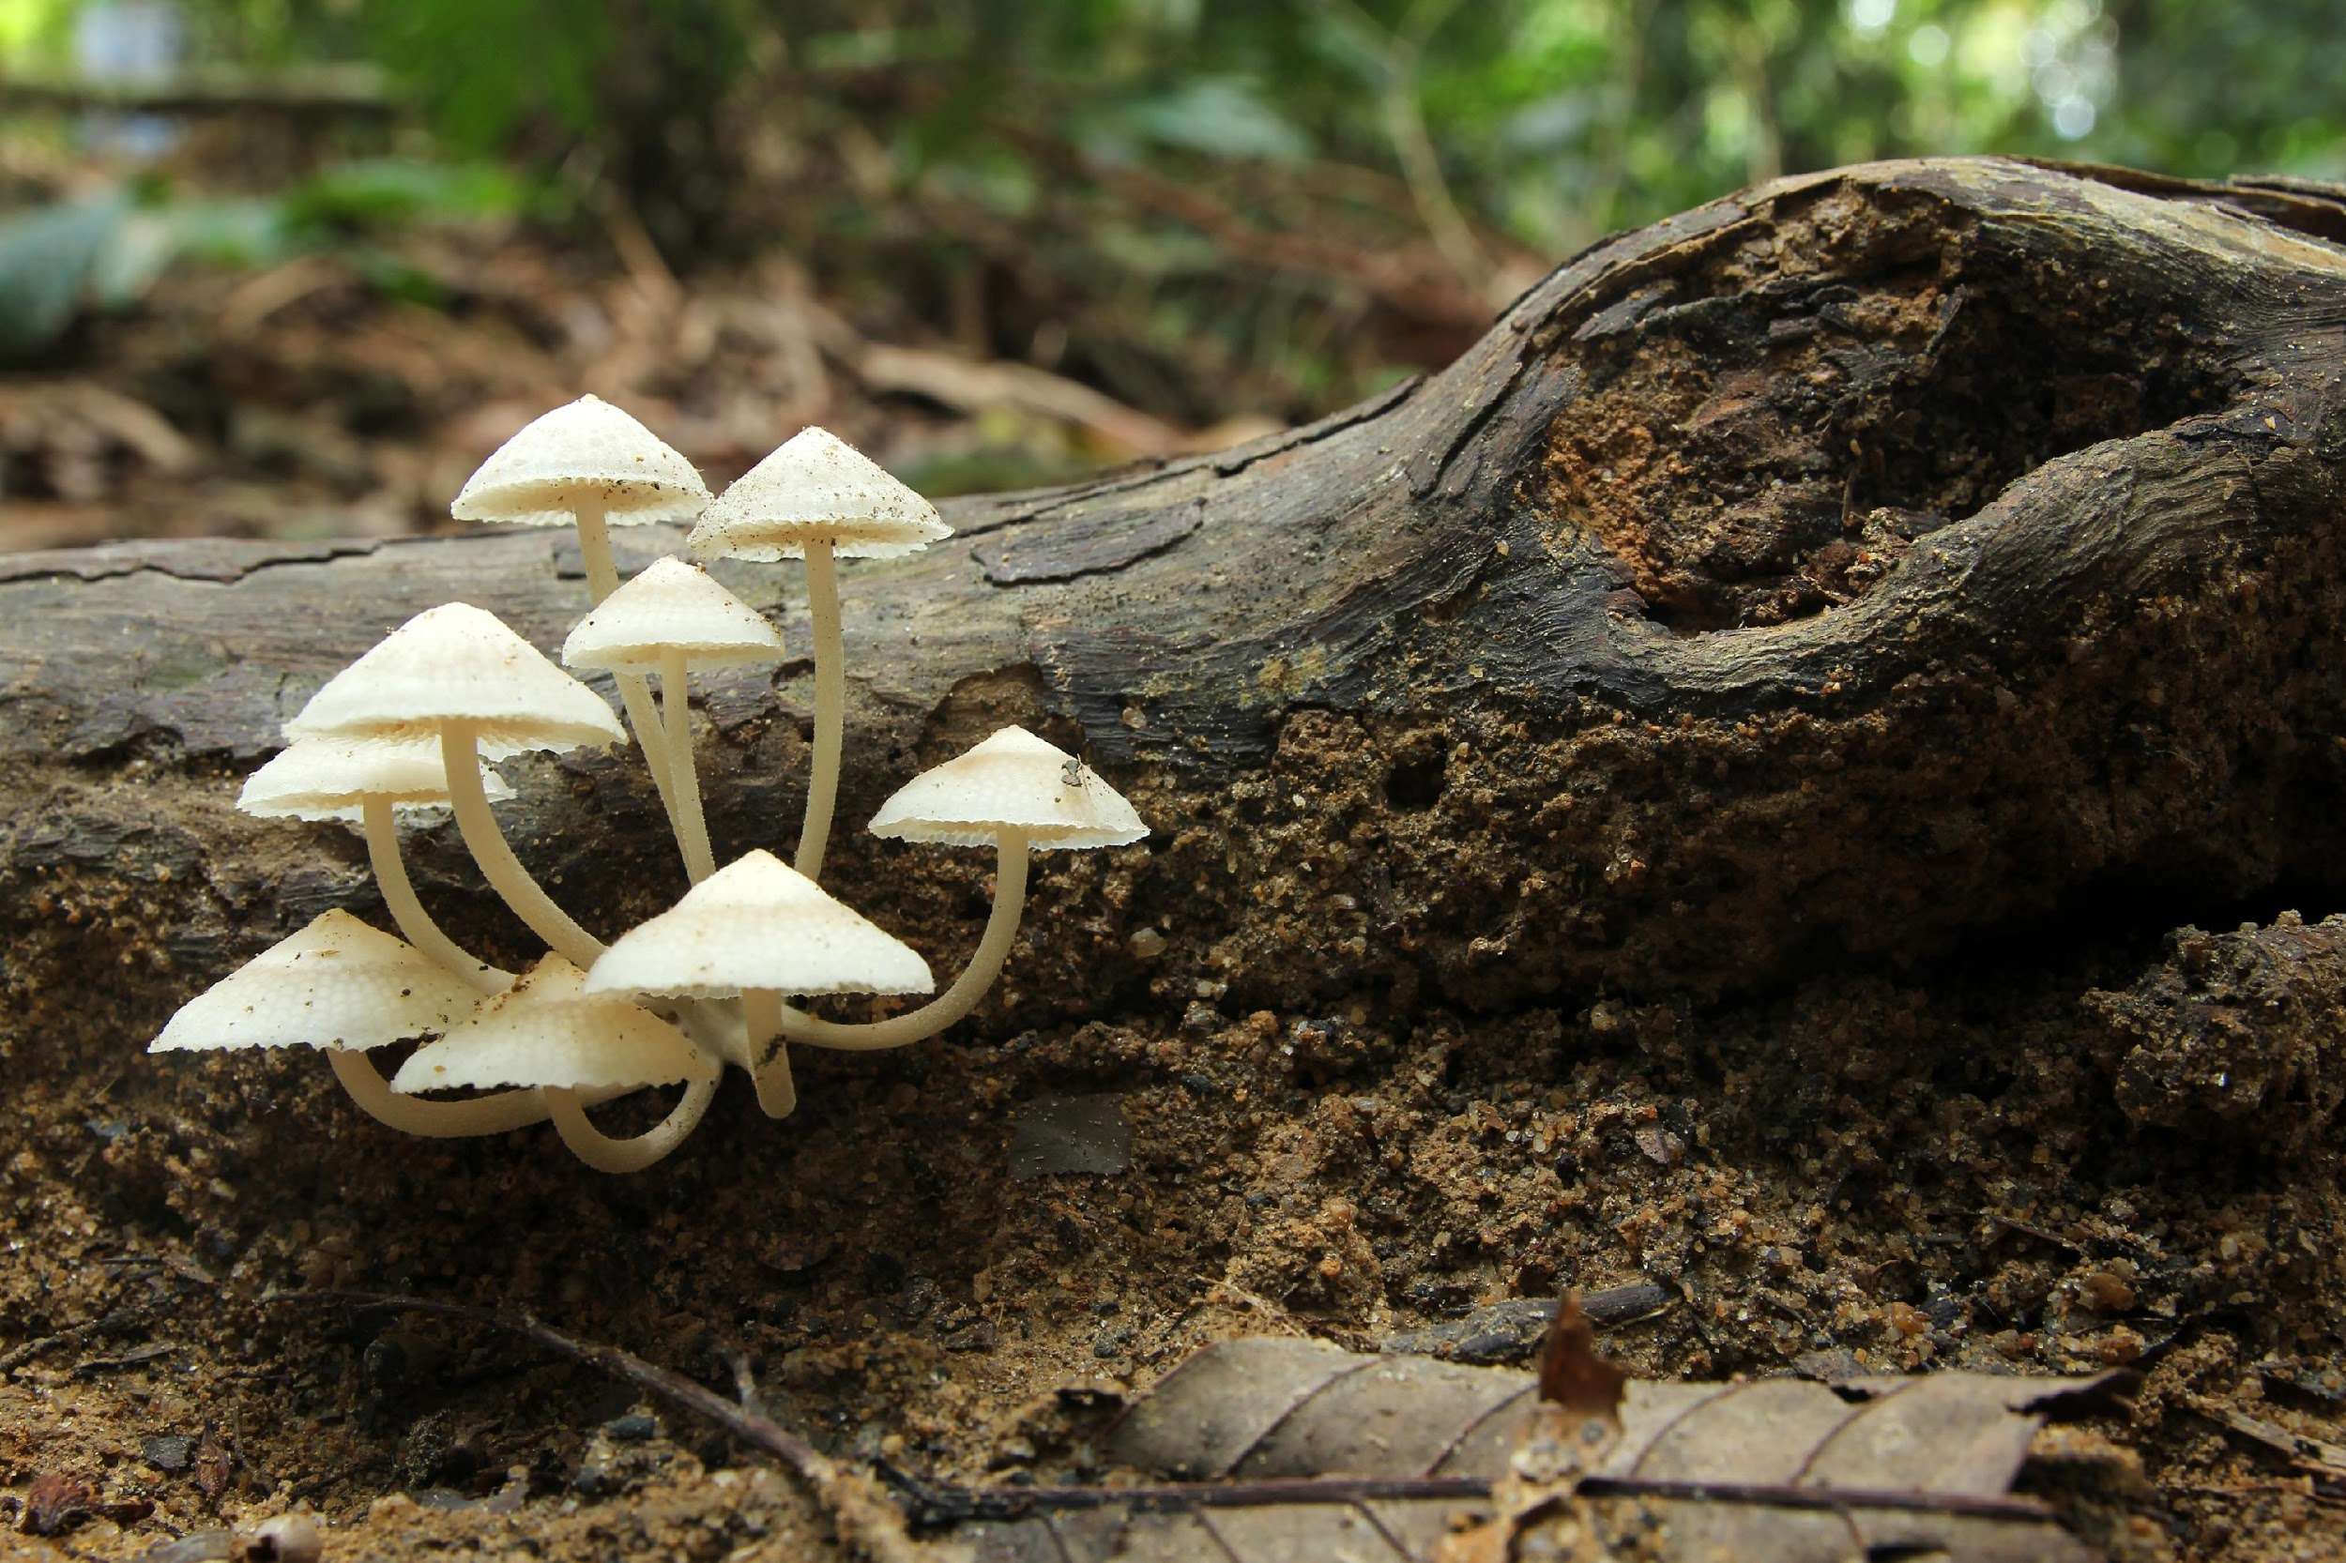
Which picture shows a primary consumer?
Notes:
Which picture shows a primary consumer?

Slide 42
Which picture shows a primary consumer?
Notes:
Which picture shows a primary consumer?
[The ant is a primary consumer because it eats plants, which are producers, and is consumed by other organisms.]

Slide 43
Secondary Consumer
Notes:
Now, let’s look at secondary consumers.
Feedback: Explicit cues can help students to prepare for what is coming next.

Slide 44
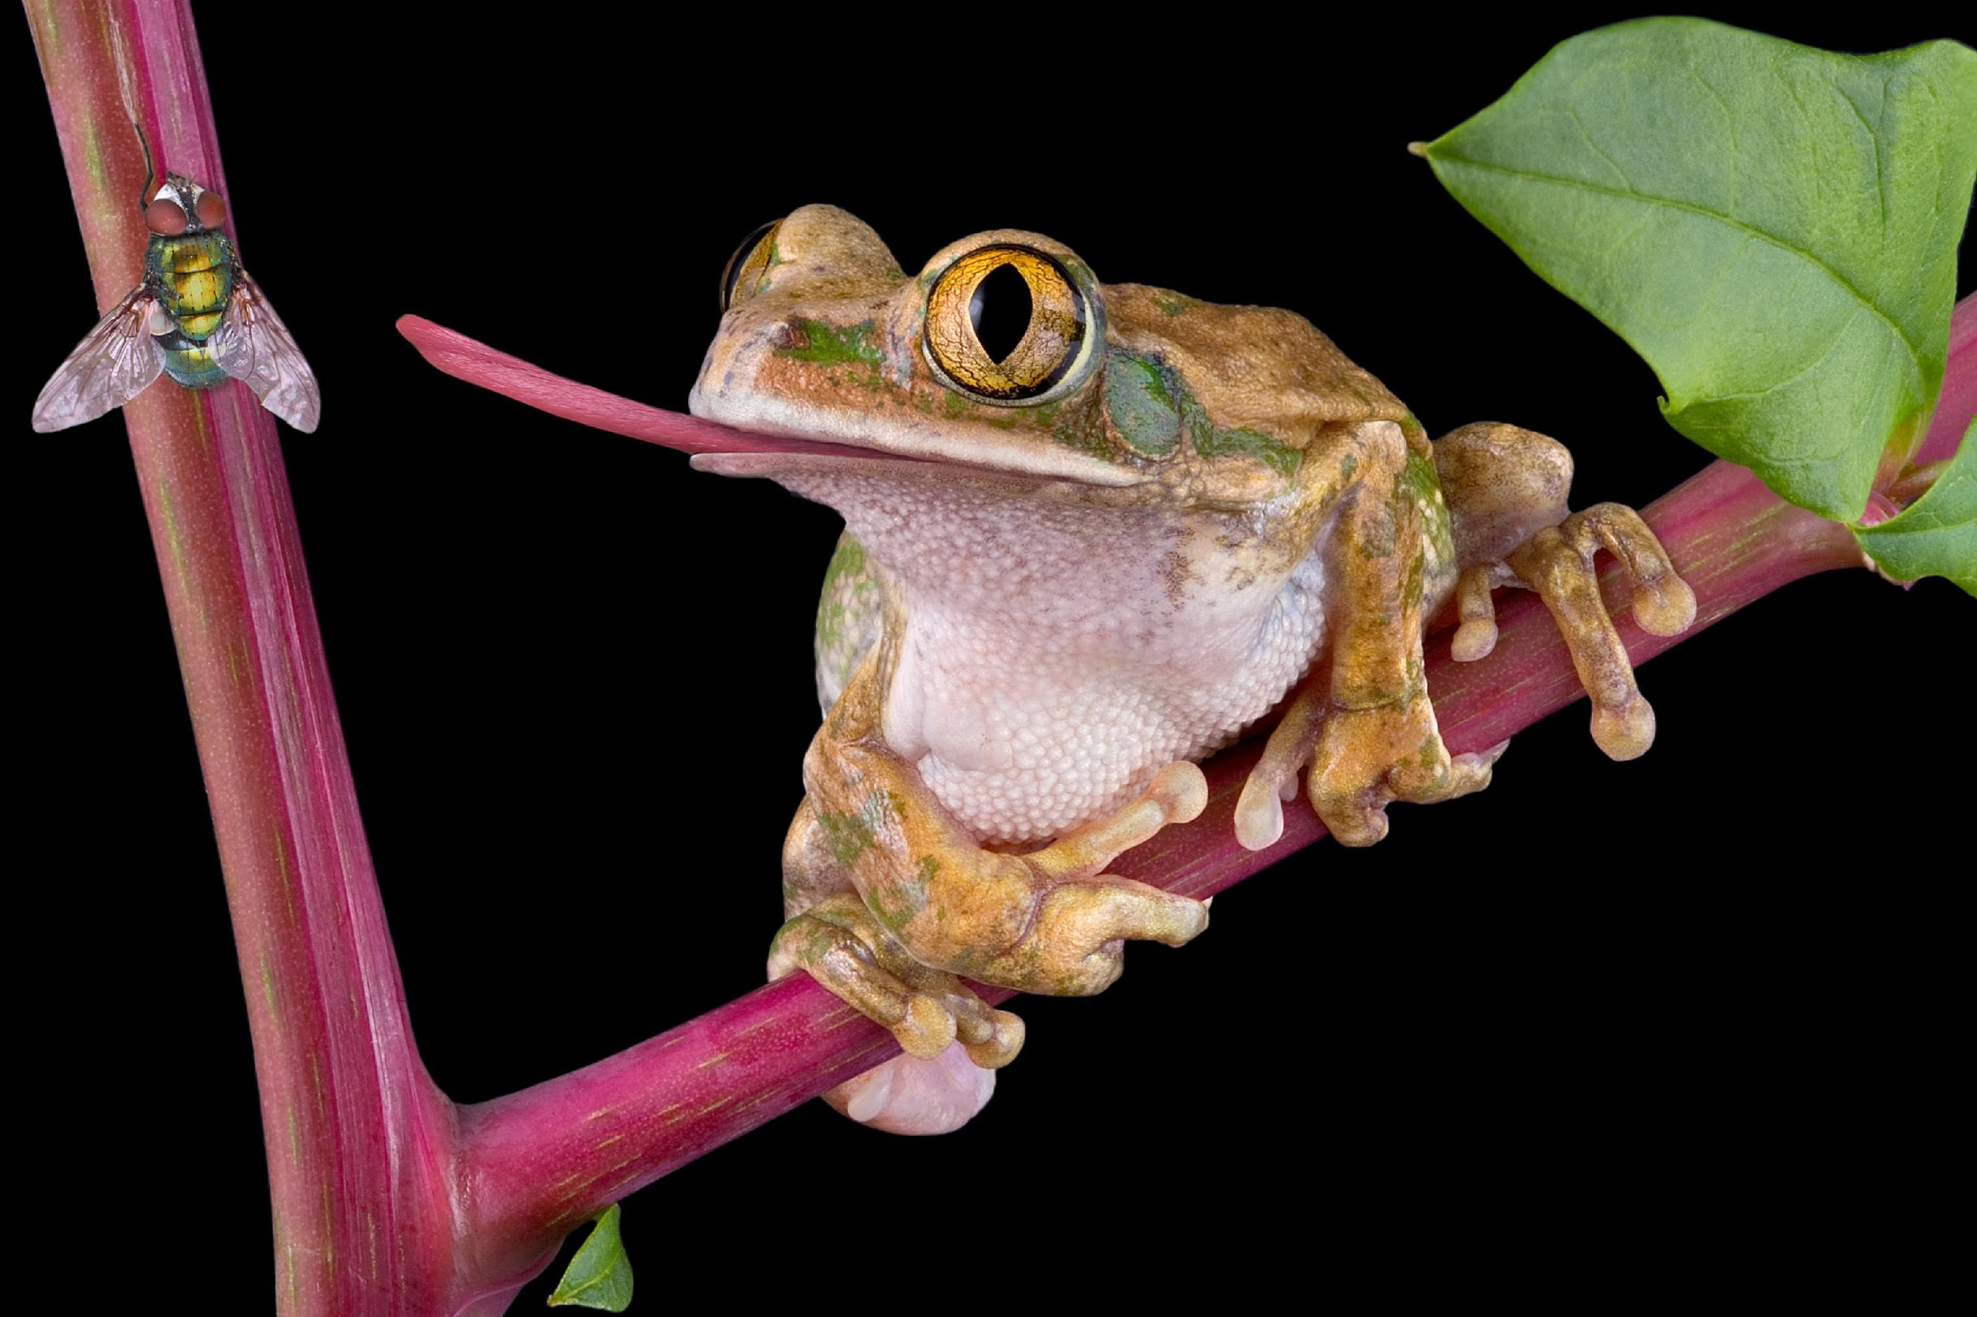
Secondary Consumers: “second-order consumers”; animals that eat primary consumers
Notes:
Secondary consumers, also known as second-order consumers, are animals that eat primary consumers.

Slide 45
Notes:
Now let’s pause for a moment to check your understanding.

Slide 46
What are secondary consumers?
Notes:
What are secondary consumers?
[Secondary consumers, also known as second-order consumer, are animals that eat primary consumers.]

Slide 47
Notes:
That’s the basic definition, but there’s a little more you should know.

Slide 48
Tertiary Consumers
Secondary Consumers
Primary Consumers
Producers
Notes:
As you can see in this pyramid, secondary consumers are less in quantity and have less energy available to them than primary consumers and producers.

Slide 49
Notes:
Now let’s pause for a moment to check your understanding.

Slide 50
True/False: Secondary consumers are more in quantity and have more energy available to them than primary consumers.
Notes:
True/False: Secondary consumers are more in quantity and have more energy available to them than primary consumers.

Slide 51
True/False: Secondary consumers are more in quantity and have more energy available to them than primary consumers.
Notes:
True/False: Secondary consumers are more in quantity and have more energy available to them than primary consumers.
[False - Secondary consumers are less in quantity and have less energy available to them than primary consumers and producers.]

Slide 52
Notes:
Now, let’s look at some examples of secondary consumers.

Slide 53
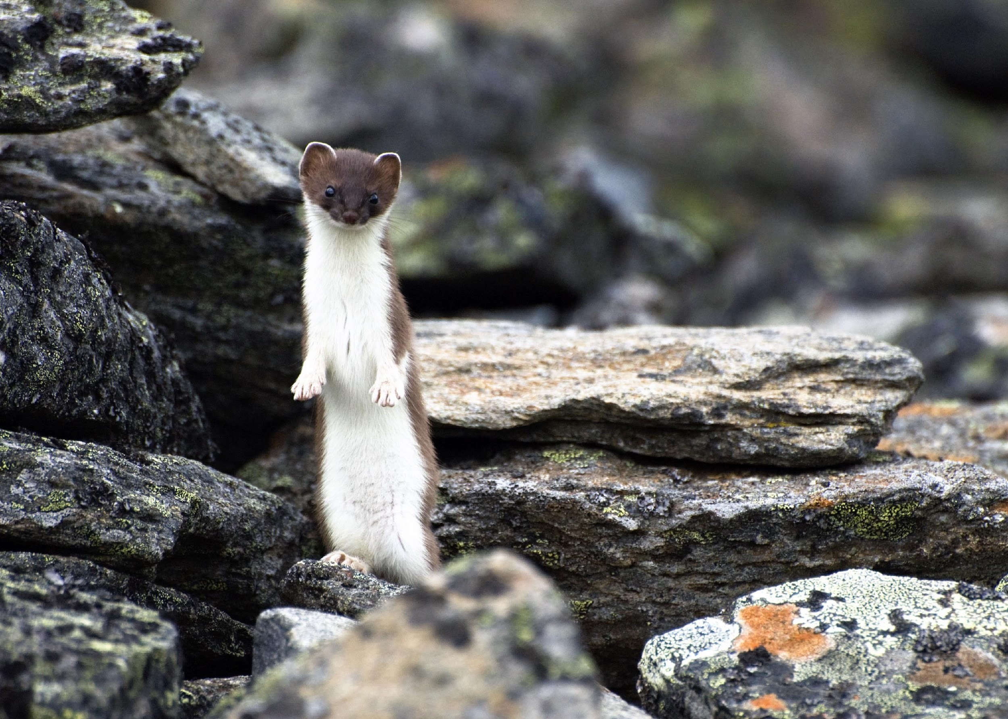
Notes:
Weasels eat medium-sized prey, like rabbits that only eat plants, so they are secondary consumers.

Slide 54
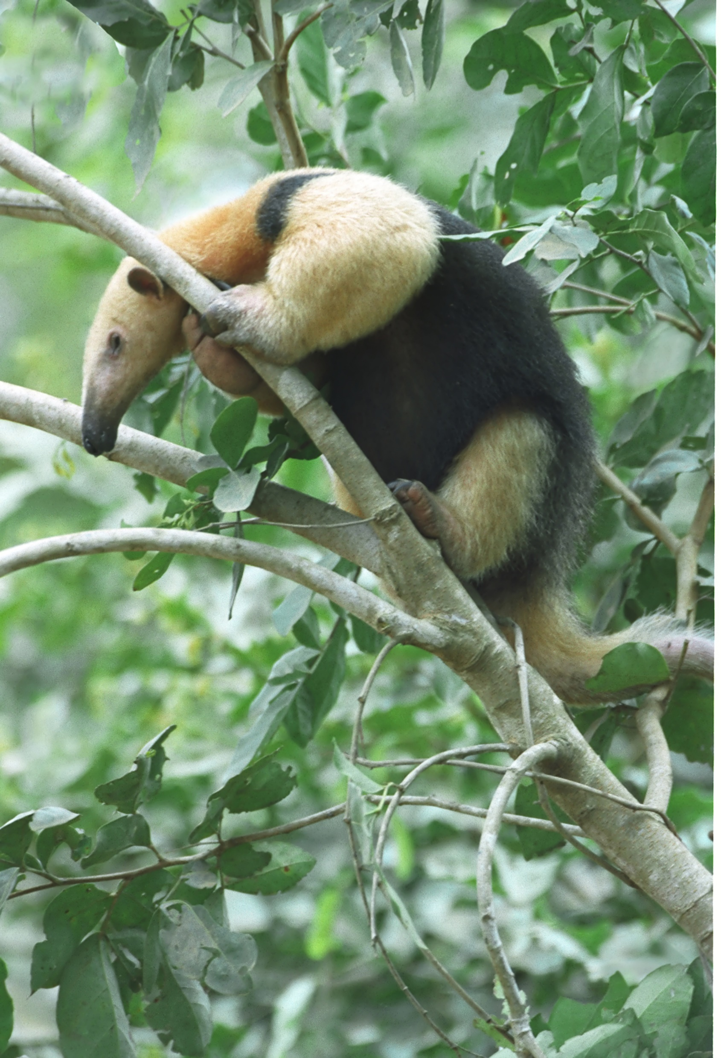
Notes:
Anteaters eat ants, which only eat plants, so they are secondary consumers.

Slide 55
Notes:
Now, let’s look at some non-examples of secondary consumers.

Slide 56
Notes:
This plant is not a secondary consumer because it is actually a producer.

Slide 57
Notes:
This elephant is not a secondary consumer. Remember it is a primary consumer because it only eats producers.

Slide 58
Notes:
Now let’s pause for a moment to check your understanding.

Slide 59
What is another example of a secondary consumer?
Notes:
What is another example of a secondary consumer?

Slide 60
Notes:
Feedback: You may choose to break the term “secondary” down in the same manner as primary, though you might also decide this is not necessary for the term.

Slide 61
Notes:
Now let’s pause for a moment to check your understanding.

Slide 62
What are secondary consumers?
Notes:
What are secondary consumers?
[Secondary consumers, also known as second-order consumer, are animals that eat primary consumers.]

Slide 63
How are primary and secondary consumers the same? How are they different?
Notes:
How are primary and secondary consumers the same? How are they different?

Slide 64
Tertiary Consumer
Notes:
Now, let’s look at tertiary consumers.

Slide 65
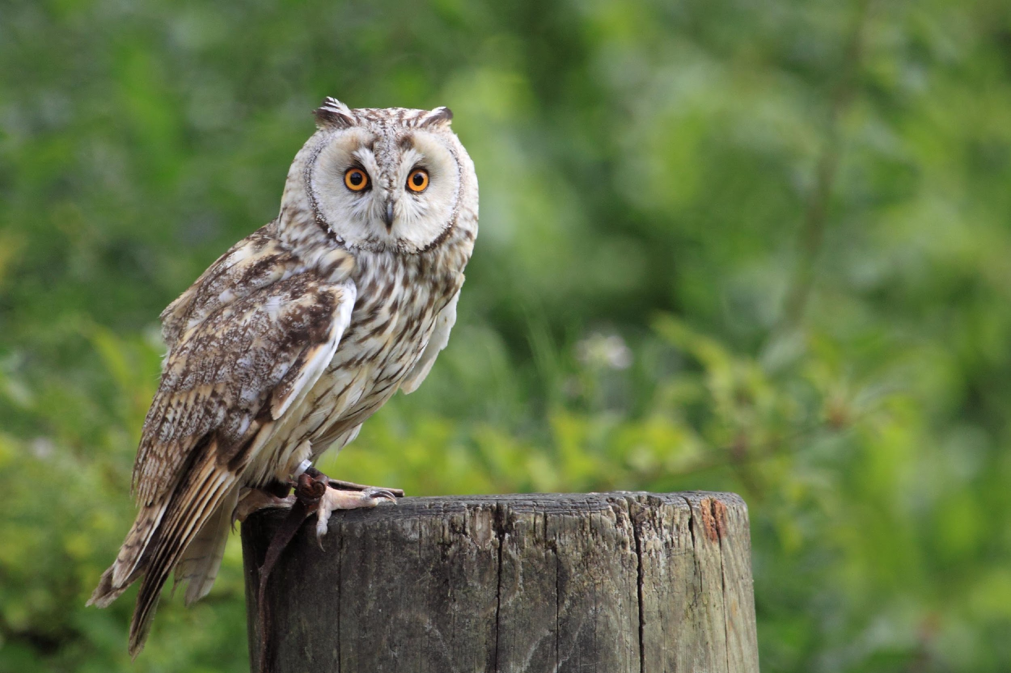
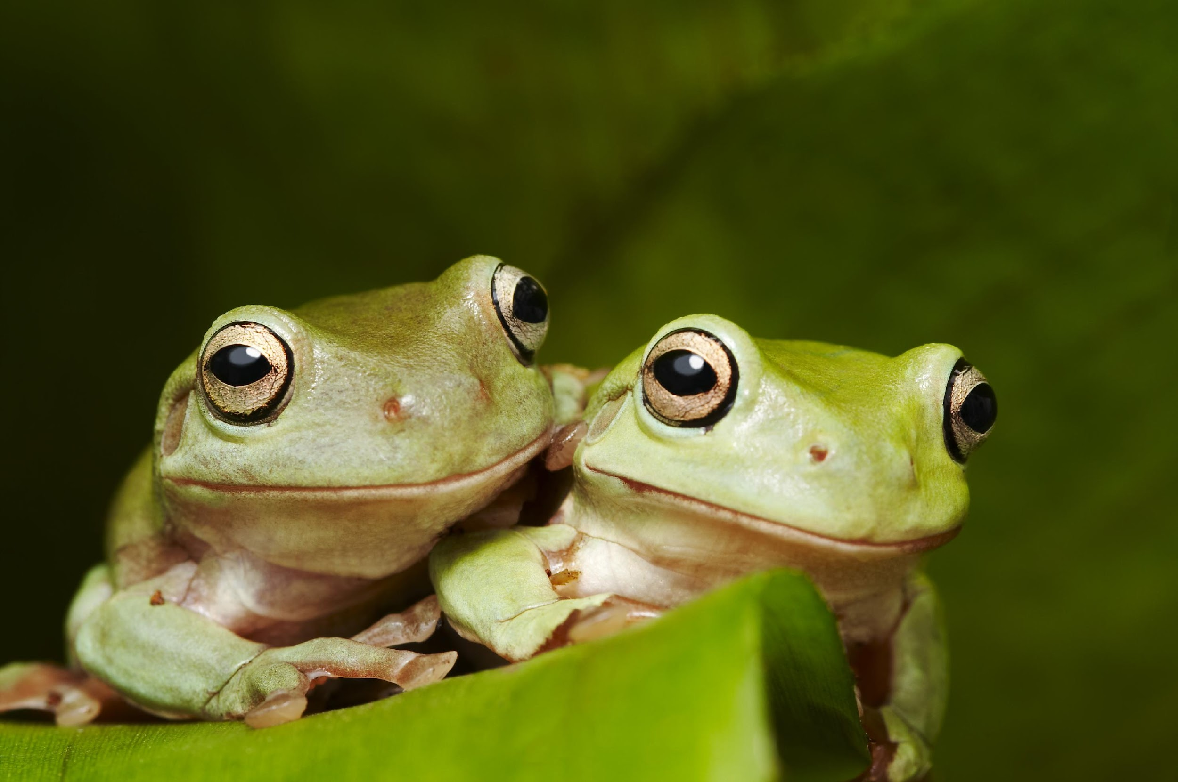
Tertiary Consumers: “third-order consumers”; animals that eat secondary consumers
Notes:
Tertiary consumers, also known as third-order consumers, are animals that eat secondary consumers.

Slide 66
Notes:
Now let’s pause for a moment to check your understanding.

Slide 67
What are tertiary consumers?
Notes:
What are tertiary consumers?
[Tertiary consumers, also known as third-order consumers, are animals that eat secondary consumers.]

Slide 68
Notes:
That’s the basic definition, but there’s a little more you should know.

Slide 69
Tertiary Consumers
Secondary Consumers
Primary Consumers
Producers
Notes:
Tertiary consumers account for less organisms and less available energy than secondary consumers.

Slide 70
Notes:
Now, let’s look at some examples of tertiary consumers.

Slide 71
Notes:
Dolphins are tertiary consumers. They eat secondary consumers like fish.

Slide 72
Notes:
Bears can be tertiary consumers.

Slide 73
Notes:
Now, let’s look at some non-examples of tertiary consumers.

Slide 74
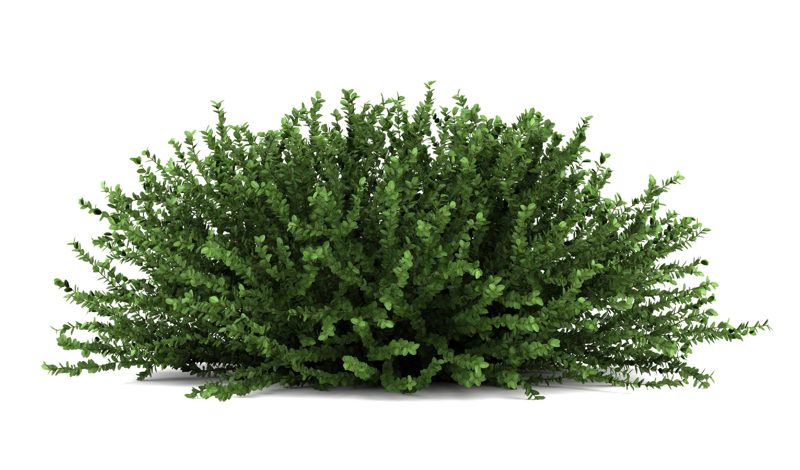
Notes:
This plant is a producer so it is not a consumer.

Slide 75
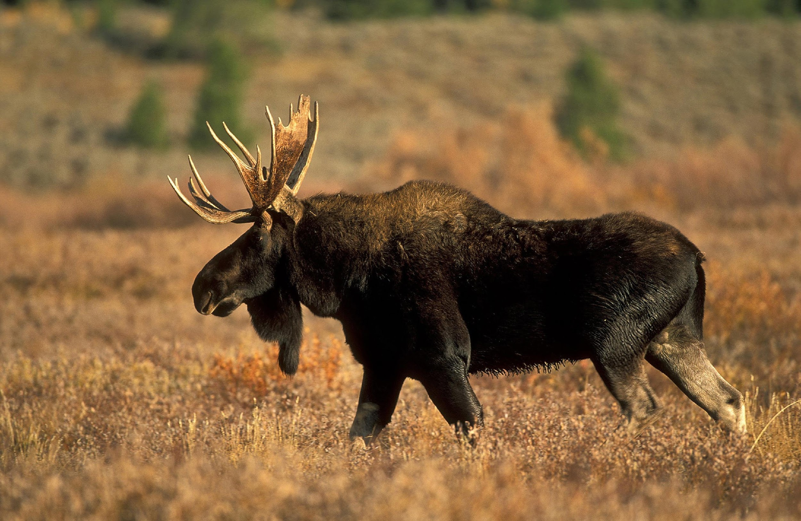
Notes:
This moose eats plants so it is a primary consumer.

Slide 76
Notes:
Now let’s pause for a moment to check your understanding.

Slide 77
What is another example of a tertiary consumer?
Notes:
What is another example of a tertiary consumer?

Slide 78
Notes:
Feedback: You may choose to break the term “tertiary” down in the same manner as primary, though you might also decide this is not necessary for the term.

Slide 79
Notes:
Now let’s pause for a moment to check your understanding.

Slide 80
What are tertiary consumers?
Notes:
What are tertiary consumers?
[Tertiary consumers, also known as third-order consumers, are animals that eat secondary consumers.]

Slide 81
Which of the following is true about secondary and tertiary consumers?
Tertiary consumers only eat producers, whereas secondary consumers eat primary consumers.
Secondary consumers are at the top of the energy pyramid
Tertiary consumers eat secondary consumers; secondary consumers eat primary consumers
Both secondary and tertiary consumers are lower on the energy pyramid than primary consumers
Notes:
Which of the following is true about secondary and tertiary consumers?

Slide 82
Which of the following is true about secondary and tertiary consumers?
Tertiary consumers only eat producers, whereas secondary consumers eat primary consumers.
Secondary consumers are at the top of the energy pyramid
Tertiary consumers eat secondary consumers; secondary consumers eat primary consumers
Both secondary and tertiary consumers are lower on the energy pyramid than primary consumers
Notes:
Which of the following is true about secondary and tertiary consumers?
[Tertiary consumers eat secondary consumers; secondary consumers eat primary consumers]

Slide 83
Which group has the smallest population and least energy available?
Primary consumers
Producers
Secondary consumers
Tertiary consumers
Notes:
Which group has the smallest population and least energy available?

Slide 84
Which group has the smallest population and least energy available?
Primary consumers
Producers
Secondary consumers
Tertiary consumers
Notes:
Which group has the smallest population and least energy available?
[Tertiary consumers]

Slide 85
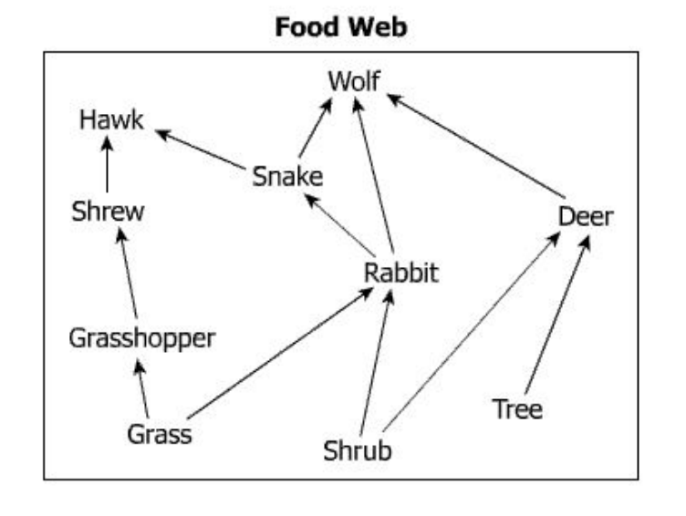
Identify the primary consumers in this food web.
Notes:
Identify the primary consumers in this food web.

Slide 86
Identify the primary consumers in this food web.
Notes:
Identify the primary consumers in this food web.
[The grasshopper, rabbit, and deer are all primary consumers because they exclusively eat plants.]

Slide 87
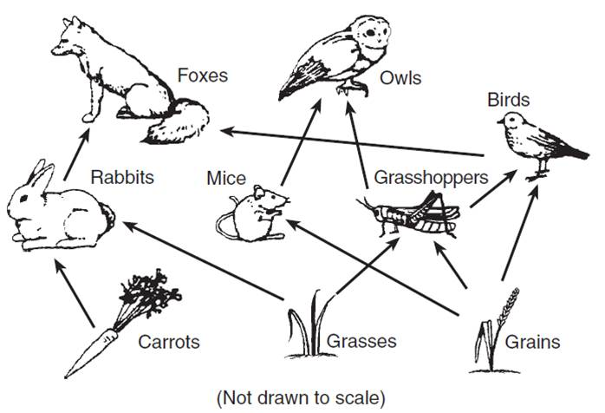
The circled organism is what type of consumer?
Notes:
The circled organism is what type of consumer?
[Tertiary]

Slide 88
Remember!!!
Notes:
So remember!

Slide 89
Primary Consumers: “first-order consumers”; animals that eat plants and are eaten by other organisms
Notes:
Primary consumers, also known as first-order consumers, are animals that eat plants and are eaten by other organisms.

Slide 90
Secondary Consumers: “second-order consumers”; animals that eat primary consumers
Notes:
Secondary consumers, also known as second-order consumers, are animals that eat primary consumers.

Slide 91
Tertiary Consumers: “third-order consumers”; animals that eat secondary consumers
Notes:
Tertiary consumers, also known as third-order consumers, are animals that eat secondary consumers.

Slide 92
Third-order Consumers
Alternative names used on
Virginia
SOLs
Second-order consumers
First-order consumers
Producers
Notes:
These are the names on the Virginia SOLs.

Slide 93
Tertiary Consumers
Secondary Consumers
Decreasing population size
Decreasing energy availability
Primary Consumers
Producers
Notes:
This pyramid shows that moving up through the levels of consumers, the amount of energy available for consumption decreases, as does the population of consumers.

Slide 94
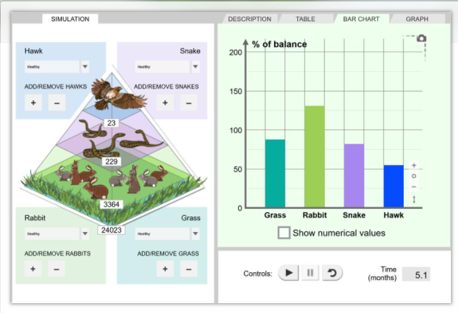
Simulation Activity
Food Chain and Ecosystem Simulation
(Gizmos)
Click the link above for a simulation to deepen your understanding of food webs, food chains, and ecosystems.
Notes:
*The food chain and ecosystem simulation can be used as a reinforcement activity for the concept of consumer levels.

Slide 95
Big Question: How are consumers important to our world?
Notes:
Our “big question” is: How are consumers important to our world?
[Pause and illicit predictions from students.]
I love all these thoughtful scientific hypotheses! Be sure to keep this question and your predictions in mind as we move through these next few lessons, and we’ll continue to revisit it.
Feedback: Offering students an opportunity to evaluate their earlier hypotheses and make changes based on their new understandings is an important part of the iterative process in science. This is a great opportunity to help students build an epistemic understanding by explicitly stating how continuing to change and build on hypotheses as your knowledge grows is an important part of the discipline of science!

Slide 96
Notes:
Thanks for watching, and please continue watching CAPs available from this website.

Slide 97
This Video Was Created With Resources From:
Questions or Comments
Michael Kennedy, Ph.D. MKennedy@Virginia.edu
Rachel L Kunemund, Ph.D. rk8vm@virginia.edu

