Slide 1
Intro
“Big Idea” Question
Review Concepts
Check-In Questions
Teacher Demo
Vocabulary
Student-Friendly Definition
Examples & Non-Examples
Morphological Word Parts
Extension Activity
Notes:
OK everyone, get ready for our next lesson. Just as a reminder, these are the different components that our lesson may include, and you’ll see these icons in the top left corner of each slide so that you can follow along more easily!

Slide 2
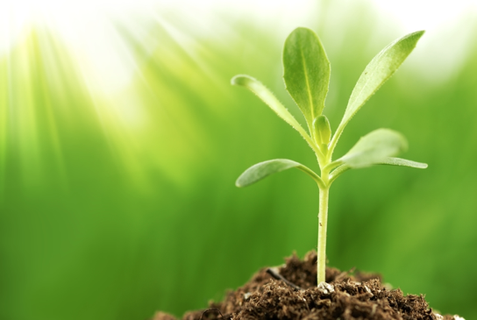
Intro
Producers
Notes:
Today we will learn about producers.

Slide 3
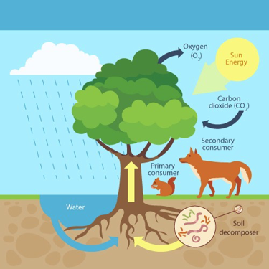
Big Questions: What relationships exist among producers, consumers, and decomposers?
Notes:
Our “big question” is: What relationships exist among producers, consumers, and decomposers?
[Pause and illicit predictions from students.]
I love all these thoughtful scientific hypotheses! Be sure to keep this question and your predictions in mind as we move through these next few lessons, and we’ll continue to revisit it.

Slide 4
Demonstration
Food Chains and Food Webs Review
The link above includes several ideas for engaging students with the topics of food chains and food webs. As you review these topics with your class, prompt students to consider how energy moves through an ecosystem.
Questions to Consider:
How can we categorize organisms at different levels within food chains and food webs?
What do the organisms at the lowest level have in common?
What is their food source?
What do the organisms at the highest level have in common?
Notes:
Let’s do a quick demonstration that will help get our brains ready to think about producers, consumers, and decomposers.

Slide 5
Notes:
Before we define the terms producer, consumer, and decomposer, let’s review some other words that you already learned, and make sure you are firm in your understanding.

Slide 6
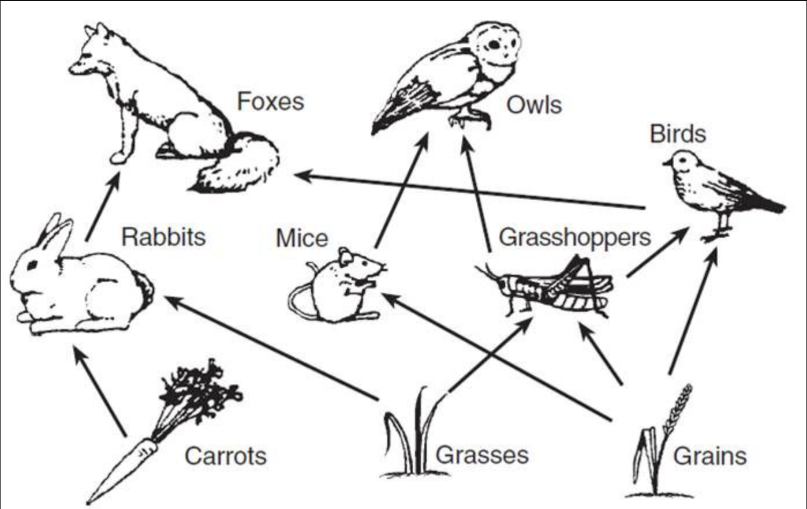
Food Webs: show the feeding relationship among organisms in an ecosystem
Notes:
Food webs show the feeding relationship among organisms in an ecosystem.

Slide 7
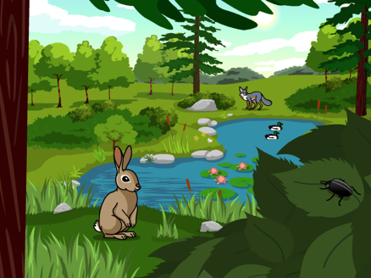
Ecosystem: a community of organisms that interact with each other and their environment
Notes:
An ecosystem is a community of organisms that interact with each other and their environment.

Slide 8
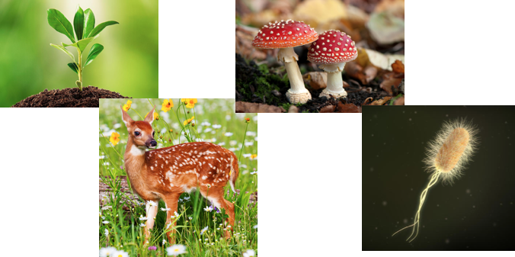
Biotic factors are the…
Ecosystem: a community of organisms that interact with each other and their environment
Notes:
These biotic factors that interact with each other in an ecosystem…

Slide 9
Abiotic factors are the…
Ecosystem: a community of organisms that interact with each other and their environment
Notes:
… While abiotic factors are the non-living things in an ecosystem’s environment that organisms interact with.

Slide 10
Notes:
Now let’s pause for a moment to check your understanding.

Slide 11
What are food webs?
Notes:
What are food webs?
[Food webs show the feeding relationship among organisms in an ecosystem.]

Slide 12
What is an ecosystem?
Notes:
What is an ecosystem?
[An ecosystem is a community of living and non-living things interacting with each other in an environment.]

Slide 13
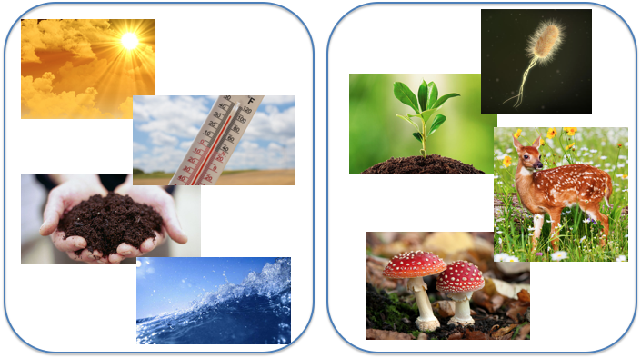
What is the difference between biotic and abiotic factors in an ecosystem?
Notes:
What is the difference between biotic and abiotic factors in an ecosystem?
[Biotic factors are the living things, or organisms, that interact with each other in an ecosystem. Abiotic factors are the non-living things in an ecosystem’s environment that organisms interact with.]

Slide 14
Producer
Notes:
Now that we’ve reviewed, let’s define our new term, producer.

Slide 15
Producers: organisms that use energy to make their own food
Notes:
Producers are organisms that use energy to make their own food.

Slide 16
Notes:
Now let’s pause for a moment to check your understanding.

Slide 17
What are producers?
Notes:
What are producers?
[Producers are organisms that use energy to make their own food.]

Slide 18
Notes:
That is the basic definition, but there is a bit more you need to know.

Slide 19
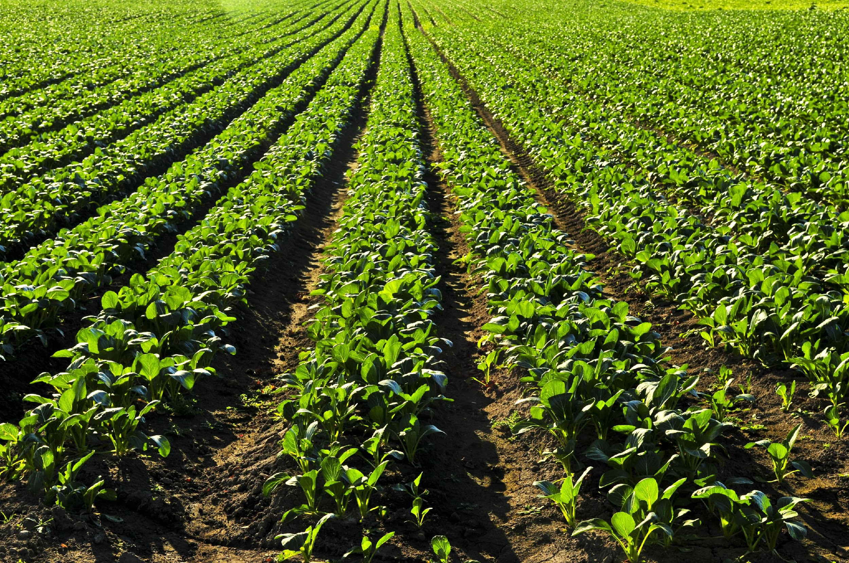
Green plants make their own food using photosynthesis
Notes:
Green plants make their own food using photosynthesis.

Slide 20
Green plants are producers
Notes:
So this makes them producers

Slide 21
Notes:
Now, let’s talk about some more specific examples of producers.

Slide 22
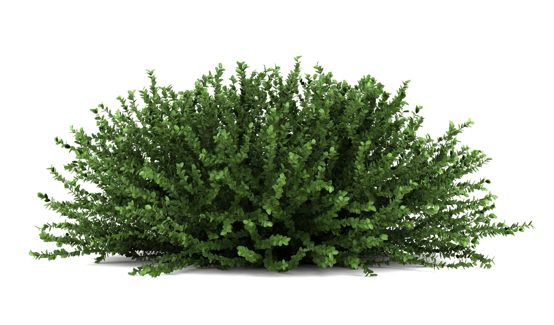
Notes:
This green plant uses photosynthesis to make its own food.

Slide 23
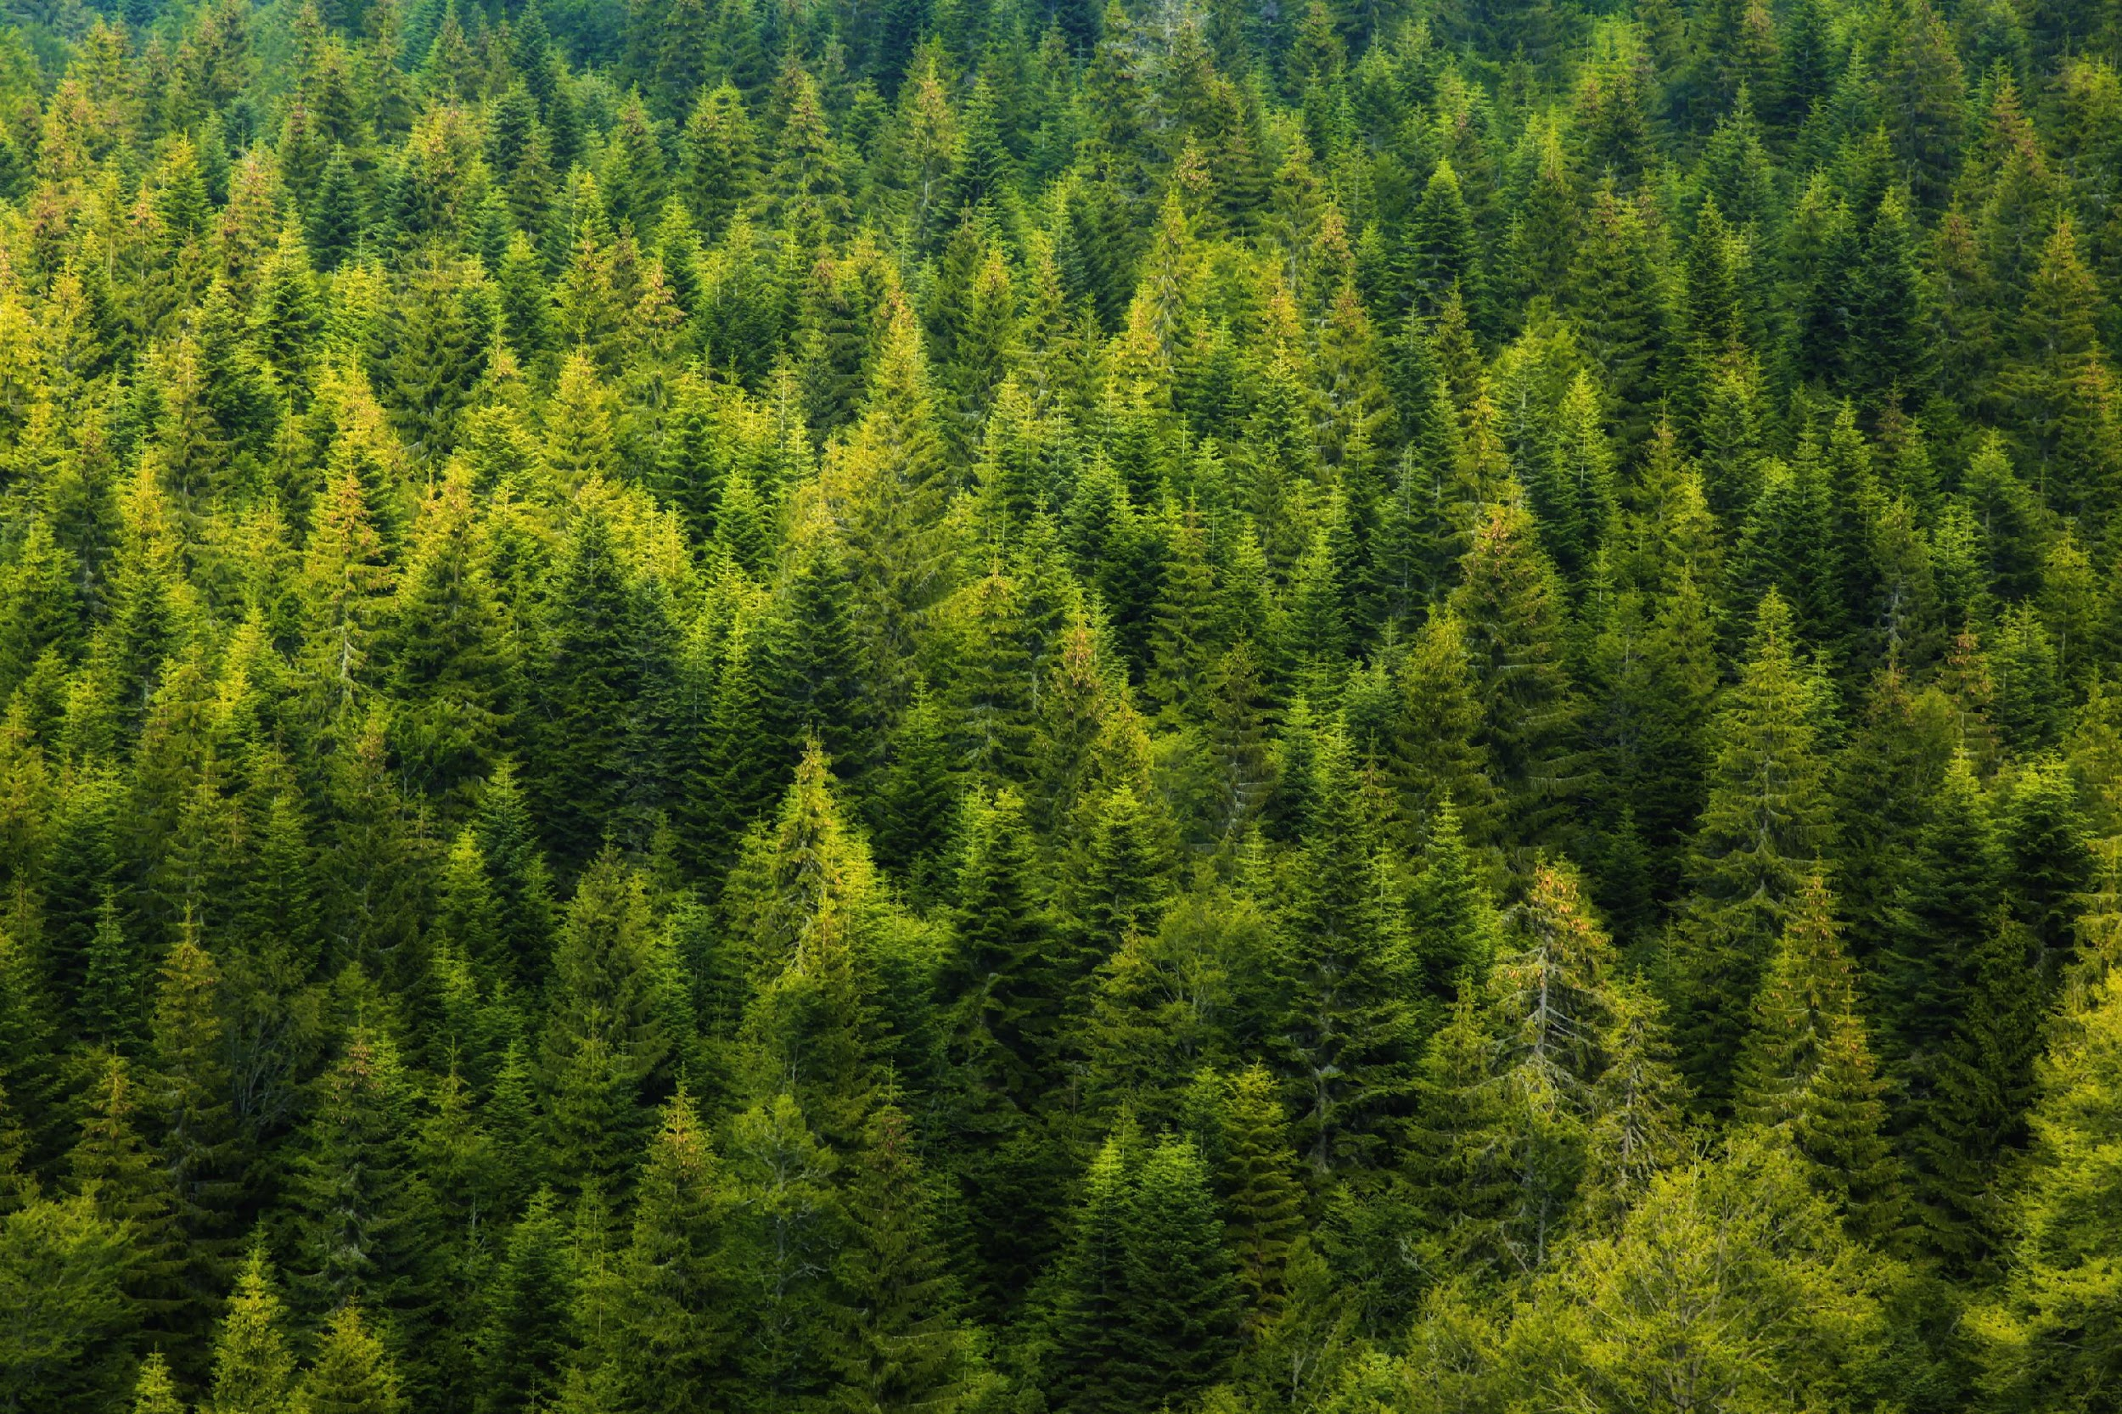
Notes:
The trees in this forest also use photosynthesis to make their own food. It’s important to note that not all producers use photosynthesis, but many of them do.

Slide 24
Notes:
Next, let’s look at some non-examples of producers.

Slide 25
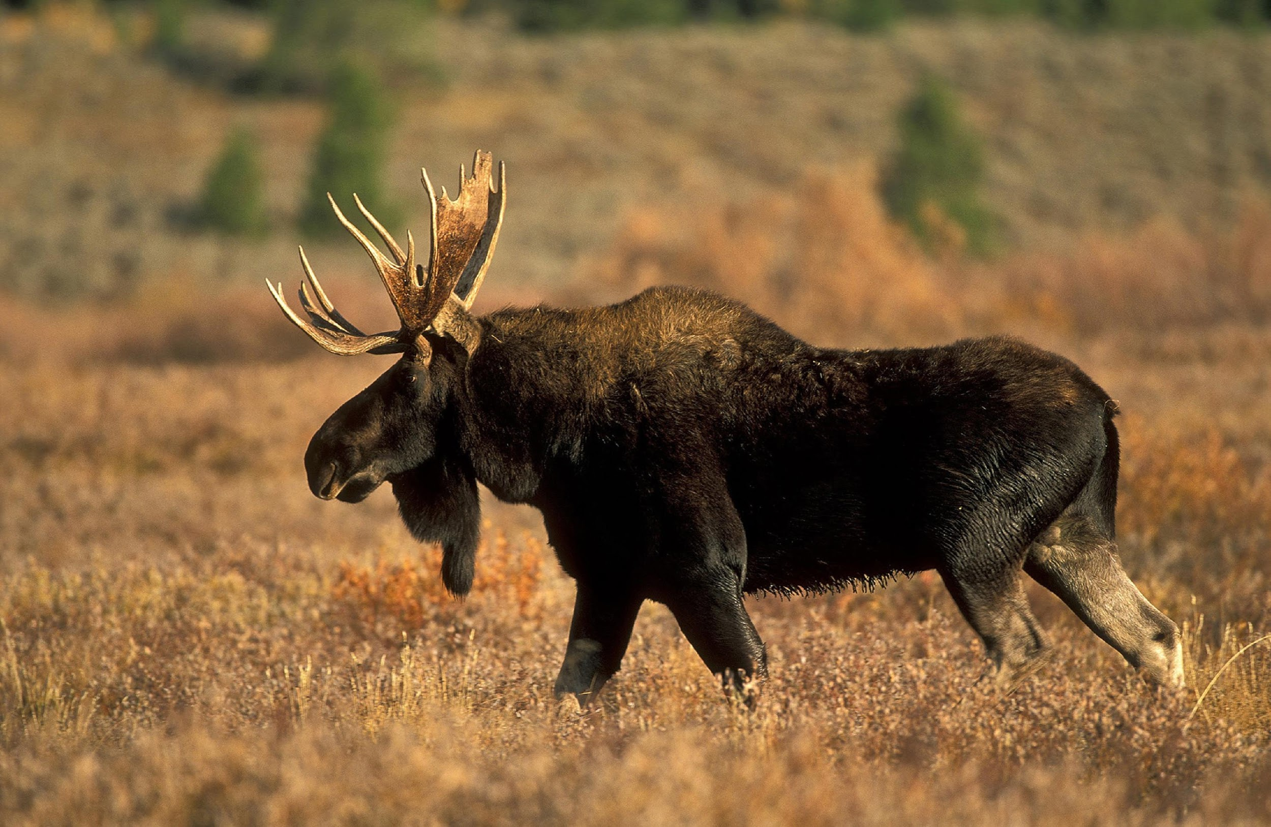
Notes:
Moose cannot make their own food, they must consume food in the form of plants.

Slide 26
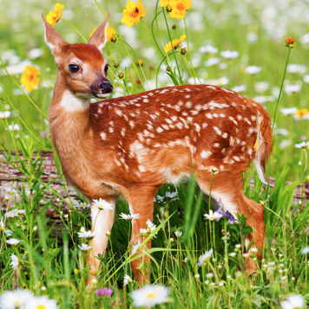
Notes:
Deer are not producers because they cannot make their own food.

Slide 27
Notes:
Let’s check-in for understanding about producers.

Slide 28
What is an example of a producer?
Notes:
What is an example of a producer?

Slide 29
Notes:
We can also break down the term producer into different word parts to help us remember the meaning. Let’s take a look!

Slide 30
Producer
Produce
-er
(root word)
(suffix)
Notes:
The word producer can be broken into two parts. The root word, produce, and the suffix, -er.

Slide 31
Producer
Produce
-er
to make
Notes:
The root word, produce, means “to make”.

Slide 32
Producer
Produce
-er
Suffix that turns a verb (to make) into a noun (maker)
Notes:
The suffix, -er, turns a verb such as “to make”, into a noun - maker.

Slide 33
Produce
-er
Producer
Someone/something that makes things
Notes:
So, when you add the suffix, -er to the root word produce, this means someone or something that makes things.

Slide 34
So, when we use the term producers, we are talking about organisms that make their own food.
Notes:
When we talk about producers in Life Science, we are referring to organisms that make their own food.

Slide 35
Notes:
Let’s check-in for understanding about producers.

Slide 36
How can we use the word parts of producer to help us remember the definition of the term?
Producer
Produce
-er
(root word)
(suffix)
Notes:
How can we use the word parts of producer to help us remember the definition of the term?
[The word producer can be broken into two parts. The root word, produce, and the suffix, -er.
The root word, produce, means “to make”.
The suffix, -er, turns a verb such as “to make”, into a noun - maker.
So, when you add the suffix, -er to the root word produce, this means someone or something that makes things.]

Slide 37
What are producers?
Notes:
What are producers?
[Producers are organisms that use energy to make their own food.]

Slide 38
List 3 examples of producers.
Notes:
List 3 examples of producers.

Slide 39
Why is a deer NOT an example of a producer?
Notes:
Why is a deer NOT an example of a producer?

Slide 40
Remember!!!
Notes:
So remember!

Slide 41
Producers: organisms that use energy to make their own food
Notes:
Producers are organisms that use energy to make their own food.

Slide 42
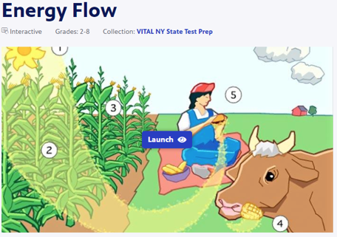
Simulation Activity
Energy Flow Interactive
(PBS Learning Media)
Click the link above to explore how energy flows between different types of organisms in an ecosystem.
In this simulation activity, you’ll learn why the amount of energy that plants get from the sun is not converted into the same amount of energy as it’s passed on to other organisms.

Slide 43
Big Questions: What relationships exist among producers, consumers, and decomposers?
Notes:
Explicit cue to revisit the big question at the end of the lesson: Okay everyone. Now that we’ve learned the term, producers, let’s reflect once more on our big question. Was there anything that we predicted earlier that was correct or incorrect? Do you have any new hypotheses to share?

Slide 44
Notes:
Thanks for watching, and please continue watching CAPs available from this website!

Slide 45
This Video Was Created With Resources From:
Questions or Comments
Michael Kennedy, Ph.D. MKennedy@Virginia.edu
Rachel L Kunemund, Ph.D. rk8vm@virginia.edu

Slide 46
Intro
“Big Idea” Question
Review Concepts
Check-In Questions
Teacher Demo
Vocabulary
Student-Friendly Definition
Examples & Non-Examples
Morphological Word Parts
Extension Activity
Notes:
OK everyone, get ready for our next lesson. Just as a reminder, these are the different components that our lesson may include, and you’ll see these icons in the top left corner of each slide so that you can follow along more easily!

Slide 47
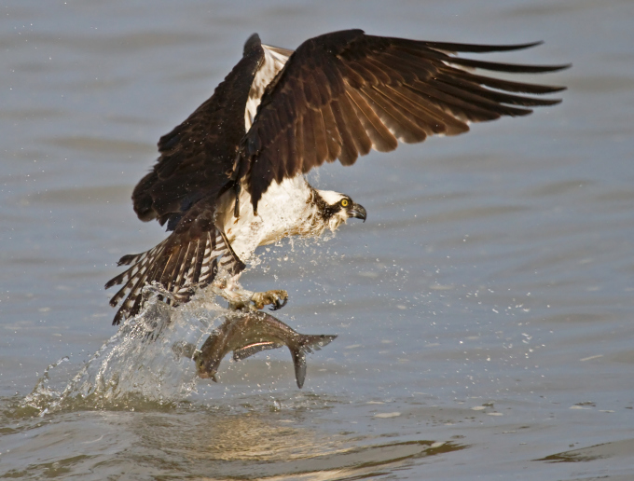
Intro
Consumers
Notes:
Today we will learn about consumers.

Slide 48
Big Questions: What relationships exist among producers, consumers, and decomposers?
Notes:
Our “big question” is: What relationships exist among producers, consumers, and decomposers?
[Pause and illicit predictions from students.]
I love all these thoughtful scientific hypotheses! Be sure to keep this question and your predictions in mind as we move through these next few lessons, and we’ll continue to revisit it.

Slide 49
Demonstration
TEACHER DIRECTIONS
If wanting to include some sort of demonstration (you may not feel it’s necessary for this term), you can consider capturing/sharing video footage of different consumers in nature (insects eating plants, deer eating leaves/grass, human eating an omnivorous meal). If doing so, be sure to engage students in questioning/making predictions based upon observations – What were some of the differences you noticed among the consumers you saw? What do you think might happen if there were no deer eating these plants? How do you think birds get their energy to fly? (etc.)
Notes:
Let’s do a quick demonstration that will help get our brains ready to think about consumers, and how they relate to our big question.

Slide 50
Notes:
Before we define the terms producer, consumer, and decomposer, let’s review some other words that you already learned, and make sure you are firm in your understanding.

Slide 51
Food Webs: show the feeding relationship among organisms in an ecosystem
Notes:
Food webs show the feeding relationship among organisms in an ecosystem.

Slide 52
Ecosystem: a community of organisms that interact with each other and their environment
Notes:
An ecosystem is a community of organisms that interact with each other and their environment.

Slide 53
Biotic factors are the…
Ecosystem: a community of organisms that interact with each other and their environment
Notes:
These biotic factors that interact with each other in an ecosystem…

Slide 54
Abiotic factors are the…
Ecosystem: a community of organisms that interact with each other and their environment
Notes:
… While abiotic factors are the non-living things in an ecosystem’s environment that organisms interact with.

Slide 55
Producers: organisms that use energy to make their own food
Notes:
Producers are organisms that use energy to make their own food.

Slide 56
Notes:
Now let’s pause for a moment to check your understanding.

Slide 57
What are food webs?
Notes:
What are food webs?
[Food webs show the feeding relationship among organisms in an ecosystem.]

Slide 58
What is an ecosystem?
Notes:
What is an ecosystem?
[An ecosystem is a community of living and non-living things interacting with each other in an environment.]

Slide 59
What is the difference between biotic and abiotic factors in an ecosystem?
Notes:
What is the difference between biotic and abiotic factors in an ecosystem?
[Biotic factors are the living things, or organisms, that interact with each other in an ecosystem. Abiotic factors are the non-living things in an ecosystem’s environment that organisms interact with.]

Slide 60
What are producers?
Notes:
What are producers?
[Producers are organisms that use energy to make their own food.]

Slide 61
Consumer
Notes:
Lastly, let’s define the term consumer.

Slide 62
Consumers: organisms which eat other organisms for energy
Notes:
Consumers eat other organisms to get the energy they need.

Slide 63
Notes:
Now let’s pause for a moment to check your understanding.

Slide 64
What are consumers?
Notes:
What are consumers?
[Consumers are organisms which eat other organisms for energy.]

Slide 65
Notes:
That is the basic definition, but there is a bit more you need to know.

Slide 66
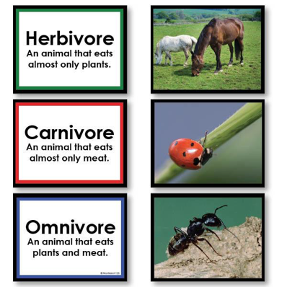
Consumers may eat plants, animals, or both plants and animals.
Notes:
It’s also important to note that consumers may eat plants, animals, or both plants AND animals. These different types of consumers are called herbivores, carnivores, and omnivores - these are probably words you’ve heard of in elementary school science.

Slide 67
Notes:
Now, let’s look at some examples of consumers.

Slide 68
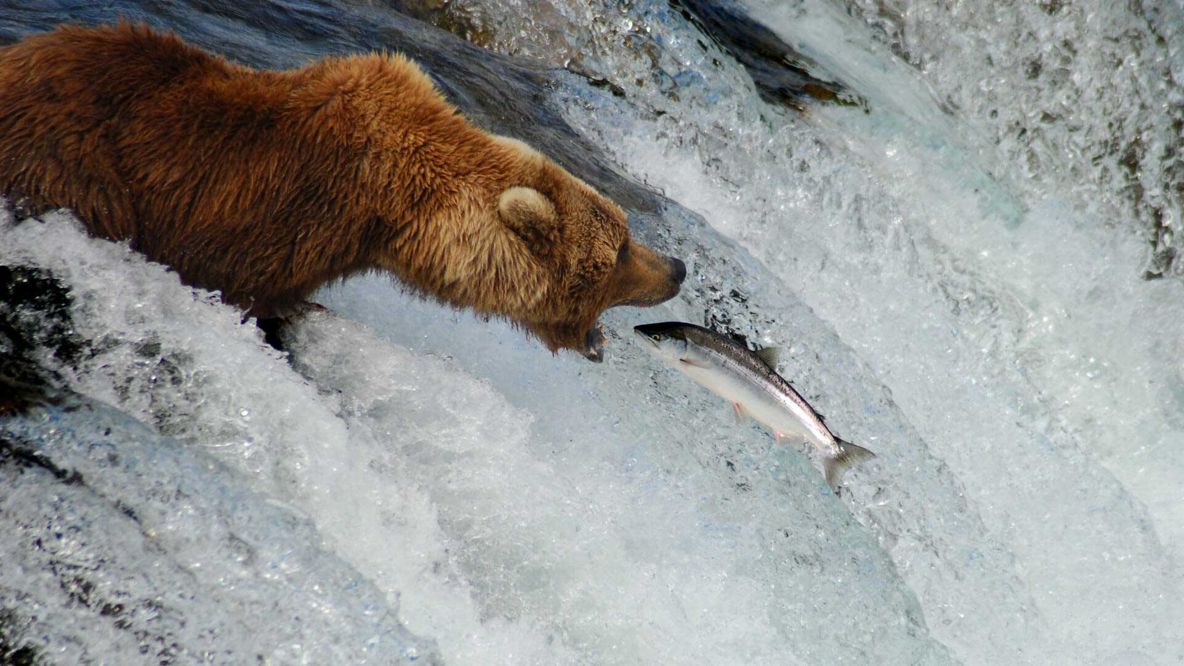
Notes:
Bears are consumers because they eat other organisms (including salmon and even berries from plants).

Slide 69
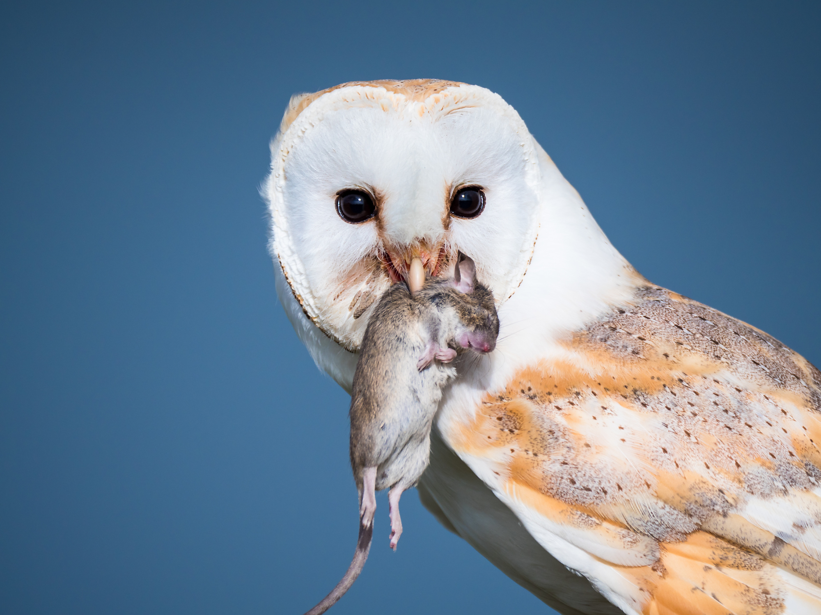
Notes:
Owls also consume other organisms – mostly rodents such as mice.

Slide 70
Notes:
People are consumers.

Slide 71
Notes:
Next, let’s talk about some non-examples of consumers.

Slide 72
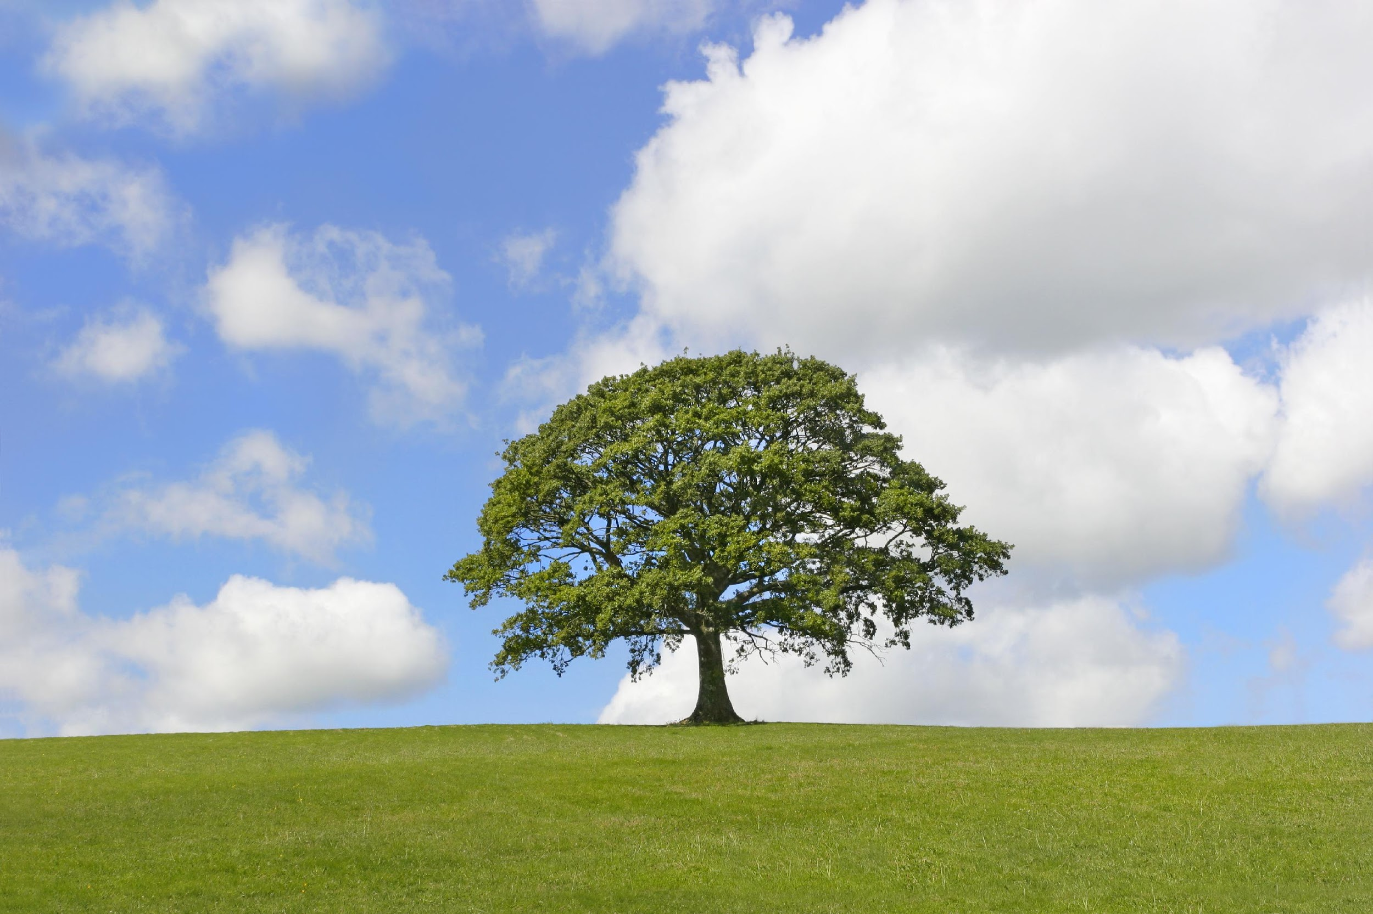
Notes:
A tree is a producer – it performs photosynthesis and uses energy from the sun to make its own food.

Slide 73
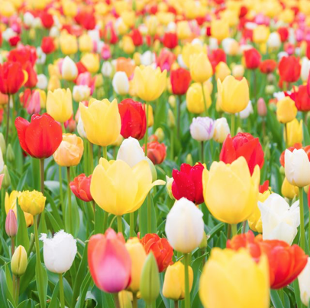
Notes:
Flowers are not consumers, they are producers.

Slide 74
Notes:
Let’s check-in for understanding.

Slide 75
What is an example of a consumer?
Notes:
What is an example of a consumer?

Slide 76
Notes:
We can also break down the term consumer into different word parts to help us remember the meaning. Let’s take a look!

Slide 77
Consumer
Consume
-er
(root word)
(suffix)
Notes:
The word consumer can be broken into two parts. The root word, consume, and the suffix, -er.

Slide 78
Consumer
Consume
-er
to eat, drink, or ingest
Notes:
The root word, consume, means “to eat, drink, or ingest”.

Slide 79
Consumer
Consume
-er
Suffix that turns a verb (to eat) into a noun (eater)
Notes:
The suffix, -er, turns a verb such as “to eat”, into a noun - eater.

Slide 80
Consume
-er
Consumer
Someone/something that eats things
Notes:
So, when you add the suffix, -er to the root word consume, this means someone or something that eats things.

Slide 81
So, when we use the term consumers, we are referring to organisms that eat other organisms.
Notes:
When we talk about consumers in Life Science, we are referring to organisms that eat other organisms.

Slide 82
Notes:
Now let’s pause for a moment to check your understanding.

Slide 83
How can we use the word parts of consumer to help us remember the definition of the term?
Consumer
Consume
-er
(root word)
(suffix)
Notes:
How can we use the word parts of consumer to help us remember the definition of the term?
[The word consumer can be broken into two parts. The root word, consume, and the suffix, -er.
The root word, consume, means “to eat, drink, or ingest”.
The suffix, -er, turns a verb such as “to eat”, into a noun - eater.
So, when you add the suffix, -er to the root word consume, this means someone or something that eats things.
When we talk about consumers in Life Science, we are referring to organisms that eat other organisms.]

Slide 84
What are consumers?
Notes:
What are consumers?
[Consumers are organisms which eat other organisms for energy.]

Slide 85
True/False: Consumers only eat other animals.
Notes:
True/False: Consumers only eat other animals.

Slide 86
True/False: Consumers only eat other animals.
Notes:
True/False: Consumers only eat other animals.
[False - consumers eat other animals, plants, or both.]

Slide 87
List 3 examples of consumers.
Notes:
List 3 examples of consumers.

Slide 88
Remember!!!
Notes:
So remember!

Slide 89
Consumers: organisms which eat other organisms for energy
Notes:
Consumers eat other organisms to get the energy they need.

Slide 90
Consumers may eat plants, animals, or both plants and animals.
Notes:
It’s also important to note that consumers may eat plants, animals, or both plants AND animals. These different types of consumers are called herbivores, carnivores, and omnivores - these are probably words you’ve heard of in elementary school science.

Slide 91
Simulation Activity
Energy Flow Interactive
(PBS Learning Media)
Click the link above to explore how energy flows between different types of organisms in an ecosystem.
In this simulation activity, you’ll learn why the amount of energy that plants get from the sun is not converted into the same amount of energy as it’s passed on to other organisms.

Slide 92
Big Questions: What relationships exist among producers, consumers, and decomposers?
Notes:
Explicit cue to revisit the big question at the end of the lesson: Okay everyone. Now that we’ve learned the term, consumers, let’s reflect once more on our big question. Was there anything that we predicted earlier that was correct or incorrect? Do you have any new hypotheses to share?

Slide 93
Notes:
Thanks for watching, and please continue watching CAPs available from this website!

Slide 94
This Video Was Created With Resources From:
Questions or Comments
Michael Kennedy, Ph.D. MKennedy@Virginia.edu
Rachel L Kunemund, Ph.D. rk8vm@virginia.edu

Slide 95
Intro
“Big Idea” Question
Review Concepts
Check-In Questions
Teacher Demo
Vocabulary
Student-Friendly Definition
Examples & Non-Examples
Morphological Word Parts
Extension Activity
Notes:
OK everyone, get ready for our next lesson. Just as a reminder, these are the different components that our lesson may include, and you’ll see these icons in the top left corner of each slide so that you can follow along more easily!

Slide 96
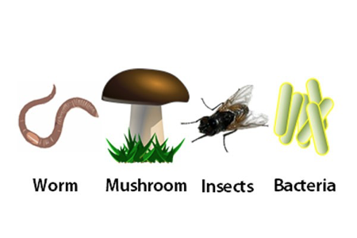
Decomposers
Intro
Notes:
Today we will learn about decomposers.

Slide 97
Big Questions: What relationships exist among producers, consumers, and decomposers?
Notes:
Our “big question” is: What relationships exist among producers, consumers, and decomposers?
[Pause and illicit predictions from students.]
I love all these thoughtful scientific hypotheses! Be sure to keep this question and your predictions in mind as we move through these next few lessons, and we’ll continue to revisit it.

Slide 98
Demonstration
TEACHER DIRECTIONS
If wanting to include some sort of demonstration (you may not feel it’s necessary for this term), you can consider capturing/sharing video footage of different consumers in nature (insects eating plants, deer eating leaves/grass, human eating an omnivorous meal). If doing so, be sure to engage students in questioning/making predictions based upon observations – What were some of the differences you noticed among the consumers you saw? What do you think might happen if there were no deer eating these plants? How do you think birds get their energy to fly? (etc.)
Notes:
Let’s do a quick demonstration that will help get our brains ready to think about consumers, and how they relate to our big question.

Slide 99
Notes:
Before we define the terms producer, consumer, and decomposer, let’s review some other words that you already learned, and make sure you are firm in your understanding.

Slide 100
Food Webs: show the feeding relationship among organisms in an ecosystem
Notes:
Food webs show the feeding relationship among organisms in an ecosystem.

Slide 101
Ecosystem: a community of organisms that interact with each other and their environment
Notes:
An ecosystem is a community of organisms that interact with each other and their environment.

Slide 102
Biotic factors are the…
Ecosystem: a community of organisms that interact with each other and their environment
Notes:
These biotic factors that interact with each other in an ecosystem…

Slide 103
Abiotic factors are the…
Ecosystem: a community of organisms that interact with each other and their environment
Notes:
… While abiotic factors are the non-living things in an ecosystem’s environment that organisms interact with.

Slide 104
Producers: organisms that use energy to make their own food
Notes:
Producers are organisms that use energy to make their own food.

Slide 105
Consumers: organisms which eat other organisms for energy
Notes:
Consumers eat other organisms to get the energy they need.

Slide 106
Consumers may eat plants, animals, or both plants and animals.
Notes:
It’s also important to note that consumers may eat plants, animals, or both plants AND animals. These different types of consumers are called herbivores, carnivores, and omnivores - these are probably words you’ve heard of in elementary school science.

Slide 107
Notes:
Now let’s pause for a moment to check your understanding.

Slide 108
What are food webs?
Notes:
What are food webs?
[Food webs show the feeding relationship among organisms in an ecosystem.]

Slide 109
What is an ecosystem?
Notes:
What is an ecosystem?
[An ecosystem is a community of living and non-living things interacting with each other in an environment.]

Slide 110
What is the difference between biotic and abiotic factors in an ecosystem?
Notes:
What is the difference between biotic and abiotic factors in an ecosystem?
[Biotic factors are the living things, or organisms, that interact with each other in an ecosystem. Abiotic factors are the non-living things in an ecosystem’s environment that organisms interact with.]

Slide 111
What are producers?
Notes:
What are producers?
[Producers are organisms that use energy to make their own food.]

Slide 112
What are consumers?
Notes:
What are consumers?
[Consumers are organisms which eat other organisms for energy.]

Slide 113
True/False: Consumers only eat other animals.
Notes:
True/False: Consumers only eat other animals.

Slide 114
True/False: Consumers only eat other animals.
Notes:
True/False: Consumers only eat other animals.
[False - consumers eat other animals, plants, or both.]

Slide 115
Decomposer
Notes:
Now, let’s define the term decomposer.

Slide 116
Decomposers: organisms that break down the remains of other dead organisms
Notes:
Decomposers break down the remains of other dead organisms.

Slide 117
Notes:
Now let’s pause for a moment to check your understanding.

Slide 118
What are decomposers?
Notes:
What are decomposers?
[Decomposers are organisms that break down the remains of other dead organisms.]

Slide 119
Notes:
That is the basic definition, but there is a bit more you need to know.

Slide 120
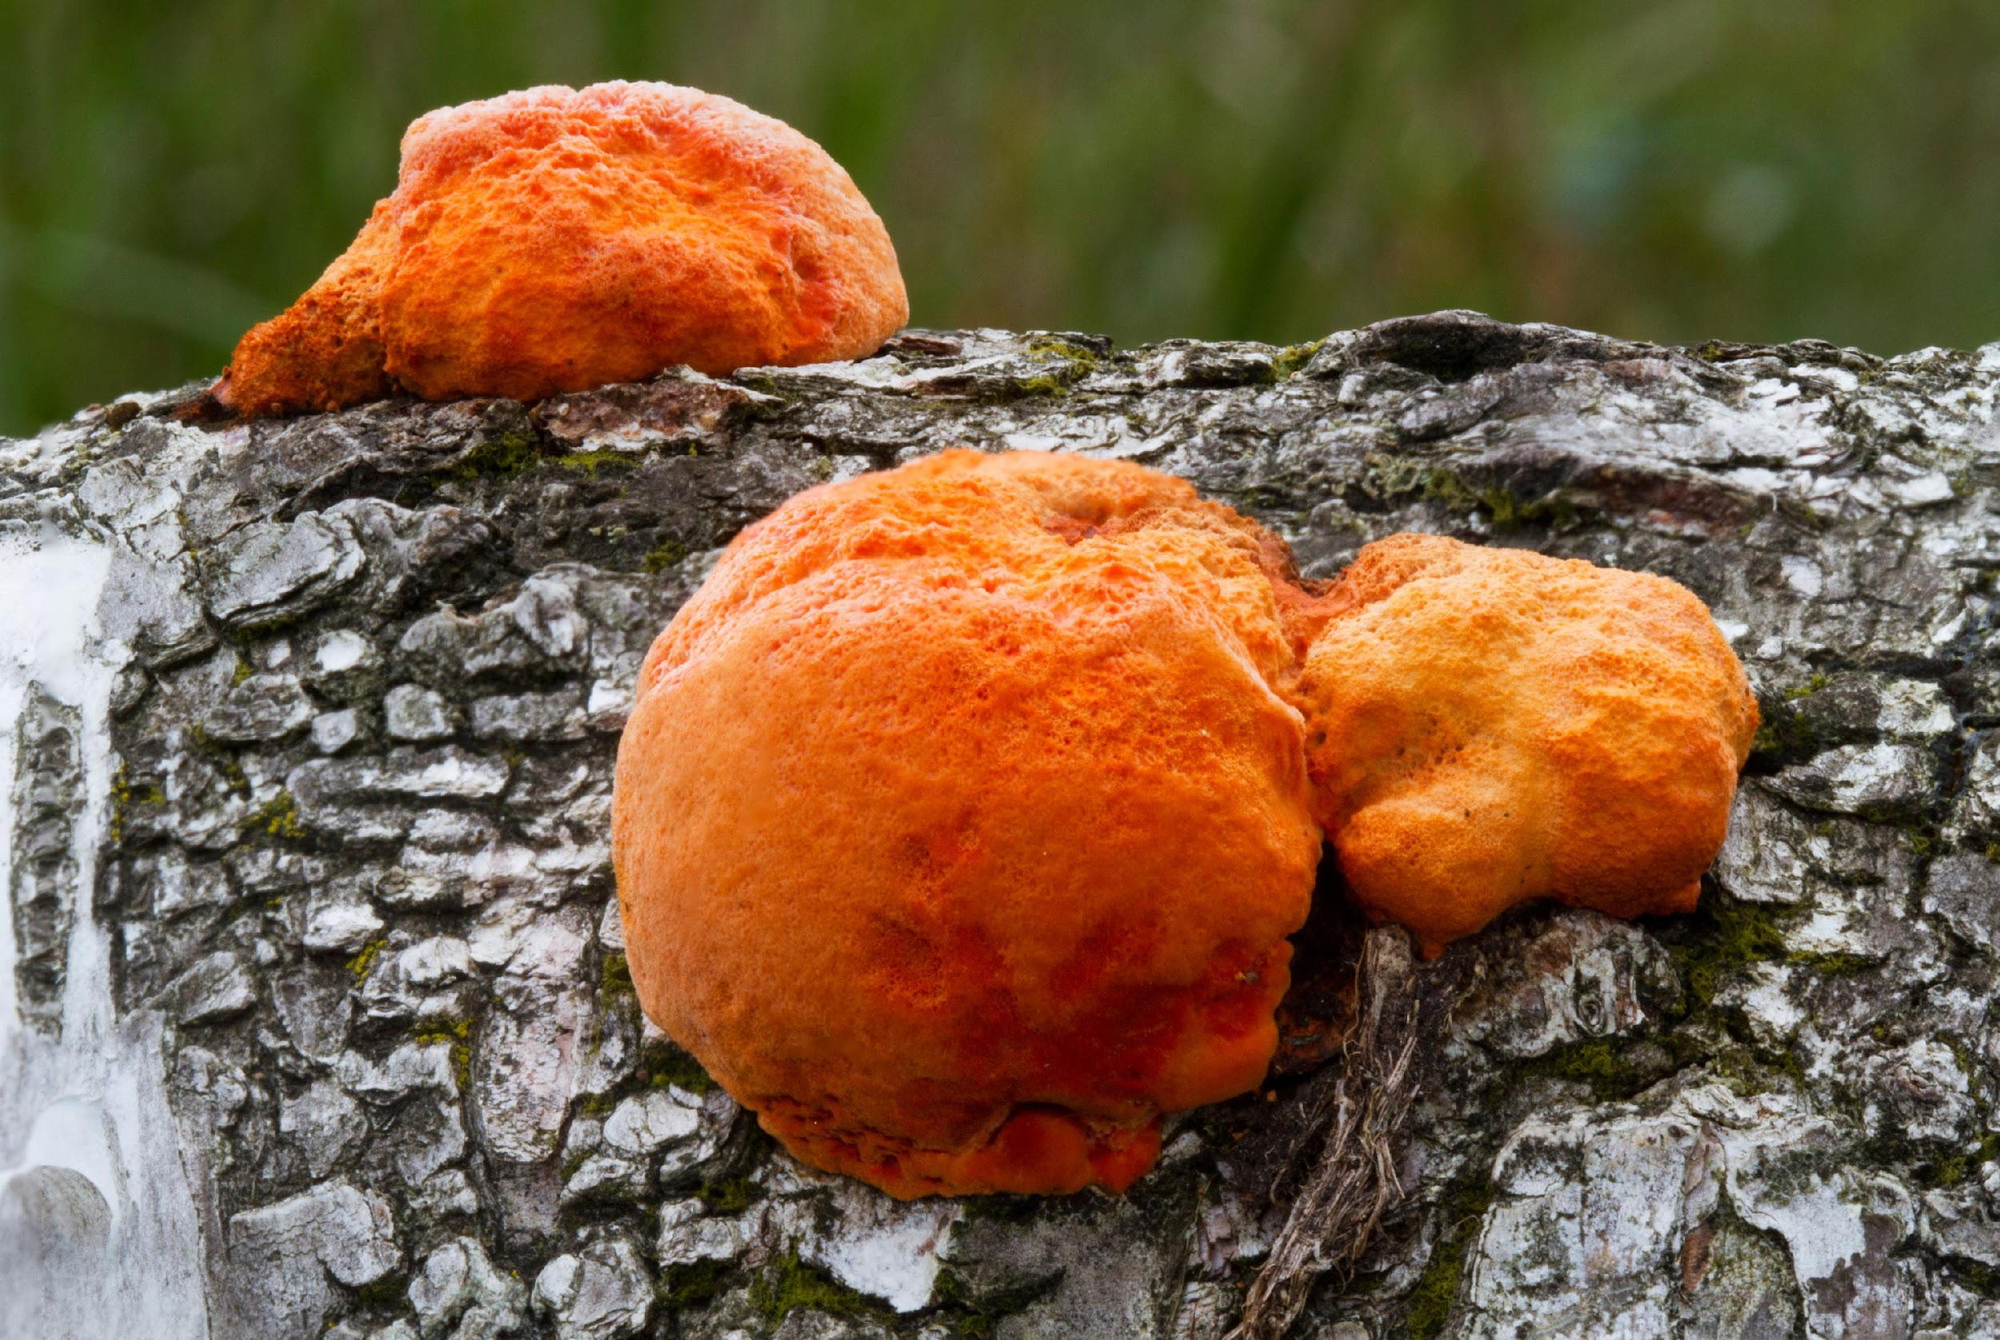
Decomposers
“Nature’s recyclers”
Why do you think they are
called “nature’s recyclers”?
Notes:
Sometimes you may hear decomposers called “nature’s recyclers”. Why do you think that is? Just like we break down cardboard, plastic, and glass when we recycle, decomposwers break down organisms.

Slide 121
Notes:
Let’s look at an example of decomposers.

Slide 122
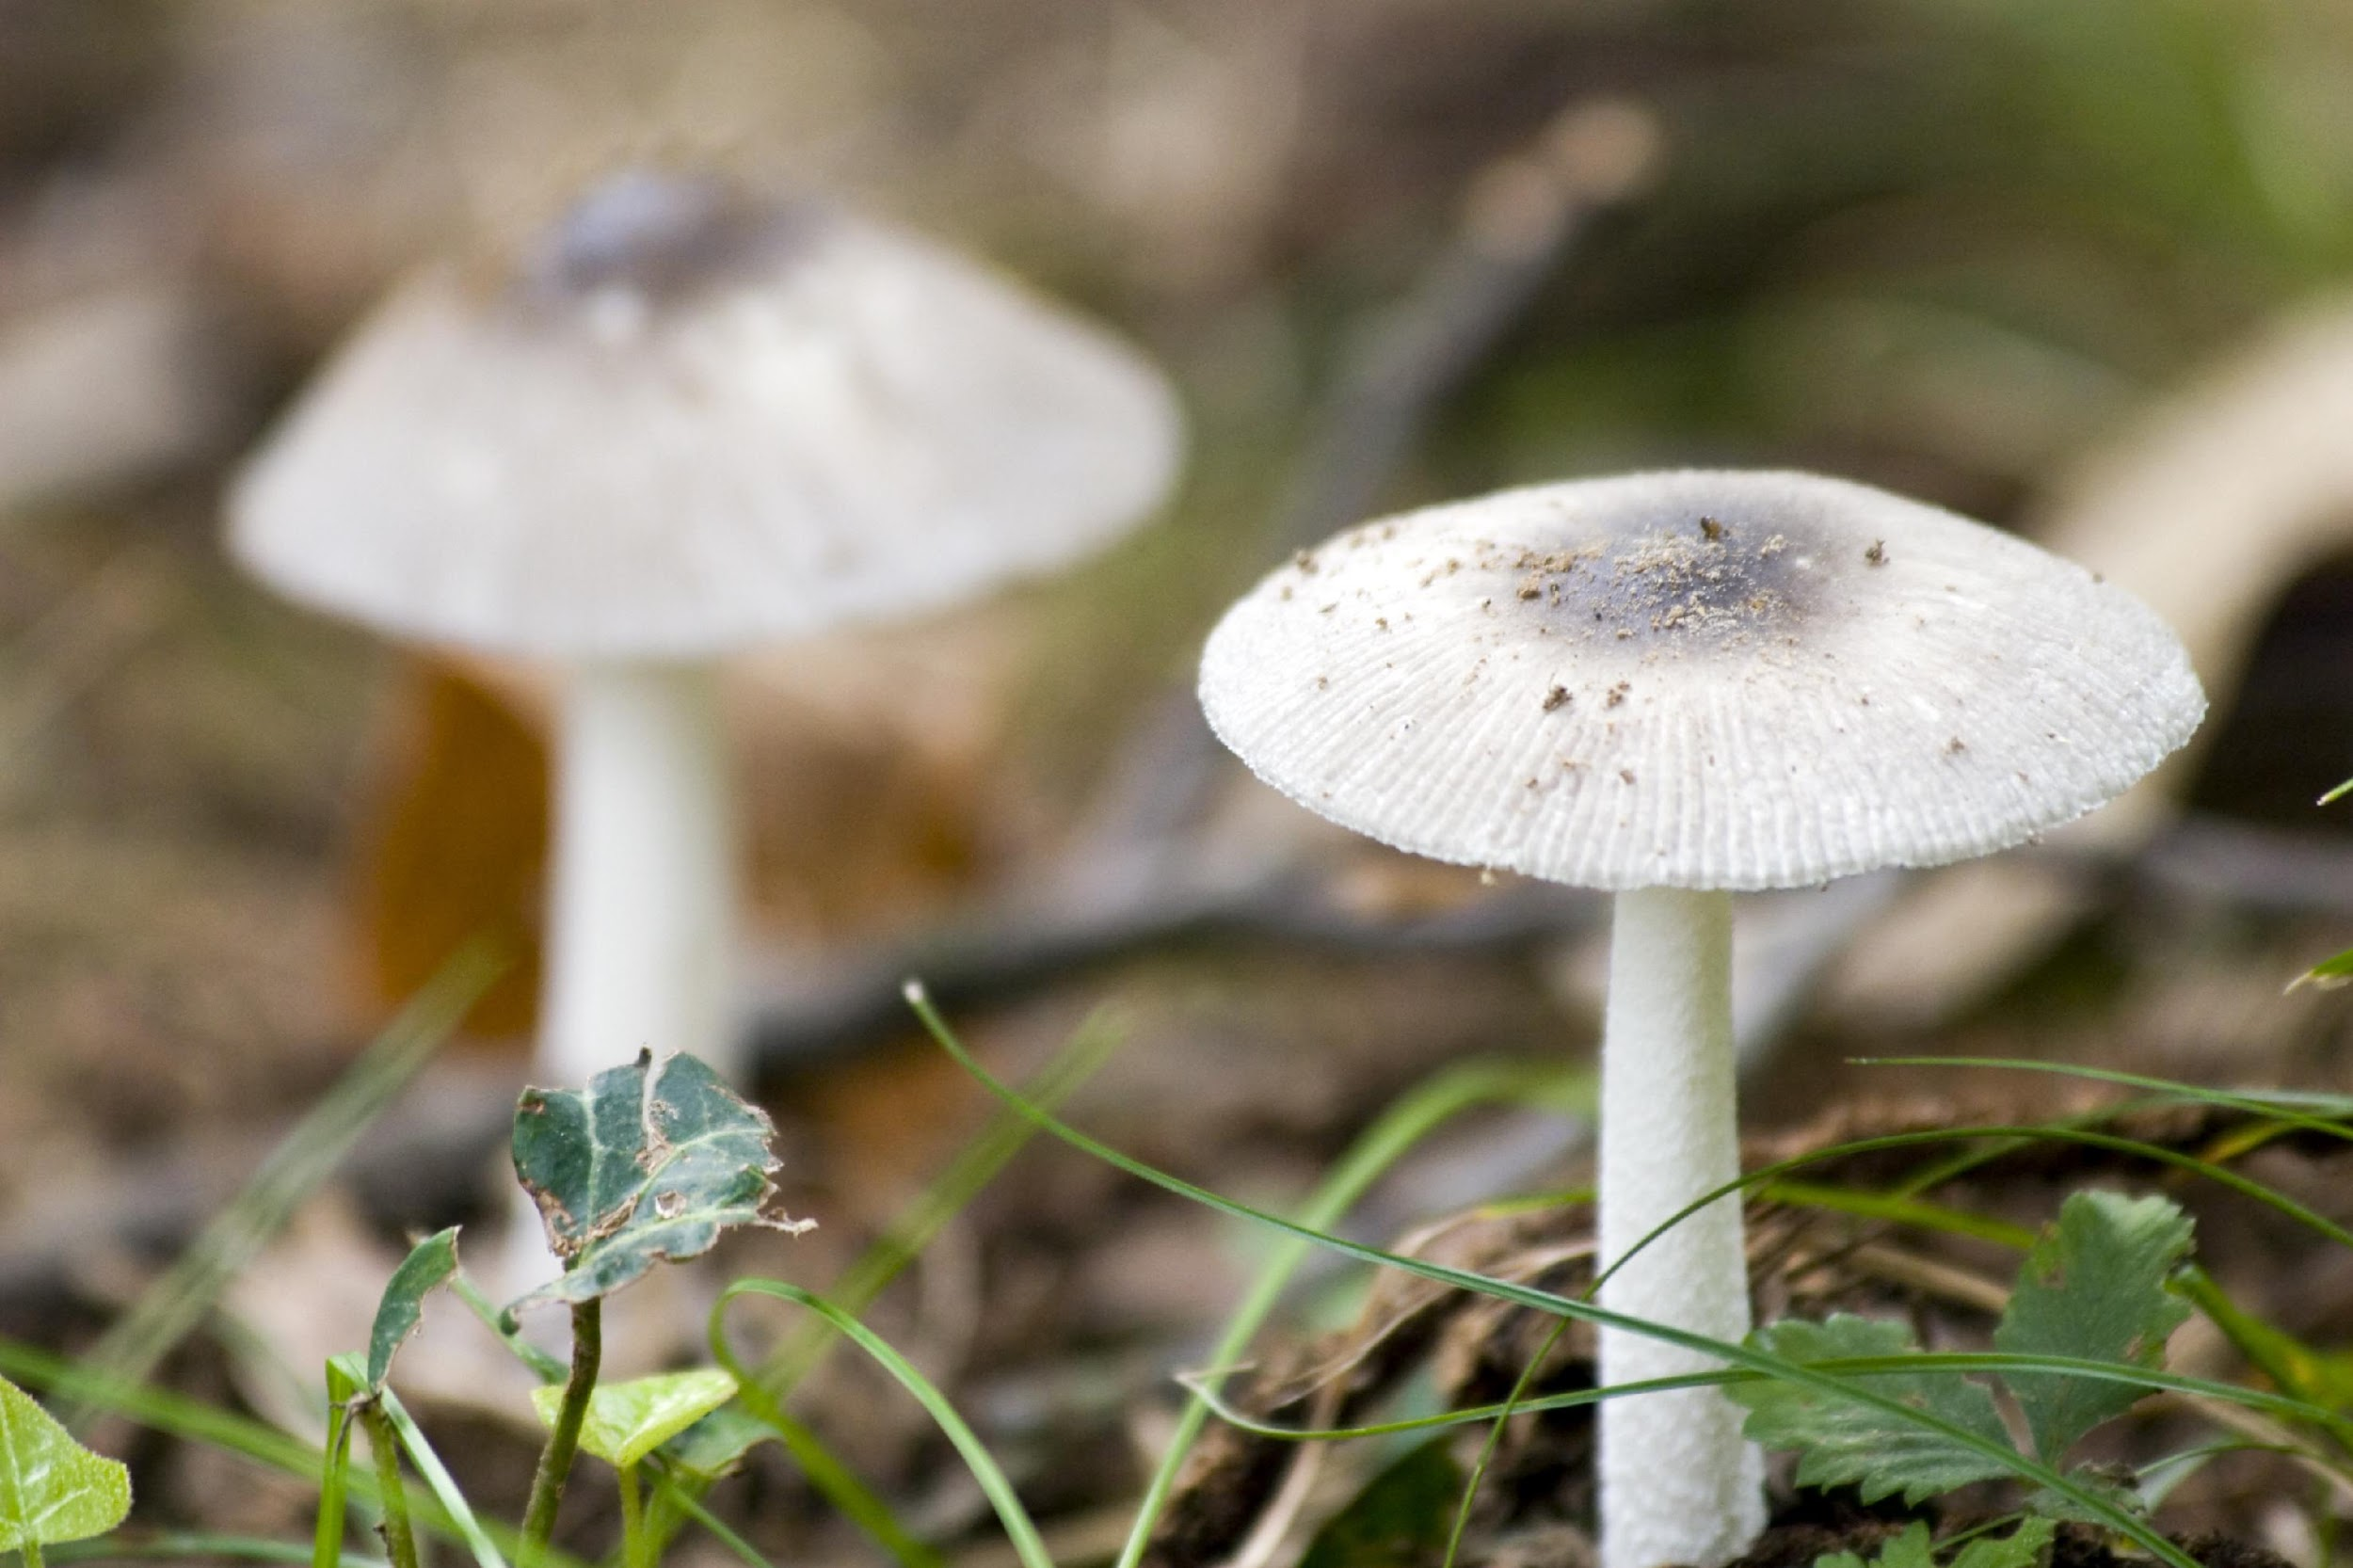
Many fungi are decomposers
Notes:
Many fungi are decomposers. Fungi do not belong to the plant or animal kingdoms, but their cells have elements of both plant and animal cells.

Slide 123
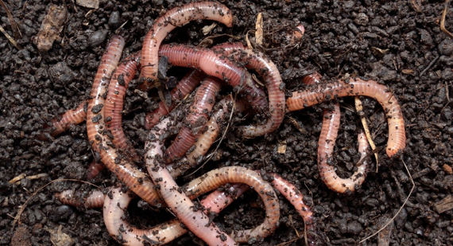
Notes:
Worms are decomposers.

Slide 124
Notes:
Next, let’s look at a non-example of decomposers.

Slide 125
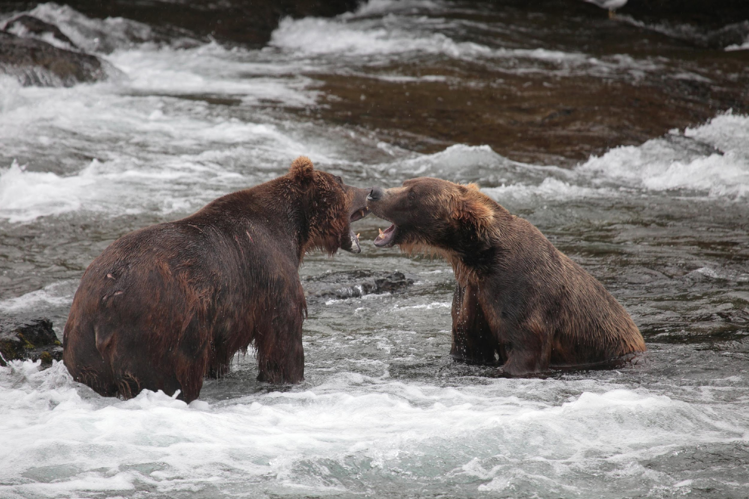
Notes:
Bears do not break down other organisms – they eat them.

Slide 126
Notes:
Trees are not decomposers - they are producers.

Slide 127
Notes:
Let’s check-in for understanding.

Slide 128
What is an example of a decomposer?
Notes:
What is an example of a decomposer?

Slide 129
Notes:
We can also break down the term decomposer into different word parts to help us remember the meaning. Let’s take a look!

Slide 130
Decomposer
De-
compose
-er
(prefix)
(root word)
(suffix)
Notes:
The word decomposer can be broken into three parts - the prefix, de-, the root word, compose, and the suffix, -er.

Slide 131
Decomposer
De-
compose
-er
undo, reverse
Notes:
The prefix de- means “undo” or “reverse”.

Slide 132
Decomposer
De-
compose
-er
to make or form by combining things
Notes:
The root word compose means to make or form by combining things.

Slide 133
De-
compose
-er
Decomposer
To undo combining things; to separate or break something down
Notes:
So at this point, when we combine the prefix de- with the root word compose, we know that decompose means to undo combining things. Or in other words, to separate or break something down.

Slide 134
Decomposer
De-
compose
-er
Suffix that turns a verb (break down) into a noun (a person/thing that breaks things down)
Notes:
Finally, the suffix -er turns a verb (to break down) into a noun (a person/thing that breaks things down).

Slide 135
De-
compose
-er
Decomposer
Something that breaks things down
Notes:
So, when we finally put all three parts together we see that decomposer refers to something that breaks things down.

Slide 136
So, when we use the term decomposers, we are referring to organisms that break down the remains of other dead organisms.
Notes:
When we use the term consumers in Life Science, we are referring to organisms that break down the remains of other dead organisms.

Slide 137
Notes:
Let’s check-in for understanding.

Slide 138
How can we use the word parts of decomposer to help us remember the definition of the term?
Decomposer
De-
compose
-er
(prefix)
(root word)
(suffix)
Notes:
How can we use the word parts of decomposer to help us remember the definition of the term?
[The word decomposer can be broken into three parts - the prefix, de-, the root word, compose, and the suffix, -er.
The prefix de- means “undo” or “reverse”.
The root word compose means to make or form by combining things.
So at this point, when we combine the prefix de- with the root word compose, we know that decompose means to undo combining things. Or in other words, to separate or break something down.
Finally, the suffix -er turns a verb (to break down) into a noun (a person/thing that breaks things down).
So, when we finally put all three parts together we see that decomposer refers to something that breaks things down.
When we use the term consumers in Life Science, we are referring to organisms that break down the remains of other dead organisms.]

Slide 139
What are decomposers?
Notes:
What are decomposers?
[Decomposers are organisms that break down the remains of other dead organisms.]

Slide 140
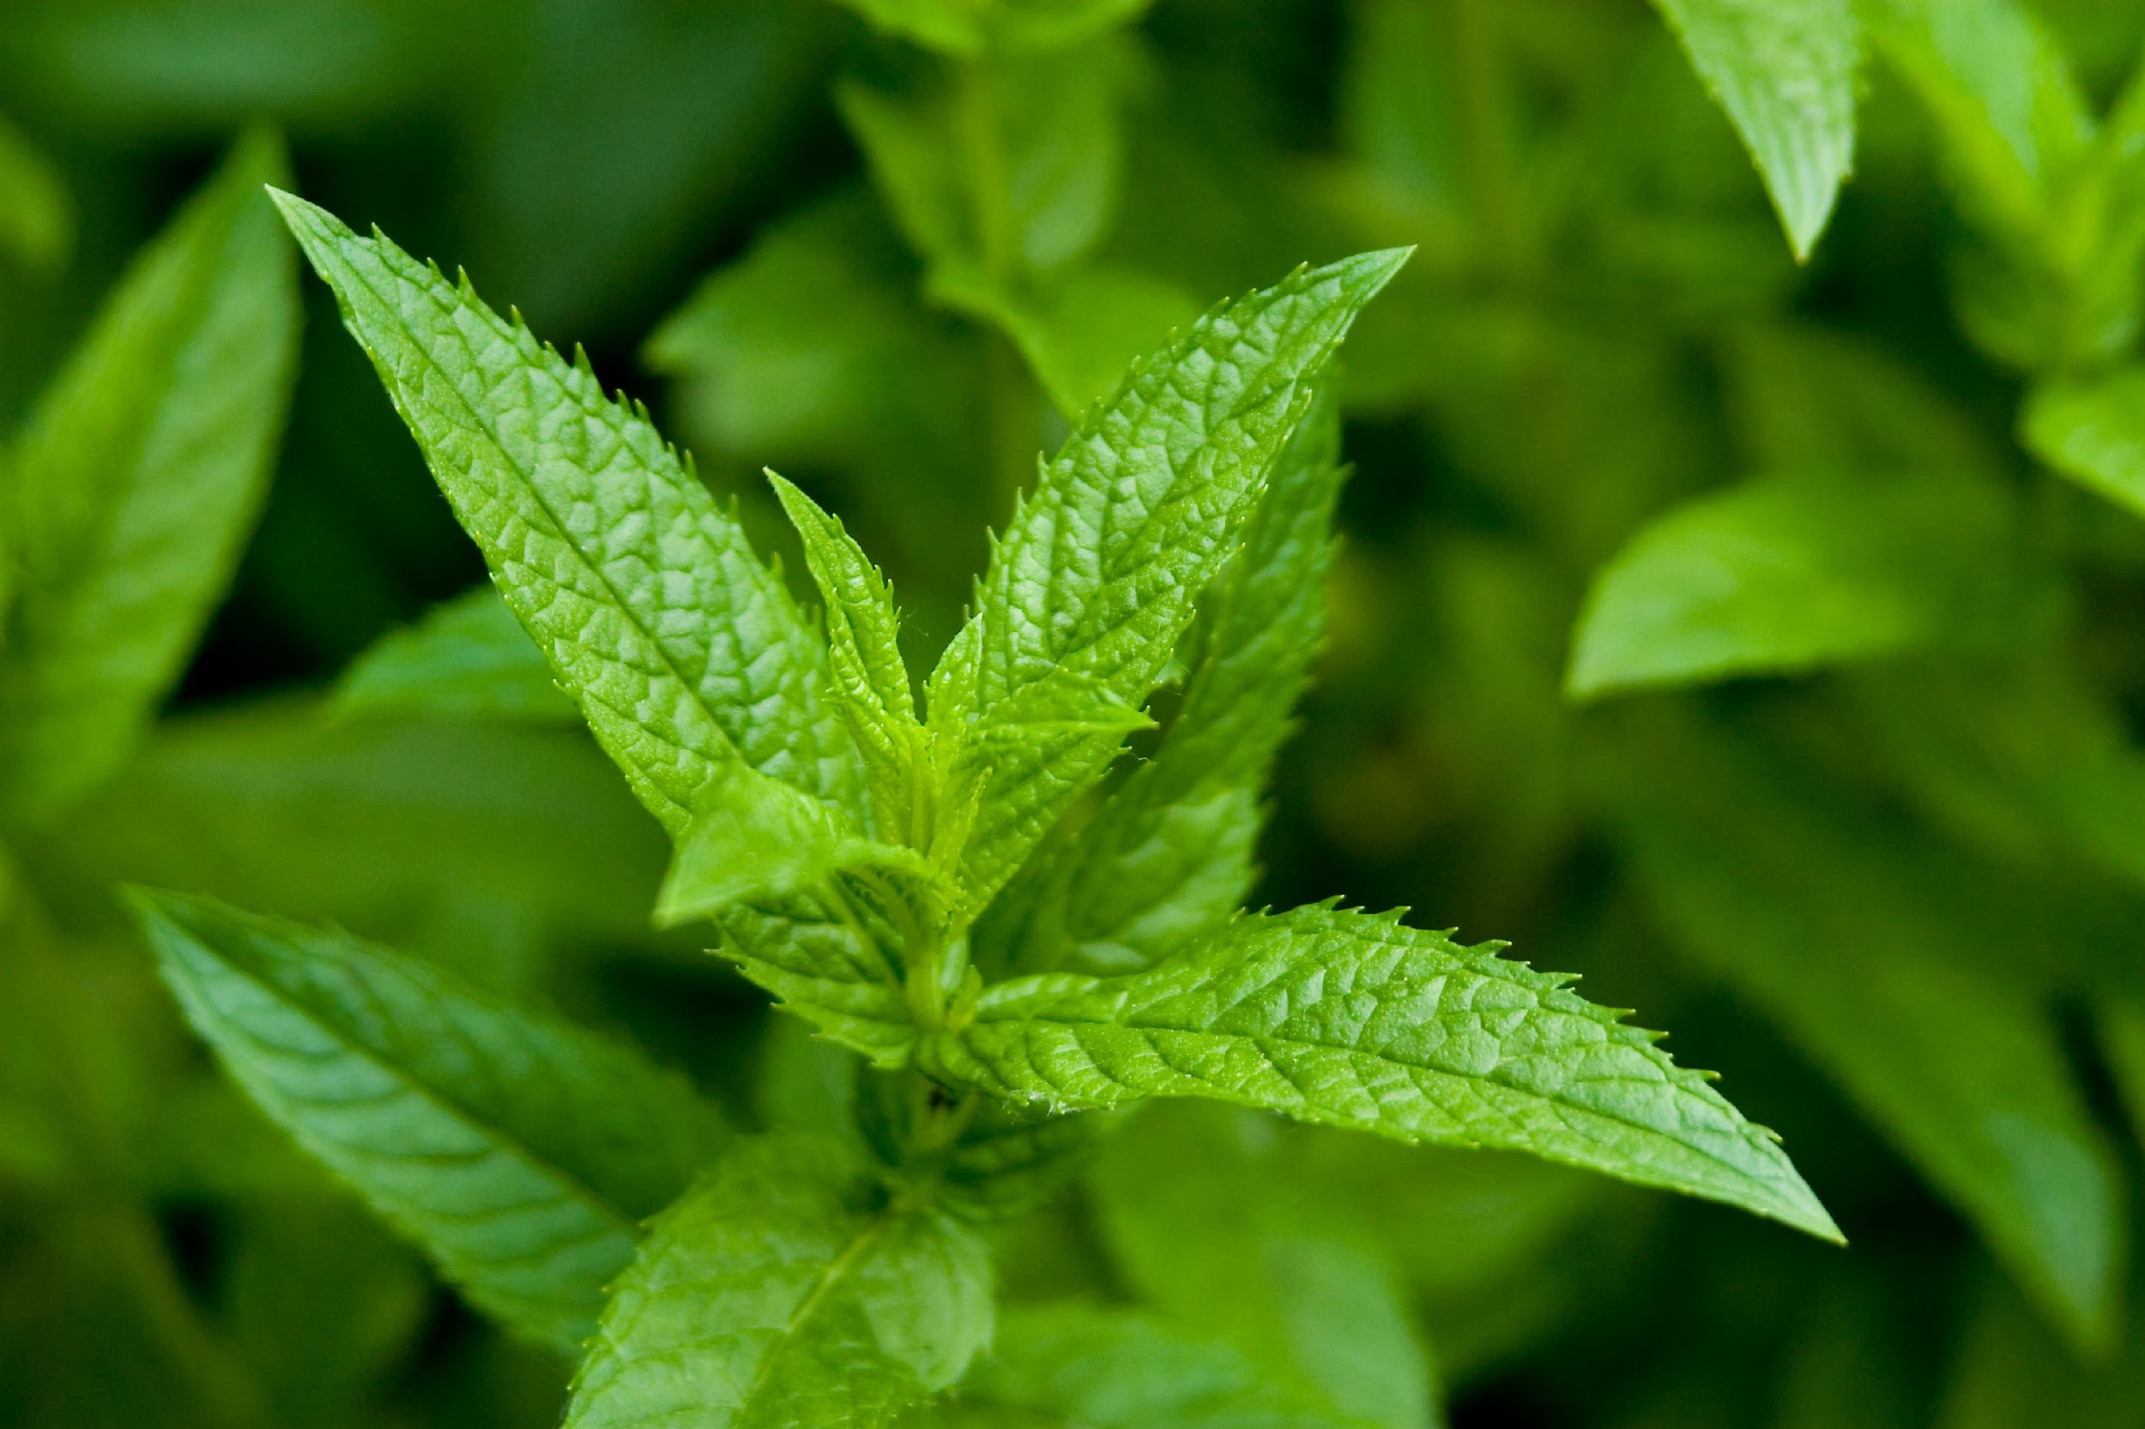
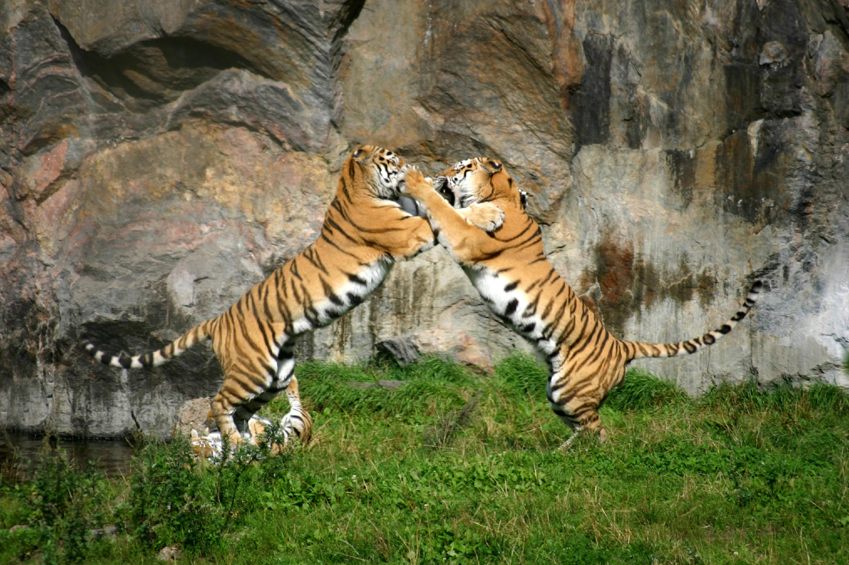
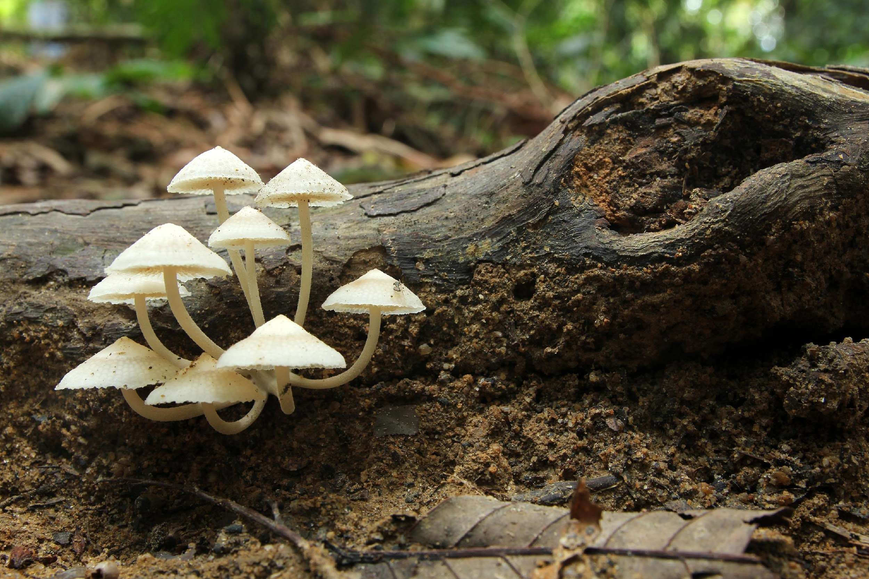
Which picture demonstrates a decomposer?
Notes:
Which picture demonstrates a decomposer?

Slide 141
Which picture demonstrates a decomposer?
Notes:
Which picture demonstrates a decomposer?
[Don’t forget that fungi, which include mushrooms, are very common decomposers.]

Slide 142
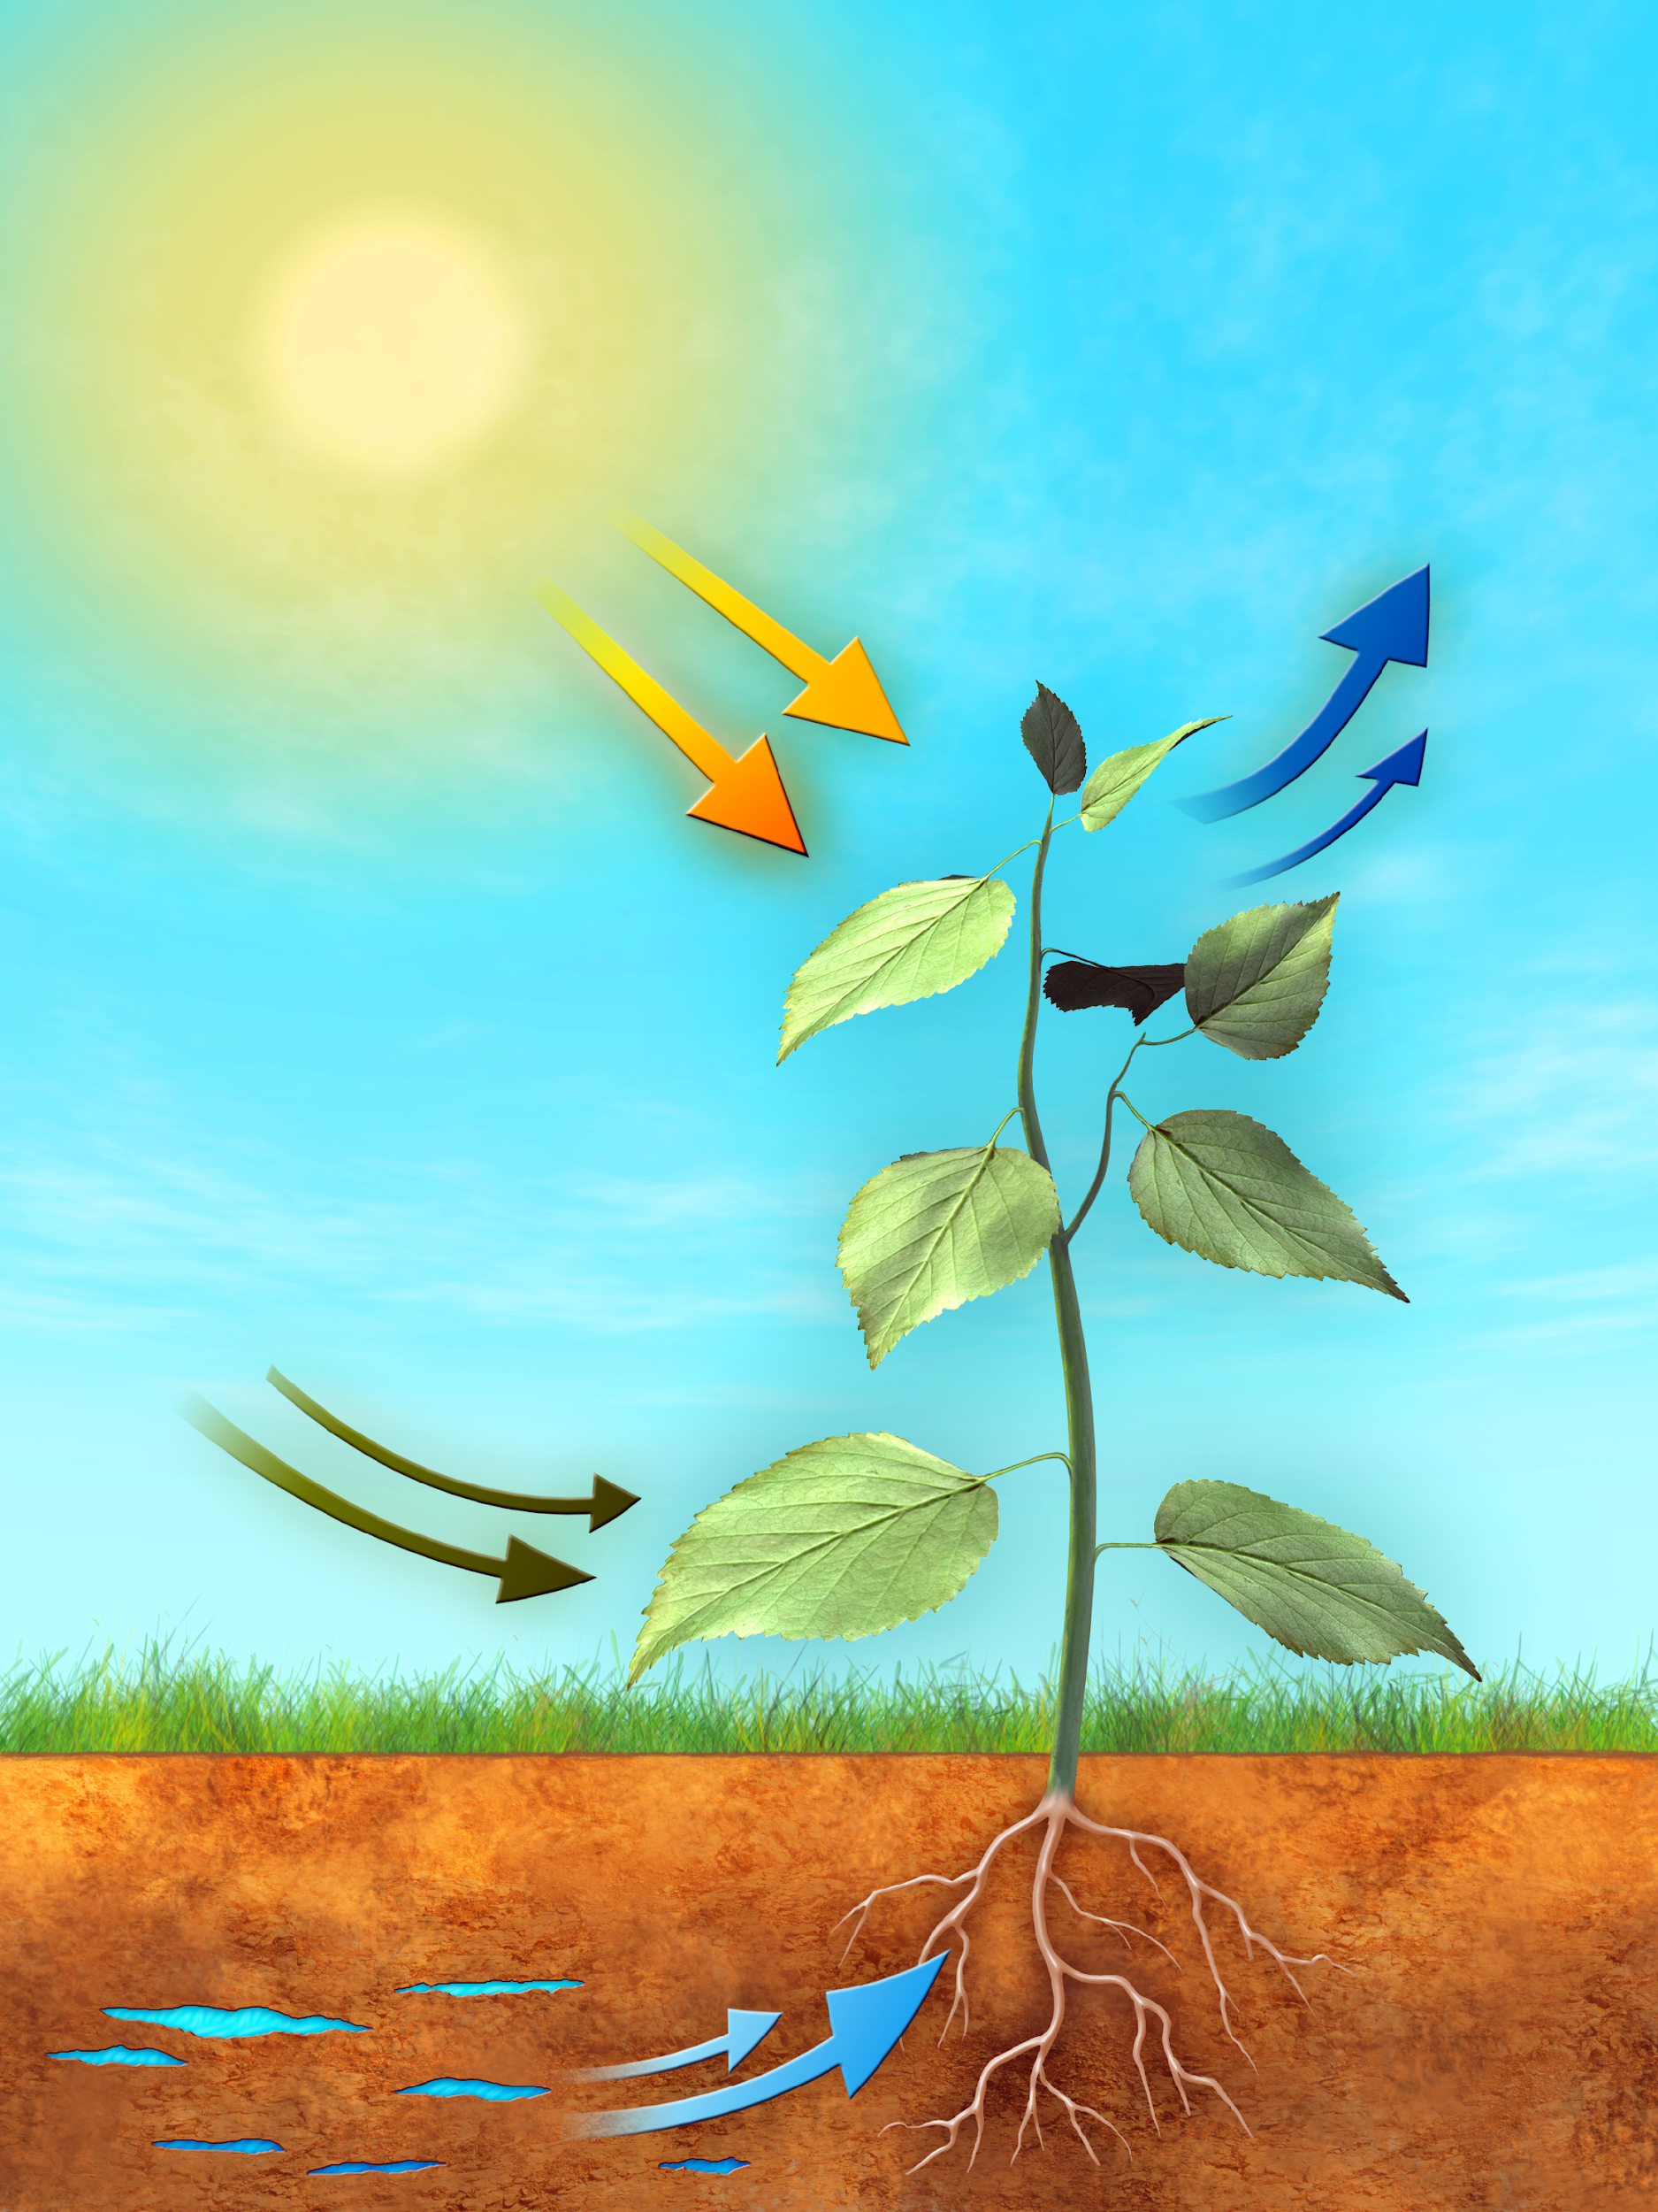
Producers use energy to ______.
Break down remains of other organisms
Make their own food
Kill other organisms
Escape potential predators
Notes:
Producers use energy to ___________.

Slide 143
Producers use energy to ____.
Break down remains of other organisms
Make their own food
Kill other organisms
Escape potential predators
Notes:
B. Make their own food – Many producers use energy from the sun in the process of photosynthesis.

Slide 144
Describe each category that we have covered.
PRODUCER D
DECOMPOSER F
CONSUMER G
Notes:
Describe each category that we have covered.

Slide 145
Describe each category that we have covered.
Makes own food
Breaks down other organisms
Eats other organisms
PRODUCER D
DECOMPOSER F
CONSUMER G
Notes:
Producer – makes its own food
Decomposer – breaks down other organisms (cellular level)
Consumer – eats other organisms

Slide 146
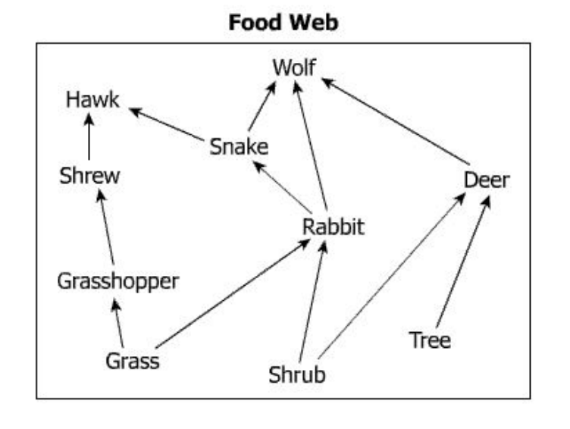
Identify the producers in this food web.
Notes:
Identify the producers in this food web.

Slide 147
Identify the producers in this food web
Notes:
The grass, shrub, and tree all make their own food. The food web shows that they do not consume any other organisms.

Slide 148
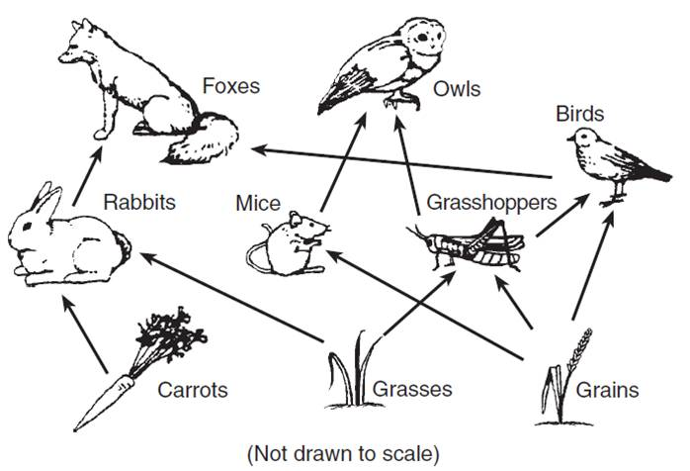
The circled organism is a ________.
Notes:
The circled organism is a ______________.

Slide 149
The circled organism is a consumer.
Notes:
The circled organism is a consumer.

Slide 150
“Nature’s recyclers” break down the remains of other organisms and are known as what?
Carnivores
Herbivores
Producers
Decomposers
Consumers
Notes:
“Nature’s recyclers” break down the remains of other organisms and are known as what?

Slide 151
“Nature’s recyclers” break down the remains of other organisms and are known as what?
Carnivores
Herbivores
Producers
Decomposers
Consumers
Notes:
“Nature’s recyclers” break down the remains of other organisms and are known as what?
[D. Decomposers – they break down organisms on a cellular level.]

Slide 152
Remember!!!
Notes:
So remember!

Slide 153
Decomposers: organisms that break down the remains of other dead organisms
Notes:
Decomposers break down the remains of other dead organisms.

Slide 154
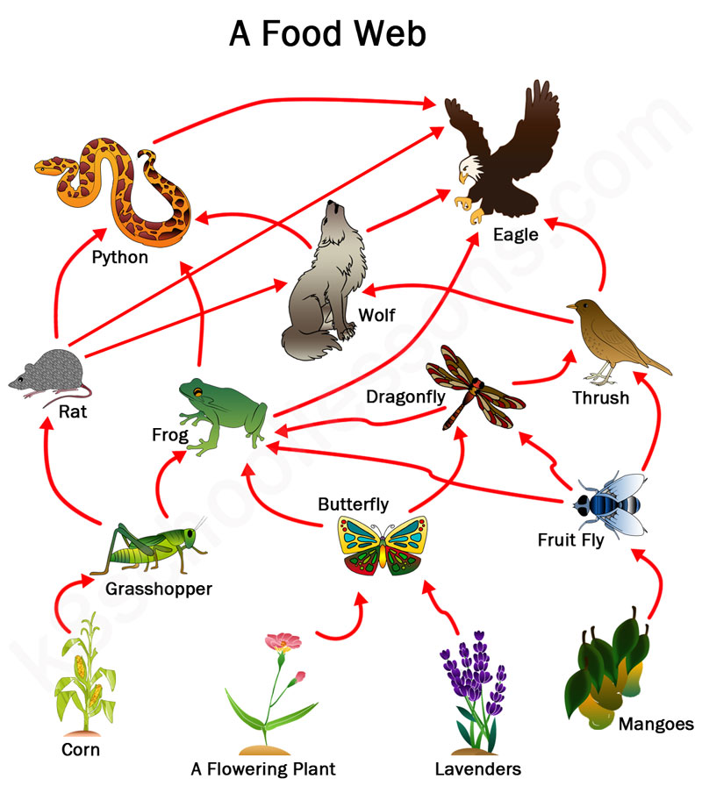
Extension Activity
Activity
Have students create their own food web, making sure to include/label consumers, producers, and decomposers.
Materials:
Paper and pencil
Colored pencils (optional)

Slide 155
Simulation Activity
Energy Flow Interactive
(PBS Learning Media)
Click the link above to explore how energy flows between different types of organisms in an ecosystem.
In this simulation activity, you’ll learn why the amount of energy that plants get from the sun is not converted into the same amount of energy as it’s passed on to other organisms.

Slide 156
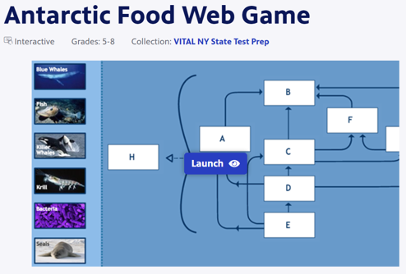
Reinforcement Game/Activity
Antarctica Food Web Game
(PBS Learning Media)
Click the link above to learn more about food chains, food webs, and the trophic levels of an Antarctic marine food web.
The Food Web Game lets you test your knowledge and build your own Antarctic food web.
Notes:
This simulation has students use knowledge of producers, consumers, and decomposers to build a food web. May be better to use this following the next lesson that covers this topic specifically, but could be a good extension activity for early finishers, or an inquiry activity that prefaces the introduction of these terms.

Slide 157
Reinforcement Game/Activity
Producers-Consumers-Decomposers Game
Click the link above to practice identifying examples of different producers, consumers, and decomposers – and watch them in action!
Notes:
This link takes students to a game (requires flash player) that reinforces their ability to differentiate between examples of producers, consumers, and decomposers.

Slide 158
Big Questions: What relationships exist among producers, consumers, and decomposers?
Notes:
Explicit cue to revisit the big question at the end of the lesson: Okay everyone. Now that we’ve learned the term, decomposers, let’s reflect once more on our big question. Was there anything that we predicted earlier that was correct or incorrect? Do you have any new hypotheses to share?

Slide 159
Notes:
Thanks for watching, and please continue watching CAPs available from this website.

Slide 160
This Video Was Created With Resources From:
Questions or Comments
Michael Kennedy, Ph.D. MKennedy@Virginia.edu
Rachel L Kunemund, Ph.D. rk8vm@virginia.edu

