Slide 1
Intro
“Big Idea” Question
Review Concepts
Check-In Questions
Teacher Demo
Vocabulary
Student-Friendly Definition
Examples & Non-Examples
Morphological Word Parts
Simulation/Activity
Notes:
OK everyone, get ready for our next lesson. Just as a reminder, these are the different components that our lesson may include, and you’ll see these icons in the top left corner of each slide so that you can follow along more easily!
Feedback: Explicit cues used at the beginning of each step makes it easy for students to follow along and be prepared to engage in the next part of the lesson.

Slide 2
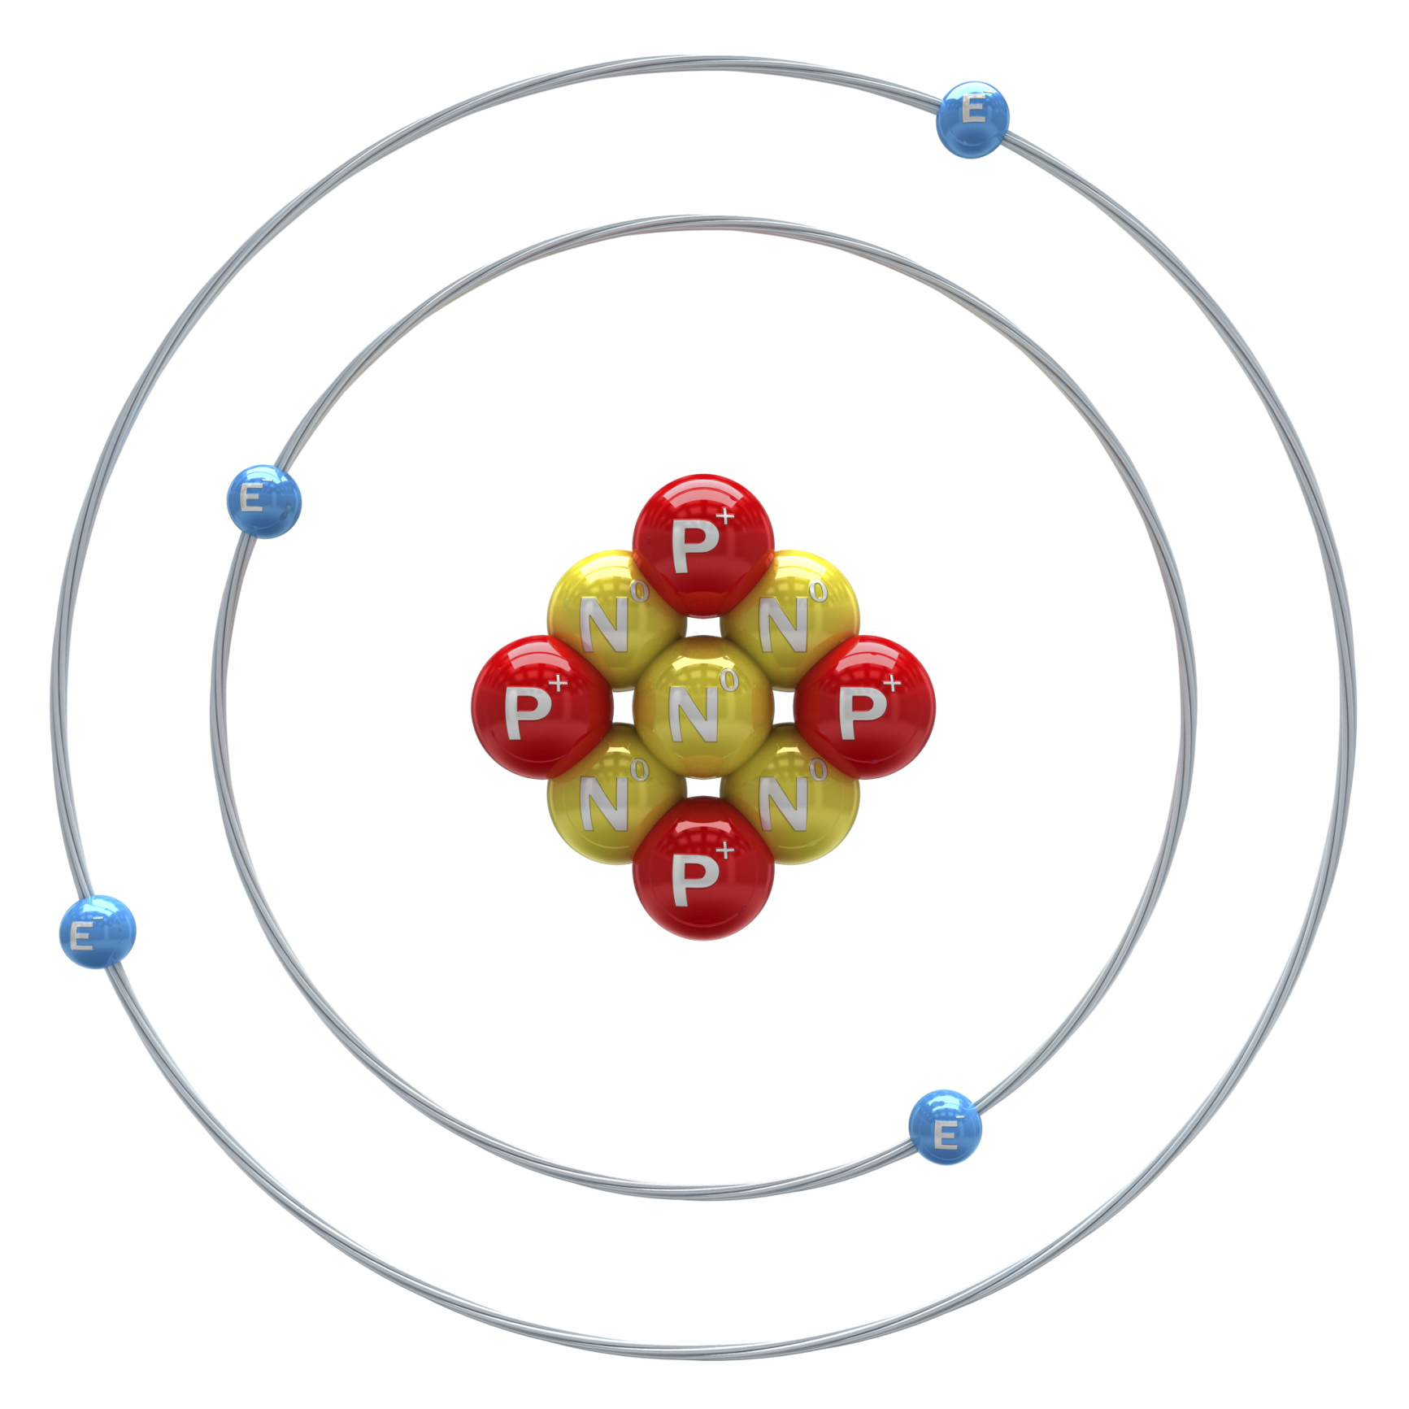
Nucleus
Intro
Notes:
Today we are going to learn about the nucleus of an atom.

Slide 3
Big Question: What is the relationship between the nucleus, protons, neutrons, and electrons in atoms?
Proton
Electron
Neutron
Notes:
Our “Big Question” is: What is the relationship between the nucleus, protons, neutrons, and electrons?
[Pause and illicit predictions from students.]
I love all these thoughtful scientific hypotheses! Be sure to keep this question and your predictions in mind as we move through these next few lessons, and we’ll continue to revisit it.
Feedback: Asking students to make predictions about the relationship between parts of an atom is a great way to activate and elicit student ideas and prior knowledge. This type of activity is evidence of the teacher planning for students’ engagement with science ideas.
Feedback: Providing a specific goal for use is crucial to letting students know what's expected and why this lesson is important.

Slide 4
Notes:
Before we move on to our new vocabulary term, let’s review some other words & concepts that you already learned and make sure you are firm in your understanding.
Feedback: Referring to prior topics that are relevant and on topic helps students make connections to the new content they will be learning and tie it to prior knowledge.

Slide 5
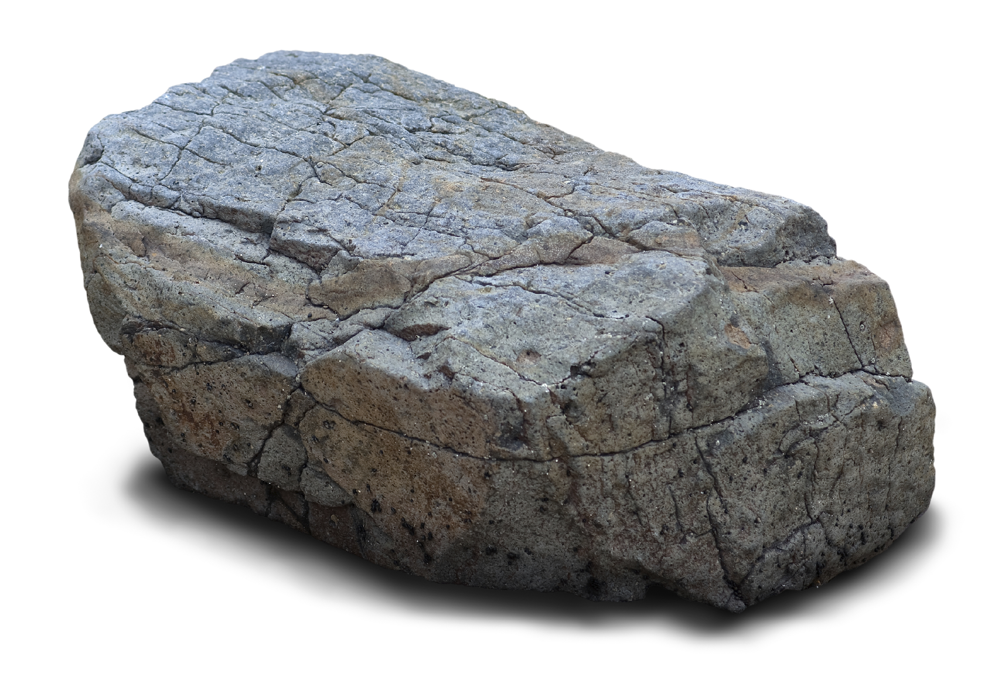
Matter: has mass and takes up space
Notes:
Matter is anything that has mass and takes up space.

Slide 6
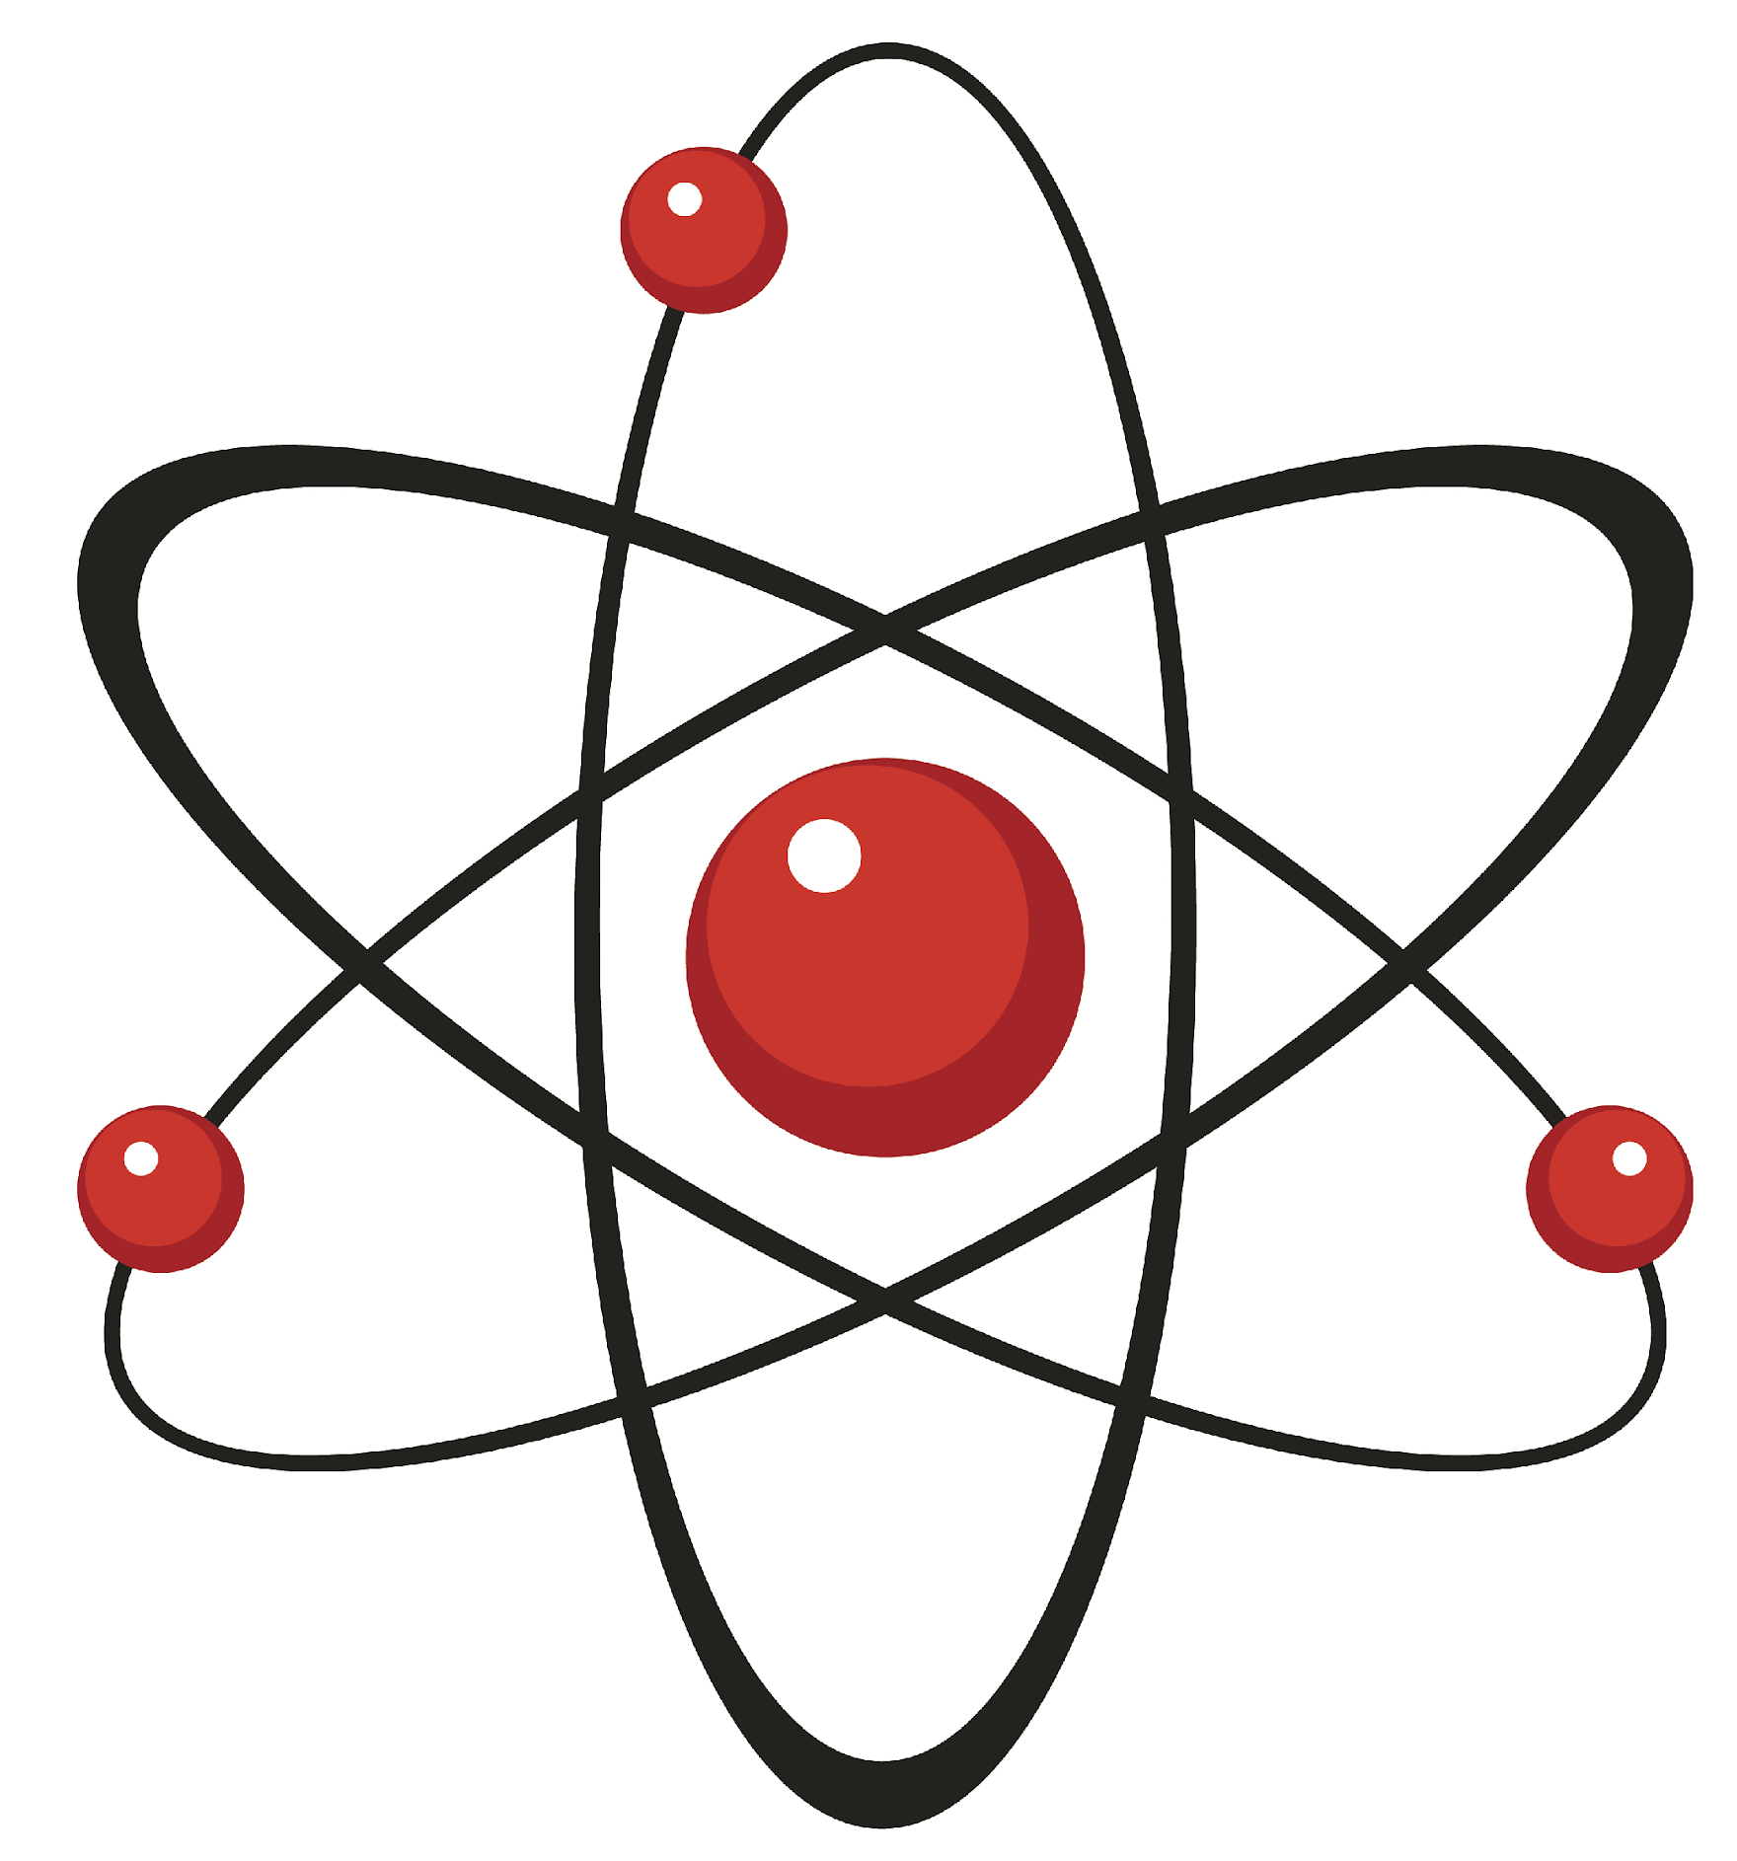
Atom: smallest whole unit of matter
Atom
Atom
Atom
Atom
Atom
Notes:
An atom is the smallest whole unit of matter.

Slide 7
Modern Atomic Model: orbitals are clouds that show where electrons are most likely to be
Notes:
The modern atomic model shows a positively charged nucleus with orbitals (clouds) that show where electrons are most likely to be

Slide 8
Notes:
Now let’s pause for a moment to check your understanding.
Feedback: Even during a review, it is important that students are held accountable by being given the opportunity to participate. This may take some encouragement on your part but I know you can get them to do it!

Slide 9
What are the two qualities of matter?
Notes:
What are the two qualities of matter?
[Matter has mass and takes up space]

Slide 10
What is an atom?
Notes:
What is an atom?
[An atom is the smallest whole unit of matter.]

Slide 11
What is the relationship between atoms and matter?
Notes:
What is the relationship between atoms and matter?
[Matter is made up of atoms]

Slide 12
What does the Modern Atomic Model show?
Notes:
What does the Modern Atomic Model show?
[The modern atomic model shows a positively charged nucleus and orbitals (clouds) that show where electrons are most likely to be.]

Slide 13
Nucleus
Notes:
Now that we’ve reviewed, let’s define our new term, nucleus.

Slide 14
Nucleus: the center of the atom that is made up of protons and neutrons
Notes:
The nucleus is the center of the atom that is made up of protons and neutrons.
Feedback: Using clear, concise language is important when helping students build understanding.

Slide 15
Notes:
Now let’s pause for a moment to check your understanding.

Slide 16
What is the nucleus of an atom?
Notes:
What is the nucleus of an atom?
[The nucleus is the center of the atom that is made up of protons and neutrons.]

Slide 17
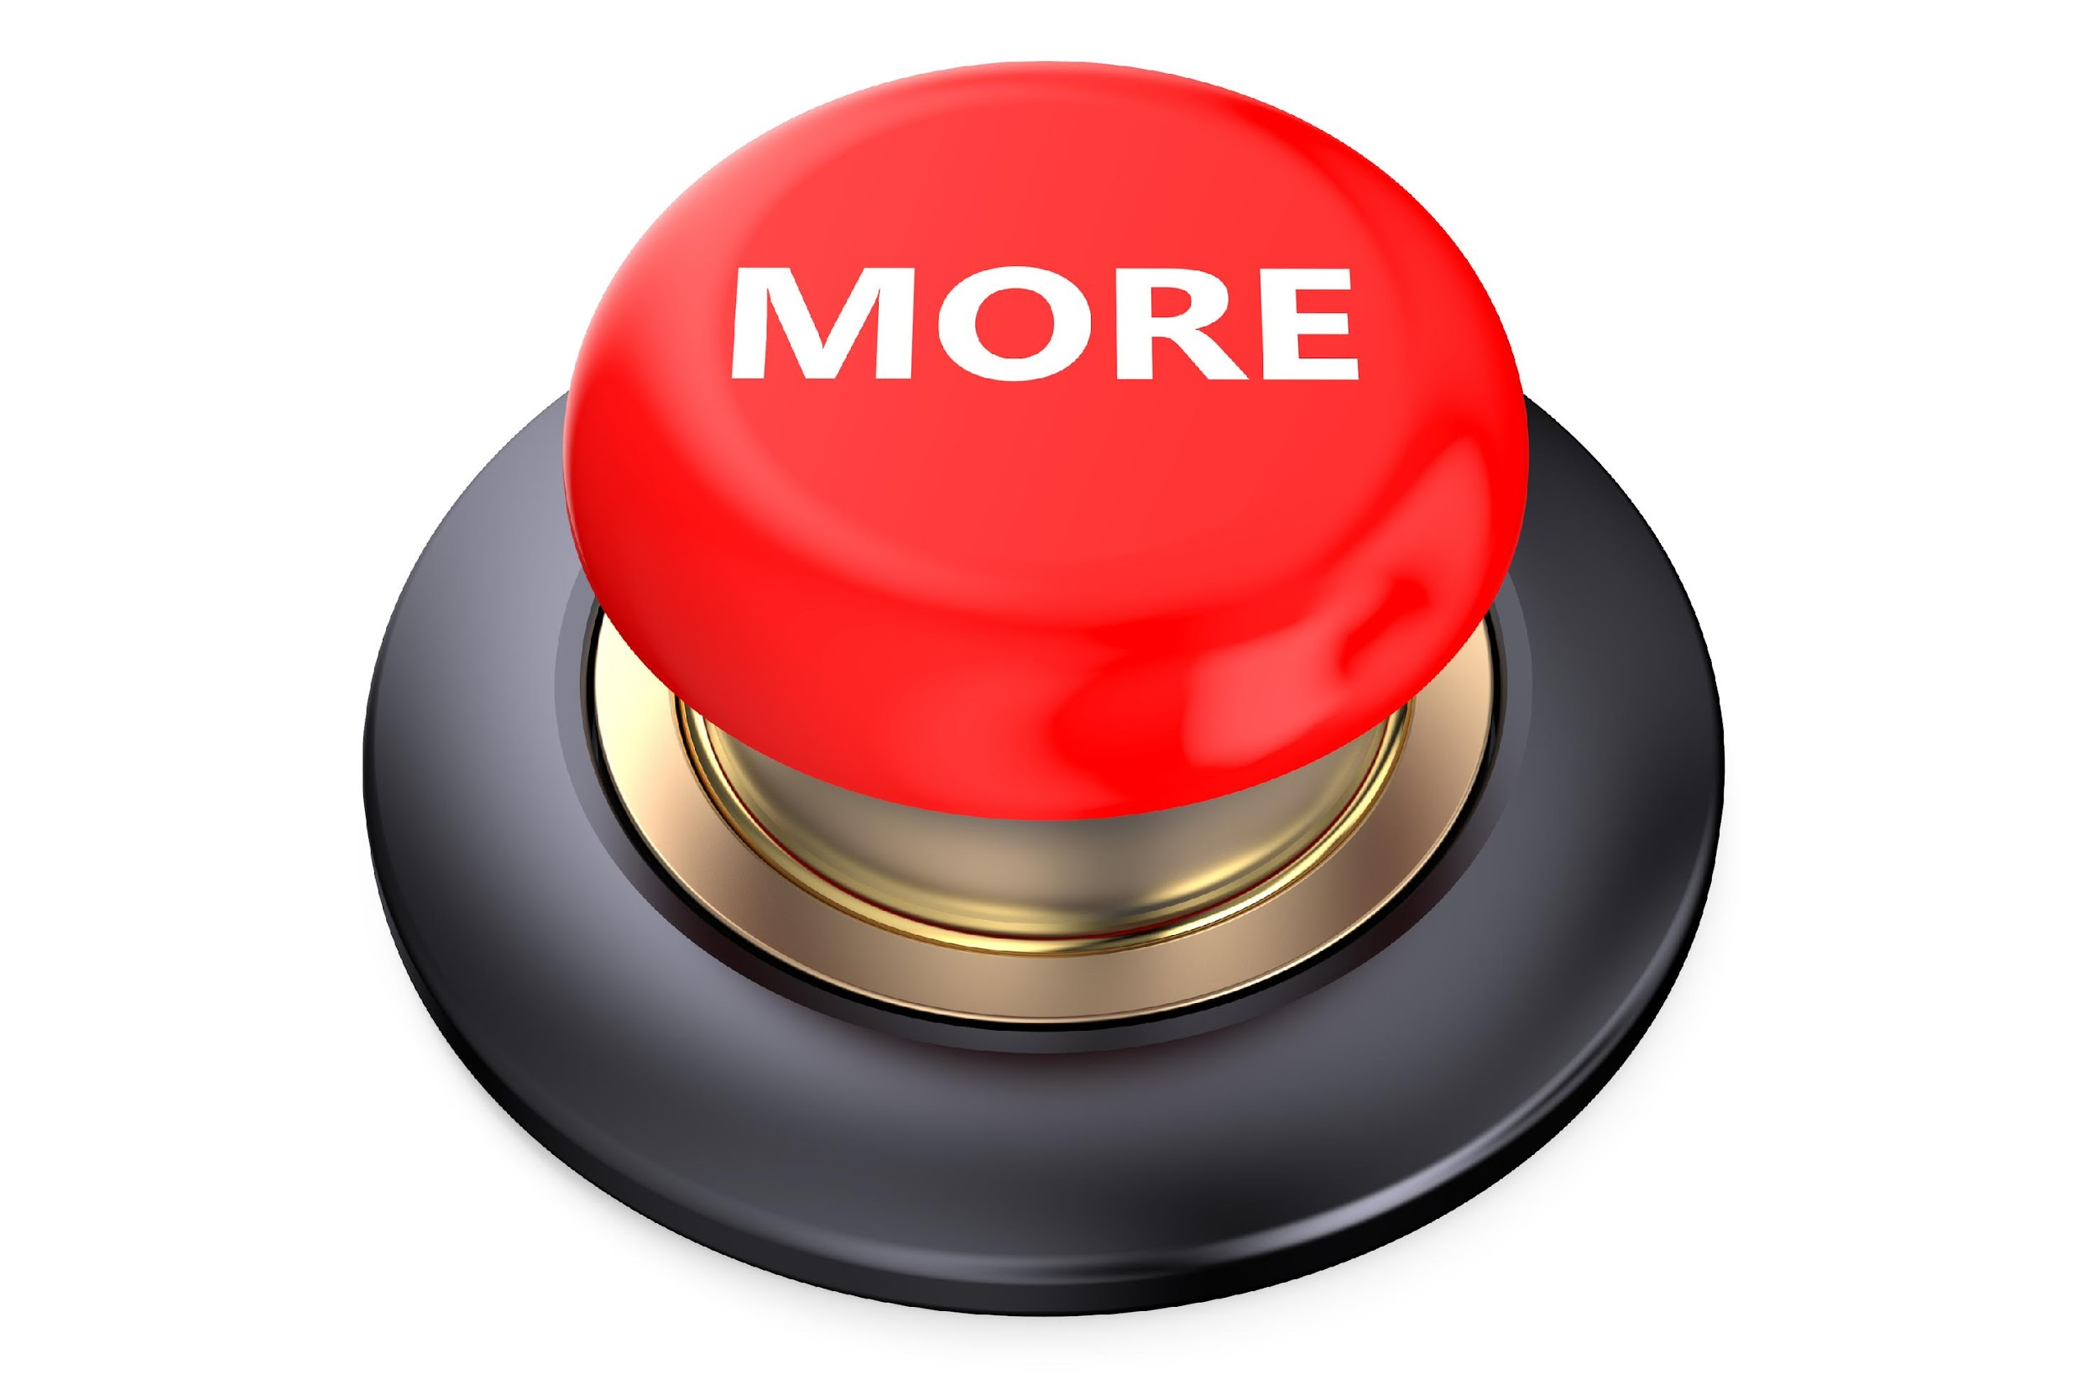
Notes:
That is the basic definition, but there is a bit more you need to know.

Slide 18
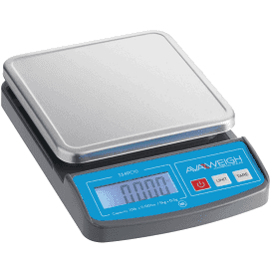
The nucleus has most of the mass of the atom
Notes:
The nucleus also contains most of the mass of an atom. Protons and neutrons are MUCH heavier and bigger than electrons.

Slide 19
Notes:
Now let’s pause for a moment to check your understanding.

Slide 20
What is the nucleus of an atom?
Notes:
What is the nucleus of an atom?
[The nucleus is the center of the atom that is made up of protons and neutrons.]
Feedback: Providing feedback is tricky but crucial. Remember to give students with feedback on their response because it helps students know what answers you are actually looking for.

Slide 21
What is the nucleus made up of?
Notes:
What is the nucleus made up of?
[Protons and neutrons]

Slide 22
What aspect of an atom is mostly contained in the nucleus?
Notes:
What aspect of an atom is mostly contained in the nucleus?
[The nucleus contains most of the mass of an atom.]

Slide 23
Notes:
Now, let’s talk about some examples of a nucleus.
Feedback: As you review examples of the new term it is important to take the time to provide students with feedback that encouraged them to continue to participate.

Slide 24
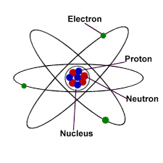
Notes:
This diagram looks a little bit different, but we can still see the nucleus. In this diagram, the nucleus is draw or shown by the circle that is surrounding the protons and neutrons.

Slide 25
Notes:
This is also an example of a nucleus, but it is different because the nucleus is not drawn. It is important to remember that the nucleus might not be drawn on all diagrams of atoms. So how do we know there is a nucleus? We know there is a nucleus because there are protons and neutrons. The nucleus is made up of protons and neutrons, so we know there is a nucleus here even though it is not drawn.

Slide 26
Notes:
Now let’s pause for a moment to check your understanding.

Slide 27
What is the nucleus of an atom made of?
Notes:
What is the nucleus of the atom made of?
[Protons and neutrons]

Slide 28
Explain how you know there is a nucleus in both of the models of an atom below.
Notes:
Explain how you know there is a nucleus in both of the models of an atom below.
[The model on the right has the nucleus drawn, so we know there is a nucleus. The model on the right does not have the nucleus drawn, but we know its there because we know the nucleus is the area that contains protons and neutrons, and we can see protons and neutrons in the model, so there must be a nucleus even though it is not drawn.]

Slide 29
Notes:
Next, let’s talk about some non-examples of a nucleus.
Feedback: Remember to take a moment to explicitly distinguish between the similarities of the non-examples and the vocabulary term you were covering today. This helps students resolve any misconceptions they may have.

Slide 30
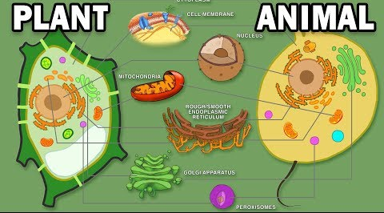
Notes:
You have probably heard about the nucleus in a plant and animal cell, but this is not what we are talking about. This type of nucleus is different than the nucleus of an atom. The nucleus in plants don’t contain protons and neutrons…so they are different than the nucleus of an atom.

Slide 31
Notes:
Protons and neutrons are also not the same thing as the nucleus. The nucleus is where protons and neutrons are found, but protons and neutrons are individual parts of the atom that we will learn more about later on.

Slide 32
Notes:
Let’s check-in for understanding.

Slide 33
Why is the nucleus in a plant or animal cell not the same as the nucleus of an atom?
Notes:
Why is the nucleus in a plant or animal cell not the same as the nucleus of an atom?
[The nucleus in an atom has ONLY protons and neutrons, the nucleus in a plant/animal cell is much more complex]

Slide 34
How are protons and neutrons different from the nucleus of an atom?
Notes:
How are protons and neutrons different from the nucleus of an atom?
[The nucleus is where protons and neutrons are found, but protons and neutrons are individual parts of the atom.]

Slide 35
Notes:
Let’s look at the word nucleus to help us remember what it means.
Feedback: Using morphological word parts can be extremely beneficial for students. It is important to take time when breaking the word down and define each individual word part for students.

Slide 36
Nucleus
=
Latin word meaning “inner part”
Inner part of an atom
Notes:
Let’s look at our word nucleus. Nucleus is a Lain word meaning “inner part”. So, by knowing that nucleus comes from the Latin word meaning “inner part” we can remember that the nucleus is the “inner part” ( or center) of an atom.

Slide 37
Notes:
Let’s check-in for understanding.

Slide 38
Nucleus
What is the Latin meaning of nucleus?
Notes:
What is the Latin meaning of nucleus?
[“inner part”]

Slide 39
Nucleus
Latin meaning = “inner part”
How does the Latin meaning of nucleus, “inner part”, help us remember what the nucleus of an atom is?
Notes:
How does the Latin meaning of nucleus, “inner part”, help us remember what the nucleus of an atom is?
[If we remember nucleus means “inner part”, we can remember that the nucleus of an atom is the inner part (or center) of an atom.]
Feedback: Remember to check for understanding when introducing morphological word parts to ensure the students understand how the word parts work together. This will save you time later by getting ahead of any misunderstandings.

Slide 40
Notes:
Lets review everything we have learned so far!!

Slide 41
What is the nucleus of an atom?
Notes:
What is the nucleus of an atom?
[The nucleus is the center of the atom made up of protons and neutrons.]

Slide 42
What is the nucleus made up of?
Notes:
What is the nucleus made up of?
[Protons and neutrons]
Feedback: As you are closing the lesson, keep in mind to monitor students' understanding so that you can determine if more instruction is needed or if there are any misunderstandings.

Slide 43
What aspect of an atom is mostly contained in the nucleus?
Notes:
What aspect of an atom is mostly contained in the nucleus?
[The nucleus contains most of the mass of an atom]

Slide 44
Explain how you know there is a nucleus in both of the models of an atom below.
Notes:
Explain how you know there is a nucleus in both of the models of an atom below.
[The model on the right has the nucleus drawn, so we know there is a nucleus. The model on the right does not have the nucleus drawn, but we know its there because we know the nucleus is the area that contains protons and neutrons, and we can see protons and neutrons in the model, so there must be a nucleus even though it is not drawn.]

Slide 45
Why is the nucleus in a plant or animal cell not the same as the nucleus of an atom?
Notes:
Why is the nucleus in a plant or animal cell not the same as the nucleus of an atom?
[The nucleus in an atom has protons and neutrons, but the nucleus in plant and animal cells do not]

Slide 46
How are protons and neutrons different from the nucleus of an atom?
Notes:
How are protons and neutrons different from the nucleus of an atom?
[The nucleus is where protons and neutrons are found, but protons and neutrons are individual parts of the atom.]

Slide 47
Nucleus
What is the Latin meaning of nucleus?
Notes:
What is the Latin meaning of nucleus?
[“inner part”]

Slide 48
Nucleus
Latin meaning = “inner part”
How does the Latin meaning of nucleus, “inner part”, help us remember what the nucleus of an atom is?
Notes:
How does the Latin meaning of nucleus, “inner part”, help us remember what the nucleus of an atom is?
[If we remember nucleus means “inner part”, we can remember that the nucleus of an atom is the inner part (or center) of an atom.]

Slide 49
Remember!!!
Notes:
So remember!
Feedback: A good general strategy for information retention is: 1) tell them what you're going to teach them, 2) teach them, and 3) tell them what you just taught them. Make sure to include the third and final step. While it is easy to think a quick review of what you just went over is unnecessary, it can be incredibly useful in helping the students remember the information over the long term.

Slide 50
Nucleus: the center of the atom that is made up of protons and neutrons
Notes:
The nucleus is the center of the atom made of protons and neutrons.

Slide 51
Big Question: What is the relationship between the nucleus, protons, neutrons, and electrons in atoms?
Proton
Electron
Neutron
Notes:
Explicit cue to revisit the big question at the end of the lesson: Okay everyone. Now that we’ve learned the term, let’s reflect once more on our big question. Was there anything that we predicted earlier that was correct or incorrect? Do you have any new hypotheses to share?
Feedback: Offering students an opportunity to evaluate their earlier hypotheses and make changes based on their new understandings is an important part of the iterative process in science. This is a great opportunity to help students build an epistemic understanding by explicitly stating how continuing to change and build on hypotheses as your knowledge grows is an important part of the discipline of science!

Slide 52
Notes:
Thanks for watching, and please continue watching CAPs available from this website.

Slide 53
This Video Was Created With Resources From:
Questions or Comments
Michael Kennedy, Ph.D. MKennedy@Virginia.edu
Rachel L Kunemund, Ph.D. rk8vm@virginia.edu

Slide 54
Intro
“Big Idea” Question
Review Concepts
Check-In Questions
Teacher Demo
Vocabulary
Student-Friendly Definition
Examples & Non-Examples
Morphological Word Parts
Simulation/Activity
Notes:
OK everyone, get ready for our next lesson. Just as a reminder, these are the different components that our lesson may include, and you’ll see these icons in the top left corner of each slide so that you can follow along more easily!

Slide 55
Protons
Intro
Proton
Nucleus
Notes:
Today we are going to learn about protons.

Slide 56
Big Question: What is the relationship between the nucleus, protons, neutrons, and electrons in atoms?
Proton
Electron
Neutron
Notes:
Our “Big Question” is: What is the relationship between the nucleus, protons, neutrons, and electrons?
Let’s look at our big question again. Were our hypotheses correct? What did we learn/have to change about our hypotheses?
Feedback: Providing students with the opportunity to make predictions about what will happen allows them to think critically about the content.

Slide 57
Notes:
Before we move on to our new vocabulary term, let’s review some other words & concepts that you already learned and make sure you are firm in your understanding.
Feedback: It is important to provide a quick review of background information before introducing your definition. Doing so can help students make connections to previously learned material.

Slide 58
Matter: has mass and takes up space
Notes:
Matter is anything that has mass and takes up space.

Slide 59
Atom: smallest whole unit of matter
Atom
Atom
Atom
Atom
Atom
Notes:
An atom is the smallest whole unit of matter.

Slide 60
Modern Atomic Model: orbitals are clouds that show where electrons are most likely to be
Notes:
The modern atomic model shows that orbitals are clouds that show where electrons are most likely to be

Slide 61
Nucleus: the center of the atom that is made up of protons and neutrons
Notes:
The nucleus is the center of the atom that is made of protons and neutrons.

Slide 62
Notes:
Now let’s pause for a moment to check your understanding.
Feedback: If you notice some students struggling to keep up when you activating prior knowledge, it is important to remember to make adjustments and scaffold your content to meet students current level of understanding.

Slide 63
What are the two qualities of matter?
Notes:
What are the two qualities of matter?
[Matter has mass and takes up space]

Slide 64
What is an atom?
Notes:
What is an atom?
[An atom is the smallest whole unit of matter.]

Slide 65
What is the relationship between atoms and matter?
Notes:
What is the relationship between atoms and matter?
[Matter is made up of atoms.]

Slide 66
What does the modern atomic model show?
Notes:
What does the modern atomic model show?
[The modern atomic model shows that orbitals are clouds that show where electrons are most likely to be.]

Slide 67
What is the nucleus of an atom?
Notes:
What is the nucleus of an atom?
[The nucleus is the center of the atom that is made up of protons and neutrons.]
Feedback: There are a lot of opportunities to respond throughout this portion of your lesson, which is so important for ensuring that your students are grasping the content.

Slide 68
What is the nucleus made up of?
Notes:
What is the nucleus made up of?
[Protons and neutrons]

Slide 69
What aspect of an atom is mostly contained in the nucleus?
Notes:
What aspect of an atom is mostly contained in the nucleus?
[The nucleus contains most of the mass of an atom]

Slide 70
Proton
Notes:
Now that we’ve reviewed, let’s define our new term, proton.

Slide 71
Protons: positively charged subatomic particles found in the nucleus of an atom
Proton
Nucleus
Notes:
Protons are positively charged subatomic particles found in the nucleus of an atom.
Feedback: It's great to consistently use images in your lesson, this helps students make connections to the words in the definition.

Slide 72
Notes:
Now let’s pause for a moment to check your understanding.

Slide 73
What are protons?
Proton
Nucleus
Notes:
What are protons?
[Protons are positively charged subatomic particles found in the nucleus of an atom.]

Slide 74
Notes:
That is the basic definition, but there is a bit more you need to know

Slide 75
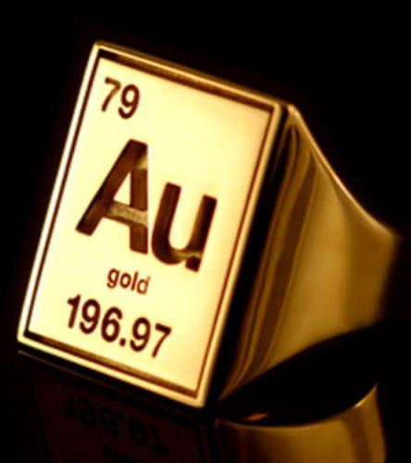
Number of protons = type of element
Notes:
Protons are important because the number of protons in an atom determine what type of element that atom makes up. If two atoms have different numbers of protons, the make up different elements.

Slide 76
AMU = Atomic Mass Unit
Notes:
Amu stands for atomic mass unit and is used by scientist to easily measure atoms since they are so small.
Feedback: Units are very important and show up all throughout science. Having an understanding of scale provides meaning to the numbers. Take your time when going over units.

Slide 77
= 1 amu
Notes:
Each proton has a weight of 1 amu (atomic mass unit).

Slide 78
Notes:
Now let’s pause for a moment to check your understanding.

Slide 79
What are protons?
Proton
Notes:
What are protons?
[Protons are positively charged subatomic particles found in the nucleus of an atom.]
Feedback: When introducing new vocabularies, it is crucial to require the students to give out their own interpretation. I would strongly encourage you to ask students to explain the concept in their own words.

Slide 80
Where are protons found?
Proton
Notes:
Where are protons found?
[In the nucleus of an atom]

Slide 81
What does AMU stand for and why is it important?
Notes:
What does AMU stand for and why is it important?
[Amu stands for atomic mass unit and it is important because it is is used by scientist to easily measure atoms since they are so small.]

Slide 82
What is the weight of each proton?
= ? amu
Notes:
What is the weight of each proton?
[Each proton has a weight of 1 amu (atomic mass unit).]

Slide 83
Notes:
Now, let’s talk about some examples of protons.

Slide 84
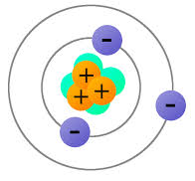
Proton
Notes:
This diagram looks a little bit different that what we have seen. There are protons in this model. We know protons are positive, so the orange circles with the + are protons. The plus means positive and positive means proton.
Feedback: It's great practice to introduce an example of the term WITH images to go along with it, this is a great way to help students make connections.

Slide 85
Notes:
We can also see protons in this diagram of an atom. Here there are no letters or signs showing protons. The nucleus is labeled, and we know protons and neutrons are in the nucleus, so we know that protons must be inside the nucleus. In this diagram, the protons are shown by the blue ciricles.

Slide 86
Proton
Notes:
This is model looks very similar to the first one. It is different because instead of a + sign, a proton is show by P. We know the P is proton and the N is neutron because this simply uses the letters they start with.

Slide 87
Notes:
Now let’s pause for a moment to check your understanding.

Slide 88
What are protons?
Proton
Notes:
What are protons?
[Protons are positively charged subatomic particles found in the nucleus of an atom.]

Slide 89
Where are the protons in this model? Explain your answer.
Notes:
Where are the protons in this model? Explain your answer.
[We know the P is proton and the N is neutron because this simply uses the letters they start with. Protons are the red particles (they aren’t red in reality, just in the model) in the nucleus.]
Feedback: Keep in mind, it is important to continuously ask students questions and check for understanding. This will let you know if further instruction on certain content is needed.

Slide 90
Where are the protons in the model? Explain your answer.
Notes:
Where are the protons in the model? Explain your answer.
[We know protons are positive, so the orange circles with the + are protons.]

Slide 91
If the protons in this model were not labeled, how could we know where to find them?
Notes:
If the protons in this model were not labeled, how could we know where to find them?
[We can also see protons in this diagram of an atom. Here there are no letters or signs showing protons. The nucleus is labeled, and we know protons and neutrons are in the nucleus, so we know that protons must be inside the nucleus. In this diagram, the protons are shown by the blue circles.]

Slide 92
Notes:
Next, let’s talk about some non-examples of protons.
Feedback: It is important to select a variety of examples and non-examples to work through with your students, particularly making sure to go over some types that might trip them up when they try it on their own.

Slide 93
Notes:
Remember that protons are NOT the same as the nucleus. The nucleus is where protons are found.

Slide 94
Notes:
Neutrons are not the same thing as protons. Protons and neutrons are found in the same place (nucleus) BUT protons and neutrons are separate parts of the atom (we will talk about neutrons later).

Slide 95
Notes:
Let’s check-in for understanding.

Slide 96
What is the relationship between protons and the nucleus?
Notes:
What is the relationship between protons and the nucleus?
[Remember that protons are NOT the same as the nucleus. The nucleus is where protons are found.]

Slide 97
Are neutrons the same as protons? Explain your answer.
Notes:
Are neutrons the same as protons?
[Neutrons are not the same thing as protons. Protons and neutrons are found in the same place (nucleus) BUT protons and neutrons are separate parts of the atom (we will talk about neutrons later).]

Slide 98
Notes:
Let’s look at the word parts of proton to help us remember what it means.
Feedback: Breaking down the vocabulary term into word parts and defining each part is essential in building student understanding of the word parts.

Slide 99
Protons
=
Prefix meaning “positive”
Protons have a positive charge
Notes:
The word proton has the prefix Pro and the prefix pro- means positive. So we can remember that protons have a positive charge.
Feedback: An important part of successfully using morphological word parts is defining each part for the students. Be sure and try to incorporate these smaller definitions in the future.

Slide 100
Notes:
Let’s check-in for understanding.

Slide 101
Protons
What does the prefix “pro-” mean?
Notes:
What does the prefix pro- mean?
[The word proton has the prefix Pro and the prefix pro- means positive.]
Feedback: As you break down the vocab term into parts, it is good practice to confirm student understanding before moving on.

Slide 102
Protons
We know that the prefix pro means “positive.” How does that help us remember what protons are?
Notes:
We know that the prefix “pro-” means “positive”. How does that help us remember what protons are?
[The word proton has the prefix Pro and the prefix pro- means positive. So we can remember that protons have a positive charge.]

Slide 103
What are protons?
Proton
Notes:
What are protons?
[Protons are positively charged subatomic particles found in the nucleus of an atom.]

Slide 104
Where are protons found?
Proton
Notes:
Where are protons found?
[In the nucleus of an atom]

Slide 105
What charge do protons have?
Proton
Notes:
What charge do protons have?
[A positive charge]
Feedback: It is important to take time throughout the close of the lesson to check for understanding one last time, this will help you know who may need more instruction or where further explanation is needed.

Slide 106
What does AMU stand for and why is it important?
Notes:
What does AMU stand for and why is it important?
[Amu stands for atomic mass unit and it is important because it is is used by scientist to easily measure atoms since they are so small.]

Slide 107
What is the weight of each proton?
= ? amu
Notes:
What is the weight of each proton?
[Each proton has a weight of 1 amu (atomic mass unit).]

Slide 108
Where are the protons in the model? Explain your answer.
Notes:
Where are the protons in the model? Explain your answer
[We know the P is proton and the N is neutron because this simply uses the letters they start with.]

Slide 109
Where are the protons in the model? Explain your answer.
Notes:
Where are the protons in the model? Explain your answer.
[We know protons are positive, so the orange circles with the + are protons.]

Slide 110
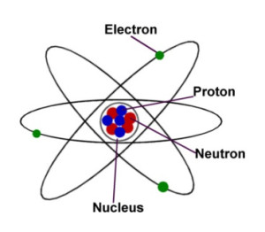
If the protons in this model were not labeled, how could we know where to find them?
Notes:
If the protons in this model were not labeled, how could we know where to find them?
[We can also see protons in this diagram of an atom. Here there are no letters or signs showing protons. The nucleus is labeled, and we know protons and neutrons are in the nucleus, so we know that protons must be inside the nucleus. In this diagram, the protons are shown by the blue circles.]

Slide 111
What is the relationship between the nucleus and protons?
Notes:
What is the relationship between the nucleus and protons?
[Remember that protons are NOT the same as the nucleus. The nucleus is where protons are found.]

Slide 112
Are neutrons the same as protons? Explain your answer.
Notes:
Are neutrons the same as protons? Explain your answer
[Neutrons are not the same thing as protons. Protons and neutrons are found in the same place (nucleus) BUT protons and neutrons are separate parts of the atom (we will talk about neutrons later).]

Slide 113
Remember!!!
Notes:
So remember!

Slide 114
Protons: positively charged subatomic particles found in the nucleus of an atom
Proton
Nucleus
Notes:
Protons are positively charged subatomic particles found in the nucleus of an atom.
Feedback: Remember, it is important that students have an opportunity to ask questions at the end of the lesson so that they can clarify their own understanding, some students may need a clear cue that it is their turn to ask questions.

Slide 115
Big Question: What is the relationship between the nucleus, protons, neutrons, and electrons in atoms?
Proton
Electron
Neutron
Notes:
Explicit cue to revisit the big question at the end of the lesson: Okay everyone. Now that we’ve learned the term, let’s reflect once more on our big question. Was there anything that we predicted earlier that was correct or incorrect? Do you have any new hypotheses to share?

Slide 116
Notes:
Thanks for watching, and please continue watching CAPs available from this website.

Slide 117
This Video Was Created With Resources From:
Questions or Comments
Michael Kennedy, Ph.D. MKennedy@Virginia.edu
Rachel L Kunemund, Ph.D. rk8vm@virginia.edu

Slide 118
Intro
“Big Idea” Question
Review Concepts
Check-In Questions
Teacher Demo
Vocabulary
Student-Friendly Definition
Examples & Non-Examples
Morphological Word Parts
Simulation/Activity
Notes:
OK everyone, get ready for our next lesson. Just as a reminder, these are the different components that our lesson may include, and you’ll see these icons in the top left corner of each slide so that you can follow along more easily!

Slide 119
Neutron
Intro
Neutron
Nucleus
Notes:
Today we are going to learn about neutrons.
Feedback: Providing clear cues as to what was coming next in the lesson helps prepared students by letting them know what to expect.

Slide 120
Big Question: What is the relationship between the nucleus, protons, neutrons, and electrons in atoms?
Proton
Electron
Neutron
Notes:
Our “Big Question” is: What is the relationship between the nucleus, protons, neutrons, and electrons?
Let’s look at our big question again. Were our hypotheses correct? What did we learn/have to change about our hypotheses?

Slide 121
Notes:
Before we move on to our new vocabulary term, let’s review some other words & concepts that you already learned and make sure you are firm in your understanding.
Feedback: Using relevant topics and content to activate prior knowledge sets the students up to make important connections to new content.

Slide 122
Matter: has mass and takes up space
Notes:
Matter is anything that has mass and takes up space.

Slide 123
Atom: smallest whole unit of matter
Atom
Atom
Atom
Atom
Atom
Notes:
An atom is the smallest whole unit of matter.

Slide 124
Modern Atomic Model: orbitals are clouds that show where electrons are most likely to be
Notes:
The modern atomic model shows that orbitals are clouds that show where electrons are most likely to be.

Slide 125
Nucleus: the center of the atom that is made up of protons and neutrons
Notes:
The nucleus is the center of the atom that is made of protons and neutrons.

Slide 126
Protons: positively charged subatomic particles found in the nucleus of an atom
Proton
Nucleus
Notes:
Protons are positively charged subatomic particles found in the nucleus of an atom.

Slide 127
Notes:
Now let’s pause for a moment to check your understanding.

Slide 128
What are the two qualities of matter?
Notes:
What are the two qualities of matter?
[Matter has mass and takes up space]

Slide 129
What is an atom?
Notes:
What is an atom?
[An atom is the smallest whole unit of matter.]
Feedback: It is important when reviewing previously learned material that you pause and check for understanding, if students are grasping previous material you may need to tailor your instruction.

Slide 130
What is the relationship between atoms and matter?
Notes:
What is the relationship between atoms and matter?
[Matter is made up of atoms.]

Slide 131
What does the modern atomic model show?
Notes:
What does the modern atomic model show?
[The modern atomic model shows that orbitals are clouds that show where electrons are most likely to be.]

Slide 132
What are protons?
Proton
Nucleus
Notes:
What are protons?
[Protons are positively charged subatomic particles found in the nucleus of an atom.]

Slide 133
What charge do protons have?
Proton
Nucleus
Notes:
What charge do protons have?
[Positive charge]

Slide 134
Neutron
Notes:
Now that we’ve reviewed, let’s define our new term, neutron.

Slide 135
Neutrons: subatomic particles with no charge (neutral charge) found in the nucleus of atoms
Neutron
Nucleus
Notes:
Neutrons are subatomic particles with no charge (neutral) found in the nucleus.
Feedback: When providing more student-friendly definitions, it is helpful to provide students with cues so that they can be prepared and know what to expect and be ready to copy down the information.

Slide 136
Notes:
Now let’s pause for a moment to check your understanding.

Slide 137
What are neutrons?
Neutron
Nucleus
Notes:
What are neutrons?
[Neutrons are subatomic particles with no charge (neutral charge) found in the nucleus of atoms.]

Slide 138
Notes:
That is the basic definition, but there is a bit more you need to know.
Feedback: It can be helpful to break the definition down and explicitly explain each part to help students understand the whole definition.

Slide 139
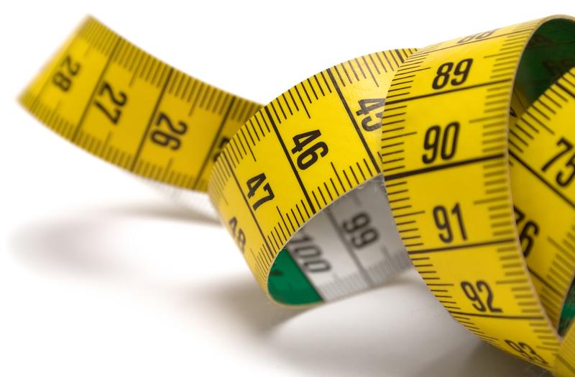
AMU = Atomic Mass Unit
Notes:
Remember AMU is how atoms are measured. So just like the mass of protons can be measured using AMU, the mass of neutrons can also be measured using AMU.

Slide 140
= 1 amu
Notes:
Neutrons, just like protons, have a mass equal to 1 amu.

Slide 141
Notes:
Now let’s pause for a moment to check your understanding.

Slide 142
What are neutrons?
Neutron
Nucleus
Notes:
What are neutrons?
[Neutrons are subatomic particles with no charge (neutral charge) and are found in the nucleus, the center of the atom.]

Slide 143
What charge do neutrons have?
Neutron
Nucleus
Notes:
What charge do neutrons have?
[Neutral]
Feedback: It's awesome to include many opportunities for students to demonstrate understanding, this can help you catch some confusion early and get students back on track.

Slide 144
What does AMU measure?
Notes:
What does AMU measure?
[AMU is how atoms are measured. So just like the mass of protons can be measured using AMU, the mass of neutrons can also be measured using AMU.]

Slide 145
What is the mass of a neutron?
= ? amu
Notes:
What is the mass of a neutron?
[Neutrons, just like protons, neutrons have a mass equal to 1 amu.]

Slide 146
Notes:
Now, let’s talk about some examples of neutrons.
Feedback: Remember to provide students with instructional cues that give them a chance to prepare for what is coming up next in the lesson, this will help orient them and be better able to engage with the content.

Slide 147
Neutron
Notes:
Here is a diagram that looks similar to what we have seen. Remember that sometimes the models will not be labeled. If this was not labeled how would we find the neutrons? We know that protons and neutrons are in the nucleus. We also know that protons are positive, so here, they are labeled by the + sign. That means that the neutrons are the red circles inside the nucleus.

Slide 148
Neutrons
Notes:
We have also seen this model. Remember in this model, protons and neutrons are labeled by P and N. Again, they are both found in the nucleus of an atom.
Feedback: Remember to try and use phrasing and language that is clear and easy for students to understand when going over examples of term meaning.

Slide 149
Notes:
Now let’s pause for a moment to check your understanding.

Slide 150
Where are protons and neutrons found?
Notes:
Where are protons and neutrons found?
[Nucleus of an atom]

Slide 151
Where are the neutrons in this model of an atom? Explain your answer.
Notes:
Where are the neutrons in this model of an atom? Explain your answer.
[The neutrons are shown by the N. We know this because they are also with the protons (P) and we know that protons and neutrons are found in the nucleus of an atom.]

Slide 152
Where are the neutrons in this model of an atom? Explain your answer.
Notes:
Where are the neutrons in this model of an atom? Explain your answer.
[We know that protons and neutrons are in the nucleus. We also know that protons are positive, so here, they are labeled by the + sign. That means that the neutrons are the red circles inside the nucleus.]

Slide 153
Notes:
Next, let’s talk about some non-examples of neutrons.
Feedback: One important component of using non-examples is by clearly distinguishing similarities and explaining why it is a non-example.

Slide 154
Notes:
Remember that protons are NOT the same as the nucleus. The nucleus is where protons are found.

Slide 155
+
Neutral
Notes:
Remember protons are also NOT the same as neutrons. They are both found in the nucleus, but protons have a positive charge and neutrons have a neutral charge.

Slide 156
Notes:
Let’s check-in for understanding.

Slide 157
How are neutrons and the nucleus of an atom related?
Notes:
How are neutrons and the nucleus of an atom related?
[Remember that protons are NOT the same as the nucleus. The nucleus is where neutrons (and protons) are found.]
Feedback: Making connections between the new content and past terms/content is important for helping students understand the bigger picture.

Slide 158
What is the relationship between protons and neutrons?
+
Neutral
Notes:
What is the relationship between protons and neutrons?
[They are both found in the nucleus but protons have a positive charge and neutrons have a neutral charge.]

Slide 159
What are neutrons?
Neutron
Nucleus
Notes:
What are neutrons?
[Neutrons are subatomic particles with no charge (neutral charge) and are found in the nucleus, the center of the atom.]

Slide 160
What charge do neutrons have?
Neutron
Nucleus
Notes:
What charge do neutrons have?
[Neutral]

Slide 161
What do AMUs measure?
Notes:
What do AMUs measure?
[Remember AMU is how atoms are measured. So just like the mass of protons can be measured using AMU, the mass of neutrons can also be measured using AMU]

Slide 162
What is the mass of a neutron?
= ? amu
Notes:
What is the mass of a neutron?
[Neutrons, just like protons, neutrons have a mass equal to 1 amu.]

Slide 163
Where are protons and neutrons found?
Notes:
Where are protons and neutrons found?
[Nucleus of an atom]

Slide 164
Where are the neutrons in this model of an atom? Explain your answer.
Notes:
Where are the neutrons in this model of an atom? Explain your answer.
[The neutrons are shown by the N. We know this because they are also with the protons (P) and we know that protons and neutrons are found in the nucleus of an atom.]
Feedback: It's really important to make sure that you're providing students with frequent opportunities to respond as you're closing the lesson – it will help you know if they understood and made sense of the content and where you can provide further instruction.

Slide 165
Where are the neutrons in this model of an atom? Explain your answer.
Notes:
Where are the neutrons in this model of an atom? Explain your answer.
[We know that protons and neutrons are in the nucleus. We also know that protons are positive, so here, they are labeled by the + sign. That means that the neutrons are the red circles inside the nucleus.]

Slide 166
How are neutrons and the nucleus of an atom related?
Notes:
How are neutrons and the nucleus of an atom related?
[Remember that protons are NOT the same as the nucleus. The nucleus is where neutrons (and protons) are found.]

Slide 167
What is the relationship between protons and neutrons?
+
Neutral
Notes:
What is the relationship between protons and neutrons?
[They are both found in the nucleus but protons have a positive charge and neutrons have a neutral charge.]

Slide 168
Remember!!!
Notes:
So remember!

Slide 169
Neutrons: subatomic particles with no charge (neutral charge) found in the nucleus of atoms
Neutron
Nucleus
Notes:
Neutrons are subatomic particles with no charge found in the nucleus of an atom.

Slide 170
Big Question: What is the relationship between the nucleus, protons, neutrons, and electrons in atoms?
Proton
Electron
Neutron
Notes:
Explicit cue to revisit the big question at the end of the lesson: Okay everyone. Now that we’ve learned the term, let’s reflect once more on our big question. Was there anything that we predicted earlier that was correct or incorrect? Do you have any new hypotheses to share?
Feedback: Providing your students with some reflection time at the end of the lesson is crucial in helping them to put the pieces together and make sense of the activity.

Slide 171
Notes:
Thanks for watching, and please continue watching CAPs available from this website.

Slide 172
This Video Was Created With Resources From:
Questions or Comments
Michael Kennedy, Ph.D. MKennedy@Virginia.edu
Rachel L Kunemund, Ph.D. rk8vm@virginia.edu

Slide 173
Intro
“Big Idea” Question
Review Concepts
Check-In Questions
Teacher Demo
Vocabulary
Student-Friendly Definition
Examples & Non-Examples
Morphological Word Parts
Simulation/Activity
Notes:
OK everyone, get ready for our next lesson. Just as a reminder, these are the different components that our lesson may include, and you’ll see these icons in the top left corner of each slide so that you can follow along more easily!

Slide 174
Electron
Intro
Electron
Notes:
Today we are going to learn about electrons.
Feedback: Using clear and consistent language when introducing today's content helps students understand what is expected.

Slide 175
Big Question: What is the relationship between the nucleus, protons, neutrons, and electrons in atoms?
Proton
Electron
Neutron
Notes:
Our “Big Question” is: What is the relationship between the nucleus, protons, neutrons, and electrons?
Let’s look at our big question again. Were our hypotheses correct? What did we learn/have to change about our hypotheses?

Slide 176
Notes:
Before we move on to our new vocabulary term, let’s review some other words & concepts that you already learned and make sure you are firm in your understanding.

Slide 177
Matter: has mass and takes up space
Notes:
Matter is anything that has mass and takes up space.

Slide 178
Atom: smallest whole unit of matter
Atom
Atom
Atom
Atom
Atom
Notes:
An atom is the smallest whole unit of matter.

Slide 179
Modern Atomic Model: orbitals are clouds that show where electrons are most likely to be
Notes:
The modern atomic model shows that orbitals are clouds that show where electrons are most likely to be.

Slide 180
Nucleus: the center of the atom that is made up of protons and neutrons
Notes:
The nucleus is the center of the atom that is made of protons and neutrons.
Feedback: It is important to give some background information or a related natural phenomena related to the topic of the lesson. This helps students make connections.

Slide 181
Protons: positively charged subatomic particles found in the nucleus of an atom
Proton
Nucleus
Notes:
Protons are positively charged subatomic particles found in the nucleus of an atom.

Slide 182
Neutrons: subatomic particles with no charge (neutral charge) found in the nucleus of atoms
Neutron
Nucleus
Notes:
Neutrons are subatomic particles with no charge (neutral charge) found in the nucleus of an atom.

Slide 183
Notes:
Now let’s pause for a moment to check your understanding.
Feedback: Remember to make adjustments to your lesson and content if you see some students not demonstrating understanding, this can help them make connections and prevent frustration.

Slide 184
What are the two qualities of matter?
Notes:
What are the two qualities of matter?
[Matter has mass and takes up space]

Slide 185
What is an atom?
Notes:
What is an atom?
[An atom is the smallest whole unit of matter.]

Slide 186
What is the relationship between atoms and matter?
Notes:
What is the relationship between atoms and matter?
[Matter is made up of atoms.]

Slide 187
What does the modern atomic model show?
Notes:
What does the modern atomic model show?
[The modern atomic model shows that orbitals are clouds that show where electrons are most likely to be.]

Slide 188
What is a nucleus?
Notes:
What is a nucleus?
[The nucleus is the center of the atom that is made of protons and neutrons.]
Feedback: You might need to move slower and more intentionally through the review of the previous day’s material. Use these checks for understanding to determine how well the students are doing with the content.

Slide 189
What is the difference between protons and neutrons?
Proton
Neutron
Notes:
What is the difference between protons and neutrons?
[Protons and neutrons are both subatomic particles found in the nucleus of an atom. However, protons have a positive charge and neutrons have no charge (neutral).]

Slide 190
Electron
Notes:
Now that we’ve reviewed, let’s define our new term, electron.

Slide 191
Electrons: negatively charged subatomic particles orbiting the nucleus
Electron
Notes:
Electrons are negatively charged subatomic particles orbiting the nucleus.

Slide 192
Notes:
Now let’s pause for a moment to check your understanding.

Slide 193
What are electrons?
Electron
Notes:
What are electrons?
[Electrons are negatively charged subatomic particles orbiting the nucleus.]
Feedback: Remember, students might look like they are understanding the definition but it is important that you check for understanding yourself by asking questions or providing them with other opportunities to respond.

Slide 194
Notes:
That is the basic definition, but there is a bit more you need to know.

Slide 195
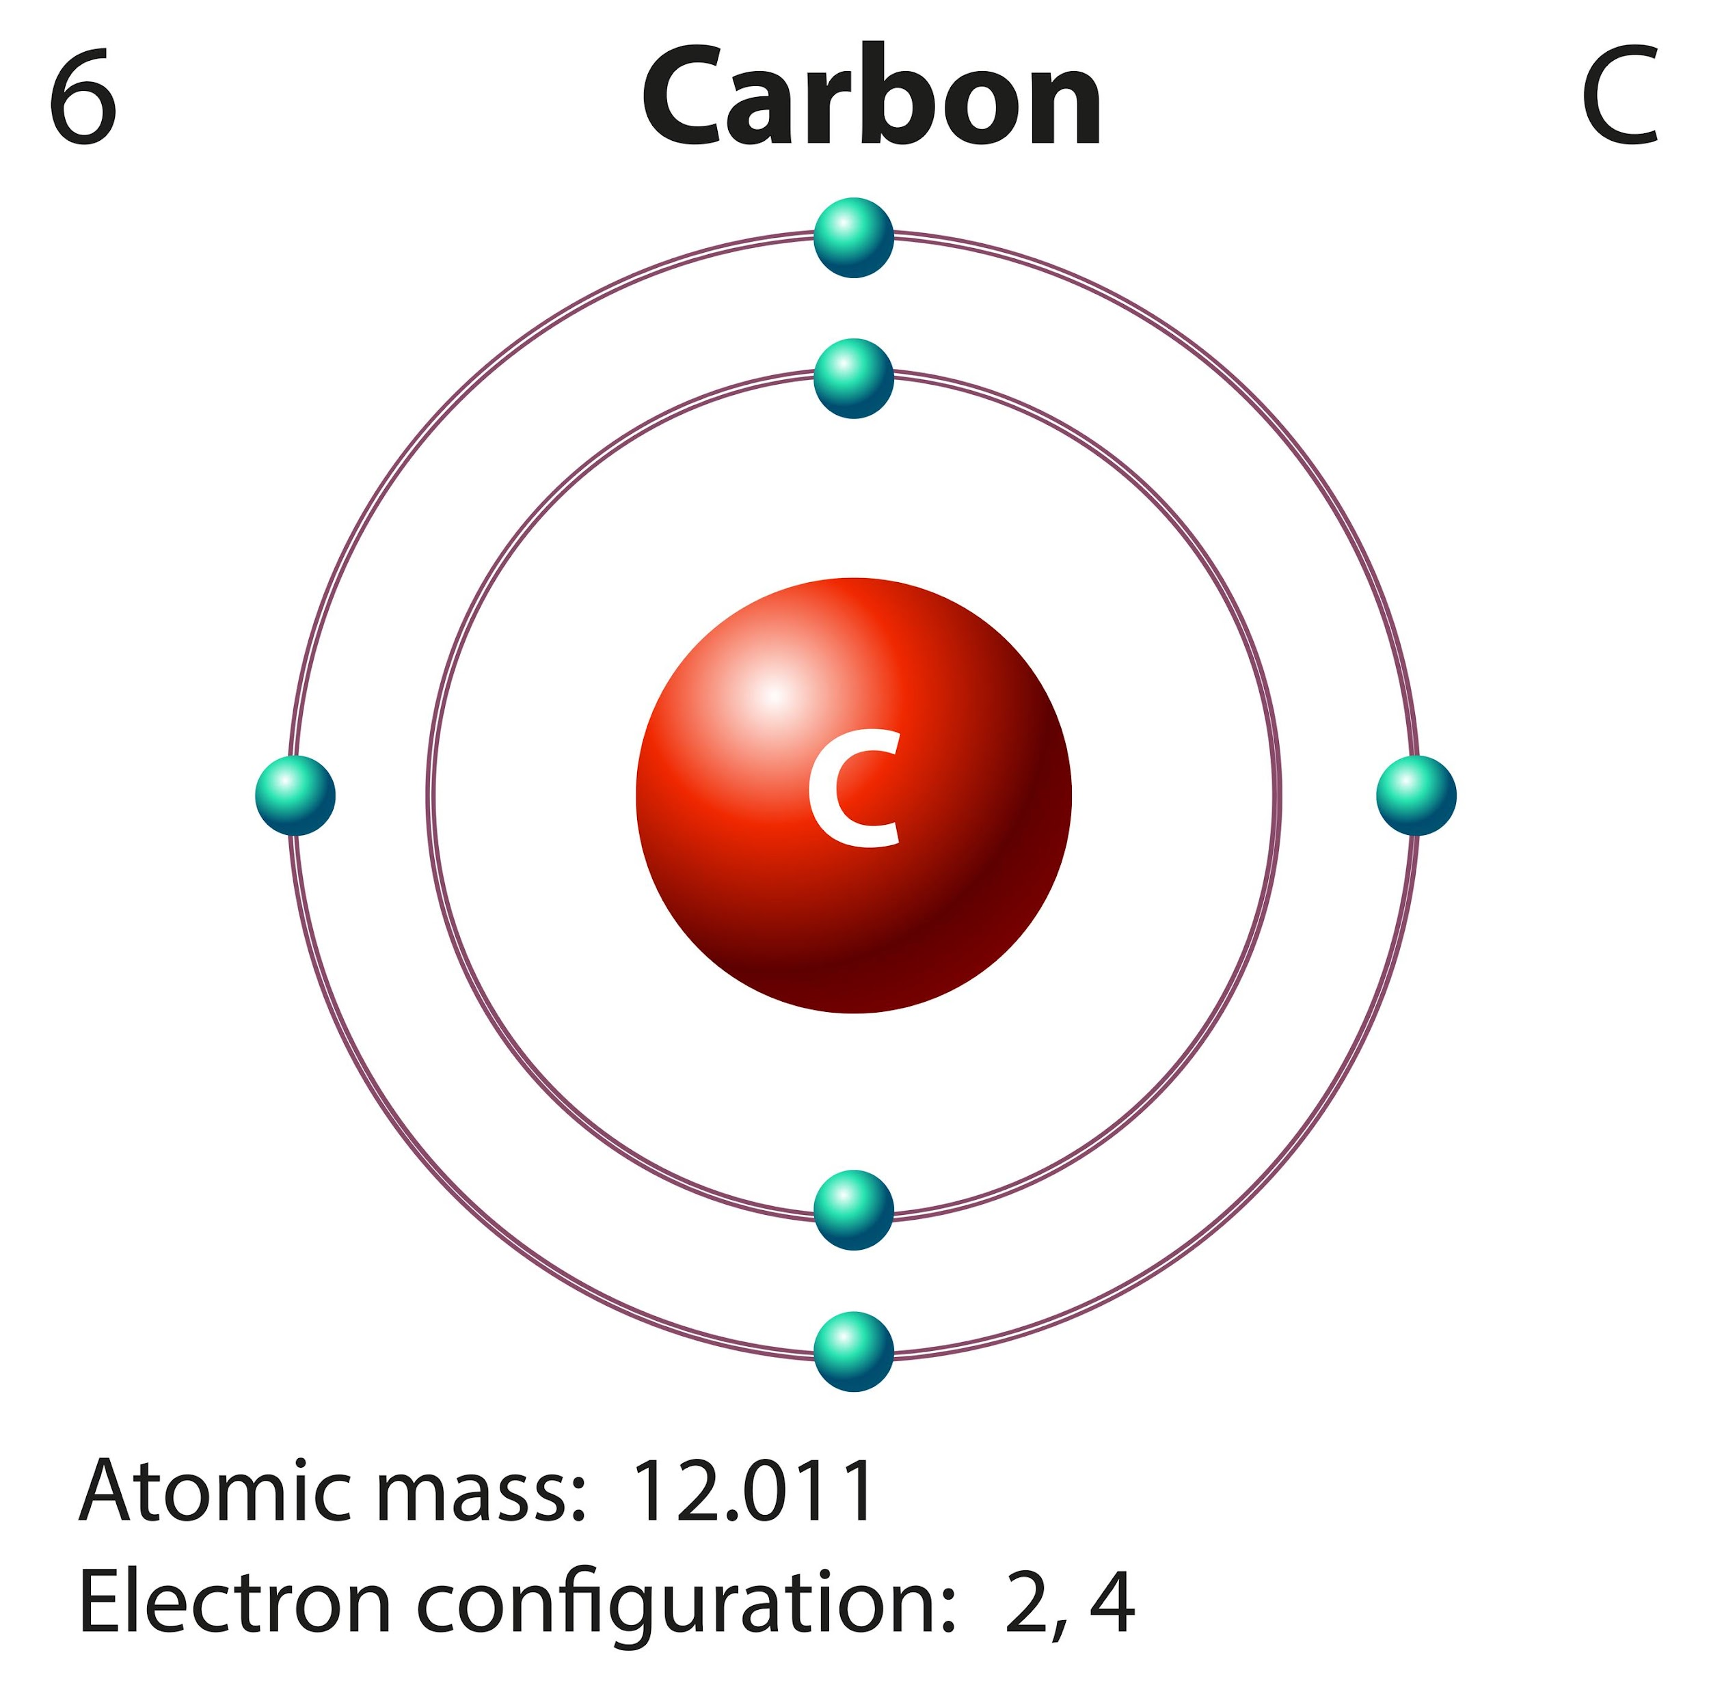
Valence Electrons: the electrons in the outer shell of an atom
Notes:
Valence electrons are the electrons in the outermost shell of an atom.

Slide 196
Valence Electrons React
Notes:
Since they are on the outer shell, they react with other atoms.

Slide 197
= no mass
Notes:
While AMU is used to measure the mass of subatomic particles, electrons are so much smaller than protons/neutrons that we consider them to have 0 mass.

Slide 198
Electron Cloud
Notes:
The space outside of the nucleus is called the electron cloud. The is where electrons are found.
Feedback: Using clear language can take make formal more complicated definitions a little easier for students to understand.

Slide 199
Electron Cloud = Volume
Notes:
The electron cloud gives the atom most of its volume.

Slide 200
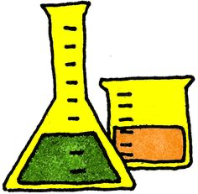
Volume is a measure of the amount of something an object can hold
Notes:
Remember, volume is a measure of the amount of something an object can hold. The volume, for example, would be a measure of how much these containers can hold.
Feedback: This is a great opportunity to make mathematical connections to when students may have considered volume in their math classes.

Slide 201
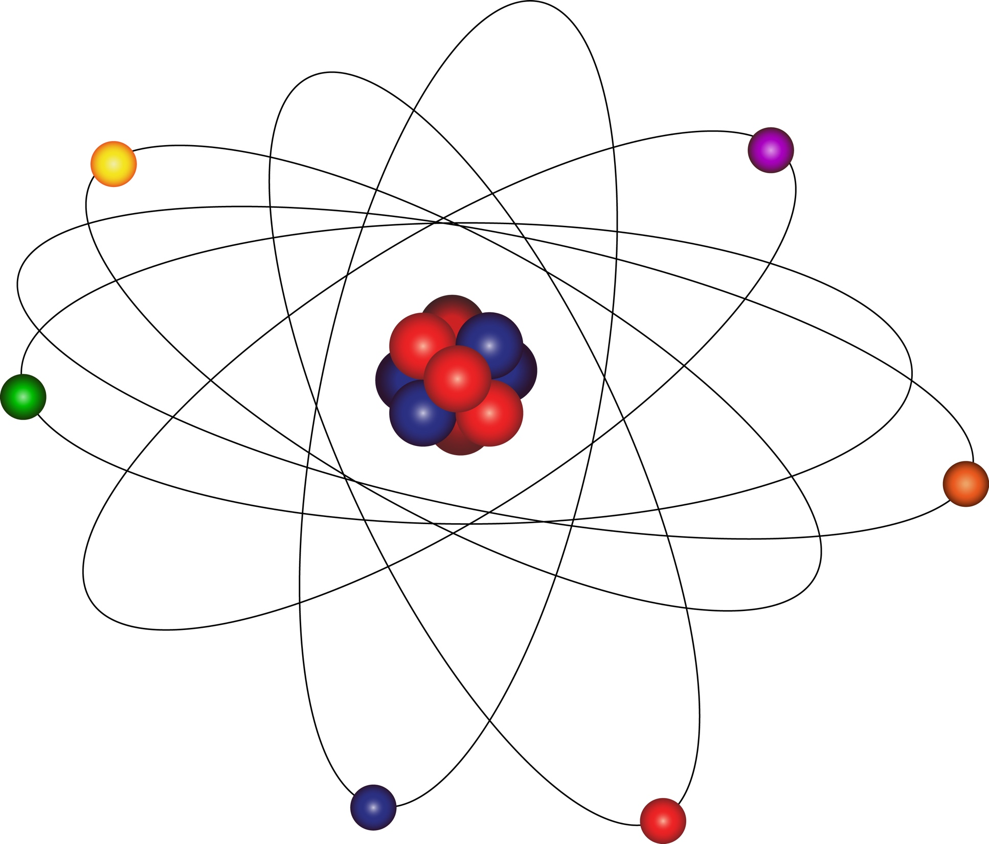
Notes:
When electrons orbit the nucleus they are moving very quickly around the nucleus in clouds.

Slide 202
Notes:
There are two models for how electrons move around the nucleus.

Slide 203
Electron Shells
Notes:
This is one model. Look at this atom. The nucleus is in the middle and the electrons are in orbits surrounding it. The first orbit has two electrons and the second orbit has four electrons. Each orbit is called an electron shell.

Slide 204
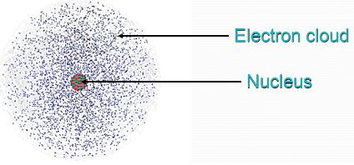
Notes:
This is the other model called the “Electron Cloud Model.” This model says that electrons move so fast we are unable to pinpoint their exact location but we can guess by drawing an an electron cloud around the nucleus.

Slide 205
DIFFERENT
Notes:
The electron cloud shows that most electrons are likely to be near the nucleus but some move further out but that they don’t stay in specific orbitals like in an electron shell.

Slide 206
Notes:
Now let’s pause for a moment to check your understanding.

Slide 207
What is an electron?
Electron
Notes:
What is an electron?
[An electron is a negatively charged particle that orbits, or moves around, the outside of the nucleus, or the center, of an atom.]
Feedback: Provide clear and straightforward directions when asking students to explain the definitions. This helps to avoid confusion!

Slide 208
What are valence electrons?
Notes:
What are valence electrons?
[Valence electrons are the electrons in the outermost shell of an atom.]

Slide 209
What is the mass of electron?
Notes:
What is the mass of an electron?
[While AMU is used to measure the mass of subatomic particles, electrons are so small compared to protons and neutrons that we consider them to have no mass.]

Slide 210
Where are electrons found?
Notes:
Where are electrons found?
[Electron cloud; around the nucleus]

Slide 211
True/False: Most of the atom’s volume comes from the electron cloud.
Notes:
True/False: Most of the atom’s volume comes from the electron cloud.

Slide 212
True/False: Most of the atom’s volume comes from the electron cloud.
Notes:
True/False: Most of the atom’s volume comes from the electron cloud.
[True]

Slide 213
Explain the two models for how electrons move in the electron cloud.
Electron Shells
Notes:
Explain the two models for how electrons move in the electron cloud.
[In the first model, the nucleus is in the middle and the electrons are in orbits surrounding it. The first orbit has two electrons and the second orbit has four electrons. Each orbit is called an electron shell.
The second model, or the “Electron Cloud Model”, says that electrons move so fast we are unable to pinpoint their exact location but we can guess by drawing an an electron cloud around the nucleus.]

Slide 214
Notes:
Now, let’s talk about some examples of electrons.
Feedback: Remember, it is important to have an organized and smooth transition to limit wasted time and reduce any disruptions. By having materials ready in advance and working on a routine with students you can easily get this done!

Slide 215
Electron
Notes:
Here we have the electron shell model, the electrons are orbiting outside of the nucleus of the atom.

Slide 216
Electron
Notes:
Here we have a more detailed example of the electron shell model. It is more detailed because it shows the protons and neutrons inside the nucleus, but it is still the electron model because it shows the electrons orbiting outside of the nucleus.

Slide 217
Notes:
This is the other model called the “Electron Cloud Model.” This model says that electrons move so fast we are unable to pinpoint their exact location but we can guess by drawing an an electron cloud around the nucleus. The small dots outside of the nucleus are electrons (or where we guess where they would be).

Slide 218
Notes:
Now let’s pause for a moment to check your understanding.

Slide 219
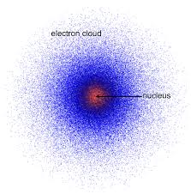
Which electron model is this? Explain your answer.
Notes:
Which electron model is this? Explain your answer.
[The “Electron Cloud Model” - this model says that electrons move so fast we are unable to pinpoint their exact location but we can guess by drawing an an electron cloud around the nucleus. The small dots outside of the nucleus are electrons (or where we guess where they would be).]

Slide 220
Which electron model is this? Explain your answer.
Notes:
Which electron model is this? Explain your answer.
[The electron shell model - it shows the electrons orbiting outside of the nucleus.]

Slide 221
What is an electron?
Electron
Notes:
What is an electron?
[An electron is a negatively charged particle that orbits, or moves around, the outside of the nucleus, or the center, of an atom.]
Feedback: Intentionally repeating key questions when engaging in this part of the lesson highlights what is important for the students.

Slide 222
What are valence electrons?
Notes:
What are valence electrons?
[Valence electrons are the electrons in the outermost shell of an atom.]

Slide 223
What is the mass of an electron?
Notes:
What is the mass of an electron?
[While AMU is used to measure the mass of subatomic particles, electrons have no mass.]
Feedback: Confirming students' understanding with lots of opportunities to respond when closing a lesson is super important before asking them to try it on their own.

Slide 224
Where are electrons found?
Notes:
Where are electrons found?
[Electron cloud; around the nucleus]

Slide 225
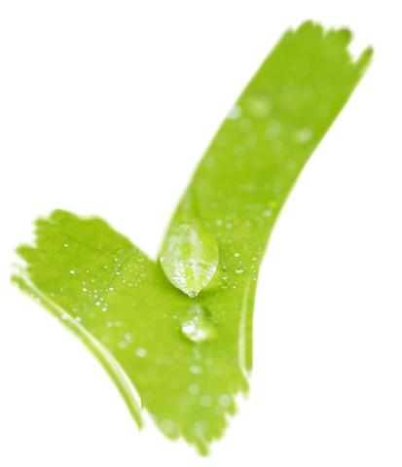
Atomic Sub-Particle
Location
Charge
Electron
Neutron
Proton
Notes:
Now that we have talked about protons, neutrons, and electrons, let’s put it all together. Fill in the rest of the chart to compare and contrast protons, neutrons, and electrons. The one thing they all have in common is that they are subatomic particles. Fill in where each is found and what charge each has.

Slide 226
Atomic Sub-Particle
Location
Charge
Electron
Neutron
Proton
Electron Cloud
Negative
Nucleus
Neutral
Nucleus
Positive
Notes:
Answer
Feedback: Visuals like this allow students to see the similarities and differences between terms. This helps to build connections, clarify misconceptions, and increase retention.

Slide 227
Remember!!!
Notes:
So remember!

Slide 228
Electrons: negatively charged subatomic particles orbiting the nucleus
Electron
Notes:
Electrons are negatively charged particle that orbits, or moves around, the outside of the nucleus, or the center, of an atom.

Slide 229
Simulation Activity
Build an Atom
(Phet Simulation)
Click on the link above to create your own atoms.
Pay attention to what happens when you add different numbers of protons, neutrons, and electrons. Predict how you think each of these subatomic particles will affect the atom you build.
Notes:
Feedback: This demonstration is a great way to introduce students to an investigation. In your classroom, you may encourage students to plan and conduct this investigation more independently since a large component of inquiry-based activities is encouraging student thinking and independence. As suggested by the slide, beginning with open-ended questions, followed by providing explicit explanations, and then asking probing questions is a great way to engage students in a discussion while also providing clear explanations.

Slide 230
Big Question: What is the relationship between the nucleus, protons, neutrons, and electrons in atoms?
Proton
Electron
Neutron
Notes:
Explicit cue to revisit the big question at the end of the lesson: Okay everyone. Now that we’ve learned the term, let’s reflect once more on our big question. Was there anything that we predicted earlier that was correct or incorrect? Do you have any new hypotheses to share?

Slide 231
Notes:
Thanks for watching, and please continue watching CAPs available from this website.

Slide 232
This Video Was Created With Resources From:
Questions or Comments
Michael Kennedy, Ph.D. MKennedy@Virginia.edu
Rachel L Kunemund, Ph.D. rk8vm@virginia.edu

