Slide 1
Intro
“Big Idea” Question
Review Concepts
Check-In Questions
Teacher Demo
Vocabulary
Student-Friendly Definition
Examples & Non-Examples
Morphological Word Parts
Simulation/Activity
Notes:
OK everyone, get ready for our next lesson. Just as a reminder, these are the different components that our lesson may include, and you’ll see these icons in the top left corner of each slide so that you can follow along more easily!

Slide 2
Intro
Energy Transfer
Conduction
Convection
Radiation
Notes:
There are three ways that energy can be transferred. They are conduction, convection, and radiation.

Slide 3
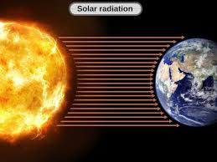
Intro
Radiation
Notes:
Today, we are going to focus on radiation.
Feedback: Providing clear cues as to what was coming next in the lesson helps set students up to be prepared by letting them know what to expect.

Slide 4
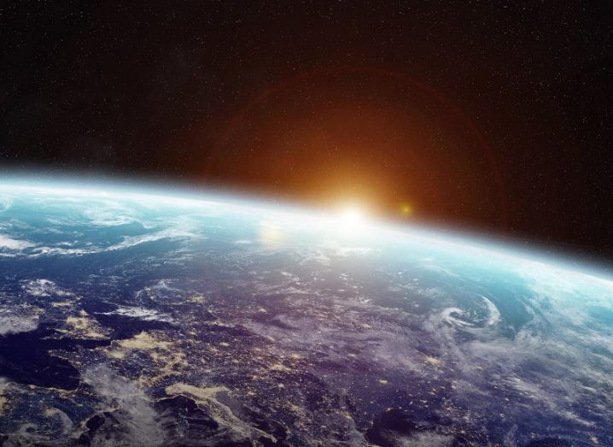
Big Question: How does radiation distribute energy, and how does it power the circulation of the earth’s atmosphere and the oceans?
Notes:
Our “big question” is: How does radiation distribute energy and how does it power the circulation of the earth’s atmosphere and oceans?
[Pause and illicit predictions from students.]
I love all these thoughtful scientific hypotheses! Be sure to keep this question and your predictions in mind as we move through these next few lessons, and we’ll continue to revisit it.
Feedback: Asking students to make predictions about how radiation distributes energy and how it powers the circulation of the earth’s atmosphere and oceans is a great way to activate and elicit student ideas and prior knowledge. This type of activity is evidence of the teacher planning for students’ engagement with science ideas.

Slide 5
Demonstration
Objective: Students will understand the difference between conduction, convection, and radiation.
Activity: The teacher will demonstrate conduction, convection, and radiation using a hot plate. The teacher will heat up a beaker of water and wait for it boil. The teacher will then explain how the beaker is being heated by conduction, the water is being heated by convection, and the air is being heated by radiation.
Materials:
Beaker
Hot plate
water
Notes:
Let’s do a quick demonstration that will help get our brains ready to think about radiation, and how it relates to our big question.
Feedback: This demonstration offers a clear and logical order of steps that help students make sense of the activity and stay engaged. Be sure to keep the students engaged throughout the demonstration by asking questions; high levels of engagement are important for student understanding and participation.

Slide 6
Notes:
Before we move on to our new vocabulary term, let’s review some other words & concepts that you already learned and make sure you are firm in your understanding.

Slide 7
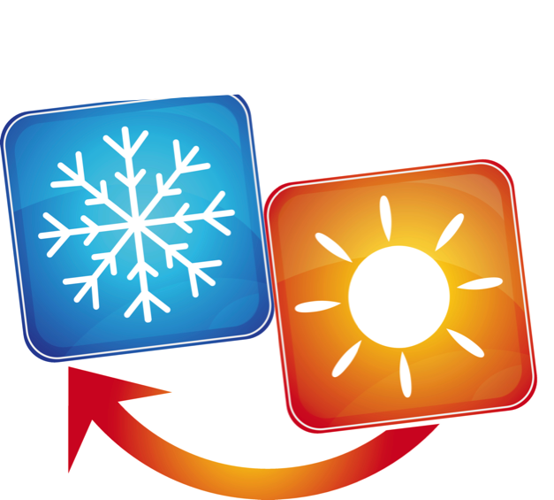
Notes:
Energy can be transferred from one object to another. When a thermal, or heat transfer occurs, heat moves from the warmer object to the colder object.

Slide 8
Conduction: requires two or more objects in direct contact to transfer heat energy
Notes:
Conduction requires two or more objects in direct contact to transfer heat energy.

Slide 9
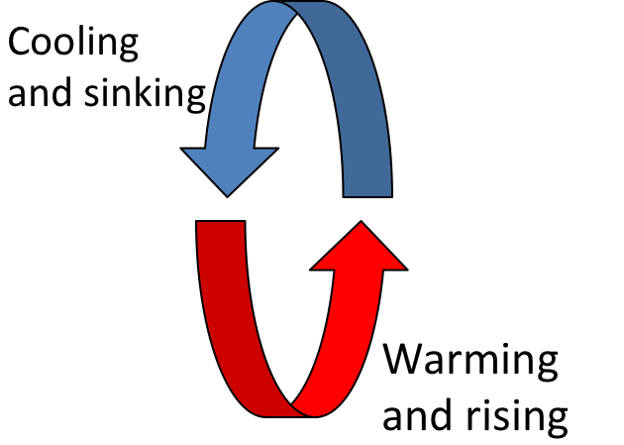
Convection: heating and cooling of a liquid or gas in a circular manner
Notes:
Convection is the heating and cooling of a liquid or gas in a circular manner.

Slide 10
Notes:
Now let’s pause for a moment to check your understanding.

Slide 11
Energy Transfer
________
_________
_________
Notes:
What are the three ways energy can be transferred? Which will we be focusing on today?

Slide 12
Energy Transfer
Conduction
Convection Radiation
Notes:
What are the three ways energy can be transferred? Which will we be focusing on today?
[There are three ways that energy can be transferred. They are conduction, convection, and radiation. Today, we will be focusing on radiation.]

Slide 13
What is the difference between conduction and convection?
Notes:
What is the difference between conduction and convection?
[Conduction requires two or more objects in direct contact to transfer heat energy.
Convection is the heating and cooling of a liquid or gas in a circular manner.]

Slide 14
What occurs when heat moves from the warmer object to the colder one?
Notes:
What occurs when heat moves from the warmer object to the colder one?
[Energy can be transferred from one object to another. When a thermal, or heat transfer occurs, heat moves from the warmer object to the colder object.]

Slide 15
Radiation
Notes:
Now that we’ve reviewed, let’s define our new term, radiation.

Slide 16
Radiation: the transfer of energy as waves
Notes:
Radiation is the transfer of energy as waves.

Slide 17
Notes:
Now let’s pause for a moment to check your understanding.

Slide 18
What is radiation?
Notes:
What is radiation?
[Radiation is the transfer of energy as waves.]

Slide 19
Notes:
That is the basic definition, but there is a bit more you need to know.

Slide 20
Notes:
Radiation energy travels as waves, which includes the forms of energy that make up the electromagnetic spectrum. A few examples of these forms of energy are radio waves, visible light, infrared (or heat), and X-rays.

Slide 21
Notes:
Infrared waves are used in remote controls.

Slide 22
Notes:
Visible light is what we humans are able to see.

Slide 23
Notes:
Ultraviolet light is emitted by the sun.

Slide 24
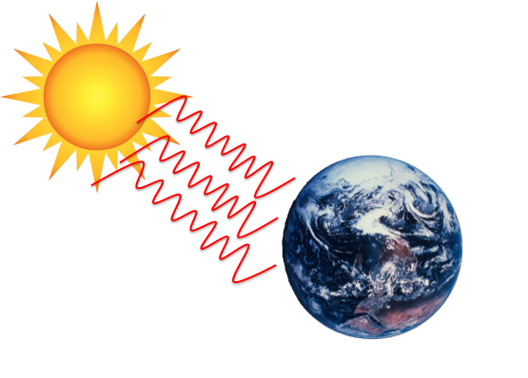
Notes:
An important idea to note is that unlike conduction or convection, radiation can travel through empty space, meaning that it does not need a medium, such as a liquid, gas, or a solid, to carry energy. That’s how energy from the Sun can reach Earth—the energy released from the Sun travels as waves through space, to Earth and the solar system.

Slide 25
Notes:
Let’s review.

Slide 26
What is radiation?
Notes:
What is radiation?
[Radiation is the transfer of energy in wave form.]

Slide 27
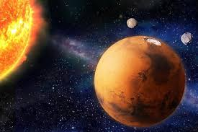
Can radiation travel through outer space?
Notes:
Can radiation travel through outer space?
[Yes, sunlight is a form of radiation and travels through space to reach us.]

Slide 28
Notes:
Now, let’s talk about some examples of radiation.

Slide 29
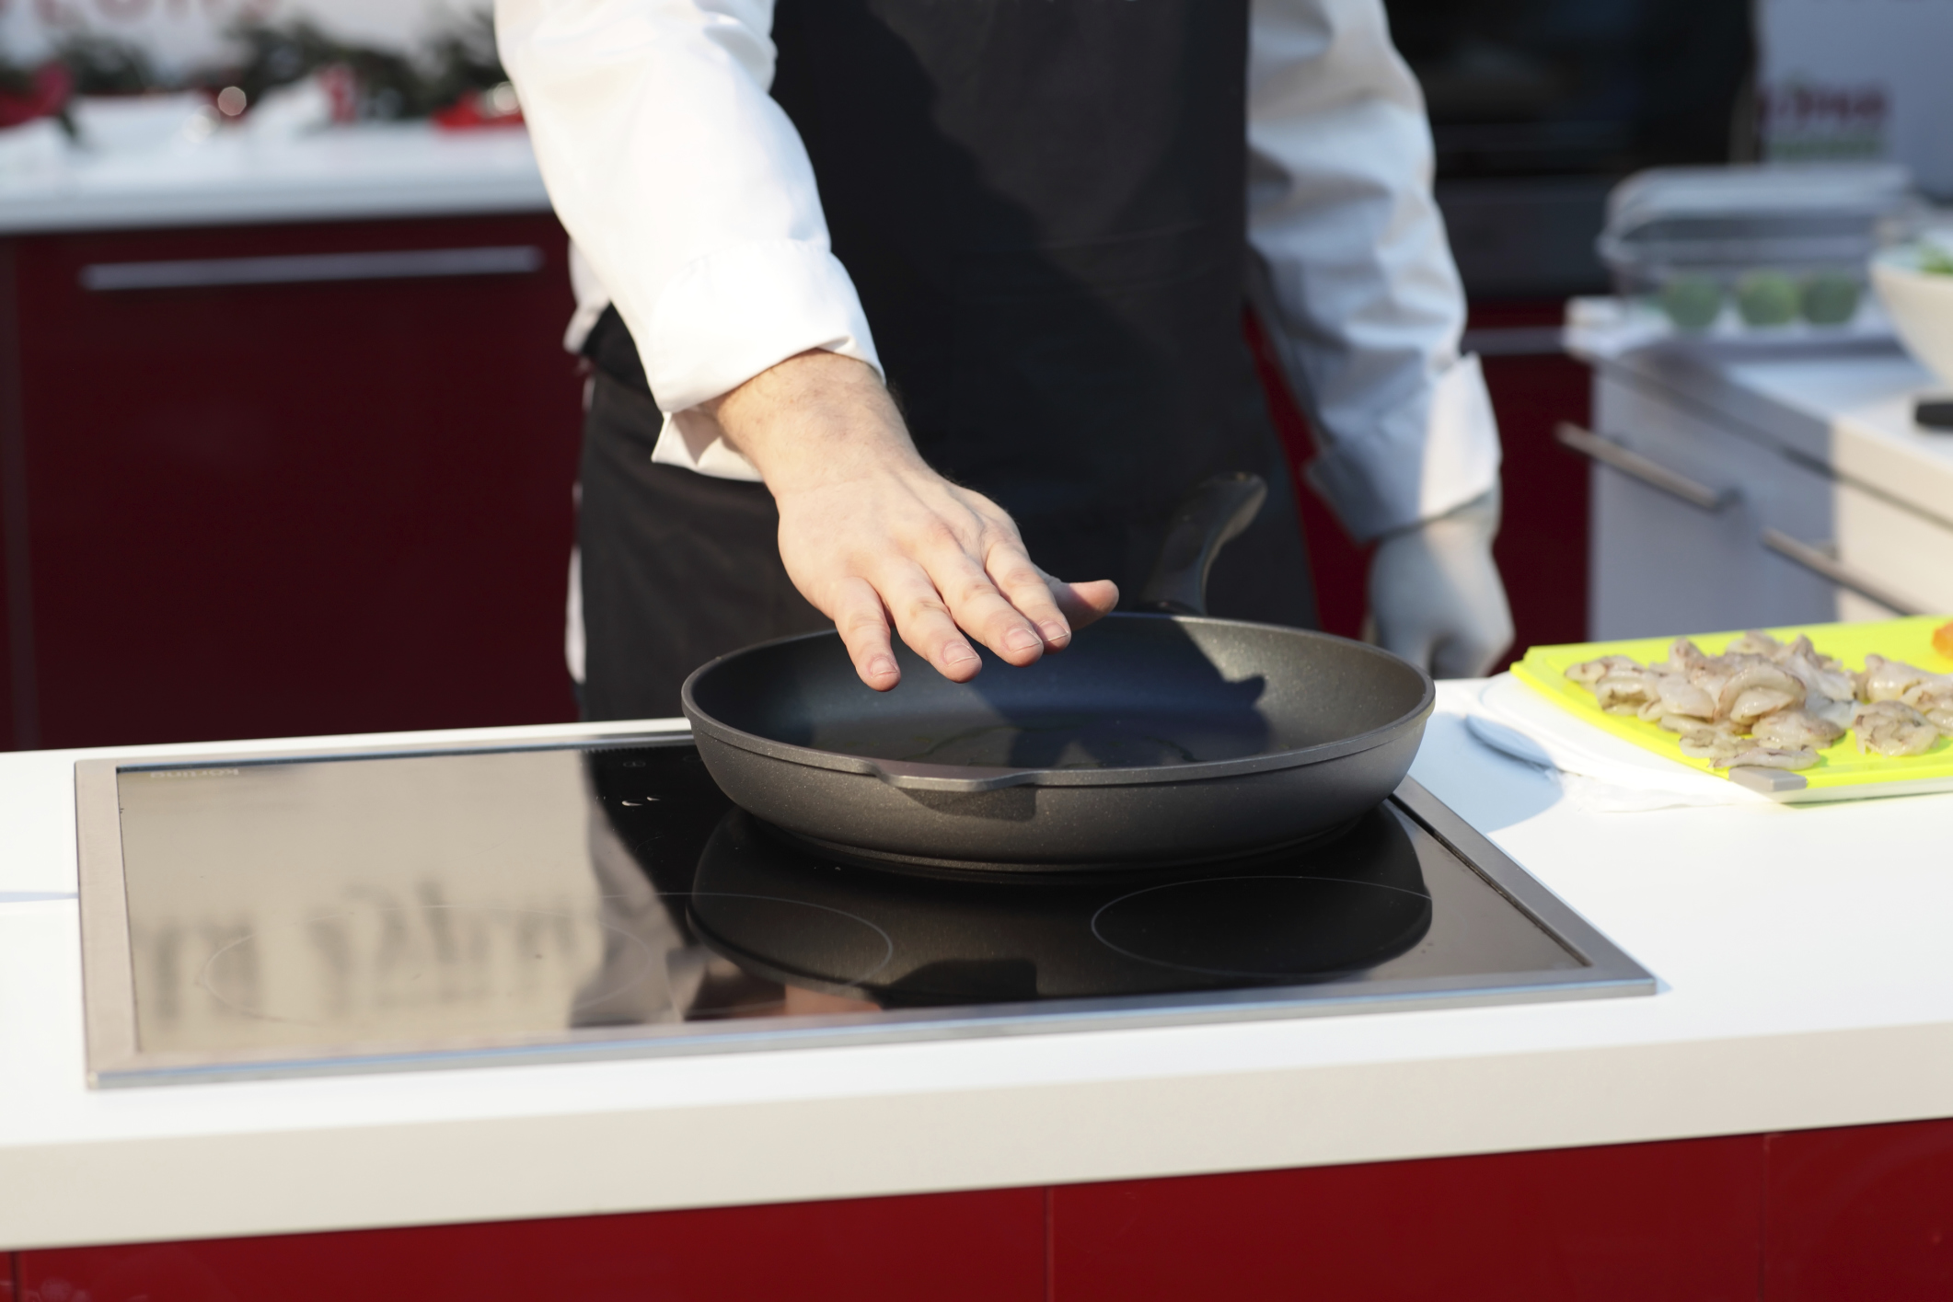
Notes:
An example of this form of radiation is observed when you hold your hand over a hot stove. Although your hand is not actually touching the stove, you know that it is hot because you can feel the heat radiating from it.
Feedback: Giving examples that relate to students’ real world experiences is an important way to help students make connections to the content.

Slide 30
Notes:
Visible light is an example of energy that radiates from the light source.

Slide 31
Notes:
Radiation of light is why we can see the stars. Visible light can travel in space.

Slide 32
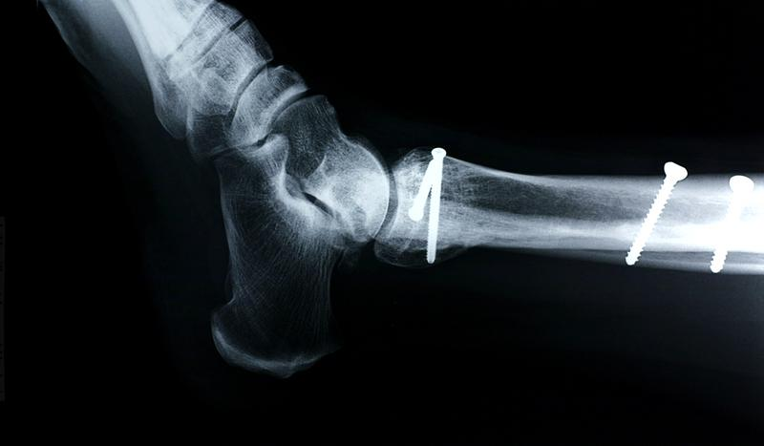
Notes:
X-rays are another example of radiation.

Slide 33
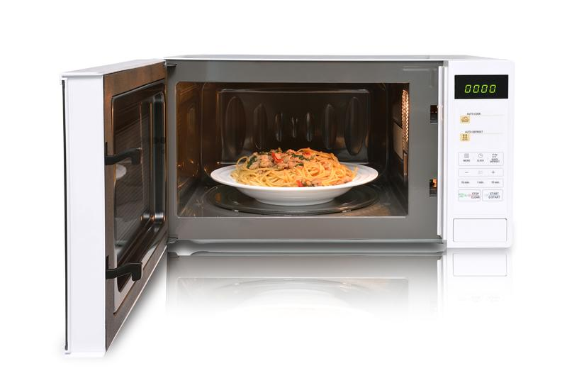
Notes:
Microwave ovens use another kind of radiation to cook food.

Slide 34
Notes:
Next, let’s talk about some non-examples of radiation.

Slide 35
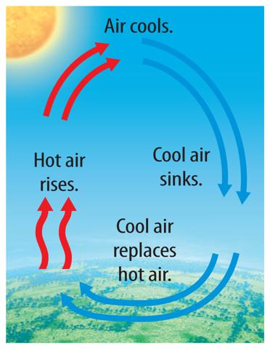
Hot air rising is not an example of radiation.
Notes:
Hot air rising is not an example of radiation.
Feedback: This is a great opportunity to ask students to explain why hot air rising is not an example of radiation and then gauge student understanding from their answers, incorporate students’ responses into discussion, and correct misconceptions.

Slide 36
Notes:
To think about the definition of radiation, it is helpful to look at its word parts.

Slide 37
radiation
Notes:
The term radiation has the word radiate in it…

Slide 38
radiation
radiate: to emit or give off
Notes:
Which means to emit or give off. So radiant energy radiates from one object to another.
Feedback: Breaking down the vocabulary term into word parts and defining each part is essential in building student understanding of the word parts.

Slide 39
Notes:
Let’s check-in for understanding.

Slide 40
What is radiation?
light moving in a wave
the transfer of energy as waves
the movement of waves in the ocean
the energy given off by a battery
Notes:
What is radiation?

Slide 41
What is radiation?
light moving in a wave
the transfer of energy as waves
the movement of waves in the ocean
the energy given off by a battery
Notes:
What is radiation?
[The transfer of energy as waves]

Slide 42
Which one is not an example of radiation?
light coming from a light bulb
hot air rising
using a microwave oven
getting X-rays at the hospital
Notes:
Which one is not an example of radiation?

Slide 43
Which one is not an example of radiation?
light coming from a light bulb
hot air rising
using a microwave oven
getting X-rays at the hospital
Notes:
Which one is not an example of radiation?
[hot air rising]

Slide 44
Why is hot air rising not an example of radiation?
Notes:
Why is hot air rising not an example of radiation?
Give students a few moments to brainstorm.

Slide 45
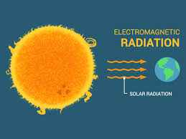
How does radiation travel?
Notes:
How does radiation travel?
in straight lines
in waves
through a medium (solid, liquid, or gas)
in living organisms

Slide 46
Remember!!!
Notes:
So remember!

Slide 47
Radiation: the transfer of energy as waves
Notes:
Radiation is the transfer of energy as waves.

Slide 48
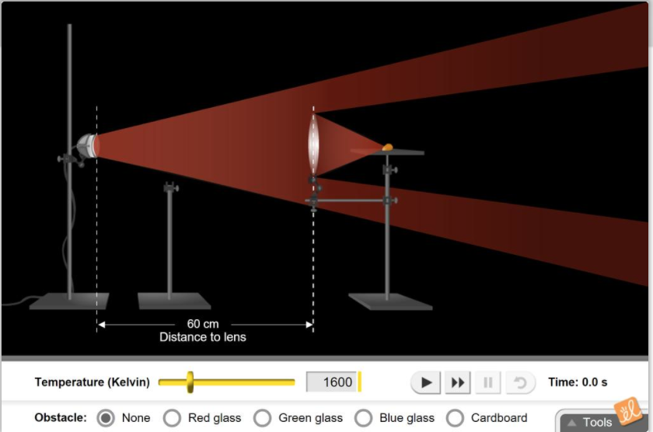
Simulation Activity
Radiation Gizmo
Use a powerful flashlight to pop a kernel of popcorn. A lens focuses light on the kernel. The temperature of the filament and the distance between the flashlight and lens can be changed. Several obstacles can be placed between the flashlight and the popcorn.
Notes:
Feedback:Providing a simulation activity is a great way to make science thinking visible. In this simulation, students have the opportunity to make predictions and apply an idea to a new situation by changing the variables in the simulation (i.e., the temperature of the filament and the distance).

Slide 49
Big Question: How does radiation distribute energy, and how does it power the circulation of the earth’s atmosphere and the oceans?
Notes:
Explicit cue to revisit the big question at the end of the lesson: Okay everyone. Now that we’ve learned the term, let’s reflect once more on our big question. Was there anything that we predicted earlier that was correct or incorrect? Do you have any new hypotheses to share?

Slide 50
Notes:
Thanks for watching, and please continue watching CAPs available from this website.

Slide 51
This Video Was Created With Resources From:
Questions or Comments
Michael Kennedy, Ph.D. MKennedy@Virginia.edu
Rachel L Kunemund, Ph.D. rk8vm@virginia.edu

