Slide 1
Intro
“Big Idea” Question
Review Concepts
Check-In Questions
Teacher Engagement
Vocabulary
Student-Friendly Definition
Examples & Non-Examples
Morphological Word Parts
Frayer Model
Simulation/Activity
Notes:
OK everyone, get ready for our next lesson. Just as a reminder, these are the different components that our lesson may include, and you’ll see these icons in the top left corner of each slide so that you can follow along more easily!

Slide 2
Intro
Reproduction
Notes:
Today, we’ll be learning about the word: Reproduction.

Slide 3
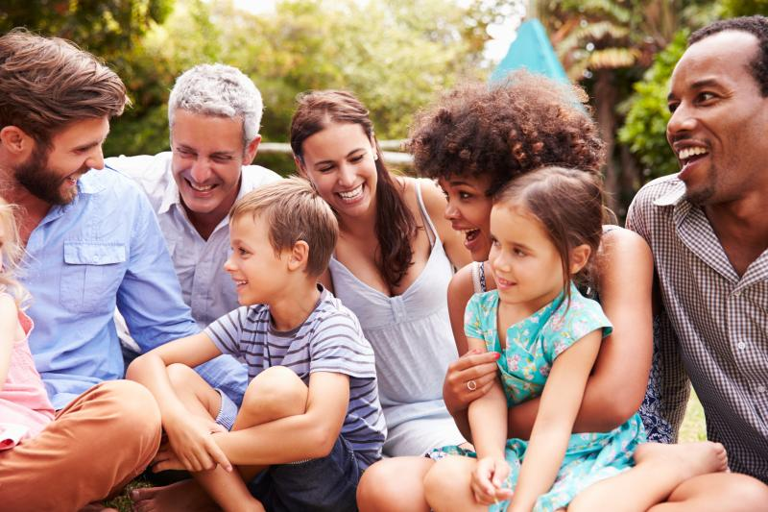
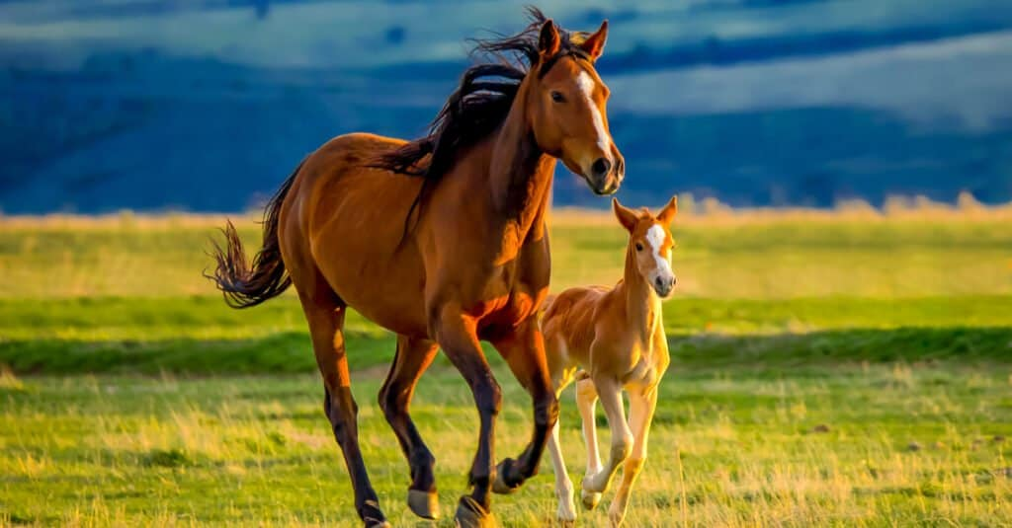
Big Question: How does reproduction help a species survive?
Notes:
Our “big question” is: How does reproduction help a species survive?
[Pause and illicit predictions from students.]
I love all these thoughtful scientific hypotheses! Be sure to keep this question and your predictions in mind as we move through these next few lessons, and we’ll continue to revisit it.

Slide 4
Notes:
Before we move on to our new topic, let’s review some other words & concepts that you already learned and make sure you are firm in your understanding.

Slide 5
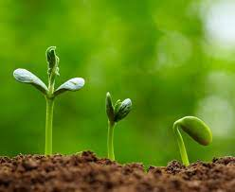
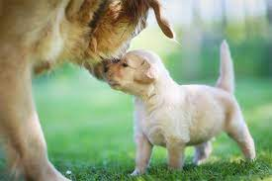
Living Thing: organisms that move, grow, change, and respond to its environment
Notes:
Living things are organisms that grow, change, and respond to its environment.

Slide 6
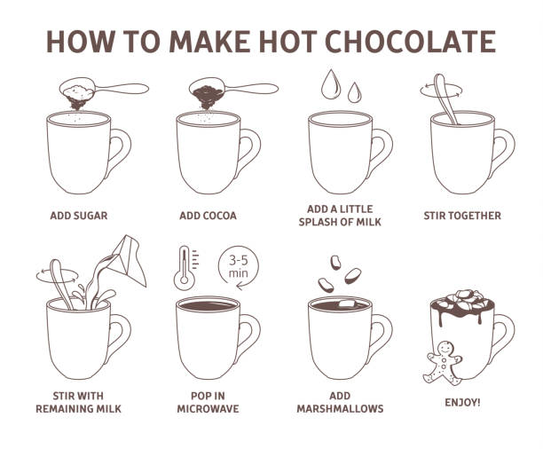
Process: a series of actions.
Notes:
Process is a series of actions. For example making hot chocolate is a process. It takes many actions to make hot chocolate.

Slide 7
Notes:
Now let’s pause for a moment to review the information we have covered already.

Slide 8
_________ __________ are organisms that move, grow, change, and respond to the environment
Abiotic Factors
Nonliving things
Living things
Notes:
______ _______ are organisms that move, grow, change, and respond to the environment.
[C. Living things]

Slide 9
_________ __________ are organisms that move, grow, change, and respond to the environment
Abiotic Factors
Nonliving things
Living things
Notes:
Living things are organisms that move, grow, change, and respond to the environment.

Slide 10
What is another word for a series of actions?
Process
Practice
System
Notes:
What is another word for a series of actions?
[A. Process]

Slide 11
What is another word for a series of actions?
Process
Practice
System
Notes:
What is another word for a series of actions? A. Process

Slide 12
Reproduction
Notes:
Now that we’ve reviewed, let’s define the word reproduction.

Slide 13
Reproduction: process by which living things create new organisms of their own kind
Notes:
Reproduction is a process by which living things create new organisms of their own kind.

Slide 14
Notes:
Let’s check-in for understanding.

Slide 15
What is reproduction?
Notes:
What is reproduction?
[A process by which living things create new organisms of their own kind.]

Slide 16
Notes:
That is the basic definition, but there is a bit more you need to know.

Slide 17
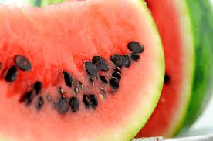
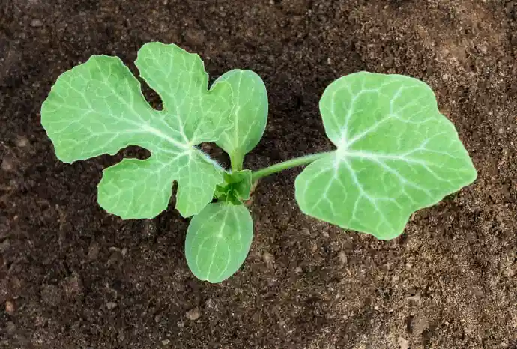
Plants can reproduce through their seeds.
Notes:
Plants can reproduce through their seeds. For example, seeds from a watermelon can be planted to reproduce more watermelons. This is one example of reproduction.

Slide 18
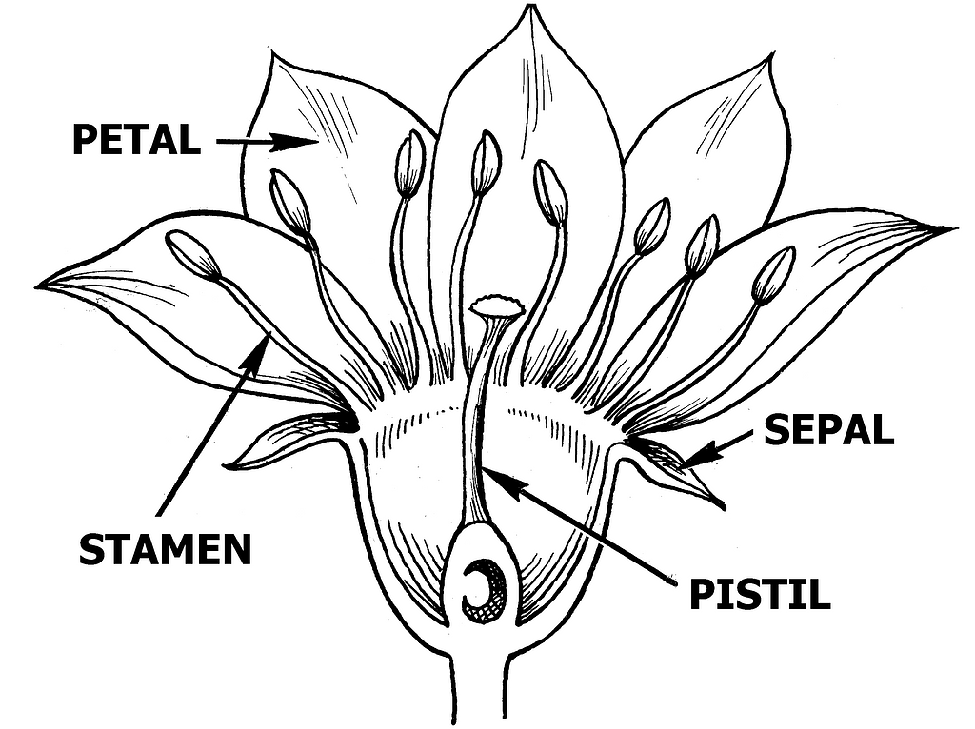
A flower is a reproductive structure that is needed for other flowers to grow.
Notes:
A flower is a reproductive structure that is needed for other flowers to grow. The flower has many parts necessary for reproduction through pollination.

Slide 19
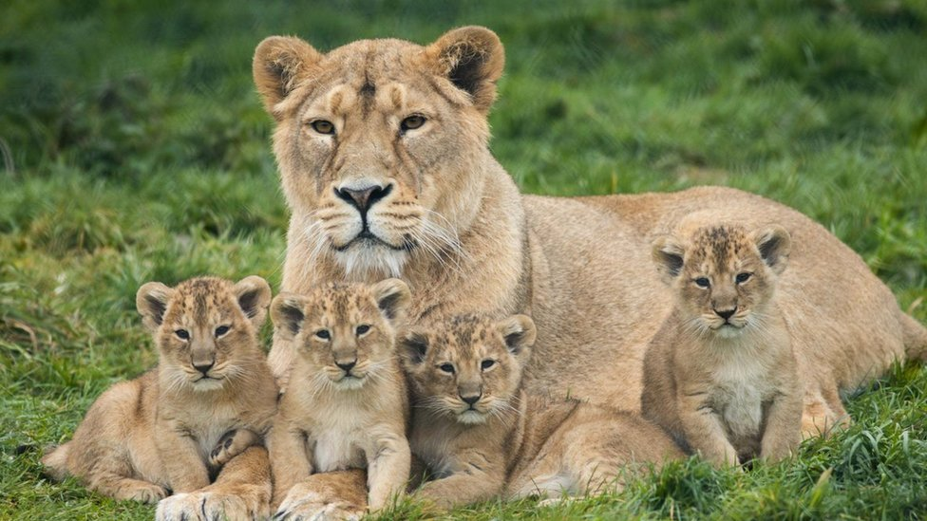
Animals also reproduce to create offspring.
Notes:
Animals also reproduce to create offspring. The lion cubs are the result of the reproduction process.

Slide 20
Notes:
Let’s check-in for understanding.

Slide 21
True or false: Plants can reproduce through seeds.
True
False
Notes:
True or false: Plants can reproduce through seeds.
[A. True]

Slide 22
True or false: Plants can reproduce through seeds.
True
False
Notes:
True or false: Plants can reproduce through seeds.
[A. True]

Slide 23
A flower is a reproductive ________ that is needed for other flowers to grow.
Notes:
A flower is a reproductive __________ that is needed for other flowers to grow.
[structure]

Slide 24
A flower is a reproductive structure that is needed for other flowers to grow.
Notes:
A flower is a reproductive __________ that is needed for other flowers to grow.
[structure]

Slide 25
True or false: Animals also reproduce to create offspring.
True
False
Notes:
True or false: Animals also reproduce to create offspring.
[True]

Slide 26
True or false: Animals also reproduce to create offspring.
True
False
Notes:
True or false: Animals also reproduce to create offspring.
[True]

Slide 27
Notes:
Now, let’s talk about some examples of reproduction.

Slide 28
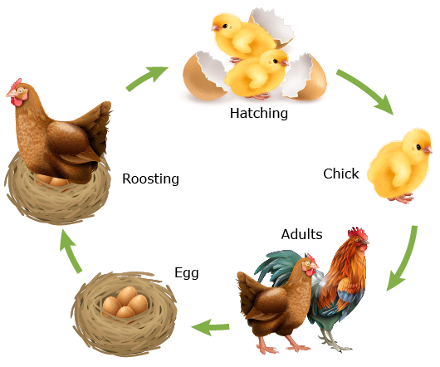
Here is an example of reproduction. This is a process where adult chickens lay eggs that hatch into chicks. Those chicks then grow into adult chickens and the process starts over again.
Notes:
Here is an example of reproduction. This is a process where adult chickens lay eggs that hatch into chicks. Those chicks then grow into adult chickens and the process starts over again.

Slide 29
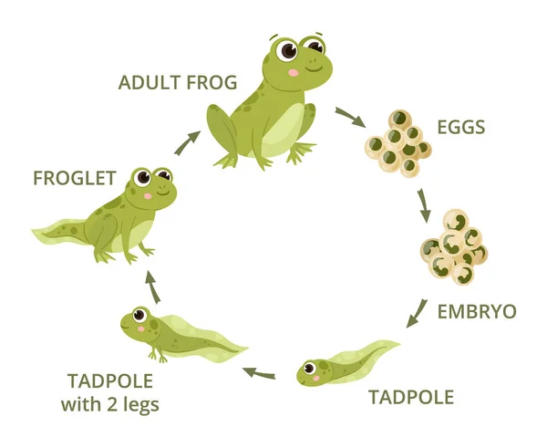
Here is another example of reproduction. This is a process where adult frogs create eggs which hatch into tadpoles. Those tadpoles grow up to be adult frogs and the process starts over again.
Notes:
Here is another example of reproduction. This is a process where adult frogs create eggs which hatch into tadpoles. Those tadpoles grow up to be adult frogs and the process starts over again.

Slide 30
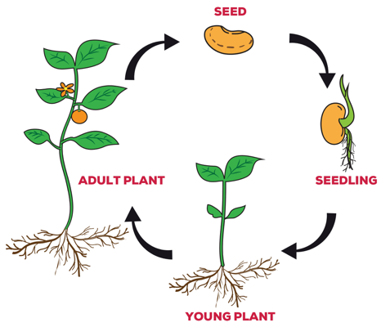
Here is another example of reproduction. The plant starts as a seed and grows into an adult plant. Then the adult plants drops another seed and the process starts again.
Notes:
Here is another example of reproduction. The plant starts as a seed and grows into an adult plant. Then the adult plants drops another seed and the process starts again.

Slide 31
Notes:
Now, let’s talk about some non-examples of reproduction.

Slide 32
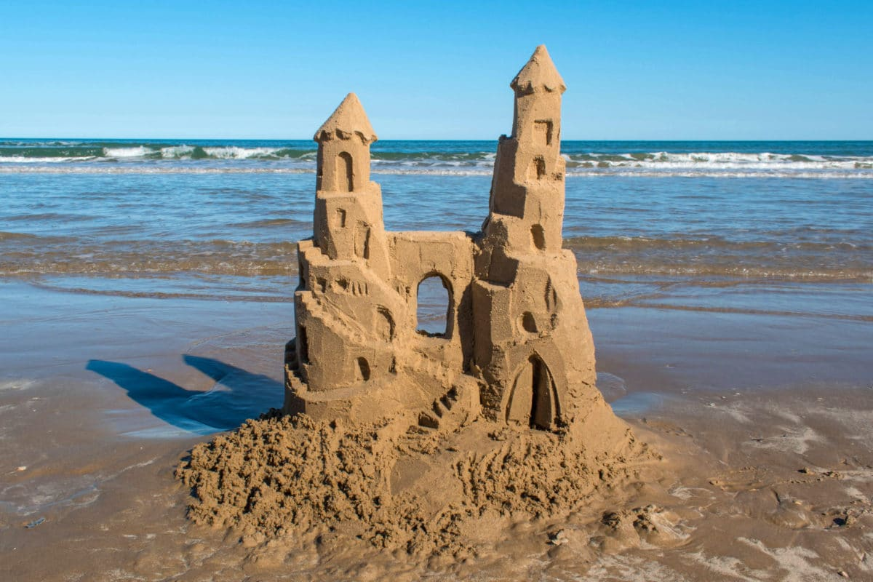
This is NOT an example of reproduction. The sand castle is a non living object and cannot create other sandcastles.
Notes:
This is a non-example of reproduction. The sand castle is a non living object and cannot create other sandcastles.

Slide 33
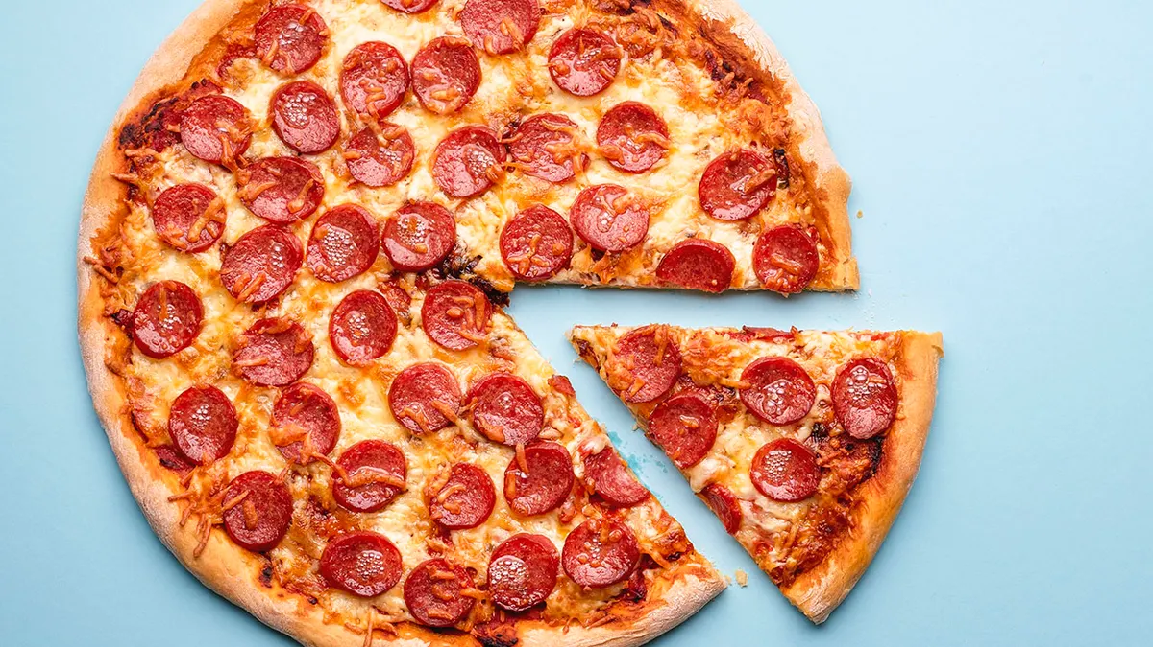
This is also NOT an example of reproduction. The pepperoni pizza is a non-living object and cannot create other pepperoni pizzas.
Notes:
This is also a non-example of reproduction. The pepperoni pizza is a non-living object and cannot create other pepperoni pizzas.

Slide 34
Notes:
Now let’s pause for a moment to check your understanding.

Slide 35
Which one is NOT an example of reproduction?
Egg to frog
Seed to plant
Sand Castle
Notes:
Which one is NOT an example of reproduction?
[Sand Castle]

Slide 36
Which one is NOT an example of reproduction?
Egg to frog
Seed to plant
Sand Castle
Notes:
Which one is NOT an example of reproduction? Sand Castle

Slide 37
Notes:
We can also break down the term reproduction into different word parts to help us remember the meaning. Let’s take a look!

Slide 38
Reproduction
(prefix)
(root)
(suffix)
Notes:
We can break up the term reproduction into three parts: a prefix, root, and a suffix

Slide 39
Reproduction
Re produc tion
do something again
Notes:
The prefix, re, means do something again.

Slide 40
Reproduction
Re produc tion
create or produce
Notes:
The root, produc, means to create or produce.

Slide 41
Reproduction
Re produc tion
an act or process
Notes:
The suffix, tion, means an act or process.

Slide 42
Re produc tion
Reproduction
The process of creating or producing again
Notes:
Reproduction means the process of creating or producing again.

Slide 43
Notes:
Let’s check-in for understanding.

Slide 44
How can we use the word parts of reproduction to help us remember the definition of the term?
Reproduction
Re produc tion
Notes:
How can we use the word parts of reproduction to help us remember the definition of the term?
[Re = do something again
Produc = to create or produce
Tion = an act or process
Reproduction is the process of creating or producing again.]

Slide 45
Remember!!!
Notes:
So remember!

Slide 46
Reproduction: process by which living things create new organisms of their own kind
Notes:
Reproduction is a process by which living things create new organisms of their own kind.

Slide 47
Notes:
We will now complete this concept map, called a Frayer model, to summarize and further clarify what you have learned about the term reproduction.

Slide 48
Definition
Picture
Reproduction
Example
How does reproduction impact my life?
Notes:
To complete the Frayer model, we will choose from four choices the correct picture, definition, example, and response to the question, “How does reproduction impact my life?” Select the best response for each question using the information you just learned. As we select responses, we will see how this model looks filled in for the term reproduction.

Slide 49
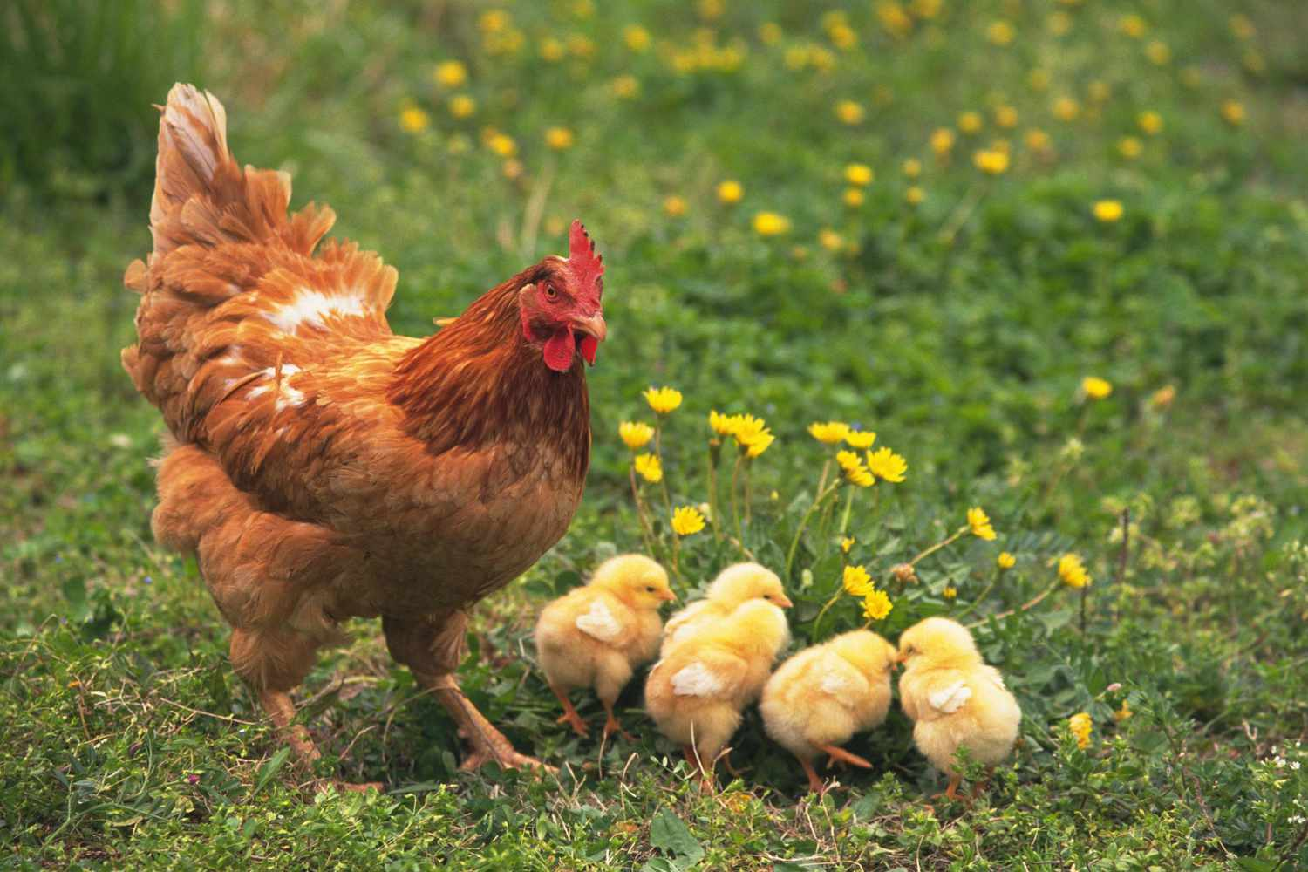
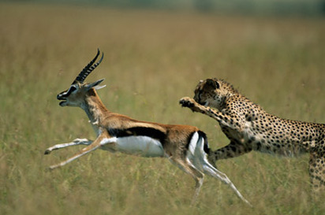
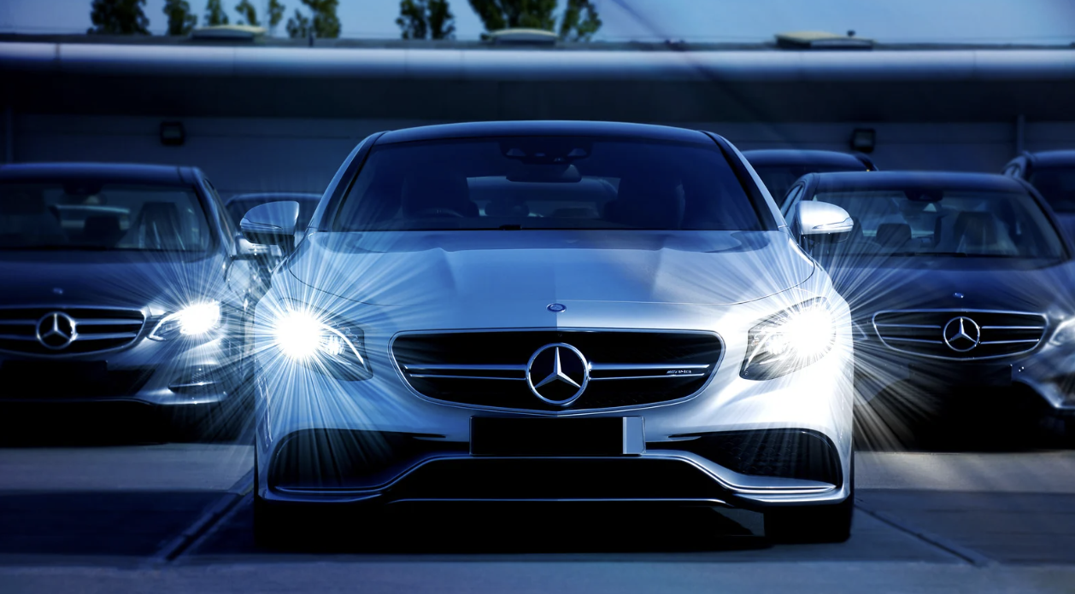
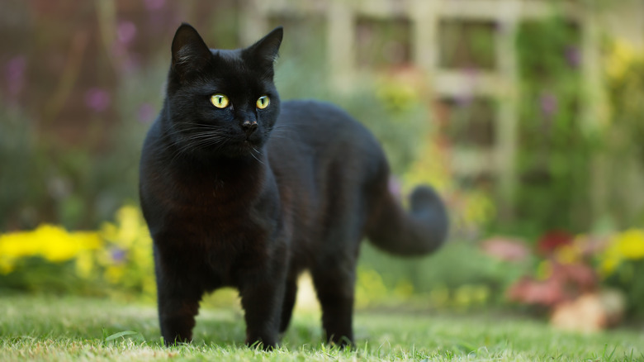
Directions: Choose the correct picture of reproduction from the choices below.
A
B
C
D
Notes:
Choose the one correct picture of reproduction from these four choices.

Slide 50
Directions: Choose the correct picture of reproduction from the choices below.
A
B
C
D
Notes:
This is the picture that shows reproduction.

Slide 51
Definition
Picture
Reproduction
Example
How does reproduction impact my life?
Notes:
Here is the Frayer model filled in with a picture of reproduction.

Slide 52
Directions: Choose the correct definition of reproduction from the choices below.
A
Process by which an organism removes waste
B
Process by which living things create new organisms of their own kind
C
Process by which animals decide where to live
D
Process by which organisms find and eat food
Notes:
Choose the one correct definition of reproduction from these four choices.

Slide 53
Directions: Choose the correct definition of reproduction from the choices below.
A
Process by which an organism removes waste
B
Process by which living things create new organisms of their own kind
C
Process by which animals decide where to live
D
Process by which organisms find and eat food
Notes:
“Process by which living things create new organisms of their own kind” is correct! This is the definition of reproduction.

Slide 54
Definition
Picture
Process by which living things create new organisms of their own kind
Reproduction
Example
How does reproduction impact my life?
Notes:
Here is the Frayer Model with a picture and the definition filled in for reproduction: Process by which living things create new organisms of their own kind.

Slide 55
Directions: Choose the correct example of reproduction from the choices below.
A
A tree’s leaves falling off
B
A human giving birth to a baby
C
A beaver chewing wood
D
A bird using twigs to build a nest
Notes:
Choose the one correct example of reproduction from these four choices.

Slide 56
Directions: Choose the correct example of reproduction from the choices below.
A
A tree’s leaves falling off
B
A human giving birth to a baby
C
A beaver chewing wood
D
A bird using twigs to build a nest
Notes:
“A human giving birth to a baby” is correct! This is an example of reproduction.

Slide 57
Definition
Picture
Process by which living things create new organisms of their own kind
Reproduction
A human giving birth to a baby
Example
How does reproduction impact my life?
Notes:
Here is the Frayer Model with a picture, definition, and an example of reproduction: A human giving birth to a baby

Slide 58
Directions: Choose the correct response for “how does reproduction impact my life?” from the choices below.
A
I am a product of reproduction, which is how I am alive right now.
B
The process of reproduction creates energy in plants.
C
The process of reproduction creates food for animals.
D
The process of reproduction makes the seasons change.
Notes:
Choose the one correct response for “how does reproduction impact my life?” from these four choices.

Slide 59
Directions: Choose the correct response for “how does reproduction impact my life?” from the choices below.
A
I am a product of reproduction, which is how I am alive right now.
B
The process of reproduction creates energy in plants.
C
The process of reproduction creates food for animals.
D
The process of reproduction makes the seasons change.
Notes:
“I am a product of reproduction, which is how I am alive right now.” That is correct! This is an example of how reproduction impacts your life.

Slide 60
Definition
Picture
Process by which living things create new organisms of their own kind
Reproduction
I am a product of reproduction, which is how I am alive right now.
A human giving birth to a baby
Example
How does reproduction impact my life?
Notes:
Here is the Frayer Model with a picture, definition, example, and a correct response to “how does reproduction impact my life?”: I am a product of reproduction, which is how I am alive right now.

Slide 61
Remember!!!
Notes:
So remember!

Slide 62
Reproduction: process by which living things create new organisms of their own kind
Notes:
Reproduction is a process by which living things create new organisms of their own kind.

Slide 63
Big Question: How does reproduction help a species survive?
Notes:
Let’s reflect once more on our big question. Our “big question” is: How does reproduction help a species survive?
Does anyone have any additional examples to share that haven’t been discussed yet?

Slide 64
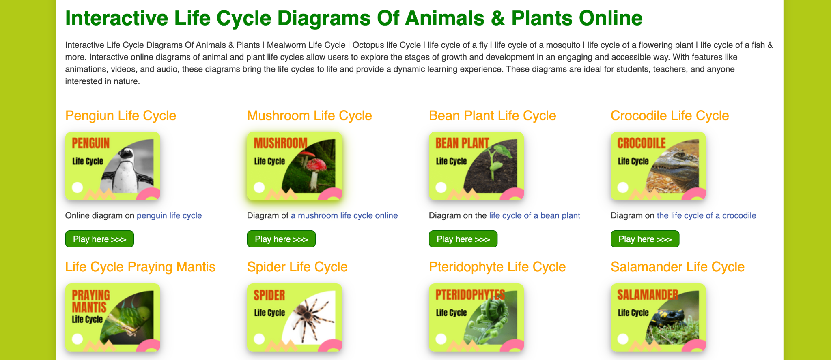
Life Cycles Activity
Interactive Life Cycle Diagrams
Click the link above to practice building plant and animal reproduction life cycle diagrams.
Notes:
Click the link above for an activity on building interactive life cycle diagrams for different plants and animals.
Feedback: Providing an activity is a great way to make science thinking visible. In this activity, students have the opportunity to make predictions and apply an idea to a new situation by changing the variables in the activity. When building a diagram for a selected plant/animal, please be sure to select both the picture and the text that goes with that picture.

Slide 65
Notes:
Thanks for watching, and please continue watching CAPs available from this website.

Slide 66
This Was Created With Resources From:
Questions or Comments
Michael Kennedy, Ph.D. MKennedy@Virginia.edu
Rachel L Kunemund, Ph.D. rk8vm@virginia.edu

