Slide 1
Intro
“Big Idea” Question
Review Concepts
Check-In Questions
Teacher Engagement
Vocabulary
Student-Friendly Definition
Examples & Non-Examples
Morphological Word Parts
Frayer Model
Simulation/Activity
Notes:
OK everyone, get ready for our next lesson. Just as a reminder, these are the different components that our lesson may include, and you’ll see these icons in the top left corner of each slide so that you can follow along more easily!

Slide 2
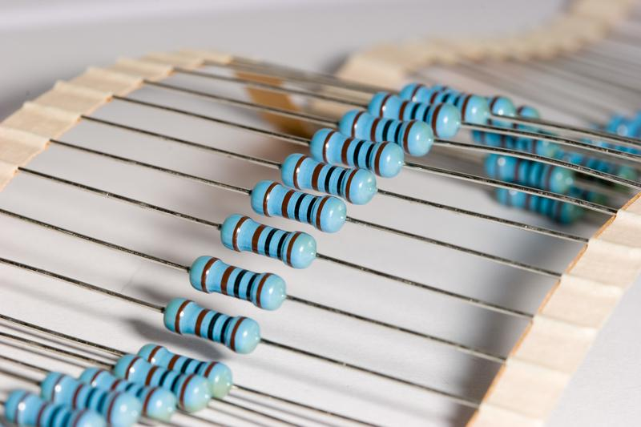
Intro
Resistance
Notes:
Today, we’ll be learning about the word: Resistance.

Slide 3
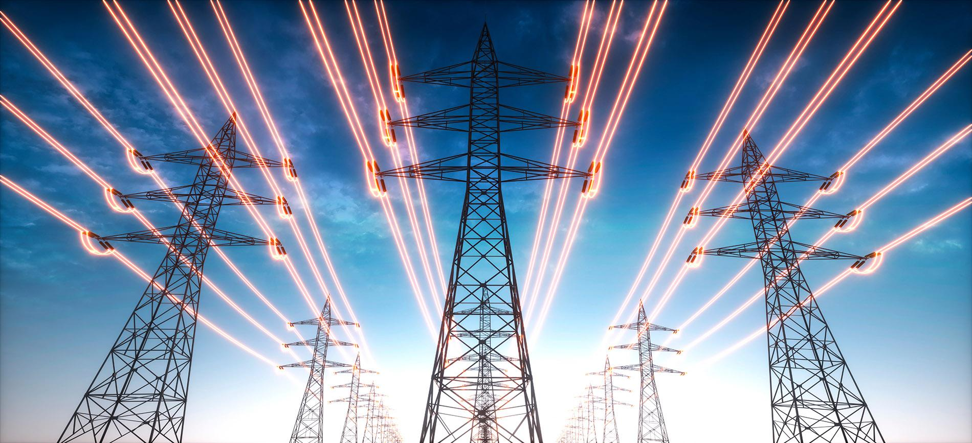
Big Question: How is electricity transmitted and used in daily life?
Notes:
Our “big question” is: How is electricity transmitted and used in daily life?
[Pause and illicit predictions from students.]
I love all these thoughtful scientific hypotheses! Be sure to keep this question and your predictions in mind as we move through these next few lessons, and we’ll continue to revisit it.

Slide 4
Notes:
Before we move on to our new topic, let’s review some other words & concepts that you already learned and make sure you are firm in your understanding.

Slide 5
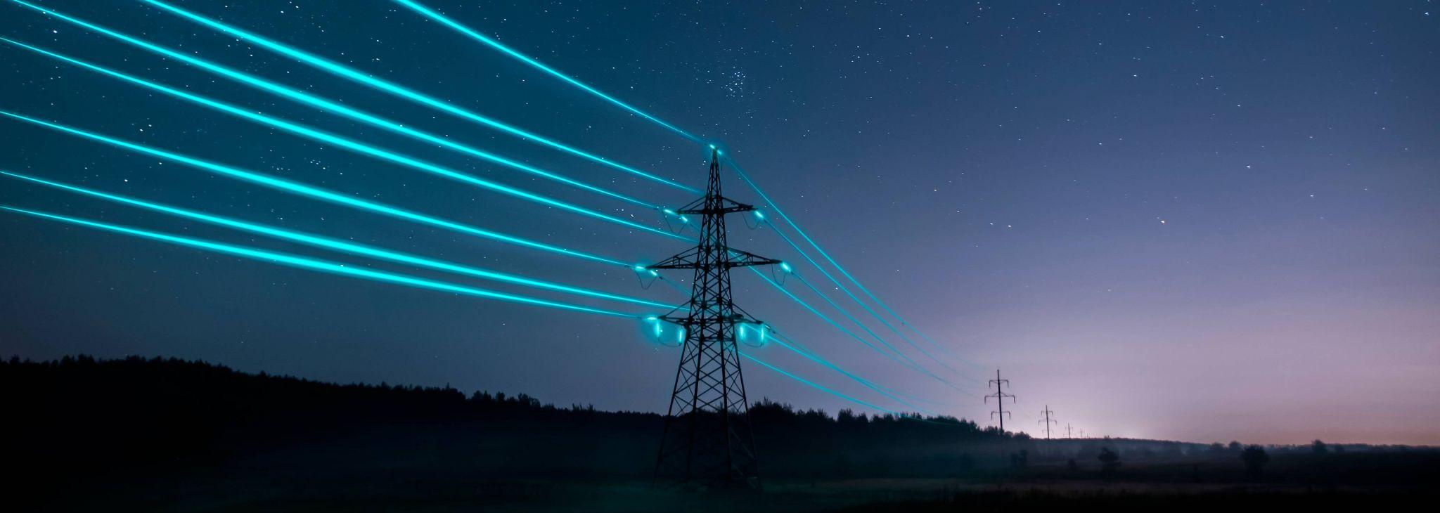
Electricity: electrical energy transformed into different forms of energy to meet needs
Notes:
Electricity is electrical energy transformed into different forms of energy to meet needs.

Slide 6
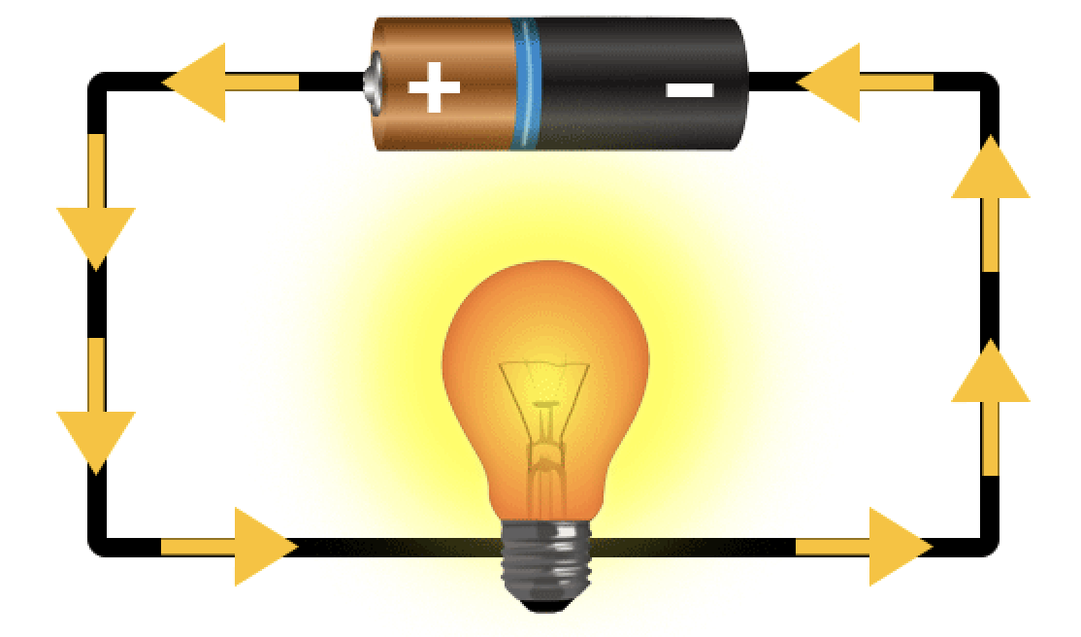
Current: an electrical charge in motion
Notes:
A current is an electrical charge in motion.

Slide 7
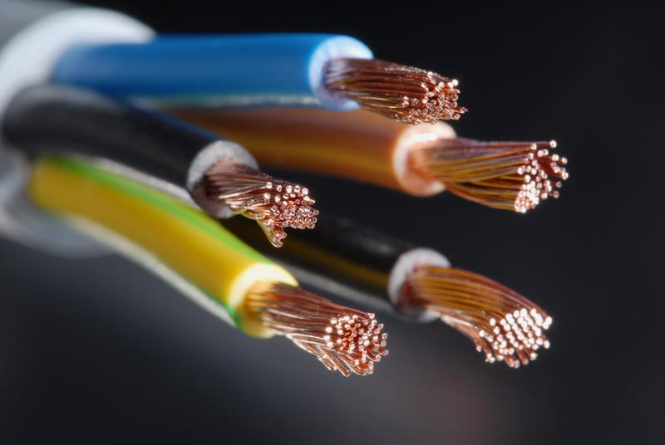
Conductor: a material that electricity can flow through
Notes:
A conductor is a material that electricity can flow through.

Slide 8
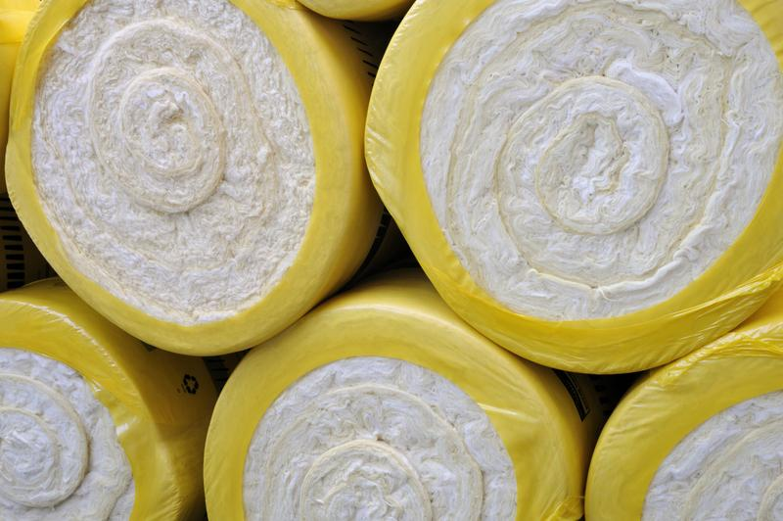
Insulator: a material that electricity cannot flow through
Notes:
An insulator is a material that electricity cannot flow through.

Slide 9
Notes:
Now let’s pause for a moment to review the information we have covered already.

Slide 10
__________ is electrical energy transformed into different forms of energy to meet needs.
Current
Electricity
Notes:
_________ is electrical energy transformed into different forms of energy to meet needs.
[Electricity]

Slide 11
__________ is electrical energy transformed into different forms of energy to meet needs.
Current
Electricity
Notes:
[Electricity] is electrical energy transformed into different forms of energy to meet needs.

Slide 12
A current is an electrical _______
in _______.
charge, motion
motion, charge
Notes:
A current is an electrical ____ in _____.
[charge, motion]

Slide 13
A current is an electrical _______
in _______.
charge, motion
motion, charge
Notes:
A current is an electrical [charge] in [motion].

Slide 14
A conductor is a material that electricity _____ flow through.
can
cannot
Notes:
A conductor is a material that electricity [can] flow through.
A. Can

Slide 15
A conductor is a material that electricity _____ flow through.
can
cannot
Notes:
A conductor is a material that electricity [can] flow through.
A. Can

Slide 16
An insulator is a material that electricity _____ flow through.
can
cannot
Notes:
An insulator is a material that electricity [cannot] flow through.
B. Cannot

Slide 17
An insulator is a material that electricity _____ flow through.
can
cannot
Notes:
An insulator is a material that electricity [cannot] flow through.
B. Cannot

Slide 18
Resistance
Notes:
Now that we’ve reviewed, let’s define the phrase Resistance.

Slide 19
Resistance: measure of how difficult it is for an electric current to flow in a material
Notes:
Resistance is the measure of how difficult it is for an electric current to flow in material.

Slide 20
Notes:
Let’s check-in for understanding.

Slide 21
What is resistance?
Notes:
What is resistance?
[Measure of how difficult it is for an electric current to flow in a material.]

Slide 22
Notes:
That is the basic definition, but there is a bit more you need to know.

Slide 23
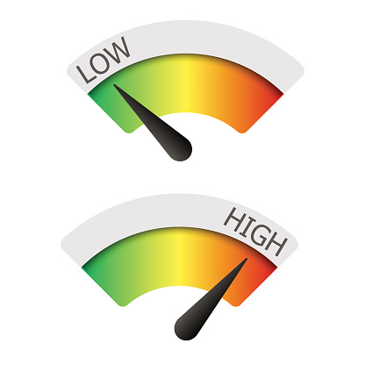
Some objects have more resistance than others. Objects can have high or low resistance.
Notes:
Some objects have more resistance than others. Objects can have high or low resistance.

Slide 24
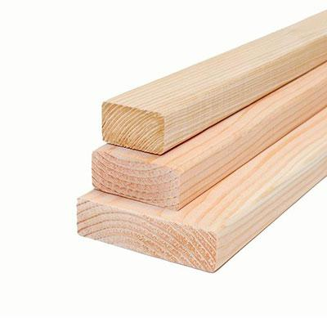
High resistance means that it is difficult for electricity to flow through the object. Examples are wood and rubber.
Notes:
High resistance means that it is difficult for electricity to flow through the object. Two examples are wood and rubber.

Slide 25
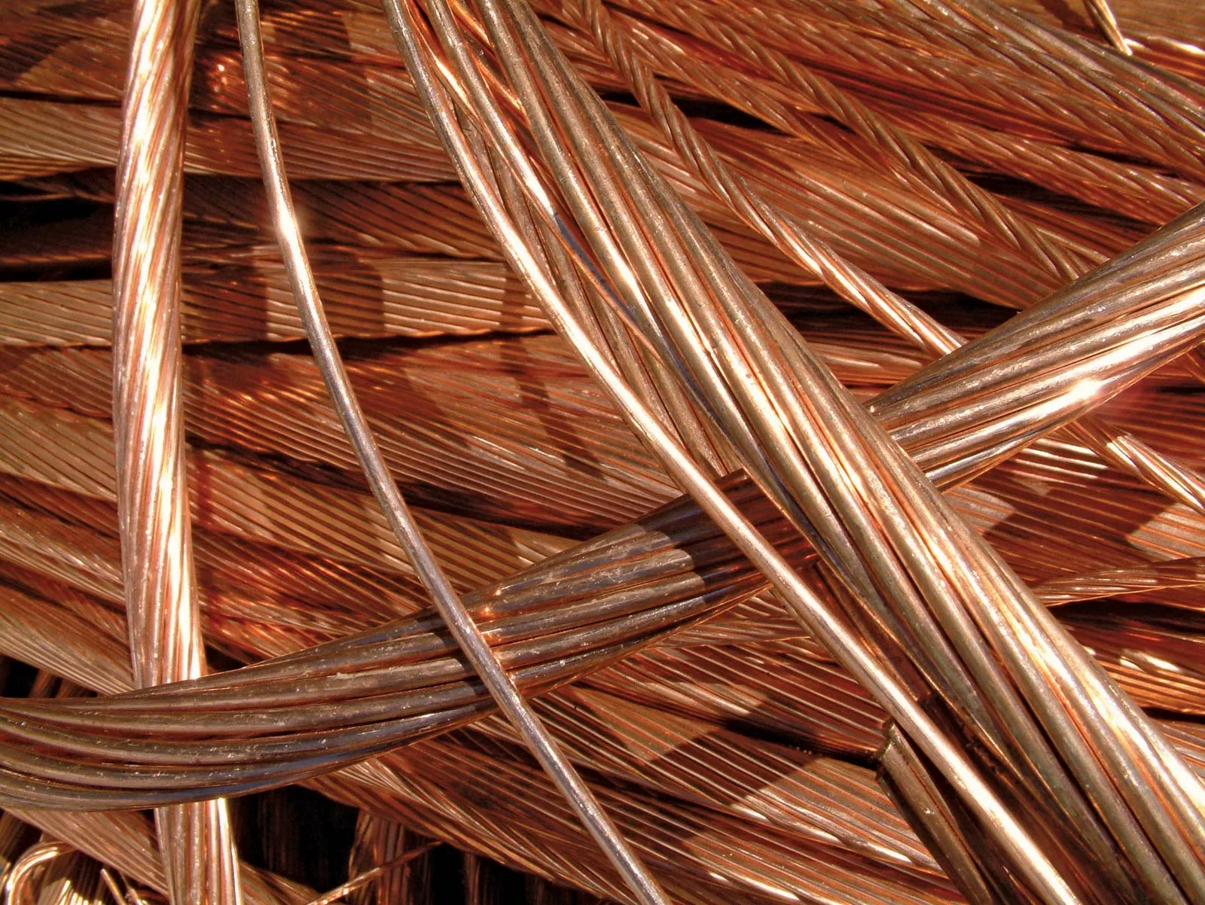
Low resistance means that it is not difficult for electricity to flow through the object. Examples are copper and gold.
Notes:
Low resistance means that it is not difficult for electricity to flow through the object. Examples are copper and gold.

Slide 26
Notes:
Let’s check-in for understanding.

Slide 27
Some objects have more resistance than others. Objects can have _____ or _____ resistance.
cold, hot
high, low
Notes:
Some objects have more resistance than others. Objects can have _____ or _____ resistance.
[B. high, low]

Slide 28
Some objects have more resistance than others. Objects can have _____ or _____ resistance.
cold, hot
high, low
Notes:
Some objects have more resistance than others. Objects can have _____ or _____ resistance.
[B. high, low]

Slide 29
Name two examples of objects with high resistance.
Notes:
Name two examples of objects with high resistance.

Slide 30
Name two examples of objects with low resistance.
Notes:
Name two examples of objects with low resistance.

Slide 31
Notes:
Now, let’s talk about some examples of resistance.

Slide 32
A light bulb has resistance. The filament in a light bulb has low resistance and allows electricity to easily flow to produce light.
filament
Notes:
A light bulb has resistance. The filament in a light bulb has low resistance and allows electricity to easily flow to produce light.

Slide 33
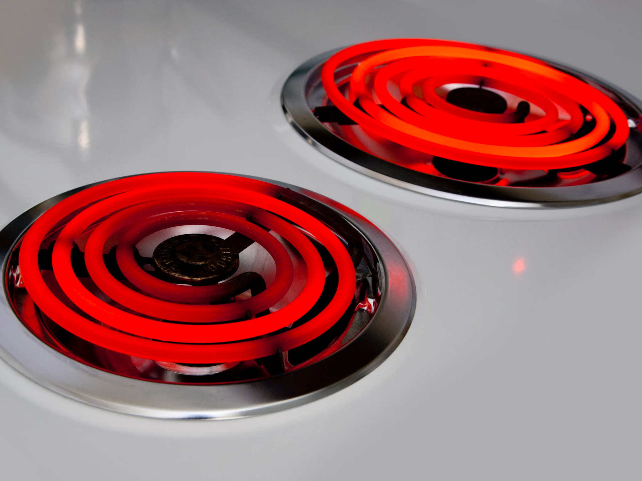
An electric stove also has resistance. The heating elements on the stove have low resistance and allow electricity to easily flow to produce heat.
Notes:
An electric stove also has resistance. The heating elements on the stove have low resistance and allow electricity to easily flow to produce heat.

Slide 34
Notes:
Now, let’s talk about some non-examples of resistance.

Slide 35
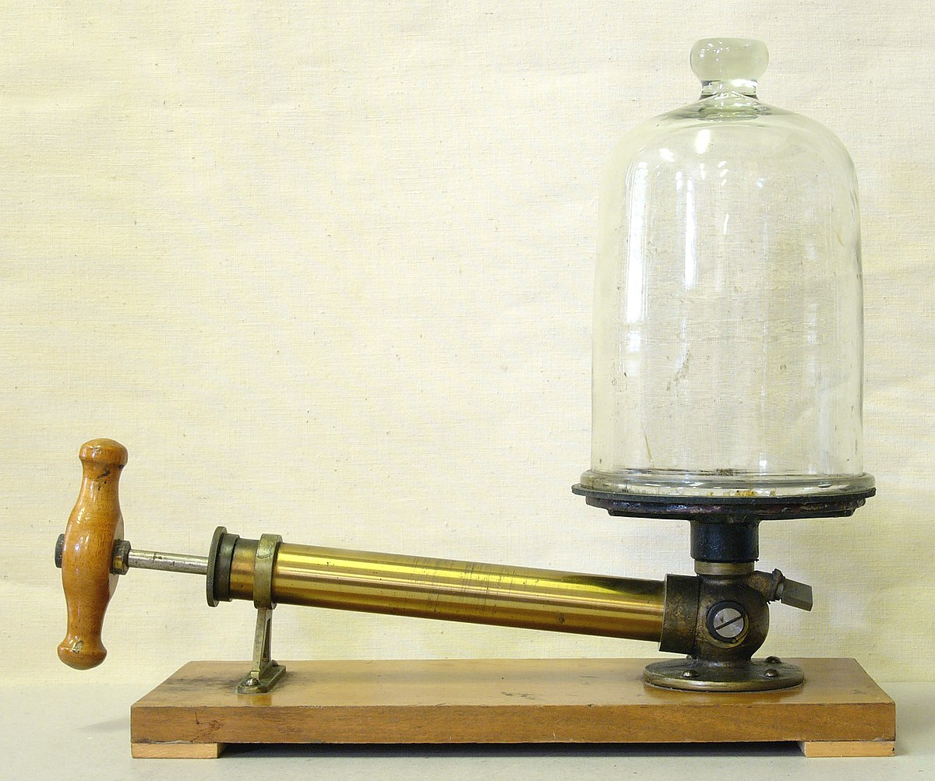
A perfect vacuum is a non-example of resistance. Perfect vacuums do not have matter and because of this, it is not possible to have resistance.
Notes:
A perfect vacuum is a non-example of resistance. Perfect vacuums do not have matter and because of this, it is not possible to have resistance.

Slide 36
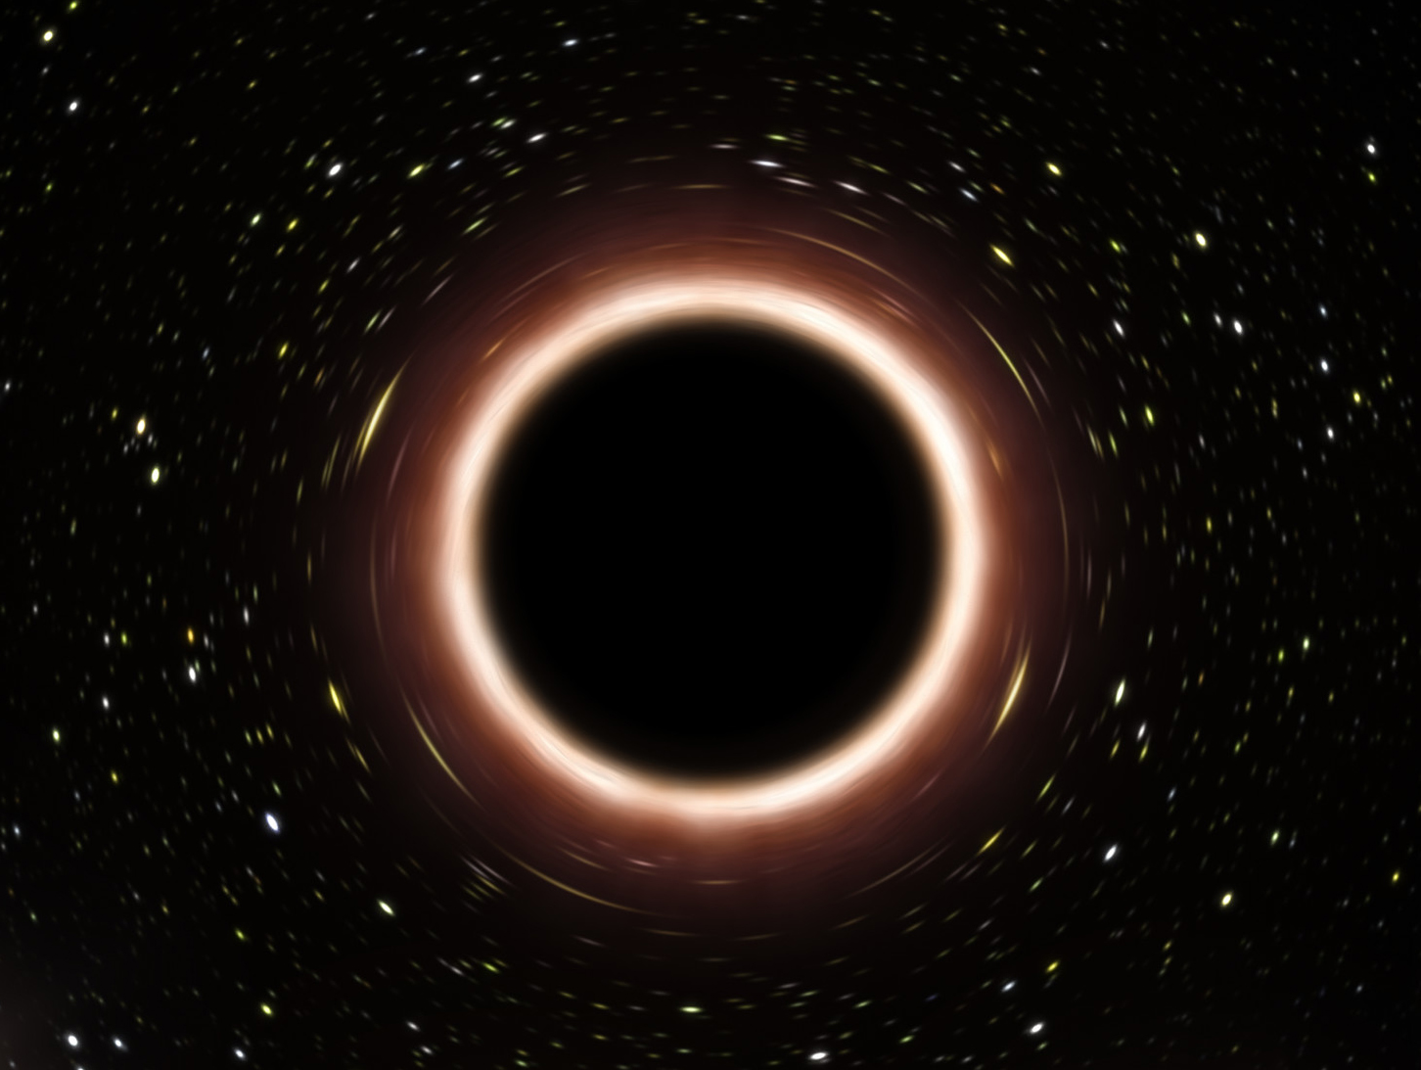
A black hole in space is another non-example of resistance. Black holes do not have matter and therefore, it is not possible to have resistance.
Notes:
A black hole in space is another non-example of resistance. Black holes do not have matter and therefore, it is not possible to have resistance.

Slide 37
Notes:
Now let’s pause for a moment to check your understanding.

Slide 38
Which is an example of having resistance?
Notes:
Which is an example of having resistance?
[Light bulb]

Slide 39
Which is an example of having resistance?
Notes:
Which is an example of having resistance?
[Light bulb]

Slide 40
Remember!!!
Notes:
So remember!

Slide 41
Resistance: measure of how difficult it is for an electric current to flow in a material
Notes:
Resistance is the measure of how difficult it is for an electric current to flow in a material.

Slide 42
Notes:
We will now complete this concept map, called a Frayer model, to summarize and further clarify what you have learned about the term resistance.

Slide 43
Definition
Picture
Resistance
Example
How does resistance impact my life?
Notes:
To complete the Frayer model, we will choose from four choices the correct picture, definition, example, and response to the question, “How does resistance impact my life?” Select the best response for each question using the information you just learned. As we select responses, we will see how this model looks filled in for the term resistance.

Slide 44
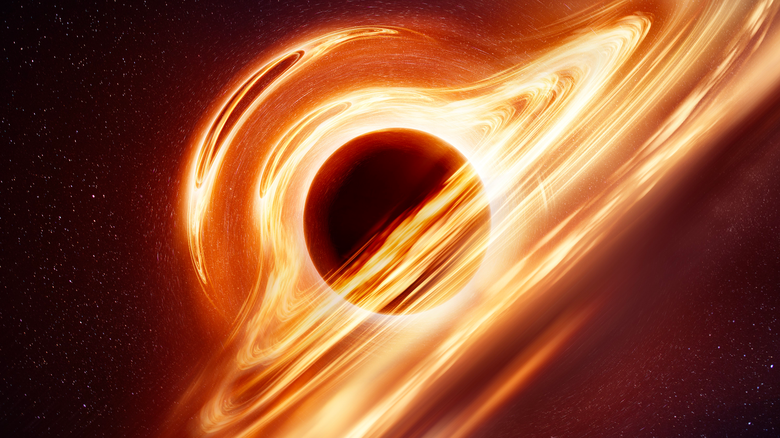
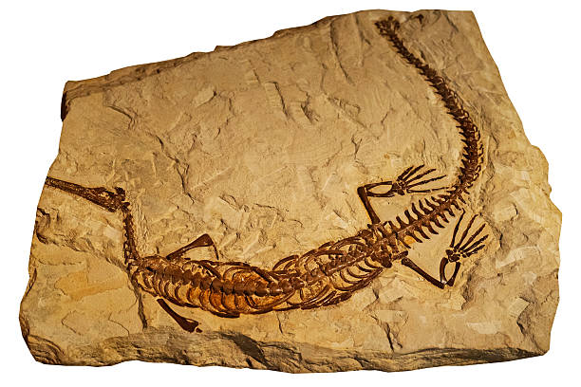
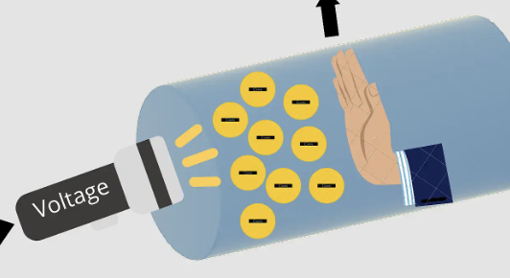
Directions: Choose the correct picture of resistance from the choices below.
A
B
C
D
Notes:
Choose the one correct picture of resistance from these four choices.

Slide 45
Directions: Choose the correct picture of resistance from the choices below.
A
B
C
D
Notes:
Choose the one correct picture of resistance from these four choices.

Slide 46
Definition
Picture
Resistance
Example
How does resistance impact my life?
Notes:
Here is the Frayer model filled in with a picture of resistance.

Slide 47
Directions: Choose the correct definition of resistance from the choices below.
A
Measure of where electricity travels
B
Measure of how difficult it is to make a mixture
C
Measure of how easy it is to grow a plant
D
Measure of how difficult it is for an electric current to flow in a material
Notes:
Choose the one correct definition of resistance from these four choices.

Slide 48
Directions: Choose the correct definition of resistance from the choices below.
A
Measure of where electricity travels
B
Measure of how difficult it is to make a mixture
C
Measure of how easy it is to grow a plant
D
Measure of how difficult it is for an electric current to flow in a material
Notes:
“Measure of how difficult it is for an electric current to flow in a material” is correct! This is the definition of resistance.

Slide 49
Definition
Picture
Measure of how difficult it is for an electric current to flow in a material
Resistance
Example
How does resistance impact my life?
Notes:
Here is the Frayer Model with a picture and the definition filled in for resistance: Measure of how difficult it is for an electric current to flow in a material.

Slide 50
Directions: Choose the correct example of resistance from the choices below.
A
A flame burning
B
Floating in space
C
Electricity flowing through a light bulb
D
Hydrogen and oxygen atoms combining to make water
Notes:
Choose the one correct example of resistance from these four choices.

Slide 51
Directions: Choose the correct example of resistance from the choices below.
A
A flame burning
B
Floating in space
C
Electricity flowing through a light bulb
D
Hydrogen and oxygen atoms combining to make water
Notes:
“Electricity flowing through a light bulb” is correct! This is an example of resistance.

Slide 52
Definition
Picture
Measure of how difficult it is for an electric current to flow in a material
Resistance
Electricity flowing through a light bulb
Example
How does resistance impact my life?
Notes:
Here is the Frayer Model with a picture, definition, and an example of resistance: Electricity flowing through a light bulb.

Slide 53
Directions: Choose the correct response for “how does resistance impact my life?” from the choices below.
A
Resistance gives us a way to classify plants and animals.
B
Resistance helps us to use electronic devices everyday.
C
Resistance provides us a way to describe ecosystems.
D
Resistance gives us the ability to swim in water.
Notes:
Choose the one correct response for “how does resistance impact my life?” from these four choices.

Slide 54
Directions: Choose the correct response for “how does resistance impact my life?” from the choices below.
A
Resistance gives us a way to classify plants and animals.
B
Resistance helps us to use electronic devices everyday.
C
Resistance provides us a way to describe ecosystems.
D
Resistance gives us the ability to swim in water.
Notes:
You chose “Resistance helps us to use electronic devices everyday.” That is correct! This is an example of how resistance impacts your life.

Slide 55
Definition
Picture
Measure of how difficult it is for an electric current to flow in a material
Resistance
Resistance helps us to use electronic devices everyday
Electricity flowing through a light bulb
Example
How does resistance impact my life?
Notes:
Here is the Frayer Model with a picture, definition, example, and a correct response to “how does resistance impact my life?”: Resistance helps us to use electronic devices everyday.

Slide 56
Remember!!!
Notes:
So remember!

Slide 57
Resistance: measure of how difficult it is for an electric current to flow in a material
Notes:
Resistance is a measure of how difficult it is for an eclectic current to flow in a material.

Slide 58
Big Question: How is electricity transmitted and used in daily life?
Notes:
Our “big question” is: How is electricity transmitted and used in daily life?
Does anyone have any additional examples to share that haven’t been discussed yet?

Slide 59
Simulation Activity
BrainPOP Circuit Builder
Click the link above for a simulation to deepen your understanding of circuits.
Have students build a circuit with a resistor to see how it affects the voltage output on the voltmeter.

Slide 60
Notes:
Thanks, and please continue watching and using CAPs available from this website.

Slide 61
This Was Created With Resources From:
Questions or Comments
Michael Kennedy, Ph.D. MKennedy@Virginia.edu
Rachel L Kunemund, Ph.D. rk8vm@virginia.edu

