Slide 1
Intro
“Big Idea” Question
Review Concepts
Check-In Questions
Teacher Engagement
Vocabulary
Student-Friendly Definition
Examples & Non-Examples
Morphological Word Parts
Frayer Model
Simulation/Activity
Notes:
OK everyone, get ready for our next lesson. Just as a reminder, these are the different components that our lesson may include, and you’ll see these icons in the top left corner of each slide so that you can follow along more easily!

Slide 2
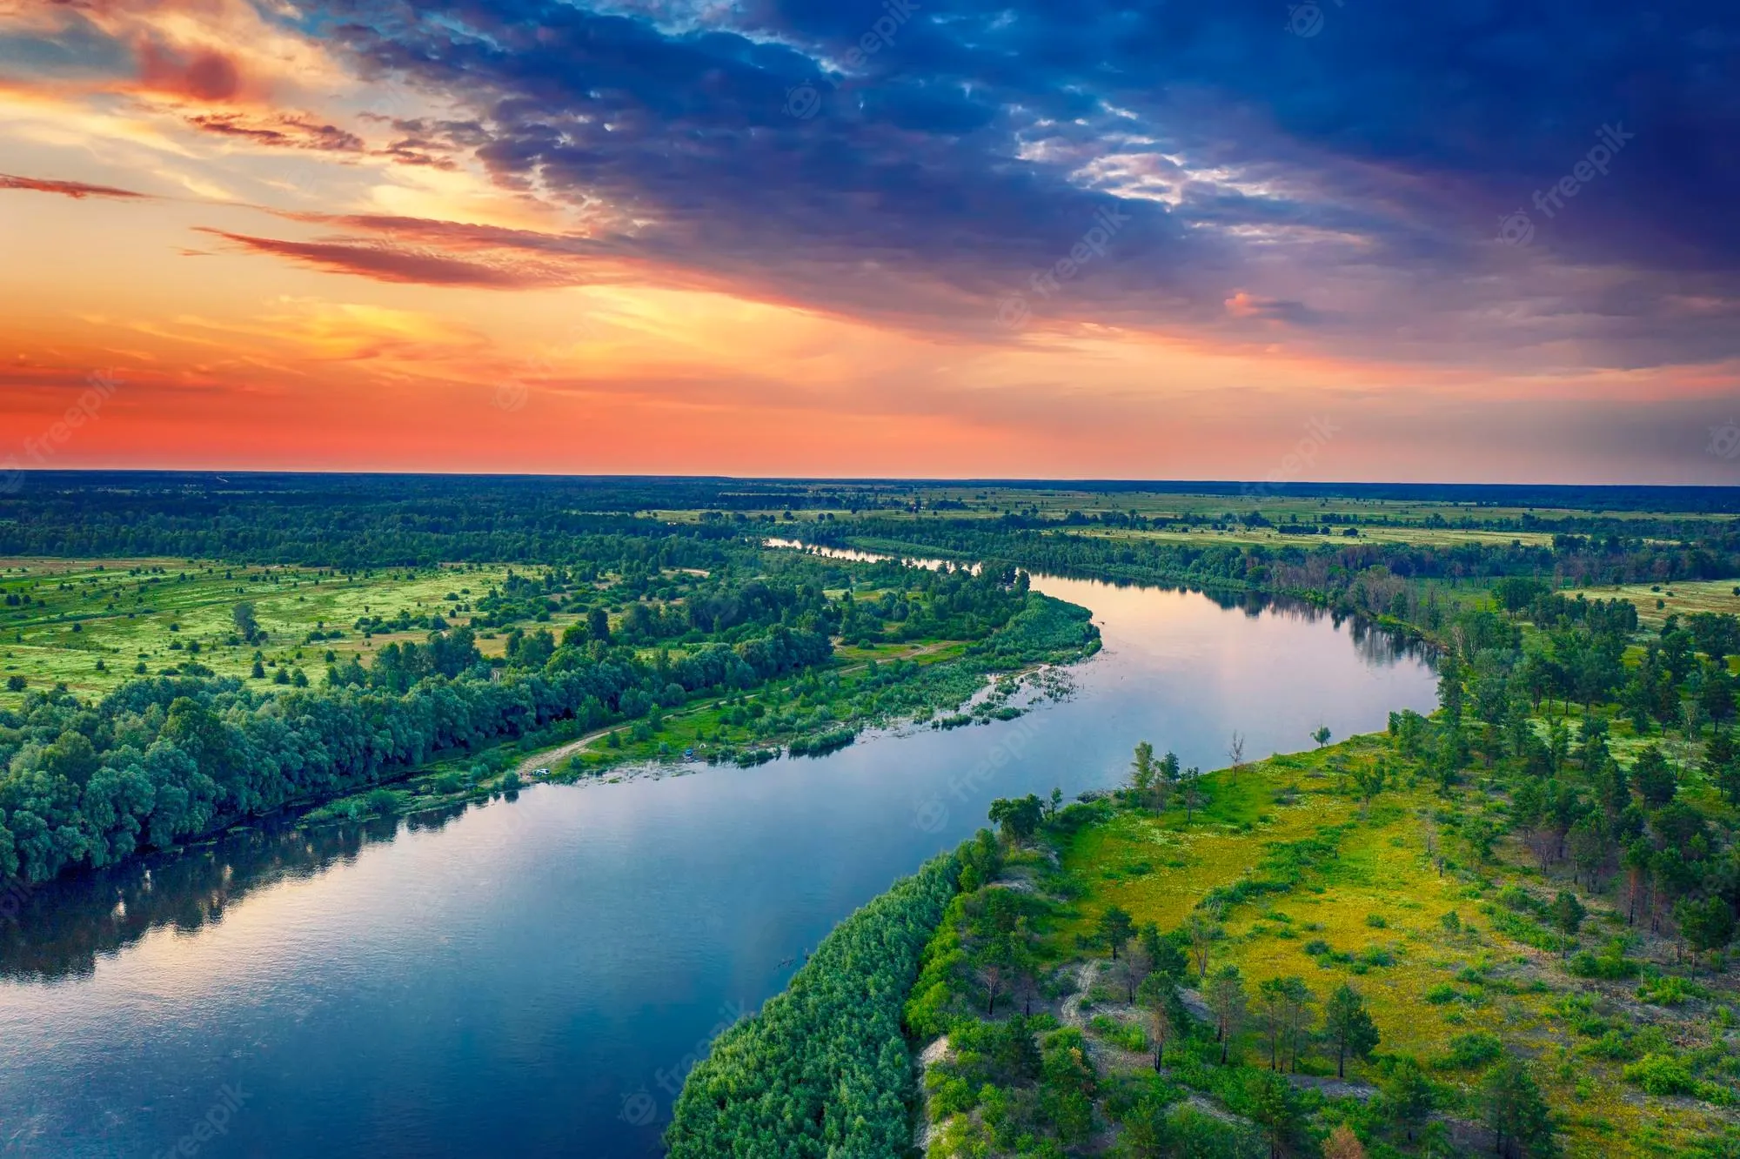
Intro
River
Notes:
Today, we’ll be learning about the word: River.

Slide 3
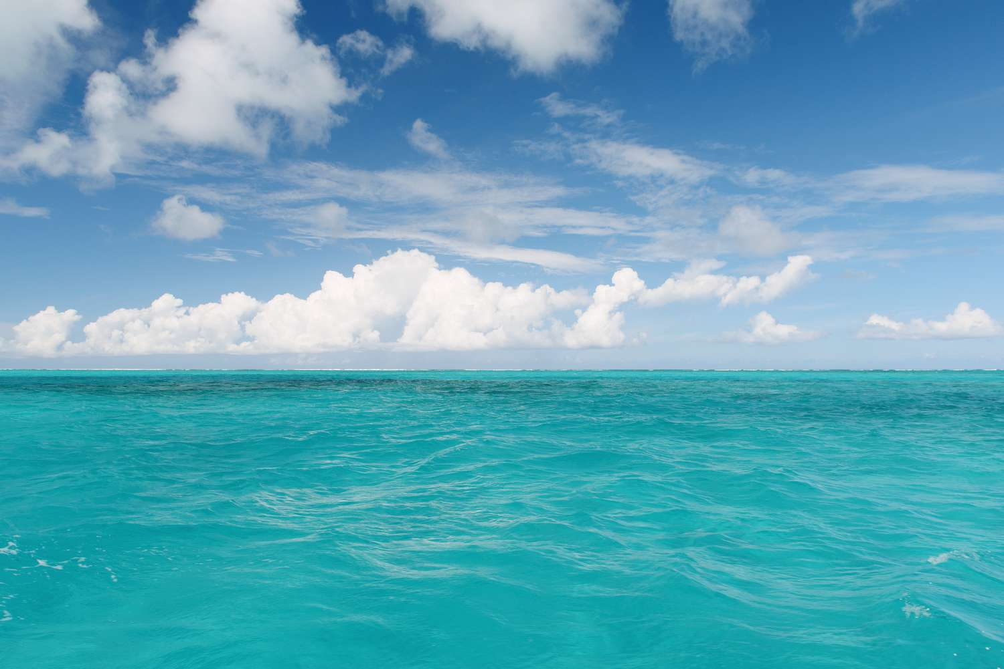
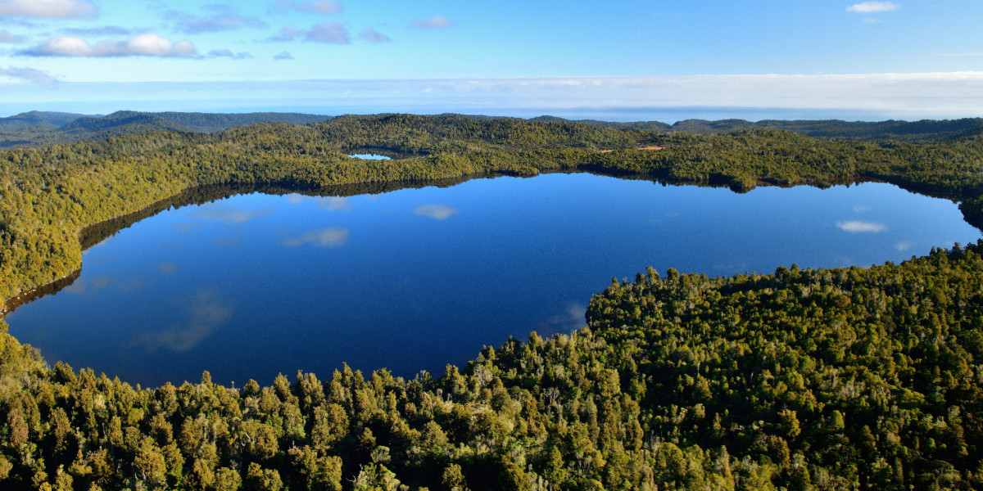
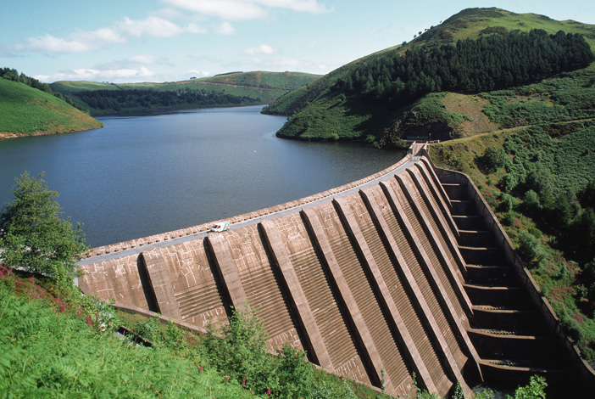
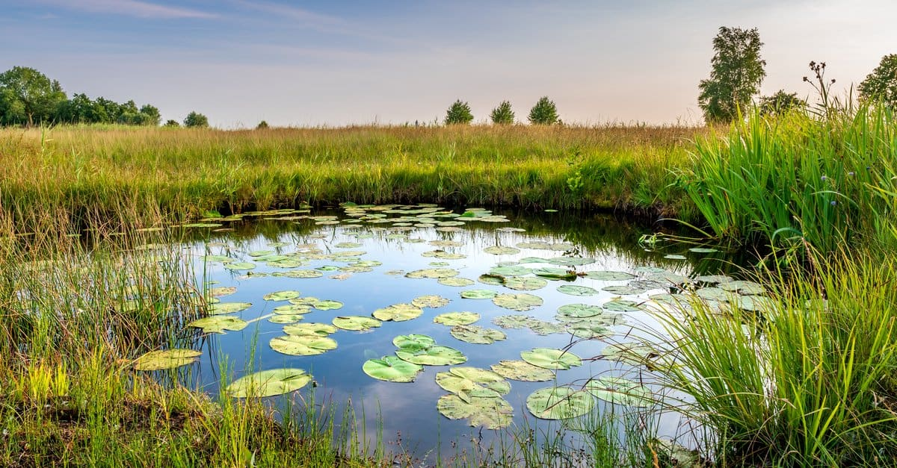
Big Question: What are the differences between lakes, oceans, ponds, reservoirs, and rivers?
Notes:
Our “big question” is: What are the differences between lakes, oceans, ponds, reservoirs, and rivers?
[Pause and illicit predictions from students.]
I love all these thoughtful scientific hypotheses! Be sure to keep this question and your predictions in mind as we move through these next few lessons, and we’ll continue to revisit it.

Slide 4
Notes:
Before we move on to our new topic, let’s review some other words & concepts that you already learned and make sure you are firm in your understanding.

Slide 5
Lake: A natural, large body of water surrounded by land
Notes:
A lake is a natural, large body of water surrounded by land.

Slide 6
Reservoir: A man-made, large body of water surrounded by land.
Notes:
A reservoir is a man-made, large body of water surrounded by land.

Slide 7
Ocean: A giant body of saltwater.
Notes:
An ocean is a giant body of saltwater.

Slide 8
Notes:
Now let’s pause for a moment to review the information we have covered already.

Slide 9
A lake is a _____, large body of water surrounded by land.
man-made
natural
Notes:
A lake is a ______, large body of water surrounded by land
[natural]

Slide 10
A lake is a _____, large body of water surrounded by land.
man-made
natural
Notes:
A lake is a ______, large body of water surrounded by land
[natural]

Slide 11
True or false: A reservoir is a man-made, large body of water surrounded by land.
True
False
Notes:
True or false: A reservoir is a man-made, large body of water surrounded by land.
[True]

Slide 12
True or false: A reservoir is a man-made, large body of water surrounded by land.
True
False
Notes:
True or false: A reservoir is a man-made, large body of water surrounded by land.
[True]

Slide 13
An ocean is a giant body of __________.
saltwater
freshwater
Notes:
An ocean is a giant body of __________.
[A. saltwater]

Slide 14
An ocean is a giant body of __________.
saltwater
freshwater
Notes:
An ocean is a giant body of __________.
[A. saltwater]

Slide 15
River
Notes:
Now that we’ve reviewed, let’s define the phrase river.

Slide 16
River: A long, winding stream of water that constantly moves.
Notes:
A river is a long, winding stream of water that constantly moves.

Slide 17
Notes:
Let’s check-in for understanding.

Slide 18
What is a river?
Notes:
What is a river?
[A river is a long, winding stream of water that constantly moves.]

Slide 19
Notes:
That is the basic definition, but there is a bit more you need to know.

Slide 20
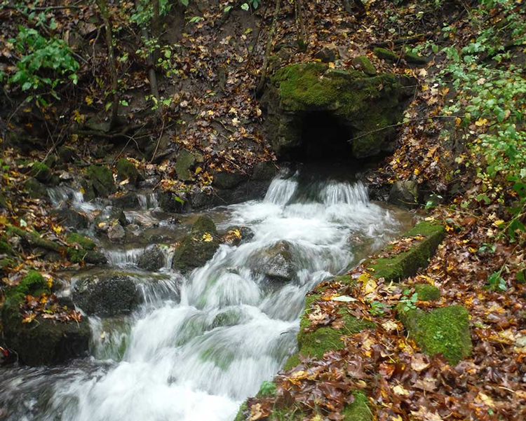
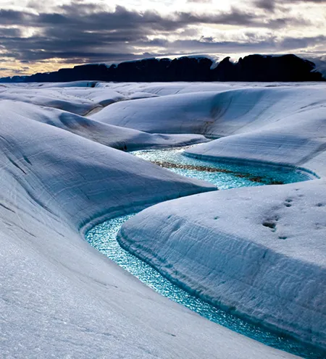
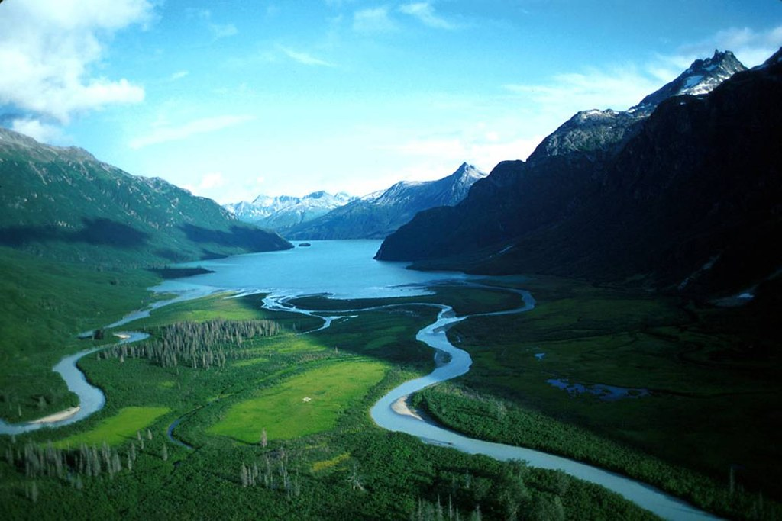
Rivers typically begin at a water source such as a spring, lake, or glacier.
spring
lake
glacier
Notes:
Rivers typically begin at a water source such as a spring, lake, or glacier.

Slide 21
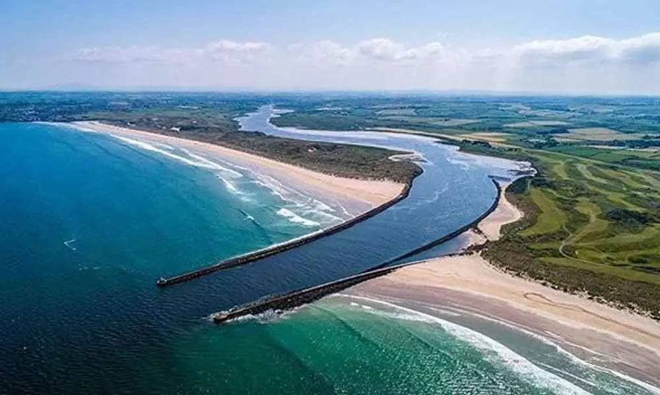
Rivers flow downhill due to gravity, eventually reaching a larger body of water, such as another river, lake, or ocean.
Notes:
Rivers flow downhill due to gravity, eventually reaching a larger body of water, such as another river, lake, or ocean.

Slide 22
Notes:
Let’s check-in for understanding.

Slide 23
Rivers can start from what types of water sources?
spring
lake
glacier
Notes:
Rivers can start from what types of water sources?
[Springs, lakes, glaciers]

Slide 24
Rivers can start from what types of water sources?
spring
lake
glacier
Notes:
Rivers can start from what types of water sources?
[Springs, lakes, glaciers]

Slide 25
Rivers flow _______ due to gravity, eventually reaching a larger body of water, such as another river, lake, or ocean.
uphill
downhill
Notes:
Rivers flow _______ due to gravity, eventually reaching a larger body of water, such as another river, lake, or ocean.
[downhill]

Slide 26
Rivers flow downhill due to gravity, eventually reaching a larger body of water, such as another river, lake, or ocean.
uphill
downhill
Notes:
Rivers flow _______ due to gravity, eventually reaching a larger body of water, such as another river, lake, or ocean.
[downhill]

Slide 27
Notes:
Now, let’s talk about some examples of river.

Slide 28
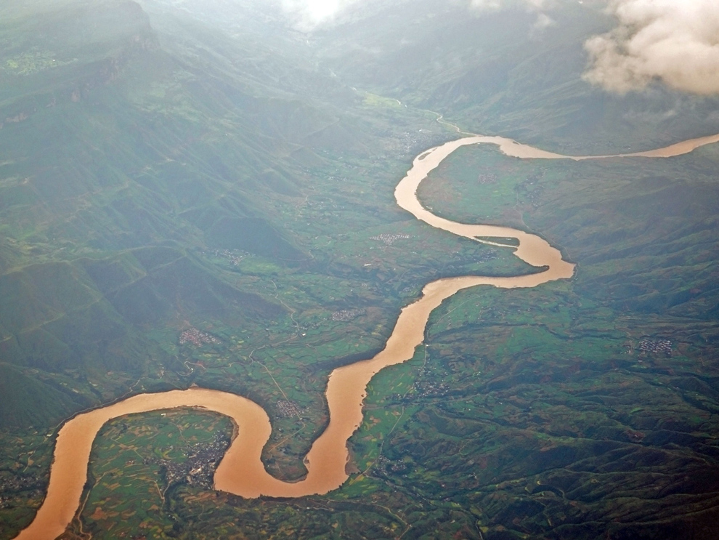
This is an example of a river. It is a long, winding stream of water that constantly moves.
Notes:
This is an example of a river. It is a long, winding stream of water that constantly moves.

Slide 29
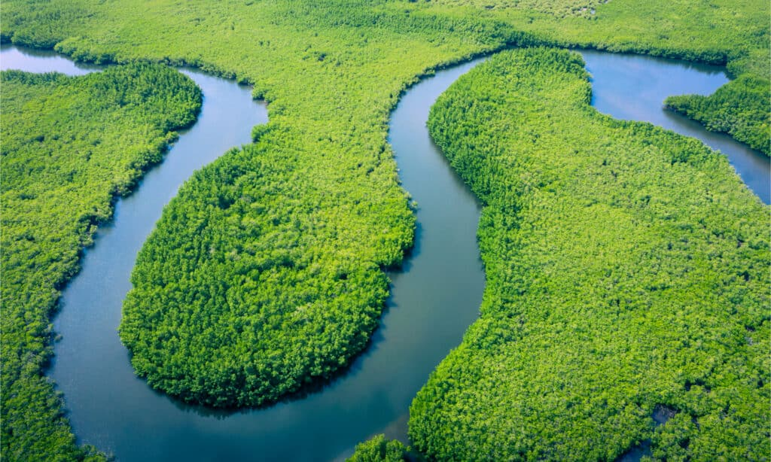
This is also an example of an river. Again, it is long, winding stream of water that constantly moves.
Photo: Georgia Coast Atlas
Notes:
This is also an example of an river. Again, it is long, winding stream of water that constantly moves.

Slide 30
Notes:
Now, let’s talk about some non-examples of river.

Slide 31
This is not a river. It is not a long, winding stream of water that is constantly moving.
Notes:
This is not a river. It is not a long, winding stream of water that is constantly moving.

Slide 32
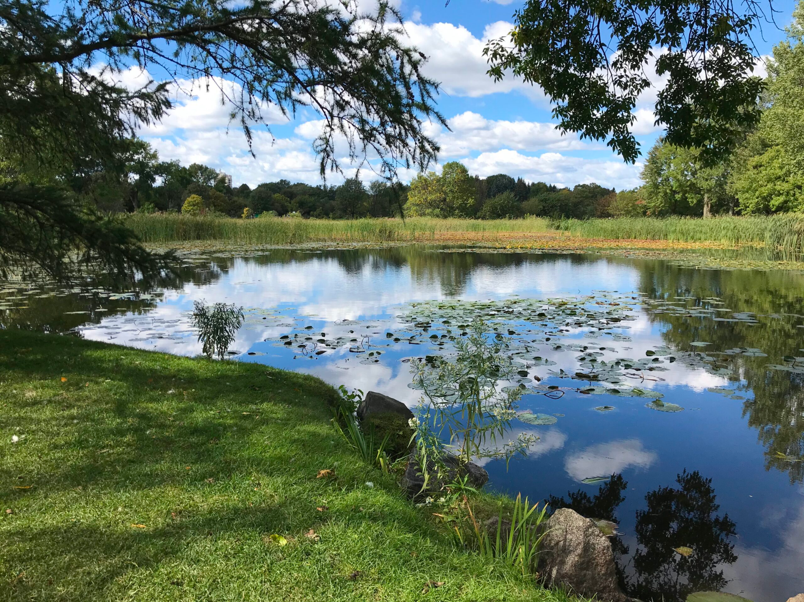
This is also not a river. It is not a long, winding stream of water that is constantly moving.
Notes:
This is also not a river. It is not a long, winding stream of water that is constantly moving.

Slide 33
Notes:
Now let’s pause for a moment to check your understanding.

Slide 34
Which of these is a river?
Notes:
Which of these is a river?
[The left picture.]

Slide 35
Which of these is a river?
Notes:
Which of these is a river?
[The left picture.]

Slide 36
Remember!!!
Notes:
So remember!

Slide 37
River: A long, winding stream of water that constantly moves.
Notes:
A river is a long, winding stream of water that constantly moves.

Slide 38
Notes:
We will now complete this concept map, called a Frayer model, to summarize and further clarify what you have learned about the term river.

Slide 39
Definition
Picture
River
Example
How do rivers impact my life?
Notes:
To complete the Frayer model, we will choose from four choices the correct picture, definition, example, and response to the question, “How do rivers impact my life?” Select the best response for each question using the information you just learned. As we select responses, we will see how this model looks filled in for the term river.

Slide 40
Directions: Choose the correct picture of a river from the choices below.
A
B
C
D
Notes:
Choose the one correct picture of a river from these four choices.

Slide 41
Directions: Choose the correct picture of a river from the choices below.
A
B
C
D
Notes:
Choose the one correct picture of a river from these four choices.

Slide 42
Definition
Picture
River
Example
How do rivers impact my life?
Notes:
Here is the Frayer model filled in with a picture of a river.

Slide 43
Directions: Choose the correct definition of a river from the choices below.
A
A man-made, large body of water surrounded by land
B
A natural, large body of water surrounded by land
C
A giant body of saltwater
D
A long, winding stream of water that constantly moves
Notes:
Choose the correct definition of a river from the choices below.

Slide 44
Directions: Choose the correct definition of a river from the choices below.
A
A man-made, large body of water surrounded by land
B
A natural, large body of water surrounded by land
C
A giant body of saltwater
D
A long, winding stream of water that constantly moves
Notes:
Choose the correct definition of a river from the choices below.
[D. A long, winding stream of water that constantly moves.]

Slide 45
Definition
Picture
A long, winding stream of water that constantly flows
River
Example
How do rivers impact my life?
Notes:
Here is the Frayer Model with a picture and the definition filled in for a river: A long, winding stream of water that constantly flows.

Slide 46
Directions: Choose the correct example of a river from the choices below.
A
A giant stream flowing from a glacier
B
A giant body of water that is formed using a dam
C
A giant body of freshwater
D
A giant home for sharks, dolphins, and whales
Notes:
Choose the correct example of a river from the choices below.

Slide 47
Directions: Choose the correct example of a river from the choices below.
A
A giant stream flowing from a glacier
B
A giant body of water that is formed using a dam
C
A giant body of freshwater
D
A giant home for sharks, dolphins, and whales
Notes:
“A giant stream flowing from a glacier” is correct! This is an example of a river.

Slide 48
Definition
Picture
A long, winding stream of water that constantly flows
River
A giant stream flowing from a glacier
Example
How do rivers impact my life?
Notes:
Here is the Frayer Model with a picture, definition, and an example of a river: A giant stream flowing from a glacier.

Slide 49
Directions: Choose the correct response for “How do rivers impact my life?” from the choices below.
A
Rivers provide oxygen.
B
Rivers can provide a source for drinking water when cleaned.
C
Rivers give us warmth in the winter.
D
Rivers give humans shelter.
Notes:
Choose the one correct response for “how do rivers impact my life?” from these four choices.

Slide 50
Directions: Choose the correct response for “How do rivers impact my life?” from the choices below.
A
Rivers provide oxygen.
B
Rivers can provide a source for drinking water when cleaned.
C
Rivers give us warmth in the winter.
D
Rivers give humans shelter.
Notes:
“Rivers can provide a source for drinking water when cleaned.” That is correct! This is an example of how rivers impact your life.

Slide 51
Definition
Picture
A long, winding stream of water that constantly flows
River
A giant stream flowing from a glacier
Rivers can provide a source for drinking water when cleaned.
Example
How do rivers impact my life?
Notes:
Here is the Frayer Model with a picture, definition, example, and a correct response to “how do rivers impact my life?”: Rivers can provide a source for drinking water when cleaned.

Slide 52
Remember!!!
Notes:
So remember!

Slide 53
River: A long, winding stream of water that constantly moves.
Notes:
A river is a long, winding stream of water that constantly moves.

Slide 54
Big Question: What are the differences between lakes, oceans, ponds, reservoirs, and rivers?
Notes:
Our “big question” is: What are the differences between lakes, oceans, ponds, reservoirs, and rivers?
Does anyone have any additional examples to share that haven’t been discussed yet?
I love all these thoughtful scientific hypotheses! Be sure to keep this question and your predictions in mind as we move through these next few lessons, and we’ll continue to revisit it.

Slide 55
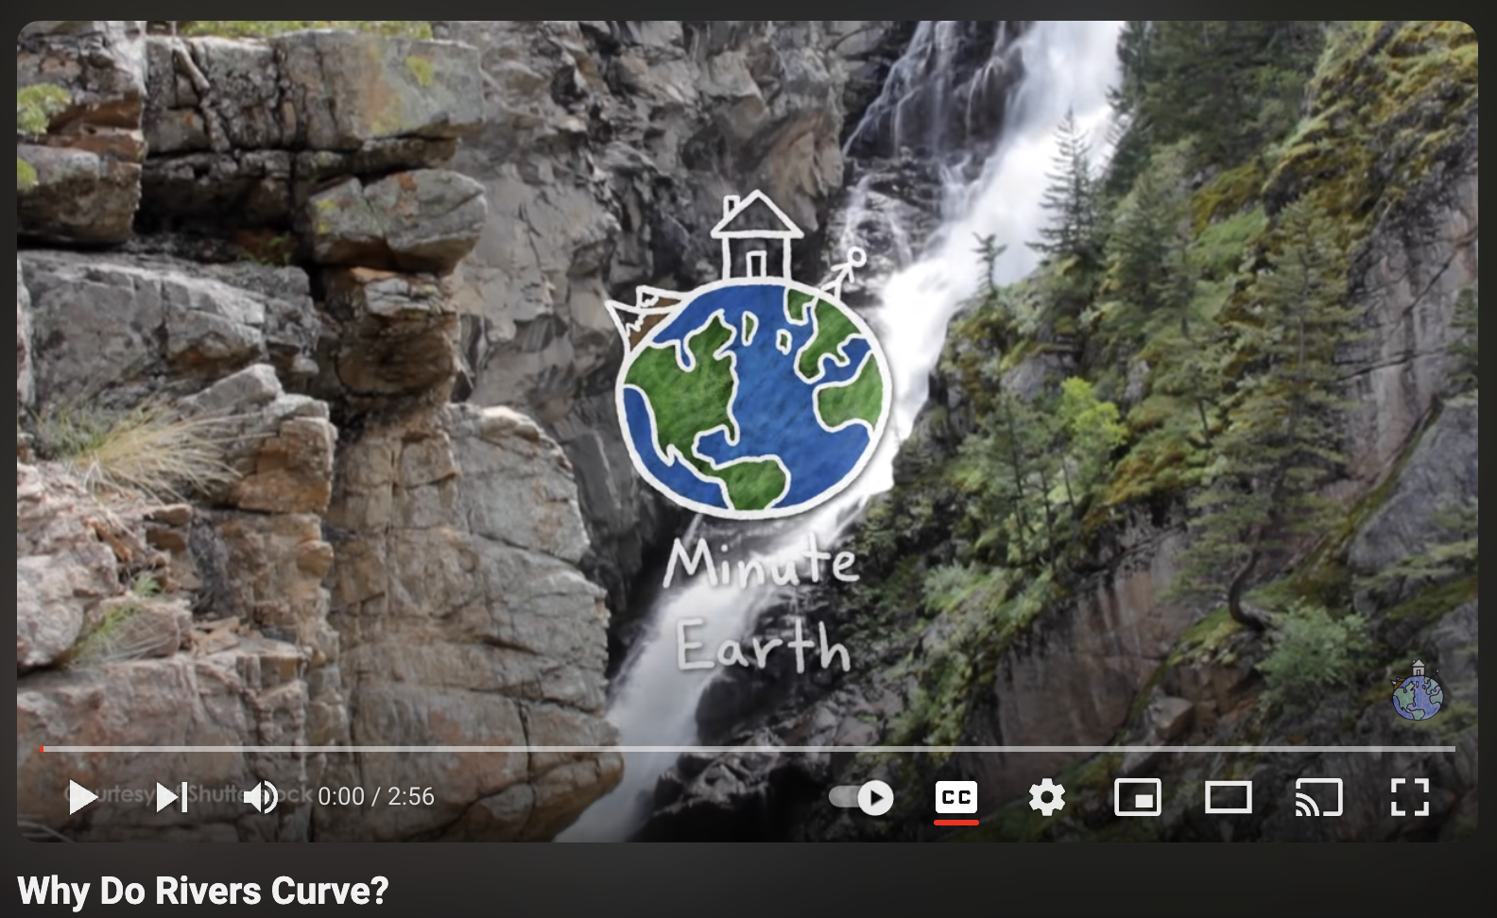
Extension Activity
Minute Earth - Curving Rivers
Click the link above for an extension video about what causes rivers to curve.
Jot down 2 or 3 new facts that you learn about rivers.
Discuss them as a class.
Notes:
Click the link above for an extension video about what causes rivers to curve. Jot down 2 or 3 new facts that you learn about rivers. Discuss them as a class.

Slide 56
Notes:
Thanks for watching, and please continue watching CAPs available from this website.

Slide 57
This Was Created With Resources From:
Questions or Comments
Michael Kennedy, Ph.D. MKennedy@Virginia.edu
Rachel L Kunemund, Ph.D. rk8vm@virginia.edu

