Slide 1
Intro
“Big Idea” Question
Review Concepts
Check-In Questions
Teacher Demo
Vocabulary
Student-Friendly Definition
Examples & Non-Examples
Morphological Word Parts
Frayer Model
Simulation/Activity
Notes:
OK everyone, get ready for our next lesson. Just as a reminder, these are the different components that our lesson may include, and you’ll see these icons in the top left corner of each slide so that you can follow along more easily!

Slide 2
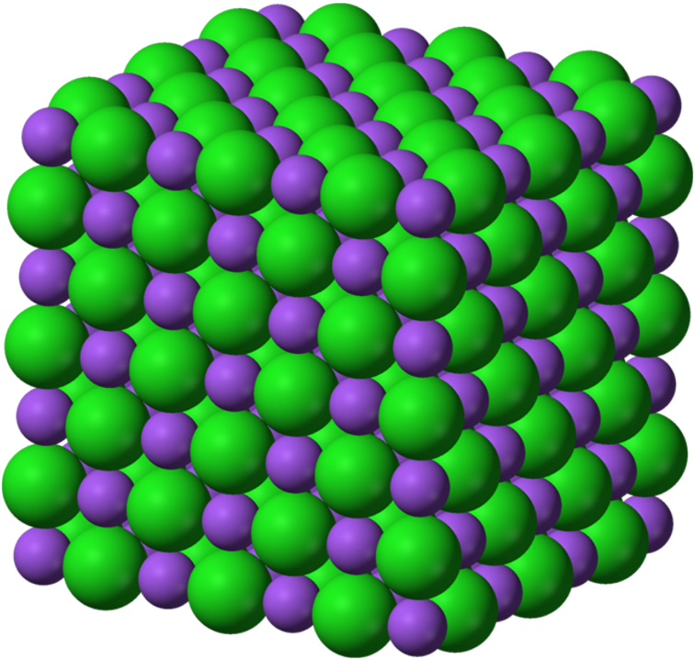
Solid
Intro
Notes:
Today we will learn about solids.

Slide 3
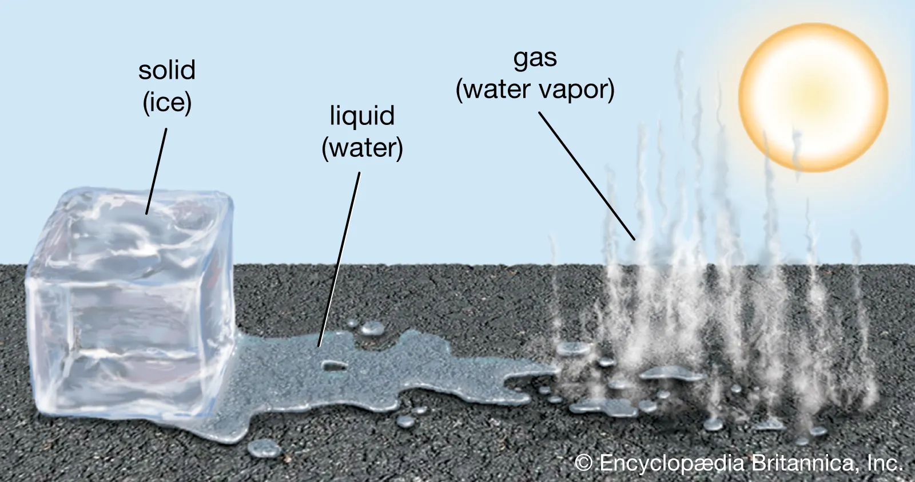
Big Question: How does temperature affect the matter around us?
Notes:
Our “big question” is: How does temperature affect the matter around us?
[Pause and illicit predictions from students.]
I love all these thoughtful scientific hypotheses! Be sure to keep this question and your predictions in mind as we move through these next few lessons, and we’ll continue to revisit it.
Feedback: Asking students to make predictions about how energy is related to states of matter is a great way to activate and elicit student ideas and prior knowledge. This type of activity is evidence of the teacher planning for students’ engagement with science ideas.

Slide 4
Notes:
Before we move on to our new vocabulary term, let’s review some other words & concepts that you already learned and make sure you are firm in your understanding.

Slide 5
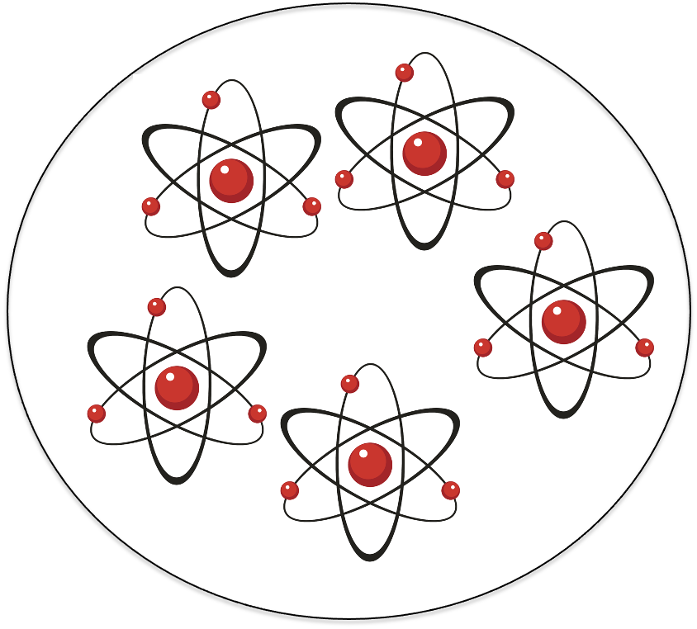
Matter: has mass and takes up space
Notes:
Matter is anything that has mass and takes up space.

Slide 6
Mass: amount of matter in an object.
Notes:
Mass is the amount of matter in an object.

Slide 7
Atom: smallest whole unit of matter.
Notes:
An atom is the smallest whole unit of matter. All matter is made up of atoms.

Slide 8
Notes:
Now let’s pause for a moment to check your understanding.

Slide 9
Matter has _______ and takes up space.
Notes:
Matter has ______ and takes up space.
[mass]

Slide 10
Matter has mass and takes up space.
Notes:
Matter has mass and takes up space.

Slide 11
What is mass?
Notes:
What is mass?
[the amount of matter in an object]

Slide 12
What is the smallest whole unit of matter?
Cell
Atom
Wave
Notes:
What is the smallest whole unit of matter?
[b.atom]

Slide 13
What is the smallest whole unit of matter?
Cell
Atom
Wave
Notes:
What is the smallest whole unit of matter? b.atom

Slide 14
Solid
Notes:
Now that we’ve reviewed, let’s define our new term, solid.
Feedback: Using cues, such as on this slide, helps prepare students for what is coming up next in the lesson. This is important especially for students who may struggle with new vocabulary instruction.

Slide 15
Solid: has particles that are tightly packed together in a fixed pattern
Notes:
A solid has particles that are tightly packed together in a fixed pattern.

Slide 16
Notes:
Now let’s pause for a moment to check your understanding.

Slide 17
What is a solid?
Notes:
What is a solid?
[A solid has particles that are tightly packed together in a fixed pattern.]

Slide 18
Notes:
That is the basic definition, but there is a bit more you need to know.

Slide 19
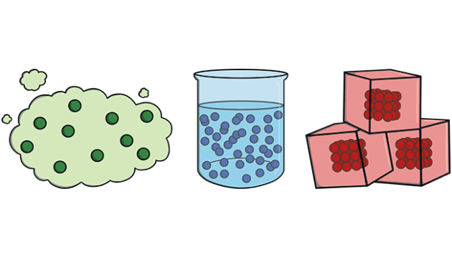
States of Matter
Gas
Liquid
Solid
Notes:
Solids are one of the three states of matter: solid, liquid, and gas. Solids are the only phase of matter that keeps its own shape and volume.

Slide 20
Notes:
Solids have a definite shape that doesn’t easily change when you move it around. For example, a book will keep the same shape whether its on your desk, in your backpack, or on the shelf.

Slide 21
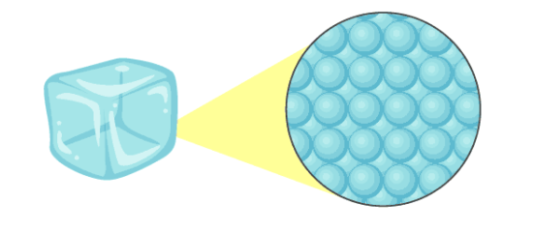
Notes:
Solids are made up of atoms that are packed tightly together and have a strong bond. Because the atoms are packed so tightly, they don’t move very much. This lets solids keep their shape the same.

Slide 22
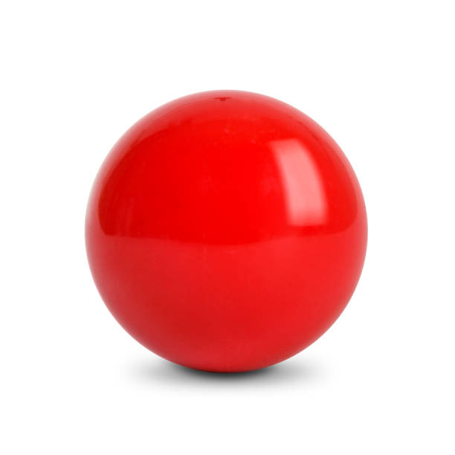
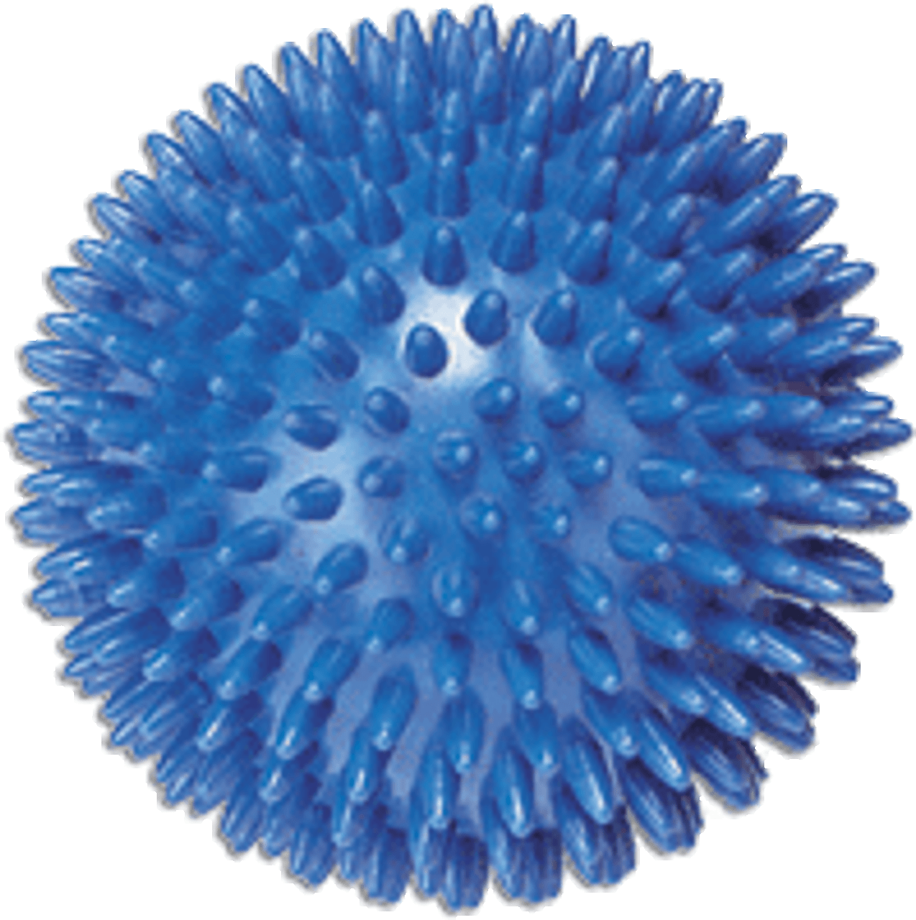
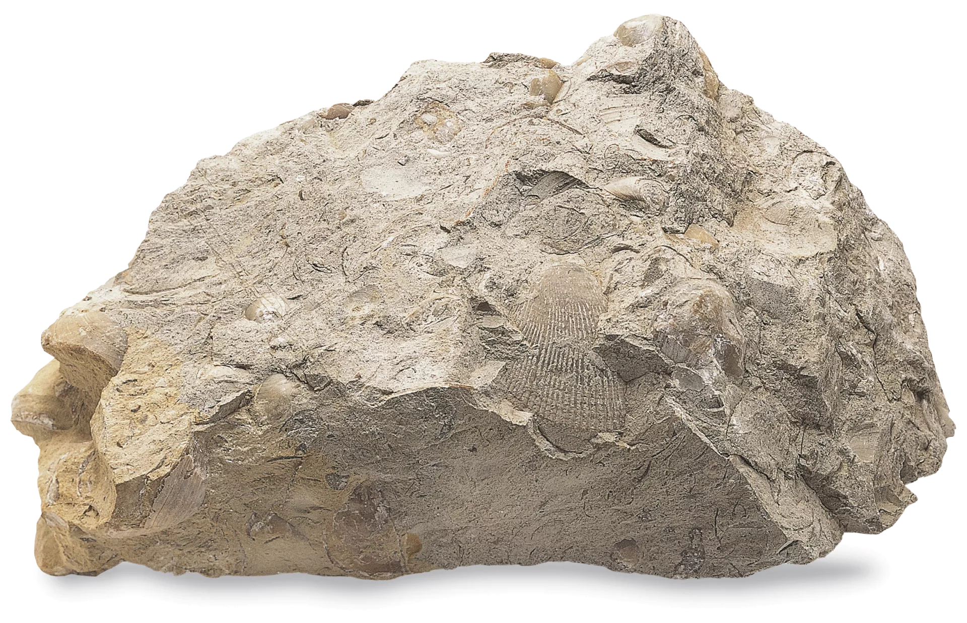
Notes:
Solids can have lots of different textures. They can feel bumpy, smooth, rough, or shiny. These different textures are caused by the different arrangement of the atoms in the solid.

Slide 23
temperature
Notes:
When the temperature of a solid begins to increase, the particles begin to gain energy and move around more. Once the temperature reaches a certain point, the particles begin to slide past each other and the solid begins to lose its shape. This process is called melting.

Slide 24
Notes:
Now let’s pause for a moment to check your understanding.

Slide 25
What are the three states of matter?
Notes:
What are the three states of matter?
[gas, liquid, solid]

Slide 26
What are the three states of matter?
Gas
Liquid
Solid
Notes:
What are the three states of matter? gas, liquid, solid

Slide 27
Solids have a definite _________.
Texture
Color
Shape
Notes:
Solids have a definite ________.
[c. shape]

Slide 28
Solids have a definite _________.
Texture
Color
Shape
Notes:
Solids have a definite shape.

Slide 29
Particles in a solid are ________ packed together.
Notes:
Particles in a solid are ________ packed together.
[tightly]

Slide 30
Particles in a solid are tightly packed together.
Notes:
Particles in a solid are tightly packed together.

Slide 31
What happens when the temperature of a solid goes up?
temperature
Notes:
What happens when the temperature of a solid goes up?
[It melts.]

Slide 32
Notes:
Now, let’s talk about some examples of solids.

Slide 33
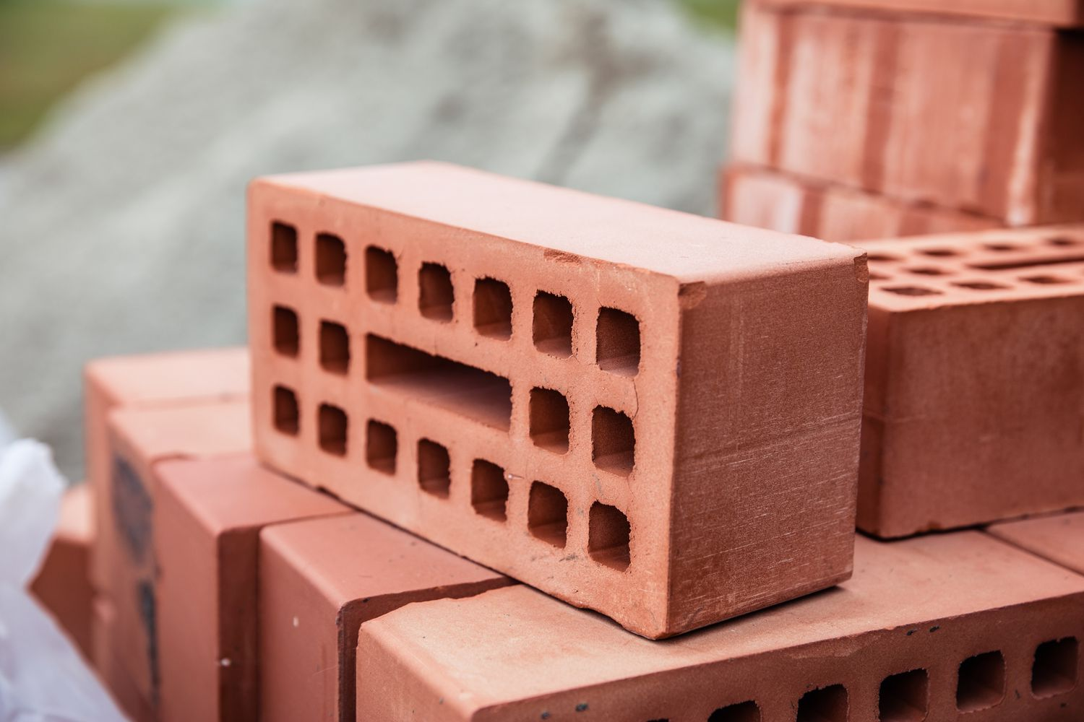
Notes:
Here is an example of a solid. A brick has strong bonds between particles so it can keep its shape when we use it to make houses or buildings.

Slide 34
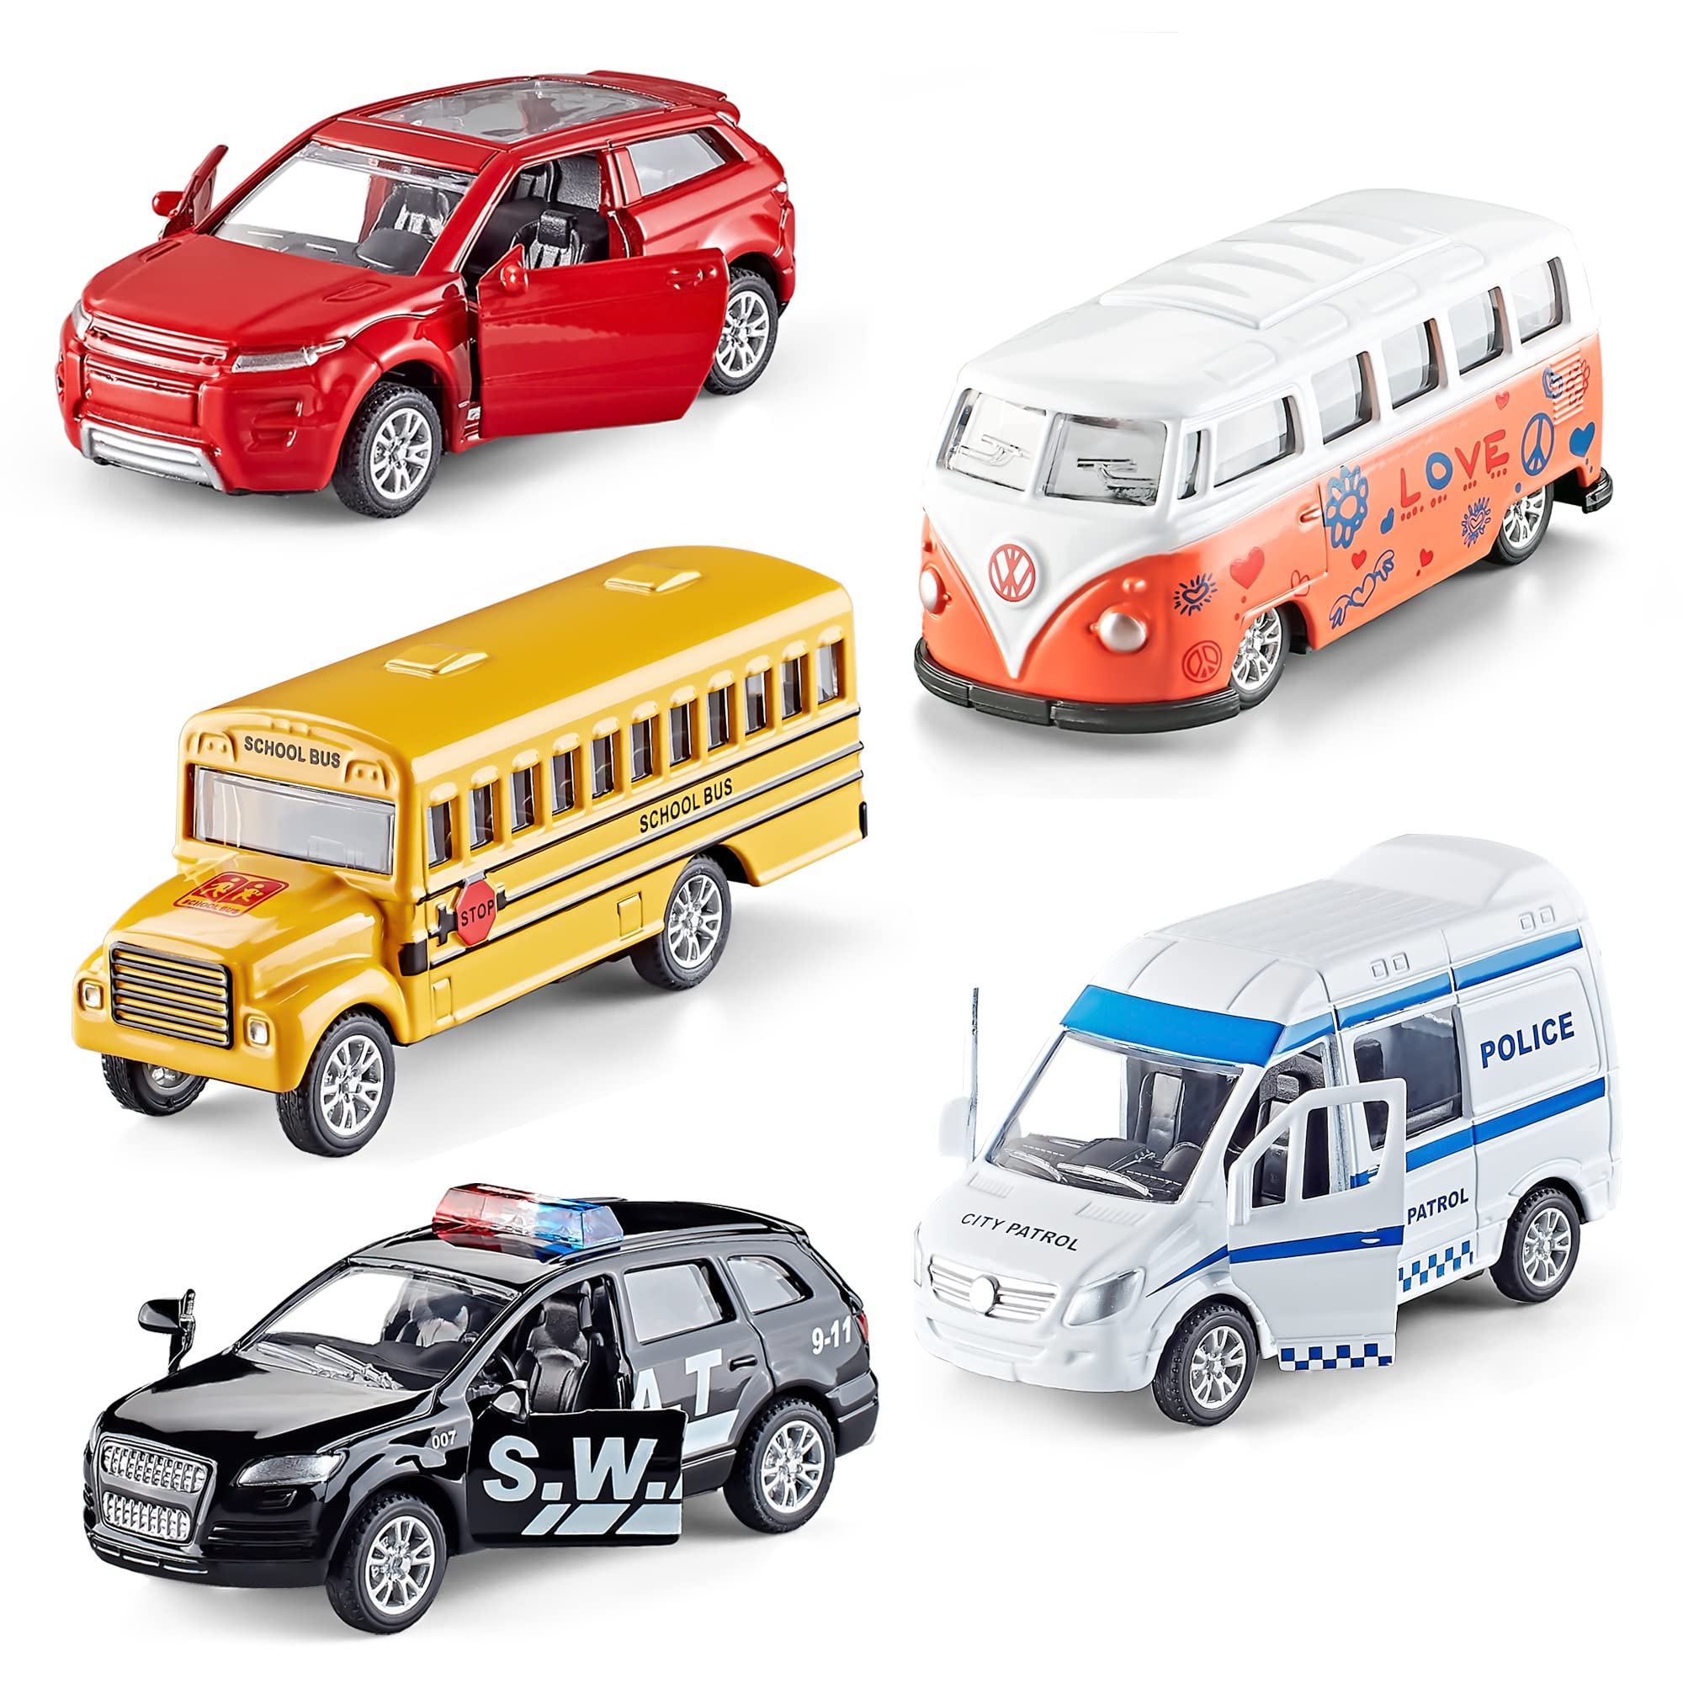
Notes:
Here is another example of a solid. Toy cars keep have a clear shape that doesn’t change when we push or move them around.

Slide 35
Notes:
Next, let’s talk about some non-examples of solids.
Feedback: Offering clear and explicit explanation for non-examples is a great way for students to make sense of the new content. Explanations for non-examples are provided in the slides below.

Slide 36
Notes:
Rain is a non-example of a solid. Rain changes it shape when it hits a surface (like your hand) or joins together to make a puddle.

Slide 37
Notes:
Ideas are another non-example of a solid. Ideas exist in our minds. They do not have mass or take up space.

Slide 38
Notes:
Now let’s pause for a moment to check your understanding.

Slide 39
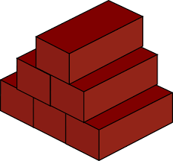
Which one is NOT an example of a solid?
Brick
Rain
Car
Notes:
Which one is NOT an example of a solid?
[Rain]

Slide 40
Which one is NOT an example of a solid?
Brick
Rain
Car
Notes:
Which one is NOT an example of a solid? Rain

Slide 41
Remember!!!
Notes:
So remember!

Slide 42
Solid: s
Solid: has particles that are tightly packed together in a fixed pattern
Notes:
A solid has particles that are tightly packed together in a fixed pattern.

Slide 43
Notes:
We will now complete this concept map, called a Frayer model, to summarize and further clarify what you have learned about the term solid.

Slide 44
Definition
Picture
Solid
Example
How do solids impact my life?
Notes:
To complete the Frayer model, we will choose from four choices the correct picture, definition, example, and response to the question, “How do solids impact my life?” Select the best response for each question using the information you just learned. As we select responses, we will see how this model looks filled in for the term solid.

Slide 45
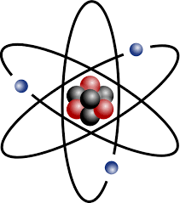
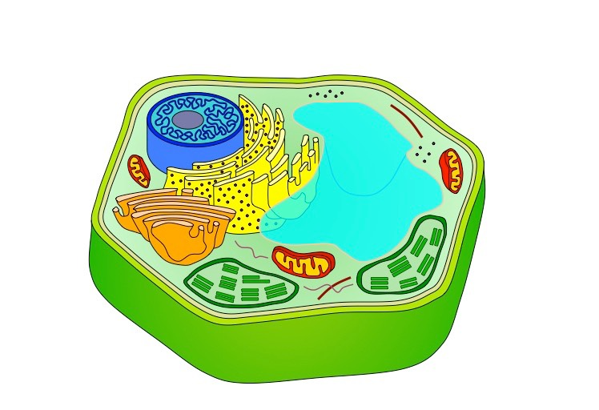
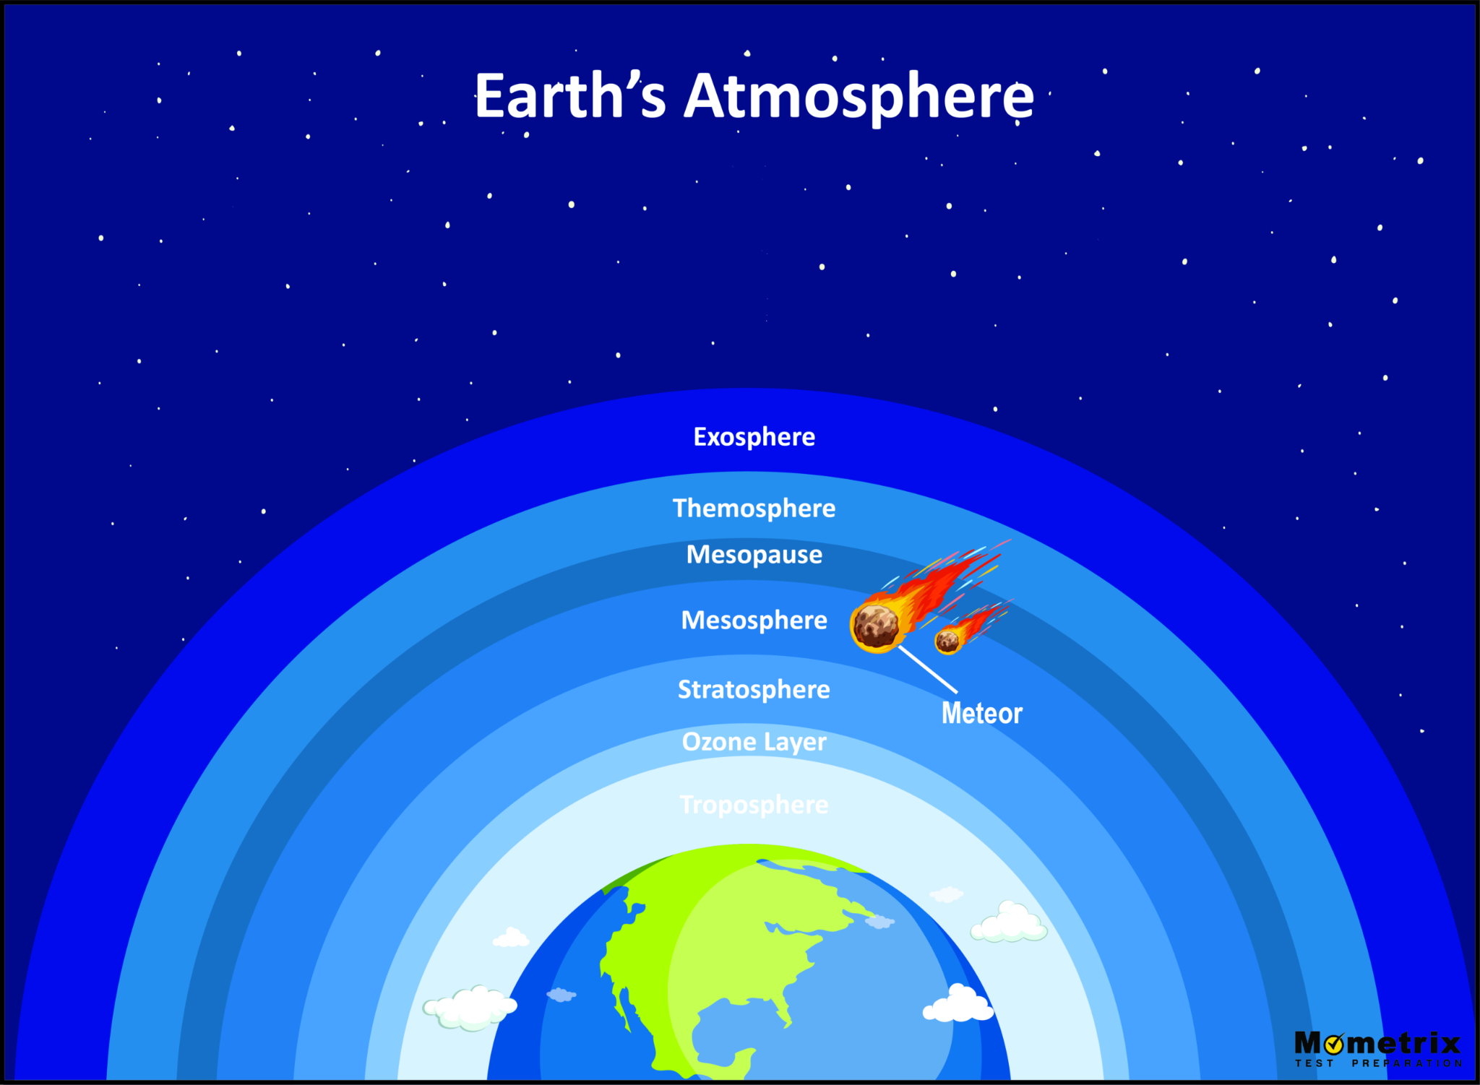
Directions: Choose the correct picture of a
solid from the choices below.
A
B
C
D
Notes:
Choose the one correct picture of solid from these four choices.

Slide 46
Directions: Choose the correct picture of a
solid from the choices below.
A
B
C
D
Notes:
This is the picture that shows a solid.

Slide 47
Definition
Picture
Solid
Example
How do solids impact my life?
Notes:
Here is the Frayer model filled in with a picture of solid.

Slide 48
Directions: Choose the correct definition of
solid from the choices below.
A
has particles that are tightly packed together in a fixed pattern
B
energy of mass in motion
C
a force that surrounds all magnets, that moves electrically charged particles in a circular path​
D
preserved remains of prehistoric life
Notes:
Choose the one correct definition of solid from these four choices.

Slide 49
Directions: Choose the correct definition of
solid from the choices below.
A
has particles that are tightly packed together in a fixed pattern
B
energy of mass in motion
C
a force that surrounds all magnets, that moves electrically charged particles in a circular path​
D
preserved remains of prehistoric life
Notes:
“Has particles that are tightly packed together in a fixed pattern” is correct! This is the definition of solid.

Slide 50
Definition
Picture
has particles that are tightly packed together in a fixed pattern
Solid
Example
How do solids impact my life?
Notes:
Here is the Frayer Model with a picture and the definition filled in for solid: has particles that are tightly packed together in a fixed pattern.

Slide 51
Directions: Choose the correct example of
a solid from the choices below.
A
The dream you had last night
B
Water in the swimming pool
C
Wind from a nearby thunderstorm
D
My chair and desk at school
Notes:
Choose the one correct example of a solid from these four choices.

Slide 52
Directions: Choose the correct example of
a solid from the choices below.
A
A
The dream you had last night
B
B
Water in the swimming pool
C
C
Wind from a nearby thunderstorm
D
D
My chair and desk at school
Notes:
“My chair and desk at school” is correct! This is an example of a solid.

Slide 53
Definition
Picture
has particles that are tightly packed together in a fixed pattern
Solid
My chair and desk at school
Example
How do solids impact my life?
Notes:
Here is the Frayer Model with a picture, definition, and an example of solid: my chair and desk at school.

Slide 54
Directions: Choose the correct response for “how do solids impact my life?” from the choices below.
A
Many of the things we use in our everyday life, like our homes, clothes, toys, and foods, are solids.
B
Solids make up Earth’s atmosphere that protects us from harmful radiation from the Sun.
C
They create the force that keeps our feet on the ground and the Earth orbiting the Sun.
D
Solids break down the food in our stomachs and create energy our bodies need to move.
Notes:
Choose the one correct response for “how do solids impact my life?” from these four choices.

Slide 55
Directions: Choose the correct response for “how do solids impact my life?” from the choices below.
A
Many of the things we use in our everyday life, like our homes, clothes, toys, and foods, are solids.
B
Solids make up Earth’s atmosphere that protects us from harmful radiation from the Sun.
C
They create the force that keeps our feet on the ground and the Earth orbiting the Sun.
D
Solids break down the food in our stomachs and create energy our bodies need to move.
Notes:
“Many of the things we use in our everyday life, like our homes, clothes, toys, and foods, are solids” That is correct! This is an example of how solids impact your life.

Slide 56
Definition
Picture
has particles that are tightly packed together in a fixed pattern
Solid
Many of the things
we use in our everyday life, like our homes, clothes, toys, and foods, are solids.
My chair and desk at school
Example
How do solids impact my life?
Notes:
Here is the Frayer Model with a picture, definition, example, and a correct response to “how do solids impact my life?”: Many of the things we use in our everyday life, like our homes, clothes, toys, and foods, are solids.

Slide 57
Big Question: How does temperature affect the matter around us?
Notes:
Our “big question” is: How does temperature affect the matter around us?
[Pause and illicit predictions from students.]
I love all these thoughtful scientific hypotheses! Be sure to keep this question and your predictions in mind as we move through these next few lessons, and we’ll continue to revisit it.

Slide 58
Notes:
Thanks for watching, and please continue watching CAPs available from this website.

Slide 59
This Video Was Created With Resources From:
Questions or Comments
Michael Kennedy, Ph.D. MKennedy@Virginia.edu
Rachel L Kunemund, Ph.D. rk8vm@virginia.edu

