Slide 1
Intro
“Big Idea” Question
Review Concepts
Check-In Questions
Teacher Demo
Vocabulary
Student-Friendly Definition
Examples & Non-Examples
Morphological Word Parts
Simulation/Activity
Notes:
OK everyone, get ready for our next lesson. Just as a reminder, these are the different components that our lesson may include, and you’ll see these icons in the top left corner of each slide so that you can follow along more easily!

Slide 2
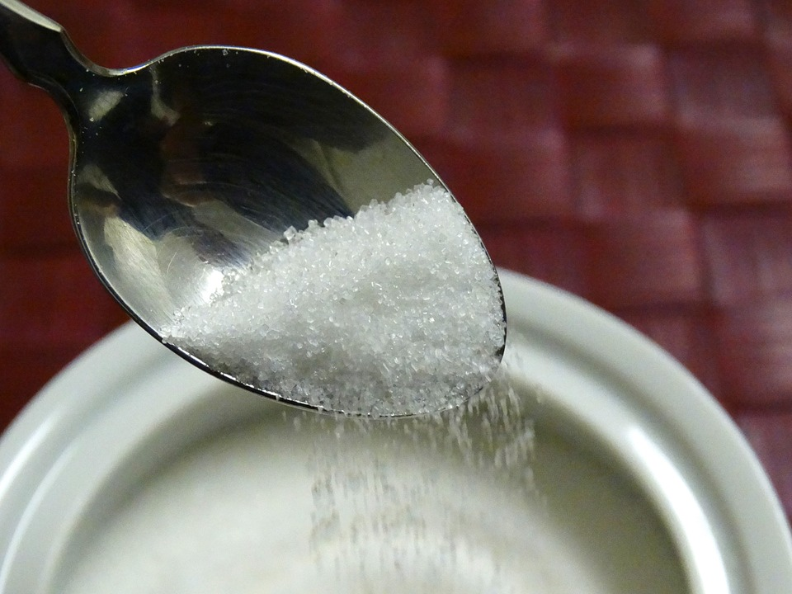
Solutes
Intro
Notes:
Today, we’re going to learn about solutes.

Slide 3
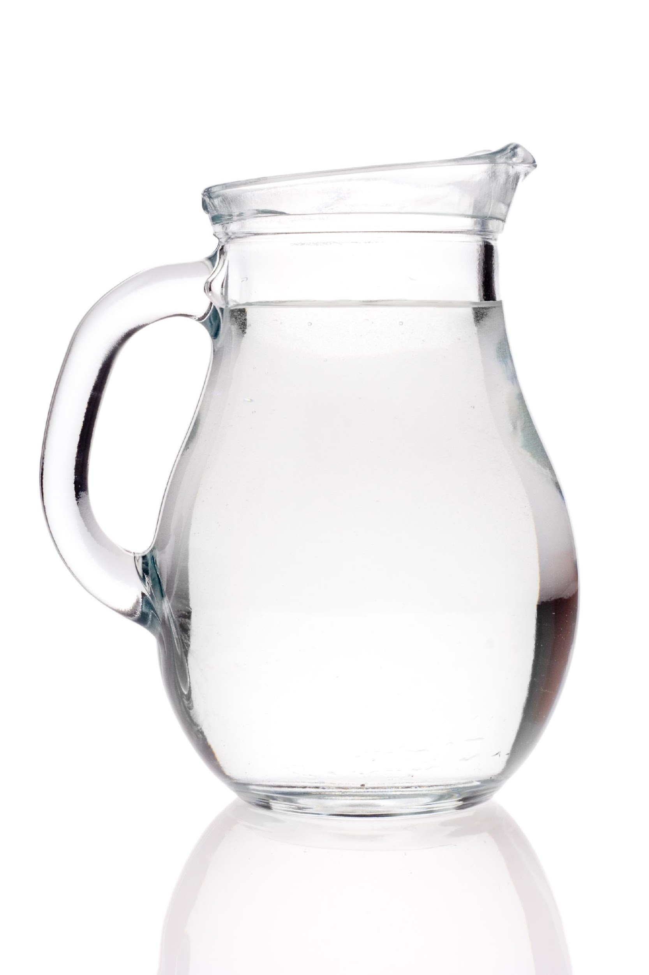
Big Question: How do you use solutes and solvents? Why are they important?
Notes:
Our “big question” is: How do you use solutes and solvents? Why are they important?
[Pause and illicit predictions from students.]
I love all these thoughtful scientific hypotheses! Be sure to keep this question and your predictions in mind as we move through these next few lessons, and we’ll continue to revisit it.

Slide 4
Demonstration
Solubility Science
TEACHER DIRECTIONS:
In the link above is a video showing how to conduct a demonstration on solubility. Follow the directions to demonstrate solubility to your students.
Before The demonstration , ask students to recall what they already know about mixtures and solutions.
After viewing: Ask students what they observed about the experiment (What do you think the solute is? How is a solution made?
*This experiment can be done without focusing on solubility by only demonstrating how different substances (solutes) can dissolve to form a solution. This demonstration can be done either in-person or virtually.
Notes:
Let’s do a quick demonstration that will help get our brains ready to think about solutes and how they relate to our big question.
Feedback: Make the demonstration clear and follow a logical order of steps that helps the students make sense of the activity and stay engaged.

Slide 5
Notes:
Now let’s pause for a moment to check your understanding.

Slide 6
True/False: These substances are called solutes because they are dissolved in the solution
Notes:
True

Slide 7
True/False: These substances are called solutes because they are dissolved in the solution
Notes:
True

Slide 8
Explain how a solution can be made by using sugar and water.
Notes:
Explain how a solution can be made by using sugar and water.
[When sugar (solute) is mixed with water, it dissolves in the water, which creates a solution.]

Slide 9
Based on your observations, which substance(s) dissolved the quickest?
Notes:
Based on your observations, which substance (s) dissolved the quickest?
*The answer will be based on which substances you use with your students.

Slide 10
Notes:
Before we move on to our new vocabulary term, let’s review some other words & concepts that you already learned and make sure you are firm in your understanding.
Feedback: Review key information that is relevant to the new term.

Slide 11
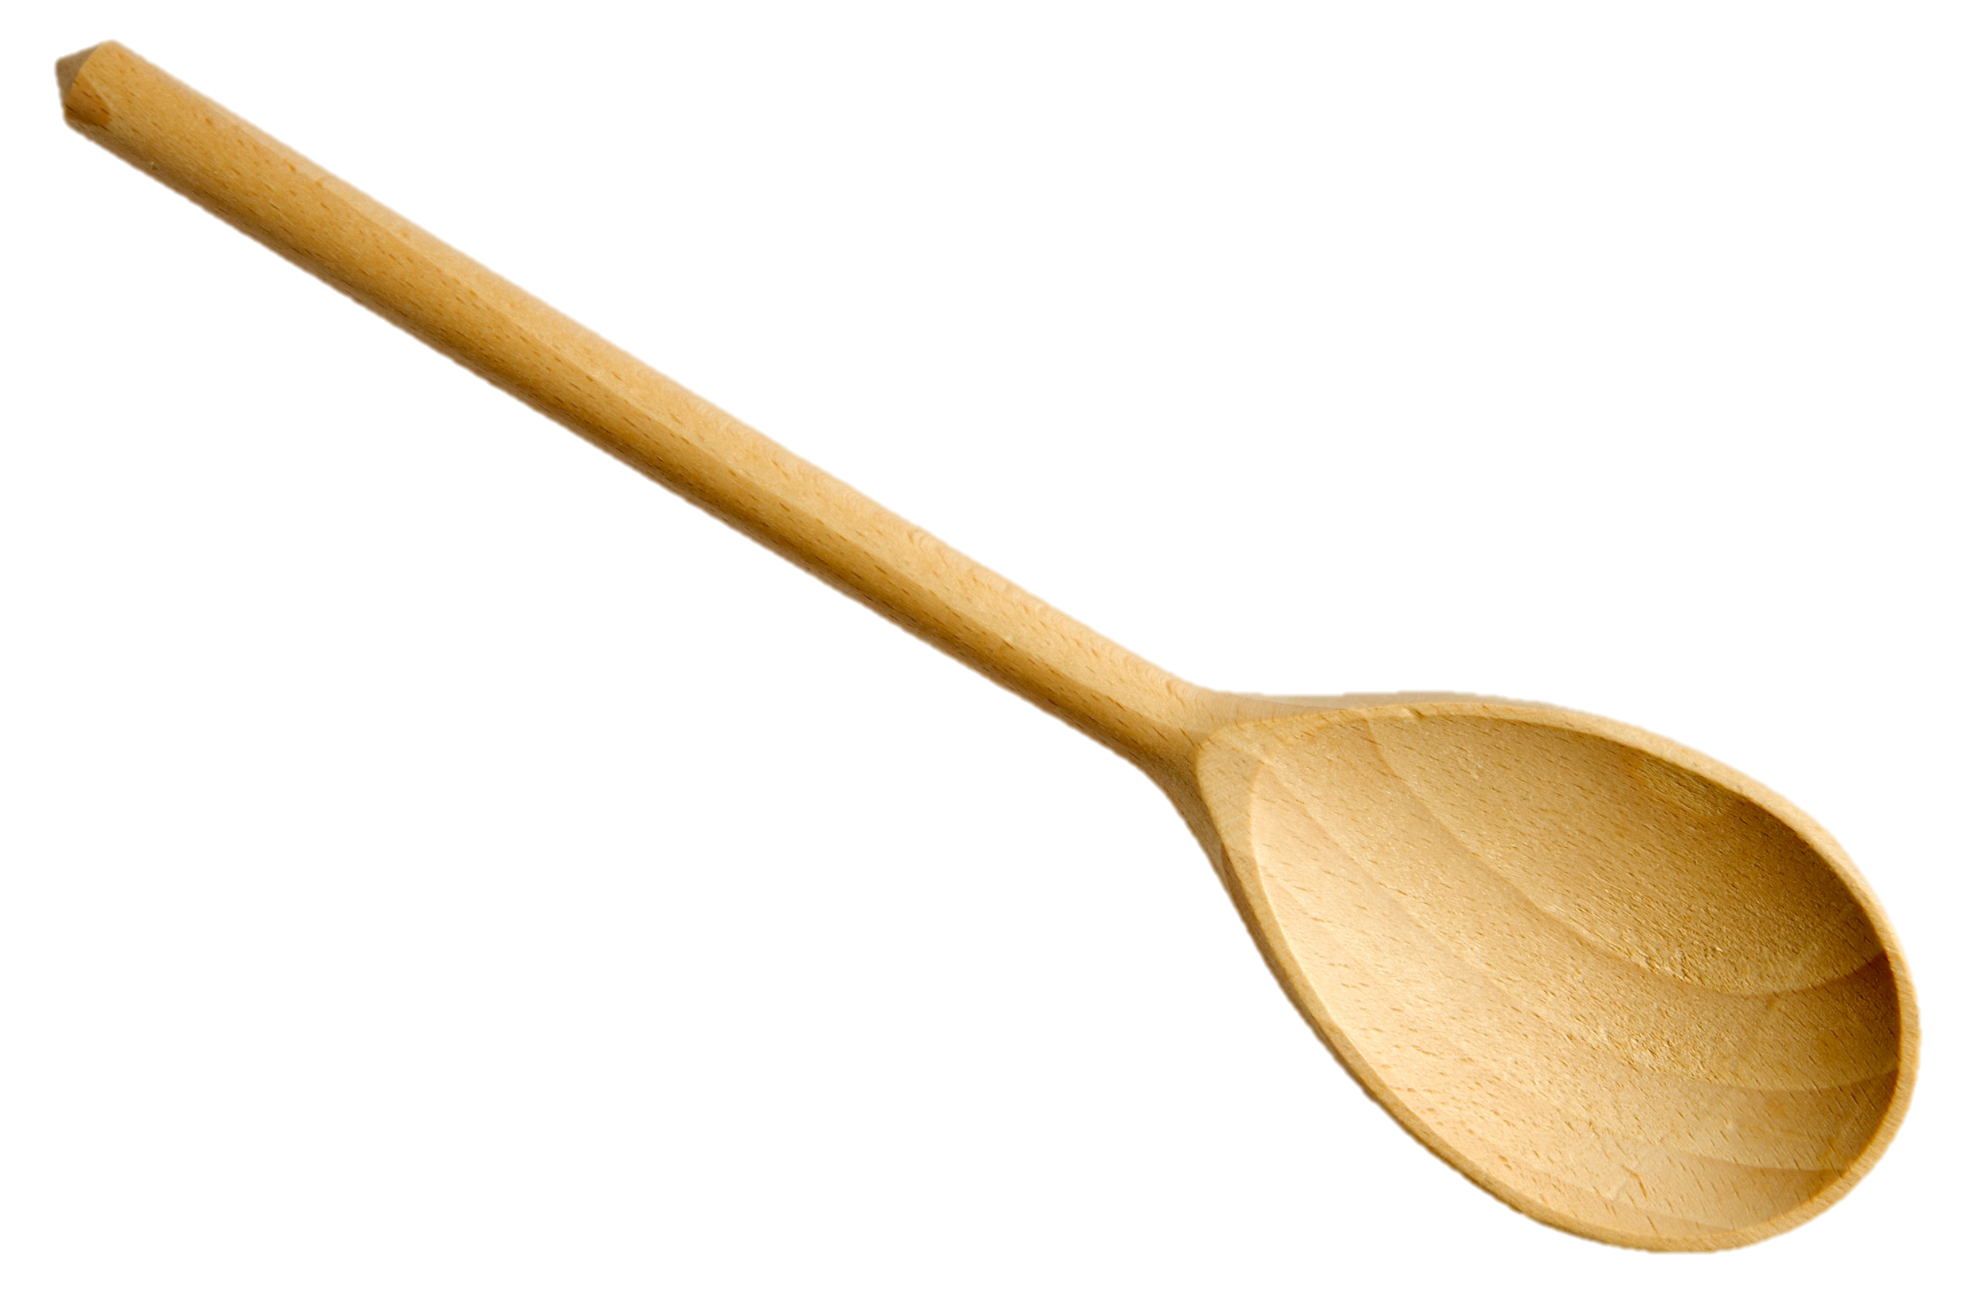
Mixture: Two or more substances are
combined physically, not chemically
Notes:
Remember that a mixture is when two or more substances are combined physically, not chemically.

Slide 12
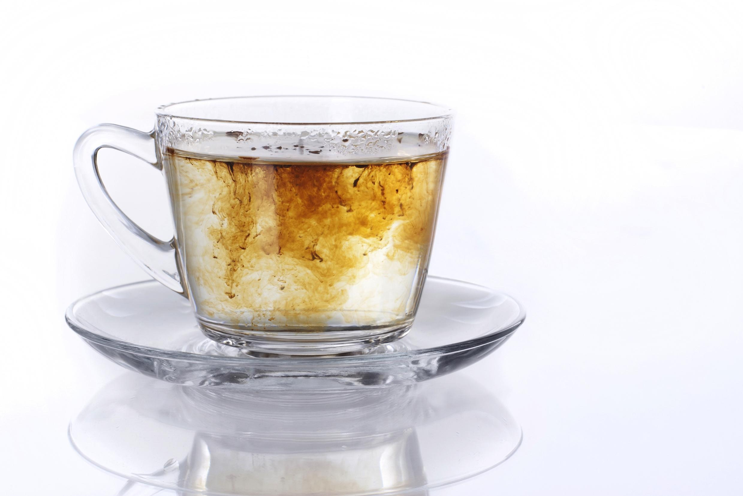
Solution: specific type of mixture where one substance dissolves into another.
Notes:
Also remember that a solution is a specific type of mixture where one substance dissolves into another.

Slide 13
Notes:
Now let’s pause for a moment to check your understanding.
Feedback: Monitoring understanding during review is an important step before moving on to new material.

Slide 14
How is a mixture formed?
Notes:
How is a mixture formed?
[Remember that a mixture is when two or more substances are combined physically, not chemically.]

Slide 15
What must happen to create a solution?
Notes:
What must happen to create a solution?
[In a mixture, one substance must dissolve into another for a solution to form.]

Slide 16
True/False: A solution is a type of mixture.
Notes:
True

Slide 17
True/False: A solution is a type of mixture.
Notes:
True

Slide 18
Solute
Notes:
Now that we’ve reviewed, let’s define our new term, solute.

Slide 19
Solute: substance that is dissolved in a solution
Notes:
A solute is a substance that is dissolved in a solution. The solute is added into a mixture and is what you can see dissolve.
Feedback: Longer more formal definitions are tricky, use clear language when providing the new definition.

Slide 20
Notes:
Now let’s pause for a moment to check your understanding.

Slide 21
What is a solute?
Notes:
What is a solute?
[A solute is a substance that is dissolved in a solution. The solute is added into a mixture and is what you can see dissolve.]

Slide 22
What is the relationship between a solute and a solution?
Notes:
What is the relationship between a solute and a solution?
[A solution is a specific type of mixture when one substance dissolves into another. The substance that is dissolved in a solution is called a solute.]

Slide 23
Notes:
Now, let’s look at examples of solutes.
Feedback: Use a clear and explicit explanation that takes the guesswork out of it for students. Using explicit descriptions makes it easier for students to grasp the content.

Slide 24
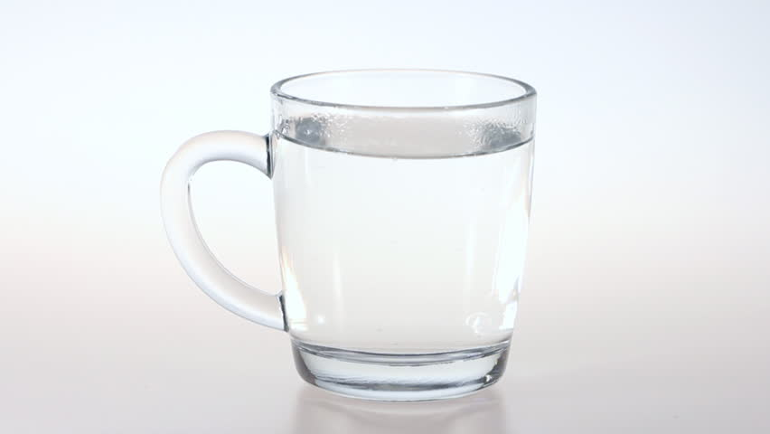
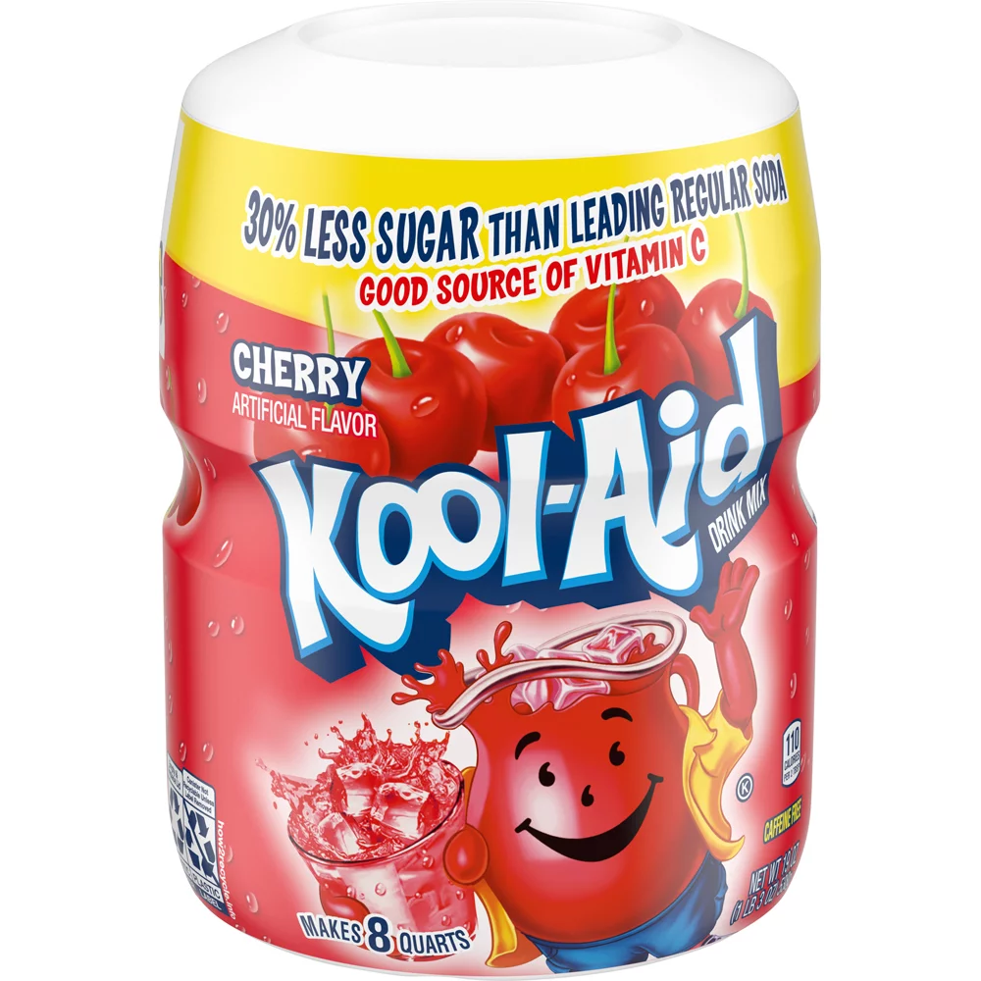
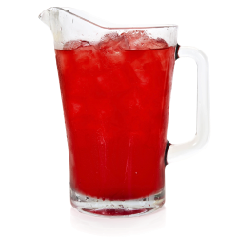
=
Solute
Dissolves
Solution
Notes:
Kool-Aid powder is an example of a solute because it dissolves in water to create a solution.

Slide 25
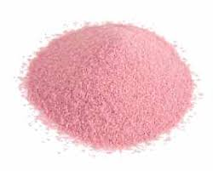
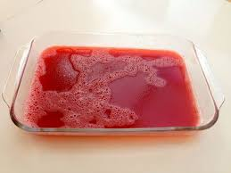
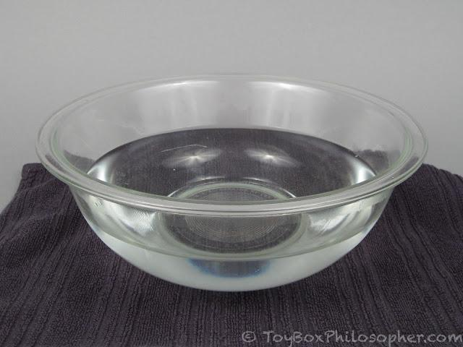
=
Solute
Dissolves
Solution
Notes:
Jell-o powder is another example of a solute. It dissolves in water to form the Jell-o solution that you put in the fridge to eat later.

Slide 26
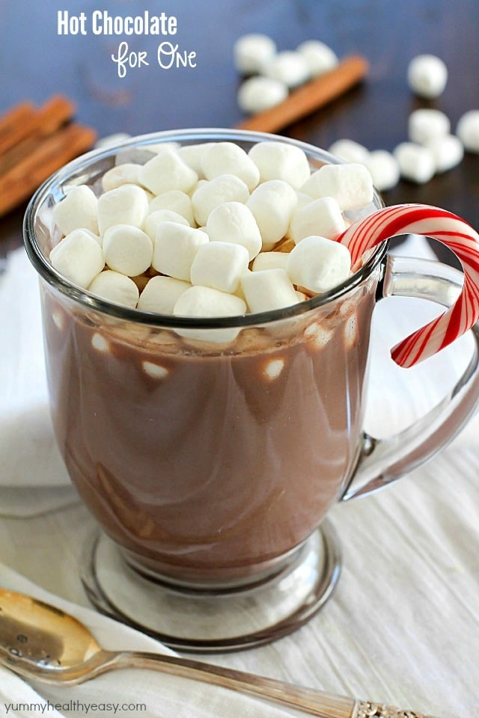
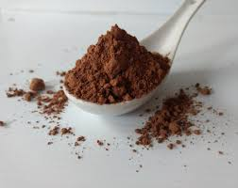
=
Solute
Dissolves
Solution
Notes:
You are even using a solute when making hot chocolate. Cocoa powder (or the hot cocoa mix) is the solute because it is dissolved into hot water (or milk) to make the solution (hot chocolate).

Slide 27
Notes:
Now let’s pause for a moment to check your understanding.

Slide 28
What is a solute?
Notes:
A solute is a substance that is dissolved in a solution. The solute is added into a mixture and is what you can see dissolve.

Slide 29
Label the solute.
=
?
?
?
Notes:
Label the solute.
[Kool-Aid powder is the solute.]

Slide 30
Label the solute.
Solute
=
?
?
Notes:
Label the solute.
[Kool-Aid powder is the solute.]

Slide 31
Why is the Kool-Aid powder the solute?
=
?
?
?
Notes:
Why is the Kool-AId powder the solute?
[It is the solute because it is the substance that is dissolved to form the solution.]

Slide 32
Give an example of a solute and explain why it is a solute.
Notes:
Give an example of a solute and explain why it is a solute.

Slide 33
Notes:
Next, let’s talk about non-examples of solutes.
Feedback: One important component of using non-examples is by clearly distinguishing similarities and explaining why it is a non-example.

Slide 34
Notes:
Kool-Aid that has been made is NOT an example of a solute. The Kool-Aid powder that is used to help create the solution (Kool-Aid liquid) is the solute because it is the substance that has been dissolved.

Slide 35
Notes:
Coffee is also not an example of a solute. This is also a solution. Coffee beans are ground up and dissolved in hot water, so coffee grounds would be a solute, but coffee itself is an example of a solution.

Slide 36
Notes:
Here, we have a Jell-O solution. It is not an example of a solute. This is the jell-o solution before going into the fridge. The jell-o powder is an example of a solute because it is dissolved to create the solution you see here.

Slide 37
Notes:
Now let’s pause for a moment to check your understanding.

Slide 38
Is coffee an example of a solute?
Notes:
Is coffee an example of a solute?
[No, it is a solution]

Slide 39
Why is this pitcher of Kool-Aid an example of a solute?
Notes:
Why is this pitcher of Kool-Aid an example of a solute?
[The Kool-Aid is a solution, the solute would be the Kool-Aid powder because the powder dissolves in water to create the solution.]

Slide 40
Notes:
Now let’s review everything we have learned about solutes.
Feedback: Take time throughout the close of the lesson to check for understanding one last time, this will help you know who may need more instruction or where further explanation is needed.

Slide 41
What is a solute?
Notes:
What is a solute?
[A solute is a substance that is dissolved in a solution. The solute is added into a mixture and is what you can see dissolve.]

Slide 42
What is the relationship between a solute and a solution?
Notes:
What is the relationship between a solute and a solution?
[A solution is a specific type of mixture when one substance dissolves into another. The substance that is dissolved in a solution is called a solute.]

Slide 43
Label the solute and solution. Explain your answer.
=
?
Dissolves
?
Notes:
Label the solute and solution. Explain your answer.
[Jell-O powder is another example of a solute. It dissolves in water to form the Jell-o solution that you put in the fridge to eat later.]

Slide 44
Label the solute and solution. Explain your answer.
=
Solute
Dissolves
Solution
Notes:
Label the solute and solution. Explain your answer.
[Jell-O powder is another example of a solute. It dissolves in water to form the Jell-o solution that you put in the fridge to eat later.]

Slide 45
Is coffee an example of a solute? Why or why not?
Notes:
Is coffee an example of a solute? Why or why not?
[No. Coffee is not an example of a solute. This is also a solution. Coffee beans are ground up and dissolved in hot water, so coffee grounds would be a solute, but coffee itself is an example of a solution.]

Slide 46
Give an example of a solute and explain how it forms a solution.
Notes:
Give an example of a solute and explain how it forms a solution.

Slide 47
Remember!!!
Notes:
So remember!
Feedback: Repeating important information is a great way to draw students' attention to key content.

Slide 48
Solute: substance that is dissolved in a solution
Notes:
A solute is a substance that is dissolved in a solution. The solute is added into a mixture and is what you can see dissolve.

Slide 49
Simulation Activity
Solutes
Click the link above to explore solutes that can be dissolved in water.
In this activity, there are different substances that could be solutes. Here they are being dissolved in water. Based on what you observe about the substances, predict if you think they are solutes (or soluble) in water. Then, click on each substance to check your answer.
Notes:
Click the link above to explore solutes that can be dissolved in water.
In this activity, there are different substances that could be solutes. Here they are being dissolved in water. Based on what you observe about the substances, predict if you think they are solutes (or soluble) in water. Then, click on each substance to check your answer.

Slide 50
Big Question: How do you use solutes and solvents? Why are they important?
Notes:
Our “big question” is: How do you use solutes and solvents? Why are they important?
Explicit cue to revisit the big question at the end of the lesson: Okay everyone. Now that we’ve learned the term, solute let’s reflect once more on our big question. Was there anything that we predicted earlier that was correct or incorrect? Do you have any new hypotheses to share?

Slide 51
Notes:
Thanks for watching, and please continue watching CAPs available from this website.

Slide 52
This Video Was Created With Resources From:
Questions or Comments
Michael Kennedy, Ph.D. MKennedy@Virginia.edu
Rachel L Kunemund, Ph.D. rk8vm@virginia.edu

Slide 53
Intro
“Big Idea” Question
Review Concepts
Check-In Questions
Teacher Demo
Vocabulary
Student-Friendly Definition
Examples & Non-Examples
Morphological Word Parts
Simulation/Activity
Notes:
OK everyone, get ready for our next lesson. Just as a reminder, these are the different components that our lesson may include, and you’ll see these icons in the top left corner of each slide so that you can follow along more easily!

Slide 54
Solvent
Intro
Notes:
Today we will be learning about solvents.

Slide 55
Big Question: How do you use solutes and solvents? Why are they important?
Notes:
Our “big question” is: How do you use solutes and solvents? Why are they important?
[Pause and illicit predictions from students.]
I love all these thoughtful scientific hypotheses! Be sure to keep this question and your predictions in mind as we move through these next few lessons, and we’ll continue to revisit it.

Slide 56
Demonstration
Solubility Science
TEACHER DIRECTIONS:
Before viewing, ask students to recall what they already know about solutes. Tell students they will be looking at the same demonstration that was done to show solutes, but this time they will be looking at solvents.
After viewing: Ask students what they observed about the experiment (What is the solute? What do you think the solvent is? How is the solution made?)
*This experiment can be done without focusing on solubility by only demonstrating how different substances (solutes) can dissolve to form a solution. This demonstration can be done either in-person or virtually. Make sure to change the solute so students can observe how substances dissolve differently in different solutes.
Notes:
Let’s do a quick demonstration that will help get our brains ready to think about solvents and how they relate to our big question.

Slide 57
Notes:
Now let’s pause for a moment to check your understanding.

Slide 58
Are the substances solutes or solvents? Explain your answer.
Notes:
Are the substances solutes or solvents?
[Solutes because they are being dissolved.]

Slide 59
Water is the solvent. Based on the experiment, what you predict a solvent might be?
Notes:
Water is the solvent. Based on the experiment, what do you predict a solvent might be?
*Pause and wait for student responses. Discuss student’s answers.

Slide 60
Based on your observations, which substance(s) dissolved the quickest? What happened when we changed the solute?
Notes:
Based on your observations, which substance(s) dissolved the quickest? What happened when we changed the solute?
[When different substances were used for the solute substances dissolved differently than they did when mixed in water.]

Slide 61
Notes:
Before we move on to our new vocabulary term, let’s review some other words & concepts that you already learned and make sure you are firm in your understanding.

Slide 62
Mixture: Two or more substances are
combined physically, not chemically
Notes:
Remember that a mixture is when two or more substances are combined physically, not chemically.

Slide 63
Solution: specific type of mixture where one substance dissolves into another.
Notes:
Also remember that a solution is a specific type of mixture where one substance dissolves into another.

Slide 64
Solute: substance that is dissolved in a solution
Notes:
A solute is a substance that is dissolved in a solution. The solute is added into a mixture and is what you can see dissolve.

Slide 65
Notes:
Now let’s pause for a moment to check your understanding.

Slide 66
How is a mixture formed?
Notes:
How is a mixture formed?
[A mixture is formed when two or more substances are combined physically, not chemically.]

Slide 67
What must happen to create a solution?
Notes:
What must happen to create a solution?
[In a mixture, one substance must dissolve into another for a solution to form.]

Slide 68
True/False: a solution is a type of mixture
Notes:
True

Slide 69
True/False: a solution is a type of mixture
Notes:
True

Slide 70
Label the solute and solution. Explain your answer.
=
?
Dissolves
?
Notes:
Label the solute and solution. Explain your answer.
[Jell-O powder is another example of a solute. It dissolves in water to form the Jell-o solution that you put in the fridge to eat later.]

Slide 71
Label the solute and solution. Explain your answer.
=
Solute
Dissolves
Solution
Notes:
Label the solute and solution. Explain your answer.
[Jell-O powder is another example of a solute. It dissolves in water to form the Jell-o solution that you put in the fridge to eat later.]

Slide 72
Solvent
Notes:
Now that we’ve reviewed, let’s define our new term, solvent.

Slide 73
Solvent: the substance into which a solute is dissolved
Notes:
A solvent is the substance into which a solute is dissolved.

Slide 74
Notes:
That is the basic definition, but there is a bit more you need to know.

Slide 75
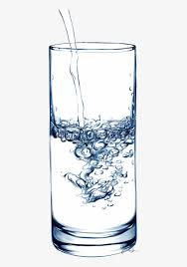
solvent
Notes:
Usually, the solvent is a liquid, and most often it’s water. But gasses and some solids can also be solvents.

Slide 76
Water = Universal Solvent
solvent
Notes:
Water is the universal solvent because it can dissolve more substances than any other liquid. In the examples we used with the tea, Jell-O, and even hot chocolate to show solutes, water was used as the solvent.

Slide 77
Notes:
Now let’s pause for a moment to check your understanding.

Slide 78
What is a solvent?
Notes:
What is a solvent?
[A solvent is the substance into which a solute is dissolved.]

Slide 79
True/False: only liquids can be solvents
solvent
Notes:
False: Usually, the solvent is a liquid, and most often it’s water. But gasses and some solids can also be solvents.

Slide 80
True/False: only liquids can be solvents
solvent
Notes:
False: Usually, the solvent is a liquid, and most often it’s water. But gasses and some solids can also be solvents.

Slide 81
What is the universal solvent?
Notes:
What is the universal solvent?
[Water is the universal solvent because it can dissolve more substances than any other liquid. In the examples we used with the tea, Jell-o, and even hot chocolate to show solutes, water was used as the solvent.]

Slide 82
Notes:
Now, let’s look at some examples of solvents. We will be looking back at the examples we used for solutes.

Slide 83
=
Solute
Solvent
Solution
Notes:
Here, the water is the solvent. The solute (Kool-Aid powder) is dissolved into the water (solvent) to form the solution (Kool-Aid). The water is the solvent because it is the substance that a solute is dissolved in.

Slide 84
=
Solute
Solvent
Solution
Notes:
When making Jell-O, water is the solvent. The jell-o powder (solute) is dissolved into the water (solvent) to make Jell-o (solution). The water is the solvent because it is the substance that the solute is dissolved in.

Slide 85
=
Solute
Solvent
Solution
Notes:
Making hot chocolate we also see solutes, solvents, and solutions. The cocoa powder is the solute, here milk or water could be the solvent depending on what you prefer and they both cause the cocoa powder to dissolve. The solution is the hot chocolate.

Slide 86
Notes:
Now let’s pause for a moment to check your understanding.

Slide 87
What is a solvent?
Notes:
What is a solvent?
[A solvent is the substance into which a solute is dissolved.]

Slide 88
In this example, why is water the solvent?
=
Solute
Solvent
Solution
Notes:
In this example, why is water the solvent?
[Here, the water is the solvent. The solute (Kool-Aid powder) is dissolved into the water (solvent) to form the solution (Kool-Aid). The water is the solvent because it is the substance that a solute is dissolved in.]

Slide 89
Explain how you use a solute, solvent, and solution when making hot chocolate.
=
?
?
?
Notes:
Explain how you use a solute, solvent, and solution when making hot chocolate.
[You mix the hot cocoa (solute) into the water (solvent). The solute (hot cocoa) dissolves in the solvent (water) to make the solution (hot chocolate).]

Slide 90
Notes:
Next, let’s talk about some non-examples of solvents.

Slide 91
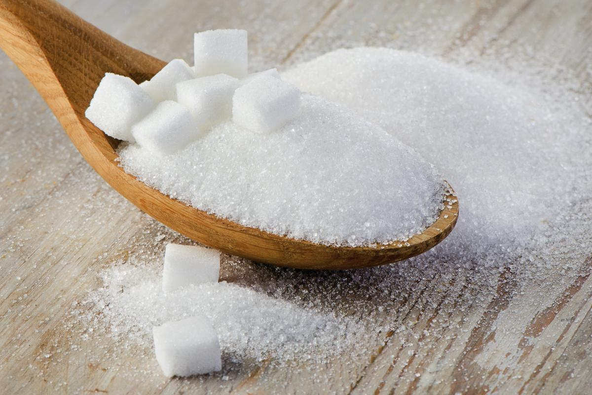
Notes:
Sugar is not a solvent. Nothing can be dissolved in sugar. Sugar is a solute, however, because it can be dissolved in a solvent, like when you add sugar to tea or coffee.

Slide 92
Notes:
After mixing Kool-Aid powder and water together, you get Kool-Aid. This pitcher of Kool-Aid is not a solvent, it is a solution. It is a solution because it was created by a solute (Kool-Aid powder) being dissolved into a solvent (water).

Slide 93
Notes:
After mixing cocoa powder and milk (or water) together, you get a cup of tea. This cup of hot chocolate is not a solvent, it is a solution. It is a solution because it was created by a solute (cocoa powder) being dissolved into a solvent (milk or water).

Slide 94
Notes:
Now let’s pause for a moment to check your understanding.

Slide 95
Is cocoa powder a solvent?
Notes:
Is cocoa powder a solvent?
[No it is a solute.]

Slide 96
Why is the pitcher of Kool-Aid not a solvent?
Notes:
Why is the pitcher of Kool-Aid not a solvent?
[It is not a solvent because it is a solution. It is a solution because it has been created after a solute has been dissolved into a solvent.]

Slide 97
Is sugar a solute, solvent, or solution? Explain.
Notes:
Is sugar a solute, solvent, or solution? Explain.
[Sugar is a solute because it can be dissolved in a solvent, like when you add sugar to tea or coffee.]

Slide 98
Notes:
Now let’s pause for a moment to check your understanding.

Slide 99
What is a solvent?
Notes:
What is a solvent?
[A solvent is the substance into which a solute is dissolved.]

Slide 100
True/False: only liquids can be solvents
solvent
Notes:
False: Usually, the solvent is a liquid, and most often it’s water. But gasses and some solids can also be solvents.

Slide 101
True/False: only liquids can be solvents
solvent
Notes:
False: Usually, the solvent is a liquid, and most often it’s water. But gasses and some solids can also be solvents.

Slide 102
Why is water the universal solvent?
Notes:
Why is water the universal solvent?
[Water is the universal solvent because it can dissolve more substances than any other liquid. In the examples we used with the tea, Jell-o, and even hot chocolate to show solutes, water was used as the solvent.]

Slide 103
Which one is an example of using a solute?
Salt on french fries
Ice on the sidewalk
Paint on a canvas
Sugar in iced tea
Notes:
Which one is an example of using a solute?

Slide 104
Which one is an example of using a solute?
Salt on french fries
Ice on the sidewalk
Paint on a canvas
Sugar in iced tea
Notes:
Which one is an example of using a solute?
[Sugar in iced tea]

Slide 105
Label the solute, solvent, and solution. Explain your answer.
=
?
?
?
Notes:
Label the solute, solvent, and solution. Explain your answer.
[When making Jell-O, water is the solvent. The Jell-O powder (solute) is dissolved into the water (solvent) to make Jell-o (solution). The water is the solvent because it is the substance that the solute is dissolved in.]

Slide 106
Label the solute, solvent, and solution. Explain your answer.
=
Solute
Solvent
Solution
Notes:
Label the solute, solvent, and solution. Explain your answer.
[When making Jell-O, water is the solvent. The Jell-O powder (solute) is dissolved into the water (solvent) to make Jell-o (solution). The water is the solvent because it is the substance that the solute is dissolved in.]

Slide 107
Remember!!!
Notes:
So remember!

Slide 108
Solvent: the substance into which a solute is dissolved
Notes:
A solvent is the substance into which a solute is dissolved.

Slide 109
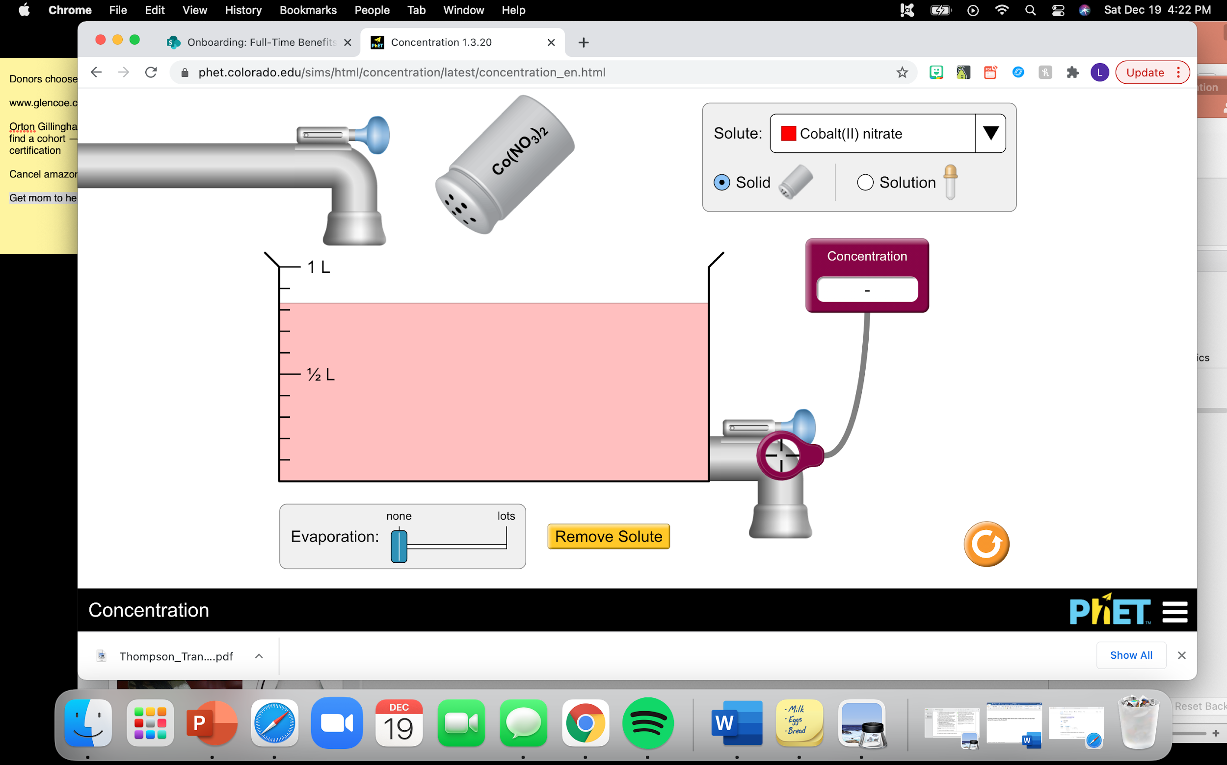
Simulation Activity
Concentration
(Phet Simulation)
Click the link above to practices using solutes and solvents to create solutions.
In this simulation, you will be adding different substances (solutes) into water (solvent). What do you observe about the different solutes? Do they all dissolve easily? Can some not dissolve in water? What is the solution?
Notes:
Click the link above to practices using solutes and solvents to create solutions.
In this simulation, you will be adding different substances (solutes) into water (solvent). What do you observe about the different solutes? Do they all dissolve easily? Can some not dissolve in water? What is the solution?

Slide 110
Big Question: How do you use solutes and solvents? Why are they important?
Notes:
Our “big question” is: How do you use solutes and solvents? Why are they important?
Based on what we learned about solvents, how did our hypotheses change/how can we add to them? How does this help us answer our big question?

Slide 111
Notes:
Thanks for watching, and please continue watching CAPs available from this website.

Slide 112
This Video Was Created With Resources From:
Questions or Comments
Michael Kennedy, Ph.D. MKennedy@Virginia.edu
Rachel L Kunemund, Ph.D. rk8vm@virginia.edu

