Slide 1
Intro
“Big Idea” Question
Review Concepts
Check-In Questions
Teacher Engagement
Vocabulary
Student-Friendly Definition
Examples & Non-Examples
Morphological Word Parts
Frayer Model
Simulation/Activity
Notes:
OK everyone, get ready for our next lesson. Just as a reminder, these are the different components that our lesson may include, and you’ll see these icons in the top left corner of each slide so that you can follow along more easily!

Slide 2
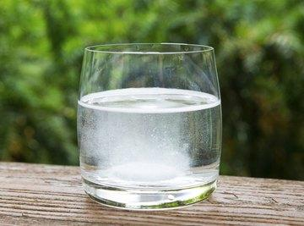
Solution
Intro
Notes:
Today, we’ll be learning about the word: Solution.

Slide 3
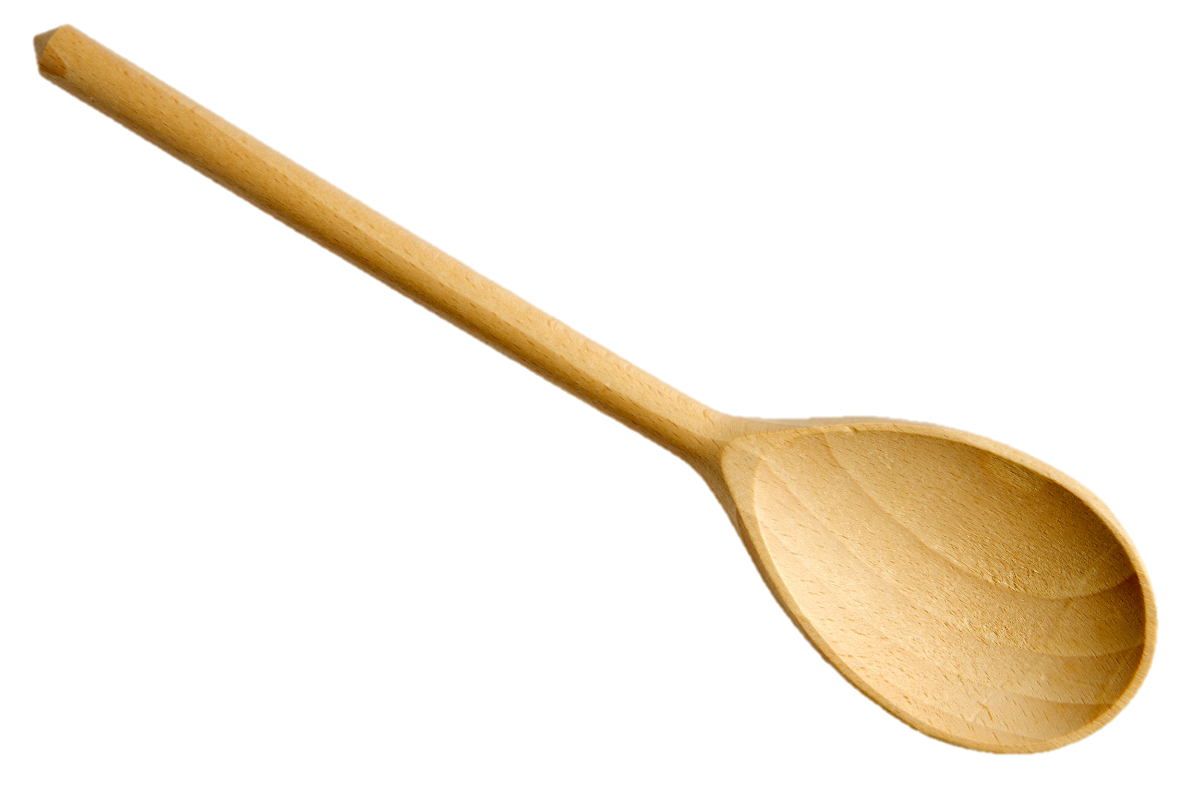
Big Question: How can two or more substances be combined?
Notes:
Our “big question” is: How can two or more substances be combined?
[Pause and illicit predictions from students.]
I love all these thoughtful scientific hypotheses! Be sure to keep this question and your predictions in mind as we move through these next few lessons, and we’ll continue to revisit it.

Slide 4
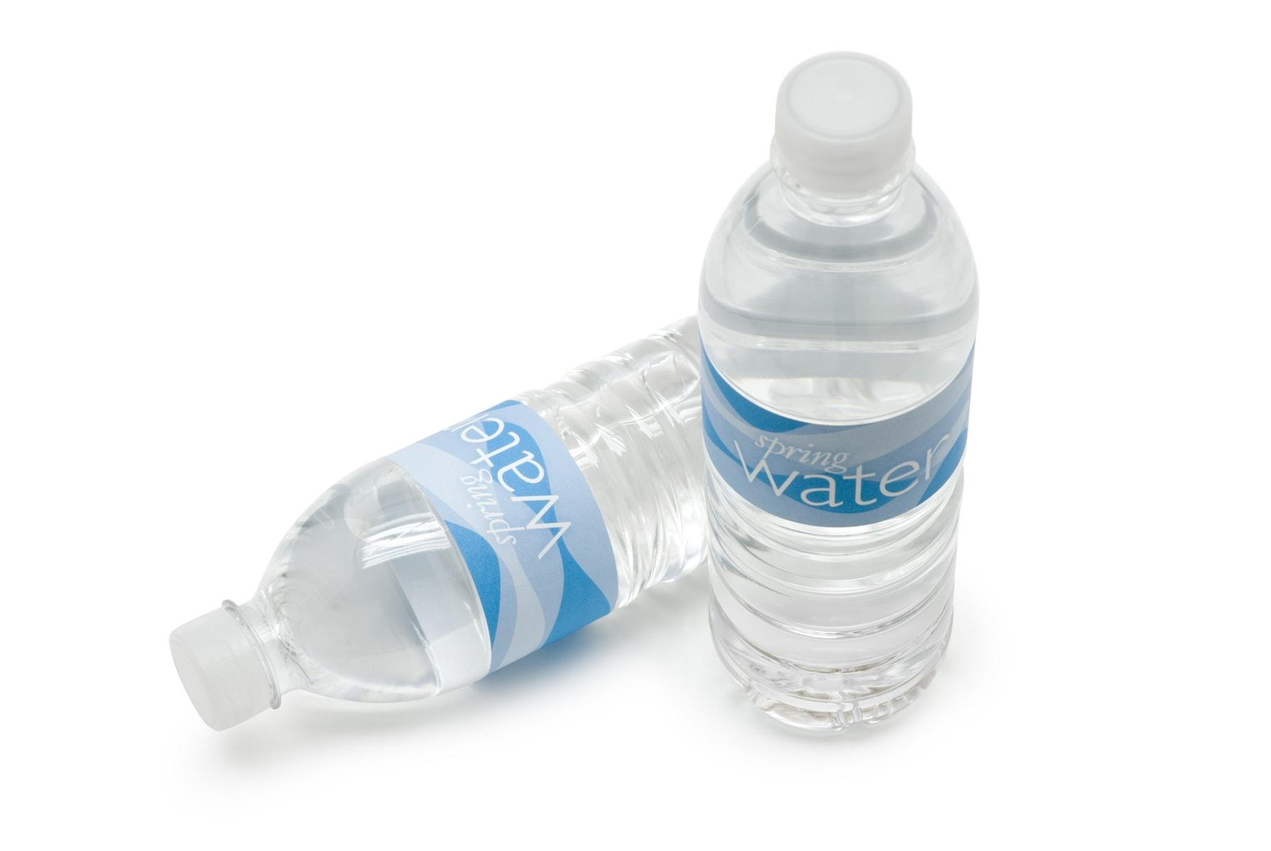
Demonstration
Materials Needed:
One drink mix packet per student, one 8oz (or more, depending on drink mix) water bottle per student
Procedure:
Have each student mix their drink packet into their water bottle according to package directions.
Group Questions:
What happened to the powder when you mixed it into the water?
Do you think you could easily separate the powder from the water now that they are mixed? Why or why not?
Notes:
Before we start learning about solutions, let’s do a demonstration.
On your tables, you each have a powder drink mix packet and a plastic water bottle. Listen to my directions on how to mix in the mix to the water. Watch me do it.
Now that we’ve mixed our drink packets into our water, let’s discuss the following questions -
What happened to the powder when you mixed it into the water?
Do you think you could easily separate the powder from the water now that they are mixed? Why or why not?

Slide 5
Notes:
Before we move on to our new topic, let’s review some other words & concepts that you already learned and make sure you are firm in your understanding.

Slide 6
Matter: has mass and takes up space
Notes:
Matter is anything that has mass and takes up space.

Slide 7
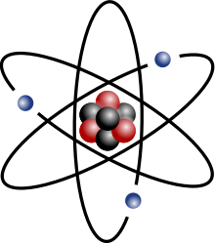
Atom: smallest whole unit of matter
Notes:
An atom is the smallest whole unit of matter. All matter is made up of atoms.

Slide 8
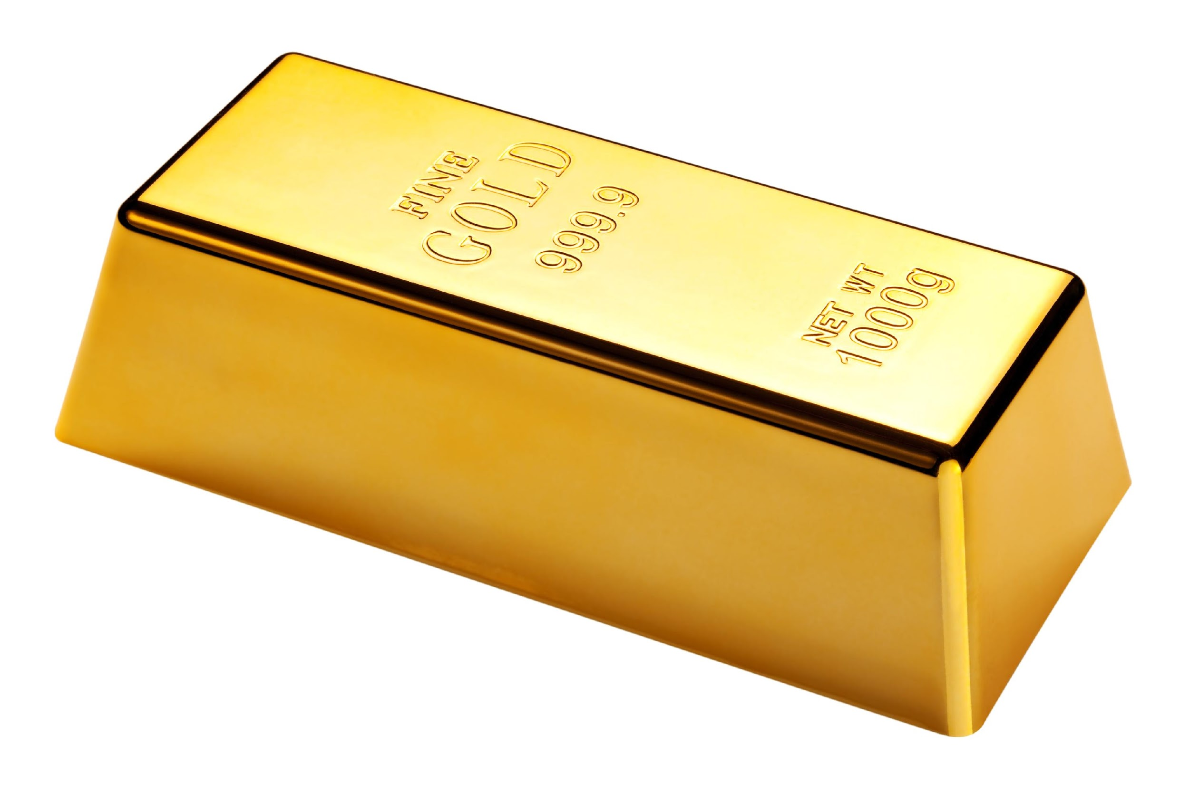
Element: a pure substance containing only one type of atom
Notes:
An element is a pure substance containing only one type of atom.

Slide 9
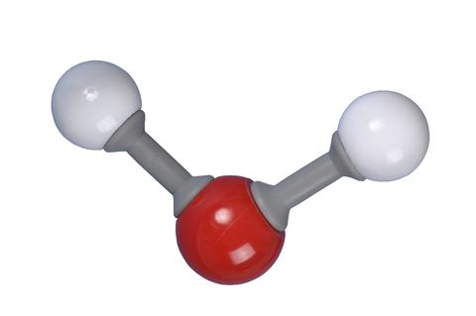
Molecule: particle containing two or more atoms of the same OR different elements
Notes:
A molecule is a particle containing 2 or more atoms of the same OR different elements. Molecules are the smallest pieces of compounds.

Slide 10
Compound: substance made up of two or more different elements
Notes:
A compound is a substance that is made up of two or more different elements.

Slide 11
Mixture: two or more substances are
combined physically, not chemically
Notes:
A mixture is when two or more substances are combined physically, not chemically.

Slide 12
In a mixture, substances are physically combined.
Notes:
In a mixture, substances are physically combined. Yet, you can still see the individual substances in the mixture. This means that if you needed to separate the substances after they were mixed together, you would be able to do that. In this picture, we see the light green and dark green circles combined into a mixture. In the mixture, we can see the individual circles and would be able to separate them if we needed to.

Slide 13
Notes:
Now let’s pause for a moment to review the information we have covered already.

Slide 14
A mixture is a blend of things _______ together that _____ their own properties.
Notes:
A mixture is a blend of different things _______ together that _____ their own properties.
[combined, keep]

Slide 15
A mixture is a blend of things combined together that keep their own properties.
Notes:
A mixture is a blend of different things combined together that keep their own properties.

Slide 16
In a mixture, substances are _______ combined…
Physically
Chemically
Notes:
In a mixture, substances are ______ combined…
Physically
Chemically

Slide 17
In a mixture, substances are _______ combined…
Physically
Chemically
Notes:
In a mixture, substances are physically combined.

Slide 18
Solution
Notes:
Now that we’ve reviewed, let’s define the phrase solution.

Slide 19
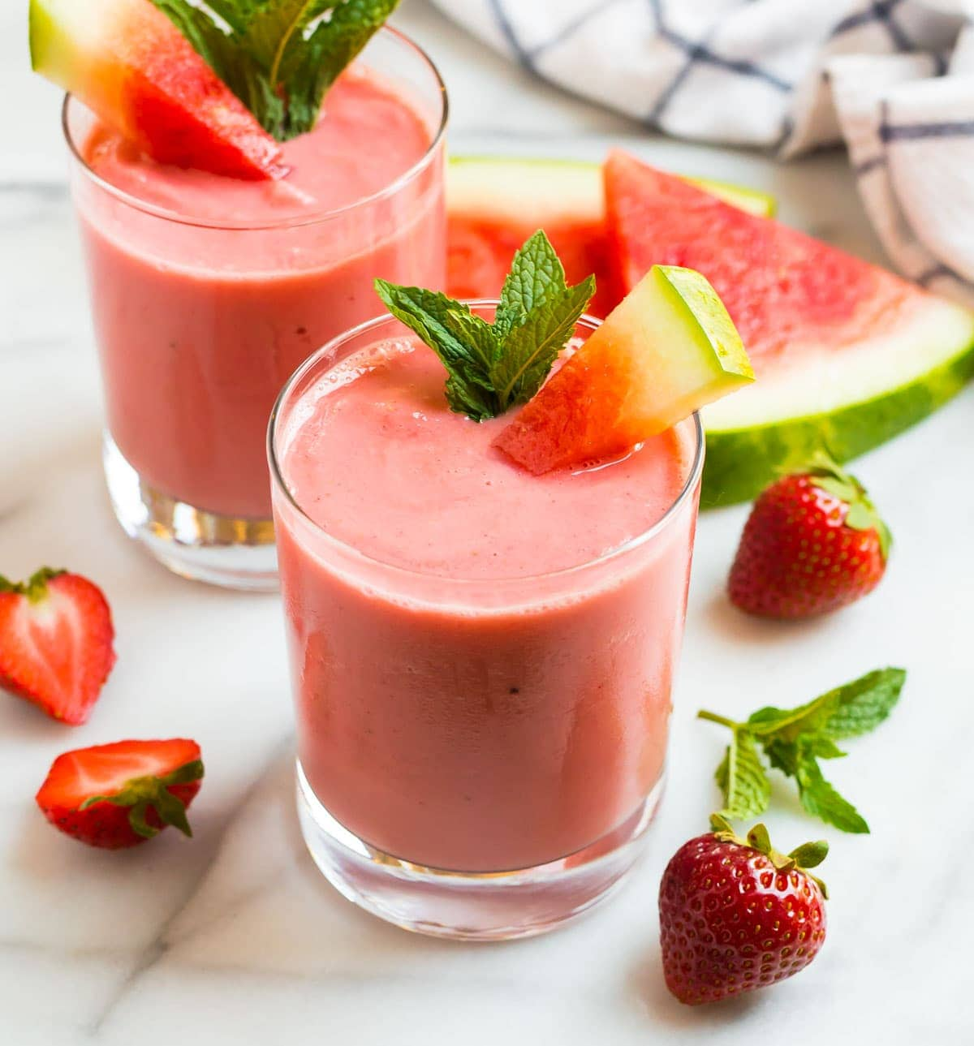
Solution: a mixture in which the components cannot be seen separately
Notes:
A solution is a mixture in which the components cannot be seen separately.

Slide 20
Notes:
Let’s check-in for understanding.

Slide 21
A solution is a _________ in which components _______ be seen separately.
Notes:
A solution is a _________ in which components __________ be seen separately.
[mixture, cannot]

Slide 22
A solution is a mixture in which components cannot be seen separately.
Notes:
A solution is a mixture in which components cannot be seen separately.

Slide 23
In this example below, the solution is a strawberry watermelon smoothie. Why can you not separate the components?
Notes:
In this example below, the solution is a strawberry watermelon smoothie. Why can you not separate the components?
[You can not separate the components, such as strawberries, watermelon, and ice, because they have all been blended or mixed together to create the smoothie.]

Slide 24
Notes:
That is the basic definition, but there is a bit more you need to know.

Slide 25
Mixture
Heterogenous
Mixture
Homogenous Mixture
(Solution)
Notes:
There are two types of mixtures: a heterogeneous mixture and a homogeneous mixture. We also call homogeneous mixtures solutions.

Slide 26
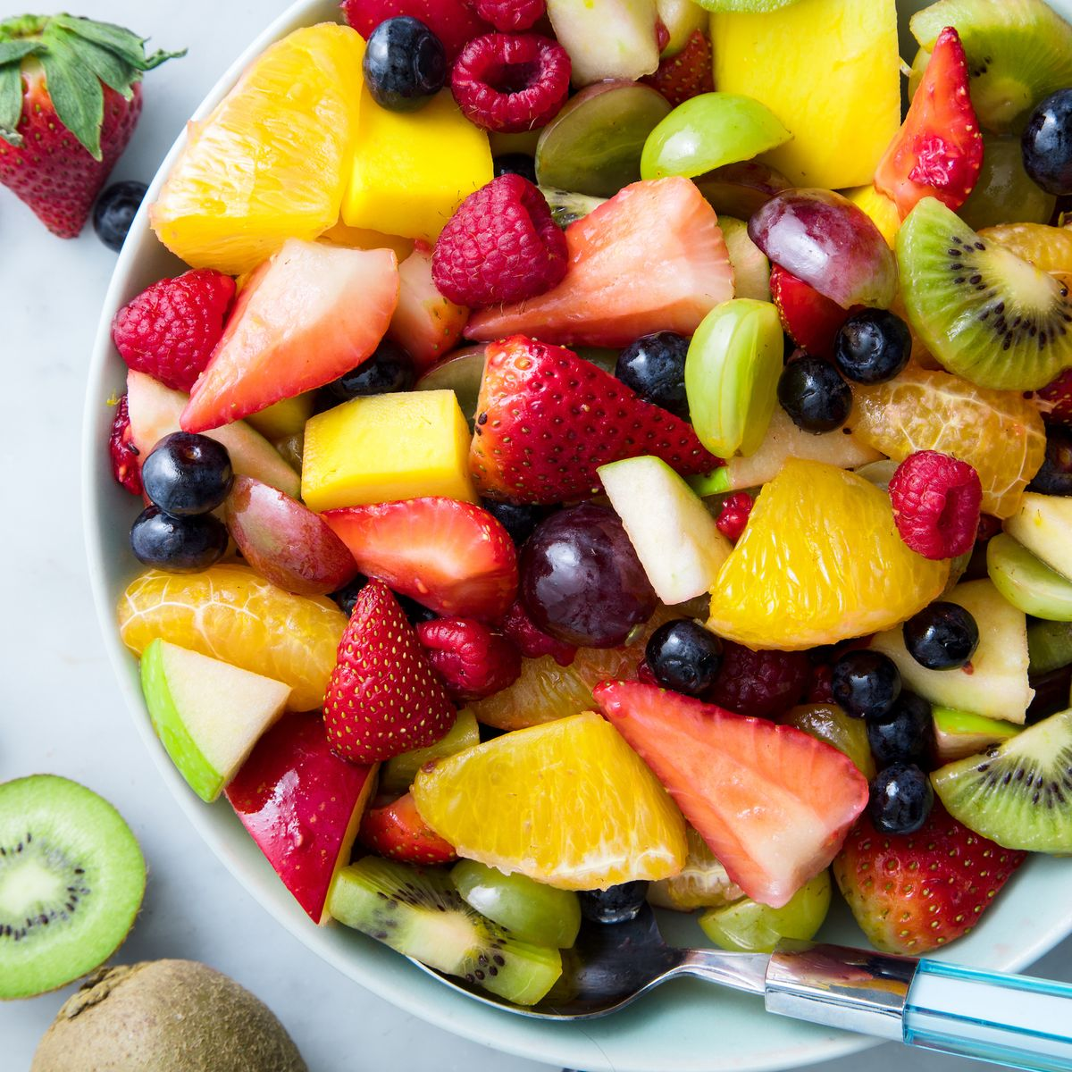
In a heterogeneous mixture, you can see and easily separate the different parts. These are not solutions.
Notes:
The second type of mixture is a Heterogeneous Mixture. In this type, you can see and easily separate the different parts, like a fruit salad with various fruits. These are not solutions.

Slide 27
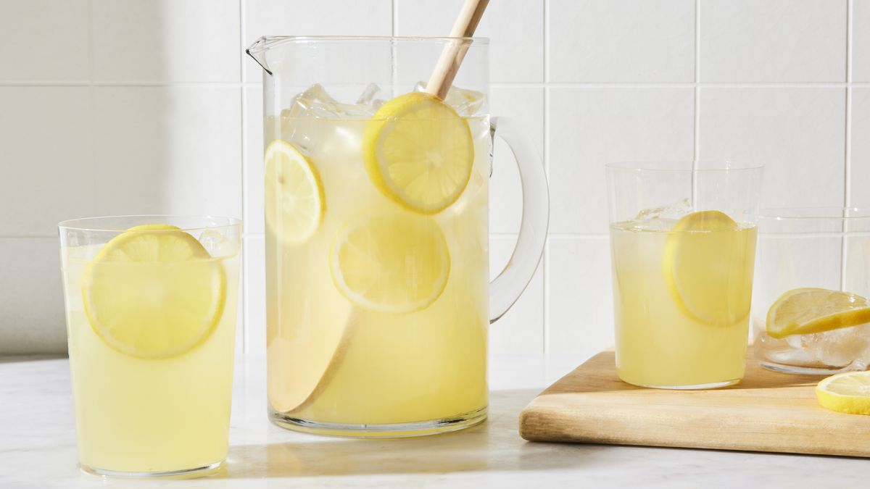
In a homogeneous mixture, you can’t see or separate the different parts. We also call these mixtures solutions.
Notes:
There are two main types of mixtures, the first is a Homogeneous Mixture. This is when everything is evenly mixed, like lemonade where you can't see or separate the sugar and lemon juice. We also call these mixtures solutions.

Slide 28
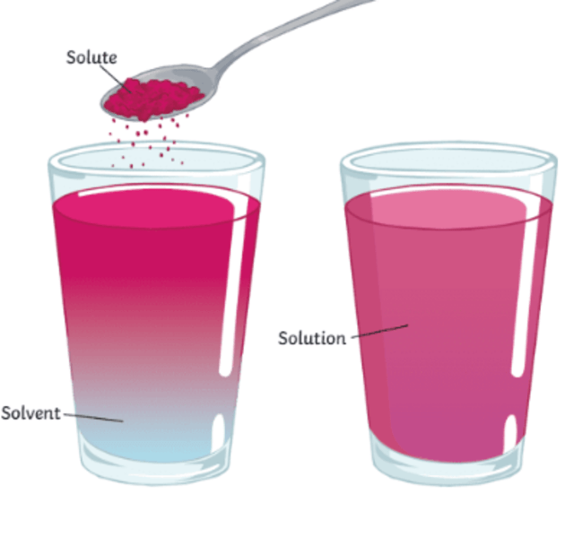
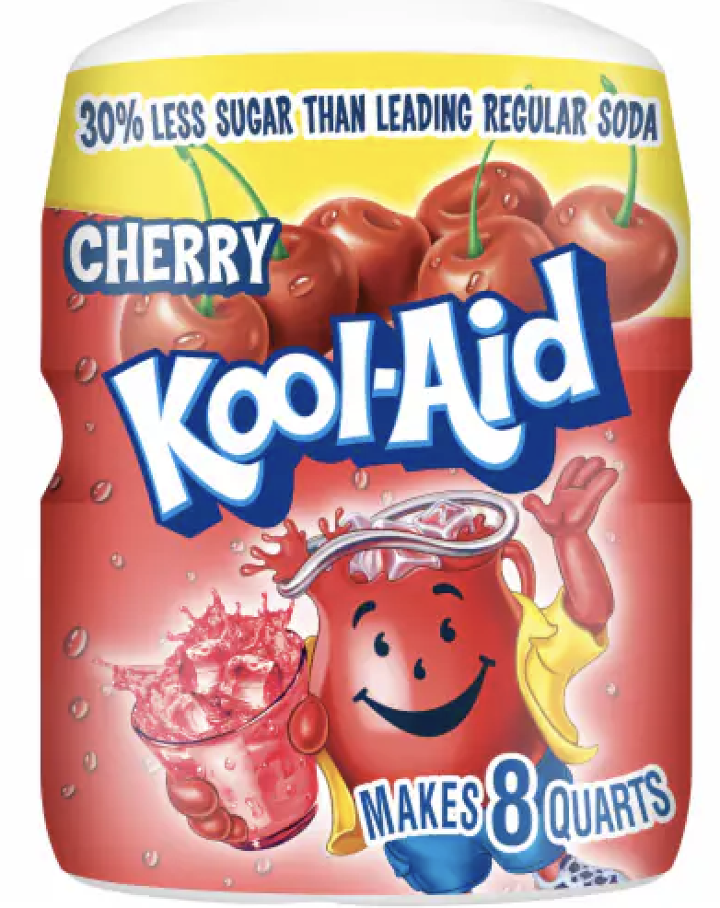
A solute is dissolved into a solvent to create some solutions.
Notes:
In some solutions, a substance known as a solute is dissolved into a liquid known as a solvent. The solute mixes into the solvent so that you cannot separate it. This is what creates a solution. In this picture, we see the solute of Koolaid powder being dissolved into the solvent of water to create a solution of Koolaid.

Slide 29
Notes:
Let’s check-in for understanding.

Slide 30
In a homogeneous mixture, you ____ see or separate the different parts. We also call these mixtures _________.
Notes:
In a homogeneous mixture, you ____ see or separate the different parts. We also call these mixtures _________.
[can’t, solutions]

Slide 31
In a homogeneous mixture, you can’t see or separate the different parts. We also call these mixtures solutions.
Notes:
[In a homogeneous mixture, you can]t see or separate the different parts. We also call these mixtures solutions.]

Slide 32
True or False: A solute is dissolved into a solvent to create some solutions.
True
False
Notes:
True or False: A solute is dissolved into a solvent to create some solutions.
True
False

Slide 33
True or False: A solute is dissolved into a solvent to create some solutions.
True
False
Notes:
True or False: A solute is dissolved into a solvent to create some solutions: True.

Slide 34
Notes:
Now, let’s talk about some examples of solutions.

Slide 35
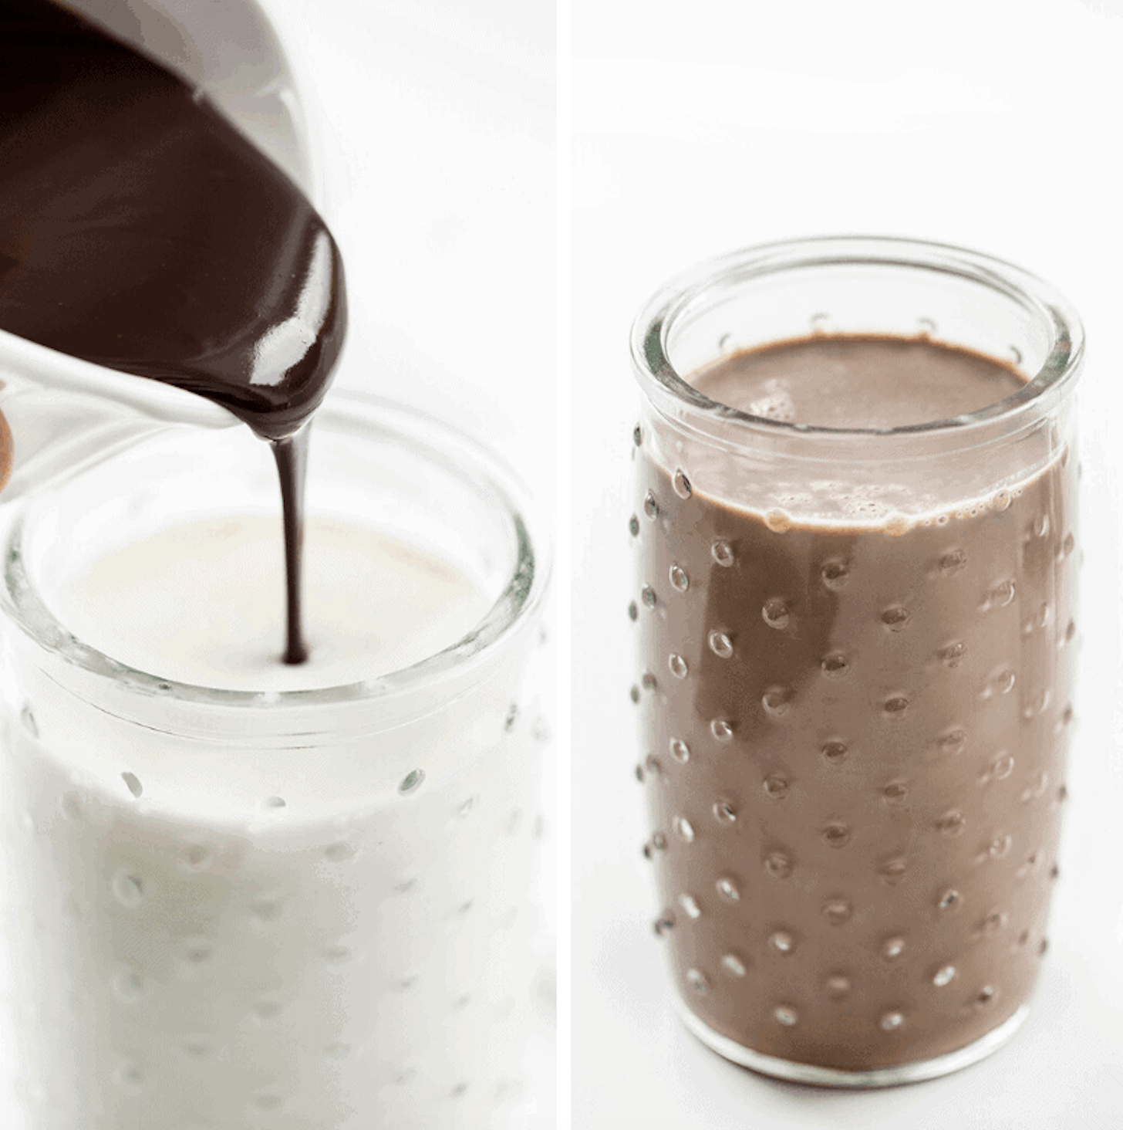
Notes:
An example of a solution is chocolate milk. When you mix chocolate syrup into plain milk, it creates chocolate milk. You cannot separate the chocolate syrup and milk once it is mixed together.

Slide 36
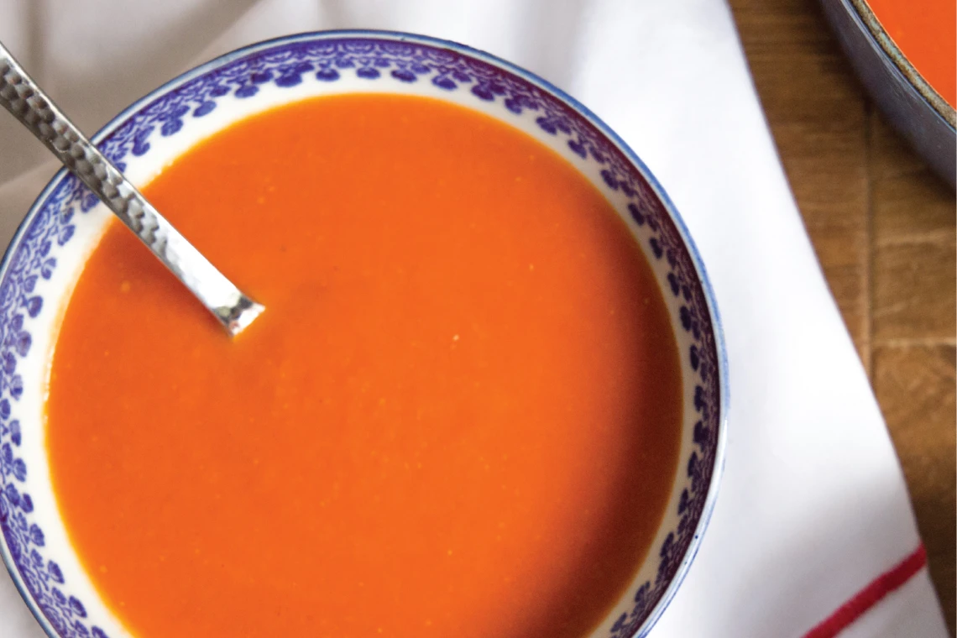
Notes:
Another example of a solution is tomato soup. You cannot easily separate the components of the soup, such as tomatoes, cream, and seasonings, once combined.

Slide 37
Notes:
Let’s check-in for understanding.

Slide 38
In a solution, you cannot easily ____ or ________ the components.
Notes:
In a solution, you cannot easily ____ or ________ the components.
[see, separate]

Slide 39
In a solution, you cannot easily see or separate the components.
Notes:
[In a solution, you cannot easily see or separate the components.]

Slide 40
Notes:
Now, let’s talk about some non-examples of constants.

Slide 41
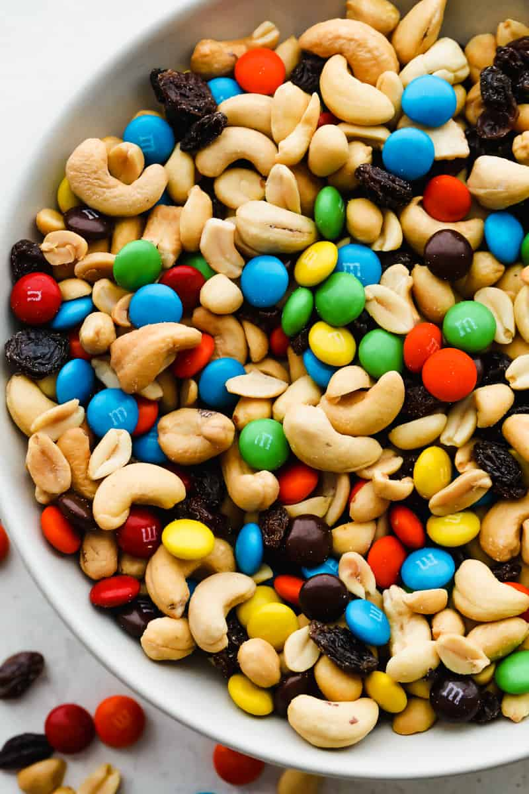
Notes:
Trail mix is an example of a heterogeneous mixture, not a solution. In trail mix, nuts, candies, dried fruits, and other ingredients are mixed together. You can separate the ingredients even after they are mixed together.

Slide 42
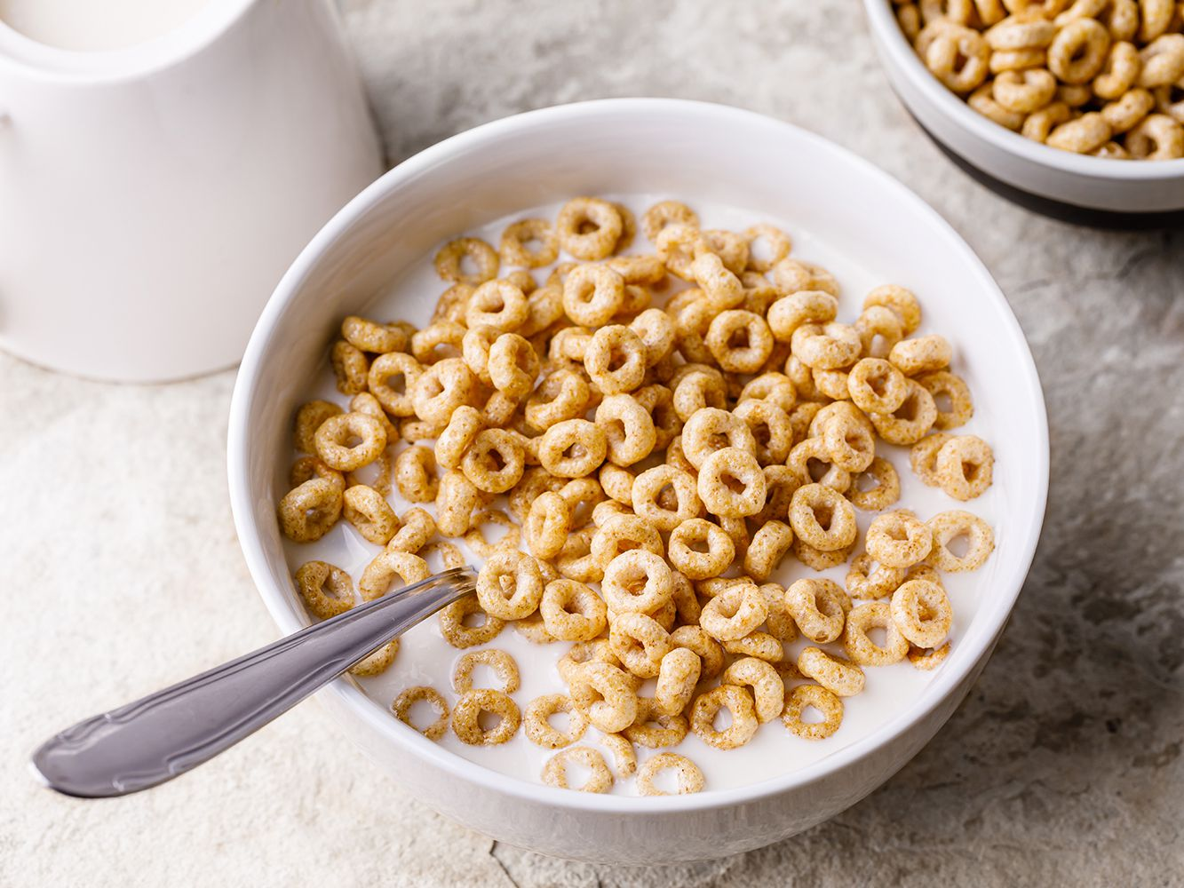
Notes:
Cereal and milk is an example of a heterogeneous mixture, not a solution. While the cereal may be soggy after being in the milk, you can still easily separate the cereal and milk from each other even after being mixed together.

Slide 43
Notes:
Now let’s pause for a moment to check your understanding.

Slide 44
How is a heterogeneous mixture different from a solution?
Notes:
How is a heterogeneous mixture different from a solution?
[A heterogeneous mixture, you can easily separate the parts, like in a trail mix you can easily separate the candies, nuts, etc. A solution, you cannot separate the parts/components, like in a smoothie you cannot easily separate the parts.]

Slide 45
Notes:
We can also break down the term constants into different word parts to help us remember the meaning. Let’s take a look!

Slide 46
Solution
(root)
(suffix)
Notes:
We can break up the term solution into two parts: root and suffix.

Slide 47
Solution
Solut = loosening or dissolving
Notes:
First, we have the root “solut” which means loosening or dissolving. In this word, it indicates that solutions are things that involve dissolving.

Slide 48
Solution
-ion = an action, process, or result
Notes:
-ion is the suffix. The “-ion” suffix means an action, process, or result. Now let’s put it all together.

Slide 49
Solut ion
Solution
A process by which something is dissolved.
Notes:
So when we put it all together, a solution means a process by which something is dissolved.

Slide 50
Notes:
Let’s check-in for understanding.

Slide 51
How can we use the word parts of solution to help us remember the definition of the term?
Solution
(root)
(suffix)
Notes:
How can we use the word parts of solution to help us remember the definition of the term?
[The root solut means loosening or dissolving.
-ion is the suffix meaning an action, process, or result.
So when we put it all together, solution means a process by which something is dissolved.]

Slide 52
Remember!!!
Notes:
So remember!

Slide 53
Solution: a mixture in which the components cannot be seen separately
Notes:
A solution is a mixture in which the components cannot be seen separately.

Slide 54
Notes:
We will now complete this concept map, called a Frayer model, to summarize and further clarify what you have learned about the term solution.

Slide 55
Definition
Picture
Solution
Example
How do solutions impact my life?
Notes:
To complete the Frayer model, we will choose from four choices the correct picture, definition, example, and response to the question, “How do solutions impact my life?” Select the best response for each question using the information you just learned. As we select responses, we will see how this model looks filled in for the term solution.

Slide 56
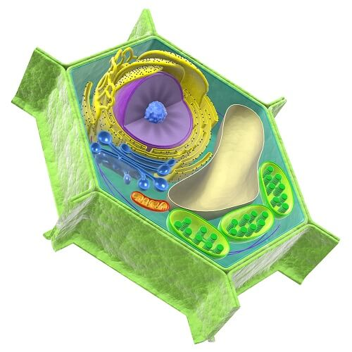
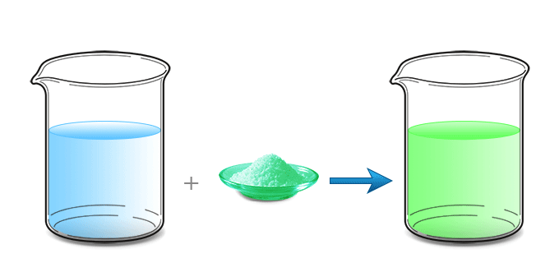
Directions: Choose the correct picture of a Solution from the choices below.
A
B
C
D
Notes:
Choose the one correct picture of solution from these four choices.

Slide 57
Directions: Choose the correct picture of a Solution from the choices below.
A
B
C
D
Notes:
This is the picture that shows a solution.

Slide 58
Definition
Picture
Solution
Example
How do solutions impact my life?
Notes:
Here is the Frayer model filled in with a picture of constants.

Slide 59
Directions: Choose the correct definition of Solution from the choices below.
A
The smallest whole unit of matter
B
Anything that has mass and takes up space
C
The powerhouse of a cell
D
A mixture in which the components cannot be seen separately
Notes:
Choose the one correct definition of solution from these four choices.

Slide 60
Directions: Choose the correct definition of Solution from the choices below.
A
The smallest whole unit of matter
B
Anything that has mass and takes up space
C
The powerhouse of a cell
D
A mixture in which the components cannot be seen separately
Notes:
“A mixture in which the components cannot be seen separately” is correct! This is the definition of solution.

Slide 61
Definition
Picture
A mixture in which the components cannot be seen separately
Solution
Example
How do solutions impact my life?
Notes:
Here is the Frayer Model with a picture and the definition filled in for solution: A mixture in which the components cannot be seen separately.

Slide 62
Directions: Choose the correct example of a Solution from the choices below.
A
A bag of potato chips
B
Flowers in a garden
C
Tea from a tea bag that dissolved in water
D
Water in a water bottle
Notes:
Choose the one correct example of a solution from these four choices.

Slide 63
Directions: Choose the correct example of a Solution from the choices below.
A
A bag of potato chips
B
Flowers in a garden
C
Tea from a tea bag that dissolved in water
D
Water in a water bottle
Notes:
“Tea from a tea bag that dissolved in water” is correct! This is an example of solution.

Slide 64
Definition
Picture
A mixture in which the components cannot be seen separately
Solution
Tea from a tea bag that dissolved in water
Example
How do solutions impact my life?
Notes:
Here is the Frayer Model with a picture, definition, and an example of a solution: Tea from a tea bag that dissolved in water.

Slide 65
Directions: Choose the correct response for “how do solutions impact my life?” from the choices below.
A
Solutions help fruits and vegetables grow that we can eat to be healthy.
B
Solutions teach us about weather so we can understand the world around us.
C
Solutions create materials we can use for shelter.
D
Solutions combine substances that we can drink or use for other purposes in our daily lives.
Notes:
Choose the one correct response for “how do solutions impact my life?” from these four choices.

Slide 66
Directions: Choose the correct response for “how do solutions impact my life?” from the choices below.
A
Solutions help fruits and vegetables grow that we can eat to be healthy.
B
Solutions teach us about weather so we can understand the world around us.
C
Solutions create materials we can use for shelter.
D
Solutions combine substances that we can drink or use for other purposes in our daily lives.
Notes:
“Solutions combine substances that we can drink or use for other purposes in our daily lives.” That is correct! This is an example of how solutions impact your life.

Slide 67
Definition
Picture
A mixture in which the components cannot be seen separately
Solution
Tea from a tea bag that dissolved in water
Solutions combine substances that we can drink or use for other purposes in our daily lives.
Example
How do solutions impact my life?
Notes:
Here is the Frayer Model with a picture, definition, example, and a correct response to “how do solutions impact my life?”: Solutions combine substances that we can drink or use for other purposes in our daily lives.

Slide 68
Remember!!!
Notes:
So remember!

Slide 69
Solution: a mixture in which the components cannot be seen separately
Notes:
A solution is a mixture in which the components cannot be seen separately.

Slide 70
Big Question: How can two or more substances be combined?
Notes:
Our “big question” is: How can two or more substances be combined?
[Pause and illicit predictions from students.]
I love all these thoughtful scientific hypotheses! Be sure to keep this question and your predictions in mind as we move through these next few lessons, and we’ll continue to revisit it.

Slide 71
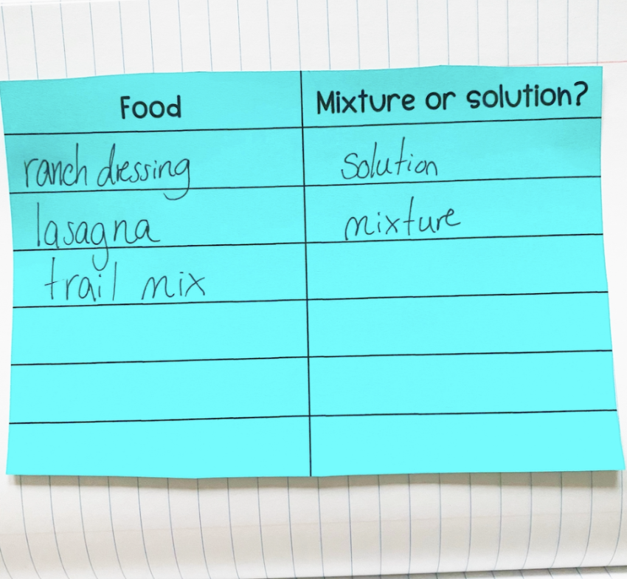
Reflection Activity
Think about the different food items in your refrigerator at home. Write some of those items on the left side of your sheet. On the right side of your sheet, decide if you think that item is a mixture or a solution. Then, ask yourselves…
Were there some items you weren’t sure were mixtures or solutions? Talk about those items with your partner to see what they think.
Are all solutions liquids? Why or why not?
Notes:
Have students make their lists and then discuss these questions with a partner or with their table before calling on groups to share one of their responses with the class.
Ask yourselves…
Were there some items you weren’t sure were mixtures or solutions? Talk about those items with your partner to see what they think.
Are all solutions liquids? Why or why not?

Slide 72
Notes:
Thanks for watching, and please continue watching CAPs available from this website.

Slide 73
This Was Created With Resources From:
Questions or Comments
Michael Kennedy, Ph.D. MKennedy@Virginia.edu
Rachel L Kunemund, Ph.D. rk8vm@virginia.edu

