Slide 1
Intro
“Big Idea” Question
Review Concepts
Check-In Questions
Teacher Demo
Vocabulary
Student-Friendly Definition
Examples & Non-Examples
Morphological Word Parts
Simulation/Activity
Notes:
OK everyone, get ready for our next lesson. Just as a reminder, these are the different components that our lesson may include, and you’ll see these icons in the top left corner of each slide so that you can follow along more easily!

Slide 2
Longitudinal Wave
Notes:
Today we are going to talk about longitudinal waves.

Slide 3
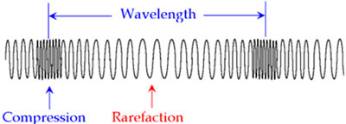
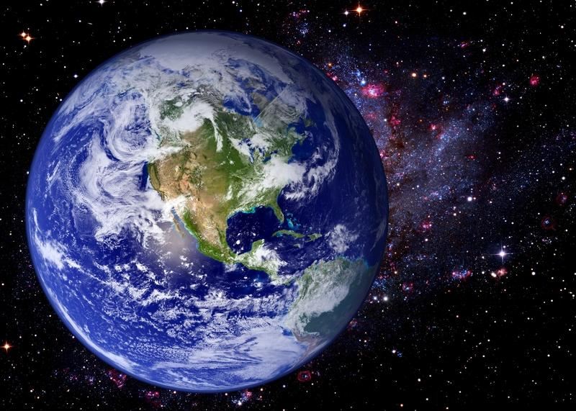
Big Question: What are the properties of sound waves, and how are they related?
Notes:
Our “big question” is: What are the properties of sound waves, and how are they related?
[Pause and illicit predictions from students.]
I love all these thoughtful scientific hypotheses! Be sure to keep this question and your predictions in mind as we move through these next few lessons, and we’ll continue to revisit it.

Slide 4
Demonstration
Objective: Allow students to see how compression and rarefaction works in longitudinal waves
Activity: The teacher will demonstrate for students how sound travel in waves using a slinky. The teacher will instruct students to look for both rarefaction and compression sections.
Materials:
Slinky
Questions:
What do you think will happen when I move the slinky?
What do you notice when the slinky moves?

Slide 5
Notes:
Before we move on to our new vocabulary term, let’s review some other words & concepts that you already learned and make sure you are firm in your understanding.

Slide 6
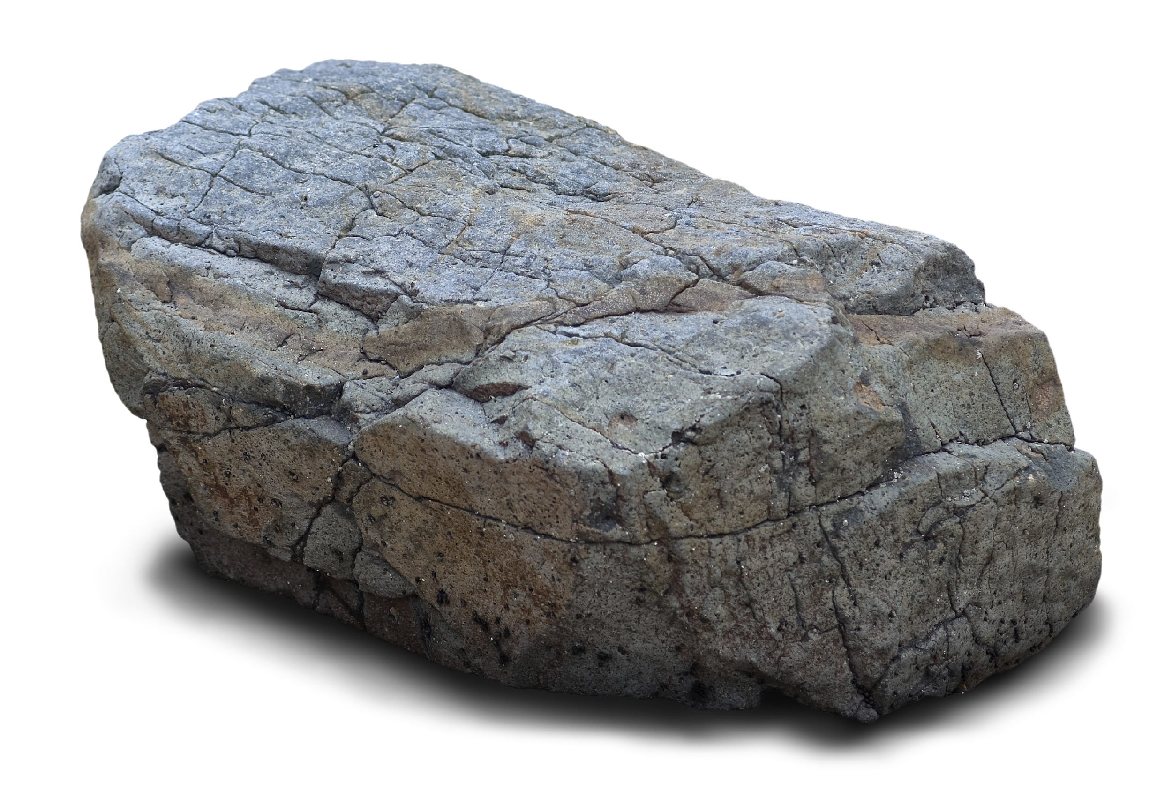
Matter: anything that has mass and take up volume, or space
Notes:
Matter is anything that has mass and takes up volume, or space.

Slide 7
Particle Theory: all matter consists of tiny particles that are in constant motion
Constant Motion
Notes:
The Particle Theory of Matter says that all matter consists of tiny particles that are in constant motion.

Slide 8
Notes:
Now let’s pause for a moment to check your understanding.

Slide 9
What is matter?
Notes:
What is matter?
[Matter is anything that has mass and takes up volume, or space.]

Slide 10
What does the particle theory of matter say about the movement of particles?
Notes:
What does the particle theory of matter say about the movement of particles?
[The particle theory of matter says that all matter consists of tiny particles that are in constant motion.]

Slide 11
Longitudinal Waves
Notes:
Now that we’ve reviewed, let’s define our new term, longitudinal waves.

Slide 12
Longitudinal wave: a wave that makes particles move back and forth along the direction of the wave
Notes:
Longitudinal waves are waves that make particles move back and forth along the direction the wave travels.

Slide 13
Notes:
Now let’s pause for a moment to check your understanding.

Slide 14
What is a longitudinal wave?
Notes:
What is a longitudinal wave?
[A longitudinal wave is a wave that makes particles move back and forth along the direction of the wave.]

Slide 15
Notes:
That is the basic definition, but there is a bit more you need to know.

Slide 16
Notes:
This means that sound is transported by particles bumping into each other!

Slide 17
Longitudinal waves experience compression
Notes:
Compression: an area in a longitudinal wave where particles are closest together.

Slide 18
And rarefactions
Notes:
And the rarefactions.
rarefaction: an area in a longitudinal wave where the particles are farthest apart

Slide 19
Notes:
Now let’s pause for a moment to check your understanding.

Slide 20
Up and down along the direction of a wave
Back and forth along the direction of the wave
Forward along the direction of the wave
In a longitudinal wave particles move:
Notes:
In a longitudinal wave particles move:

Slide 21
Up and down along the direction of a wave
Back and forth along the direction of the wave
Forward along the direction of the wave
In a longitudinal wave particles move:
Notes:
In a longitudinal wave particles move:
[Back and forth along the direction of the wave]

Slide 22
What is the difference between compressions and rarefactions?
Notes:
What is the difference between compressions and rarefactions?
[Compressions are the area in the waves where the particles are closest together and rarefactions are where they are farthest apart]

Slide 23
Notes:
Now, let’s talk about some examples of longitudinal waves.

Slide 24
Notes:
Here is an example of a longitudinal wave-you can see the particles moving back and forth in the direction of the wave as the hand causes the motion.

Slide 25
Notes:
Next, let’s talk about some non-examples of longitudinal waves.

Slide 26
Notes:
This is not an example of a longitudinal wave - this is a transverse wave.

Slide 27
Notes:
Now let’s pause for a moment to check your understanding.

Slide 28
Which is an example of a longitudinal wave? How can you tell?
Notes:
Which is an example of a longitudinal wave? How can you tell?

Slide 29
Which is an example of a longitudinal wave? How can you tell?
Notes:
Which is an example of a longitudinal wave? How can you tell?
[You can see the compressions and rarefactions.]

Slide 30
What is a longitudinal wave?
Notes:
What is a longitudinal wave?
[Longitudinal waves are waves that make particles move back and forth along the direction the wave travels]

Slide 31
What is the difference between compressions and rarefactions?
Notes:
What is the difference between compressions and rarefactions?
[Compressions are the area in the waves where the particles are closest together and rarefactions are where they are farthest apart]

Slide 32
Remember!!!
Notes:
So remember!

Slide 33
Longitudinal wave: a wave that makes particles move back and forth along the direction of the wave
Notes:
Longitudinal waves are waves that make particles move back and forth along the direction the wave travels.

Slide 34
Big Question: What are the properties of sound waves, and how are they related?
Notes:
Explicit cue to revisit the big question at the end of the lesson: Okay everyone. Now that we’ve learned the term, let’s reflect once more on our big question. Was there anything that we predicted earlier that was correct or incorrect? Do you have any new hypotheses to share?

Slide 35
Notes:
Thanks for watching, and please continue watching CAPs available from this website.

Slide 36
This Video Created With Resources From:
Questions or Comments
Michael Kennedy, Ph.D. MKennedy@Virginia.edu
Rachel L Kunemund, Ph.D. rk8vm@virginia.edu

Slide 37
Intro
“Big Idea” Question
Review Concepts
Check-In Questions
Teacher Demo
Vocabulary
Student-Friendly Definition
Examples & Non-Examples
Morphological Word Parts
Simulation/Activity
Notes:
OK everyone, get ready for our next lesson. Just as a reminder, these are the different components that our lesson may include, and you’ll see these icons in the top left corner of each slide so that you can follow along more easily!

Slide 38
Medium
Notes:
Today we’re going to talk about medium.

Slide 39
Big Question: What are the properties of sound waves, and how are they related?
Notes:
Our “big question” is: What are the properties of sound waves, and how are they related?
[Pause and illicit predictions from students.]
I love all these thoughtful scientific hypotheses! Be sure to keep this question and your predictions in mind as we move through these next few lessons, and we’ll continue to revisit it.

Slide 40
Notes:
Before we move on to our new vocabulary term, let’s review some other words & concepts that you already learned and make sure you are firm in your understanding.

Slide 41
Longitudinal wave: a wave that makes particles move back and forth along the direction of the wave
Notes:
Longitudinal waves are waves that make particles move back and forth along the direction the wave travels.

Slide 42
Compression: where particles are closely packed
Notes:
A longitudinal sound wave is made of two main parts. Compressions where particles are closely packed...

Slide 43
Rarefaction: where particles are loosely packed
Notes:
...and rarefactions where particles are loosely packed.

Slide 44
Notes:
Now let’s pause for a moment to check your understanding.

Slide 45
What is a longitudinal wave?
Notes:
What is a longitudinal wave?
[Longitudinal waves are waves that make particles move back and forth along the direction the wave travels.]

Slide 46
What is the difference between compression and rarefaction?
Notes:
What is the difference between compression and rarefaction?
[Compressions are where particles are closely packed while rarefactions are where particles are loosely packed.]

Slide 47
Medium
Notes:
Now that we’ve reviewed, let’s define our new term, medium.

Slide 48
Medium: any material that waves travel through
Notes:
A medium is any material that waves can travel through.

Slide 49
Notes:
Now let’s pause for a moment to check your understanding.

Slide 50
What is a medium?
Notes:
What is a medium?
[A medium is any material that waves travel through.]

Slide 51
Notes:
That is the basic definition, but there is a bit more you need to know.

Slide 52
Notes:
A medium can be either a solid, liquid or gas! That is why we can hear sound on earth. The sound waves can travel through the air. Air is a medium.

Slide 53
340 m/s = speed of sound
(through air, on Earth)
Notes:
Different mediums allow sound to travel at different speeds. The speed of sound we hear in the air is 340 m/s.

Slide 54
Sounds waves move through mediums using vibrations
Notes:
Vibration is the movement of particles that occurs in solids, liquids, or gases.

Slide 55
Notes:
You can pluck a guitar string which will vibrate. This vibration causes the particles in the air to collide and the sound wave to travel to your ear.

Slide 56
Notes:
You can also feel vibration that travels in waves - not just hear it. Sound waves travel at different frequencies, and lower frequencies can be hard to hear, but you can feel them. We’ll learn more about frequencies in another lesson.

Slide 57
Notes:
Now let’s pause for a moment to review the information we have covered already.

Slide 58
What is a medium?
Notes:
What is a medium?
[A medium is any material that waves can travel through.]

Slide 59
A medium can be:
Solid
Gas
Liquid
All of the above
Notes:
A medium can be:
Solid
Gas
Liquid
All of the above

Slide 60
A medium can be:
Solid
Gas
Liquid
All of the above
Notes:
A medium can be:
Solid
Gas
Liquid
All of the above

Slide 61
What is a vibration?
Notes:
What is a vibration?
[A vibration is the movement of particles that occurs in solids, liquids, or gases.]

Slide 62
Notes:
Now, let’s talk about some examples of mediums.

Slide 63
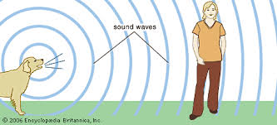
Notes:
Air can be a medium for sound waves.

Slide 64
Notes:
Wood can be a medium for sound waves. Think about if you knock on wood - can you hear it?

Slide 65
Notes:
This is an example of what sound waves look like in water.

Slide 66
Notes:
Let’s check-in for understanding.

Slide 67
Which of these is an example of a medium?
Notes:
Which of these is an example of a medium?

Slide 68
Which of these is an example of a medium?
Notes:
Which of these is an example of a medium?
[All of them! Mediums can be solid (ex: wood), liquid (ex: water), or gas (ex: air)]

Slide 69
What is a medium?
Notes:
What is a medium?
[A medium is any material that waves can travel through.]

Slide 70
What types of substances can make up a medium? What are some examples?
Notes:
What types of substances can make up a medium? What are some examples?
[Solids (ex: wood, metal, drum head, etc.), liquids (ex: water, etc.), gases (ex: air, etc.)]

Slide 71
What is a vibration?
Notes:
What is a vibration?
[A vibration is the movement of particles that occurs in solids, liquids, or gases.]

Slide 72
Remember!!!
Notes:
So remember!

Slide 73
Medium: any material that waves travel through
Notes:
A medium is any material that waves can travel through.

Slide 74
Big Question: What are the properties of sound waves, and how are they related?
Notes:
Explicit cue to revisit the big question at the end of the lesson: Okay everyone. Now that we’ve learned the term, let’s reflect once more on our big question. Was there anything that we predicted earlier that was correct or incorrect? Do you have any new hypotheses to share?

Slide 75
Notes:
Thanks for watching, and please continue watching CAPs available from this website.

Slide 76
This Video Created With Resources From:
Questions or Comments
Michael Kennedy, Ph.D. MKennedy@Virginia.edu
Rachel L Kunemund, Ph.D. rk8vm@virginia.edu

Slide 77
Intro
“Big Idea” Question
Review Concepts
Check-In Questions
Teacher Demo
Vocabulary
Student-Friendly Definition
Examples & Non-Examples
Morphological Word Parts
Simulation/Activity
Notes:
OK everyone, get ready for our next lesson. Just as a reminder, these are the different components that our lesson may include, and you’ll see these icons in the top left corner of each slide so that you can follow along more easily!

Slide 78
Sound Waves
Intro
Notes:
Today we will be defining sound waves.

Slide 79
Big Question: What are the properties of sound waves, and how are they related?
Notes:
Our “big question” is: What are the properties of sound waves, and how are they related?
[Pause and illicit predictions from students.]
I love all these thoughtful scientific hypotheses! Be sure to keep this question and your predictions in mind as we move through these next few lessons, and we’ll continue to revisit it.

Slide 80
Demonstration
TEACHER DIRECTIONS:
Remove the lid from a cardboard pencil case or tissue box. Arrange a series of rubber bands stretched over the box from thinnest to thickest. Have students pluck each rubber band and talk about your observations. Place a ruler on its edge across the rubber bands, like a bridge. Pluck each rubber band again and talk about what changed. Students will learn that thinner, shorter bands produce higher sound pitches because they produce shorter sound waves. The ruler across the bands acts like a dampener and should change the pitch the tightened rubber bands make.
During: During the demonstration ask students to predict what will happen and how it will sound as you pluck different rubber bands.
Questions: What do you notice when you pluck the rubber bands?
Can you predict how it will sound like as you pluck different rubber bands?
Notes:
Let’s do a quick demonstration that will help get our brains ready to think about amplitude, and how it relates to our big question.

Slide 81
Notes:
Before we move on to our new vocabulary term, let’s review some other words & concepts that you already learned and make sure you are firm in your understanding.

Slide 82
Longitudinal wave: a wave that makes particles move back and forth along the direction of the wave
Notes:
Longitudinal waves are waves that make particles move back and forth along the direction the wave travels.

Slide 83
Compression: where particles are closely packed
Notes:
A sound wave is made of 2 main parts. Compressions where particles are closely packed...

Slide 84
Rarefaction: where particles are loosely packed
Notes:
...and rarefaction where particles are loosely packed.

Slide 85
Medium: any material that waves travel through
Notes:
A medium is any material that waves can travel through.

Slide 86
Vibration: the movement of particles that occurs in solids, liquids, or gases
Notes:
Vibration is the movement of particles that occurs in solids, liquids, or gases.

Slide 87
Notes:
Now let’s pause for a moment to check your understanding.

Slide 88
What are longitudinal waves?
Notes:
What are longitudinal waves?
[Longitudinal waves are waves that make particles move back and forth along the direction the wave travels.]

Slide 89
What is the difference between compression and rarefaction?
Notes:
What is the difference between compression and rarefaction?
[Compressions are where particles are closely packed while rarefactions are where particles are loosely packed.]

Slide 90
What is a medium?
Notes:
What is a medium?
[A medium is any material that waves can travel through.]

Slide 91
What is a vibration?
Notes:
What is a vibration?
[A vibration is the movement of particles that occurs in solids, liquids, or gases.]

Slide 92
Sound Waves
Notes:
Now that we’ve reviewed, let’s define our new term, sound waves.

Slide 93
Sound waves: are longitudinal waves that travel through a medium
Notes:
Sound waves are longitudinal waves that travel through a medium.

Slide 94
Notes:
Now let’s pause for a moment to check your understanding.

Slide 95
What are sound waves?
Notes:
What are sound waves?
[Sound waves are longitudinal waves that travel through a medium.]

Slide 96
Notes:
That is the basic definition, but there is a bit more you need to know.

Slide 97
Notes:
Sound always goes away from the source.

Slide 98
Notes:
Now let’s pause for a moment to check your understanding.

Slide 99
Sound waves: are ________ waves that travel through a _____.
Notes:
Sound waves are _______ waves that travel through a _______.

Slide 100
Sound waves: are longitudinal waves that travel through a medium.
Notes:
Sound waves are longitudinal waves that travel through a medium.

Slide 101
Notes:
Now, let’s talk about some examples of sound waves.

Slide 102
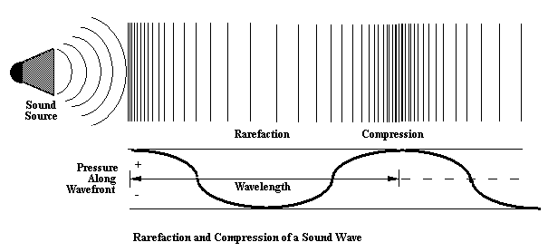
Notes:
Here we can see a sound wave with the compression and rarefaction you would expect to see in a longitudinal wave.

Slide 103
Notes:
Next, let’s talk about some non-examples of sound waves.

Slide 104
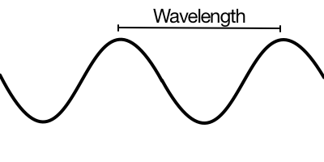
Notes:
Because this is a transverse wave it is not a sound wave-remember sound waves are longitudinal waves.

Slide 105
Notes:
Now let’s pause for a moment to check your understanding.

Slide 106
Why is this an example of a sound wave?
Notes:
Why is this an example of a sound wave?
[Sound waves are with the compression and rarefaction you would expect to see in a longitudinal wave.]

Slide 107
Why is this not an example of a sound wave?
Notes:
Why is this not an example of a sound wave?
[Because this is a transverse wave it is not a sound wave - remember sound waves are longitudinal waves.]

Slide 108
What type of wave is a sound wave?
Notes:
What type of wave is a sound wave?
[Sound waves are longitudinal waves]

Slide 109
What does a sound wave travel through?
Notes:
What does a sound wave travel through?
[A medium]

Slide 110
Remember!!!
Notes:
So remember!

Slide 111
Sound waves: are longitudinal waves that travel through a medium
Notes:
Sound waves are longitudinal waves that travel through a medium.

Slide 112
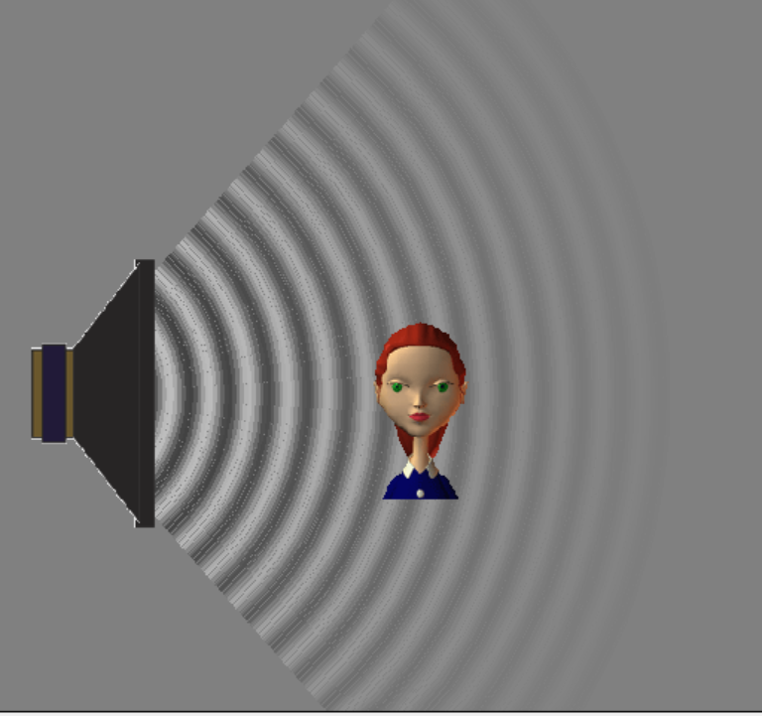
Simulation Activity
Sound Waves
This simulation lets you see sound waves. Adjust the frequency or volume and you can see and hear how the wave changes. Move the listener around and hear what she hears.

Slide 113
Big Question: What are the properties of sound waves, and how are they related?
Notes:
Explicit cue to revisit the big question at the end of the lesson: Okay everyone. Now that we’ve learned the term, let’s reflect once more on our big question. Was there anything that we predicted earlier that was correct or incorrect? Do you have any new hypotheses to share?

Slide 114
Notes:
Thanks for watching, and please continue watching CAPs available from this website.

Slide 115
This Video Created With Resources From:
Questions or Comments
Michael Kennedy, Ph.D. MKennedy@Virginia.edu
Rachel L Kunemund, Ph.D. rk8vm@virginia.edu

