Slide 1
Intro
“Big Idea” Question
Review Concepts
Check-In Questions
Teacher Demo
Vocabulary
Student-Friendly Definition
Examples & Non-Examples
Morphological Word Parts
Extension Activity
Notes:
OK everyone, get ready for our next lesson. Just as a reminder, these are the different components that our lesson may include, and you’ll see these icons in the top left corner of each slide so that you can follow along more easily!

Slide 2
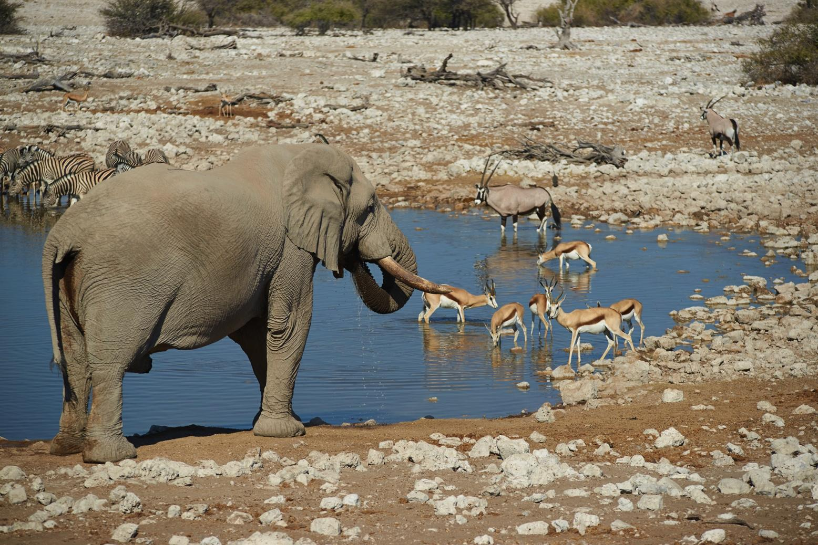
Species
Notes:
Today we’ll be focusing on species.

Slide 3
Big Question: How do scientists determine what organisms are part of a species?
Notes:
Our “big question” is: How do scientists determine what organisms are part of a species?
[Pause and illicit predictions from students.]
I love all these thoughtful scientific hypotheses! Be sure to keep this question and your predictions in mind as we move through these next few lessons, and we’ll continue to revisit it.
Feedback: Feedback: Asking students to make predictions about how scientists determine what organisms are part of a species is a great way to activate and elicit student ideas and prior knowledge. This type of activity is evidence of the teacher planning for students’ engagement with science ideas. Further, this type of activity helps to build students’ epistemic knowledge of how and why scientists engage in specific practices. Making connections to science practices is an important way to help students understand their own role and potential within the field of science.

Slide 4
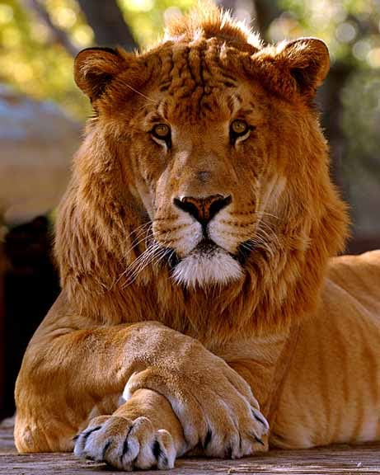
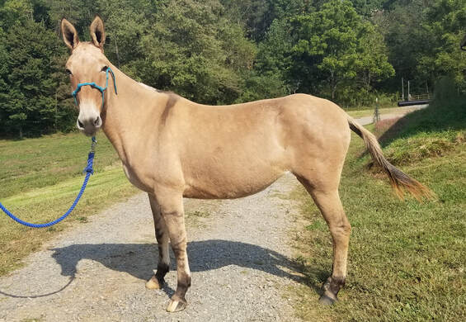
Demonstration
Ligers and Mules Presentation
Use the presentation linked above to generate interest for the topic of species, to activate prior knowledge, and to encourage students to consider the qualifications for the title “species”.
Notes:
Feedback: Have students recall the characteristics of life and make predictions about how tiny cells are able to carry out all the necessary functions to support life. Beginning with open-ended questions, followed by providing explicit explanations, and then asking probing questions is a great way to engage students in a discussion while also providing clear explanations.

Slide 5
Notes:
Before we get into our topic for today, let’s review some other words & concepts that you already learned and make sure you are firm in your understanding.

Slide 6
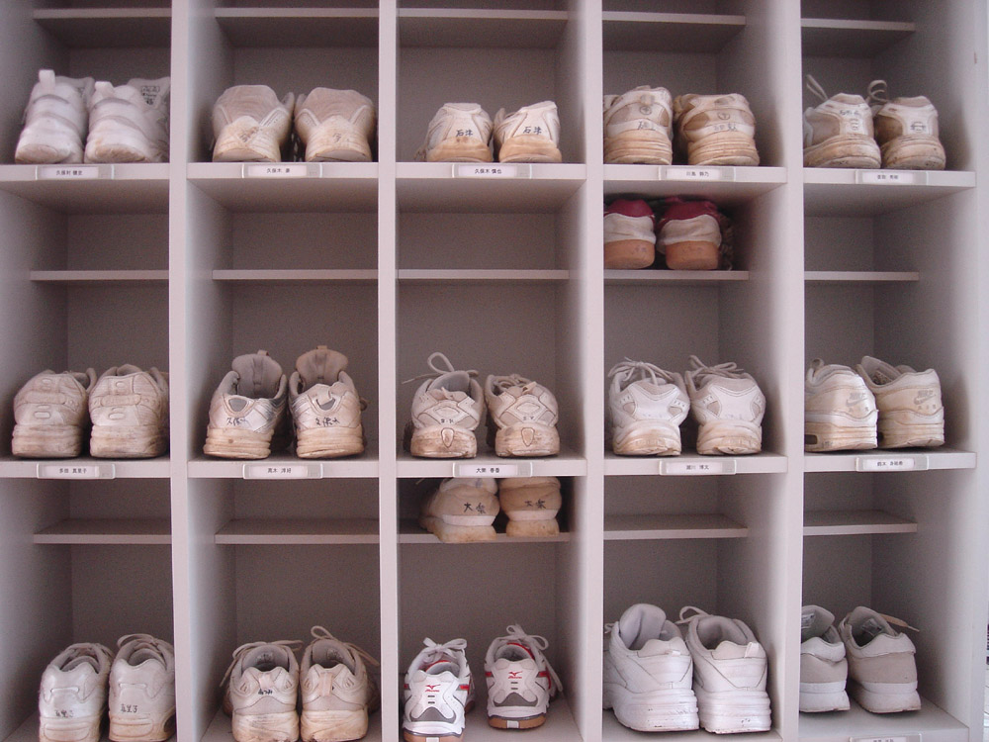
Scientific Classification: system to organize different types of living things according to their different characteristics
Notes:
We use a classification system to organize different types of living things according to their different characteristics.

Slide 7
Ecology
Biome
Ecosystem
Community
Population
Species
Notes:
In ecology, there are five levels of organization.

Slide 8
Ecology
Biome
Ecosystem
Community
Population
Species
Notes:
This lesson addresses species.

Slide 9
Notes:
Now let’s pause for a moment and check for understanding.

Slide 10
What is scientific classification?
Notes:
What is scientific classification?
[We use a classification system to organize different types of living things according to their different characteristics.]

Slide 11
Species
Notes:
Now that we’ve reviewed, let’s define our term, species.

Slide 12
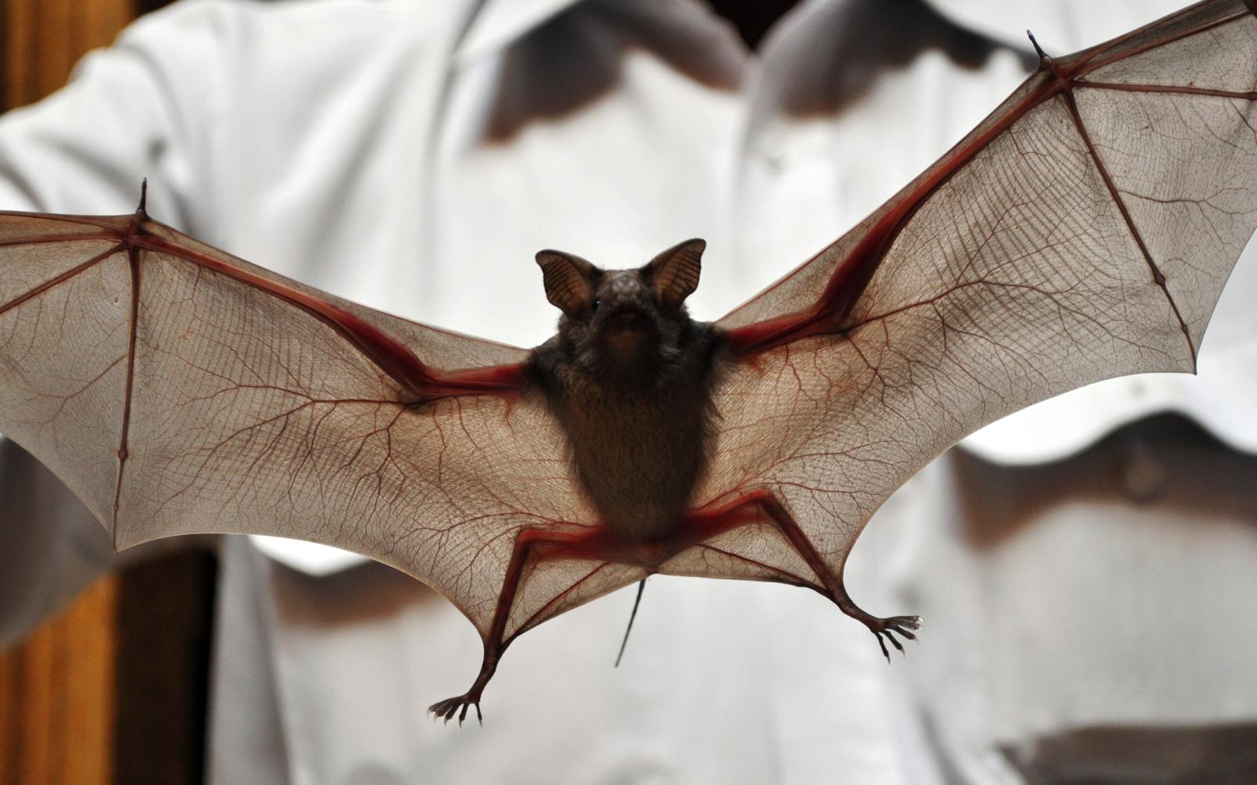
Species: a type of organism that can reproduce viable offspring, which means the offspring can also produce offspring
Notes:
A species is a type of organism that can reproduce viable offspring, which means the offspring can also produce offspring.

Slide 13
Notes:
Now let’s pause for a moment and check for understanding.

Slide 14
What is a species?
Notes:
What is a species?
[A species is a type of organism that can reproduce viable offspring, which means the offspring can also produce offspring.]

Slide 15
Notes:
That is the basic definition, but there is a bit more you need to know.

Slide 16
“Reproduce viable offspring”
Offspring can also produce offspring
Notes:
A species is a type of organism that can reproduce viable offspring, which means the offspring can also produce offspring.
Feedback: Clear and concise language is important when explaining new terms.

Slide 17
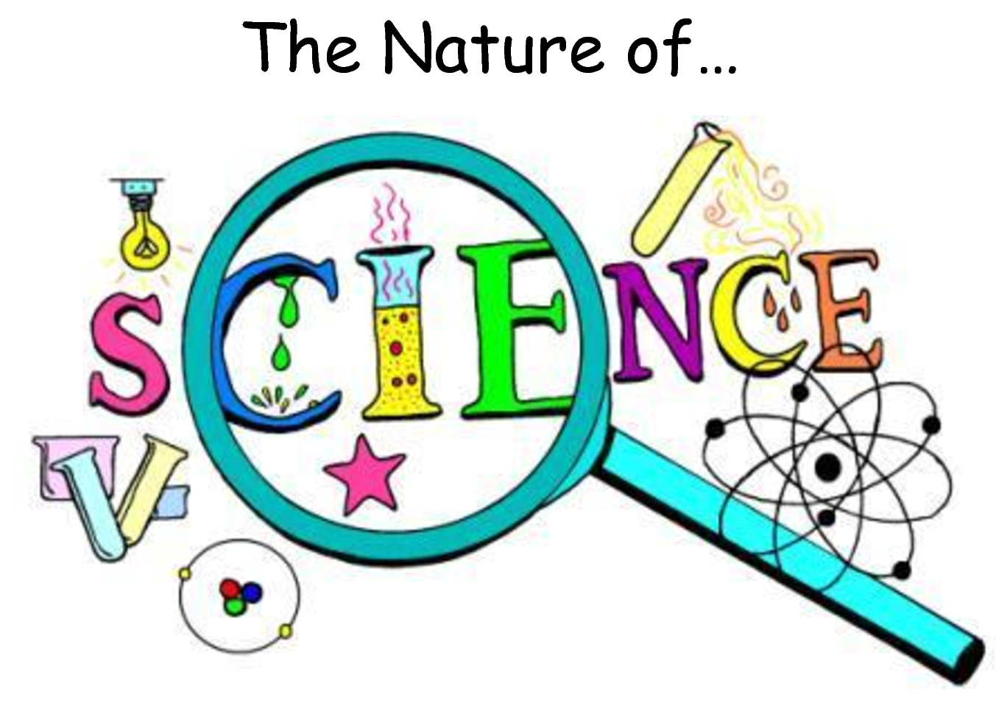
The use of the term “species” relates to the Nature of Science. Scientists have long-debated how species should be defined, and ideas about species have changed in light of new information, including discoveries in genetics.

Slide 18
Notes:
Now let’s pause for a moment and check for understanding.

Slide 19
What is a requirement regarding reproduction for organisms to be considered a species?
Notes:
What is a requirement regarding reproduction for organisms to be considered a species?
[The organism’s offspring must able be able to produce offspring.]

Slide 20
Notes:
Now, let’s look at some examples of species.

Slide 21
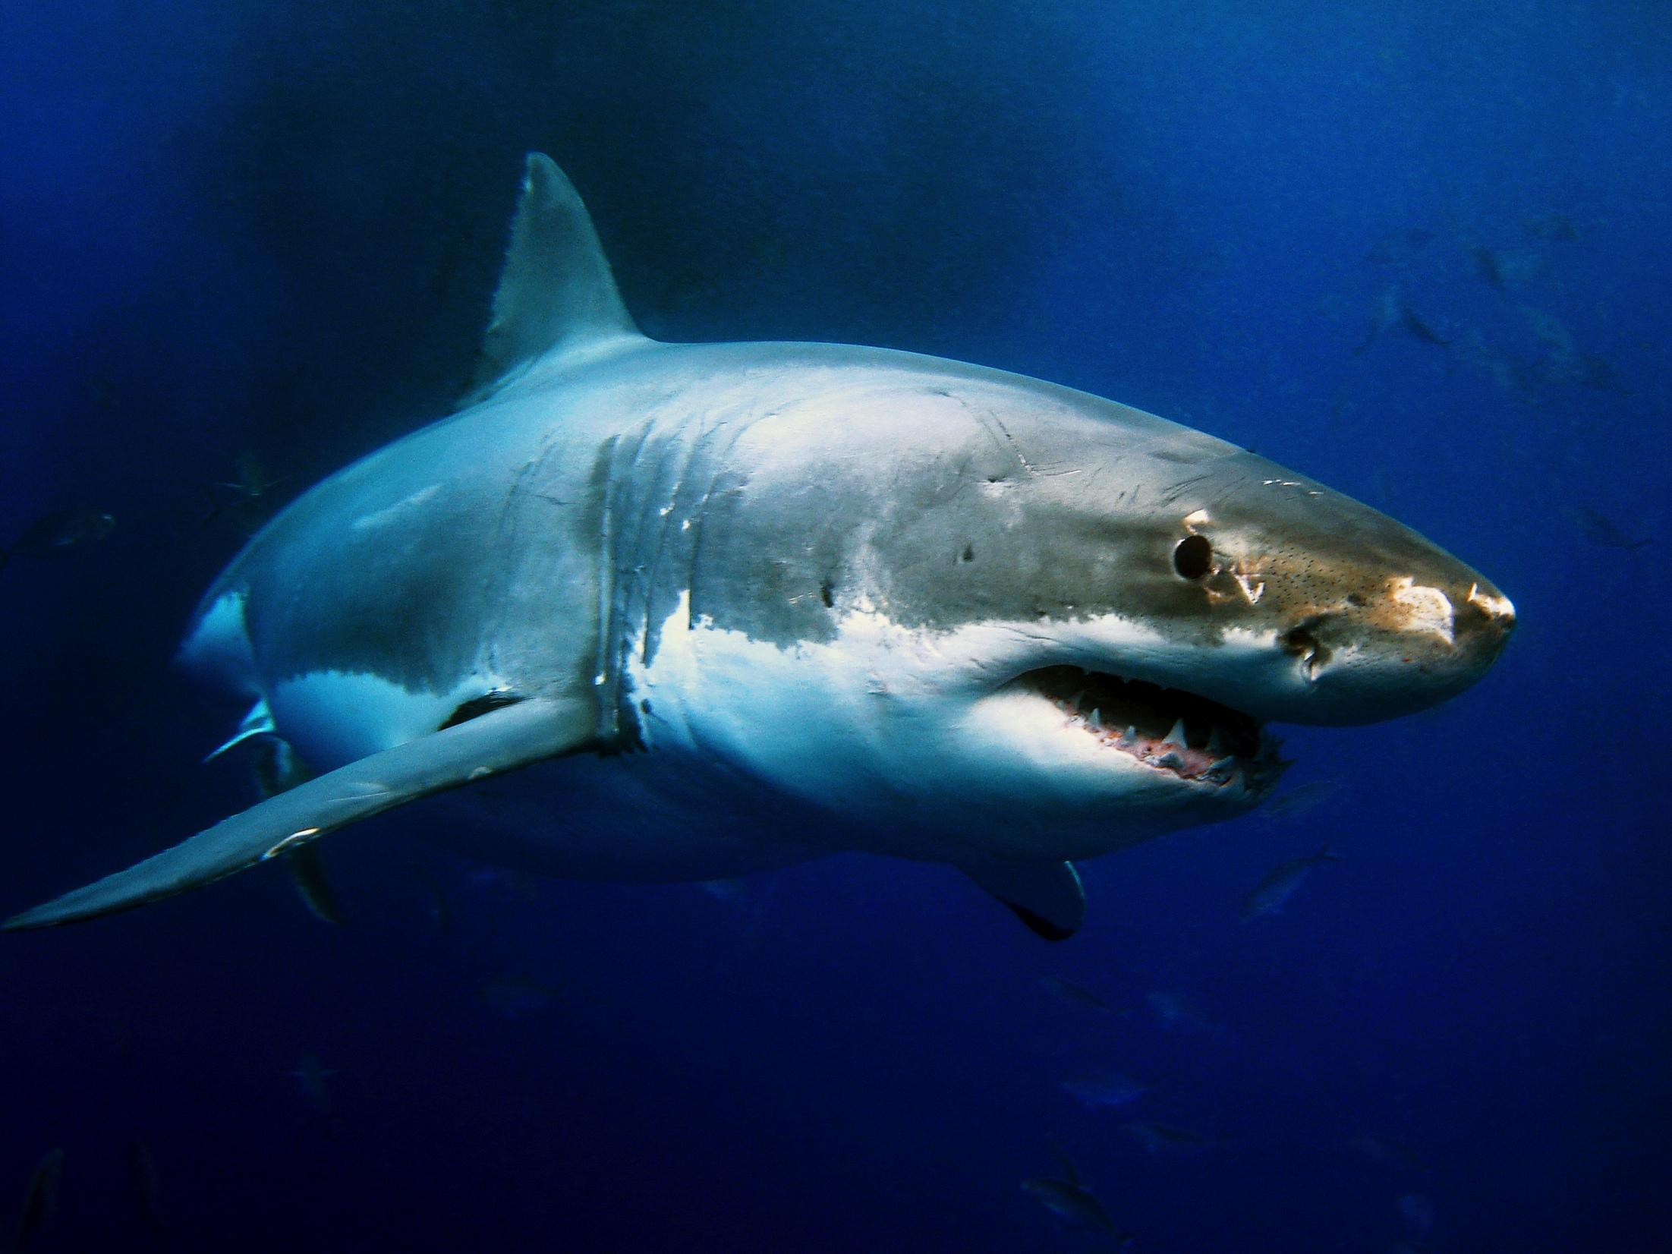
Notes:
This is a picture of a great white shark. It is an example of a species.

Slide 22
Notes:
In this picture of a watering hole, there are several species. The elephant is one example of a species. The antelope is another species.

Slide 23
Notes:
Next, let’s look at some non-examples of species.

Slide 24
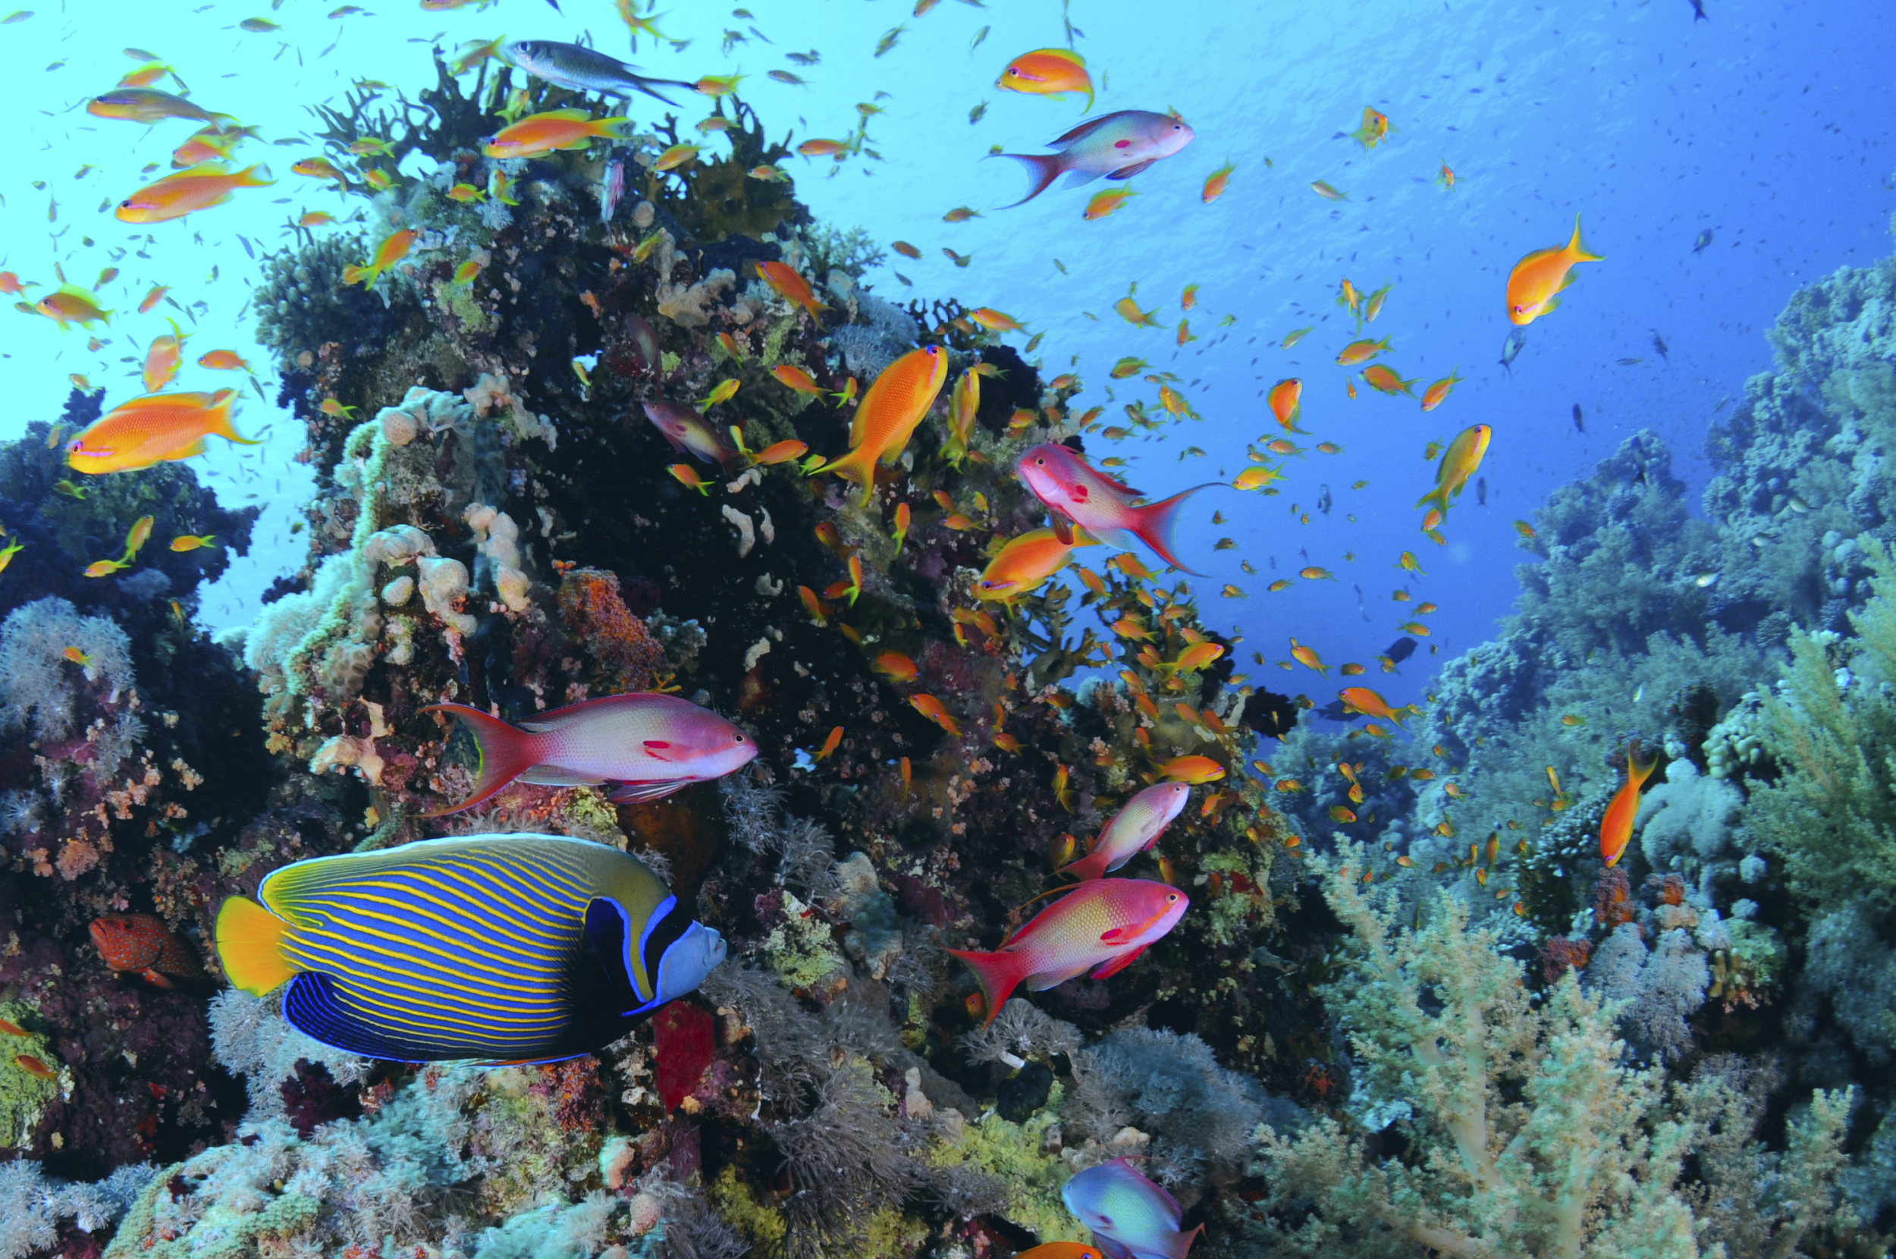
Many different species
Notes:
This is a group of fish. It is not an example of species. There are many different species within the group of fishes.

Slide 25
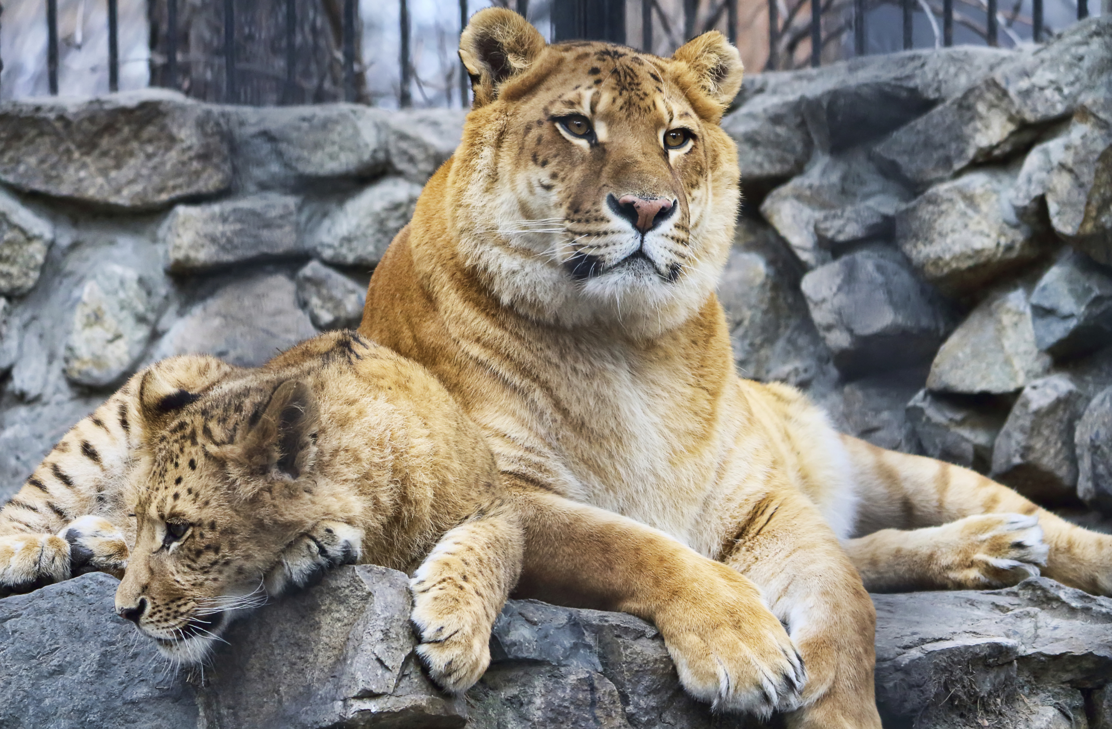
Notes:
A liger is also NOT a species. It is the offspring of a tiger and lion, but the liger cannot reproduce itself.

Slide 26
Notes:
Now let’s pause for a moment and check for understanding.

Slide 27
What is an example of a species?
Notes:
What is an example of a species?

Slide 28
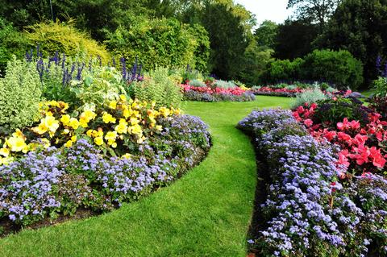
Why is this not an example of the term species?
Notes:
Why is this not an example of the term species?
Feedback: It is very important when giving non-examples to make sure to offer opportunities for students to think about and discuss why it is not an example.

Slide 29
What is a species?
Notes:
What is a species?
[A species is a type of organism that can reproduce viable offspring, which means the offspring can also produce offspring.]

Slide 30
Remember!!!
Notes:
So remember!

Slide 31
Species: a type of organism that can reproduce viable offspring, which means the offspring can also produce offspring
Notes:
A species is a type of organism that can reproduce viable offspring, which means the offspring can also produce offspring.

Slide 32
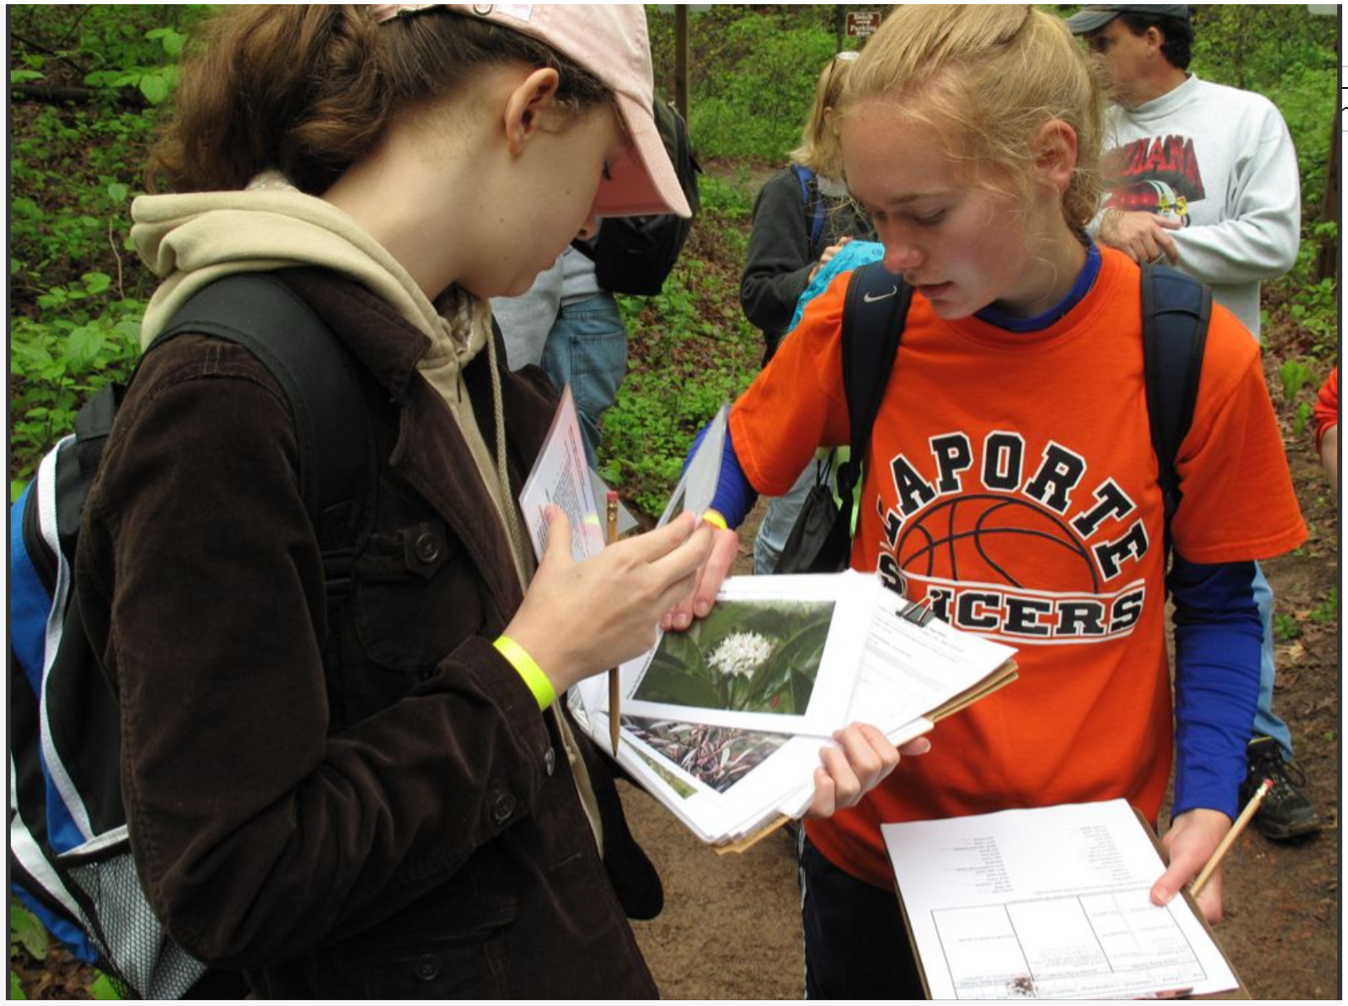
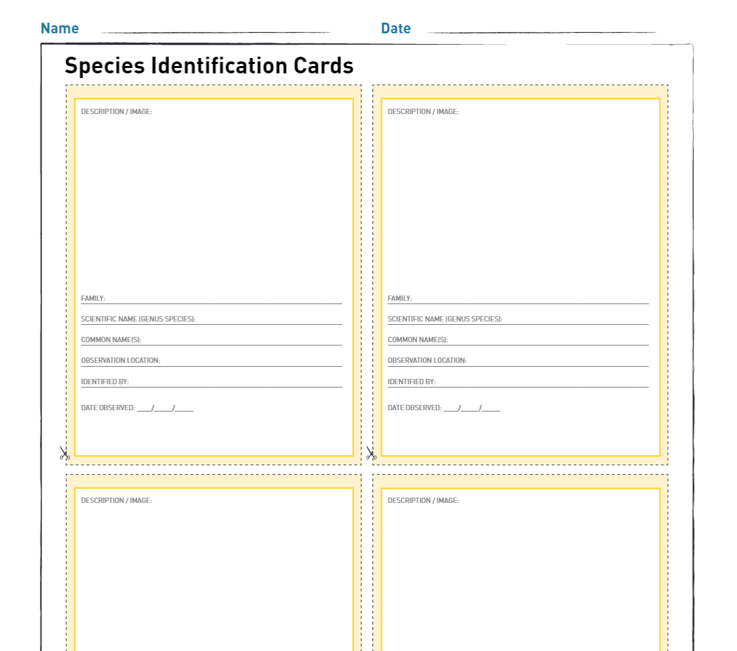
Extension Activity
Species Identification
Click the link above for more information on the species identification activity.
Notes:
Feedback: The species identification activity can be a great way to show students the implications of the “species” label and to demonstrate how this label is used by scientists to categorize organisms and better-understand the ecology of an area.

Slide 33
Big Question: How do scientists determine what organisms are part of a species.
Notes:
Explicit cue to revisit the big question at the end of the lesson: Okay everyone. Now that we’ve learned more about species, let’s reflect once more on our big question. Was there anything that we predicted earlier that was correct or incorrect? Do you have any new thoughts to share?
Feedback: Offering students an opportunity to evaluate their earlier hypotheses and make changes based on their new understandings is an important part of the iterative process in science. This is a great opportunity to help students build an epistemic understanding by explicitly stating how continuing to change and build on hypotheses as your knowledge grows is an important part of the discipline of science!

Slide 34
Notes:
Thanks for watching, and please continue watching CAPs available from this website.

Slide 35
This Video Was Created With Resources From:
Questions or Comments
Michael Kennedy, Ph.D. MKennedy@Virginia.edu
Rachel L Kunemund, Ph.D. rk8vm@virginia.edu

