Slide 1
Intro
“Big Idea” Question
Review Concepts
Check-In Questions
Teacher Engagement
Vocabulary
Student-Friendly Definition
Examples & Non-Examples
Morphological Word Parts
Frayer Model
Simulation/Activity
Notes:
OK everyone, get ready for our next lesson. Just as a reminder, these are the different components that our lesson may include, and you’ll see these icons in the top left corner of each slide so that you can follow along more easily!

Slide 2
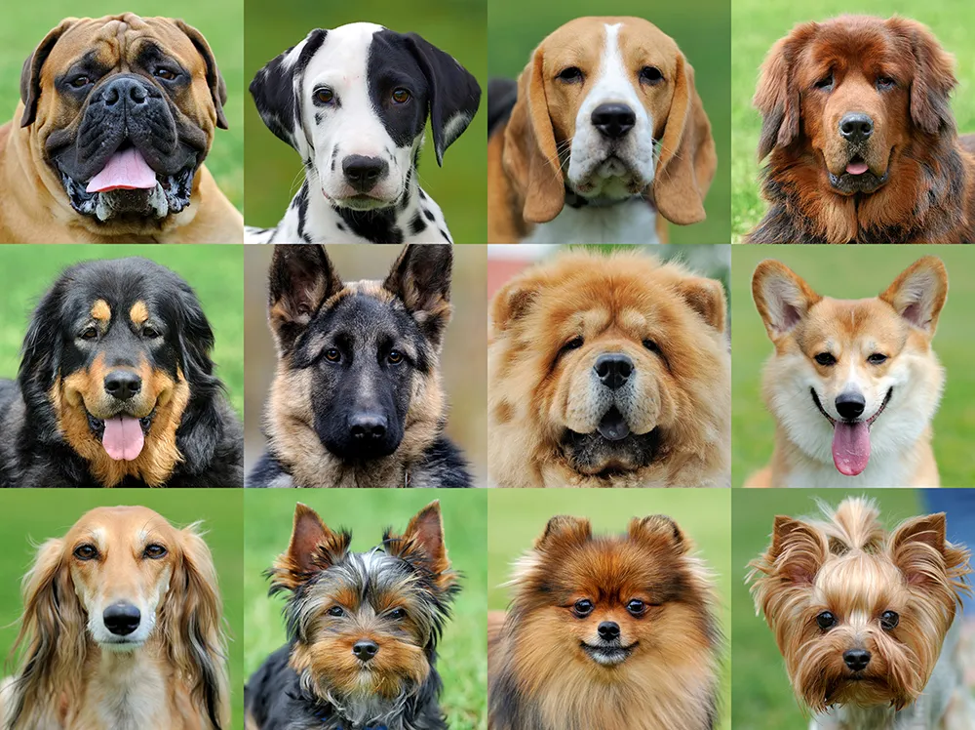
Intro
Species
Notes:
Today, we’ll be learning about the word: Species.

Slide 3
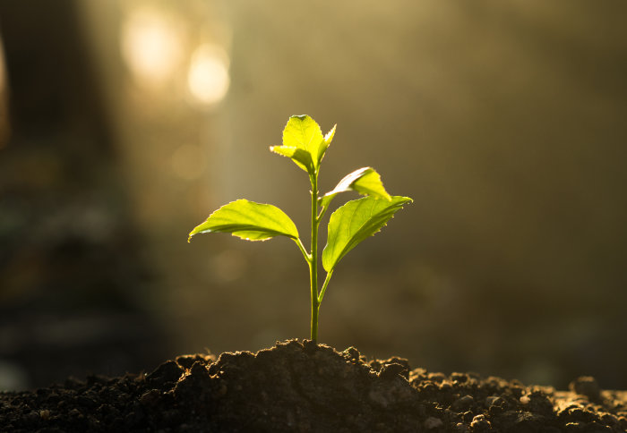
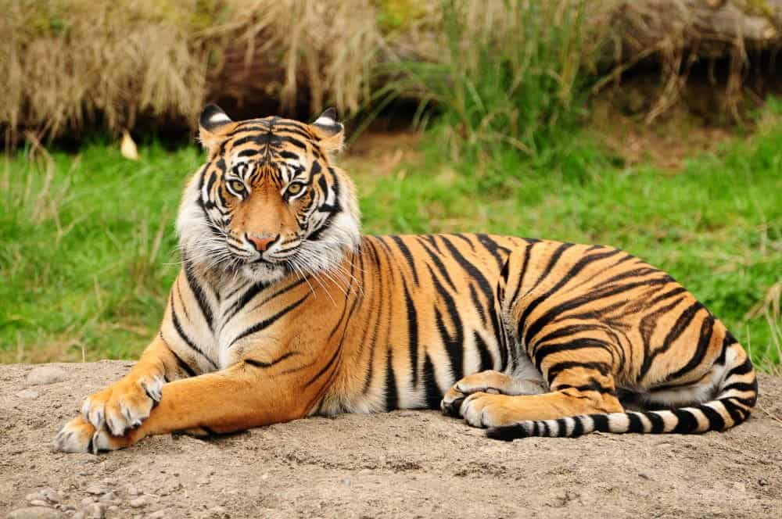
Big Question: How do plants and animals interact with their environments?
Notes:
Our “big question” is: How do plants and animals interact with their environments?
[Pause and illicit predictions from students.]
I love all these thoughtful scientific hypotheses! Be sure to keep this question and your predictions in mind as we move through these next few lessons, and we’ll continue to revisit it.

Slide 4
Notes:
Before we move on to our new topic, let’s review some other words & concepts that you already learned and make sure you are firm in your understanding.

Slide 5
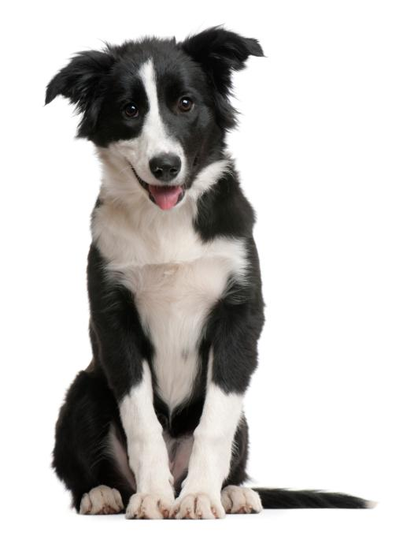
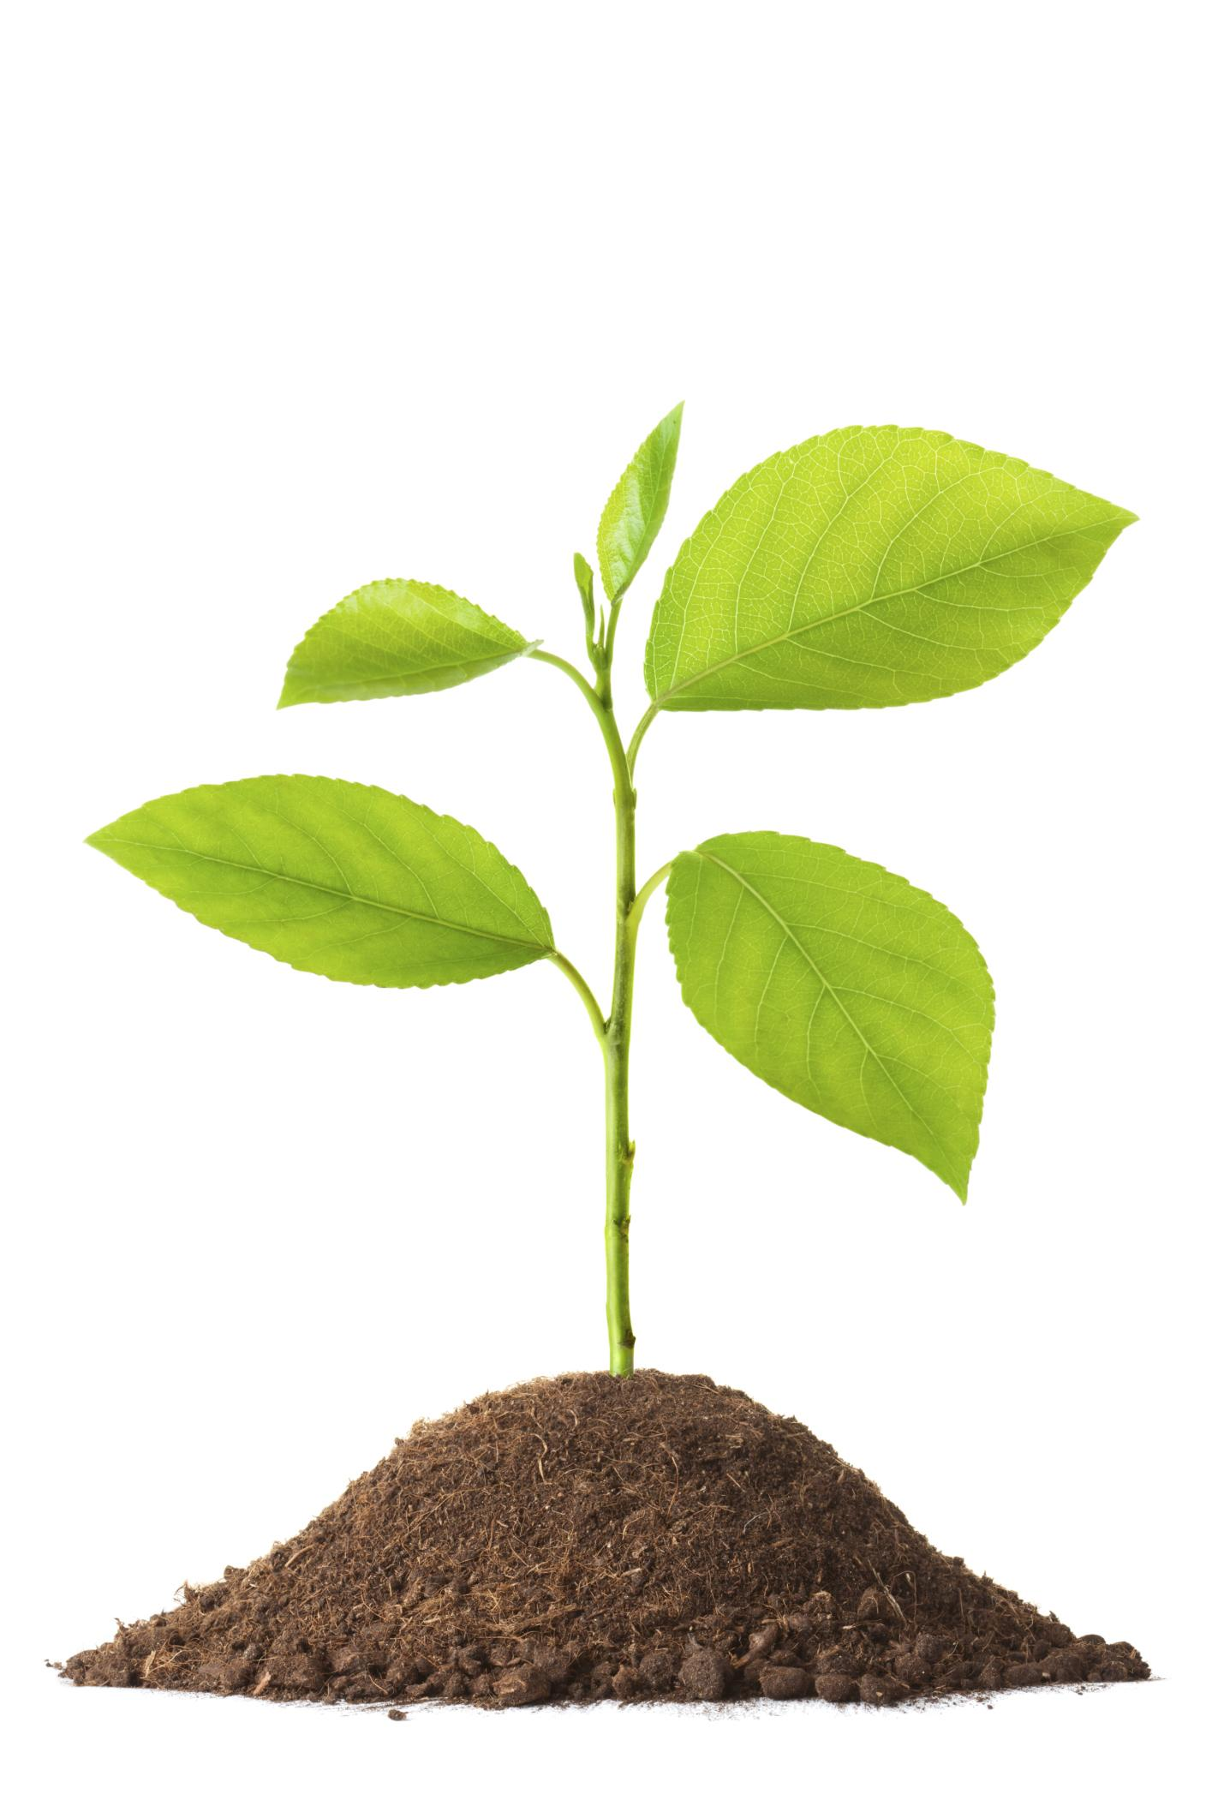
Organism: any living thing
Notes:
An organism is any living thing.

Slide 6
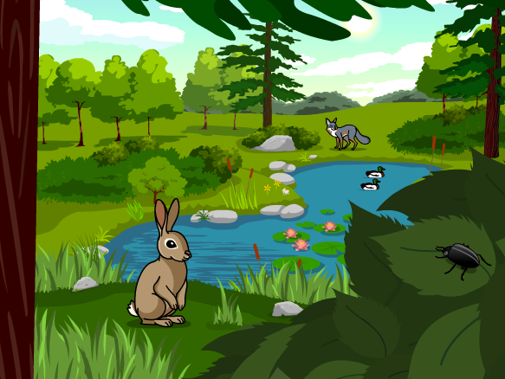
Ecosystem: an area where living and nonliving things interact.
Notes:
An ecosystem is an area where living and nonliving things interact.

Slide 7
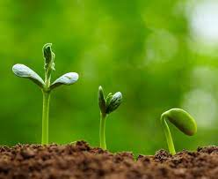
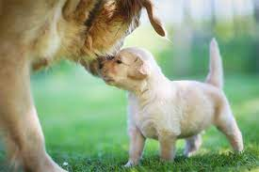
Living Thing: organisms that move, grow, change, and respond to its environment
Notes:
Living things are organisms that grow, change, and respond to its environment.

Slide 8
Reproduction: process by which living things create new organisms of their own kind
Notes:
Reproduction is the process by which living things create new organisms of their own kind.

Slide 9
Notes:
Now let’s pause for a moment to review the information we have covered already.

Slide 10
True or false: An organism is any living thing.
True
False
Notes:
True or false: An organism is any living thing.
[A. True]

Slide 11
True or false: An organism is any living thing.
True
False
Notes:
True or false: An organism is any living thing. True
[B. False]

Slide 12
What is another word for an area where living and nonliving things interact?
System
Ecosystem
Economy
Notes:
What is another word for an area where living and nonliving things interact?
[B. Ecosystem]

Slide 13
What is another word for an area where living and nonliving things interact?
System
Ecosystem
Economy
Notes:
What is another word for an area where living and nonliving things interact? B. Ecosystem

Slide 14
_________ __________ are organisms that move, grow, change, and respond to the environment
Living things
Non-living things
Abiotic Factors
Notes:
______ _______ are organisms that move, grow, change, and respond to the environment.
[A. Living things]

Slide 15
_________ __________ are organisms that move, grow, change, and respond to the environment
Living things
Non-living things
Abiotic Factors
Notes:
Living things are organisms that move, grow, change, and respond to the environment.

Slide 16
________ is the process by which living things create new organisms of their own kind.
Relationship
Resistance
Reproduction
Notes:
________ is the process by which living things create new organisms of their own kind.
[C. Reproduction]

Slide 17
________ is the process by which living things create new organisms of their own kind.
Relationship
Resistance
Reproduction
Notes:
Reproduction is the process by which living things create new organisms of their own kind.

Slide 18
Species
Notes:
Now that we’ve reviewed, let’s define the word species.

Slide 19
Species: a group of similar organisms that can reproduce
Notes:
Species is a group of similar organisms that can reproduce.

Slide 20
Notes:
Let’s check-in for understanding.

Slide 21
What is a species?
Notes:
What is a species?
[A group of similar organisms that can reproduce.]

Slide 22
Notes:
That is the basic definition, but there is a bit more you need to know.

Slide 23
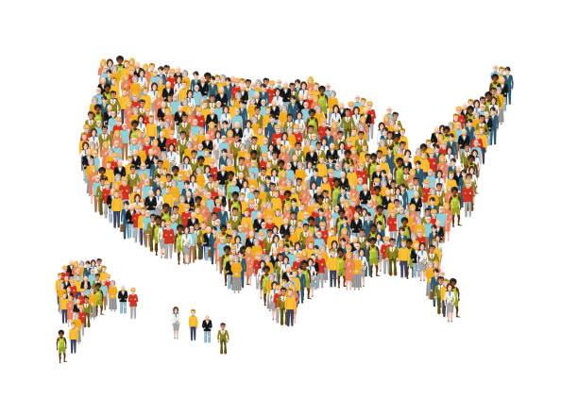
All the organisms of the same species that live in the same place at the same time are a population.
Notes:
All the organisms of the same species that live in the same place at the same time are a population. For example, the human species that live in the United States make up the population of the United States.

Slide 24
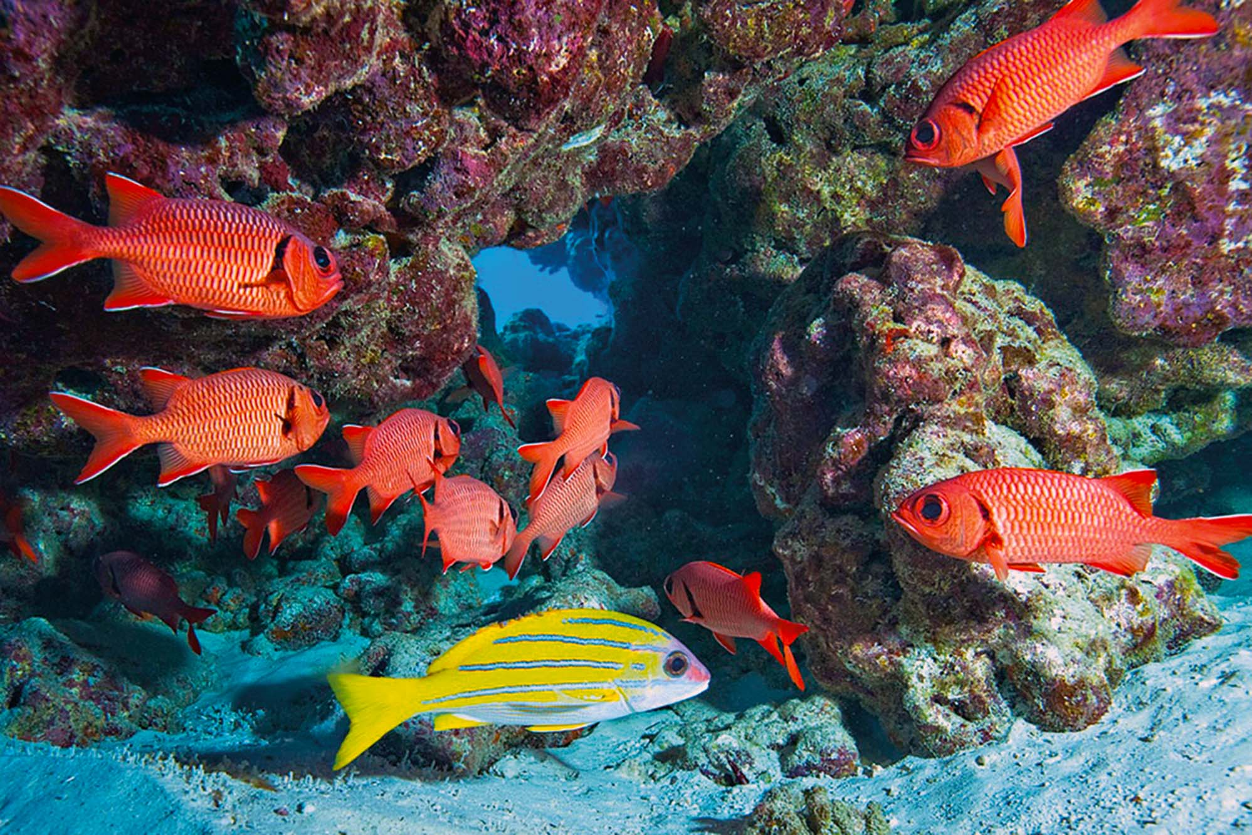
The populations of a species that live in the same place at the same time together make up a community.
Notes:
The populations of a species that live in the same place at the same time together make up a community. In this picture, the redfish species are living in the coral reef at the same time together. Therefore, they make up a community.

Slide 25
Notes:
Let’s check-in for understanding.

Slide 26
All the organisms of the same species that live in the same place at the same time are a _________.
Sample
Population
Group
Notes:
All the organisms of the same species that live in the same place at the same time are a ___________.
[B. Population]

Slide 27
All the organisms of the same species that live in the same place at the same time are a _________.
Sample
Population
Group
Notes:
All the organisms of the same species that live in the same place at the same time are a population.
[B. Population]

Slide 28
True or false: The populations of a species that live in the same place at the same time together make up a community.
True
False
Notes:
True or false: The populations of a species that live in the same place at the same time together make up a community.
[A. True]

Slide 29
True or false: The populations of a species that live in the same place at the same time together make up a community.
True
False
Notes:
True or false: The populations of a species that live in the same place at the same time together make up a community.
[A. True]

Slide 30
Notes:
Now, let’s talk about some examples of species.

Slide 31
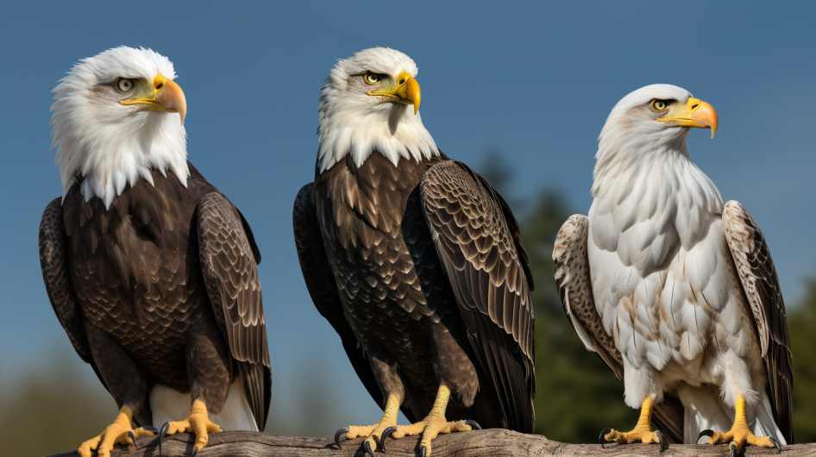
Notes:
Here is an example of a species. This picture shows the bald eagle species. These eagles are all similar and can reproduce.

Slide 32
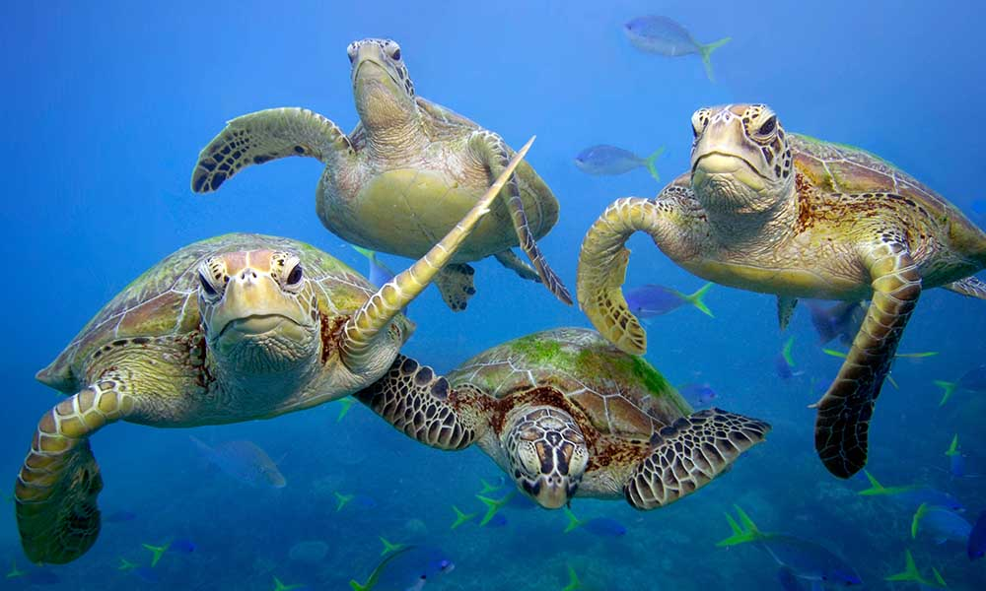
Notes:
Here is another example of a species. This picture shows the green sea turtle species. The sea turtle species are similar in this picture and they can reproduce.

Slide 33
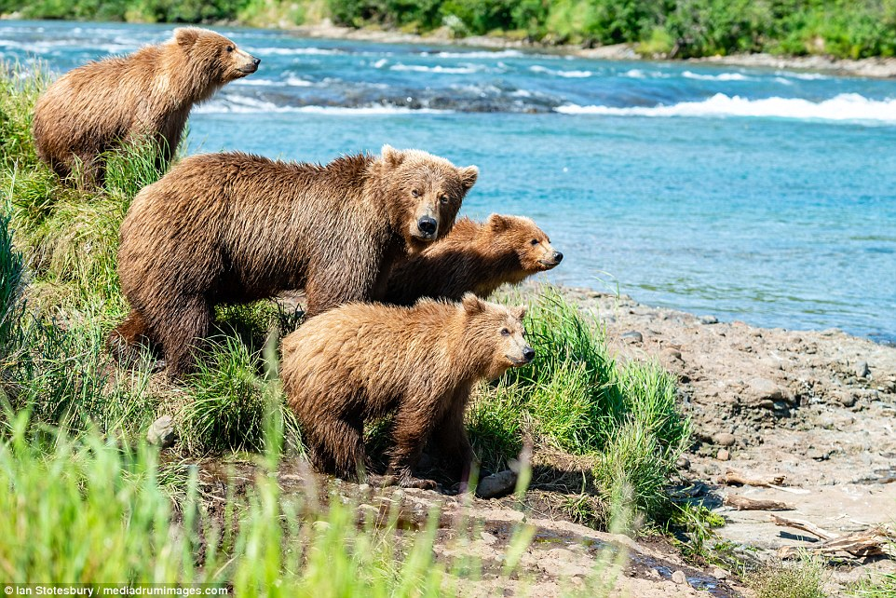
Notes:
Here is another example of a species. This picture shows the grizzly bear species. Again, you can see that the grizzly bears look similar and can reproduce.

Slide 34
Notes:
Now, let’s talk about some non-examples of species.

Slide 35
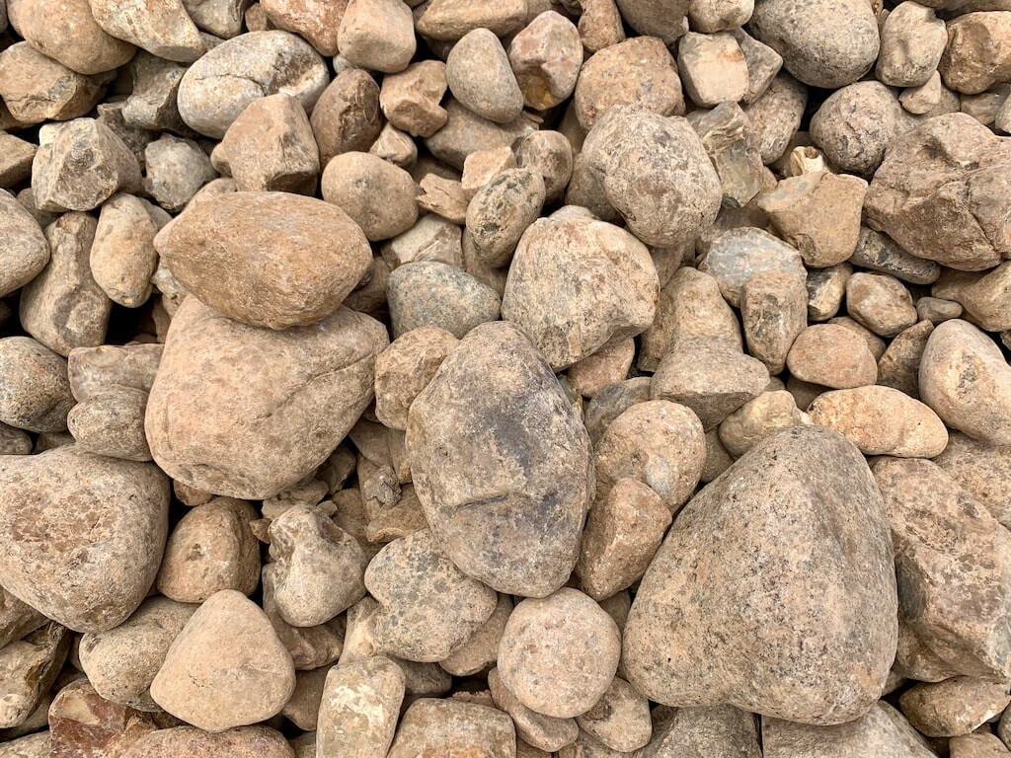
Notes:
This is a non-example of a species. Though the rocks all look similar, they are not able to reproduce.

Slide 36
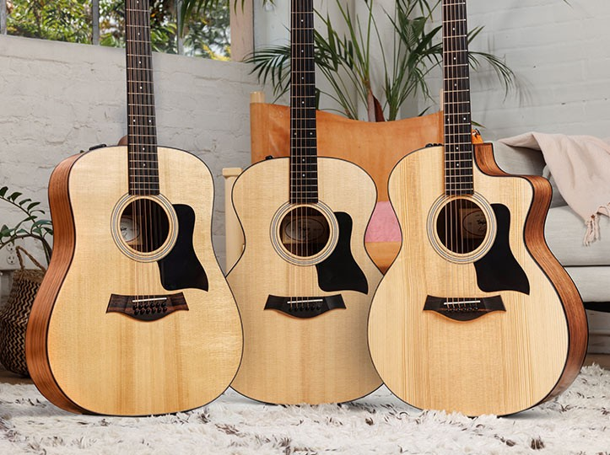
Notes:
This is also a non-example of a species. Though the acoustic guitars all look similar, they are not able to reproduce.

Slide 37
Notes:
Now let’s pause for a moment to check your understanding.

Slide 38
Which one is NOT an example of a species?
Bald Eagles
Acoustic Guitars
Green Sea Turtles
Notes:
Which one is NOT an example of a species?
[Acoustic guitars]

Slide 39
Which one is NOT an example of a species?
Bald Eagles
Acoustic Guitars
Green Sea Turtles
Notes:
Which one is NOT an example of a species? Acoustic guitars. The acoustic guitars look similar, but they are not able to reproduce.
[Acoustic guitars]

Slide 40
Remember!!!
Notes:
So remember!

Slide 41
Species: a group of similar organisms that can reproduce
Notes:
Species is a group of similar organisms that can reproduce.

Slide 42
Notes:
We will now complete this concept map, called a Frayer model, to summarize and further clarify what you have learned about the term species.

Slide 43
Definition
Picture
Species
Example
How does species impact my life?
Notes:
To complete the Frayer model, we will choose from four choices the correct picture, definition, example, and response to the question, “How does species impact my life?” Select the best response for each question using the information you just learned. As we select responses, we will see how this model looks filled in for the term species.

Slide 44
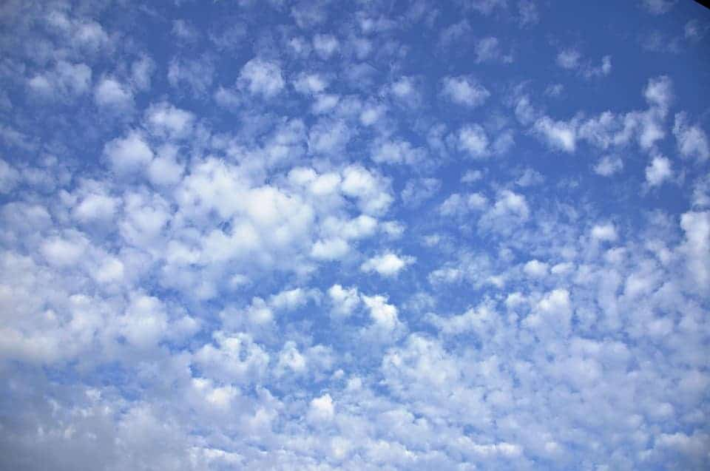
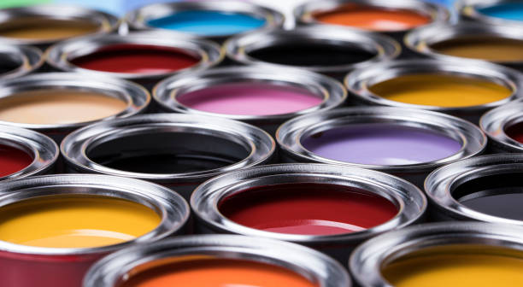
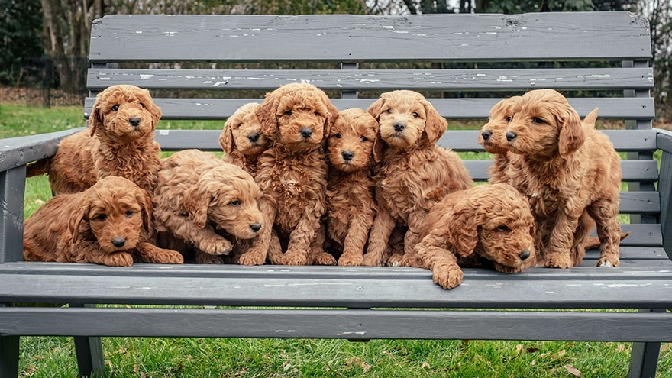
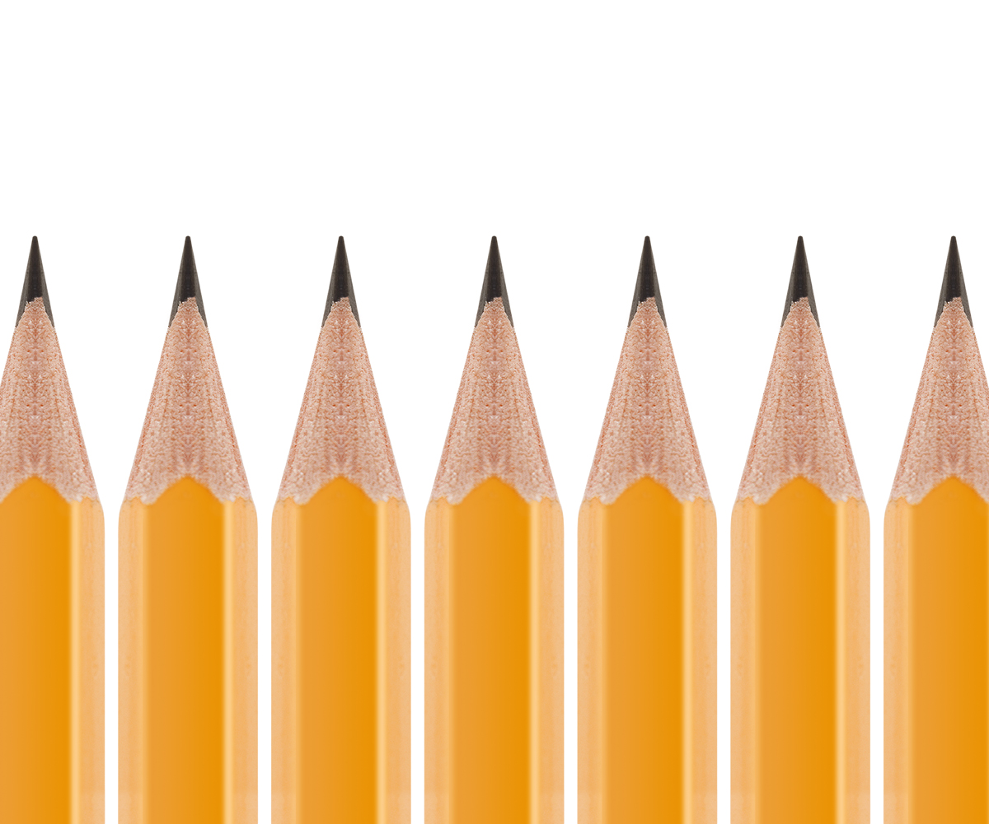
Directions: Choose the correct picture of species from the choices below.
A
B
C
D
Notes:
Choose the one correct picture of species from these four choices.

Slide 45
Directions: Choose the correct picture of species from the choices below.
A
B
C
D
Notes:
This is the picture that shows species.

Slide 46
Definition
Picture
Species
Example
How does species impact my life?
Notes:
Here is the Frayer model filled in with a picture of species.

Slide 47
Directions: Choose the correct definition of species from the choices below.
A
A group of different organisms
B
A group of similar organisms that can reproduce
C
A group of organisms that cannot reproduce
D
A group of non-living things
Notes:
Choose the one correct definition of species from these four choices.

Slide 48
Directions: Choose the correct definition of species from the choices below.
A
A group of different organisms
B
A group of similar organisms that can reproduce
C
A group of organisms that cannot reproduce
D
A group of non-living things
Notes:
“A group of similar organisms that can reproduce” is correct! This is the definition of species.

Slide 49
Definition
Picture
A group of similar organisms that can reproduce
Species
Example
How does species impact my life?
Notes:
Here is the Frayer Model with a picture and the definition filled in for species: A group of similar organisms that can reproduce

Slide 50
Directions: Choose the correct example of species from the choices below.
A
A group of similar books
B
A group of similar black bears
C
A group of similar cars
D
A group of similar trumpets
Notes:
Choose the one correct example of species from these four choices.

Slide 51
Directions: Choose the correct example of species from the choices below.
A
A group of similar books
B
A group of similar black bears
C
A group of similar cars
D
A group of similar trumpets
Notes:
“A group of similar black bears” is correct! This is an example of species.

Slide 52
Definition
Picture
A group of similar organisms that can reproduce
Species
A group of similar black bears
Example
How does species impact my life?
Notes:
Here is the Frayer Model with a picture, definition, and an example of species: A group of similar black bears.

Slide 53
Directions: Choose the correct response for “how does species impact my life?” from the choices below.
A
Species allow us to produce food
B
Species give us the ability to use our senses
C
We are a part of the human species
D
We use species to get to school
Notes:
Choose the one correct response for “how does species impact my life?” from these four choices.

Slide 54
Directions: Choose the correct response for “how does species impact my life?” from the choices below.
A
Species allow us to produce food
B
Species give us the ability to use our senses
C
We are a part of the human species
D
We use species to get to school
Notes:
“We are a part of the human species” That is correct! This is an example of how species impacts your life.

Slide 55
Definition
Picture
A group of similar organisms that can reproduce
Species
A group of similar black bears
We are a part of the human species
Example
How does species impact my life?
Notes:
Here is the Frayer Model with a picture, definition, example, and a correct response to “how does species impact my life?”: We are a part of the human species.

Slide 56
Remember!!!
Notes:
So remember!

Slide 57
Species: a group of similar organisms that can reproduce
Notes:
Species is a group of similar organisms that can reproduce.

Slide 58
Big Question: How do plants and animals interact with their environments?
Notes:
Let’s reflect once more on our big question. Our “big question” is: How do plants and animals interact with their environments?
Does anyone have any additional examples to share that haven’t been discussed yet?

Slide 59
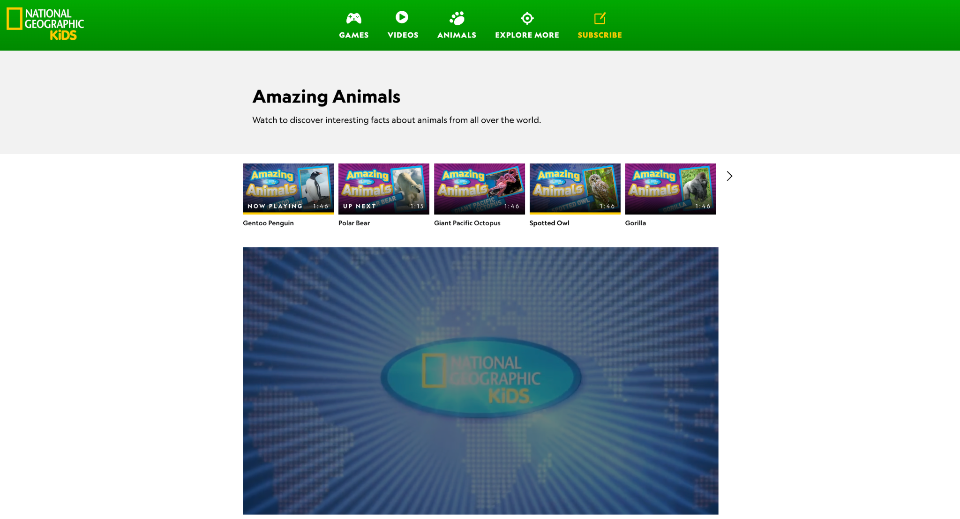
Species Activity
Species Videos
(National Geographic Kids)
Click the link to go to a series of videos about different animal species. Choose different animal species to learn a little bit more about them.
Jot down 1 or 2 facts about each species that you find interesting or new to you!
Notes:
Click the link to go to a series of videos about different animal species. Choose different animal species to learn a little bit more about them. Have students jot down 1 or 2 facts about each species that they find interesting or new to them. Have a discussion about these noticings after each video.

Slide 60
Notes:
Thanks for watching, and please continue watching CAPs available from this website.

Slide 61
This Was Created With Resources From:
Questions or Comments
Michael Kennedy, Ph.D. MKennedy@Virginia.edu
Rachel L Kunemund, Ph.D. rk8vm@virginia.edu

