Slide 1
Intro
“Big Idea” Question
Review Concepts
Check-In Questions
Teacher Demo
Vocabulary
Student-Friendly Definition
Examples & Non-Examples
Morphological Word Parts
Simulation/Activity
Notes:
OK everyone, get ready for our next lesson. Just as a reminder, these are the different components that our lesson may include, and you’ll see these icons in the top left corner of each slide so that you can follow along more easily!

Slide 2
Speed of Light
Intro
Notes:
Today we will learn about speed of light.

Slide 3
Big Question: What is the importance of the speed of light?
Notes:
Our “big question” is: What is the importance of the speed of light?
[Pause and illicit predictions from students.]
I love all these thoughtful scientific hypotheses! Be sure to keep this question and your predictions in mind as we move through this lesson, and we’ll revisit it.

Slide 4
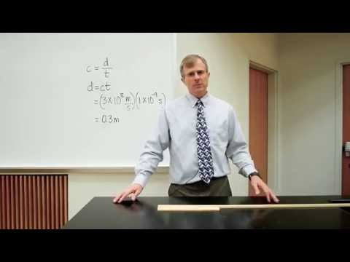
Demonstration
Light travels 30 cm in one nanosecond.
Notes:
Light travels 30 cm in one nanosecond.
Feedback: Keep in mind that you can use questions and opportunities to participate to keep students engaged. Engagement is key to promoting student understanding.

Slide 5
Notes:
Before we move on to our new vocabulary term, let’s review some other words & concepts that you already learned and make sure you are firm in your understanding.
Feedback: Referring to prior topics that are relevant and on topic helps students make connections to the new content they will be learning and tie it to prior knowledge.

Slide 6
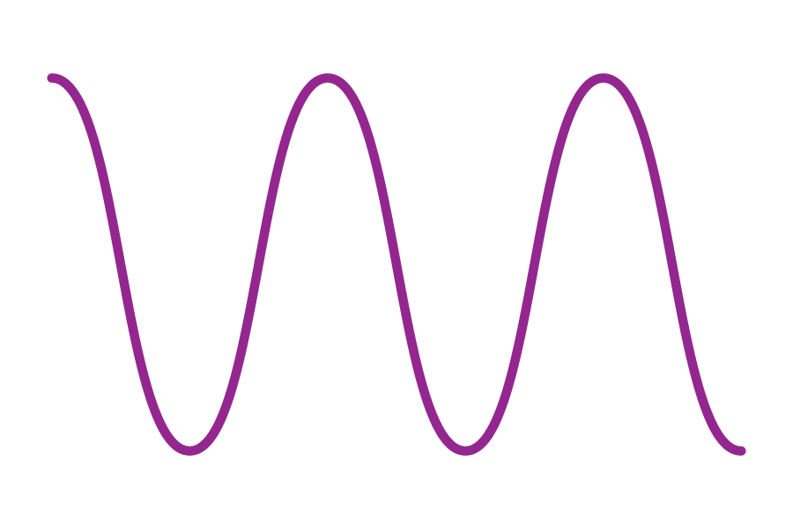
Waves: disturbances that travel through a medium, transporting energy from one location to another without transporting matter
Notes:
Waves are disturbances that travel through a medium, transporting energy from one location to another without transporting matter.

Slide 7
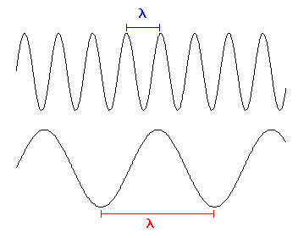
Wavelengths: the distance between two successive crests or troughs of a wave
Notes:
Wavelength is the distance between two successive crests or troughs of a wave.

Slide 8
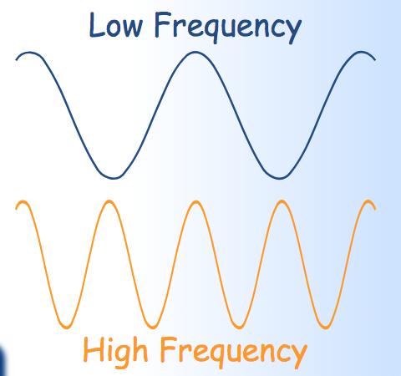
Frequency: the number of waves that pass a fixed point in unit time
Notes:
Frequency is the number of waves that pass a fixed point in unit time.

Slide 9
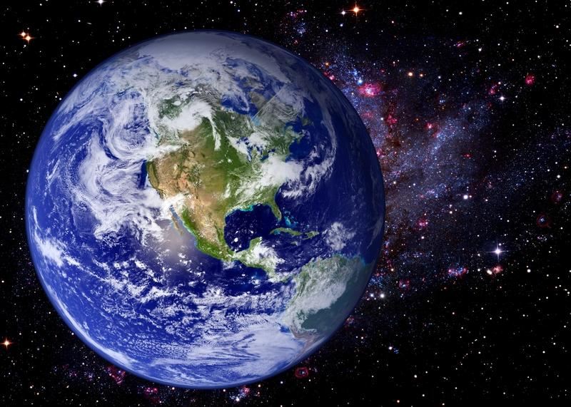
Medium: any material that waves can travel through
Notes:
A medium is any material that waves can travel through.

Slide 10
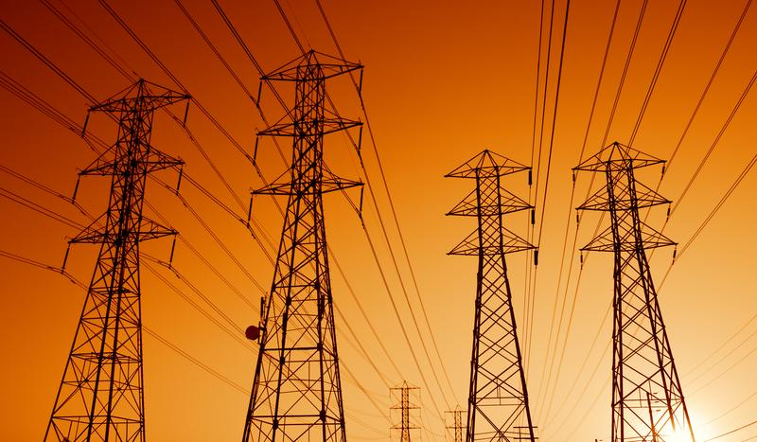
Electric Current: the movement of electrically charged particles
Notes:
Electric current is the movement of electrically charged particles.

Slide 11
Notes:
Now let’s pause for a moment to check your understanding.
Feedback: If you notice some students struggling to keep up when you activating prior knowledge, it is important to remember to make adjustments and scaffold your content to meet students current level of understanding.

Slide 12
Electric current is the ________ of electrically charged particles.
Notes:
Electric current is the ____________ of electrically charged particles.
[movement]

Slide 13
Electric current is the movement of electrically charged particles.
Notes:
Electric current is the movement of electrically charged particles.

Slide 14
What is the relationship between a medium and waves?
Notes:
What is the relationship between a medium and waves?
[A medium is any material that waves can travel through.]

Slide 15
What are waves?
Notes:
What are waves?
[Waves are disturbances that travel through a medium, transporting energy from one location to another without transporting matter.]

Slide 16
How are wavelength and frequency related?
Notes:
How are wavelength and frequency related?
[Wavelength and frequency are inversely related. The longer the wavelength, the lower the frequency of the wave. The shorter the wavelength, the higher the frequency of the wave.]

Slide 17
Speed of Light
Notes:
Now that we’ve reviewed, let’s define our new term, speed of light.

Slide 18
Speed of Light: the distance light can travel in a unit of time through a given substance
Notes:
The speed of light is the distance light can travel in a unit of time through a given substance.
Feedback: Longer more formal definitions are tricky so it is even more important to use clear language when providing the new definition.

Slide 19
Notes:
Let’s check-in for understanding.

Slide 20
What is the speed of light?
Notes:
What is the speed of light?
[The speed of light is the distance light can travel in a unit of time through a given substance.]

Slide 21
Notes:
That is the basic definition, but there is a bit more you need to know.

Slide 22
Speed of Light = Wavelength x Frequency
c = λ x ƒ
Notes:
The speed of light equals wavelength times frequency. Here we can also see the equation with the symbols for each.

Slide 23
Speed of Light = Wavelength x Frequency
c = λ x ƒ
Notes:
Remember, wavelength is the distance between two successive crests or troughs of a wave.

Slide 24
Speed of Light = Wavelength x Frequency
c = λ x ƒ
Notes:
Remember, frequency is the number of waves that pass a fixed point in unit time.

Slide 25
Notes:
Let’s check-in for understanding.

Slide 26
What is the equation for speed of light?
Notes:
What is the equation for speed of light?
[The speed of light equals wavelength times frequency]
Feedback: Remember, students might look like they are understanding the definition but it is important that you check for understanding yourself by asking questions or providing them with other opportunities to respond.

Slide 27
Notes:
Now, let’s talk about some examples of speed of light.
Feedback: Remember to try and use phrasing and language that is clear and easy for students to understand when going over examples of term meaning.

Slide 28
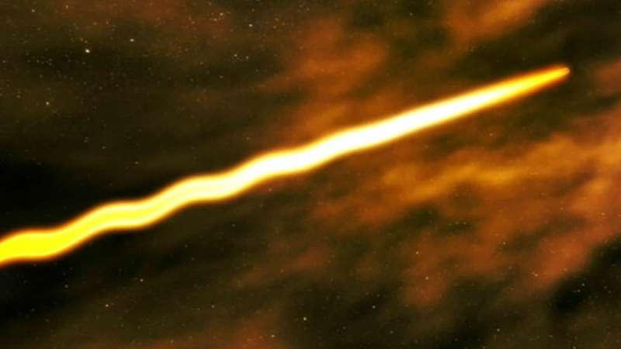
Notes:
The speed of light in a vacuum is about 300,000 km per second.

Slide 29
Notes:
In water, light slows down and only travels at about 225,000 km per second.

Slide 30
Notes:
In glass, light slows down even more to about 200,000 km per second.

Slide 31
Notes:
Let’s check-in for understanding.

Slide 32
How does the speed of light change in different substances?
Notes:
How does the speed of light change in different substances?
[The speed of light depends on the medium the waves are traveling through. Light travels fastest in a vacuum]

Slide 33
How do we define the speed of light?
Notes:
How do we define the speed of light?
[The speed of light is the distance light can travel in a unit of time through a given substance.]
Feedback: When introducing new vocabularies, it is crucial to require the students to give out their own interpretation. I would strongly encourage you to ask students to explain the concept in their own words.

Slide 34
In a vacuum, light can travel at ______ km per second
Notes:
In a vacuum, light can travel at ______ km per second.
[300,000]

Slide 35
In a vacuum, light can travel at 300,000 km per second
Notes:
In a vacuum, light can travel at 300,000 km per second.

Slide 36
What is the equation for speed of light?
C = λ / ƒ
C = λ x ƒ
C = ƒ / λ
Notes:
What is the equation for speed of light?
[C = λ x ƒ]

Slide 37
What is the equation for speed of light?
C = λ / ƒ
C = λ x ƒ
C = ƒ / λ
Notes:
What is the equation for speed of light?
[C = λ x ƒ]

Slide 38
Remember!!!
Notes:
So remember!

Slide 39
Speed of Light: the distance light can travel in a unit of time through a given substance
Notes:
The speed of light is the distance light can travel in a unit of time through a given substance.

Slide 40
Speed of Light = Wavelength x Frequency
c = λ x ƒ
Notes:
The speed of light equals wavelength times frequency. Here we can also see the equation with the symbols for each.

Slide 41
Big Question: What is the importance of speed of light?
Notes:
Explicit cue to revisit the big question at the end of the lesson: Okay everyone. Now that we’ve learned the term, let’s reflect once more on our big question. Was there anything that we predicted earlier that was correct or incorrect? Do you have any new hypotheses to share?
Feedback: Providing your students with some reflection time at the end of the lesson is crucial in helping them to put the pieces together and make sense of the content.

Slide 42
Notes:
Thanks for watching, and please continue watching CAPs available from this website.

Slide 43
This Video Created With Resources From:
Questions or Comments
Michael Kennedy, Ph.D. MKennedy@Virginia.edu
Rachel L Kunemund, Ph.D. rk8vm@virginia.edu

