Slide 1
Intro
“Big Idea” Question
Review Concepts
Check-In Questions
Teacher Engagement
Vocabulary
Student-Friendly Definition
Examples & Non-Examples
Frayer Model
Simulation/Activity
Notes:
OK everyone, get ready for our next lesson. Just as a reminder, these are the different components that our lesson may include, and you’ll see these icons in the top left corner of each slide so that you can follow along more easily!

Slide 2
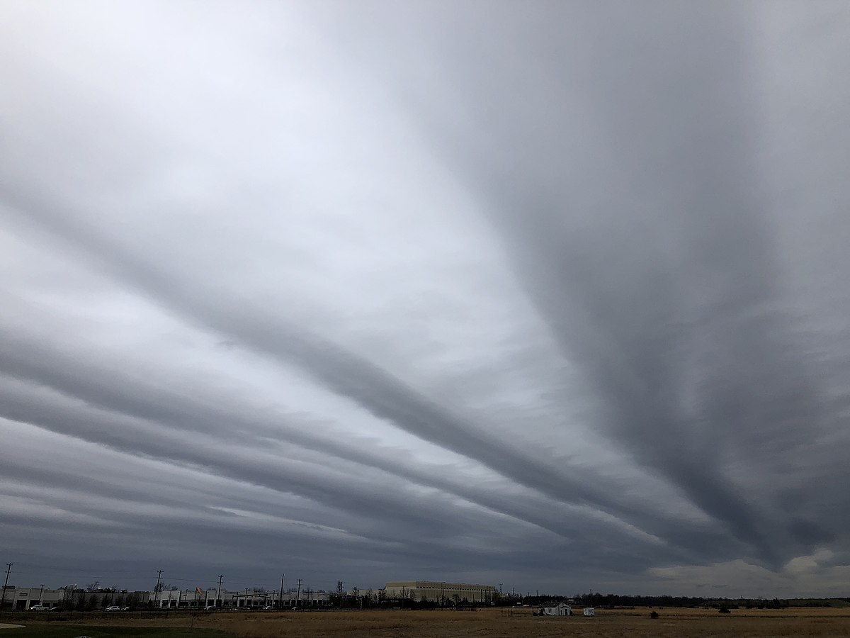
Intro
Stratus clouds
Notes:
Today, we’ll be learning about the phrase: Stratus clouds.

Slide 3
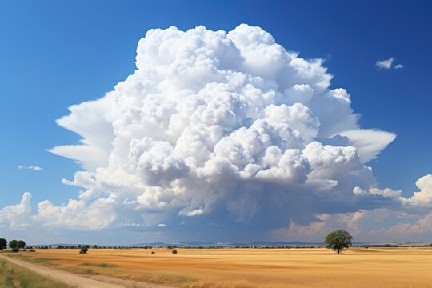
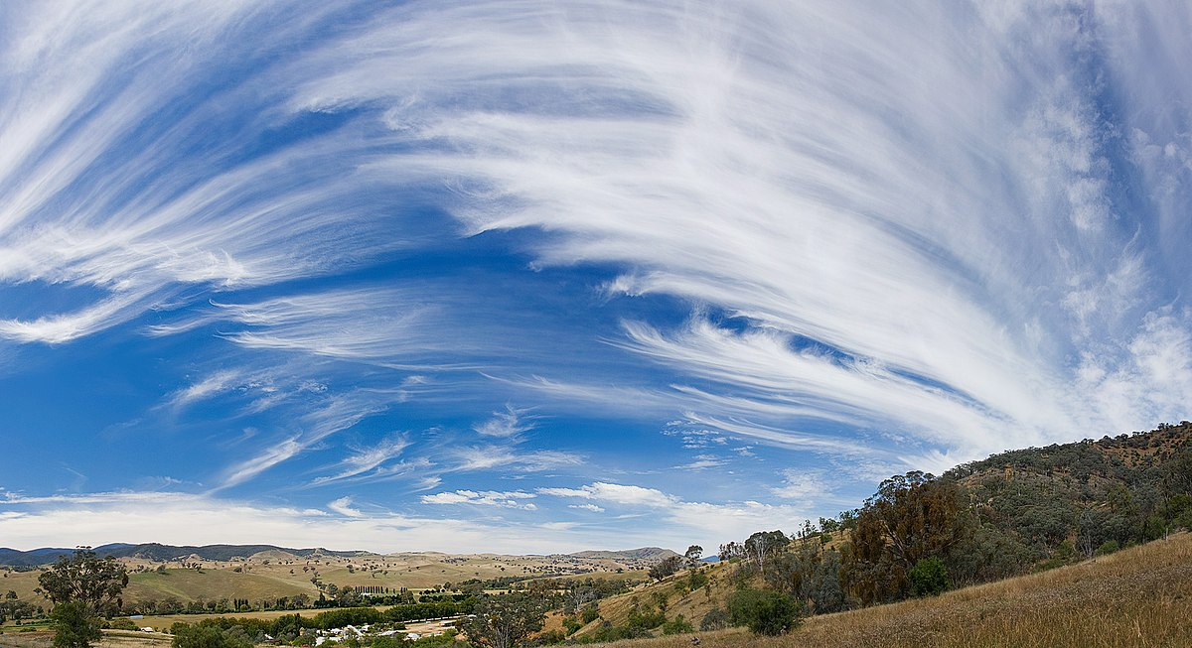
Big Question: How can I predict weather events by tracking weather conditions?
Notes:
Our “big question” is: How can I predict weather events by tracking weather conditions?
[Pause and illicit predictions from students.]
I love all these thoughtful scientific hypotheses! Be sure to keep this question and your predictions in mind as we move through these next few lessons, and we’ll continue to revisit it.

Slide 4
Notes:
Before we move on to our new topic, let’s review some other words & concepts that you already learned and make sure you are firm in your understanding.

Slide 5
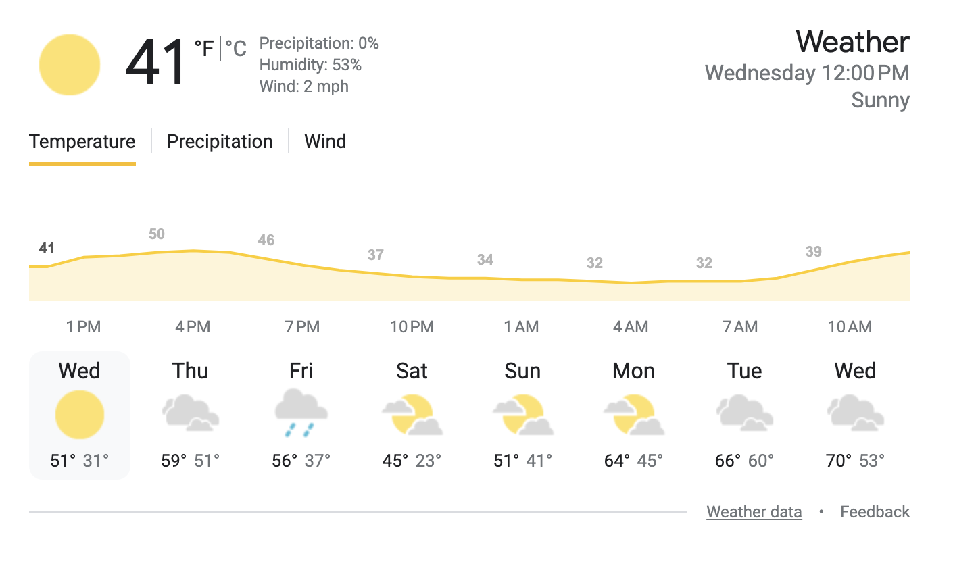
Forecast: A prediction or guess of what the weather will be
Notes:
Forecast is a prediction or guess of what the weather will be.

Slide 6
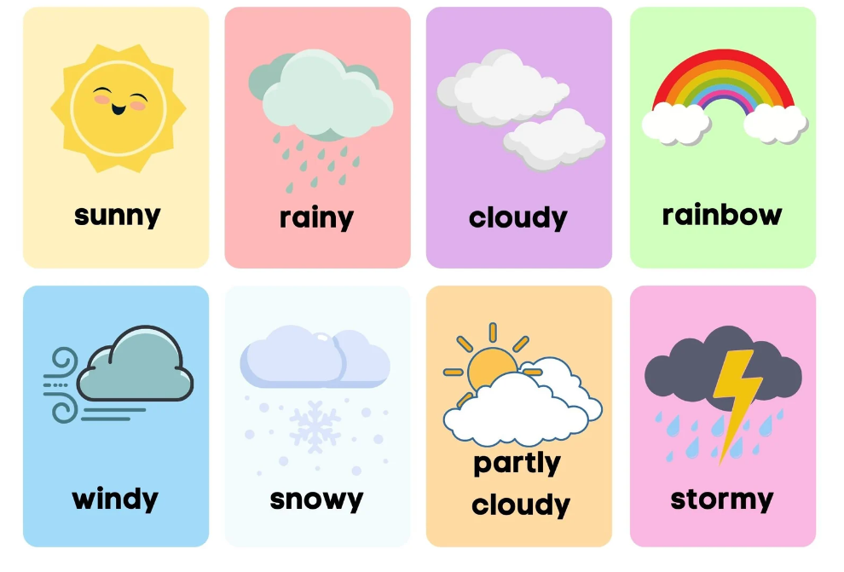
Weather: What is happening in the air outside
Notes:
Weather is what is happening in the air outside

Slide 7
Cumulus clouds: fluffy, white clouds with flat bottoms
Notes:
Cumulus clouds are fluffy, white clouds with flat bottoms.

Slide 8
Cumulonimbus clouds: large, tall clouds with dark bottoms
Notes:
Cumulonimbus clouds are large, tall clouds with dark bottoms.

Slide 9
Notes:
Now let’s pause for a moment to review the information we have covered already.

Slide 10
A forecast is a _______ or guess of what the weather will be.
prediction
fact
Notes:
A forecast is a ________ or guess of what the weather will be.
[A. prediction]

Slide 11
A forecast is a _______ or guess of what the weather will be.
prediction
fact
Notes:
A forecast is a ________ or guess of what the weather will be.
[A. prediction]

Slide 12
Weather is what is happening in the air outside. What words describe the weather in the boxes below?
Notes:
Weather is what is happening in the air outside. What words describe the weather in the boxes below?
[sunny, rainy, cloudy, stormy, snowy, windy]

Slide 13
Weather is what is happening in the air outside. What words describe the weather in the boxes below?
Notes:
Weather is what is happening in the air outside. What words describe the weather in the boxes below?
[sunny, rainy, cloudy, stormy, snowy, windy]

Slide 14
Cumulus clouds are ______, white clouds with flat bottoms.
fluffy
wispy
Notes:
Cumulus clouds are ______, white clouds with flat bottoms.
[A. fluffy]

Slide 15
Cumulus clouds are ______, white clouds with flat bottoms.
fluffy
wispy
Notes:
Cumulus clouds are ______, white clouds with flat bottoms.
[A. fluffy]

Slide 16
Cumulonimbus clouds are large, ______ clouds with dark bottoms.
short
tall
Notes:
Cumulonimbus clouds are large, ______ clouds with dark bottoms.
[B. tall]

Slide 17
Cumulonimbus clouds are large, ______ clouds with dark bottoms.
short
tall
Notes:
Cumulonimbus clouds are large, ______ clouds with dark bottoms.
[B. tall]

Slide 18
Stratus clouds
Notes:
Now that we’ve reviewed, let’s define the phrase stratus clouds.

Slide 19
Stratus clouds: smooth, gray clouds that cover the whole sky
Notes:
Stratus clouds are smooth, gray clouds that cover the whole sky.

Slide 20
Notes:
Let’s check-in for understanding.

Slide 21
What are stratus clouds?
Notes:
What are stratus clouds?
[Smooth, gray clouds that cover the whole sky.]

Slide 22
Notes:
That is the basic definition, but there is a bit more you need to know.

Slide 23
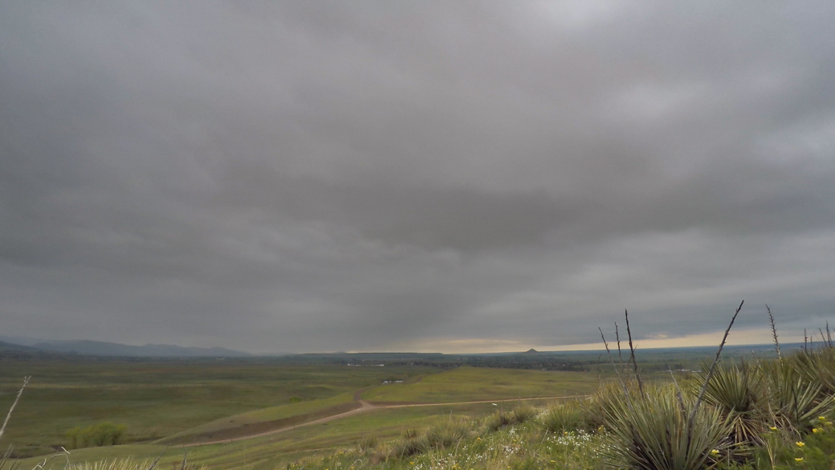
Because stratus clouds cover the whole sky, they block out direct sunlight.
Notes:
Because stratus clouds cover the whole sky, they block out direct sunlight.

Slide 24
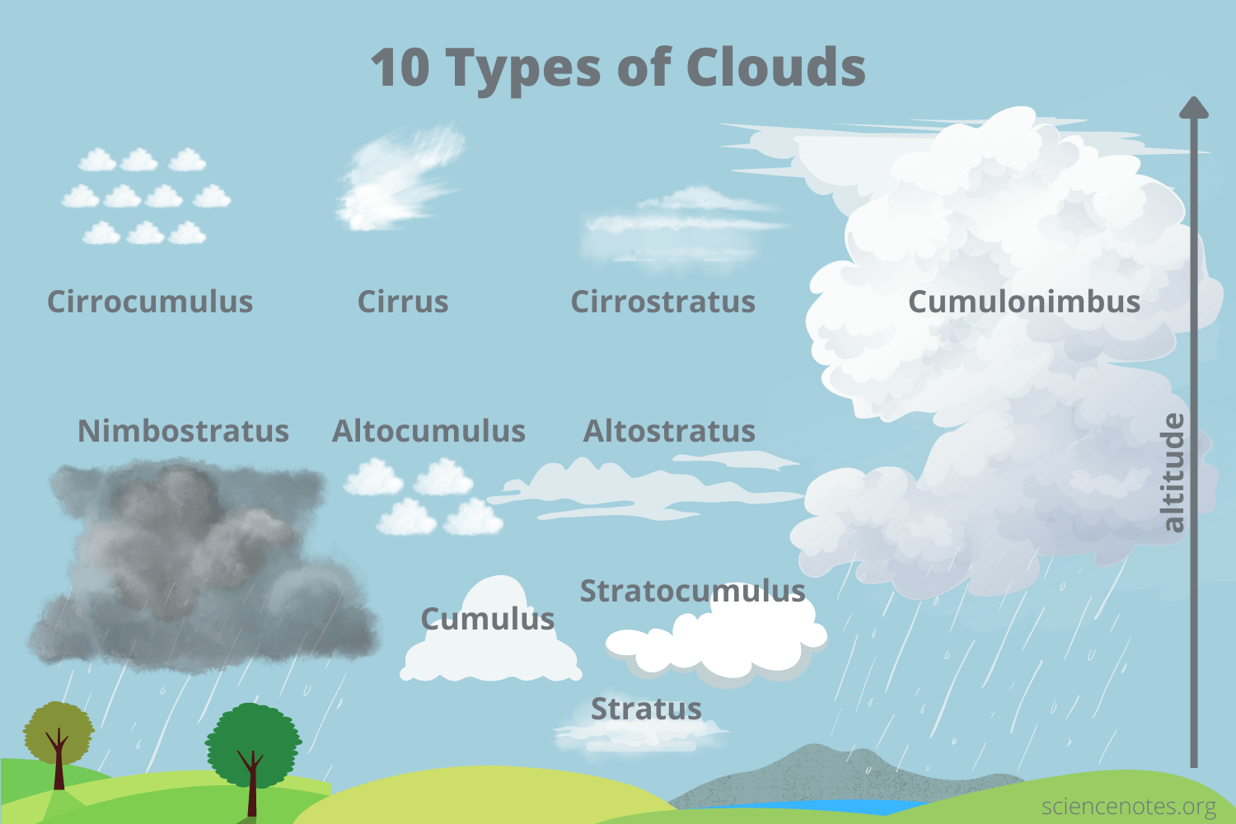
Stratus clouds are low-level clouds. They often form below 6,500 feet in altitude.
low
level
Notes:
Stratus clouds are low-level clouds. They often form below 6,500 feet in altitude.

Slide 25
Light rain and drizzle are usually associated with stratus clouds.
Notes:
Light rain and drizzle are usually associated with stratus clouds.

Slide 26
Notes:
Let’s check-in for understanding.

Slide 27
True or false: Because stratus clouds cover the whole sky, they block out direct sunlight.
True
False
Notes:
True or false: Because stratus clouds cover the whole sky, they block out direct sunlight.
[A. True]

Slide 28
True or false: Because stratus clouds cover the whole sky, they block out direct sunlight.
True
False
Notes:
True or false: Because stratus clouds cover the whole sky, they block out direct sunlight.
[A. True]

Slide 29
Stratus clouds are _____-level clouds. They often form below 6,500 feet in altitude.
low
medium
high
Notes:
Stratus clouds are ______-level clouds. They often form below 6,500 feet in altitude.
[A. low]

Slide 30
Stratus clouds are _____-level clouds. They often form below 6,500 feet in altitude.
low
medium
high
low
Notes:
Stratus clouds are ______-level clouds. They often form below 6,500 feet in altitude.
[A. low]

Slide 31
True or false: Heavy rain and downpours are usually associated with stratus clouds.
True
False
Notes:
True or false: Heavy rain and downpours are usually associated with stratus clouds.
[A. False - light rain and drizzle]

Slide 32
True or false: Heavy rain and downpours are usually associated with stratus clouds.
True
False
Notes:
True or false: Heavy rain and downpours are usually associated with stratus clouds.
[A. False - light rain and drizzle]

Slide 33
Notes:
Now, let’s talk about some examples of stratus clouds.

Slide 34
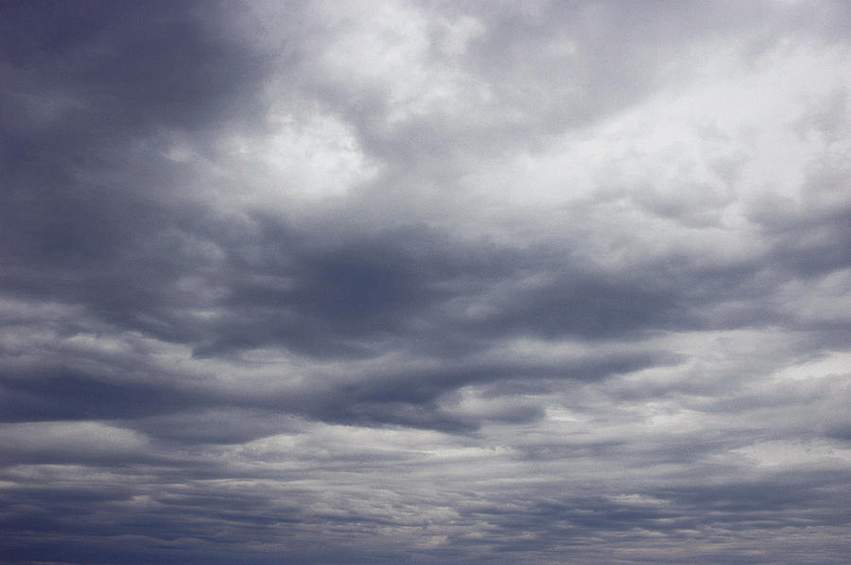
This is an example of stratus clouds. They are smooth, gray clouds that cover the whole sky.
Notes:
This is an example of stratus clouds. They are smooth, gray clouds that cover the whole sky.

Slide 35
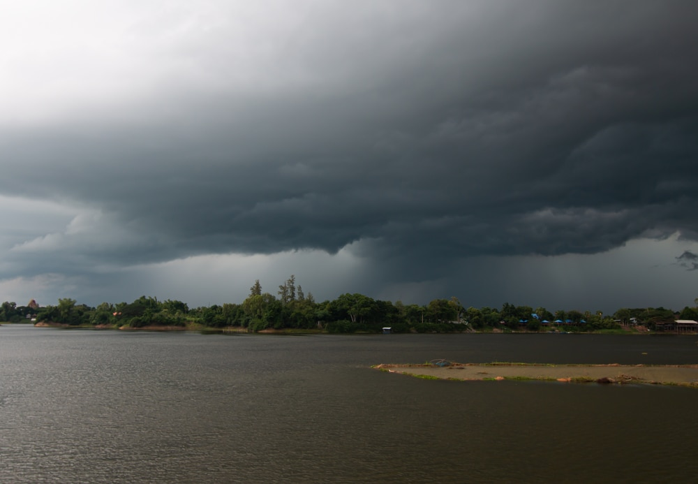
This is also an example of stratus clouds. They are smooth, gray clouds that cover the whole sky.
Notes:
This is also an example of stratus clouds. They are smooth, gray clouds that cover the whole sky.

Slide 36
Notes:
Now, let’s talk about some non-examples of stratus clouds.

Slide 37
These are not stratus clouds. They are not smooth, gray clouds that cover the whole sky.
Notes:
These are not stratus clouds. They are not smooth, gray clouds that cover the whole sky.

Slide 38
These are also not stratus clouds. They are not smooth, gray clouds that cover the whole sky.
Notes:
These are also not stratus clouds. They are not smooth, gray clouds that cover the whole sky.

Slide 39
Notes:
Now let’s pause for a moment to check your understanding.

Slide 40
Which picture shows stratus clouds?
Notes:
Which picture shows stratus clouds?
[The right picture.]

Slide 41
Which picture shows stratus clouds?
Notes:
Which picture shows stratus clouds?
[The right picture.]

Slide 42
Remember!!!
Notes:
So remember!

Slide 43
Stratus clouds: smooth, gray clouds that cover the whole sky
Notes:
Stratus clouds are smooth, gray clouds that cover the whole sky.

Slide 44
Notes:
We will now complete this concept map, called a Frayer model, to summarize and further clarify what you have learned about the term stratus clouds.

Slide 45
Definition
Picture
Stratus
clouds
Example
How do stratus clouds impact my life?
Notes:
To complete the Frayer model, we will choose from four choices the correct picture, definition, example, and response to the question, “How do stratus clouds impact my life?” Select the best response for each question using the information you just learned. As we select responses, we will see how this model looks filled in for the term stratus clouds.

Slide 46
Directions: Choose the correct picture of stratus clouds from the choices below.
A
B
C
D
Notes:
Choose the correct picture of stratus clouds from the choices below.

Slide 47
Directions: Choose the correct picture of stratus clouds from the choices below.
A
B
C
D
Notes:
Choose the correct picture of stratus clouds from the choices below.

Slide 48
Definition
Picture
Stratus
clouds
Example
How do stratus clouds impact my life?
Notes:
Here is the Frayer model filled in with a picture of stratus clouds.

Slide 49
Directions: Choose the correct definition of stratus clouds from the choices below.
A
Large, tall clouds with dark bottoms
B
High, feathery clouds
C
Fluffy, white clouds with flat bottoms
D
Smooth, gray clouds that cover the whole sky
Notes:
Choose the correct definition of stratus clouds from the choices below.

Slide 50
Directions: Choose the correct definition of stratus clouds from the choices below.
A
Large, tall clouds with dark bottoms
B
High, feathery clouds
C
Fluffy, white clouds with flat bottoms
D
Smooth, gray clouds that cover the whole sky
Notes:
Choose the correct definition of stratus clouds from the choices below.
[D. Smooth, gray clouds that cover the whole sky.]

Slide 51
Definition
Picture
Smooth, gray clouds that cover the whole sky
Stratus
clouds
Example
How do stratus clouds impact my life?
Notes:
Here is the Frayer Model with a picture and the definition filled in for stratus clouds: Smooth, gray clouds that cover the whole sky.

Slide 52
Directions: Choose the correct example of stratus clouds from the choices below.
A
Small clouds that look like cotton balls
B
Large clouds that look stormy
C
Clouds high in the sky that look wispy
D
Clouds that look like a big gray blanket across the sky
Notes:
Choose the correct example of stratus clouds from the choices below.

Slide 53
Directions: Choose the correct example of stratus clouds from the choices below.
A
Small clouds that look like cotton balls
B
Large clouds that look stormy
C
Clouds high in the sky that look wispy
D
Clouds that look like a big gray blanket across the sky
Notes:
“Clouds that look like a big gray blanket across the sky” is correct! This is an example of stratus clouds.

Slide 54
Definition
Picture
Smooth, gray clouds that cover the whole sky
Stratus
clouds
Clouds that look like a big gray blanket across the sky
Example
How do stratus clouds impact my life?
Notes:
Here is the Frayer Model with a picture, definition, and an example of stratus clouds: Clouds that look like a big gray blanket across the sky.

Slide 55
Directions: Choose the correct response for “How do stratus clouds impact my life?” from the choices below.
A
Stratus clouds tell me to look out for a severe storm.
B
Stratus clouds tell me to expect some snow.
C
Stratus clouds tell me that I might not see the sun today.
D
Stratus clouds tell me that it is going to be nice outside.
Notes:
Choose the one correct response for “how do stratus clouds impact my life?” from these four choices.

Slide 56
Directions: Choose the correct response for “How do stratus clouds impact my life?” from the choices below.
A
Stratus clouds tell me to look out for a severe storm.
B
Stratus clouds tell me to expect some snow.
C
Stratus clouds tell me that I might not see the sun today.
D
Stratus clouds tell me that it is going to be nice outside.
Notes:
“Stratus clouds tell me that I might not see the sun today.” That is correct! This is an example of how stratus clouds impact your life.

Slide 57
Definition
Picture
Smooth, gray clouds that cover the whole sky
Stratus
clouds
Clouds that look like a big gray blanket across the sky
Stratus clouds tell me that I might not see the sun today.
Example
How do stratus clouds impact my life?
Notes:
Here is the Frayer Model with a picture, definition, example, and a correct response to “how do stratus clouds impact my life?”: Stratus clouds tell me that I might not see the sun today.

Slide 58
Remember!!!
Notes:
So remember!

Slide 59
Stratus clouds: smooth, gray clouds that cover the whole sky
Notes:
Stratus clouds are smooth, gray clouds that cover the whole sky.

Slide 60
Big Question: How can I predict weather events by tracking weather conditions?
Notes:
Our “big question” is: How can I predict weather events by tracking weather conditions?
Does anyone have any additional examples to share that haven’t been discussed yet?
I love all these thoughtful scientific hypotheses! Be sure to keep this question and your predictions in mind as we move through these next few lessons, and we’ll continue to revisit it.

Slide 61
Extension Activity
Stratus Clouds
Extension Video
Click the link above for an extension video on stratus clouds.
Jot down 2 or 3 new facts that you learn about stratus clouds.
Discuss them as a class.
Notes:
Click the link above for an extension video on stratus clouds. Jot down 2 or 3 new facts that you learn about stratus clouds. Discuss them as a class.

Slide 62
Notes:
Thanks for watching, and please continue watching CAPs available from this website.

Slide 63
This Was Created With Resources From:
Questions or Comments
Michael Kennedy, Ph.D. MKennedy@Virginia.edu
Rachel L Kunemund, Ph.D. rk8vm@virginia.edu

