Slide 1
Intro
“Big Idea” Question
Review Concepts
Check-In Questions
Teacher Demo
Vocabulary
Student-Friendly Definition
Examples & Non-Examples
Morphological Word Parts
Simulation/Activity
Notes:
OK everyone, get ready for our next lesson. Just as a reminder, these are the different components that our lesson may include, and you’ll see these icons in the top left corner of each slide so that you can follow along more easily!

Slide 2
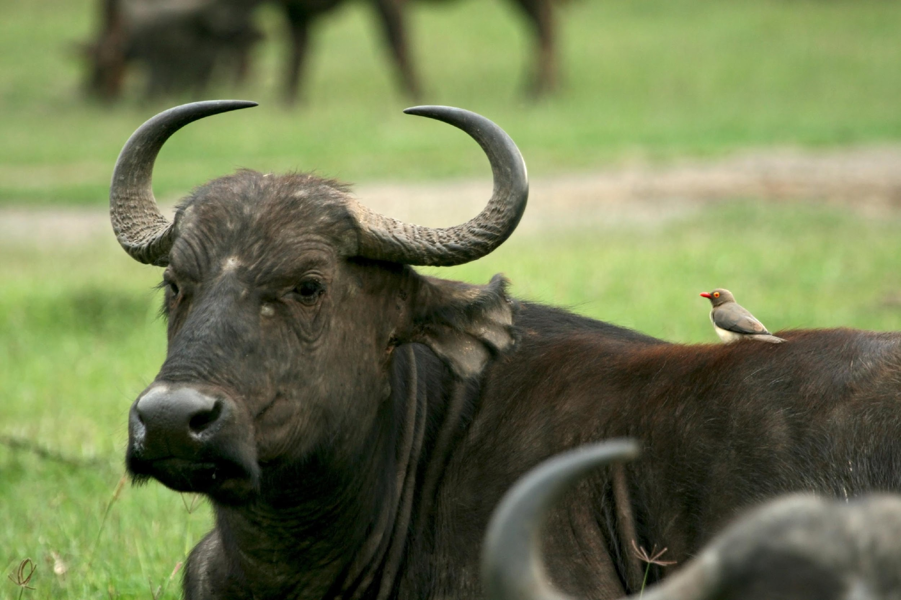
Symbiotic Relationships
Intro
Mutualism, commensalism, and parasitism
Notes:
Today we will learn about symbiotic relationships. This includes three types of relationships: mutualism, commensalism, and parasitism

Slide 3
Big Questions: What types of reactions do organisms within an ecosystem share and how do these interactions affect individual fitness?
Notes:
Our “big question” is: What types of interactions do organisms within an ecosystem share and how do these interactions affect individual fitness?
[Pause and illicit predictions from students.]
I love all these thoughtful scientific hypotheses! Be sure to keep this question and your predictions in mind as we move through these next few lessons, and we’ll continue to revisit it.

Slide 4
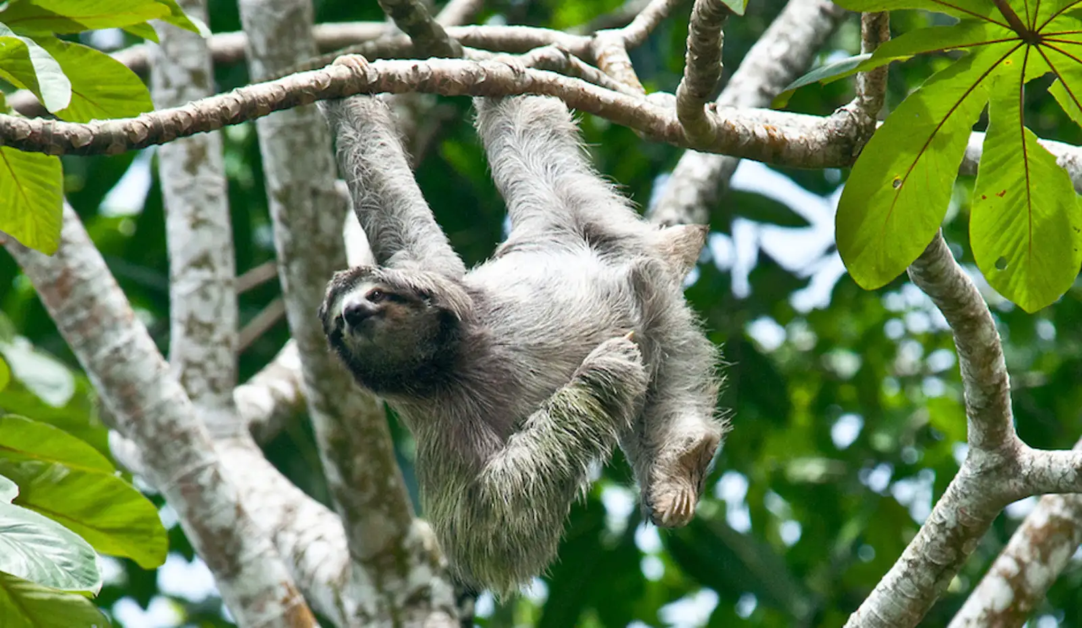
Demonstration
Moths and Sloths: A Strange Relationship
Linked above is an article describing the symbiotic relationship between sloths and moths. This example is a great way to get students interested in the topic and to engage their prior knowledge about types of relationships. You may choose to have students read the article with a partner or to go through the article as a class with check-in questions. In the speaker notes is an explanation of how one teacher uses the article as a warm-up. This warm-up was taken from the BetterLesson website linked here.
Notes:
I begin this lesson asking if students know what sloths are. I allow for a student or two to describe them, and once students have done so, I show this undeniably cute picture with an overhead projector. After the "awww... so cute!" comments die down, I ask my largely Spanish speaking population if they know the Spanish word for sloths. Some students may offer the answer if they know, but if not, I let them know that a sloth is called a perezoso in Spanish. I then ask students what else the word perezoso means and they tend to quickly reply, "lazy". I then let them know that the word sloth can also mean lazy in English too.
I then ask students to reflect on what they know about sloths and why they may be called by names synonymous with laziness in more than one language. Answers will vary, but most students will offer that sloths are slow moving animals that tend to spend most of their time up in trees.
I build on this prior knowledge to set up the lesson by saying, "Yes, sloths are pretty lazy... so lazy, in fact, that they only come down from the trees to use the bathroom once per week." I then tell them that one possible explanation of why they come down so infrequently is that they are more exposed to dangerous predators on the ground and are much safer in the trees. I then ask students if this is the case, why would they ever come down? Why not just do like birds do and let gravity take care of their business?
I allow students to offer a few potential explanations before I show them this considerably less cute picture of a sloth on one of its weekly trips to the restroom. Students usually ask, "what's wrong with it?", but if they don't offer a question, I'll guide them with, "what's different about this sloth?" They tend to point out that it's fur looks kind of nasty and has green stuff in it. I assure them that nothing's wrong with this sloth, it's engaging in behavior that helps it survive, but that the answer to why it comes out of the trees so infrequently (and at all, considering it's more vulnerable to predators on the ground), and why it's fur looks kind of green depend on understanding the web of symbiotic relationships that sloths find themselves enmeshed with other species.
I let the students know that we're going to answer these questions by reading an article, but that first we'll need to review some of the different types of symbiotic relationships we discussed in the previous lesson.

Slide 5
Notes:
Before we move on to our new vocabulary term, let’s review some other words & concepts that you already learned and make sure you are firm in your understanding.
Feedback: Cues are an important way to prepare students for what is coming next.

Slide 6
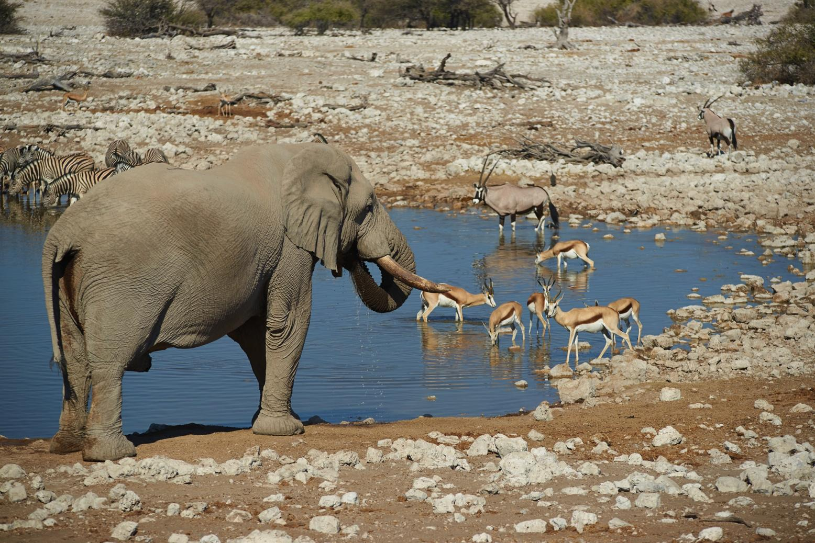
Community: when two or more organisms of different species interact in the same area
Notes:
A community is when two or more organisms of different species interact in the same area.

Slide 7
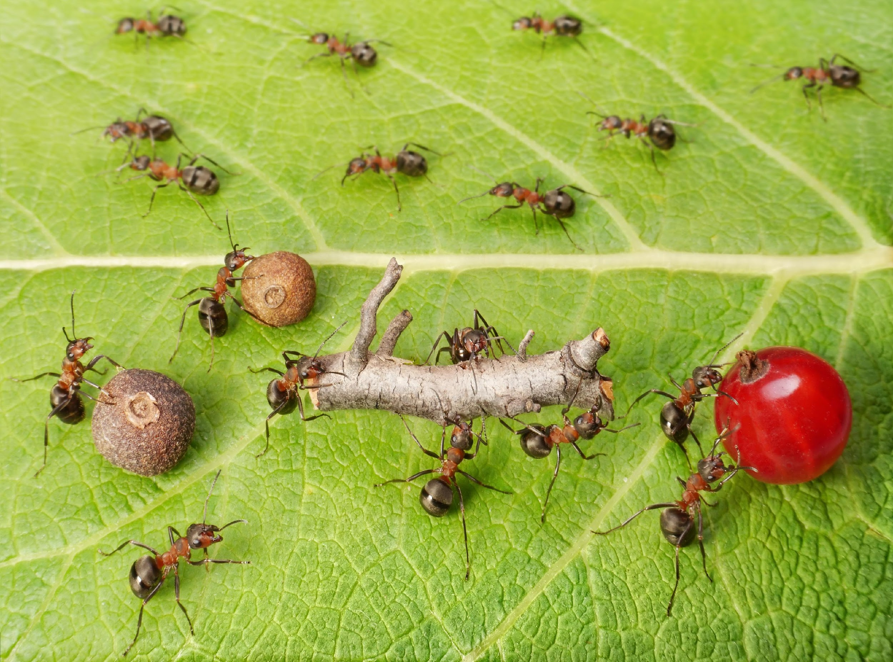
Friendly Relationships
Cooperation
Notes:
Some relationships within communities are friendly. Cooperation, as we see with these ants here, is a friendly relationship.

Slide 8
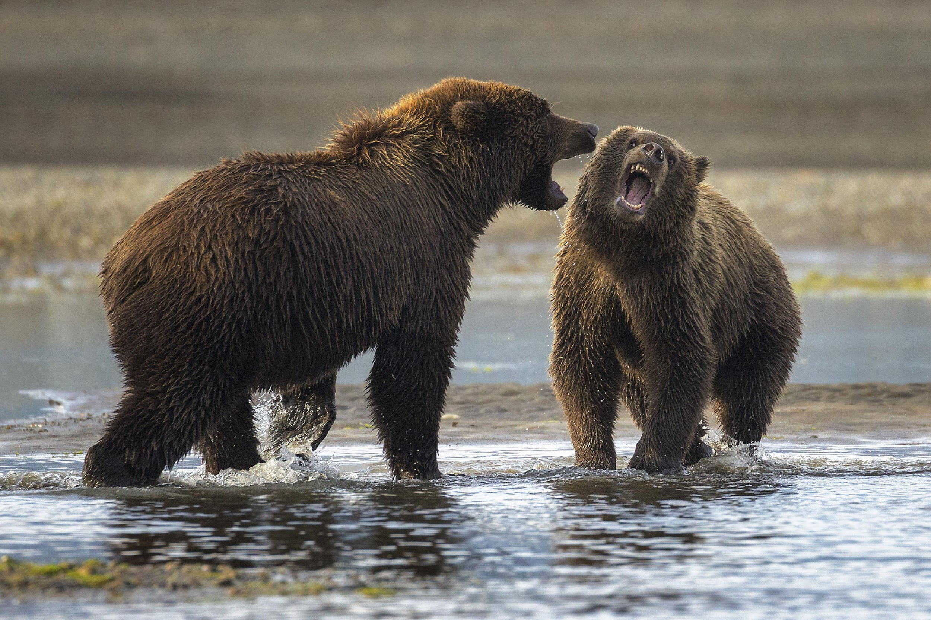
Hostile Relationships
Competition
Notes:
Some relationships within communities are hostile. Competition, as we see between these bears as they fight for territory, can be hostile.

Slide 9
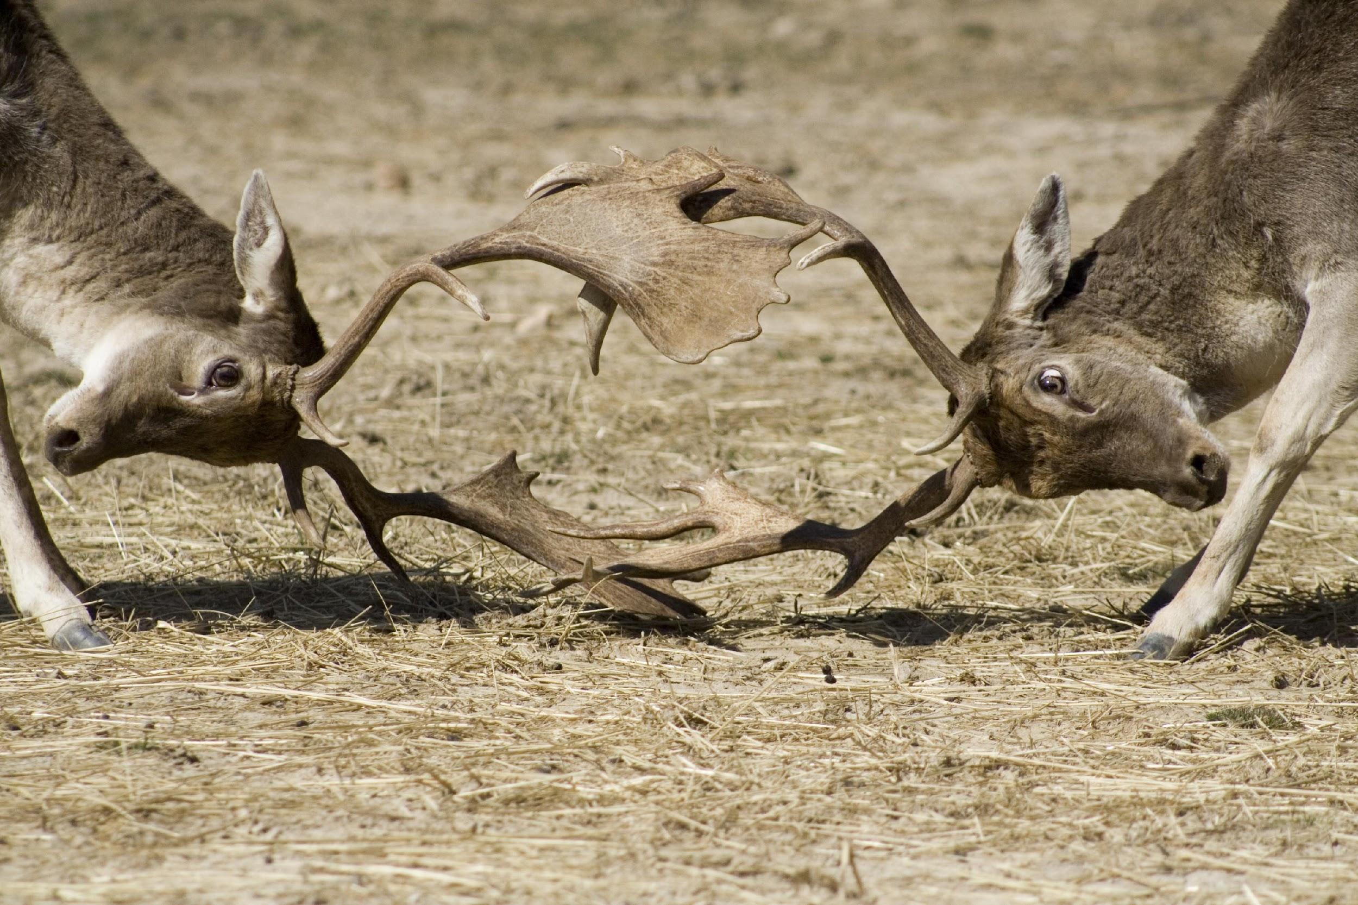
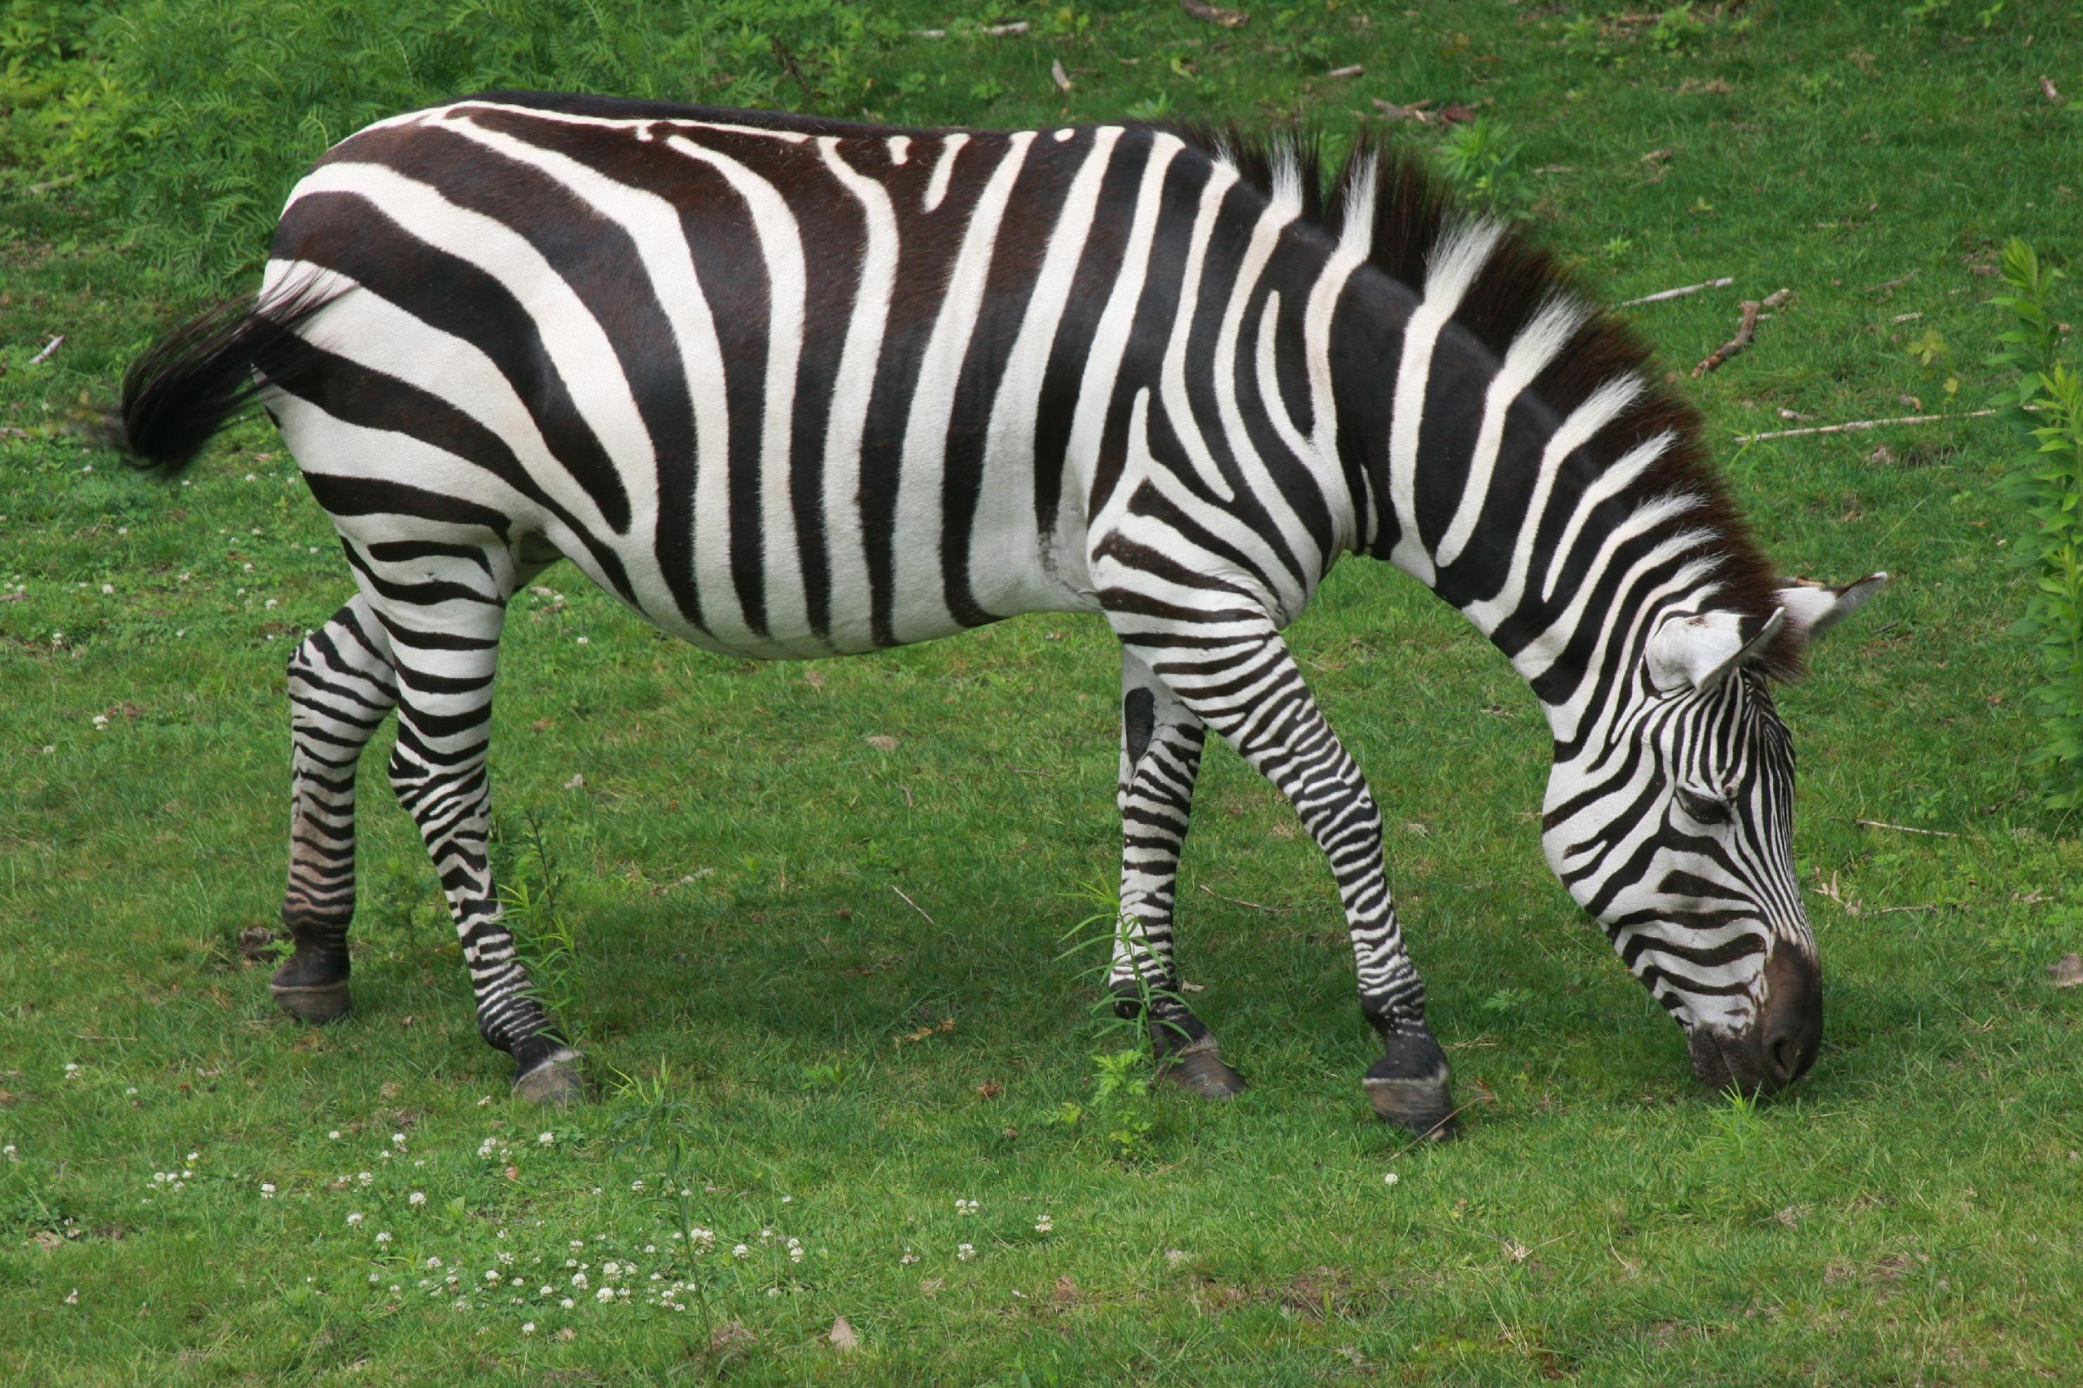
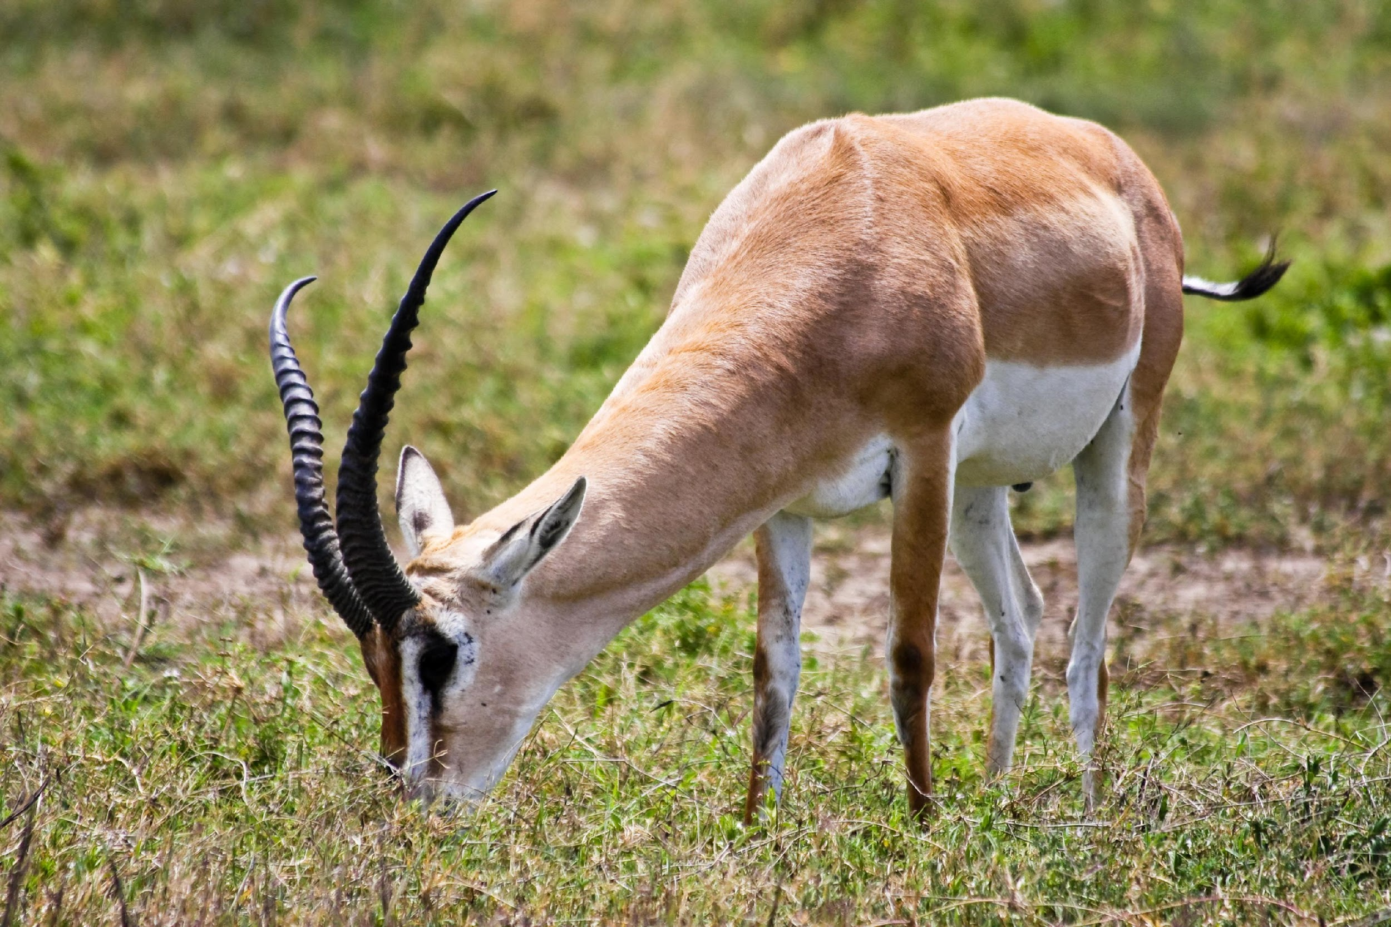
Same Species
Different Species
Notes:
Animals can compete or cooperate with others of the same species or different species.

Slide 10
Notes:
Now let’s pause for a moment to check your understanding.

Slide 11
What is a community?
Notes:
What is a community?
[A community is when two or more organisms of different species interact in the same area.]

Slide 12
Can you give an example of a friendly community relationship?
Notes:
Can you give an example of a friendly community relationship?
[Cooperation]

Slide 13
Can you give an example of a hostile community relationship?
Notes:
Can you give an example of a hostile community relationship?
[Competition]

Slide 14
Symbiotic Relationships
Notes:
Now let’s turn our attention to three special types of symbiotic relationships!

Slide 15
Symbiosis
Notes:
First, let’s define what symbiosis means.

Slide 16
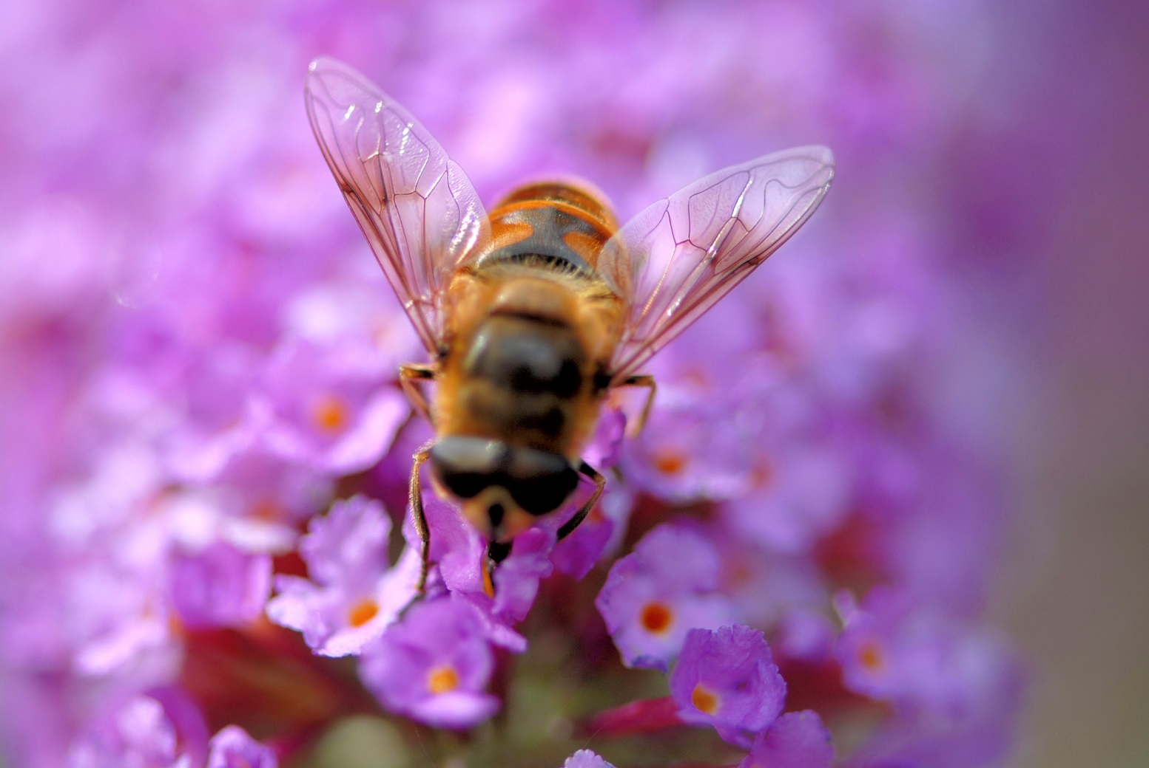
Symbiosis: a close, long term interaction between two or more species
Notes:
Symbiosis is a close, long term interaction between two or more species.

Slide 17
Notes:
Now let’s pause for a moment to check your understanding.

Slide 18
What is symbiosis?
Notes:
What is symbiosis?
[Symbiosis is a close, long term interaction between two or more species.]

Slide 19
Notes:
That is the basic definition, but there is a little more you need to know.

Slide 20
Bee
Flower
Notes:
This bee and this flower have a symbiotic relationship. The bee depends on the flower for food and the flower depends on the bee for spreading pollen to help it reproduce.

Slide 21
Notes:
Now let’s pause for a moment to check your understanding.

Slide 22
How are the bee and the flower an example of a symbiotic relationship?
Notes:
How are the bee and the flower an example of a symbiotic relationship?
[This bee and this flower have a symbiotic relationship. The bee depends on the flower for food and the flower depends on the bee for spreading pollen to help it reproduce.]

Slide 23
Notes:
Now, let’s look at some examples of symbiosis.

Slide 24
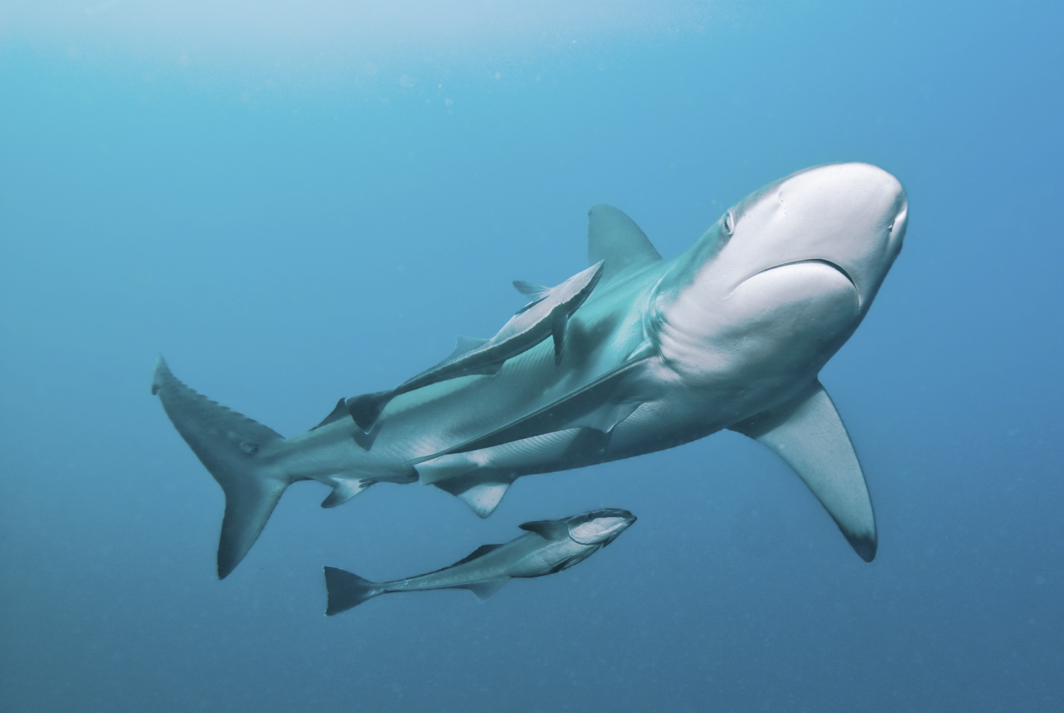
Notes:
This shark and the two remora fish are also an example of symbiosis. The remora fish eat leftover food that the shark leaves behind. In this example of symbiosis, the shark is unaffected by the relationship.

Slide 25
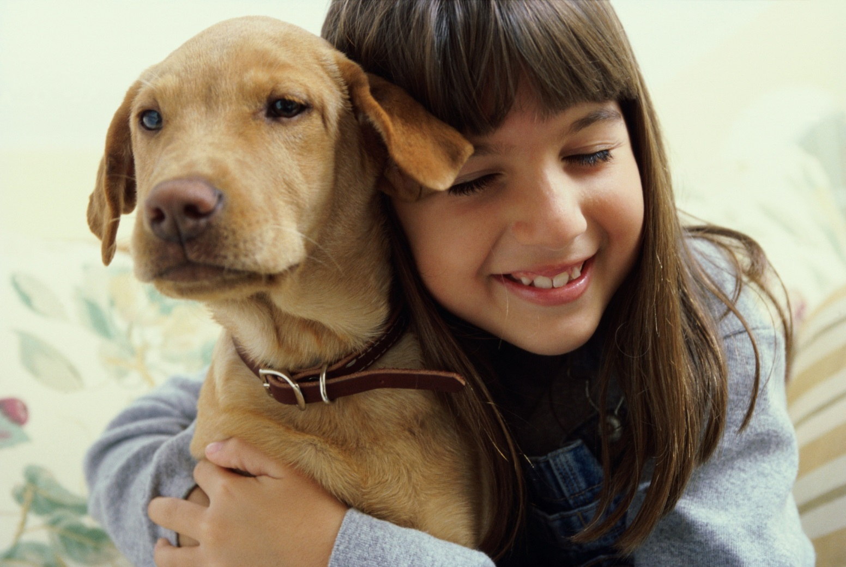
Notes:
A family dog is another example of symbiosis. The family provides the dog with food and shelter and the dog provides protection and companionship.

Slide 26
Notes:
Now let’s pause for a moment to check your understanding.

Slide 27
What is another example of a symbiotic relationship?
Notes:
What is another example of a symbiotic relationship?

Slide 28
Notes:
Let’s break down the word symbiosis into parts to help us remember the definition of the term.

Slide 29
Symbiosis
Sym
bio
sis
Notes:
Symbiosis can be broken up into three parts that help us learn the meaning: sym, bio, and sis. Each part has important meaning.

Slide 30
Symbiosis
Sym
bio
sis
Together
Notes:
Sym means together.

Slide 31
Symbiosis
Sym
bio
sis
Life or living things
Notes:
Bio means life or living things.

Slide 32
Symbiosis
Sym
bio
sis
Condition or state of
Notes:
Sis means condition or state of.

Slide 33
Sym
bio
sis
Symbiosis
State of living things living together
Notes:
So when we put these word parts together, we see that symbiosis means the state of living things living together.

Slide 34
Notes:
Now let’s pause for a moment to check your understanding.

Slide 35
How can we use the word parts of symbiosis to help us remember the definition of the term?
Symbiosis
Sym
bio
sis
Notes:
How can we use the word parts of symbiosis to help us remember the definition of the term?
[Symbiosis can be broken up into three parts that help us learn the meaning: sym, bio, and sis. Each part has important meaning.
Sym means together.
Bio means life or living things.
Sis means condition or state of.
So when we put these word parts together, we see that symbiosis means the state of living things living together.]

Slide 36
Notes:
There is a bit more you should know about symbiosis.

Slide 37
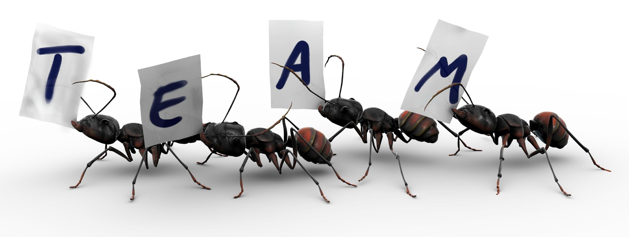
Symbiotic Relationships
Exist when two or more organisms of different species live in close proximity and develop long-term interaction patterns
***See notes for a review video!
Notes:
“Symbiosis” ( 2 min review video: https://www.youtube.com/watch?v=2AM3ARs9MMg )

Slide 38
Notes:
Now let’s pause for a moment to check your understanding.

Slide 39
What is the definition of symbiosis?
Notes:
What is the definition of a symbiosis?
[Symbiosis is a close, long term interaction between two or more species.]

Slide 40
Share an example of an animal or plant interaction.
How does this show symbiosis?
Notes:
Share an example of an animal or plant interaction. How does this show symbiosis?

Slide 41
Parasitism
Commensalism
Mutualism
Symbiotic Relationships
Notes:
There are three main types of symbiotic relationships: commensalism, parasitism, and mutualism.

Slide 42
Parasitism
Commensalism
Mutualism
Symbiotic Relationships
Notes:
First, let’s talk about parasitism.

Slide 43
Parasitism
Notes:
Let’s define what parasitism means.

Slide 44
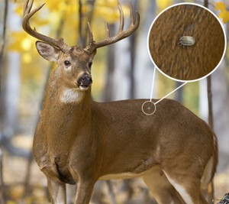
Parasitism: a relationship in which one organism benefits and one organism is harmed
Notes:
Parasitism is a relationship in which one organism benefits and one organism is harmed.

Slide 45
Notes:
Now let’s pause for a moment to check your understanding.

Slide 46
What is parasitism?
Notes:
What is parasitism?
[Parasitism is a relationship in which one organism benefits and one organism is harmed.]

Slide 47
Parasitism
A relationship in which one organism benefits and one organism is harmed
Notes:
In the example of a deer and a tick, the tick is the organism that benefits and the deer is the organism that is harmed.

Slide 48
Notes:
Now, let’s look some examples of parasitism.

Slide 49
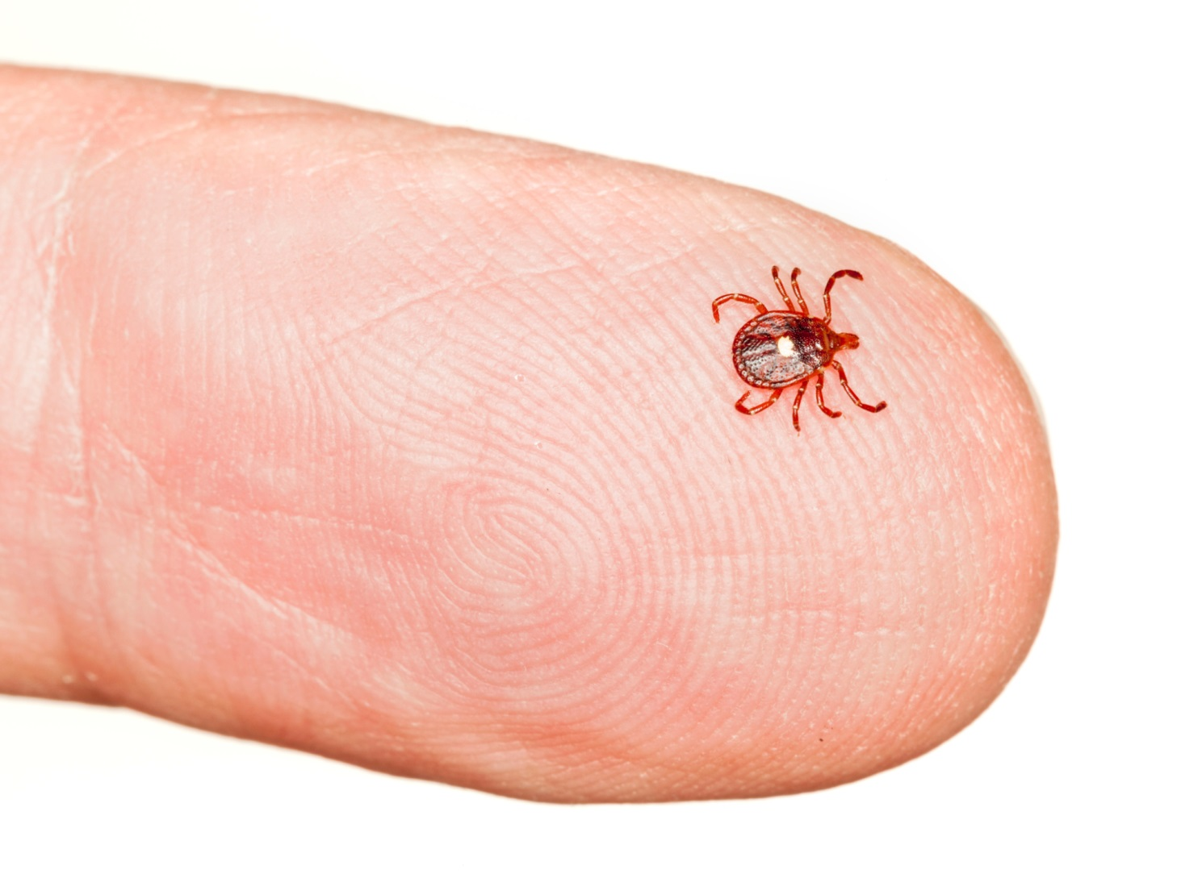
Notes:
This tick living on a human is an example of parasitism. The tick eats the blood from the human and transmits disease. The tick benefits from the relationship and the human is harmed. Therefore, this is an example of parasitism.

Slide 50
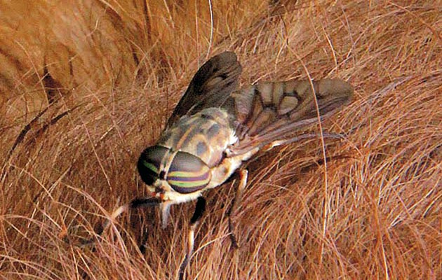
Notes:
This horse fly is another example of parasitism. The fly eats the blood from the horse and transmits disease. In this example, the fly benefits from the horse by getting food and the horse is harmed by receiving disease. Therefore, this is an example of parasitism.

Slide 51
Notes:
Next, let’s talk about some non-examples of parasitism.

Slide 52
Notes:
This shark and the two remora fish are a non example of parasitism. The fish eat leftover food that the shark does not eat. The shark is unaffected by the relationship. Because neither the shark nor the fish are harmed by the relationship, this is not an example of parasitism.

Slide 53
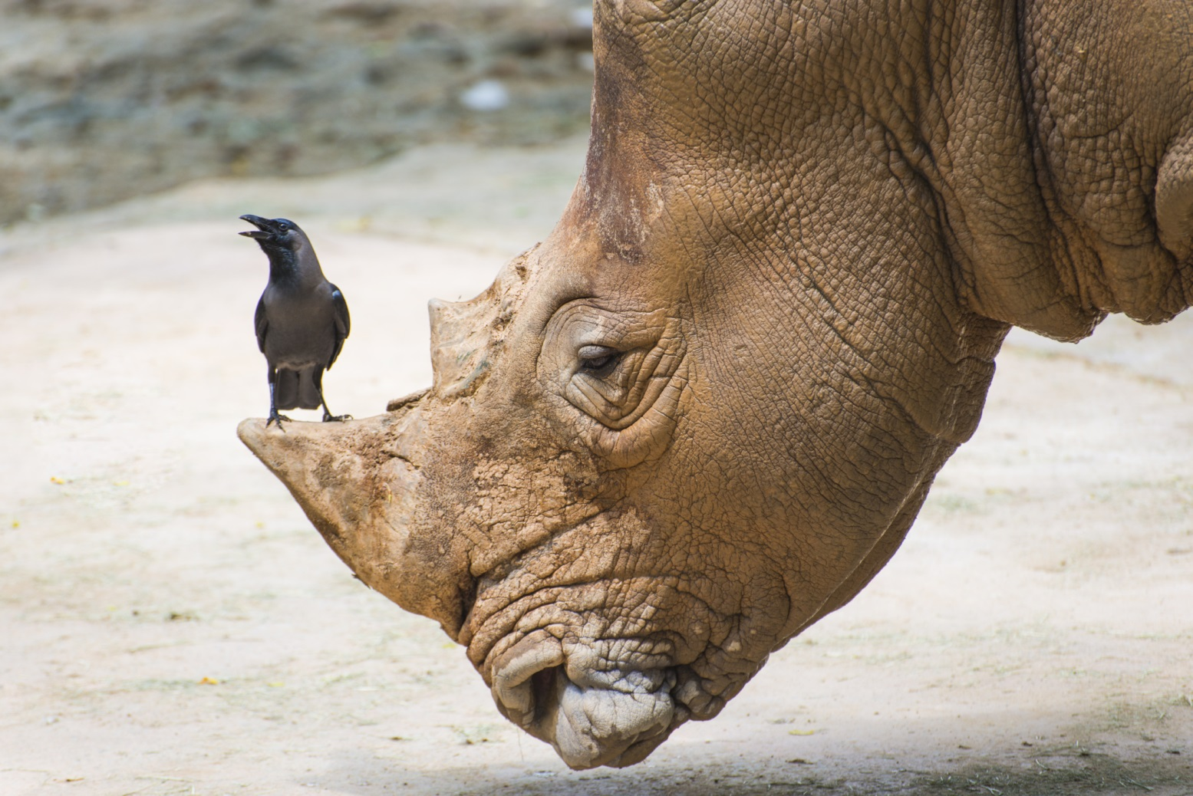
Notes:
The relationship of this rhinoceros and the bird is a non example of parasitism. The bird eats ticks and other parasites off of the rhino so the rhino is getting pest control and the bird gets food. This is not an example of parasitism because both organisms are benefitting.

Slide 54
Notes:
Let’s check-in for understanding.

Slide 55
What is parasitism?
A relationship where both organisms benefit
A relationship in which two organisms are both harmed
When individuals work together
A relationship in which one organism benefits and the other is harmed
Notes:
What is parasitism?

Slide 56
What is parasitism?
A relationship where both organisms benefit
A relationship in which two organisms are both harmed
When individuals work together
A relationship in which one organism benefits and the other is harmed
Notes:
Parasitism is a relationship in which one organism benefits and the other is harmed.

Slide 57
Are the following examples of parasitism ?
Notes:
Are the following examples of parasitism?

Slide 58
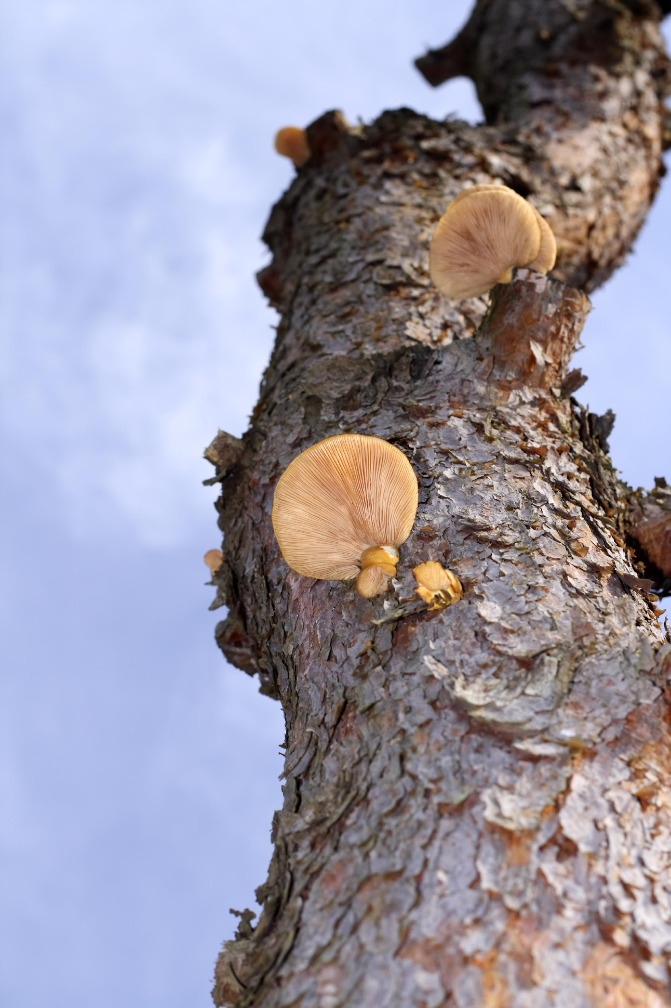
YES
The mushroom sucks nutrients from the tree
Notes:
The mushroom sucks nutrients from the tree

Slide 59
YES
YES
The mushroom sucks nutrients from the tree
Notes:
Yes. The mushroom benefits from this relationship but it harms the tree.

Slide 60
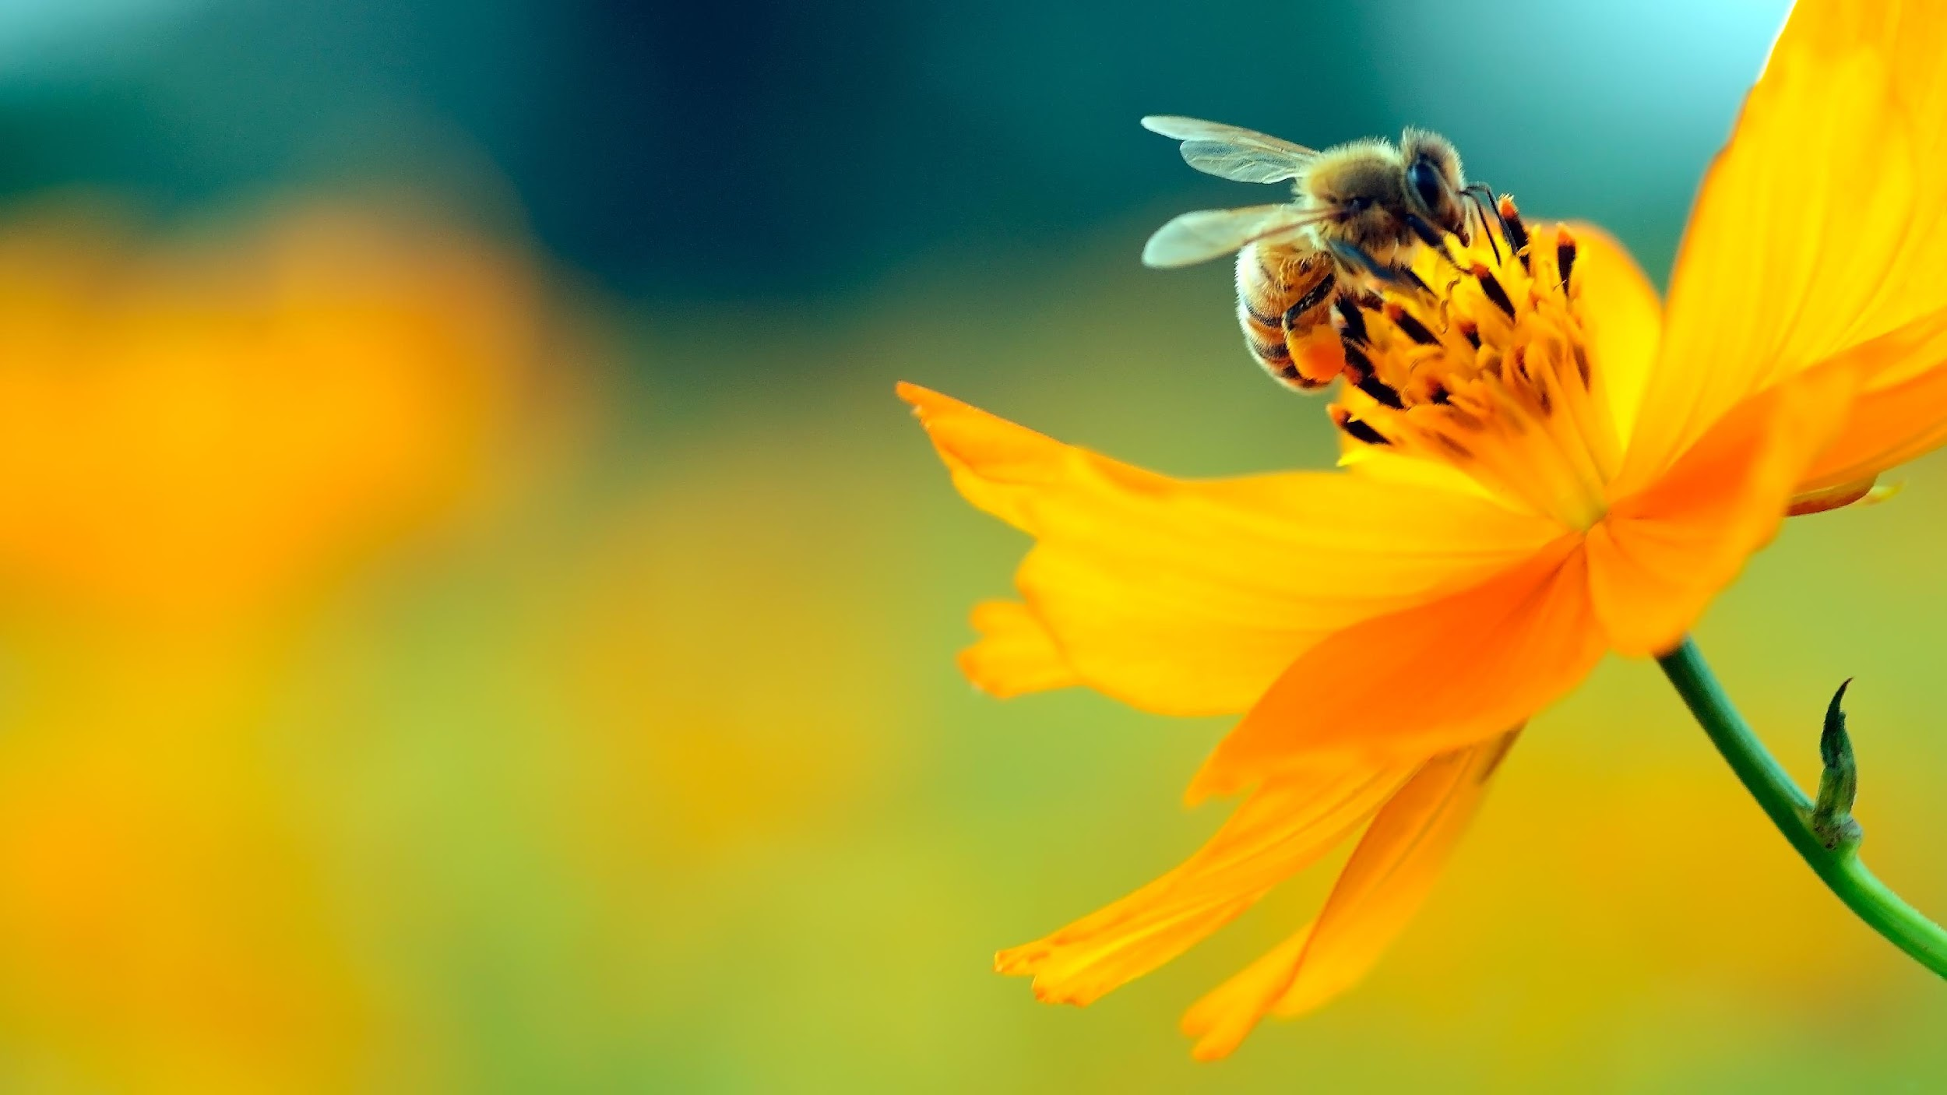
The bee takes pollen from the plant and delivers it to another plant.
Notes:
The bee takes pollen from the plant and delivers it to another plant

Slide 61
NO
Notes:
Both benefit from this – not parasitism

Slide 62
Parasitism
Commensalism
Mutualism
Symbiotic Relationships
Notes:
Now let’s talk about the next symbiotic relationship: commensalism.

Slide 63
Commensalism
Notes:
Now let’s define commensalism.

Slide 64
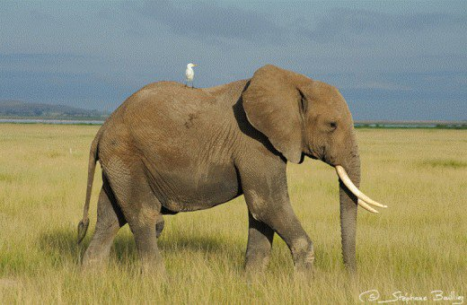
Commensalism: a relationship in which one organism benefits and the other is unaffected
Notes:
A commensalism is a relationship in which one organism benefits and the other is unaffected.

Slide 65
Notes:
Let’s check-in for understanding.

Slide 66
What is commensalism?
Notes:
What is commensalism?
[Commensalism is a relationship in which one organism benefits and the other is unaffected.]

Slide 67
Notes:
Now, let’s look at an example of commensalism.

Slide 68
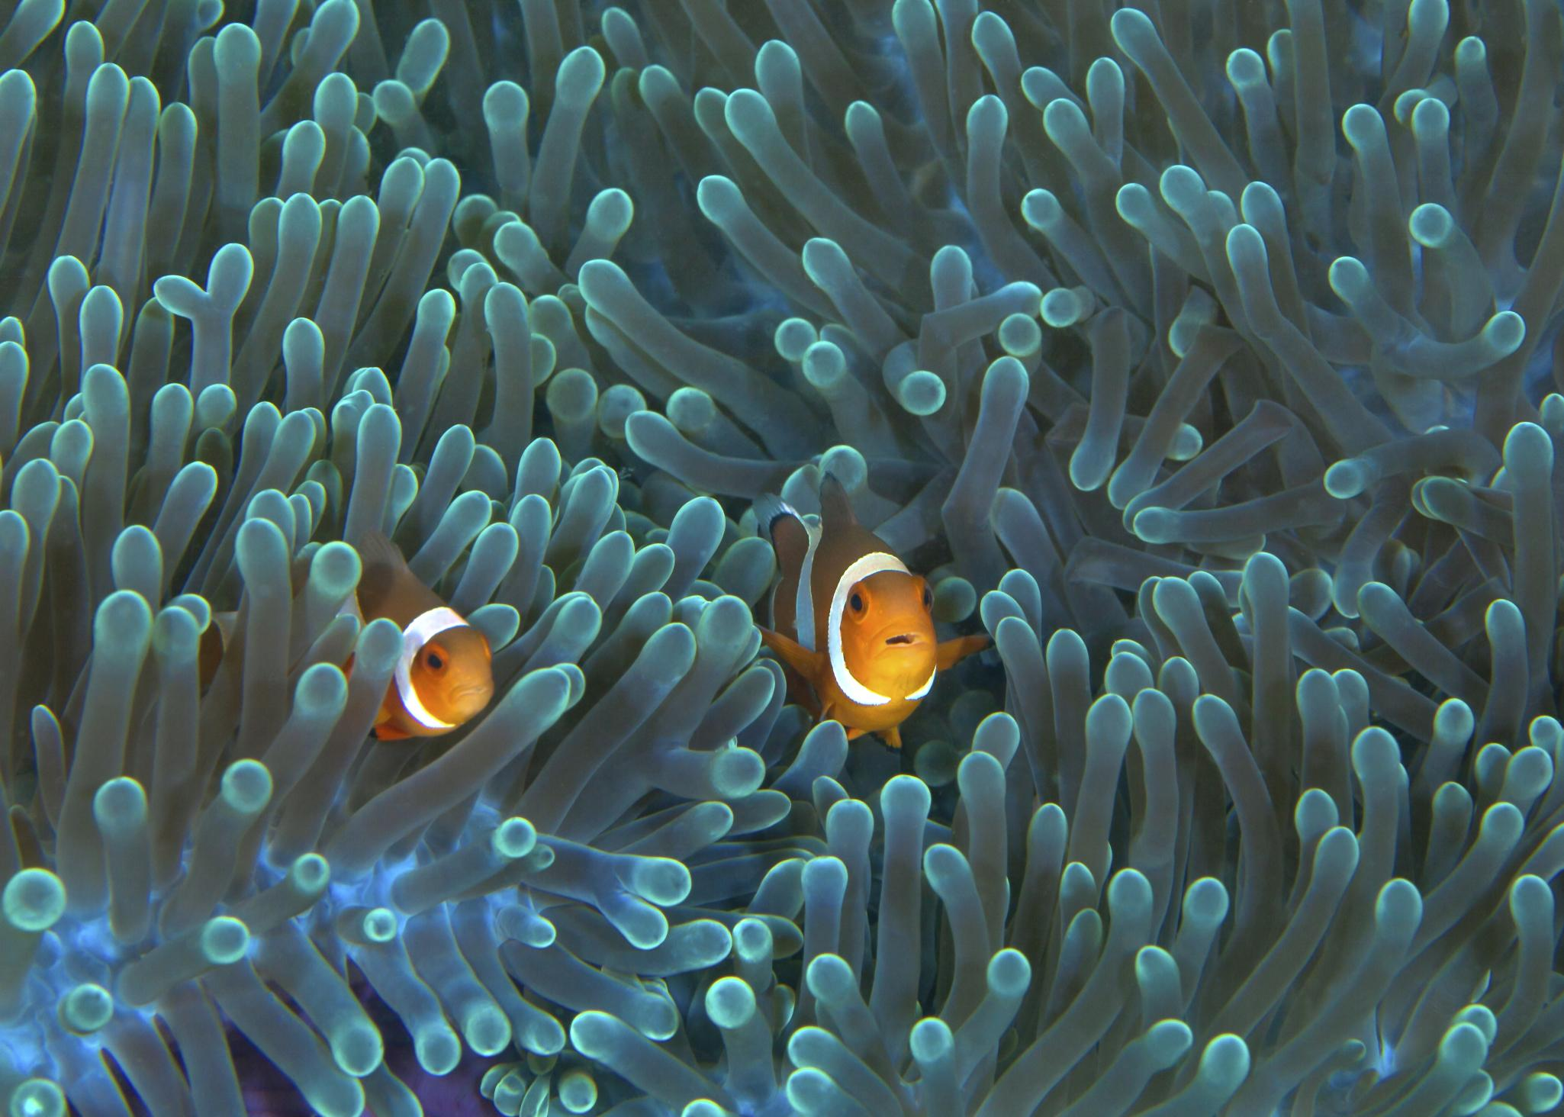
Anemone is unaffected Commensalism
Notes:
This clown fish and the anemone are another example of commensalism. The clown fish receives protection from the anemone because the clown fish’s predators are poisoned by the anemones. The anemone is unaffected in this relationship, therefore, this is an example of commensalism.

Slide 69
Notes:
Next, let’s talk about some non-examples of commensalism.

Slide 70
Both organisms benefit Commensalism
Notes:
The relationship of this rhinoceros and the bird, called an oxpecker, is not an example of commensalism. The bird eats ticks and other parasites off of the rhino so the rhino is getting pest control and the bird gets food. It is not an example of commensalism because both organisms are benefitting.

Slide 71
One organism benefits
One organism is harmed
Commensalism
Notes:
Ticks and humans are another non example of commensalism. In this relationship, the tick eats the blood of the host (in this case the human) and can transmit disease. In this example, the human is harmed by the relationship and the tick benefits. This is not an example of commensalism because neither organism is unaffected.

Slide 72
Notes:
Let’s check-in for understanding.

Slide 73
What is commensalism?
Notes:
What is commensalism?
[A commensalism is a relationship in which one organism benefits and the other is unaffected.]

Slide 74
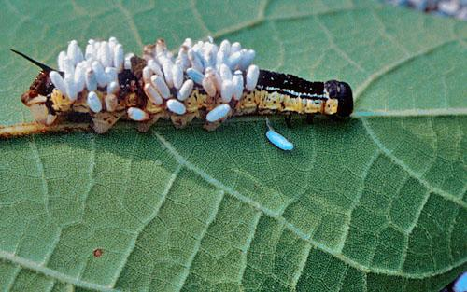
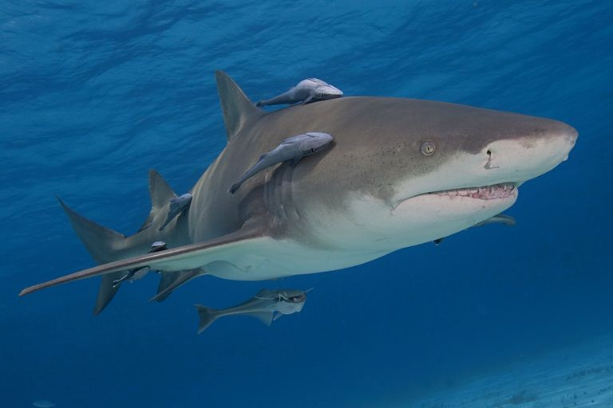
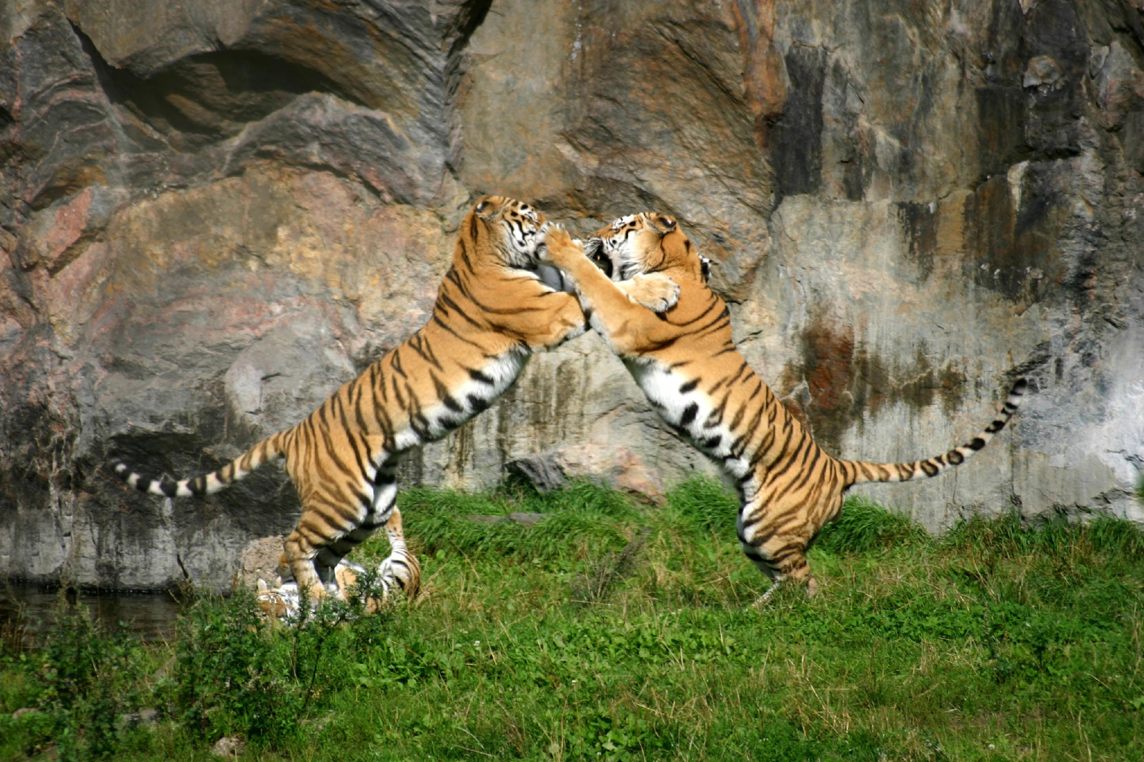
Which picture demonstrates commensalism?
Notes:
Which picture demonstrates commensalism?

Slide 75
Which picture demonstrates commensalism?
Notes:
The shark and the remora fish demonstrate commensalism because the remora fish benefit from living in close proximity to the shark and the shark is unaffected by their presence.

Slide 76
Parasitism
Commensalism
Mutualism
Symbiotic Relationships
Notes:
Finally, let’s talk about mutualism.

Slide 77
Mutualism
Notes:
Let’s define mutualism.

Slide 78
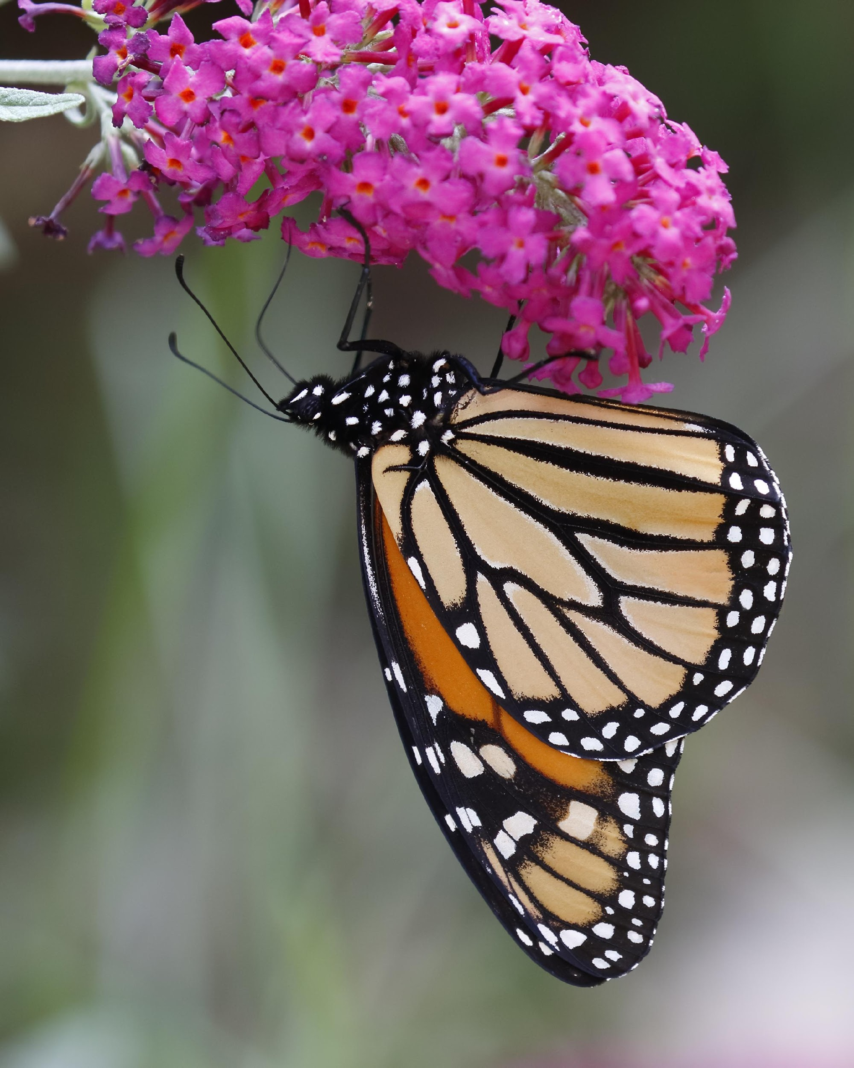
Mutualism: a relationship in which one organism benefits and the other also benefits
Notes:
A mutualism is a relationship in which one organism benefits and the other also benefits. Similar to the bee and the flower, other pollinators such as butterflies get food from flowers while also helping the flower to distribute pollen and reproduce.

Slide 79
Notes:
Let’s check-in for understanding.

Slide 80
What is mutualism?
Notes:
What is mutualism?
[Mutualism is a relationship in which one organism benefits and the other also benefits.]

Slide 81
Notes:
Now, let’s talk about some examples of mutualism.

Slide 82
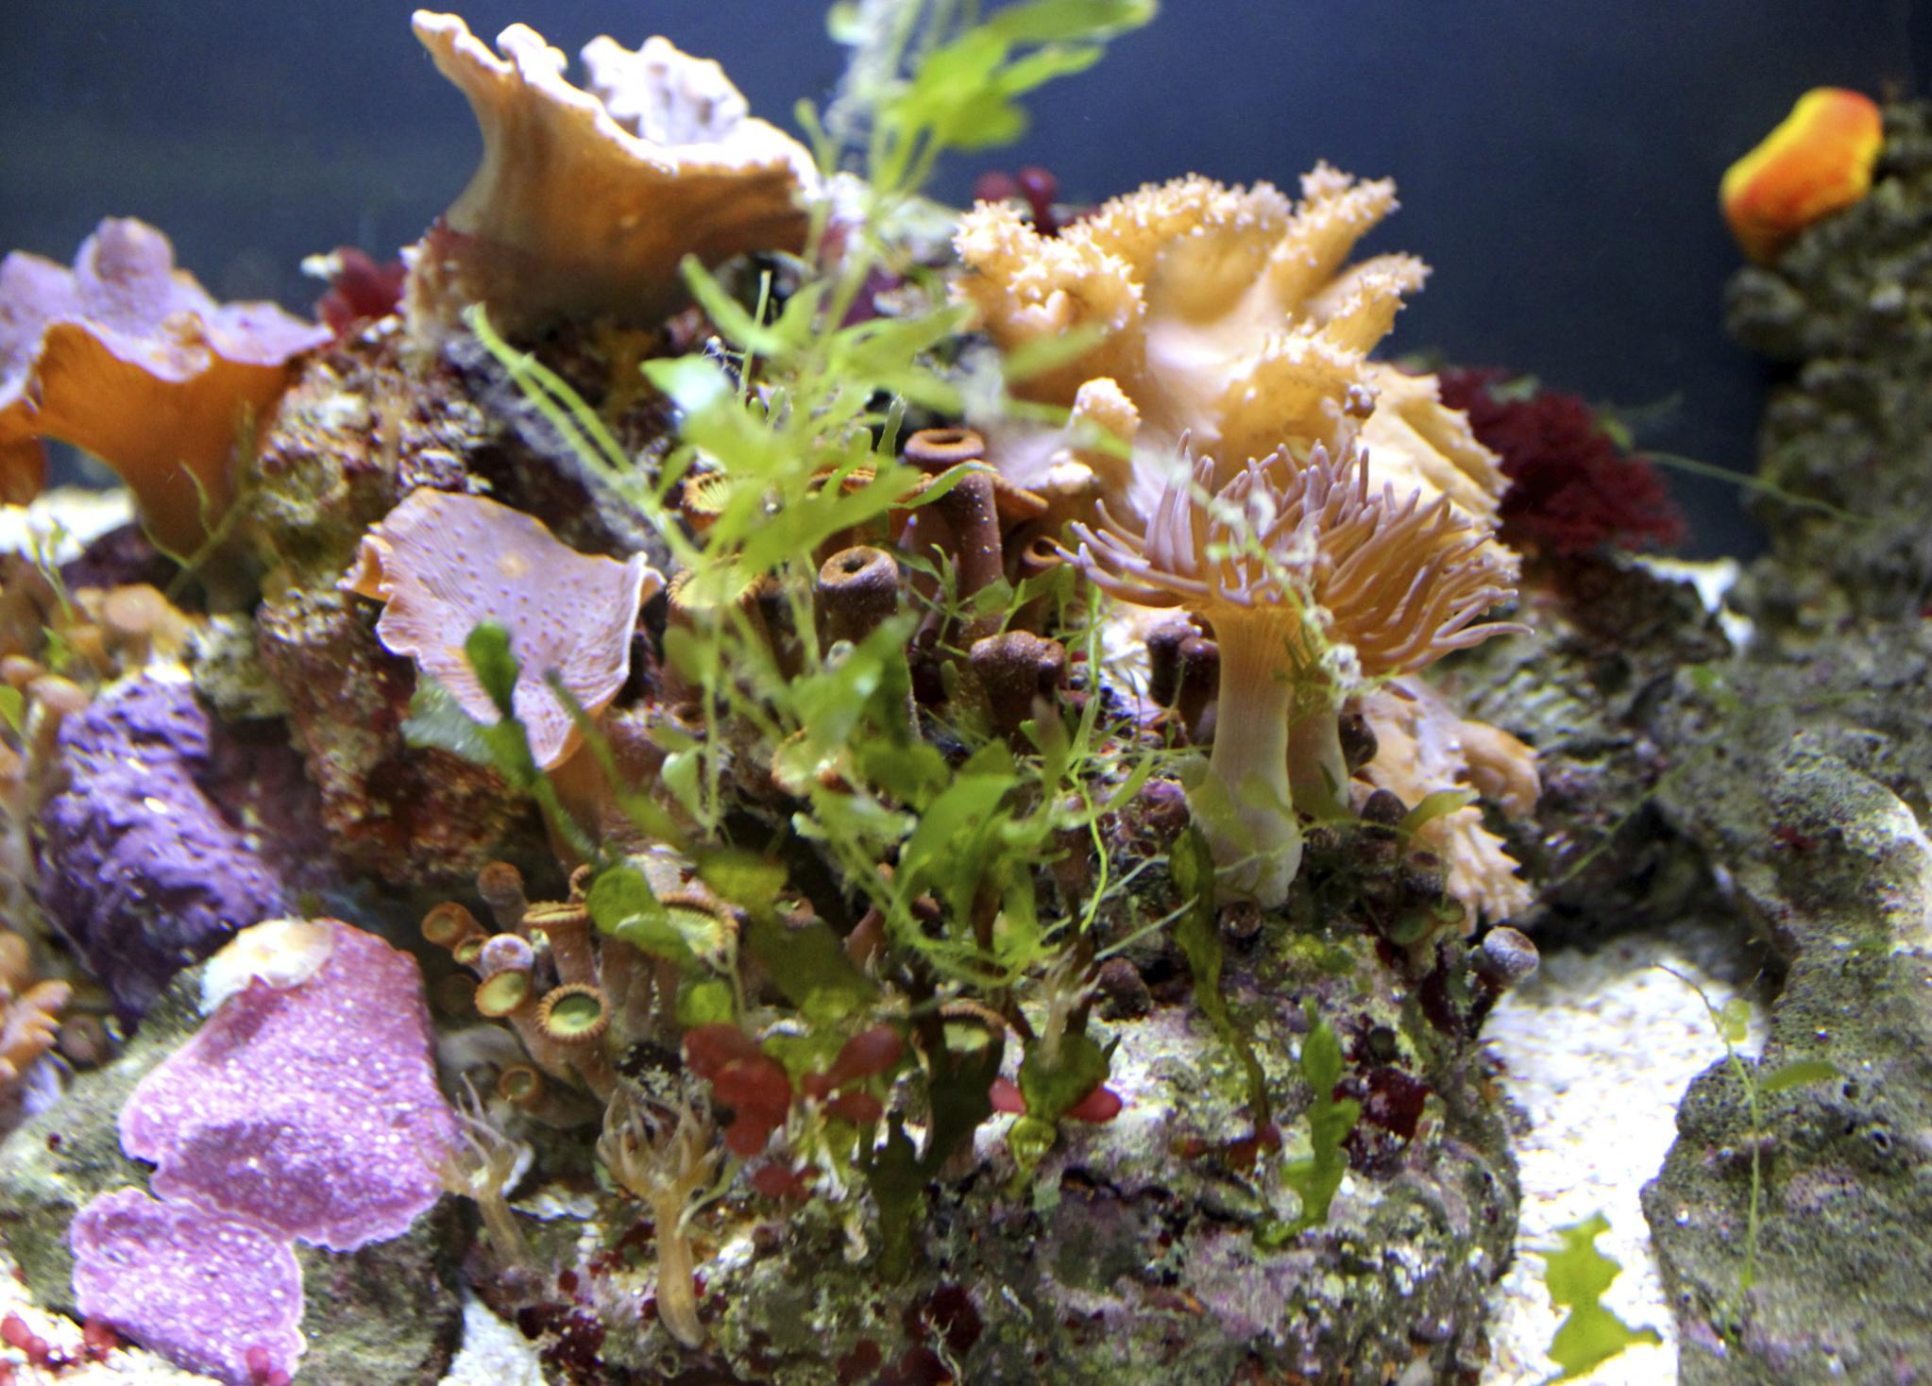
Notes:
Coral and algae is an example of mutualism. In this example, a coral receives the extra food that the algae make by photosynthesis. The algae receives a place to live from the coral. This is an example of mutualism because both organisms are benefitting. Let’s look at one final example.

Slide 83
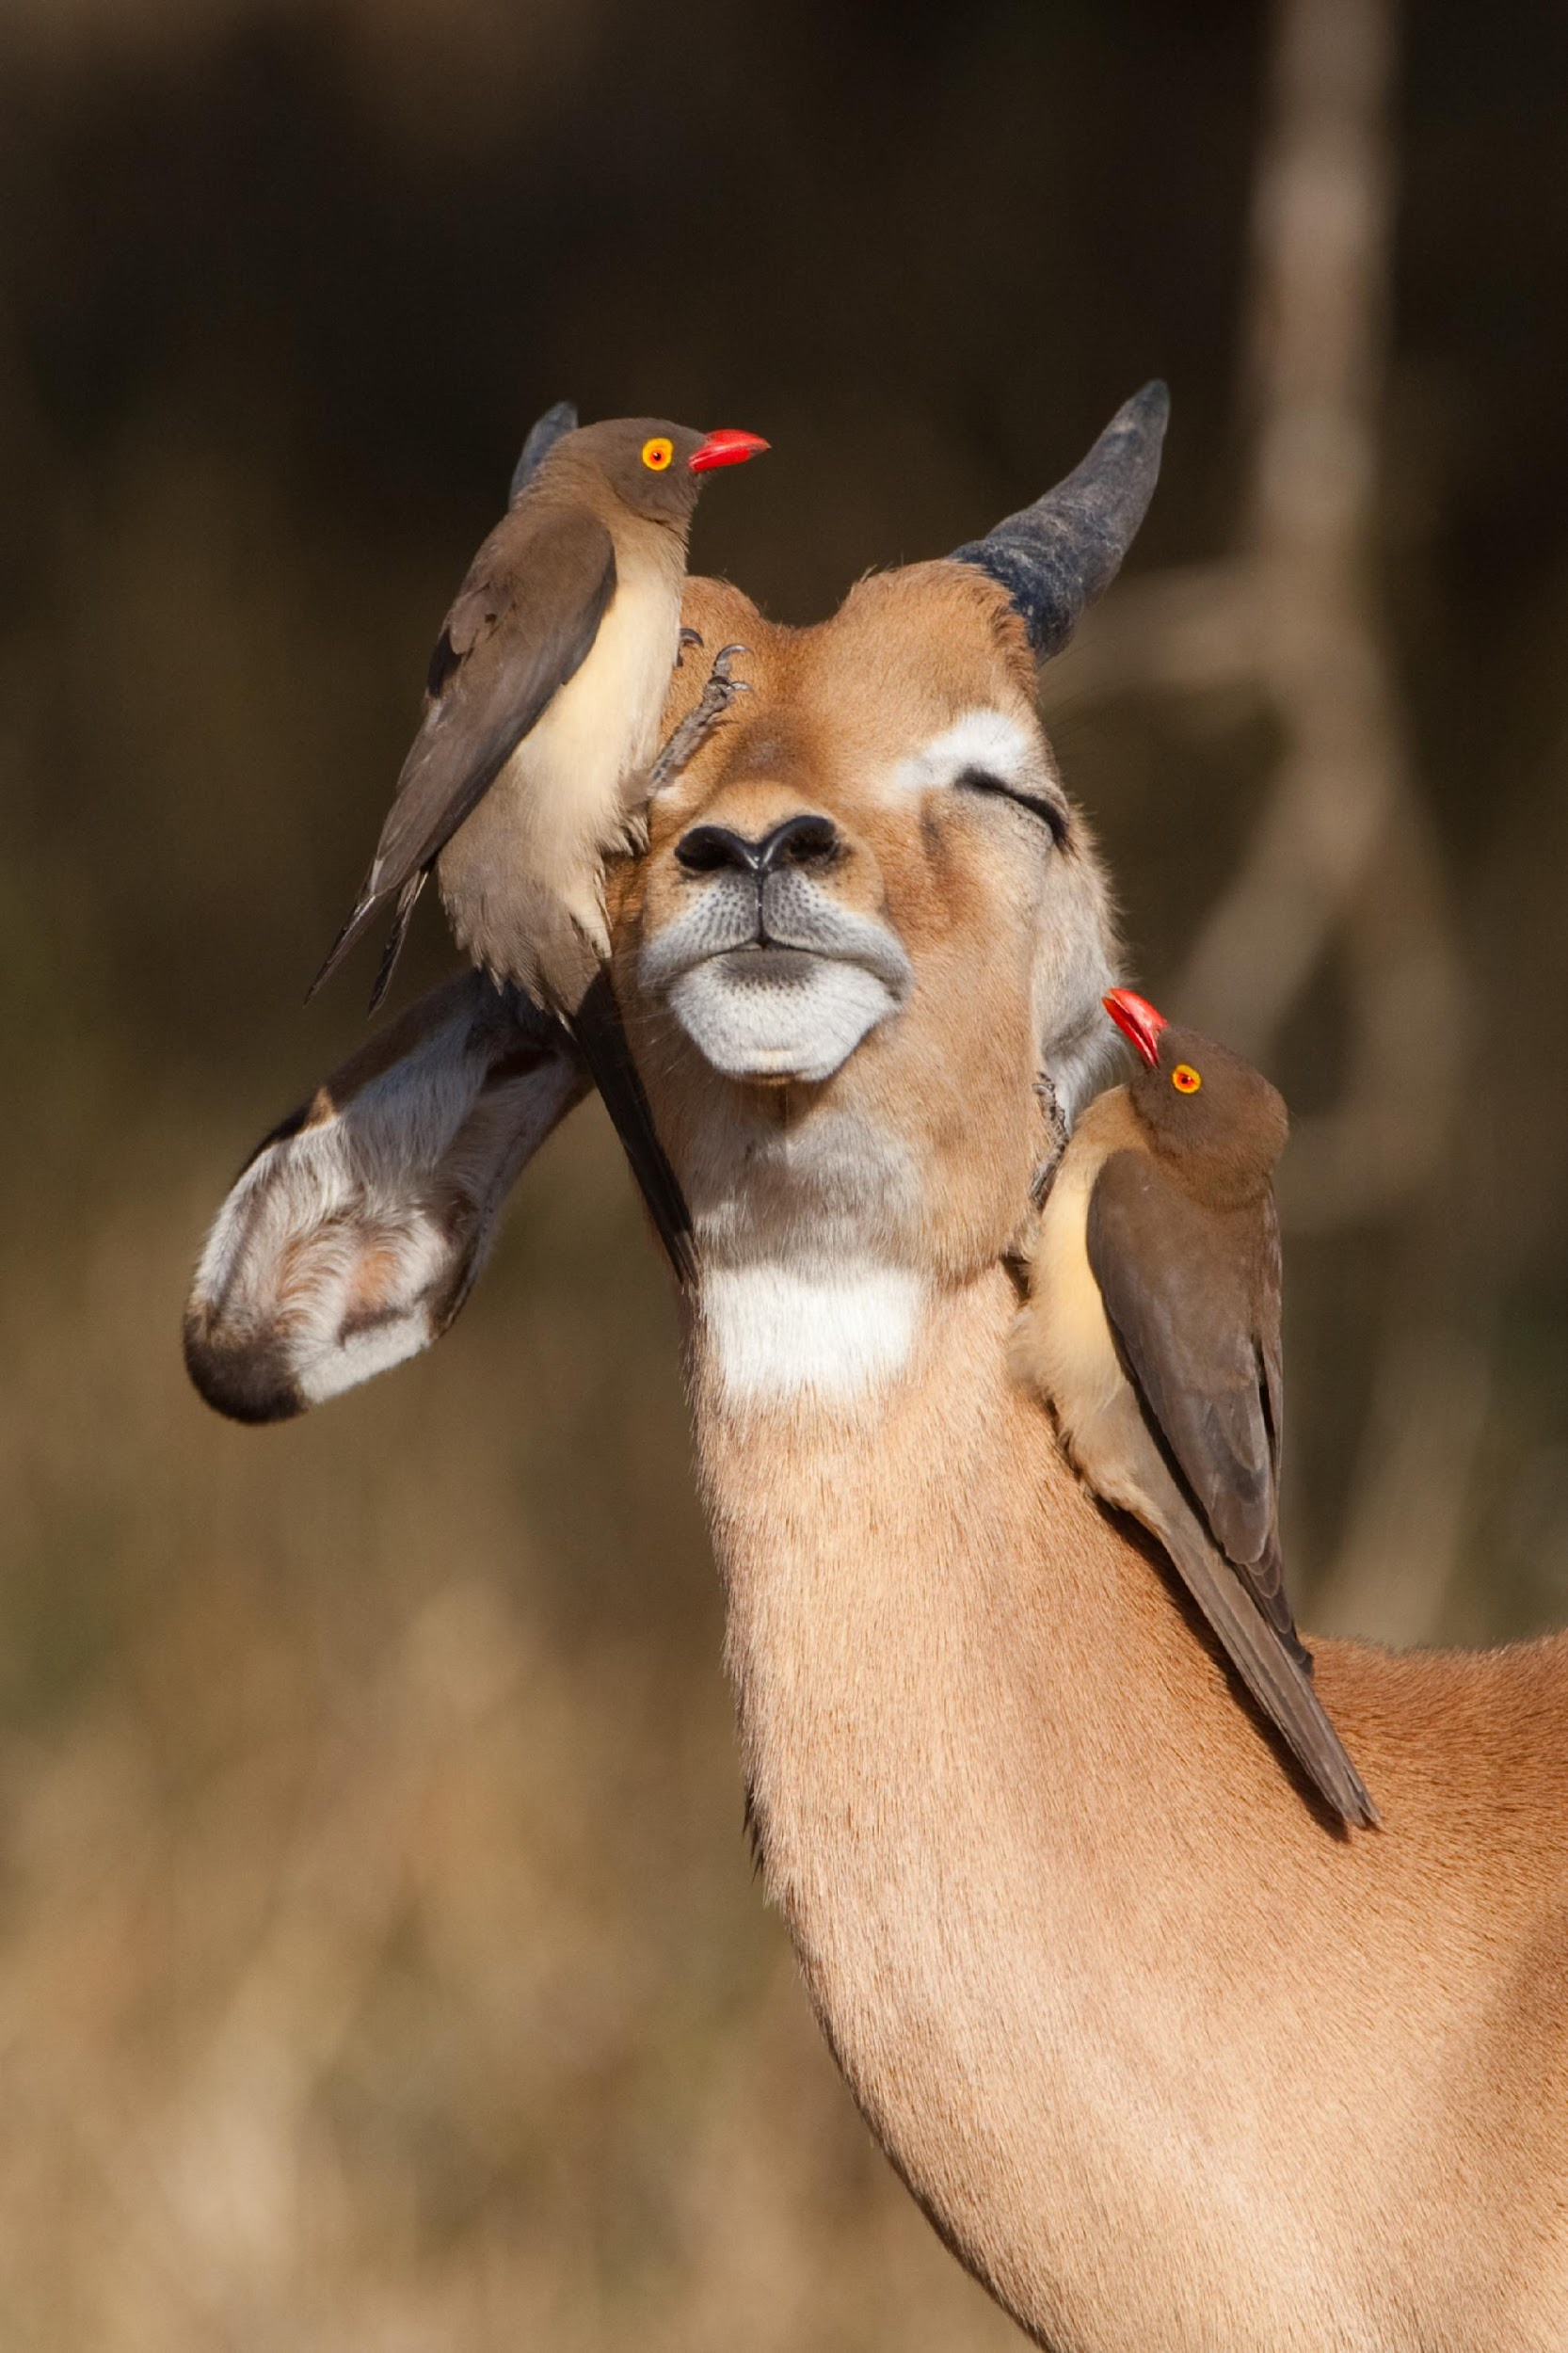
Notes:
This is an oxpecker cleaning the ticks of an impala. In this mutual relationship, the oxpeckers get food (ticks) while the impala gets ticks removed – both benefit!

Slide 84
Notes:
Next, let’s look at a non-example of mutualism.

Slide 85
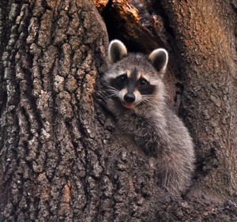
Tree is unaffected Mutualism
Notes:
The raccoon lives in this tree. The tree is unaffected by this relationship so it is not an example of mutualism.

Slide 86
Notes:
Let’s check-in for understanding.

Slide 87
What is an example of mutualism?
Notes:
What is an example of mutualism?

Slide 88
Mutualism occurs when one organism ___(1)___ and another organism ___(2)___.
(1)
Is harmed
Benefits
Is unaffected
Dies
(2)
Is harmed
Benefits
Is unaffected
Dies
Notes:
Mutualism occurs when one organism _______ and another organism ______.

Slide 89
Mutualism occurs when one organism ___(1)___ and another organism ___(2)___.
(1)
Is harmed
Benefits
Is unaffected
Dies
(2)
Is harmed
Benefits
Is unaffected
Dies
Notes:
BOTH benefit

Slide 90
Commensalism
Mutualism
Parasitism
Ionic Bond
Metallic Bond
Notes:
Now let’s talk about how commensalism, mutualism, and parasitism. Let’s think about how these terms are similar and different.

Slide 91
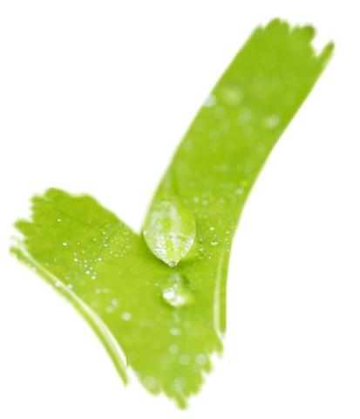
Relationships
Between
Organisms
Commensalism
Mutualism
Parasitism
Notes:
They are all examples of relationships between organisms.

Slide 92
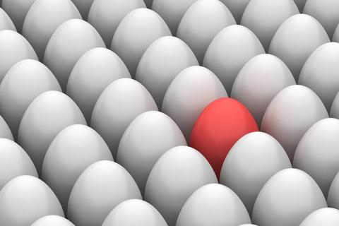
Relationship
Notes:
They are all some form of relationship, but they are not the same thing.

Slide 93
Only one
Species Benefits
Both Species Benefit
One
Species is Harmed
One
Species is Unaffected
Commensalism
Mutualism
Parasitism
Notes:
The differences between commensalism, mutualism, and parasitism have to do with how species benefit, are harmed, or are unaffected. How would you fill in this chart?

Slide 94
Only one
Species Benefits
Both Species Benefit
One
Species is Harmed
One
Species is Unaffected
Commensalism
Mutualism
Parasitism
Notes:
While all of these are relationships between organisms, in commensalism and parasitism only one species actually benefits. Mutualism is different.

Slide 95
Only one
Species Benefits
Both Species Benefit
One
Species is Harmed
One
Species is Unaffected
Commensalism
Mutualism
Parasitism
Notes:
In mutualism, both species benefit.

Slide 96
Only one
Species Benefits
Both Species Benefit
One
Species is Harmed
One
Species is Unaffected
Commensalism
Mutualism
Parasitism
Notes:
In parasitism one species is actively harmed. This is different than commensalism and mutualism.

Slide 97
Only one
Species Benefits
Both Species Benefit
One
Species is Harmed
One
Species is Unaffected
Commensalism
Mutualism
Parasitism
Notes:
In commensalism, one species benefits and the other is unaffected. Commensalism is a relationship where one species benefits and the other is unaffected.

Slide 98
Notes:
Let’s check-in for understanding.

Slide 99
Which of the following is NOT a type of symbiotic relationship?
Parasitism
Cooperatism
Commensalism
Mutualism
Notes:
Which of the following is not a type of symbiotic relationship?

Slide 100
Which of the following is NOT a type of symbiotic relationship?
Parasitism
Cooperatism
Commensalism
Mutualism
Notes:
Which of the following is not a type of symbiotic relationship?
[Cooperation]

Slide 101
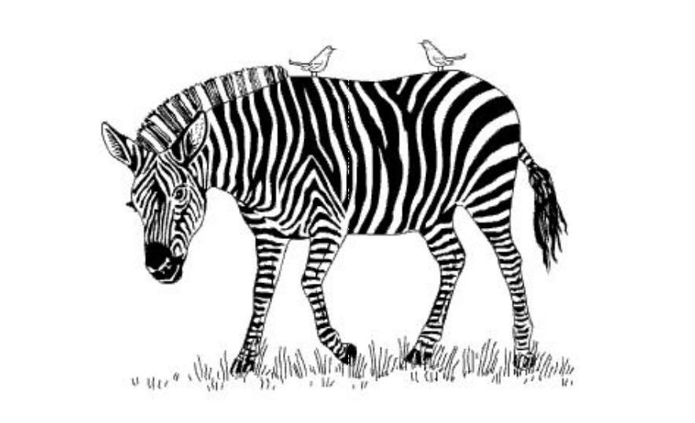
The picture shows a zebra and two birds. The birds feed and remove ticks off of the zebra while also alerting it when a predator is near. What is the primary type of interaction between these two organisms?
Mutualism
Commensalism
Competition
Parasitism
Notes:
The picture shows a zebra and two birds. The birds feed and remove ticks off of the zebra while also alerting it when a predator is near. What is the primary type of interaction between these two organisms?

Slide 102
The picture shows a zebra and two birds. The birds feed and remove ticks off of the zebra while also alerting it when a predator is near. What is the primary type of interaction between these two organisms?
Mutualism
Commensalism
Competition
Parasitism
Notes:
The picture shows a zebra and two birds. The birds feed and remove ticks off of the zebra while also alerting it when a predator is near. What is the primary type of interaction between these two organisms?
[Mutualism]

Slide 103
Which of the following is an example of parasitism?
A tick feeding on a dog’s blood
A bee pollinating a flower
A clownfish finding shelter in a sea anemone
Some birds migrating to the South for winter
Notes:
Which of the following is an example of parasitism?

Slide 104
Which of the following is an example of parasitism?
A tick feeding on a dog’s blood
A bee pollinating a flower
A clownfish finding shelter in a sea anemone
Some birds migrating to the South for winter
Notes:
Which of the following is an example of parasitism?
[A tick feeding on a dog’s blood.]

Slide 105
Remember!!!
Notes:
So remember!

Slide 106
Symbiosis: a close, long term interaction between two or more species
Notes:
Symbiosis is a close, long term interaction between two or more species.

Slide 107
Parasitism: a relationship in which one organism benefits and one organism is harmed
Notes:
Parasitism is a relationship in which one organism benefits and one organism is harmed.

Slide 108
Commensalism: a relationship in which one organism benefits and the other is unaffected
Notes:
A commensalism is a relationship in which one organism benefits and the other is unaffected.

Slide 109
Mutualism: a relationship in which one organism benefits and the other also benefits
Notes:
A mutualism is a relationship in which one organism benefits and the other also benefits. Similar to the bee and the flower, other pollinators such as butterflies get food from flowers while also helping the flower to distribute pollen and reproduce.

Slide 110
Extension Activity
Categorizing Relationships
The resource linked above outlines a class activity that will give students practice with identifying different types of symbiotic relationships. The activity is formatted so that students work in small groups and can share their thoughts on categorization.

Slide 111
Big Questions: What types of reactions do organisms within an ecosystem share and how do these interactions affect individual fitness?
Notes:
Explicit cue to revisit the big question at the end of the lesson: Okay everyone. Now that we’ve learned about symbiotic relationships, let’s reflect once more on our big question. Was there anything that we predicted earlier that was correct or incorrect? Do you have any new hypotheses to share?
Feedback: Offering students an opportunity to evaluate their earlier hypotheses and make changes based on their new understandings is an important part of the iterative process in science. This is a great opportunity to help students build an epistemic understanding by explicitly stating how continuing to change and build on hypotheses as your knowledge grows is an important part of the discipline of science!

Slide 112
Notes:
Thanks for watching, and please continue watching CAPs available from this website.

Slide 113
This Video Was Created With Resources From:
Questions or Comments
Michael Kennedy, Ph.D. MKennedy@Virginia.edu
Rachel L Kunemund, Ph.D. rk8vm@virginia.edu

