Slide 1
Intro
“Big Idea” Question
Review Concepts
Check-In Questions
Teacher Engagement
Vocabulary
Student-Friendly Definition
Examples & Non-Examples
Morphological Word Parts
Simulation/Activity
Notes:
OK everyone, get ready for our next lesson. Just as a reminder, these are the different components that our lesson may include, and you’ll see these icons in the top left corner of each slide so that you can follow along more easily!

Slide 2
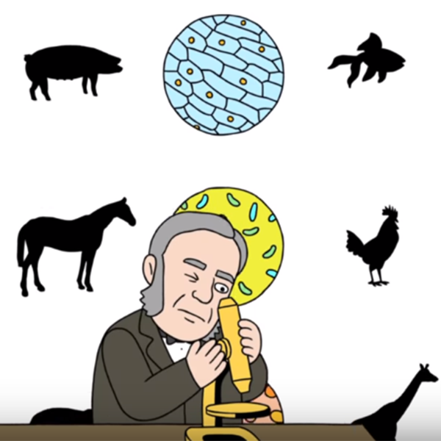
Cell Theory
Intro
Notes:
Today we are going to learn about the cell theory.

Slide 3
Big Question: How does the development of the cell theory relate to the nature of science?
Notes:
Our “big question” is: How does the development of the cell theory relate to the nature of science?
[Pause and illicit predictions from students.]
I love all these thoughtful guesses! Be sure to keep this question and your predictions in mind as we move through these next few lessons, and we’ll continue to revisit it.

Slide 4
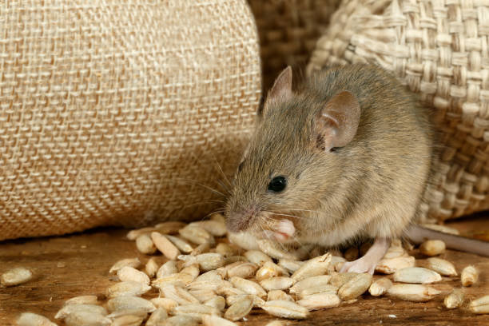
Engagement Activity
Can life come from nonliving things?
Notes:
Let’s look at a scenario that introduces today’s topic of study.
There was once a farmer who kept finding mice in his grain house. He concluded that the mice were coming from the grain itself - that all the ingredients necessary for making a new mouse come together randomly, so to speak. What do you think about the farmer’s hypothesis? What kind of investigation do you think he could conduct to test this hypothesis?
*Allow students to turn and talk before sharing ideas with the class.
We know now that living things come from other living things - they don’t just randomly appear from nonliving substances. This may seem obvious, but there really was a time in history when the idea of “spontaneous generation” of living things was widely accepted. Today we are going to look at some advancements within science that allowed us to gain this understanding. It all started with the ability to see small substances that had never been seen before!
Feedback: This is a great opportunity to build students’ epistemic understanding of how the field of science has changed over time. The iterative nature of science, and the way that new ideas build on or refute prior knowledge to advance the field, is a great connection to students’ own learning of concepts in class.

Slide 5
Notes:
Before we move on to our new topic, let’s review some other words & concepts that you already learned and make sure you are firm in your understanding.

Slide 6
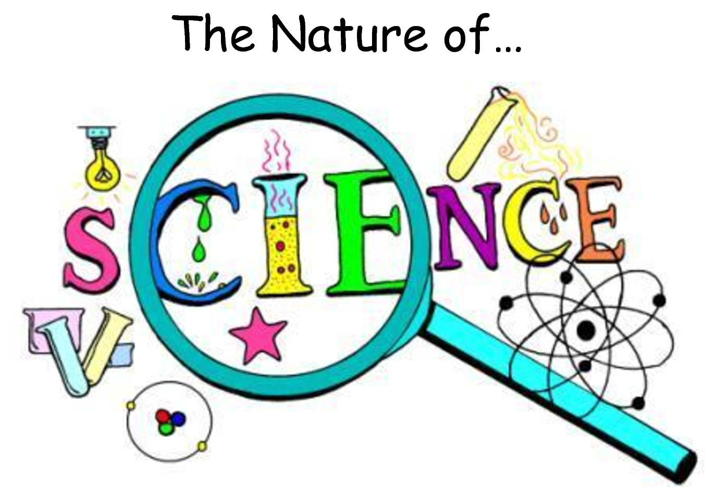
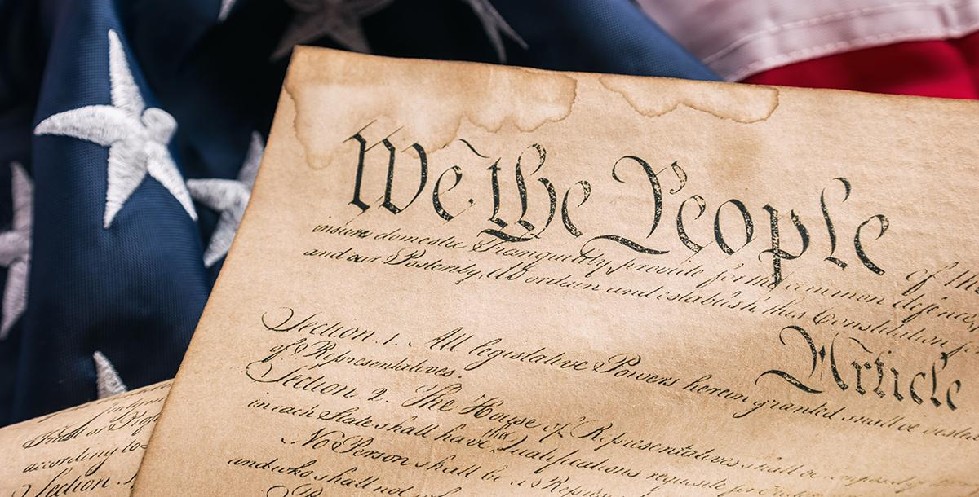
Notes:
The nature of science refers to some foundational concepts that guide scientists’ thinking about the natural world. We can think of it like the Constitution of the United States – just as the constitution is like a “code” that US citizens live by, the nature of science is a sort of “code” that scientists live by.

Slide 7
Notes:
The nature of science includes 6 concepts that guide scientists’ thinking and their approach to seeking new information.

Slide 8
We can understand the natural world through science.
Science is based on evidence – observational and experimental.
Science is a blend of logic and innovation.
Scientific ideas can change as new data is collected.
Science is a complex, social endeavor.
Scientists must try to remain objective to avoid bias.
Notes:
These 6 concepts included in the nature of science are...
We can understand the natural world through science.
Science is based on evidence – observational and experimental.
Science is a blend of logic and innovation.
Scientific ideas can change as new data is collected.
Science is a complex, social endeavor.
Scientists must try to remain objective to avoid bias.
Feedback: These are great concepts to refer back to throughout other powerpoints. Building students’ understanding of the epistemologies of science is important to help them engage in scientific practices and understand when and why they are doing so within their science classes.

Slide 9
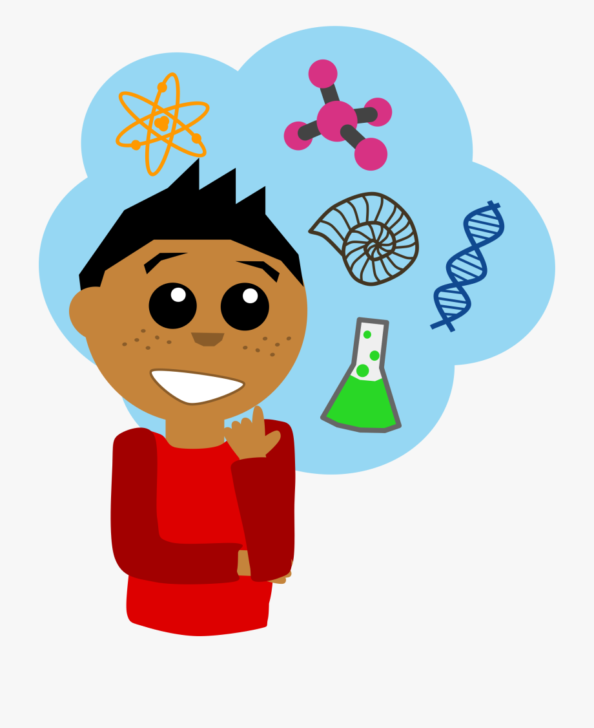
Hypothesis: an “educated guess” that must be tested
Notes:
A hypothesis is an educated guess that must be tested. Like we discussed in our review of the scientific method, when you have a question or problem that you want to investigate, you use existing knowledge to develop a hypothesis, then test it in an experiment.

Slide 10
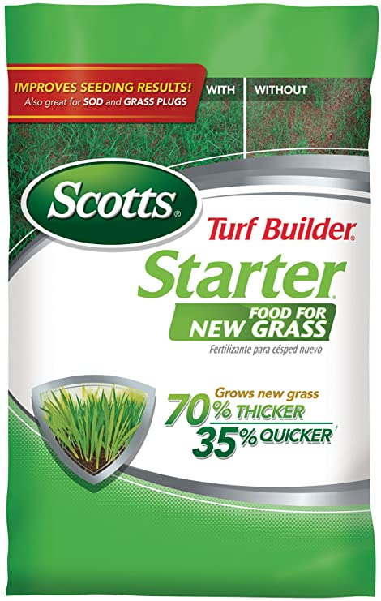
If I use Scott’s fertilizer, then my grass will grow faster.
Notes:
The statement “If I use Scott’s fertilizer, then my grass will grow faster” is an example of a hypothesis because it is an educated guess that I can test.
The company claims on the bag that this fertilizer will help me grow grass 35% faster than if I didn’t use this fertilizer. I can conduct an experiment to test whether or not this hypothesis is true.

Slide 11
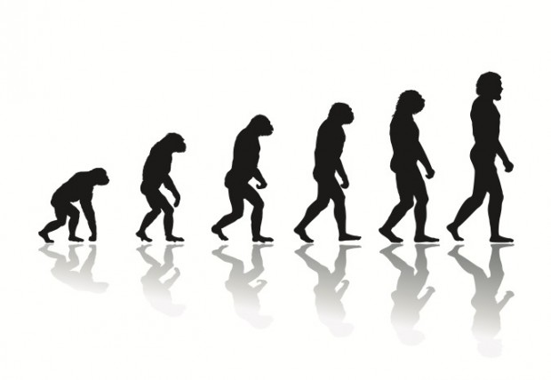
Theory: a widely accepted explanation that has stood up to repeated testing
Notes:
A theory is a widely accepted explanation that has stood up to repeated testing. Theories provide us with an explanation as to why natural phenomena occur. The theory of evolution, or how humans came to exist, is one example of a scientific theory. It hasn’t been proven, but there is a lot of evidence to support this idea. Acceptance of a theory can change over time in light of new data/information.

Slide 12
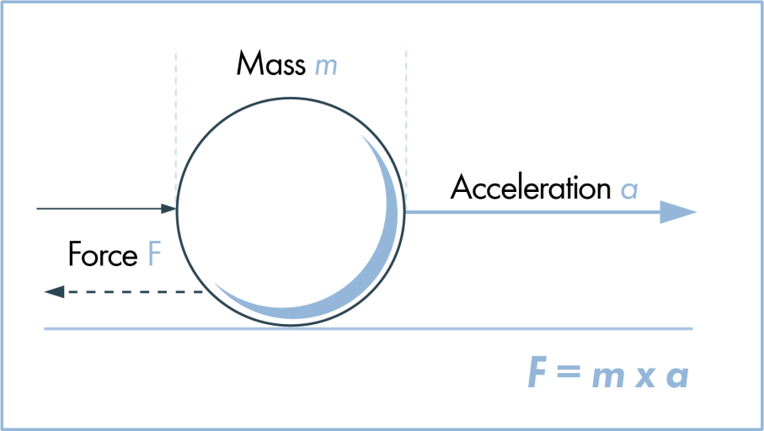
Law: an explanation that always occurs under certain conditions
Notes:
A law is an observation that always occurs under certain conditions. These usually involve math, as scientists come up with formulas that explain how natural phenomena occur. Newton’s second law of motion, the law of force, is one example of a scientific law. This is considered a scientific law because this formula will always explain the amount of force that an object has.
Feedback: It is important in providing these definitions to use clear, concise language.

Slide 13
Notes:
Now let’s pause for a moment to review the information we have covered already.

Slide 14
Which of the following is NOT one of the 6 concepts to know about the nature of science?
We can understand the natural world through science.
Science is a complex, social endeavor.
Scientific ideas can change as we collect more data.
Once you find an answer you don’t need science anymore.
Notes:
Which of the following is NOT one of the 6 concepts to know about the nature of science?

Slide 15
Which of the following is NOT one of the 6 concepts to know about the nature of science?
We can understand the natural world through science.
Science is a complex, social endeavor.
Scientific ideas can change as we collect more data.
Once you find an answer you don’t need science anymore.
Notes:
Which of the following is NOT one of the 6 concepts to know about the nature of science?
[Once you find an answer you don’t need science anymore. → In fact, as we participate in science investigations, we usually come across more questions that we want to answer!]
Feedback: It is important here to explain why this answer is not correct, as done above.

Slide 16
What is a hypothesis?
An explanation that always occurs
An educated guess that must be tested
A widely accepted explanation
Notes:
What is a hypothesis?

Slide 17
What is a hypothesis?
An explanation that always occurs
An educated guess that must be tested
A widely accepted explanation
Notes:
What is a hypothesis?

Slide 18
What’s the main difference between a theory and a law?
Notes:
What’s the difference between a theory and a law?
[A theory is a widely accepted explanation for natural phenomena, while a law is an observation that always occurs.] Theories can attempt to explain why a law exists.

Slide 19
Cell Theory
Notes:
Now that we’ve reviewed, let’s define cell theory.

Slide 20
Cell Theory: the scientific theory stating that all living things are made of cells.
Notes:
Cell theory is the scientific theory stating that all living things are made of cells. This theory was developed by a few different scientists as advancements were made in microscope technology, and the rules of this theory changed as microscopes improved and new information was gathered.

Slide 21
Notes:
Let’s check-in for understanding.

Slide 22
What is cell theory?
Notes:
What is cell theory?
[The scientific theory that all living things are made of cells.]

Slide 23
Notes:
That is the basic definition, but there is a bit more you need to know.

Slide 24
Cell Theory
is made up of 3 basic rules
Notes:
The cell theory is made up of 3 basic principles, or rules. When we observe something in the natural world that meets all three of these rules, that means it is a living thing.

Slide 25
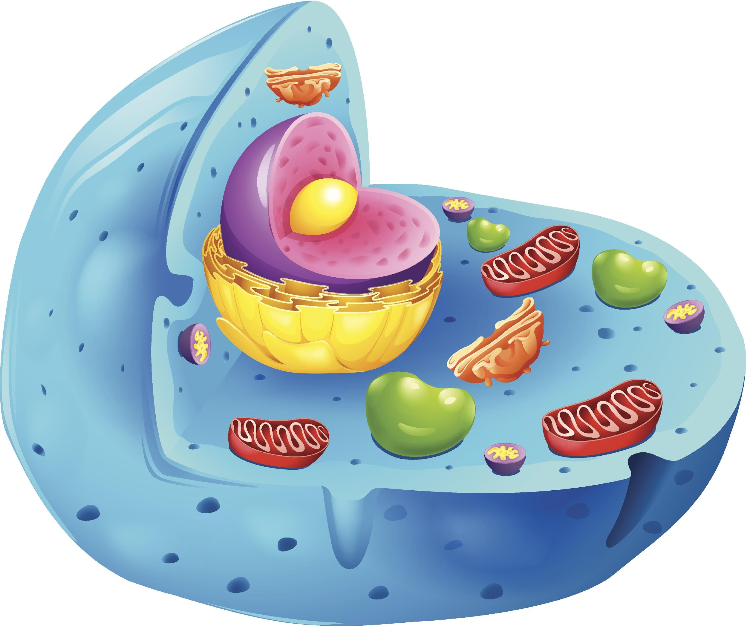
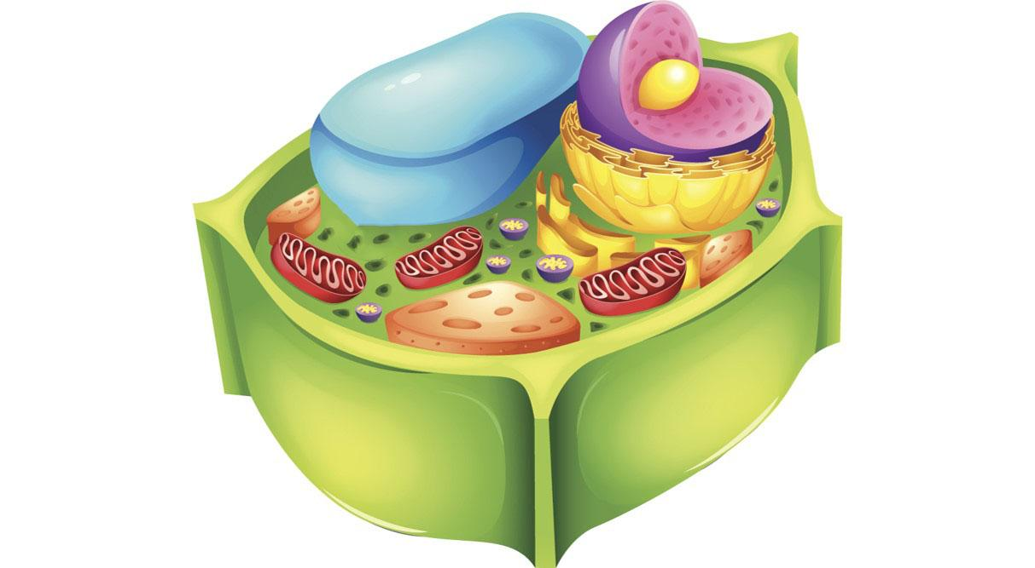
Rule #1: The cell is the basic unit of life.
Notes:
Rule #1: The cell is the basic unit of life.

Slide 26
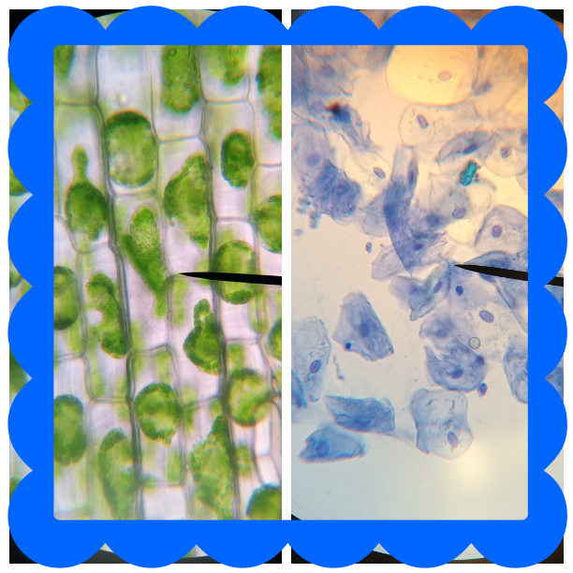
Rule #2: All living things are made of one or more cells.
Notes:
Rule #2: All living things are made up of one or more cells. Here we can see the cells that we might find in plants and animals. It’s worth noting that organisms with many cells often have different types of cells that look different from one another and serve different purposes.

Slide 27
Rule #3: All new cells are made from cells that already exist.
Notes:
Rule #3: All new cells are made from cells that already exist. Here we see a basic illustration of one cell dividing into two new cells. We will learn more about this process later on!

Slide 28
Notes:
Let’s check-in for understanding.

Slide 29
What are 3 rules of cell theory?
Notes:
What are the 3 rules of cell theory?
[Rule #1 - The cell is the basic unit of life.
Rule #2 - All living thing are made up of one or more cells.
Rule #3 - All the new cells are made from cell that already exist.]

Slide 30
Notes:
Now, let’s talk about some examples that cell theory can be applied to.

Slide 31
Remember!!!
Cell Theory: the scientific theory that all living things are made of cells.
Notes:
REMEMBER: Cell theory states that all living things are made of cells. This means that if cell theory applies to something we observe, it must be considered a living thing.

Slide 32
Does cell theory apply to this plant?
Notes:
Does cell theory apply to this plant?
[Yes – plants are living things.]

Slide 33
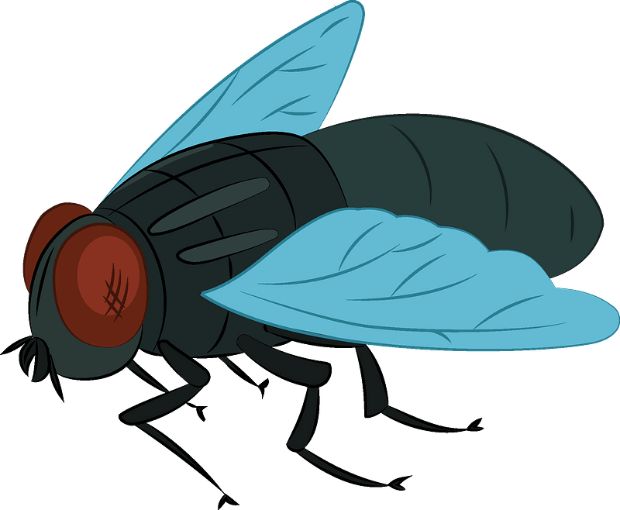
Does cell theory apply to this fly?
Notes:
Does cell theory apply to this fly?
[Yes – flies are living things.]

Slide 34
Notes:
Let’s check-in for understanding.

Slide 35
What are some examples of the application of cell theory?
Notes:
What are some examples of the application of cell theory?

Slide 36
Notes:
Now, let’s talk about some non-examples, or objects that cell theory does not apply to.

Slide 37
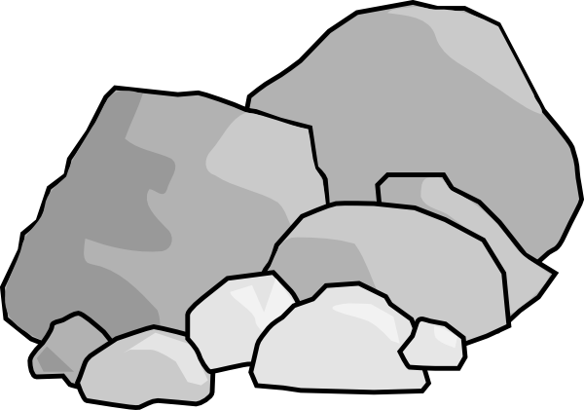
Does cell theory apply to these rocks?
Notes:
Does cell theory apply to these rocks?
[No – rocks are not living things.]
Feedback: It is important to explain why non examples do not fit, as is done above.

Slide 38
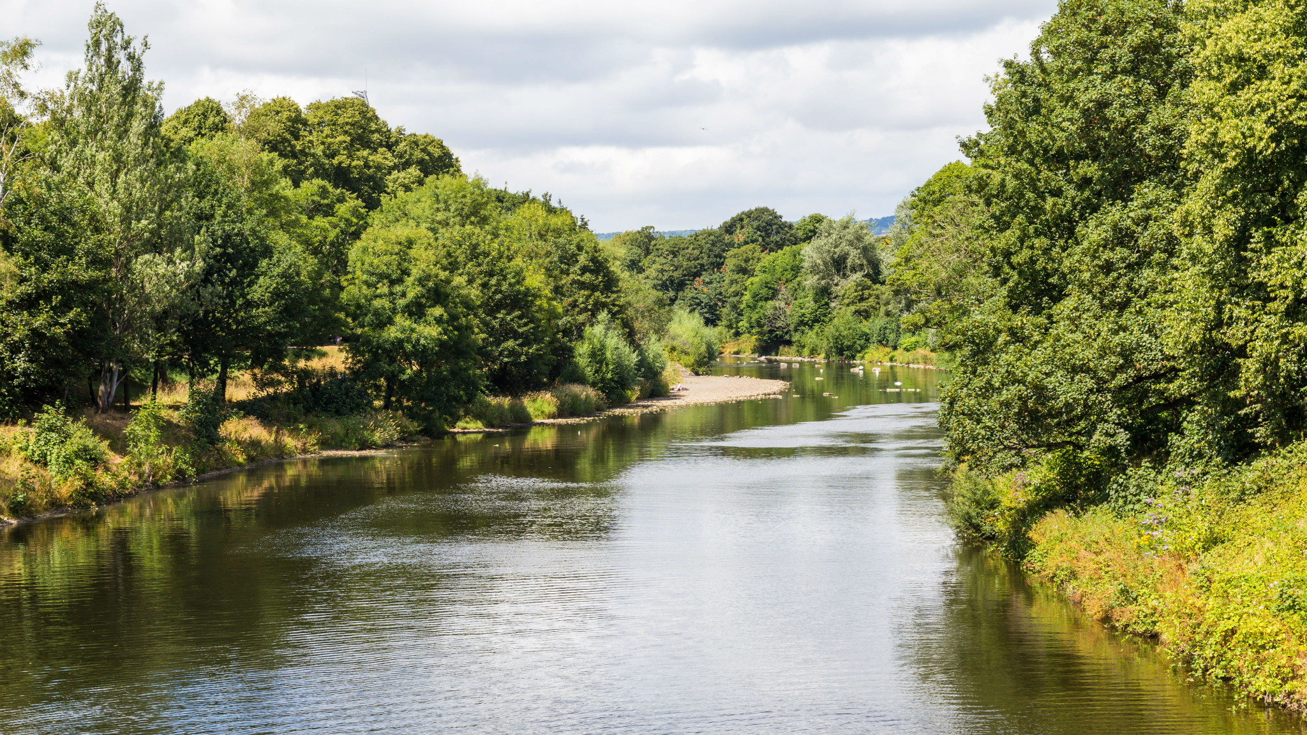
Does cell theory apply to this river?
Notes:
Does cell theory apply to this river?
[No – while there are likely many living things in and around the river water, the river itself is not alive. Water is an important resources for living things.]

Slide 39
Does cell theory apply to these toys?
Notes:
Does cell theory apply to these toys?
[No – toys are not living things, though sometimes they are made to look like living things.]

Slide 40
Notes:
Let’s check-in for understanding.

Slide 41
What are some non-examples of the application of cell theory?
Notes:
What are some non-examples of the application of cell theory?

Slide 42
What is the definition of cell theory?
Notes:
What is the definition of cell theory?
[The scientific theory that all living things are made of cells.]

Slide 43
What is the number of basic rules to know in cell theory?
Notes:
What is the number of basic rules to know in cell theory?
[Three.]

Slide 44
Which is NOT one of the rules of cell theory?
All living things are made of one or more cells.
Non-living things have cells too.
The cell is the basic unit of life.
All new cells are made from cells that already exist.
Notes:
Which is NOT one of the rules of cell theory?

Slide 45
Which is NOT one of the rules of cell theory?
All living things are made of one or more cells.
Non-living things have cells too.
The cell is the basic unit of life.
All new cells are made from cells that already exist.
Notes:
Which is NOT one of the rules of cell theory?

Slide 46
Notes:
We’ve learned what the cell theory is, but there’s still a bit more we need to discuss.

Slide 47
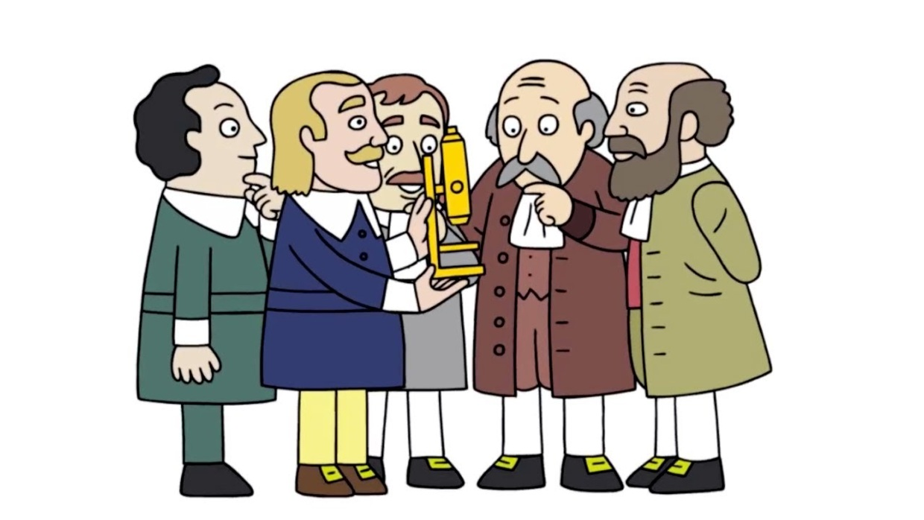
The development of cell theory is an example of how the nature of science concepts help guide scientists’ thinking.
Notes:
The development of cell theory is an example of how the nature of science concepts help to guide scientists’ thinking.

Slide 48
Big Question: How does the development of the cell theory relate to the nature of science?
The Wacky History of Cell Theory
Notes:
Our big question asks us to think about how the development of the cell theory relates to the nature of science.
Before we look at specific examples of how these two things are connected, click on this link to watch a short video clip about the history of the cell theory. As you watch, try to think about how the scientists who developed cell theory followed the nature of science concepts throughout this process. Feel free to look back at your notes if needed!
*Notice: This video has availability of subtitles in multiple languages.
Feedback: Prepare some open-ended questions to follow up this video so that students can share their thoughts about how the scientists who developed cell theory followed the nature of science concepts throughout the process. Engaging students in discussion is important to help them learn to communicate about their scientific ideas.

Slide 49
Notes:
Now, let’s talk about some specific examples of how the nature of science concepts relate to the development of cell theory.

Slide 50
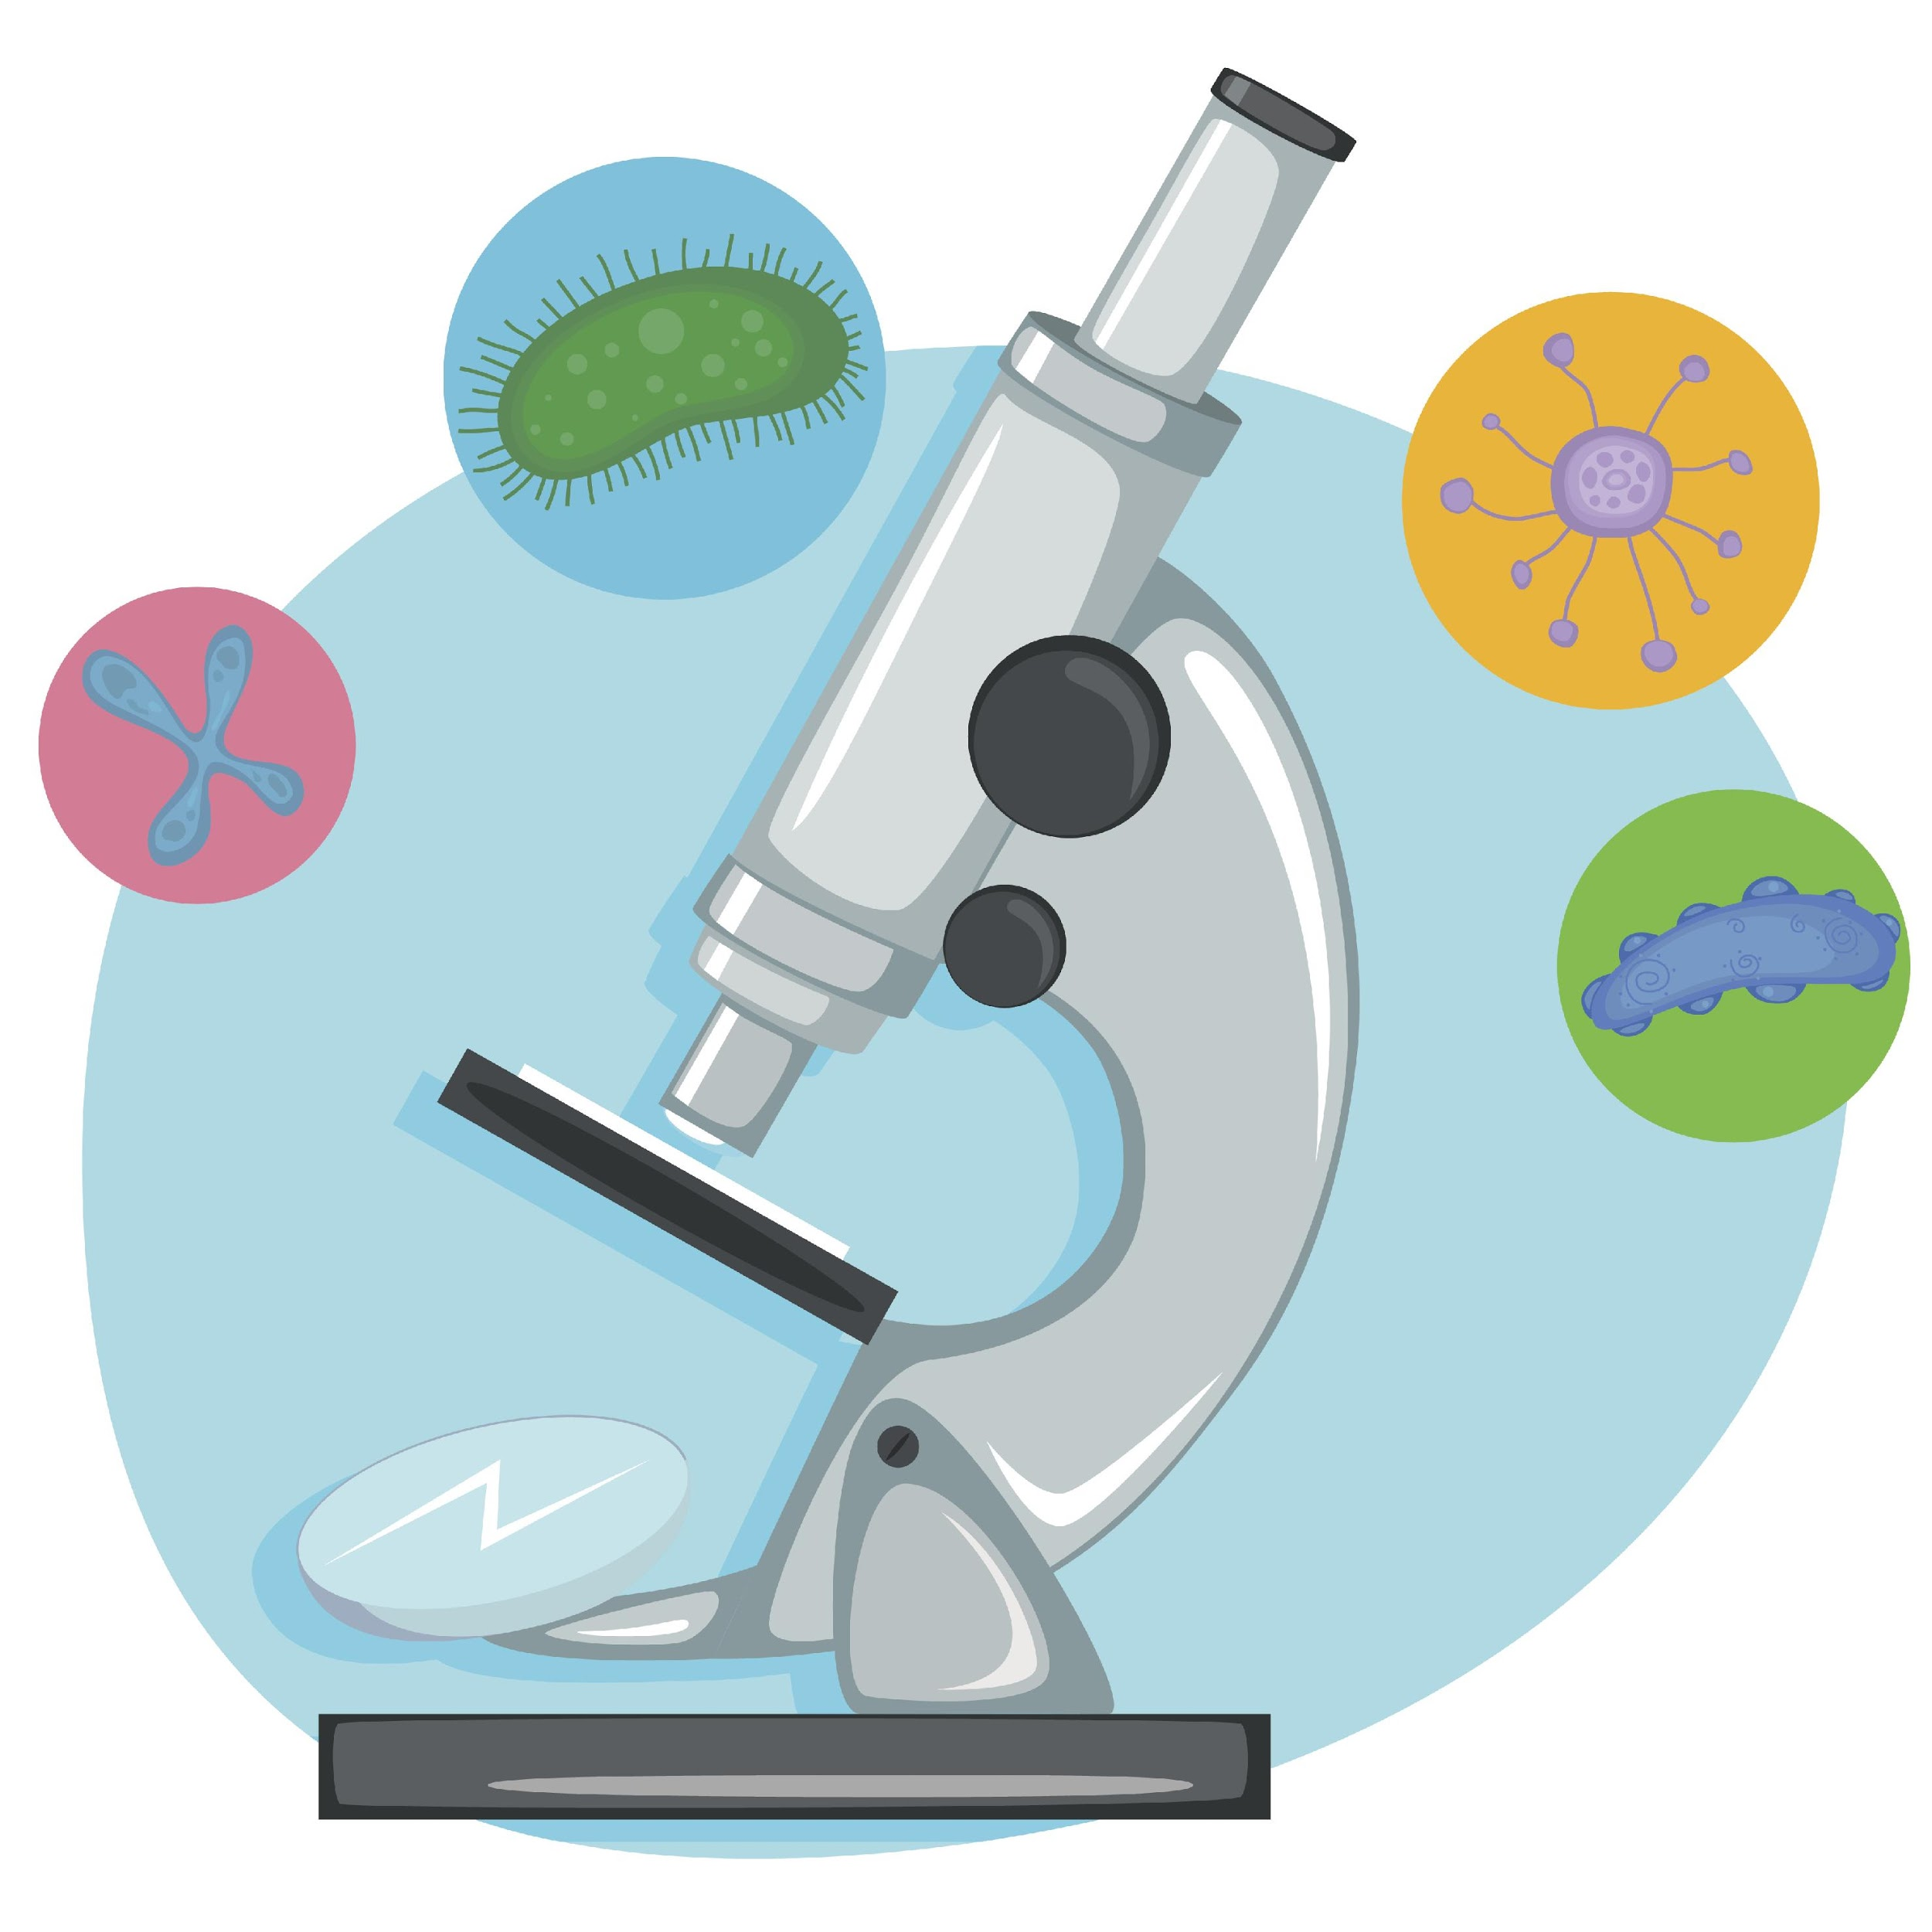
Science helps us understand the natural world.
Notes:
First, the nature of science states that science helps us understand the natural world. The development of the microscope gave us a completely new view of the natural world that had never been seen before, as these objects were too small to see with the naked eye. With the invention of the microscope, we were able to gain an understanding of how the natural world works on a microscopic scale which eventually led to the development of cell theory.

Slide 51
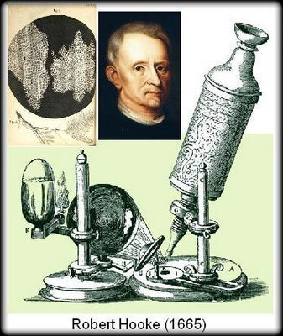
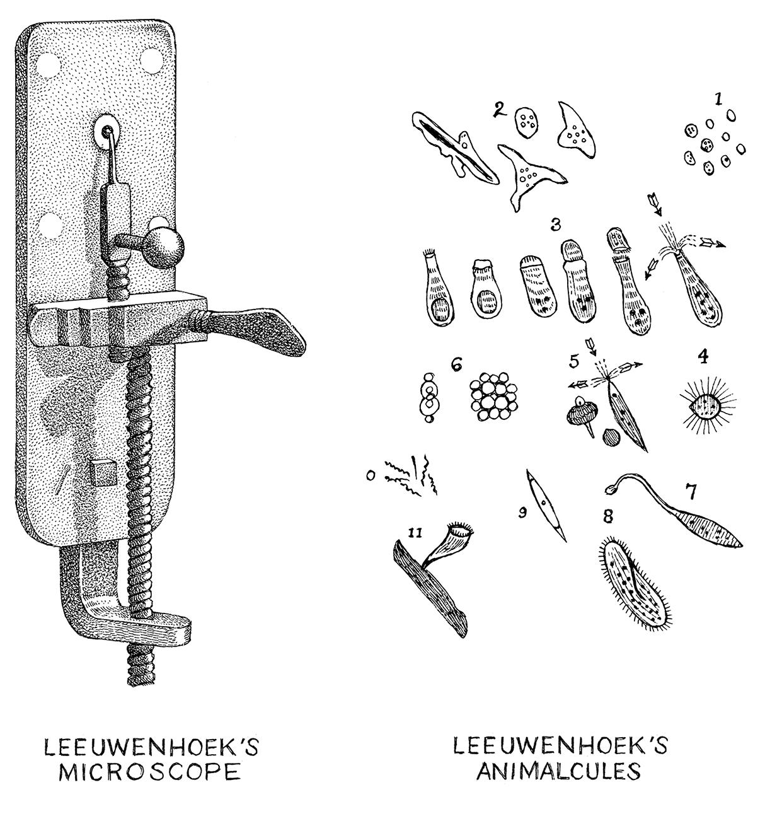
Science is based on observational and experimental evidence.
Notes:
The nature of science also states that science is based on observational and experimental evidence. Scientists who developed microscopes, such as Anton van Leeuwenhoek and Robert Hooke, first discovered cells due to observational and experimental evidence that they gathered as they looked at different objects. Further, scientists who used microscopes to explore cells of plants and animals, like Matthias Schleiden, Theodor Schwann, and Rudolf Virchow, found additional evidence through their observations and experiments that resulted in the development of the cell theory.

Slide 52
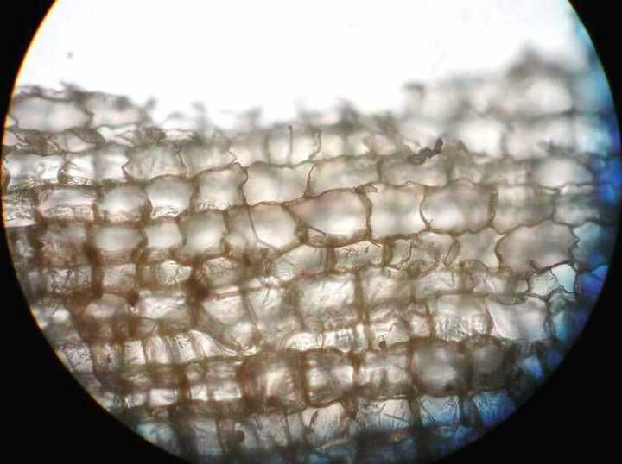
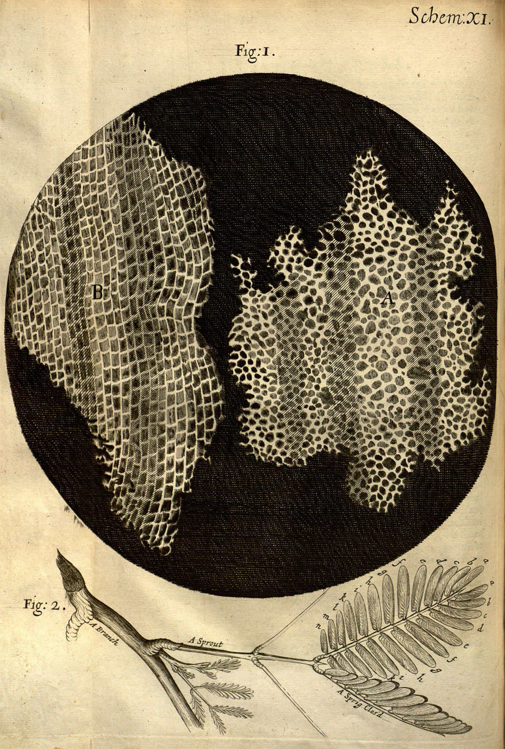
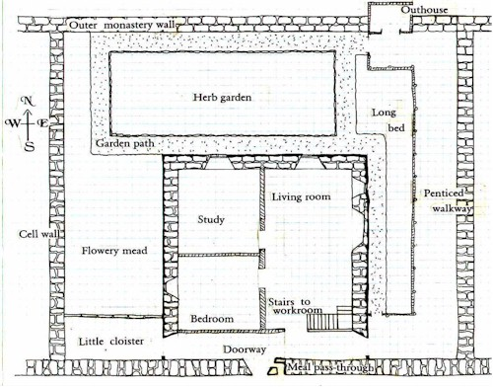
Science is a blend of logic and innovation.
Notes:
Another nature of science concept states that science is a blend of logic and innovation. Hooke’s coining of the term “cell” after viewing a slice of cork under his microscope is great example of how scientists blend logic and innovation. Hooke was innovative in developing his version of a microscope and, after viewing cork under the microscope’s lens, he used logic in coming up with the term “cell,” as the box-like shapes he observed reminded him of the cells, or rooms.

Slide 53
Scientific ideas can change with new data.
1665
1680s
1838
1839
1855
Robert Hooke: coined the term “cells”
Anton van Leeuwenhoek: observed living cells (bacteria)
Matthias Schleiden: discovered plants are made of cells
Theodor Schwann: discovered animals are made of cells
Rudolf Virchow: confirmed that cells come from other living cells
Notes:
The nature of science also states that scientific ideas can change with new data. The development of cell theory summarizes this concept perfectly. From the initial discovery of cells to the three basic principles of the theory itself, each scientist involved in this process presented new data from their observations and experiments that led to changes in the world’s understanding of cells over time. A great example is the rule that all cells come from other cells. IT was once that the cells could come from nonliving substances.
Feedback: This visual is a great way to help students understand the concept of scientific ideas changing with new data. Share with students that science is not static today either - their generation will continue to build and push ways of thinking by engaging in scientific practices!

Slide 54
Science is a complex, social endeavor.
1838
1839
1855
Matthias Schleiden: discovered plants are made of cells
Theodor Schwann: discovered animals are made of cells
Rudolf Virchow: confirmed that cells come from other living cells
Notes:
We also see the nature of science concept which states that science is a complex, social endeavor illustrated here. When Schleiden found that all plants are made of cells and Schwann found that all animals are made of cells, they partnered up as they realized there had to be some connection with these discoveries, and developed cell theory.

Slide 55
Scientists must remain objective to avoid bias.
1838
1839
1855
Matthias Schleiden: discovered plants are made of cells
Theodor Schwann: discovered animals are made of cells
Rudolf Virchow: confirmed that cells come from other living cells
Notes:
Lastly, we can even see the nature of science concept stating that scientists must remain objective to avoid bias. As Schleiden and Schwann faced disagreement on that third rule of cell theory, about cells coming from other cells, they remained objective by waiting until Virchow stepped in before this final rule was confirmed as part of the theory.

Slide 56
Notes:
Let’s check-in for understanding.

Slide 57
What does the nature of science have to do with the development of cell theory?
Cell theory is an example of how the nature of science concepts help guide scientists’ thinking.
Absolutely nothing.
The same scientists who came up with the nature of science also created cell theory.
Notes:
What does the nature of science have to do with the development of cell theory?

Slide 58
What does the nature of science have to do with the development of cell theory?
Cell theory is an example of how the nature of science concepts help guide scientists’ thinking.
Absolutely nothing.
The same scientists who came up with the nature of science also created cell theory.
Notes:
What does the nature of science have to do with the development of cell theory?
[Cell theory is an example of how the nature of science concepts help guide scientists’ thinking.]

Slide 59
Name one example of how the development of cell theory relates to the nature of science concepts.
Notes:
Name one example of how the development of cell theory relates to the nature of science concepts.
[Students can state any of the examples from the 6 previous PowerPoint slides. If student proposes a different connection that was not covered in PowerPoint, use your discretion to determine acceptability.]

Slide 60
Remember!!!
Notes:
So remember!

Slide 61
Cell Theory: the scientific theory that all living things are made of cells.
Notes:
Cell theory is the scientific theory that all living things are made of cells. This theory was developed by a few different scientists as advancements were made in microscope technology.

Slide 62
Cell Theory
is made up of 3 basic rules
Notes:
The cell theory is made up of 3 basic principles, or rules. When something we observe in the natural world that meets all three of these rules, that means it is a living thing.

Slide 63
Rule #1: The cell is the basic unit of life.
Notes:
Rule #1: The cell is the basic unit of life.

Slide 64
Rule #2: All living things are made of one or more cells.
Notes:
Rule #2: All living things are made up of one or more cells.

Slide 65
Rule #3: All new cells are made from cells that already exist.
Notes:
Rule #3: All new cells are made from cells that already exist.

Slide 66
The development of cell theory is an example of how the nature of science concepts help guide scientists’ thinking.
Notes:
And lastly, the development of cell theory is an example of how the nature of science concepts help to guide scientists’ thinking.

Slide 67
Reinforcement Activity
Cell Theory WebQuest
Click the link above to access a PDF that includes questions about the cell theory, as well as web-based resources for students to access for information to answer questions.
Students will also depict the development of cell theory over time by creating their own timeline.
Notes:
Feedback:

Slide 68
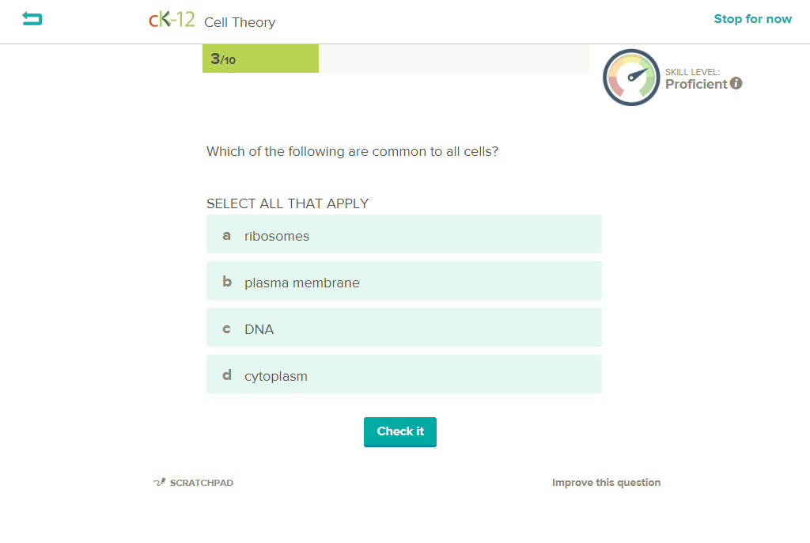
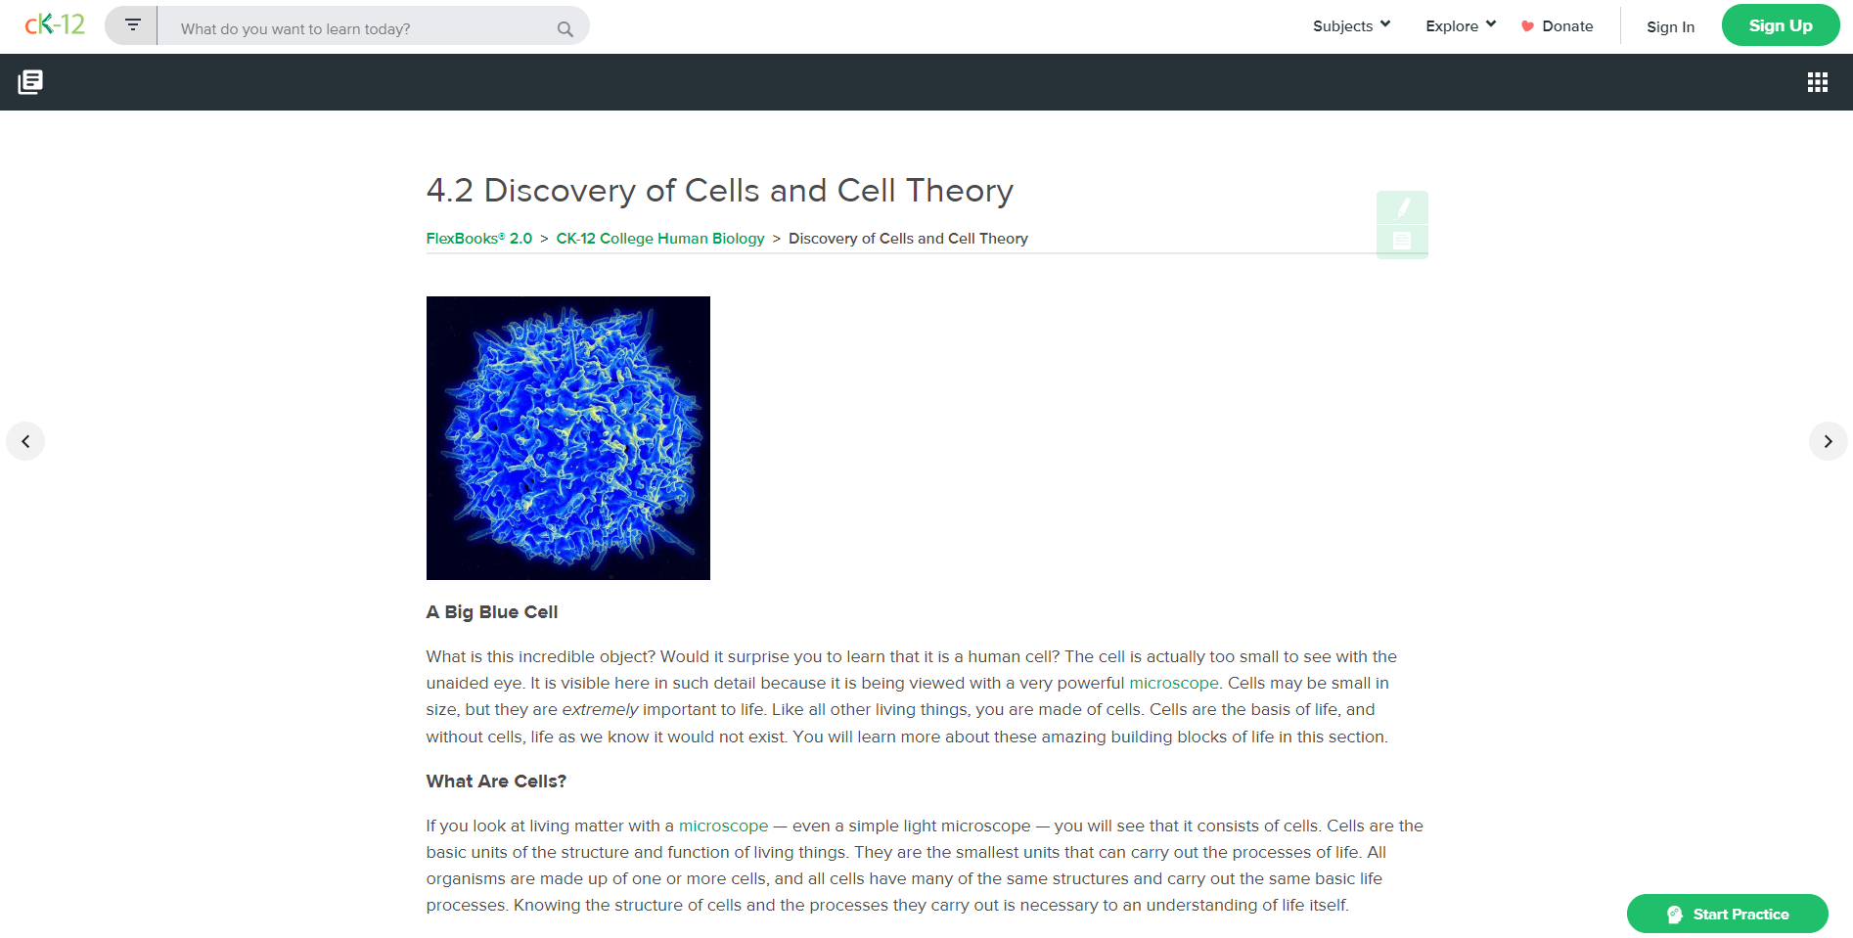
Reinforcement Activity
Flexbooks Reading & Adaptive Practice Questions
(Cell Theory)
Click the link above to access a student-friendly reading passage about the discovery of cells and cell theory.
Once finished reading, students can select the “start practice” button in the bottom right corner to complete computer-adaptive practice questions about the topic.
Notes:
Feedback: These reinforcement activities are a great way to differentiate learning experiences for your students based on their needs and interests. Students do not all need to complete the same activity or at the same time. These activities can be easily included for if students finish early or need an alternative activity.

Slide 69
Big Question: How does the development of the cell theory relate to the nature of science?
Notes:
Explicit cue to revisit the big question at the end of the lesson: Okay everyone. Let’s reflect once more on our big question. Does anyone have any additional examples to share that haven’t been discussed yet?

Slide 70
Notes:
Thanks for watching, and please continue watching CAPs available from this website.

Slide 71
This Video Was Created With Resources From:
Questions or Comments
Michael Kennedy, Ph.D. MKennedy@Virginia.edu
Rachel L Kunemund, Ph.D. rk8vm@virginia.edu

