Slide 1
Intro
“Big Idea” Question
Review Concepts
Check-In Questions
Teacher Engagement
Vocabulary
Student-Friendly Definition
Examples & Non-Examples
Morphological Word Parts
Simulation/Activity
Notes:
OK everyone, get ready for our next lesson. Just as a reminder, these are the different components that our lesson may include, and you’ll see these icons in the top left corner of each slide so that you can follow along more easily!

Slide 2
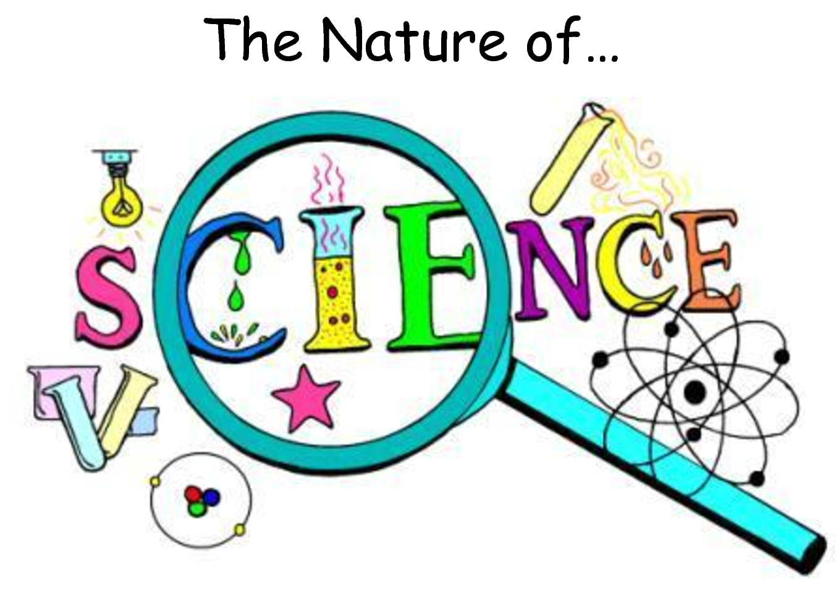
Intro
6 Concepts to Know
Notes:
Today we’ll be learning about 6 concepts referred to as the nature of science...

Slide 3
Big Question: How does the nature of science relate to the development of hypotheses, theories, and laws?
Notes:
Our “big question” is: How does the nature of science relate to the development of hypotheses, theories, and laws?
[Pause and illicit predictions from students.]
I love all these thoughtful guesses! Be sure to keep this question and your predictions in mind as we move through these next few lessons, and we’ll continue to revisit it.

Slide 4
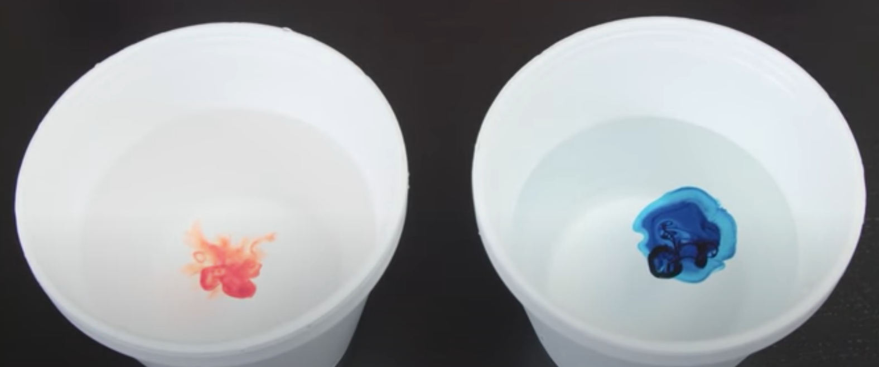
Demonstration
Materials Needed:
Document camera, 2 styrofoam cups, two different food dyes, hot and cold water
Procedure:
Explain that you have a cup of hot and cold water. You will be putting one drop of food coloring into each at the same time. Have students predict which temperature of water will cause the color to spread out into the water faster with a Think-Pair-Share. You can record responses as tallies on the boards and make it a competition! Add a drop of food coloring to each and allow students to observe via projection of the document camera footage.
Notes:
Before we jump in, let’s look at a short demonstration related to the nature of science.
Which temperature of water do you think will cause the color to spread out within the liquid faster?
Let’s observe and see if our guess was correct…
Notice that the hot water caused the color to move much faster through the liquid. What we call “heat” really has to do with how fast molecules are moving - that movement of the water molecules causes the food dye to move as well.
This small and simple experiment demonstrates a few of the principles that make up what we call the “nature of science”. Science gives us insight into the natural world. Science is based upon data, which we collected through simple observation. Science is also a collaborative and social process. Without communication, science cannot move forward. Notice that I had you all work with a partner in generating your predictions for what would happen. If we had uncovered new information about water, we would certainly want to share that with others who are studying it. Scientific understanding also changes as new data is collected, much like those of you who guessed that the color would move fastest in the cold cup. We are going to dive further into these principles and others today.

Slide 5
Notes:
Before we move on to our new topic, let’s review some other words & concepts that you already learned and make sure you are firm in your understanding.

Slide 6
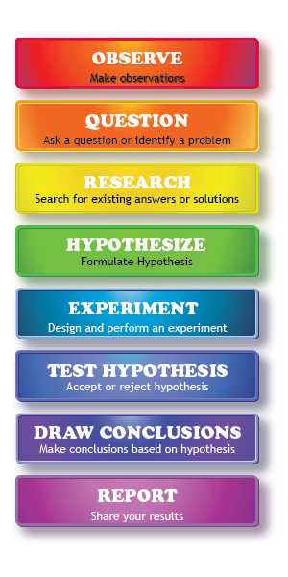
Scientific Method: steps that investigators follow to answer questions about the natural world
Notes:
One term that you’ve likely heard year after year in science class is the scientific method. The scientific method is a series of steps that investigators follow to answer questions about the natural world. By following the same steps, investigators are able to copy and check the work that is done by others. Let’s do a quick review of these steps.

Slide 7
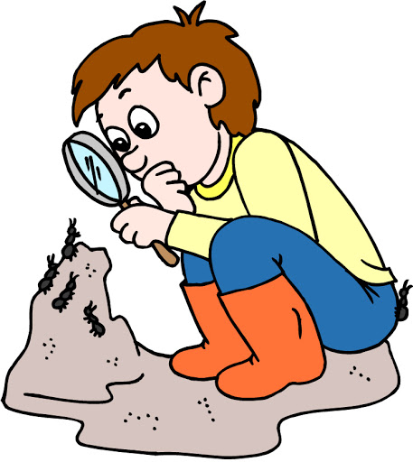
Observation
Notes:
The first step of the scientific method always begins with making an observation, or noticing something interesting that you’d like to explore further.

Slide 8
Question
Notes:
As you observe interesting things, you may find yourself asking some questions about what you saw, or you may even notice a problem that needs to be fixed.

Slide 9
Research
Notes:
This leads you to doing some research into different answers and solutions that may already exist about that topic and helps you to further develop your own ideas.

Slide 10
Hypothesis
Notes:
Researching those existing ideas helps you develop your own hypothesis. A hypothesis is a suggested explanation or idea that can be tested through an experiment. It’s super important to note that a hypothesis must be able to be tested! The hypothesis predicts what will happen and why.

Slide 11
Experiment
Notes:
Investigators use experiments to test their hypotheses. Experiments must be designed carefully, well-controlled and documented so that they can be replicated (or repeated) by other investigators. Experimental results are recorded as data that can be used to determine whether or not the hypothesis is supported.

Slide 12
Draw Conclusions & Share Results
Notes:
Finally, after you conduct your experiment, you should be able to draw conclusions about whether your hypothesis was supported or not. Hypotheses that are not supported are rejected.

Slide 13
Notes:
Now let’s pause for a moment to review the information we have covered already.

Slide 14
What are the steps that investigators follow to answer questions about the natural world called?
Experiment
Scientific Method
Questions
Notes:
What are the steps that investigators follow to answer questions about the natural world called?

Slide 15
What are the steps that investigators follow to answer questions about the natural world called?
Experiment
Scientific Method
Questions
Notes:
What are the steps that investigators follow to answer questions about the natural world called?
[Scientific Method]

Slide 16
Which of the following is NOT one of the 6 concepts to know about the nature of science?
We can understand the natural world through science.
Science is a complex, social endeavor.
Scientific ideas can change as we collect more data.
Once you find an answer you don’t need science anymore.
Notes:
Which of the following is NOT one of the 6 concepts to know about the nature of science?
[Once you find an answer you don’t need science anymore. → In fact, as we participate in science investigations, we usually come across more questions that we want to answer!]

Slide 17
The first step of the Scientific Method always begins with making an...
Notes:
The first step of the scientific method always begins with making an...
[Observation]

Slide 18
A hypothesis must be...
Notes:
A hypothesis must be...
[testable / able to be tested through an experiment]

Slide 19
Nature of Science
Notes:
Now that we’ve reviewed, let’s define the phrase Nature of Science.

Slide 20
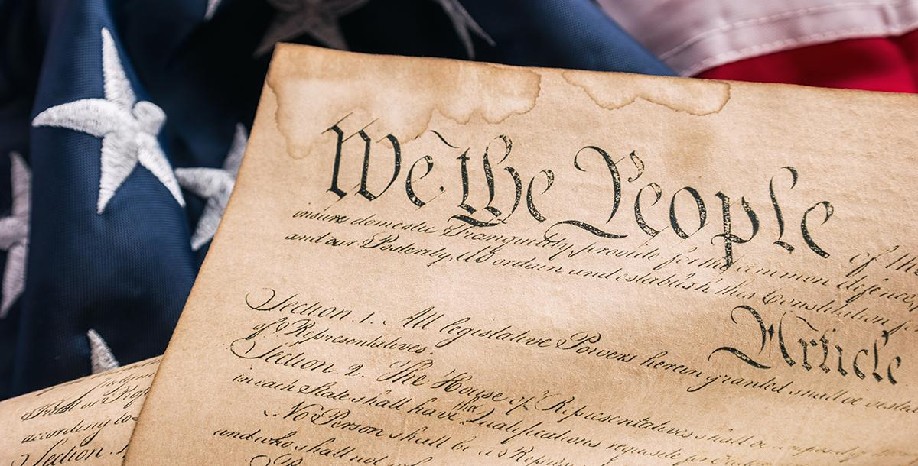
Cell Theory: foundational ideas that guide scientists’ thinking about the natural world
Notes:
The nature of science refers to some foundational concepts that guide scientists’ thinking about the natural world.
We can think of it like the Constitution of the United States. Just as the constitution is like a “code” that US citizens live by, the nature of science is a sort of “code” that scientists live by.

Slide 21
Notes:
Let’s check-in for understanding.

Slide 22
What is the nature of science?
Notes:
What is the nature of science?
[The nature of science refers to some foundational concepts that guide scientists’ thinking about the natural world.]

Slide 23
Notes:
That is the basic definition, but there is a bit more you need to know.

Slide 24
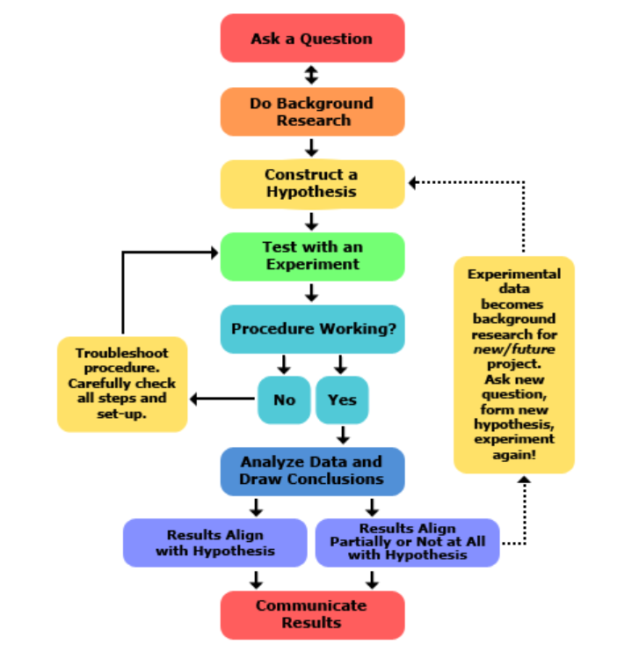
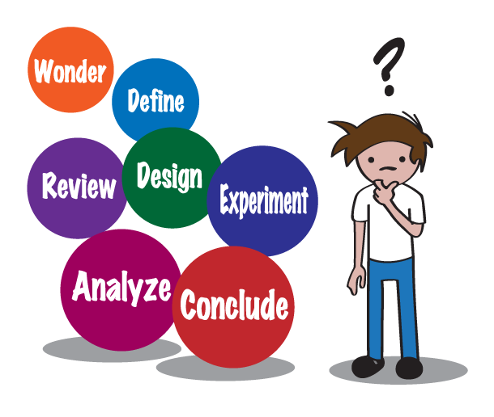
Notes:
The scientific method gives us steps to follow as we begin learning how to conduct investigations. However, if you look up “the scientific method,” you’ll see that there are different steps listed sometimes. That’s because science is a process that can vary or change from case to case, or one experiment to the next. For example, as we begin an investigation, we may realize that something isn’t working, we need to go a different direction with an idea, or we may need to think of a new idea altogether. In these instances, we may not complete every step of the scientific method.

Slide 25
6 Concepts to Know
Notes:
That’s where “The Nature of Science” comes in! The nature of science involves testing and refining our current understanding of the world around us – just like the steps of the scientific method help us do. However, it includes 6 broader concepts, or general guidelines, for us to understand and follow as we participate in scientific inquiry. Let’s take a closer look at these 6 concepts.

Slide 26
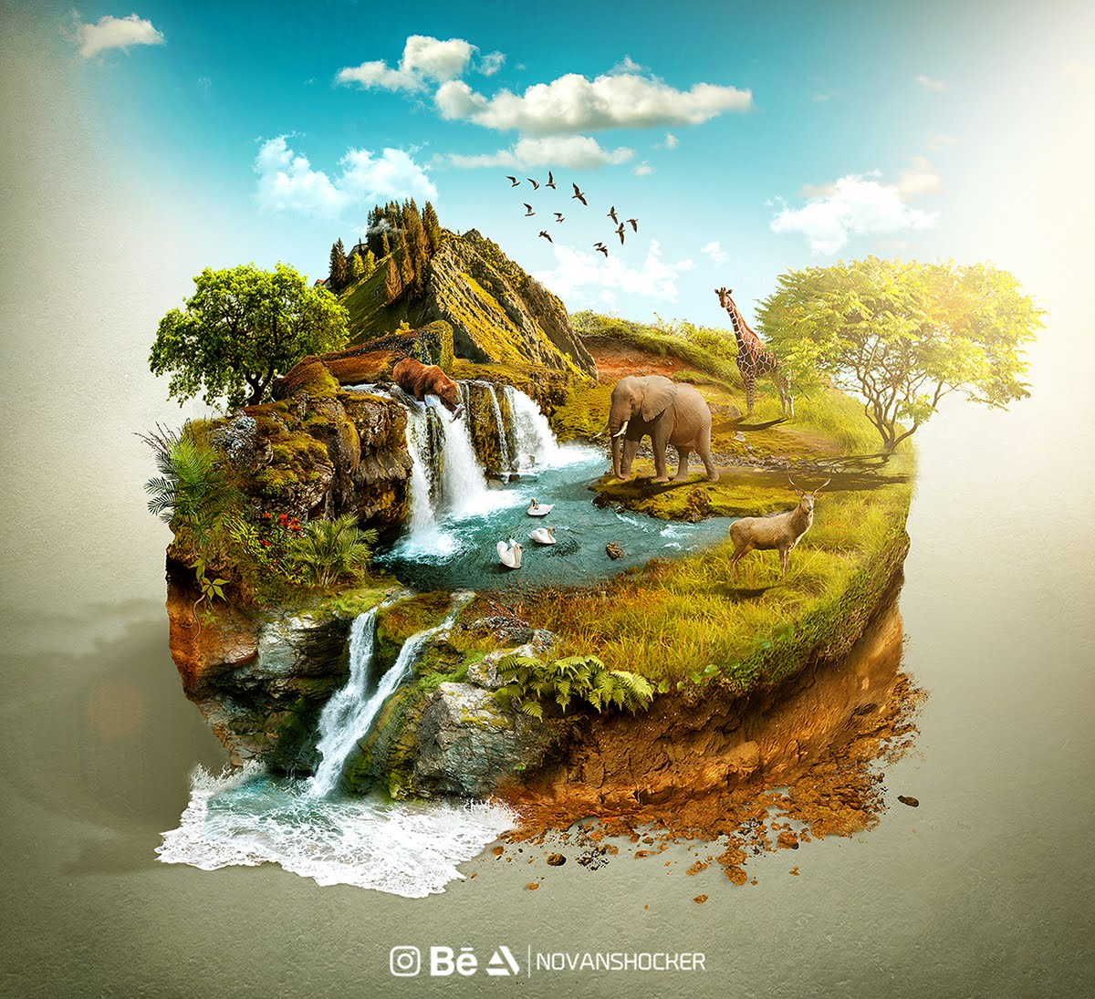
We can understand the natural world through science.
Notes:
First, we can gain an understanding of things in the world around us through science. Science can help us find many different answers, but not answers to everything – only things that can be observed, measured, and tested in the natural world.

Slide 27
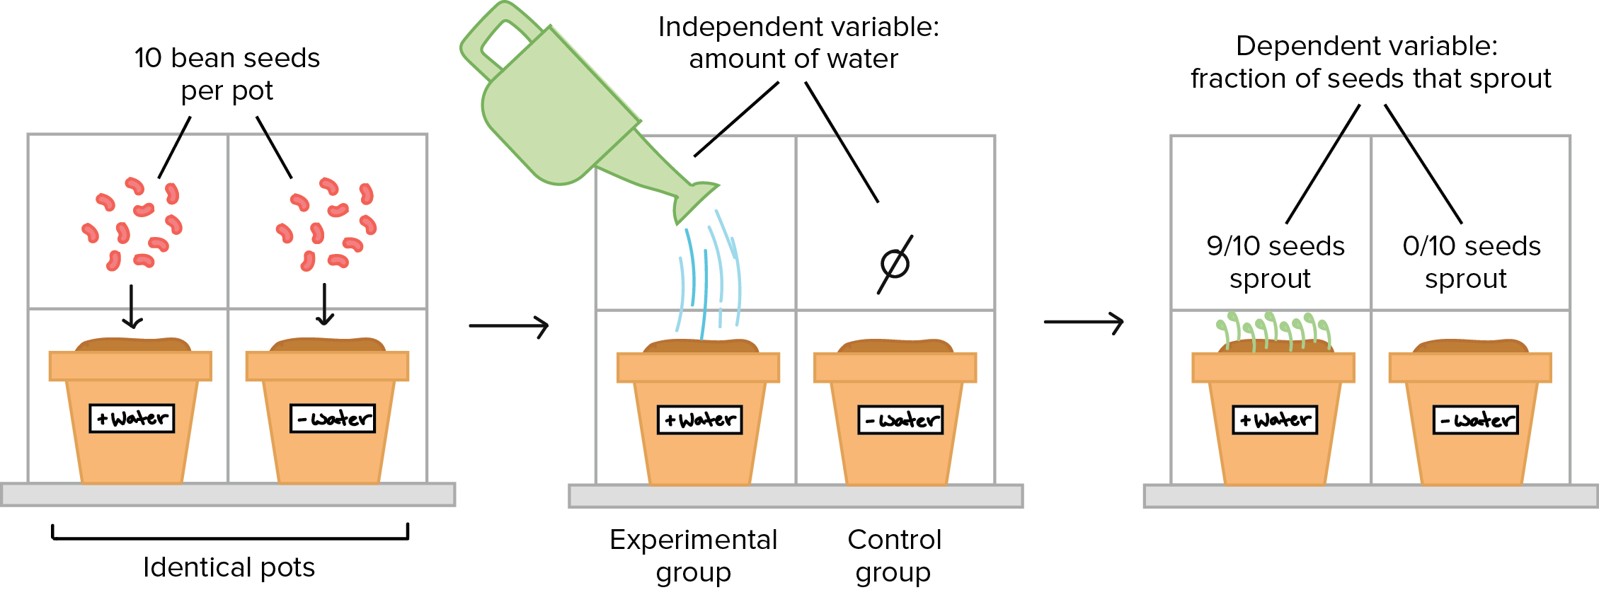
Science is based on evidence –
both observational and experimental.
Notes:
Everything in science begins with an observation that makes us curious about something. Then we gather more evidence through experiments and more observations to determine answers to the questions or problems that we were curious about.

Slide 28
Science is a blend of logic and innovation.
Notes:
Engaging in science involves the use of current understandings and science knowledge, as well as creative, innovative ideas and tools that help us expand on what we already know and understand. Sometimes new information is uncovered systematically, but other times we might learn new things through creative or even accidental processes.

Slide 29
Scientific ideas can change as new data is collected.
Notes:
Science and technology are closely related to each other. We use science to understand the natural world through observation and experimentation, and new technologies are developed to aid in gathering data. As we collect new data, we gain fresh insights and raise new questions, and this can prompt a need for additional investigations. Through this process, scientific ideas and knowledge can change over time. Just as new technologies can help us learn more about our world, new scientific discoveries can lead to advancements in technology.

Slide 30
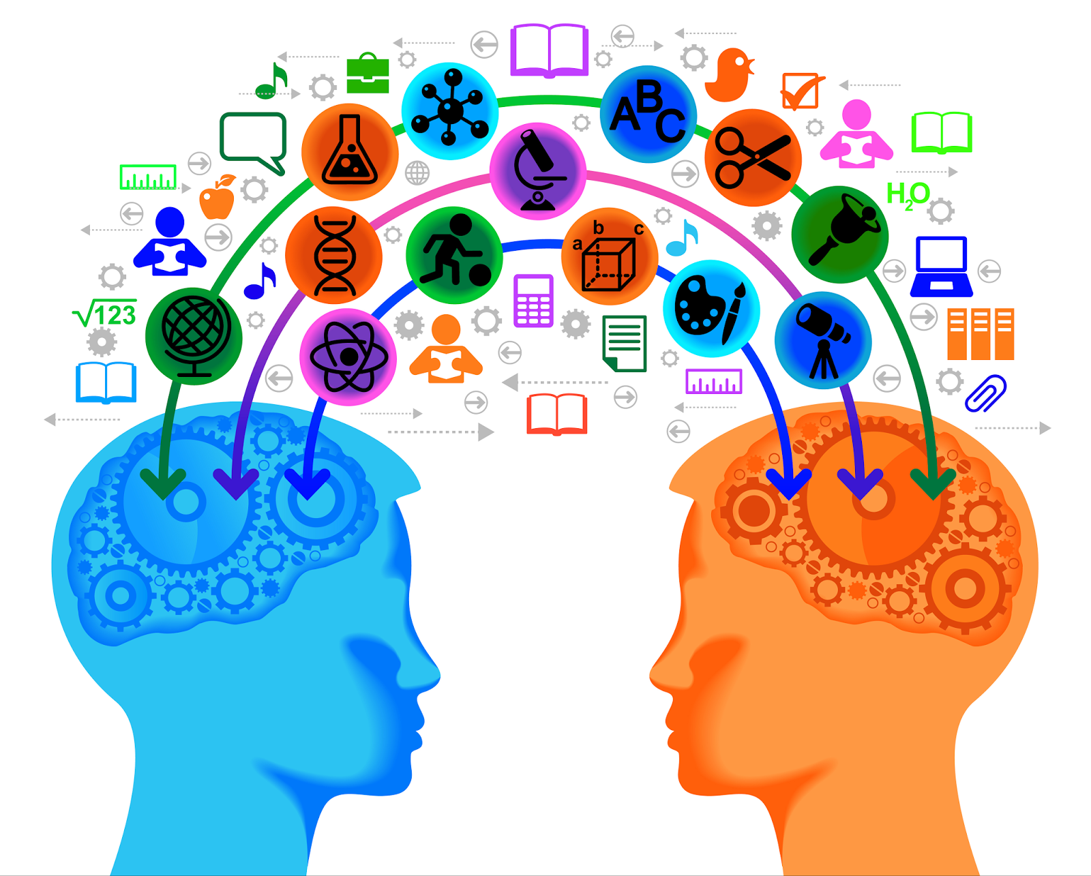
Science is a complex, social endeavor.
Notes:
Science involves communication, teamwork, collaboration, careful examination, creativity, and the ability to think outside the box, or innovation. Scientific results are not meaningful unless they are communicated with others and analyzed by different perspectives.

Slide 31
Scientists must try to remain objective to avoid bias.
Notes:
Everyone has their own beliefs, feelings, or opinions about things we encounter in the world. But when scientists are investigating a question or problem, it’s important that they set these personal opinions aside so that they do not impact the results.
For example, let’s say we were conducting an experiment to determine if Android or Apple cell phones get better service in our school building. You might be a huge fan of Apple phones and really think that this brand is the best, but you must remain objective and set your personal beliefs aside so that your opinion does not influence the results of the experiment.
While scientists do their best to avoid being subjective, it is difficult to avoid completely and subjectivity has influenced many scientific results and influenced scientific processes historically.

Slide 32
Notes:
Let’s check-in for understanding.

Slide 33
What is the difference between the scientific method and the nature of science?
Notes:
What is the difference between the scientific method and the nature of science?
[The nature of science includes broad/general guidelines for scientists, while the scientific method is a set of specific steps to follow.]

Slide 34
Which of the following is NOT one of the 6 concepts to know about the nature of science?
We can understand the natural world through science.
Science is a complex, social endeavor.
Scientific ideas can change as we collect more data.
Once you find an answer you don’t need science anymore.
6 Concepts to Know
Notes:
Which of the following is NOT one of the 6 concepts to know about the nature of science?

Slide 35
Which of the following is NOT one of the 6 concepts to know about the nature of science?
We can understand the natural world through science.
Science is a complex, social endeavor.
Scientific ideas can change as we collect more data.
Once you find an answer you don’t need science anymore.
6 Concepts to Know
Notes:
Which of the following is NOT one of the 6 concepts to know about the nature of science?
[Once you find an answer you don’t need science anymore. → In fact, as we participate in science investigations, we usually come across more questions that we want to answer!]

Slide 36
Remember!!!
Notes:
So remember!

Slide 37
Cell Theory: foundational ideas that guide scientists’ thinking about the natural world
Notes:
The nature of science refers to some foundational concepts that guide scientists’ thinking about the natural world.
We can think of it like the Constitution of the United States. Just as the constitution is like a “code” that US citizens live by, the nature of science is a sort of “code” that scientists live by.

Slide 38
We can understand the natural world through science.
Notes:
First, we can gain an understanding of things in the world around us through science. Science can help us find many different answers, but not answers to everything – only things that can be observed, measured, and tested in the natural world.

Slide 39
Science is based on evidence –
both observational and experimental.
Notes:
Everything in science begins with an observation that makes us curious about something. Then we gather more evidence through experiments and more observations to determine answers to the questions or problems that we were curious about.

Slide 40
Science is a blend of logic and innovation.
Notes:
Engaging in science involves the use of current understandings and science knowledge, as well as creative, innovative ideas and tools that help us expand on what we already know and understand. Sometimes new information is uncovered systematically, but other times we might learn new things through creative or even accidental processes.

Slide 41
Scientific ideas can change as new data is collected.
Notes:
Science and technology are closely related to each other. We use science to understand the natural world through observation and experimentation, and new technologies are developed to aid in gathering data. As we collect new data, we gain fresh insights and raise new questions, and this can prompt a need for additional investigations. Through this process, scientific ideas and knowledge can change over time. Just as new technologies can help us learn more about our world, new scientific discoveries can lead to advancements in technology.

Slide 42
Science is a complex, social endeavor.
Notes:
Science involves communication, teamwork, collaboration, careful examination, creativity, and the ability to think outside the box, or innovation. Scientific results are not meaningful unless they are communicated with others and analyzed by different perspectives.

Slide 43
Scientists must try to remain objective to avoid bias.
Notes:
Everyone has their own beliefs, feelings, or opinions about things we encounter in the world. But when scientists are investigating a question or problem, it’s important that they set these personal opinions aside so that they do not impact the results.
For example, let’s say we were conducting an experiment to determine if Android or Apple cell phones get better service in our school building. You might be a huge fan of Apple phones and really think that this brand is the best, but you must remain objective and set your personal beliefs aside so that your opinion does not influence the results of the experiment.
While scientists do their best to avoid being subjective, it is difficult to avoid completely and subjectivity has influenced many scientific results and influenced scientific processes historically.

Slide 44
Big Question: How does the nature of science relate to the development of hypotheses, theories, and laws?
Notes:
Explicit cue to revisit the big question at the end of the lesson: Okay everyone. Let’s reflect once more on our big question. Does anyone have any additional examples to share that haven’t been discussed yet?

Slide 45
Notes:
Thanks for watching, and please continue watching CAPs available from this website.

Slide 46
This Video Was Created With Resources From:
Questions or Comments
Michael Kennedy, Ph.D. MKennedy@Virginia.edu
Rachel L Kunemund, Ph.D. rk8vm@virginia.edu

Slide 47
Intro
“Big Idea” Question
Review Concepts
Check-In Questions
Teacher Engagement
Vocabulary
Student-Friendly Definition
Examples & Non-Examples
Morphological Word Parts
Simulation/Activity
Notes:
OK everyone, get ready for our next lesson. Just as a reminder, these are the different components that our lesson may include, and you’ll see these icons in the top left corner of each slide so that you can follow along more easily!

Slide 48
Intro
Hypothesis, Theory, and Law –
What’s the difference???
Notes:
In this lesson, we’ll define the terms hypothesis, theory, and law, and we’ll also discuss the differences between these three things.

Slide 49
Big Question: How does the nature of science relate to the development of hypotheses, theories, and laws?
Notes:
Our “big question” is: How does the nature of science relate to the development of hypotheses, theories, and laws?
[Pause and illicit predictions from students.]
I love all these thoughtful guesses! Be sure to keep this question and your predictions in mind as we move through these next few lessons, and we’ll continue to revisit it.

Slide 50
Notes:
Before we move on to our new topic, let’s review some other words & concepts that you already learned and make sure you are firm in your understanding.

Slide 51
Nature of Science: foundational ideas that guide scientists’ thinking about the natural world
Notes:
The nature of science refers to some foundational concepts that guide scientists’ thinking about the natural world.
We can think of it like the Constitution of the United States. Just as the constitution is like a “code” that US citizens live by, the nature of science is a sort of “code” that scientists live by.

Slide 52
6 Concepts to Know
Notes:
The nature of science involves testing and refining our current understanding of the world around us – just like the steps of the scientific method help us do. However, it includes 6 broader concepts, or general guidelines, for us to understand and follow as we participate in scientific inquiry. Let’s take a closer look at these 6 concepts.

Slide 53
We can understand the natural world through science.
Notes:
First, we can gain an understanding of things in the world around us through science. Science can help us find many different answers, but not answers to everything – only things that can be observed, measured, and tested in the natural world.

Slide 54
Science is based on evidence –
both observational and experimental.
Notes:
Everything in science begins with an observation that makes us curious about something. Then we gather more evidence through experiments and more observations to determine answers to the questions or problems that we were curious about.

Slide 55
Science is a blend of logic and innovation.
Notes:
Engaging in science involves the use of current understandings and science knowledge, as well as creative, innovative ideas and tools that help us expand on what we already know and understand. Sometimes new information is uncovered systematically, but other times we might learn new things through creative or even accidental processes.

Slide 56
Scientific ideas can change as new data is collected.
Notes:
Science and technology are closely related to each other. We use science to understand the natural world through observation and experimentation, and new technologies are developed to aid in gathering data. As we collect new data, we gain fresh insights and raise new questions, and this can prompt a need for additional investigations. Through this process, scientific ideas and knowledge can change over time. Just as new technologies can help us learn more about our world, new scientific discoveries can lead to advancements in technology.

Slide 57
Science is a complex, social endeavor.
Notes:
Science involves communication, teamwork, collaboration, careful examination, creativity, and the ability to think outside the box, or innovation. Scientific results are not meaningful unless they are communicated with others and analyzed by different perspectives.

Slide 58
Scientists must try to remain objective to avoid bias.
Notes:
Everyone has their own beliefs, feelings, or opinions about things we encounter in the world. But when scientists are investigating a question or problem, it’s important that they set these personal opinions aside so that they do not impact the results.
For example, let’s say we were conducting an experiment to determine if Android or Apple cell phones get better service in our school building. You might be a huge fan of Apple phones and really think that this brand is the best, but you must remain objective and set your personal beliefs aside so that your opinion does not influence the results of the experiment.
While scientists do their best to avoid being subjective, it is difficult to avoid completely and subjectivity has influenced many scientific results and influenced scientific processes historically.

Slide 59
Notes:
Let’s check-in for understanding.

Slide 60
What is the difference between the scientific method and the nature of science?
Notes:
What is the difference between the scientific method and the nature of science?
[The nature of science includes broad/general guidelines for scientists, while the scientific method is a set of specific steps to follow.]

Slide 61
Which of the following is NOT one of the 6 concepts to know about the nature of science?
Science only progresses through systematic and structured procedures.
Science is a blend of logic and innovation.
Scientific ideas can change as we collect more data.
We can understand the natural world through science.
6 Concepts to Know
Notes:
Which of the following is NOT one of the 6 concepts to know about the nature of science?

Slide 62
Which of the following is NOT one of the 6 concepts to know about the nature of science?
Science only progresses through systematic and structured procedures.
Science is a blend of logic and innovation.
Scientific ideas can change as we collect more data.
We can understand the natural world through science.
6 Concepts to Know
Notes:
Which of the following is NOT one of the 6 concepts to know about the nature of science?
[Science only progresses through systematic and structured procedures. → Plenty of important scientific discoveries have been made through creative innovation and sometimes even on accident!]

Slide 63
Hypothesis
Notes:
Now that we’ve reviewed, let’s define hypothesis.

Slide 64
Hypothesis: an “educated guess” that must be tested
Notes:
A hypothesis is an educated guess that must be tested. Like we discussed with the nature of science and the scientific method, when you have a question or problem that you want to investigate, you use existing knowledge to develop a hypothesis, then test it with an experiment.

Slide 65
Notes:
Let’s check-in for understanding.

Slide 66
What is a hypothesis?
Notes:
What is a hypothesis?
[A hypothesis is an educated guess that must be tested. Like we discussed with the nature of science and the scientific method, when you have a question or problem that you want to investigate, you use existing knowledge to develop a hypothesis, then test it with an experiment.]

Slide 67
Notes:
Now, let’s talk about some examples of hypotheses.

Slide 68
If I use Scott’s fertilizer, then my grass will grow faster than if it has no fertilizer.
Notes:
The statement “If I use Scott’s fertilizer, then my grass will grow faster” is an example of a hypothesis because it is an educated guess that I can test. The company claims on the bag that this fertilizer will help me grow grass 35% faster than if I didn’t use this fertilizer. I can conduct an experiment to test whether or not this hypothesis is true.

Slide 69
If I brush my teeth twice a day, then I will not get a cavity.
Notes:
The statement “If I brush my teeth twice a day, then I will not get a cavity,” is another example of a hypothesis because it is an educated guess that we can test. We came up with this hypothesis because we’ve heard people recommend brushing twice a day to avoid problems at the dentist, like cavities. Now we can test this hypothesis by conducting an experiment to determine if brushing twice a day actually does prevent us from getting a cavity.

Slide 70
Notes:
Let’s check-in for understanding.

Slide 71
Write your own hypothesis - remember, it has to be something we could test.
Notes:
Write your own hypothesis - remember, it has to be something we could test.

Slide 72
Theory
Notes:
Now that we’ve reviewed, let’s define theory.

Slide 73
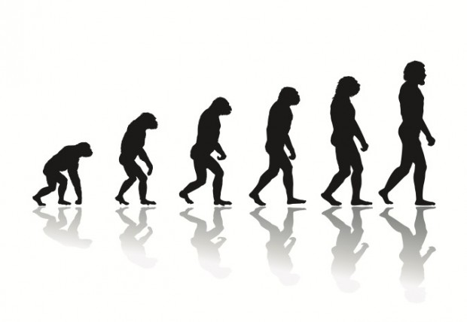
Theory: a widely accepted explanation that has stood up to repeated testing
Notes:
A theory is a widely accepted explanation for natural occurrences that has stood up to repeated testing.

Slide 74
Notes:
Let’s check-in for understanding.

Slide 75
What is a theory?
Notes:
What is a theory?
[A theory is a widely accepted explanation for natural occurrences that has stood up to repeated testing.]

Slide 76
Notes:
Now, let’s talk about some examples of theories.

Slide 77
Evolution
Notes:
The theory of evolution, or how humans came to exist, is one example of a scientific theory. It hasn’t been proven, but there is a lot of evidence to support this idea. This makes it a theory, or a widely accepted explanation, for how modern organisms developed over time.

Slide 78
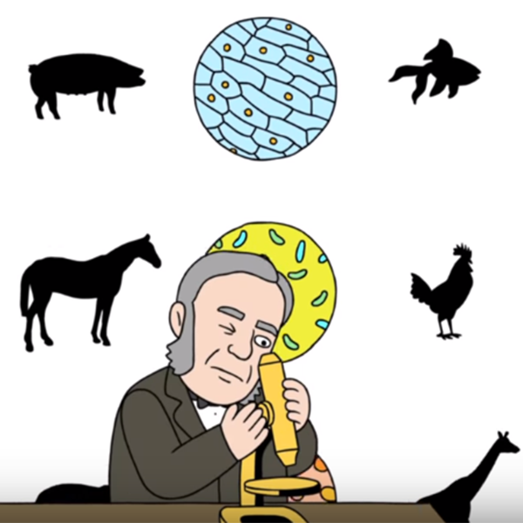
Cell Theory
Notes:
Cell theory is another example of a scientific theory that we’ll actually be focusing on in more detail during our next lesson. It is a basic set of principles that apply to cells which have been widely accepted by scientists for centuries and has developed over time as more evidence has become available.

Slide 79
Notes:
Let’s check-in for understanding.

Slide 80
What are examples of theories?
Notes:
What are examples of theories?

Slide 81
Law
Notes:
Now that we’ve reviewed, let’s define law.

Slide 82
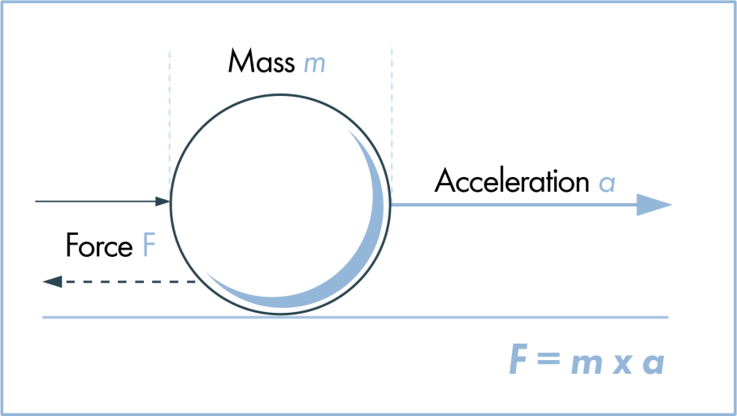
Law: an observation that always occurs under certain conditions
Notes:
A law is an observation that always occurs under certain conditions. These usually involve math, as scientists come up with formulas that help explain natural phenomena. Theories often attempt to explain why these observations happen consistently.

Slide 83
Notes:
Let’s check-in for understanding.

Slide 84
What is a law?
Notes:
What is a law?
[A law is an observation that always occurs under certain conditions. These usually involve math, as scientists come up with formulas that help explain natural phenomena. Theories often attempt to explain why these observations happen consistently.]

Slide 85
Notes:
Now, let’s talk about some examples of laws.

Slide 86
Newton’s Law of Force
Notes:
Newton’s second law of motion, the law of force, is one example of a scientific law. Newton came up with this mathematical formula to explain that force is the product of an object’s mass and its rate of acceleration, or how quickly it is moving. This is considered a scientific law because, given the appropriate conditions, it will always explain the amount of force that an object has.

Slide 87
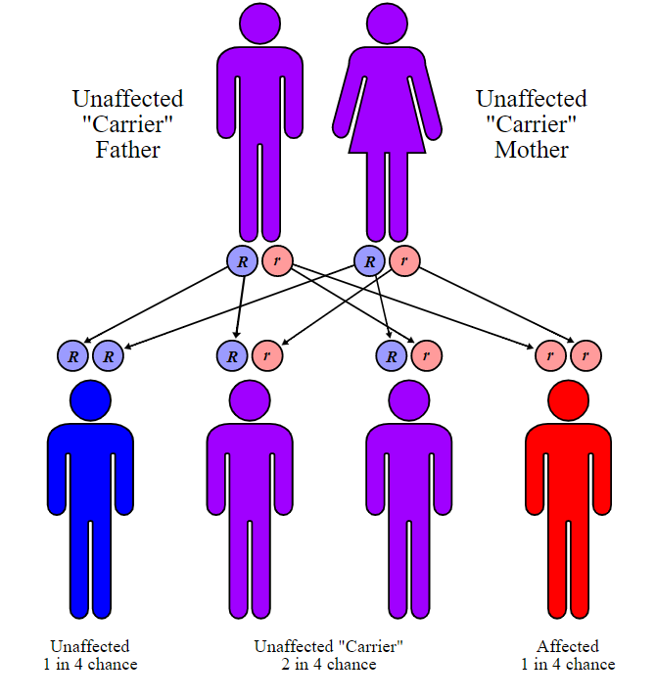
Mendel’s Laws of Inheritance
Notes:
Another example of a scientific law is Mendel’s Laws of Inheritance. We’ll be learning about these laws in more detail when we get to our unit on genetics later in the school year. But the laws of inheritance are considered laws because they can, given the appropriate conditions, reliably explain how we get the different physical traits that we have.

Slide 88
Notes:
Let’s check-in for understanding.

Slide 89
What is an example of a law? Explain your answer.
Notes:
What is an example of a law? Explain your answer.

Slide 90
Notes:
These three terms can be easily confused, so listen closely as we go over some important information that will help you keep them straight.

Slide 91
An educated guess that must be tested.
Notes:
First, theories and laws both begin with a hypothesis – or an educated guess that must be tested. When you have a hypothesis, you conduct an experiment to test it, and that experiment may result in a new theory or law.

Slide 92
Notes:
Second, some people may say that something isn’t true because it’s “just a theory.” But scientists actually consider theories AND laws to be acceptable ways to explain natural phenomena.

Slide 93
Testable Explanations
Facts
Hypotheses
Laws
(explain what happens)
Theories
(explain why something happens)
Notes:
However, although both are acceptable ways to explain things, there are some key differences. Laws are proven facts – they work every time and explain what happens, usually using some type of math formula. On the other hand, theories are really just hypotheses that have been tested repeatedly – they’re the best possible explanation that we have currently found to describe why something happens.

Slide 94
Notes:
Let’s check-in for understanding.

Slide 95
What is a hypothesis?
An explanation that always occurs
An educated guess that must be tested
A widely accepted explanation
Notes:
What is a hypothesis?
[An educated guess that must be tested]

Slide 96
What is a hypothesis?
An explanation that always occurs
An educated guess that must be tested
A widely accepted explanation
Notes:
What is a hypothesis?

Slide 97
What is a theory?
An explanation that always occurs
An educated guess that must be tested
A widely accepted explanation
Notes:
What is a theory?

Slide 98
What is a theory?
An explanation that always occurs
An educated guess that must be tested
A widely accepted explanation
Notes:
What is a theory?
[A widely accepted theory]

Slide 99
What is a law?
An explanation that always occurs
An educated guess that must be tested
A widely accepted explanation
Notes:
What is a law?

Slide 100
What is a law?
An explanation that always occurs
An educated guess that must be tested
A widely accepted explanation
Notes:
What is a law?
[An explanation that always occurs]

Slide 101
What is the main difference between a theory and a law?
Notes:
What is the main difference between a theory and a law?
[A theory is a widely accepted explanation for natural phenomena, while a law is an explanation that always occurs.]

Slide 102
Videos to Re-Explain
(In lieu of a Demonstration)
Fact vs. Theory vs. Hypothesis vs. Law... EXPLAINED!
What's the difference between scientific law and theory?
Notes:
As a demonstration doesn’t necessarily apply here, you may choose to share the two video links above with your students so they can hear these concepts explained again.

Slide 103
Notes:
Before we move on to our new topic, let’s review some other words & concepts that you already learned and make sure you are firm in your understanding.

Slide 104
Hypothesis: an “educated guess” that must be tested
Notes:
A hypothesis is an educated guess that must be tested. Like we discussed with the nature of science and the scientific method, when you have a question or problem that you want to investigate, you use existing knowledge to develop a hypothesis, then test it with an experiment.

Slide 105
Theory: a widely accepted explanation that has stood up to repeated testing
Notes:
A theory is a widely accepted explanation for natural occurrences that has stood up to repeated testing.

Slide 106
Law: an observation that always occurs under certain conditions
Notes:
A law is an observation that always occurs under certain conditions. These usually involve math, as scientists come up with formulas that help explain natural phenomena. Theories often attempt to explain why these observations happen consistently.

Slide 107
Reflection Activity
What components of the scientific method were included in our water and food dye experiment?
Which principles of the nature of science do you think were demonstrated?
Notes:
Have students discuss these questions with a partner or with their table before calling on groups to share one of their responses with the class. You may write responses on the board to keep track and to keep students thinking toward new answers.
Alternative: If you know of a simulation or other reinforcement activity that could correspond with this topic, please contact a member of the team and let them know.

Slide 108
Big Question: How does the nature of science relate to the development of hypotheses, theories, and laws?
Notes:
Explicit cue to revisit the big question at the end of the lesson: Okay everyone. Let’s reflect once more on our big question. Does anyone have any additional examples to share that haven’t been discussed yet?

Slide 109
Notes:
Thanks for watching, and please continue watching CAPs available from this website.

Slide 110
This Video Was Created With Resources From:
Questions or Comments
Michael Kennedy, Ph.D. MKennedy@Virginia.edu
Rachel L Kunemund, Ph.D. rk8vm@virginia.edu

