Slide 1
Intro
“Big Idea” Question
Review Concepts
Check-In Questions
Teacher Demo
Vocabulary
Student-Friendly Definition
Examples & Non-Examples
Morphological Word Parts
Simulation/Activity
Notes:
OK everyone, get ready for our next lesson. Just as a reminder, these are the different components that our lesson may include, and you’ll see these icons in the top left corner of each slide so that you can follow along more easily!

Slide 2
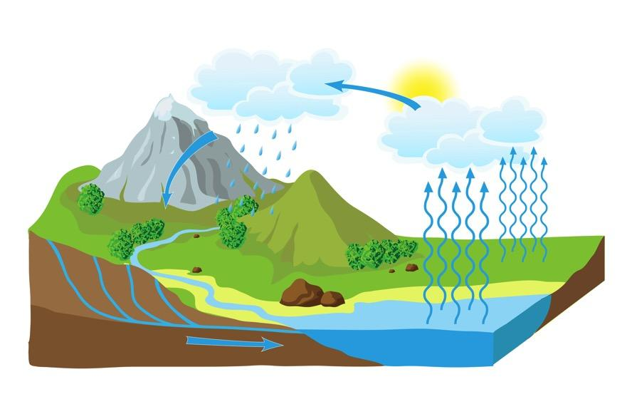
Intro
Water Cycle
Notes:
Today we will learn about Water Cycle.

Slide 3
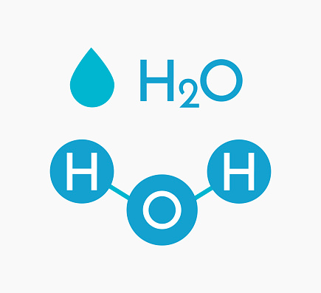
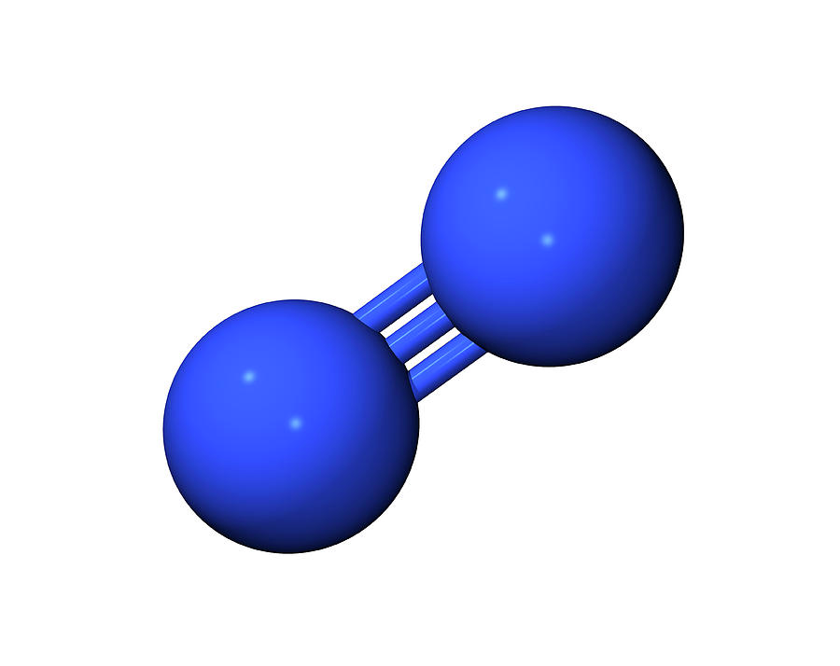
Big Question: What is the importance of the water and nitrogen cycles?
Notes:
Our “big question” is: What is the importance of the water and nitrogen cycles?
[Pause and illicit predictions from students.]
I love all these thoughtful scientific hypotheses! Be sure to keep this question and your predictions in mind as we move through these next few lessons, and we’ll continue to revisit it.
Feedback: Asking students to make predictions about the importance of the water and nitrogen cycles is a great way to activate and elicit student ideas and prior knowledge. This type of activity is evidence of the teacher planning for students’ engagement with science ideas.

Slide 4
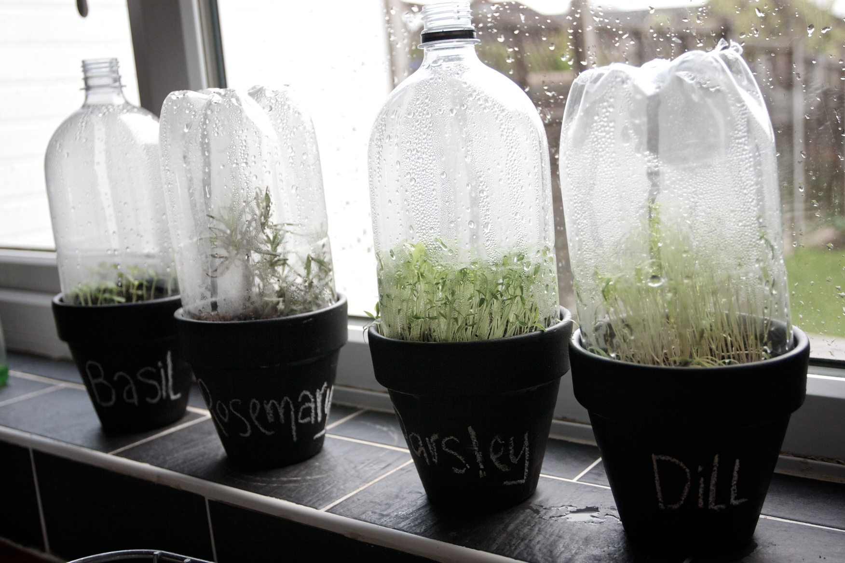
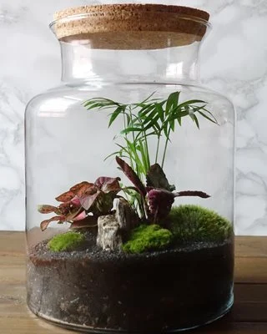
Demonstration
By simply placing a clear covering, such as a soda bottle, over a potted plant, you can show students the processes of transpiration and precipitation. The water released from the plants attaches to the clear cover and as droplets condense they fall back to the soil (this is how terrariums work). Have students identify the parts of the water cycle that they observe.
Notes:
Feedback: This demonstration is a great way to introduce students to an investigation. In your classroom, you may encourage students to plan and conduct this investigation more independently since a large component of inquiry-based activities is encouraging student thinking and independence. Beginning with open-ended questions, followed by providing explicit explanations, and then asking probing questions is a great way to engage students in a discussion while also providing clear explanations.

Slide 5
Notes:
Before we move on to our new vocabulary term, let’s review some other words & concepts that you already learned and make sure you are firm in your understanding.

Slide 6
Cycles: events that happen in the same order over and over again
Notes:
Much of life on Earth depends on cycles. Cycles are events that happen in the same order over and over again. The end of one cycle marks the beginning of another.

Slide 7
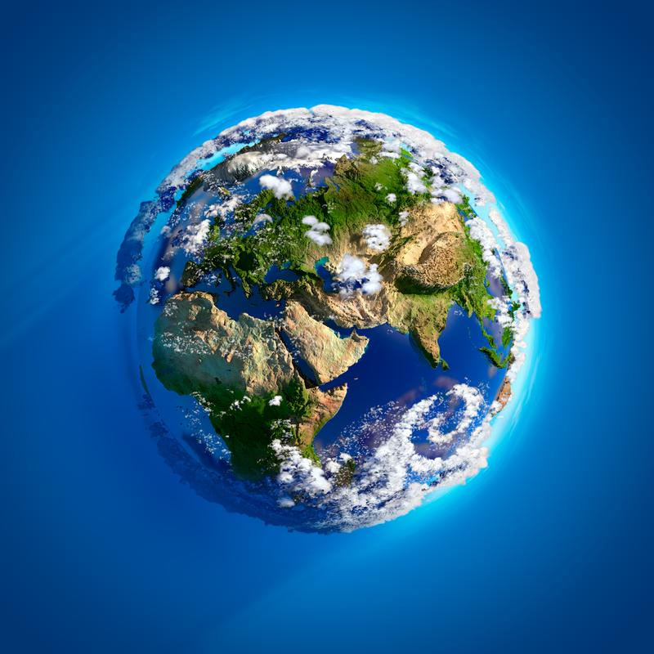
Atmosphere: the layers of gas, that have distinct characteristics, surrounding the Earth’s surface
Notes:
Atmosphere is the layers of gas, that have distinct characteristics, surrounding the Earth’s surface. Sometimes, the atmosphere is called a “blanket” of gases.

Slide 8
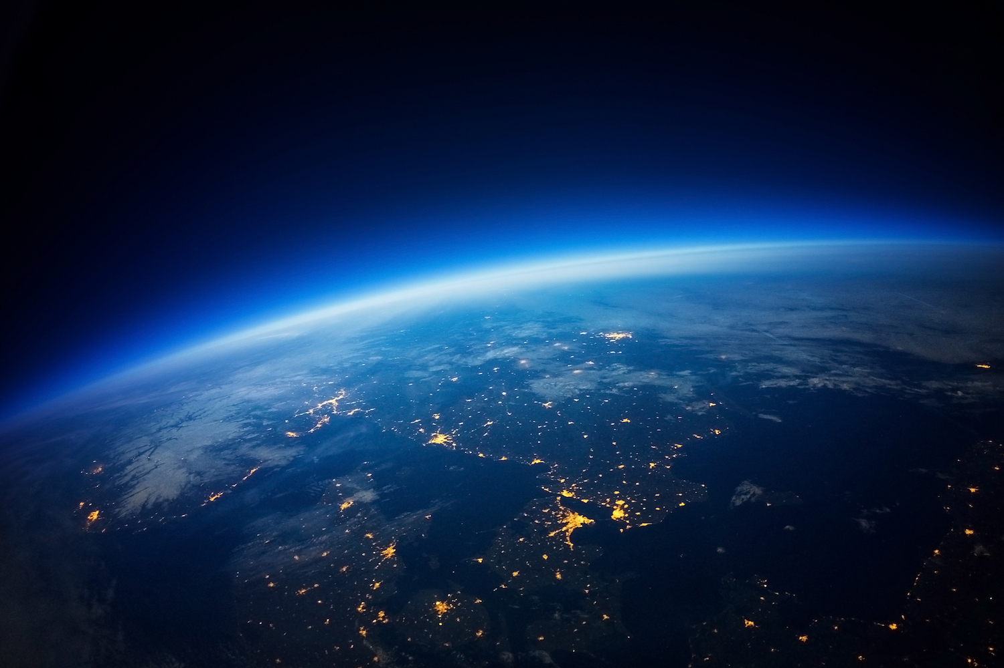
The atmosphere is invisible from Earth’s surface, but from outer space it can be seen.
Notes:
These gases are invisible to human eyes as we look up from the surface of Earth, but astronauts can see the atmosphere quite clearly from space.

Slide 9
Hydrosphere: all the water on Earth
Notes:
The hydrosphere is all the water on our planet.

Slide 10
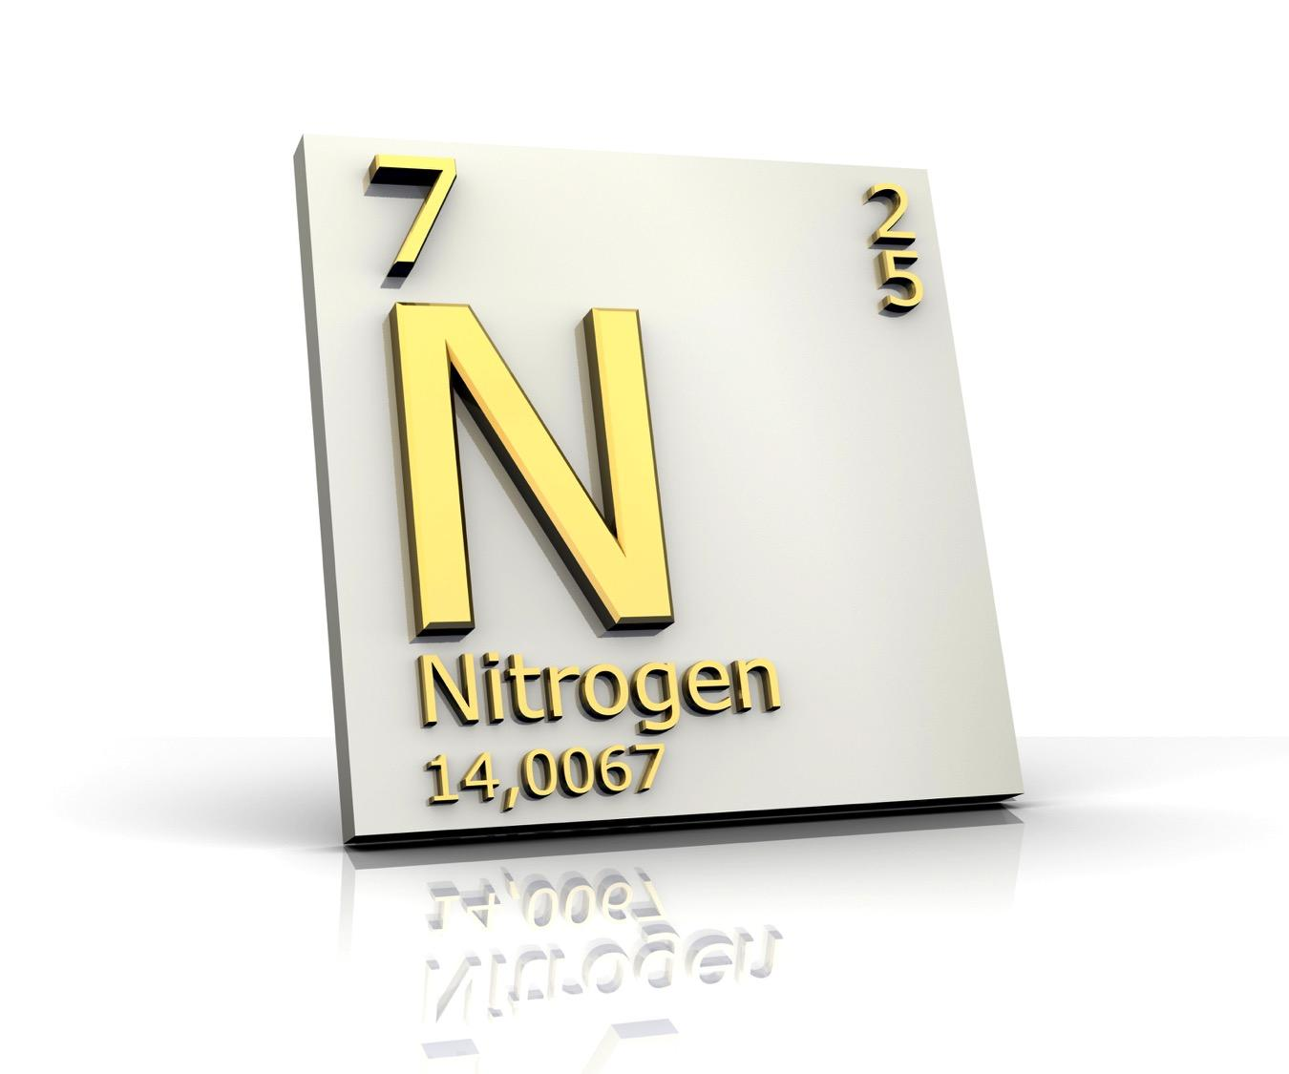
Notes:
Nitrogen is an element that is important to life. It is in the air around us, the planets and animals we eat, and in the soil beneath us. Nitrogen is everywhere!

Slide 11
78%
Nitrogen
Notes:
In fact, nitrogen makes up about 78% of the Earth’s atmosphere. So nitrogen is an important element for us to know about.

Slide 12
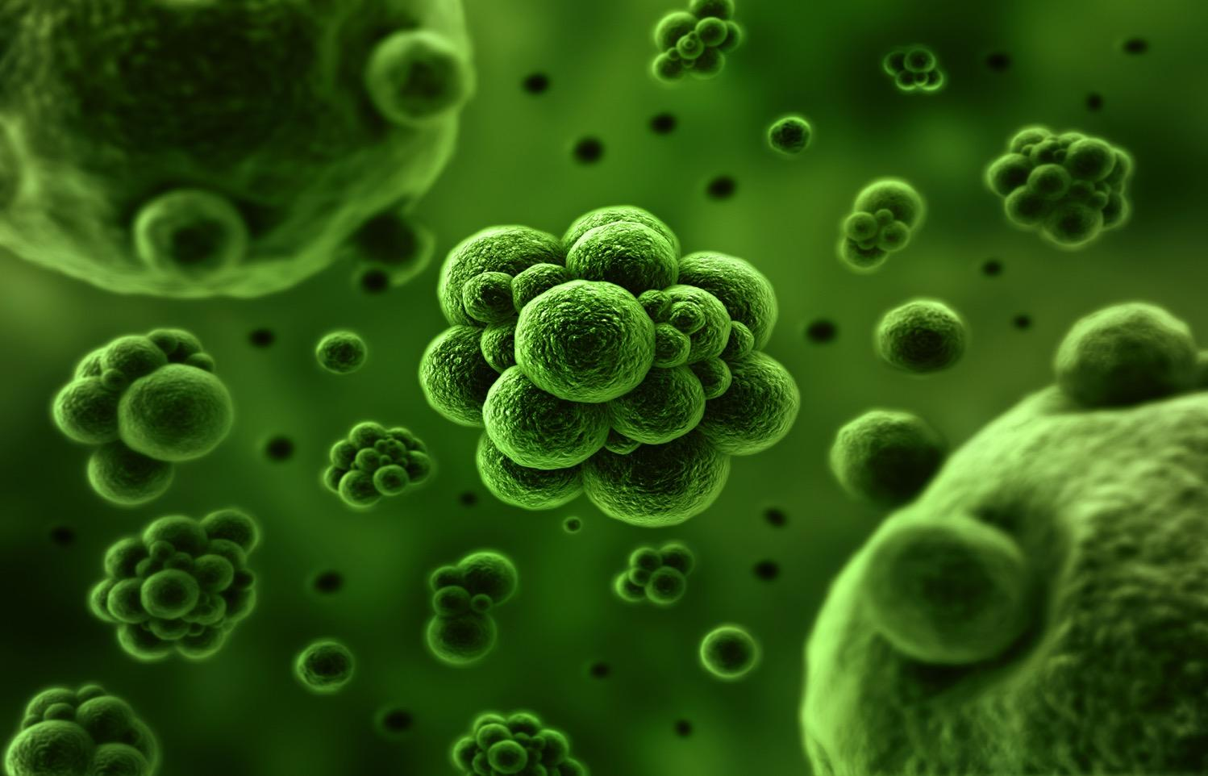
78%
Nitrogen
Notes:
Bacteria are very tiny one-celled organisms. Bacteria are found everywhere.

Slide 13
Notes:
Now let’s pause for a moment to check your understanding.

Slide 14
What is the hydrosphere?
All the layers of Earth below the surface
All the water on Earth
All the invisible gas layers around the Earth
None of the above
Notes:
What is the hydrosphere?

Slide 15
What is the hydrosphere?
All the layers of Earth below the surface
All the water on Earth
All the invisible gas layers around the Earth
None of the above
Notes:
What is the hydrosphere?
[All the water on Earth]

Slide 16
What is the atmosphere?
All the layers of Earth below the surface
All the water on Earth
All the gas layers around the Earth
None of the above
Notes:
What is the atmosphere?

Slide 17
What is the atmosphere?
All the layers of Earth below the surface
All the water on Earth
All the gas layers around the Earth
None of the above
Notes:
What is the atmosphere?
[All the gas layers around the Earth]

Slide 18
How much of the Earth’s atmosphere is made of nitrogen?
Notes:
How much of the Earth’s atmosphere is made of nitrogen?
[78%]

Slide 19
What is a cycle?
Notes:
What is a cycle?
[Cycles are events that happen in the same order over and over again.]

Slide 20
Water Cycle
Notes:
Now that we’ve reviewed, let’s define our new term, Water Cycle.

Slide 21
Water Cycle: the process through which water moves from Earth through the atmosphere and returns to Earth
Notes:
The Water Cycle is the process through which water moves from Earth through the atmosphere and returns to Earth.

Slide 22
Notes:
Let’s check-in for understanding.

Slide 23
What is the Water Cycle?
Notes:
What is the Water Cycle?
[The Water Cycle is the process through which water moves from Earth through the atmosphere and returns to Earth.]

Slide 24
Notes:
That is the basic definition, but there is a bit more you need to know.

Slide 25
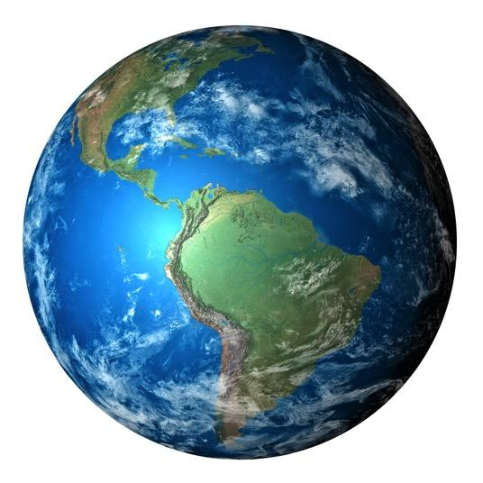
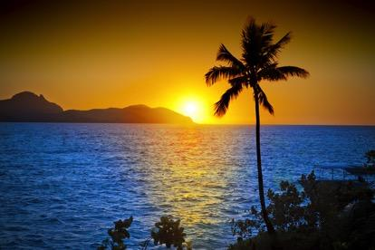
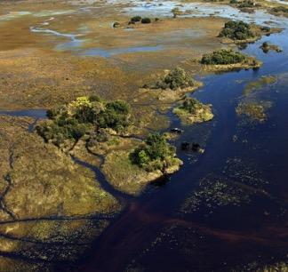
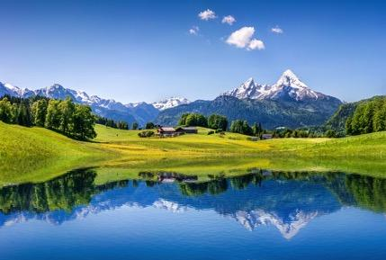
All Water on Earth
Notes:
All water on Earth is part of the Water Cycle.

Slide 26
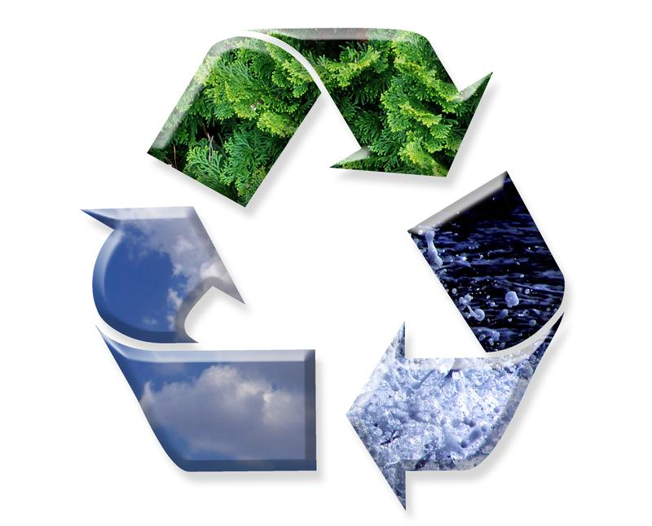
Energy
Water
Nutrients
Notes:
The Water Cycle is a part of the flow, or exchange of energy, on Earth. The Water Cycle supports life by recycling water and nutrients.

Slide 27
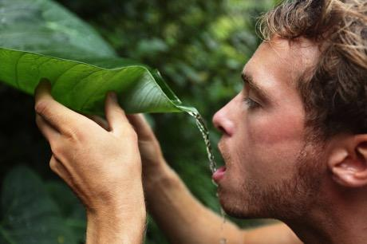
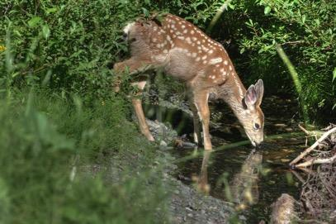
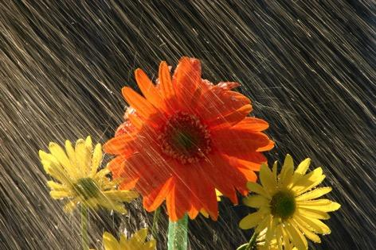
People
Animals
Plants
Notes:
The Water Cycle brings freshwater to people, animals, and plants all around the world.

Slide 28
Transpiration
Respiration
Enter Water Cycle
Evaporation
Notes:
There are three ways water can enter the Water Cycle.

Slide 29
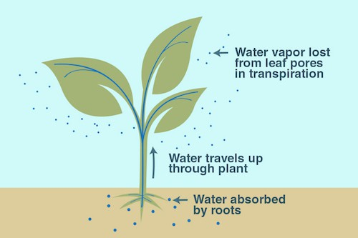
Transpiration
Plants release water from their leaves
Notes:
In transpiration, plants release water from their leaves.
Feedback: Visuals are a great way to help students build connections about new content.

Slide 30
Evaporation
Water changes from liquid to vapor
Notes:
In evaporation, water changes from liquid to vapor.

Slide 31
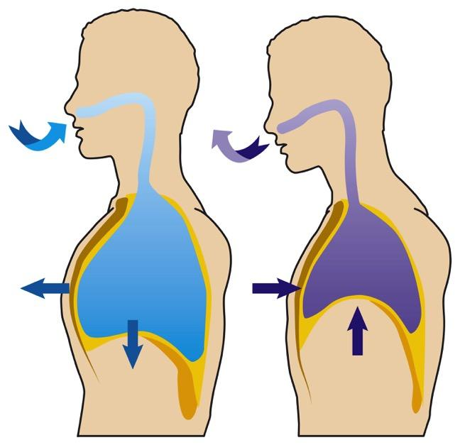
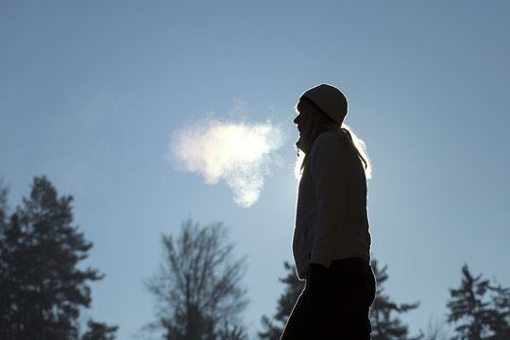
Respiration
Organisms release water as waste
Notes:
And in respiration, organisms, like humans and animals, release water as waste. We can see this happening when our breath fogs in cold weather. The fog is created when the water vapor freezes.

Slide 32
Notes:
Let’s check-in for understanding.

Slide 33
What is the Water Cycle?
Notes:
What is the water cycle?
[The Water Cycle is the process through which water moves from Earth through the atmosphere and returns to Earth.]

Slide 34
Which of the following is NOT a way water can enter the Water Cycle?
Transcription
Respiration
Evaporation
Transpiration
Notes:
Which of the following is NOT a way water can enter the Water Cycle?

Slide 35
Which of the following is NOT a way water can enter the Water Cycle?
Transcription
Respiration
Evaporation
Transpiration
Notes:
Which of the following is NOT a way water can enter the Water Cycle?
[Transcription]

Slide 36
Notes:
Let’s dive deeper into the different components of the Water Cycle.

Slide 37
Condensation
Notes:
After water enters the atmosphere, the water vapor cools and returns to its liquid state.

Slide 38
Precipitation
Notes:
When enough water condenses in the sky, the water falls back to land. The water can come down as rain, snow, hail, etc.

Slide 39
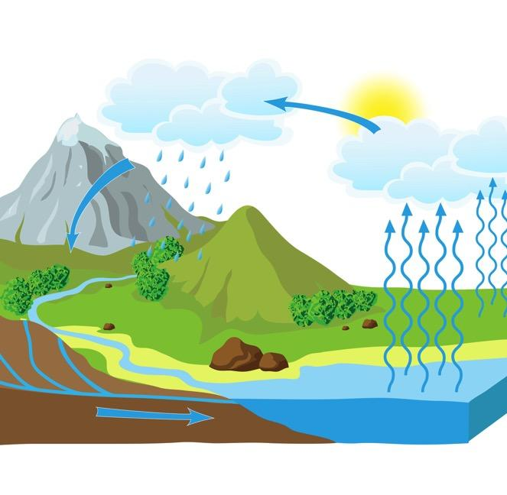
Runoff
Groundwater
Notes:
Precipitation that falls on land can become runoff or groundwater.

Slide 40
Runoff
Notes:
Runoff water is water that flows into streams and rivers.

Slide 41
Groundwater
Notes:
Groundwater is water that seeps into the ground.

Slide 42
Notes:
Let’s check-in for understanding.

Slide 43
What is the circled portion of the water cycle called?
Notes:
What is the circled portion of the water cycle called?
[Condensation]

Slide 44
Water that precipitates and flows into streams or rivers is called what?
Groundwater
Drinking water
Runoff
Waterfall
Salt water
Notes:
Water that precipitates and flows into streams or rivers is called what?

Slide 45
Water that precipitates and flows into streams or rivers is called what?
Groundwater
Drinking water
Runoff
Waterfall
Salt water
Notes:
Water that precipitates and flows into streams or rivers is called what?
[Runoff]

Slide 46
What is precipitation?
Notes:
What is precipitation?
[When enough water condenses in the sky, the water falls back to land. The water can come down as rain, snow, hail, etc.]

Slide 47
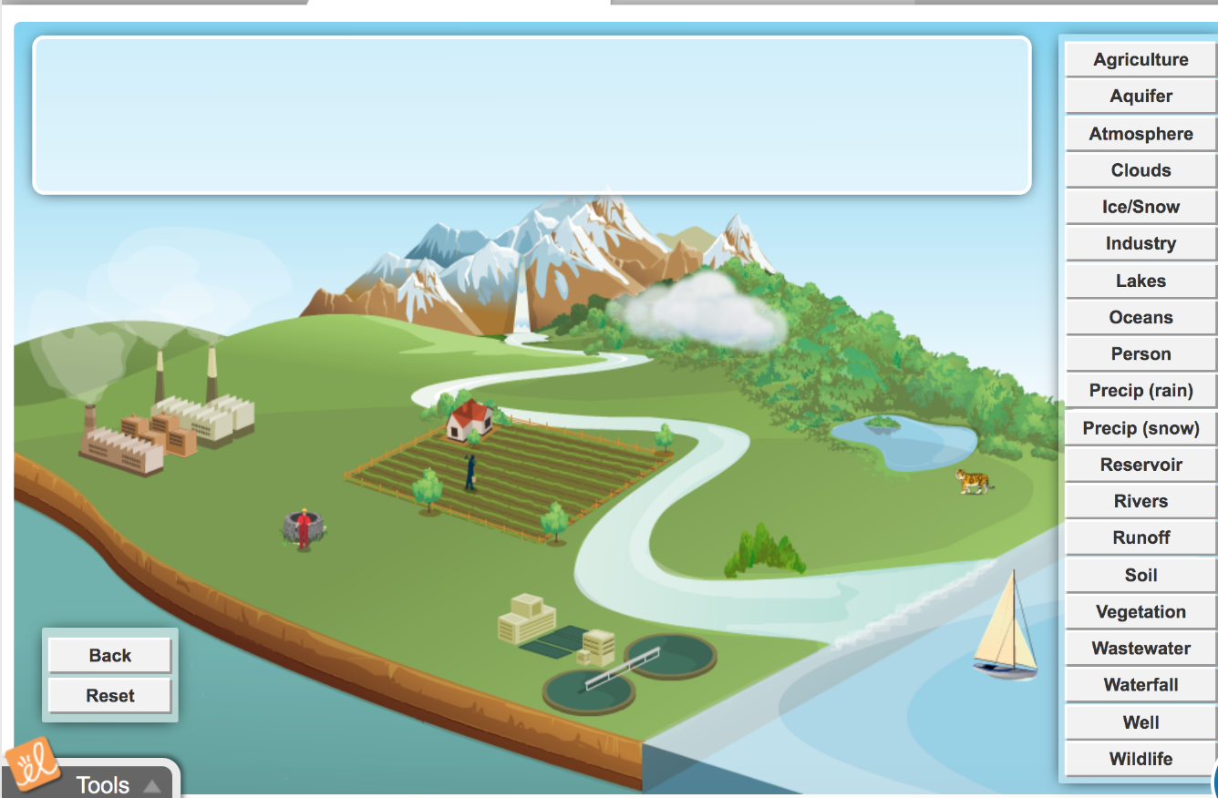
Simulation Activity
Water Cycle
(Gizmos)
Click the link above to explore the water cycle.
Notes:
Feedback: Simulation activities are an important way to help students make science thinking visible. In this case, the simulation helps students to model science phenomena.

Slide 48
Remember!!!
Notes:
So remember!

Slide 49
Water Cycle: the process through which water moves from Earth through the atmosphere and returns to Earth
Notes:
The Water Cycle is the process through which water moves from Earth through the atmosphere and returns to Earth.

Slide 50
Water enters the cycle in three ways
Notes:
Water enters the cycle in three ways – transpiration, respiration, evaporation.

Slide 51
Precipitation
Notes:
Precipitation - When enough water condenses in the sky, the water falls back to land. The water can come down as rain, snow, hail, etc.

Slide 52
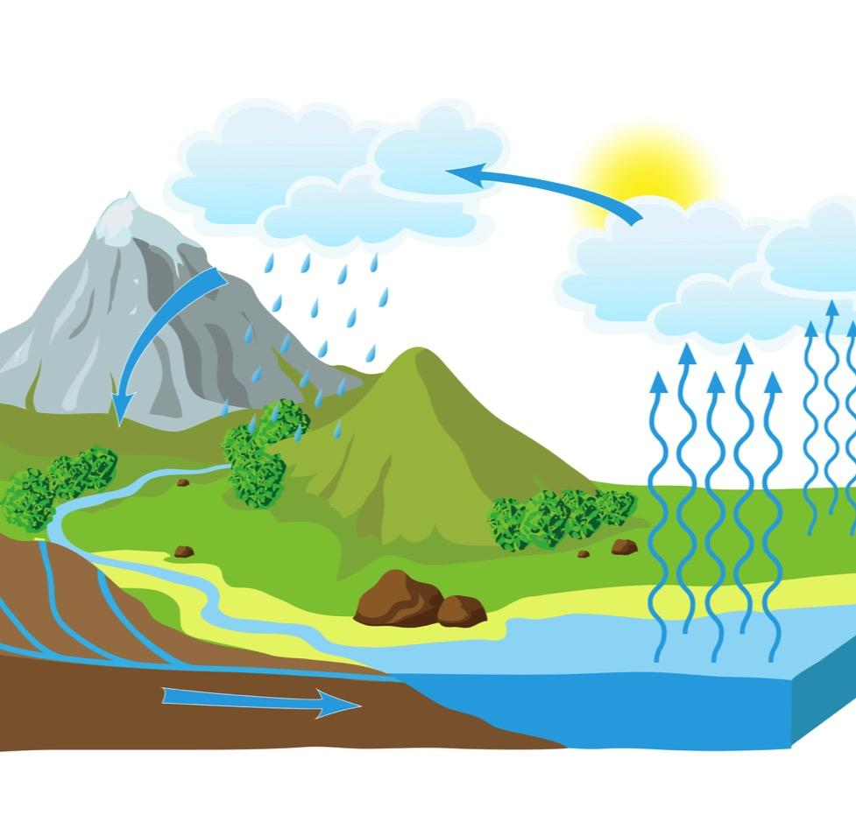
Runoff
Returns as runoff or groundwater
Notes:
Depending on where it lands, it returns as runoff or groundwater.

Slide 53
Repeats all over again (cycle)
Notes:
Then it repeats all over again.

Slide 54
Big Question: What is the importance of the water and nitrogen cycles?
Notes:
Explicit cue to revisit the big question at the end of the lesson: Okay everyone. Now that we’ve learned the term, let’s reflect once more on our big question. Was there anything that we predicted earlier that was correct or incorrect? Do you have any new hypotheses to share?

Slide 55
Notes:
Thanks for watching!

Slide 56
This Video Was Created With Resources From:
Questions or Comments
Michael Kennedy, Ph.D. MKennedy@Virginia.edu
Rachel L Kunemund, Ph.D. rk8vm@virginia.edu

Slide 57
Intro
“Big Idea” Question
Review Concepts
Check-In Questions
Teacher Demo
Vocabulary
Student-Friendly Definition
Examples & Non-Examples
Morphological Word Parts
Simulation/Activity
Notes:
OK everyone, get ready for our next lesson. Just as a reminder, these are the different components that our lesson may include, and you’ll see these icons in the top left corner of each slide so that you can follow along more easily!

Slide 58
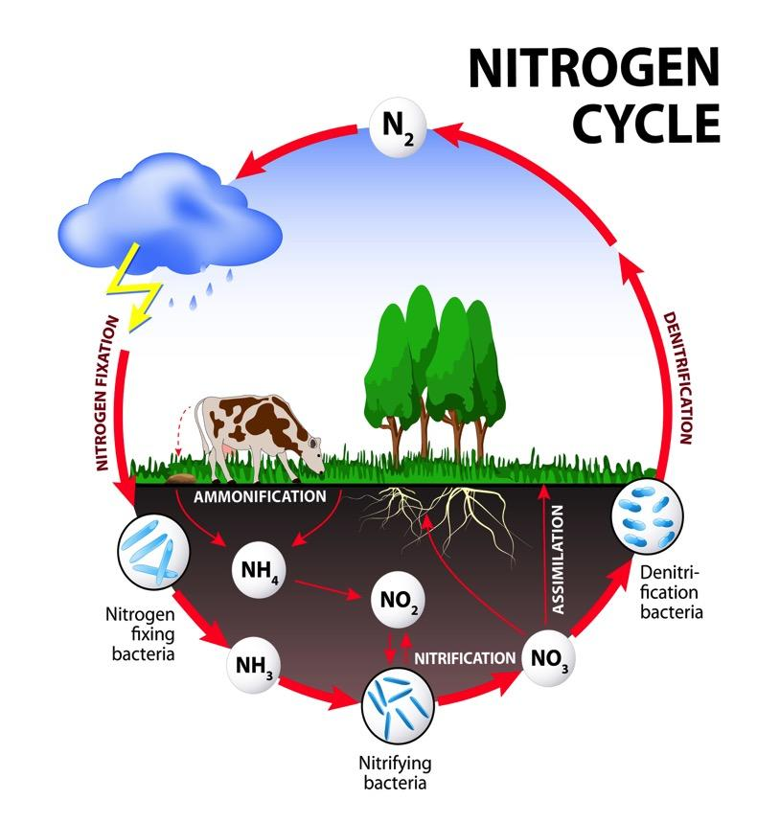
Intro
The Nitrogen Cycle
Notes:
Today we’re going to learn about the nitrogen cycle.

Slide 59
Big Question: What is the importance of the water and nitrogen cycles?
Notes:
Before we start, let’s think about our “big question”: What is the importance of the water and nitrogen cycles?
Today we will be focusing specifically on the nitrogen cycle!
[Pause and illicit predictions from students.]
I love all these thoughtful scientific hypotheses! Be sure to keep this question and your predictions in mind as we move through these next few lessons, and we’ll continue to revisit it.

Slide 60
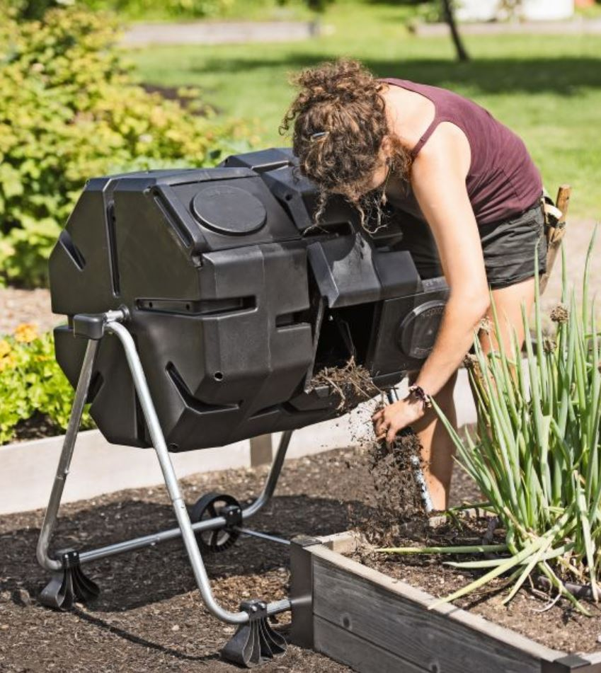
Demonstration
Garden Engagement
If your school has a garden or garden program, this lesson could be a great opportunity for a visit to the garden area. You can use the compost, soil, plants, and air to talk about the four stages of the nitrogen cycle and to prompt students to recall the key players within each stage.
Notes:
Use the school garden area or garden resources to review the four stages of the nitrogen cycle.

Slide 61
Notes:
Before we move on to our new vocabulary term, let’s review some other words & concepts that you already learned and make sure you are firm in your understanding.

Slide 62
Cycles: events that happen in the same order over and over again
Notes:
First, remember that much of life on Earth depends on cycles. Cycles are events that happen in the same order over and over again. The end of a on cycle marks the beginning of another.

Slide 63
Atmosphere: the layers of gas, that have distinct characteristics, surrounding the Earth’s surface
Notes:
Atmosphere is the layers of gas, that have distinct characteristics, surrounding the Earth’s surface. Sometimes, the atmosphere is called a “blanket” of gases.

Slide 64
The atmosphere is invisible from Earth’s surface, but from outer space it can be seen.
Notes:
These gases are invisible to human eyes as we look up from the surface of Earth, but astronauts can see the atmosphere quite clearly from space.

Slide 65
Hydrosphere: all the water on Earth
Notes:
The hydrosphere is all the water on our planet.

Slide 66
Notes:
Nitrogen is an element that is important to life. It is in the air around us, the planets and animals we eat, and in the soil beneath us. Nitrogen is everywhere!

Slide 67
78%
Nitrogen
Notes:
In fact, nitrogen makes up about 78% of the Earth’s atmosphere. So nitrogen is an important element for us to know about.

Slide 68
Water Cycle: the process through which water moves from Earth through the atmosphere and returns to Earth
Notes:
The Water Cycle is the process through which water moves from Earth through the atmosphere and returns to Earth.

Slide 69
Notes:
Now let’s pause for a moment to check your understanding.

Slide 70
What is the hydrosphere?
All the layers of Earth below the surface
All the water on Earth
All the invisible gas layers around the Earth
None of the above
Notes:
What is the hydrosphere?

Slide 71
What is the hydrosphere?
All the layers of Earth below the surface
All the water on Earth
All the invisible gas layers around the Earth
None of the above
Notes:
What is the hydrosphere?
[All the water on Earth]

Slide 72
What is the atmosphere?
All the layers of Earth below the surface
All the water on Earth
All the gas layers around the Earth
None of the above
Notes:
What is the atmosphere?

Slide 73
What is the atmosphere?
All the layers of Earth below the surface
All the water on Earth
All the gas layers around the Earth
None of the above
Notes:
What is the atmosphere?
[All the gas layers around the Earth]

Slide 74
How much of the Earth’s atmosphere is made of nitrogen?
Notes:
How much of the Earth’s atmosphere is made of nitrogen?
[78%]

Slide 75
What is a cycle?
Notes:
What is a cycle?
[Cycles are events that happen in the same order over and over again.]

Slide 76
The Nitrogen Cycle
Notes:
Now that we’ve reviewed, let’s define our new term, the nitrogen cycle.

Slide 77
The Nitrogen Cycle: the process through which nitrogen moves back and forth between plants, animals, bacteria, the atmosphere, and soil
Notes:
The nitrogen cycle is the process through which nitrogen moves back and forth between plants, animals, bacteria, the atmosphere, and soil.

Slide 78
Notes:
Let’s check-in for understanding.

Slide 79
What is the nitrogen cycle?
Notes:
What is the nitrogen cycle?
[The nitrogen cycle is the process through which nitrogen moves back and forth between plants, animals, bacteria, the atmosphere, and soil.]

Slide 80
Notes:
That is the basic definition, but there is a bit more you need to know.

Slide 81
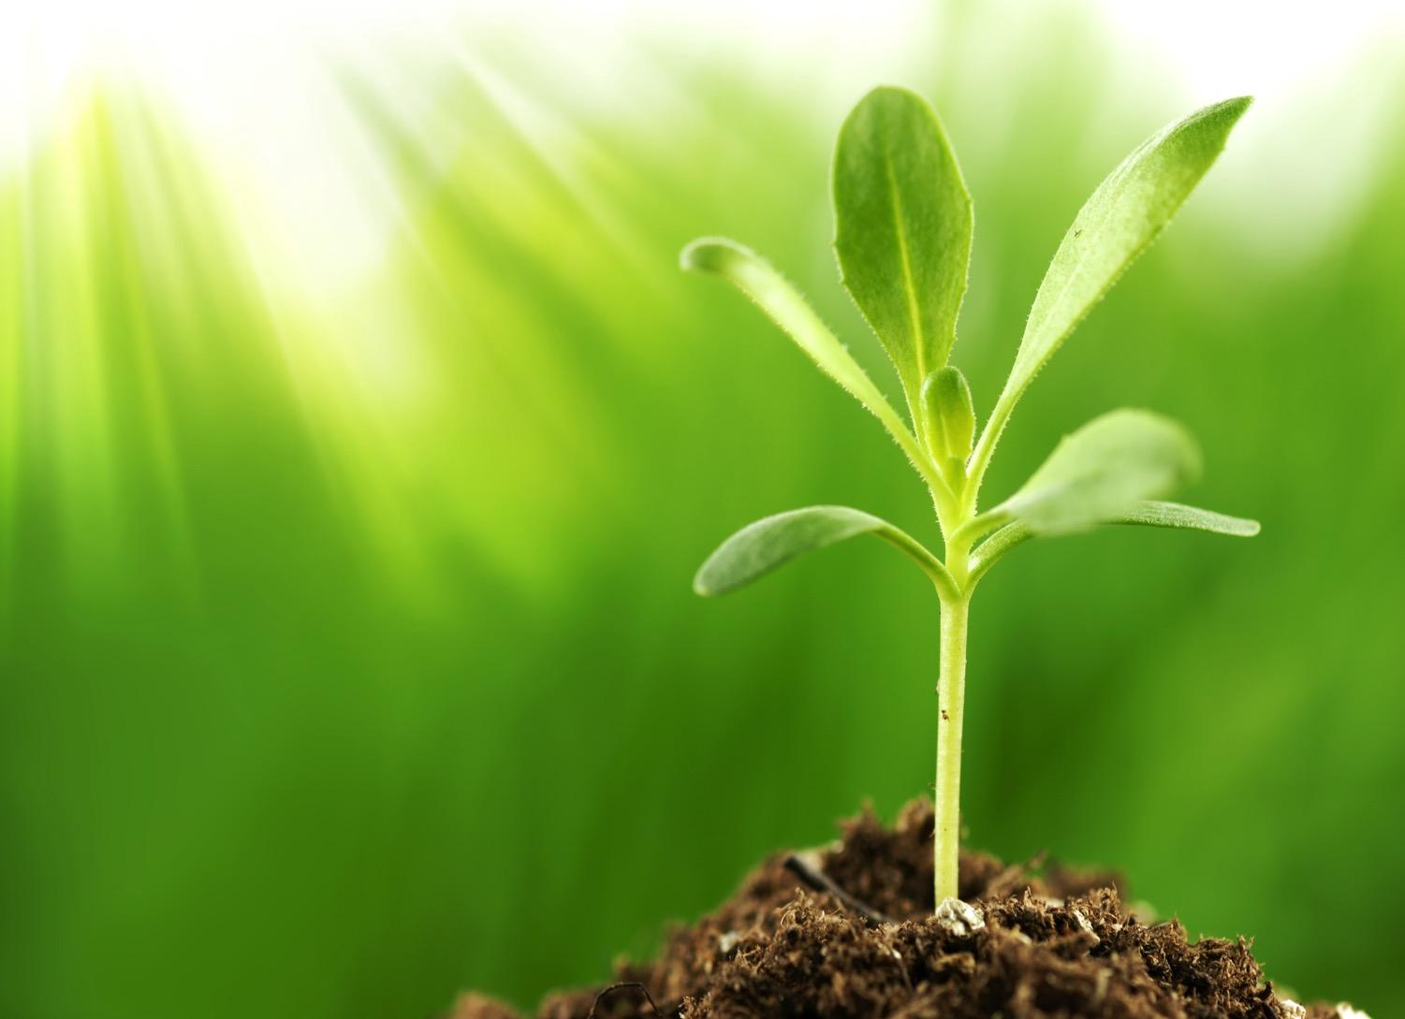
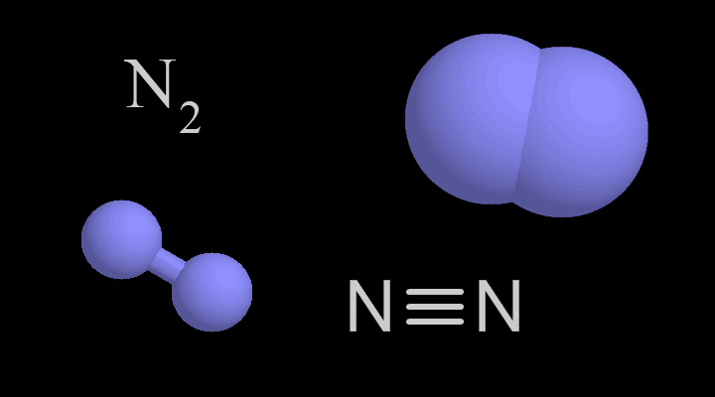
Atmospheric
Nitrogen
Notes:
Nitrogen from the atmosphere cannot be used by plants.
The two atoms that make up nitrogen are very, very tightly bound together.
Because of this, the nitrogen must be changed or converted to different forms.
The two atoms must be broken apart.

Slide 82
Fixation
Nitrification
Nitrogen Cycle
Ammonification
Assimilation
Notes:
The nitrogen cycle has four stages: fixation, nitrification, assimilation, and ammonification.
Each part of the cycle converts, of changes, the nitrogen so it can be used differently.

Slide 83
Fixation
N
NH
+
4
2
Atmospheric
Nitrogen
Ammonium
Notes:
The first stage of the nitrogen cycle is fixation.
In the fixation stage, atmospheric nitrogen is changed to ammonium.

Slide 84
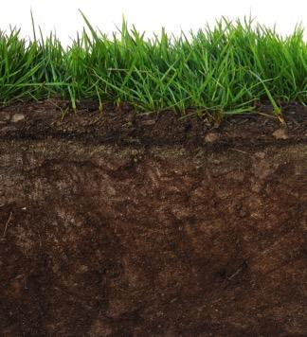
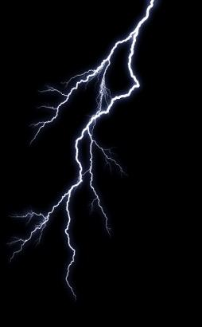
N
NH
+
3
2
Atmospheric
Nitrogen
Ammonia
Notes:
Fixation can happen with bacteria in the soil or by lightning
The bacteria or the lightning break apart the atoms and produce nitrogen oxides which come down to earth as nitrates. Plants can use nitrates.

Slide 85
Notes:
Let’s check-in for understanding.

Slide 86
What is fixation?
Notes:
What is fixation?
[Fixation is the conversion of atmospheric nitrogen to ammonia by bacteria in the soil or lightning.]

Slide 87
Nitrification
NO
+
2
N
NH
+
3
Nitrites
2
Atmospheric
Nitrogen
NO
Ammonium
-
3
Nitrates
Notes:
The next stage is nitrification.
In this stage, the ammonium is changed into nitrites and nitrates by bacteria in the soil.

Slide 88
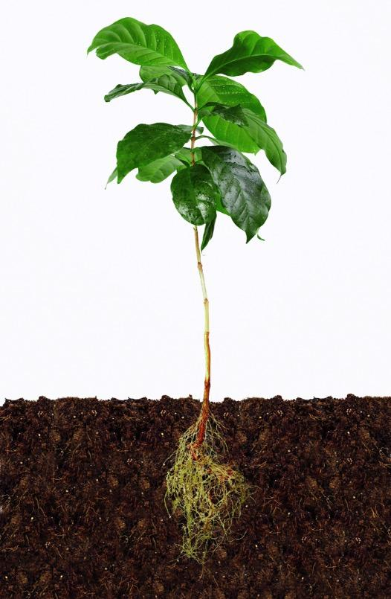
NO
+
2
NO
-
3
Nitrites
Nitrates
Notes:
Nitrates and nitrites can be used by plants.
This leads to the third stage.

Slide 89
Notes:
Let’s check-in for understanding.

Slide 90
What is nitrification?
Notes:
What is nitrification?
[Nitrification is when bacteria in the soil changes ammonia to nitrites and nitrates.]

Slide 91
Assimilation
NO
+
2
NO
-
3
Nitrites
Nitrates
Notes:
The third stage is assimilation.
During assimilation, nitrates and nitrites are absorbed by the plant’s roots.
Inside the plant, nitrates and nitrites are converted to protein which is needed by plants and animals!

Slide 92
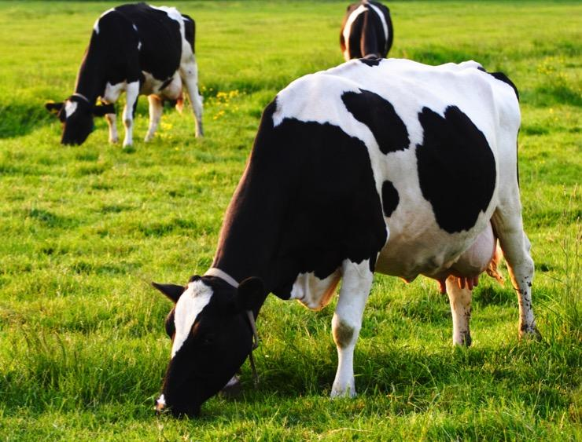
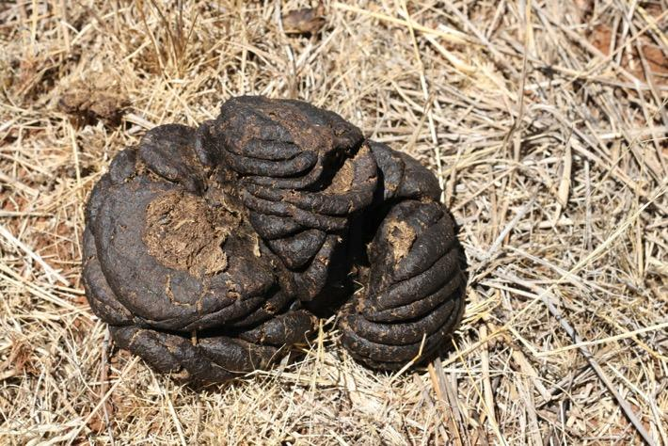
Notes:
After the first three stages of the nitrogen cycle—fixation, nitrification, and assimilation—a few things can happen.
Animals can eat the plants and their excrement can lead to the next stage in the nitrogen cycle.

Slide 93
Notes:
Or the animals can eat the plants and then die which can also lead to the next stage in the nitrogen cycle.

Slide 94
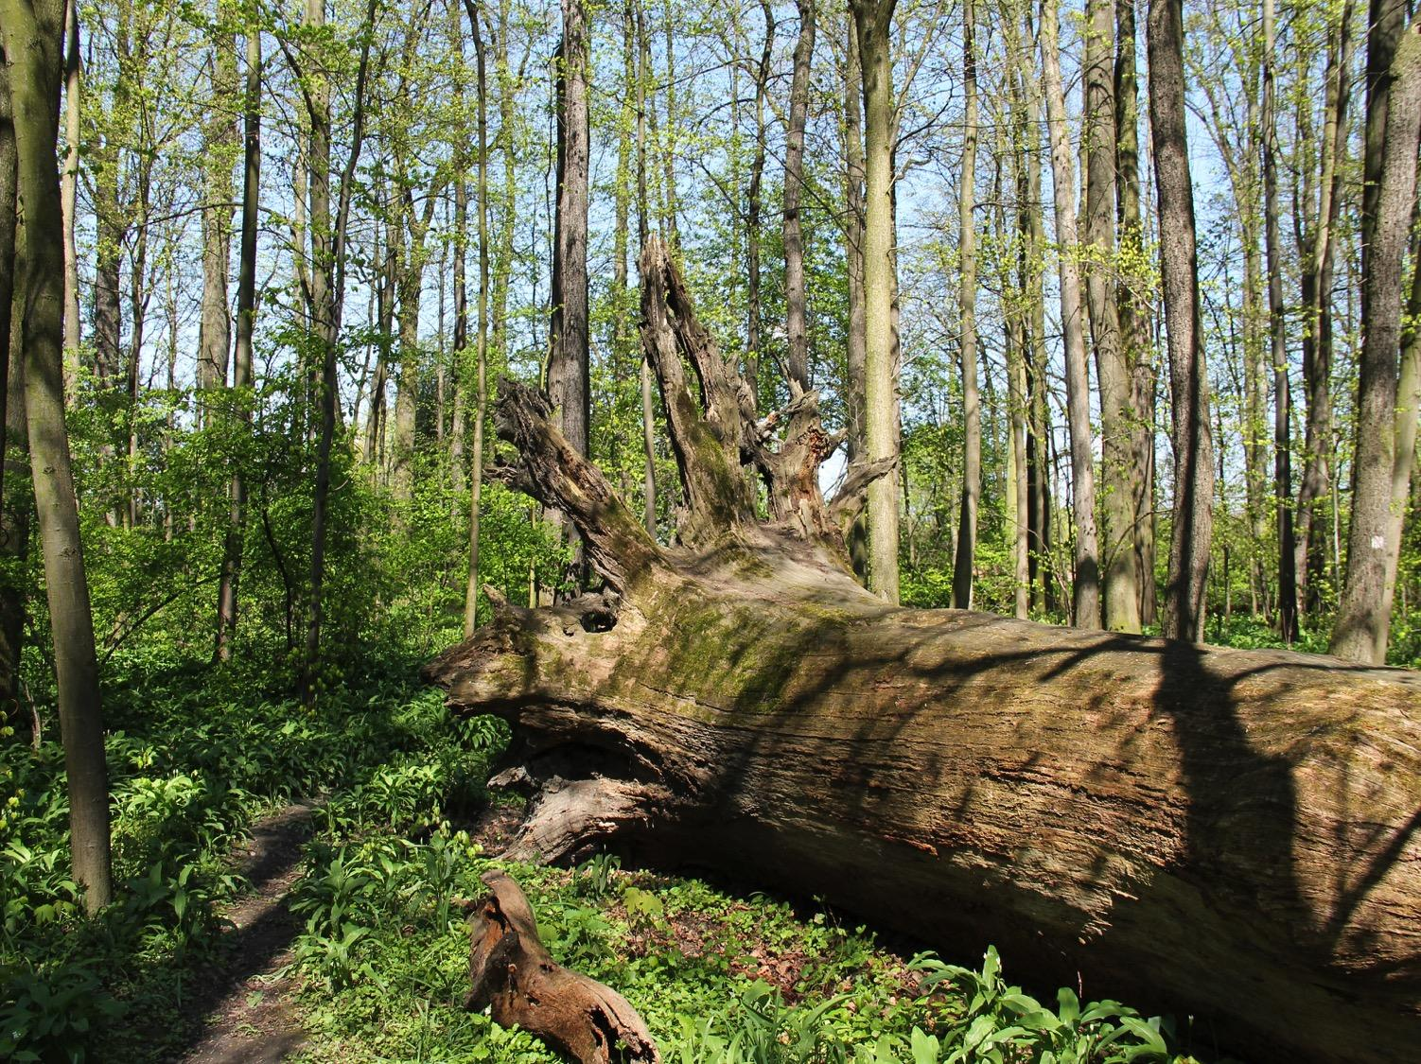
Notes:
Or the plants can die which can lead to the final stage in the nitrogen cycle.

Slide 95
Notes:
Let’s check-in for understanding.

Slide 96
What is assimilation?
Notes:
What is assimilation?
[Assimilation is the uptake of nitrates and nitrites by plants.]

Slide 97
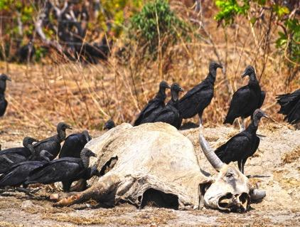
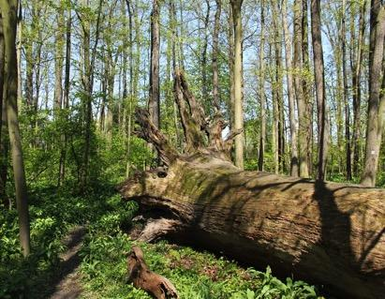
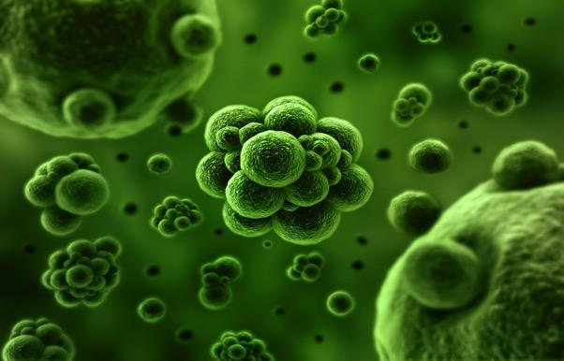
NH
+
4
Notes:
The last stage in the nitrogen cycle is ammonification. In this stage, the plants, animals, or animal waste are decomposed—or broken apart—by bacteria in the soil.

Slide 98
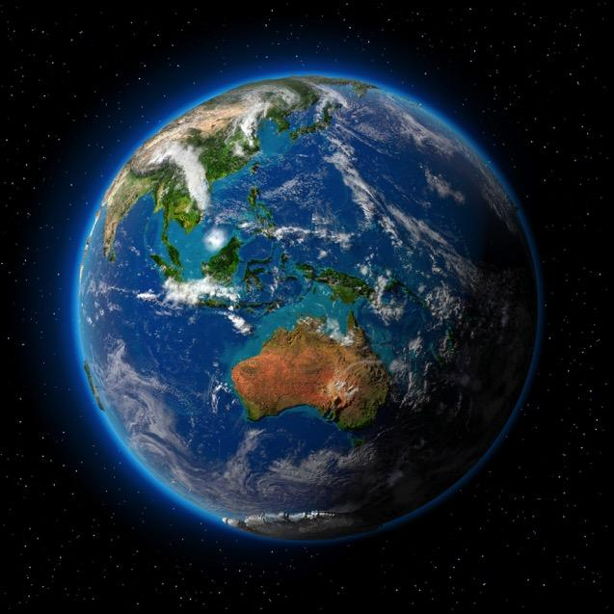
Absorbed by plant roots
Released into atmosphere
Notes:
When this happens, nitrogen is either released back into the atmosphere or it is turned back into nitrites or nitrates and absorbed by the plant roots again.

Slide 99
Notes:
Let’s check-in for understanding.

Slide 100
What is ammonification?
Notes:
What is ammonification?
[In this stage, the plants, animals, or animal waste are decomposed—or broken apart—by bacteria in the soil.]

Slide 101
Notes:
Now, let’s talk about some examples of the nitrogen cycle.

Slide 102
Goat is decomposed
in the last stage of the
nitrogen cycle
Notes:
An example of the nitrogen cycle is goat. He is—very sadly—dead. He ate grass when he was alive so his body will be decomposed as the last stage of the nitrogen cycle.

Slide 103
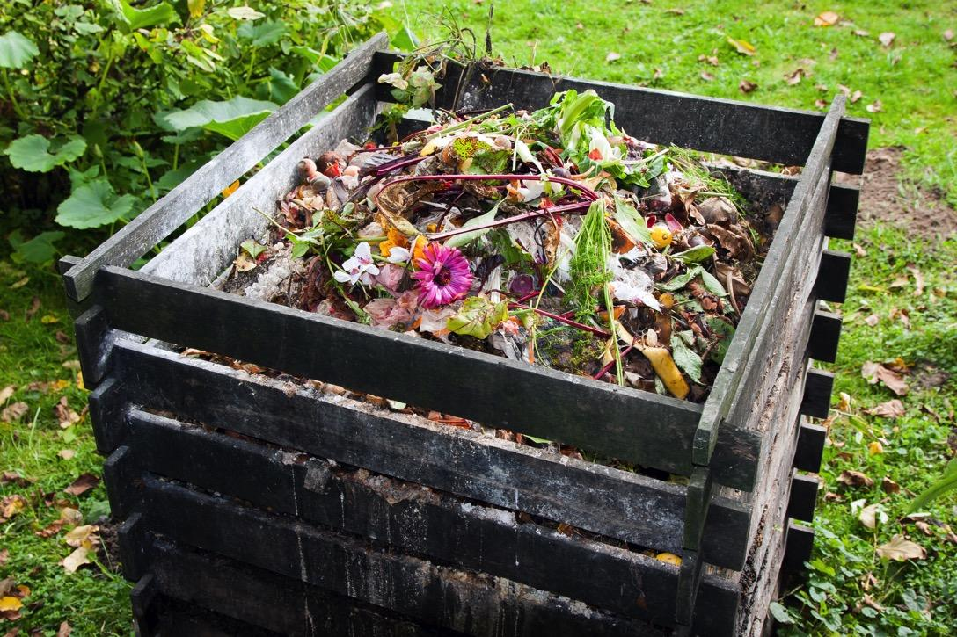
Compost piles
continue the
nitrogen cycle
Notes:
Many farmers and gardeners have compost piles. These are piles of dead and decaying plants such as fruits and vegetables. This compost is put back into the soil to continue the nitrogen cycle and help plants grow.

Slide 104
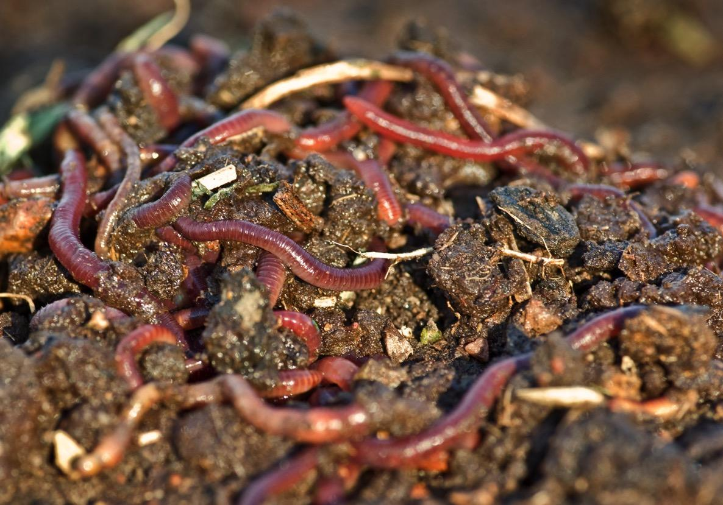
Notes:
Often farmers put worms into their garden. These worms help break down the decaying plants and animals and the animal excrement and put nitrogen back into the nitrogen cycle.

Slide 105
Notes:
Next, let’s talk about some non-examples of the nitrogen cycle.

Slide 106
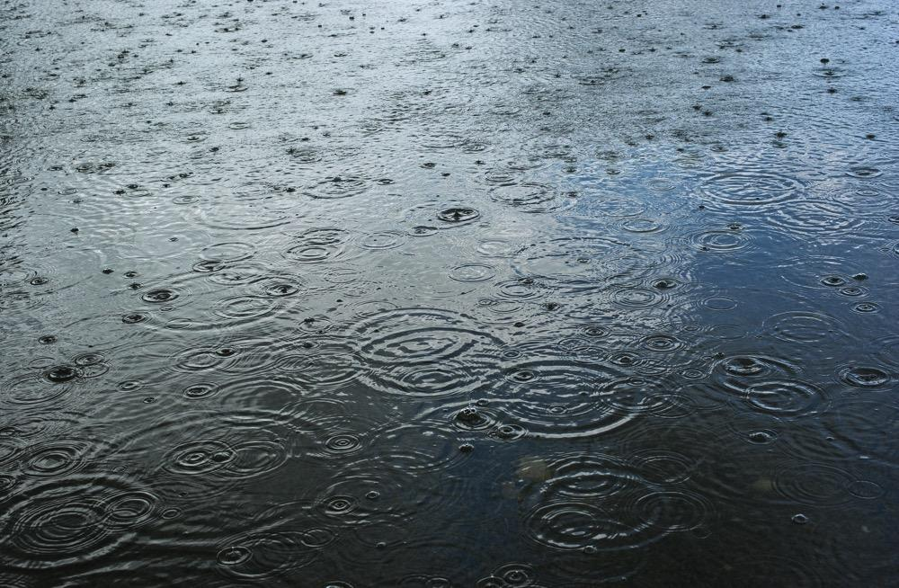
Notes:
A nonexample is rain. Rain, or precipitation, is a part of the water cycle NOT the nitrogen cycle. It does not deal with nitrogen.

Slide 107
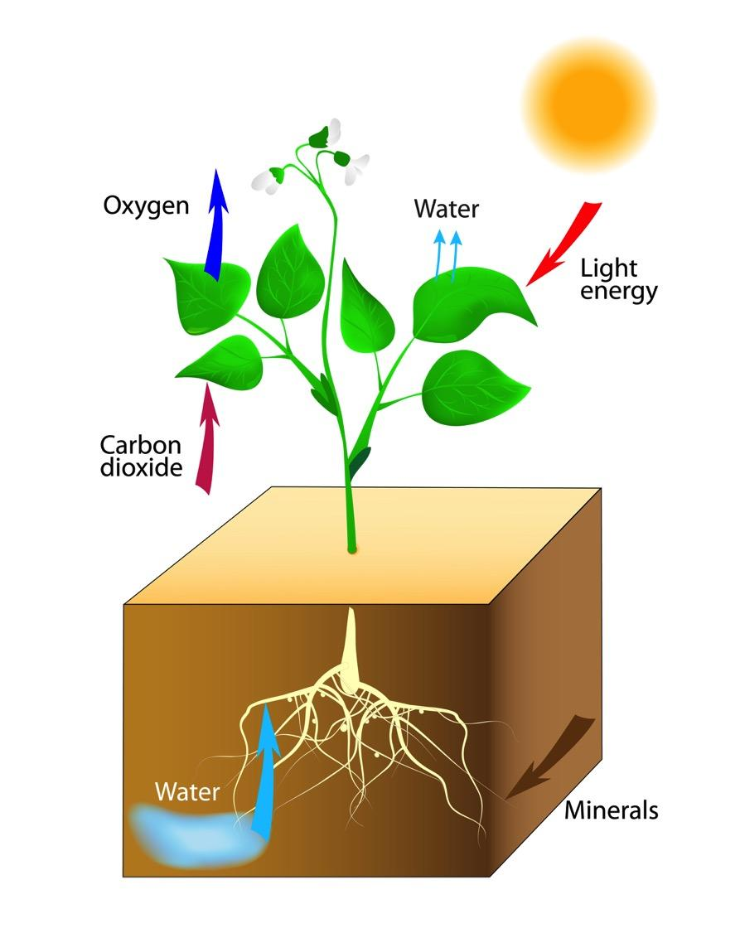
Notes:
Another non-example is photosynthesis. This is a cycle, but it does not involve nitrogen. The photosynthesis cycle involves the sun and water and carbon dioxide, NOT nitrogen.

Slide 108
Notes:
Let’s check-in for understanding.

Slide 109
What are some examples of the nitrogen cycle?
Notes:
What are some examples of the nitrogen cycle?

Slide 110
What are some non-examples of the nitrogen cycle?
NON
Notes:
What are some non-examples of the nitrogen cycle?

Slide 111
What is the nitrogen cycle?
Notes:
What is the nitrogen cycle?
[The nitrogen cycle is the process through which nitrogen moves back and forth between plants, animals, bacteria, the atmosphere, and soil.]

Slide 112
What are the four parts of the nitrogen cycle and what do they do?
Notes:
What are the four parts of the nitrogen cycle and what do they do?
[Fixation - conversion from atmospheric nitrogen to ammonia by bacteria or lightning
Nitrification - conversion of ammonia to nitrates or nitrates by bacteria
Assimilation - uptake of nitrates or nitrites by plants and conversion to proteins
Ammonification - plants, animals, or animal waste are decomposed—or broken apart—by bacteria in the soil.]

Slide 113
Remember!!!
Notes:
So remember!

Slide 114
The Nitrogen Cycle: the process through which nitrogen moves back and forth between plants, animals, bacteria, the atmosphere, and soil
Notes:
The nitrogen cycle is the process through which nitrogen moves back and forth between plants, animals, bacteria, the atmosphere, and soil.

Slide 115
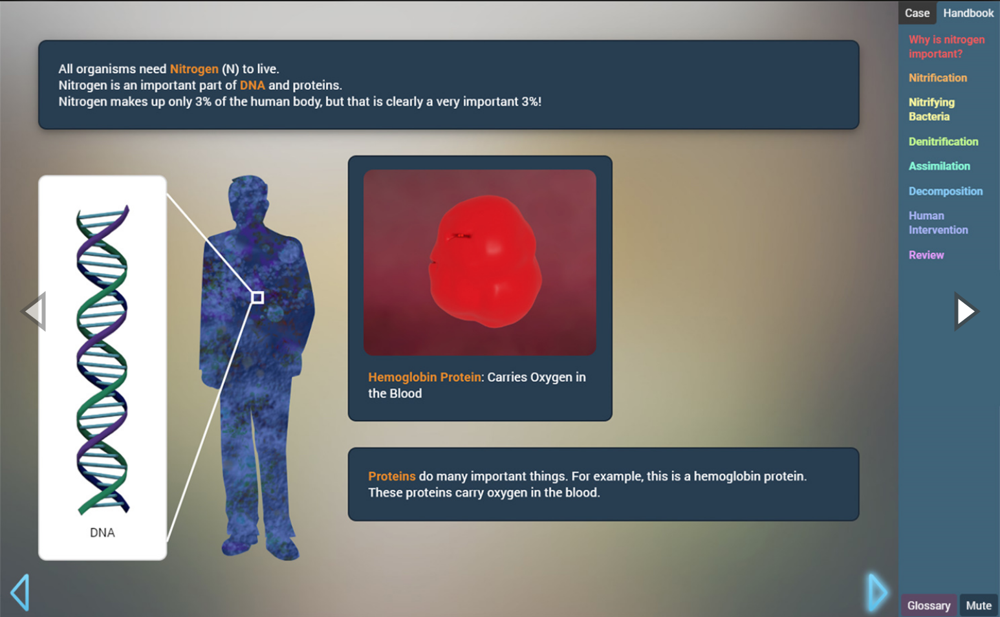
Simulation Activity
The Nitrogen Cycle
(Gizmos)
Click the link above to explore this case about the nitrogen cycle.
Notes:
Feedback: This simulation is a great way for students to engage authentically with science practices.

Slide 116
Big Question: What is the importance of the water and nitrogen cycles?
Notes:
Explicit cue to revisit the big question at the end of the lesson: Okay everyone. Now that we’ve learned the term, let’s reflect once more on our big question. Was there anything that we predicted earlier that was correct or incorrect? Do you have any new hypotheses to share?

Slide 117
Notes:
Thanks for watching!

Slide 118
This Video Was Created With Resources From:
Questions or Comments
Michael Kennedy, Ph.D. MKennedy@Virginia.edu
Rachel L Kunemund, Ph.D. rk8vm@virginia.edu

