Slide 1
Intro
“Big Idea” Question
Review Concepts
Check-In Questions
Teacher Demo
Vocabulary
Student-Friendly Definition
Examples & Non-Examples
Morphological Word Parts
Simulation/Activity
Notes:
OK everyone, get ready for our next lesson. Just as a reminder, these are the different components that our lesson may include, and you’ll see these icons in the top left corner of each slide so that you can follow along more easily!

Slide 2
Intro
Visible Light
Notes:
Today we’re going to learn about visible light.

Slide 3
Big Question: What is the electromagnetic spectrum? How do we experience it in everyday life?
Notes:
Before we start, let’s think about our “big question”: What is the electromagnetic spectrum? How do we experience it in everyday life?
[Pause and illicit predictions from students.]
I love all these thoughtful scientific hypotheses! Be sure to keep this question and your predictions in mind as we move through these next few lessons, and we’ll continue to revisit it.

Slide 4
Notes:
Before we move on to our new vocabulary term, let’s review some other words & concepts that you already learned and make sure you are firm in your understanding.

Slide 5
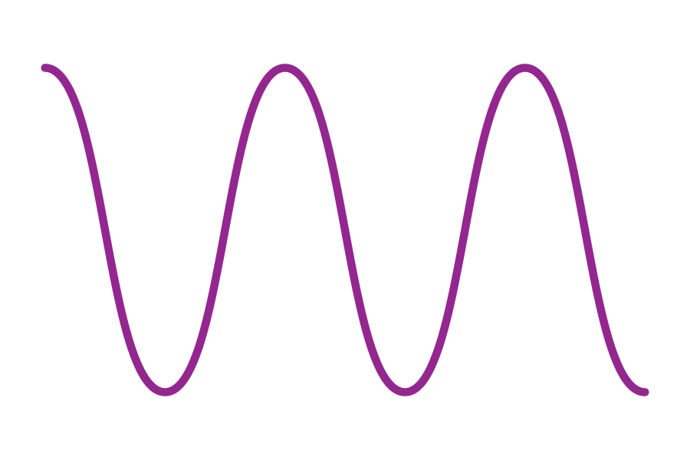
Waves: disturbances that travel through a medium, transporting energy from one location to another without transporting matter
Notes:
Waves are disturbances that travel through a medium, transporting energy from one location to another without transporting matter.

Slide 6
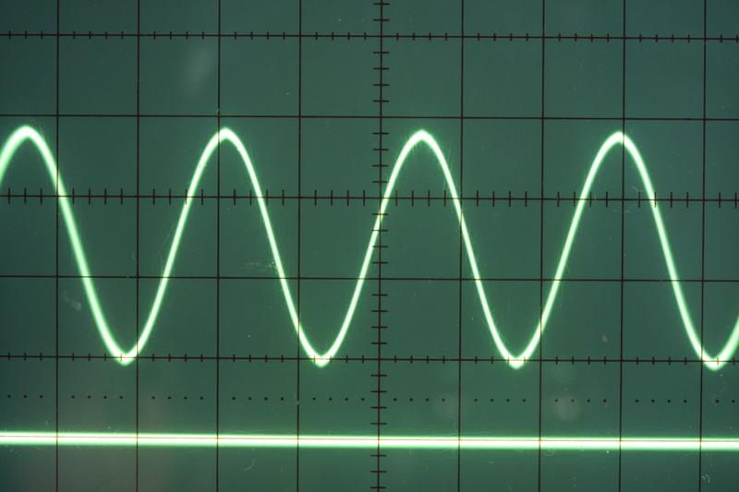
Transverse Waves: waves that travel perpendicularly to the direction they are moving
Notes:
Transverse waves are waves that travel perpendicularly to the direction they are moving.

Slide 7
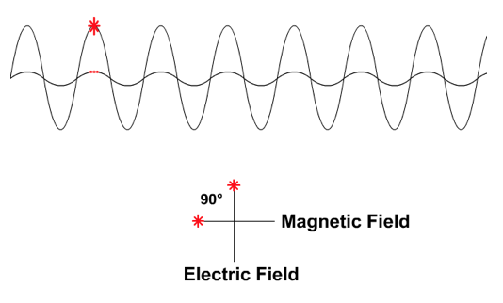
Electromagnetic Waves: waves that are created as a result of vibrations between an electric field and a magnetic field
Notes:
Electromagnetic waves are waves that are created as a result of vibrations between an electric field and a magnetic field.

Slide 8
Electromagnetic Spectrum: range of all types of electromagnetic waves
Notes:
The electromagnetic spectrum is the range of all types of magnetic waves.

Slide 9
Notes:
Now let’s pause for a moment to check your understanding.
Feedback: It's really important to make sure that you're providing students with frequent opportunities to respond as you're activating prior knowledge – it will save so you so much time if you confirm understanding before asking them to try something independently.

Slide 10
What is the difference between waves and transverse waves?
Notes:
What is the difference between waves and transverse waves?
[Transverse waves are simply a type of wave that moves perpendicularly to the direction they are moving. This is not the case for all waves.]

Slide 11
What are electromagnetic waves?
Notes:
What are electromagnetic waves?
[Electromagnetic waves are waves that are created as a result of vibrations between an electric field and a magnetic field.]

Slide 12
What is the electromagnetic spectrum?
Notes:
What is the electromagnetic spectrum?
[The electromagnetic spectrum is the range of all types of electromagnetic waves. These are created as result of vibrations between an electric field and a magnetic field.]

Slide 13
Visible Light
Notes:
Now that we’ve reviewed, let’s define our new term, visible light.

Slide 14
Visible Light : the part of the electromagnetic spectrum you can see with your eyes
Notes:
Radiant energy is energy that is radiating continuously from a source.
{the part of the electromagnetic spectrum you can see with your eyes}
Feedback: When providing more student-friendly definitions, it is helpful to provide students with cues so that they can be prepared and know what to expect and be ready to copy down the information.

Slide 15
Notes:
Let’s check-in for understanding.

Slide 16
What is visible light?
Notes:
What is visible light?
Feedback: Provide clear and straightforward directions when asking students to explain the definitions. This helps to avoid confusion!

Slide 17
Notes:
That is the basic definition, but there is a bit more you need to know.

Slide 18
Visible light is in the range of wavelengths that we can see with our own eyes
Notes:
Visible light is the range of wavelengths we can see with our own eyes

Slide 19
Travels in waves
Notes:
Visible light travels in straight lines until it strikes an object where it can be reflected absorbed, or transmitted. We will learn more about these terms later in the unit.

Slide 20
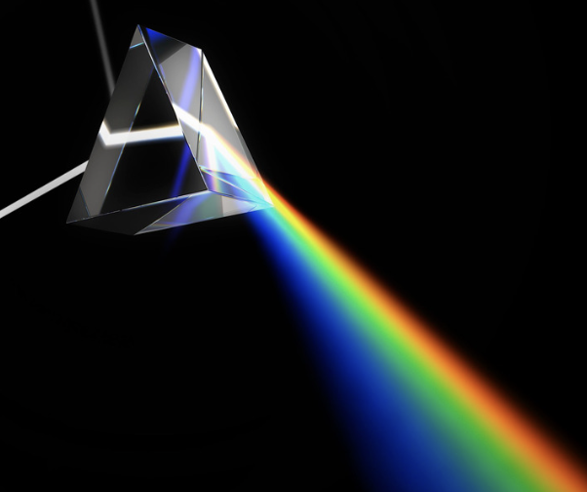
As visible light shines through a prism we see all the different colors as their wavelengths change
Notes:
As visible light shines through a prism we see all the different colors as their wavelengths change

Slide 21
Notes:
Let’s check-in for understanding.

Slide 22
How does visible light travel?
Notes:
How does visible light travel?
[In straight lines]

Slide 23
Notes:
Now, let’s talk about some examples of visible light.
Feedback: It's good to pick a variety of examples to work through with your students. This prepares them for some types that might trip them up when they try it on their own.

Slide 24
Notes:
The lightbulb emits visible light that you can see

Slide 25
Notes:
A rainbow is visible light, we can see all the colors because the light has passed through a prism like a drop of water

Slide 26
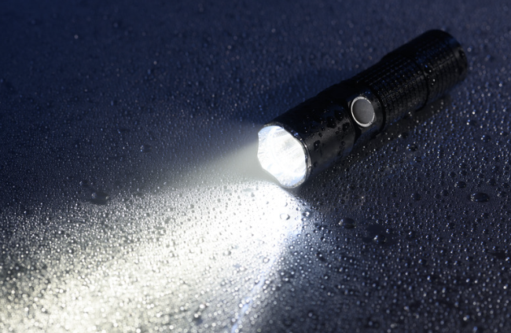
Notes:
A flashlight is visible light, we can see the light

Slide 27
Notes:
Next, let’s talk about some non-examples of visible light.

Slide 28
Sound Waves
Notes:
Sound waves are not an example of visible light. They are waves are mechanical energy and require a medium and we cannot see
Feedback: Non-examples often need some explanation to make it clear to students the difference. Using clear and simple language can help with this.

Slide 29
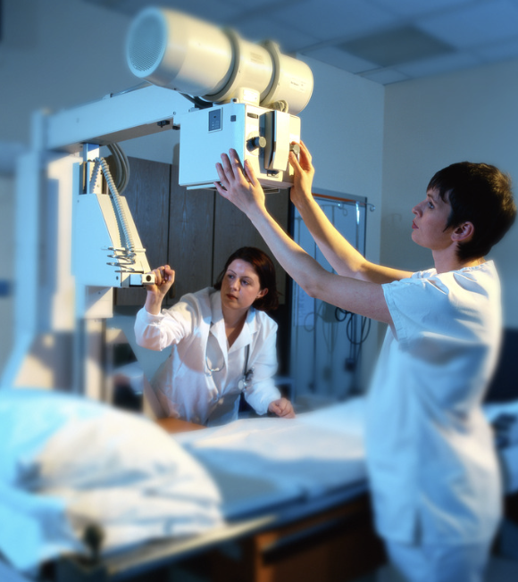
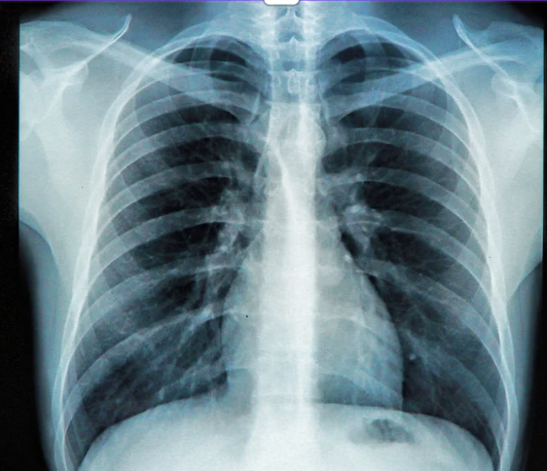
X-Rays
Notes:
X-rays are not visible light. You can not see the rays coming out of the xray machine but you can see the image it produces through technology
Feedback: Non-examples often need some explanation to make it clear to students the difference. Using clear and simple language can help with this.

Slide 30
Notes:
Let’s check-in for understanding.

Slide 31
What are examples of visible light?
Notes:
What are examples of visible light?
[The Sun, a campfire, a microwave, etc.]

Slide 32
Notes:
Let’s check-in for understanding.

Slide 33
Visible Light is carried in ________.
Sound waves
Ocean waves
Electromagnetic waves
Notes:
Visible light is carried in __________.
[Electromagnetic waves]

Slide 34
Visible light is carried in ________.
Sound waves
Ocean waves
Electromagnetic waves
Notes:
Visible Light is carried in __________.
[Electromagnetic waves]

Slide 35
What is visible light?
Notes:
What is radiant energy?
[Radiant energy is energy that is radiating continuously from a source.]

Slide 36
Explain how visible light travels.
Notes:
Explain how visible travels.
[visible light travels in waves not lines until it strikes an object where it can be reflected, absorbed, or transmitted.

Slide 37
Notes:
We will now complete this concept map, called a Frayer model, to summarize and further clarify what you have learned about the term wave.

Slide 38
Definition
Picture
Visible Light
Example
How does visible light impact my life?
Notes:
To complete the Frayer model, we will choose from four choices the correct picture, definition, example, and response to the question, “How do waves impact my life?” Select the best response for each question using the information you just learned. As we select responses, we will see how this model looks filled in for the term wave.

Slide 39
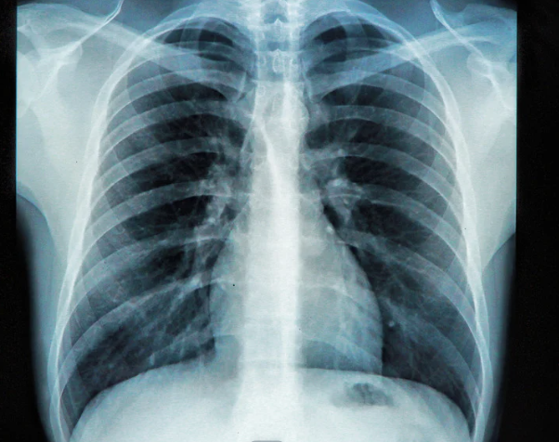
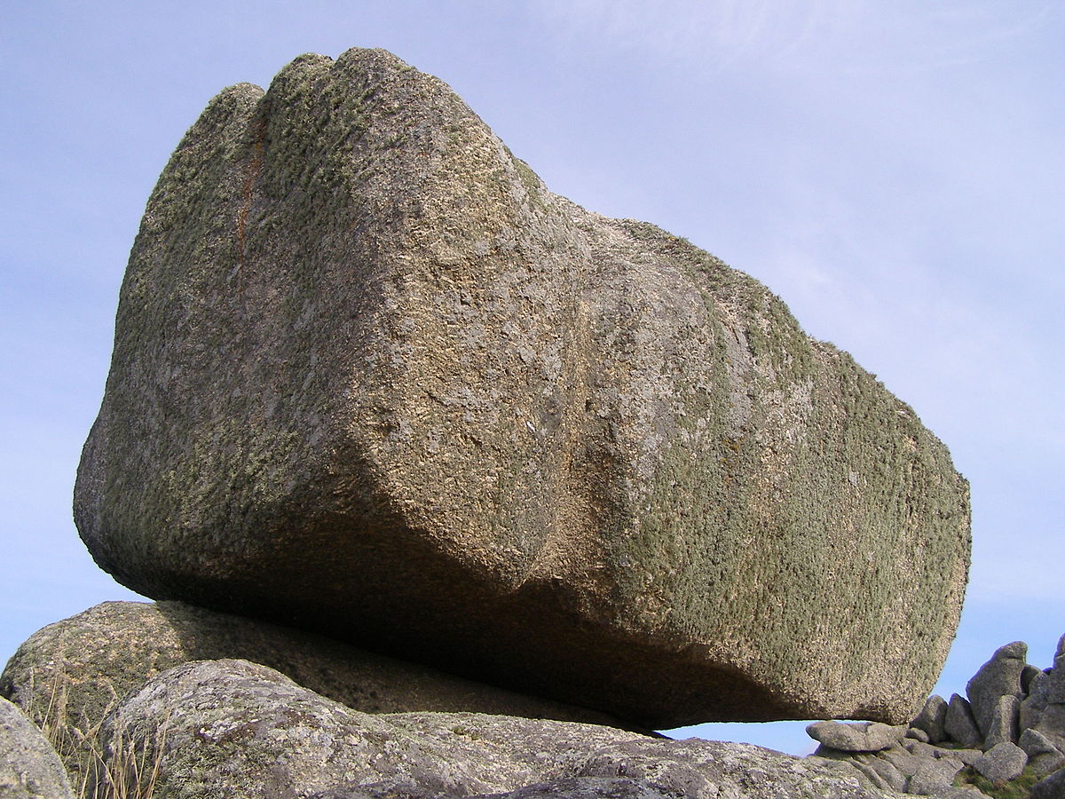
Directions: Choose the correct picture of visible light from the choices below.
A
B
C
D
Notes:
Choose the one correct picture of a visible light from these four choices.

Slide 40
Directions: Choose the correct picture of visible light from the choices below.
A
B
C
D
Notes:
This is the picture that shows a visible light.

Slide 41
Definition
Picture
Visible Light
Example
How does visible light impact my life?
Notes:
Here is the Frayer model filled in with a picture of a visible light.

Slide 42
Directions: Choose the correct definition of visible light from the choices below.
A
How fast an object is traveling
B
The part of the electromagnetic spectrum that can be seen by the human eye
C
A repeating motion that carries energy from one place to another.
D
A material in which electrons can not move around easily
Notes:
Choose the one correct definition of visible light from these four choices.

Slide 43
Directions: Choose the correct definition of visible light from the choices below.
A
How fast an object is travelling
B
The part of the electromagnetic spectrum that can be seen by the human eye
C
A repeating motion that carries energy from one place to another.
D
A material in which electrons can not move around easily
Notes:
“The part of the electromagnetic spectrum that can be seen by the human eye.
” is correct! This is the definition of visible light.

Slide 44
Definition
Picture
The part of the electromagnetic spectrum that can be seen by the human eye
Visible Light
Example
How does visible light impact my life?
Notes:
Here is the Frayer Model with a picture and the definition filled in for visible light: a repeating motion that carries energy from one place to another.

Slide 45
Directions: Choose the correct example of a visible light from the choices below.
A
A rainbow in the sky
B
An apple hanging on a tree
C
A dog running after a ball
D
A ripple of water in a pond
Notes:
Choose the one correct example of a visible light from these four choices.

Slide 46
Directions: Choose the correct example of a visible light from the choices below.
A
A rainbow in the sky
B
An apple hanging on a tree
C
A dog running after a ball
D
A ripple of water in a pond
Notes:
“a rainbow in the sky” is correct! This is an example of a visible light.

Slide 47
Definition
Picture
The part of the electromagnetic spectrum that can be seen by the human eye
Wave
A rainbow in the sky
Example
How does visible light impact my life?
Notes:
Here is the Frayer Model with a picture, definition, and an example of a wave: a ripple of water in a pond.

Slide 48
Directions: Choose the correct response for “how does visible light impact my life?” from the choices below.
A
Visible light is in the food we eat and give us the nutrition our bodies need to survive
B
Visible light helps me see the world around me
C
Visible light helps me hear the world around me
D
Visible light erodes the surface of rocks giving them their shape
Notes:
Choose the one correct response for “how does visible light impact my life?” from these four choices.

Slide 49
Directions: Choose the correct response for “how do waves impact my life?” from the choices below.
A
Visible light is in the food we eat and give us the nutrition our bodies need to survive
B
Visible light helps me see the world around me
C
Visible light helps me hear the world around me
D
Visible light erodes the surface of rocks giv
Notes:
“Waves carry sound and light energy that help me to see and hear the world around me.” That is correct! This is an example of how visible light impacts your life.

Slide 50
Definition
Picture
The part of the electromagnetic spectrum that can be seen by the human eye
Wave
A rainbow in the sky
Visible light helps me see the world around me
Example
How does visible light impact my life?
Notes:
Here is the Frayer Model with a picture, definition, example, and a correct response to “how do waves impact my life?”: Waves carry sound and light energy that help me to see and hear the world around me.

Slide 51
Remember!!!
Notes:
So remember!
Feedback: A good general strategy for information retention is: 1) tell them what you're going to teach them, 2) teach them, and 3) tell them what you just taught them. Make sure to include the third and final step. While it is easy to think a quick review of what you just went over is unnecessary, it can be incredibly useful in helping the students remember the information over the long term.

Slide 52
Visible Light : the part of the electromagnetic spectrum you can see with your eyes
Notes:
Visible Light is the part of the electromagnetic spectrum you can see with your eyes

Slide 53
Travels in waves
Notes:
Visible Light travels in waves until it strikes an object where it can be reflected absorbed, or transmitted. We will learn more about these terms later in the unit.

Slide 54
Big Question: What is the electromagnetic spectrum? How do we experience it in everyday life?
Notes:
Explicit cue to revisit the big question at the end of the lesson: Okay everyone. Now that we’ve learned the term, let’s reflect once more on our big question. Was there anything that we predicted earlier that was correct or incorrect? Do you have any new hypotheses to share?

Slide 55
Notes:
Thanks for watching, and please continue watching CAPs available from this website.

Slide 56
This Video Was Created With Resources From:
Questions or Comments
Michael Kennedy, Ph.D. MKennedy@Virginia.edu
Rachel L Kunemund, Ph.D. rk8vm@virginia.edu

